Slide 1
EFSA’s ongoing and planned activities in the application of NAMs for the risk assessment of chemical substances including those at nanoscale
Maria Chiara Astuto, Irene Cattaneo & Djien Liem
Methodology and Scientific Support Unit
CUSP Workshop, 07.02.2023

Slide 2
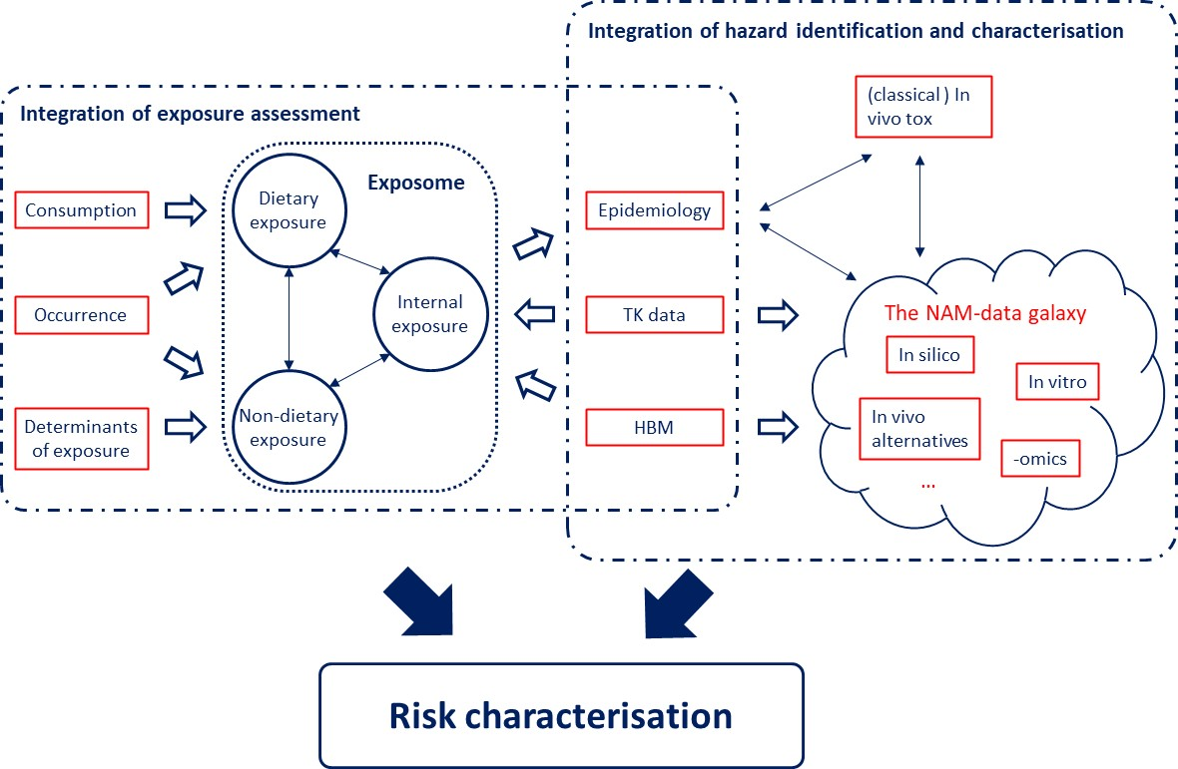
Future of Chemical Risk Assessment 2019

Slide 3


EFSA Strategy 2027
Goals:
Actions:
Improve the quality of scientific guidance and methodologies
Develop and integrate NAM-based approaches for regulatory risk assessment
Minimisation of animal testing
Ensure more informative risk assessments
Make use of wider, improved and new data streams
Launch experimental case studies for filling data gaps identified in EFSA risk assessments using NAMs
Define in parallel the mid-term strategy (i.e. development of a Roadmap for action)
Explore the use of AI for integrating NAMs data in risk assessments
Increase international cooperation (i.e. via NanoNetwork, APCRA, and ILMERAC Working Group on NAMs)
Notes:
Shortly as a background, EFSA has committed itself in its Strategy 2027 to promote the implementation of NAMs in risk assessment practice, not only for the sole purpose of minimising animal testing but also to move towards a more informative risk assessment.
To achieve this goal, also set in the EFSA Strategy for 2027, EFSA 1) developed a roadmap for action, 2) outsourced experimental case studies with the aim of fulfilling the datagaps identified in EFSA RA using NAMs, 3) is exploring the use of AI, and 4) is working to increase international cooperation.

Slide 4
Ongoing & Planned Activities 2020-2027
SCIENTIFIC COMMITTEE AND PANELS
SC WG on Botanicals
SC WG on use of Read Across in chemical RA
SC WG Biomarkers of Effect (in prep)
…
GRANTS & PROCUREMENT
AI for NAMs
AOP Development & Transcriptomics for RA
Chemical hazard Database: OpenFoodTox
Interhuman Variability in Toxicodynamics
NAMs Case Studies
NAMS4NANO: method development & case studies
Toxicokinetics: TKPlate, AMPHIDEB & ADME4NGRA…
INTERNATIONAL COOPERATION:
Accelerating the Pace for Chemical RA (APCRA)
International Liaison group for MEthods of Risk Assessment of Chemicals in food (ILMERAC)
Global Coalition for Regulatory Science Research (GCRSR)
EU projects
EFSA network with MSs on Nanotechnology
…

Slide 5



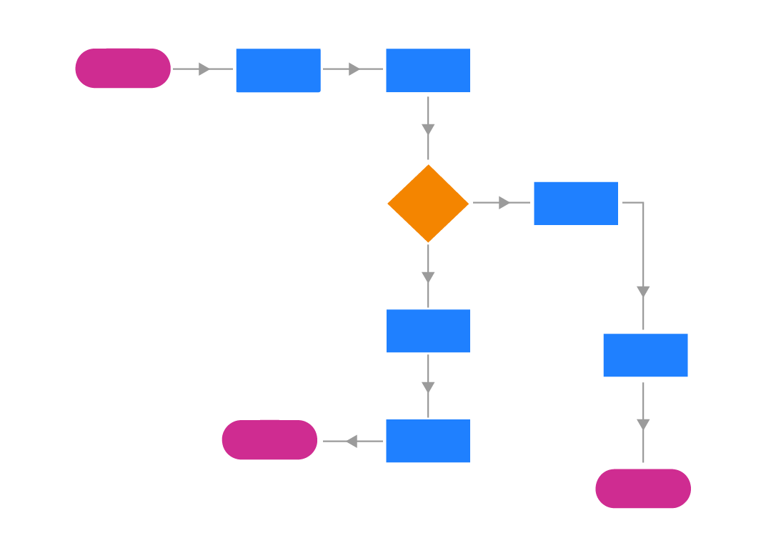
Key Objectives EFSA
Organise EFSA’s NAMs activities
Share knowledge and expertise on NAM-based methods and approaches
Evaluate outcomes together
Introduce new approaches in EFSA’s guidance documents for chemical RA

Slide 6
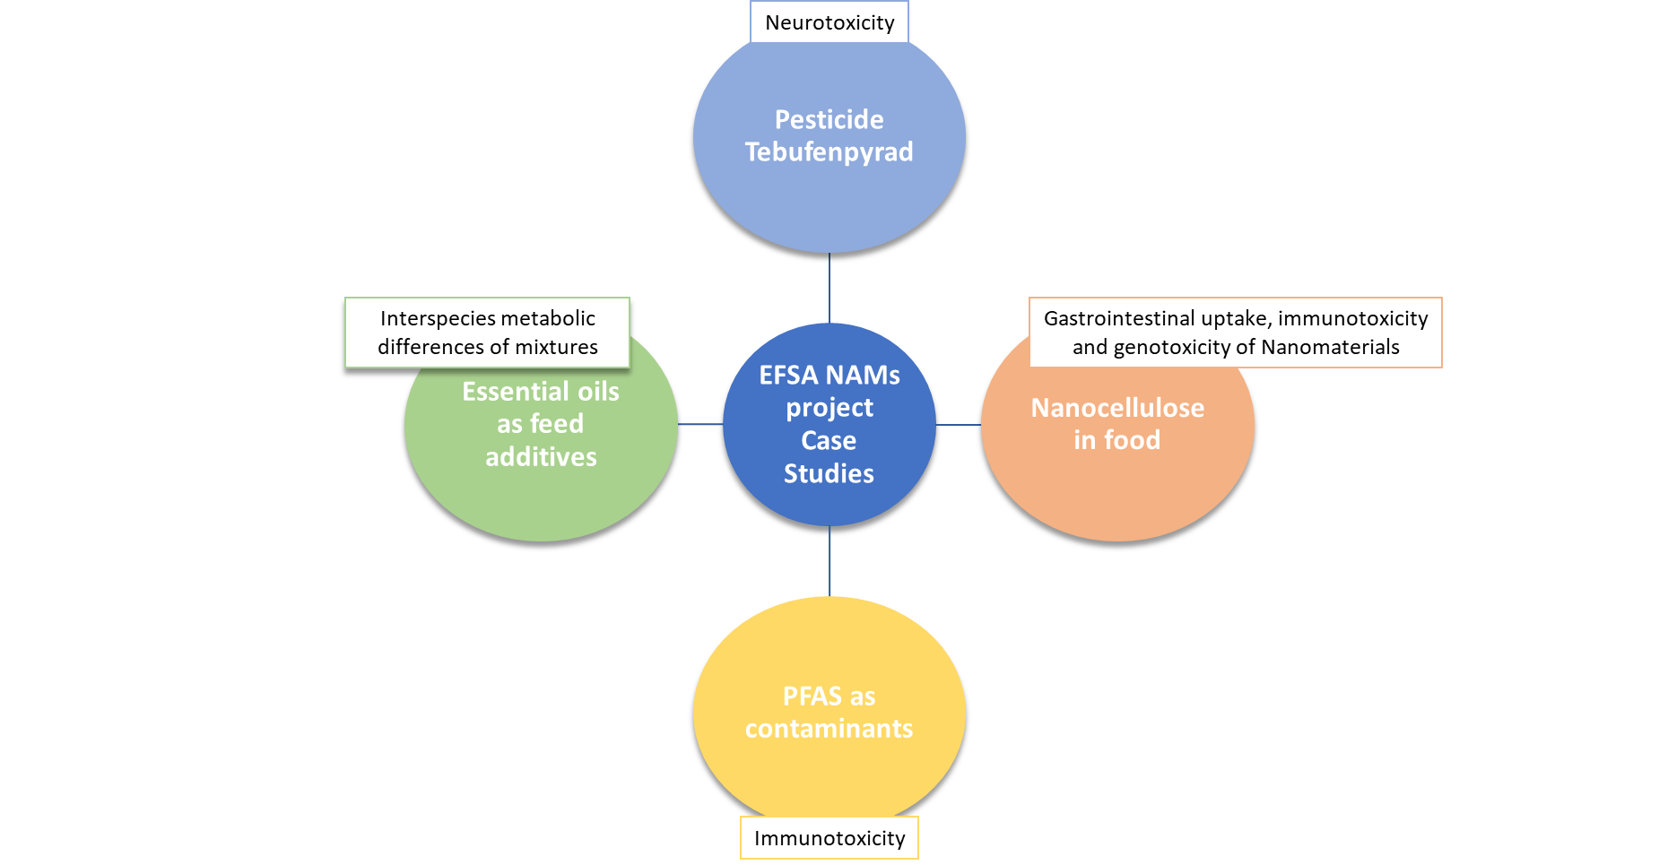
EFSA NAMs Project ongoing case studies, sectors and toxicological endpoints covered
EFSA Pilot Project on NAMs for the risk assessment of the pesticide Tebufenpyrad
Part 1, ‘Development of physiologically-based kinetic (PBK) model coupled with pulmonary and dermal exposure’ (GP/EFSA/SCER/2020/02)
Part 2, ‘Hazard characterisation and identification of the Reference Point’ (NP/EFSA/SCER/2020/02)
EFSA Project on the use of NAMs to explore interspecies metabolic differences on essential oils as feed additives (OC/EFSA/SCER/2021/14)
Q1 2024
Q4 2022
EFSA Project on NAMs for the hazard assessment of nanofibers (GP/EFSA/SCER/2020/04)
Q2 2023
EFSA Project on the use of NAMs to explore the immunotoxicity of the contaminant PFAS (OC/EFSA/SCER/2021/13)
Q1 2024
Notes:
In 2019, EFSA started a dedicated project on NAMs to promote their implementation in regulatory risk assessment. Within EFSA’s remit, information from animal studies is frequently available but often with deficiencies that generate uncertainties when performing humans’ and animals’ health risk assessments.
This EFSA NAMs project specifically addresses these identified data gaps and aims to investigate the possibility of filling them by generating new NAM-based information instead of in vivo data.
To create a real proof of concept cases, we implemented a new targeted approach which consists of co-designing studies bringing together researchers and risk assessors in a dedicated workshop with experts in the field. After the workshop EFSA finalises the technical specifications and launches open calls for a grant or procurement, with the ultimate goal of incorporating the generated data in EFSA’s risk assessments.

Slide 7
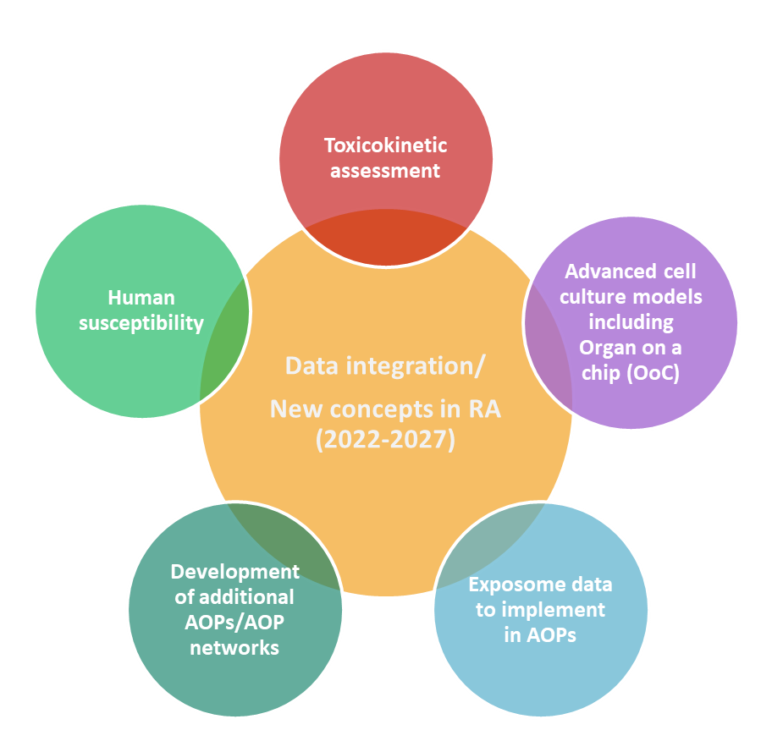


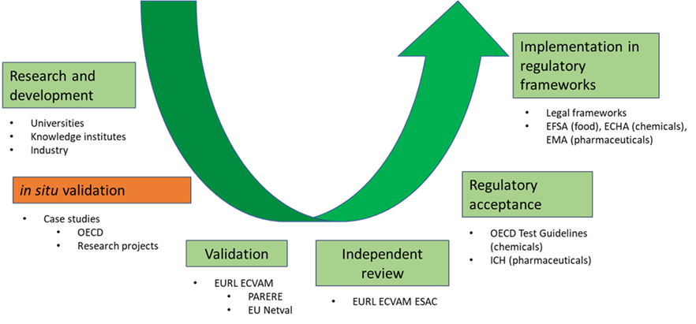
NAMs Roadmap: SIX prioritised areas
Address reporting templates; Develop guidance on the integration of NAM-based data into feed and food risk assessment
Phases of regulatory readiness for NAMs
Escher et al., 2022
https://doi.org/10.2903/sp.efsa.2022.EN-7341
Notes:
In 2020, EFSA launched a call for the NAMs Roadmap.
ToR: 8 objectives including:
Mapping relevant activities and organisations
Identify working areas, challenges and blockers
Identify cooperation opportunities
Prioritisation working areas and possible partners
This roadmap was prepared by Fraunhofer ITEM, Free University Amsterdam, RIVM, Eura and the National Food Institute Denmark (DTU) and published in May 2022 and the results are presented on this slide..
It shows on the left side the proposed working areas with a main focus on: 1) data integration and 2) EFSA’s role to link between researchers, risk assessors and risk managers in and outside the EU (incl. EFSA’s sister agencies, JRC, research institutions and RA partners in and outside the EU, including FDA, EPA, Health Canada, etc).
On the right side, the roadmap indicated six levels of regulatory readiness, which are used to specify the implementation process from validation starting with research until fully validated and implemented approaches.
The roadmap is now being used to set priorities and to start activities internally in EFSA and outsource work to others through Grants and Procurement calls.

Slide 8
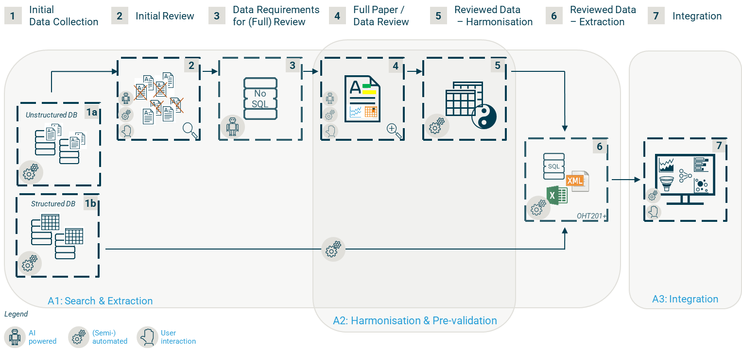

AI4nams
EFSA Project on Exploring the use of Artificial Intelligence (AI) for extracting and integrating NAM-based data for chemical risk assessment (OC/EFSA/SCER/2021/08)
Final report: June 2023
First deliverable (to be published soon): review of AI tools supporting the search and extraction, harmonisation and pre-validation, and integration of NAMs-based data into networks similar to AOPs.
Notes:
- EFSA has prioritised New Approach Methodologies (NAMs) and Artificial Intelligence (AI) as themes requiring strategic consideration regarding the future of scientific assessments.
- Need to explore the use of AI for NAM-based chemical risk assessment, EFSA initiated the project AI4NAMS to investigate potential applications in searching, extracting, and integrating NAMs-based data into chemical risk assessment to selected chemicals or chemical groups relevant to EFSA and finally for their integration in “AOP-like knowledge networks”.
- AI4NAMS is structured into three major work packages A, B, and C. In work package A, suitable AI tools supporting the review process are reviewed and evaluated. In work package B, six selected case studies either based on a stressor or an endpoint (adverse outcome) are implemented to test promising AI tools for a specific use case. Finally, in work package C, a proposal for recommendations and development priorities for the use of AI for NAMs to be considered in the implementation of the SPIDO NAMs and AI roadmap is made.

Slide 9
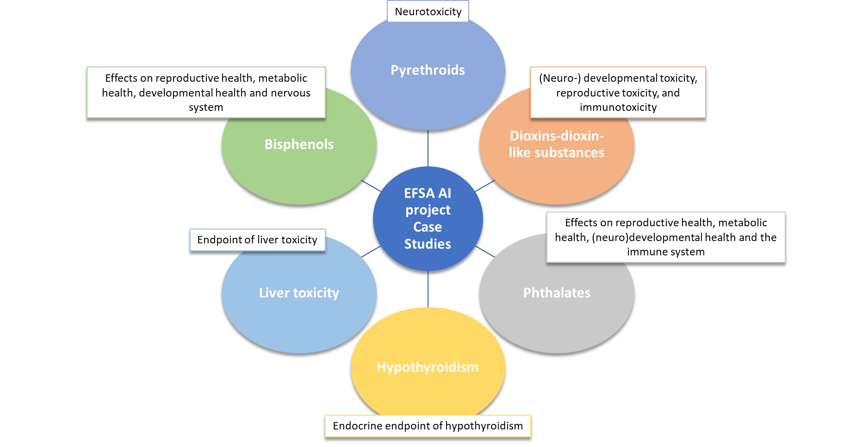
AI4NAMS CASE STUDIES
Notes:
In work package B six selected case studies either based on a stressor or an endpoint (adverse outcome) are implemented to test promising AI tools for a specific use case. The selected case studies represent topics with different levels of scientific complexity and data availability, as well as different focus areas with regard to the workflow steps.

Slide 10
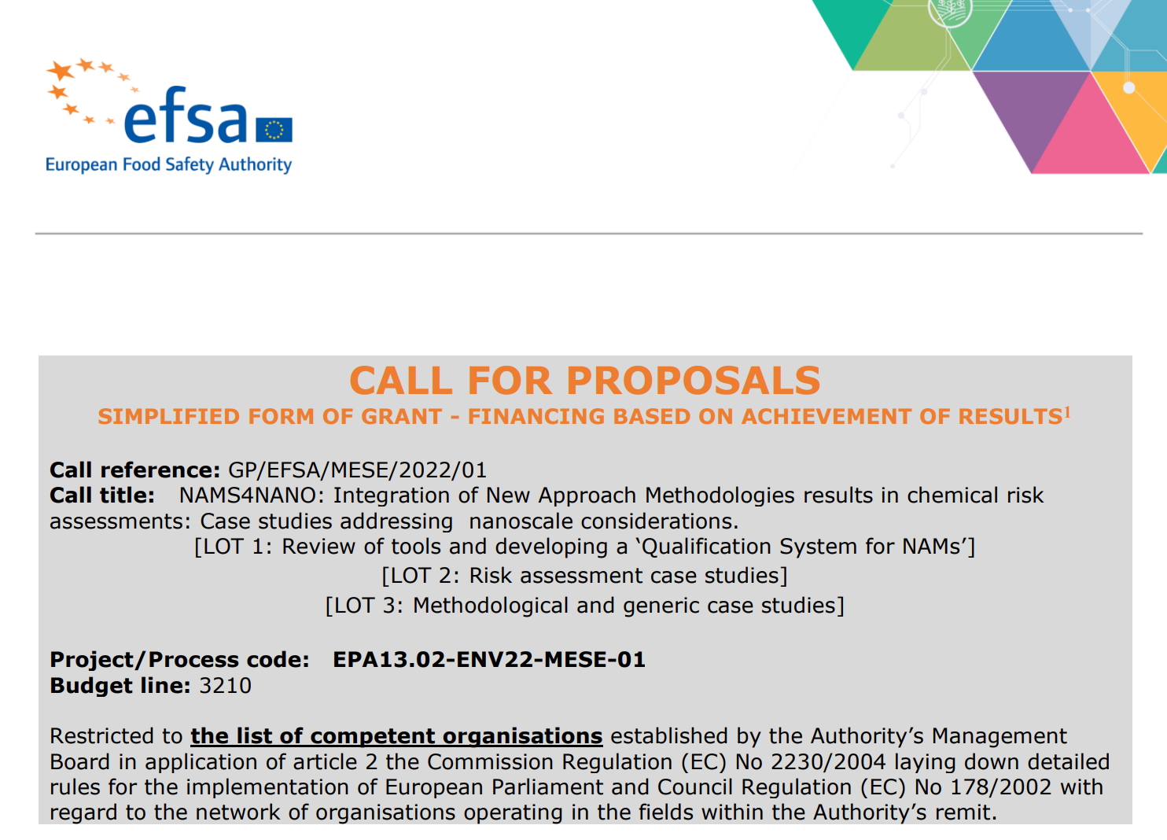


New EFSA Project ‘NAMs4NANO’
Title: NAMS4NANO (GP/EFSA/MESE/2022/01)
Integration of New Approach Methodologies results in chemical risk assessments: case studies addressing nanoscale considerations
First phase: (3 LOTs)
Design EFSA relevant case studies in the area of nanomaterials integrating NAMs and existing data
Development of methodologies
to promote the use of NAMs data and its integration in EFSA risk assessments
Second phase: (to be launched in 2024)
Design case studies on nanoplastics
Develop a risk assessment guidance for nanocontaminants and promote an international risk assessment for nanoplastics
Will start soon and expected to end by the first semester of 2026

Slide 11
First phase (2023-2026)
Objective 1: Reviewing the available NAM-based tools and methods for assessing the toxicity of nanoparticles, in particular those developed by recent EU Research projects.
Objective 2: Developing a qualification system for facilitating the regulatory use of NAM tools and methods, using the experience from EU and international agencies (EMA, US FDA).
Objective 3: Designing and conducting a first set of proof-of-concept case studies to demonstrate that the combination of existing in vivo information and NAM-based data can provide better information for safety assessments than new in vivo studies.
LOT 1: Review of tools and developing a ‘Qualification System for NAMs’
LOT 2: Risk assessment case studies
3 Objectives in 3 LOTs
LOT 3: Methodological and generic case studies

Slide 12
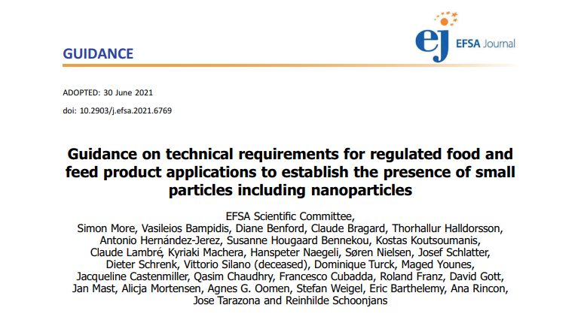
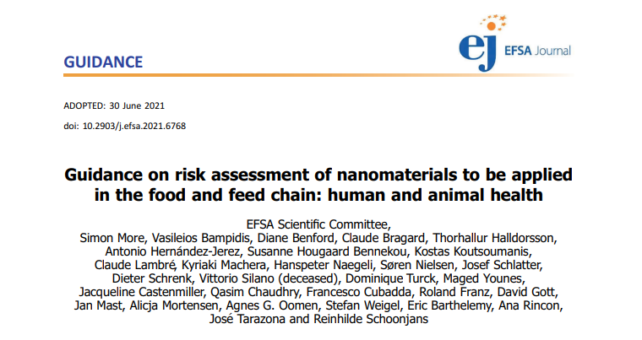


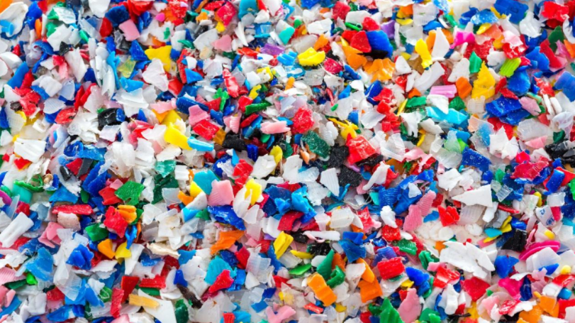
Second phase (from 2024)
Further EFSA Call for proposals will cover a second set of case studies under Objective 3
as well as additional objectives:
Objective 4: Support the EFSA Scientific Committee in developing guidance for NAMs data integration and implementing hypothesis-driven NGRA in the area of nanotechnology (e.g. considering tools compatible with EFSA IT structure, cross-cutting guidance, and specific considerations for nano-enabled products under EFSA’s remit).
Objective 5: Designing a networking strategy with EU MSs (considering the EFSA Nano Network and the Pesticide Steering Network) for supporting applicants in preparing dossiers for nanomaterials, including practical examples and recommendations for integrating and collecting NAMs data in IUCLID.
Objective 6: Adapting the achieved knowledge to the assessment of nanocontaminants and (co)leading an international engagement for assessing the risk of food relevant nanocontaminants, including nanoplastics.

Slide 13
Ongoing & Planned Activities 2022
Integration of hazard identification and characterisation
Integration of exposure assessment
(classical ) In vivo tox
Exposome
Dietary exposure
Consumption
Epidemiology
Internal
exposure
Occurrence
TK data
The NAM-data galaxy
…
In silico
Non-dietary
exposure
nano
In vitro
IATA
Determinants of exposure
HBM
In vivo alternatives
-omics

Slide 14
NAMs: Tangible outcomes
To fill data gaps in chemical RA without generating new in vivo data
Towards a mechanistic-based risk assessment
Enhanced acceptance/confidence to use NAMs, IATA and biomarker data in the derivation of Health Based Guidance Values
Internationally harmonised guidance (MSs, OSOA, ILMERAC, FAO/WHO, OECD)

Slide 15








Stay connected
SUBSCRIBE TO
efsa.europa.eu/en/news/newsletters
efsa.europa.eu/en/rss
Careers.efsa.europa.eu – job alerts
LISTEN TO OUR PODCAST
Science on the Menu –Spotify, Apple Podcast and YouTube
FOLLOW US ON TWITTER
@efsa_eu @methods_efsa
@plants_efsa @animals_efsa
FOLLOW US ON LINKEDIN
Linkedin.com/company/efsa
FOLLOW US ON INSTAGRAM
@one_healthenv_eu
CONTACT US
efsa.europe.eu/en/contact/askefsa
Notes:
Example of graphic layout

