Slide 1





Hg and MMHg speciation in the Scheldt Estuary and Belgian Part of the North Sea (BPNS) sediments
Tianhui Ma
Prof. dr. Yue Gao; Prof. dr. Martine Leermakers; Dr. Vincent Perrot
Tianhui.ma@vub.be
15/06/2022

Slide 2

Introduction
Principal forms: Hg°, Hg²⁺, Monomethylmercury (MMHg) and Dimethylmercury (DMHg)
Natural sources: volcanoes, vegetation and water
Anthropogenic sources: Cinnabar, fossil fuels, industrial processes
Hazardous environmental pollutant: Neurotoxic
Famous poison incident:
Minamata disease (1956)
Human exposure: consumption of fish
Minamata disease: deformed limbs
Notes:
Hg exist in many physical and chemical forms. Like Hg0, Hg2+, MMHg, DMHg. The organic form of Hg is more toxic. More than half of the Hg in the environment today is from anthropogenic sources.
From the Minamata disease, scientists found the consumption of fish is the main human exposure to Hg, especially predatory fish.
2

Slide 3
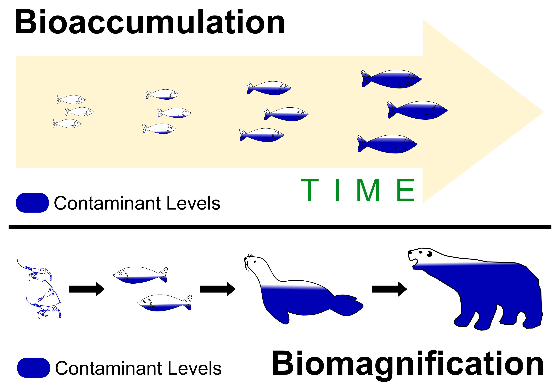
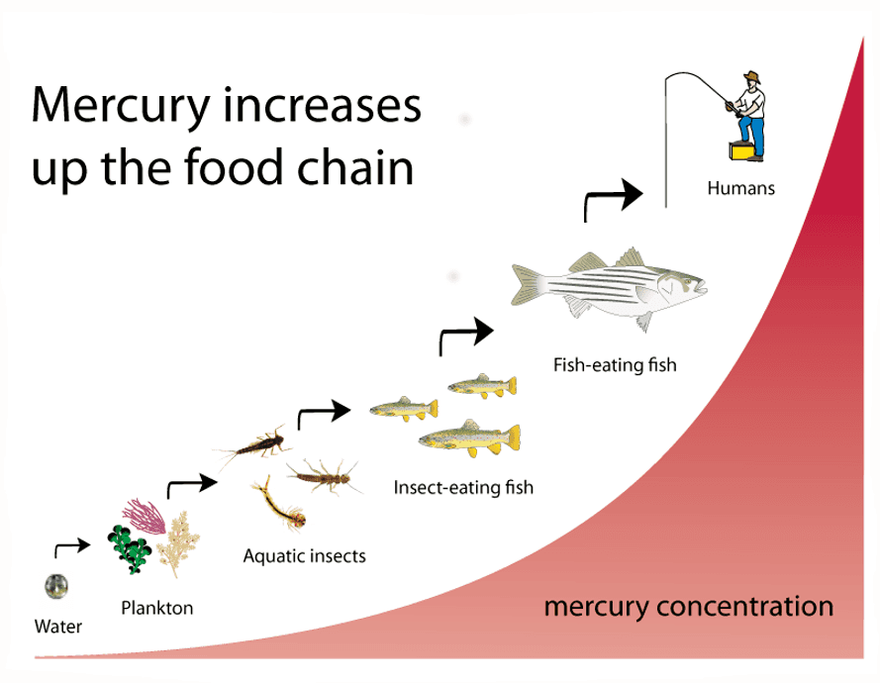
Hg: Bioaccumulation & Biomagnification
Notes:
Total Hg and MeHg can be bioaccumulated in function of the age of the fish. (Biomagnification) Along the food chain, total Hg and MeHg concentrations increase and the % MeHg increases. (Since MeHg can enter the cell plasma)

Slide 4
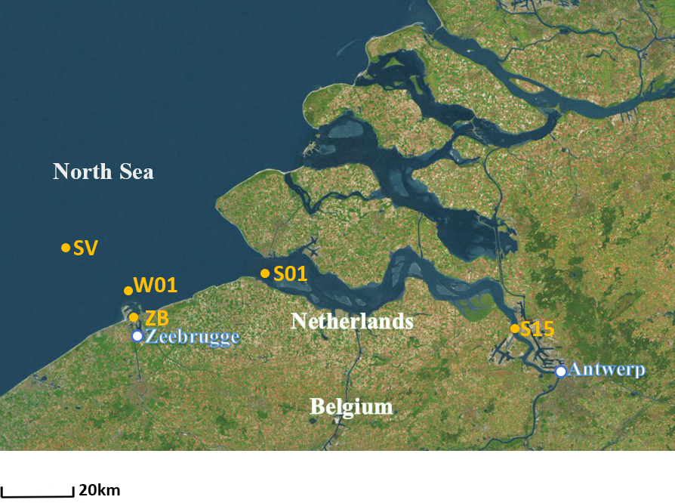
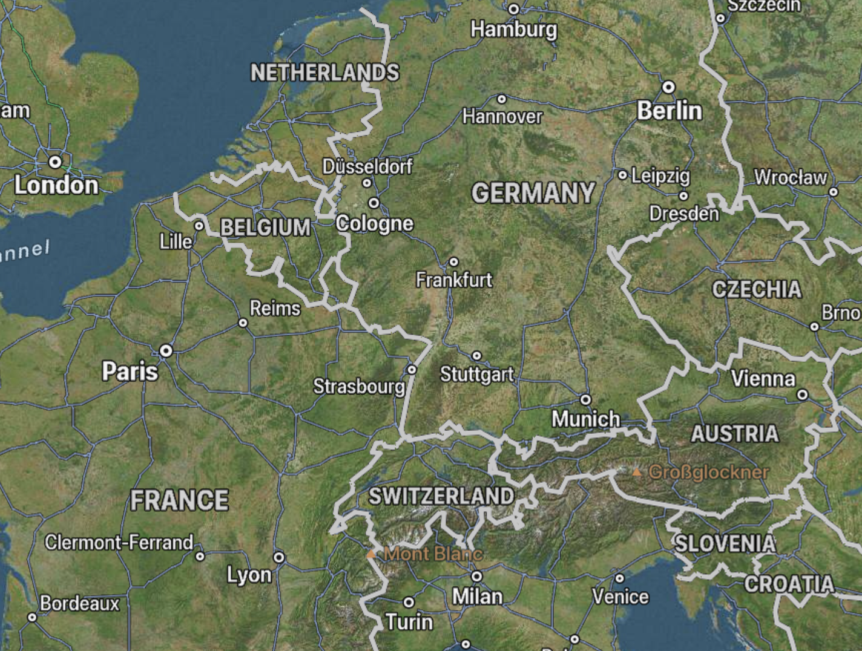

Sampling sites
Belgica campaign in March 2020 & 2021
Scheldt estuary and Belgian Part of the
North Sea (BPNS)
Sediment sampling station
2020: SV, W01, ZB and S15
2021: SV, ZB, S01 and S15
Antwerp
Scheldt estuary
Piran
Map of sampling sites
Notes:
Our sampling sites were located in this zone between Belgium and the Netherlands. Sampling sites are the Scheldt estuary and the BPNS. Click The Scheldt estuary is a well-mixed estuary that includes geophysical and biological processes. It receives freshwater from densely populated and industrialized areas such as Antwerp and Brussels. The port of Antwerp is the second-largest seaport in Europe after Rotterdam.
Click Two campaigns on Belgica cruise were took place in March 2020, 2021. The sediment (4 stations: W01, SV, S15 and ZB) sampling stations are shown. S15 is located in the Scheldt estuary. S01 is… Other sediment sampling stations are located in the BPNS . W01 changed to S01 in the 2nd sampling year. Historically contaminated estuary due to heavy industrial activities. But there was a gap of monitoring for this estuary, so we restarted from 2020 on for metal contamination, especially Hg too.

Slide 5
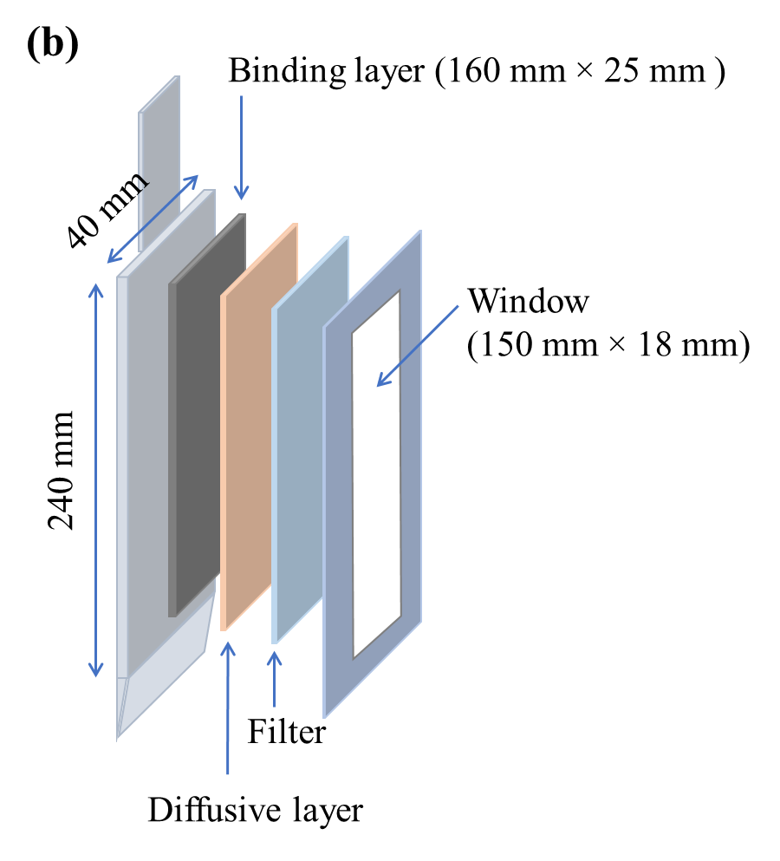
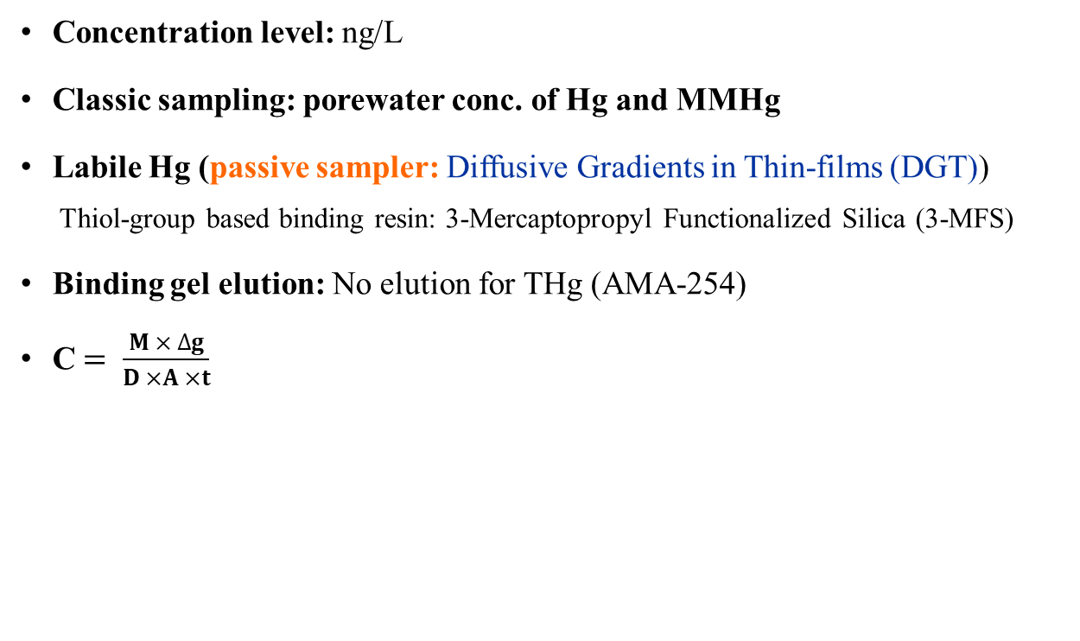
Porewater sampling
Diffusive Gradients in Thin-films (DGT)
Concentration level: ng/L
Classic sampling: porewater conc. of Hg and MMHg
Labile Hg (passive sampler: Diffusive Gradients in Thin-films (DGT))
  Thiol-group based binding resin: 3-Mercaptopropyl Functionalized Silica (3-MFS)
Binding gel elution: No elution for THg (AMA-254)
C$= \frac{M × ∆g}{D ×A ×t}$
C: Concentration of Hg in the solution (ng mL⁻¹)
M: Accumulated Mass on the binding gel (ng)
Δg: The total thickness of the diffusive gel and filter (cm)
D: The diffusion coefficient of Hg in the diffusive gel (cm² s⁻¹)
A: Exposed area (cm²)
t: Deployed time (s)
DGT probe (for sediment deployment)
Advantage of this technique:
High resolution profiles of solutes in sediment porewater (1 cm)
Labile fraction measurement
Dynamic process of porewater and solid phase
In situ deployment if possible
Notes:
In this study, both…Normally, Hg concentration level is ng/L in porewater. Porewater in sediment include labile and non-labile Hg. bioavailable
To determine the level of labile Hg, a passive sampler was used. Click DGT technique can be used to sample labile Hg species using thiol-group based resin gels and agarose diffusive gel. In this study, 3-MFS is the resin to bind Hg. A DGT probe is shown in this figure which can be deployed in sediment for a certain time to accumulate Hg.

Slide 6
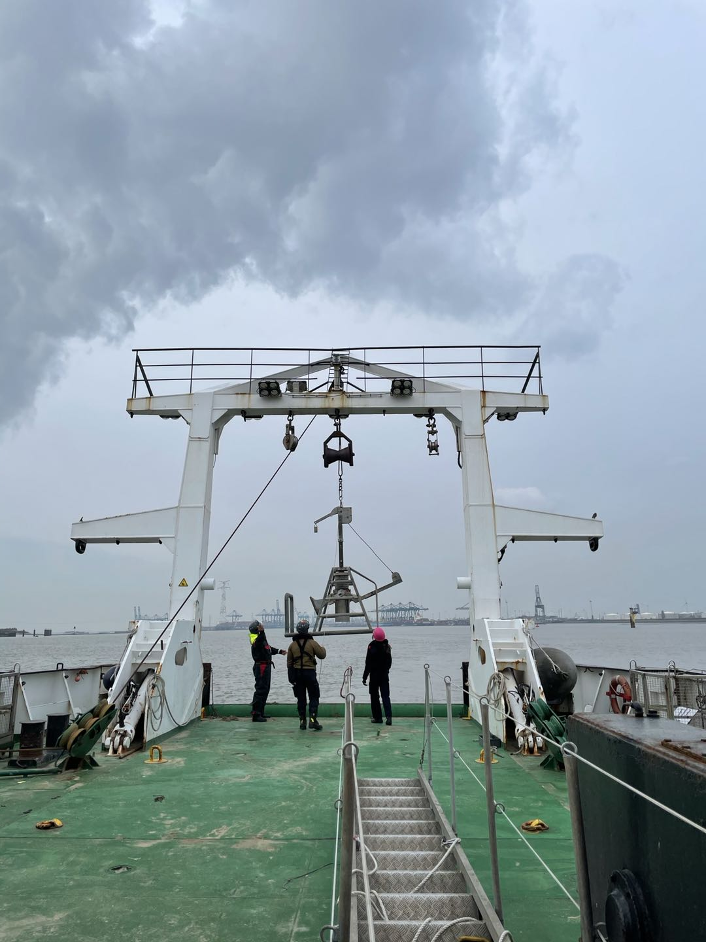
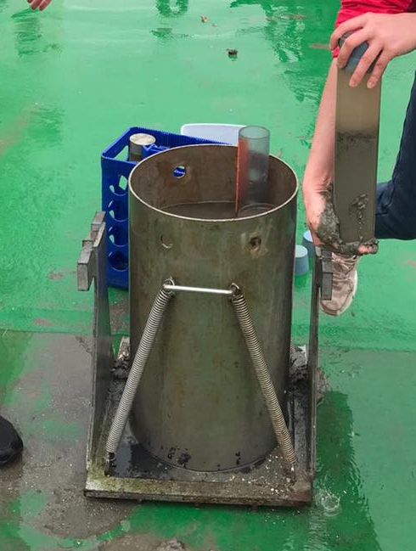
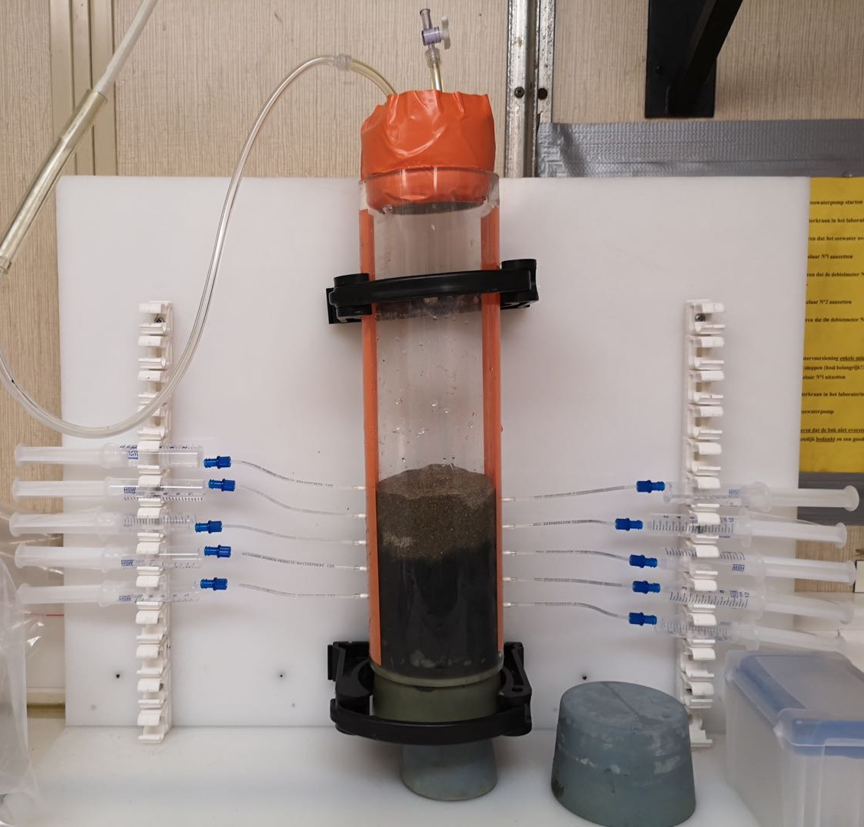
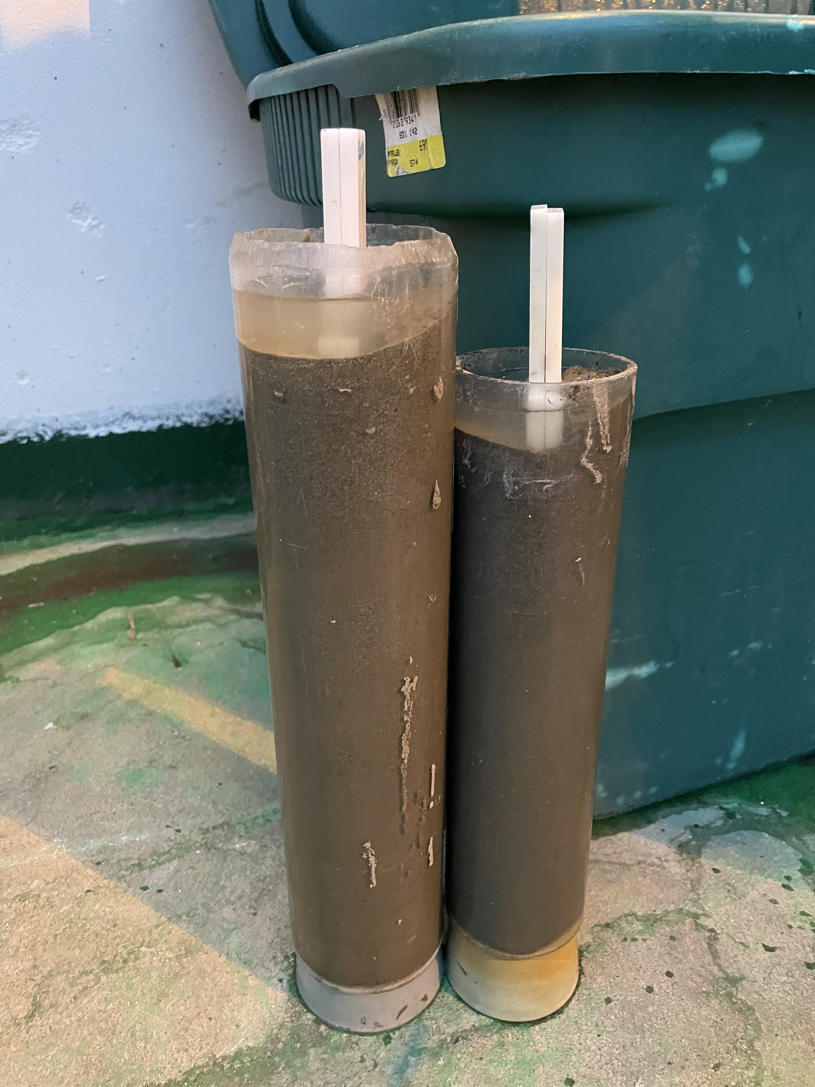
Sediment sampling and DGT deployment
Boxcorer
Sediment sub-sampling
Sediment sub-core
with DGT probes
Pre-drilled sediment core with Rhizons
Notes:
Sediment samples were collected by inserting sub-cores into the Reynek boxcore. DGT probes were deployed for 24 hours and sediment porewater was collected with the help of rhizons in a pre-drilled core filled with N₂

Slide 7
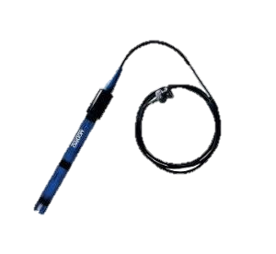
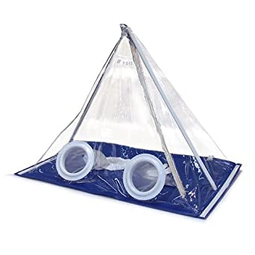
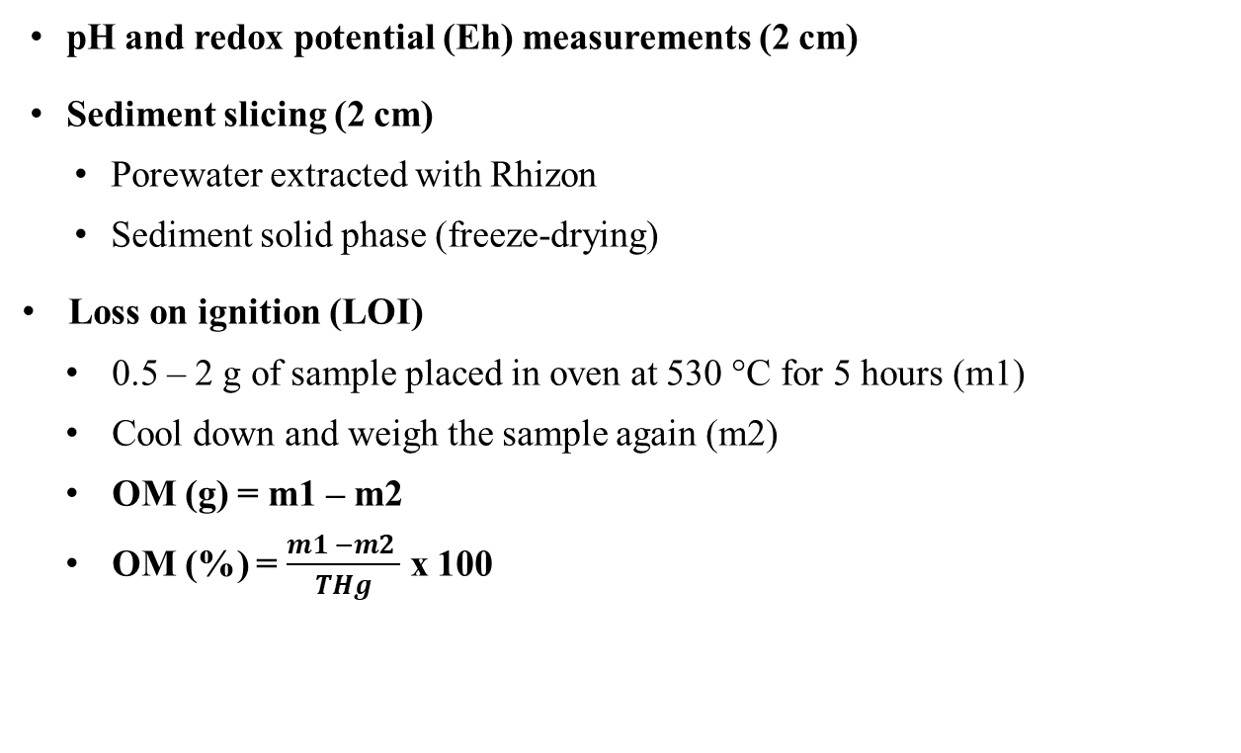
Sediment sampling and treatment
pH, Eh measurements (2 cm)
pH and redox potential (Eh) measurements (2 cm)
Sediment slicing (2 cm)
  Porewater extracted with Rhizon
  Sediment solid phase (freeze-drying)
Loss on ignition (LOI)
  0.5 – 2 g of sample placed in oven at 530 °C for 5 hours (m1)
  Cool down and weigh the sample again (m2)
  OM (g) = m1 – m2
  OM (%) = $\frac{m1 −m2 }{THg}$ x 100
Sediment core slicing, porewater and solid phase collection (2 cm)
DGT deployment in sediments (1 cm)
Notes:
Estimating the amount of OM

Slide 8
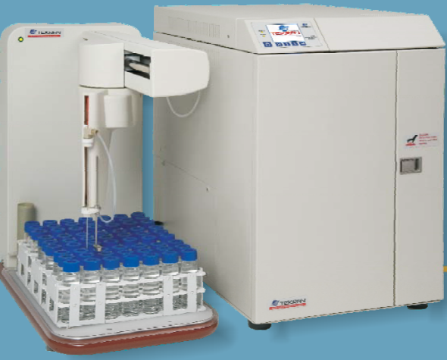
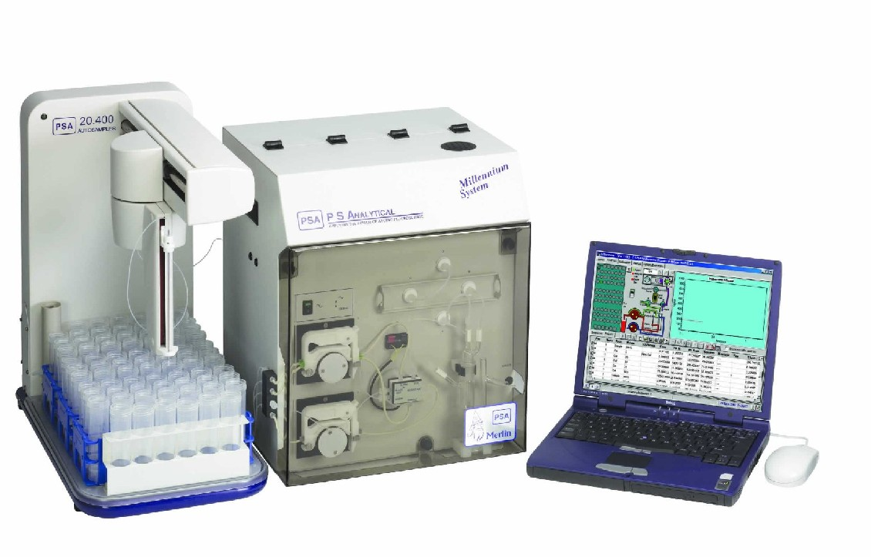
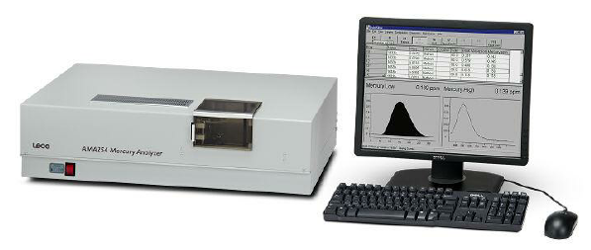
Hg speciation and analysis
Sample analysis
  Advanced Mercury Analyser (AAS AMA-254)
    Cold Vapor-Atomic Fluorescence Spectrometer (CV-AFS PSA)
    Gas Chromatography-Atomic Fluorescence Spectrometer (GC-AFS)
AAS (AMA-254)
CV-AFS (PSA)
GC-AFS (Tekran® Model 2700)
Notes:
Click AMA-254 can analyse the DGT resin gel and sediment solid phase. THg in porewater samples was analysed with CV-AFS PSA. GC-AFS for MMHg analysis. Sediment solid phase (freeze-drying): digest with 6 M nitric acid

Slide 9
Sediment: pH and Eh
2020
Sediment features
ZB: mud
S15: mixture of sand and clay
W01: fine mixture of sand and clay
SV: mixture of sand and clay
S01: sand
pH and Eh
pH: small variations, except SV (2020) & S01 (2021)
Anoxic conditions under Sediment Water Interface (SWI), except S01 (2021)
2021
Notes:
Sediment samples were muddy at ZB, and mixed with and sand clay at all the other sampling stations. pH profiles show constant trend in all the stations, except SV and S01, a peak appeared at -3 cm and pH values increased at the bottom. Incresing trend was found in S01
Eh: From redox potential profiles, we may see clearly that sediments in all the stations become anoxic quickly below the SWI. But S01 has positive Eh values in the whole profile.
9

Slide 10
Sediment: pH and Eh
Sediment features
ZB: mud
S15: mixture of sand and clay
W01: fine mixture of sand and clay
SV: mixture of sand and clay
S01: sand
pH and Eh
pH: small variations, except SV (2020) & S01 (2021)
Anoxic conditions under Sediment Water Interface (SWI), except S01 (2021)
2021
Notes:
Sediment samples were muddy at ZB, and mixed with and sand clay at all the other sampling stations. pH profiles show constant trend in all the stations, except SV and S01, a peak appeared at -3 cm and pH values increased at the bottom. Incresing trend was found in S01
Eh: From redox potential profiles, we may see clearly that sediments in all the stations become anoxic quickly below the SWI. But S01 has positive Eh values in the whole profile.
10

Slide 11
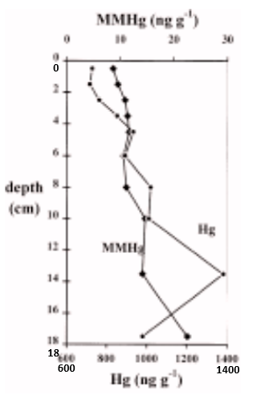
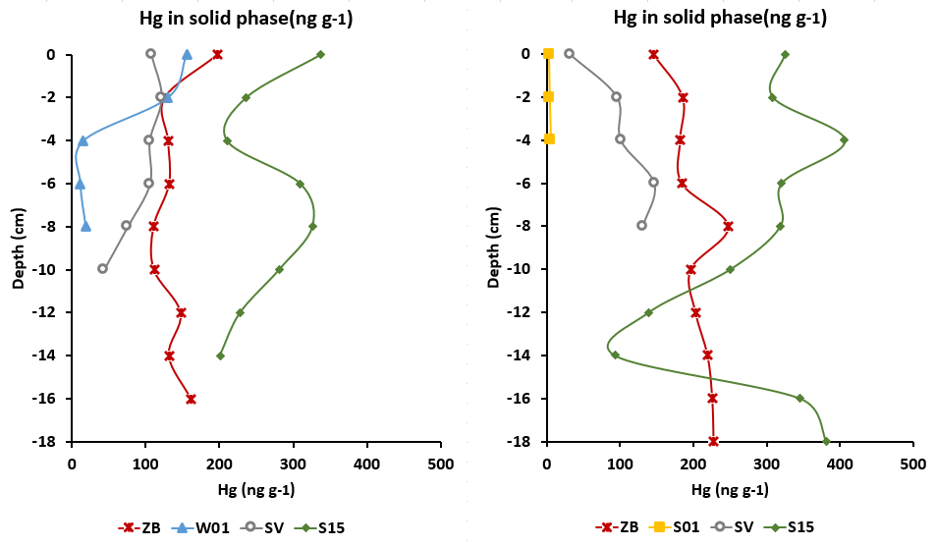
Hg in sediment solid phase
[Hg]: S15>ZB>SV>W01 (/S01)
W01: sharp decrease from SWI to -4 cm
SV: inverse trend in 2020 and 2021
ZB: peak at -8 cm in 2021
S15:
Hg (AUG, 1990) [1] >> Hg (MAR, 2021) > Hg (MAR, 2020)
Peak at -4 cm
MMHg? S15 and ZB
August, 1990
March, 2020
March, 2021
[1] Baeyens et al., 1998
Notes:
Beside the porewater analysis, sediment solid phase was analysed. ZB and SV show comparable results.
However, in W01, a sharp decrease was found from SWI to -4 cm.
In S15, highest Hg concentration, around 330 ng/g was observed in the solid phase (highest labile Hg conc in the same station) There might be a resupply from solid phase to porewater which can results in high labile Hg concentration. It needs further dynamic investigation, for example: sequential extraction may help to explain the resupply of Hg from solid phase to porewater.
The results are compared with the sampling results in August, 1990. This sampling station is located very close to S15. The concentration was at least twice higher than our results, it indicate, the Hg pollution in sediment was much better than the 90s in the upper Scheldt estuary.
Obviously, two peaks in 2021

Slide 12
Hg in sediment solid phase
[Hg]: S15>ZB>SV>W01 (/S01)
W01: sharp decrease from SWI to -4 cm
SV: inverse trend in 2020 and 2021
ZB: peak at -8 cm in 2021
S15:
Hg (AUG, 1990) [1] >> Hg (MAR, 2021) > Hg (MAR, 2020)
Peak at -4 cm
MMHg? S15 and ZB
August, 1990
March, 2020
March, 2021
[1] Baeyens et al., 1998
Notes:
Beside the porewater analysis, sediment solid phase was analysed. ZB and SV show comparable results.
However, in W01, a sharp decrease was found from SWI to -4 cm.
In S15, highest Hg concentration, around 330 ng/g was observed in the solid phase (highest labile Hg conc in the same station) There might be a resupply from solid phase to porewater which can results in high labile Hg concentration. It needs further dynamic investigation, for example: sequential extraction may help to explain the resupply of Hg from solid phase to porewater.
The results are compared with the sampling results in August, 1990. This sampling station is located very close to S15. The concentration was at least twice higher than our results, it indicate, the Hg pollution in sediment was much better than the 90s in the upper Scheldt estuary.
Obviously, two peaks in 2021

Slide 13
Hg in sediment solid phase
[Hg]: S15>ZB>SV>W01 (/S01)
W01: sharp decrease from SWI to -4 cm
SV: inverse trend in 2020 and 2021
ZB: peak at -8 cm in 2021
S15:
Hg (AUG, 1990) [1] >> Hg (MAR, 2021) > Hg (MAR, 2020)
Peak at -4 cm
MMHg? S15 and ZB
August, 1990
March, 2020
March, 2021
[1] Baeyens et al., 1998
Notes:
Beside the porewater analysis, sediment solid phase was analysed. ZB and SV show comparable results.
However, in W01, a sharp decrease was found from SWI to -4 cm.
In S15, highest Hg concentration, around 330 ng/g was observed in the solid phase (highest labile Hg conc in the same station) There might be a resupply from solid phase to porewater which can results in high labile Hg concentration. It needs further dynamic investigation, for example: sequential extraction may help to explain the resupply of Hg from solid phase to porewater.
The results are compared with the sampling results in August, 1990. This sampling station is located very close to S15. The concentration was at least twice higher than our results, it indicate, the Hg pollution in sediment was much better than the 90s in the upper Scheldt estuary.
Obviously, two peaks in 2021

Slide 15
1990-S15

Slide 16
Hg in sediment solid phase
MMHg (ng/g) - 2021
MMHg peaks correspondance to THg peaks
Small ratio of MMHg to THg for both stations (below 1.5%)
MMHg concentration is not always influenced by THg variations
  For S15: Significantly positive correlation (R² = 0.6839, p = 0.004<0.05) MMHg level increases with increasing THg
  For ZB: No correlation (R² = 0.023, p>0.05)
Positive correlation between [MMHg] and % OM (S15), no correlation between MMHg and OM in ZB
Notes:
S15 and ZB selected

Slide 17
Hg in sediment solid phase
MMHg (ng/g) - 2021
MMHg peaks correspondance to THg peaks
Small ratio of MMHg to THg for both stations (below 1.5%)
MMHg concentration is not always influenced by THg variations
  For S15: Significantly positive correlation (R² = 0.6839, p = 0.004<0.05) MMHg level increases with increasing THg
  For ZB: No correlation (R² = 0.023, p>0.05)
Positive correlation between [MMHg] and % OM (S15), no correlation between MMHg and OM in ZB
Notes:
S15 and ZB selected

Slide 18
Hg in sediment porewater
Total and labile Hg (ng/L)
2020
[THg] increased towards
the bottom, except S15
ZB: labile Hg fluctuated under
  SWI
W01 and SV: THg > Labile Hg
SV: inverse trend between THg
and Labile Hg
S15: Labile Hg > THg under
SWI (technical problem)
(P): Porewater
Notes:
In March, 2020. Labile Hg conc in ZB were much higher than W01 and SV. In ZB, almost all Hg presented as labile Hg in porewater due to the concentrations were almost the same with the Hg in porewater. In station W01, Hg concentrations in porewater were higher than labile Hg. In station SV, almost all the Hg present as labile Hg from SWI to -3 cm, then porewater higher than DGT as a general phenomenon. In station S15, labile Hg conc were much higher than THg in porewater, there might be sth wrong due to the technical problem, since we measured high porewater conc than DGT in March 2021.
18

Slide 19
Hg in sediment porewater
Total and labile Hg (ng/L)
2020
[THg] increased towards
the bottom, except S15
ZB: labile Hg fluctuated under
  SWI
W01 and SV: THg > Labile Hg
SV: inverse trend between THg
and Labile Hg
S15: Labile Hg > THg under
SWI (technical problem)
(P): Porewater
Notes:
In March, 2020. Labile Hg conc in ZB were much higher than W01 and SV. In ZB, almost all Hg presented as labile Hg in porewater due to the concentrations were almost the same with the Hg in porewater. In station W01, Hg concentrations in porewater were higher than labile Hg. In station SV, almost all the Hg present as labile Hg from SWI to -3 cm, then porewater higher than DGT as a general phenomenon. In station S15, labile Hg conc were much higher than THg in porewater, there might be sth wrong due to the technical problem, since we measured high porewater conc than DGT in March 2021.
19

Slide 20
Hg in sediment porewater
Total and labile Hg (ng/L)
2020
[THg] increased towards
the bottom, except S15
ZB: labile Hg fluctuated under
  SWI
W01 and SV: THg > Labile Hg
SV: inverse trend between THg
and Labile Hg
S15: Labile Hg > THg under
SWI (technical problem)
(P): Porewater
Notes:
In March, 2020. Labile Hg conc in ZB were much higher than W01 and SV. In ZB, almost all Hg presented as labile Hg in porewater due to the concentrations were almost the same with the Hg in porewater. In station W01, Hg concentrations in porewater were higher than labile Hg. In station SV, almost all the Hg present as labile Hg from SWI to -3 cm, then porewater higher than DGT as a general phenomenon. In station S15, labile Hg conc were much higher than THg in porewater, there might be sth wrong due to the technical problem, since we measured high porewater conc than DGT in March 2021.
20

Slide 21
(P): Porewater
Notes:
In March, 2020. Labile Hg conc in ZB were much higher than W01 and SV. In ZB, almost all Hg presented as labile Hg in porewater due to the concentrations were almost the same with the Hg in porewater. In station W01, Hg concentrations in porewater were higher than labile Hg. In station SV, almost all the Hg present as labile Hg from SWI to -3 cm, then porewater higher than DGT as a general phenomenon. In station S15, labile Hg conc were much higher than THg in porewater, there might be sth wrong due to the technical problem, since we measured high porewater conc than DGT in March 2021.
21

Slide 22
Hg in sediment porewater
Total and labile Hg (ng/L)
2020
[THg] increased towards
the bottom, except S15
ZB: labile Hg fluctuated under
  SWI
W01 and SV: THg > Labile Hg
SV: inverse trend between THg
and Labile Hg
S15: Labile Hg > THg under
SWI (technical problem)
(P): Porewater
Notes:
In March, 2020. Labile Hg conc in ZB were much higher than W01 and SV. In ZB, almost all Hg presented as labile Hg in porewater due to the concentrations were almost the same with the Hg in porewater. In station W01, Hg concentrations in porewater were higher than labile Hg. In station SV, almost all the Hg present as labile Hg from SWI to -3 cm, then porewater higher than DGT as a general phenomenon. In station S15, labile Hg conc were much higher than THg in porewater, there might be sth wrong due to the technical problem, since we measured high porewater conc than DGT in March 2021.
22

Slide 23
Hg in sediment porewater
Total and labile Hg (ng/L)
2021
Higher [Hg] in porewater in
SV and S15
No labile Hg data from S01
(sandy sediment)
Compare to THg, inverse trend of labile Hg in S15 was found
→ Dredging/dumping operation(s) between the two sampling campaigns in 2020 and 2021
Low [labile Hg] in ZB
Sharp peaks in ZB (THg) MMHg?
Notes:
23

Slide 24
Hg in sediment porewater
Total and labile Hg (ng/L)
2021
Higher [Hg] in porewater in
SV and S15
No labile Hg data from S01
(sandy sediment)
Compare to THg, inverse trend of labile Hg in S15 was found
→ Dredging/dumping operation(s) between the two sampling campaigns in 2020 and 2021
Low [labile Hg] in ZB
Sharp peaks in ZB (THg) MMHg?
Notes:
24

Slide 25
Hg in sediment porewater
MMHg (ng/L) - 2021
Classic sampling
S01: < LoD
ZB: sharp peaks at -10 cm, correspond to THg in porewater
SV: [MMHg] decreased from -9 cm
S15: high [MMHg] at the SWI and decreasing trend
  similar to labile Hg profile
Notes:
LoD 15 pg/L
25

Slide 26
Conclusions
&
Perspectives
Labile Hg conc. can be assessed by DGT in sediment
2020 & 2021: different profiles of Hg species in sediment
Higher Hg concentration in SV and S15 porewater in 2021
S15: Highest Hg concentration in sediment porewater and solid phase
Dynamic supply of Hg from solid phase to porewater is important
Small percentage of MMHg to THg in sediment porewater and solid phase.
To improve the study of MMHg in sediment
Optimization of porewater analysis
Assess labile MMHg with DGT
Sequential extractions to identify the Hg binding phases in sediment

Slide 27


Thank you for your attention!
Contact:
Tianhui Ma
Tianhui.Ma@vub.be

Slide 28
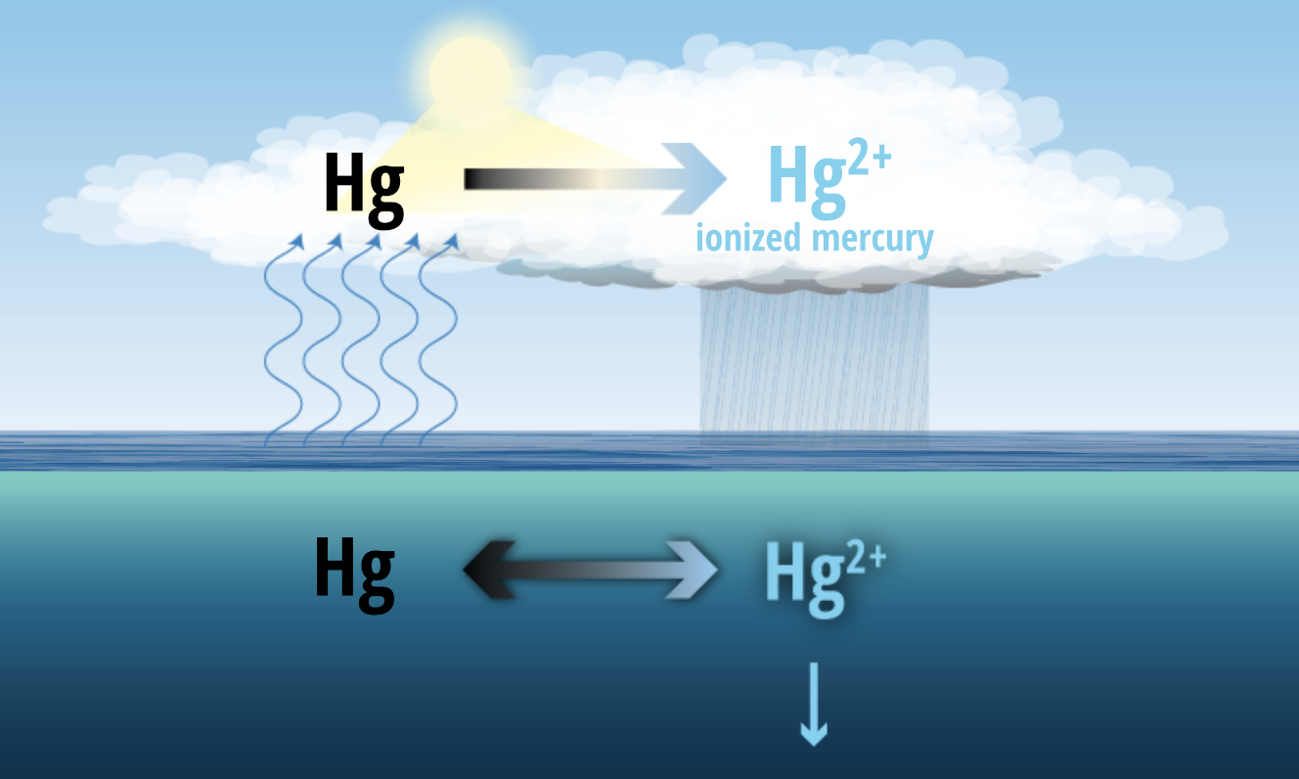
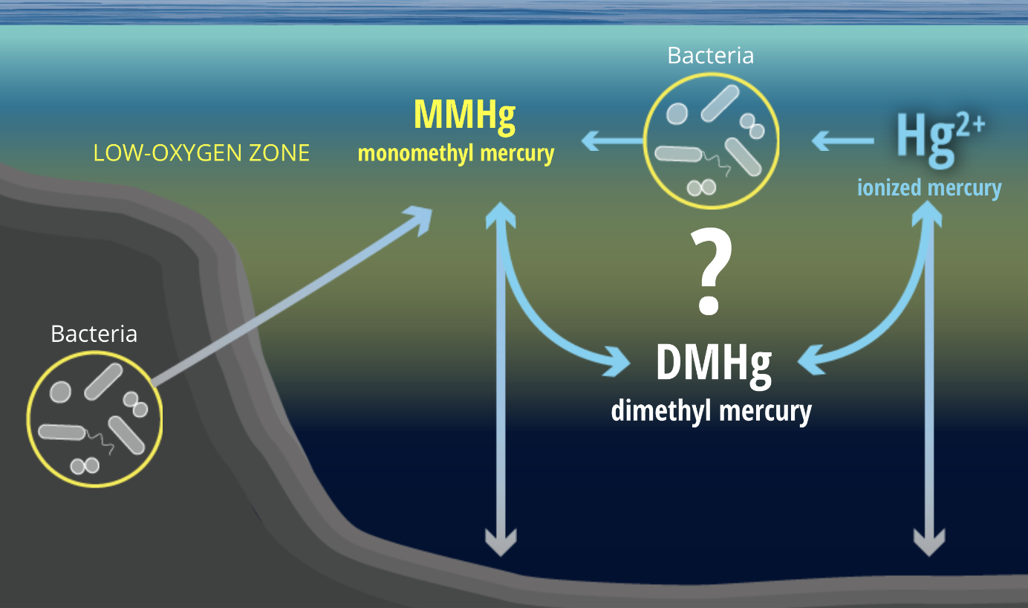
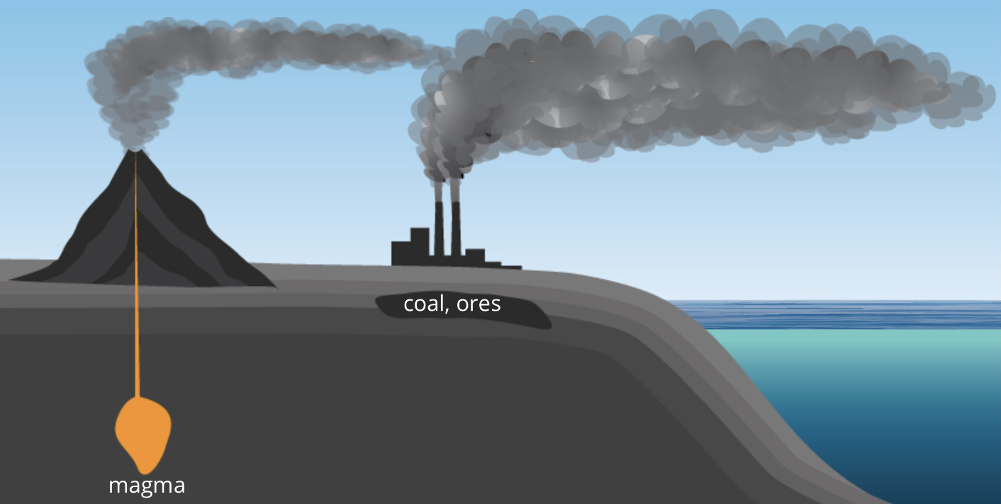
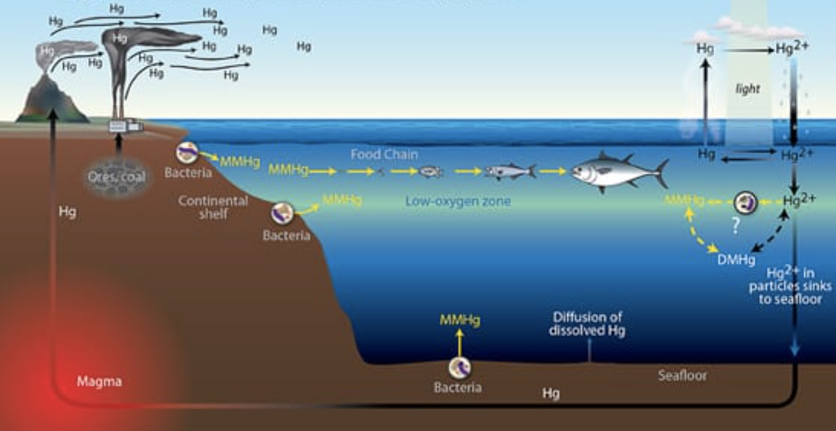
The Hg cycle
Atmosphere
Terrestrial
Aquatic
Notes:
Hg forms can interchange in atmospheric, aquatic and terrestrial environments. Click The cycling pathways are complex. Click Click
The major sources of Hg in the atmosphere are human activities. Volcanic eruptions are a natural source of Hg in the atmosphere. Rainwater carries much of the atmospheric Hg to the land and oceans. Click Click Click
In the atmosphere, sunlight converts elemental Hg to ionized Hg2+, which falls to earth by rain. About 80% of the Hg2+ enters the ocean is converted back to Hg0 and evaporates back to the atmosphere. Click Click Some of the Hg2+ hat remains in the ocean sticks to particles of organic matter and falls to the seafloor. Some enters the food chain. Click Click
Bacteria in oxygen-poor zones can convert Hg2+ to MMHg. DMeHg is the most toxic form of Hg and present in seawater at very low levels.
28

Slide 29
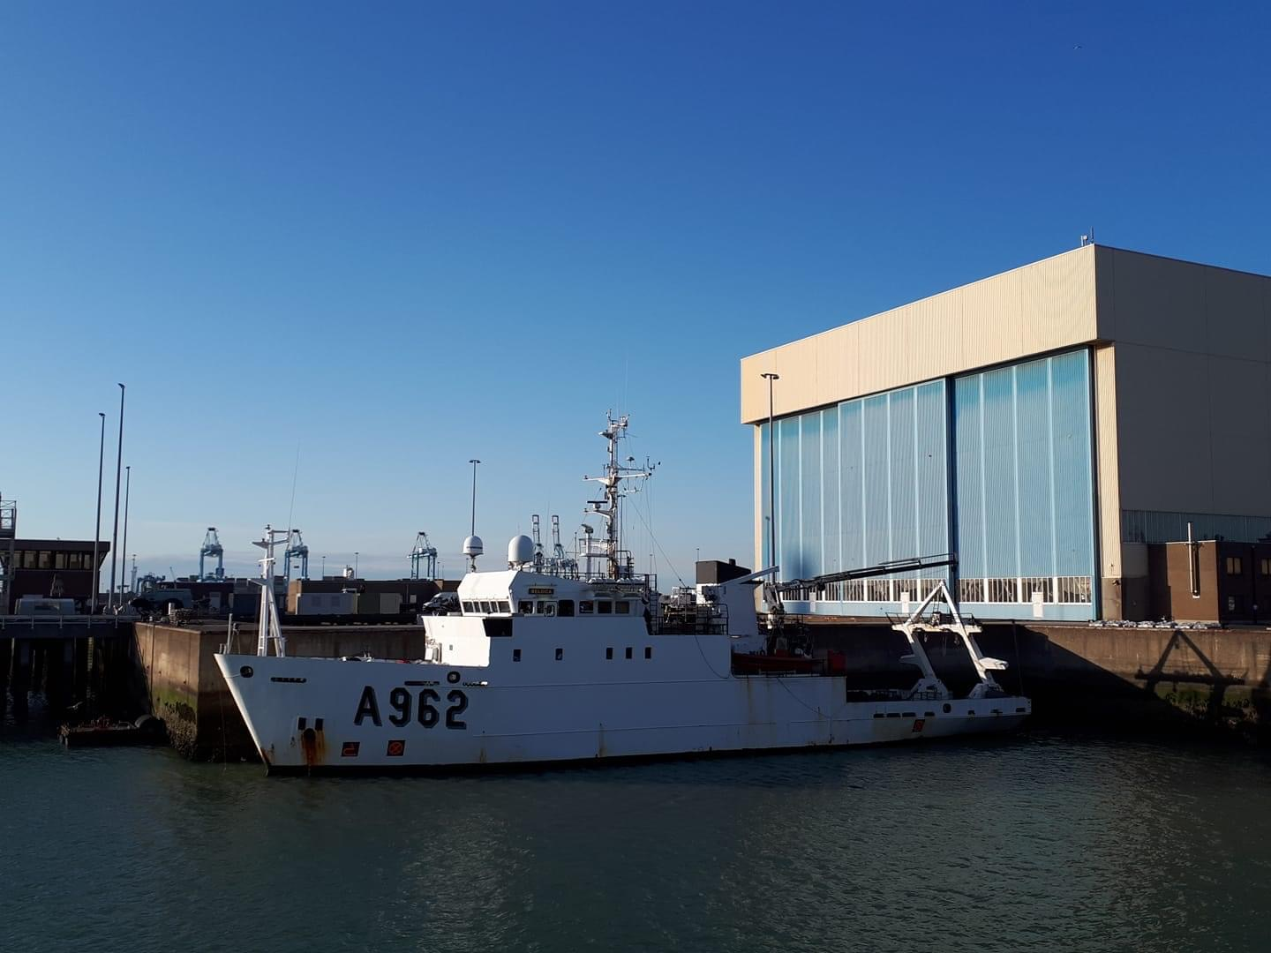
Hg and MMHg speciation in the Scheldt Estuary and Belgian Part of the North Sea (BPNS) sediments
IASWS 2022
IASWS 2022
Tianhui Ma
Tianhui.ma@vub.be
Promotors: Prof. dr. Yue Gao; Prof. dr. Martine Leermakers
15/06/2022
FWO LEAD project
Notes:
29

