Slide 1

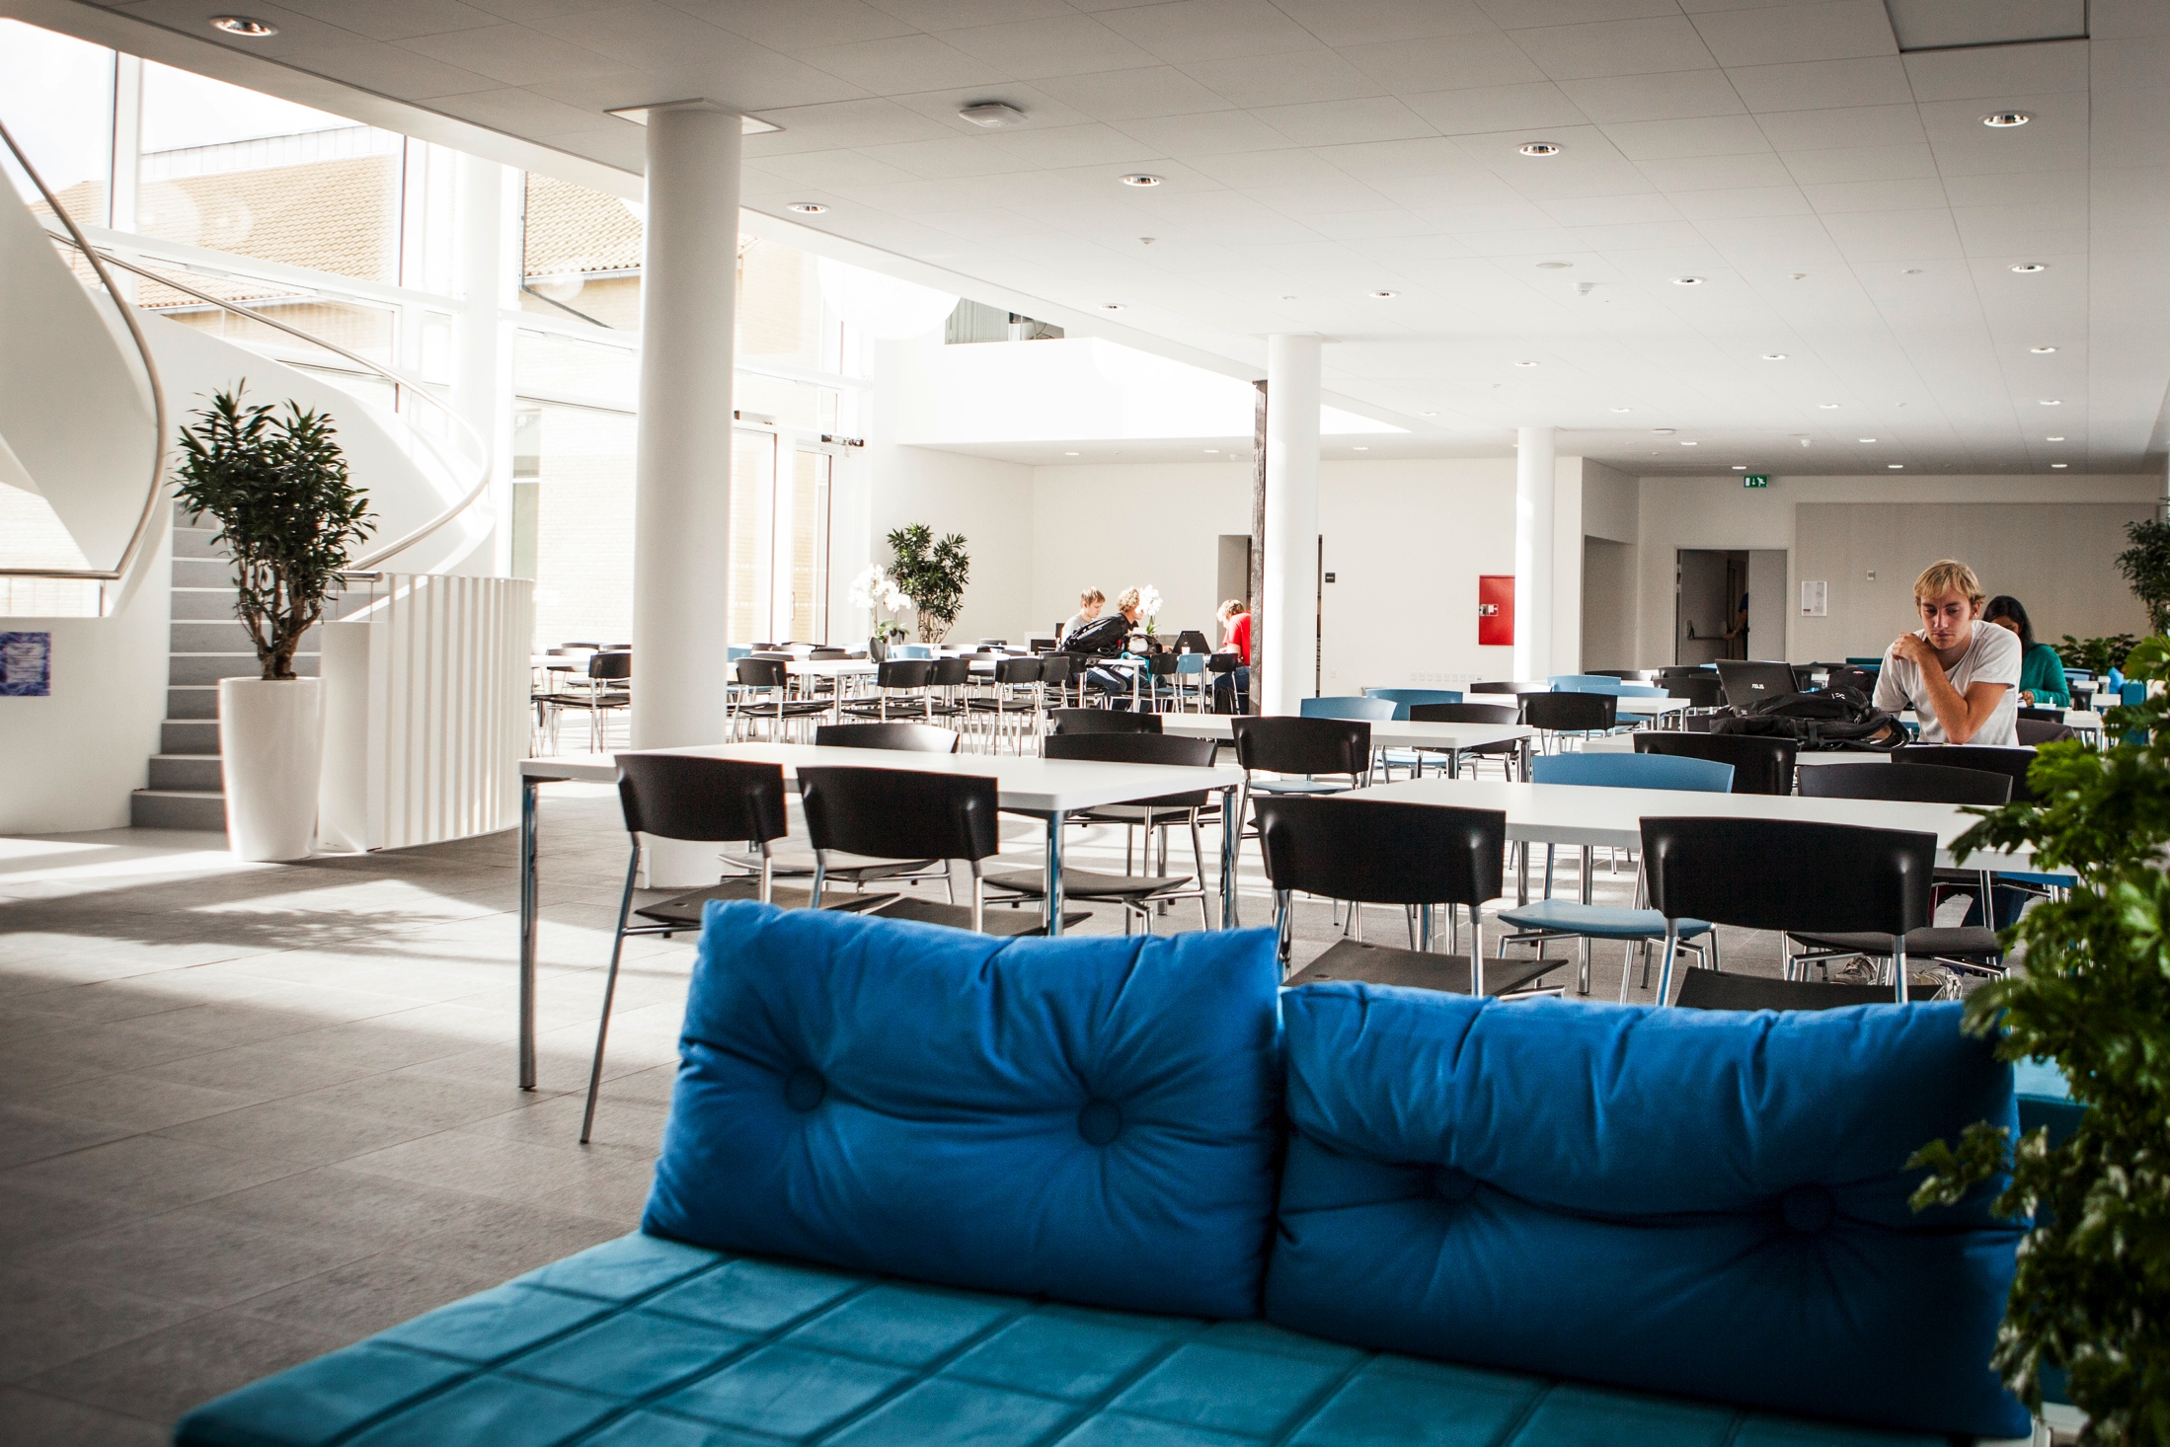
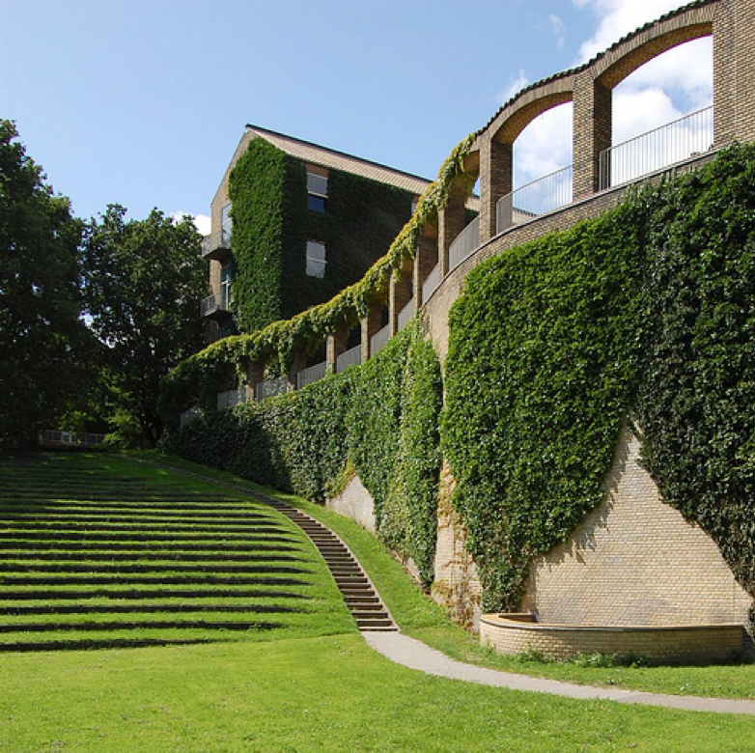

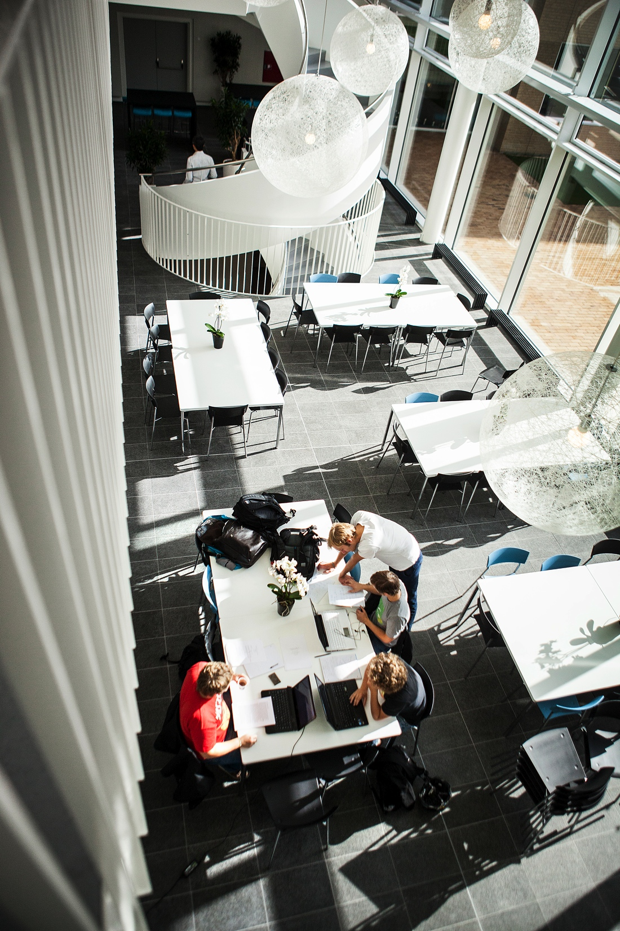
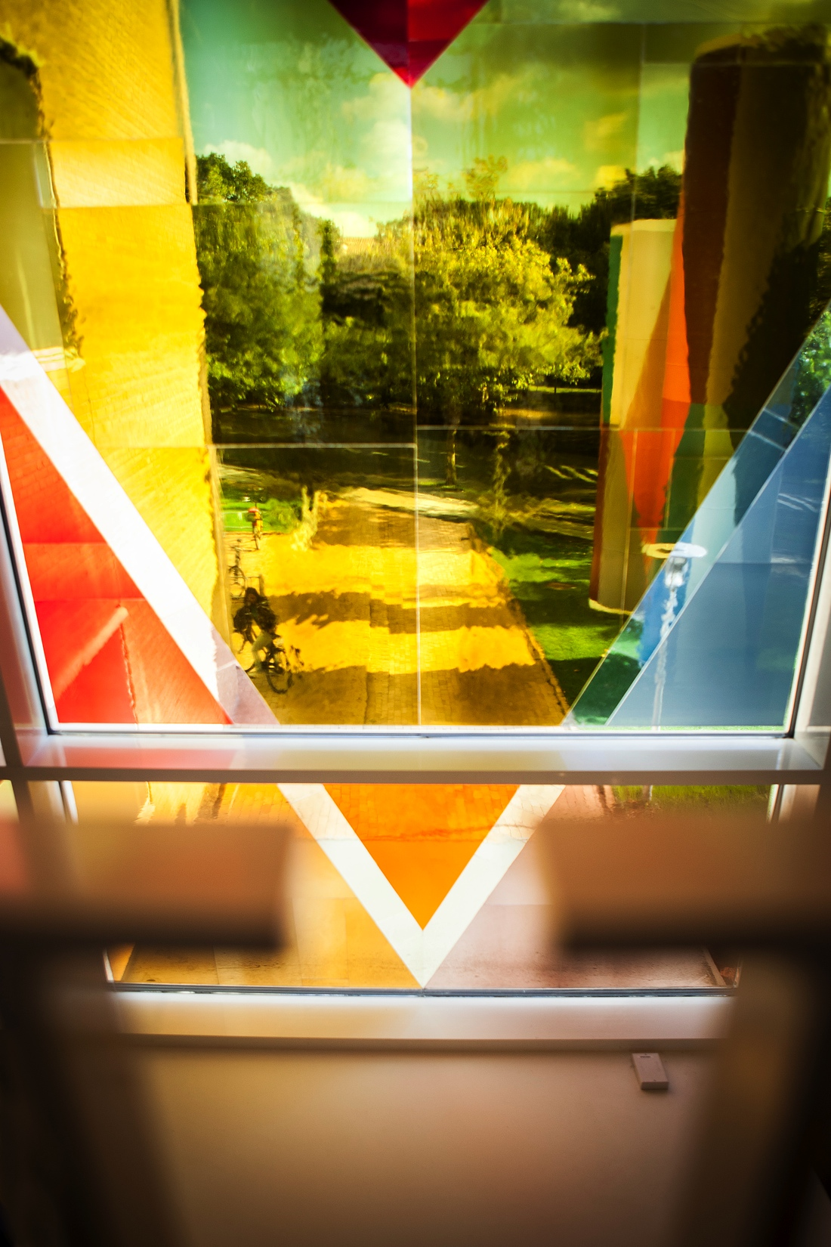
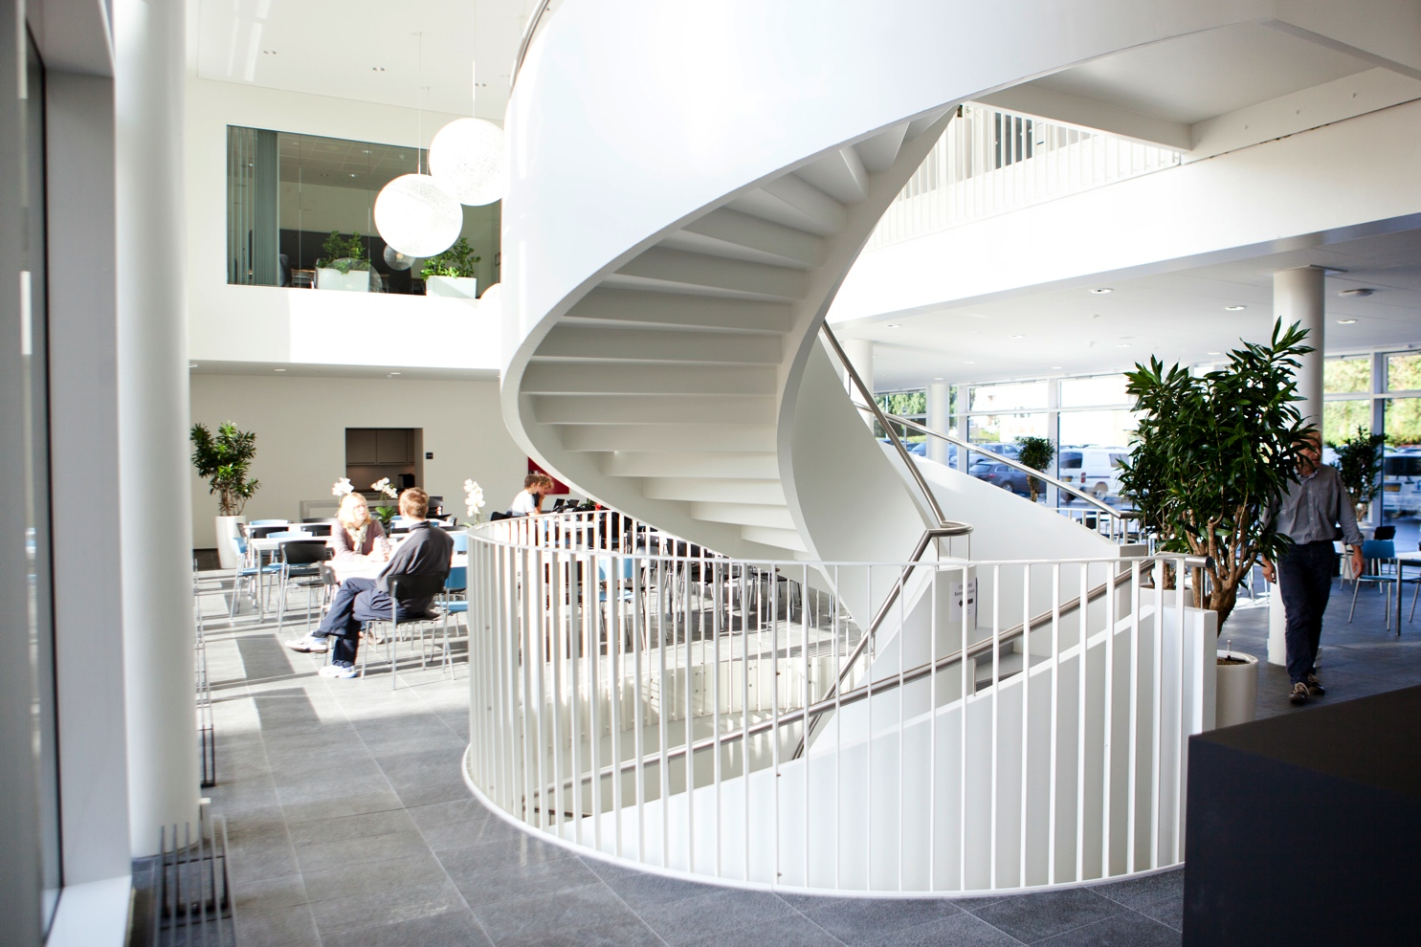



Aptamers at work – effective neutralization of SARS-CoV-2 and identifying protein biomarkers in biofluids using highly parallelized RNA aptamer screens.
GRC – RNA Nanotechnology 12 January 2023
Jørgen Kjems
Interdisciplinary Nanoscience Center (iNANO)
Department for Molecular Biology and Genetics
Aarhus University

Slide 2
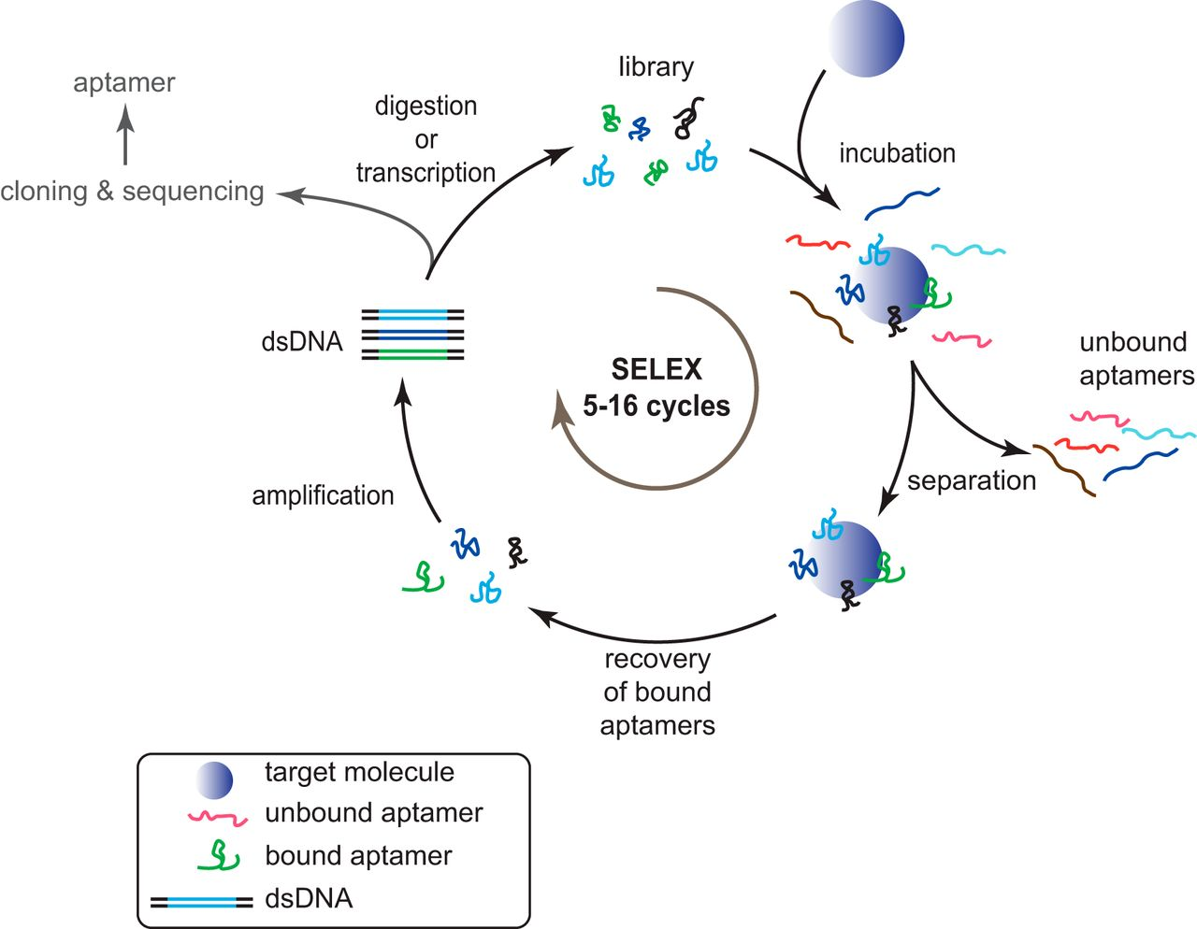
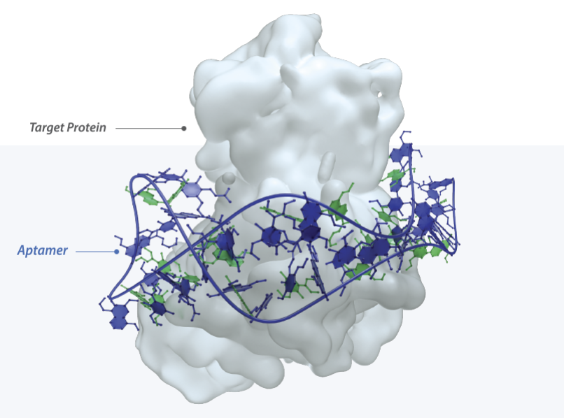
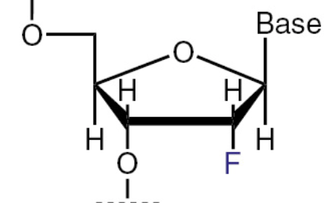
Creating aptamers by SELEX
(Systematic Evolution of Ligands by EXponential Enrichment)
RNAs 10¹⁶
2’-F makes aptamers stable in biofluids

Slide 3

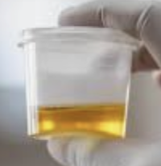

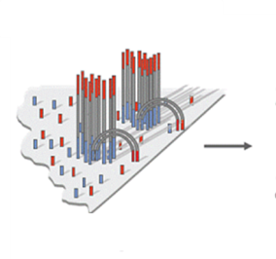
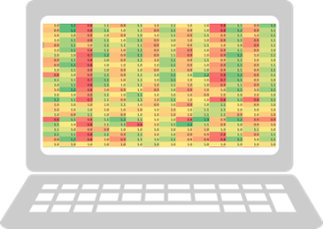
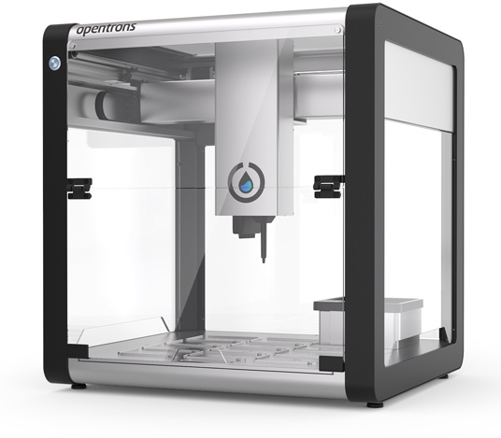

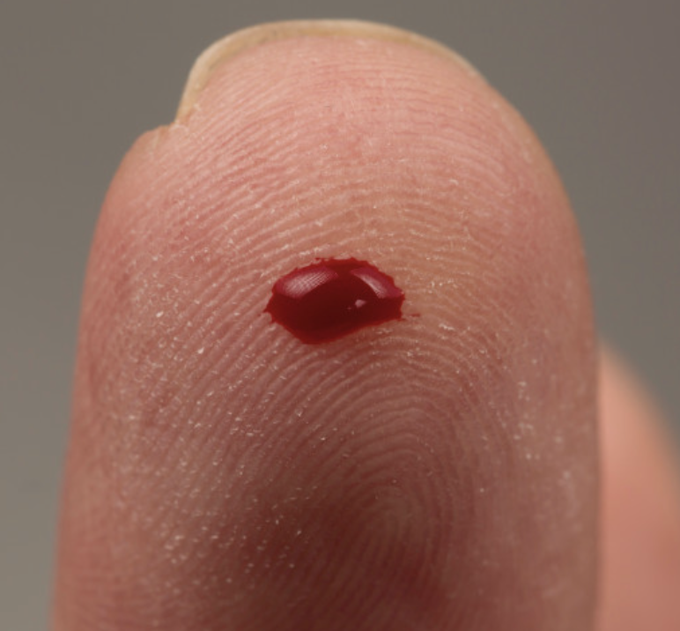
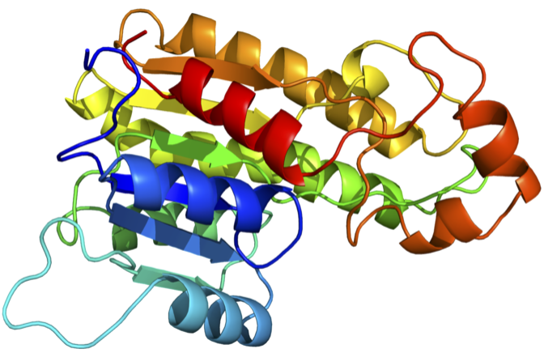
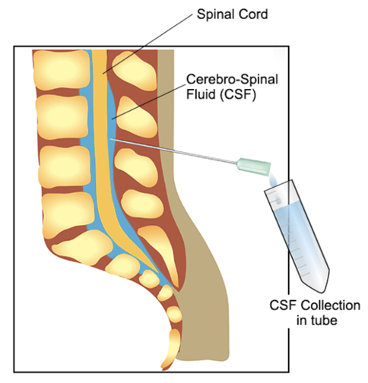
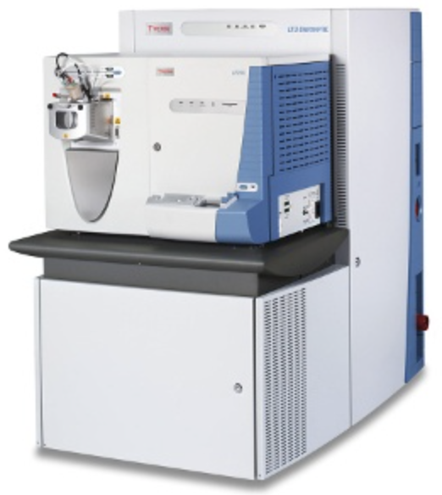



APTASHAPE workflow
3-4 rounds SELEX
(Training selection)
1 round SELEX
(Branched selection)
Neuronal network
Machin learning
Select infection-sensitive aptamers
100 ul beer
NGS
10⁸ RNAs
+
Robot
Healthy
Illumina
diseased
100 ul beer
Aptamer
Library of
10¹⁵ random RNAs
Plasma specific sequences
10¹⁰ RNAs
Treated
Robot
Synthesis discriminative aptamers and affinity pull-down of biomarker
Discard non-binders
1 ul plasma
Identification of biomarker by
Mass Spectroscopy
Fe
20 ul CSF

Slide 4
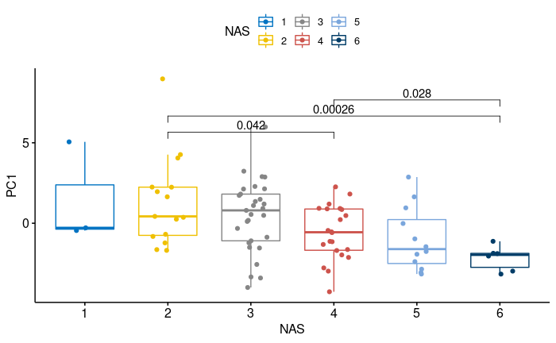
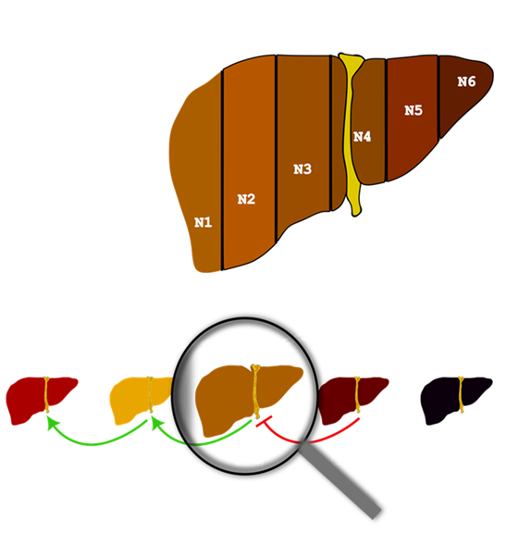
APTASHAPE – human fatty liver disease diagnostics
Cohort: 174 liver FLD patients (Clinical samples from Henning Grønbæk, Skejby Hospital)
Clinically identification of NASH status 1-6
PC1
NASH severity score
Unpublished

Slide 5
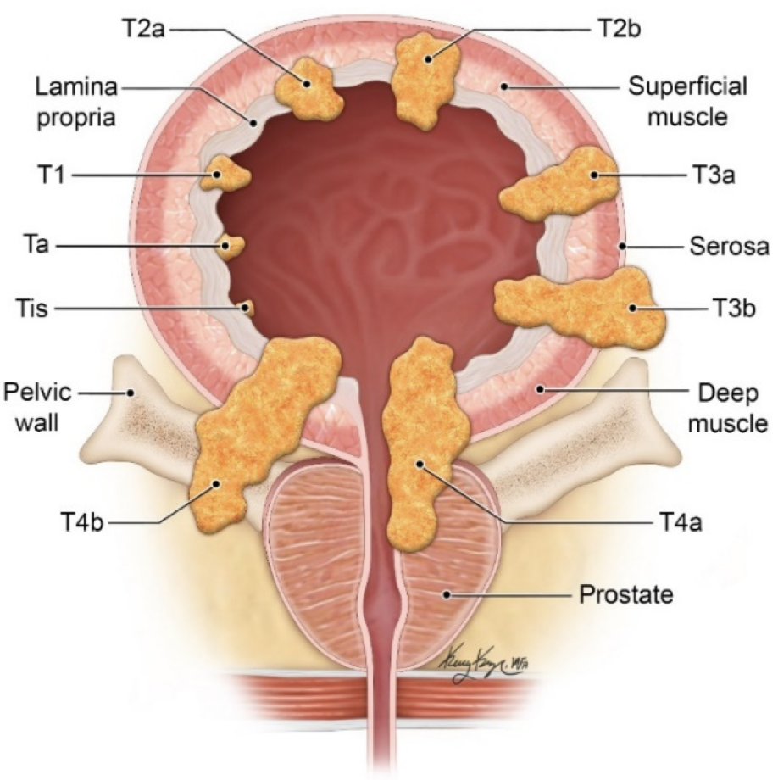
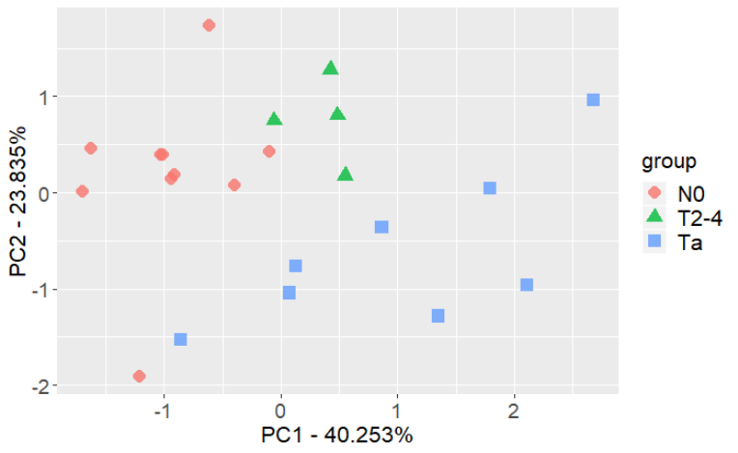
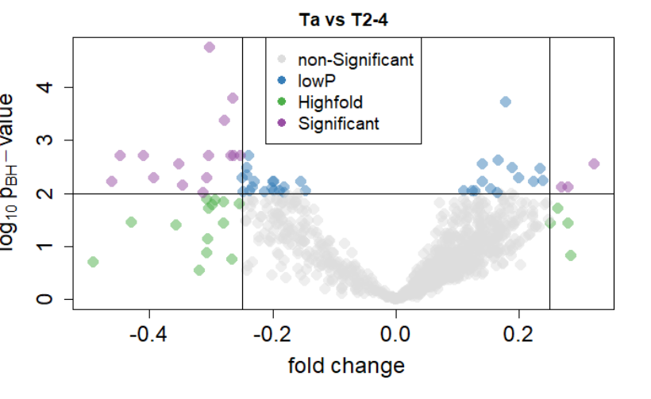
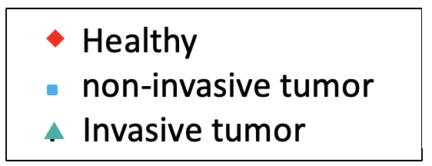
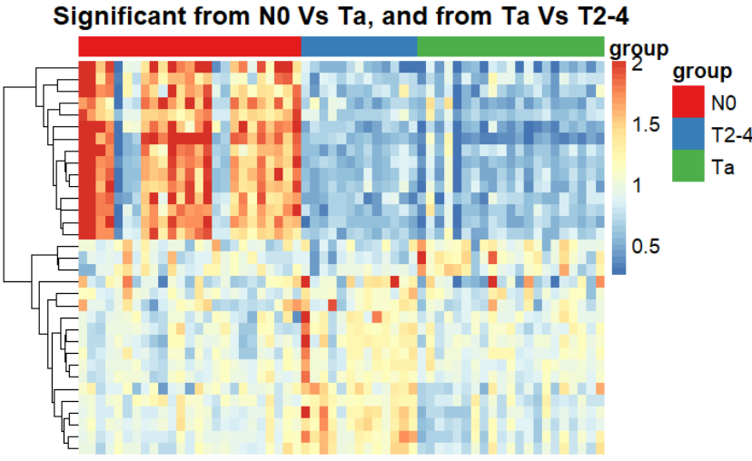
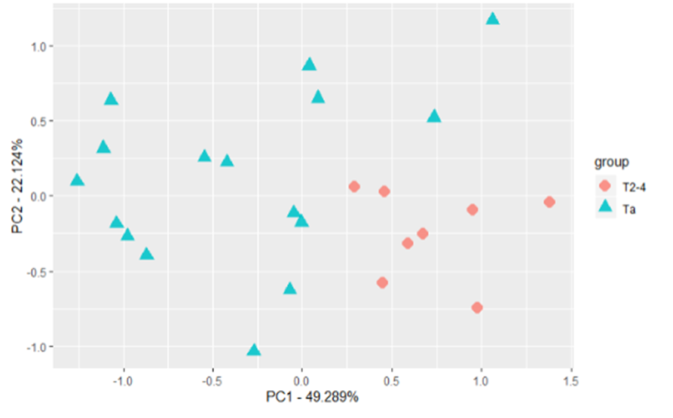
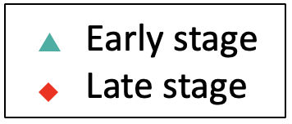
Aptashape - Bladder cancer
Sick-Healthy supervised
Identification of descriptive aptamers
T_{a}- (T2-4) supervised
Healthy T2-4 Ta
Fjelstrup et al. NAR Cancer, 4:3 (2022)

Slide 6
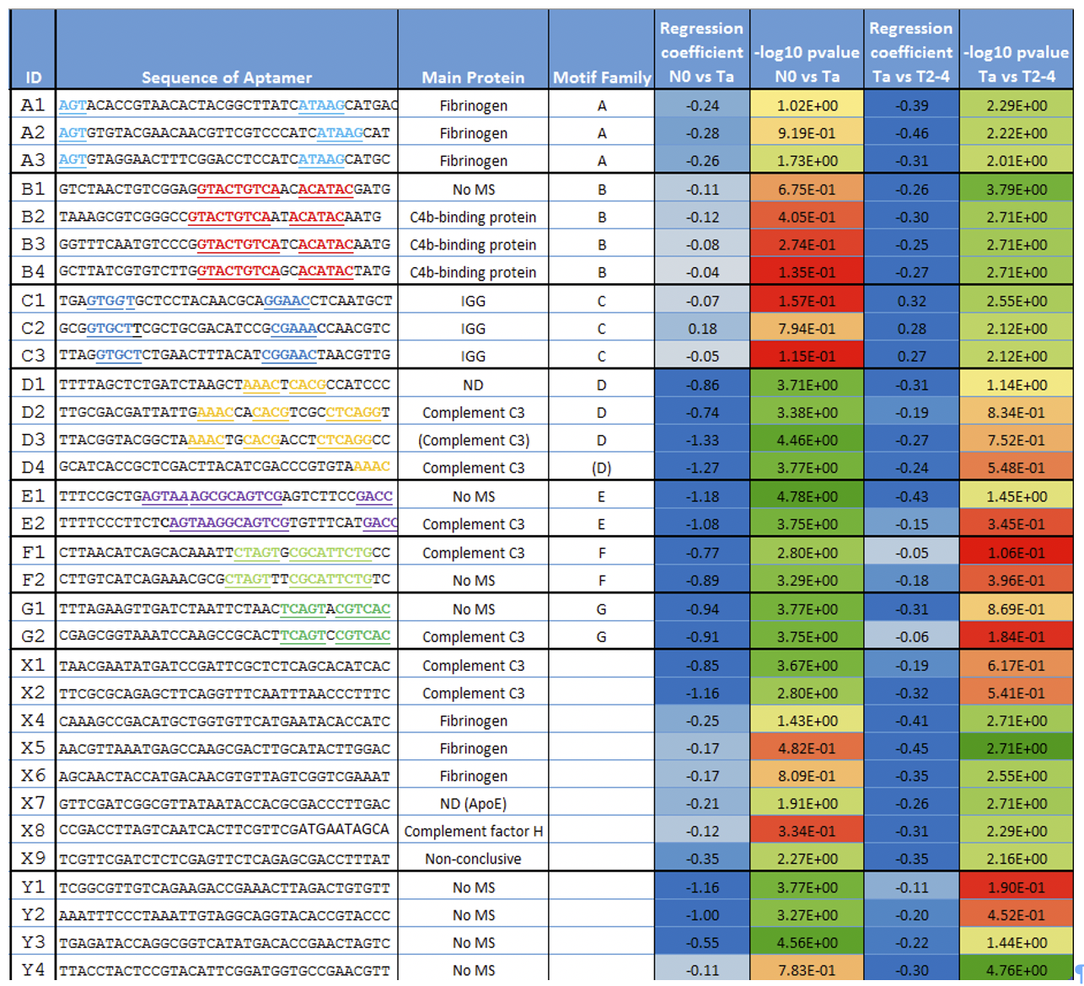
Characterization of protein biomarkers in bladder cancer by affinity precipitation and MS

Slide 7
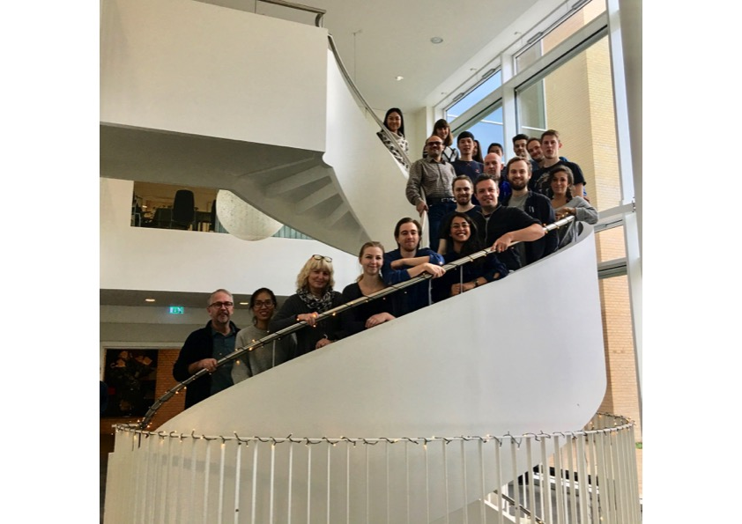



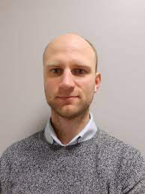
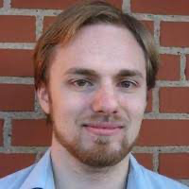
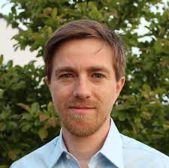
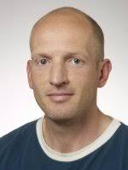
Acknowledgements
The aptamist team
Collaborators:
Lars Dyrskjøt
Karin Birkenkamp-Demtröder
Peter Garred (KU)
Peter Heegaard (DTU)
Thomas Benfield (HH) Natasha B. Michaelsen
Line Reinert
Søren Paludan
Ralf Wagner
Asger Jørgensen
Postdoc
Søren Fjelstrup
Data Scientist
Daniel M. Dupont
Assist.Professor
Claus Bus
Lab Manager

