Slide 1







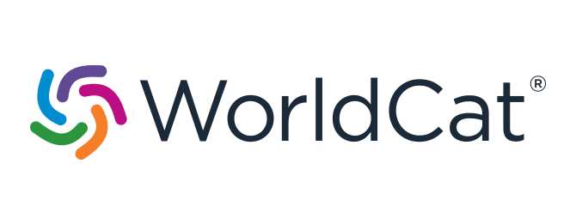


Finding Open Access Literature
CREATED BY
AS PART OF
FUNDED BY
Numerous search engines specialise in finding open access publications and provide worldwide, free access to full texts.
Name | Description
base- search.net | The Bielefeld Academic Search Engine is one of the world's largest search engines for academic web documents. The index includes a huge number of documents from more than 10,000 data providers and growing. The majority of the academic content included is open access.
core.ac.uk | CORE is dedicated to aggregate all open access research worldwide. It is the world's largest collection of freely available full texts and improves the findability of open access content provided by repositories and journals.
dissem.in | Dissemin supports authors to make a paywalled version of their paper freely available to the public. By analysing the publication, Dissemin evaluates whether publications are openly accessible or not and invites authors to upload them to a repository.
europe pmc.org | The platform provides access to a worldwide collection of life science publications and preprints, containing millions of full texts from trusted sources. Further, it connects research articles to related resources thus promoting reproducibility.
oclc.org/en/oaister | OAIster is a union catalogue containing more than 50 millions open access records. These are searchable via WorldCat.org and aggregated from over 2,000 data providers.
explore. openaire.eu | The The OpenAIRE Research Graph is one of the largest open data collections. Around 450 million metadata records are aggregated, cleaned, classified and linked with semantic relationships.
openaccess button.org | In addition to the search function via title, identifiers, URL or citations, the search engine includes the option of requesting a scholarly publication from the authors, provided it is not open access.
osf.io | Open Science Framework is a cross-disciplinary platform for searching articles, data and materials, as well as for managing your own research and collaborations.
share.osf.io | SHARE's open tools and services help to bring together scholarly work distributed across different research ecosystems to make it more discoverable.
OSF
SHARE
For more information visit open-access.network.
This work is available under a Creative Commons Attribution 4.0 International License.
Logos used are excluded from this license.

Slide 2
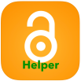


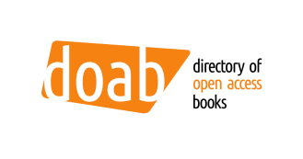


Finding Open Access Literature
CREATED BY
AS PART OF
FUNDED BY
Some browser plug-ins or extensions support searching for open access versions of scholarly articles.
Name | Description
openaccess button.org | Among other tools OA.Works also offers the browser extension Open Access Button, which provides free and legal access to specialist publications or automatically requests them from authors.
oahelper.org | The OAHelper supports searches for open access versions of articles. It is available as an app for iOS or as a browser extension for MacOS, Chrome or Firefox.
unpay wall.org | Unpaywall offers a browser extension for Chrome and Firefox. It is automatically searching for open access versions of scholarly publications which are originally published behind a paywall.
In addition, there are specialised services for finding open access books and open access journals.
Name | Description
oapen.org | Open access e-books are made available as full texts via the OAPEN library platform. These are e-books specifically for the humanities and social sciences.
directory.doabooks.org | The Directory of Open Access Books is a directory for peer-reviewed open access monographs and book publishers. It is community-driven and provides access to the Open Access Toolkit which gives practical tips for publishing open access books.
doaj.org | The Directory of Open Access Journals indexes high-quality, open access and peer-reviewed journals. It is non-profit and aims to increase the visibility and reputation of open access journals.
qoam.eu | The marketplace for scientific journals that publish articles in open access offers authors the opportunity to qualitatively evaluate their publication output in a journal.
For more information visit open-access.network.
This work is available under a Creative Commons Attribution 4.0 International License.
Logos used are excluded from this license.

