Slide 1




AutSPACEs: co-creating a citizen science platform
@AutSPACEs
10.5281/zenodo.7550764

Slide 2
What is AutSPACEs?
@AutSPACEs
10.5281/zenodo.7550764
Notes:
So, firstly, I’d like to give a brief overview of AutSPACEs.

Slide 3
Research for real world Change.
AutSPACEs
Autism research into Sensory Processing for Accessible Community Environments.
@AutSPACEs
10.5281/zenodo.7550764
Notes:
AutSPACEs stands for investigating sensory processing for accessible community environments

Slide 4
Research for real world Change.
AutSPACEs
Autism research into Sensory Processing for Accessible Community Environments.
Participatory research to co-create an open source, citizen science platform.
@AutSPACEs
10.5281/zenodo.7550764
Notes:
We are using a methodology combining rigorously participatory research with elements of open source development to co-create a citizen science platform – and we’ll unfold those elements throughout this presentation.

Slide 5
Our Goals
Share people’s stories and adaptive techniques with others who have similar experiences
Educate neurotypical people to better support their friends, family and colleagues
Advise organisations on how they can design and adapt spaces to improve people’s lives
@AutSPACEs
10.5281/zenodo.7550764
Notes:
All of this work is being done so that the project can share people’s stories and adaptive techniques with others who have similar experiences three goals which we have to support autistic people, we can add a fourth: to support other researchers and communities.

Slide 6
Our Goals
Share people’s stories and adaptive techniques with others who have similar experiences
Educate neurotypical people to better support their friends, family and colleagues
Advise organisations on how they can design and adapt spaces to improve people’s lives
Participatory citizen science that strives to empower autistic people throughout.
@AutSPACEs
10.5281/zenodo.7550764
Notes:
we can add a fourth: to support autistic people by committing to a research process which is empowering and offers genuine opportunities.

Slide 7
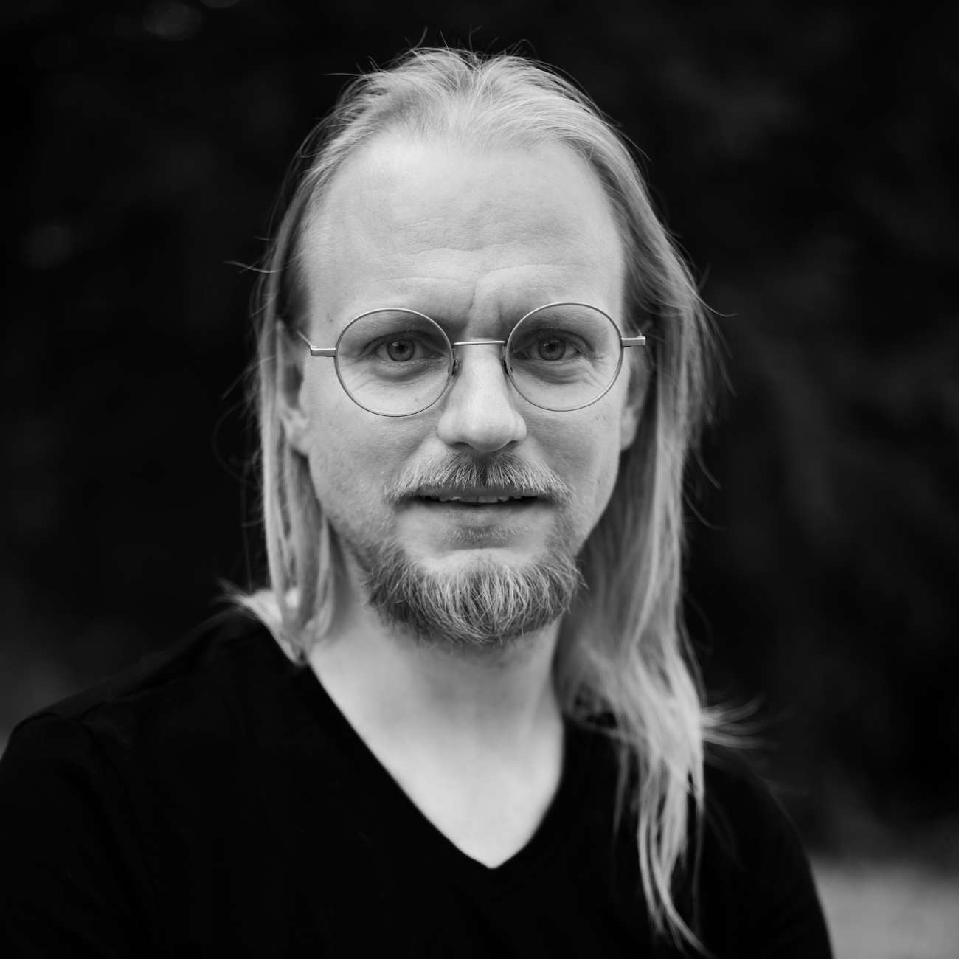
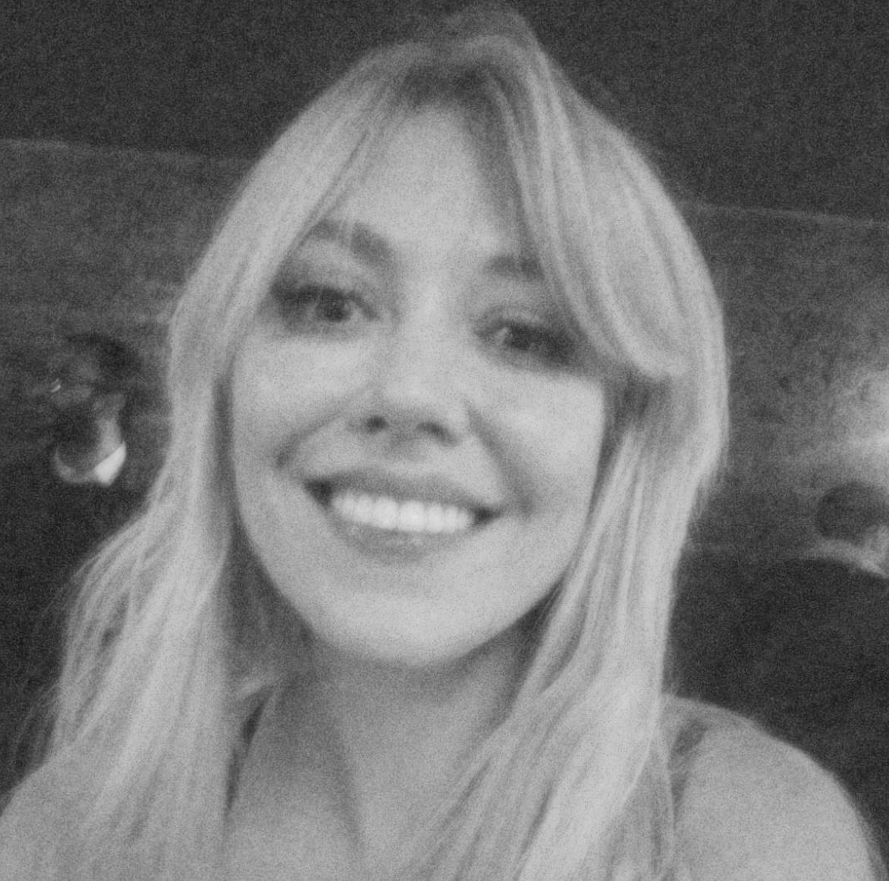
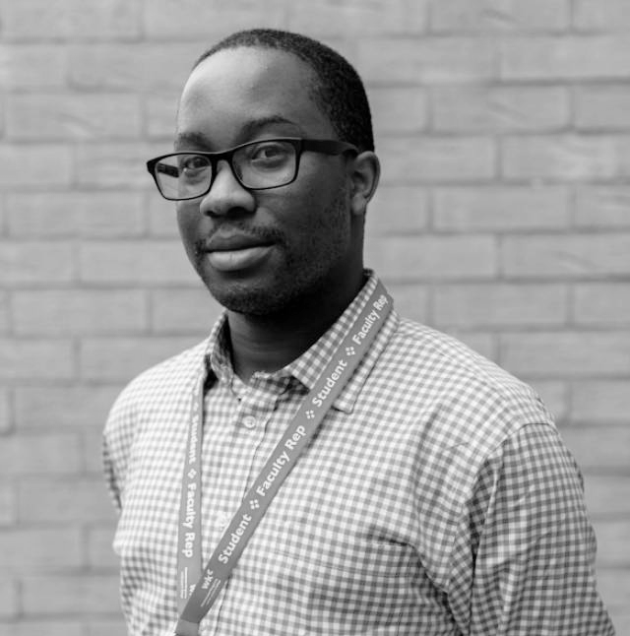
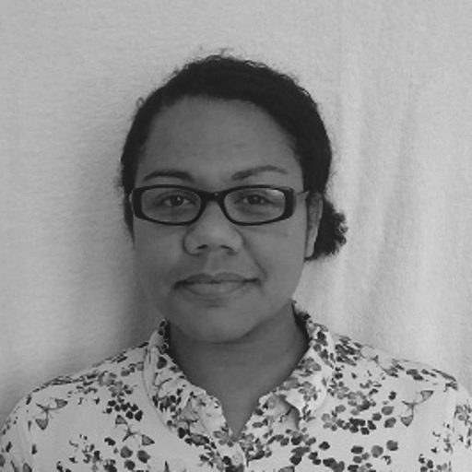
Who we are.
Bastian Greshake Tzovaras
Georgia Aitkenhead
Otis Smith
Helen Duncan
@AutSPACEs
10.5281/zenodo.7550764
Notes:
Introduce ourselves in order
Bastian: …we’re also here representing the wider AutSPACEs community which includes open-source developers, volunteers, autistic collaborators, and family members of autistic people, so we’d like to acknowledge all of you and your hard work!

Slide 8
The Challenge
@AutSPACEs
10.5281/zenodo.7550764
Notes:
So, firstly, I’d like to give a brief overview of AutSPACEs.

Slide 9
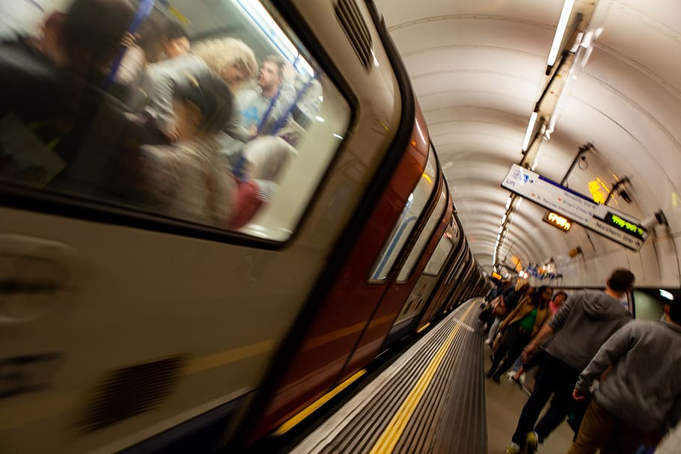
90% of autistic people process sensory information differently from non-autistic people
@AutSPACEs
10.5281/zenodo.7550764
Notes:
Depending on the study, it is estimated around 9/10 autistic people experience sensory processing differences compared to non-autistic people.
https://journals.sagepub.com/doi/abs/10.1177/1362361309103794

Slide 10


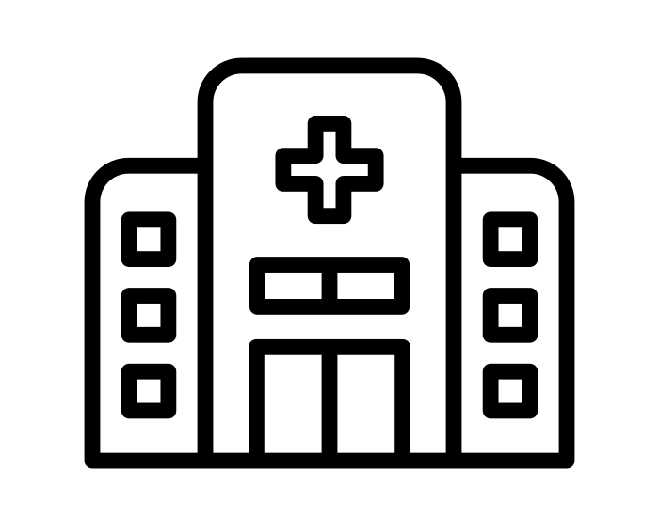


Research for real world change.
Public transport
Public parks
Hospitals
Schools and universities
@AutSPACEs
Workplaces
10.5281/zenodo.7550764
Notes:
Hospital by fauzan akbar from NounProject.com, School by Ralf Schmitzer from NounProject.com, Train by Nabila from NounProject.com, Office by Ninejipjip from NounProject.com, Public Park by Chanut is Industries from NounProject.com
Importantly, this is not a defect, but unfortunately many environments are not built with neurodiversity in mind. This means that lots of public spaces are not accessible or are uncomfortable for many autistic people to be in.

Slide 11
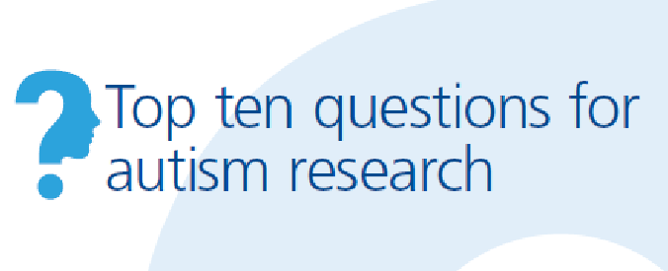
Research to meet community priorities.
5. Which environments/supports are most appropriate in terms of achieving the best life outcomes in autistic people?
9. How can sensory processing in autism be better understood?
@AutSPACEs
10.5281/zenodo.7550764
Notes:
As well as being a prevalent and impactful feature of autism, understanding sensory processing and its effects is also a priority of the community according to a James Lind priority setting alliance led by Autistica in 2016. The research questions the AutSPACEs project investigates come from a report done by Autistica which identified the top 10 research questions that the community wanted to investigate.

Slide 12
Our approach
@AutSPACEs
10.5281/zenodo.7550764
Notes:
So, firstly, I’d like to give a brief overview of AutSPACEs.

Slide 13
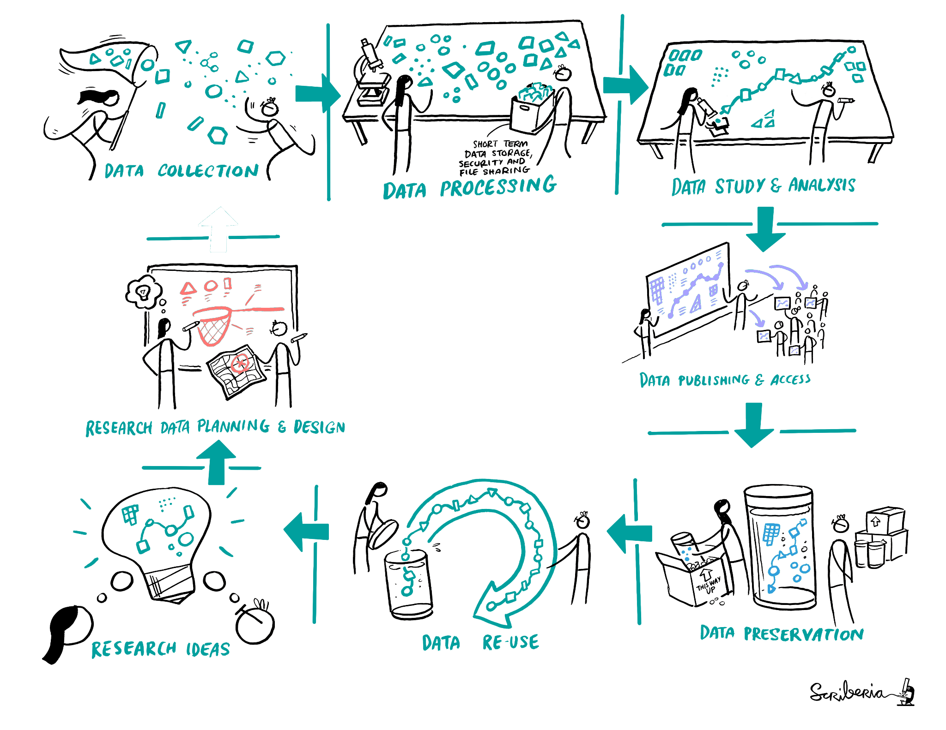
Co-developing a Citizen Science Platform
Engaging people who are not professional scientists in scientific research at scale.
Research design driven by a community.
More reflective of the wider population.
Real world experiences.
Research results support the community.
Citizen Science
@AutSPACEs
10.5281/zenodo.7550764
Notes:
Georgia

Slide 14
“Nothing about us, without us.”
Disability Rights Movement
@AutSPACEs
10.5281/zenodo.7550764

Slide 15
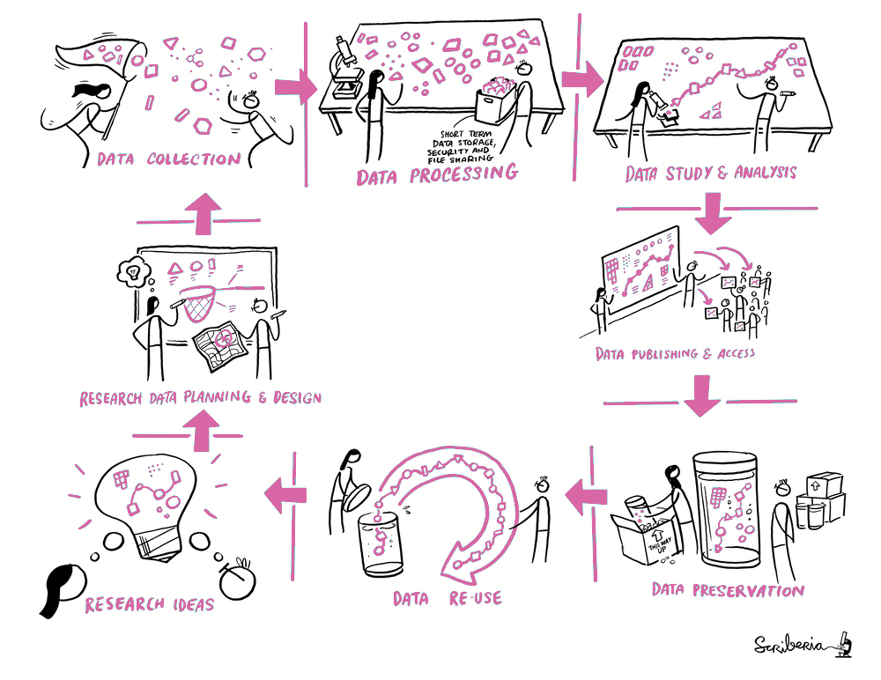
From consultation to collaboration
2 Scoping sessions held with 26 autistic people, their supporters, and researchers.
3 Focus groups held with autistic people, their supporters, researchers and developers.
1-2-1 co-working with committed collaborators.
@AutSPACEs
10.5281/zenodo.7550764
Notes:
Georgia

Slide 16
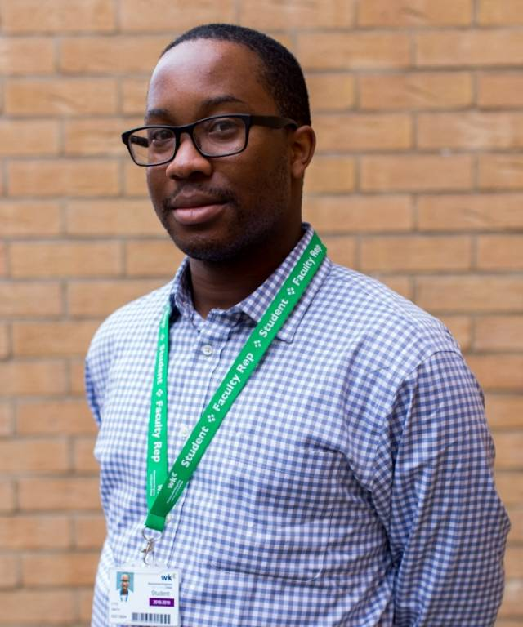
Otis Smith: my take on citizen science
@AutSPACEs
10.5281/zenodo.7550764
Notes:
Slide for Otis!

Slide 17
From consultation to co-creation.
“just one thing or question or visual per page, and then…press next”
“one thing up at a time”
“you don’t want too many things on the page at the same time, because it’s just too much”
“I’ve always been better if there’s less information on one page”
From Focus Groups…
@AutSPACEs
10.5281/zenodo.7550764

Slide 18
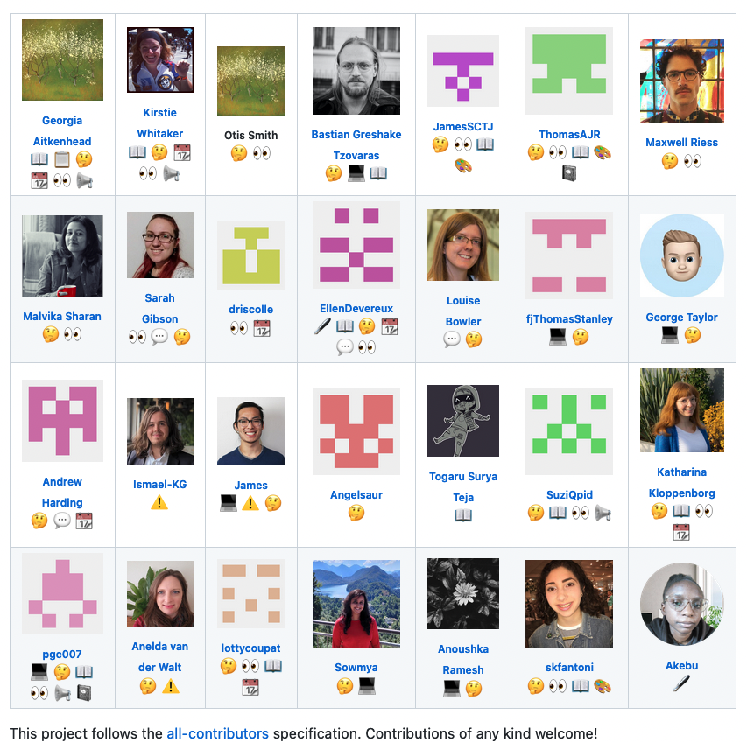
From consultation to co-creation.
From Focus Groups…
…to Design Decisions…
Co-working and Meet up Groups…
10.5281/zenodo.7550764

Slide 19
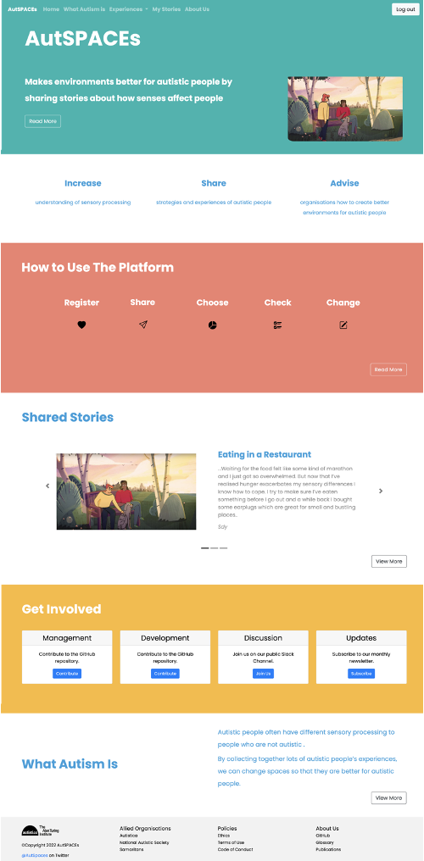
From consultation to co-creation.
From Focus Groups…
…to Design Decisions…
Co-working and Meet up Groups…
…design iterations…
To a platform built by the community, for the community.
From Focus Groups…
…to Design Decisions…
Co-working and Meet up Groups…
…supported design iterations…
To a platform built by the community
10.5281/zenodo.7550764

Slide 20
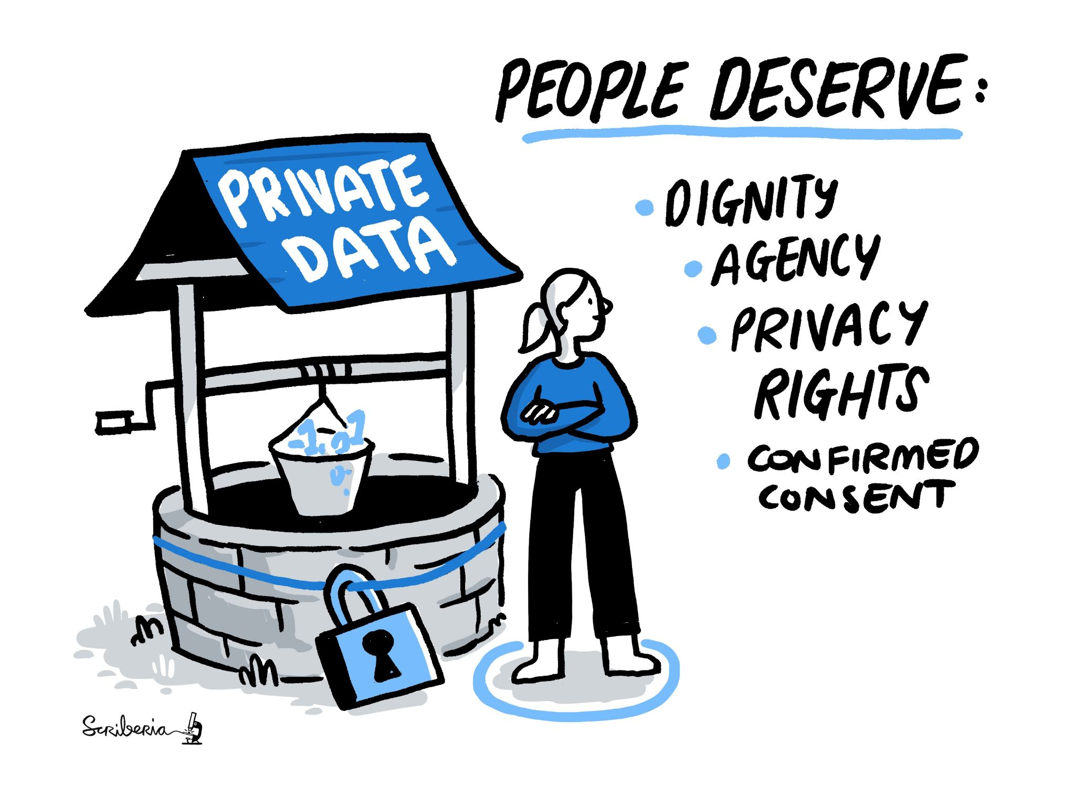

Data and Agency.
Highest standards of data protection
Consent that is dynamic and informed
Co-created data management and moderation
@AutSPACEs
10.5281/zenodo.7550764
Notes:
Data, agency, and consent were identified as key priorities in the scoping sessions and focus groups. Integral to AutSPACEs is the respectful and responsible management of people’s data. This means giving people agency over how theIr data is used and who it is shared with. This is built into the platform’s design.
We have a fine-grained, dynamic consent model and functionality, which means users will be able to choose for each experience whether to share it publicly or for research, and will easily be able to withdraw consent. This contrasts with “all-or-none” consent which is often used in research.

Slide 21
From co-creation to leadership.
Collaborative workshop
Citizen scientist co-leads
User personas
Community engagement
Tailored code of conduct and moderation strategy
10.5281/zenodo.7550764
Notes:
How we got to this stage
Focus groups
Existing frameworks
Put it together
Next step: testing with how we train moderators

Slide 22
Solutions & Innovations: Story Categorisation
Red, Green and Amber
Red= Breaks CoC and will not be approved for public sharing
Green= Meets all requirements
Amber= Doesn’t break CoC but contains potentially triggering content so will be flagged
@AutSPACEs
10.5281/zenodo.7550764
Notes:
Add colours so that it is more universally understood (traffic lights)
Amber is viewable but flagged
When you sign up, you tell us what you don’t want to see
Agency for the users
So that it’s not algorithmically assigned based on generalized “fake news vs not fake news”
All documents are living documents, it is always meant to adapt to the users, to the content, and as we learn and build the community.

Slide 23
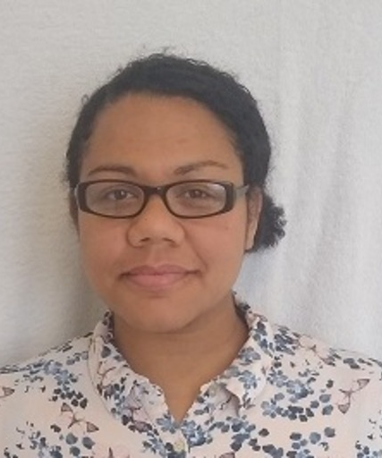
Helen Duncan: the AutSPACEs platform
@AutSPACEs
10.5281/zenodo.7550764
Notes:
Slide for Helen!

Slide 24
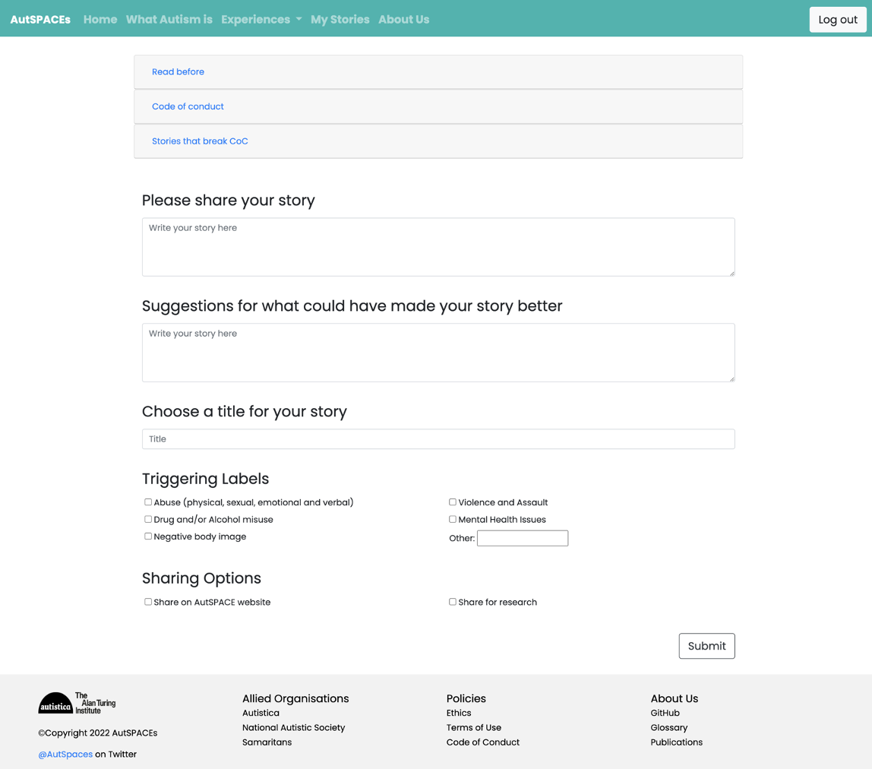
Users can enter their own stories
They can add triggering labels
And decide if and how they want their data to be shared
@AutSPACEs
10.5281/zenodo.7550764

Slide 25
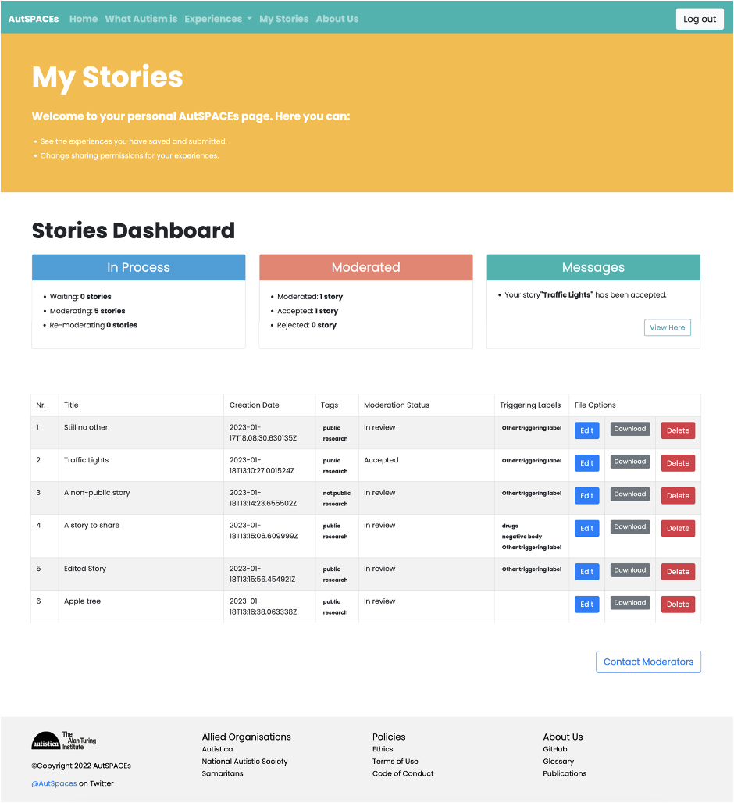
Users can download, edit, and delete all their stories via the “My Stories” page
Stories are moderated by community members
Moderated stories that users have decided to share are then visible to all visitors to the site
@AutSPACEs
10.5281/zenodo.7550764

Slide 26
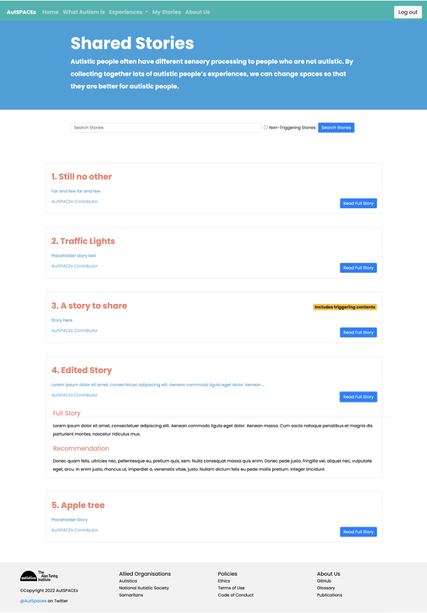
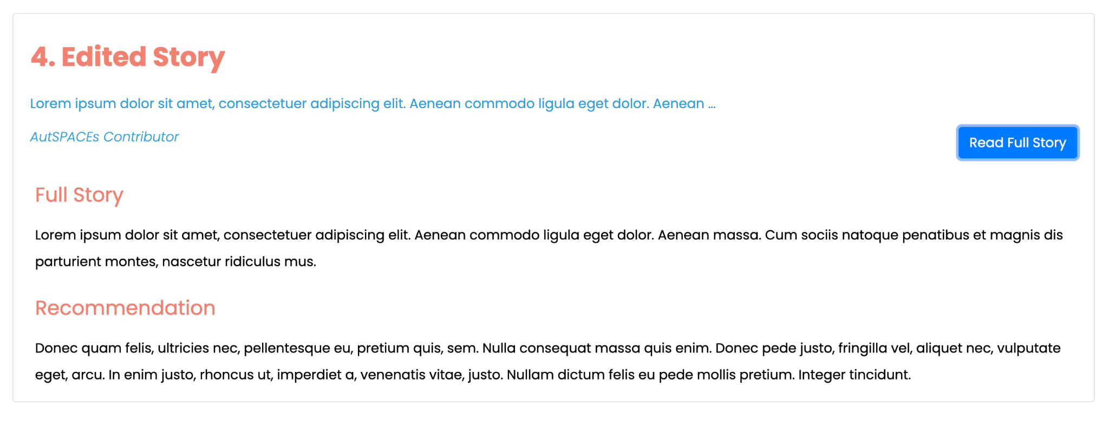
Moderated stories that users have decided to share are then visible to all visitors to the site
@AutSPACEs
10.5281/zenodo.7550764

Slide 27




Thank you to the project team and thank you for listening!
KIRSTIE WHITAKER
JAMES CUSACK
BETHAN DAVIES
CALLUM MOLE
KAT MANNING
SUZANNE IWAI
JAMES KIM
ROBIN TAYLOR
SOWMYA RAJAN
MALVIKA SHARAN
TOM AUGUR
LOTTY COUPAT
SOLEDAD LI
ANOUSHKA RAMESH
OPEN LIFE SCIENCES
SUSANNA FANTONI
JAMES SCOTT
The AutSPACEs Open Source Community
...and all of our amazing autistic collaborators!!
@AutSPACEs
10.5281/zenodo.7550764
Notes:
Big ambitions - all of these are addressing a specific need but are also more broadly applicable - a much more thorough kind of accessible, diverse, and inclusive science, world and web.

