Slide 1
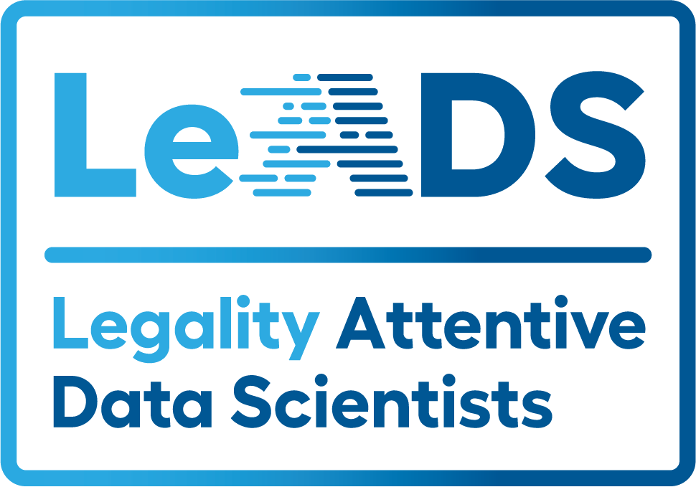




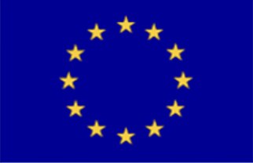
DTC Genetic Testing Consent Policies from a Contextual Integrity, Legal, and Actionability Lens
Xengie Doan¹, Fatma Sumeyra Dogan², Arianna Rossi¹, Wilhemenia Maria Botes¹, Gabriele Lenzini¹, Fryderyk Zoll²
¹SnT, University of Luxembourg, ² Jagiellonian University
Introduction
Direct-to-consumer (DTC) genetic testing companies have a market value of 1.29 USD in 2021, with Europe taking the third largest revenue share.
Though this may seem like a convenient service, what are the risks to an individuals’ privacy with unclear secondary data usage, data used for unstated research purposes, or lack of withdrawal and deletion of samples and data that users may not be fully informed of when they give consent?
Genetic data is sensitive and bound by stricter rules in the EU. However, the level of compliance in terms of legality and informational transparency with these rules in DTC companies is not known.
To answer this question, we will examine top DTC companies' consent policies based on Nissenbaum’s Contextual Integrity (CI) framework and analyze the results using a legal and information flow and parameter analysis.
Results
We identified a total of 7 information flows that relate to a customer’s genetic data in terms of storage, usage by the company, or sharing with third parties from the privacy policy of AncestryDNA.
Information Flow
One example of identifying a CI information flow from the text is as follows.
“At our partner laboratories, we extract your DNA from your saliva and convert it into machine-readable biometric data (“DNA Data”) that we process to provide you with an ethnicity estimate and communities suggestions. We also process your DNA Data to provide you information about your degree of relatedness to other users in our DNA database and any genetic associated with certain biological, physiological, or behavioral traits, such as hair thickness and eye color or traits associated with wellness.”
  Conclusion and Discussion
  Though the AncestryDNA privacy policy is actually one of the more organized documents compared to other websites, the information flow is missing important elements to properly make a risk and benefit analysis as a customer. To summarize areas of concern:
  Not having a definite period of data retention
  Parameter bloating of 2-14 parameters
  Missing recipient and sender
  The GDPR went into effect in 2018, and though there has been a positive outcome for consent and related privacy policies, companies may not fully comply. The DGA is also coming into effect next year and we would be interested in how prepared these companies would be and how would they comply.
Methods
We accessed the privacy policy of the UK version of AncestryDNA.com in Dec 2022 to collect and analyze publicly available information to determine the CI flow.
An information flow contains a sender, recipient, transmission principle, attribute, and subject. We identified any information flows relating to a customer’s genetic information and once these are identified we can carry out the following analyses:
Identifying Incomplete Flows
CI Parameter Bloating
Legal Analysis
Vague Statement Analysis (In Progress)
Fig. 1 depicts an information flow describing how AncestryDNA uses the customer’s DNA Data
Future Work
We are working to complete the analysis, adding the vague statement analysis and repeating the methods on other websites for a future publication. We hope to contribute further legal analyses and guidelines for privacy policies.
Individually, we are also pursuing our Ph.D. research.
  Fatma is planning to examine several privacy policies from DTCs on the base of Contextual Integrity flow analysis and evaluate the results under the light of EU legislation namely; GDPR, EHDS, and DGA.
  Xengie is planning to propose technical and user-friendly models of collective consent.
Incomplete Flows
We found one missing sender, recipient, and subject in this preliminary analysis. While the subject can often be assumed to be the customer’s DNA data, the missing sender and recipient is more concerning as it means the data controller and/or recipient/processor are unclear.
CI Parameter Bloating
6 out of 7 information flows introduced parameter bloating, where there were more than two parameters in a flow. The example shown above contains 4 parameters for the transmission principle. We identified a large range of bloat from 2 to 14.
Legal Analysis
The sensitive nature of genetic data requires stricter regulation however when during our study we witnessed that the reflection and implementation of legislation are far from perfect. Incomplete flows cause more influential outcomes in this data processing framework when it is compared with other data types.
References
Direct-to-Consumer (DTC) Genetic Testing - Market Study by Global Industry Analysts, Inc. https://www.strategyr.com/market-report-direct-to-consumer-dtc-genetic-testing-forecasts-global-industry-analysts-inc.asp.
Shvartzshnaider, Yan, Noah Apthorpe, Nick Feamster, and Helen Nissenbaum. "Going against the (appropriate) flow: A contextual integrity approach to privacy policy analysis." In Proceedings of the AAAI Conference on Human Computation and Crowdsourcing, vol. 7, pp. 162-170. 2019.
Nissenbaum, Helen. "Privacy as contextual integrity." Wash. L. Rev. 79 (2004): 119.
Guinchard A. Taking proportionality seriously: The use of contextual integrity for a more informed and transparent analysis in EU data protection law. Eur Law J. 2018;24:434–457. https:// doi.org/10.1111/eulj.12273
Contact: xengie.doan@uni.lu linkedin/in/xdoan
Contact: fatma.sumeyra.dogan@uj.edu.pl www.linkedin.com/in/fatmasd
This work has been funded by the European Union’s Horizon 2020 Innovative Training Networks, Legality Attentive Data Scientists (LEADS) under Grant Agreement ID 956562

