Slide 1


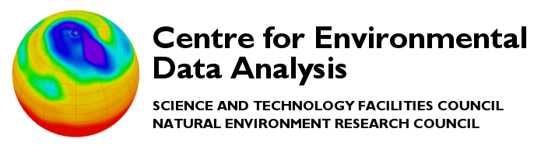





Update on the Near-line Data Store - Milestone 3
Jack Leland & Neil Massey
Notes:
The abstract pattern can be removed or repositioned if required. Be careful to ‘Send to Back’ so that it does not obscure any important information.

Slide 2


Overview
1 (re)Introduction to the NLDS
2 A (brief) rundown
3 Next milestones
Notes:
To replace with a photo of your own: 1) Send the geometric shape overlay to the back – Right-Click > Send to Back > Send to Back. 2) Replace image – use the guides provided to correctly position it. 3) Send your image to the back so that the geometric overlay re-appears over the image.

Slide 3
The Near-line Data Store
A successor to Joint Data Migration App (JDMA)
Multi-tiered storage solution
  “Hot” storage : disk
  “Warm” storage : object storage
  “Cold” storage : tape
Unified storage interface - connect to this, rather than each storage type
RESTful API
  Client library connects to API, client program uses client library
  API is published in OpenAPI via FastAPI
Portable!
Implements CRUD (create, read, update, destroy)

Slide 4
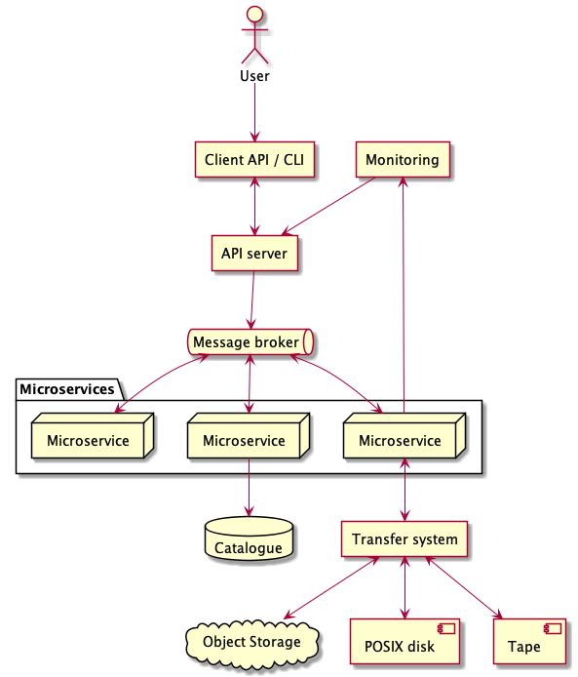
The key elements
Client
Handles user authentication (OAuth2 password flow)
Server
Verifies user authentication
Relays client requests to message broker
Microservice layer
Worker - process requests
Indexer - build a list of files
Transfer - make the file transfer
Catalog - store the file details
Monitor - user monitoring
Logging - system monitoring

Slide 5
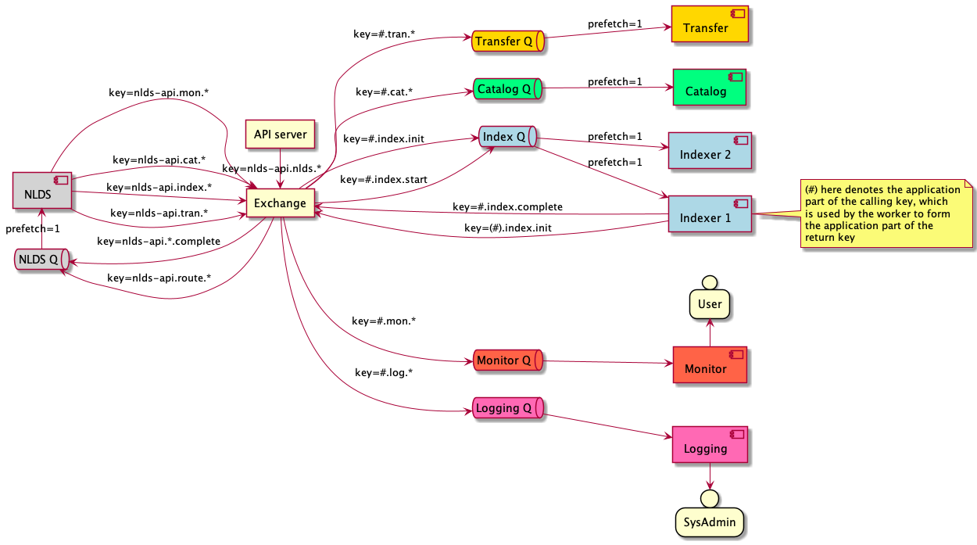
My preferred overview diagram

Slide 6
The current state
In short…
Achieved milestone 3!
Now able to PUT and GET from the object store
Catalog implemented

Slide 7
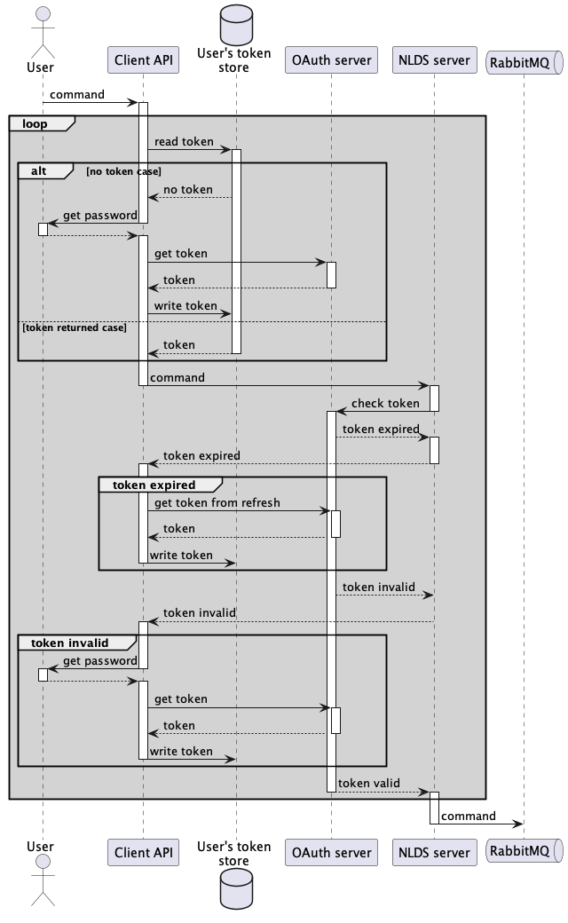
The Client & Server
Uses requests, click, uvicorn, fastapi
Now handles PUT, PUTLIST, GET, GETLIST requests
No update or delete yet
Unsure how cancel could work…
Generates UUID for transaction_id

Slide 8
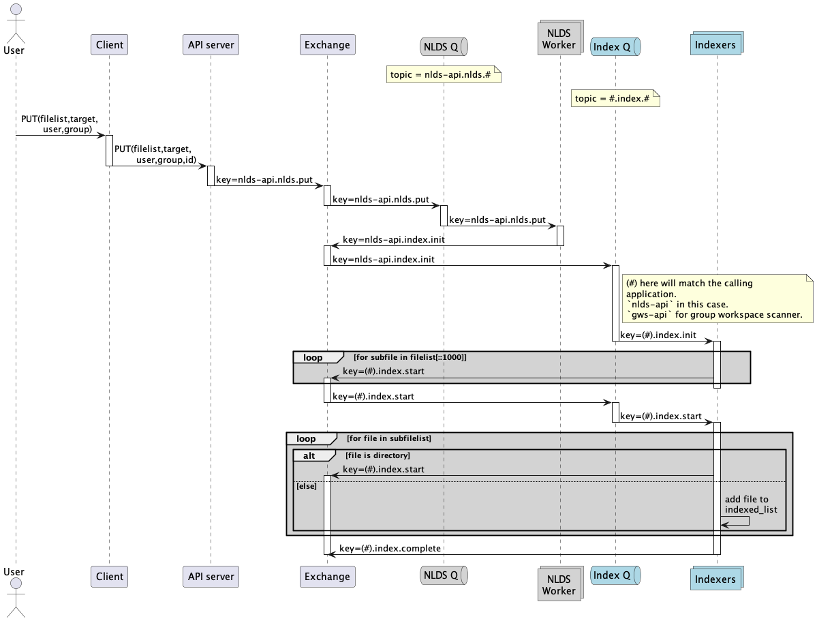
The Indexer
Initially splits up lists into chunks of 1000
Walks any directories and stats files
Can then further separate lists by maximum message size
Retries any failed items with a delay

Slide 9
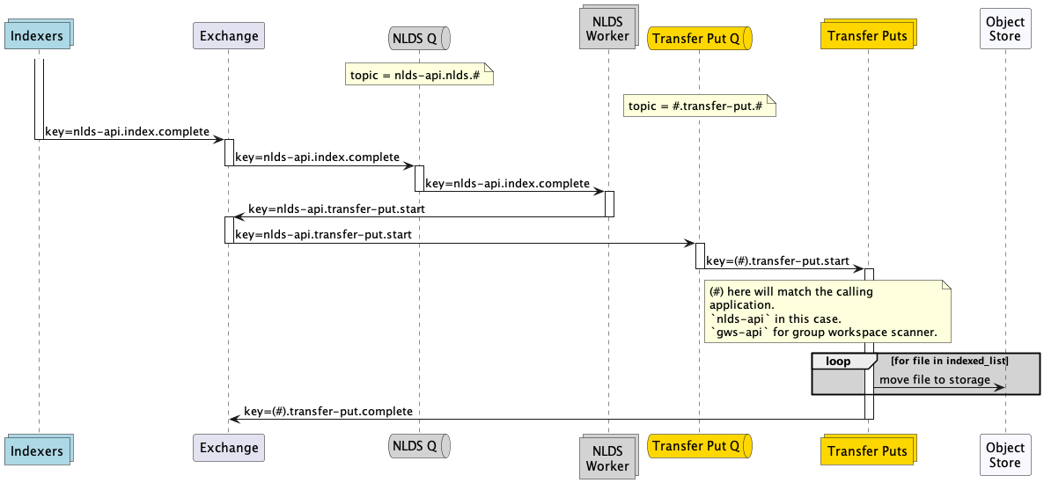
The Put Transfer
Checks privileges on files (optionally)
Creates bucket with transaction_id
Uploads files using minio client
  Possibility to use an alternate asyncio client
Again, retries failed attempts with delay and retry count cap

Slide 10
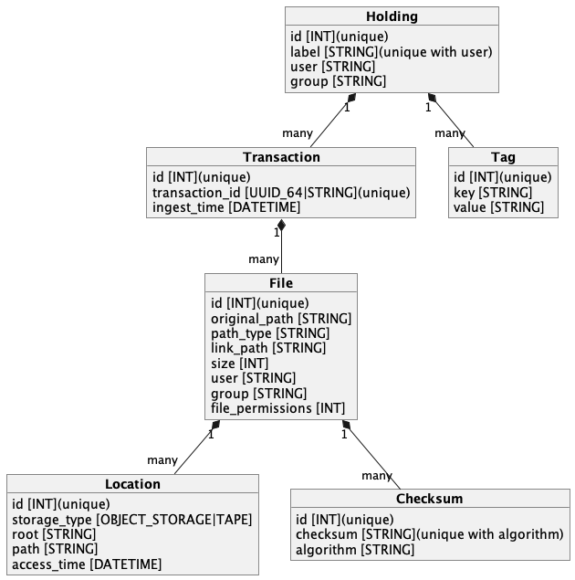
The Catalog
Handles the database of NLDS holdings
Puts a holding after successful transfer
Gets a holding as first step of get transfer
SQLAlchemy so implementation agnostic
Currently SQLite

Slide 11
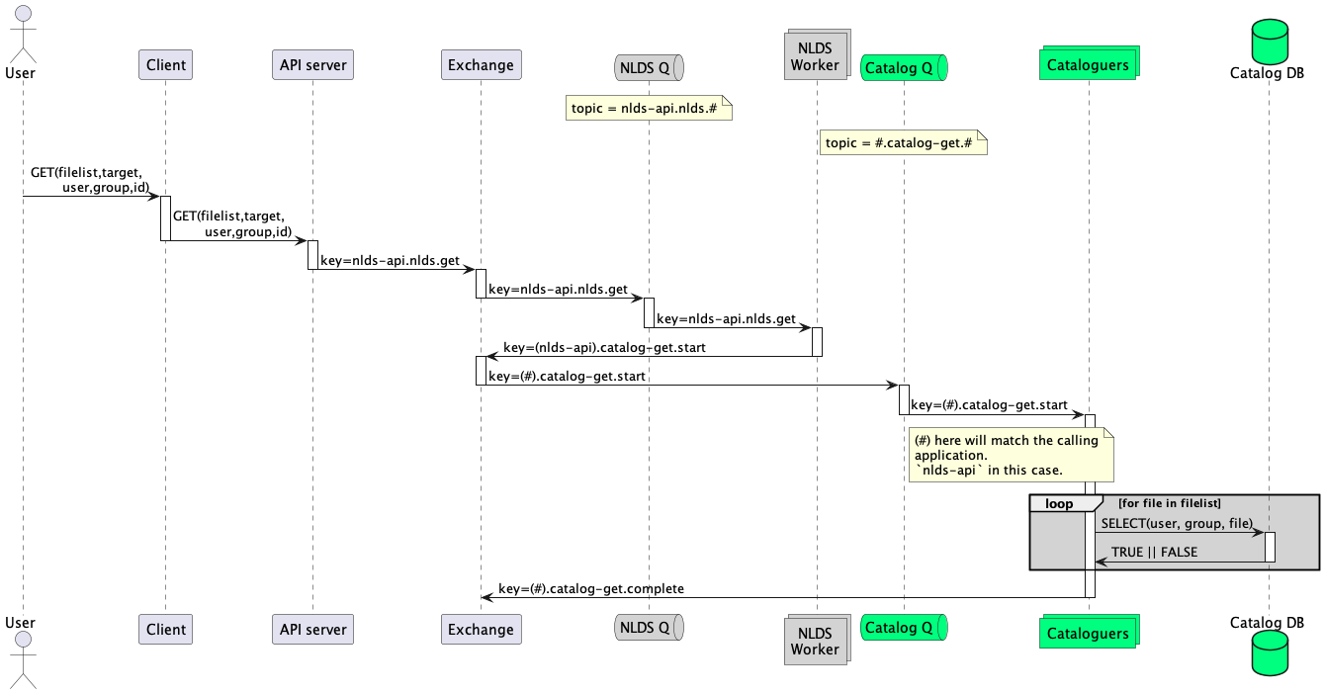
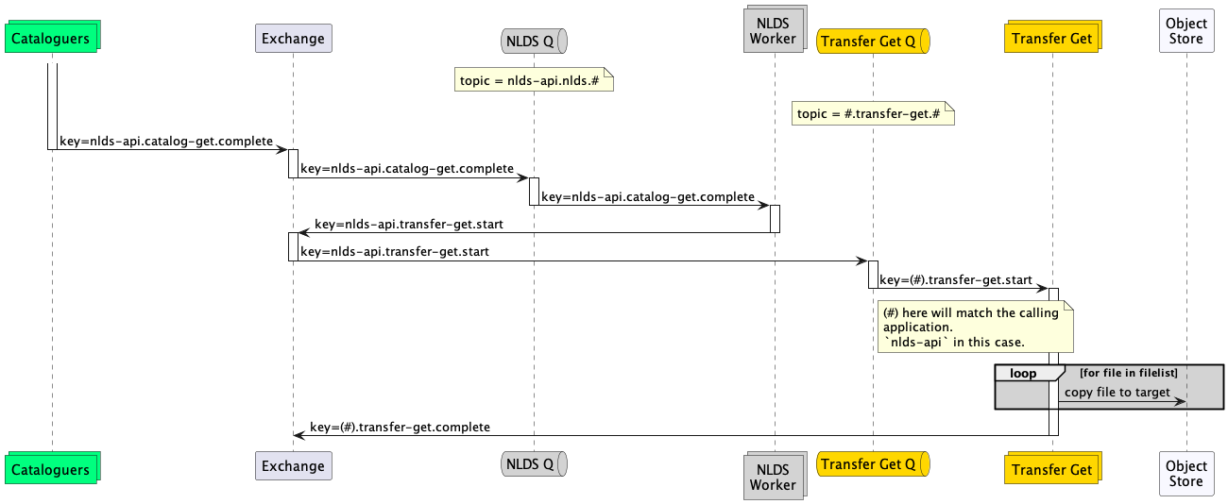
The Get Transfer
Checks write privileges on target / original location (optionally)
Downloads files using minio client
Again implements delayed retry mechanism
When getting:
  Can get to a new target location
  Can restore to original location

Slide 12
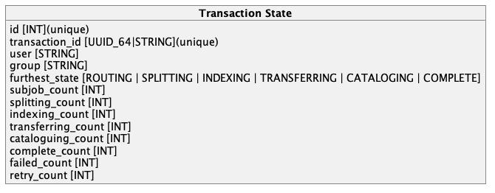
The Monitor
Stores the ‘state’ of each job
Keeps track of:
  spawned subjobs
  how many subjobs have got to each point
Uses SQLAlchemy
Still under development!
  May store separate state for each subjob
  May have a separate table of failed files

Slide 13
Next steps
Milestone 4: User Interactivity 22 November 2022
Add tags to holdings
Query holdings / files
  get lists of files by file name, holding id, tags
Query progress of transfers
Milestone 5: Tape Interoperability 31 January 2023
Write files / backup to tape
Read and restore files from tape
  Will need ‘artificial deletion’ - i.e. we delete from the object store and the tape restores it on access

Slide 14
Next next steps
Milestone 6: Tape Policy 28 February 2023
Decide what to delete from object store and when
Other things on the to-do list
Stress testing of whole system
Assess against NLA / archive test case
Move RabbitMQ server to Kubernetes
Deploy completely independently from CEDA architecture
One-click docker desktop deployment
Handling of empty directories, sym-links, finding of common path
Longer list on github issues/project board

Slide 15


Current open questions
What should the monitoring (user interface) look like?
How would a cancel command work
  Another database?
How should checksumming work?
Notes:
Please replace photo of presenter with a portrait of your own. 1) Send the geometric shape overlay to the back – Right-Click > Send to Back > Send to Back. 2) Replace image – use the guides provided to correctly position it. 3) Send your portrait to the back so that the geometric overlay re-appears over the portrait.

Slide 16


Thank you!
Any Questions?
jack.leland@stfc.ac.uk
neil.massey@stfc.ac.uk
NLDS was supported through the ESiWACE2 project. The project ESiWACE2 has received funding from the European Union's Horizon 2020 research and innovation programme under grant agreement No 823988.
Notes:
The abstract pattern can be removed or repositioned if required. Be careful to ‘Send to Back’ so that it does not obscure any important information.

