Slide 1




TRIC: Traceability and Reproducibility through Individual Containerization
Dominic Kennedy∗, Paula Olaya∗, Jay Lofstead†, Rodrigo Vargas‡, Michela Taufer∗
∗ University of Tennessee, Knoxville, TN, USA
† Sandia National Laboratories, Albuquerque, NM, USA
‡ University of Delaware, Newark, DE, USA
NSDF All-Hands meeting October 2022

Slide 2

Trustworthiness in Scientific Workflows
Computational workflows play a key role in scientific discovery. These workflows are growing more complex
For scientists using these workflows to aid in research, trusting data, methods, software, and hardware becomes more necessary than ever
Scientist(s)
Scientific Workflow
Data visualization suite
Machine learning model
Data preprocessing
Data collection
Heterogeneous infrastructure
Notes:
Scientists achieve trust in their findings when they can
Trace back through an in-depth data lineage
Explain computational methods and their output through an execution record trail

Slide 3
Traceability and Explainability
Scientists achieve trust when they can
Trace back through an in-depth data lineage
Explain computational methods and their output through an execution record trail
01
02
03
04
05
06
07
08
Data
09
App
10
11
12
Notes:
Scientists achieve trust in their findings when they can
Trace back through an in-depth data lineage
Explain computational methods and their output through an execution record trail

Slide 4
Containerized Scientific Workflows
Traditionally, when containers are used in scientific workflows, the entire workflow is deployed into one monolithic container

Slide 5
Containerized Scientific Workflows
Traditionally, when containers are used in scientific workflows, the entire workflow is deployed into one monolithic container
This coarse-grained approach makes it difficult to precisely track the thread of execution
No identification and preservation of intermediate data
No records of workflow component interactions
No reusability; no composability

Slide 6

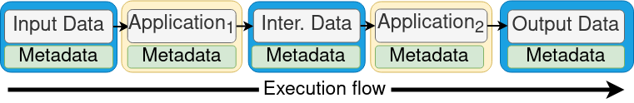
Fine Grained Containerization for Workflow Trust
A fine-grained approach to decouples and encapsulates each workflow component into its own independent container
Automatic annotation of the workflow with data provenance and execution record trails

Slide 7



Plugin for Fine Grained
Containerized Workflows
We develop a Singularity/Apptainer plugin that extends the Singularity/Apptainer runtime to support fine-grained containerized workflows
Our plugin transforms a monolithic workflow into a collection of fine-grained containers hosting applications and data separately which enables
Identification of all components and their interactions
Automatic annotation of the workflow with data provenance and execution record trails

Slide 8
Augmented Functionalities
workflow --create
Allows users the ability to adapt their workflows to fine-grained containerized environment
  Via a web interface
  Or via a predefined workflow definition
Initializes containers with metadata partitions

Slide 9
Fine Grained Workflow Creation
Our fine-grained containerized environment provides traceability and explainibility
We decouple data and applications of traditionally monolithic workflows
We encapsulate each component into individual containers
A data container follows a file-system-in-a-file model and includes an individual dataset (i.e., input, intermediary, or output data)
The application container includes the executable or script with the respective software stack (i.e., OS, libraries, and packages)

Slide 10
Fine Grained Workflow Creation
Our fine-grained containerized environment provides traceability and explainibility
We decouple data and applications of traditionally monolithic workflows
We encapsulate each component into individual containers
We annotate containers with execution metadata
A data container follows a file-system-in-a-file model and includes an individual dataset (i.e., input, intermediary, or output data)
The application container includes the executable or script with the respective software stack (i.e., OS, libraries, and packages)
The execution metadata exposes: unique hash code (UUID), container name, creation time, command line and record trail

Slide 11
Augmented Functionalities
workflow -- exec
Executes fine-grained containerized workflows by connecting data and application containers
Collects execution metadata that builds:
  Data lineage
  Execution record trail
Annotates the output container with this metadata

Slide 12
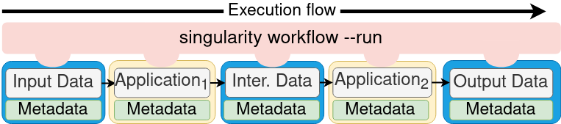
Fine Grained Workflow Execution
Locates all the workflow containers
Connects and executes the containers, with zero copy data transfer
Annotates containers with dynamically generated metadata

Slide 13
Running an Earth Science Workflow
We demonstrate the applicability of our environment for SOMOSPIE [1] (an earth science workflow)
Example metadata from real workflow
[1] Paula Olaya, Dominic Kennedy, Ricardo Llamas, Leobardo Valera, Rodrigo Vargas, Jay Lofstead, and Michela Taufer, “Building Trust in Earth Science Findings through Data Traceability and Results Explainability”. IEEE Transactions on Parallel Distributed Systems (TPDS).

Slide 14

Check Out Our Repository!
github.com/TauferLab/ContainerizedEnv

