Slide 1


Arctic PASSION (Pan-Arctic Observing System of Systems):
EO relevant activities
Jonathan Bamber, University Bristol, Technical University Munich.
with contributions from Gorm Dybkjaer DMI; Anna Irrgang, AWI; Kirsikka Heinila, FEI (lots of other groups involved in EO...)

Slide 2
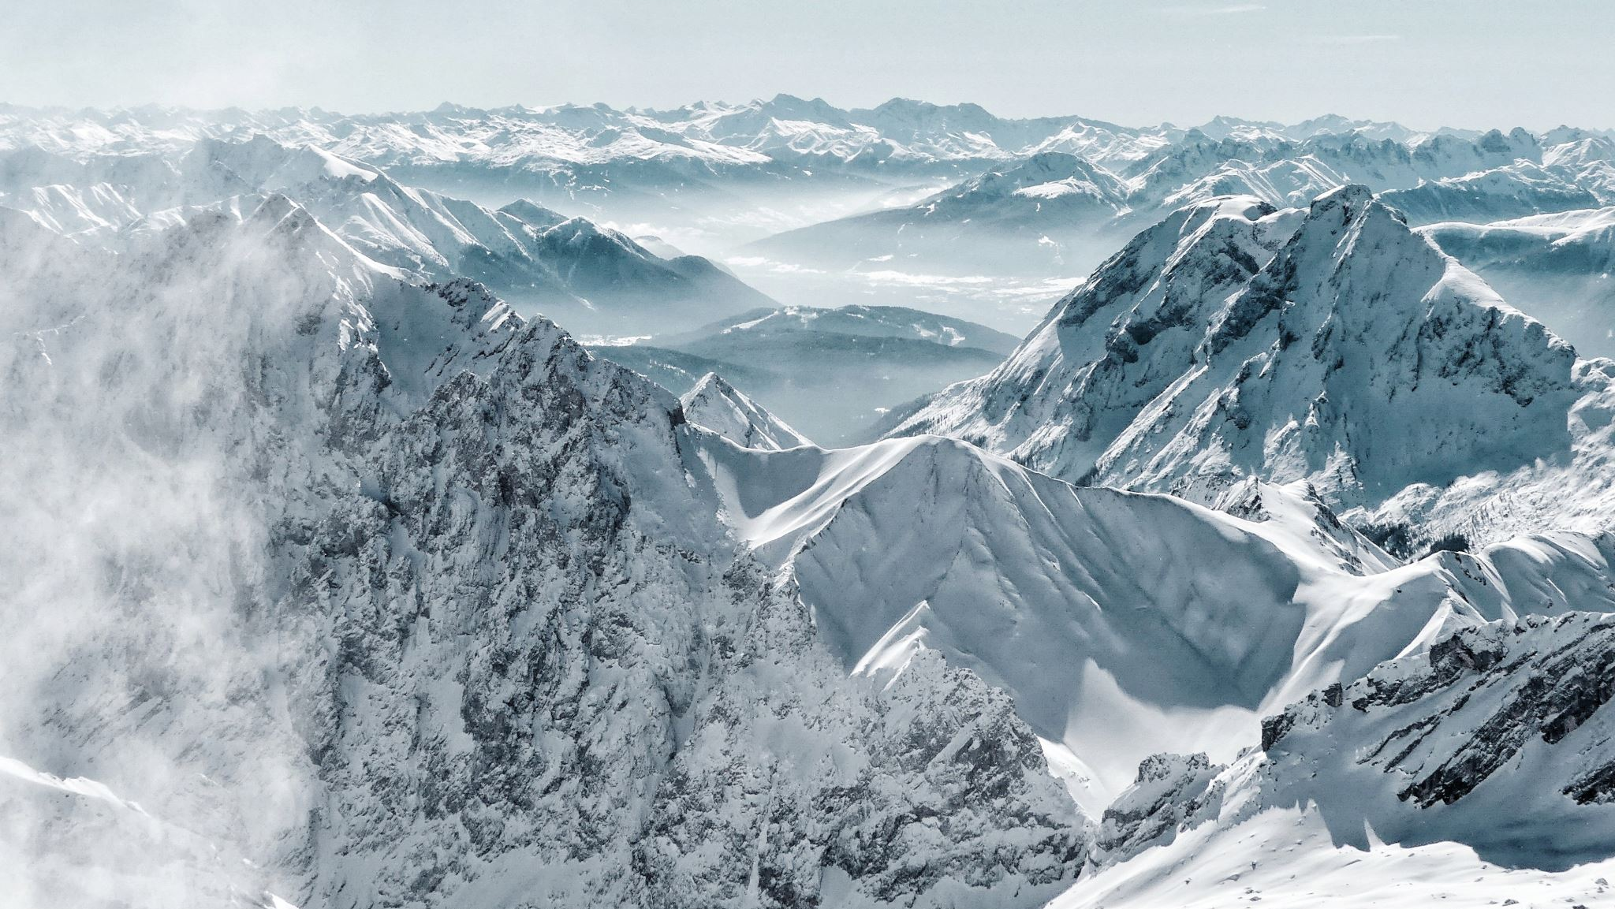
Brief overview of AP:
Goal: is the co-creation and implementation of a coherent, integrated Arctic observing system: the ‘Pan-Arctic Observing System of Systems - pan-AOSS’.
Aims to overcome known flaws in the present observing system by refining its operability, improving, and extending pan-Arctic scientific and community-based monitoring and the integration with Indigenous and Local knowledge, by streamlining the access and interoperability of Arctic Data systems and services, and by ensuring the economic viability and sustainability of the observing system for years to come.
43 partners from 17 countries. €15M over 4 years
Started July 2021, ends June 2025.

Slide 3
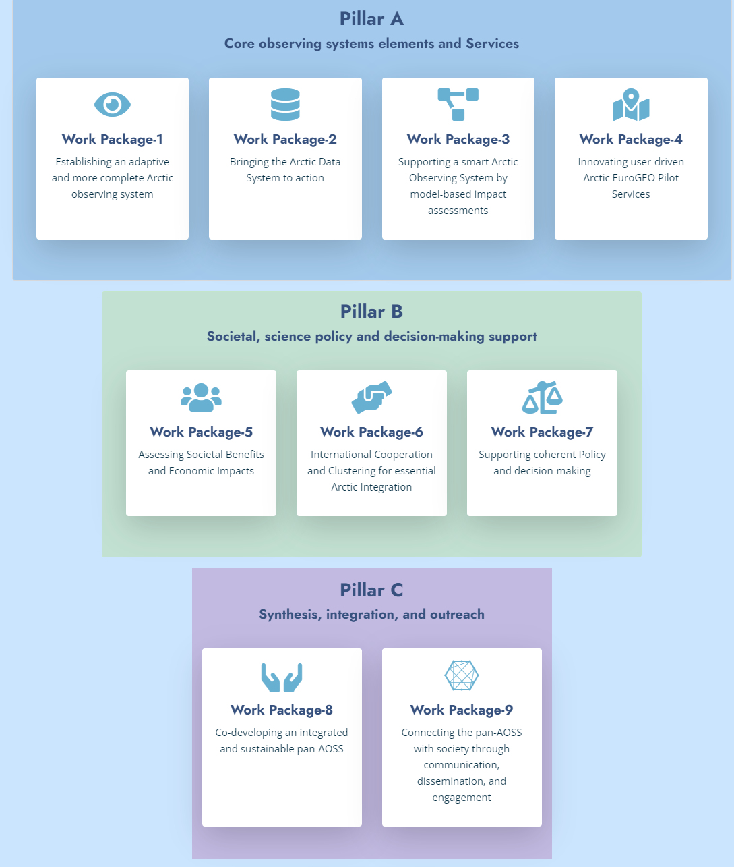
Structure:
Focus is on ACVs and SAVs,
not products but services

Slide 4
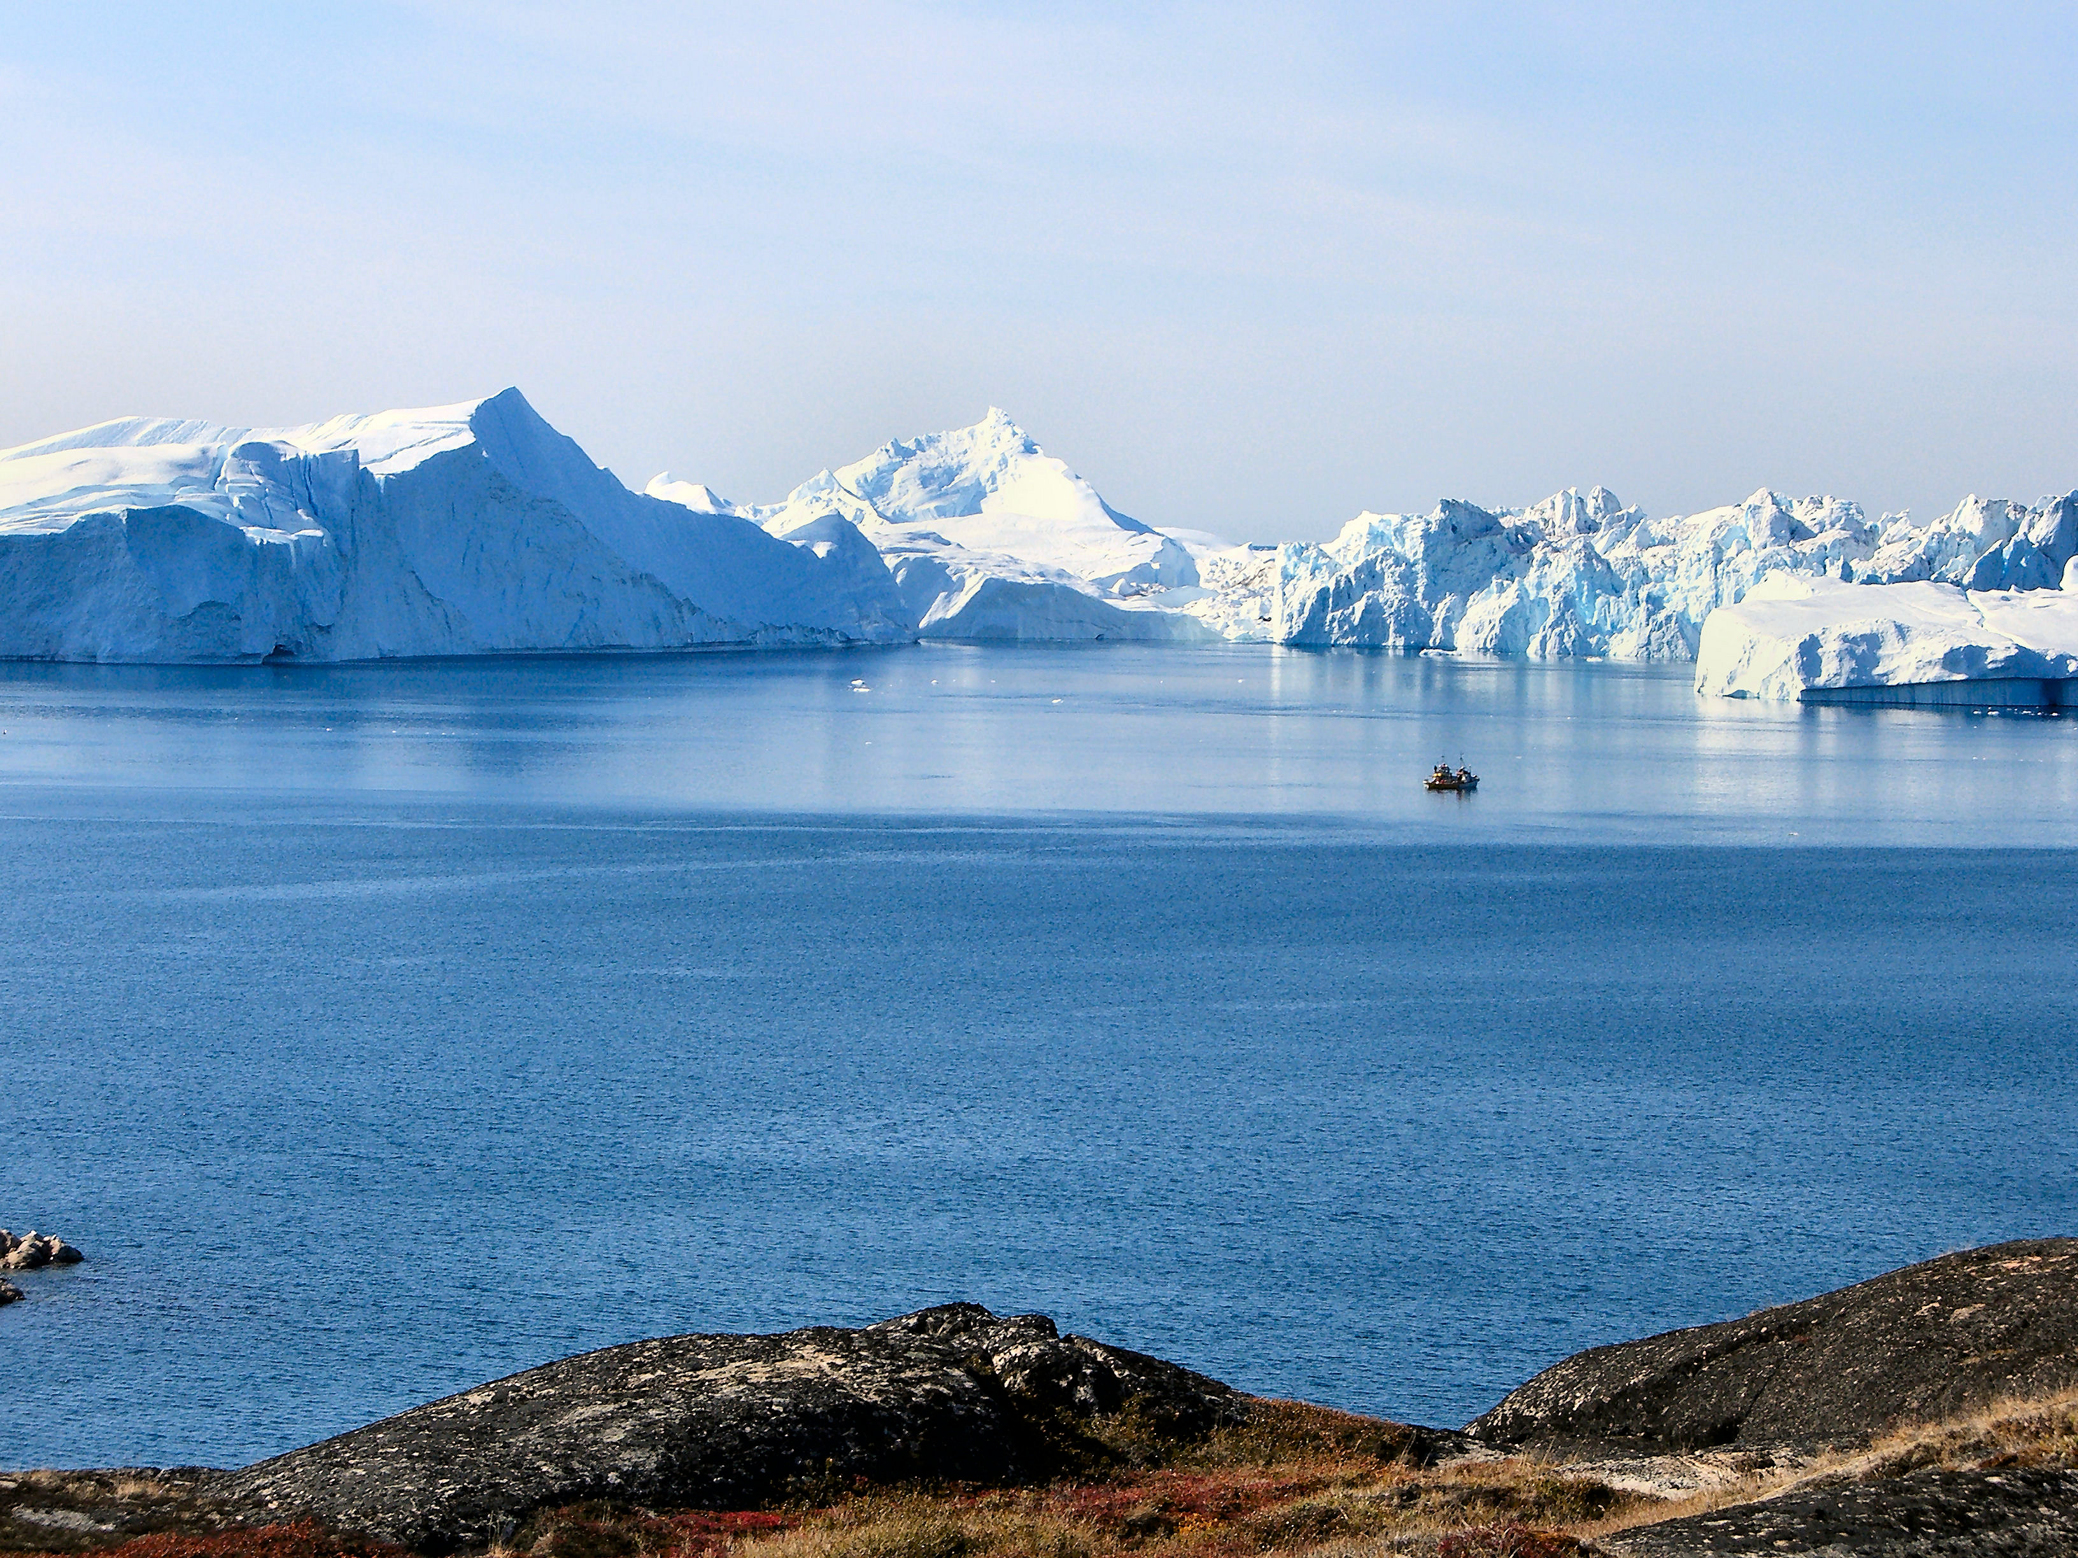
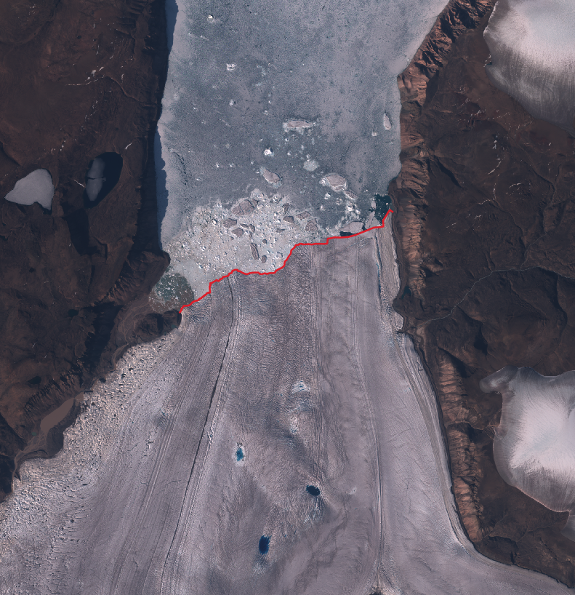
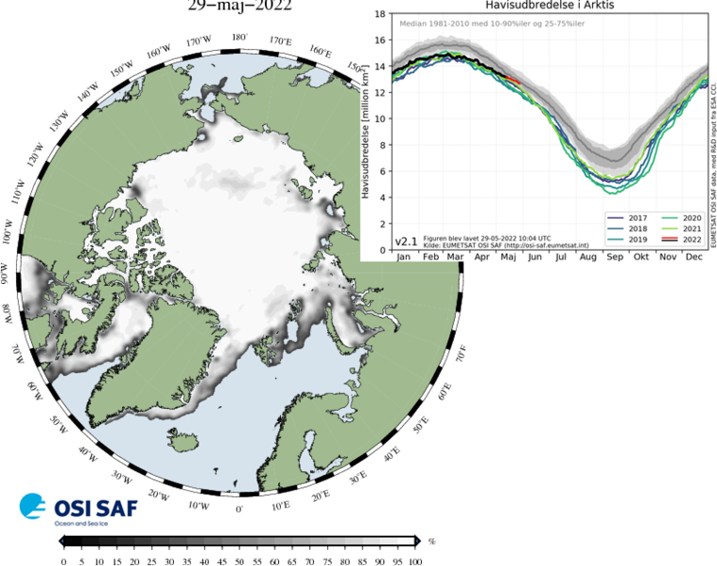
Cryosphere related EO activities
UOB (land ice):
A high-resolution pan-Arctic meltwater flux dataset
Pan-Arctic calving fronts & iceberg fluxes from ML and Sentinel data (plus historic)
Glacier and GrIS mass balance
DMI (sea ice & land ice):
Ice sheet skin temperatures
Iceberg tracking
Sea ice conc. & ice edge from deep ML => climate data record

Slide 5
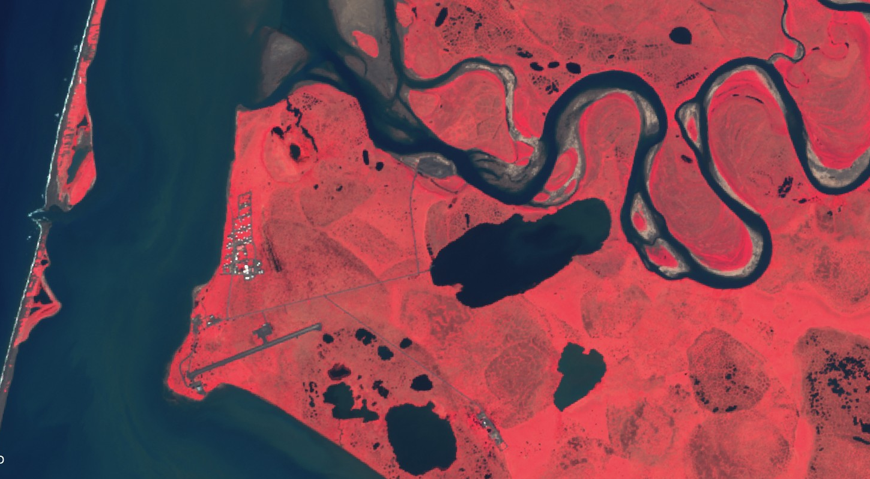
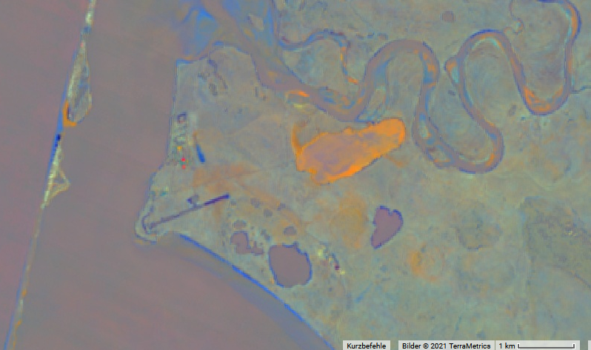
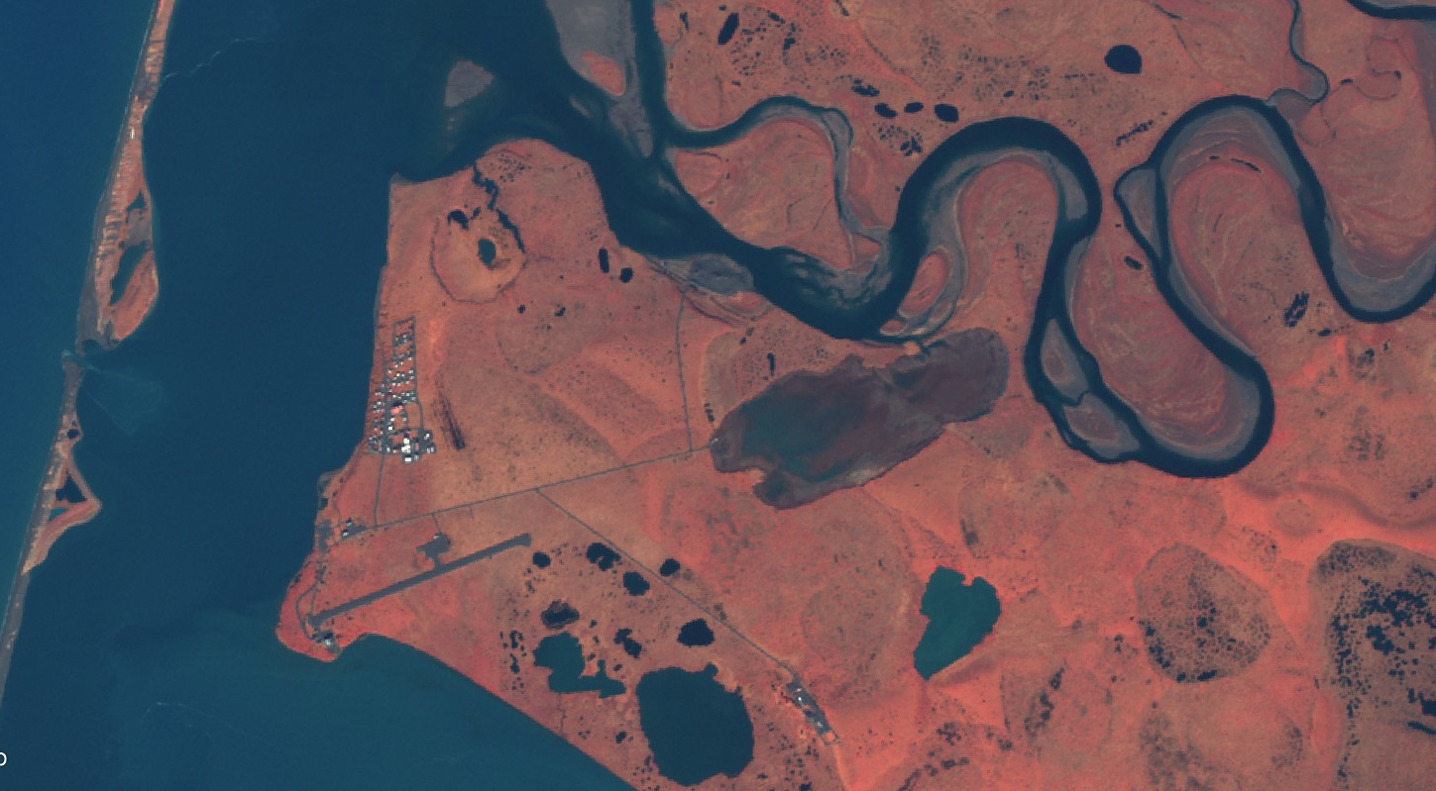
Cryosphere related EO activities, II
Sentinel-2
AWI (permafrost):
Permafrost disturbance maps (Landsat and S2)
Impact studies
Barrier Island Migration
FEI (Syke, lake ice):
Lake ice service integrated into TARKKA+
Daily NRT LI extent using S2 and Landsat-8
2016-07-13
Lake Drainage
Lake drainage
Lake Expansion
Coastal Erosion
ESA GlobPermafrost + ESA CCI+ Permafrost: Nitze @ AWI
2016-10-01
Sentinel-2

Slide 6
ESA cooperation & Summary:
Working on multiple existing ECVs, SAVs and potential new ones
Heavy dependence on Sentinels, L2, L3 products
Strong relevance to several CCIs and their successors
Focus is primarily on services (c.f. CMEMS, CLMS etc., not products & operational)
Land ice (UoB), sea ice (DMI), permafrost (AWI) and lake ice (FEI) all have EO components....
www.arcticpassion.eu

