Slide 1
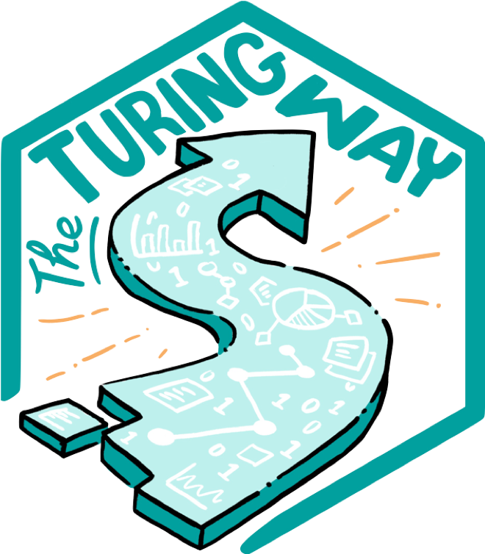
Open Science & Reproducibility: Ethically-led computational research
Malvika Sharan
Pronouns: she/her/hers
@turingway, CC-BY 4.0, The Turing Way, Zenodo: https://zenodo.org/record/7428708
Notes:
TIMING: 0

Slide 2
Objectives
Setting the tone: Scientific errors have real world effect!
Define reproducible and open research
How reproducible and open principles relate to ethics
Reflect on your own work (current or future)
Apply best practices & share resources from your own work!
@turingway, CC-BY 4.0, The Turing Way, DOI: 10.5281/zenodo.7428708

Slide 3


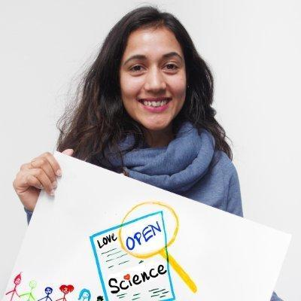




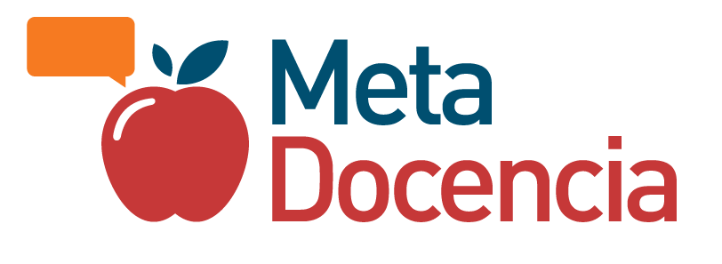

PhD in Bioinformatics
Open Access & Open Source research publications
Computational and Open Science skill training (2015-)
Community Building in Open Science (2016-) - EMBL-HD
Co-lead of The Turing Way & Open Life Science (2019-)
Senior Researcher
Tools, Practices and Systems
The Alan Turing Institute, UK
@malvikasharan, @turingway, CC-BY 4.0, The Turing Way, DOI: 10.5281/zenodo.7428708
Notes:
TIMING: 2

Slide 4
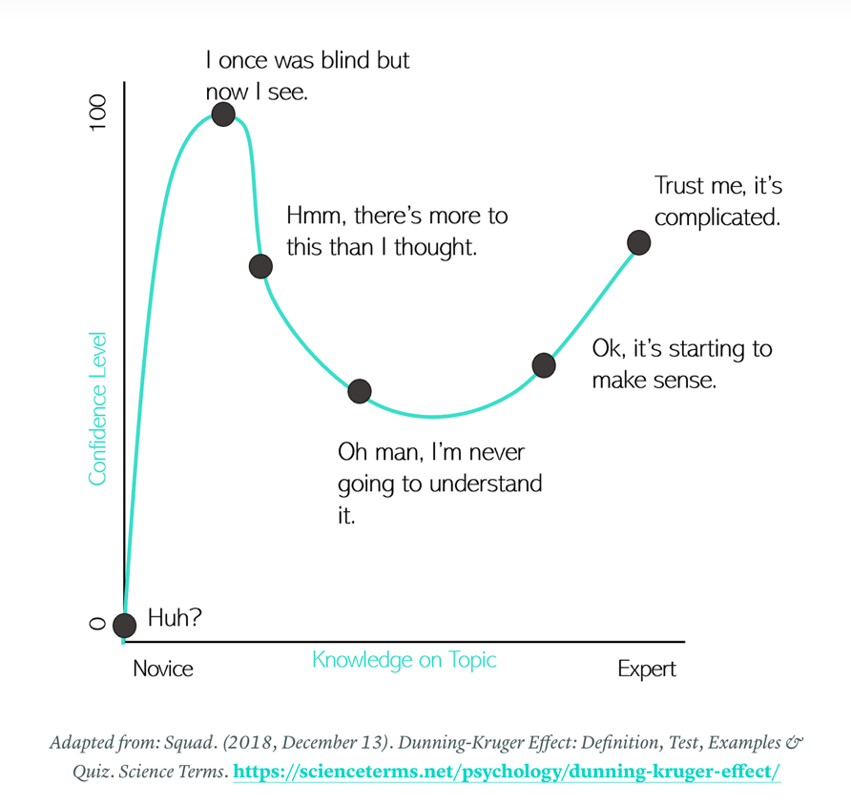
Disclaimer:
You probably already know all about it!
Kaylee Somerville, The Hidden Power of Intellectual Humility - The Decision Lab. 2020.
https://thedecisionlab.com/insights/society/the-hidden-power-of-intellectual-humility

Slide 5
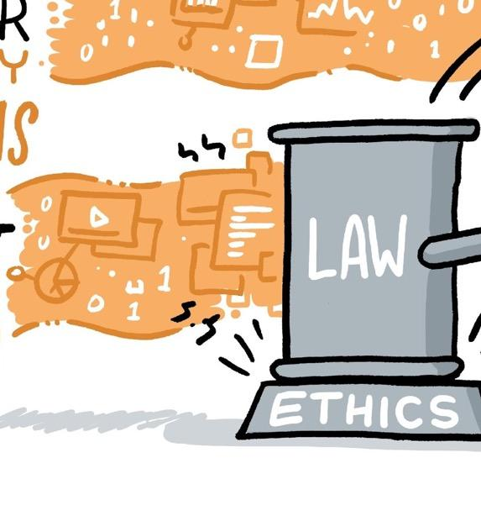
Scientific errors have real world effects
Researchers have an obligation to consider the ethical standards (right actions) and their impact on society.
CC-BY 4.0, https://the-turing-way.netlify.app/ethical-research/ethical-research.html, DOI: 10.5281/zenodo.7428708
Notes:
Taking ethics as the study of what behaviours are right and what behaviours are wrong, ethical research highlights actions we take in research.

Slide 6
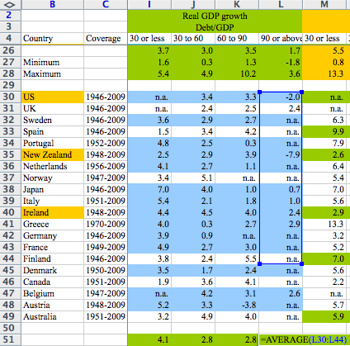
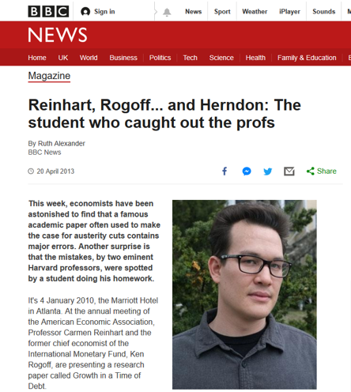
Scientific errors have real world effects
@turingway, CC-BY 4.0,
The Turing Way, DOI: 10.5281/zenodo.7428708
https://statmodeling.stat.columbia.edu/2013/04/16/memo-to-reinhart-and-rogoff-i-think-its-best-to-admit-your-errors-and-go-on-from-there
https://www.bbc.co.uk/news/magazine-22223190
Notes:
This is an example from a famous academic paper by Harvard professors, Carmen Reinhart and Kenneth Rogoff that was often used to make the case for austerity cuts (budget reduction, public tax increase) at the time of economic crisis (to deal with global recession) contains major errors.
Thomas Herndon, a phd student back in 2013, but now a professor was looking at this paper with an intention to replicate the findings. After several failed attempts he got in touch with the author requesting for the original data, which they shared in an excel sheet. He immediately found out
The authors had accidentally only included 15 of the 20 countries under analysis in their key calculation (having excluded Australia, Austria, Belgium, Canada and Denmark);
For some countries, some data was missing;
High debt is correlated with somewhat lower growth, but the relationship is much gentler and there are lots of exceptions to the rule.

Slide 7
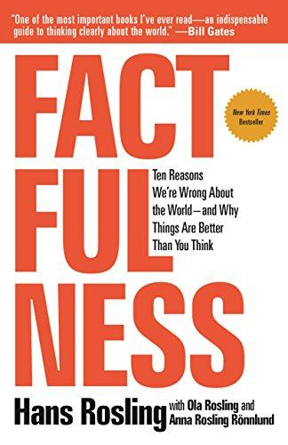
Scientific errors have real world effects
“We will redouble our efforts to avoid such errors in the future …” - Reinhart & Rogoff
“Our problem is that we don’t know what we don’t know, and even our guesses are informed by unconscious and predictable biases.” - Hans Rosling
@turingway, CC-BY 4.0,
The Turing Way, DOI: 10.5281/zenodo.7428708
https://www.gapminder.org/, Rosling, H., Rönnlund, A. R., & Rosling, O. (2018). Factfulness: Ten Reasons We're Wrong About the World--and Why Things Are Better Than You Think. ‏https://www.bbc.co.uk/news/magazine-22223190
Notes:
Low reproducibility stems mostly from authors' omitting to provide crucial information in scientific papers and we stress that sharing all computer code and data is not a solution.
Author said that “We are grateful to Herndon et al. for the careful attention. We will redouble our efforts to avoid such errors in the future.”
mistaken way to examine (country specific) data provides an intellectual rationalisation for things that affect how people think about the world, especially people in power, eventually affects how the world works. - Daniel Hamermesh

Slide 8
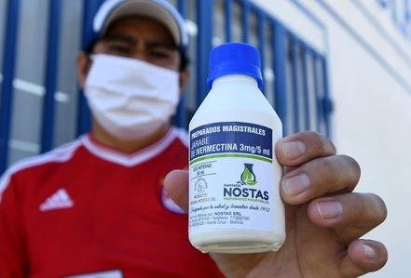
Price of Popularity
Researchers in Australia publishes unreliable COVID-19 data with their preprint and misreported that an anti-parasite drug could stop the virus from replicating in cells.
In a desperate attempt to save dying patients, doctors began justifying the drug’s use against COVID-19 as the virus spread aggressively throughout Latin America.
Reardon, S. (2021). Flawed ivermectin preprint highlights challenges of COVID drug studies. Nature, 596, 173–174. doi: 10.1038/d41586-021-02081-w. Mega, E. R. (2020). Latin America’s embrace of unproven COVID treatment hinders drug trials. Nature, 586, 481–482. doi: 10.1038/d41586-020-02958-2, Slides under DOI: 10.5281/zenodo.7428708
Notes:
Ivermectin grabbed attention in April, when scientists were throwing every already-approved drug they could at the coronavirus. Researchers in Australia had noted that high doses of ivermectin could stop the virus from replicating in cells¹. Shortly afterwards, a preprint appeared online that suggested the drug could reduce coronavirus-related deaths in people.
The paper’s irregularities came to light when Jack Lawrence, a master’s student at the University of London, was reading it for a class assignment and noticed that some phrases were identical to those in other published work. When he contacted researchers who specialize in detecting fraud in scientific publications, they found other causes for concern, including dozens of patient records that seemed to be duplicates, inconsistencies between the raw data and the information in the paper, patients whose records indicate they died before the study’s start date, and numbers that seemed to be too consistent to have occurred by chance.
The paper was retracted in June, but it was a bit too late for Latin America, where the eagerness to use the treatment only grew as the virus spread aggressively in their countries. The problem is when non-evidence-based public policies are made.

Slide 9
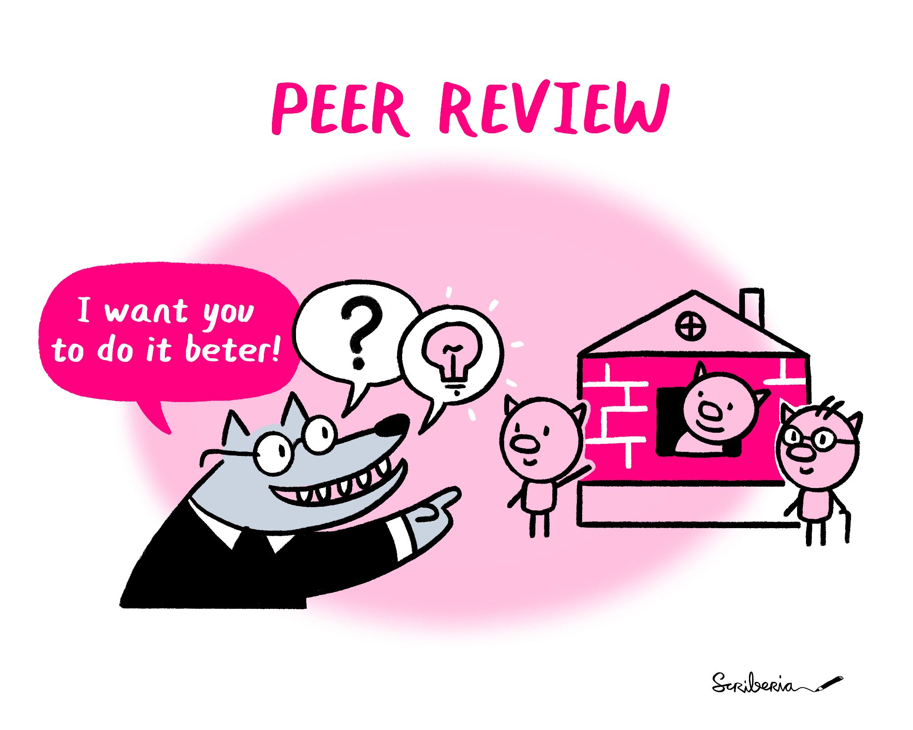
Post-publication Peer Review is Important, But …
To consult the [experts] after an experiment is finished is often merely to ask to conduct a post mortem examination. […] can perhaps say what the experiment died of. - Ronald Fisher
@turingway, CC-BY 4.0,
The Turing Way, DOI: 10.5281/zenodo.7428708
https://statmodeling.stat.columbia.edu/2013/04/16/memo-to-reinhart-and-rogoff-i-think-its-best-to-admit-your-errors-and-go-on-from-there
https://www.bbc.co.uk/news/magazine-22223190
Notes:
https://www.ncbi.nlm.nih.gov/pmc/articles/PMC4831566/

Slide 10
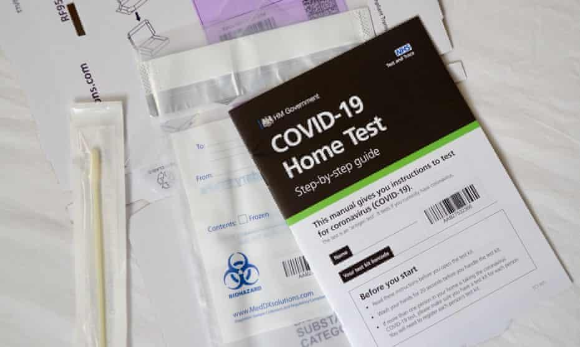
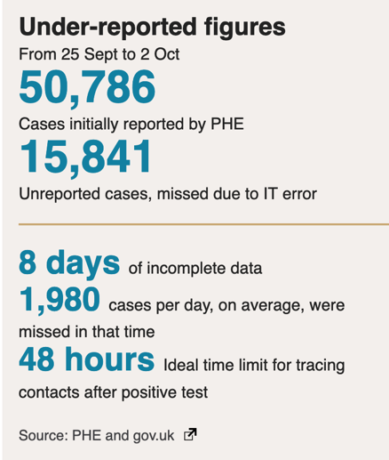
Public Scrutiny is Important for Accountability
@turingway, CC-BY 4.0,
The Turing Way, DOI: 10.5281/zenodo.7428708
Kelion, B. L. (2020). Excel: Why using Microsoft's tool caused Covid-19 results to be lost. BBC News. https://www.bbc.co.uk/news/technology-54423988
Notes:
The badly thought-out use of Microsoft's Excel software was the reason nearly 16,000 coronavirus cases went unreported in England.
The issue was caused by the way the agency brought together logs produced by commercial firms paid to analyse swab tests of the public, to discover who has the virus. They filed their results in the form of text-based lists - known as CSV files - without issue. Public Health England had set up an automatic process to pull this data together into Excel templates so that it could then be uploaded to a central system and made available to the NHS Test and Trace team, as well as other government computer dashboards. Each template could handle only about 65,000 rows of data rather than the one million-plus rows that Excel is actually capable of. And since each test result created several rows of data, in practice it meant that each template was limited to about 1,400 cases. When that total was reached, further cases were simply left off. unreported cases meant as many as 48,000 contacts had not been traced and therefore not made aware that they may have been exposed to COVID. Which means that likely some of them were in fact infected - potentially spreading the infection.

Slide 11
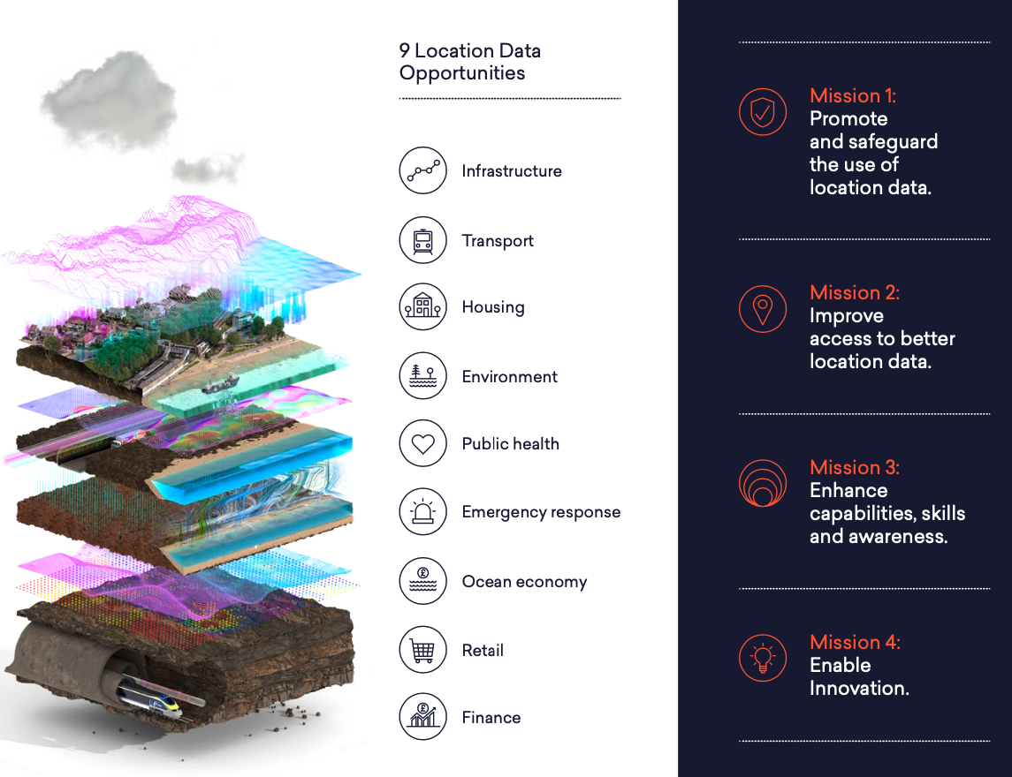
Bias and ‘That’s what you would expect there’
Data about location, or ‘geospatial’ data, is the record of what we do, and where we do it. - GOV
There is a danger that [...] how it is analysed, can reflect inherent biases about a location and, equally, can influence how the findings of a project are interpreted. - UKSA
Unlocking the power of location:The UK’s geospatial strategy. (2020) GOV. https://www.gov.uk/government/publications/unlocking-the-power-of-locationthe-uks-geospatial-strategy
Ethical considerations in the use of geospatial data for research and statistics. (2022, March 01). UK Statistics Authority. uksa.statisticsauthority.gov.uk/publication/ethical-considerations-in-the-use-of-geospatial-data-for-research-and-statistics/pages/5. Office, C.

Slide 12
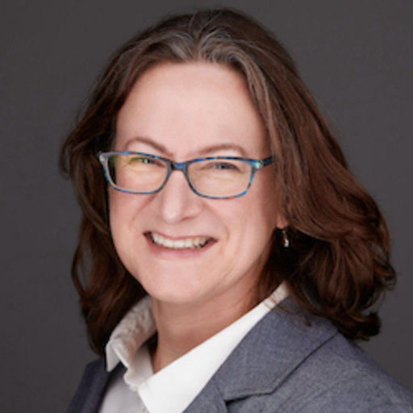
Misconduct in Biomedical Research: “The Dark Side of Science”
Systematic scan of 20,000 papers in 40 journals published over 20 years shows inappropriately duplicated images in about 4% of them.
“We need to rely on science, but we need to be better able to distinguish good science from bad. We need to make science more self-correcting.”
Elisabeth Bik
Microbiologist by training,
Scientific misconduct hunter by passion, professional scientific integrity consultant
Bik, E. M., Fang, F. C., Kullas, A. L., Davis, R. J., & Casadevall, A. (2018). Analysis and Correction of Inappropriate Image Duplication: the Molecular and Cellular Biology Experience. Molecular and Cellular Biology, 30037982. https://pubmed.ncbi.nlm.nih.gov/30037982
Genetics has an estimated retraction rate 0.15%. Fabrication/falsification and plagiarism were almost mutually exclusive reasons for article retraction of entire retracted papers in life science. Dal-Ré, R., & Ayuso, C. (2019). Reasons for and time to retraction of genetics articles published between 1970 and 2018. Journal of Medical Genetics, 56(11), 734–740. doi: 10.1136/jmedgenet-2019-106137
Notes:
Research misconduct (ie, fabrication, falsification, plagiarism)2 accounted for 53%, whereas duplication and error were responsible for 14% and 21%, respectively

Slide 13
Avoid Errors Before the Harm Occurs
Mistaken research design or analysis processes
  Design for reproducible and collaborative research
Lack of diverse tools, methods and expertise to draw from
  Openly shared community-developed data-handling tools
Inappropriate baseline comparison and assumption of future use
  Lack of technical understanding and ethical implications
@turingway, CC-BY 4.0,
The Turing Way, DOI: 10.5281/zenodo.7428708
Allison, D. B., Brown, A. W., George, B. J., & Kaiser, K. A. (2016). Reproducibility: A tragedy of errors. Nature, 530(7588), 27. doi: 10.1038/530027a
Notes:
https://www.ncbi.nlm.nih.gov/pmc/articles/PMC4831566/

Slide 14
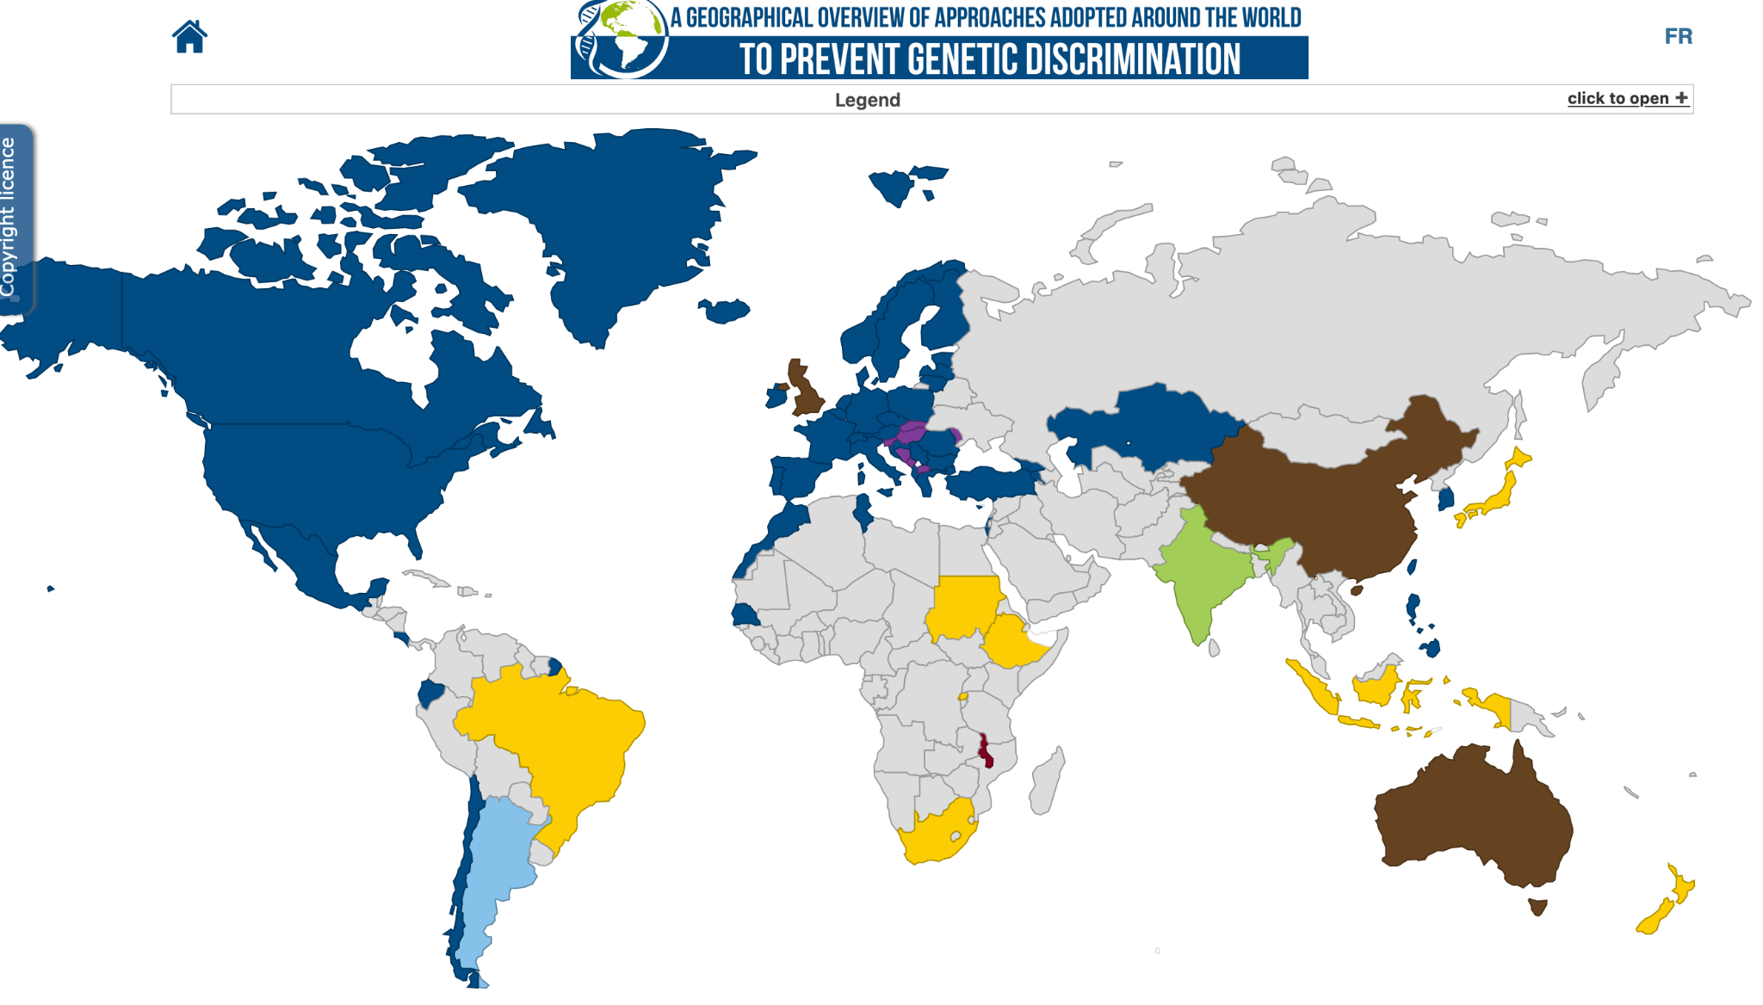
Tracking discrimination in personalised medicine
“No one shall be subjected to discrimination based on genetic characteristics”
Universal Declaration on the Human Genome & Human Rights, adopted by 77 nations in 1997
Genetic Discrimination Observatory. https://gdo.global
Joly, Y., Salman, S., Ngueng Feze, I., Granados Moreno, P., Stanton-Jean, M., Lacey, J., ...Love, R. (2017). DNA Testing for Family Reunification in Canada: Points to Consider. Journal of International Migration and Integration, 18(2), 391–404. doi: 10.1007/s12134-016-0496-7,
Notes:
Genomics is offering new possibilities for therapies and treatments for some complex diseases, as well as new diagnostic methods. When a technology related to personalised medicine grows too quickly through excitement of potential, they may undermine of sometimes not consider what could go wrong.
Societal, ethical and legal consideration. In the human genomics and genetics, the stakes are particularly high, because of the risks posed by increased availability of, and access to, sensitive genomic data.
---
tailored treatment of individual patients, a process requiring detailed phenotypic and genetic information. Although the widespread collection of such data can help to advance the implementation of precision healthcare, the genomic sequencing data being amassed also include private information that could potentially be used as a basis for genetic discrimination. It is important for the genetics community to be aware of these risks and to contribute to policies designed to monitor and mitigate threats to the equitable treatment of individuals or populations on the basis of genetics.

Slide 15
Tracking discrimination in personalised medicine
“No one shall be subjected to discrimination based on genetic characteristics”
Universal Declaration on the Human Genome & Human Rights, adopted by 77 nations in 1997
There have been concerns on the increasing use of DNA tests in family reunification processes of nationals in Canada from certain regions including Africa, Asia, and Latin America. [1]
Genetic Discrimination Observatory. https://gdo.global
[1] Joly, Y., Salman, S., Ngueng Feze, I., Granados Moreno, P., Stanton-Jean, M., Lacey, J., ...Love, R. (2017). DNA Testing for Family Reunification in Canada: Points to Consider. Journal of International Migration and Integration, 18(2), 391–404. doi: 10.1007/s12134-016-0496-7,
Notes:
Citizenship and Immigration Canada has adopted a policy of suggesting DNA testing only as a last resort [...], in practice, there have been concerns on the increasing use of DNA tests in family reunification processes of nationals from certain regions including Africa, Asia, and Latin America. [1]
---

Slide 16
Tracking discrimination in personalised medicine
Citizenship and Immigration Canada has adopted a policy of suggesting DNA testing only as a last resort [...], in practice, there have been concerns on the increasing use of DNA tests in family reunification processes of nationals from certain regions including Africa, Asia, and Latin America. [1]
Increasing availability of genetic information and the patenting of human genes may lead, respectively, to a loss of reproductive autonomy and a reduction in equitable access to medical care; hence new regulations and/or legislation may be required to ensure appropriate control over genetic information and use of intellectual property rights in human genes.
Joly, Y., Salman, S., Ngueng Feze, I., Granados Moreno, P., Stanton-Jean, M., Lacey, J., ...Love, R. (2017). DNA Testing for Family Reunification in Canada: Points to Consider. Journal of International Migration and Integration, 18(2), 391–404. doi: 10.1007/s12134-016-0496-7 [1], Daca-Roszak, P., Swierniak, M., Jaksik, R., Tyszkiewicz, T., Oczko-Wojciechowska, M., Zebracka-Gala, J., ...Zietkiewicz, E. (2018). Transcriptomic population markers for human population discrimination. BMC Genetics, 19(1), 1–11. doi: 10.1186/s12863-018-0663-2 [2]
Notes:
Genomics is offering new possibilities for therapies and treatments for some complex diseases, as well as new diagnostic methods. When a technology related to personalised medicine grows too quickly through excitement of potential, they may undermine of sometimes not consider what could go wrong.
Societal, ethical and legal consideration. In the human genomics and genetics, the stakes are particularly high, because of the risks posed by increased availability of, and access to, sensitive genomic data.
---
tailored treatment of individual patients, a process requiring detailed phenotypic and genetic information. Although the widespread collection of such data can help to advance the implementation of precision healthcare, the genomic sequencing data being amassed also include private information that could potentially be used as a basis for genetic discrimination. It is important for the genetics community to be aware of these risks and to contribute to policies designed to monitor and mitigate threats to the equitable treatment of individuals or populations on the basis of genetics.

Slide 17
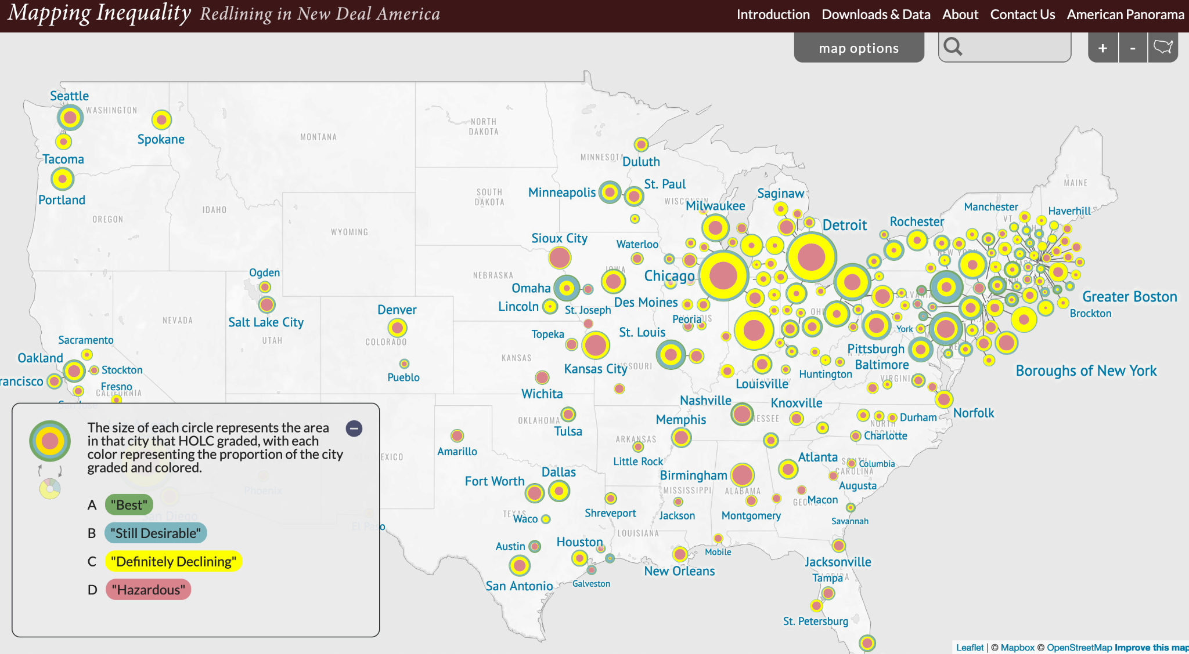
The term ‘redlining’ was coined by the sociologist John McKnight in the 1960s, to define the discriminatory practice of avoiding investment in communities with unfavourable or high-risk demographics, typically with large minority and immigrant populations. Interactive map: https://dsl.richmond.edu/panorama/redlining/#loc=5/39.1/-94.58
Notes:
In the context of USA, The term ‘redlining’ was coined by the sociologist John McKnight in the 1960s, to define the discriminatory practice of avoiding investment in communities with unfavourable or high-risk demographics, typically with large minority populations.
Redlining violates the anti-discrimination provisions of the Equal Credit Opportunity Act, as well as the provision of the Community Reinvestment Act that requires banks to adequately serve the needs of their geographic assessment areas.
There is a danger that geospatial data, and how it is analysed, can reflect inherent biases about a location and, equally, can influence how the findings of a project are interpreted.

Slide 18
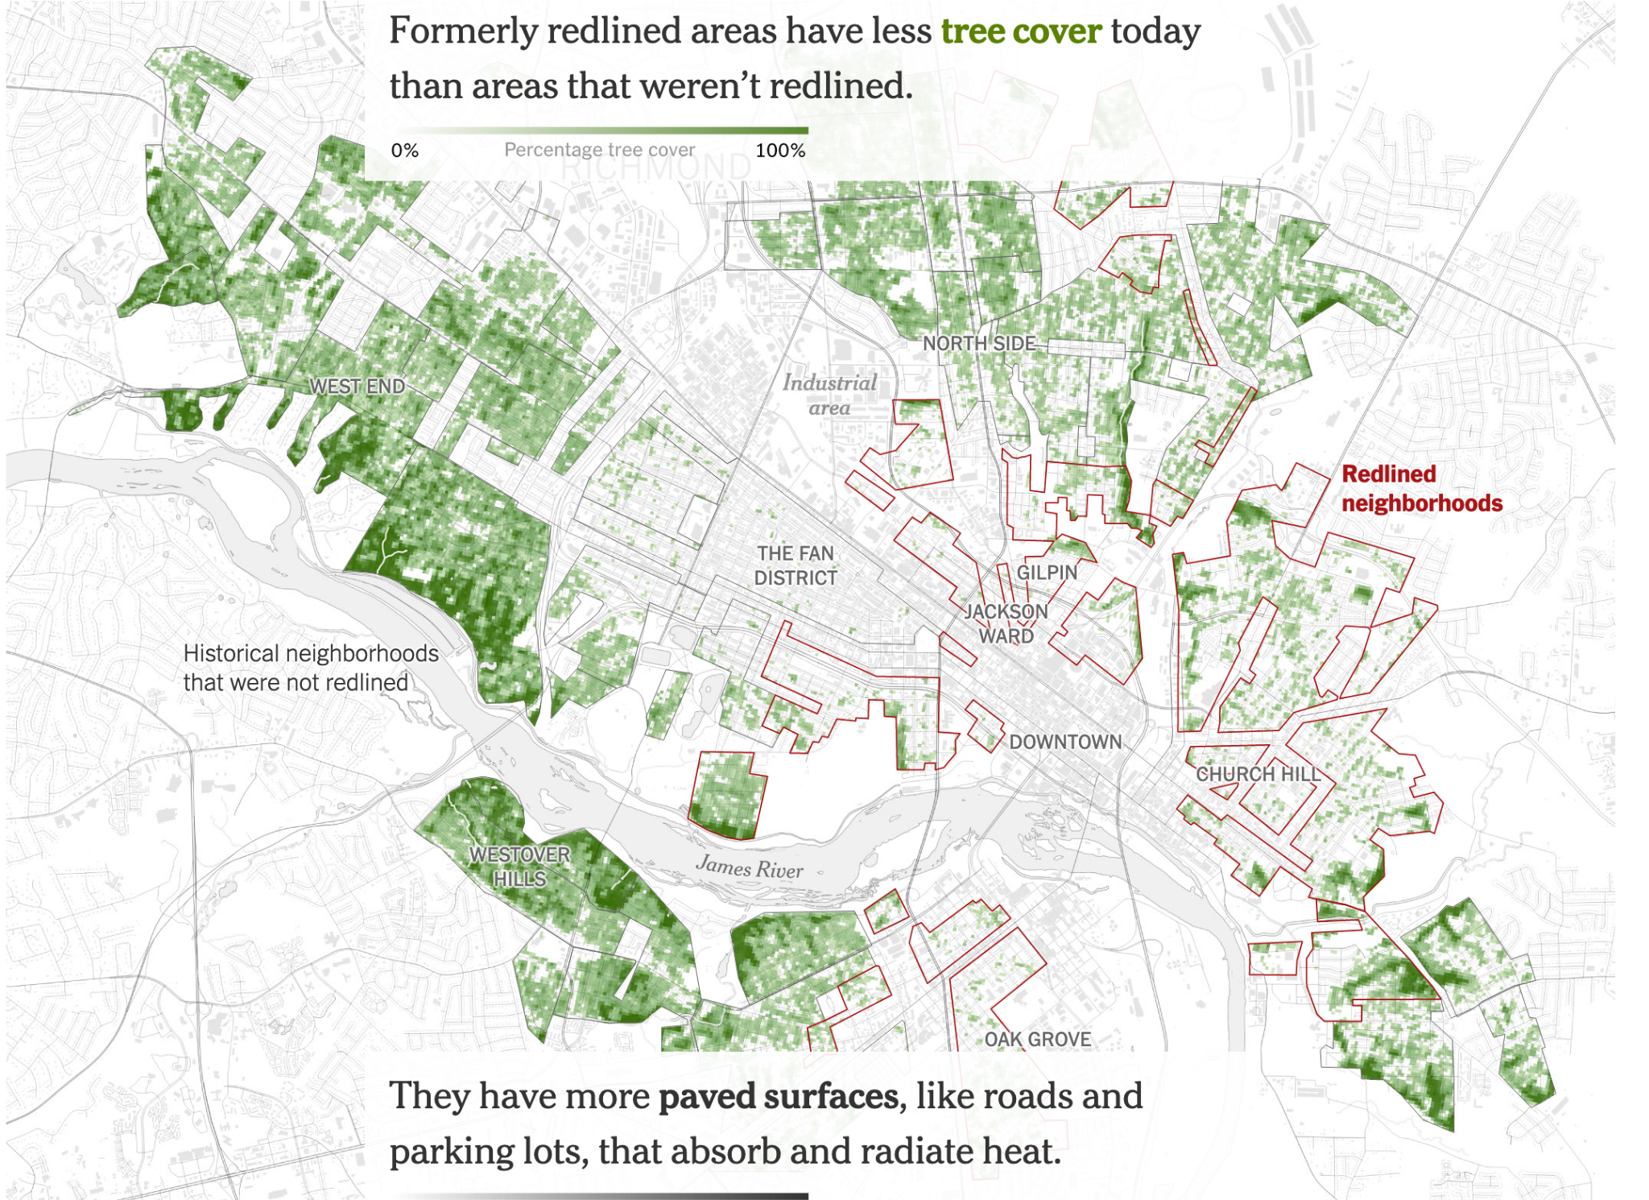
Redlining was outlawed by the 1970s - but the practice has left lasting marks.
Low access to housing finance, less investment, more paved surfaces, reduced tree cover → influencing extreme heat and worse impact of climate change.
Plumer, B., Popovich, N., & Palmer, B. (2022). How Decades of Racist Housing Policy Left Neighborhoods Sweltering. New York Times. https://www.nytimes.com/interactive/2020/08/24/climate/racism-redlining-cities-global-warming.html
Notes:
The researchers’ analysis in virginia and portland shows that the gaps in temperature among neighborhoods were pronounced - with high temperature in areas redlined. Redlining prevented minority families from owning homes, fueling today’s racial wealth gap. They also led to decades of disinvestment in already-struggling neighborhoods, which helped shape the current built environment, exacerbating the disparities of the urban heat island effect.

Slide 19
The Turing Way
@malvikasharan @turingway, Image by Scriberia for The Turing Way, Shared under CC-BY 4.0, DOI: 10.5281/zenodo.7428708
Notes:
This is where, now, I’d like to introduce you to The Turing Way. A project that I co-lead.

Slide 20
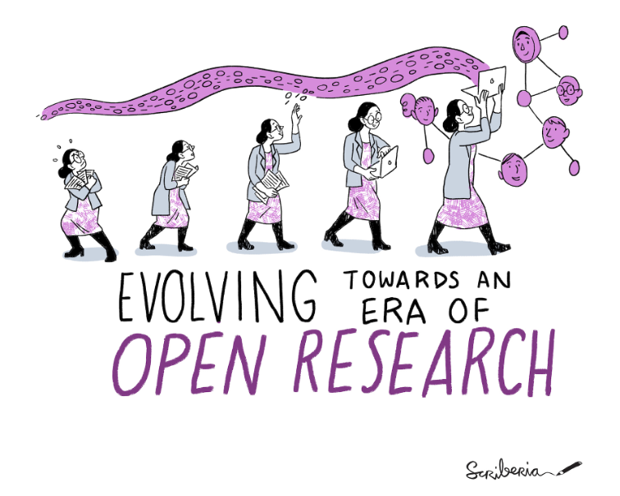
The Turing Way
An Open Science and community lead guide on Data Science.
We involve and support a diverse community to make research reproducible, ethical, and collaborative for everyone.
@malvikasharan @turingway, Image by Scriberia for The Turing Way, Shared under CC-BY 4.0, DOI: 10.5281/zenodo.7428708
Notes:
The Turing Way is an open science project that involves and supports its diverse community in making research reproducible, ethical, open and inclusive for everyone. To make our work truly beneficial and comprehensible for as many people as possible we collaborate with individuals and organisations with diverse skills, backgrounds, lived experiences and domain knowledge.

Slide 21

The national institute for data science and artificial intelligence
@malvikasharan, DOI: 10.5281/zenodo.7428708, https://www.turing.ac.uk/news/enigma-machine-goes-display-alan-turing-institute
Notes:
It is a part of the Alan Turing Institute, which is the National Institute for data science and artificial intelligence in the UK.

Slide 22
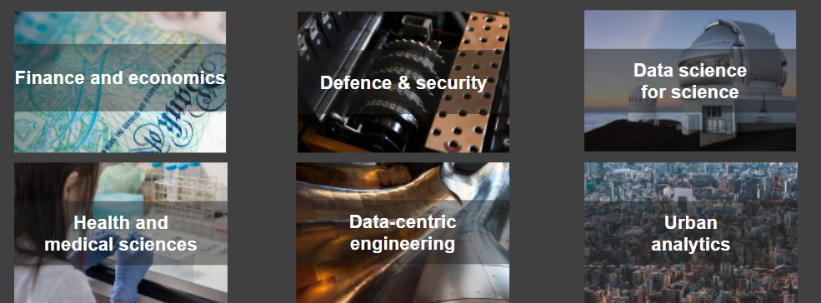
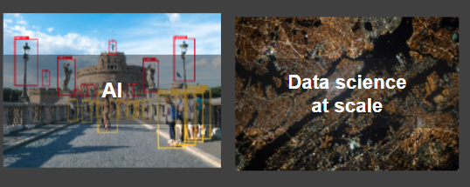
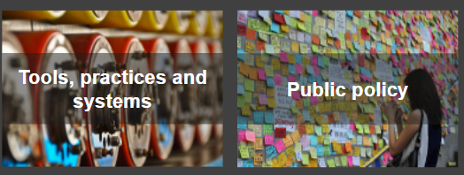
Research Programmes
Sector specific research
Integration of best practices
https://www.turing.ac.uk/, DOI: 10.5281/zenodo.7428708

Slide 23
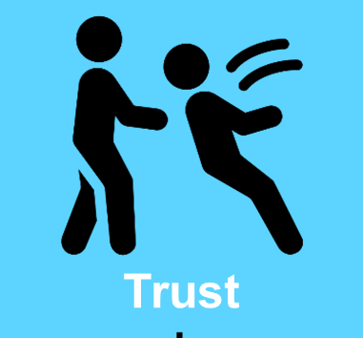

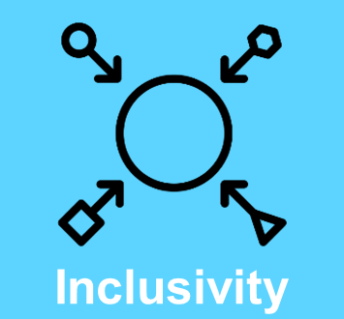
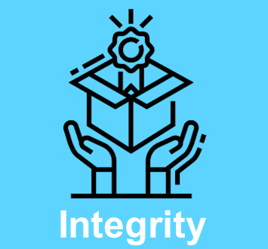
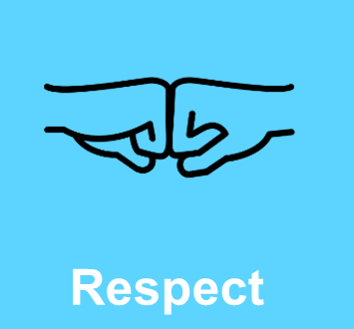
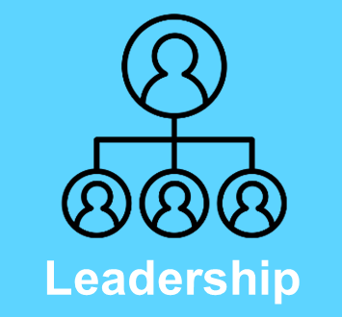
Tools, Practices and Systems
Trustworthy systems
Transparent reporting
Inclusive interoperable design
Ethical integrity
Respectful co-creation
Leadership in open research
@malvikasharan @turingway, CC-BY 4.0, https://www.turing.ac.uk/, DOI: 10.5281/zenodo.7428708
Notes:
​​A cross-cutting research programme that hosts The Turing Way is called tools, practices and systems. The core values of this program are to embed best practices across the Turing research and team, as well as deliver trustworthy systems, transparent reporting, inclusive interoperable design, ethical integrity, respectful co-creation, and leadership in open research. The Turing Way sits across most of these goals and provides a central resource for good practices to all our researchers within the UK and internationally.

Slide 24
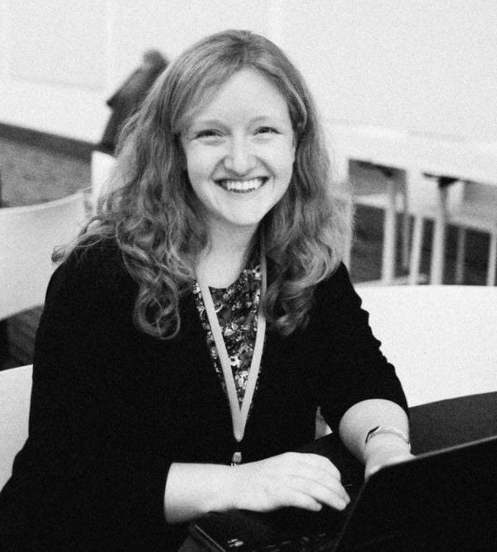
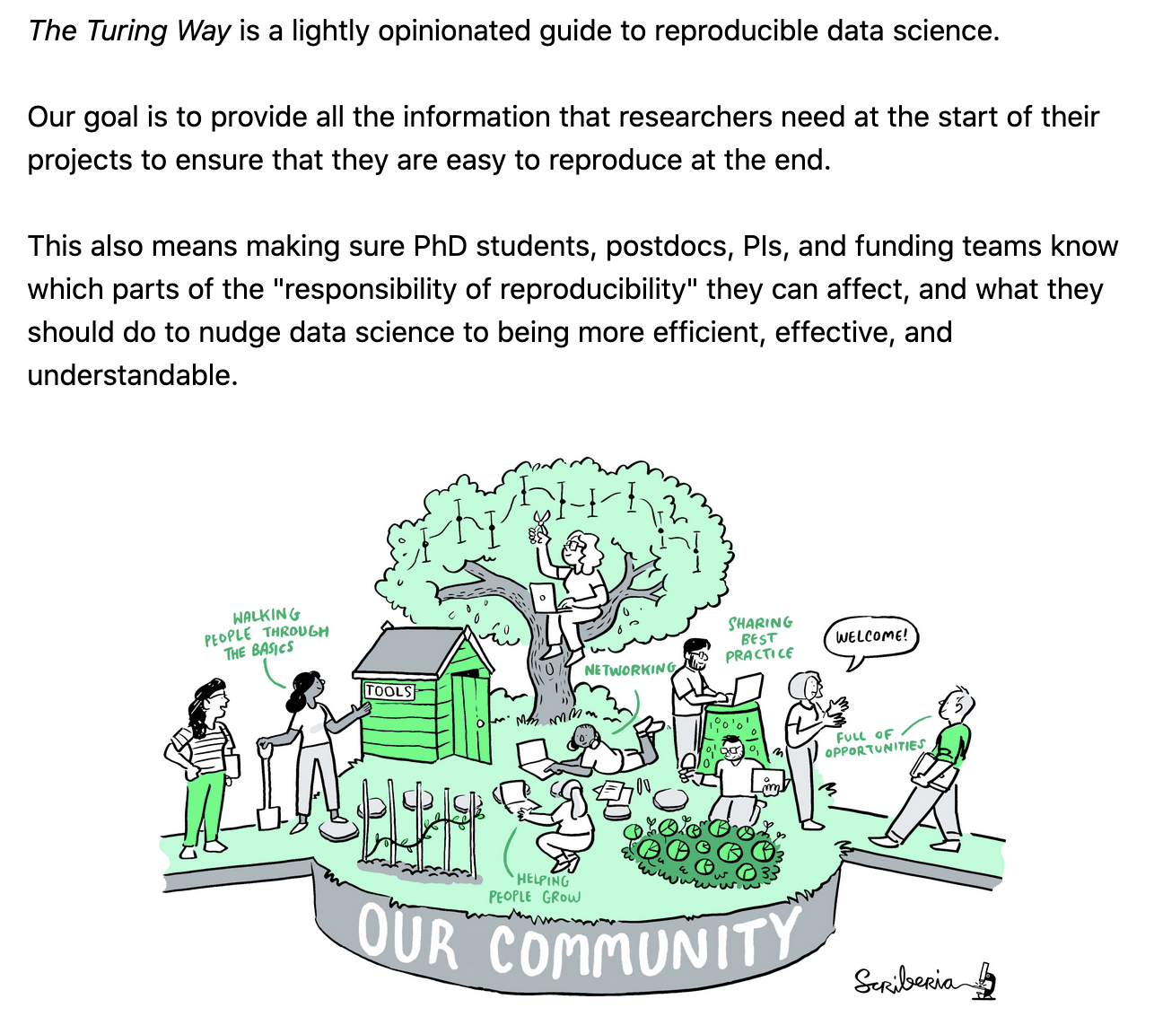
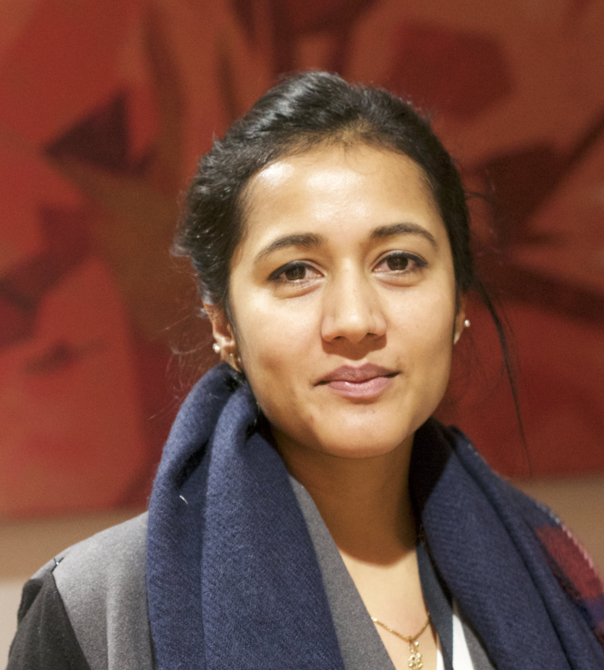
The Turing Way Book on Reproducibility
Kirstie Whitaker
Director: Tools, Practices & Systems Programme (TPS)
Malvika Sharan
TPS Senior Researcher: Open Research & Community
Notes:
It was started as a book on reproducibility by Kirstie Whitaker, who is the project lead. I started as a community manager in 2020, and now I co-lead this project. Shared as a lightly opinionated guide, The Turing Way handbook provides reproducible tools and practices to help ensure that the researchers, funders, policymakers and all different stakeholders in research know what their responsibility of reproducibility is, where they can make an impact, and how they can make their work more efficient and understandable.

Slide 25
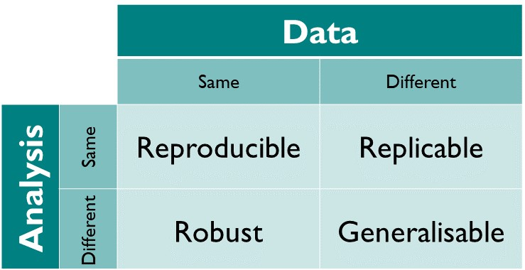
Reproducibility
@malvikasharan @turingway, CC-BY 4.0, https://github.com/alan-turing-institute/the-turing-way, DOI: 10.5281/zenodo.7428708
Notes:
Reproducibility is When the same analysis is applied to the same data, it should give the same result. There are other concepts around reproducibility like replicability – when the same analysis is applied to different data or experiments in different conditions, then there is robustness and generalisability as well. However, reproducibility in computational analysis should be maintained as a minimum criteria to ensure quality and integrity of our research.

Slide 26
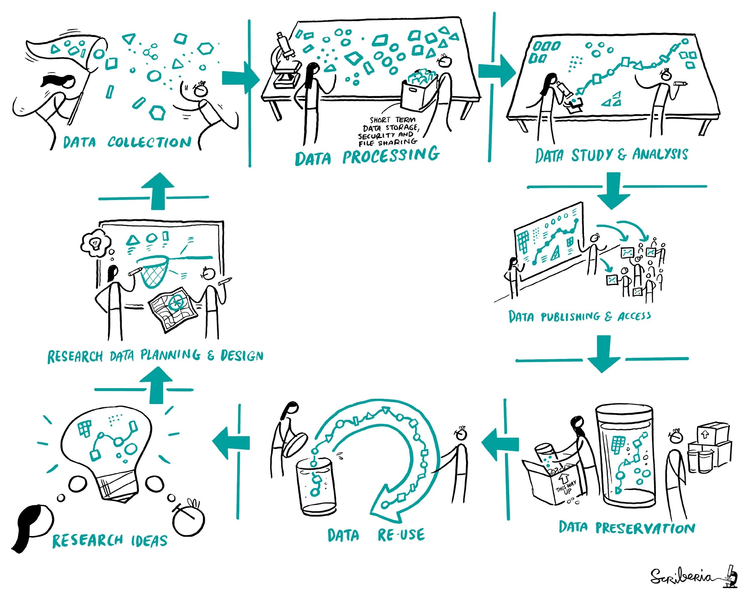
Reproducibility
@malvikasharan @turingway, CC-BY 4.0, CC-BY image by The Turing Way and Scriberia, DOI: 10.5281/zenodo.7428708
Notes:
It starts right when you have a research idea. You want to communicate with others, plan and design your work. Then you will describe your protocol and collect data sets. Then, you start processing and wrangling your data, conducting your studies and analysis, publishing your data, and other research components so everybody can access it. Then comes the archiving that can ensure that your data is reusable, meaning that someone else can go through this whole process of reproducing or building upon your work.

Slide 27
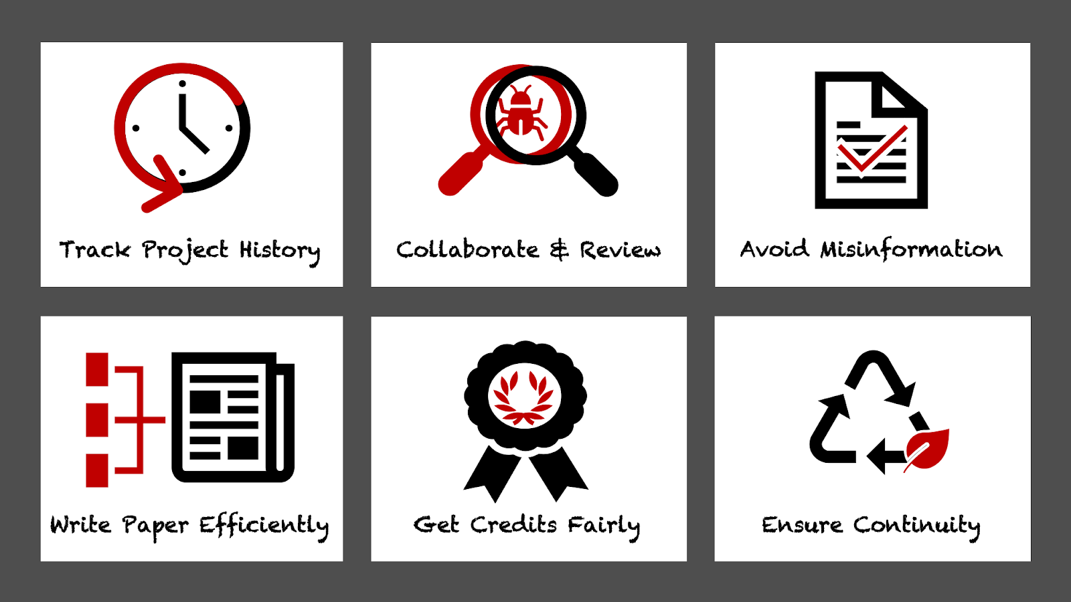
Why do reproducible research?
https://the-turing-way.netlify.app/reproducible-research/overview/overview-benefit.html, DOI: 10.5281/zenodo.7428708
Notes:
There are many benefits in doing reproducible research:
1. Tracking the history of your research – this includes data, tools, methods, codes and documentation used in the project. This ensures research sustainability, fair acknowledgement of contributors and maximum usefulness to others. For me, keeping thorough records of what I am doing helps me to remember where to start when I’ve had a break from a certain research activity.
2. To facilitate collaboration and the review process – reproducible workflows enable other researchers and reviewers to have full access to all the different parts of the project that are necessary for validation of the research outcomes. This means that you will publish validated research and avoid misinformation.
3. Write papers and other research outputs efficiently – documenting the project throughout will make writing up easier and you are likely to already meet the highest-level journal guidelines for availability of datasets and metadata. I am structuring my projects to be reproducible from the outset so I am building a research compendium as I go along.
4. Credit work fairly – other researchers can use and reproduce different parts of your project such as data, code and protocols. All these parts will have DOI’s and therefore are individually citable pieces of work. This means you will get fair recognition for this work and your research is likely to have more impact as you will get cited more – articles that include statements that link their data have a 25% higher citation impact on average.
5. Ensuring continuity of your work – progress of reproducible projects can easily be tracked and continued allowing you and others to build on your research. It’s a more sustainable approach to research.

Slide 28
Held to higher standards than others
Is not considered for promotion
Publication bias towards novel findings
Barriers to reproducible research
Requires additional skills
Plead the 5th
Support additional users
Takes time
https://doi.org/10.6084/m9.figshare.5537101
#TuringWay @turingway, DOI: 10.5281/zenodo.7428708

Slide 29
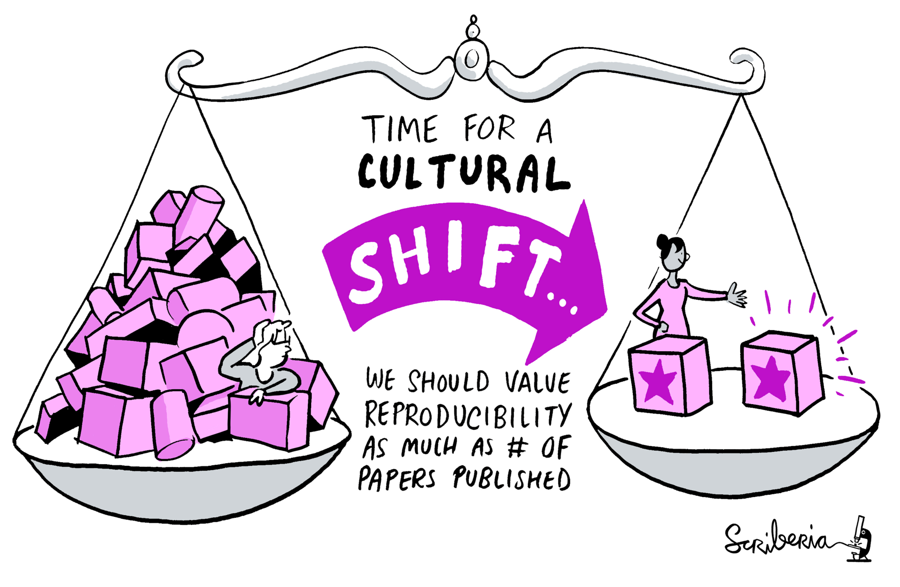
Held to higher standards than others
Is not considered for promotion
Publication bias towards novel findings
Barriers to reproducible research
Requires additional skills
Plead the 5th
Takes time
The Turing Way
Support additional users
https://doi.org/10.6084/m9.figshare.5537101
#TuringWay @turingway, DOI: 10.5281/zenodo.7428708

Slide 30
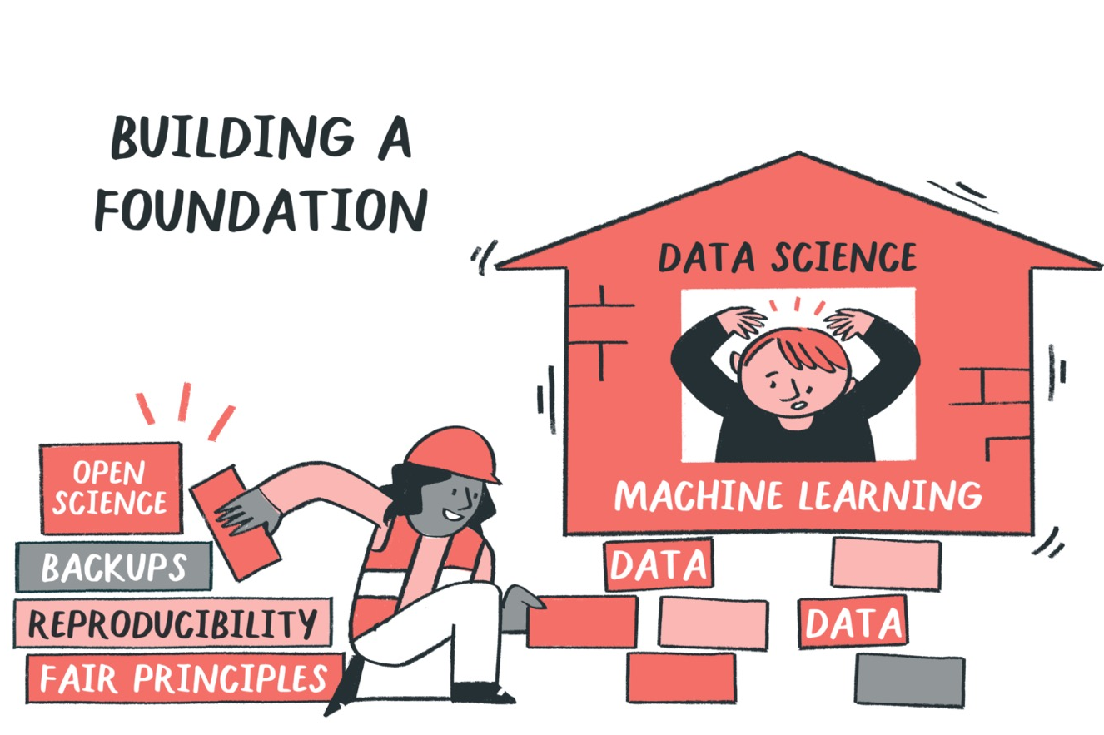
Open Science as foundational skill-set
Purpose of openness is to ensure reproducible, ethical and collaborative research process and outcome.
Not all data can or should be published.
@malvikasharan @turingway, CC-BY 4.0, https://github.com/alan-turing-institute/the-turing-way, DOI: 10.5281/zenodo.6587260
Notes:
Open science should be foundational to all research. Purpose of openness is to ensure scientific integrity, rigor and quality by applying
reproducible, ethical and collaborative approaches. So, although we may place huge importance in outcome, openness or reproducibility is not a one off thing.

Slide 31
“An article about computational science in a scientific publication is not the scholarship itself, it is merely advertising of the scholarship. The actual scholarship is the complete software development environment and the complete set of instructions which generated the figures.”
— Buckheit and Donoho (paraphrasing John Claerbout)
WaveLab and Reproducible Research, 1995
(slide courtesy of Chris Holdgraf and the Jupyter Team)
@turingway, CC-BY 4.0, The Turing Way, DOI: 10.5281/zenodo.7428708
Notes:
Read quote
Sharing the code and the data only is like giving a poorly specified recipe, like one that is missing at which temperature we should set the oven, or which type of flour we should use. Those details can completely change the outcome of our recipe.

Slide 32
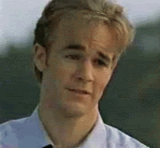
Take home message
Sharing your code and data isn’t enough
@turingway, CC-BY 4.0, The Turing Way, DOI: 10.5281/zenodo.7428708
Notes:
These are really important steps and better than nothing! But they are not enough to achieve full reproducibility

Slide 33
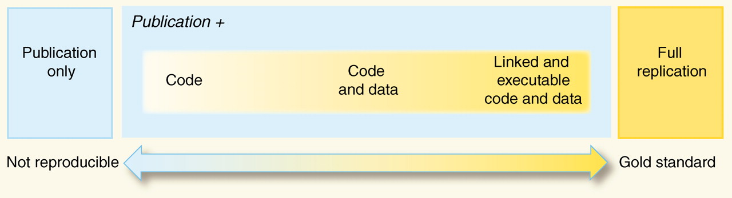
We need research environment and guidelines too!
Peng, 2011, doi: 10.1126/science.1213847
@turingway, CC-BY 4.0, The Turing Way, DOI: 10.5281/zenodo.7428708
Notes:
Illustration from Peng in 2011 about how code and data aren’t enough to do a full replication.
You don’t want to let perfect be the enemy of the good here! All movement along this axis is progress towards better science.
you may have experienced the challenge of actually EXECUTING someone else’s code…..

Slide 34

We need research environment and guidelines too!
Peng, 2011, doi: 10.1126/science.1213847
@turingway, CC-BY 4.0, The Turing Way, Slides’ DOI: 10.5281/zenodo.7428708
Notes:
…..And its really hard!
Your experience of not being able to get someone else’s code to run on their machine is extremely common!
Why? If our computational environment differs from the original creator of the code, these differences might prevent the code from working.

Slide 35
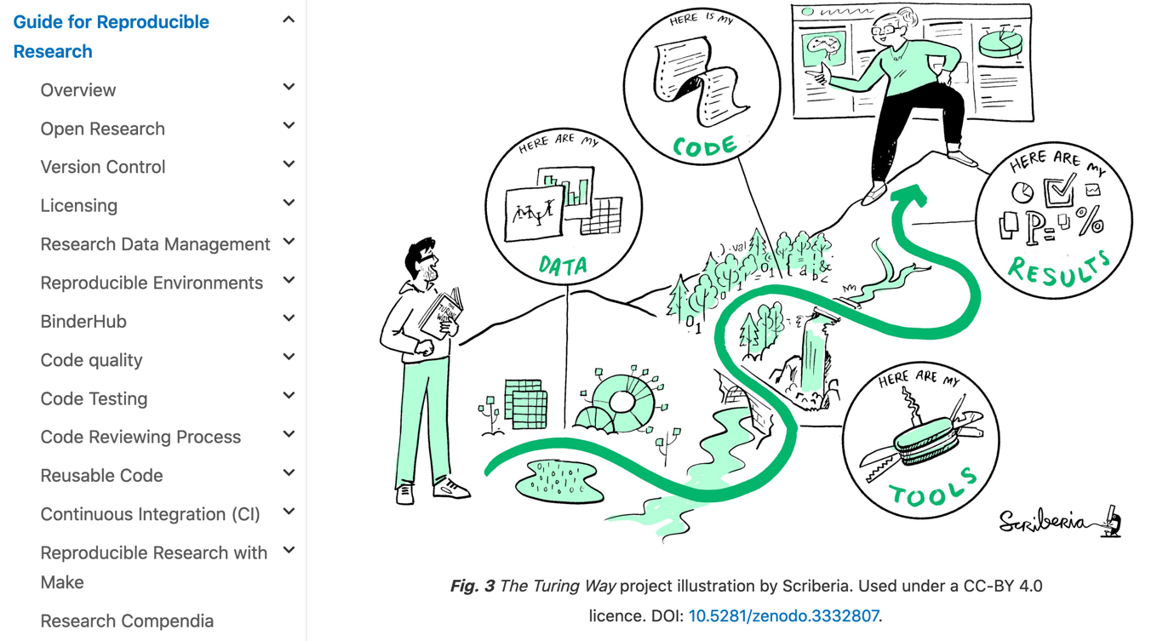
Guide for Reproducible Research
@malvikasharan @turingway, CC-BY 4.0, Book: https://the-turing-way.netlify.app/welcome, DOI: 10.5281/zenodo.7428708
Notes:
With this understanding, the project started with contributors who documented best practices, guidance and recommendations in chapters, describing various concepts and tools that can ensure the reproducibility aspects of data research.
These chapter include topics such as open research, version control, licensing, data management, code testing and reviewing, continuous integration and so on.
However, these data practices were not enough, as research also includes the way we communicate our work with others, how do we design our project, how efficiently we collaborate with each other. All these while ensuring the highest ethical standards and research integrity in our research.

Slide 36
Computational Reproducibility
Track changes to your code/resource (version control)
Write clean, understandable and error free code
Save and share your workflow and computational environment
Make your code open for others to test, use and collaborate on
@malvikasharan, CC-BY 4.0, CC-BY image by The Turing Way and Scriberia, , DOI: 10.5281/zenodo.7428708

Slide 37
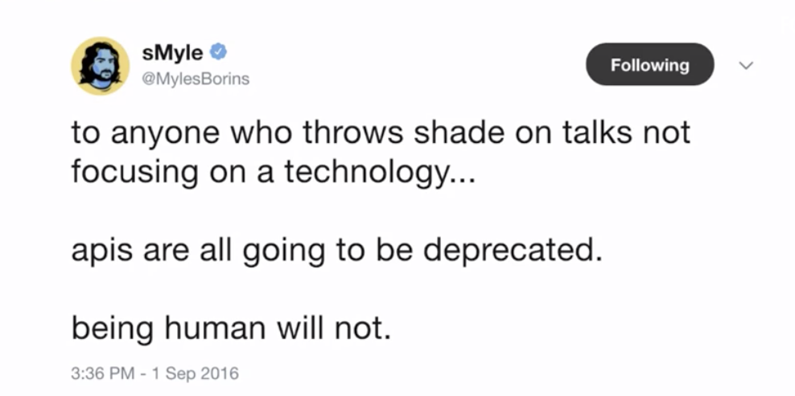
Projects are for people!
Publicly accessible research that anyone can (re)use, modify, and distribute for any purpose.
Book: https://the-turing-way.netlify.app/welcome, @malvikasharan @turingway, Slides: 10.5281/zenodo.7428708
Notes:
TIMING: 4

Slide 38
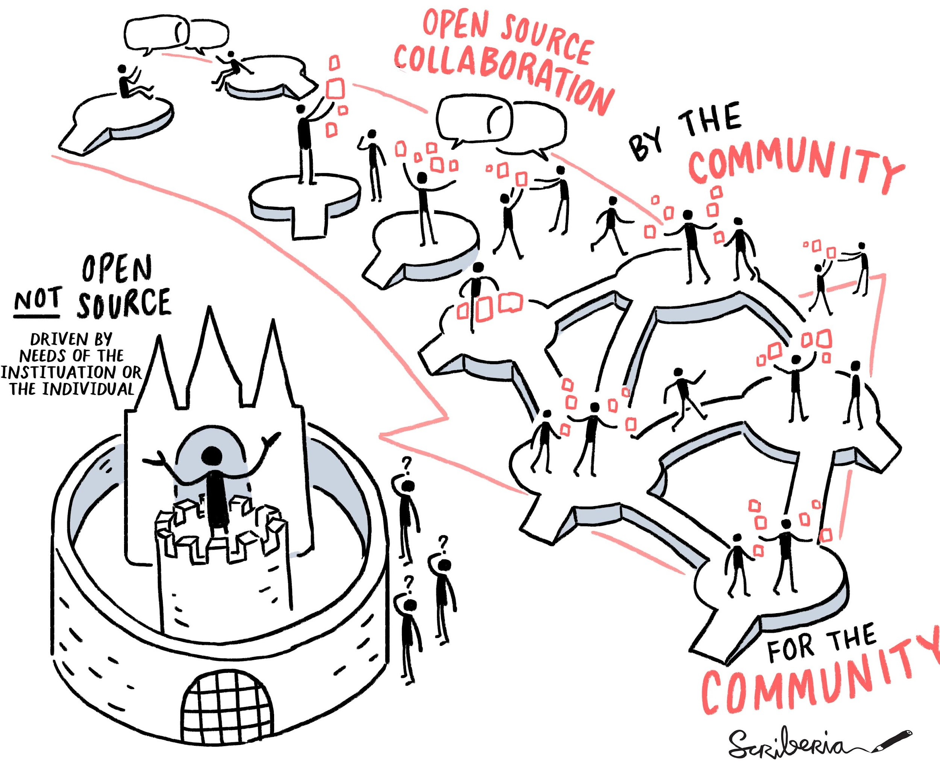
Open Science
Everyone can freely access, reuse, reproduce, build upon and distribute research objects.
@malvikasharan, Image by Scriberia for The Turing Way, Shared under CC-BY 4.0, DOI: 10.5281/zenodo.7428708
Notes:
To define for everyone once again, Open Science is a way of conducting research where everyone can access, reuse, reproduce, build upon and distribute resources freely, without any barrier. Although the success of open science can be seen through the outcomes, more importance should be placed in the communities built by diverse participants who share common values and interests, and share knowledge and expertise for mutual benefit.

Slide 39
Open Science
Everyone can freely access, reuse, reproduce, build upon and distribute research objects.
Community framework for collaboration, peer production and sustainability.
elly, Anthony, "With Head, Heart and Hand: Dimensions of Community Building" (Boolarong Press) ISBN 978-0-86439-076-9,
Wenger, McDermott, Snyder, A Guide to Managing Knowledge: Cultivating Communities of Practice. HBS (2002)
@malvikasharan, Image by Scriberia for The Turing Way, Shared under CC-BY 4.0, DOI: 10.5281/zenodo.7428708
Notes:
Open Science Communities use open science practices for collaboration, peer-production and sustainability of research objects that are beneficial for them.
Aim is to ensure active participation in the development and decision-making process of research they use.
This means that diverse contributors are given opportunities to come into the project with different perspectives, participate in the development process and integrate their combined values in the product by-design.

Slide 40
Open Science aims to transform research by making it more transparent → accessible → reliable → reproducible → reusable → collaborative → beneficial to society.
To achieve this openness in research, we need to make each element of the research process ...
publicly available,
with permission to view, use, modify and distribute, and
description for how one can collaborate.
@turingway, CC-BY 4.0, The Turing Way, DOI: 10.5281/zenodo.7428708
Notes:
So what actually is open science?
If we define open science - it aims to transform research by making it more reproducible, transparent, reusable, collaborative, accountable, and accessible to society’.
So it pushes for change in the way that research is carried out and disseminated by digital tools.
To achieve this openness in research, each element of the research process should:
Be publicly available: It is difficult to use and benefit from knowledge hidden behind barriers such as passwords and paywalls.
Be reusable: Research outputs need to be licensed appropriately, so that prospective users know any limitations on re-use.
Be transparent: With appropriate metadata to provide clear statements of how research output was produced and what it contains.

Slide 41
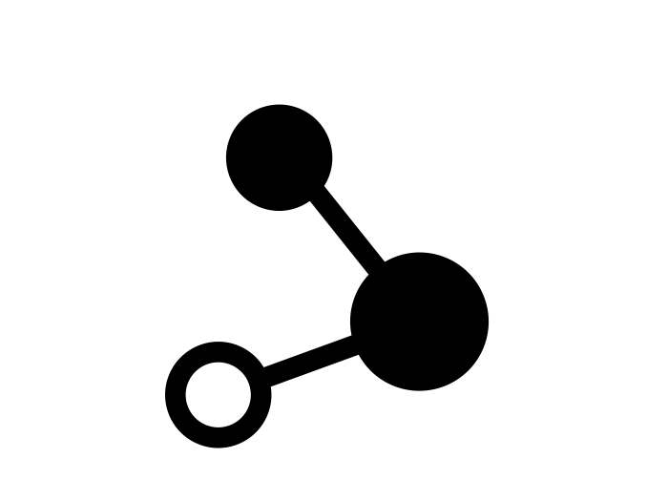
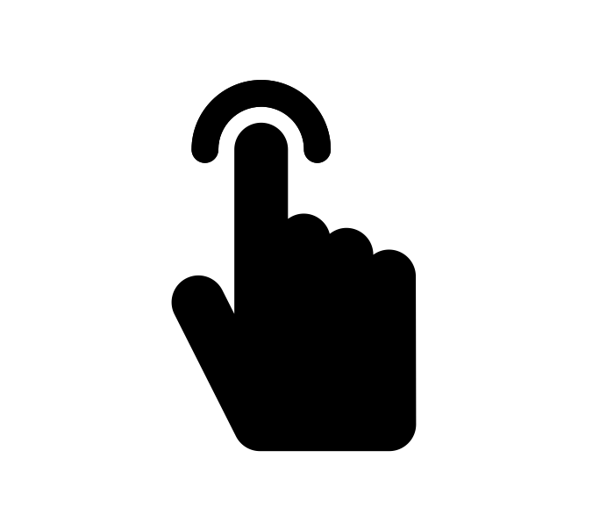
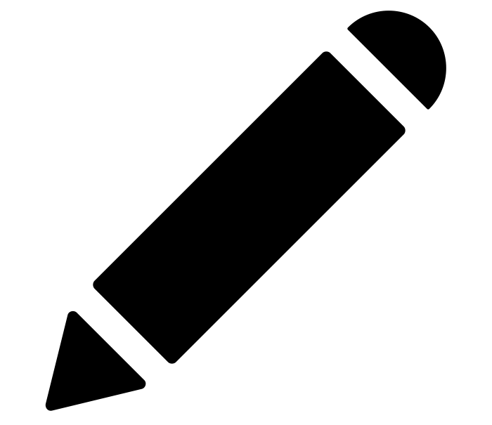
Truly Open Licenses: common elements
use
Anyone can use the work for any purpose
modify
Anyone can modify the work
share
Anyone can redistribute both the original and modified work
Open source software is software that can be freely used, modified, and shared (in both modified and unmodified form) by anyone.
- GitHub Glossary, Open Source
@openlifesci, CC-BY 4.0, The Turing Way, DOI: 10.5281/zenodo.7428708
Notes:
As Open Leaders, we want to be as permissive as possible, and allow others to freely use, modify, and share our work.

Slide 42
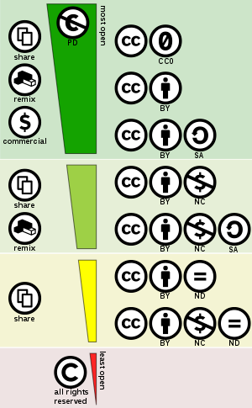
Assignment: Add a License
Use a different license for content, code and data. For example
Writing/docs/images/metadata: CC-BY
Code: MIT License
Data will also have different license based on what you can/can’t share!
@openlifesci, CC-BY 4.0, Image: Shaddim; Original CC license icons licensed under CC BY 4.0, DOI: 10.5281/zenodo.7428708

Slide 43
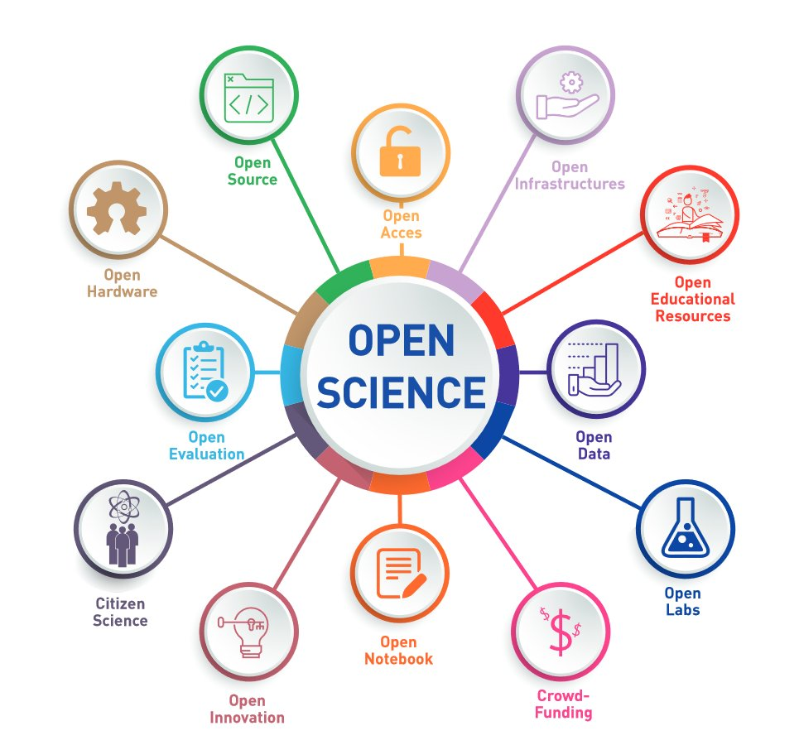
UNESCO regards science as a human right -- the greatest collective endeavour -- that has significant value as a common good.
Openness of
diversity of
knowledge
-Toward a UNESCO Recommendation on Open Science: Canadian Commission for UNESCO By Ella Chan, Dick Bourgeois-Doyle, Michael Donaldson, and Eleanor Haine-BennettOttawa, Canada, April 2020, UNESCO presentation of 17 Feb 2021
Notes:
open science is an umbrella term used to talk about multiple concepts and streams of practices (like software, data, publications, education and processes).
Open science communities are developed around one or combinations of these streams where each community builds and cares for resources that are meaningful for them based on their contexts.
This illustration is taken from the Recommendation on Open Science by the Canadian Commission for UNESCO.
UNESCO regards science as a human right-- “the greatest collective endeavour”--and an enterprise that has significant value as “a common good”.

Slide 44
UNESCO regards science as a human right -- the greatest collective endeavour -- that has significant value as a common good.
… aims to turn right to Open Science into duty to be exercised by researchers, institutions, educators, publishers, employers, libraries, and policymakers, facilitated by Member States.
Openness of
diversity of
knowledge
-Toward a UNESCO Recommendation on Open Science: Canadian Commission for UNESCO By Ella Chan, Dick Bourgeois-Doyle, Michael Donaldson, and Eleanor Haine-BennettOttawa, Canada, April 2020, UNESCO presentation of 17 Feb 2021
Notes:
In the 2017 recommendation, UNESCO aims to turn the right to Open Science into a duty to be exercised by researchers, institutions, educators, publishers, employers, libraries, and policymakers, facilitated by Member States.
Participants in science includes everyone including government and public, as they are the beneficiaries.

Slide 45

Open Science
Open Research
Open Scholarship
We often use these terms interchangeably - all mean the same open practices and considerations for you!
Book: https://the-turing-way.netlify.app/welcome, @turingway, CC-BY 4.0, DOI: 10.5281/zenodo.7428708
Notes:
So one thing I found a bit confusing when I started learning about Open Science was that there are many umbrella terms such as Open science, open research, and open scholarship. They are all essentially defining the same thing - an approach to more open ways of working in research. And today I am going to use these words interchangeably to mean the whole approach of open working.

Slide 46
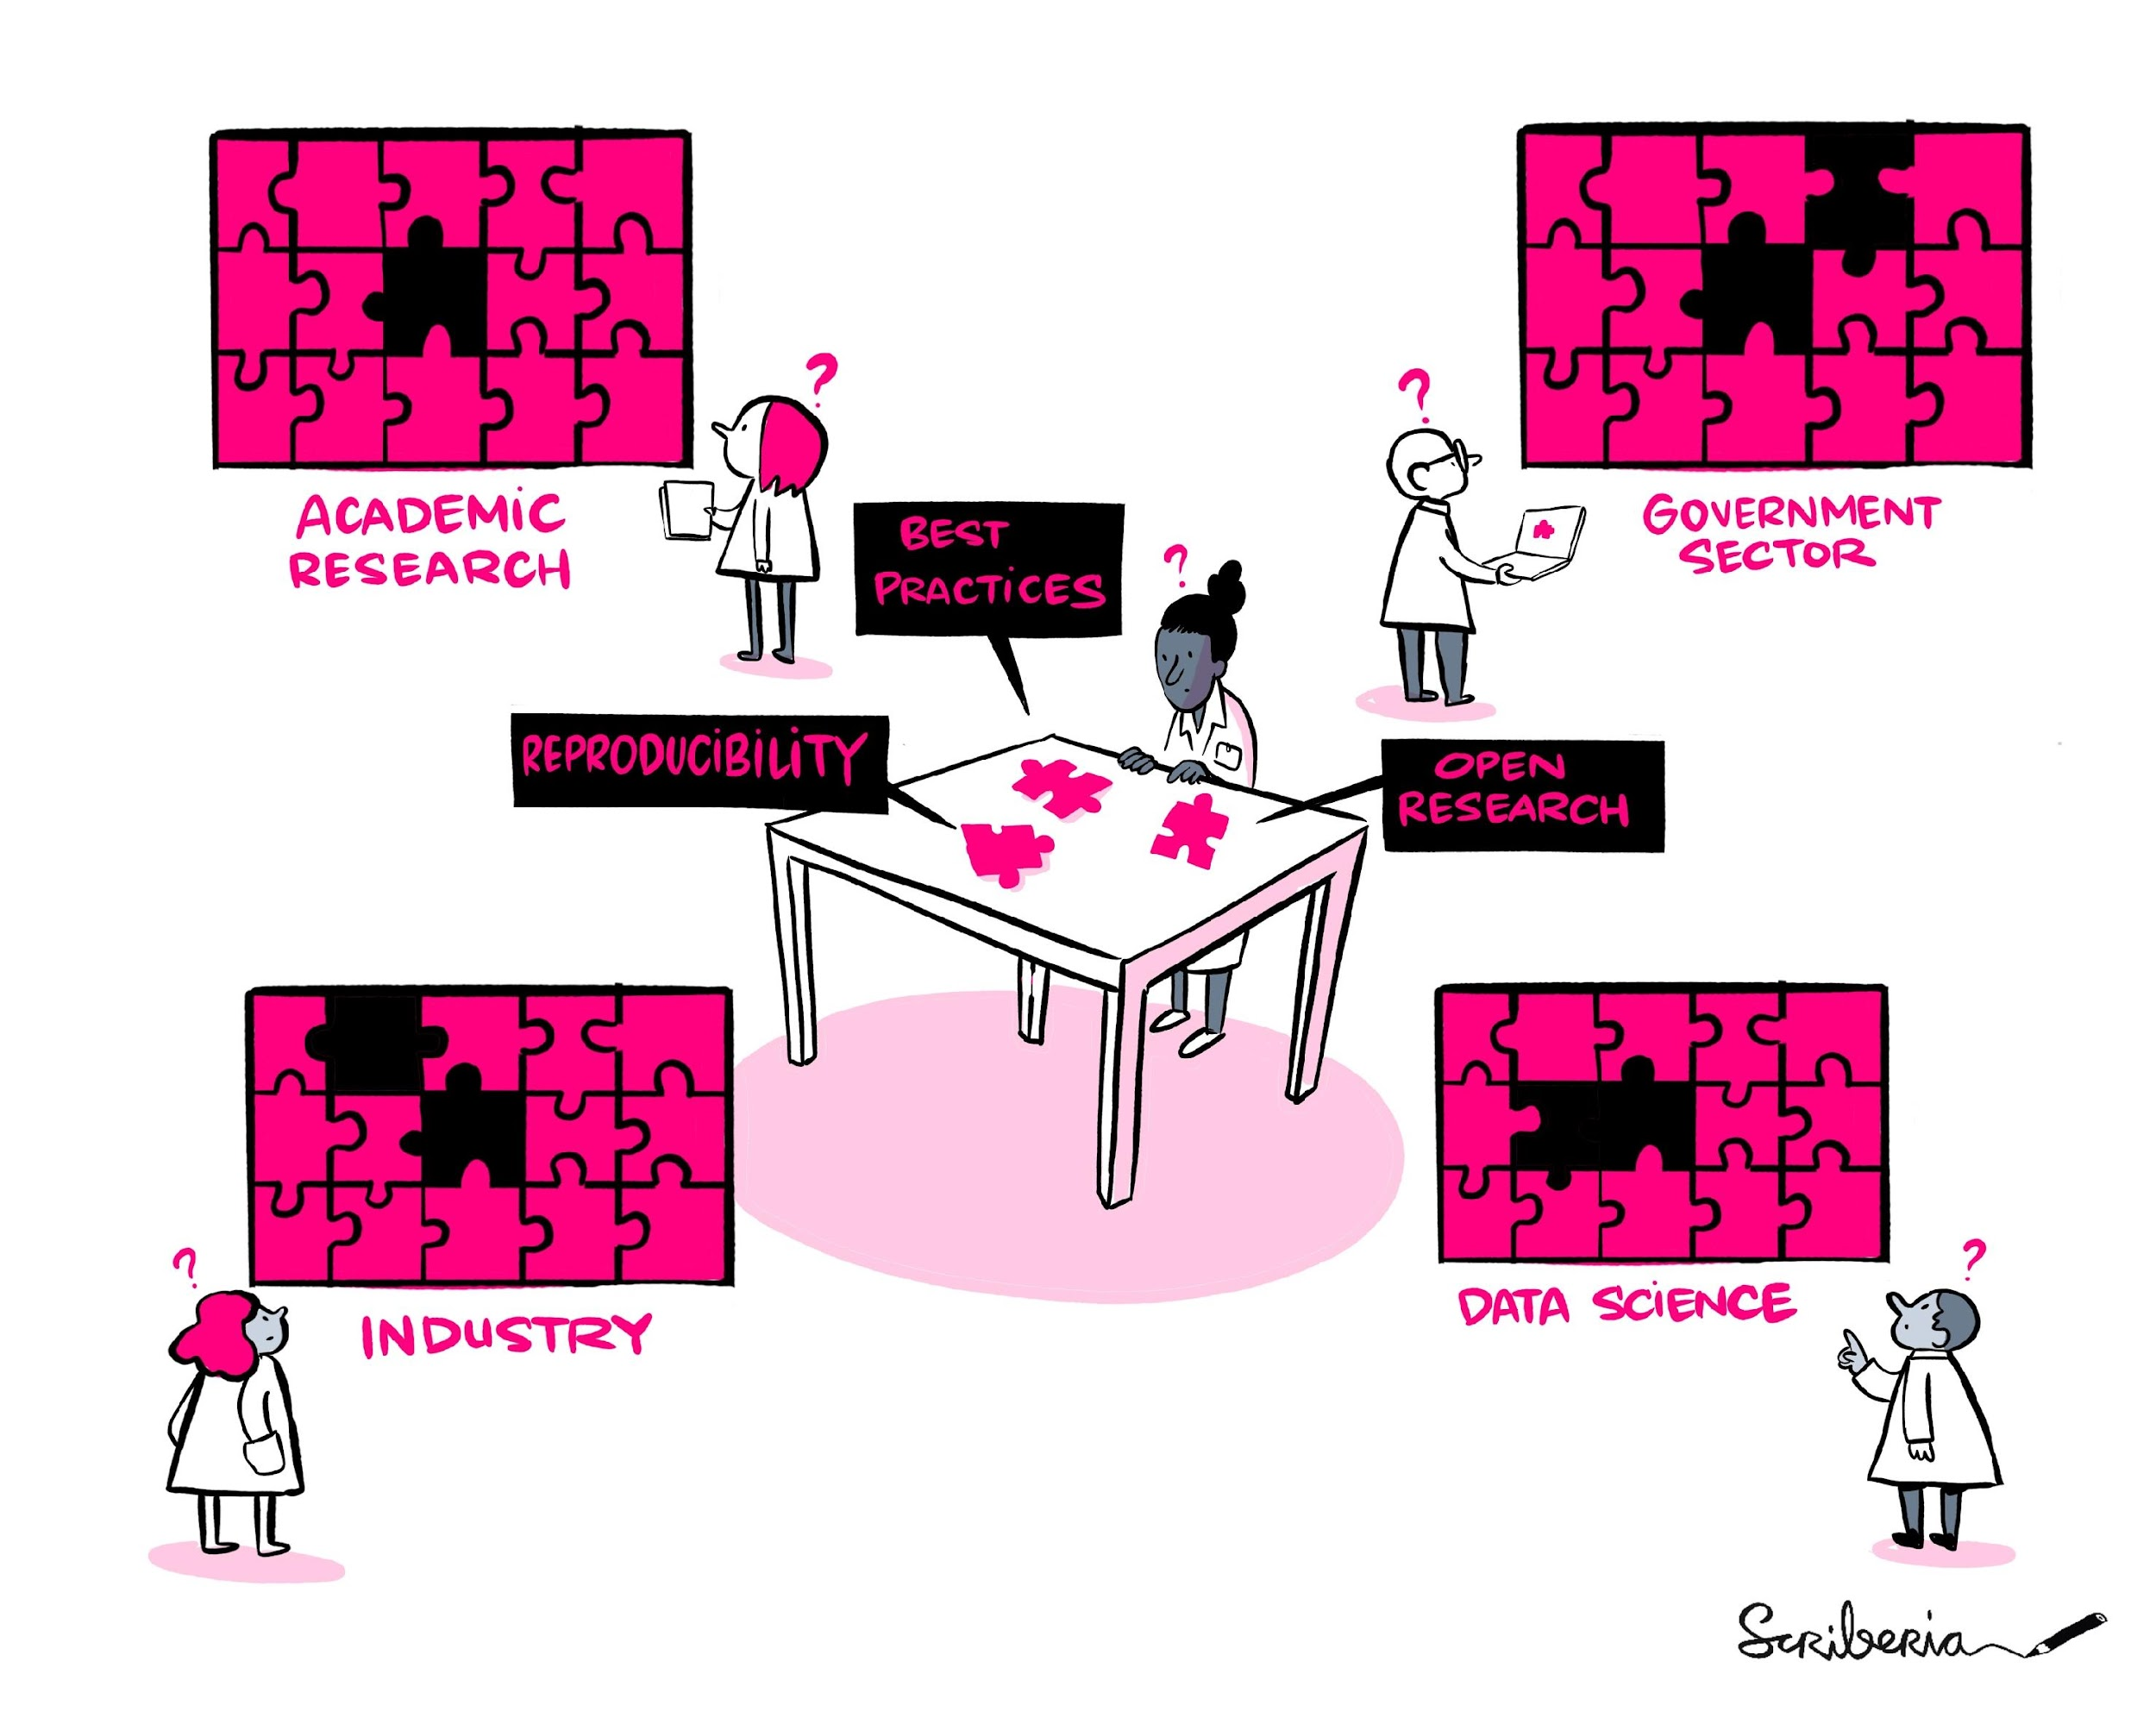
Integrating open science
Open Science means different things in different contexts, and hence, there is no fixed “best practice”.
Many barriers to openness.
@malvikasharan, Image by Scriberia for The Turing Way, Shared under CC-BY 4.0, DOI: 10.5281/zenodo.6587260
Ten arguments against Open Science that you can win. (2022, May 26). https://www.software.ac.uk/blog/2020-12-17-ten-arguments-against-open-science-you-can-win
Notes:
Ideally everyone would know how to apply open science practices – but as we saw, Open science means many things and best practices for different contexts look very different. Although we can draw from our lived experiences at grassroots level - top-down recommendations, guidelines and support should be provided to integrate open science practices across academia, industry and government sectors. Furthermore, unfortunately skills for open science are widely or effectively taught. Researchers often struggle to share data, code and methods openly, important to allow others to investigate each component and combine them to reproduce the original research. Practices for open and reproducible research is a shared responsibility, everyone should know how they can apply them in their work at different stages of research.

Slide 47
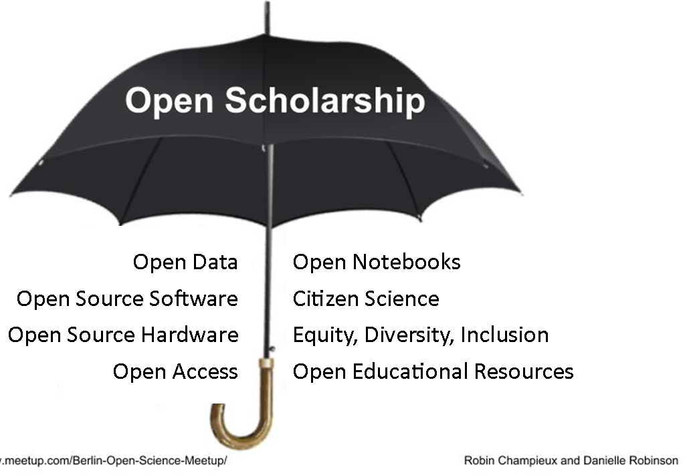
What are some barriers we should work to remove?
Transparency →
Reproducibility →
Research Quality →
Sustainability
+
/ methods
Collaboration →
Inclusive Research →
Equity and Diversity →
Global Accessibility
/ participatory
@turingway, CC-BY 4.0, The Turing Way, DOI: 10.5281/zenodo.7428708
Notes:
Open Research is made up of lots of different practices that you can see here under the umbrella.
Thinking about and implementing all of these different practices can be overwhelming and you do not have to start doing them all at once. Some might not relate to the work you do and some take quite a bit of training to achieve. So I’m going to give an overview of all these practices so you can see what might be something you could start to do.
I’m going to explain these different practices in a bit and give you some examples of them.
When we think about the outcomes of all of these practices, they can be grouped into two areas, so really the outcomes of doing open science are:
Firstly - sustainability so the transparency of opening up research leads to the ability to reproduce research and this then increases the overall quality of research leading to more sustainable research. So more researchers can reuse the methods you publish, open data can be further explored etc.
And secondly, the openness and consideration for inclusive practice leads to an overall increase of equity, diversity and inclusion in research for researchers, the wider scientific community and the general public.
And these outcomes are related to the motivations that researchers have for adopting open research.

Slide 48
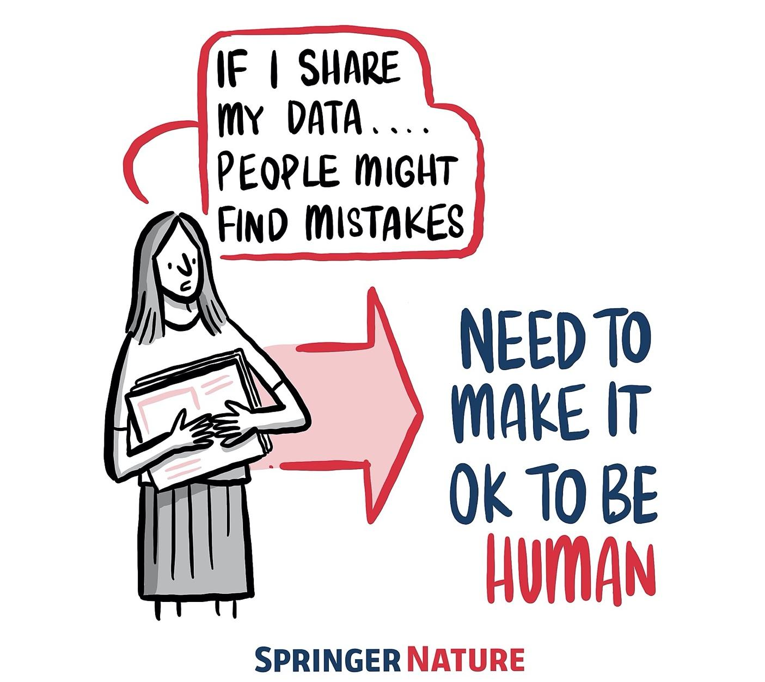
Applying best practices in our research requires intention, resources, time and collaboration, which can be overwhelming.
Blog post: https://www.software.ac.uk/blog/2020-12-17-ten-arguments-against-open-science-you-can-win,
DOI: 10.5281/zenodo.7428708
Notes:
TIMING: 4

Slide 49
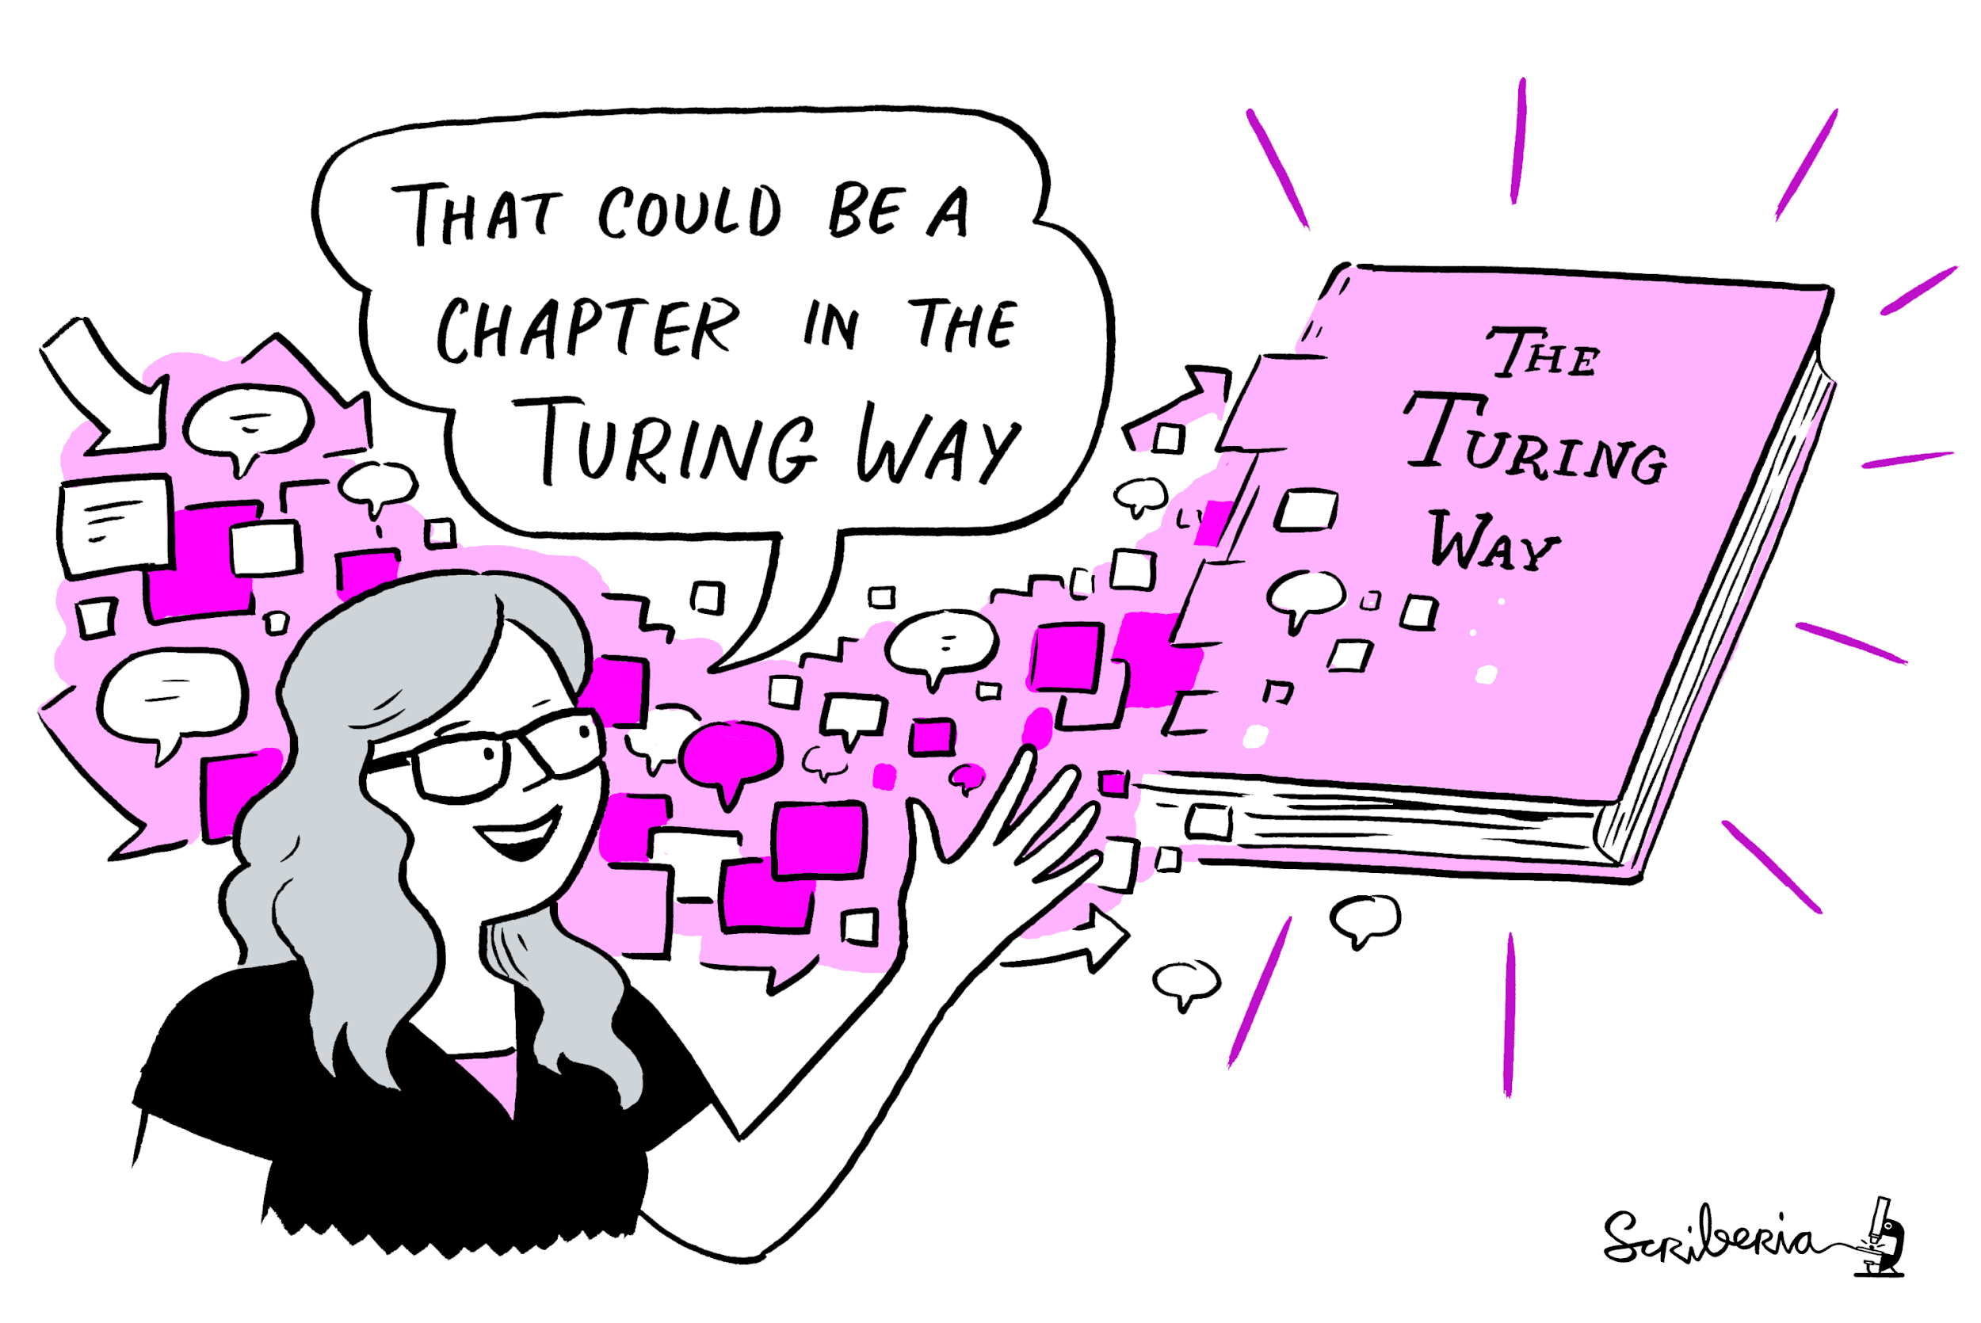
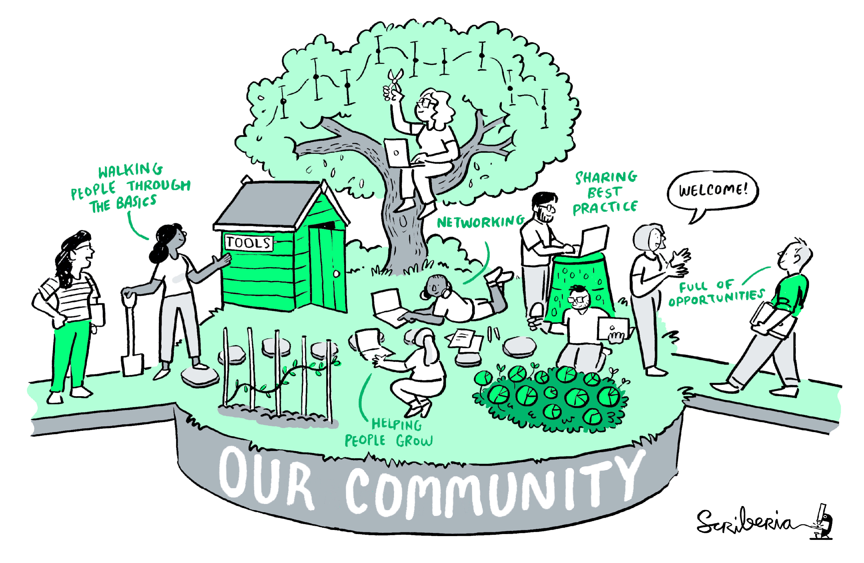
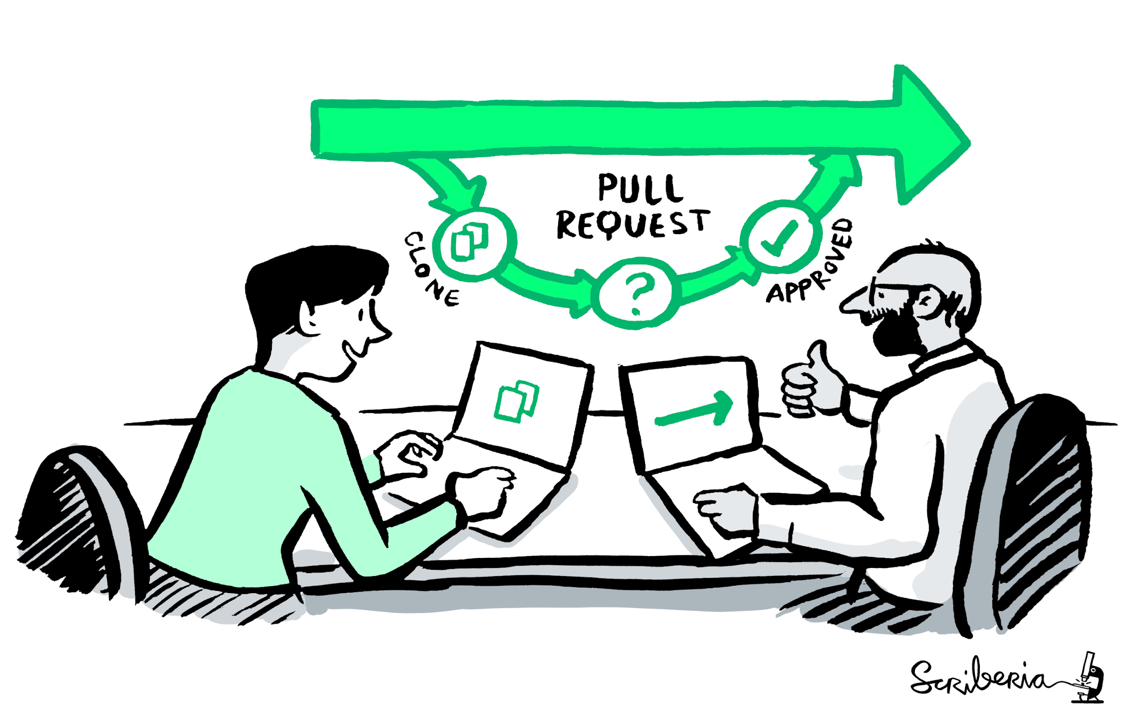


A Book
A Community
Book:
the- turing-way.netlify.app/
GitHub:
github.com/alan-turing-
institute/the- turing-way
Twitter:
twitter.com/turingway
Email:
theturingway@gmail.com
CC-BY 4.0, The Turing Way
An Open Source Project
A Culture of Collaboration
Notes:
The Turing Way is a Book.
A community where people come together to collaboratively write chapters, build and maintain resources, share their skills and ideas around best practices in data science and research.
We apply open source principles in the development and maintenance of this project.
And finally, it's built on the culture of collaboration, which is the process and the backbone of our project.
As a community-developed resource, The Turing Way is always a work in progress.

Slide 50


A book: “Work in Progress”
Book: https://the-turing-way.netlify.app/welcome, @malvikasharan @turingway, Slides: 10.5281/zenodo.7428708
Notes:
In addition to the guide for reproducible research: project design, communication, collaboration and ethical research.
We also record all the community practices that we are developing and practising within the Turing Way in our community handbook.

Slide 51


@malvikasharan @turingway, CC-BY 4.0, CC-BY image by The Turing Way and Scriberia, , DOI: 10.5281/zenodo.7428708
Notes:
And finally the guide for project design. Before you dive into the community aspects, please note that: The Turing Way is not a book that you read from cover to cover – you simply should not. We advise everyone to start with the tool, concept and method that they need now, in their current work. Same goes for researchers looking to engage in the project through resource development – they can share skills and resources that they are currently using in their projects, a skill they recently learned, a challenge they experienced and learned how to solve, or a case study from their work.

Slide 52


Guide for Communication
@malvikasharan @turingway, CC-BY 4.0, Book: https://the-turing-way.netlify.app/welcome, DOI: 10.5281/zenodo.7428708
Notes:
In the guide to communication we discuss

Slide 53


Guide for Collaboration
@malvikasharan @turingway, CC-BY 4.0, Book: https://the-turing-way.netlify.app/welcome, DOI: 10.5281/zenodo.7428708
Notes:
In the guide to collaboration we discuss

Slide 54


Guide for Ethical Research
@malvikasharan @turingway, CC-BY 4.0, Book: https://the-turing-way.netlify.app/welcome, DOI: 10.5281/zenodo.7428708
Notes:
Guide to Ethical Research includes chapters introducing the main concepts, case study on working with institutional ethics boards, and ethics in preclinical research.
We don't see ethics as a static or one-off part of the research process. Ethical research includes recognising where your data comes from, and the impact of collecting and using it in your work. Therefore, we explore relationship between ethics, law, policy and human right, and discuss activism and internal policy advocacy as well.

Slide 55


Ethical and Collaborative Research
Respect - Protect - Fulfil
Project Design
Data and Methodology
Equity, diversity, accessibility
Consent, privacy and security
Further Societal Consequences
Notes:
Researchers and data scientists should, in general ensure that they:
respect human rights: this means not doing work that itself abuses human rights
protect human rights: this means trying to ensure that their work cannot be used by others to abuse human rights
fulfil human rights: this means doing work that actively helps other people be able to enjoy all their human rights

Slide 56







Project and community growth
>3 years, >260 Live Chapters
Community resources, events, guidance, templates, training
400+ direct GitHub contributors and thousands of users
https://zenodo.org/record/3332807
@malvikasharan @turingway, CC-BY 4.0, https://star-history.t9t.io/#alan-turing-institute/the-turing-way, DOI: 10.5281/zenodo.7428708
Notes:
We have seen our project and community grow in the last three years. We currently host over 250 sub-chapters across five guides.
In order to ensure that our community members are able to participate irrespective of their previous experience of working with the Open Source or data science community, we provide the resources, guidance, templates, training and pathways that they can use to stay involved in the community.
We have over 325 direct contributors on GitHub, where we develop our resources and 1000s of users. For example, our illustrations, which I have intensively used in my talk, have been downloaded nearly 10000 times.
We also maintain social media presence and communicate about the project so that it can reach to as many people as possible and we can bring new voices in. For a community that started at a grassroot level, we are very grateful to have these members working with us.

Slide 57
Qualitative/notable impacts
Resources are being used by learners, educators, community builders, policy makers and researchers globally
Reproducibility of scientific results in the EU 2020 (report)
An Emerging Technology Charter by Mayor of London (policy)
Innovation Scholars: UKRI grant 2020 (funding call)
NASA TOPS, CodeRefinary and Library Carpentries training materials
Recommended in Goldacre Review for modern open working into health data
Cited by 30+ peer-reviewed articles & 100+ online publications
Highly commended by HiddenRef and Royal Society Athena Awards
@turingway, Image by Scriberia and The Turing Way Community, CC-BY 4.0, DOI: 10.5281/zenodo.7428708
Notes:
Our moonshot goal is to make reproducibility too easy not to do. And that can happen when there are system and structure level changes by influencing research at the national and international levels, where inclusive practices and reproducibility are as important as a data and algorithm. We promote our resources for use by learners, educators, policymakers and researchers globally.
Resources are being used by learners, educators, community builders, policy makers and researchers globally
Reproducibility of scientific results in the EU 2020 (report)
An Emerging Technology Charter by Mayor of London (policy)
Innovation Scholars: UKRI grant 2020 (funding call)
CodeRefinary and Library Carpentries training materials
Recommended in Goldacre Review for modern open working into health data
Cited by 30+ peer-reviewed articles & 100+ online publications

Slide 58
Evidence of successful replication or extension
Quality Assurance of Code for Analysis and Research, Office for National Statistics , UK
Turing Data Stories, Turing Commons and The Environmental Data Science book, The Alan Turing Institute
FAIR Cookbook by researchers at University of Oxford, Novartis, FAIRplus Consortia
UCL Institute of Health Informatics Coding Club Handbook, University College London
A Citizen Science Guide for Research Libraries, LIBER Citizen Science Working Group
@turingway, Image by Scriberia and The Turing Way Community, CC-BY 4.0, DOI: 10.5281/zenodo.7428708
Notes:
Due to community engagement and collaboration that happens in open, we have also Evidence of successful replication or extension that include
●Quality Assurance of Code for Analysis and Research, Office for National Statistics , UK
●Turing Data Stories and The Environmental Data Science book, The Alan Turing Institute
●FAIR Cookbook by researchers at University of Oxford, Novartis, FAIRplus Consortia
●UCL Institute of Health Informatics Coding Club Handbook, University College London
●A Citizen Science Guide for Research Libraries, LIBER Citizen Science Working Group

Slide 59













Thanks to our community of contributors & users!
Notes:
None of this work would be possible without our community of collaborators.
We'd like to invite you to become a contributor to the Turing Way, to help us develop chapters of data, transparent reporting, communication and other topics that can help others to stay updated with current practices. We welcome all kinds of contributions.
Case studies, and lived experiences, are welcome too. You don't need to have coding experience to contribute! You just need an idea and a willingness to learn.

Slide 60

Community Support for Open Collaboration
Community Handbook: https://the-turing-way.netlify.app/community-handbook, DOI: 10.5281/zenodo.7428708
Notes:
As the project has massively expanded over the last year, we are currently working to understand and design an open governance model for the Turing Way. The goal is to ensure that community members can democratically contribute to decision making, especially when those decision will have an impact on them,
This project is currently co-led with Anne Lee Steele under the Open Life Science, which is a training and mentoring programme for systematically applying open science principles in our work.

Slide 61
Addressing Common Concerns
Sharing something on openly does NOT automatically make it reusable
Work shared with an open license NOT to be used without attribution
Sharing with a license does NOT give away your rights to publish or sell
Reproducibility for you does NOT mean the reproducibility for others
Open science does NOT mean publishing sensitive and private data
Not sharing data openly does NOT remove your responsibility for reproducibility
@openlifesci, CC-BY 4.0, The Turing Way, DOI: 10.5281/zenodo.7428708
Notes:
Not attributing to authors violates academic ethics.

Slide 62
Reproducibility
Open Science
Is my code/data correct?
Can others read and test it?
Is my workflow robust?
Have I provided guidance?
Is my work citable?
Is my code/data freely available?
Can others modify and share it?
Is my workflow reusable?
Have I provided permission?
Is my work open for collaboration?
Reproducibility should ensure higher scientific standards allowing others to test and reuse your work ...
… and Open Science should allow anyone to reuse, report errors, fix issues, build on and collaborate
CC-BY 4.0, The Turing Way, DOI: 10.5281/zenodo.7428708

Slide 63

So many things to consider: Where can I start?
FAIR principles
Findable,
Accessible
Interoperable
Reusable
CC-BY 4.0, CC-BY image by The Turing Way and Scriberia, DOI: 10.5281/zenodo.7428708
Notes:
The FAIR principles are considered the gold standard for data management and stewardship, and are being implemented across many different disciplines.
FAIR stands for: Findable, Accessible, Interoperable,Reusable
There is currently a large focus and drive towards using FAIR particularly within European funded research.

Slide 64

FAIR principles from Wilkinson et al. (2016)
DOI: 10.1038/sdata.2016.18
Notes:
The FAIR principles was developed for data management but it is now used for many different purposes such as sharing software, educational materials, workflows and even physical samples.
It is a simple set of principles but it’s implementation can take time and must be considered separately by each discipline, as it can’t be applied in exactly the same way in every discipline so that is why this talk is called first steps down a long and winding road.
So Implementing FAIR is a journey that each domain has to go down for greater reproducibility and sustainability of research.

Slide 65



FAIR data analogy: You would not buy food with no labels!
Annotation makes it easier to find important things
FAIR doesn’t require data to be open, but needs Metadata information along with detailed research process.
Metadata: “data descriptors” that facilitate cataloguing data and data discovery
Adapted from talk by Philippe Rocca-Serra (2020)
Notes:
To give you an analogy to explain the FAIR principles, I’m going to use food cans to represent data.
You would not be happy if you went to the supermarket and it was filled with cans that had no labels.
Food cans are packaged in many different ways and contain important information on the outside about their contents.
The annotations on the labels are important if to help us find the products we want, to improve the accessibility of the products (so to have it on the right shelf in the right aisle), to have information that the contents meets certain food standards.
The labels also often contain information about how to combine that product with others to cook our favourite recipes (interoperable) and storage information to be able to use or reuse it.
So that is the idea with the Fair principles – your data needs to be somewhere others can find it easily so we need to tell other researchers where it is or how to get hold of it, it needs to be accessible, or at least the metadata does, so ideally shared openly in an open repository, it needs to be easily combined with other datasets so there must be agreed standards such as methods and nomenclature, and it needs to be in a format that can be reused – so ideally raw data with well described metadata and in a file type that can be used by others such as csv files.

Slide 66
Open and reproducibility enable ethical research
Reproducibility can be facilitated by open, but open is a choice
Best practices should be considered at all stages for ethical integrity
As open as possible, as closed as necessary
  Open principles should be applied when you can
  NEVER for private, confidential or sensitive data (ethically)
Start with FAIR (Findable, Accessible, Interoperable, Reusable)
@malvikasharan, @turingway, CC-BY 4.0, The Turing Way, DOI: 10.5281/zenodo.7428708

Slide 67

Meeting you where you are!
Join the community
Learn a new skill
Share your skills
Collaborate with others
Mentor others’ contributions
Represent this community
We value your participation!
CC-BY image by The Turing Way & Scriberia, @malvikasharan @turingway, DOI: 10.5281/zenodo.7428708
Notes:
With that overview of open science and the Turing way, I'd like to invite you to become a contributor to the Turing Way, You don't need to have coding experience to contribute! You just need an idea and a willingness to learn.
So, if you are new to the community, you can join us. You can learn a new skill or share your skills. You can collaborate with others and receive mentoring or mentor others’ contributions. You can also represent this community. We welcome all kinds of contributions.

Slide 68

The Turing Way Events
- Collaboration Cafes
    1st & 3rd Wednesdays (14:00 UTC)
- Coworking Calls
    Mondays (10:00 UTC)
- Fireside Chats
    Monthly on Friday
- More ways to connect
    bit.ly/turingway
CC-BY image by The Turing Way & Scriberia, @turingway, @malvikasharan, CC-BY 4.0, DOI: 10.5281/zenodo.7428708
Notes:
We have multiple community events and calls weekly and you are invited to join us.
I host collaboration cafes every month, and coworking call each week. There is also an onboarding call for folks new to the project.
You can find details in the shared notes - bit.ly/turingway.

Slide 69

Attend a Book Dash
Virtual week-long Hackathon like event to work with others on The Turing Way: 14 - 18 November 2022
Attend the community share out tomorrow at 11:00 and 17:00 UTC
    bit.ly/turingway
CC-BY image by The Turing Way & Scriberia, @turingway, @malvikasharan, CC-BY 4.0, DOI: 10.5281/zenodo.7428708
Notes:
We have multiple community events and calls weekly and you are invited to join us.
I host collaboration cafes every month, and coworking call each week. There is also an onboarding call for folks new to the project.
You can find details in the shared notes - bit.ly/turingway.

Slide 70

Reflection Exercise
What are the some technical or ethical concerns you have about your work?
Who are impacted by your work?
What resources or expertise you need but don’t have access to?
What resources and expertise other need to use your work?
What tools and practices you have yet to learn about?
@turingway, CC-BY 4.0,
The Turing Way, DOI: 10.5281/zenodo.7428708

Slide 71


Acknowledgements & Links
The Turing Way community members
Book: the-turing-way.netlify.com
Twitter: twitter.com/turingway
Mastodon: fosstodon.org/@turingway
GitHub: github.com/alan-turing-institute/the-turing-way
Useful links & opportunities are listed here: https://bit.ly/turingway
Illustrations by Scriberia for The Turing Way community: https://zenodo.org/record/3332807

