Slide 1
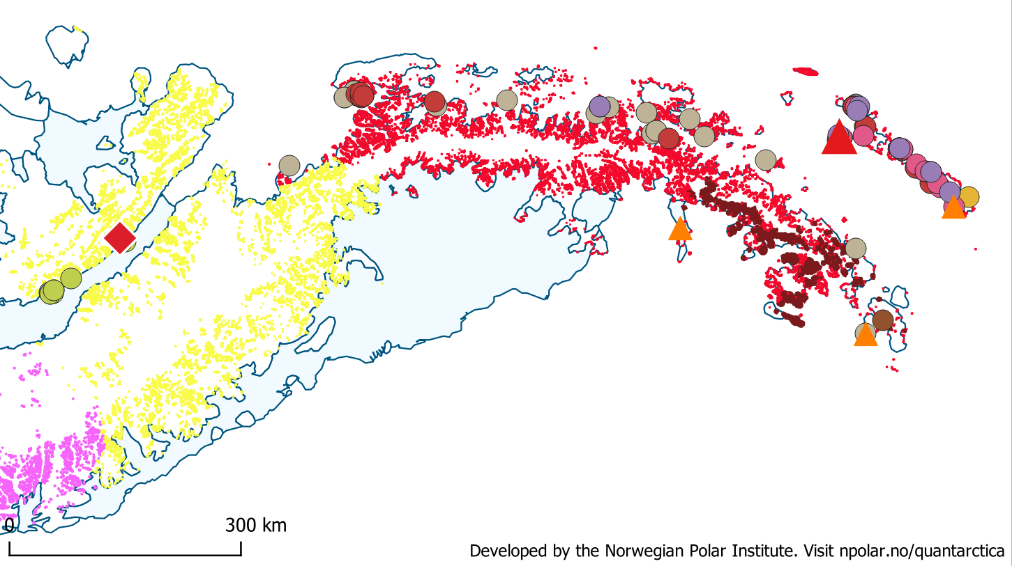
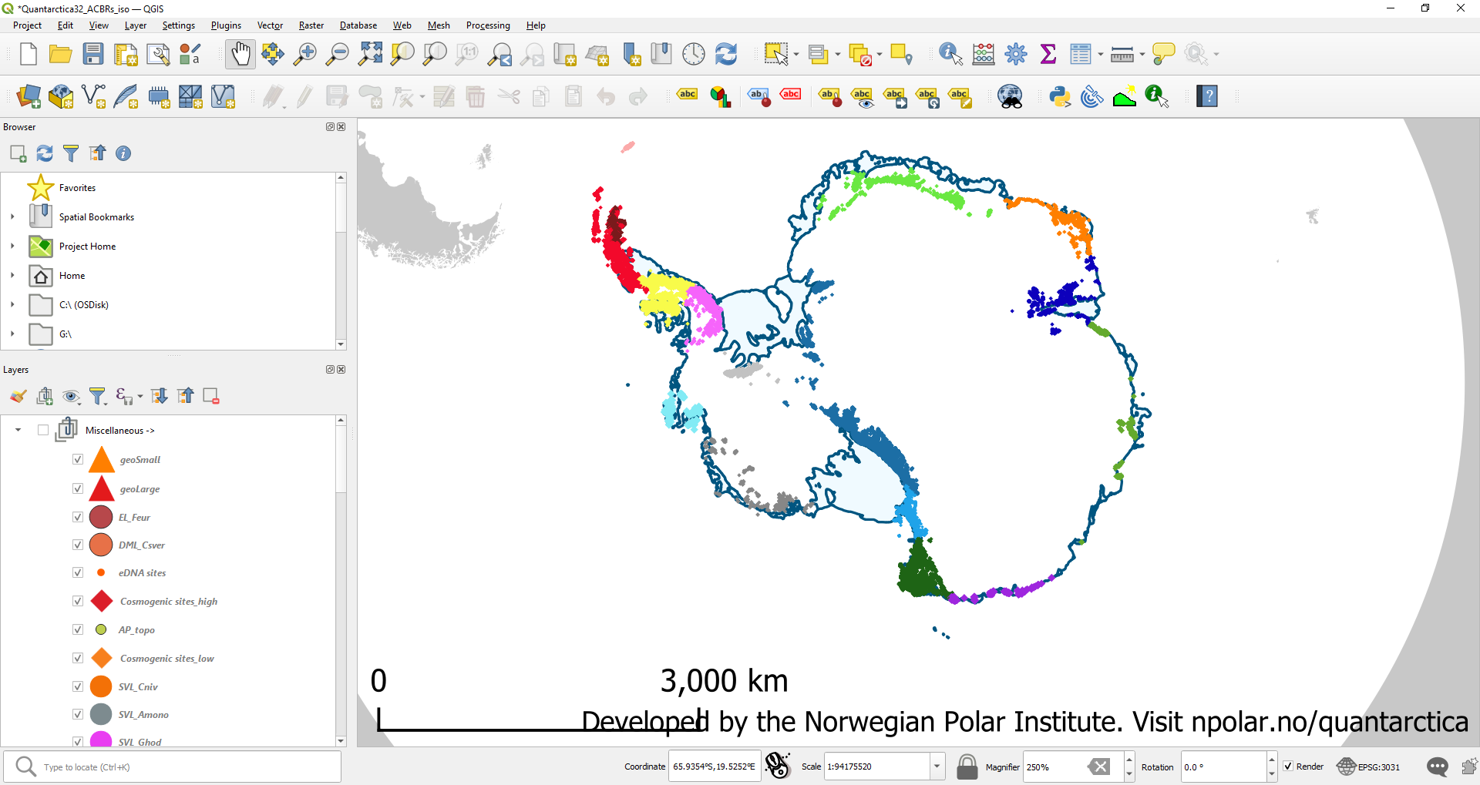
3. North-West Antarctic
Peninsula
Deception Island
Ablation Point Massif
Seal Nunataks
Penguin Island
4. Central South
Antarctic Peninsula
Antarctic Peninsula
Paulet Island
Figure S1. All terrain ice-free shown as colour-shaded regions for the two Antarctic Conservation Biodiversity Regions (ACBRs) that contain springtail species on the Antarctic Peninsula that match those used in figures 1 and 2. Distribution of springtail species shown as coloured dots, and geochronological sites as a red diamond, to match those used in figure 2. The geothermal areas are highlighted as small (orange) and large (red) sites as used in figure 1. ACBR region 3, North-West Antarctic Peninsula in red, shows sites where springtails are associated to geothermal areas; all species in this region are also found on offshore Islands. ACBR region 4, Central South Antarctic Peninsula in yellow, shows the sites for the only springtail species (green dots) only found at these sites on Alexander Island, which coincide with the cosmogenic dated site at Ablation Point Massif, which may have remained ice-free at the LGM.

Slide 2
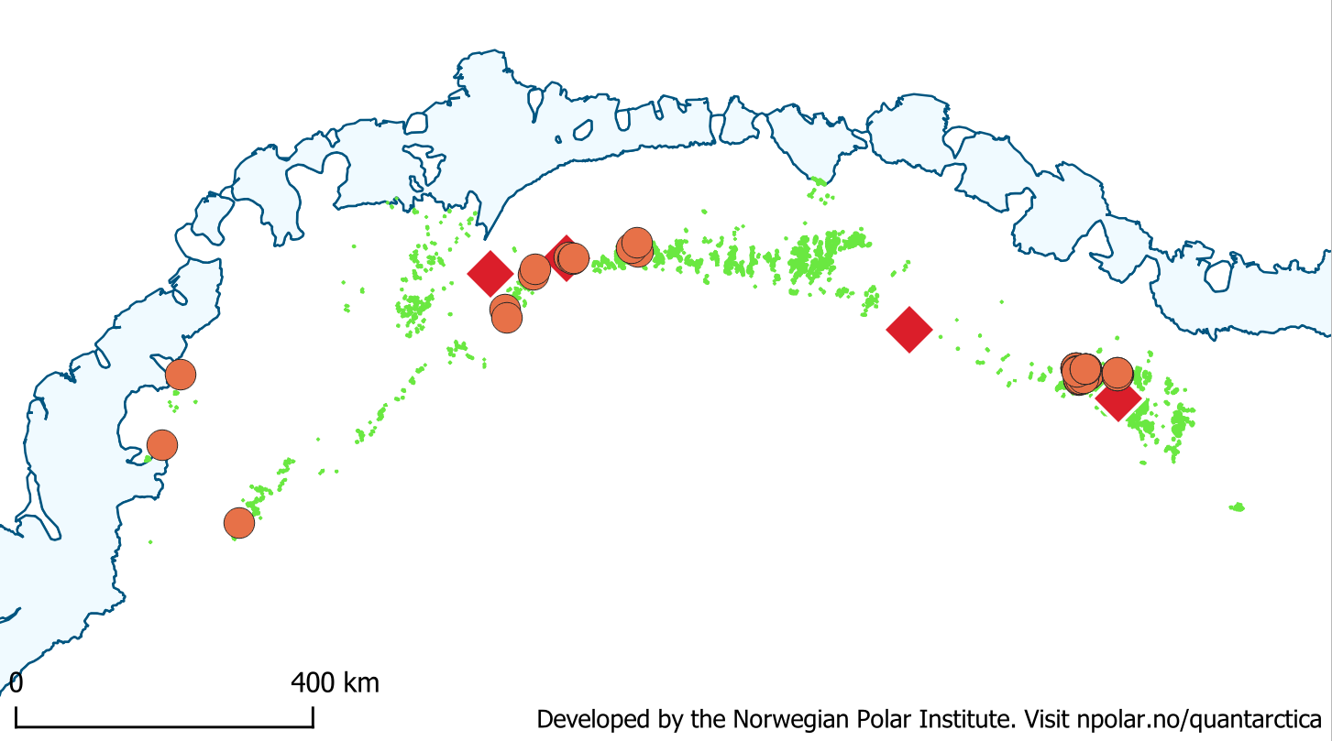
Steingarden Nunataks
Sverdrup Mountains
Grjotfjellet
Sør Rondane Mountains
6. Dronning
Maud Land
Figure S2. All terrain ice-free shown as colour-shaded region for the Antarctic Conservation Biodiversity Region (ACBRs) Dronning Maud Land and used in figures 1 and 2. The springtail species is endemic to this region where springtails do not overlap with any geothermal area. Distribution of springtail occurrence records shown as orange coloured dots, and geochronological sites as red diamonds, revealing that records are within 100 km of likely LGM refuges indicated by cosmogenic dating.

Slide 3
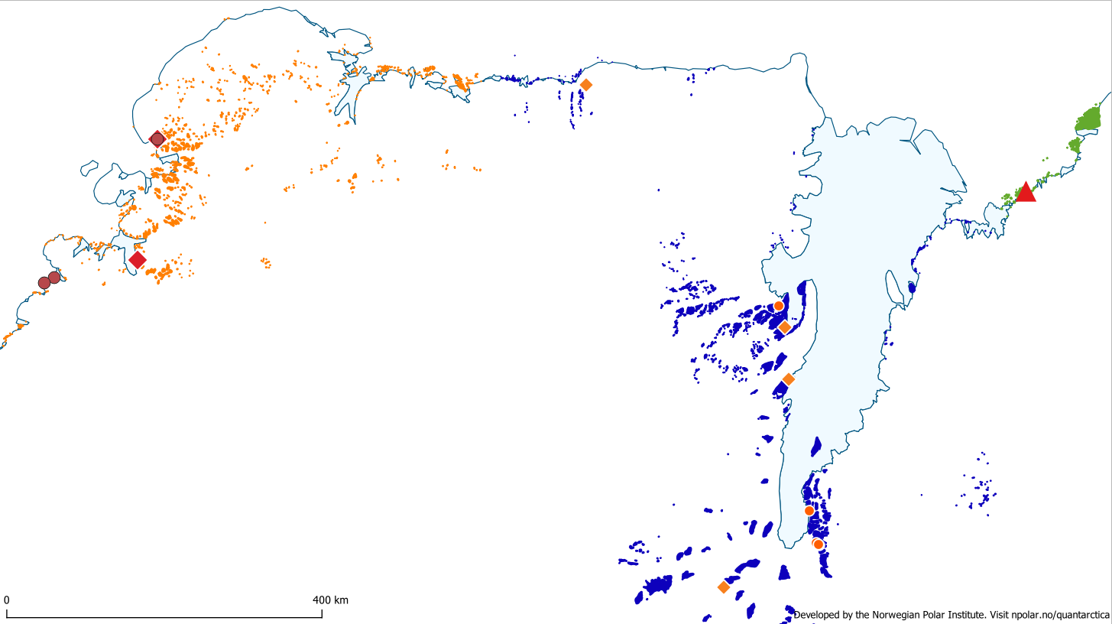
5. Enderby
Land
7. East Antarctica
Mt Henderson, Framnes Mountains
Mt Riiser-Larsen
Broknes Peninsula
McLeod Massif
Condon Hills
Fisher Massif
Mt Ruker
16. Prince Charles Mountains
Figure S3. All terrain ice-free shown as colour-shaded regions for three Antarctic Conservation Biodiversity Regions (ACBRs). Across all three ACBRs, Enderby Land contains the only records of any springtails (brown dots) that also coincide within 100 km of geochronological sites (red diamonds) revealing likely LGM refuges. Prince Charles Mountains ACBR contains geochronological sites (orange diamonds) revealing likely LGM refuges, but where only springtail eDNA signatures have been identified at five sites (orange dots) (see main text). No springtails overlap with the geothermal area (Broknes Peninsula, red triangle) in the East Antarctica ACBR.

Slide 4
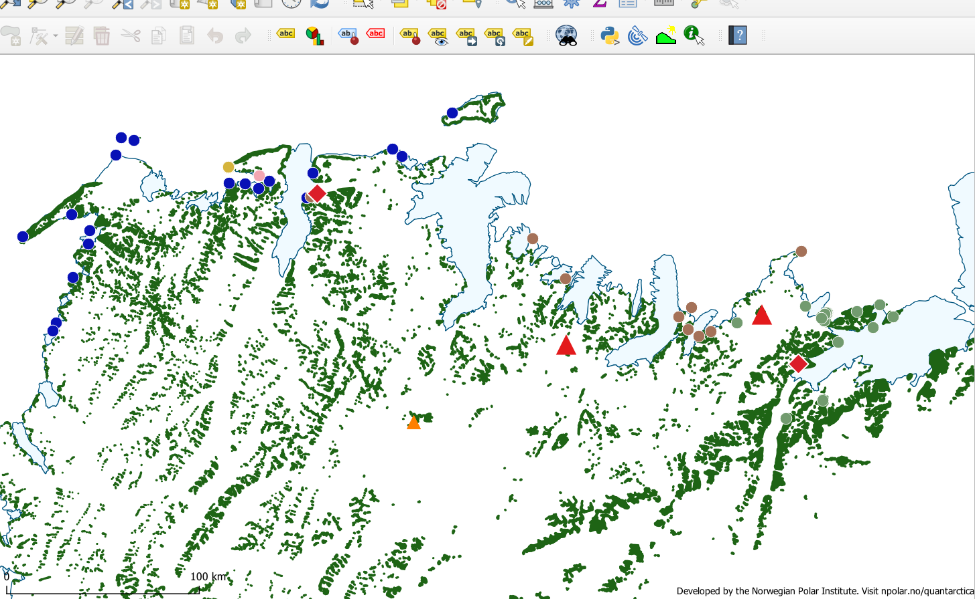
8. North Victoria
Land
Walsh Spur
Mt Melbourne
Mt Rittman
Black Ridge
The Pleiades
Figure S4. All terrain ice-free shown as colour-shaded regions for the North Victoria Land Antarctic Conservation Biodiversity Region (ACBR). Across this region five springtail species are known (coloured dots) where all species are within 100 km of geochronological sites (red diamonds) revealing likely LGM refuges in coastal regions. No springtails overlap directly with the geothermal areas shown (red and orange triangles), but are within 100 km of two springtail species (green and brown dots).

Slide 5
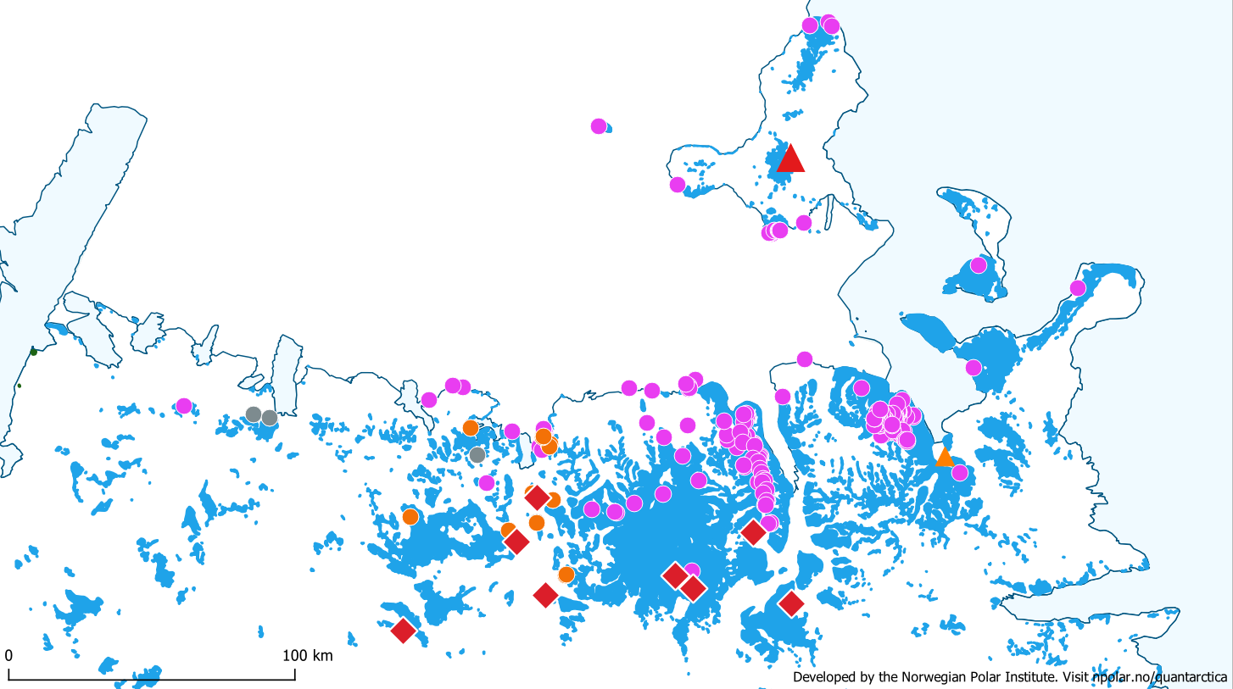
9. South Victoria
Land
Mt Erebus
Royal Society Range
Mt Suess
Mt Gran
Stocking Glacier
Robison
Nunatak
Allan Hills
Arena Valley
Beacon Valley
Olympus Range
Labyrinth
Mackay Glacier region
Figure S5. All terrain ice-free shown as colour-shaded regions for the South Victoria Land Antarctic Conservation Biodiversity Region (ACBR). Across this region three springtail species are known (coloured dots) where all species are within 100 km of geochronological sites (red diamonds) revealing likely LGM refuges in coastal regions. No springtails overlap directly with the two geothermal areas shown (red and orange triangles), but are within 100 km of one springtail species (pink dots). The geochronological sites (red diamonds) at Mt Gran and Mt Suess contain the entire species diversity for South Victoria Land, and all three species know from the region are found at the Mt Suess (Gondola Ridge) site.

Slide 6
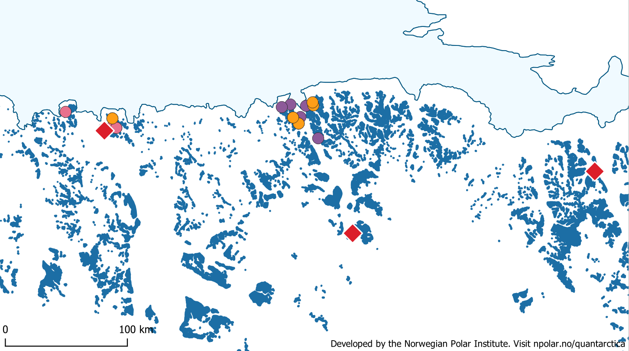
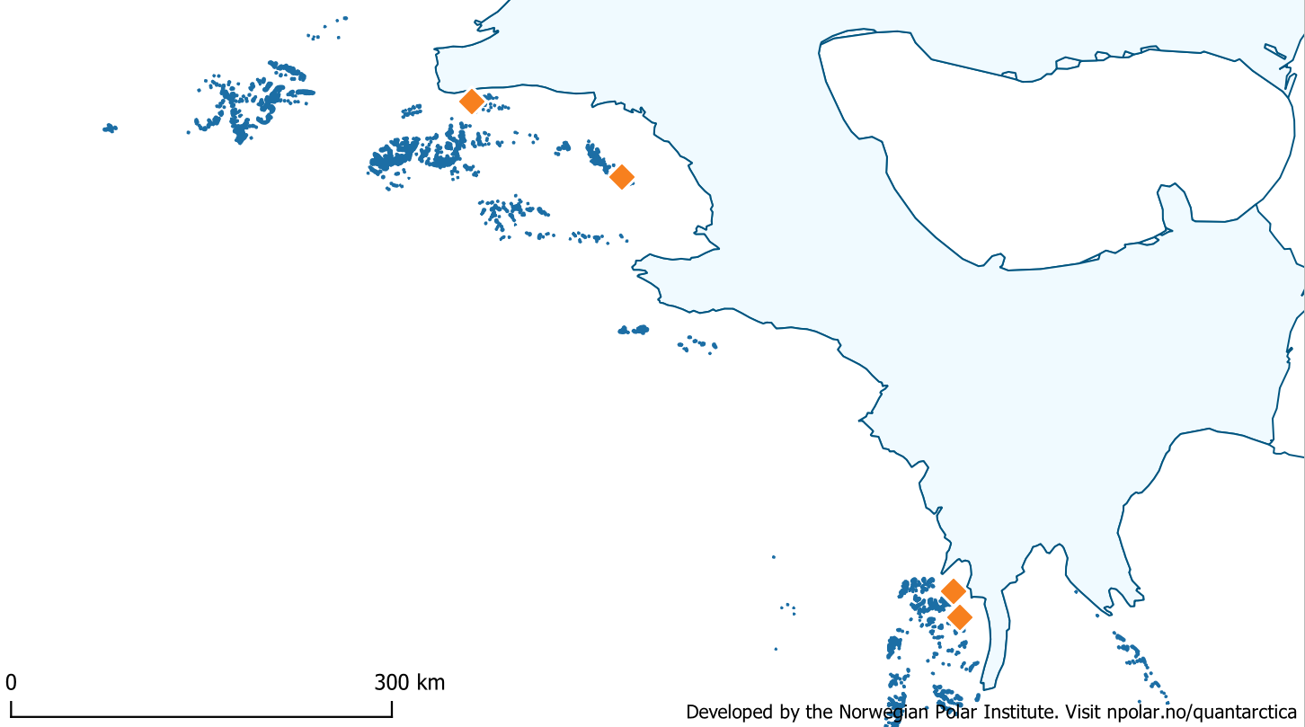
10. Transantarctic Mountains
10. Transantarctic
Mountains
Taylor Ridge
Mt Kyffin
East
West
Roberts Massif
Figure S6. All terrain ice-free shown as colour-shaded regions for the Transantarctic Mountains Conservation Biodiversity Region (ACBR). Across this region three springtail species are known (coloured dots) from the east Transantarctic Mountains where all three species are within 100 km of geochronological sites (red diamonds) revealing likely LGM refuges in coastal regions. No springtails are found in the west Transantarctic Mountains but geochronological sites (orange diamonds) do reveal likely LGM refuges in these coastal regions.
Schmidt Hills
Dufek Massif
Mt Provender
Mt Skidmore

Slide 7
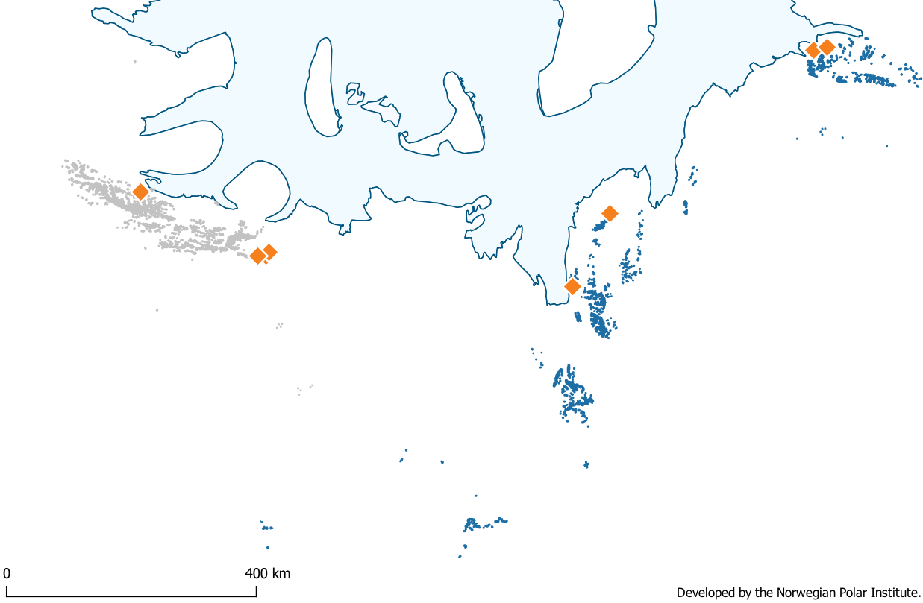
11. Ellsworth Mountains
10. ‘West’ Transantarctic Mountains
Flowers Hills
Patriot Hills
Marble Hills
Independence Hills
Figure S7. All terrain ice-free shown as colour-shaded regions for the Ellsworth Mountains Conservation Biodiversity Region (ACBR). As we observe for the west Transantarctic Mountains (see also figure S6) there are no records of springtails in the Ellsworth Mountains but geochronological sites (orange diamonds) do reveal likely LGM refuges in these coastal regions.

