Slide 1


BEYOND OPEN ACCESS
Supporting diverse, equitable, and sustainable scholarly publishing with open values and infrastructure

Slide 2
Forum for Open Research in MENA
October 27, 2022
Amanda Stevens
Associate Director of Publishing Services
Public Knowledge Project (PKP) https://pkp.sfu.ca/ astevens@publicknowledgeproject.org
Notes:
Who is in the audience?
Librarians
University administrators
Researchers or faculty members at universities
Journal Editors
Publishers
Service providers
Government, policy makers
Who did I miss?

Slide 3
In the beginning…
Research was published by learned societies and university presses and distributed freely to institutions and other researchers with no expectation to make money.
In the 1950s commercial publishers began buying and setting up journals and then selling subscriptions to journals to institutions and libraries. ¹
Notes:
¹ Fyfe A, Coate K, Curry S, Lawson S, Moxham N, Røstvik CM. 2017. Untangling Academic Publishing: A history of the relationship between commercial interests, academic prestige and the circulation of research. Zenodo. https://doi.org/10.5281/zenodo.546100
This was part of broader changes to universities, the role of researchers and professors, and assessment practices.

Slide 4
In the 1990s
The open access (OA) movement began with the birth of the internet and as journal subscription fees increased to levels libraries could no longer afford.
The argument was, institutions and researchers produce the research and articles for free, why must they pay such high fees to access it?

Slide 5
In the early 2000s
The first OA journals were established
OA declarations were made and signed by thousands, including the Budapest Open Access Initiative (BOAI) and the Berlin Declaration on Open Access
Open Journal Systems (OJS) was released to support open access publishing - a free and open source software application for managing the peer review workflow and publishing scholarly journals online.

Slide 6
Now open access is a common practice
Almost 30% of research is published OA.²
Many journals have transitioned to OA
There are many new OA journals
Many funders, governments, and institutions require OA research outputs
Most large commercial publishers have OA publishing programs
Notes:
² Piwowar H, Priem J, Larivière V, Alperin JP, Matthias L, Norlander B, Farley A, West J, Haustein S. 2018. The state of OA: A large-scale analysis of the prevalence and impact of Open Access articles. PeerJ, 6(e4375). https://doi.org/10.7717/peerj.4375

Slide 7
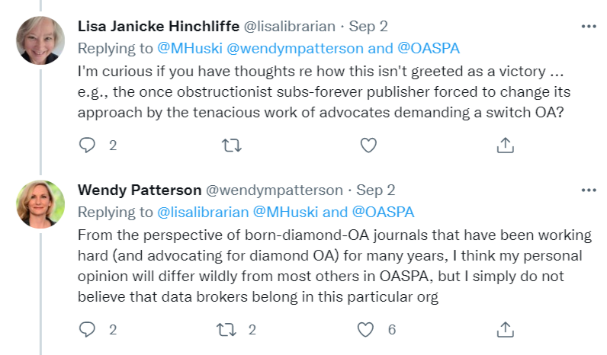
Elsevier joined the Open Access Scholarly Publishers Association (OASPA)
SUBHEADER
noximil certemus veremor temus;
Notes:
In September, the Open Access Scholarly Publishing Association (OASPA) announced that publishing giant Elsevier had been accepted as a new member.
OASPA includes many commercial publisher members, but not a company as large as Elsevier or as synonymous with evil profit-mongering (whether that’s a fair claim or not).
This incited discussion in the OA community
They also questioned whether OASPA’s privacy and data use policies violate OASPA’s Code of Conduct. - include an explanation of how data is used and saved, and be fully available and accessible at all times on the journal or publisher website" - specifically that they are not forthcoming with how data is used and saved.

Slide 8
What has changed?
Article processing charges (APCs) are a new source of revenue for publishers
Libraries make transformative agreements instead of pay-to-read agreements with publishers to fund APCs and move journals to OA
70% of revenue comes from public sources ³
Institutions and researchers are still buying back the research they produced
Commercial publishers still dominate, with profits of 30% (standard profit margin is 10-20%) ³
Notes:
³ Buranyi, S. 2017. Is the staggeringly profitable business of scientific publishing bad for Science? The Guardian 27 June 2017. https://www.theguardian.com/science/2017/jun/27/profitable-business-scientific-publishing-bad-for-science
At this point we need to ask, what has changed, 20-25 years later? Have we reached our goals? Have our goals changed?
Article processing charges (APCs) have replace subscription fees as a source of revenue for publishers. Some journals that publish OA and no longer charge subscription fees now charge APCs to authors to fund publishing costs.
And instead of making subscription or pay-to-read agreements with libraries/institutions, publishers make transformative agreements that allow libraries to pay APCs on behalf of authors.
This leaves us with libraries/institutions still paying a lot of money to commercial publishers

Slide 9
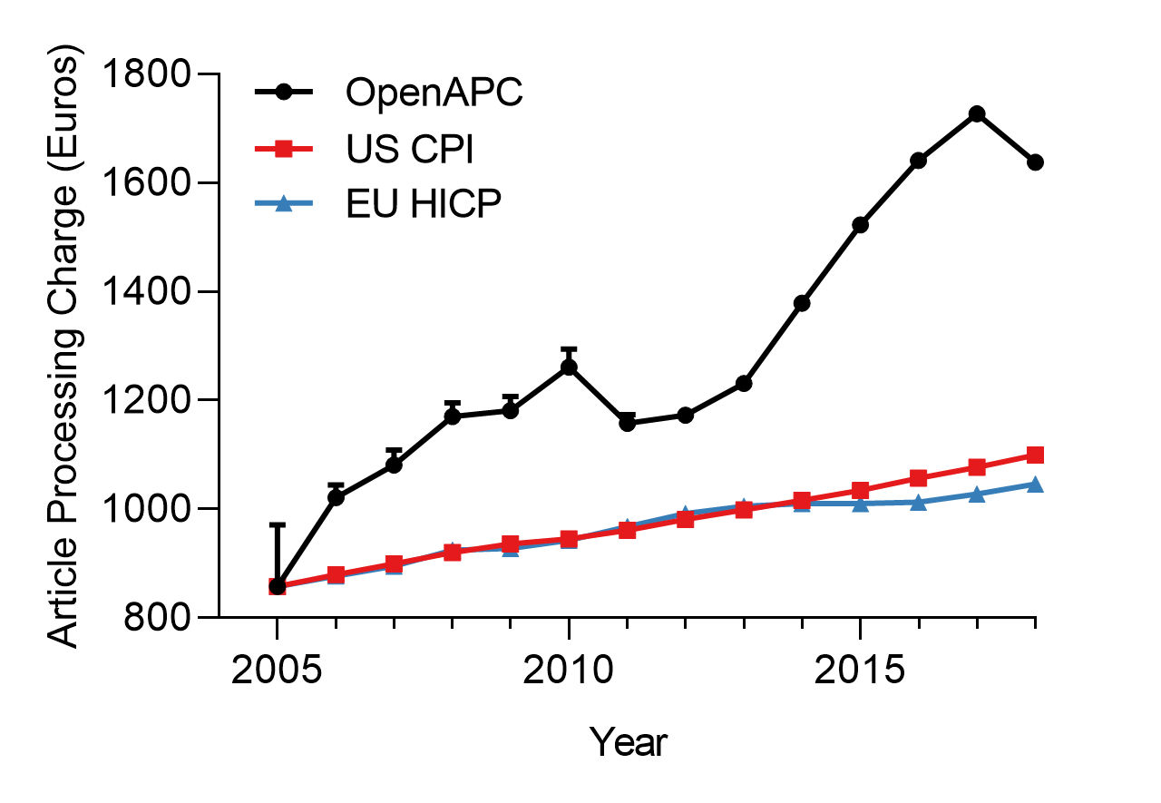
What has changed?
The mean APC rate doubled between 2005 and 2018, to €1,600, at much higher than the rate of inflation. ⁴
Notes:
⁴ Khoo, S. Y.-S., 2019. Article Processing Charge Hyperinflation and Price Insensitivity: An Open Access Sequel to the Serials Crisis. LIBER Quarterly: The Journal of the Association of European Research Libraries, 29(1), 1–18. https://doi.org/10.18352/lq.10280

Slide 10
What has changed?
Nature’s APC is €11,000, which is equivalent to an annual salary of a scientist in an African institution and more than the annual salary of an assistant professor at a medical school in India⁵
€200 - €1,000 is sufficient to pay publishing costs⁵
Many researchers and institutions cannot afford to publish, including in low income countries⁶ , in social sciences and humanities, and early-career researchers⁷
Notes:
⁵ Pai, Madjukar, 2020. How Prestige Journals Remain Elite, Exclusive And Exclusionary. Forbes 30 November 2020. https://www.forbes.com/sites/madhukarpai/2020/11/30/how-prestige-journals-remain-elite-exclusive-and-exclusionary/
⁵Butler LA, Matthias L, Simard MA, Mongeon P, Haustein S. 2022. The Oligopoly's Shift to Open Access. How For-Profit Publishers Benefit from Article Processing Charges (Version v2). Zenodo. https://doi.org/10.5281/zenodo.7158818
⁶ Mekonnen A, Downs C, Effiom EO, Kibaja M, Lawes MJ, Omeja P, Ratsoavina FM, Razafindratsima O, Sarkar D, Stenseth NChr, Chapman CA. 2022. Can I afford to publish? A dilemma for African scholars. Ecology Letters, 25(4), 711–715. https://doi.org/10.1111/ele.13949
⁷ Olejniczak AJ, Wilson MJ. 2020. Who’s writing open access (OA) articles? Characteristics of OA authors at Ph.D.-granting institutions in the United States. Quantitative Science Studies, 1(4), 1429–1450. doi: https://doi.org/10.1162/qss_a_00091
This article asks, what else could be done with that money?
“Even if funders agree to pay these high fees, it will draw often scarce resources from being spent on research towards profitable publisher entities who benefit from publicly funded research, as well as free labor of authors and peer reviewers."

Slide 11
Going beyond open access
Equity in research production and distribution
Diversity in publications, content, and contributors
Sustainability of tools and infrastructure
Notes:
We have changed some things about scholarly publishing, in making more content open access to readers, but we’ve created new inequities in access to research production and distribution.
This makes us think more broadly about our goals for open access and how we want to do open access in a way that leads to equity in research production and distribution; diversity in publications, content, and contributors; and sustainability of tools and infrastructure.
These are all buzzwords. What do they really mean, for you, your institution, your research, or your publishing?
Please think about what these terms mean to you after the presentation or as I’m talking.
I will talk about what they mean in relation to OJS and PKP and practical ways we can realize them in our publishing practices.
I don’t think APCs are bad or that every journal or publisher that charges APCs are bad.
A NOTE ABOUT APCs: Every organization and publication is unique and in some cases APCs might be the best revenue model. I just want to explore some other options and for us to look at where we’re going collectively and what we’re investing in long-term and the implications.

Slide 12
Equity
Diamond OA presents a more equitable model of publishing, with no fees to read or publish
A recent study showed that 60% of diamond OA journals use OJS ⁸
As free software, OJS supports (diamond) OA by lowering the costs of publishing
This leads to greater diversity in types of journals and content, in addition to diversity in researchers who are able to publish
Notes:
⁸ Bosman J, Frantsvåg JE, Kramer B, Langlais P, Proudman V. 2021. OA Diamond Journals Study. Part 1: Findings. Zenodo. https://doi.org/10.5281/zenodo.4558704
There is no barrier for researchers to publish in diamond OA journals.
There was a recent study done by Science Europe, cOAlition S, OPERAS, and the French National Research Agency on diamond OA journals, to better understand who they are, what are their practices, what are their needs, and how they can be better supported.

Slide 13
Diversity
38% of OA diamond journals are multilingual, compared to 14% of APC-based journals ⁸
OJS is one of the only journal publishing applications that supports multilingual publishing
OJS has been translated into over 60 languages
OJS is the most widely used publishing software in the world, with highest usage in the global south⁷
The countries with the highest OJS usage are Indonesia (11,535 journals) and Brazil (2,653) ⁹
Notes:
⁸ Bosman J, Frantsvåg JE, Kramer B, Langlais P, Proudman V. 2021. OA Diamond Journals Study. Part 1: Findings. Zenodo. https://doi.org/10.5281/zenodo.4558704
⁹ Khanna S, Ball J, Alperin JP, Willinsky J. 2022. Recalibrating the Scope of Scholarly Publishing: A Modest Step in a Vast Decolonization Process. SciELO Preprints. https://doi.org/10.1590/SciELOPreprints.4729
Diversity and equity mean researchers being able to work and publish in their own language and about their own region. And researchers being able to access research in their own language and about their region.

Slide 14
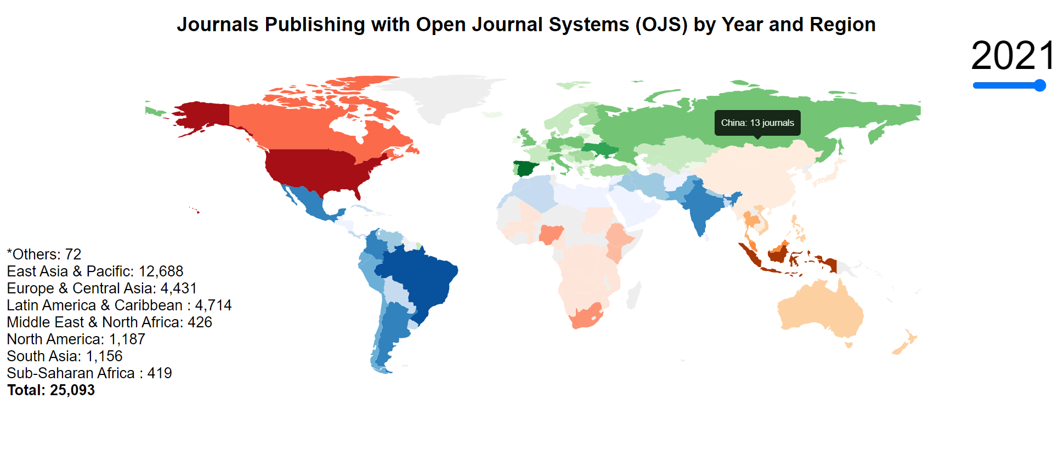

Diversity
Notes:
This image shows the usage of OJS by region.

Slide 15
Sustainability
The UNESCO Recommendations on Open Science recognize the importance of open, community-owned infrastructure for long term sustainability of open science¹⁰
Interoperability with open standards like ORCID, Crossref, and ROR, so there is no vendor lock-in
Notes:
¹⁰ UNESCO. 2021. UNESCO Recommendation on Open Science. https://en.unesco.org/science-sustainablefuture/open-science/recommendation
Sustainability means having control over the tools and infrastructure that we use for scholarly publishing - now and in the future - and interoperability.
When we operate our own tools, we’re more self-reliant, not dependent on vendors that are driven by profit and commercial interests.
UNESCO defines open scientific knowledge as: open access to scientific publications, research data, metadata, open educational resources, software, and source code and hardware that are available in the public domain or under copyright and licensed under an open licence that allows access, re-use, repurpose, adaptation and distribution.

Slide 16
Invest in open infrastructure
OJS is an example of open infrastructure that can be used for OA projects and activities
Open infrastructure can be developed alongside existing activities
In the 2.5% Commitment, David Lewis suggests investing 2.5% of your subscription budget in open infrastructure
This could your own projects or an external project you use or appreciate
Notes:
⁷ Lewis, David W. 2017. The 2.5% Commitment. http://doi.org/10.7912/C2JD29
All of the previous projects are examples of open infrastructure – using open tools to build our own infrastructure.
These institutions still have journal subscriptions and transformative agreements, but investing in open infrastructure alongside that helps move us towards the OA world we want.
I’m sure that many of you have similar projects and I look forward to hearing about some of them during our discussion.
If you don’t, look at what your capacity is, who you can collaborate with to reach your own goals for open access.
If you

Slide 17
Global Sustainability Coalition for Open Science Services (SCOSS)
SCOSS projects
  Directory of Open Access Journals
  SHERPA/RoMEO
  OAPEN
  PKP
  DOAB
  OpenCitations
  Public Knowledge Project
  arXiv
  Redalyc/AmeliCA
  Dspace
Notes:
SCOSS is an organization that helps institutions invest in open infrastructure by evaluating and recommending projects every year and providing avenues for funding them.

Slide 18
Open infrastructure projects
National or regional portals
Institutional platforms
Library publishing programs
Preprint archives, repositories, and overlay journals
Notes:
These are other models we can use to support OA (in particular, diamond OA) and work towards this vision of OA that involve working together, sharing resources, building our own tools, and becoming less dependent on profit-driven service and content providers.

Slide 19
National or regional platforms
Multiple universities or organizations pool their resources to fund and operate one publishing platform
National platforms support regional content and local languages
Use open source software like OJS
OJS is used for national platforms in Finland, Denmark, and Sweden, to name a few.

Slide 20
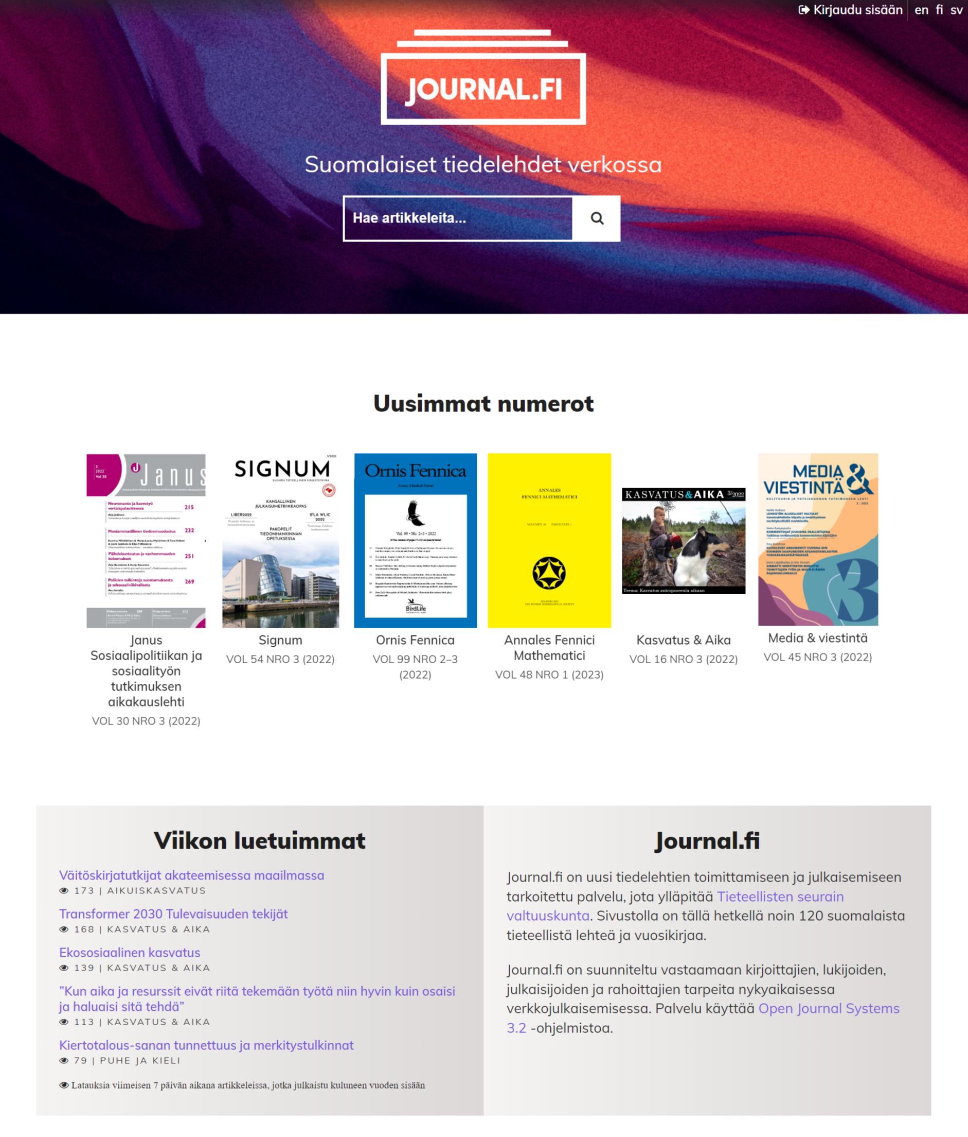
Finnish Journal.fi platform
Established by the Federation of Finnish Learned Societies in 2017, Journal.fi uses OJS to host 100 OA journals from Finland in different fields, in mainly Finnish and English.
It provides metadata distribution, preservation, and Crossref and ORCID services.

Slide 21
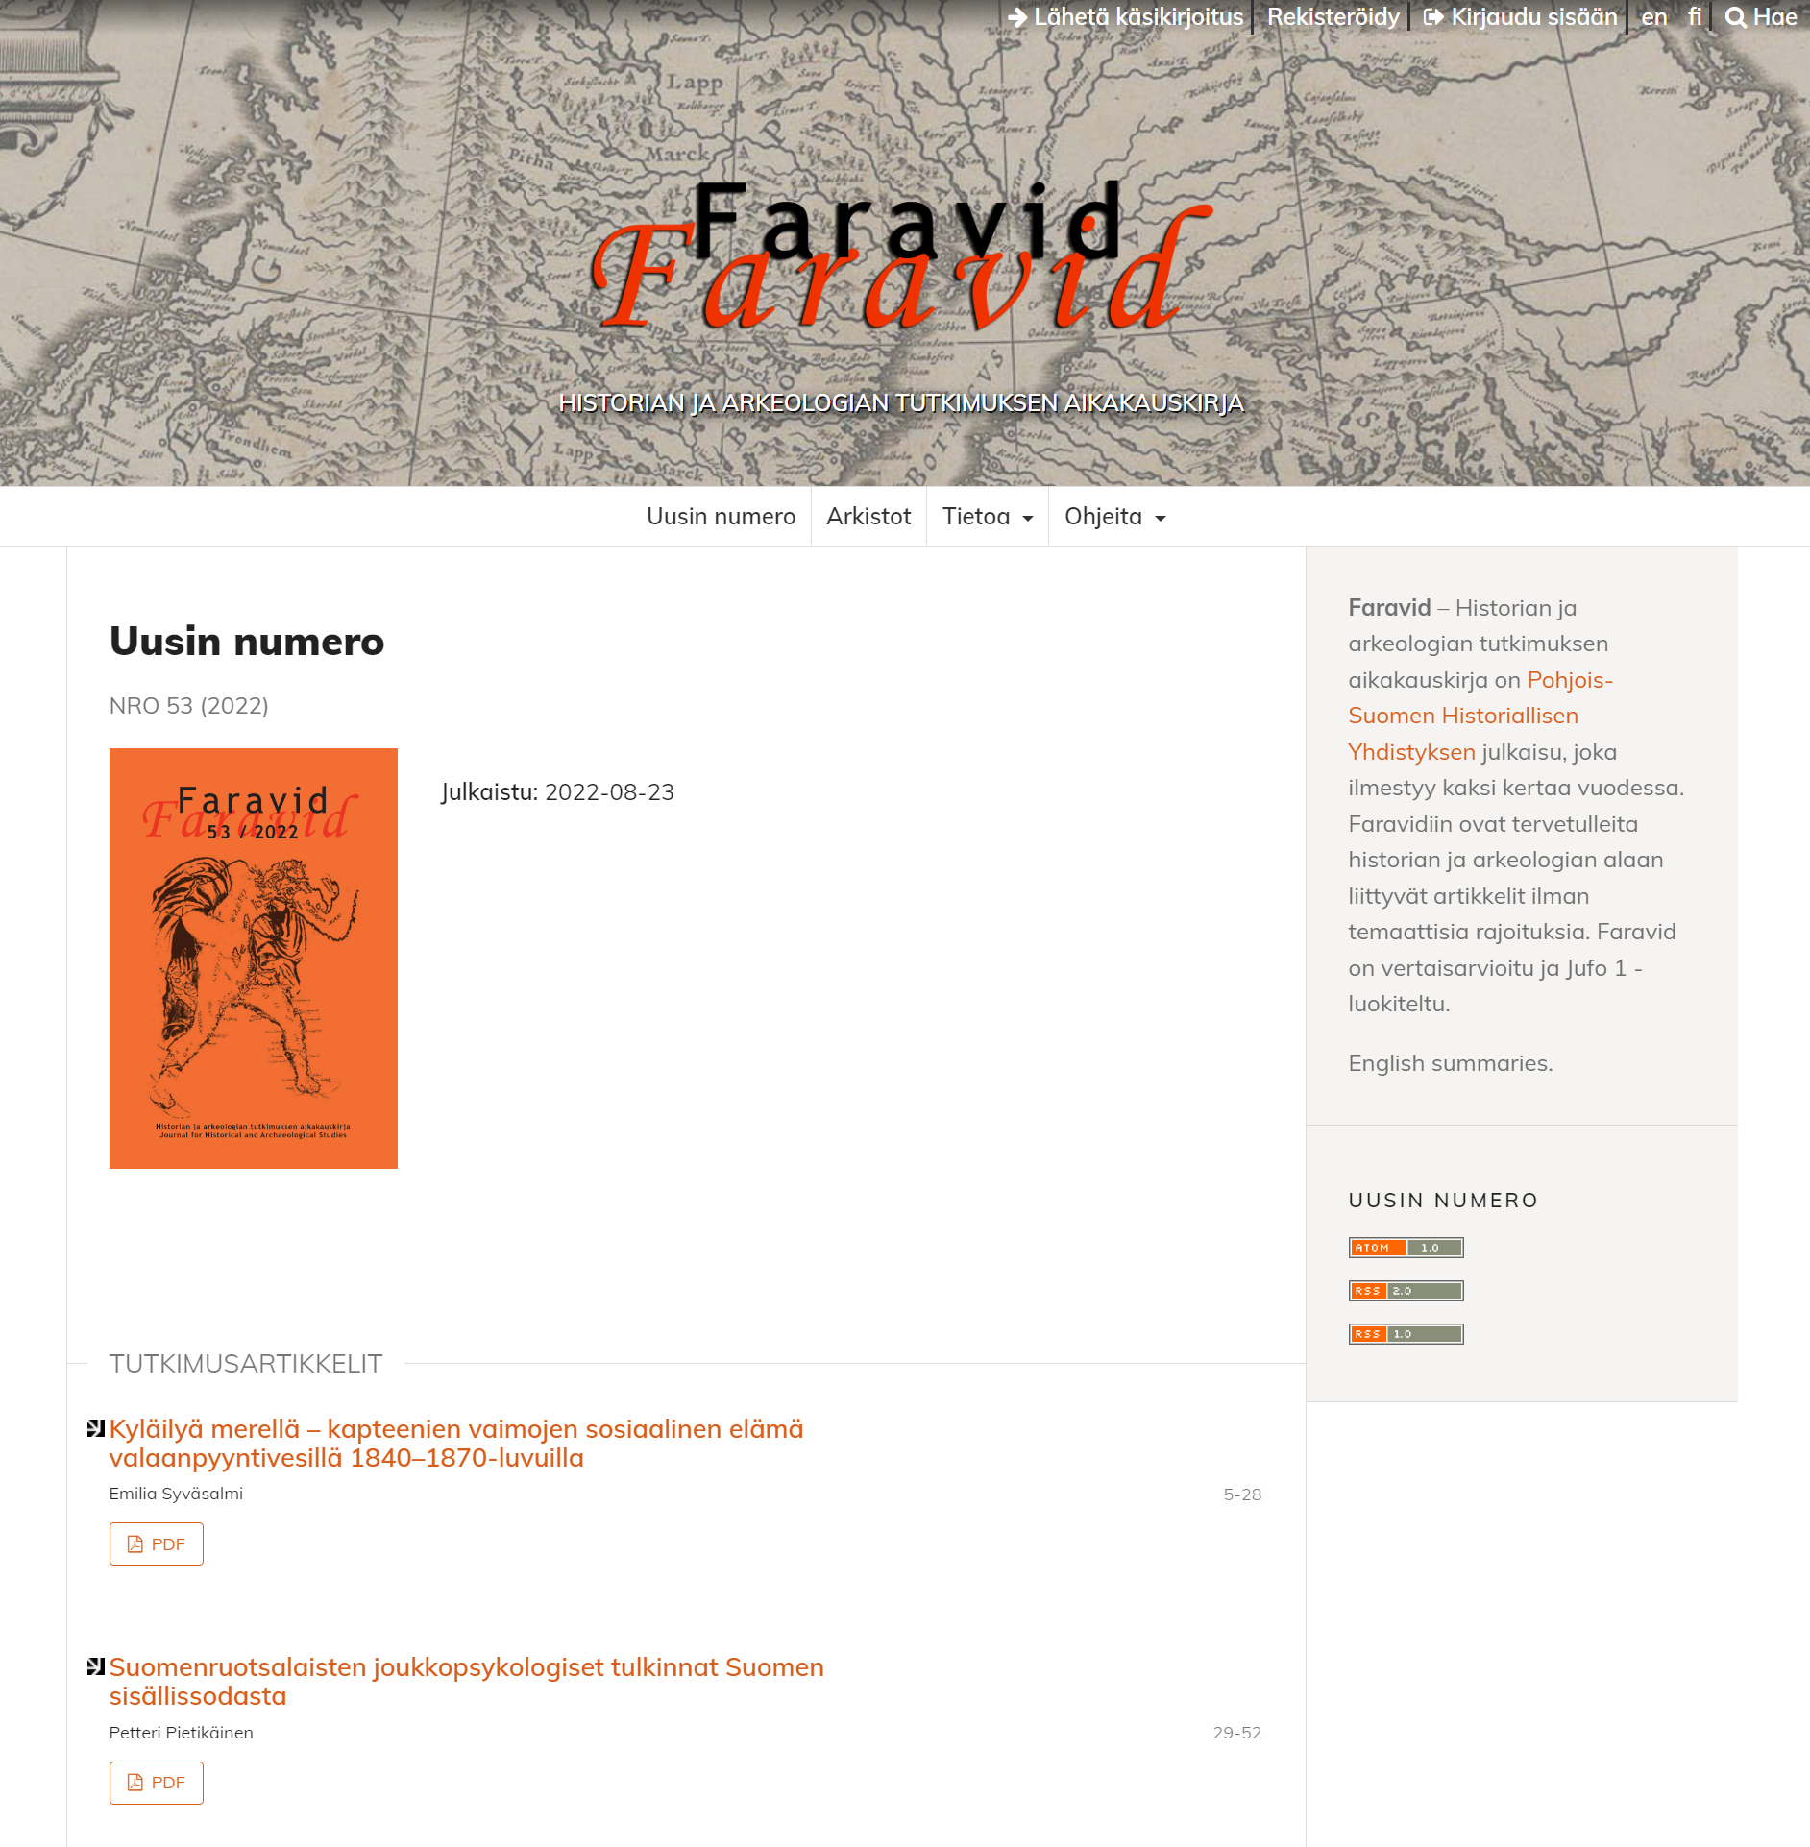
Finnish Journal.fi platform
The service is free for society members and journals receive funding for publishing from a consortium of Finnish universities, research institutes, and research funders.
They contribute theme, plugin, and other software development to PKP.

Slide 22
Library and institutional publishers
Libraries use OJS to support library publishing activities, including offering hosting and support services to faculty journals.
Library publishing is common in Canada and the United States
In other countries it’s more common for the institution to provide journal hosting and support
Library Publishing Coalition
Notes:
² Buranyi, S. 2017. Is the staggeringly profitable business of scientific publishing bad for Science? The Guardian 27 June 2017. https://www.theguardian.com/science/2017/jun/27/profitable-business-scientific-publishing-bad-for-science
* copy and paste to reuse *
FONT:
Header:
Impact, uppercase
Subheads and Table:
Trebuchet MS, bold, uppercase
Body:
Times, sentence-case

Slide 23
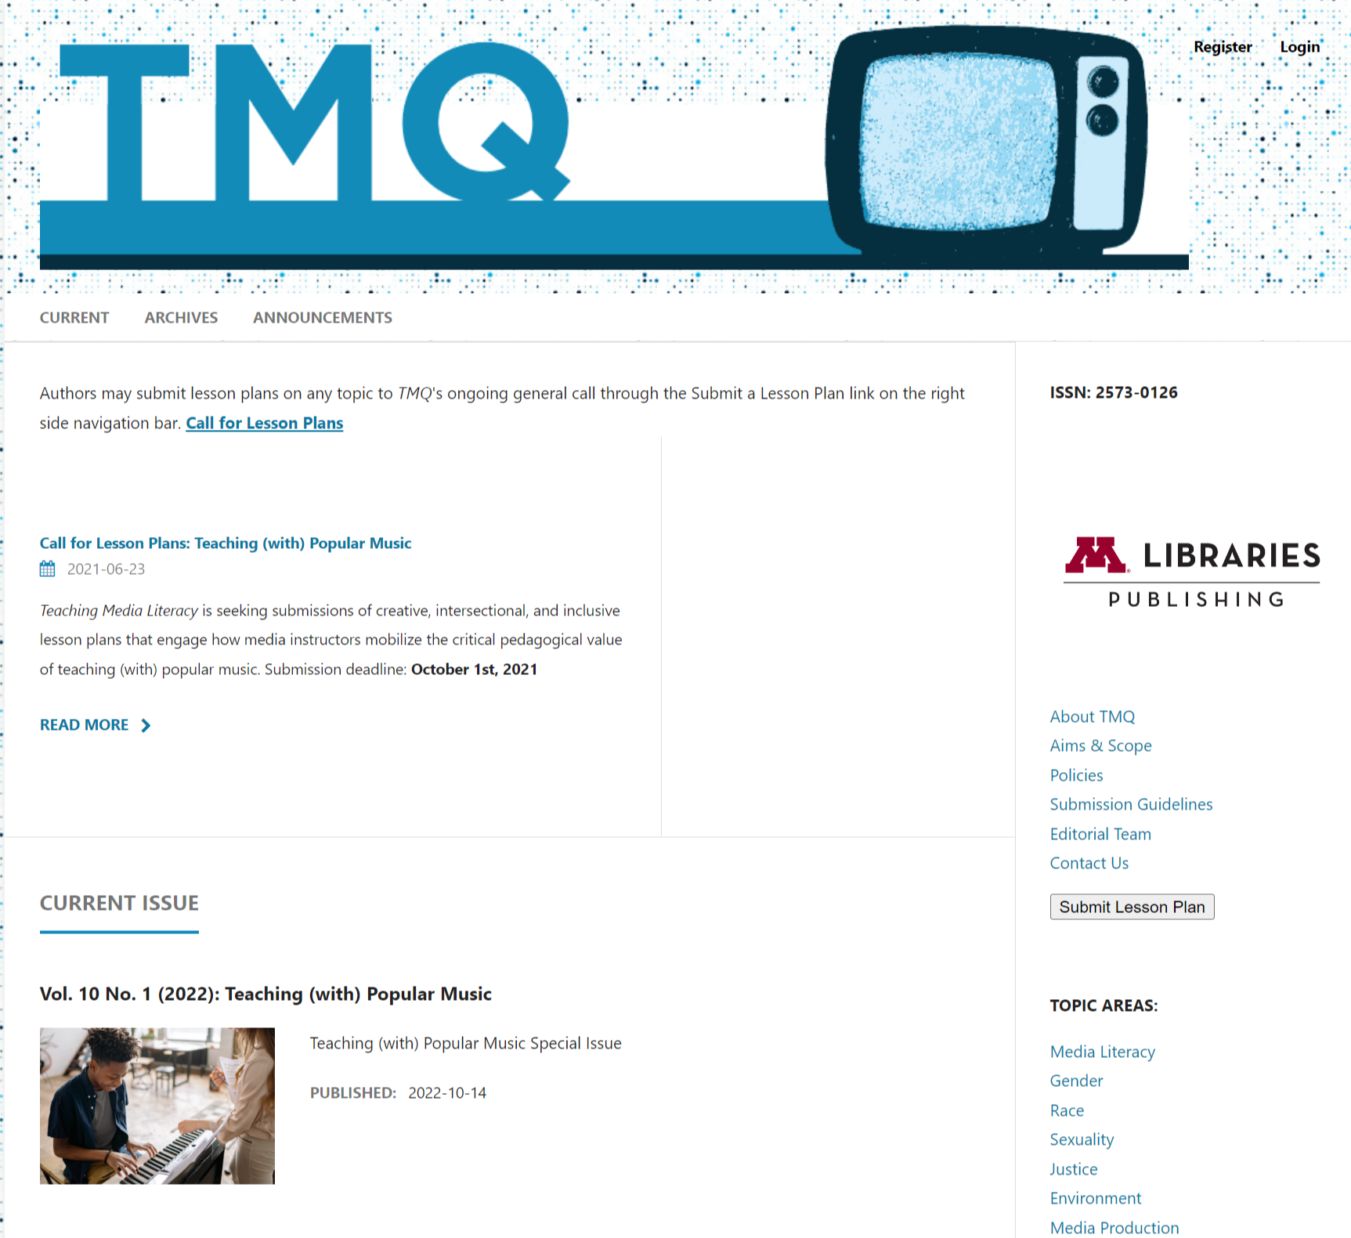
University of Minnesota
University of Minnesota Library’s publishing program supports 20 journals, which are hosted by PKP Publishing Services (with free student journal hosting). They moved from Bepress in 2018 and funded development of a usage statistics dashboard for OJS.

Slide 24
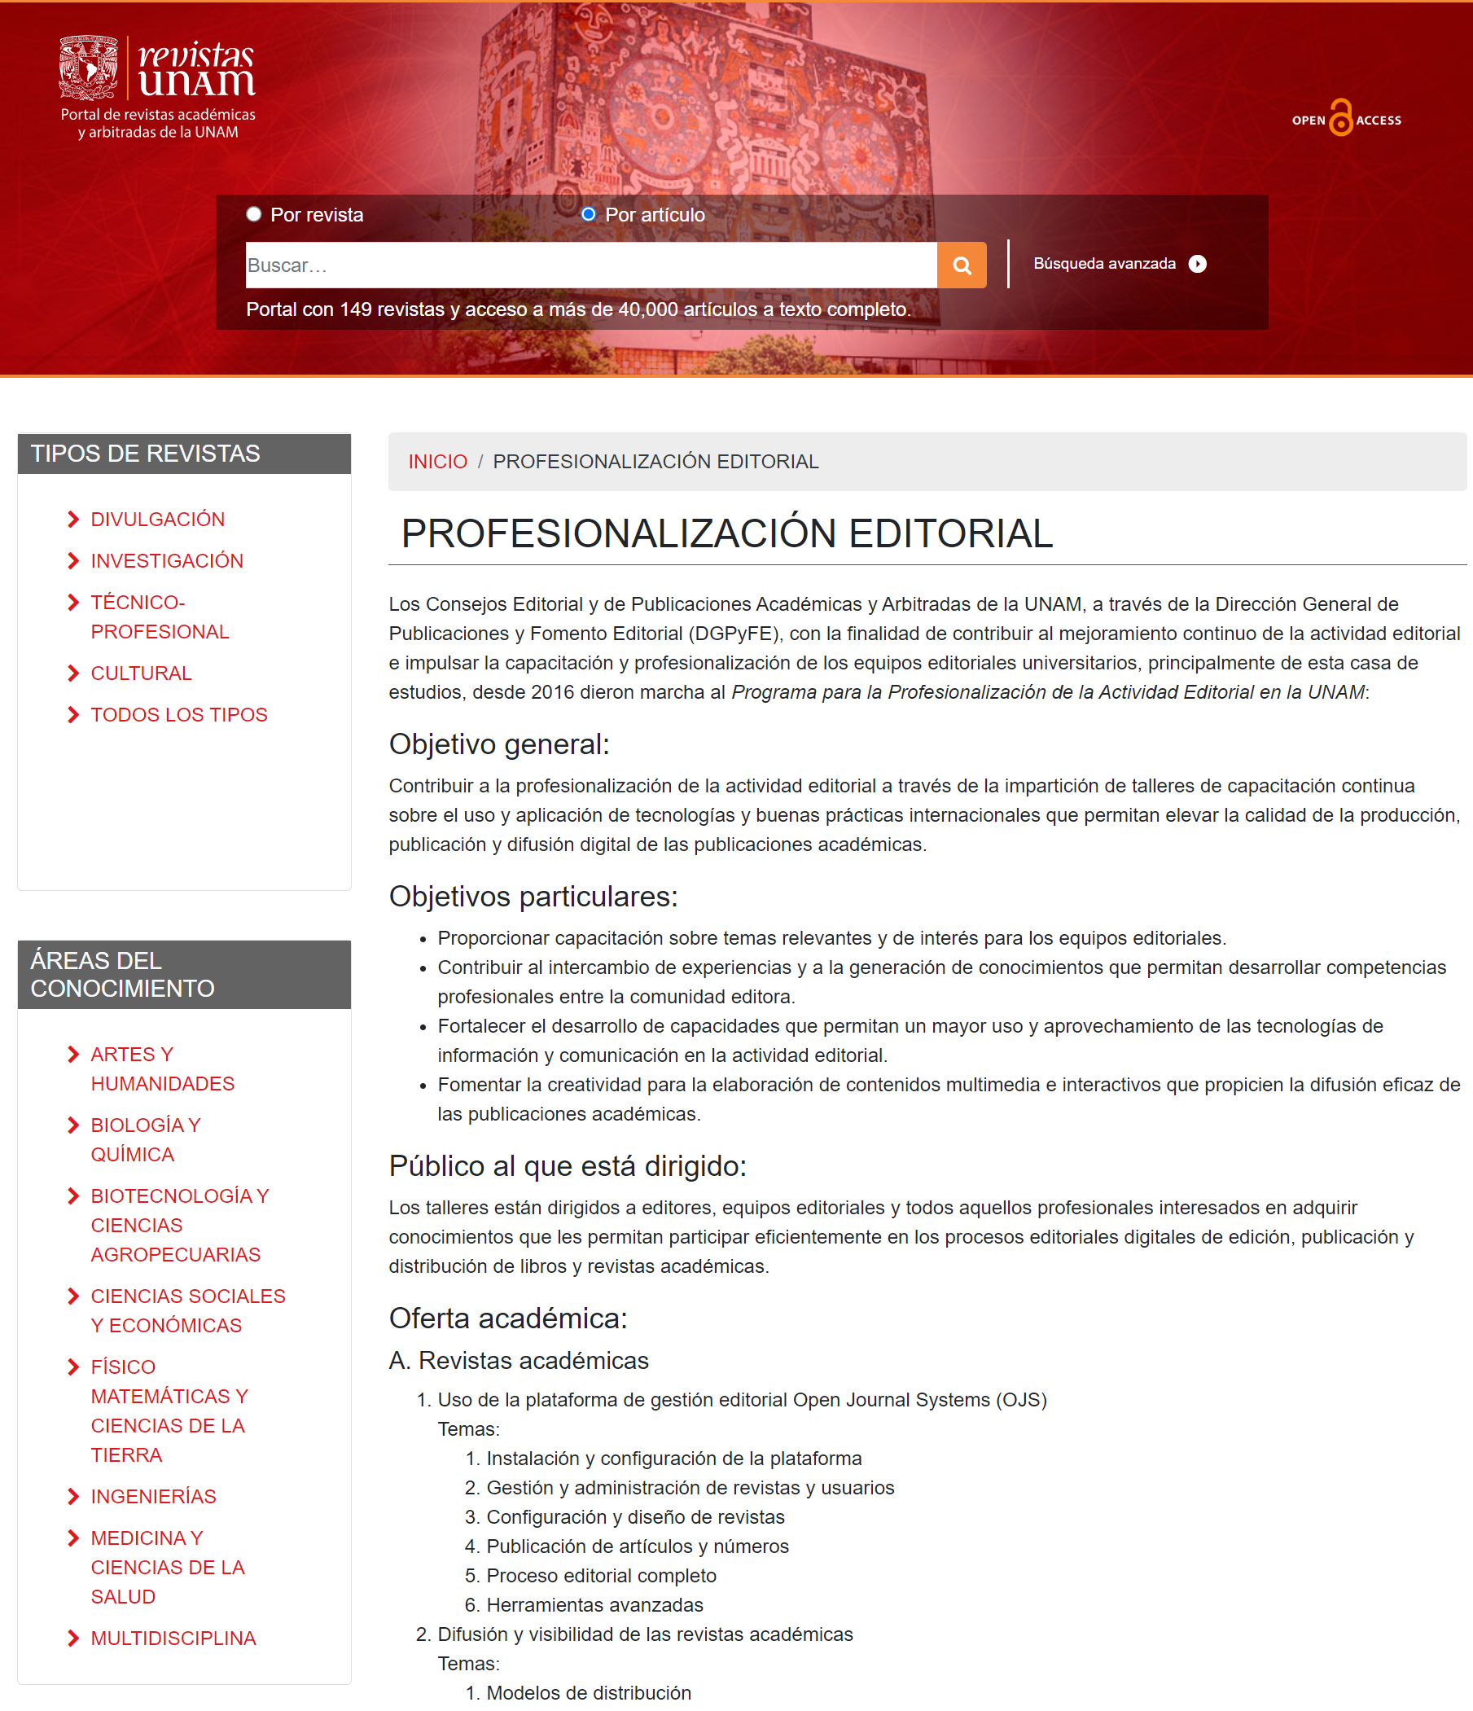
Revistas UNAM
The institutional portal for journals at the Universidad Nacional Autónoma de México hosts more than 145 OA journals on OJS.
They provide training to editors across Mexico and contribute to PKP software translation and documentation.
Notes:
In Latin America, most journals are operated by university departments.
In South Africa, the Academy of Science of South Africa adopted the SciELO model of open access,
pioneered by Brazil, for independent journal publishers to share publishing infrastructure

Slide 25
Coalition Publica
A partnership between Erudit and PKP to build a national infrastructure for OA journals in the social sciences and humanities in Canada
Funded by the Social Sciences and Humanities Research Council and the Partnership for Open Access
Member journals receive funding, are assisted in adopting OJS, and have their content disseminated on Erudit

Slide 26
Guiding values and principles
OASPA Revised Principles of Transparency and Best Practice
FOREST Framework for Values-Driven Scholarly Communication
UNESCO Recommendation on Open Science
FAIR Guiding Principles for scientific data management and stewardship
Principles of Open Scholarly Infrastructure
Notes:
I have given you some examples of how PKP software contributes to equitable, diverse, and sustainable open access.
These sets of values and principles can help you assess service providers and establish your own organizational practices in ways that work toward an equitable, diverse, and sustainable scholarly publishing ecosystem.

Slide 27
Join the PKP community
PKP is funded by:
  Grants
  Publishing Services
  Development partners
  Sustainers
Other contributions include:
  Translation
  Documentation
  Software development and coding
  Participating in working groups and committees
  Supporting users on the PKP Community Forum
Notes:
PKP is sustained by and accountable to its global user community.
This ensures PKP software develops in line with community needs.
Our community is very diverse and we have resource constraints, so we can’t do everything, but we include user voices and contributions in our software development, process for prioritizing features, governance, and creation of core features and resources.

Slide 28
Questions? Stories? Ideas?

Slide 29


