Slide 1
Good community governance:
insights from the nonprofit and scholarly communication sectors
November 2, 2022
Ravin Cline, Samuel Moore and Richard Dunks
Invest in Open Infrastructure | investinopen.org | @investinopen

Slide 2
Welcome! We’re glad you’re here.
Logistics
Sessions are recorded. Recordings available on-demand from Zoom Events Lobby after session.
Shared notes doc link in Zoom chat. Please sign in!
Have a question? Please flag in Zoom chat.
Notes:
Missing screenshots

Slide 3
Ground rules & expectations
This Summit is designed as a place for learning & conversation.
Be curious: Ask for clarifications, ask deep questions to challenge our thinking.
Hold space for others: Be curious about others’ perspectives, hold space for them to ask questions and contribute.
Be respectful: We want to build community, not tear it down.
Code of Conduct: https://investinopen.org/code-of-conduct/

Slide 4
Ground rules & expectations
Sharing information from sessions & discussions
Recordings and notes are accessible by Summit registrants.
  Breakout rooms are not recorded - please help take notes!
Shared note docs: Please do NOT share the link to note docs beyond the Summit.
Chatham House Rule applies:
  You can share what you’ve learnt, screenshots of slides, etc on social media, but please don’t share who said it or who heard it
  Share information and stories at the level that you would at a conference
  On shared notes, we would like to record the names of person(s) who asked a question/made a comment – you can edit your name out if you prefer.

Slide 5
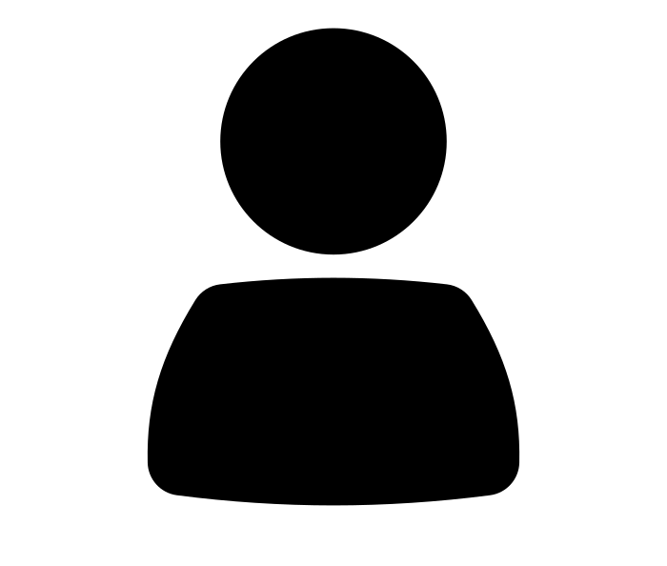
Collective funding at this Funders Summit
What areas of opportunity are open for funding?
Preprint infrastructure
Good community governance
Financial health
Critical and at-risk infrastructure
Technical reliability and security
Adoption
Your idea
Person by Diego Naive from Noun Project

Slide 6
What do you think?
Chatterfall: Write in Zoom chat but wait to press send until we say go!
What interests you about community governance of open infrastructure?
Type in 1 min
(I don’t know yet is an acceptable answer :) )

Slide 7
Why governance?
Our interest in this work
Goal: To understanding foundational concepts necessary for building vibrant, resilient, and community-driven services that provide value to stakeholders while adhering to essential principles for true openness and accountability.
Desired Outcomes:
To document and describe the current literature on nonprofit governance broadly and in the scholarly communication space
To improve our ability to advocate for more and better diversity and community-engagement with open infrastructure services
To better shape IOI’s own internal governance practices to be more open, transparent, and community driven

Slide 8
Insights from Nonprofit Governance Research
Ravin Cline, PhD Candidate
University of Texas, Dallas

Slide 9
Research question
Document and describe the current literature on nonprofit governance, identifying key works, relevant concepts, and reliable frameworks for understanding nonprofit governance to help shape IOI’s internal governance and external advocacy as we work to share key frameworks for understanding foundational concepts necessary for building vibrant, resilient, and community-driven services that provide value to stakeholders while adhering to essential principles for true openness and accountability.
What is good/bad governance?
Why is good governance important?

Slide 10
Research Questions
What is governance?
Why is governance important?
What are the key concepts we should understand?
What are the important models of governance in nonprofits?

Slide 11
What is governance?
Latin: That which steers or guides an organization
In nonprofit research, governance includes
  Accountability
  Fiduciary matters
  Policy creation, adherence, and revision
  Onboarding and dismissal of the Executive Director
  Protecting the mission
  Strategic planning
(Carver 2011; Cornforth 2004; Cornforth 2012; Bradshaw 2009)

Slide 12
Why is governance important?
Demands transparency
  Public disclosure of policies and practices
  Public disclosure of budget, financial statements and annual reports
Builds trust
  Bi-directional communication with stakeholders (emails, newsletters, social media)
Maintains accountability for outputs and outcomes
Solidifies nonprofit’s reputation and legitimacy
  Fidelity to the mission
Encourages diversity and inclusion
  Maintains feedback from various stakeholders
  Ensures awareness about the needs of the served population
(Moreno-Albarracín, et. al. 2020; Brown 2002; Buse et al. 2016)

Slide 13
Structure and function of the board
Board meetings: Where decisions are made and opportunities discussed
Strategic planning: Sets the path and drives action. Establishes committees, timetables, and task forces
Streamlined structure: Allows board and staff to operate in tandem toward mission
Composition of the board and the staff: Right people, right position, right mission
Leadership of the board and the organization: Board chair, Executive
The mission: The statement that drives the organization’s purpose, the passion of it board and staff, and its work
(Board Source 2016)

Slide 14
Key concept: Board Relationship and Theory
Principal-agent
  Relationship between board and Executive Director
Stakeholder (internal/external)
  Relationship between board and community
Representative Bureaucracy (Representative governance)
  Relationship between board and community

Slide 15
Models of governance
Contingency
Models of governance
  Continuum
    Policy
      Diff between governance and management
    Executive-centered
    Board-centered
(Bradshaw 2009; Carver 2011; Herman and Heimovics 1990, LeRoux & Langer 2016, Chait et al. 2005, Bernstein 2007 )

Slide 16
Models of governance
Policy board
Executive-centered
Board-centered
The “right” model is contingent on the internal structures and external context in which the organization operates
(Bradshaw 2009; Carver 2011; Herman and Heimovics 1990, LeRoux & Langer 2016, Chait et al. 2005, Bernstein 2007 )

Slide 17
Key Findings
Governance is foundational. It affects an organization’s
  Finances and fundraising
  Reputation
  Organizational structure and longevity
  Programming
  Morale
Governance’s relationship to accomplishing the mission and meeting needs of the principal
Governance’s relationship to transparency, accountability, and trust

Slide 18
Key Findings
Governance is foundational to managing for success in:
  Finances and fundraising
  Reputation
  Organizational structure and longevity
  Programming
  Morale
Good governance is essential to accomplishing the organization’s mission (meeting needs of the principal)
Good governance is vital for transparency, accountability, and trust

Slide 19
Future research
How a nonprofit creates governance structures with stakeholder input
The question of DEI in board governance is an extensive topic to explore further.
  Representative bureaucracy is a good place to start.
    Passive
    Active
  How to recruit?

Slide 20
Future research
The contingency approach
  Literature discusses age, size, ideology, revenue source and other contingencies
  What contingencies are relevant for this space?
  How does the contingency approach relate to our continuously changing external environment? Might it be more efficient and/or effective?
    Crisis, like COVID
      Effects on internal environment
    Rapid increase of available information
    Extensive access to information

Slide 21
Community Governance of open infrastructure services
Dr. Samuel A. Moore, University of Cambridge

Slide 22
Research Questions
Why is good governance essential for scholarly communication infrastructures? (academic publishing, data infrastructures, repositories, etc.)
What does governance look like in scholarly communication? How can it be improved?
How can we embed good governance within scholarly communication infrastructures and services?

Slide 23
Method:
2. Project analysis of governance approaches in this space:
  IOI’s Catalog of Open Infrastructure Services
  Project analysis:
    Datacite, Dryad, SPARC, ScholarLed, ORCiD, etc
    Mission statements, vision statements, bylaws, principles, etc.
1. Desk research of literature on governance
  COPIM work (Towards Better Practices for the Community Governance of Open Infrastructures, J. Adema and P. Hart; Exploring Models for Community Governance, Moore)
  Educopia work (Community Cultivation guide, Mapping the Scholarly Communication Landscape)
  Literature on the commons (Ostrom, Governing Knowledge Commons, De Angelis and associated left approaches)
3. Speculative proposal
  What might a minimum viable system of governance look like for scholarly communication?

Slide 24
Key Findings (part 1)
Good governance requires consideration of a number of elements:
  Organisation size, scale, ambition, complexity (governance does not scale well)
  Structures for external/internal accountability, polycentricism, mission, values, rules, etc
  Situatedness (what kind of organisation is it and who is its community?): local norms, community diversity, trust and shared effort to a particular goal
There are no off-the-shelf models for community governance, although Ostrom points us towards things that work (boundaries, conflict resolution, nested enterprises, etc.) – governance is a process
Accountable community governance is not done well in this space. The better approaches are those by larger non-profits (e.g., ORCiD)

Slide 25
Key Findings (part 2)
While there are no off-the-shelf models for community governance, part 2 of the report explores the following elements as necessary to consider and define for good governance:
  Organisational structure (how is accountable decision-making embedded in the organisation’s structure) – boards, hierarchies, etc.
  Democratic process (ownership, sunsetting/selling/etc, who can make decisions, bylaws, conflict resolution)
  Norms, values (mission, vision, culture, diversity)
It is vital that these elements are documented publicly (so that they may be improved)

Slide 26
Next steps
Research now needed to explore:
  Whether this minimum standard can be formalised and developed further into a toolkit or choice architecture allowing organisations to develop accountable governance
  How to embed governance from a project’s creation
    … and ensure it is responsive to how organisations grow
  How to utilise users of pre-existing infrastructures (in an antagonistic space):
    Authors/editors/reviewers
    Governance ‘interventions’

Slide 27
Discussion

Slide 28
What’s happening next?
Today: deep dive into funding causes and conditions
(in 90 mins) 9pm GMT
Financial health and risks for nonprofits in research
Tania Hernández Ortiz sheds light on some of the financial strengths, risks and vulnerabilities of nonprofit organizations in this sector and opportunities for funders to help create a more financially robust and resilient open research ecosystem.

Slide 29
What’s happening next?
Last chance to receive your funds - cobudget joining link in the chat.
Thursday: Deep dives into funding Causes and Conditions
Criticality & at-risk-ness
Technical reliability & security
Adoption
3pm GMT
Panel will discuss what critical and at-risk infrastructure can mean in open research and scholarship and infrastructure.
Katharina Meyer, Sovereign Tech Fund
Carly Strasser, Chan Zuckerberg Initiative
5:00pm GMT
Panel will outline key issues affecting the reliability and security of open infrastructure and discuss potential interventions.
Abigail Cabunoc Mayes, GitHub
Sean Goggins, CHAOSS
Bilal Mateen, Wellcome Trust
Ivan Oransky, Simons Foundation
7:30pm GMT
Through this open discussion, we hope to gather information about and reflect on existing initiatives in training and community engagement for open infrastructure, facilitate the sharing of insights from engaging with diverse stakeholder groups, and identify opportunities for further research and investment.

Slide 30
Questions? Email emmy@investinopen.org or directly message @Emmy Tsang on Slack!

