Slide 1
GNNs to calculate AM1-BCC charges
November 10, 2022 | Force field release meeting

Slide 2
Overview
GNN structure
Developing a GNN:
  Hyperparameters / GNN structure
  Atom features
  Datasets
  Targets and metrics
Current model performances
Next steps

Slide 3
Why GNN charges?
Faster and not conformationally-dependent
Would be great to get this into Rosemary
Targeting AM1-BCC for now – could move onto other charge models in future, e.g. RESP
Notes:
Convolution and readout layers

Slide 4
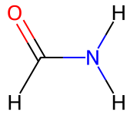
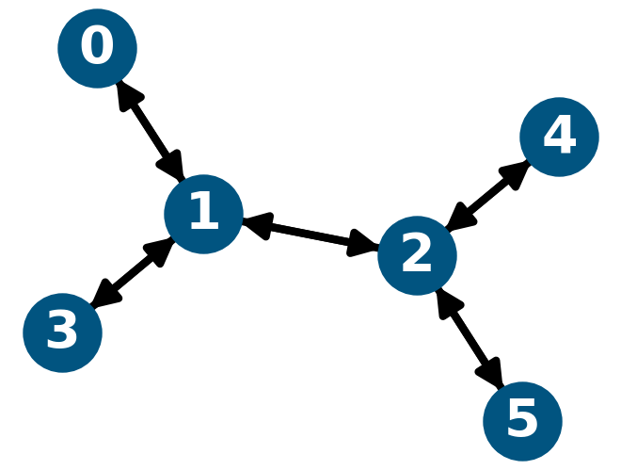
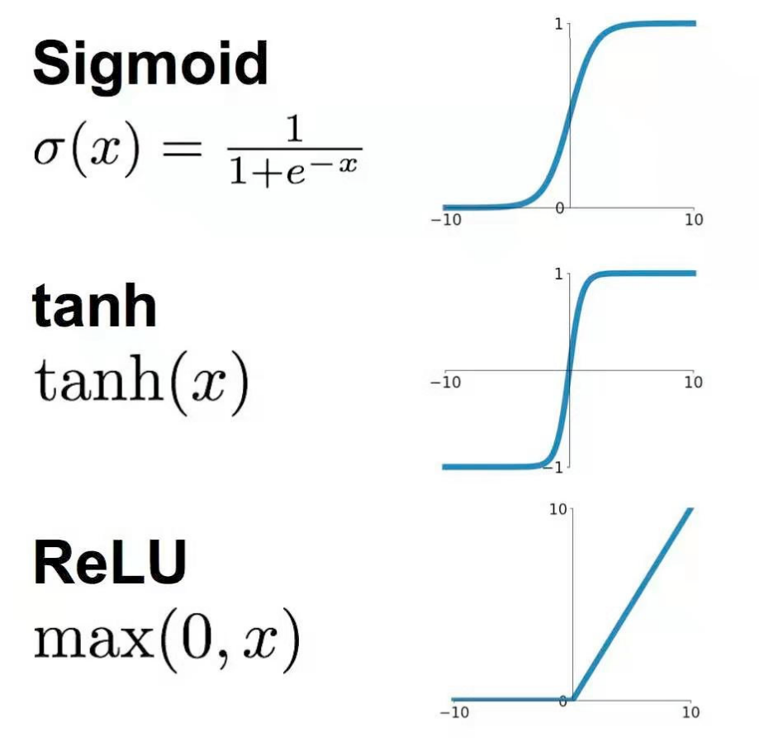
GNNs
Structure
[1., 0., 0., 0.],
[0., 1., 0., 0.],
[0., 0., 1., 0.],
[0., 0., 0., 1.],
[0., 0., 0., 1.],
[0., 0., 0., 1.]
Fully connected layers
Convolution
Readout

Slide 5
Hyperparameters
Developing a GNN
Search space
Number of convolution layers: 3, 4, 5
Number of convolution features: 64, 128, 256
Number of readout layers: 1, 2
Number of readout features: 64, 128, 256
Learning rate: 10⁻³, 10⁻⁴, 10⁻⁵
Activation function: ReLU, Sigmoid, Tanh
Notes:
Convolution and readout layers

Slide 6
Atom features
Developing a GNN
 | v1 | v2 | v3
AtomicElement
AtomConnectivity
AtomIsInRing
AtomIsInRingOfSize: 3, 4, 5, 6
AtomAverageFormalCharge (resonance)
AtomHybridization
Notes:
Convolution and readout layers

Slide 7
Data
Developing a GNN
Datasets
Curated ZINC and ChEMBL datasets from Bleiziffer et al. 2018
  ChEMBL: 107254 molecules
  ZINC: 256184 molecules
Enamine Discovery Diversity sets (10240, 50240 molecules)
  Filtered with same criteria as Bleiziffer et al. 2018
  6537 records
OpenFF Industry benchmark set
  13715 molecules
Notes:
Machine Learning of Partial Charges Derived from High-Quality Quantum-Mechanical Calculations Patrick Bleiziffer, Kay Schaller, and Sereina Riniker. J. Chem. Inf. Model.2018583579-590 https://doi.org/10.1021/acs.jcim.7b00663

Slide 8
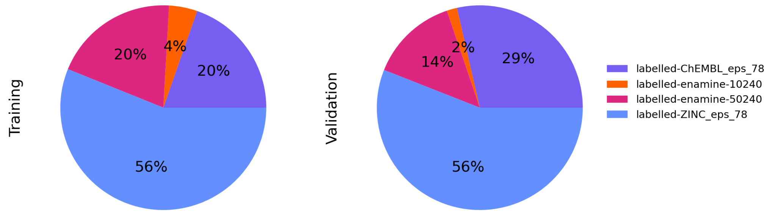
Data
Developing a GNN
Dataset split
Pooled datasets: enamine, ZINC, ChEMBL
Selected molecules to cover all atom environments with no more than 10 molecules each (168911 total)
Split by diversity (Dice similarity between Morgan fingerprints)
Training: 80%
Validation: 20%
Test:
  SPICE
  Peptide chains (1-5)
  OpenFF benchmark set

Slide 9
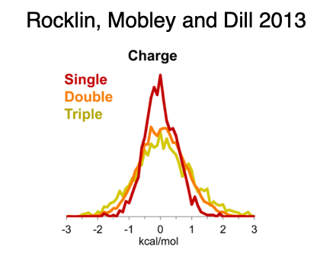
Training
Developing a GNN
Ways to achieve AM1-BCC charges
Training directly to AM1-BCC charges
Training to AM1 charges and applying (retrained) BCCs
Metrics
Charge RMSE
Properties not used, e.g.:
  Dipoles
  ESPs

Slide 10
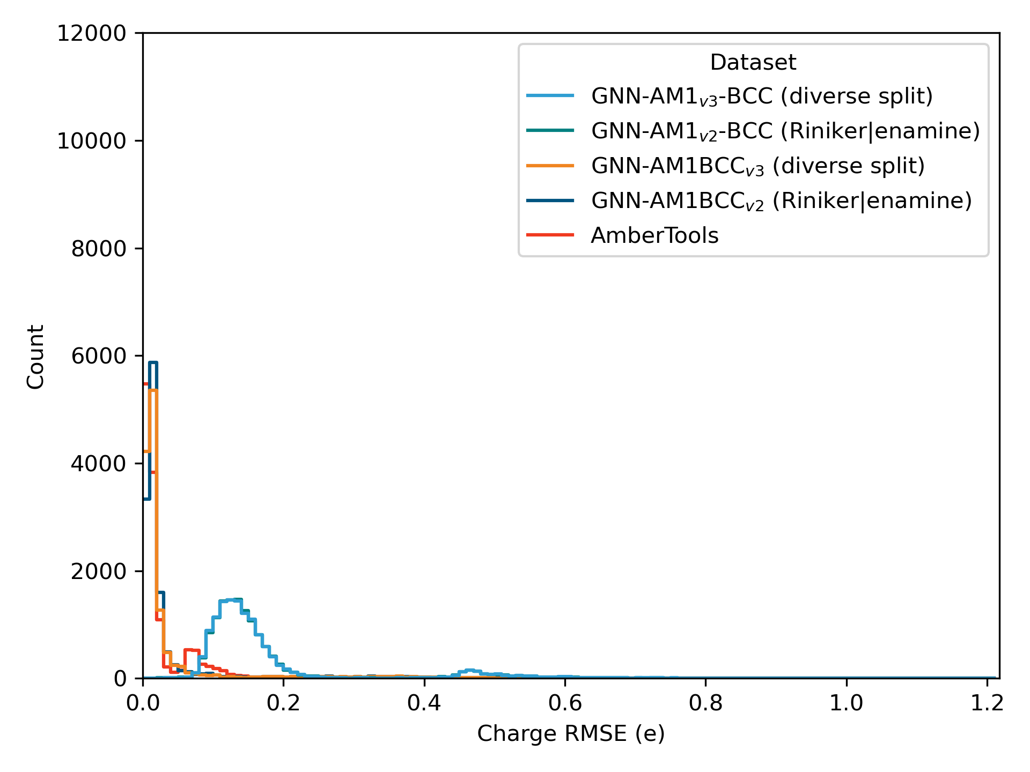
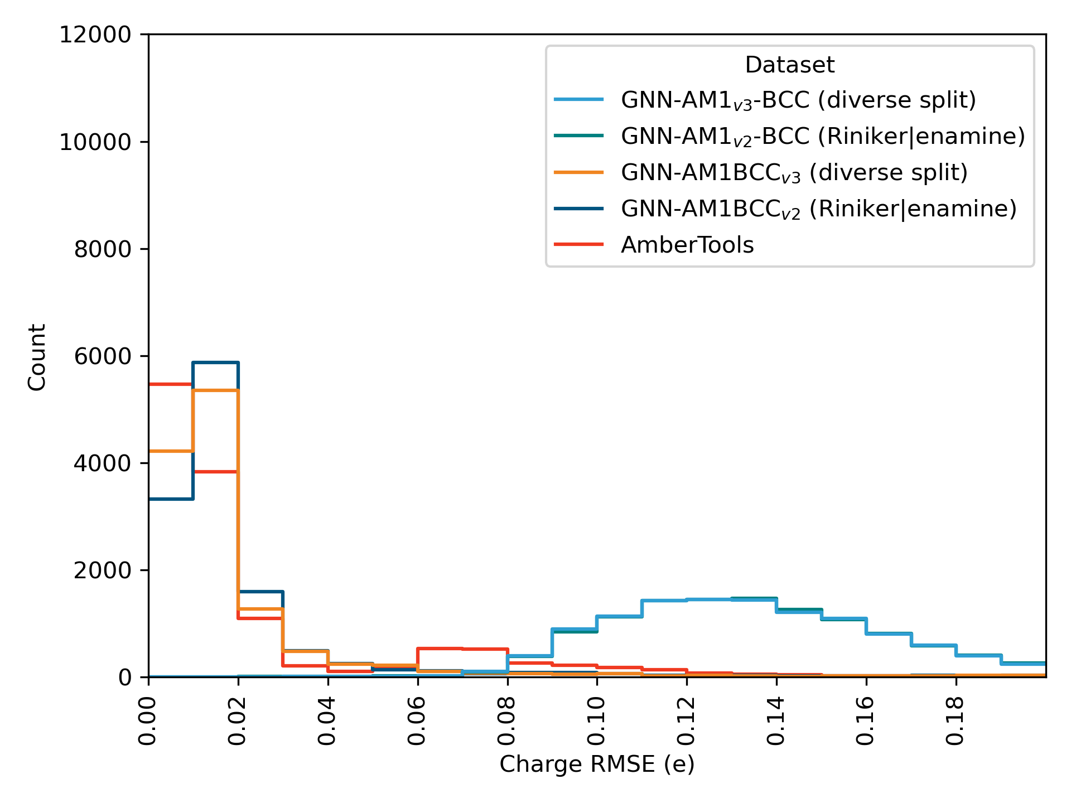
Current models
Spice dataset

Slide 11
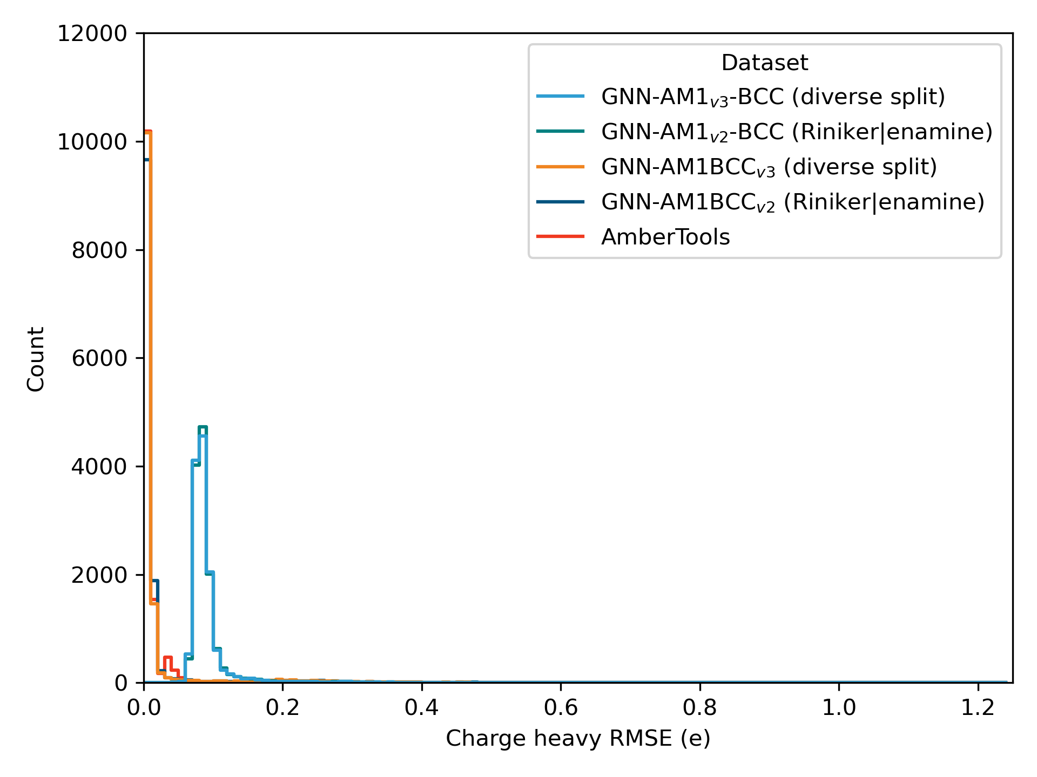
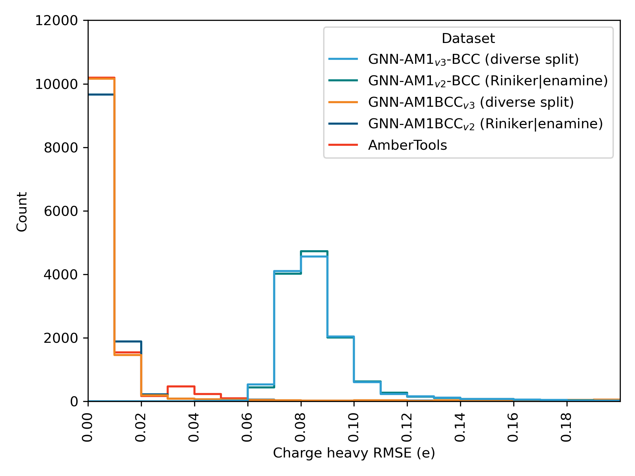
Current models
Spice dataset

Slide 12
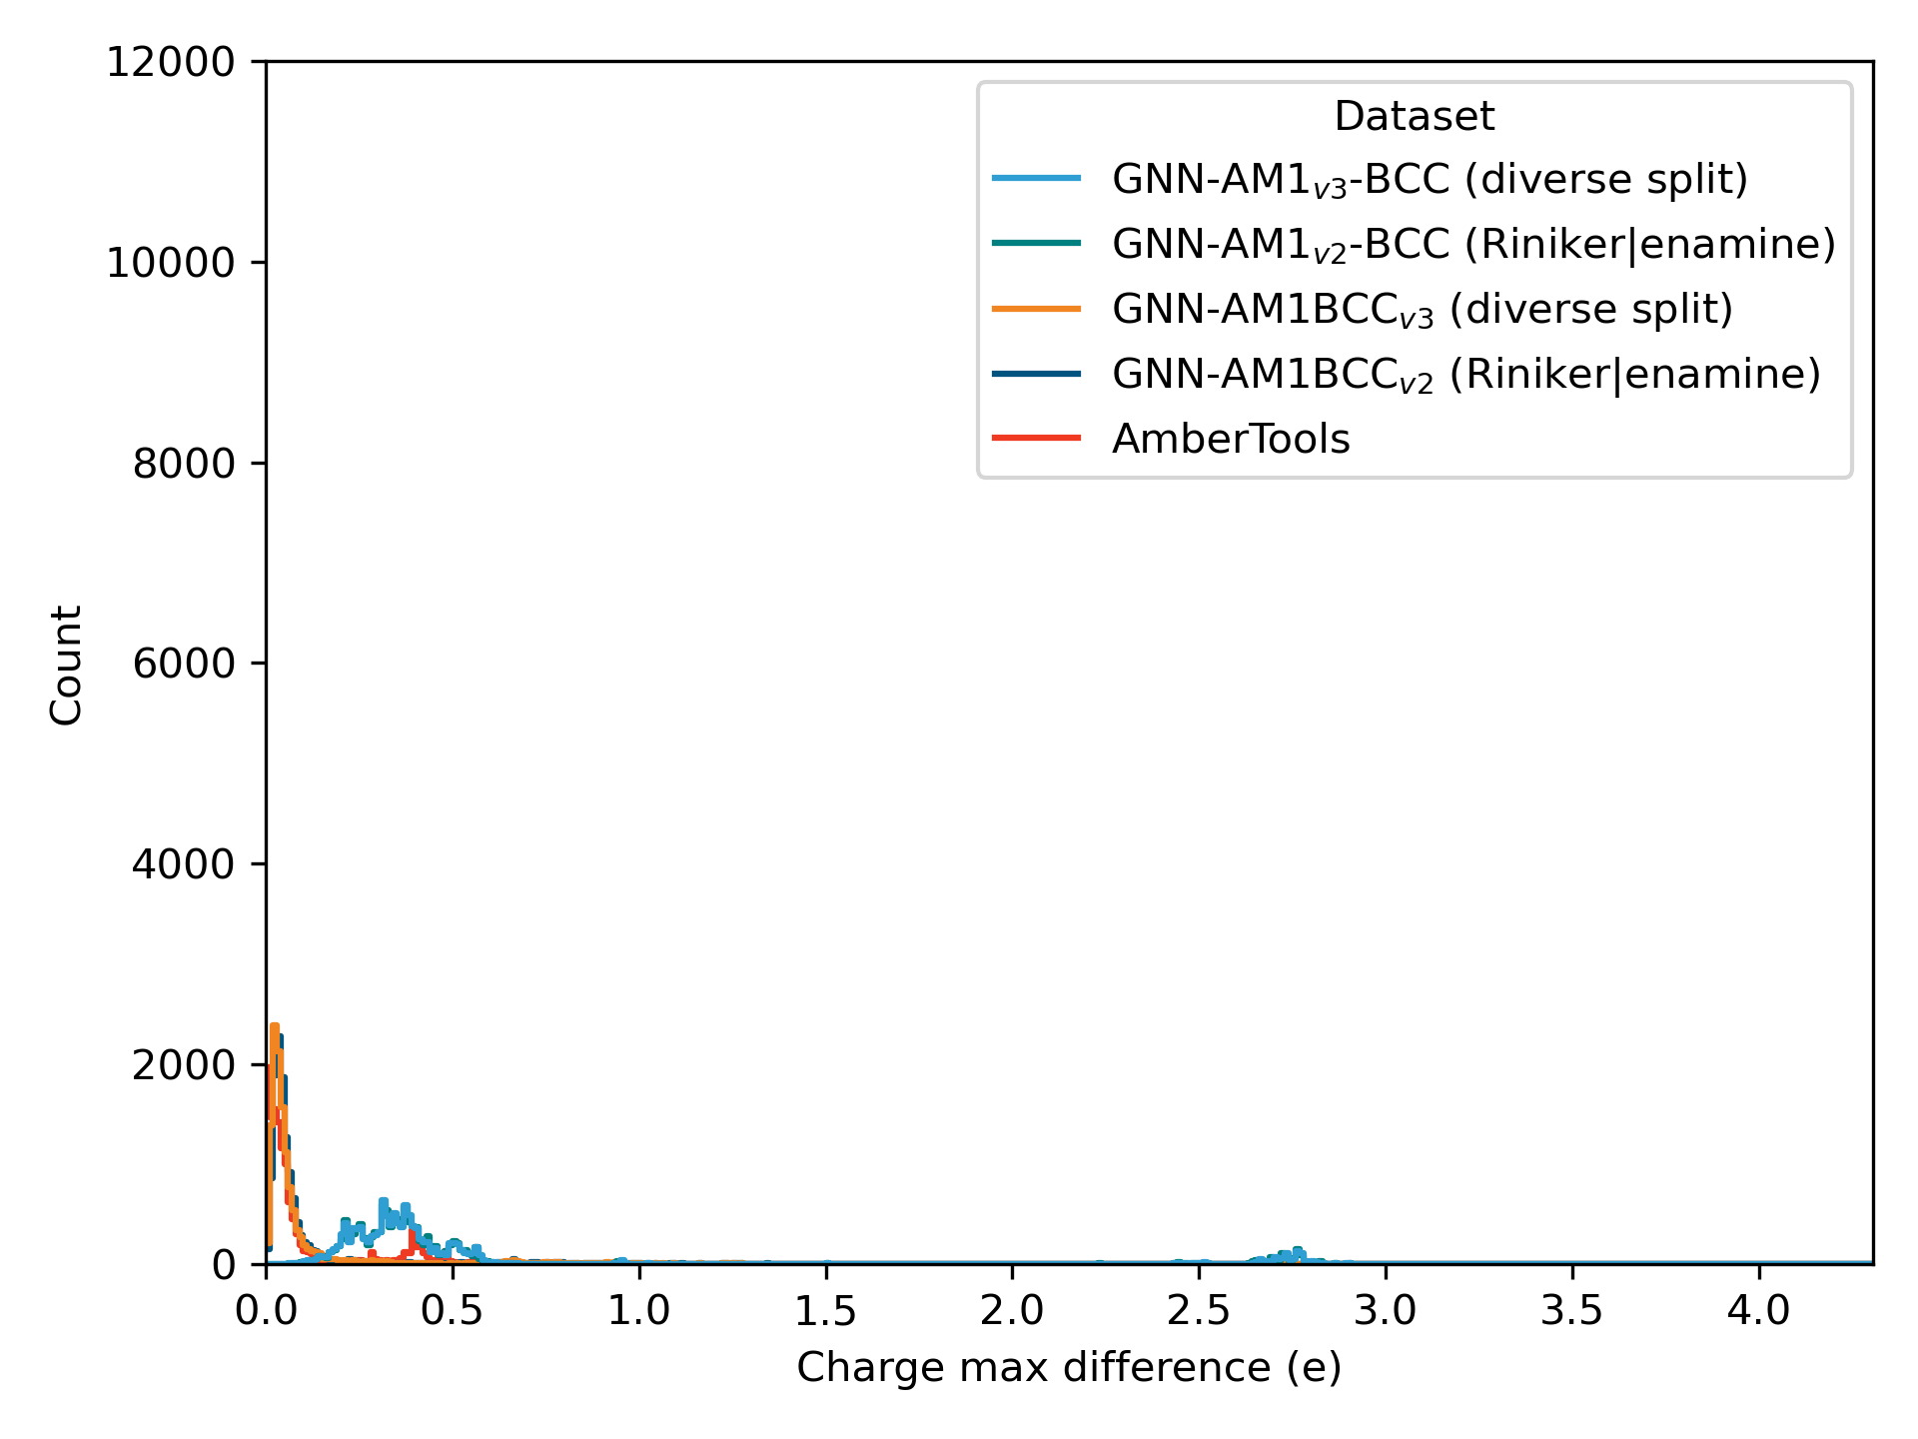
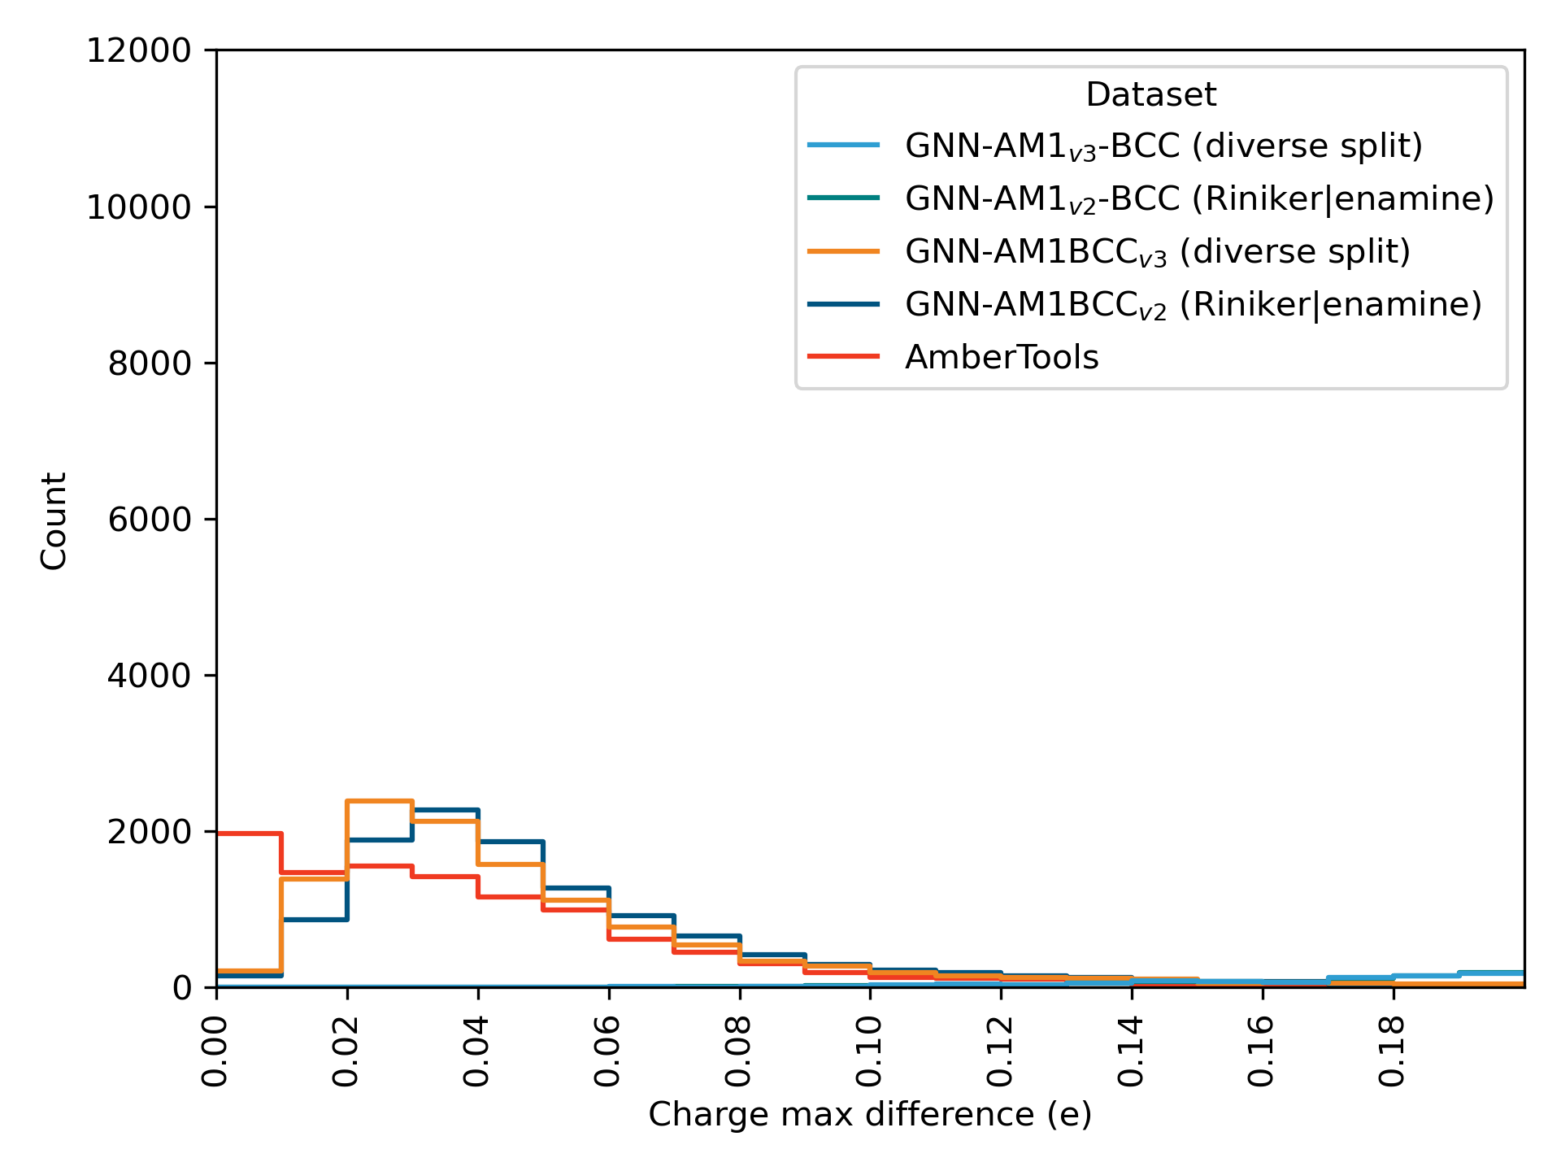
Current models
Spice dataset

Slide 13
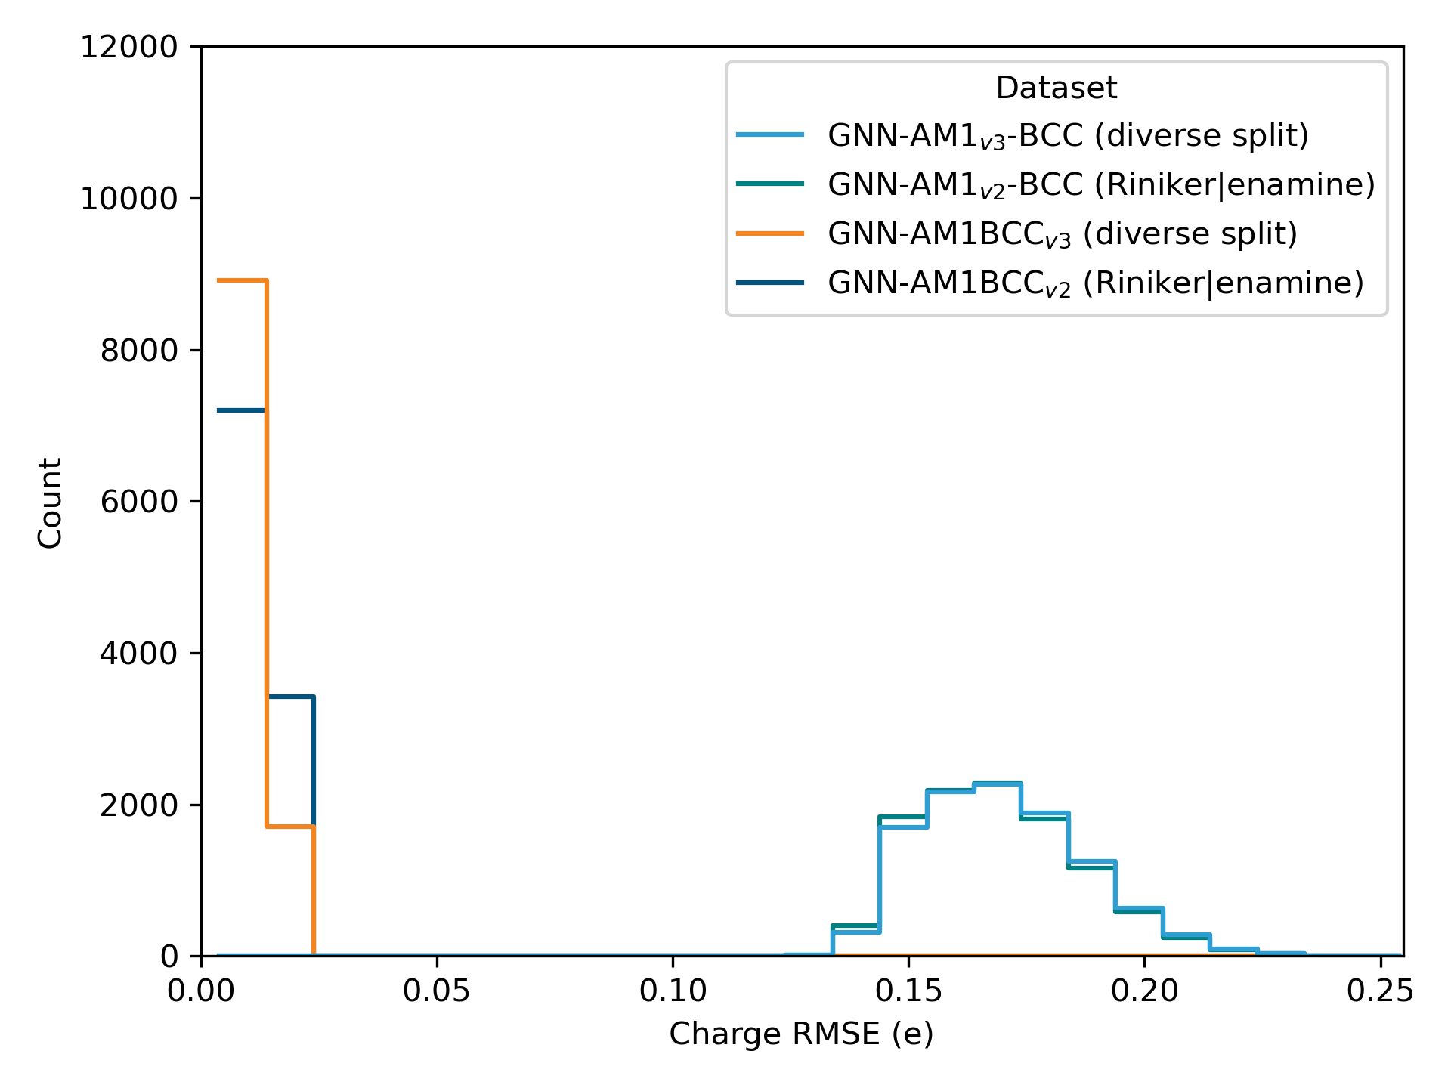
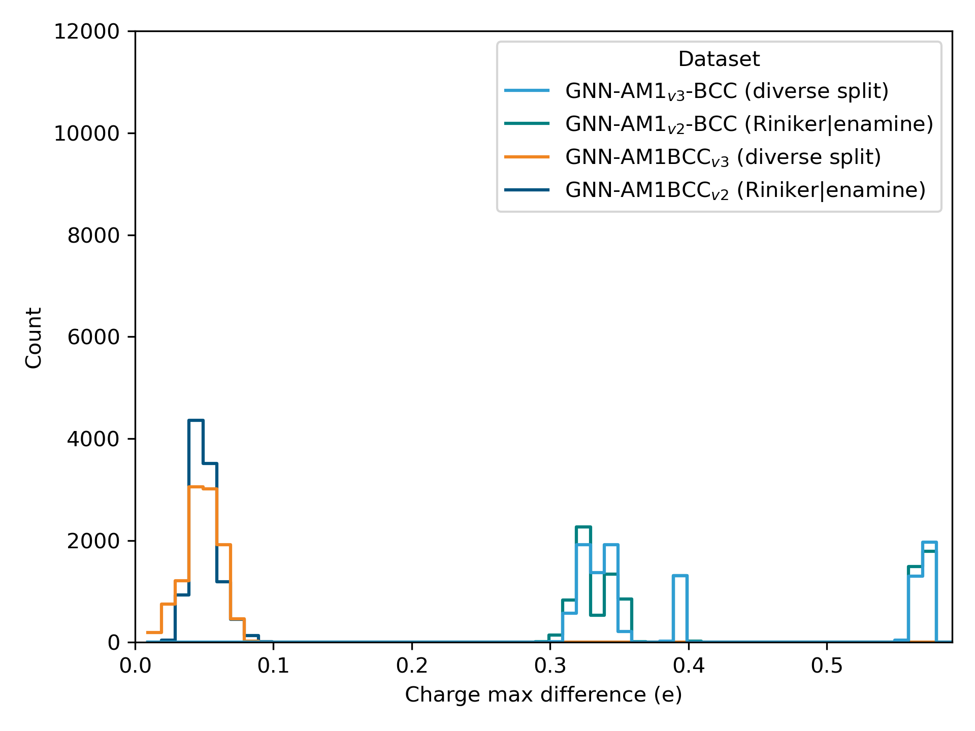
Current models
Peptides (length 1-5)

Slide 14
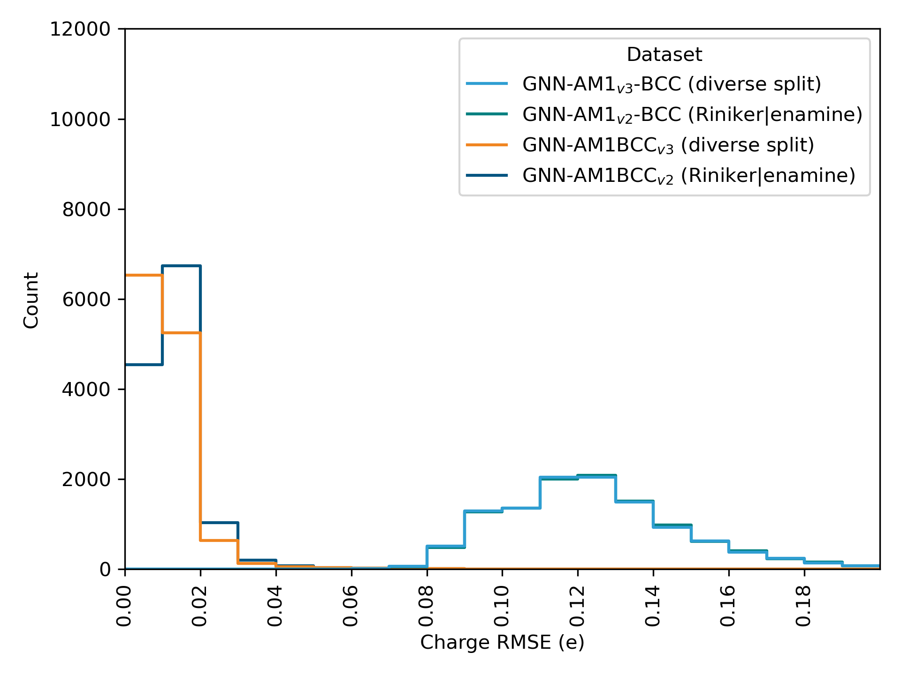
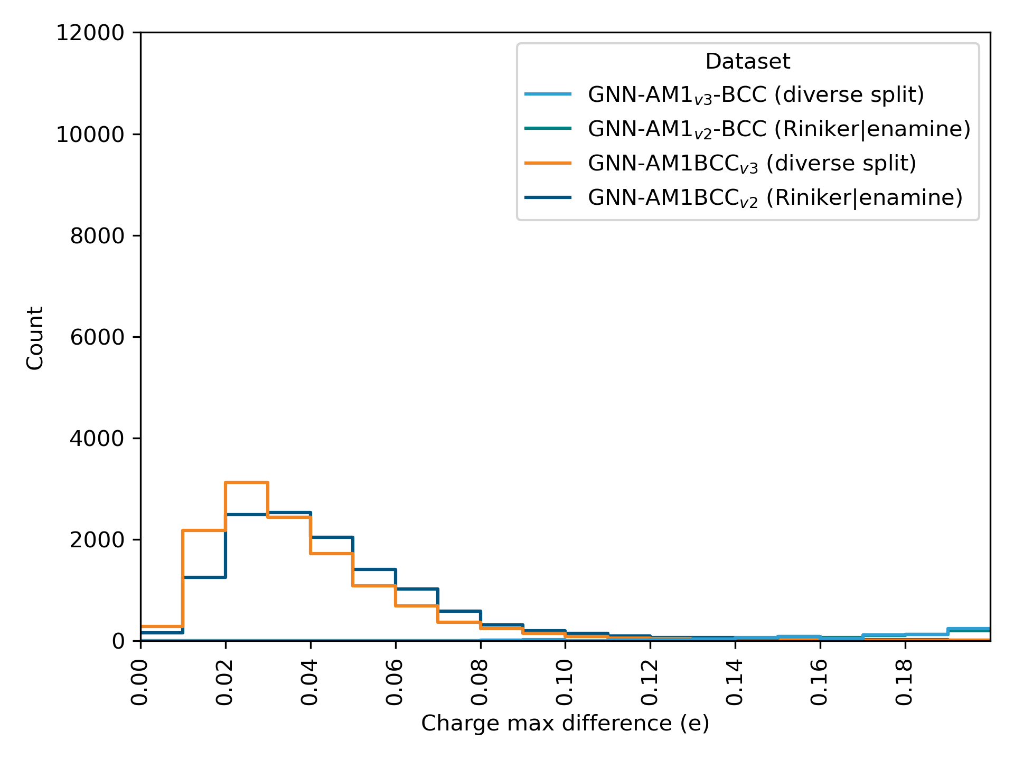
Current models
OpenFF Benchmark set

Slide 15
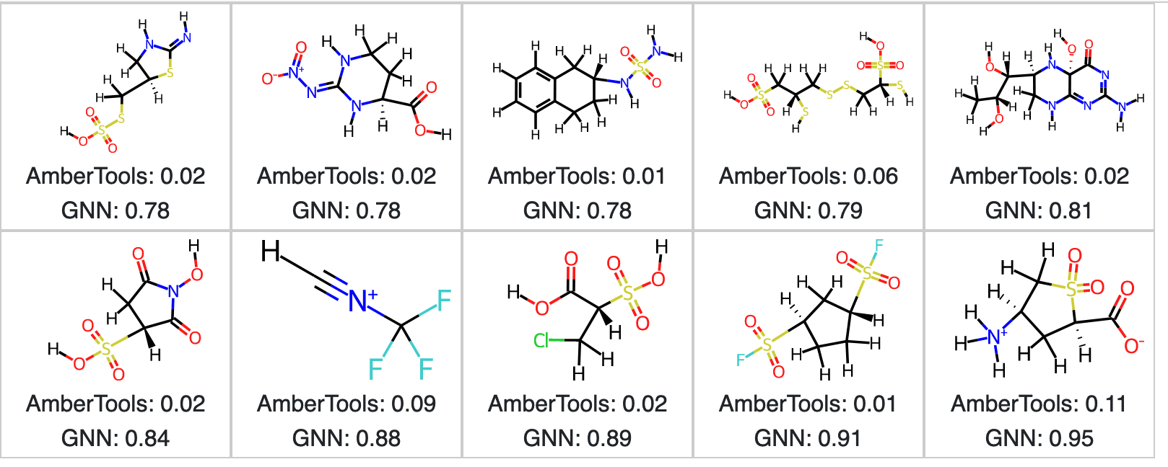
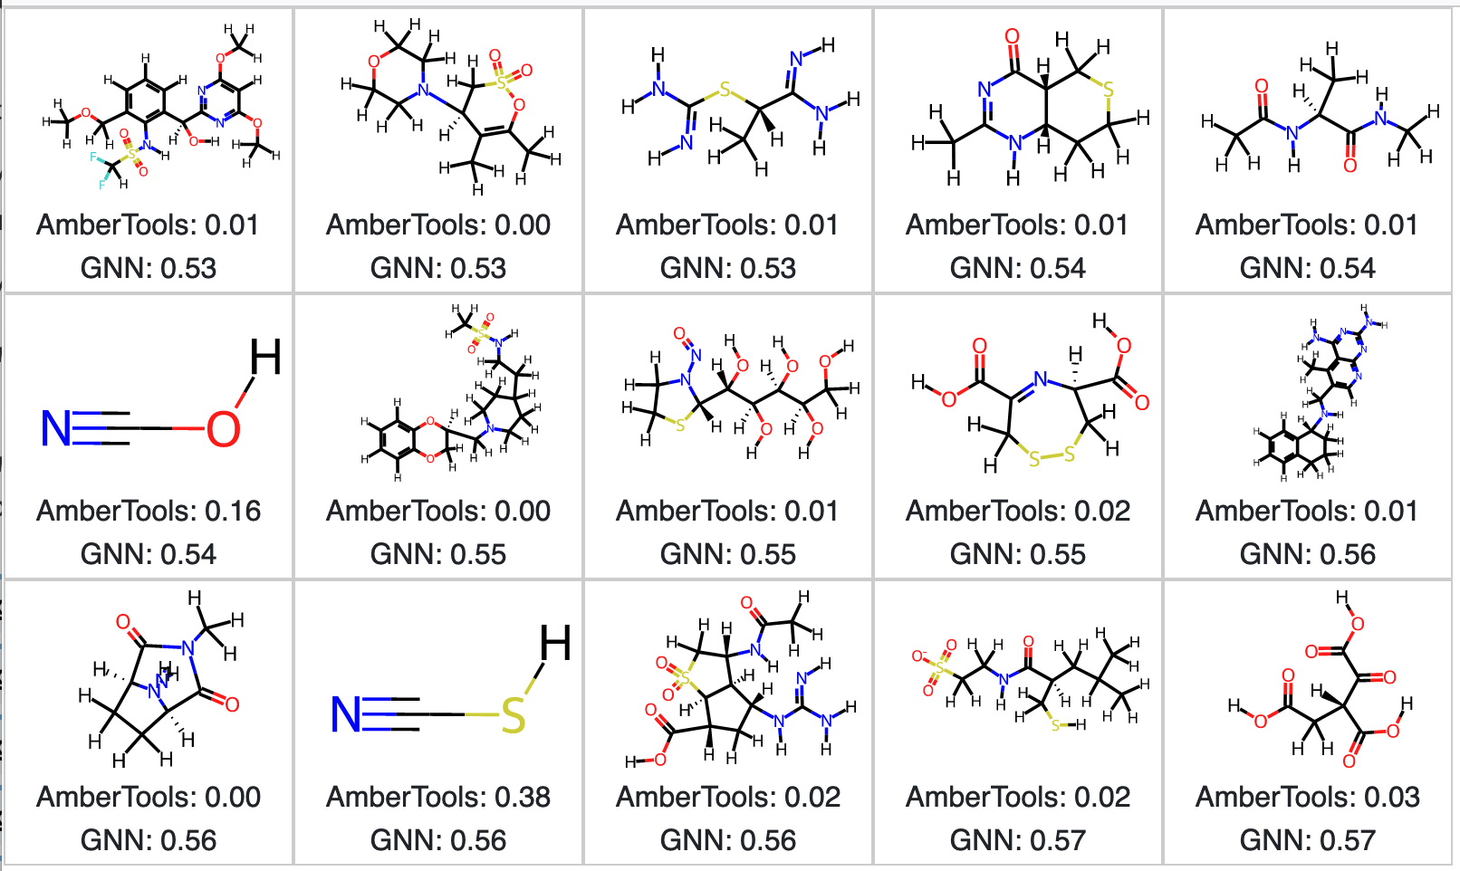
Current models
Examples of poorly performing molecules

Slide 16
Future directions
Next steps
Fix bug in training datasets with some mixed-up records – re-train
Look closer into outliers
  Possibly add to training set, especially with more S or H environments
Finish computing AM1-BCC charges for larger molecules with AmberTools
Improving efficiency / adding documentation / user-friendliness to OpenFF NAGL
Other directions
Improving BCC training
Investigate architectures with edge features

Slide 17
Slide graveyard

Slide 18
Theory
Message-passing neural networks
[0.14 , 0.091, 0. , ..., 0.363, 0.192, 0. ],
[0.127, 0.196, 0. , ..., 0.373, 0.306, 0.002],
[0.066, 0.242, 0. , ..., 0.432, 0.333, 0.135],
[0.321, 0.25 , 0. , ..., 0.59 , 0.528, 0. ],
[0.241, 0.323, 0. , ..., 0.368, 0.351, 0. ],
[0.241, 0.323, 0. , ..., 0.368, 0.351, 0. ]
[1., 0., 0., 0.],
[0., 1., 0., 0.],
[0., 0., 1., 0.],
[0., 0., 0., 1.],
[0., 0., 0., 1.],
[0., 0., 0., 1.]
Notes:
How MPNNs work
General structure

Slide 19
Theory
Message-passing neural networks
Notes:
How MPNNs work
General structure

