Slide 1


Meeting different stakeholders’ needs
Emma Lazzeri, GARR
orcid.org/0000-0003-0506-046X

Slide 2
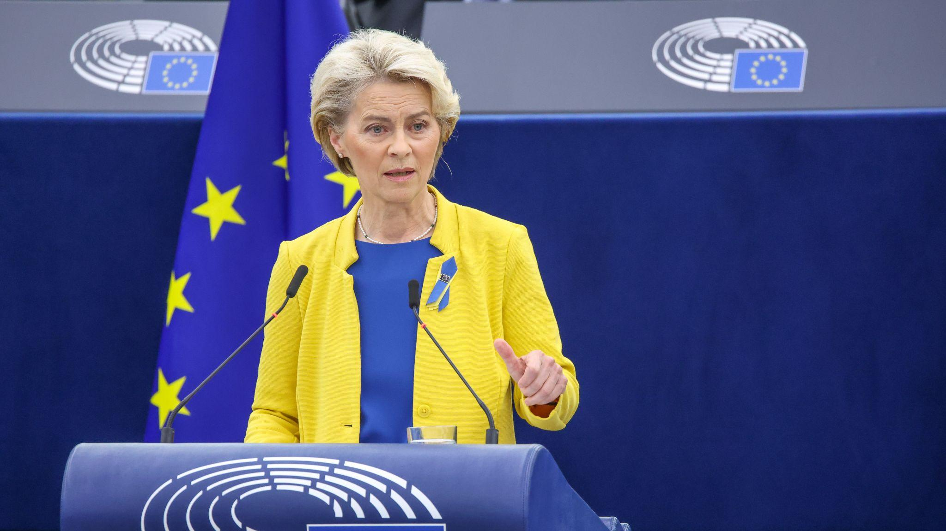
Slide title
“We need an enabling business environment, a workforce with the right skills [...]”
Text
Bullet
  More bullets
    Some extra bullets
2022 State of the Union Address by President von der Leyen,
14 September 2022, Strasbourg

Slide 3
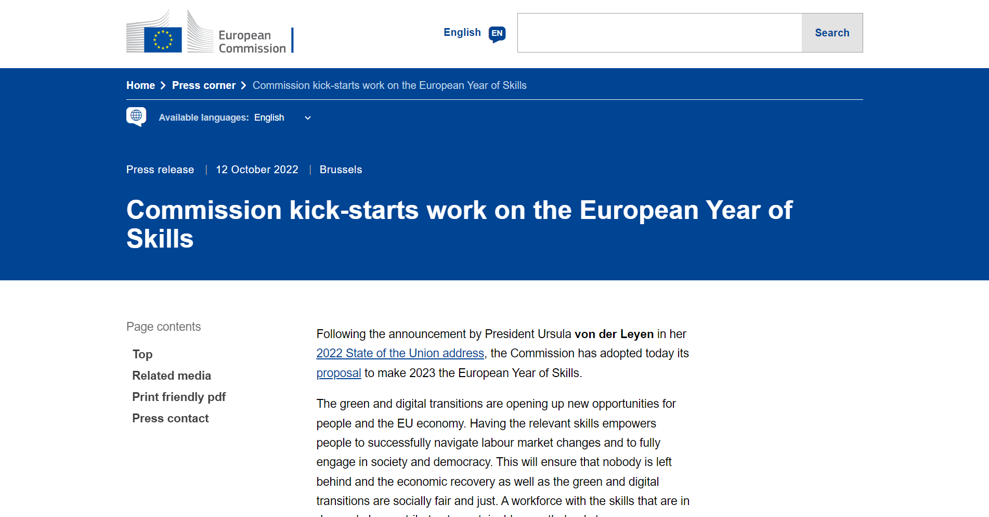

Slide 4

We need skills to put FAIR into practice!
Photo by Cookie the Pom on Unsplash

Slide 5
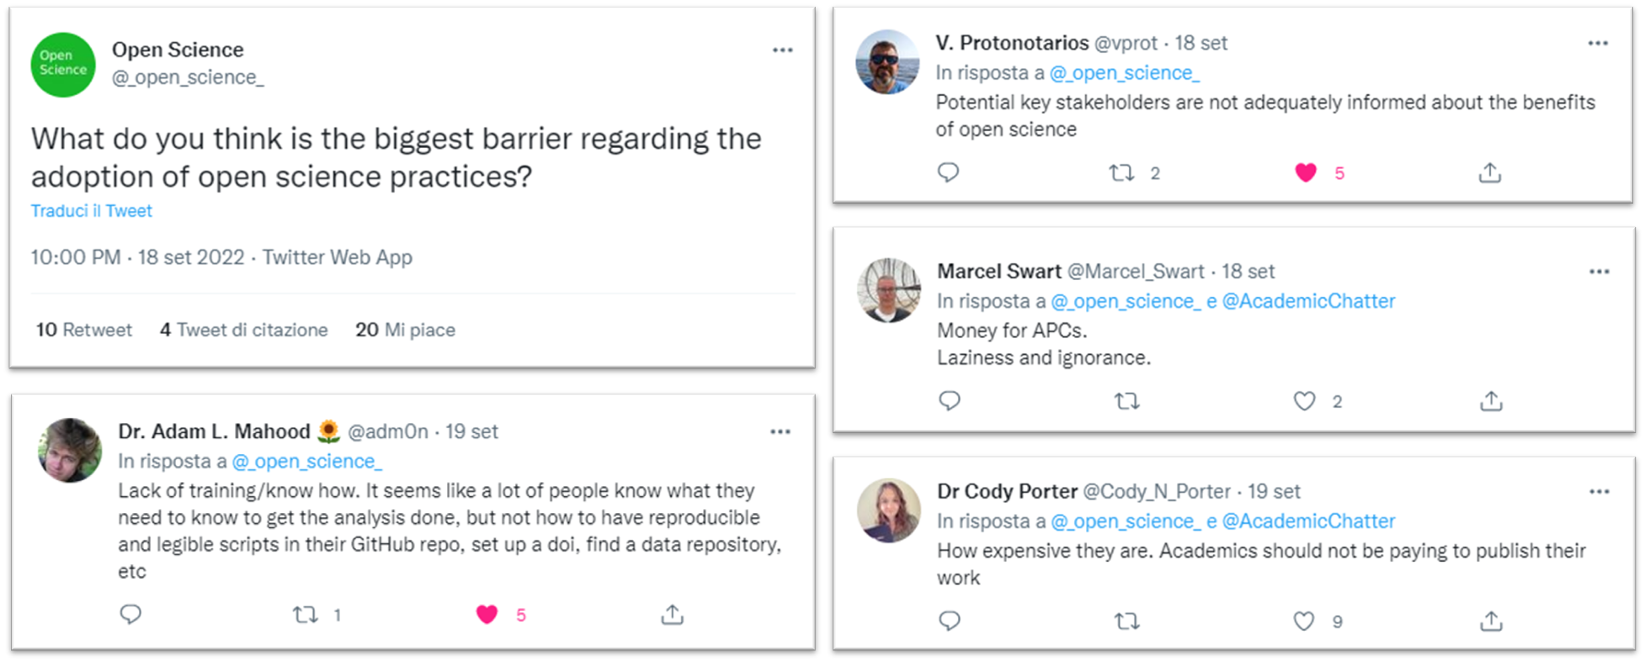
Meeting the stakeholders’ needs
https://twitter.com/_open_science_/status/1571589893595463682?t=dK7ApIFOVp7ACFTXxeBXAA&s=08

Slide 6

Filling the gaps
Supporting an EOSC-ready digitally skilled workforce:
Researchers can transform how they carry out research and exploit research outputs, leading to better quality and contributing to the Horizon Europe EOSC Partnership.
Horizon Europe call INFRA 2021 EOSC01-01
Bullet
  More bullets
    Some extra bullets

Slide 7
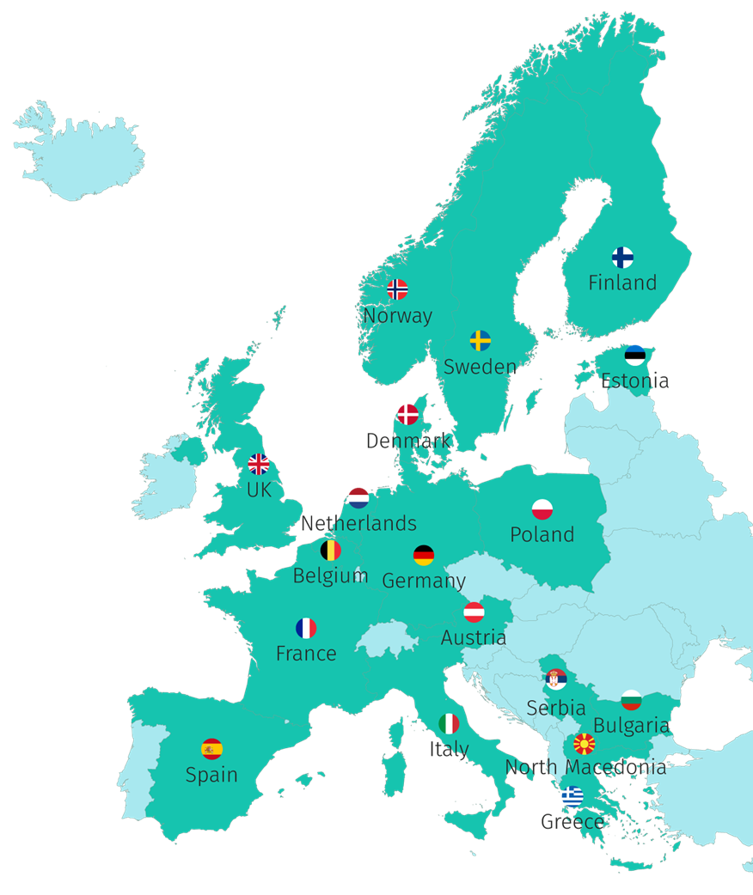





44 Participants, 18 Countries
“Key doers” in Open Science in their Country/Region/Domain
2 ESFRI Research Infrastructures
7 millions €

Slide 8

Filling the gaps
Lack of Open Science and data expertise,
Lack of a clear definition of data professional profiles and corresponding career paths, and
Fragmentation in training resources.
Photo by Randy Laybourne on Unsplash

Slide 9



FAIR and Open Science also means
Making science and its results accessible
to different actors
(policy makers, civil servants, citizens, private sector, ....)
using adequate language
(mother tongues, differentiating messages, …)
using the right mean
(social, dedicated events, blog, reports, interviews, ....)

Slide 10


Keeping in mind
Responsible Research and Innovation
Scientific research and technological development processes that take into account effects and potential impacts on the environment and society
Science for policy
Increase the impact of research results on policy and society at large

Slide 11



How?
Propose
Coordinate
Enable
A FAIR-by-design methodology for open science teaching and learning
Network of Competence Centers on Open Science and FAIR Data
Raise competences for an EOSC-skilled European workforce

Slide 12
Key Concepts
Harmonise curricula and learning paths
Lifelong learning through professional networks
FAIR-by-design learning materials
Minimum viable
skillset
Train
of
Trainers
Competence Centre Network

Slide 13

Developing paths for different targets…
Photo by George Bakos on Unsplash

Slide 14

Science for Policy
honest brokers,
civil servants,
policy makers
need to:
inform through evidence,
understand the needs of policy makers,
consider ethical issues at the science for policy interface

Slide 15

Institutions
undergraduate,
PhD, researchers
data stewards and professionists, including data librarian and curators, legal and ethical experts
need to:
count on adequate skilled professionists,
data experts and support staff,
train undergraduates and scientists at different career levels

Slide 16

Professional Networks
lifelong learning through peer networks
need to:
be empowered to put into practice lifelong learning through the learn by doing and best practice sharing

Slide 17

Research Infrastructures and thematic communities
Research Infrastructure professionals, Researchers belonging to specific communities
need to:
Acquire specific OS and RDM skills
Tailor training on specific needs to embed FAIR principles in the research workflow

Slide 18

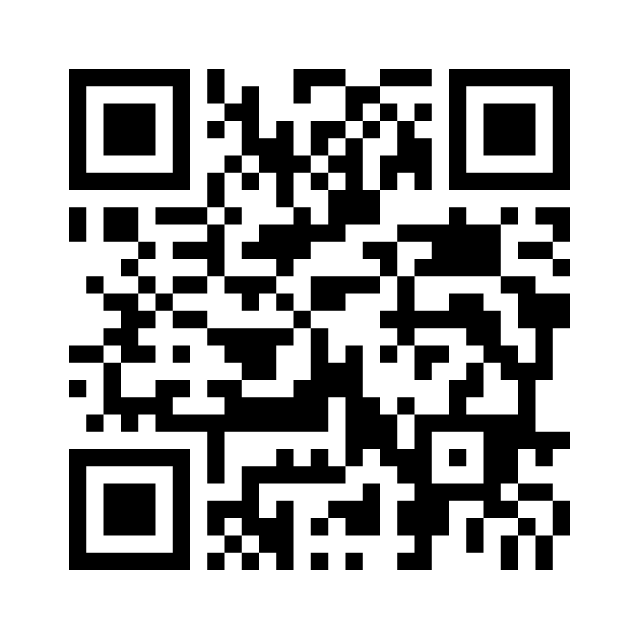
Have
your say!
Photo by krakenimages on Unsplash
www.menti.com
4395 8135

Slide 19


Thank you!
Questions?
This presentation is released under a CC-BY 4.0 license. To cite this presentation, please copy and paste: Lazzeri, Emma. (2022, November 14). Meeting different stakeholders’ needs. EOSC Symposium, Prague, 2022. doi: 10.5281/zenodo.7319683

Slide 20

Links and references
2022 State of the Union Address by President von der Leyen, 14 September 2022, Strasbourg, https://ec.europa.eu/commission/presscorner/detail/en/speech_22_5493
Commission kick-starts work on the European Year of Skills, 12 October 2022, https://ec.europa.eu/commission/presscorner/detail/en/ip_22_6086
Skills4EOSC in CORDIS, https://cordis.europa.eu/project/id/101058527
Photo by Tamanna Rumee on Unsplash

