Slide 1
Open-Source Software in Academic Libraries: Benefits & Service
(Galala University) Case Study
By: Mohamed Sayed Ibrahim

Slide 2

Introduction and definition
This introduction provides an overview of open-source software (OSS).First, we found multiple definitions of (OSS), but all of them speak about the same major topics: it is free, accessible, and developing. For example, in 1997, Bruce Perens established The Open-Source Definition and published it in the Debian Free Software Guidelines with many licenses and conditions, such as Free Redistribution, Source Code, and License Distribution, among others.
(Kavanagh, 2004)
Second, the purpose of this paper or why at this time we chose this topic, there are many reasons for that, but we believe that the main reason is financial funding because closed software has a high cost and in third world countries it is not easy to provide the financial cost and that is why we explain the greatest benefit from software Open source is low cost.

Slide 3





Comparison between open and closed source
There are many values used for comparison between open and closed source but I will use some distinct issue categories so I will explain 5 them cost, service, support, innovation, usability Security.
(Lile, 2015)
1.Cost
2. Service and Support
3. Innovation (development)
4. Usability
5. Security

Slide 4
.
From this comparison, I found that open-source software best than closed-source software from the five distinct I take it in comparison, I will explain the Open-source system for the library with two (koha-Dspace)
Distinct | Open source | Closed source
1.Cost | low | high
2.Service and Support | Easy way from the community | Easy way from the installation company
3.Innovation (development) | Less time and fund | Take time and fund
4.Usability | Easy way from the community and manual | Easy way from the installation company and manual
5. Security | Good | Good

Slide 5
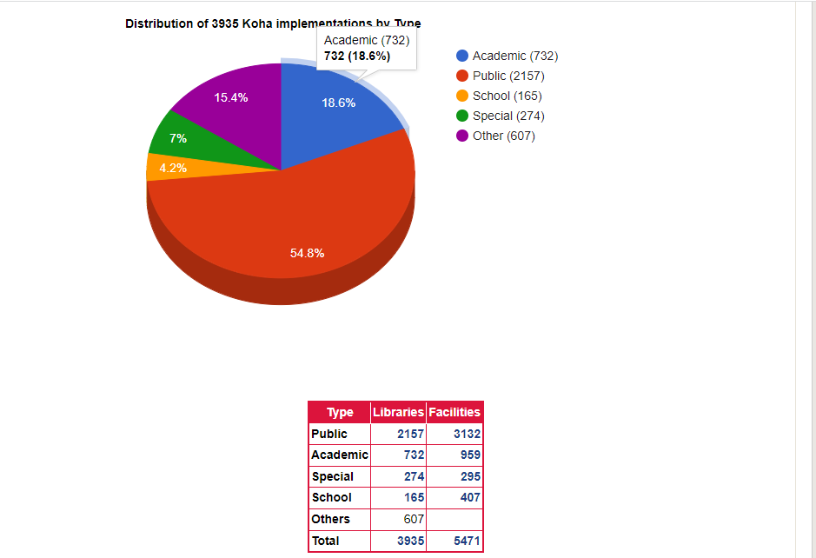
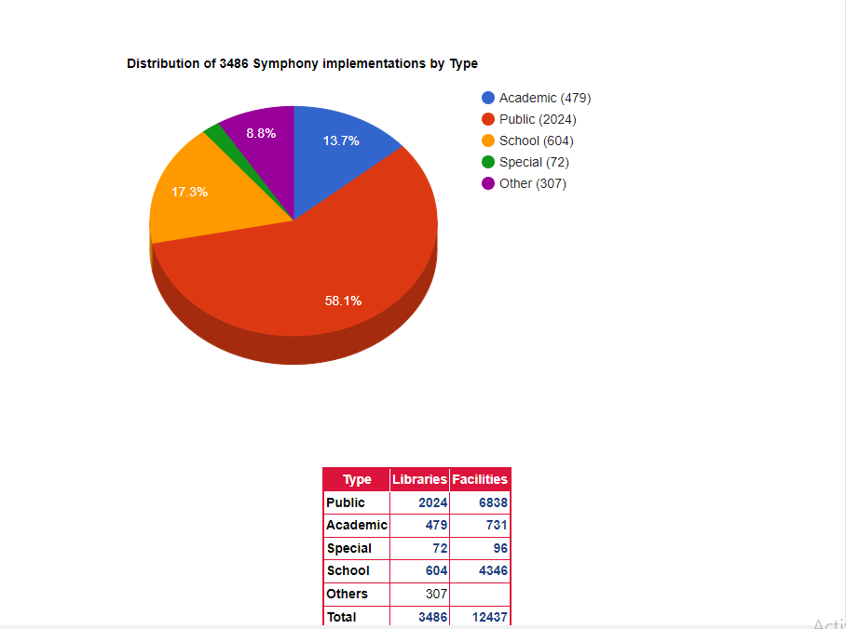
(Koha)
Symphony
Koha has been installed in 3,935 libraries, spanning 5,471 facilities or branches)
Symphony has been installed in 3,486 libraries, spanning 12,437 facilities or branches)
implementations by Type of Library
implementations by Type of Library
(Library Technology Guides:2020.)

Slide 6
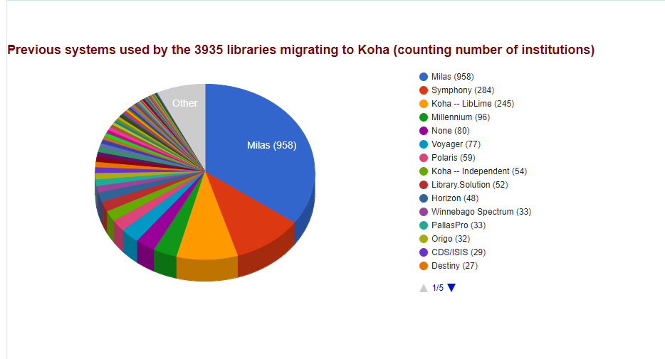
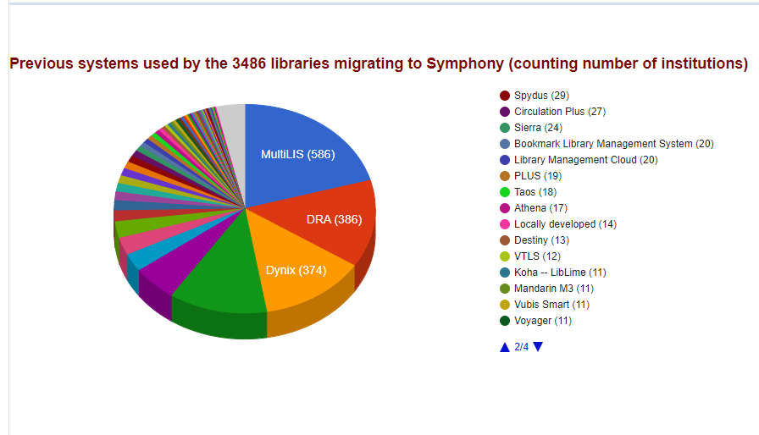
System migration patterns for Koha System migration patterns for Symphony
(Library Technology Guides:2020.)

Slide 7
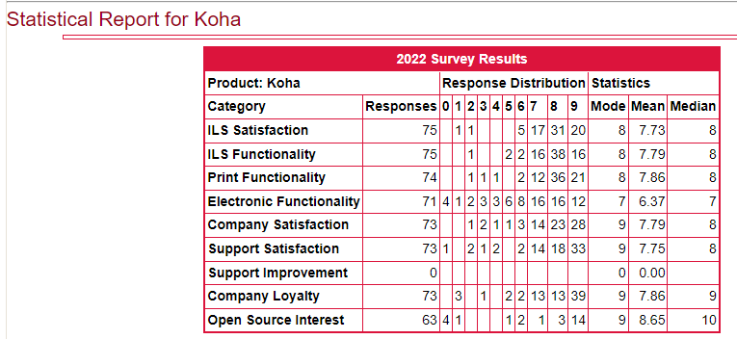
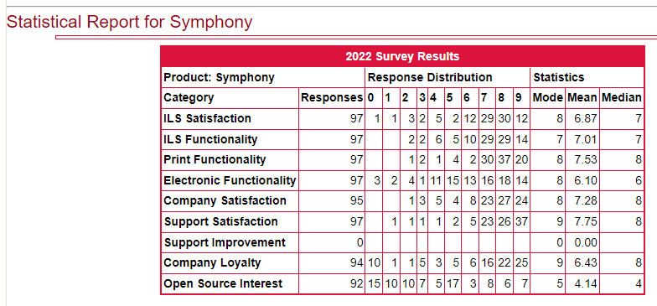
Koha Satisfaction Ratings
Symphony Satisfaction Ratings
(Library Technology Guides:2020.)

Slide 8
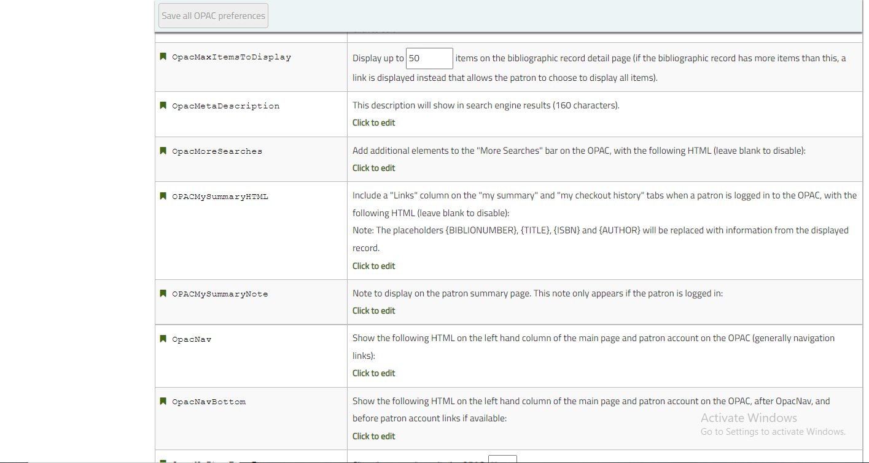
(Koha services and features)
There are three kind of users for system admin- librarian – opac user
Admin :
Online public access catalog (OPAC):

Slide 9
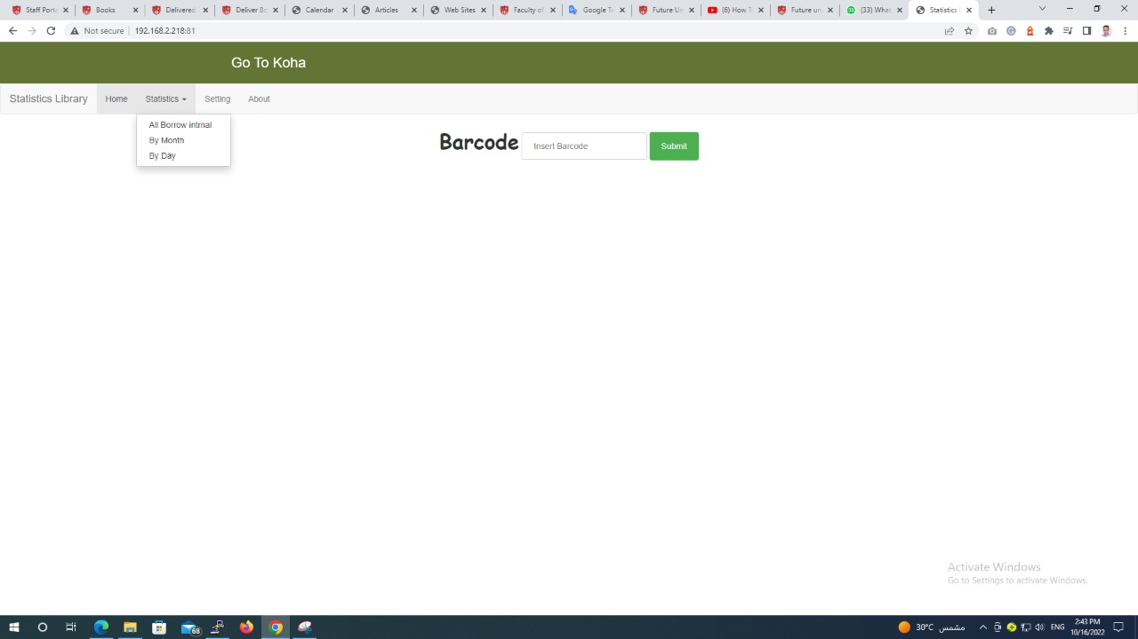
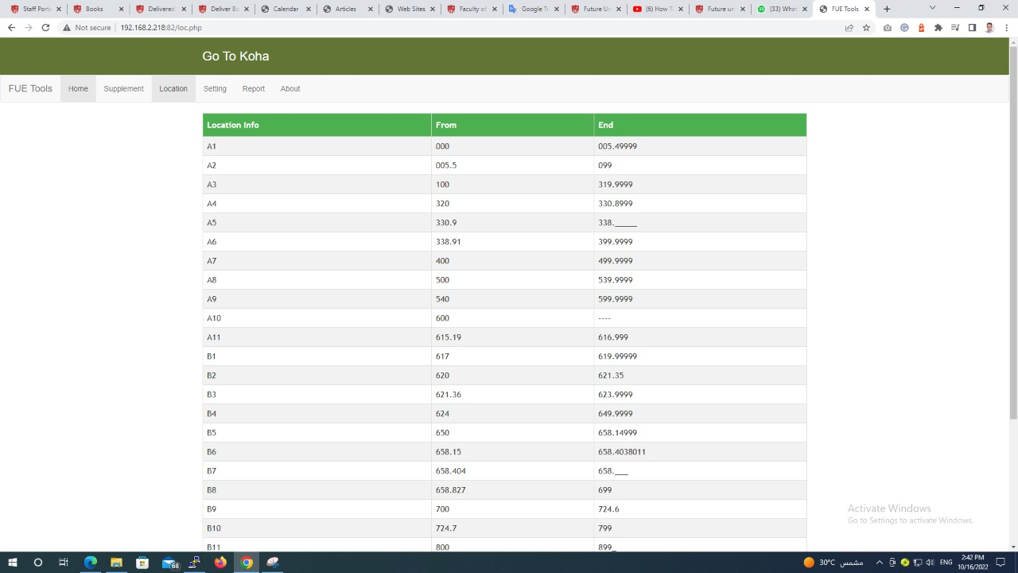
Modules (development):

Slide 10
language:
you can insert more than 25 languages to make staff and OPAC translate to this language and this problem was a big problem specific in the mean region because the Arabic language and in the closed source take a big effort and time to do but when the problem appears all developers in many countries try to solve it and solve it in 2010 and development more and more to 2016 it is a perfect way and do this in the system by this link:
https://wiki.koha-community.org/wiki/Correcting_Search_of_Arabic_records.
And we can put multiple languages in system very easy with the instructor in this link:
http://kohageek.blogspot.com/2013/05/how-to-add-new-language-translation.html#comment-form.
Catalog (update) :
in this part, I mean that the koha system is more flexible in keeping up any updates in cataloging standards like RDA we can change 50% of the RDA standard in every catalog record with very easy without taking time from more than one way for example from the system in MARC modification templates we can make a template to transfer data from the field to another like 260 to 264 and else field or export data out of the system and use application marc edit and change data and return to the system.

Slide 11
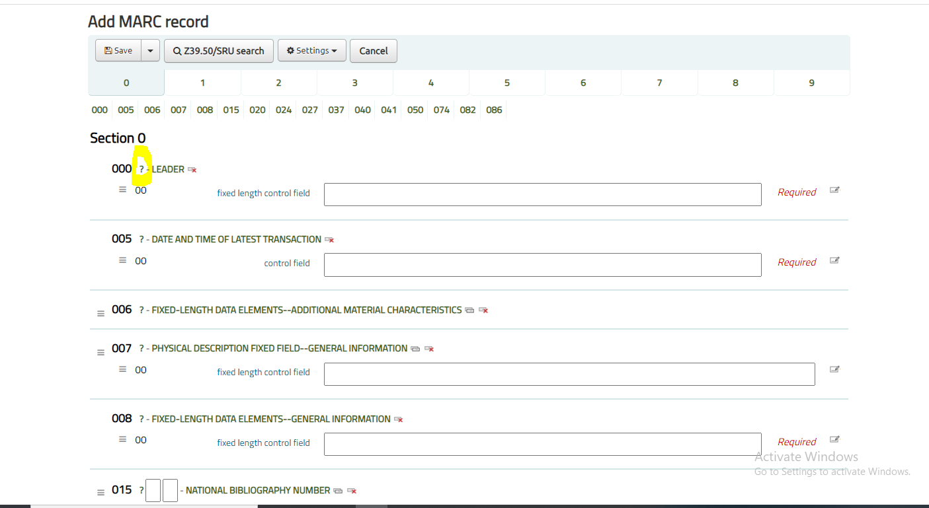
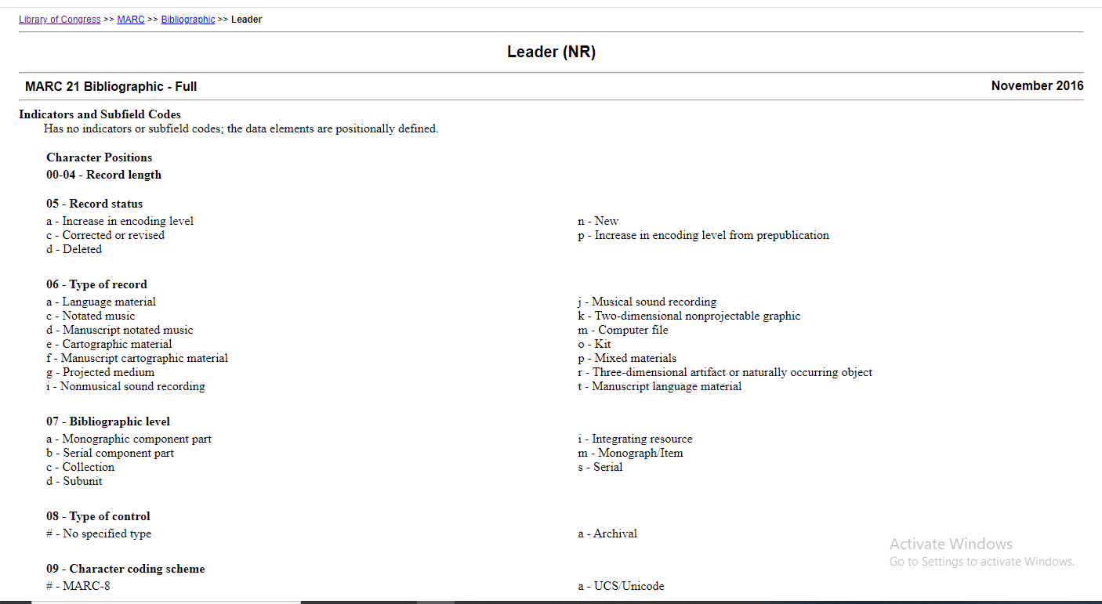
For the librarians:
Cataloging :

Slide 12
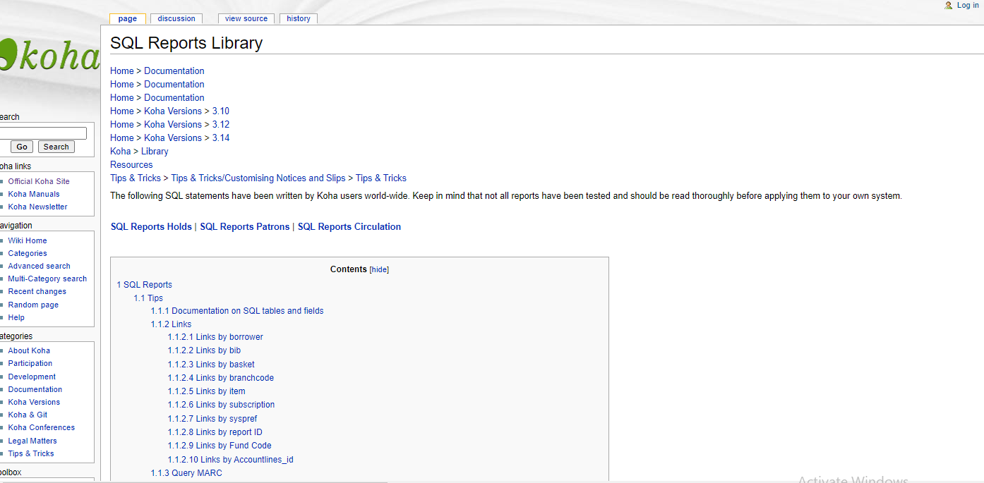
Report:

Slide 13
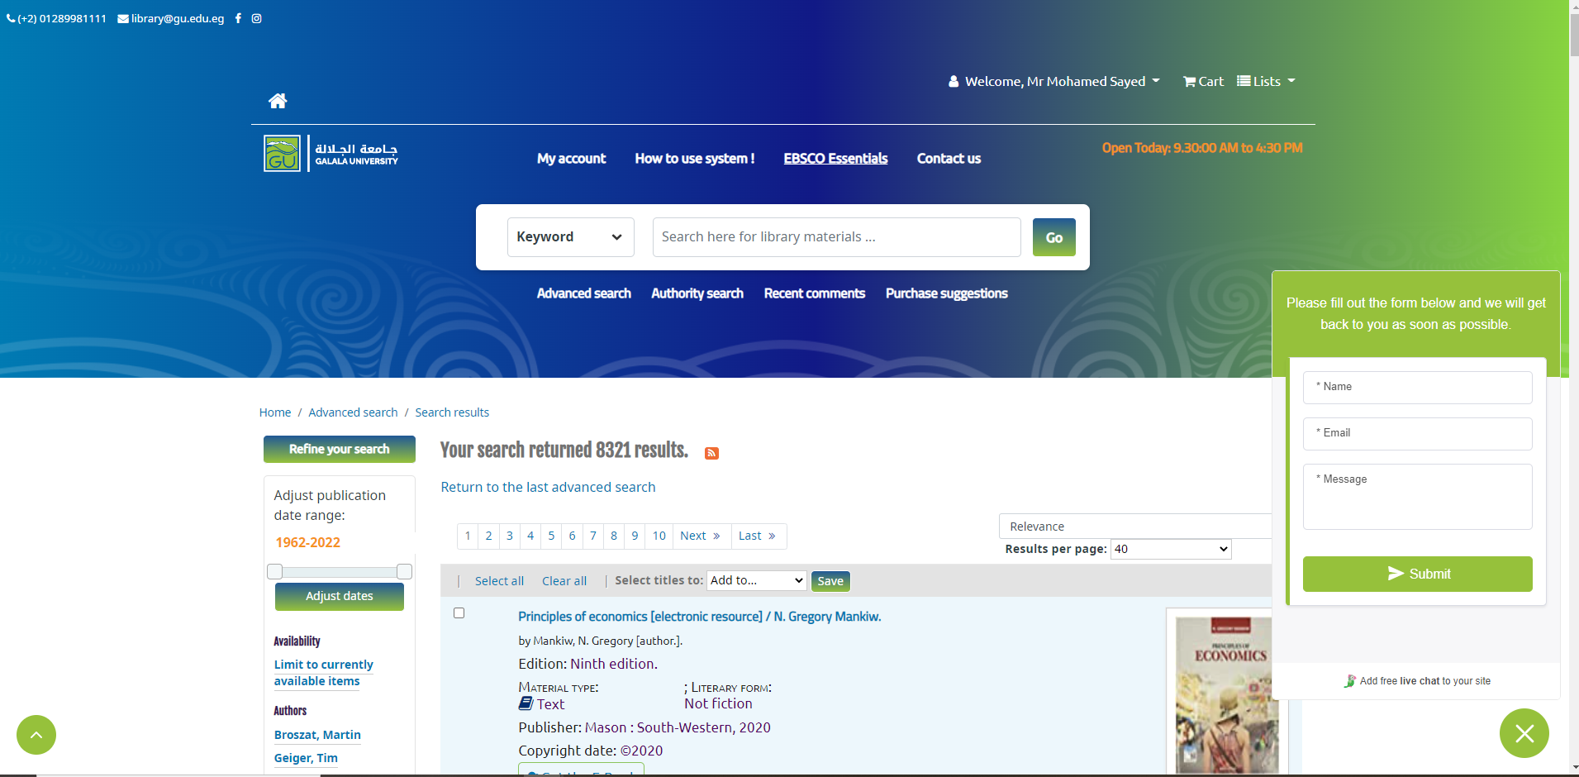
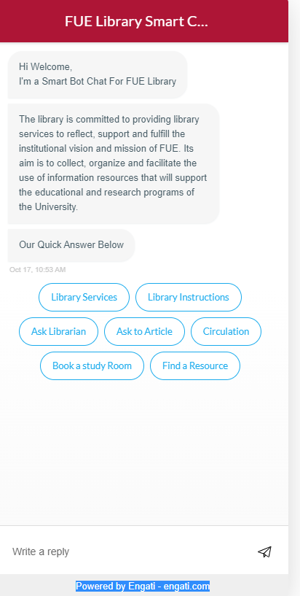
opac user:
Chatbot:

Slide 14
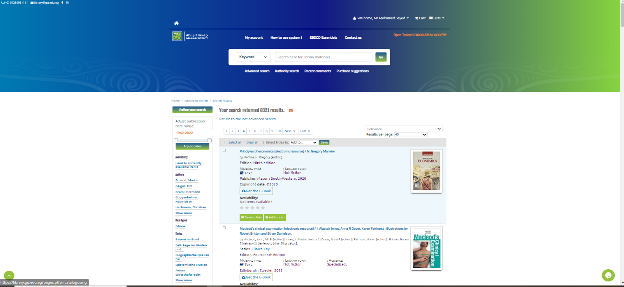
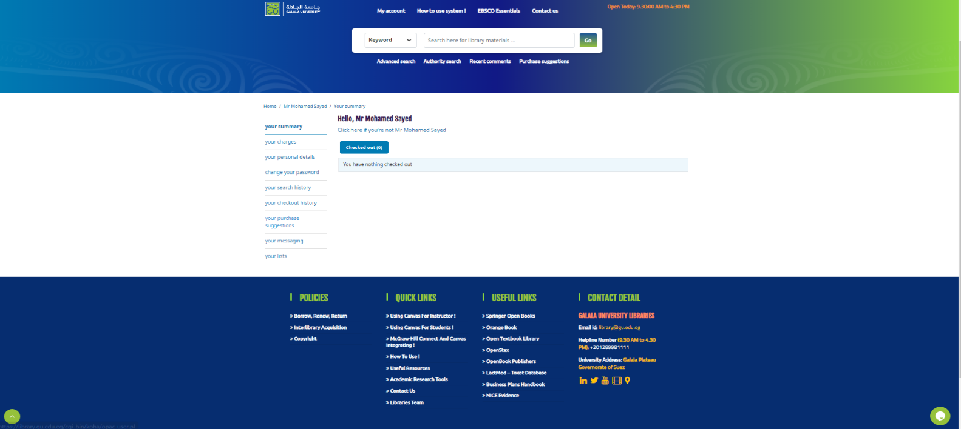
E-book:
My account:

Slide 15
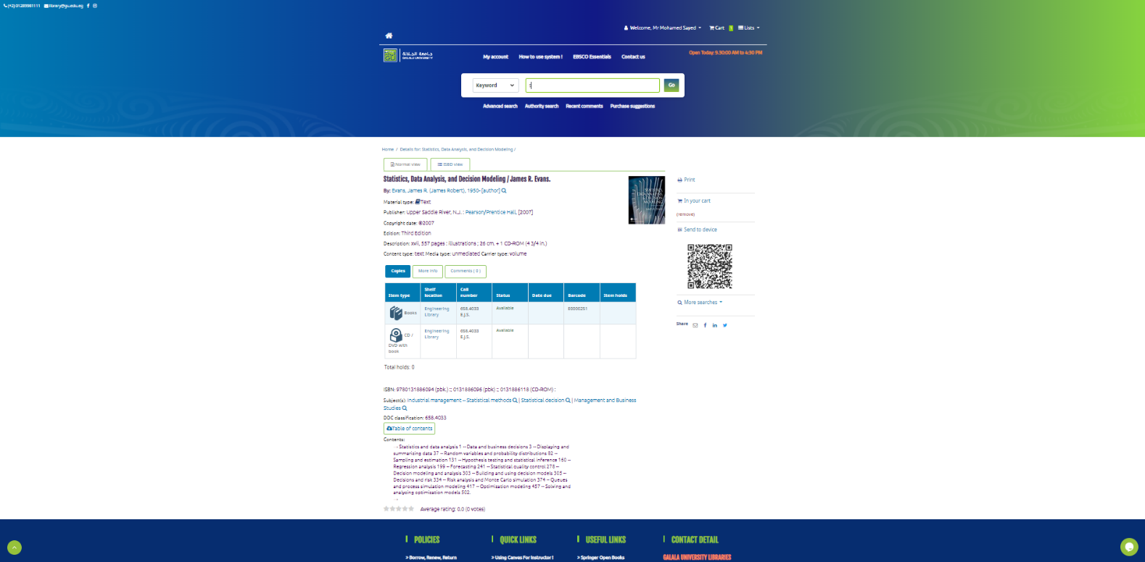
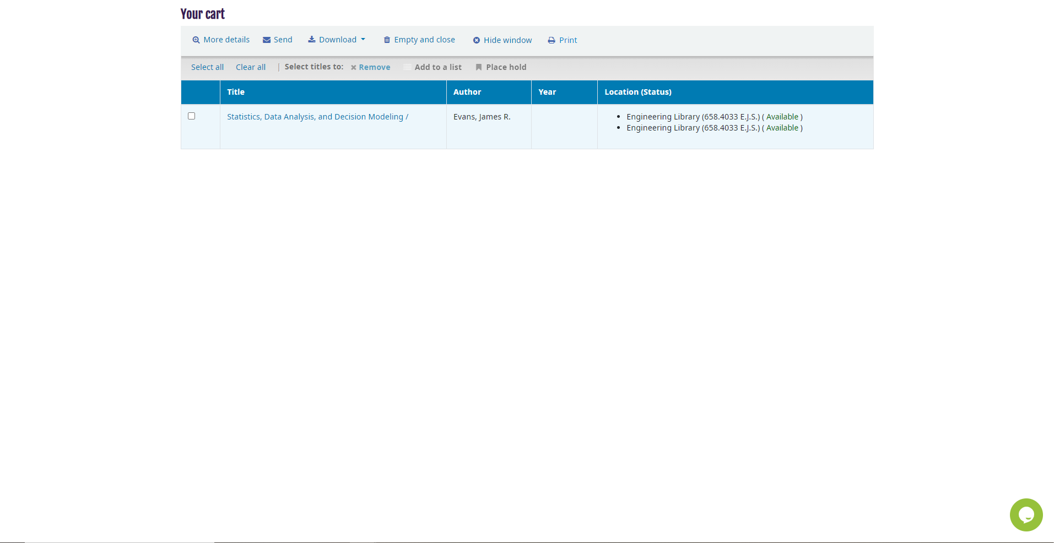
Data record

Slide 16
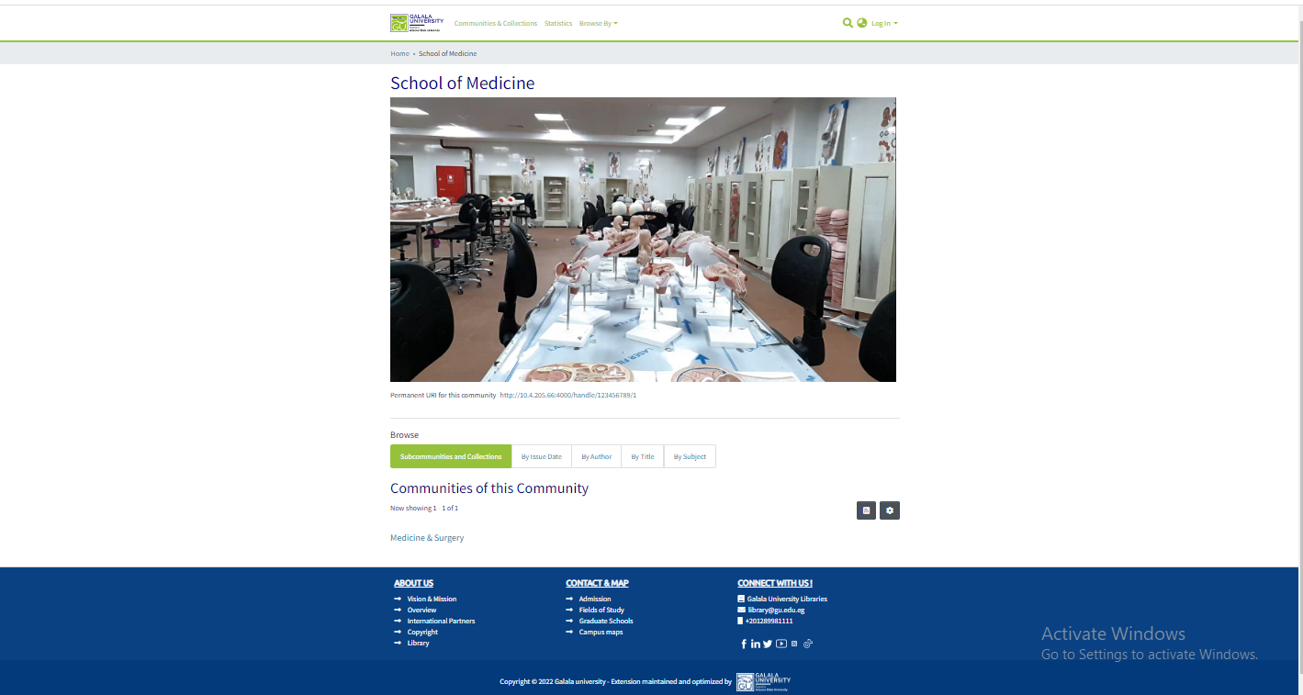
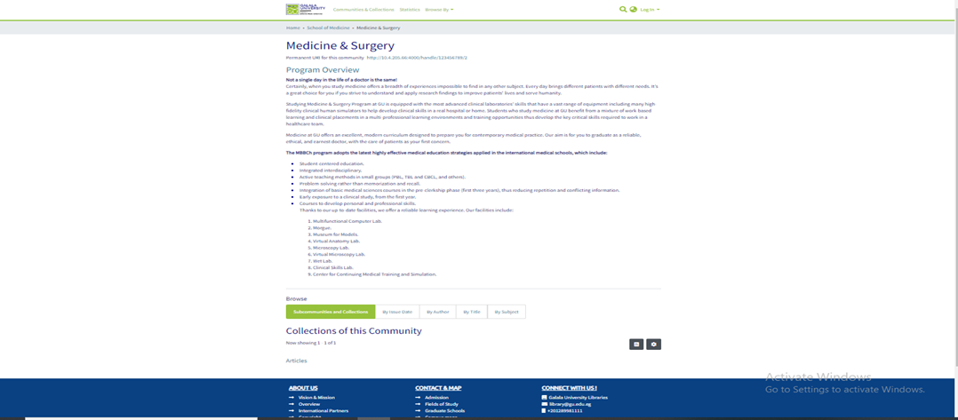
(Dspace)
The definition that DSpace is a digital repository for the institutions so we can use this software for all data in the academic institutions for example the University’s intellectual and research products for the professor and the academic staff, and the student projects, now I will some of services and features in this system.
* Notice: Total Known Installations 3,051 all around the world
SERVICES:

Slide 17
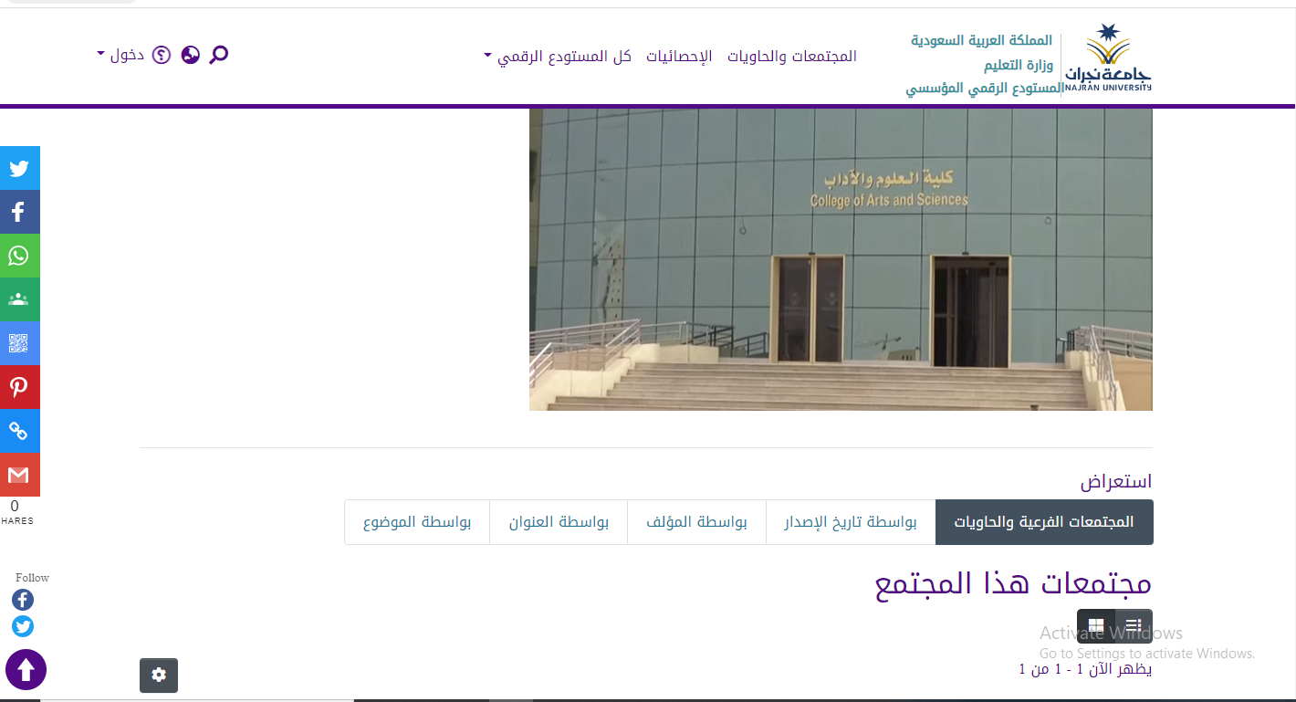
2-Manage and preserve all format of digital content (PDF, Word, JPEG, MPEG, TIFF files): that mean we can put all format in system without no problem. (https://dspace.lyrasis.org/features/)
3-Interface available in 22 languages: in this site we will found that dspace is support Arabic language in interface we can se this in this link “ https://repo-nu.maktabat-online.com/home”

Slide 18
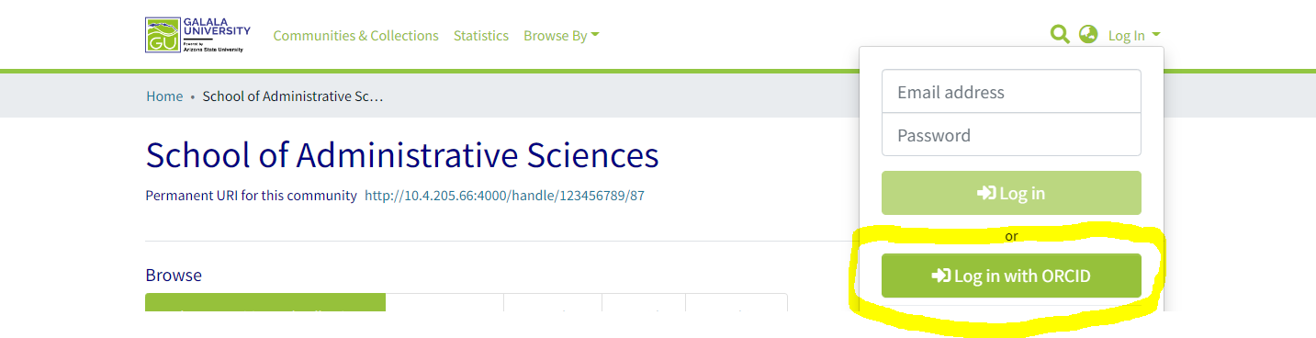
4-Optimized for Google Scholar indexing.
5- ORCID Integration with dspace:

Slide 19
Conclusion
In this paper, I explain the difference between open source and closed sources and provide an example of this system in an academic library, obtaining the following results:
1-Because of the low cost, support, and ease of use, open-source software is the best option for academic libraries.
2-Based on the statistics in the paper, I believe that open-source systems will be the future of systems in all fields in 5 or 10 years, depending on human resource technology development.

