Slide 1
A Balanced Assessment of Open Science in MENA
Mootaz Elnozahy
KAUST

Slide 2
Why… Open Science is Great

Slide 3

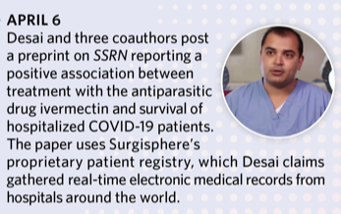
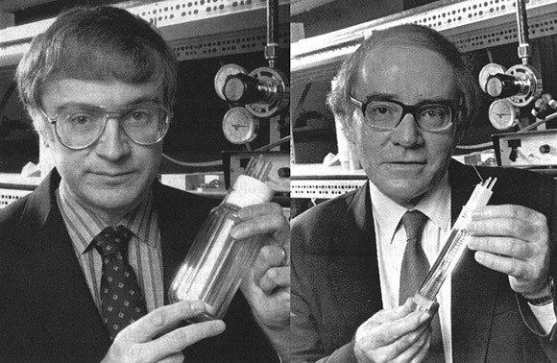

A Historical Perspective: Reproducibility
The desire for reproducible research is as old as the scientific method
The science about reproducible science
“Consistent Inference of Probabilities for Reproducible Experiments”, Y. Tikochinsky, N. Z. Tishby, and R. D. Levine
Cold Fusion 1989

Slide 4
Example: Computer Science
1988: Open Software Foundation
1991: Linux starts as an open source OS
1993: FreeBSD
1993: First open source Web browser (Mozilla)
The Internet explodes!
…
Early on, researchers started volunteering their codes via “Self-archiving”
The importance of openness cannot be overemphasized

Slide 5
Fast Forward to 2022
Conferences are in three categories:
“Encourage” submission of data after paper acceptance
“Encourage” submission of data during paper review
”Mandate” submission of data as part of paper review
Governments, funding agencies, philanthropy are all behind open science
Issues:
Expense and overhead
Industrial research
Might stifle work on radically new platforms

Slide 6

But then… Open Access got in
Most publishers switched
Governments mandate
Started in late 80’s, researchers sharing their publications on ftp servers
arXive is born
Trend took an altruistic turn of making research widely available
Open access’s origin had little to do with reproducible research, yet
Open Access and Open Science are almost synonymous

Slide 7
The Dark Side
Open access is a new business model:
shift the cost from research consumers to research producers
shift the advertising from libraries to authors
A Publisher Savior
A point to ponder: Wall Street private equity firms invest heavily in open access journals & research infrastructure
But it is good for research consumers, isn’t it?

Slide 8
Good for Researchers?
Dear Dr. Mootaz Elnozahy,
Greeting from XXXXX!!
Hope this email finds you in good health.
As we are celebrating open access week on this occasion, we are providing special waiver of 20%-30% for submission of your eminence work on or before 30th of this month towards publication in our journal XXXXX
Journal Impact Factor: 2.1
Publication date: November 1st

Slide 9
The Flood
Prior to Open Access:
  publishers had to survive on QUALITY
  the community resisted the introduction of new journals
  a researcher had a reasonable number of periodicals to know what is happening
Today
  pay to publish model prevails
  new journals introduced all the time
  Impossible to keep up, most research is write-only, seldom read

Slide 10
In the Middle East

Slide 11
On the Access Side
YES, WE BENEFIT BECAUSE LIBRARIES WEREN’T PROPERLY RESOURCED

Slide 12
Research in the Middle East
Pay-to-publish model increases the barrier for researchers
  $2000/paper is very expensive
  Standard practice: Waivers of 50% for tier 3 which encompasses most of the middle east… still too steep
Lure to publish in “cheap” journals ($50 to $90) is too strong
  Condemns researchers in the region to low-quality publications
Evaluation systems copied from the developed world without regard to local conditions or needs
  Pressure to publish not commensurate with resources, needs, or reality
Open science requires heavy infrastructure
  May drive researchers to avoid forums that stress reproducibility

Slide 13
Danger: A Research Caste System
Unwittingly
Open science requires infrastructure and expenses that raise the barrier to entry
Open access’s business model may create perverse incentives for researchers in tier 3 countries toward ”cheaper” journals
This will engender a system where researchers in most of the region will be condemned to a lower caste. This MUST be avoided

Slide 14
Suggestions
Create community-run publishing systems that eschew profit
Set evaluation criteria that serve the region and its intrinsic needs
Further collaborations and pooling resources,
  perhaps the Arab League can be useful after all?

