Slide 1
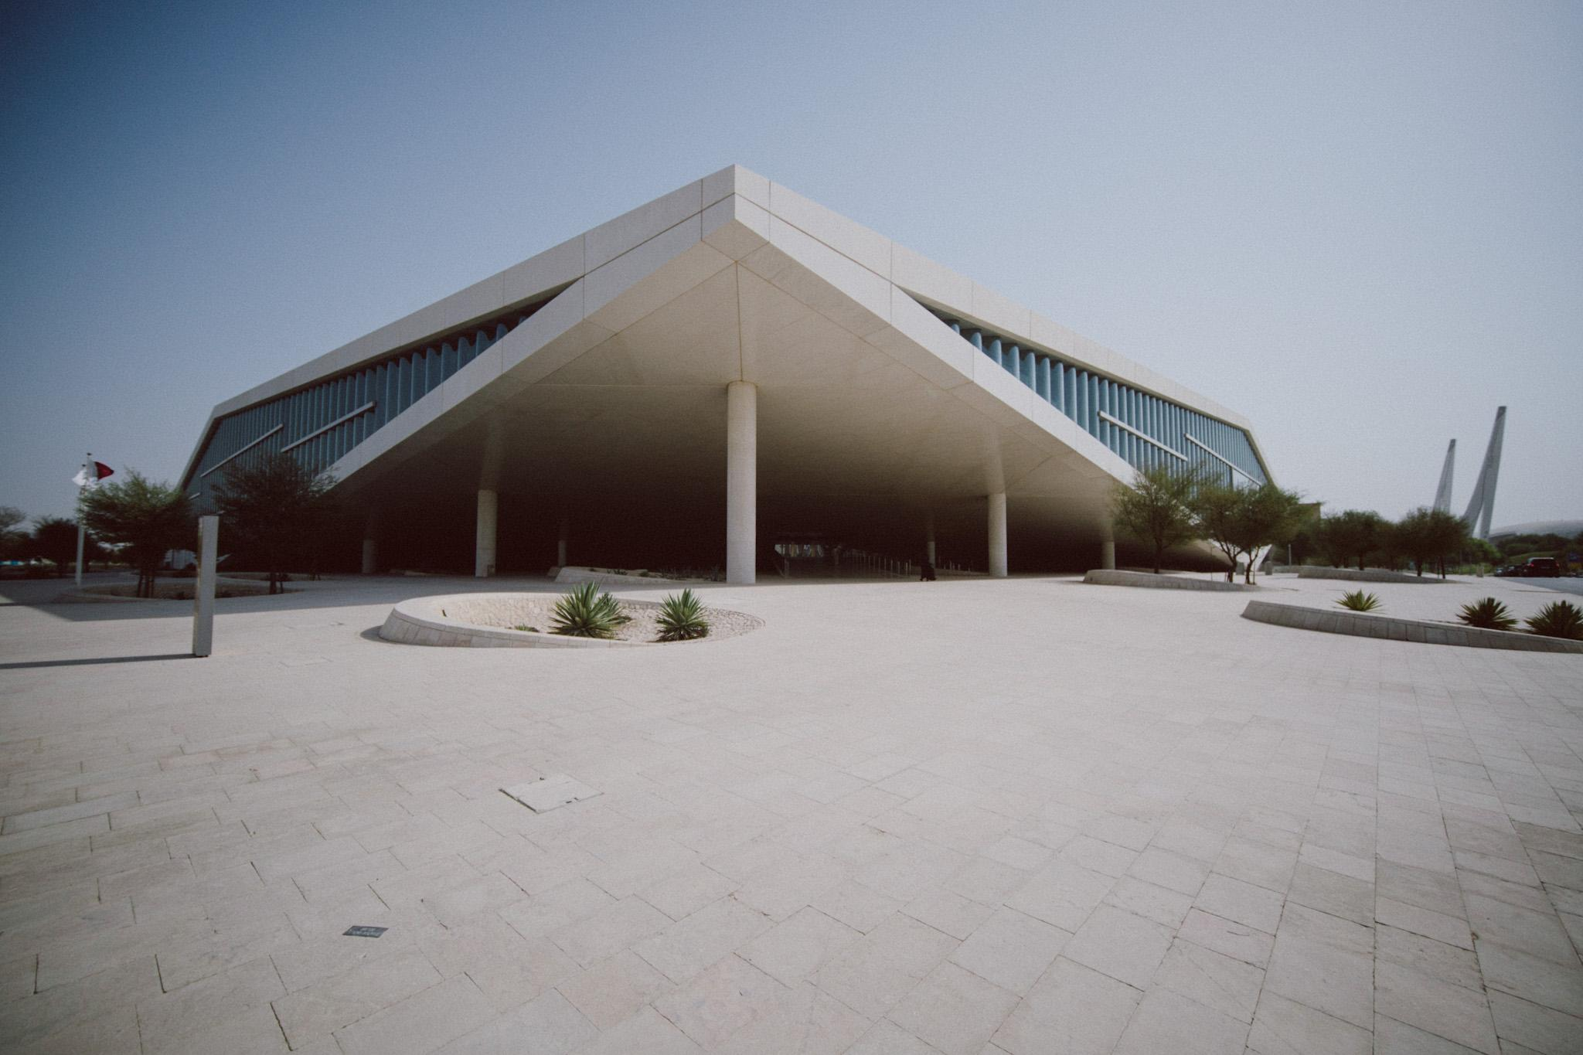
Using Agile Methods to Navigate Complex Publisher Open Access Workflows: The Case of the Qatar National Library Open Access Fund
Alwaleed Alkhaja
Senior Intellectual Property Librarian
Digital Content and Engagement

Slide 2
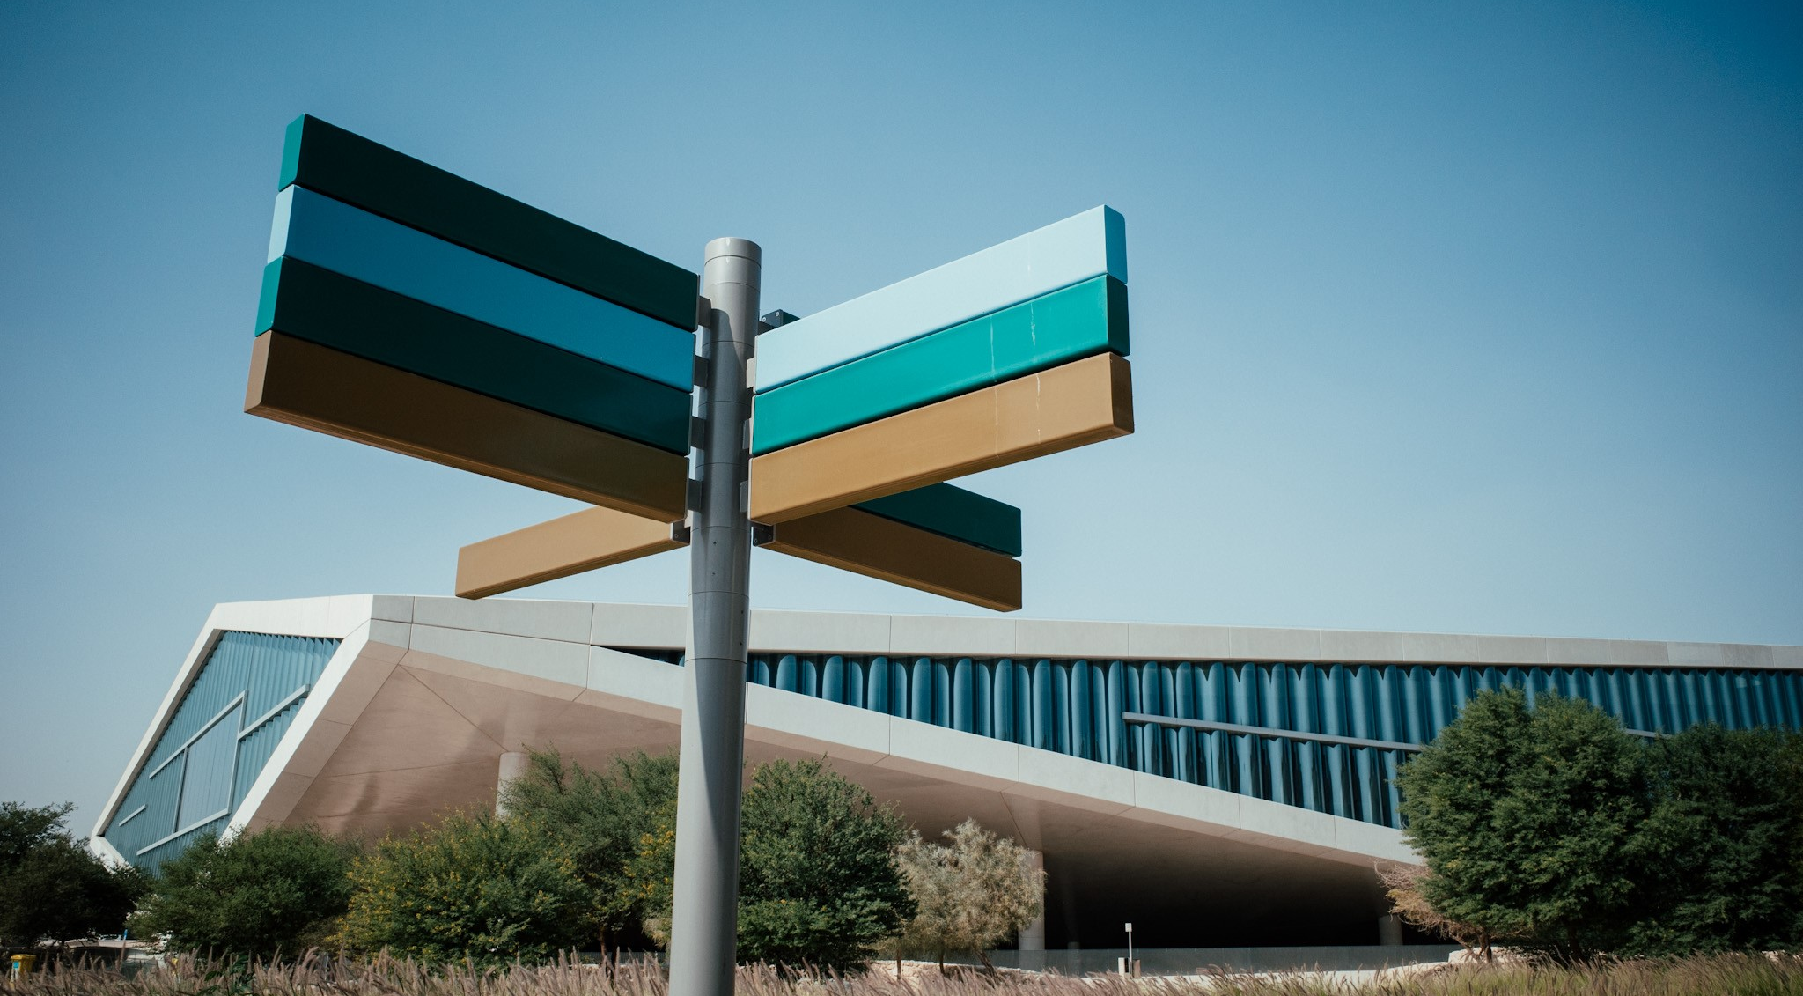
What are we doing?
Which problem(s) are we addressing?
What is still needed?

Slide 3
Qatar National Library
A mission to "preserve the nation's and region's heritage and enable the people of Qatar to positively influence society by creating an exceptional environment for learning and discovery"
Serves multiple functions from a heritage library, research library, and public library serving various segments of Qatari society.

Slide 4

How can we maximize the use of Qatar’s research outputs?
Notes:
Given this context, we asked ourselves a question a couple years ago, how can we maximize the use of Qata’rs research output in the context of our own copyright law

Slide 5
The potential problem with e-resource subscriptions
Publisher/Vendor’s Content (Journals, Books, etc)
Content behind subscription wall
Notes:
To understand our approach, loets look first out a e-resource licensing typically works

Slide 6
The potential problem with e-resource subscriptions
Publisher/Vendor’s Content (Journals, Books, etc)
Library pays annual fee to have access to content
Content behind subscription wall
Notes:
To mention its out of date - does not explicitly mention digital works, document delivery, interlibrary loan

Slide 7
The potential problem with e-resource subscriptions
Publisher/Vendor’s Content (Journals, Books, etc)
Publisher/Vendor’s Content (Journals, Books, etc)
Library pays annual fee to have access to content
Content behind subscription wall
Content accessible with subscription
Notes:
Once the library pays the fee it has access to all of the publisher’s content

Slide 8
Some of this content is published by
Qatar-based researchers
Publisher/Vendor’s Content (Journals, Books, etc)
Publisher/Vendor’s Content (Journals, Books, etc)
subscription
Content behind subscription wall
Qatar published content behind subscription wall
Content accessible with subscription
Notes:
Sometimes, Qatar based researched choose to publish with this publisher, and we get access to this Qatar published content in the subscription - seen here in maroon

Slide 9
Some of this content is published by
Qatar-based researchers
Publisher/Vendor’s Content (Journals, Books, etc)
Loss of access
Sometimes, Library has access to perpetual content acquired in agreement
Inactive Subscription
Library dependent on subscription to content + loss of access to Qatar published content
Content behind subscription wall
Qatar published content behind subscription wall
Content accessible with subscription
Notes:
The problem you see is when we lose a subscription we also look access to all of this Qatar based research
Sometimes we have perpetual access as part of the agreement which allows to keep previous publication, but with an inactive subscription we also lose out on new content

Slide 10

Notes:
We saw that open research is key, and specifically open access

Slide 11

Free to use
Can be shared with anyone for any purpose
Can be
modified
Notes:
Which is research that is not only free to use, but can be modified/remixed or can be shared with anyone for any purpose

Slide 12

Qatar National Library Open Access Program
Image courtesy of QNL Press
Notes:
A couple years back in 2015, the library set up an open access program and fund

Slide 13
Objectives of the program
To cover open access publishing costs for Qatar-based researchers
To create and contribute to the permanent archive of Qatar-based research at the QNL.

Slide 14
Why have a fund?
Qatar based researchers want their articles to be open access
The choice of publishing open access is dependent on availability of funds
There is a lack of institutional support in Qatar for open access
There is a lack of sufficient funding support from research grant agencies
Notes:
Why did the Library create one>? Well, We saw that

Slide 15

Authors who have exhausted all other sources of funding for publications
Corresponding author MUST be affiliated with Qatar-based institution
Publishing in journals that meet QNL criteria
e.g . Listing in Directory of Open Access Journals
Eligibility criteria
Notes:
Publishing in journals that meet QNL criteria
e.g . Listing in Directory of Open Access Journals
Authors who have exhausted all other sources of funding for publications

Slide 16
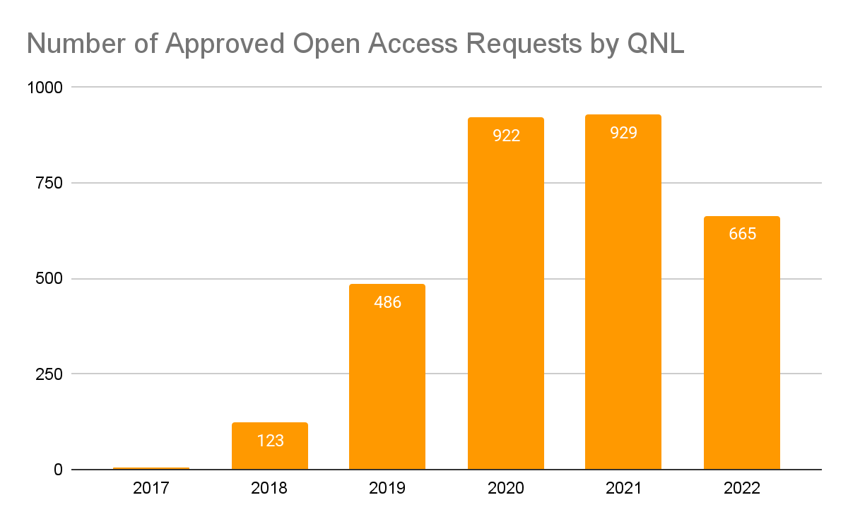
Approved Requests by the Library
1387
Authors
*
33
Institutions
*Until September 15 2022
Notes:
This plot shows the growth of requests coming from
With the efforts more than 50% of papers with a Qatar based corresponding authors are now open acces

Slide 17
How we process payments?
Central payment through agreements
Payment of individual requests through QF Procurement (OAAF)
Two types of agreements:
Agreements for fully open access publications
Agreements that combine reading and publishing
Two types of payments
Purchase order (PO)
Credit Card Payment
Notes:
We do this through two means

Slide 18
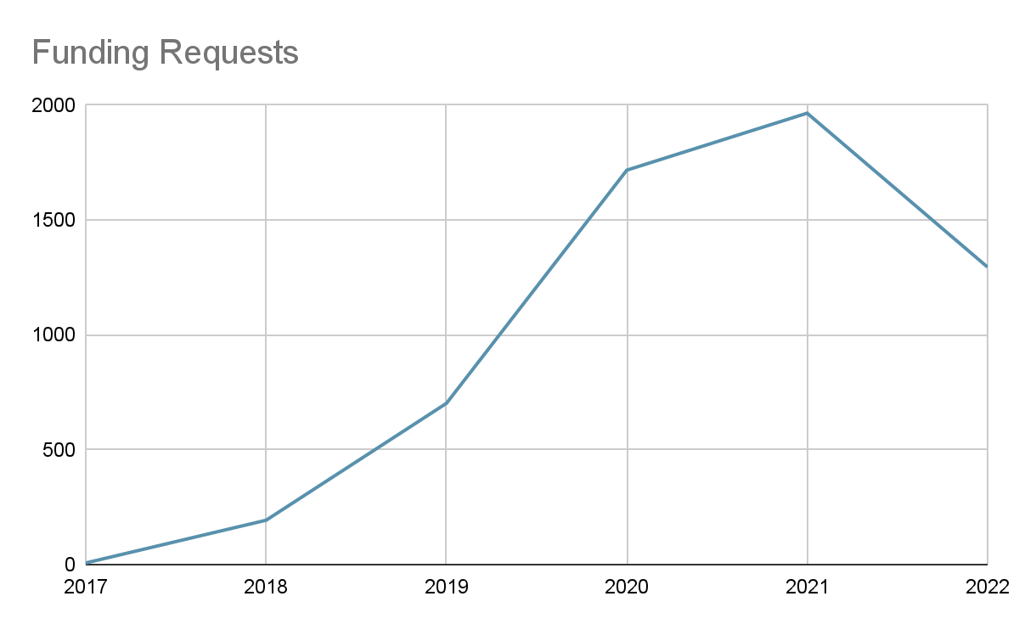
Complexities

Slide 19
Complexities
Upto 15 different publisher agreements
More than 50 publishers
Different payment methods
Introduction of taxes
Non-DOAJ journals
Journals vs books
Different licences
Different workflows

Slide 20
Ah…the workflows
Some publishers | others…
Have systems to track requests | Use email
Allow to include articles in peer review | Only allow accepted articles
Allow license change | Do not allow
Allow inclusion after publication | Only allow before publication
Are flexible | Are not flexible

Slide 21

In 2018: How to run a new service with limited (human) resources?
Notes:
Delays in Communication
Complaints
Confusion between team about updates / changes to workflows
Publishers did not make it easier
Each publisher had a different use case
Besides, there were no defined workflows for assignment of tasks between administrators, which caused an unequal division of work and tensions within the unitteam. The lack of regular meetings and the dependency to communicate by email caused a lack of efficient communicationflow of information. Although there were attempts by the QNL team to document different publisher workflows on a shared network folder, there was a significant lag between publisher workflow/system updates and the document. This delay in capturing information caused inconsistent workflow application by different team members and variances in troubleshooting, which, in turn, caused further errors and delays in service delivery, leading to increased frustration of some of the authors..

Slide 22

Agile
Notes:
We saw that open research is key, and specifically open access

Slide 23

Kanban Board
Notes:
We saw that open research is key, and specifically open access

Slide 24

Daily Standup
Meetings
Notes:
We saw that open research is key, and specifically open access

Slide 25

Immediate Workflow Documentation updates
Notes:
We saw that open research is key, and specifically open access

Slide 26

Quick problem solving
(daily cycles)
Notes:
We saw that open research is key, and specifically open access

Slide 27
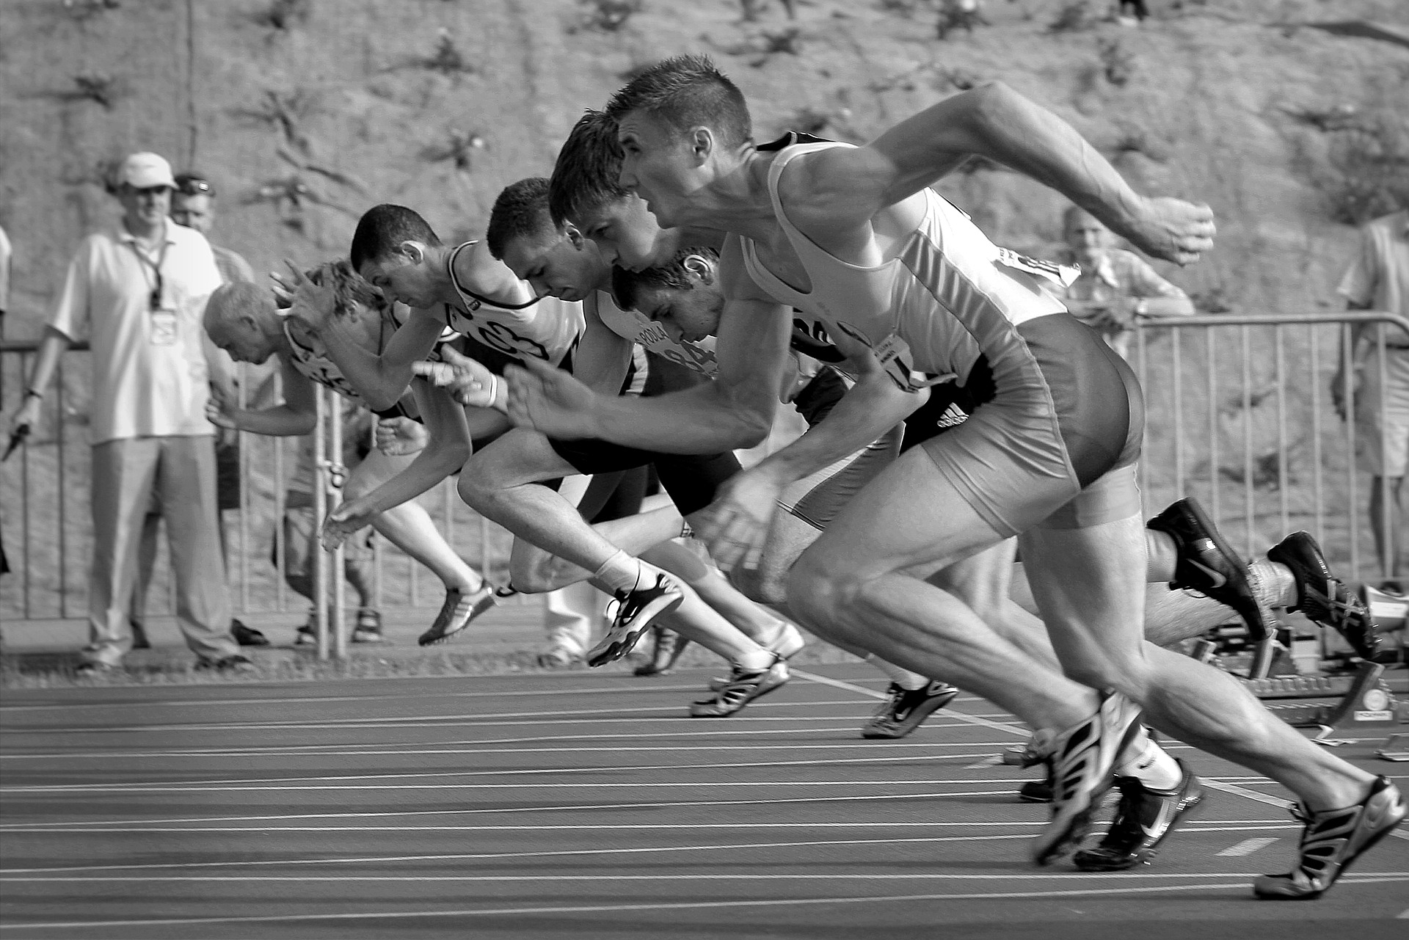
Sprints
Notes:
We saw that open research is key, and specifically open access

Slide 28

Building a team
Notes:
We saw that open research is key, and specifically open access

Slide 29
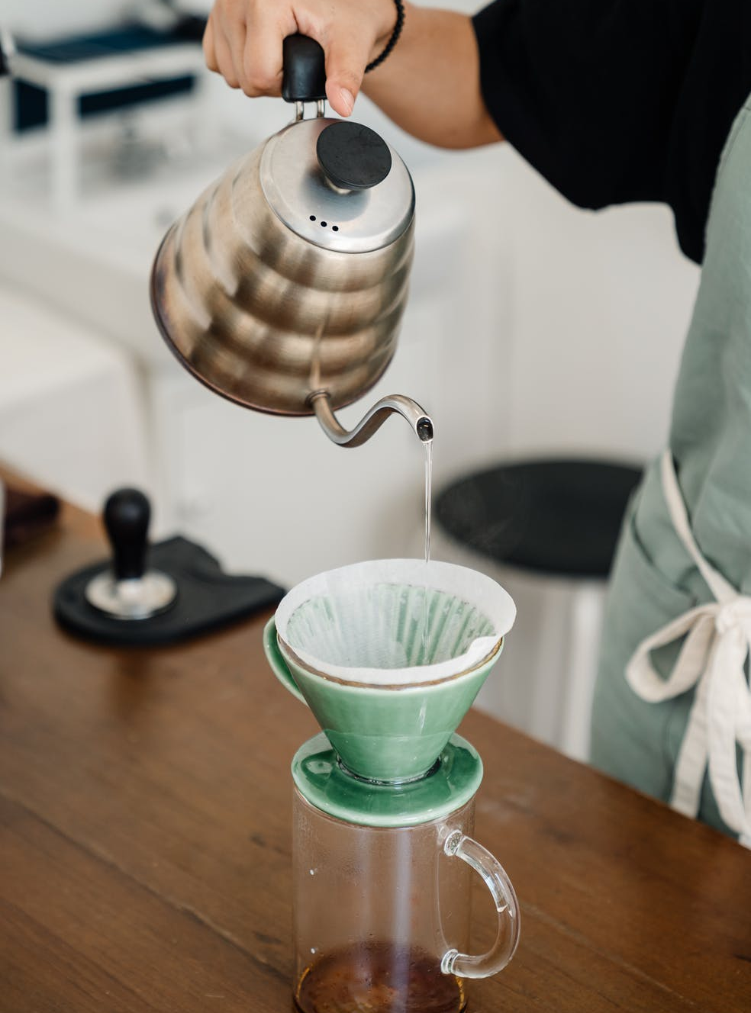

Example of Outcome: Addressing Bottlenecks
Backlog
To do
In progress
Awaiting Reply
Resolved

Slide 30
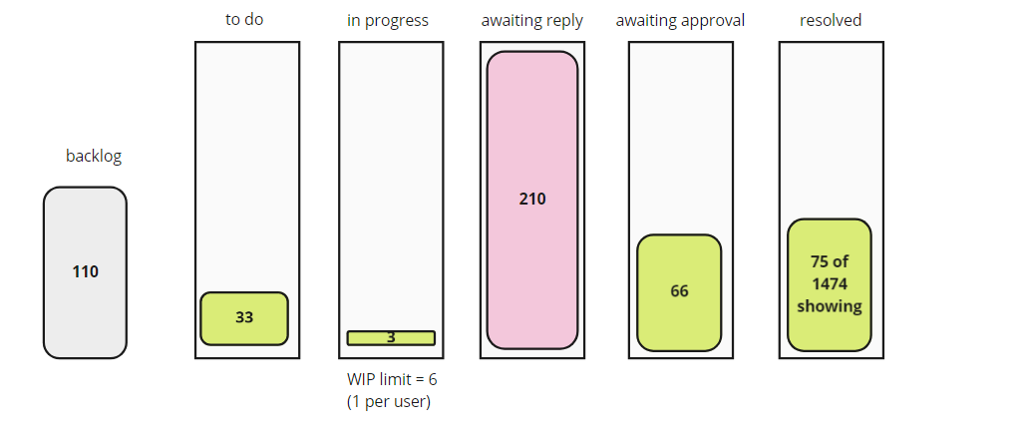
Example of Outcome: Addressing Bottlenecks

Slide 31
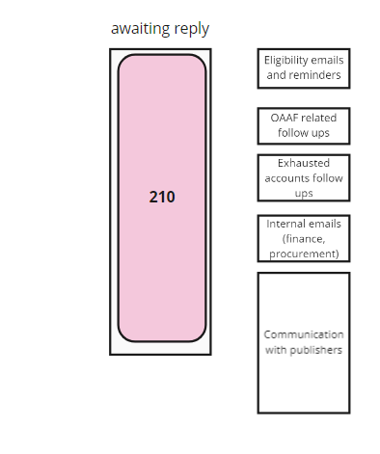
Example of Outcome: Addressing Bottlenecks

Slide 32
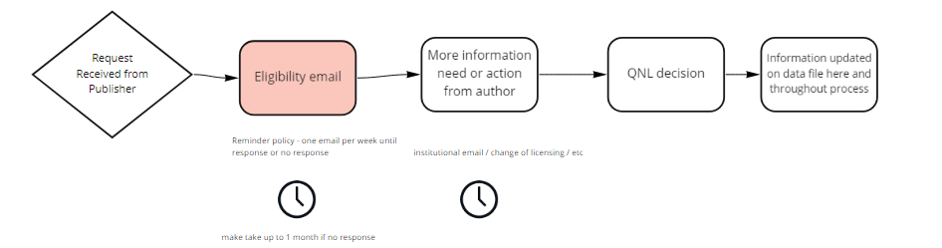
Example of Outcome: Addressing Bottlenecks

Slide 33
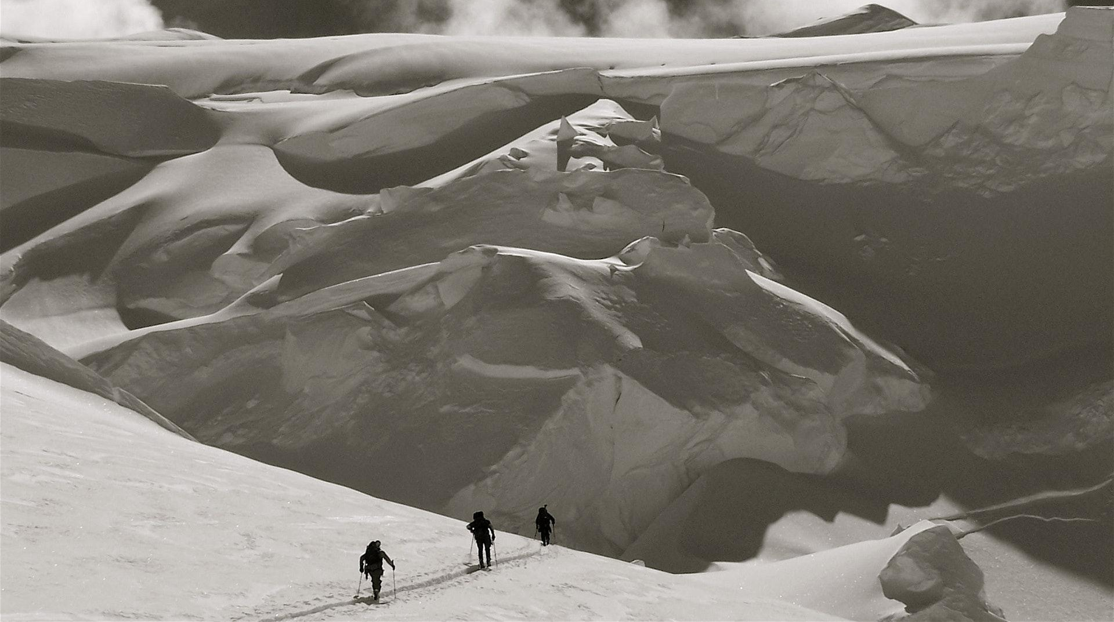
Some challenges ….
Notes:
So yes its great - its being becoming popular but its still not easy and we have some challenges locally

Slide 34
What we still need
Community sharing of workflows and best practices
Consensus between publishers on workflows
Alternative communication systems
Easier payment options
More Flexibility
Notes:
So far its been an initiative from QNL and our consortium partners -
We are still working on figuring out the best model for cost sharing with institutions
We still need to figure out a long term solution for non agreement funding
However to have complete open access solution we will need

Slide 35

To be open - we need multiple solutions

Slide 36

We are doing this as a consortium
Notes:
We are not doing this alone, instead we doing this as national consortium which has institutional partners in Qatar, such as Qatar University, HBKU, Sidra, HMC and more

Slide 37
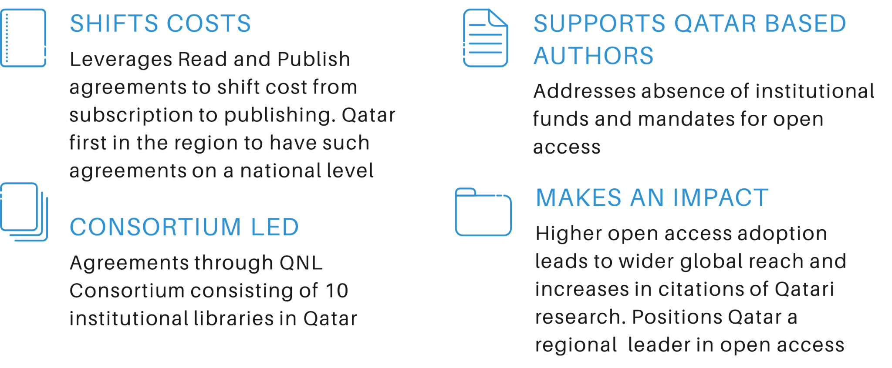
The QNL Consortium

Slide 38

We are launching
Manara - Qatar Research Repository
Notes:
So yes its great - its being becoming popular but its still not easy and we have some challenges locally

Slide 39

SCOSS: Global Sustainability Coalition for Open Science Services
SCOSS: Global Sustainability Coalition for Open Science Services

Slide 40

Global Sustainability
Coalition
for Open Science Services
(SCOSS)
Challenge:
Many open infrastructures were created using short-term project money and are no longer sustainable. OA &OS infrastructure has grown in number and usage.
Funding for operations neglected.
We want an equitable and inclusive research culture.
Risk: Services risk stagnation, downsizing or pay walling
Aim: Helping sustain the infrastructure to support the implementation of OS
Officially formed in early 2017, SCOSS’s purpose is to provide a new co-ordinated cost-sharing framework that will ultimately enable the broader OA and OS community to support the non-commercial services on which it depends

Slide 41
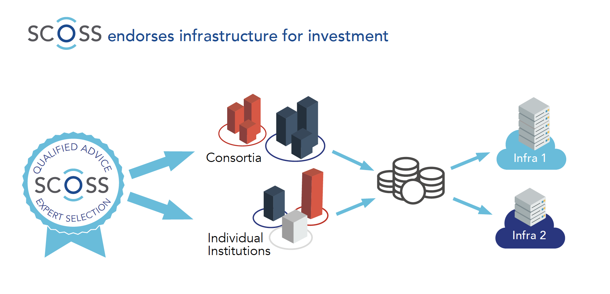
SCOSS
Who we are and what do we do
Community-led and governed
A consolidated voice that vets OS not for profit infra before recommending it for funding to help infra on unstable footing
Assess funding needs
Alert funding needs to the community
Provide more transparency on costs
Increases efficiency for investors
! Strongly encourage good governance !
Not a subscription or payment agency

Slide 42


Pilot cycle

Slide 43




2nd funding cycle
&
https://doabooks.org
https://oapen.org
https://opencitations.net/
https://pkp.sfu.ca/
https://scoss.org/how-it-works/current-funding-calls

Slide 44




3rd funding cycle
https://arXiv.org
https://www.redalyc.org
https://www.amelica.org
https://duraspace.org/dspace/

Slide 45

What if all of us can have access to all research content?

Slide 46
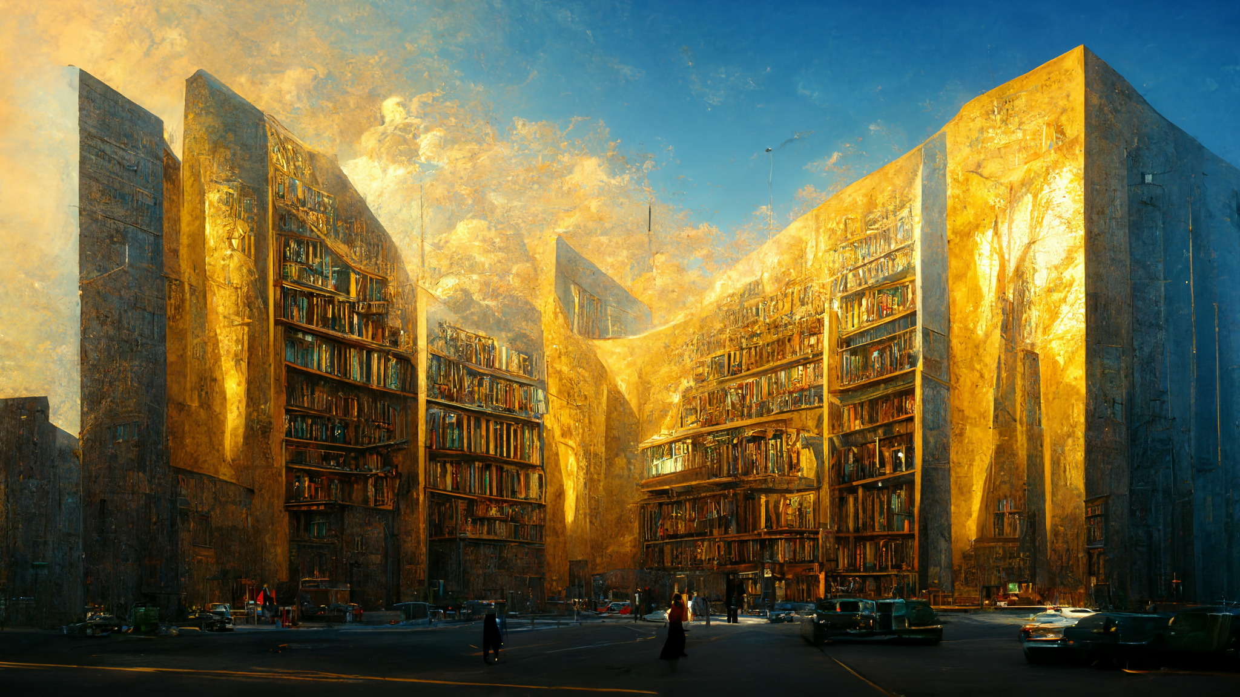

Slide 47
Thank You
Alwaleed Alkhaja
aalkhaja@qnl.qa
https://www.qnl.qa/en/open-access-at-qnl/about

