Slide 1

Train the Trainer Workshop: How to Ensure Researchers Share Their FAIR Data: Practical Tips and Tools
Welcome
Cristina Magder / UK Data Service
27 October 2022
DOI: 10.5281/zenodo.7296982

Slide 2
Workshop netiquette
The presentations will be recorded and shared with the participants shortly after the event.
Please ensure you are muted during the presentations.
Any questions can be added in chat, or anonymously via Padlet.
All slides and materials will be made available on Zenodo for future use under a CC BY licence.

Slide 3
Today’s Speakers and Facilitators
Cristina Magder – Data Collections Development Manager @UK Data Service, UK Data Archive
Johana Chylíková – Methodological research, data management @Czech Social Science Data Archive
Dimitri Prandner – Senior research associate, data acquisition, data management @Austrian Social Science Data Archive
Marijana Glavica – Acting head @Croatian Social Science Data Archive
Otto Bodi-Fernandez – Senior research associate @Austrian Social Science Data Archive
Oliver Watteler – Deputy head of Data Acquisitions and Access @GESIS Leibniz Institute for the Social Sciences
Maureen Haaker – Senior Qualitative Data and Training Officer @UK Data Service, UK Data Archive
Vlad Voina – Data Integrity Officer @UK Data Service, UK Data Archive

Slide 4

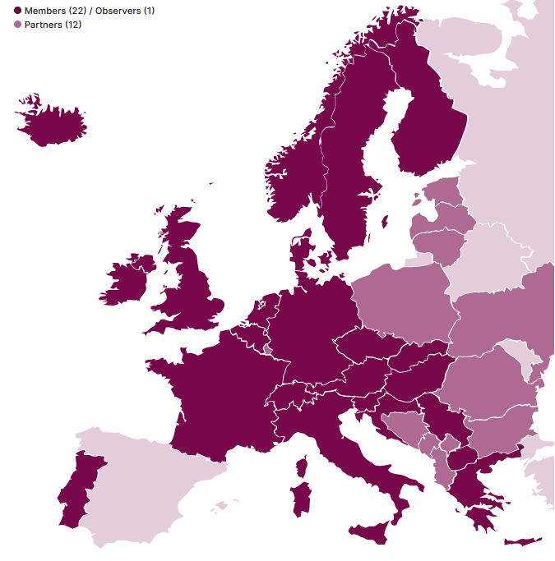
Our vision is that the provision of access to social science data and metadata is vital – for both science and society.
For this we must offer services to data producers to easily describe and store their data – if needed in a secured environment.
We will adhere to the FAIR (Findable, Accessible, Interoperable, Reusable) data principles to make data findable and provide information about the data, where they are, how they can be accessed.
We will also focus on providing training and enabling the transfer of expertise and sharing of knowledge on data, as well as relevant rules and regulations.

Slide 5
Mission of CESSDA
Provide a distributed and sustainable research infrastructure
  enabling the research community to conduct high-quality research in the social sciences,
  contributing to the production of effective solutions to the major challenges facing society today.
Facilitate teaching and learning in the social sciences.

Slide 6
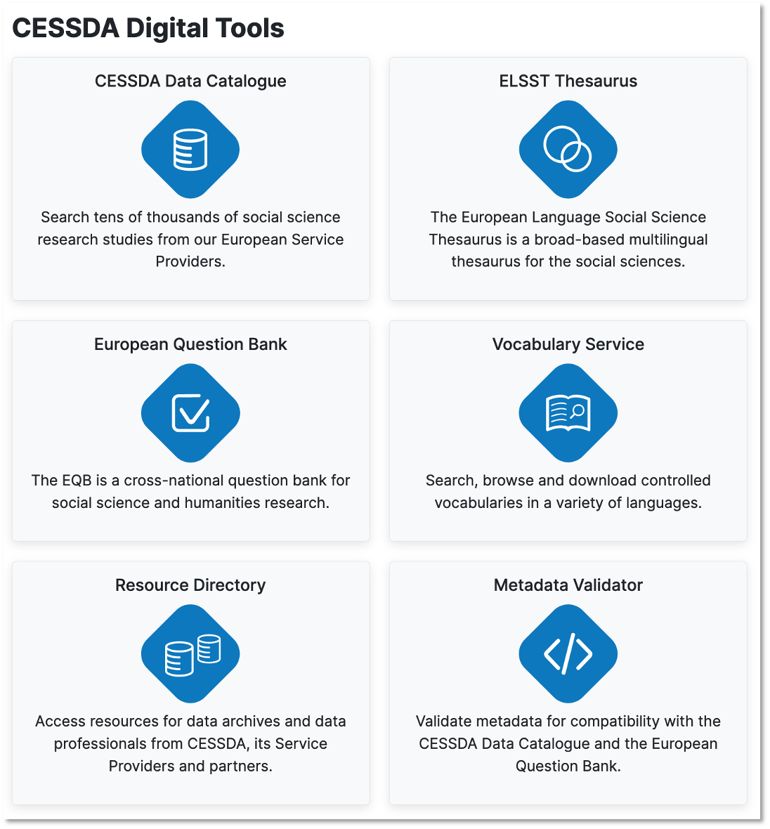
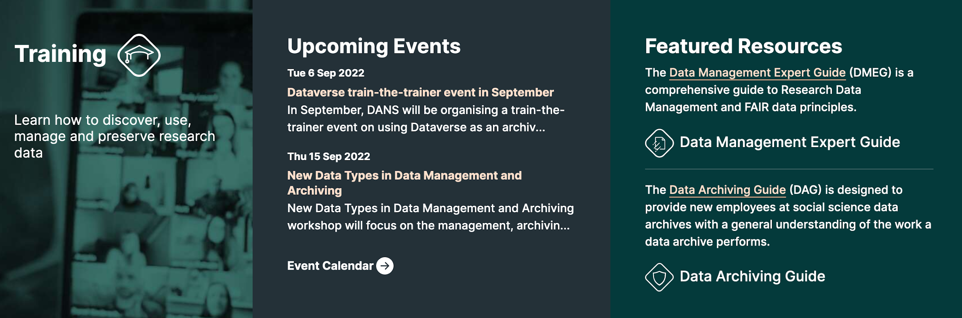
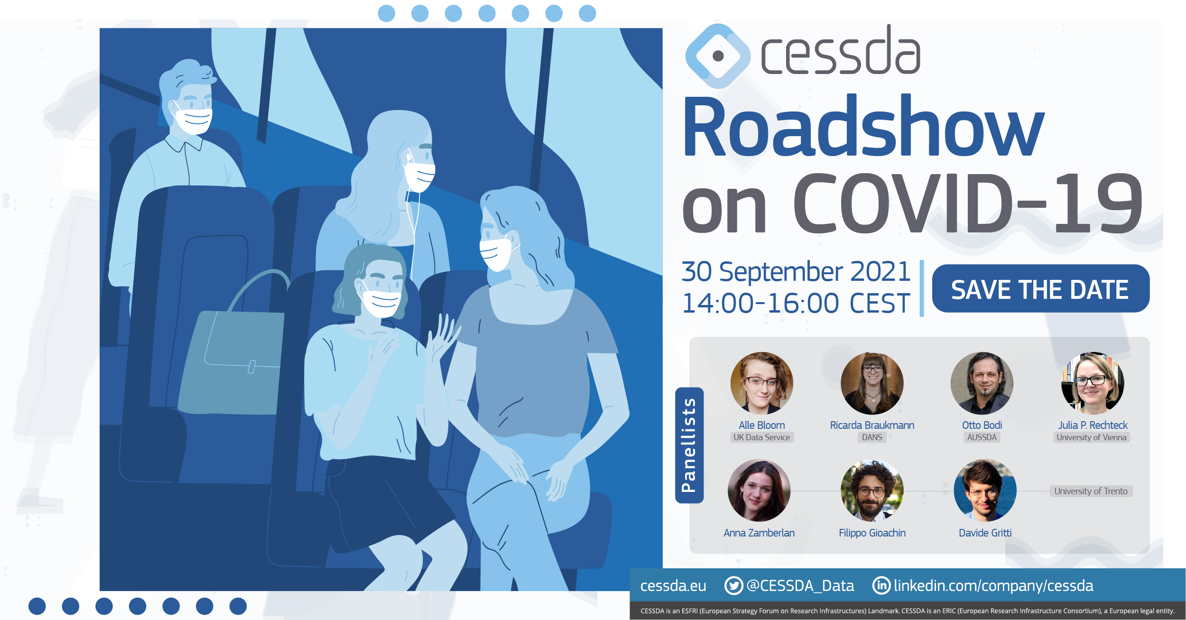

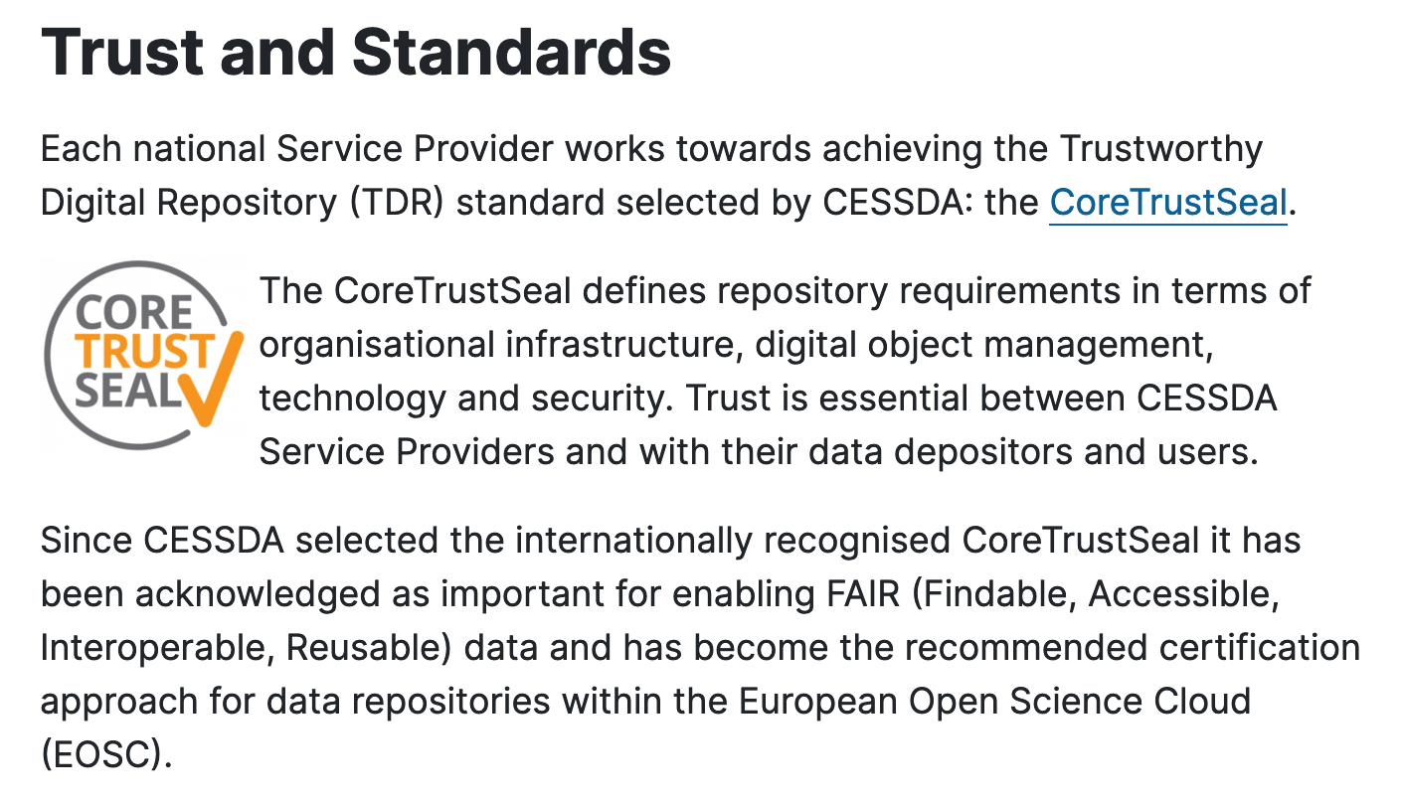


Services Supporting Research

Slide 7
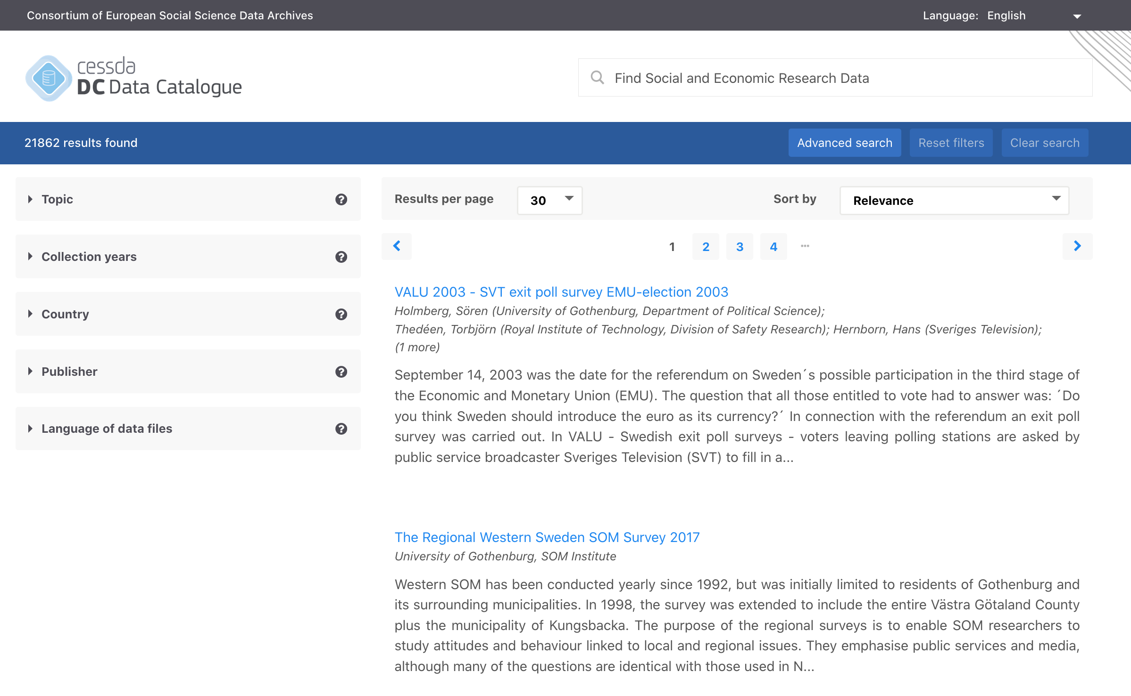
https://datacatalogue.cessda.eu/
CESSDA Data Catalogue

Slide 8
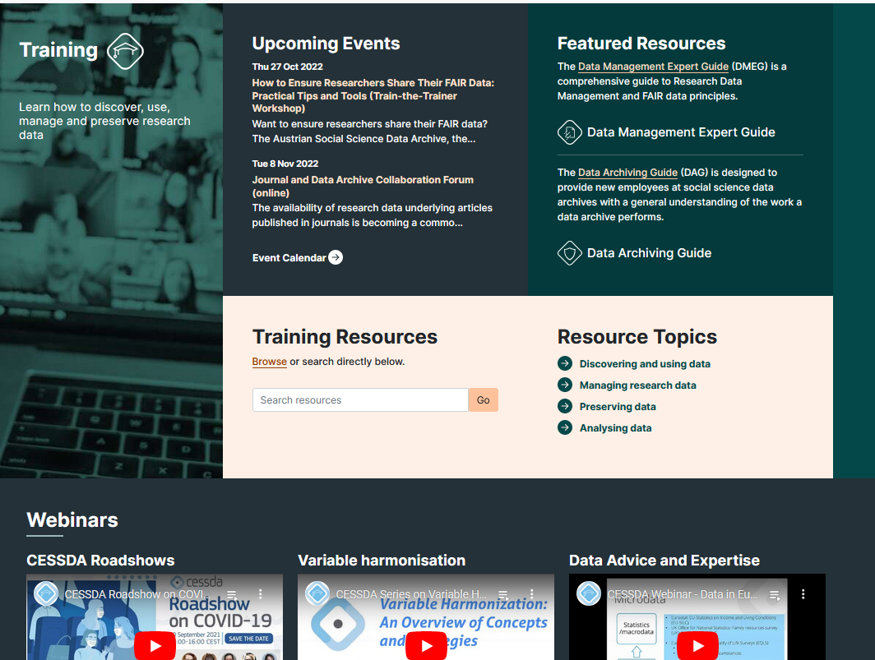
https://www.cessda.eu/Training

Slide 9
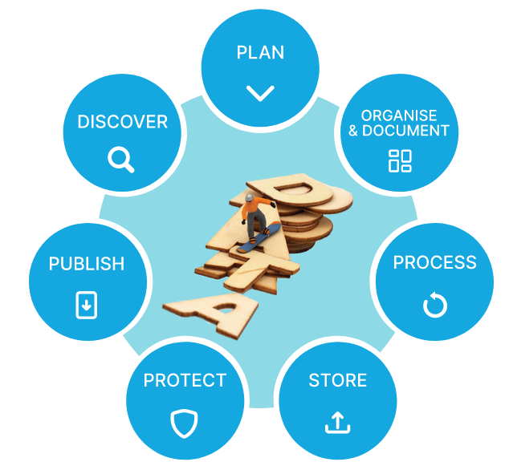

CESSDA Data Management Expert Guide
created by European experts to help social science researchers make their research data Findable, Accessible, Interoperable and Reusable (FAIR)
7 chapters following the data life-cycle
https://zenodo.org/record/3820473#.YRZfs4hKhPY
dmeg.cessda.eu

Slide 10
Today’s Programme (CEST)
10.00 - 10.15 Welcome
10.15 - 10.50 Session 1: Open Science and data management planning basics: key concepts, tools and resources
10.50 - 11.00 Break
11.00 - 12.30 Session 2: Consent and ethical protocols in the Open Science landscape
12.30 - 13.30 Lunch break
13.30 - 13.45 Session 3: Data protection considerations and anonymisation in the GDPR context
13.45 - 14.30 Session 4: Licence frameworks @CESSDA archives
14.30 - 14.45 Break
14.45 - 15.15 Breakout rooms: Successes, challenges and potential in Open Science, Consent and Ethical considerations and Licences and Anonymisation training
15.15 - 15.30 Close

Slide 11
Main Objective of the workshop
1. Raise awareness of key tools and resources available for Open Science training
2. Enable a platform to exchange ideas regarding key training topics
3. Provide training materials and worksheets for future reuse

Slide 12
Next Session: Open Science and data management planning basics: key concepts, tools and resources
Licence: CC-BY 4.0

