Slide 1


Meeting different stakeholders’ needs
for FAIR data training
Emma Lazzeri, GARR
orcid.org/0000-0003-0506-046X

Slide 2
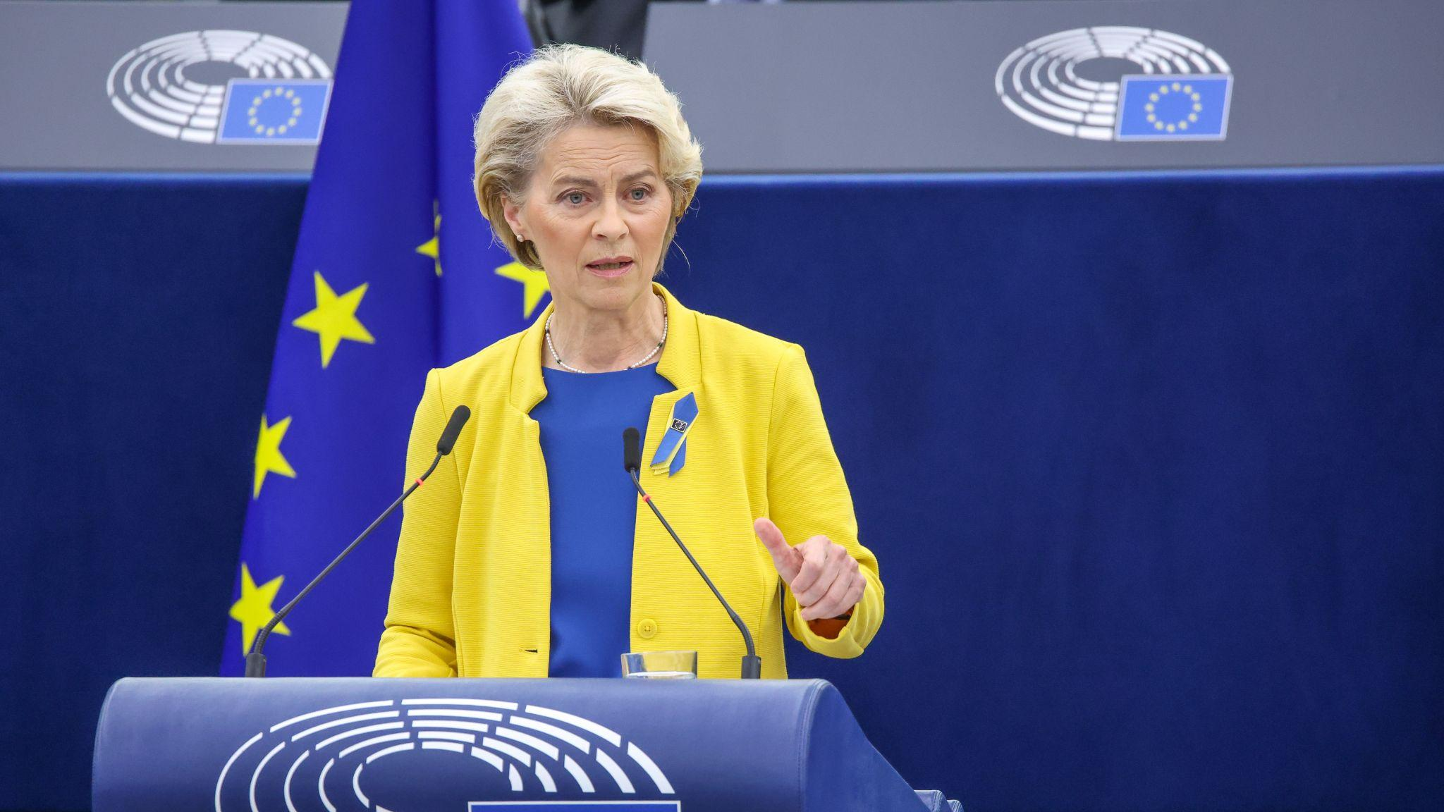
Slide title
“We need an enabling business environment, a workforce with the right skills [...]”
Text
Bullet
  More bullets
    Some extra bullets
2022 State of the Union Address by President von der Leyen,
14 September 2022, Strasbourg

Slide 3
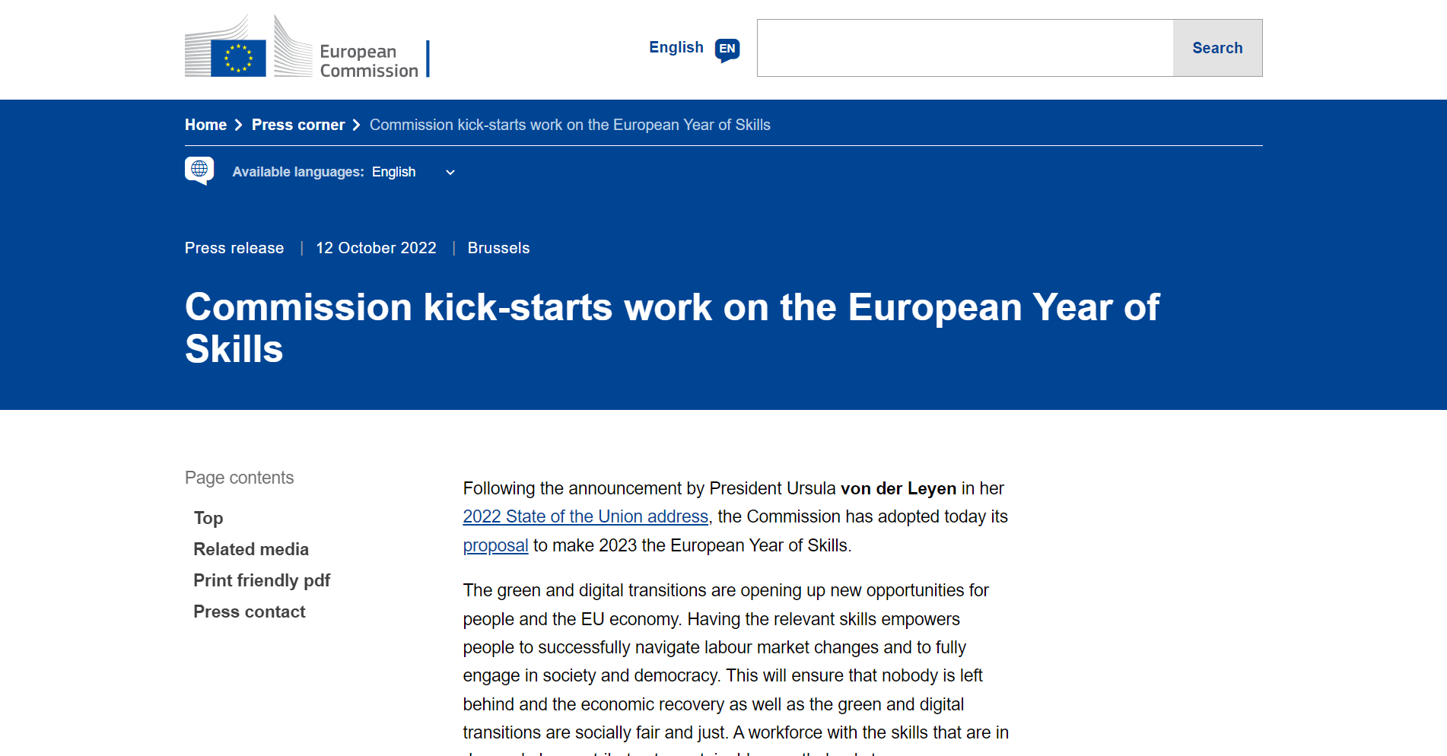

Slide 4

We need skills to put FAIR into practice!
Photo by Cookie the Pom on Unsplash

Slide 5
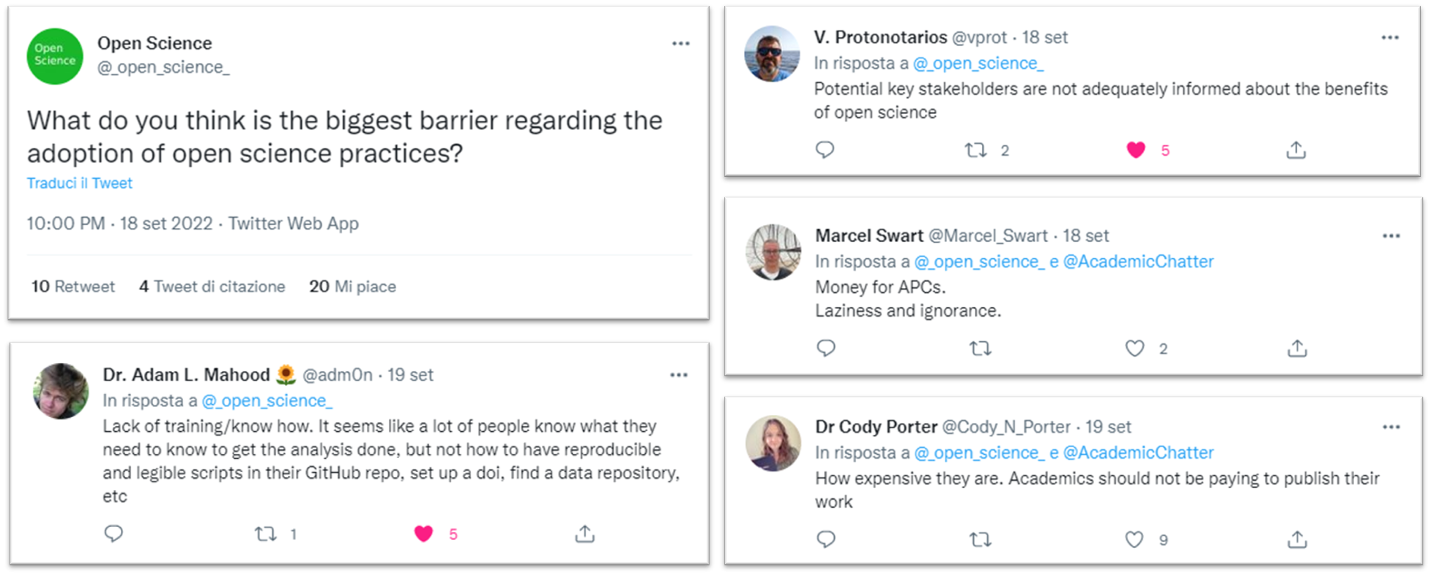
Meeting the stakeholders’ needs
https://twitter.com/_open_science_/status/1571589893595463682?t=dK7ApIFOVp7ACFTXxeBXAA&s=08

Slide 6

Filling the gaps
Supporting an EOSC-ready digitally skilled workforce:
Researchers can transform how they carry out research and exploit research outputs, leading to better quality and contributing to the Horizon Europe EOSC Partnership.
Horizon Europe call INFRA 2021 EOSC01-01
Bullet
  More bullets
    Some extra bullets

Slide 7
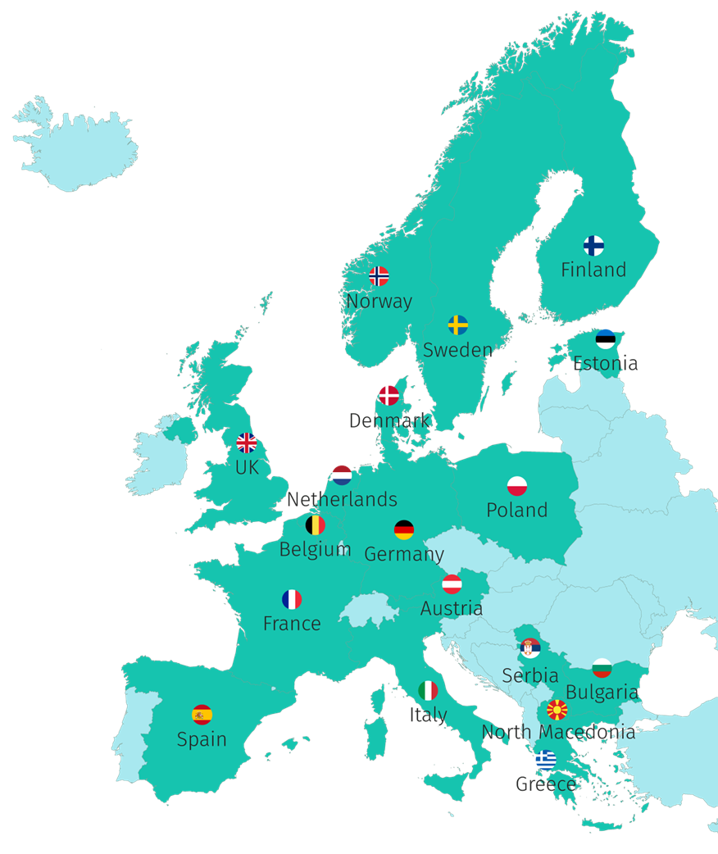





44 Participants, 18 Countries
“Key doers” in Open Science in their Country/Region/Domain
2 ESFRI Research Infrastructures
7 millions €

Slide 8

Filling the gaps
Lack of Open Science and data expertise,
Lack of a clear definition of data professional profiles and corresponding career paths, and
Fragmentation in training resources.
Photo by Randy Laybourne on Unsplash

Slide 9



FAIR and Open Science also means
Making science and its results accessible
to different actors
(policy makers, civil servants, citisens, private sector, ....)
using adequate language
(mother tongues, differentiating messages, …)
using the right mean
(social, dedicated events, blog, reports, interviews, ....)

Slide 10


Keeping in mind
Responsible Research and Innovation
Scientific research and technological development processes that take into account effects and potential impacts on the environment and society
Science for policy
Increase the impact of research results on policy and society at large

Slide 11



How?
Propose
Coordinate
Enable
A FAIR-by-design methodology for open science teaching and learning
Network of Competence Centers on Open Science and FAIR Data
Raise competences for an EOSC-skilled European workforce

Slide 12
Key Concepts
Harmonise curricula and learning paths
Lifelong learning through professional networks
FAIR-by-design learning materials
Minimum viable
skillset
Train
of
Trainers
Competence Centre Network

Slide 13





Developing paths for different targets…
Science for policy: honest brokers, civil servants, policy makers
Institutions: undergraduate, PhD, data stewards and professionists, including data librarian and curators, legal and ethical experts
Research Infrastructures and thematic communities: designing training with and for researchers and professionists
Professional networks: lifelong learning through peer networks
Photo by Majestic Lukas on Unsplash

Slide 14
… with specific needs
Science for policy: need to inform through evidence, understand the needs of policy makers, consider ethical issues at the science for policy interface
Institutions: need to count on adequate skilled professionists, not only researchers but data experts and support staff, need to train undergraduates and scientists at different career levels
Research Infrastructures and thematic communities: need to tailor training on specific needs to embed FAIR principles in the research workflow
Professional networks: need to be empowered to put into practice lifelong learning through the learn by doing and best practice sharing

Slide 15


Thank you!
Questions?
This presentation is released under a CC-BY 4.0 license. To cite this presentation, please copy and paste: Clare, Helen, Davidson, Joy, Lazzeri, Emma. (2022, November 03). Awareness rising on Open Science, EOSC and FAIR Principles. EOSC tripartite event in Georgia 2022. Zenodo. https://doi.org/10.5281/zenodo.7276050.

Slide 16

Links and references
2022 State of the Union Address by President von der Leyen, 14 September 2022, Strasbourg, https://ec.europa.eu/commission/presscorner/detail/en/speech_22_5493
Commission kick-starts work on the European Year of Skills, 12 October 2022, https://ec.europa.eu/commission/presscorner/detail/en/ip_22_6086
Skills4EOSC in CORDIS, https://cordis.europa.eu/project/id/101058527
Photo by Tamanna Rumee on Unsplash

