Slide 1



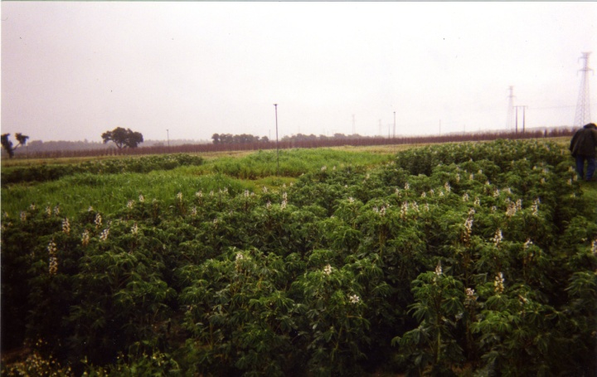
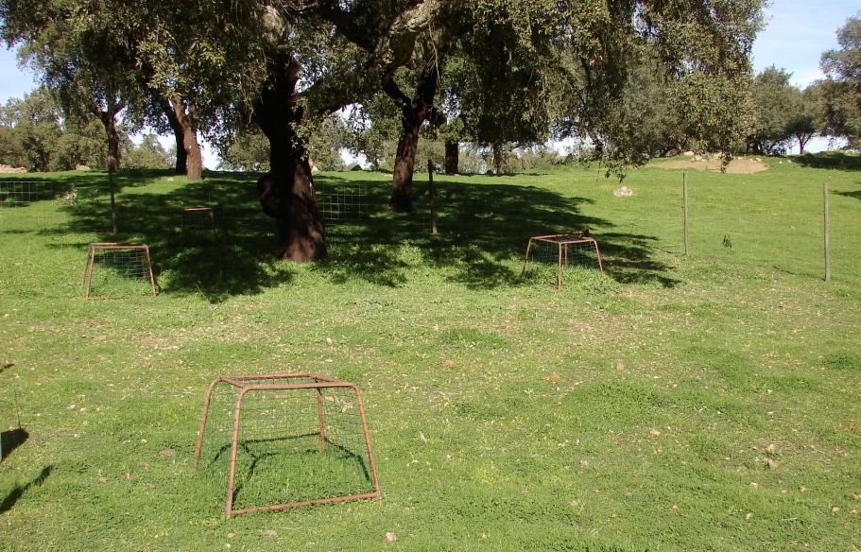
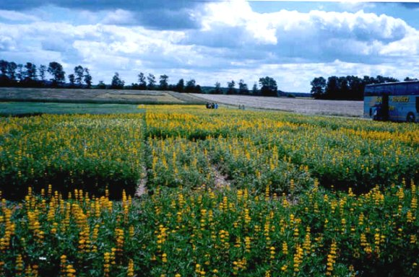
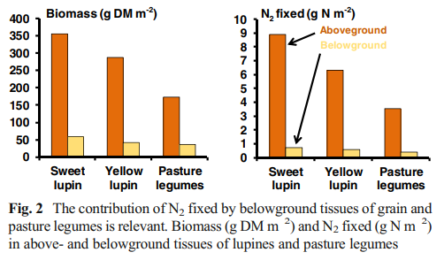
Underestimated role of nodulated roots for soil fertility and quality
Corina Carranca¹ and Manuel Madeira²
¹Instituto Nacional de Investigação Agrária, UEISAFSV, Oeiras
email: corina.carranca@iniav.pt
²Instituto Superior de Agronomia, Universidade Técnica de Lisboa
Introduction:
Most estimates of symbiotic N₂ fixation rely on shoot N only; limited knowledge on the contribution of belowground tissues to soil N is partly due to difficulties in undertaking quantitative studies on belowground inputs.
Material and methods:
Experiments, A, B, C were run in three Portuguese regions with Mediterranean-type climate: A: Pegões, at south west; B: Óbidos, at central west; C: Estremoz and Vaiamonte, at south inland.
Inoculated sweet lupine (Lupinus albus L.) was sown in 2001/2002 and 2003/3004 (A); yellow lupine (L. luteus L.) was sown in 2004/2005 and 2005/2006 (B); and two improved pastures older >5- and 12-yr-old at Estremoz and one >30-yr-old in 2010/2011 and 2012/2013 (C) with subclover (Trifolium subterranean L.). Oat (Avena sativa L.) and non-legumes in pastures were used as reference crops for ¹⁵N technique to estimate N₂ fixed by legumes.
Objectives:
A field study was run in Portugal to evaluate the contribution of nodulated roots of grain and pasture legumes in soil fertility.
A
B
C
Fig. 1. View of Portuguese experimental sites with sweet lupine at Pegões (A), yellow lupine at Óbidos (B), and improved pastures with subclover at Vaiamonte (C).
Results and discussion:
In A and B, roots and nodules represented 15-16% of aerial dry weight (DW) (Fig. 2), and 21% in pastures (C). Total N concentration in top plants was quite similar in A, B and C (24 g N kg⁻¹ DW), but it varied significantly in recovered roots and nodules:12.2, 25.8, 19.5 g N kg⁻¹ DW, respectively in A, B and C. This belowground material contributed to 7-9% of total fixed N in A and B, and 11% in case of pasture legumes, in agreement with literature (Pinto et al. Plant Soil, 2021).
Further long-term studies on the contribution of belowground tissues to the soil N fertility and soil structure are fully encouraged. Rhizodeposits also contribute strongly for stable organic matter in soils improving the soil structure.
Acknowledgment: Authors acknowledge the Pest-GREEN-IT project, held by ITQB NOVA, Oeiras, Portugal.

