Slide 1


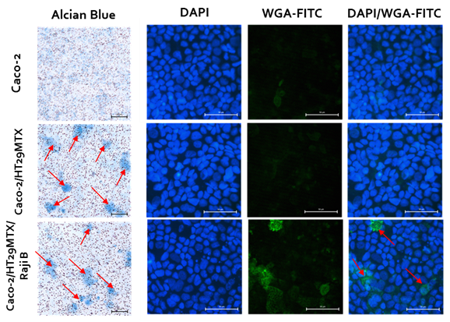
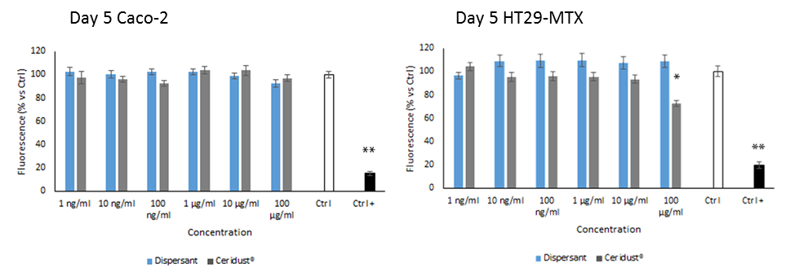
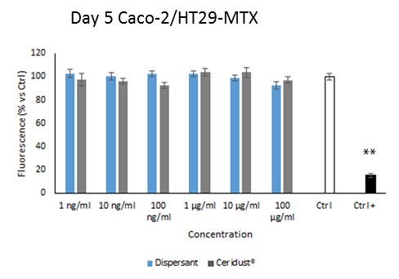





Plastics Fate and Effects in the Human Body
USEFUL GUT MODEL FOR PLASTIC PARTICLES EFFECTS ASSESSING
Giulia Antonello, Marianna Esposito, Francesco Barbero, Camille Macaraig Mansilungan, Ivana Fenoglio, Chiara Riganti, Enrico Bergamaschi
USEFUL GUT MODEL FOR PLASTIC PARTICLES EFFECTS ASSESSING
Giulia Antonello, Marianna Esposito, Francesco Barbero, Camille Macaraig Mansilungan, Ivana Fenoglio, Chiara Riganti, Enrico Bergamaschi
Introduction:
Emerging evidence suggest that human exposure to micro-plastics is rising and it most happened via ingestion and/or inhalation (Wright SL et al. 2017). In fact, plastics particles were detected in various product for human consumption such as seafood, honey, sugar, and drinking water (von Moos et al. 2012; Liebezeit et al. 2013; Koelmans et al. 2019). Once ingested, they can reach the intestinal epithelium. Their biocompatibility or toxic effects on gastro-intestinal barrier is matter of debate, also because of the lack of suitable models of physiological digestion and gastro-intestinal barrier.
The simplest model developed is represented by Caco-2 cells cultured on semi-permeable filter supports for 21 days, a time point that make them differentiating into enterocyte-like cells, with transport and permeability features like human intestinal tissue (Lundquist et al 2016). A more complex model is composed of the co-culture of Caco-2 and HT29-MTX cells that to methotrexate (MTX) develop the ability to produce mucus (Gamboa et al. 2013): this model includes the mucus-secreting goblet cells important for the presence of mucus layer in the intestine. To better mimic the intestinal physiology, another cell type (Raji B) can be added to the co-culture to allow Caco-2 differentiation into gut-associated lymphoid tissue microfold cells (M-cells) that can transport micro- and nanoparticles through transcytosis process (Gullberg et al. 2000).
Methods:
Cells culture: Caco-2 and HT29-MTX cells were obtained from American Type Culture Collection (ATCC) and were grown in adhesion in Dulbecco's Modified Eagle Medium (DMEM Gibco by Life Technologies ™), supplemented 10% Foetal bovine serum (FBS), 1% penicillin and streptomycin, and 1% non-essential amino acid (NEAA) at 37°C with 95% humidity and 5% CO₂. Raji B cells were obtained from ATCC, and they were conditioned to grow in suspension in DMEM (Gibco by Life Technologies ™), supplemented with, 10% FBS, 1% penicillin and streptomycin at 37°C with 95% humidity and 5% CO₂. Cells were sub-cultured 3 times per week.
Gut models: for all the three models we seeded cells on the apical compartment of a 6-well cell culture insert (pore diameter 1µm, growth area 4.2 cm2) (Falcon, Becton Dickinson, Franklin Lakes, NJ, USA) with a density of 9*10⁴ cells/cm² for 21 days. For the simplest model we used only Caco-2 cells, for the second one we mixed Caco-2 and HT29-MTX cells in a ratio of 9:1, and for the third one we used the same Caco-2/HT29-MTX co-cultures, adding to the basolateral compartment 1*10⁵ Raji B cells for the last 7 days. The medium was changed 2-3 times a week.
Exposure to HD-PE micro-particles: Cells were exposed to HD-PE micro-particles (suspended in PBS 0.25% BSA w/v) for 4 h a day for 5 consecutive days replacing the cell medium with fresh medium without phenol red containing increasing concentrations of Ceridust® (1, 10, 100 ng/ml 1, 10, 10 µg/ml) or the corresponding volume of dispersant. Medium only was used as negative control, while 30% DMSO as positive control.
Cytotoxicity evaluation: Alamar blue™ (ThermoFisher Scientific) was used as viability assay. At the end of incubation time, the medium was replaced by DMEM without phenol red + 10% Alamar blue™ cell viability reagent, which is incubated for 4h. A blank was prepared with cell culture medium and Alamar Blue™ reagent in the absence of cells. The resulting fluorescence is read on a microplate reader Synergy HT (Biotek Instruments, Winooski, VT) (λex: 530/25 nm; λem: 590/35 nm) and analysed by plotting fluorescence intensity versus particles concentration.
Results:
With the aim to better mimic the human physiology in a gut model, we validated the triple co-culture model of Caco-2/HT29-MTX/Raji B cells for the mucus production and the successfully Caco-2 cells differentiation into Microfold cells (Fig.1). Then we tested on Caco-2/HT29-MTX mono- and co-culture the sub-chronic toxicity (5 days) of HD-PE micro-particles (Ceridust®) finding more susceptibility of mucus-secreting HT29-MTX cells that Caco-2 cells, may be due to the presence of a great amount of mucus that can entrap the particles increasing the contact with cells (Fig.2). There was no toxicity when the cell lines were cultured together (Fig.3).
Figura 1. Mucus staining and M-cell staining. The barrier models were fixed and stained with Alcian blue or WGA-FITC (green), mounted with Fluoroshield with DAPI (nucleus: blue) and imaged with LEICA DM IRB microscope. Arrows: mucus production in the co-cultureRepresentative images are shown.
Figure 2. Cell viability of Caco-2 and HT29-MTX cells after 4 h daily exposure to HD-PE microparticles.
Figure 3. Cell viability of Caco-2/HT29-MTX co-culture after 4 h daily exposure to HD-PE microparticles.
Conclusions
These preliminary results indicate that gut triple co-culture model could be useful to study the effect of plastics particles on gut barrier thanks to its features that reflect the most important ones of the human intestine epithelium. Moreover, these findings together suggest a different sensibility to HD-PE micro-particles of the diverse cells type. For this reason, further experiments will be necessary to understand the driving force of this differences by extending the incubation time to chronic period, using advanced condition such as particles in vitro simulated digestion and dynamic flow on cell model and assessing the possible changes in physiology such as mucus production, barrier permeability and integrity, and the induction of inflammation.
References
Wright SL, Kelly FJ. Plastic and Human Health: A Micro Issue? Environ Sci Technol. 2017 Jun 20;51(12):6634-6647. doi: 10.1021/acs.est.7b00423. Epub 2017 Jun 7. PMID: 28531345.
von Moos, N.; Burkhardt-Holm, P.; Köhler, A. Uptake and effects of microplastics on cells and tissue of the blue mussel Mytilus edulis L. after an experimental exposure Environ. Sci. Technol. 2012, 46 (20) 11327– 11335 DOI: 10.1021/es302332w
Liebezeit, G.; Liebezeit, E. Non-pollen particulates in honey and sugar Food Addit. Contam., Part A 2013, 30 (12) 2136– 2140 DOI: 10.1080/19440049.2013.843025
Koelmans AA, Mohamed Nor NH, Hermsen E, Kooi M, Mintenig SM, De France J. Microplastics in freshwaters and drinking water: Critical review and assessment of data quality. Water Res. 2019 May 15;155:410-422. doi: 10.1016/j.watres.2019.02.054. Epub 2019 Feb 28. PMID: 30861380; PMCID: PMC6449537.
Gamboa JM, Leong KW. In vitro and in vivo models for the study of oral delivery of nanoparticles. Advanced Drug Delivery Reviews. 2013 Jun;65(6):800-810. DOI: 10.1016/j.addr.2013.01.003. PMID: 23415952; PMCID: PMC3773489.
Gullberg E, Leonard M, Karlsson J, Hopkins AM, Brayden D, Baird AW, Artursson P. Expression of specific markers and particle transport in a new human intestinal M-cell model. Biochem Biophys Res Commun. 2000 Dec 29;279(3):808-13. doi: 10.1006/bbrc.2000.4038. Erratum in: Biochem Biophys Res Commun 2001 Mar 9;281(4):1063. PMID: 11162433.
Coordination and Management
WORK PACKAGE 3 – HUMAN HAZARD ASSESSMENT
Scientific coordination: Rudolf Reuther, ENAS (DE) rudolf.reuther@enas-online.com
Project coordination: Mark Morrison, Optimat (UK) mark.morrison@optimat.co.uk
Project management: Nadine Bresch, ERS (DE) nadine.bresch@european-research-services.eu
Dissemination management: Lesley Tobin, Optimat (UK) lesley.tobin@optimat.co.uk
hello@plasticsfate.eu www.plasticsfate.eu @plasticsfate Linkedin.com/groups/12519441
PlasticsFatE has received funding from the European Union’s Horizon 2020 Research and Innovation programme, under the Grant Agreement number 965367

