Slide 1


Open Science!
What and why?
Matthias Landwehr, Head of Open Science
University of Konstanz, September 2022
Image: Gerd Altmann, Pixabay License
This course is part of the Re:ERUA work package Open Science for Transparent Research and Public Engagement and co-funded by the Horizon 2020 programme.
All contents of this presentation are, unless otherwise stated,
licensed under the Creative Commons BY 4.0 International

Slide 2
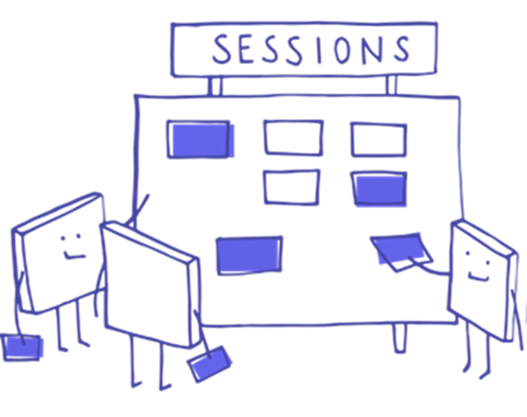
Contents:
Definition and history of Open Science
Benefits for research and teaching
Further information
Manfred Steger, Pixabay License

Slide 3

”Open science is the idea that scientific knowledge of all kinds should be openly shared as early as is practical in the discovery process.“
Michael Nielsen,
Quantum physicist
Image: Colin Behrens, Pixabay License

Slide 4

”An approach to the scientific process that focuses on spreading knowledge as soon as it is available using digital and collaborative technology. Expert groups, publications, news and events.“
European Commission
Image: Colin Behrens, Pixabay License

Slide 5
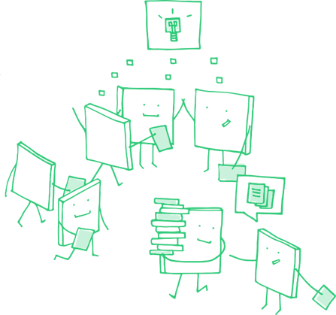
Open Science
...bundles [...] strategies and procedures, all of which aim to [...] to make all components of the scientific process [...] openly accessible and reusable.
Mission Statement of the German-speaking Open Science AG (own translation)
Manfred Steger, Pixabay License

Slide 6
Open Science
Open Science is a collective term for the adaptation of digital technologies in the science system and the associated (intended) changes in research cultures and processes.
One of the basic assumptions of Open Science is that digitalisation facilitates access to scientific methods, data and publications and promotes exchange within the science system and with other subsystems (economy and society).
KOWI – European Liaison Office of the German Research Organisations

Slide 7

The European Union as a driver
Open Science

Slide 8

Basic Principles
  Transparency
  Reproducibility
  Reusability
  Open communication
Manfred Steger, Pixabay License

Slide 9

Elements (1/2)
  Open Access
  Unrestricted and free access to scientific information
  Open Data and Research Data Management
  Systematic collection, management, processing, analysis, annotation, storage, archiving and reusable publication of all data from the research process. Commitment to the FAIR principles.
  Open Educational Resources
  Create, find and use free and open materials for education and teaching in universities, colleges and schools.
Manfred Steger, Pixabay License

Slide 10
Elements (2/2)
  Open Source
  Use open source technology (software and hardware) and open and provide own technologies
  Open Peer Review
  Transparent and traceable quality assurance in scientific processes through open peer review procedures
  Citizen Science and Science Communication
  Presenting the results of science and research to the public, actively involving the public in science and research.
Manfred Steger, Pixabay License

Slide 11

  Open Science changes the science system
  New metrics: Establishing new indicators to measure research quality and impact
  Competencies and incentive systems: Consideration of Open Science aspects in the training of researchers and the evaluation of research careers
Change of Mentality
Manfred Steger, Pixabay License

Slide 12

It is more work for me!
Why should others benefit from my work?
I want to publish and get cited!
Why Should I do that?
Manfred Steger, Pixabay License

Slide 13

Benefits for Research and Teaching
Visibility: Impact factor is not everything
Data sets can also be cited, visibility is generally increased, more hits through freely available publication
Reusability: New insights through give and take
Reused scientific data and results lead to new insights, reuse and profit is always possible itself
Increased efficiency
Management of data and open and transparent workflows facilitate one's own research and strengthen one's own work
Manfred Steger, Pixabay License

Slide 14

Change of mentality and culture
Anchoring in society
Data is an integral part of society
Open Science
Manfred Steger, Pixabay License

Slide 15



KIM Offer and Related Links
Individual advice upon request
Your local contact point
Information platform
open-access.network
More information
forschungsdaten.info

Slide 16

Open Science at the University of Konstanz
Team Open Science
Contact point and responsible office at KIM for all questions on this topic
  Open Access
  Advice, financial support and help with the journal search
  Research Data Management
  Advice, storage services and repositories
Advanced Data and Information Literacy Track (ADILT)
Interdisciplinary Data and Information Literacy Programme
kim.uni.kn/openscience
Manfred Steger, Pixabay License

Slide 17
Overview of all Course Modules
1. Open Science
2. Open Access
3. Research Data Management
4. FAIR Data
5. Repositories
6. Persistent Identifiers (PIDs)
7. Legal Questions in Open Science
8. Open Educational Resources

Slide 18
Sources
    European Commission
    https://ec.europa.eu/info/research-and-innovation/strategy/strategy-2020-2024/our-digital-future/open-science_en [25.07.2022]
    https://ec.europa.eu/info/sites/default/files/research_and_innovation/knowledge_publications_tools_and_data/documents/ec_rtd_factsheet-open-science_2019.pdf [25.07.2022]
    Mission Statement – AG Open Science (in Germany only)
    https://ag-openscience.de/mission-statement/ [25.07.2022]
    KOWI European Liaison Office of the German Research Organisations
    https://www.kowi.de/en/kowi/Horizon-Europe/horizon-europe/tabid-746/open-science.aspx [25.07.2022]
    The University of Konstanz’ Open Science Course https://www.kim.uni-konstanz.de/openscience/onlinekurs-open-science-von-daten-zu-publikationen/ [29.08.2022]

Slide 19
List of Figures
    Slide 1, 20: Gerd Altmann, Pixabay License, edited by P. Helmecke
    Slide 3,4: Colin Behrens, Pixabay License, edited by P. Helmecke
    Any other images from Manfred Steger, Pixabay License, edited by P. Helmecke

Slide 20

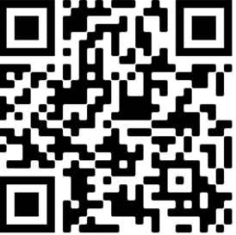
Thank you very much!
Matthias Landwehr
University of Konstanz, September 2022
Email: openscience@uni-konstanz.de
Web Page: kim.uni.kn/openscience
Image: Gerd Altmann, Pixabay License
All contents of this presentation are, unless otherwise stated,
licensed under the Creative Commons BY 4.0 International

