Slide 1

Updating Linked Data practices for FAIR Digital Object principles
Stian Soiland-Reyes, Leyla Jael Castro, Daniel Garijo, Marc Portier, Carole Goble, Paul Groth
The University of Manchester
University of Amsterdam
https://orcid.org/0000-0001-9842-9718
@soilandreyes
First International Conference on FAIR Digital Objects
Leiden, 2022-10-27

Slide 2
FAIR Digital Object (FDO) – conceptual view
Rigid Persistent Identifiers
Self-describing digital objects
Distributed architecture
Machine actionable
Encapsulation of operations
  CRUD
  Extensible operations
Data/metadata abstraction
  Several types of metadata
Predictable implementation of FAIR
for active objects, not just static data
FDO Type
Operation
Collection
Operation
FDO
Operation
Bytes
Bytes
PID
20.301/a
PID Record
FDO
Attributes
20.123: “Alice” 20.789: <http://...>
20.456: 10.1234/ab
FDO
Metadata
PID Profile
https://fairdo.org/
http://shorturl.at/klrw2
Notes:
A FAIR Digital Object, conceptually speaking, is a data structure that describes a. A Persistent Identifier (PID) can be looked up to a PID Record, where we find a list of attributes of the FDO. These can be references, the most important one is the type, as that tells us the purpose of the FDO and what attributes to expect.
The PID Profile tells us how conceptual FDOs are realized with particular technologies, for instance using DOIs and a PID record in JSON.
For Data objects there are usually some bytes that can be requested through Operations like the familiar CRUD (Create-Read-Update-Delete), but also
Attributes can reference other FDOs, so you don’t need to squeeze it all into the PID Record but can have separate Metadata in different formats that describe this FDO further.
Now crucially all of these are FDOs, it’s turtles all the way down, so what I just said also apply to types, profiles, metadata and operations, and these are therefore can be distributed and re-used. A Collection is likewise just another FDO that points to the PIDs of other FDOs.

Slide 3
Linked Data

Slide 4
Triples?
<knows>
<plays>
<Alice>
<Bob>
<Football>
<knows>
<Alice> <knows> <Bob> .
<Alice> <knows> <Charlie> .
<Alice> <plays> <Tennis> .
<Bob> <knows> <Charlie> .
<Bob> <plays> <Football> .
<Charlie> <plays> <Tennis> .
<plays>
<Charlie>
<plays>
<Tennis>
http://www.w3.org/TR/rdf11-primer/
https://commons.apache.org/proper/commons-rdf/introduction.html

Slide 5
URI as identifier
r:knows
r:plays
p:Alice
p:Bob
a:Football
r:knows
@prefix p: <http://example.com/people/>
@prefix r: <http://example.com/relations/>
@prefix a: <http://example.org/activities/>
p:Alice r:knows p:Bob .
p:Alice r:knows p:Charlie .
p:Alice r:plays a:Tennis .
a:Bob r:knows p:Charlie .
a:Bob r:plays a:Football .
p:Charlie r:plays a:Tennis .
r:plays
p:Charlie
r:plays
a:Tennis

Slide 6
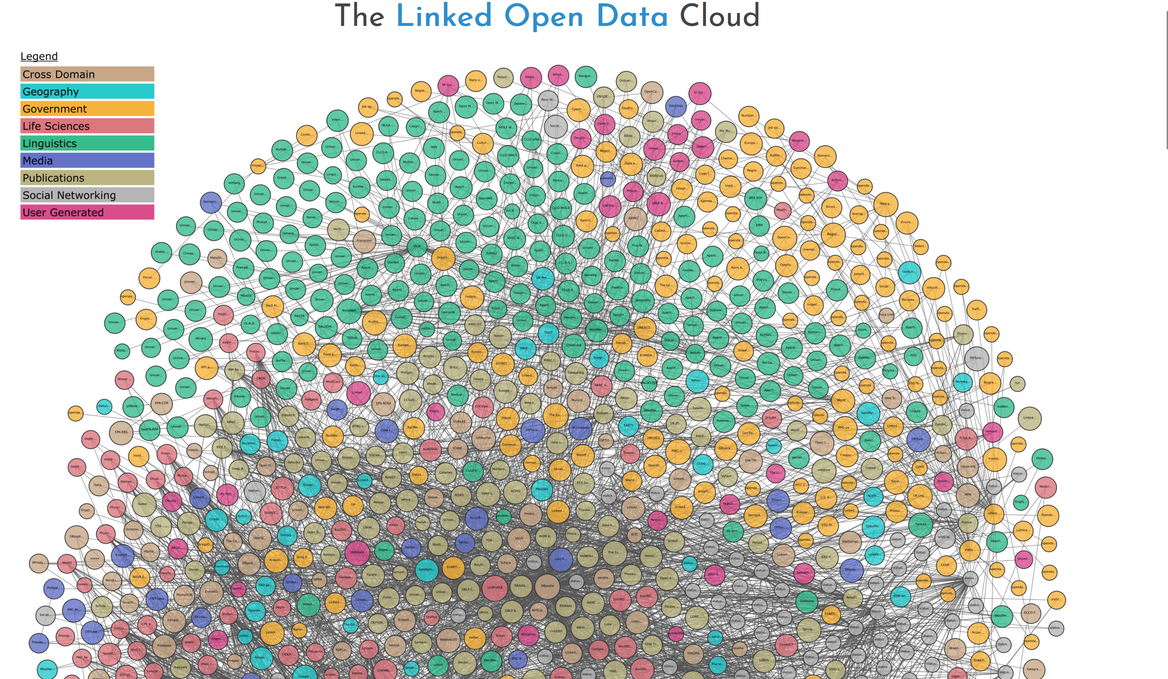
Linked Open Data
https://lod-cloud.net/

Slide 7
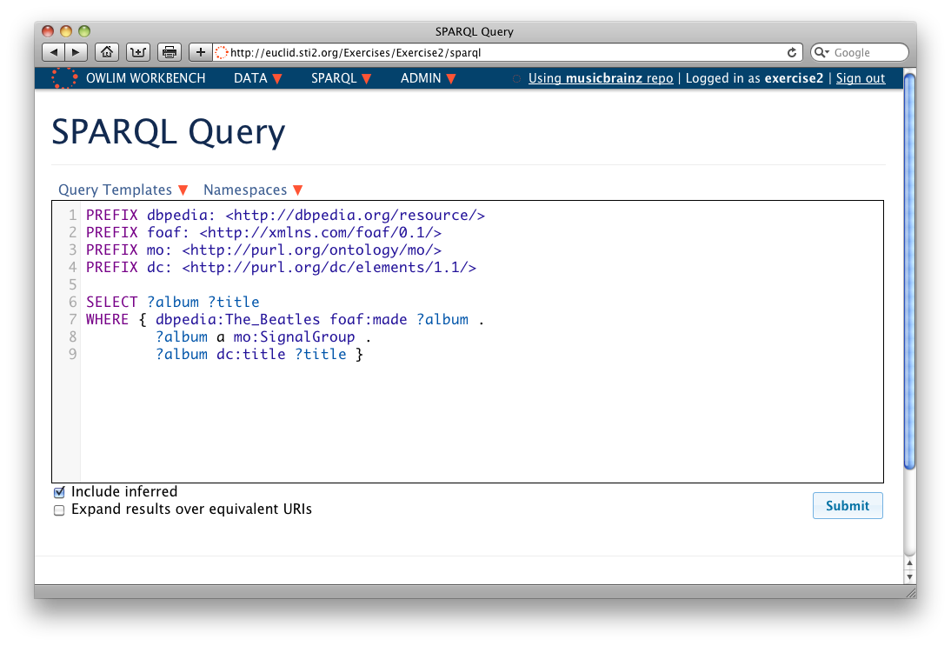
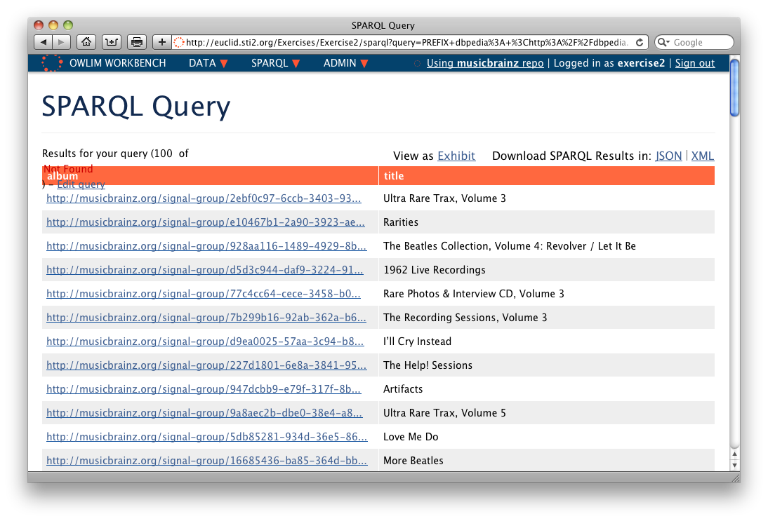
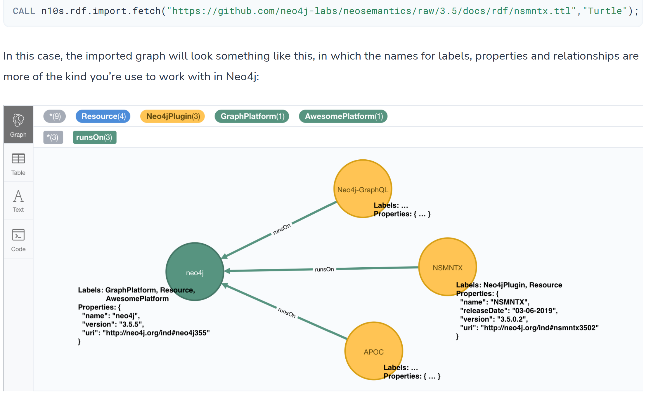
Turning Linked Data into
Knowledge Graphs
Mature Linked Data tooling available
Powerful analytics and querying
Merging of graphs
Mappings and import/export
Ontology
http://www.w3.org/TR/sparql11-overview/
Adapted from
https://euclid-project.eu/modules/chapter2.html
https://neo4j.com/labs/neosemantics/4.1/import/

Slide 8
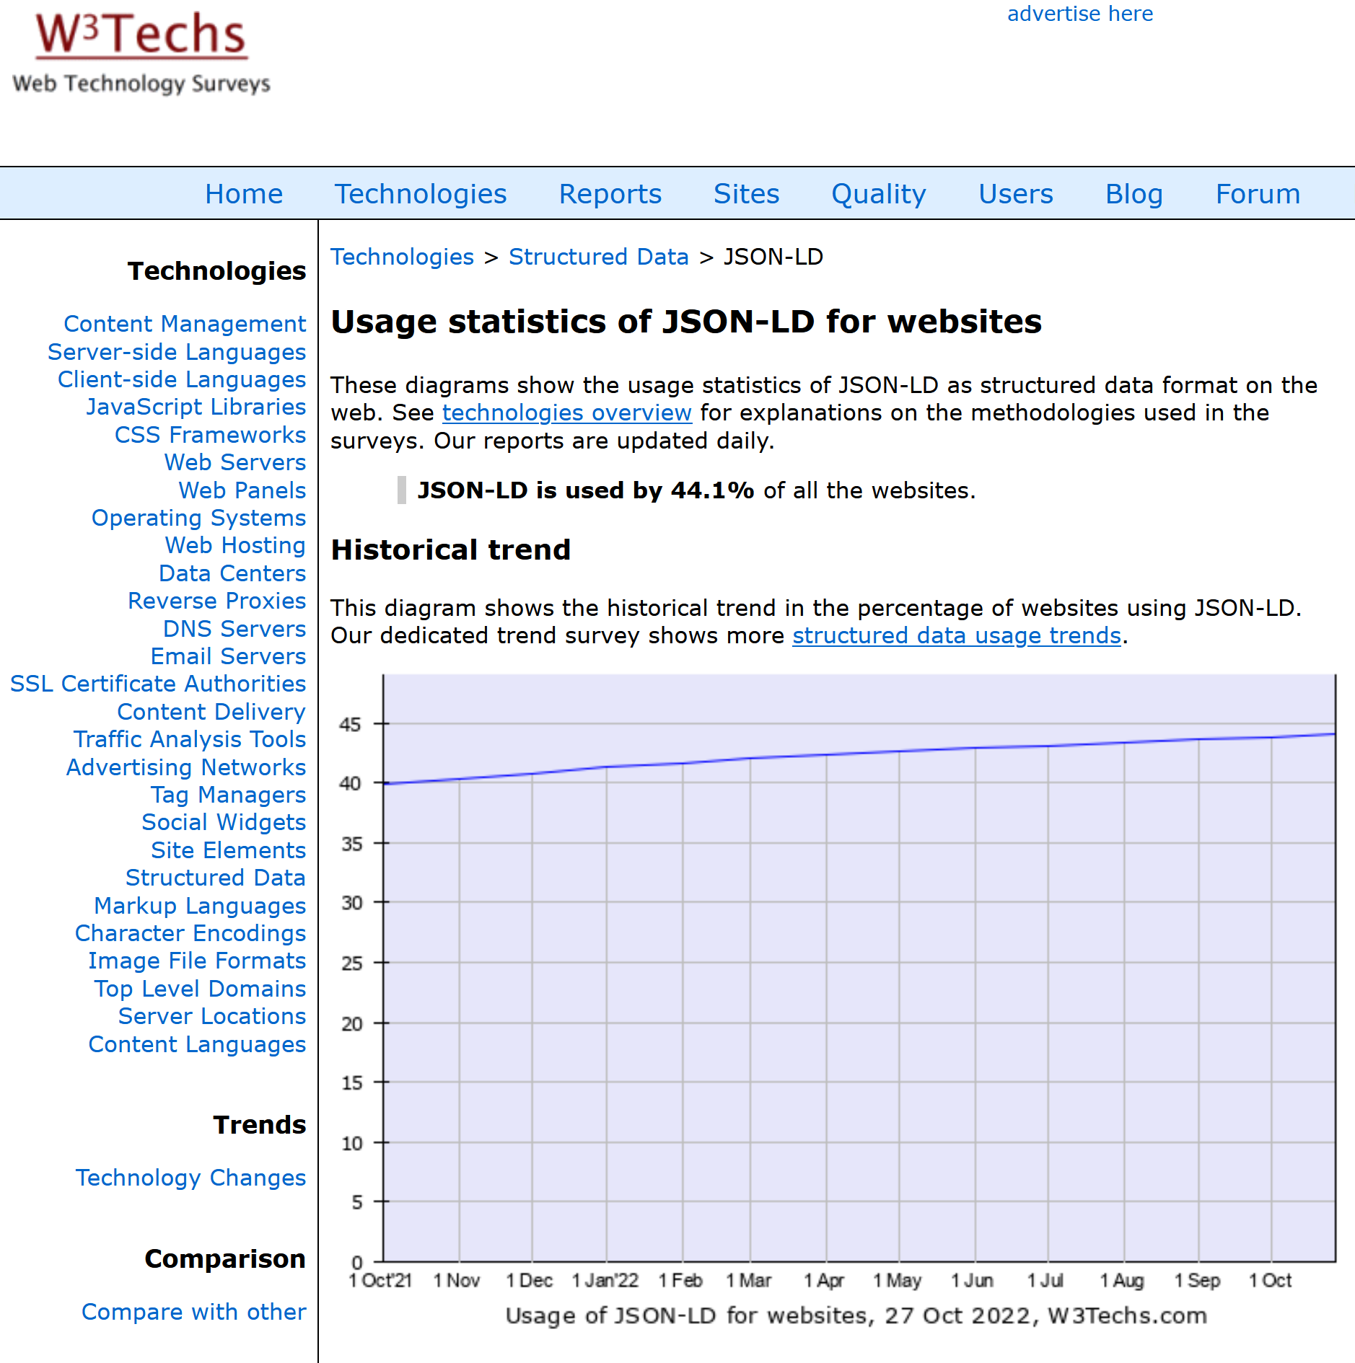
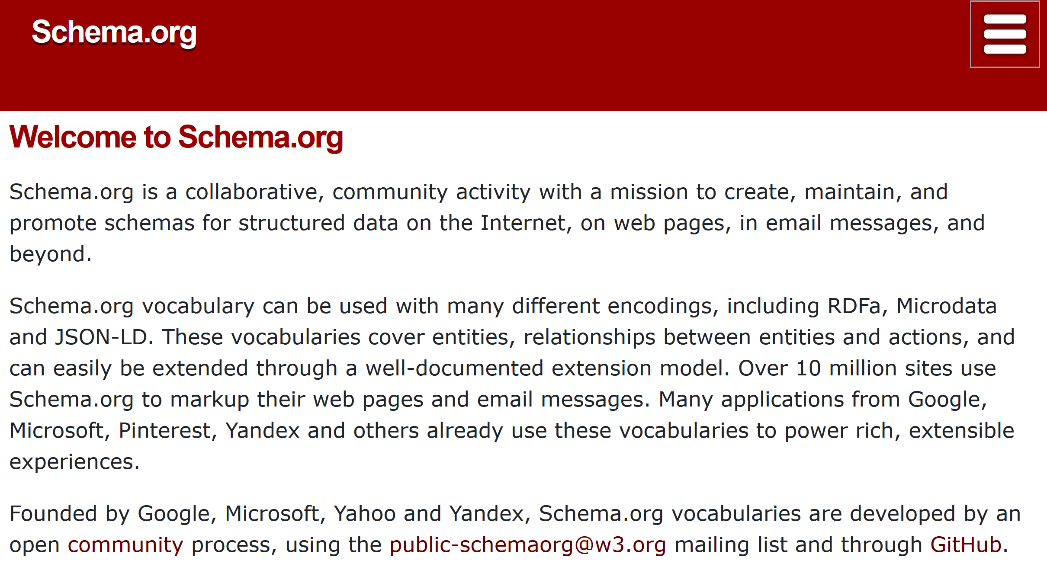
Linked Data is familiar to
Web Developers
https://schema.org/
Trends:
Moving away from rigid semantics, more light-weight use
Examle-driven documentation
Linking to Web pages with embedded metadata
https://w3techs.com/technologies/details/da-jsonld

Slide 9


















Implementing FDO using
RO-Crate
Structured metadata about the RO-Crate and content
RO-Crate Metadata file
id
type
description
datePublished
…
author
organisation
license
  Infrastructure independent – avoiding repository/service silos
  Practical, lightweight, robust
  Familiar, developer friendly,
  web-native, machine- and human-readable, search engine accessible
  Adoptable Linked Data JSON and PIDs
  Embrace diversity, legacy, unknowns, open-ended, multi-interpretation, self-describing, interlingua
  Adaptable Metadata Profiles
RO-Crate Content
id
type
description
datePublished
creator
size
format
…
By reference (PID, URL)
https://github.com/o/script
files
directories
https://doi.org/10.5281/zenodo.5841615
https://doi.org/10.3233/DS-210053
https://www.researchobject.org/ro-crate/

Slide 10
FAIR Signposting

Slide 11
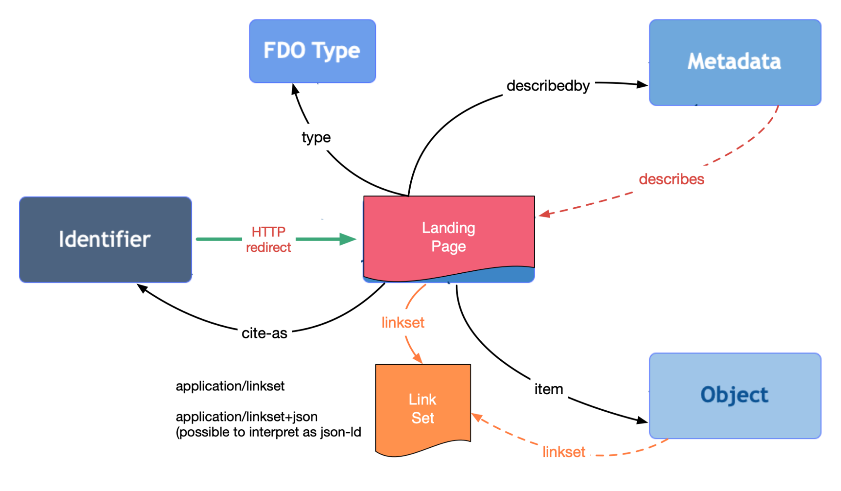
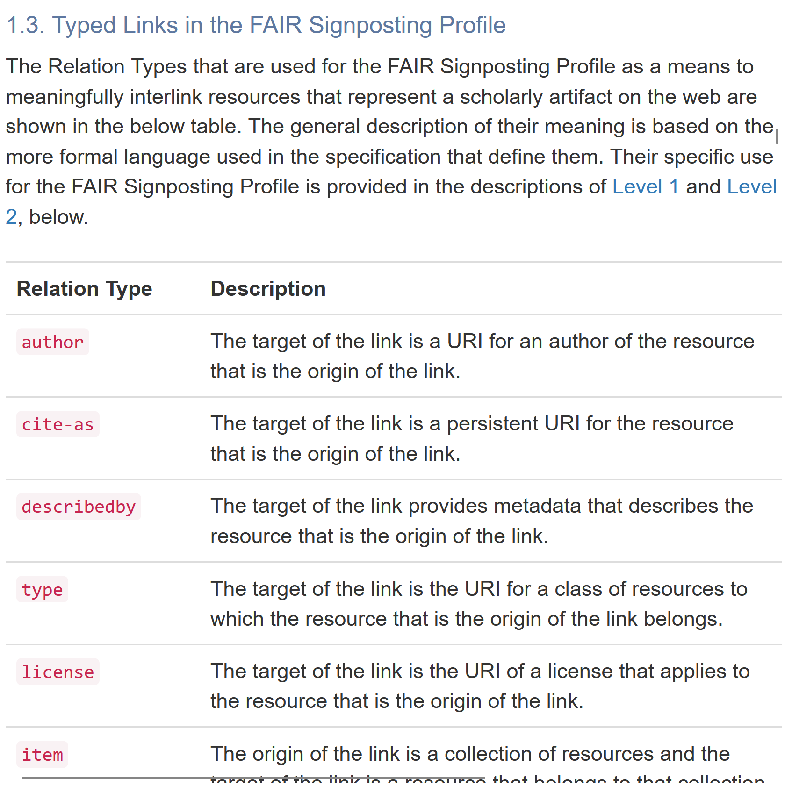
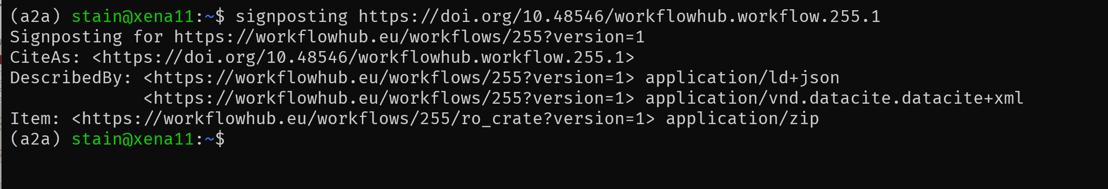
FAIR Signposting
https://signposting.org/FAIR/
https://pypi.org/project/signposting/

Slide 12
What can Linked Data learn from FDO?
Use and indicate Persistent identifiers
.. make sure they resolve! No heuristics, please
Always make types explicit
.. and indicate type system used
Make Linked Data active objects – Link to API operations

Slide 13
What can FDO learn from LD?
Keep it simple
Encourage organic growth
Legacy systems won’t go away (easily)
Consider consumption first (e.g. querying)
Exploit existing tooling
Establish best practices and shared vocabularies

Slide 14








Thank you !

