Slide 1

Dataverse introduction
Finding data in a Dataverse repository
Example presentation
DOI: https://doi.org/10.5281/zenodo.7037614
Notes:
This is an example presentation on Dataverse as a repository software that can be used in a workshop introducing dataverse as a system to find data.

Slide 2
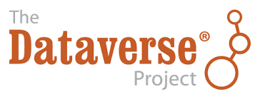
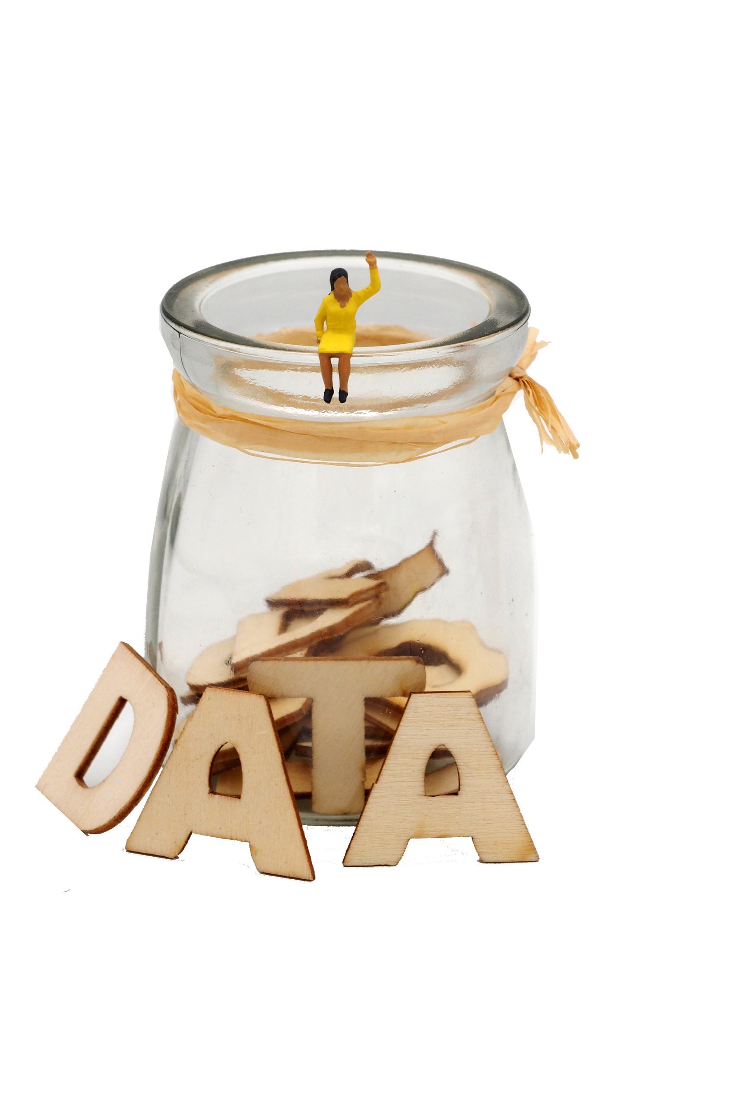
Overview
Dataverse introduction
Finding data in a Dataverse repository
Using data from a Dataverse repository
This presentation follows the instructions presented in the Dataverse End User Manual created in the SSHOC project available at: https://doi.org/10.5281/zenodo.6347488
Image: CC-BY-SA CESSDA DMEG https://dmeg.cessda.eu/
Notes:
Provide overview
This session is about introducing types of data available and how to find data for a research project.
Five sections
Lectures/talking but also practical activities where the aim is to find data for a specific research question
Assumes no prior knowledge but we recognise you may come with relevant experience and knowledge, therefore - opportunity to share and learn from each other

Slide 3
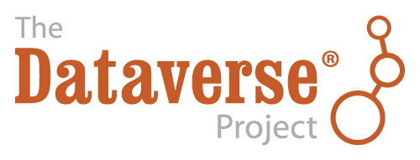
Dataverse
Dataverse is an open source research data repository software, that is being developed by Harvard’s Institute for Quantitative Social Science (IQSS) since 2006
and supported by the The Global Dataverse Community Consortium (GDCC).
It is used to share, preserve, cite, explore, and analyze research data.
https://dataverse.org/
Notes:
Here you can mention your own repository

Slide 4
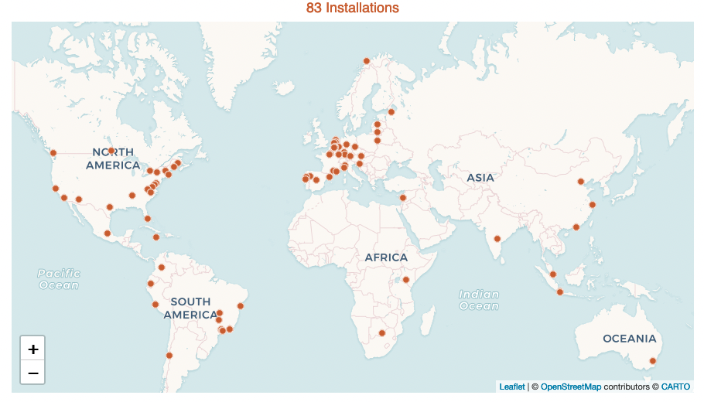
Dataverse
Notes:
Dataverse has 83 installations worldwide.
The most recent number is available at https://dataverse.org/

Slide 5
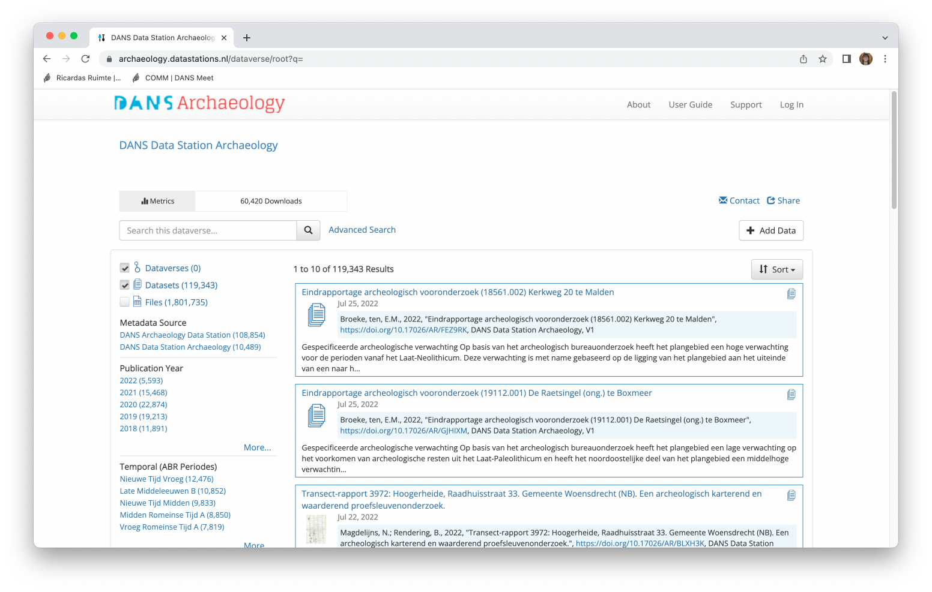
DANS Data Station
Notes:
You can show your own archive here as an example

Slide 6
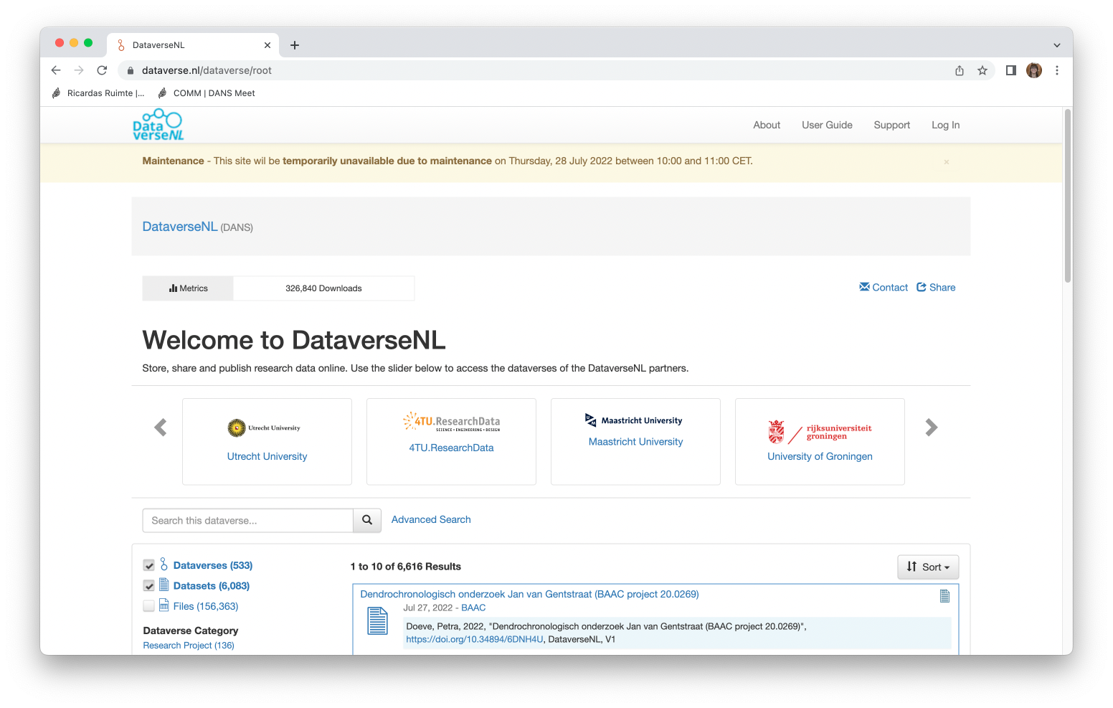
DataverseNL
Notes:
You can show your own archive here as an example

Slide 7
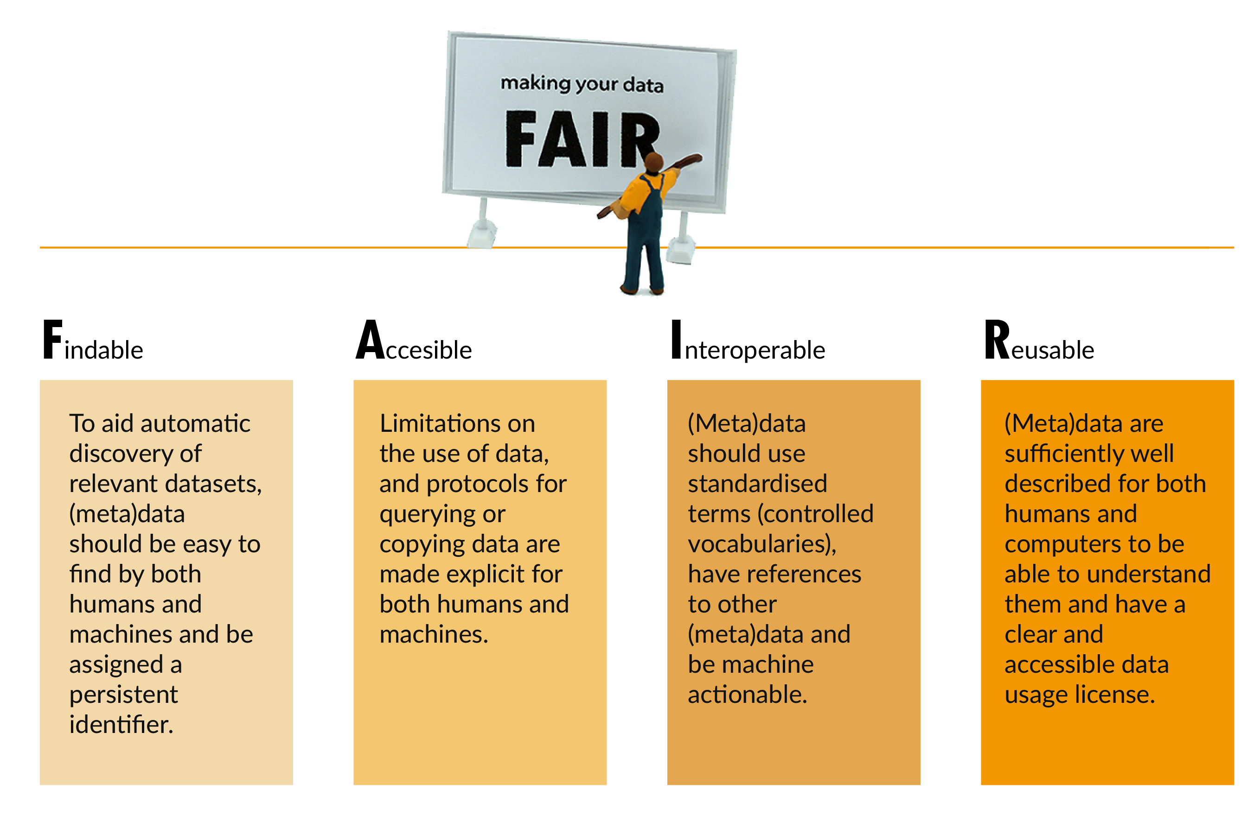
Dataverse helps make data FAIR
Image: CC-BY-SA CESSDA DMEG https://dmeg.cessda.eu/
Notes:
Explain the FAIR principles in short

Slide 8
Dataverse helps make data FAIR
Datasets have a Persistent Identifiers (PID), e.g. DOI
Includes standardized metadata blocks for different domains
  Metadata fields can be customized per collection
  Templates can be created for easier metadata entry
Metadata can be exported in various formats
Information on features: https://dataverse.org/software-features
Notes:
Dataverse has certain features that helps make data FAIR, we list them for Findable

Slide 9
Dataverse helps make Data FAIR
Datasets have a Persistent Identifiers (PID), e.g. DOI
Datasets can be openly available or access can be restricted
  Restrictions can be indicated per data file
Metadata is openly accessible even for restricted datasets
Information on features: https://dataverse.org/software-features
Notes:
Dataverse has certain features that helps make data FAIR, we list them for Accessible

Slide 10
Dataverse helps make Data FAIR
Includes standardized metadata blocks for different domains
Metadata can be exported in various formats
Controlled vocabularies can be connected to use standardised terms to describe data
Information on features: https://dataverse.org/software-features
Notes:
Dataverse has certain features that helps make data FAIR, we list them for Interoperable

Slide 11
Dataverse helps make Data FAIR
Datasets can be openly available or access can be restricted
  Restrictions can be indicated per data file
Supports various licenses
Statistical files (SPSS, STATA) are transformed into tabular data files
Information on features: https://dataverse.org/software-features
Notes:
Dataverse has certain features that helps make data FAIR, we list them for Reusable

Slide 12
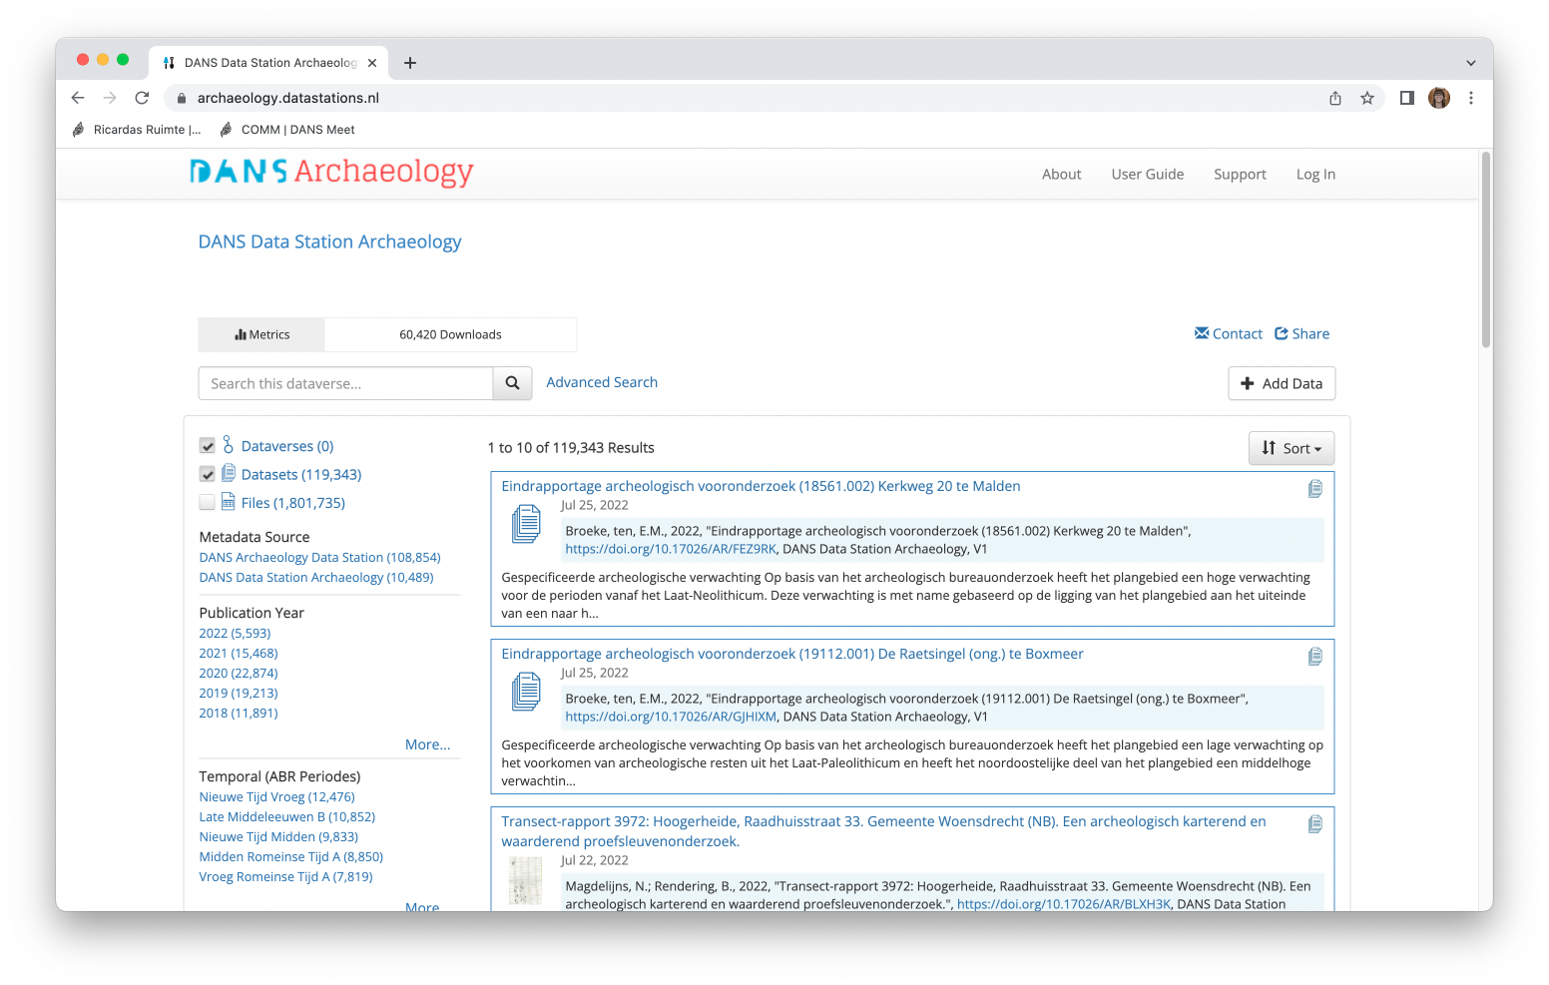
A closer look into a Dataverse repository
Number of datasets and files
Facets to filter
Example repsitory: DANS Data Station Archeaology: https://archaeology.datastations.nl/
Notes:
Here you can show your own repository

Slide 13
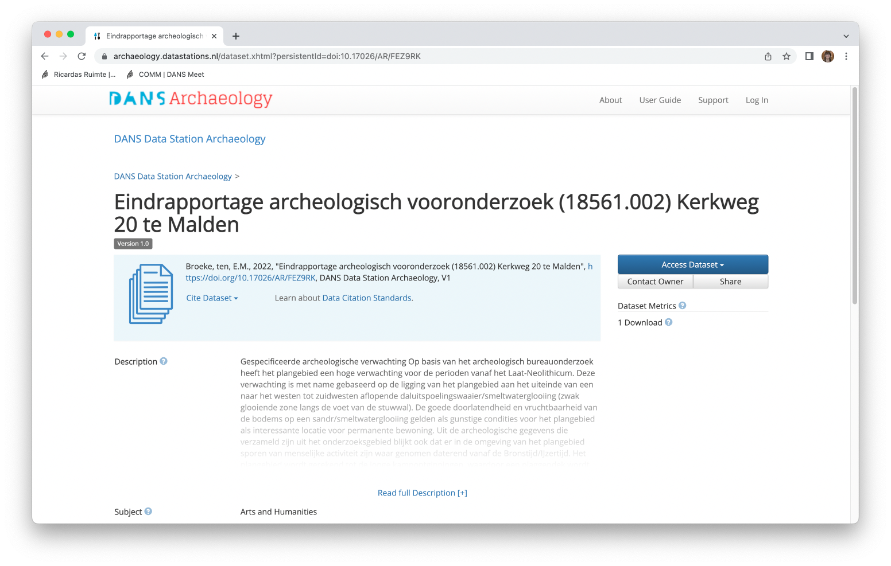
A closer look into a Dataverse repository
Citation information
Download information and metrics
Example repsitory: DANS Data Station Archeaology: https://archaeology.datastations.nl/
Notes:
Here you can show your own repository

Slide 14
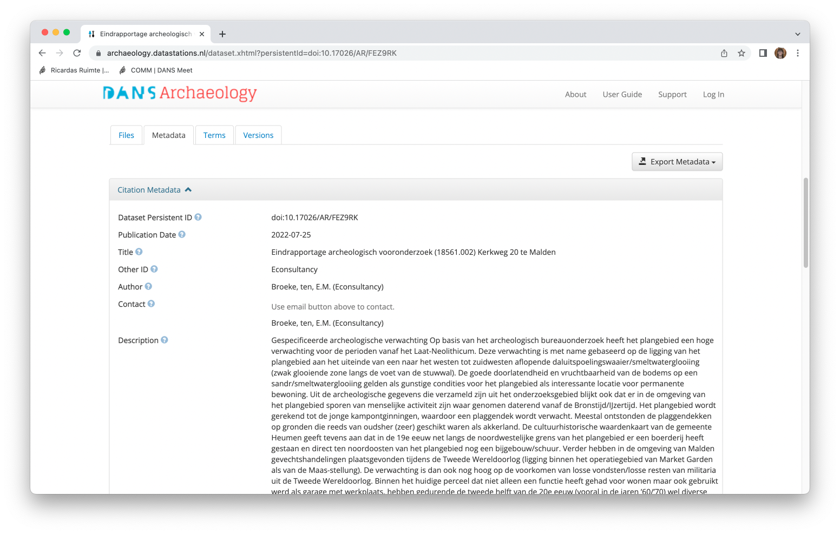
A closer look into a Dataverse repository
General information
Example repsitory: DANS Data Station Archeaology: https://archaeology.datastations.nl/
Notes:
Here you can show your own repository

Slide 15
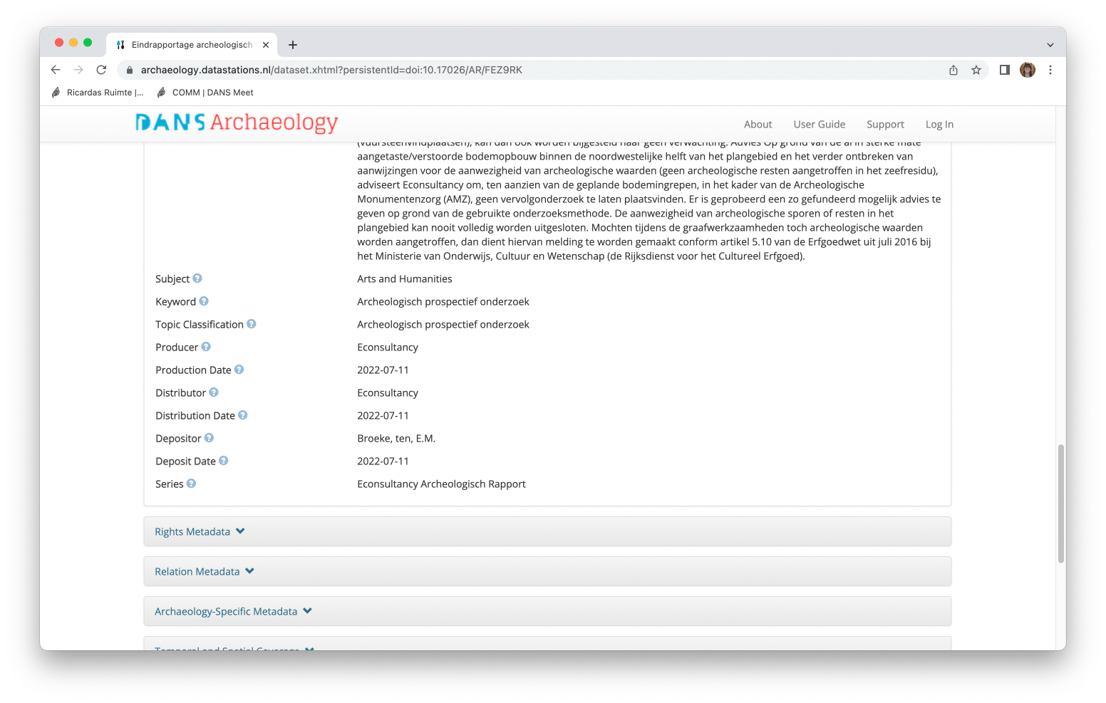
A closer look into a Dataverse repository
Example repsitory: DANS Data Station Archeaology: https://archaeology.datastations.nl/
Notes:
Here you can show your own repository

Slide 16
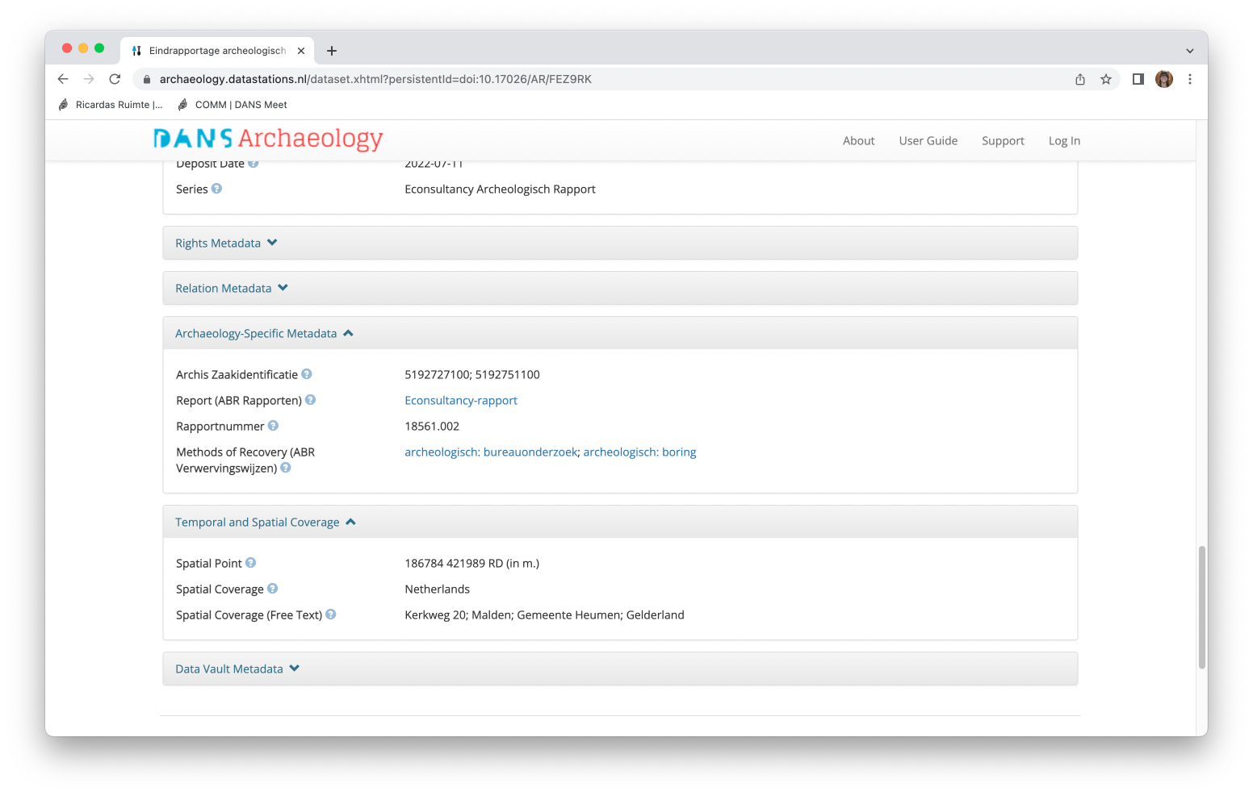
A closer look into a Dataverse repository
Domain-specific information
Example repsitory: DANS Data Station Archeaology: https://archaeology.datastations.nl/
Notes:
Here you can show your own repository

Slide 17
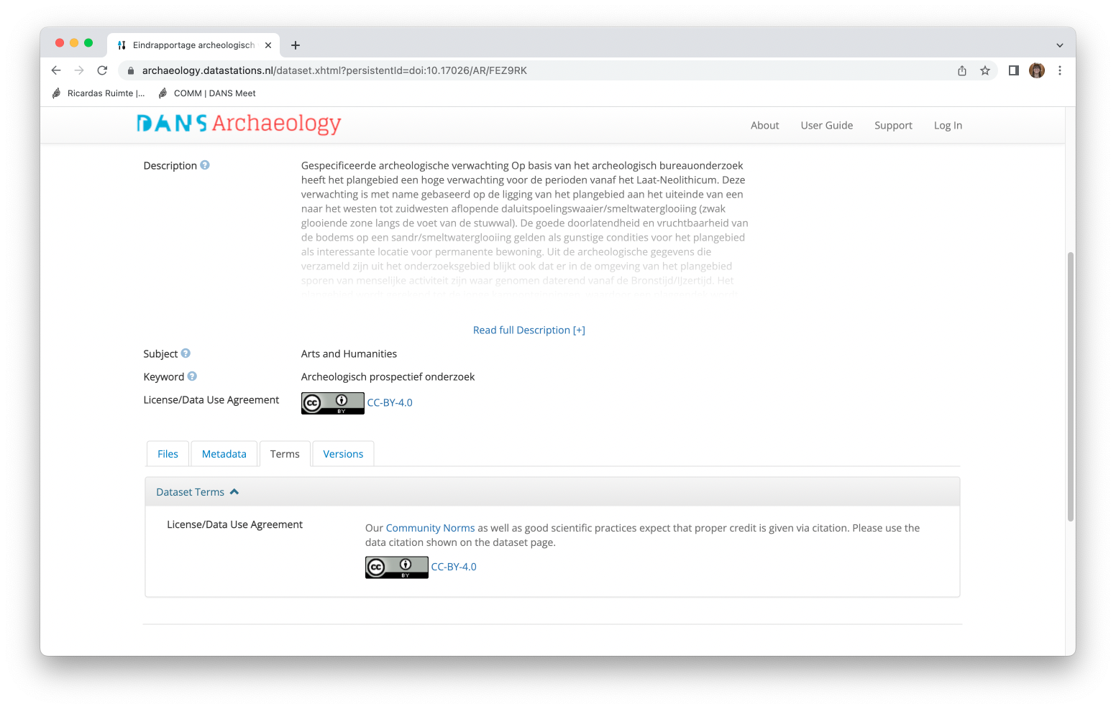
A closer look into a Dataverse repository
Information on license and terms of use
Example repsitory: DANS Data Station Archeaology: https://archaeology.datastations.nl/
Notes:
Here you can show your own repository

Slide 18
Finding data in a Dataverse repository
Information taken from Dataverse End User Manual available at: https://doi.org/10.5281/zenodo.6347488
Notes:
Feel free to use your own example
Dataverse is organised according to collections.
An example here is given from the Dutch DataverseNL platform where different Dutch research institutes have their own collection or subdataverse

Slide 19
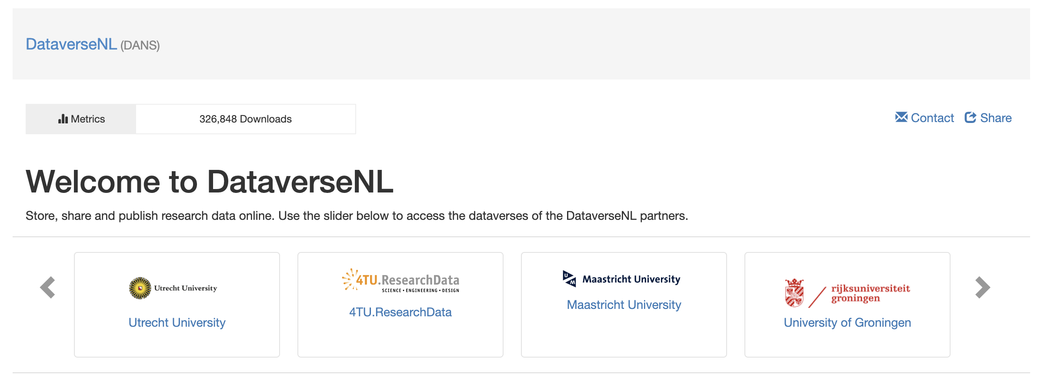
Finding data in a Dataverse repository
Searching and browsing
Dataverses and it’s collections (sub-Dataverses)
Example from: https://dataverse.nl/
Information taken from Dataverse End User Manual available at: https://doi.org/10.5281/zenodo.6347488
Notes:
Feel free to use your own example
Dataverse is organised according to collections.
An example here is given from the Dutch DataverseNL platform where different Dutch research institutes have their own collection or subdataverse

Slide 20
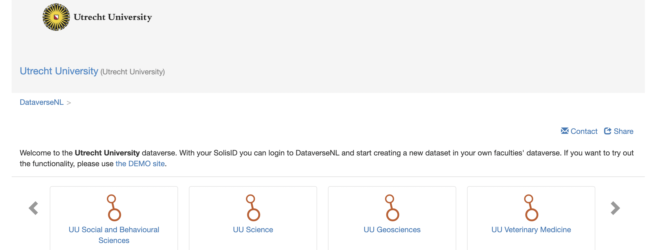
Finding data in a Dataverse repository
Searching and browsing
Dataverses and it’s collections (sub-Dataverses)
Example from: https://dataverse.nl/
Information taken from Dataverse End User Manual available at: https://doi.org/10.5281/zenodo.6347488
Notes:
Feel free to use your own example
Dataverse is organised according to collections.
An example here is given from the Dutch DataverseNL platform where different Dutch research institutes have their own collection or subdataverse. The University Utrecht for instance has sub-Dataverses for their different faculties.

Slide 21
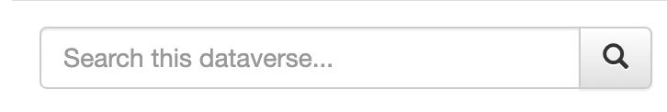
Finding data in a Dataverse repository
Searching and browsing
Basic search using the search bar
  Through all available metadata of the Dataverse installation
  Depending on the full-text indexing configuration of the Dataverse installation you may also be able to search in file contents
  accepts terms, queries (using AND or OR), and exact phrases (in parentheses).
Information taken from Dataverse End User Manual available at: https://doi.org/10.5281/zenodo.6347488
Notes:
Instructions from chapter 2 of the manual

Slide 22
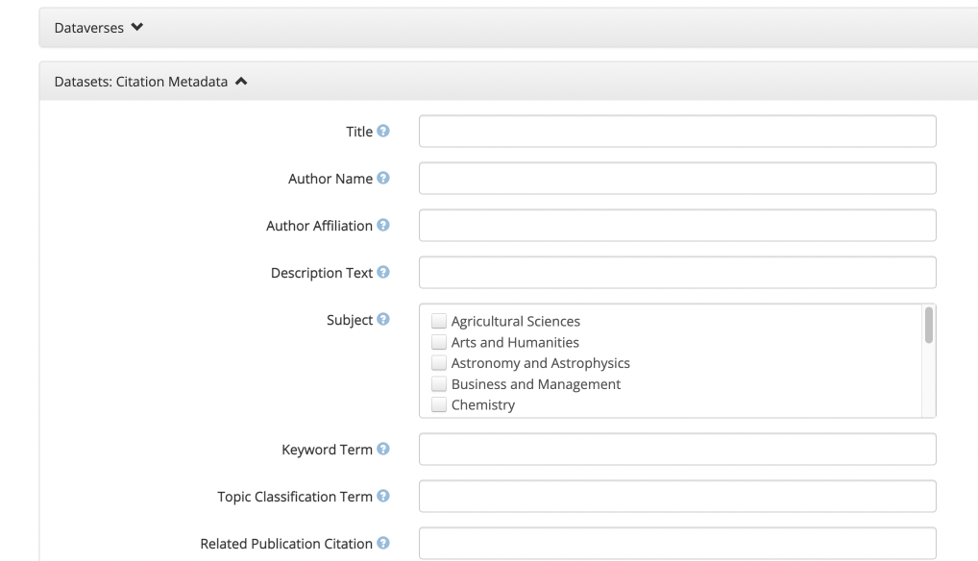
Finding data in a Dataverse repository
Searching and browsing
Advanced search
  Allows you to refine search further
  Search specific Dataverses
  Search specific Datasets
  Search specific files
Example from: https://archaeology.datastations.nl/
Information taken from Dataverse End User Manual available at: https://doi.org/10.5281/zenodo.6347488
Notes:
Instructions from chapter 2 of the manual

Slide 23
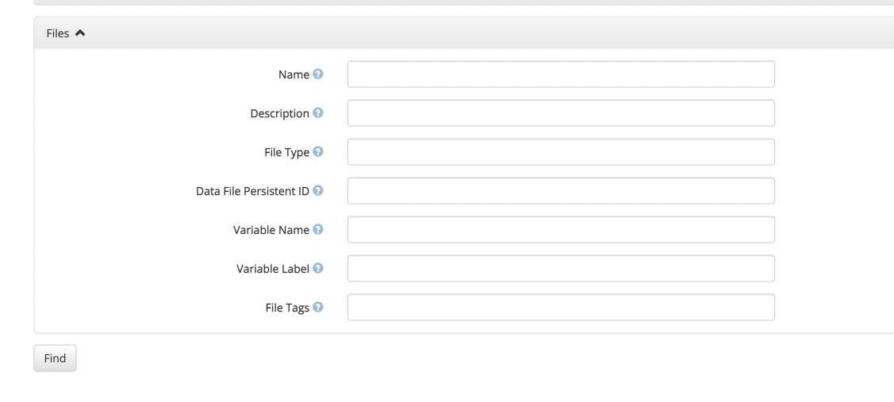
Finding data in a Dataverse repository
Searching and browsing
Advanced search
  Allows you to refine search further
  Search specific Dataverses
  Search specific Datasets
  Search specific files
Example from: https://archaeology.datastations.nl/
Information taken from Dataverse End User Manual available at: https://doi.org/10.5281/zenodo.6347488
Notes:
Instructions from chapter 2 of the manual

Slide 24
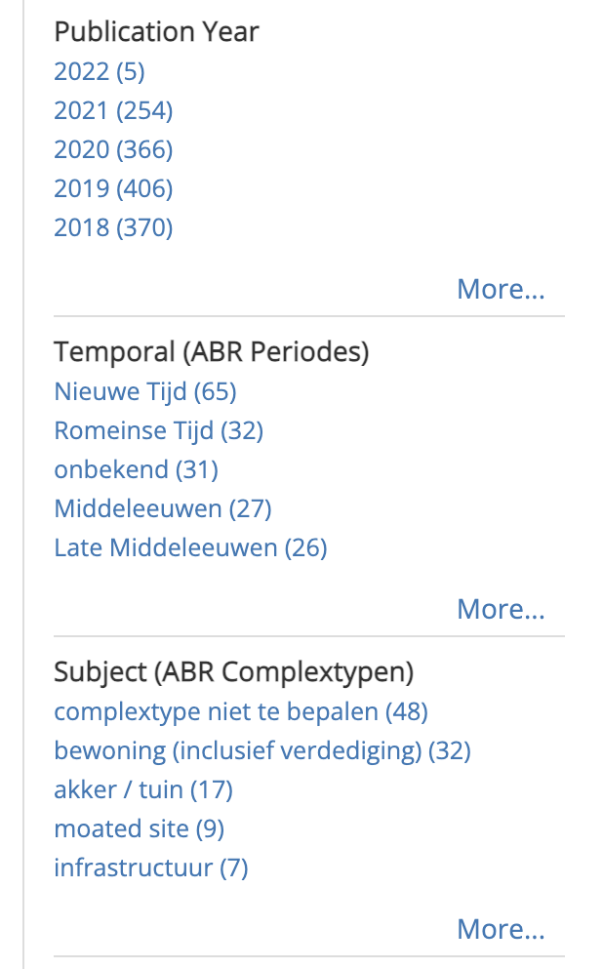
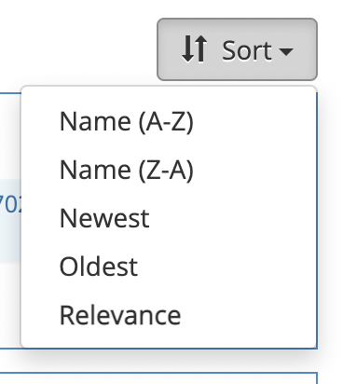
Finding data in a Dataverse repository
Viewing and sorting search results
You can use the facets on the left-hand side of the search results
You can sort results by name, date, or relevancy of the search results (the default).
Example from: https://archaeology.datastations.nl/
Information taken from Dataverse End User Manual available at: https://doi.org/10.5281/zenodo.6347488
Notes:
Instructions from chapter 2 of the manual

Slide 25
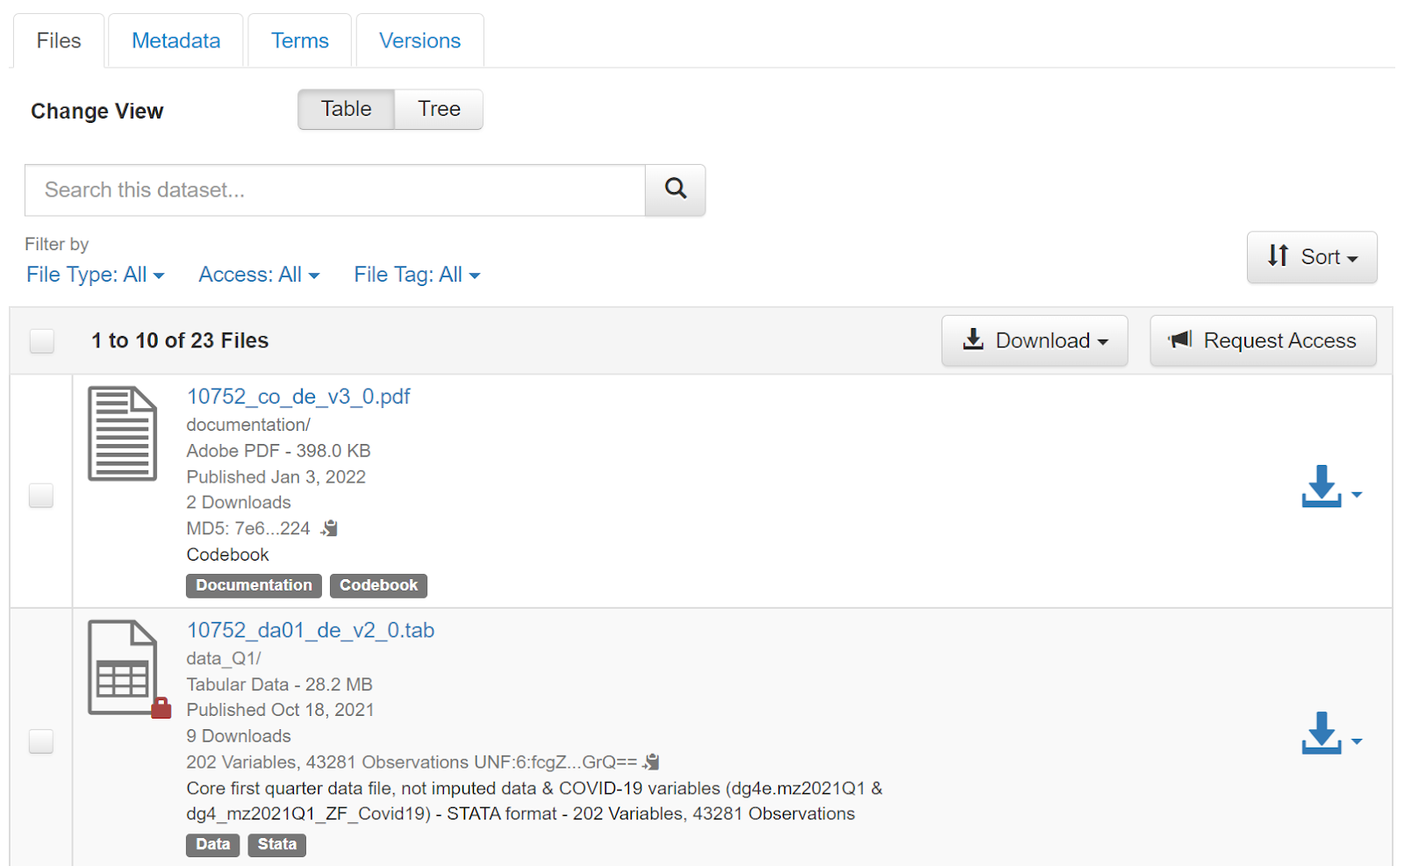
Using data from a Dataverse repository
Once you have found an interesting dataset:
You can search within the dataset to find specific files
You can view additional file information
  Restricted files are indicated with a small lock
  Open files can be downloaded right away
Information taken from Dataverse End User Manual available at: https://doi.org/10.5281/zenodo.6347488
Notes:
Instructions from chapter 3 of the manual

Slide 26
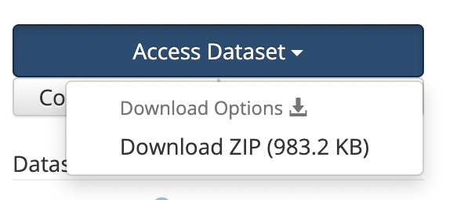
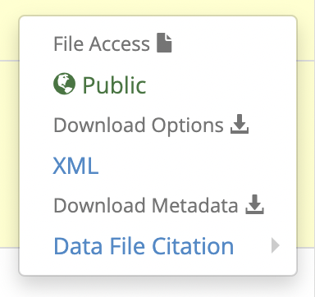
Using data from a Dataverse repository
Downloading data – open data
All data → click ‘Access Dataset’
  Different options
  Downloads a .zip file with folder structure determined by the creator
Individual files → Select in files tab and click ‘Download’ (top-right corner)
  Downloads selected files in .zip file
Metadata of datasets or files can be downloaded using the ‘Export metadata’ field
Download url for specific files can be used by APIs
Information taken from Dataverse End User Manual available at: https://doi.org/10.5281/zenodo.6347488
Notes:
Instructions from chapter 3 of the manual

Slide 27
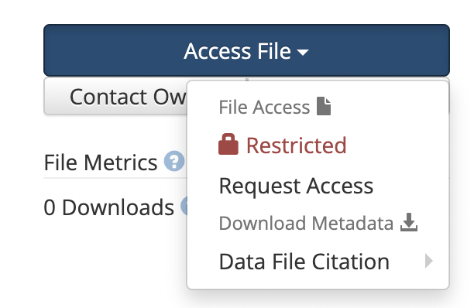
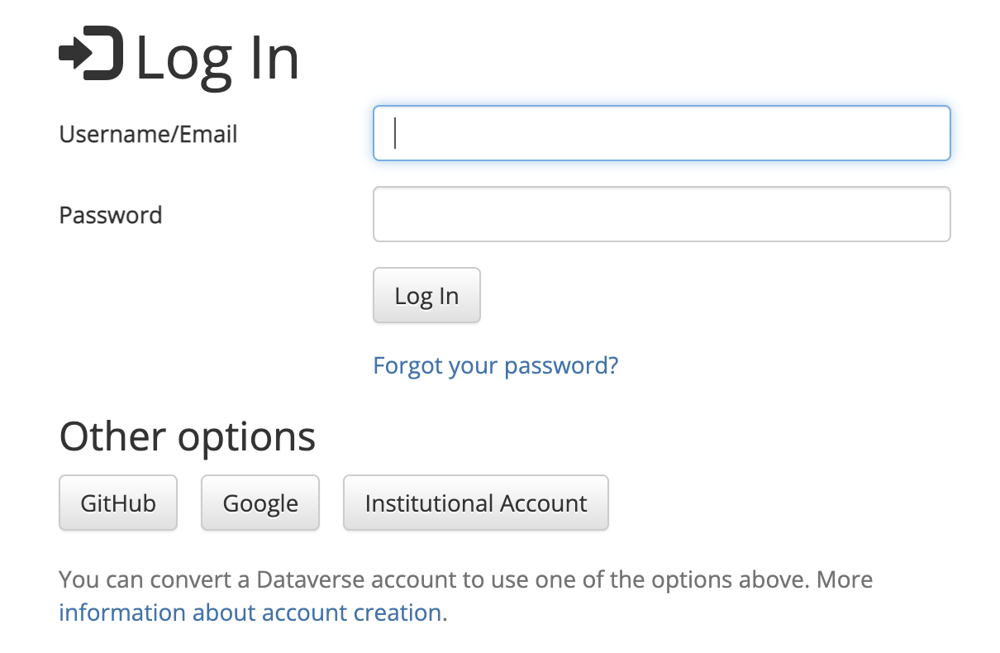
Using data from a Dataverse repository
Downloading data – restricted access
If a dataset or a file is not openly available, you need to request access
→ This will requires you to log in
Dataverse can be configured to support various log ins
  Username/Email and Password
  Institutional Log In
  ORCID
  Microsoft Azure AD
  GitHub
  Google
Information taken from Dataverse End User Manual available at: https://doi.org/10.5281/zenodo.6347488
Notes:
Instructions from chapter 3 of the manual

Slide 28
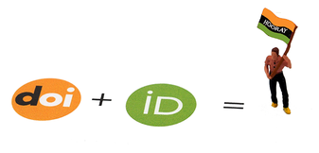
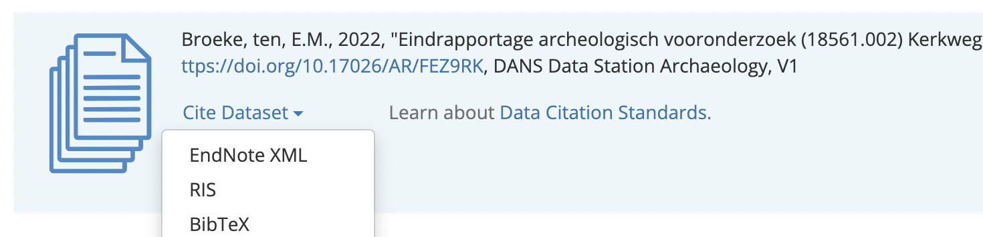
Using data from a Dataverse repository
Citing data
It’s important to cite the dataset you use to give credit to the authors
It’s important to include the Persistent Identifiers such as the dataset DOI
You can export different styles by clicking ‘Cite Dataset’ to add the dataset to your preferred reference management system.
Example from: https://archaeology.datastations.nl/
Image: CC-BY-SA CESSDA DMEG https://dmeg.cessda.eu/
Information taken from Dataverse End User Manual available at: https://doi.org/10.5281/zenodo.6347488
Notes:
Instructions from chapter 3 of the manual

Slide 29
Time to try it yourself
Go to https://archaeology.datastations.nl/ and look datasets that fit your interest
Notes:
You can end the presentation with a link to your repository where participants can search for data themselves.

Slide 30
Dataverse Features - Dataset metadata
Datasets have a Persistent Identifiers (PID)
  DOI or Handle are supported by Dataverse
Metadata fields can be customized per collection
Controlled vocabularies can be connected
Templates can be created for easier metadata entry
Supports various licenses
Information on features: https://dataverse.org/software-features
Notes:
Here you can mention your own repository

Slide 31
Dataverse Features - Data file metadata
File ingestion:
  Tabular data (SPSS, Stata, R, Excel, C/TSV) are transformed
  ZIP file ingestion & tree view
  Other formats are uploaded as is
Access restrictions can be set at file-level
Information on features: https://dataverse.org/software-features
Notes:
Here you can mention your own repository

Slide 32
Dataverse Features
Metadata can be exported in various formats
DDI
DDI HTML Codebook
OpenAire / DataCite
Dublin core
OAI-ORE
Schema.org JSON-LD
JSON

Slide 33
Any questions?

