Slide 1

How to Find and Access Data in Europe
A practical introduction
Example presentation
DOI: https://doi.org/10.5281/zenodo.7037614
Notes:
This is an example presentation which is based on presentation by Irena Vipavc Brvar (ADP) and
Jennifer Buckley (UKDS) available here. This presentation provides a couple of slides that you may find useful when talking about Finding and Accessing data in Europe.
It follows a lot of the elements described in the DMEG chapter on data discovery: https://dmeg.cessda.eu/Data-Management-Expert-Guide/7.-Discover

Slide 2
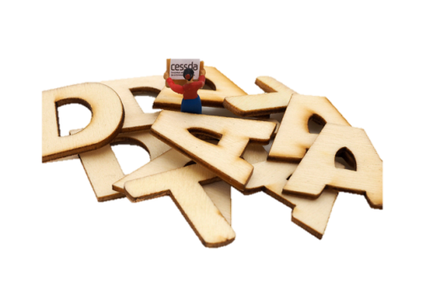

Overview
Data types and sources
Identify what you need
Searching data archives
Evaluating data: quality and usefulness
Accessing data
This presentation is based on the Discover chapter of the CESSDA Data Management Expert Guide (DMEG) available at https://dmeg.cessda.eu/
Image: CC-BY-SA CESSDA DMEG https://dmeg.cessda.eu/
Notes:
Provide overview
This session is about introducing types of data available and how to find data for a research project.
Five sections
Lectures/talking but also practical activities where the aim is to find data for a specific research question
Assumes no prior knowledge but we recognise you may come with relevant experience and knowledge, therefore - opportunity to share and learn from each other

Slide 3
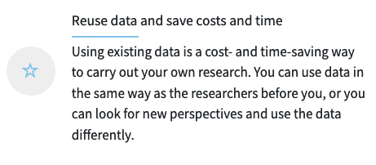
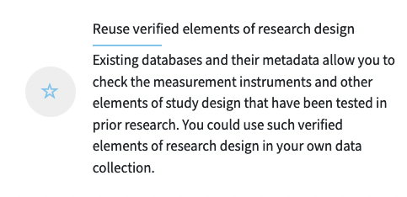

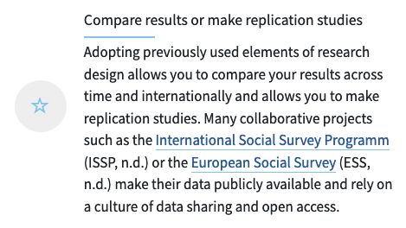
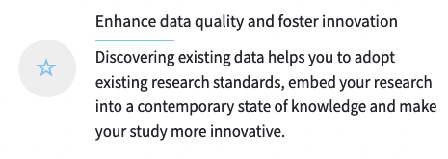
Why re-use data?
Images: CC-BY-SA CESSDA DMEG https://dmeg.cessda.eu/
Notes:
You can make this an interactive introduction and ask workshop participants why they would want to re-use data?

Slide 4
Data Types and Sources

Slide 5
Activity 1
Your knowledge and experience of the data landscape
Introduce yourself
Tell us about your research work (current, future, past)
Did you use or you intend to use available data for your work? Tell us about it.
Notes:
Activity 1: Your knowledge and experience of the data landscape (a warmer activity)
Activity 1 aims are to get participants talking, identify some key data sources/types, and assess participants prior knowledge
Participants write some ideas individually (give about 1 min)
Then share with neighbour (give 2-3 minutes)
Get feedback from each group (possibly making a list on flip chart etc) and ask participants to introduce each other

Slide 6
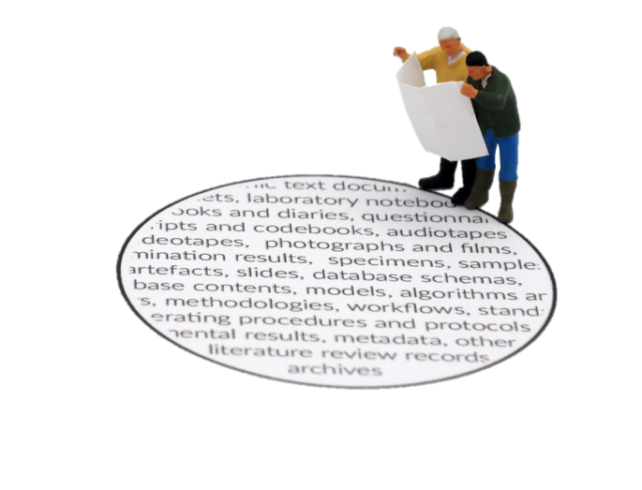


Types of data
Thinking about the types of data available can help you work out what you need and how to find it.
Quantitative and Qualitative
Images: CC-BY-SA CESSDA DMEG https://dmeg.cessda.eu/
Notes:
Thinking about the types of data available can help you work out what you need and how to find it. It can help you understand what is possible and help you navigate the volume of data you can find.
We will now discuss some ways to classify data.

Slide 7
Types of data: level of analysis
Microdata
Macro data
System level
Aggregate
characteristics of higher-level units such as the state or the political system e.g. electoral system (PR or single-member districts) and member of EU
Meso data
about populations, groups, regions and countries constructed by combining information on lower level units (e.g. unemployment rate, fertility)
data on collective and cooperative actors such as commercial companies, organizations or political parties
data from individual units (often people or households) often from surveys, a census and administrative records
Notes:
We can distinguish between types of data at different levels of analysis:
Microdata - data from individual units (often people or households). Common sources of microdata include surveys, a census and administrative records
Aggregate macro data refers to data about populations, groups, regions and countries constructed by combining information on lower level units. Examples of aggregate data include demographics, rate of unemployment for countries (or regions) and GDP. The information on lower level units may come from surveys, a census and administrative records. System level macro data refers to information about characteristics of higher-level units such as the state or the political system that is not based on summaries of lower-level units. Specific examples include ‘Electoral system (PR or single-member districts)’
Meso data: a term used to describe data on collective and cooperative actors such as commercial companies, organizations or political parties
We can distinguish between types of data at different levels of analysis:
Microdata - data from individual units (often people or households). Common sources of microdata include surveys, a census and administrative records
Aggregate macro data refers to data about populations, groups, regions and countries constructed by combining information on lower level units. Examples of aggregate data include demographics, rate of unemployment for countries (or regions) and GDP. The information on lower level units may come from surveys, a census and administrative records. System level macro data refers to information about characteristics of higher-level units such as the state or the political system that is not based on summaries of lower-level units. Specific examples include ‘Electoral system (PR or single-member districts)’
Meso data: a term used to describe data on collective and cooperative actors such as commercial companies, organizations or political parties

Slide 8
Types of data: time
Cross-sectional
Repeated cross sectional
Time series
Longitudinal
one-point of time (a snap shot)
cross-sectional surveys repeated with new samples
series of data points in time order (often equally spaced in time)
follow the same units over time e.g. household panel studies collect information from a sample of households in regular ‘waves’
usually information on multiple cases and variables
data from the different samples allows analysis of trends
aggregate macro data are often time-series data.
time points may come from sample surveys e.g. unemployment from labour force surveys
Notes:
We can differentiate data by how time is represented:
Cross-sectional – data from one-point of time for multiple cases and variables (a snap-shot)
Repeated cross sectional – when cross-sectional surveys, which collect data from a sample in a single point of time, are repeated with new samples we get repeated cross-sectional data. Comparing data from the different samples then allows analysis of trends
A time series is a series of data points in time order, often at equally spaced points in time. Aggregate macro data for countries and regions are often time-series data. The individual time points may come from sample surveys. For example, the standard measure of unemployment in many European countries comes from countries Labour Force Survey.
Longitudinal studies – follow the same units over time. Panel studies collect information from the panel members in intervals known as ‘waves’, which tend to be frequent. [example of household panel studies]

Slide 9
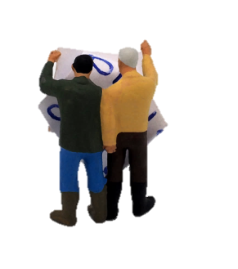
Sources of data
There are many sources of data.
Images: CC-BY-SA CESSDA DMEG https://dmeg.cessda.eu/

Slide 10
Data repositories
Digital archives collecting, preserving and displaying datasets, related documentation and metadata.
Types of repository
Domain-specific trusted repositories (e.g. CESSDA archives) - focus on high-quality data with a potential for reuse
Institutional research data repositories e.g. universities
General purpose repositories e.g. Zenodo, Figshare, Harvard Dataverse
Notes:
Data can often be accessed through a data repository, which is a digital archive collecting, preserving and displaying datasets, related documentation and metadata (OpenAIRE, 2017). There different types of data repository.
The CESSDA archives are examples of domain-specific trusted repositories. As a general rule, this kind of repositories includes only high-quality data with a potential for reuse.
Institutional research data repositories
General purpose repositories such as Zenodo (n.d.), Figshare (n.d.) or Harvard Dataverse (2017).

Slide 11

A registry of research data repositories
Search
by subject, content type and country
for data archives with a certificate (a trusted repository), open access or for data sets that have a persistent identifier
Notes:
On this website you can find a registry of research data repositories
Re3data.org is a registry of over 1500 research data repositories,.
You can search by subject, content type and country. In addition, you can select whether you want to search for data archives with a certificate (a trusted repository), with data sets that are available via open access or for data sets that have a persistent identifier.

Slide 12




European Social Science Data Archives
Data collections include:
variation between archives
quantitative data - major source of individual level data
qualitative data
outputs of
  major academic projects
  government/policy
  small research teams
  individual researchers
recent and less recent data
different languages
List of archivesin CESSDA and logo’s available at https://www.cessda.eu/About/Consortium-and-Partners/List-of-Service-Providers
Notes:
European social science data archives provide access to extensive collections of data.
Each archive’s collection is unique.
Archives vary in size. Large archives may provide both national and international data and small archives can have more limited national data collections.
Quantitative data is most common, particularly data from social surveys. Making social science archives a key source of individual level data
Some archives also include qualitative data, for example, interview transcripts and field notes.
Sources of data include major collaborative studies, official statistics and government studies to small research projects and individual researchers.
Collections can include current data (though note the processing of data means data might not be archived for many months after data collection). They can also include older data collections including studies that have been collecting data over decades.
There is a general trend towards greater data archiving and sharing due to interest in enhancing public investments in research and in making research more transparent.

Slide 13
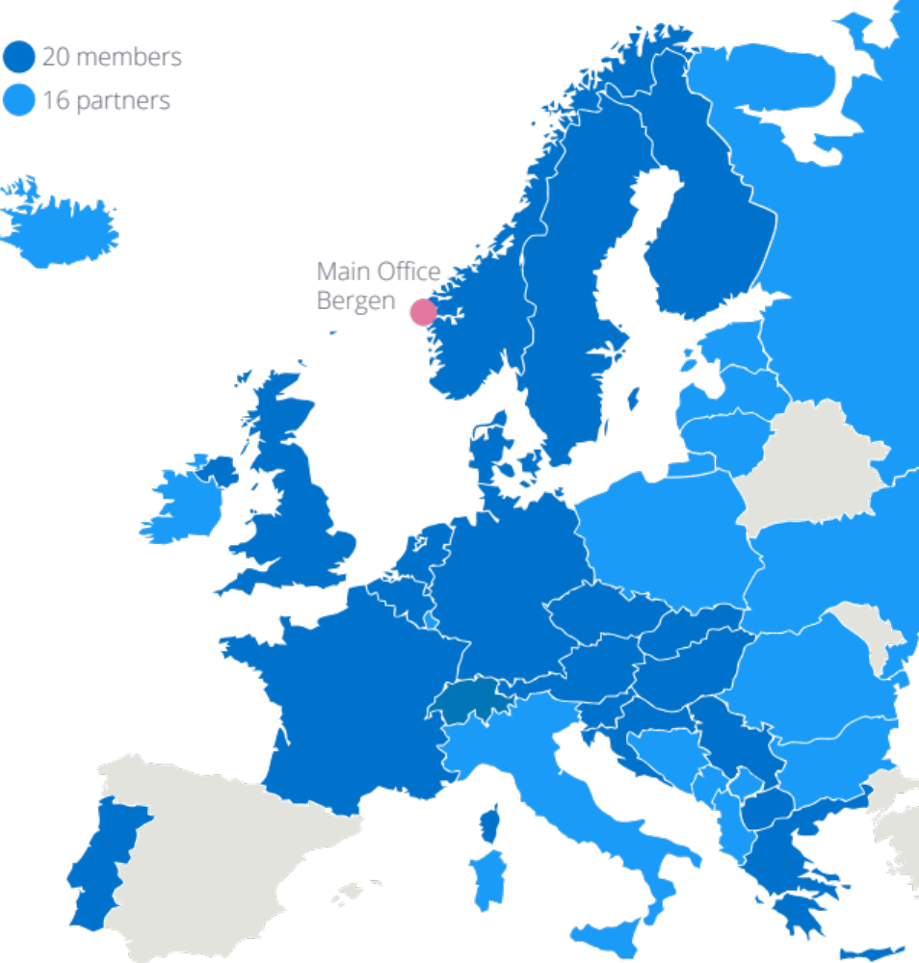

CESSDA
Cross-European resource discovery
Improved quality of data and metadata
A wider selection of comparable data
Certification of data archiving organisations
Professional training for data archivists and scientific community
Improved mechanisms for data access and analysis
Strong involvement of organisations outside Europe
Notes:
Some background
CESSDA is the Consortium of European Social Science Data Archives.
Its vision is to provide a full scale sustainable research infrastructure that enables the research community to conduct high-quality research which in turn leads to effective solutions to the major challenges facing society today.
Key tasks underlying this vision include
developing standards and best practices around the management and archiving of social science data
facilitating researcher access to important resources
Ways this work is being developed include e-services such as the CESSDA data catalogue, training and coordinating the network of European data service providers.

Slide 14
Highlight your own archive
Here you may want to highlight your own data archive

Slide 15

Cross-national studies
International survey research programmes include many European countries
International Social Survey Programme (ISSP)
European Social Survey (ESS)
European Values Survey (EVS)
Eurobarometer (EB)
Survey of Health, Ageing and Retirement Europe (SHARE)
Generations and gender programme (GGP)
Notes:
Many European countries participate in international survey research programmes. Current programmes cover a range of themes/topics. Here are some examples…
A list of more studies available in the DMEG https://dmeg.cessda.eu/Data-Management-Expert-Guide/7.-Discover/Data-repositories-as-data-resources/International-surveys
You can pick one and highlight one that is relevant.

Slide 16
Five key data providing organizations
IMF - time series data on economic and financial indicators
Eurostat – Statistics office of European Union
LIS - harmonised socio-economic micro datasets
World Bank - Free and open access to global development data
OECD – key source of comparable statistical, economic and social data
Notes:
A wide range of organisation provide access to key sources of data.
Here are 5 important examples, especially of macro/aggregate time series data.
Eurostat is an important one to highlight for data about European countries …
You can provide more background if you like, see the presentation this is based on: https://dmeg.cessda.eu/content/download/4931/54681/file/TTT_PR_Ch7_SlidesHowtofinddata_v1.1.pptx

Slide 17
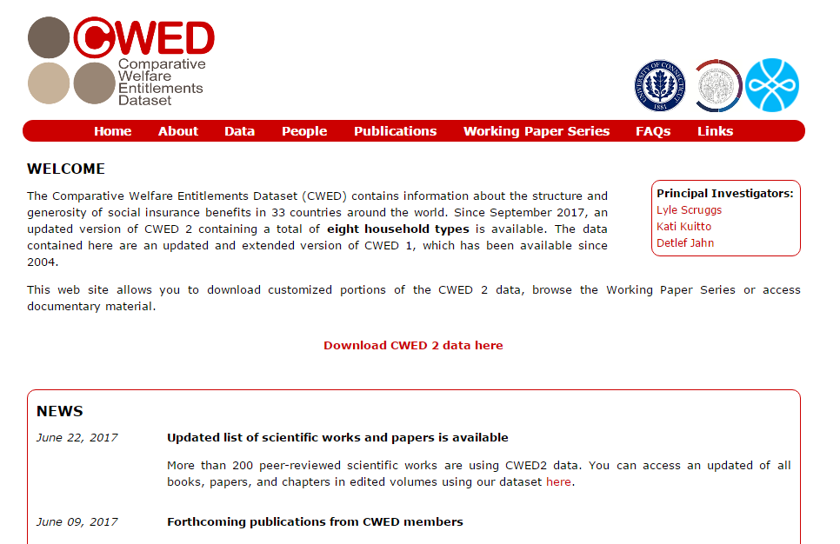
Direct from project websites
Some research projects share research data through project websites
Example: http://cwed2.org/
Notes:
You may want to skip or include this slide as it is mainly to illustrate that data can also be found on individual sites.
---
Researchers might also share their data via their dedicated websites.
One example is the Comparative Welfare Entitlements Dataset (CWED), which contains information about the structure and generosity of social insurance benefits in 33 countries around the world.
The data contained here are an updated and extended version of CWED 1, which has been available since 2004.
This web site allows you to download customized portions of the CWED 2 data, browse the Working Paper Series or access documentary material. http://cwed2.org/

Slide 18
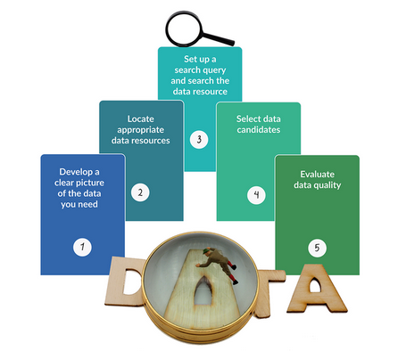
Identify what you need
Images: CC-BY-SA CESSDA DMEG https://dmeg.cessda.eu/

Slide 19
Four ways we can use archived data
New analysis: one or multiple data sources e.g. combine micro and macro, just secondary data or secondary data combined with primary data
Replication: replicate the analysis of a previous study.
Use of study design/methodology: e.g. data collection tools (interview schedules & survey questions) or sampling strategies
Teaching : Subject-based or research methods, Datasets made for training purposes – e.g. easySHARE
Notes:
Archived data can be used in multiple ways.
One common use is new data analysis - New data analysis can involve one or multiple data sources. For example, you might want to combine data from different levels of analysis such as microdata from a survey (such as the ESS) with regional statistics (from Eurostat). You can also use secondary data only or combine secondary with new primary data.
Archived data can also be used to replicate the analysis of a previous study.
Researchers can also make use of archived data’s design/methodology including data collection tools and sampling strategies. For example, those designing a survey can find questions from the mass of archived survey projects, which includes surveys designed by experts. Those designing qualitative work can also make use of the detailed notes to replicate a study.
EXAMPLE - The Living and working on Sheppey project offers an interesting example. The project explored the changes in working lives over 40 years on the Isle of Sheppy (Kent, UK) by combining archived and newly collected data. In the new project, researchers replicated a part of the study where school pupils were asked to complete essay where they imagined themselves in old age reflecting back on their lives.
Archived data is a great resource for teaching, giving learner experience of real-life research. Data can enhance subject based learning and is key for research methods teaching. Many data providers offer datasets specifically designed for learners. For instance, easyShare is a longitudinal data set created especially for training purposes. It contains only selected variables merged into a single data file. It is more user-friendly than the complete set of SHARE panel data.
In the rest of this session, we are mainly thinking about the first use.

Slide 20
Identifying data needs
Research Question
Key concepts
How to operationalise?
(concepts can be complex and difficult to measure)
  What is the ideal dataset for addressing this question?
  Compromises needed in reality
  Key features
  Multidimensional
  Groups of people
  Dependent/ independent variables
  What variables/multiple variables?
  Comparable/established measures (e.g. Schwarz Human Values)
Notes:
A big part of finding data for a research project is identifying what data you need.
Your data needs largely depend on the research question/objectives. We can think of this process as imagining the ideal dataset to answer your research question. In reality you might need to make compromises but an understanding of the ideal gives you some way to evaluate the potential sources you find.
Key concepts - A first step can be to specify the main concepts of interest.
Consider the key features of the concepts you want to find within data e.g. if interested in political behaviour, are interested in voting or a broader concept of political behaviour
For multidimensional concepts, are you interested in any specific theoretical dimensions – e.g. online or offline political behaviour (and possibly how they relate to each other)
Are you also interested in identifying specific groups/types of people such as men and women?
Depending on the type of research question/approach it might be useful to specify the dependent and independent variables. For instance, if looking at gender differences in political participation online, your dependent variable is some measure(s) of online participation and gender is one independent variable – what other independent variables do you need/want to include?
Next, you can consider how to operationalise these concepts (at least ideally)
Your concepts may be complex and difficult to measure (they often are in the social sciences) but thinking about the key features you want can help find the most suitable data. For example, for operationalising religiosity, we can consider how people self identify as belonging to a religious group or alternatively information about the practice of religious activities. For social class, we can have individuals ‘subjective’ social class or use occupation based classifications. Think about what is most important for you.
In quantitative research, you may need information from different variables. To measure complex concepts. For instance, rather than asking about household income directly, surveys might use multiple questions asking about different forms of income and the information can then be combined to create a more accurate measure of overall household income.
You may want to use measures that are comparable to other studies (or that expand on other studies) In the social sciences, many concepts are measured in standard ways.
E.g. The 'Human Values Scale' a well-established 21-item measure of human values, developed by the Israeli psychologist, Professor Shalom Schwartz. It is designed to classify respondents according to their basic value orientations. The Human Values Scale has been included in every ESS round to date.
attitudes towards the welfare state are often measured in surveys with questions asking whether it is the government’s responsibility to provide certain forms of welfare, often labelled as “role of government”.
There are also important official or harmonised approaches to measuring some concepts, which are designed to provide comparable and validated measures. For instance, all members of the EU must use the International Labour Office (ILO) standardised measure of unemployment in their Labour Force Surveys.
ILO also developed the International Standard of Occupational Classification (ISCO) to harmonise the measurement of occupations. Using ISCO codes, the European Socio-Economic Classification (ESeC) was developed in the early 2000s as a comparable measure of socio-economic status (SES).
Like all measures, standardised approaches have strengths and weaknesses but you will generally find literature examining their validity and reliability.

Slide 21
Identifying data needs
Population
Geography
Time
Unit of analysis
Study design and sample
  Who are you concerned with?
  e.g. people/adults/EU citizens, migrants, local authorities
  e.g. specific countries or regions,
  all EU countries or A10 countries (2004)
  As most recent as possible
  a specific period (e.g. 2008-2018)
  a long a period as possible
  data from people at multiple time points?
  individuals, households,
  regions or countries?
  Do you need representative (random) sample?
  Size (large sample for inferences about small groups)
Notes:
Ideal Population
What population does your research focus on e.g. European citizens, school children, migrants to the EU, local authorities?
Geographical coverage
Does the population have a specific geographical coverage? e.g, a specific country, countries that are EU member or the “A10” countries joining in 2004?
Time
What period do you want your data to cover? E.g. as recent as possible, from a specific period? For as long a period as possible?
Do you need data from the same sample at different time points?
Units of analysis
Are you interested in individuals, households, regions or countries?
Sample type
A key question in relation to sample type is whether you need data to be representative of a specific population. If so, you most likely need to find data collected from a sample taken using random sampling techniques. Large – especially important for making estimates about small sub-populations – e.g. political activists

Slide 22
Identifying data needs
Task: identify data needs - Evaluating data worksheet
Notes:
Give participants time to think about their needs

Slide 23
Find data resources
Images: CC-BY-SA CESSDA DMEG https://dmeg.cessda.eu/

Slide 24



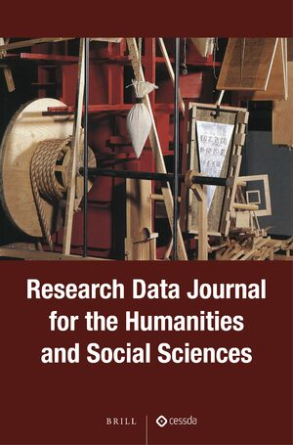
Find data resources
Registries of data repositories
Search engines
Metadata aggregators
Data catalogues
Data Journals
Notes:
As mentioned before under sources of data there are many data sources you can consult.
The DMEG summarizes ways to find data resources: https://dmeg.cessda.eu/Data-Management-Expert-Guide/7.-Discover/The-process-of-data-discovery
Registries like re3data or openAIRE explore
Search engines like google or google datasearch
CESSDA and the data catalogue can be relevant
re3data is a registry of researh data repositories which may be able to help you find relevant data

Slide 25
Searching data resources
Images: CC-BY-SA CESSDA DMEG https://dmeg.cessda.eu/

Slide 26
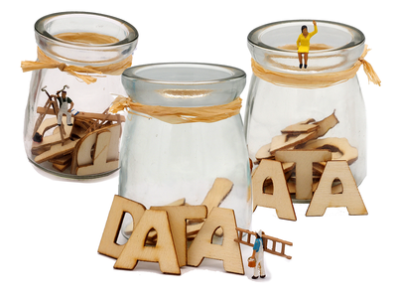
Searching data resources
Images: CC-BY-SA CESSDA DMEG https://dmeg.cessda.eu/
Notes:
Now I will tell you how to search data in data archives

Slide 27
Three types of search
  Search for data on a topic
  Search for a specific dataset
  Browse data collections by type or theme
Notes:
There are three common main types of searches
Search for data on a specific topic
Search for a specific dataset (that you know of from other studies)
Browse data collections by type or theme (allowed by some archives)
We will focus on the first (which is often the most common)

Slide 28
Search for data by topic: show your own archive
Here you may want to show the interface of your own data archive
Notes:
Here you can include slides from your own archive.
More extensive slides are available in the presentation by Irena Vipavc Brvar (ADP) and
Jennifer Buckley (UKDS) available here

Slide 29
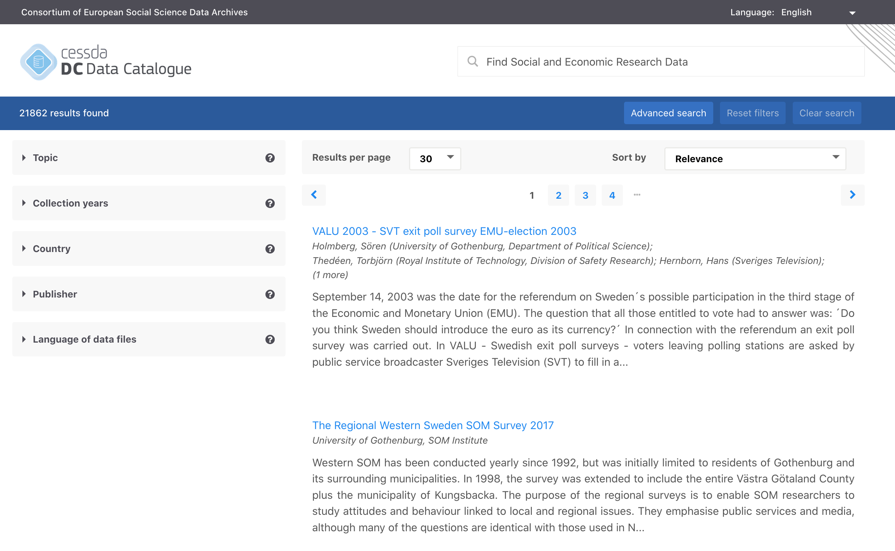
https://datacatalogue.cessda.eu/
CESSDA Data Catalogue
Search data collection of all CESSDA members
https://datacatalogue.cessda.eu/

Slide 30
Finding data in practice
Evaluate search terms
  How well do they relate to your data needs?
  Spelling/language
  “Exact terms”, Boolean Logic (AND OR) – check how search tool works
Searching can be hard
  Too many results
  No results
  Results not relevant
Sort, filter, advance search
Notes:
Searching archives can be demanding; the volume of data available, while useful, makes finding data for a specific purpose difficult
Alternatively, you might struggle to get results or al least results that seem relevant.
What you can do? Two general strategies.
1. Think about your search terms
How do your search terms relate to your data needs
e.g. interested in doing research on a specific groups such as fathers many social surveys may ask about children and family life but not necessarily index the data using the term fathers
lots of useful data for examining migration topics might come from studies not specifically focused on migration. For example, for migrant labour market outcomes, you may want to focus on identifying data on employment and then checking if you can identify migration status.
Using exact terms can reduce number of results/make them more relevant e.g.
Spelling can be an issue – American and English spelling – ageing and aging
2. Sort results and use filters – refer to your ideal data to refine by data types, date and geography
Check settings on search tool – are you searching titles, subjects, variables etc.

Slide 31

ELSST
https://elsst.cessda.eu/
Multilingual thesaurus of social science concepts.
Hierarchical and non-hierarchical relationships between concepts.
Use to:
  broaden or narrow a search
  find terms used to index data in other languages
  ELSST can be used more widely to index data & embedded within search tool.
Notes:
One tool that can help is ELSST.
ELSST is a multilingual thesaurus for the social sciences. It contains concepts which aim to be language- and country-neutral, i.e. relevant to all languages and member counties.
Concepts are linked through hierarchical and non-hierarchical relations. Users can exploit these relationships to broaden or narrow their search to possibly more relevant concepts.
ELSST also supports multilingual information retrieval. When embedded into a search engine, it allows a user to query the system in one language and retrieve data indexed with the term in another language of ELSST.
The English language version contains over 3,000 concepts, including Preferred Terms that are used to index data and Non-preferred terms that are not used by indexers but lead indexers to the Preferred Terms. 90 % of the Preferred Terms used to index data have been translated into all the other languages, with several languages having 100% coverage.
It may be useful to consider alternative spellings of key search terms.

Slide 32
Activity
Task
Search for data using a data catalogue
  Any national data service
  See CESSDA for links: www.cessda.eu/Consortium
Notes:
If you like you can here already include an activity to search for data.
Or ask participants to find data in your own repository

Slide 33
Select and evaluate data
Images: CC-BY-SA CESSDA DMEG https://dmeg.cessda.eu/

Slide 34
Evaluating Data quality

Slide 35
Metadata and documentation
Metadata ("data about data“)
Documentation
descriptors that facilitate cataloguing data and data discovery.
user guides, survey questionnaires, interview schedules and fieldwork notes
  Catalogue records (with links to documentation)
  Quality can vary
  Efforts to improve data documentation
  Check for helpdesks/training
Notes:
Metadata and documentation are key to making sense of the data.
Metadata or "data about data" are descriptors that facilitate cataloguing data and data discovery.
Documentation might include user guides, survey questionnaires, interview schedules and fieldwork notes
Archives produce catalogue records containing metadata. Documentation is often accessible directly from the catalogue record (without needing to register), usually as fully searchable PDF documents (but format and quality varies, especially for older studies).
The quality and accessibility of metadata data and documentation can vary. A core aim of CESSDA is that data collections have documentation that allows use without recourse to the data creator.
Work by CESSDA and its’ service providers as well as many other research and data professionals is improving the way data is documented e.g. metadata standards such as consistent categories and researchers being trained in research data management
Some services (where resources allow) offer support to help users understand data through helpdesks and training.

Slide 36
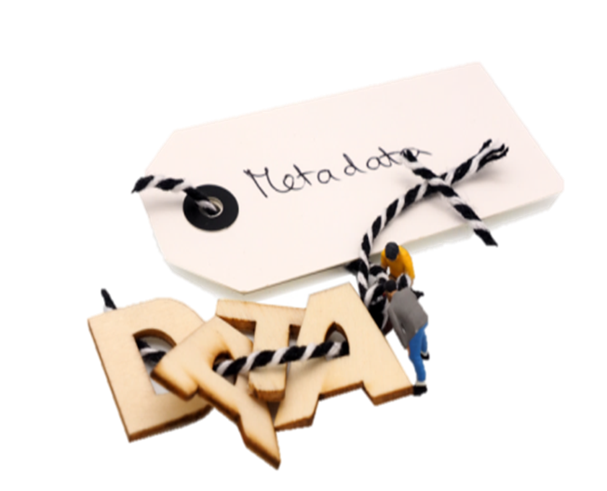
What to look for when assessing quality?
  Why the data was created?
  What the dataset contains?
  How data was collected?
  Who collected the data and when?
  How was the data processed?
  Any manipulations done to the data?
  What quality assurance procedures were used?
Images: CC-BY-SA CESSDA DMEG https://dmeg.cessda.eu/
Notes:
Asking some simple questions about the data can help determine its quality.
[Trainer note: for more interaction, you can get participants to think of list – then show to confirm]
Answers to many questions on the catalogue page/website
For others, you may need to review supporting documentation such as User Guides, Technical Reports
If you cannot answer these questions easily, you need to consider if you can use this data meaningfully. If you have unanswered questions, you may be able to ask the data archive or data owners for further information.

Slide 37
But is it useful?
Ideal
Possible
Research question
  Compare
    key concepts
    population
    geographical area
    time period
    units of analysis
    study/sample design
Notes:
Evaluate the usefulness of data for a specific purpose using metadata and documentation – i.e. comparing a dataset to the ideal dataset identified previously.
units of analysis
access
time period(s)
geographical coverage
include the correct characteristics/concepts of interest
nature of the sample
You may need to make some compromises – in terms of data and research questions.

Slide 38
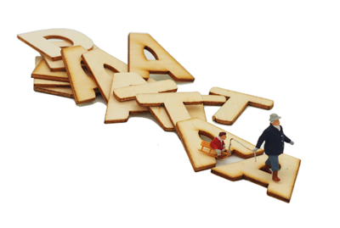
Accessing data
Now finally, I’ve found some great data, how to I get it?
  Licenses
  Access process
  Getting started
Images: CC-BY-SA CESSDA DMEG https://dmeg.cessda.eu/

Slide 39
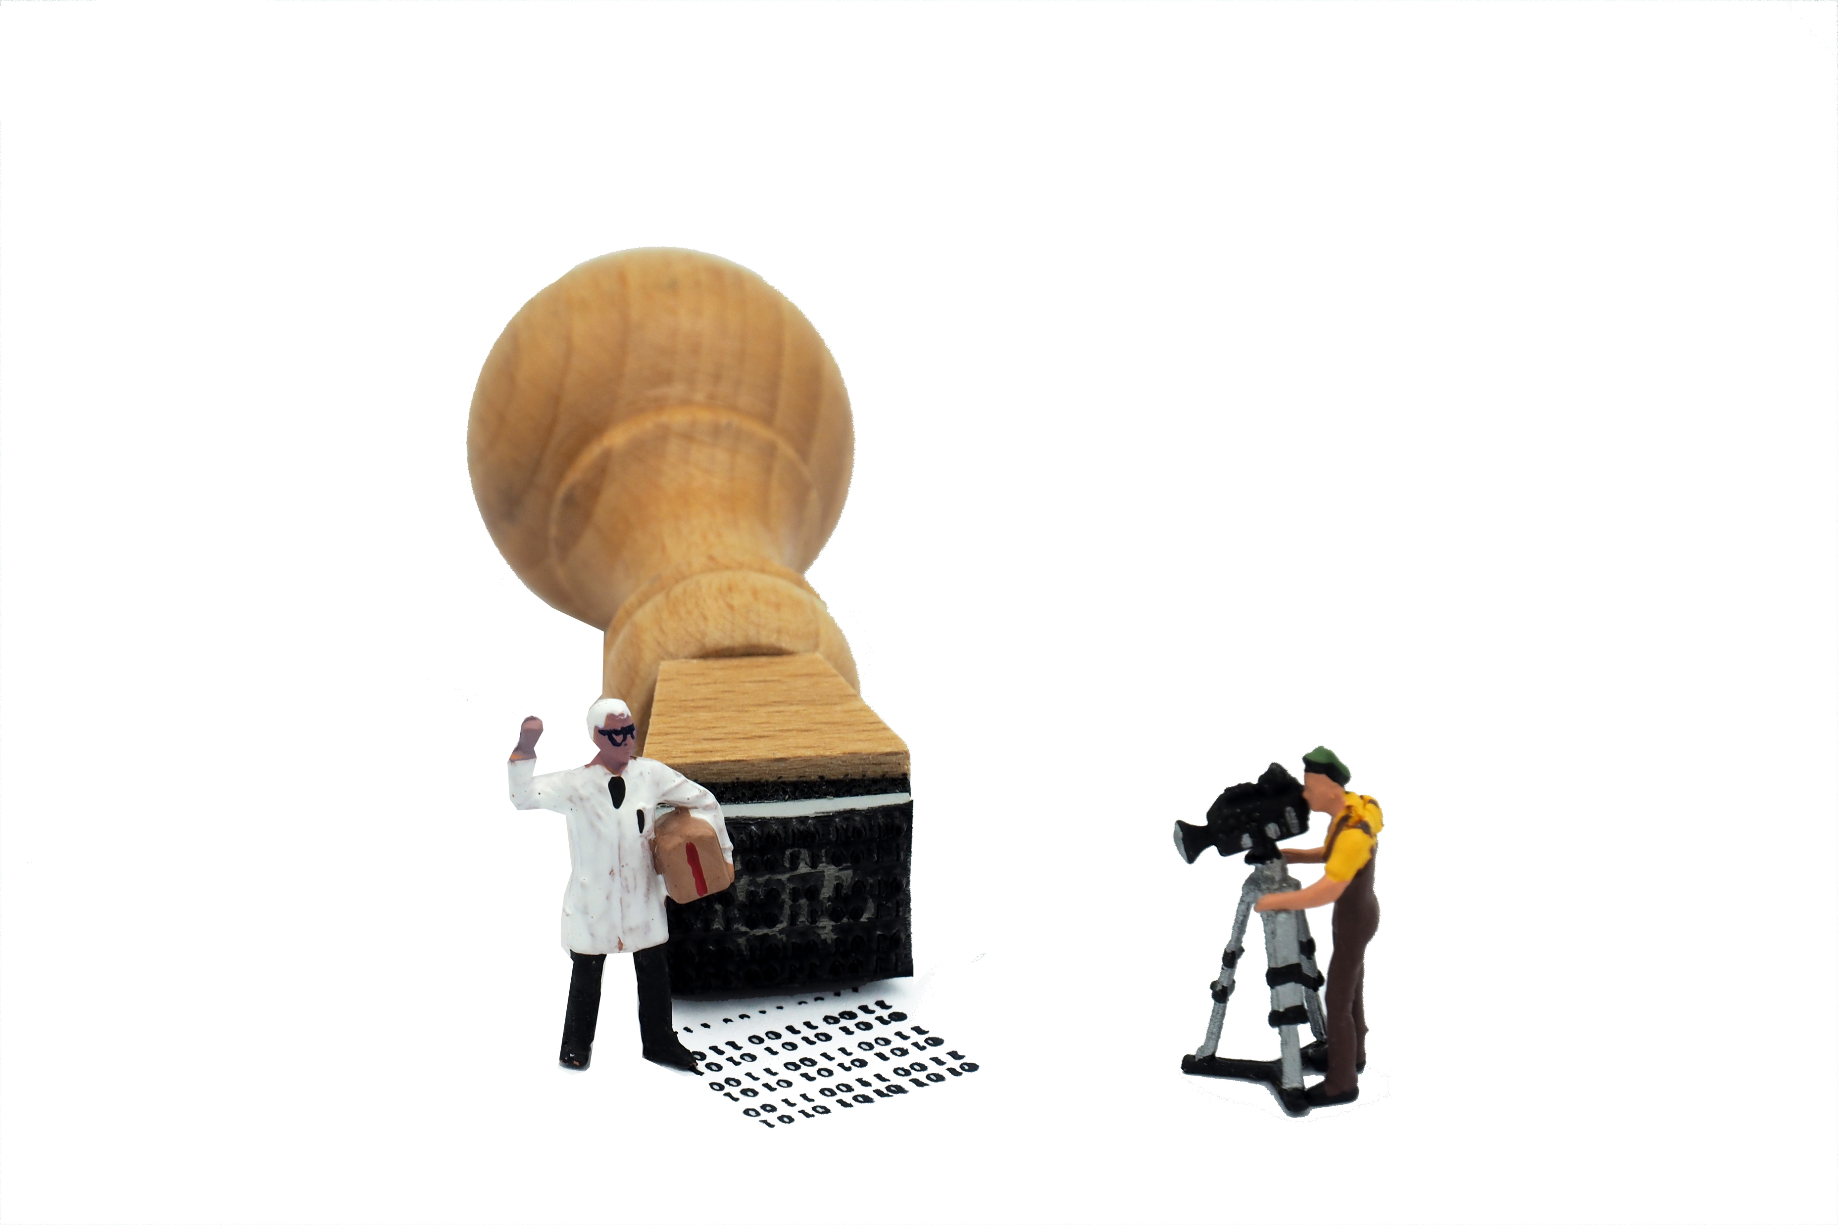
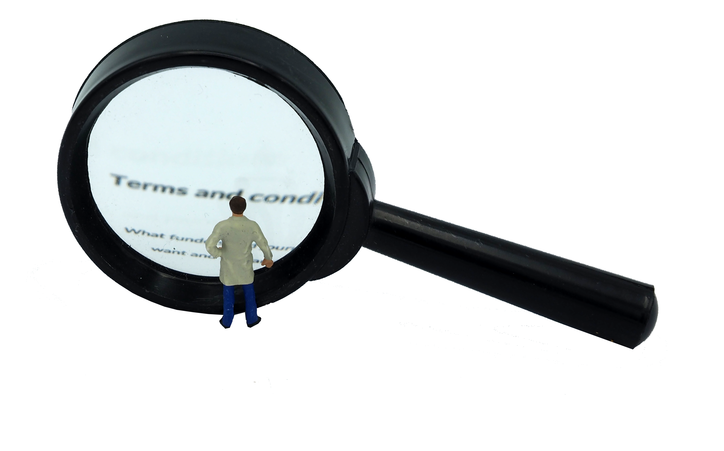
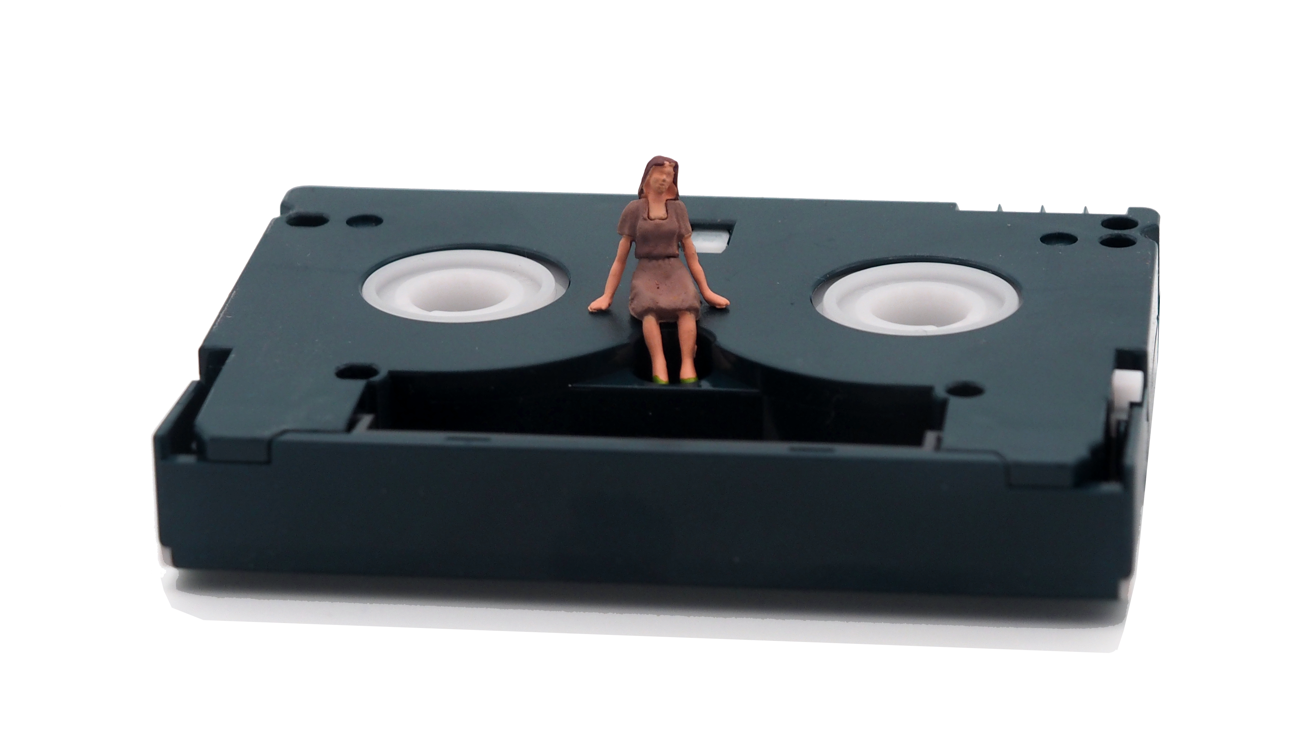

Accessing data
Open data
any user, no registering (acknowledge source)
Registration
  often with institutional user name and password
  may wait for user name or password
  register use of data
Terms and conditions
  e.g.: not trying to identify individuals
  not distributing data to others
  “data is for non-commercial use only”
Download
from catalogue (but sometimes complete a request form)
Images: CC-BY-SA CESSDA DMEG https://dmeg.cessda.eu/
Notes:
Open - Some services support access to open data collections that any type of user can download without registering (but they may need to acknowledge the source).
Registration - you usually need to register with the data service before accessing data.
University researchers may be able to register using their institutional user name and password
You usually need to provide an e-mail address (and possibly institutional details).
You may also have to wait for a username and password before you can access data.
You may need to register the use of data
Terms and conditions - You will usually be agreeing to terms and conditions as part of the registration and process or when accessing data. Common terms and conditions include not trying to identify individuals, households or organisations in the data and not distributing data to others. Some restrictions about use of data are common e.g. “data is for non-commercial use only” or for “use in research or teaching” only.
Download - Often you download data directly from the catalogue. However, some services ask users to complete a form to request data.

Slide 40
Accessing data
  Sometimes permission from the data owners required
  Sensitive or confidential data = more strict (and lengthy) process
  Some services operate a dedicated safe room
  Access by users outside the country can be prohibited
  Free (except for commercial use and supplementary services)
  → If you are unsure, ask the relevant data service for help.
Images: CC-BY-SA CESSDA DMEG https://dmeg.cessda.eu/
Notes:
Additionally, access to some data collections may require permission from the data owners (and therefore often an additional stage in the access procedure)
More strict applications generally operate for any data collections considered to contain sensitive or confidential data and some services provide access through dedicated safe rooms or remote settings.
Access to data, documentation and metadata is generally free. Charges can apply for commercial use and for supplementary services such as burning data to a CD or distributing data by post.
You should find access conditions displayed clearly in the catalogue for each data collection. If you are unsure however, ask the relevant data service for help.

Slide 41
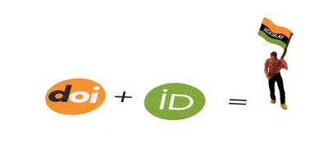
And finally…remember to cite data
Why?
It gives credit the data creators
It makes data easier to find
How?
Give enough information to locate the exact version of the data
Look for recommended citation
Use persistent identifiers (Digital Object Identifier - DOI)
Images: CC-BY-SA CESSDA DMEG https://dmeg.cessda.eu/
Notes:
When using existing data, it is good practice to cite the data.
Data citations gives credit to the data creators and allows other researchers to find the data.
Many services provide recommended citations for each data collection and in general, a citation should include enough information so that the exact version of the data being cited can be located.
Many services give persistent identifies for their data such as a Digital Object Identifier (DOI), which link to the data used (even if the location of the data changes).

Slide 42
Any questions?

