Slide 1
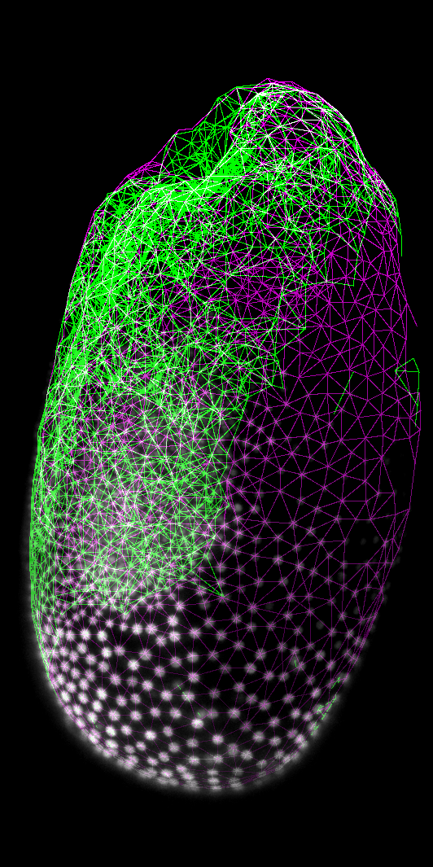






Interactive Image Data Flow Graphs
and reproducible GPU-accelerated image processing
Martin Schätz
MCM16 - Workshop
@haesleinhuepf @SchatzCZ
@PoLDresden
Adapted from Robert Haase, PoL, TU Dresden

Slide 2
Hitchhiking through a diverse Bio-image Analysis Software Universe
Where to go and how to get there
... and deciding which software to use
Notes:
Hitchhiking through a diverse Bio-image Analysis Software Universe

Slide 3

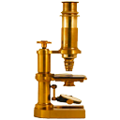


How to select the right software
depending on analysis goal
Do you want to track cells?
Do you want to measure object properties in 2D?
Do you want to visualize your data in 3D?
No
No
No
Other tools
Yes
Yes
Yes
ImageJ / Fiji
Napari
Logos may be subject to copyright of the respective communities https://imagej.net/plugins/trackmate/ https://imagej.nih.gov/
https://fiji.sc/ https://napari.org

Slide 4


How to select the right software
depending on image data type
Big data?
Is it 2D?
Yes
Yes
QuPath
No
No
BigDataViewer
BigStitcher
BigDataProcessor2
BigWarp
ImageJ / Fiji
Logos may be subject to copyright of the respective communities https://imagej.nih.gov/ https://fiji.sc/ https://github.com/qupath https://www.ilastik.org/

Slide 5



How to select the right software
depending on image data type and skills in the team
Big data?
Is it 2D?
Yes
Yes
QuPath
No
No
BigDataViewer
BigStitcher
BigDataProcessor2
BigWarp
ImageJ / Fiji
Logos may be subject to copyright of the respective communities
https://www.python.org/ https://www.dask.org/ https://cupy.dev/

Slide 6


How to select the right software
depending on available computing resources
Do you own a powerful graphics processing unit?
Is it CUDA-compatible?
Yes
Yes
No
No
pyopencl / clesperanto
Logos may be subject to copyright of the respective communities
https://cupy.dev/ https://clesperanto.net https://scikit-image.org

Slide 7
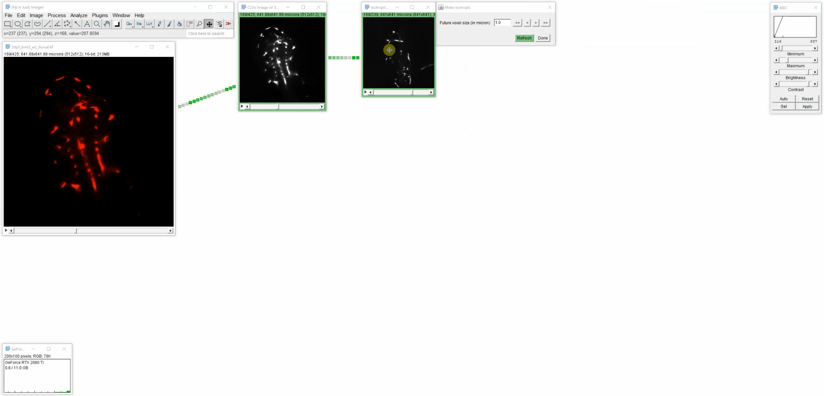
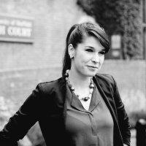
Multi-lingual code generation “clEsperanto”
Code export to
ImageJ Macro
Icy Protocols*
Java
Javascript
QuPath Groovy*
Jython
Matlab
Python*
C++*
(* experimental)
Special thanks to Elisabeth Kugler for sharing open data!
Elisabeth Kugler
@KuglerElisabeth
https://clij.github.io/assistant/supplementary_methods_section_generator
Image data source: Elisabeth Kugler; labs of Tim Chico and Paul Armitage, The University of Sheffield (UK)" https://zenodo.org/record/4204839#.X8DCRGj7Q2w

Slide 8
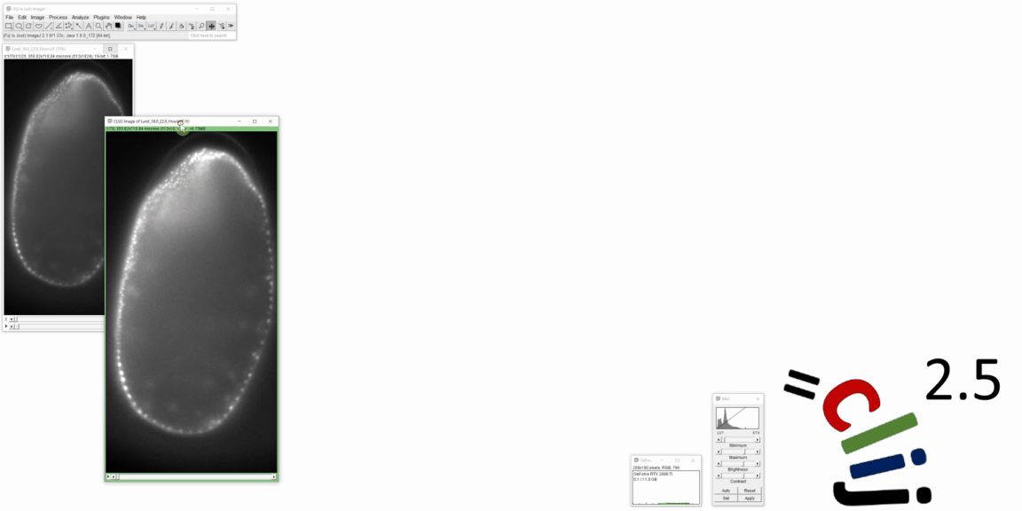
Interactive Image Data Flow Graphs in Fiji
10x
Image data source: Mauricio Rocha Martins, Norden lab MPI CBG (now at IGC Ciência)

Slide 9
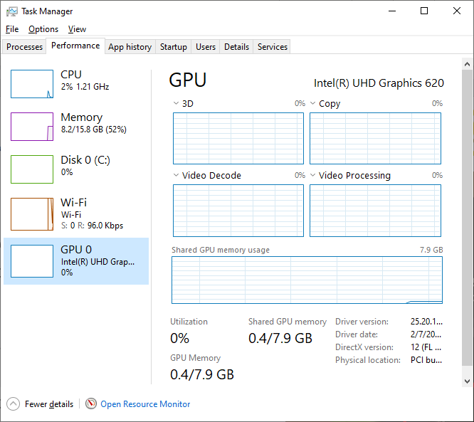
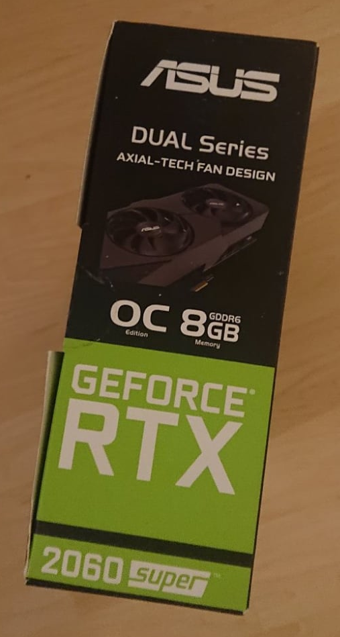
Checklist
When does GPU-accelerated image processing make sense?
You need
a workflow that is slow, ideally:
      (image processing time / image loading time) > 10 to 100,
Enough graphics card memory,
  > 5 times image size
Basic coding experience
A recent Intel, AMD or Nvidia GPU (integrated, dedicated, external)
If you really want to get the most out of it:
a graphics card with GDDR6 memory (memory bandwidth > 400 Gb/s).
Disclosure: I don’t receive any money or anything from any GPU vendor.

Slide 10
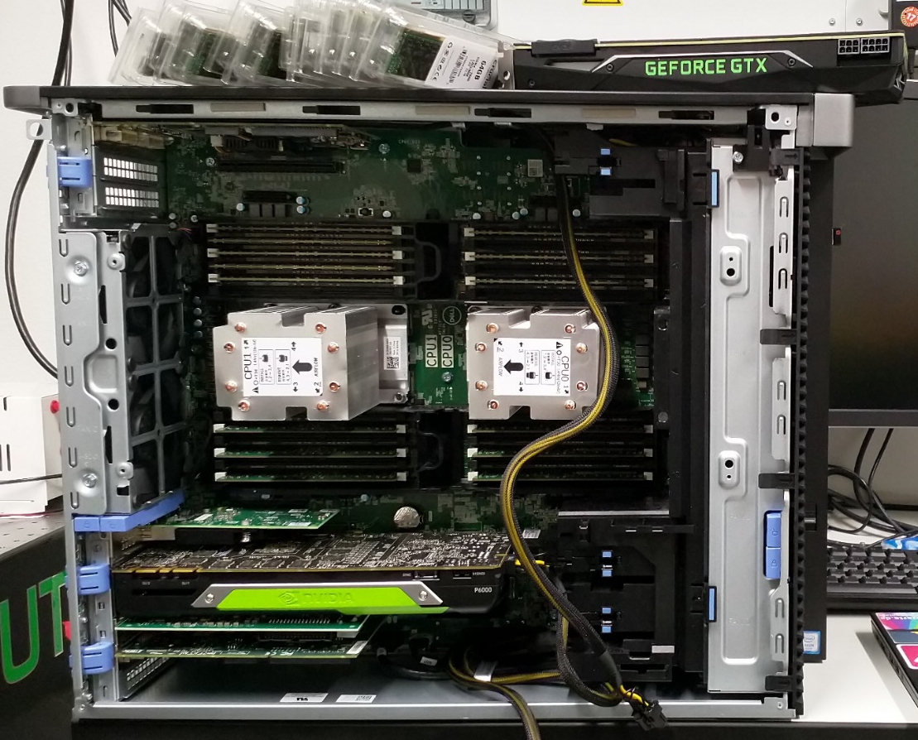
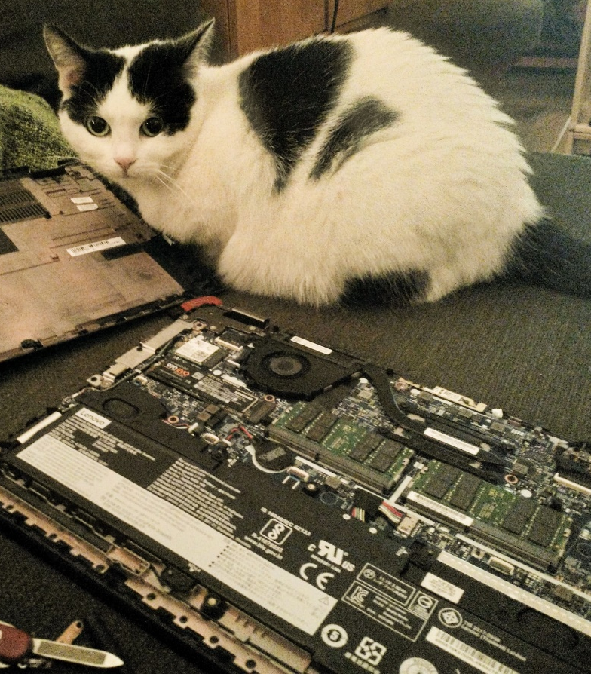
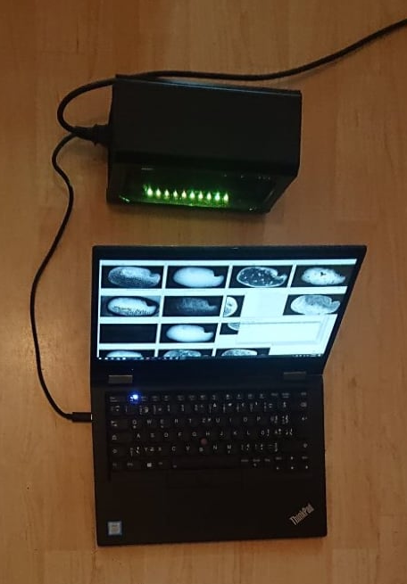
Graphics Processing Units (GPUs)
… don’t have to be expensive.
Central Processing Unit (CPU)
Graphics Processing Unit (GPU)
HPC
dedicated GPUs
integrated GPUs
external “eGPUs”

Slide 11
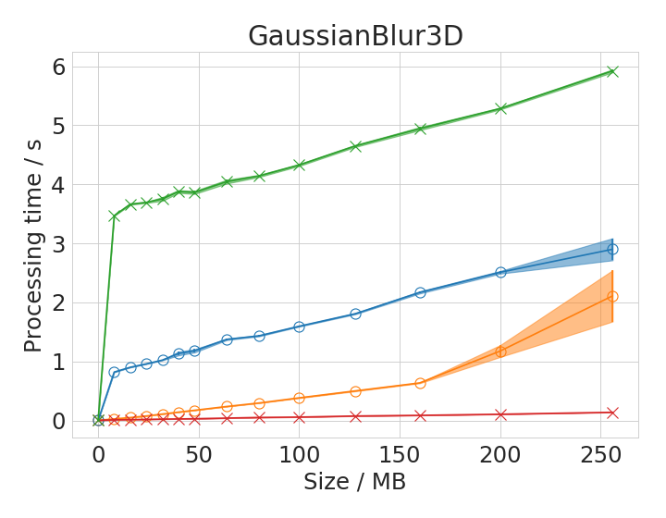


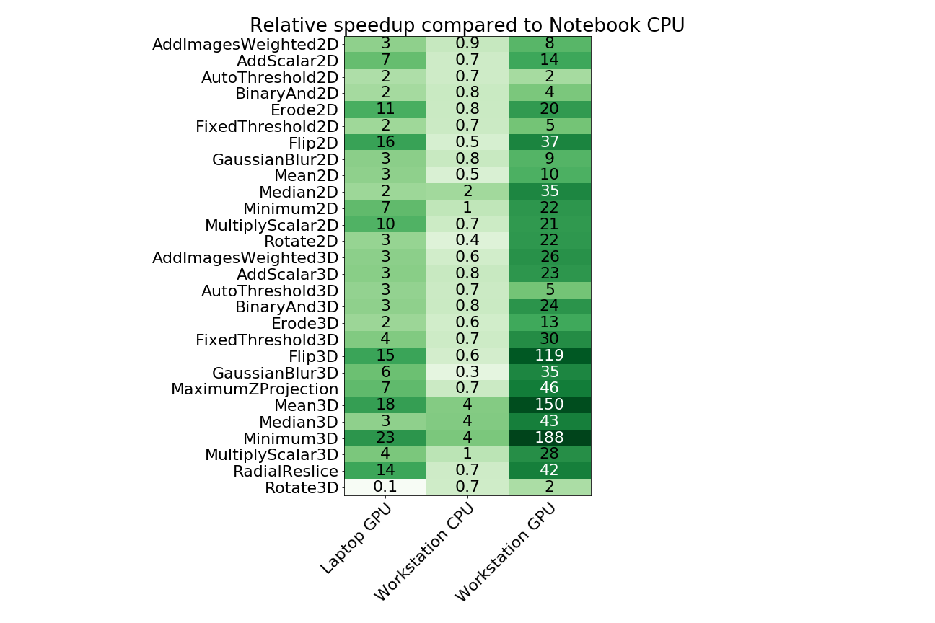
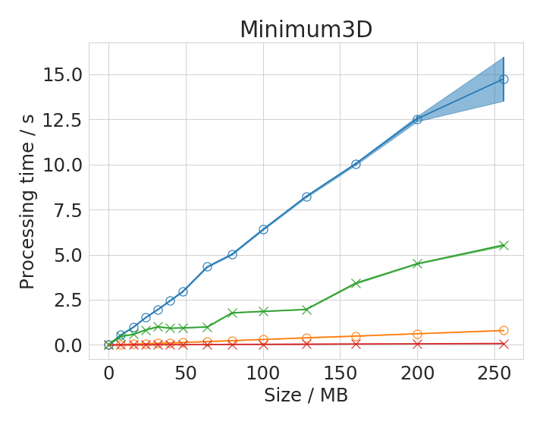
Benchmarking
Comparison of processing performance Fiji versus CLIJ: 1-2 orders of magnitude speedup are possible
Speedup factor compared to Laptop CPU
vs.
8 MB (2D)
2x Intel Xeon Silver 4110
Nvidia Quadro P6000
64 MB (3D)
Intel Core i7-8650U
Intel UHD 620 GPU
Laptop GPU
Workstation GPU
https://www.youtube.com/watch?v=uMj0OS1TiQE&t=873s
Nat Methods 17, 5-6 (2020) doi:10.1038/s41592-019-0650-1

Slide 12
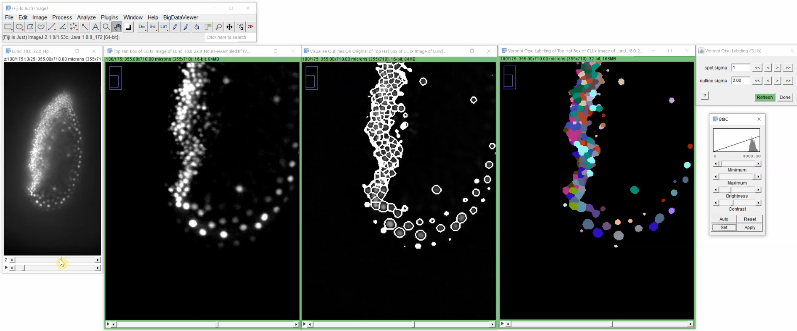
GPU-accelerated 3D image segmentation
https://github.com/clEsperanto/pyclesperanto_prototype/blob/master/demo/segmentation/voronoi_otsu_labeling.ipynb
Image data source: Daniela Vorkel, Myers lab, MPI CBG / CSBD

Slide 13
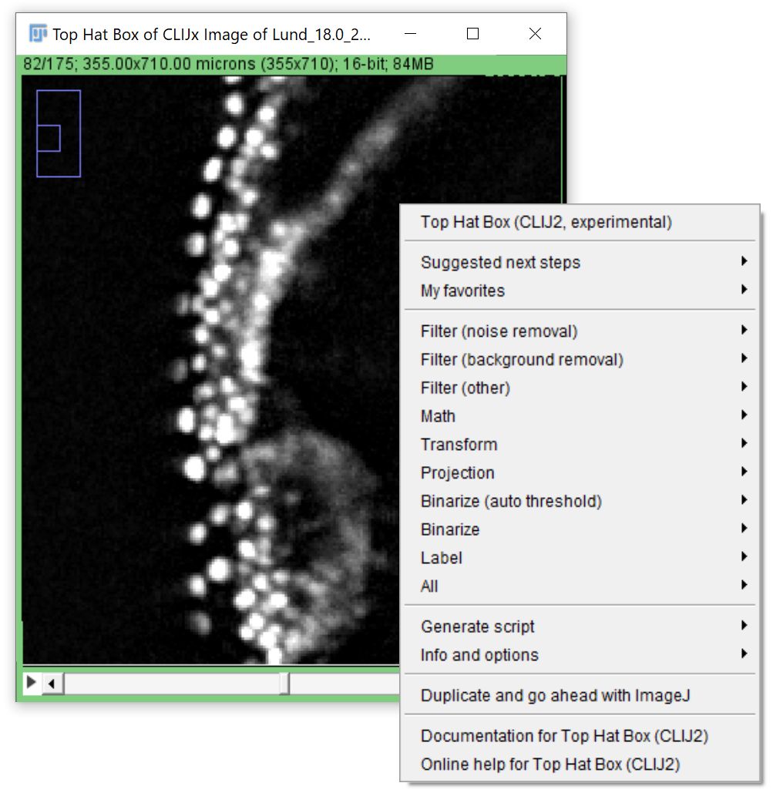
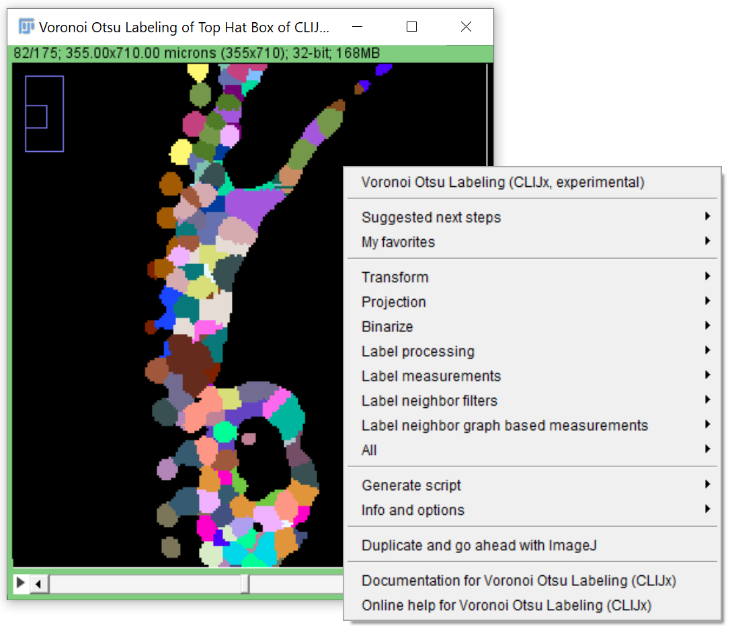
Image Data Flow Graph design
The menu order is intentional: From preprocessing to analysis
https://clij.github.io/assistant/getting_started

Slide 14
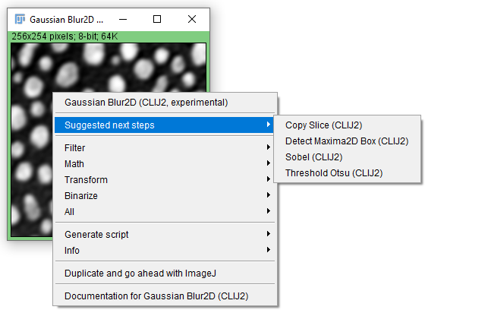
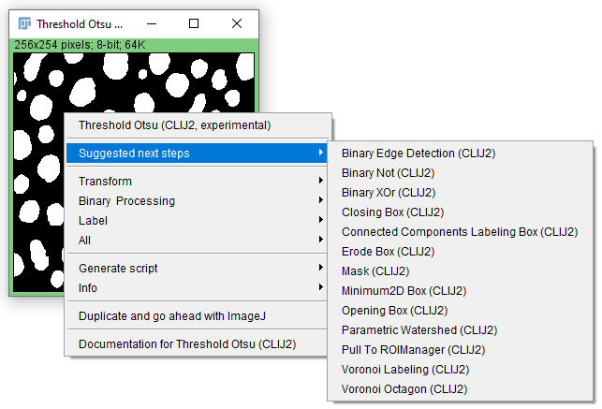
Expert system: Suggestions
Explore suggestions!
https://clij.github.io/assistant/getting_started

Slide 15
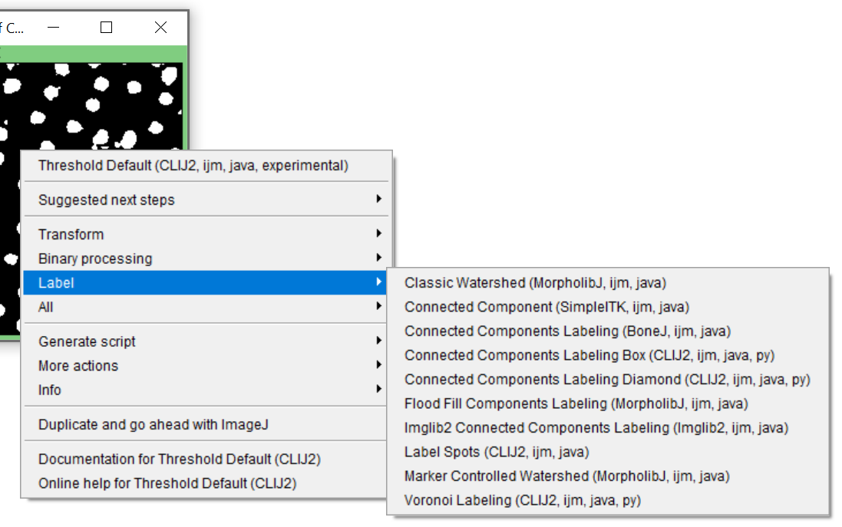
Extensions
Watch out for other image processing libraries.
ImageJ 3D Suite
BoneJ
MorpholibJ
SimpleITK
Imglib2
ImageJ
ImageJ2
https://clij.github.io/assistant/installation#extensions

Slide 16
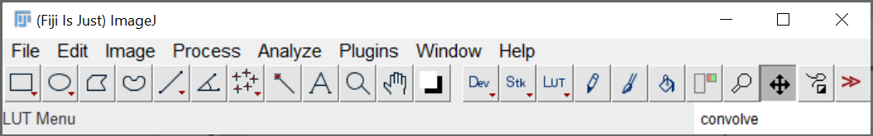
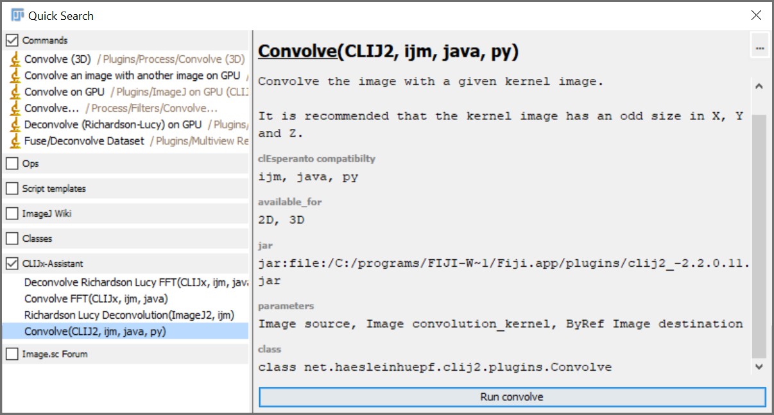
Fiji search bar
In Fijis search bar result, there is a new category: CLIJx-assistant which offers IDFG operations
https://clij.github.io/assistant/getting_started

Slide 17
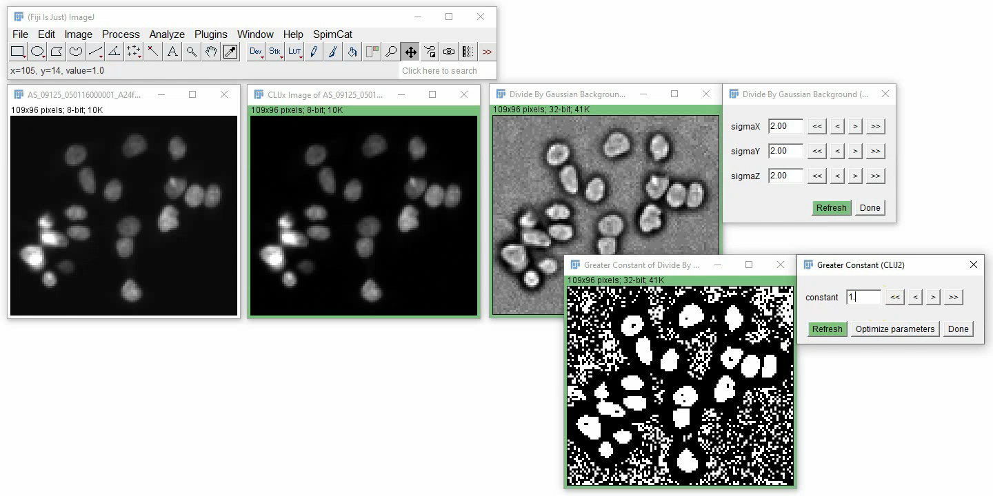
Parameter optimization
If your image data flow graph ends in a binary image, you can optimize numeric parameters automatically.
https://clij.github.io/assistant/parameter_optimization

Slide 18
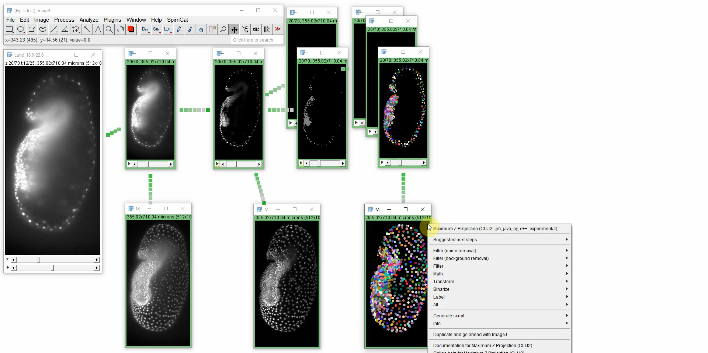
Multi-lingual code generation “clEsperanto”
Code export to
ImageJ Macro
Icy Protocols*
Java
Javascript
QuPath Groovy*
Jython
Matlab
Python*
C++*
(* experimental)
https://clij.github.io/assistant/macro_export
http://clesperanto.net/

Slide 19
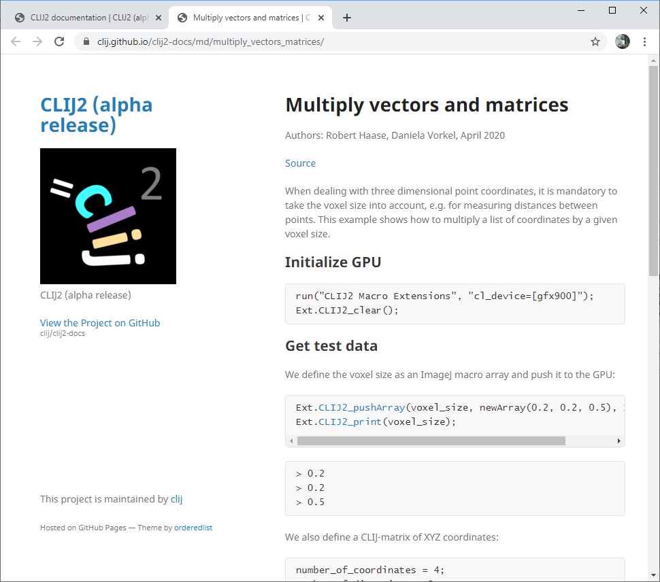
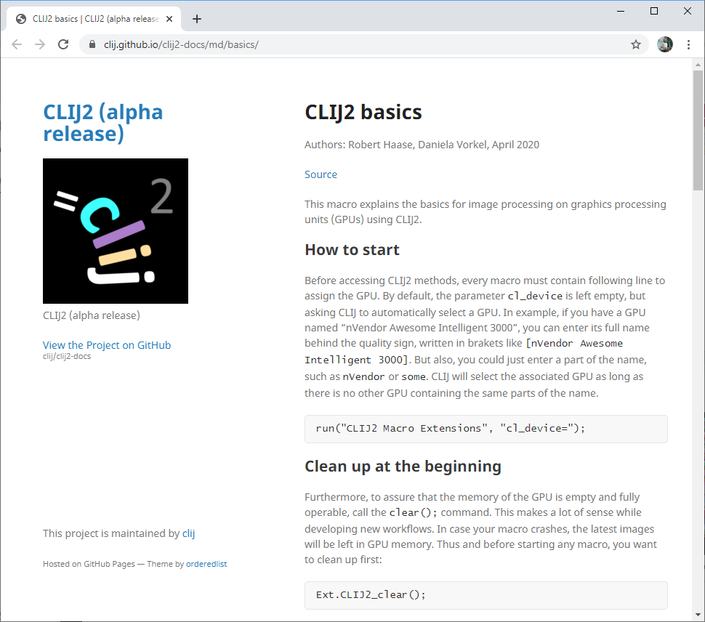
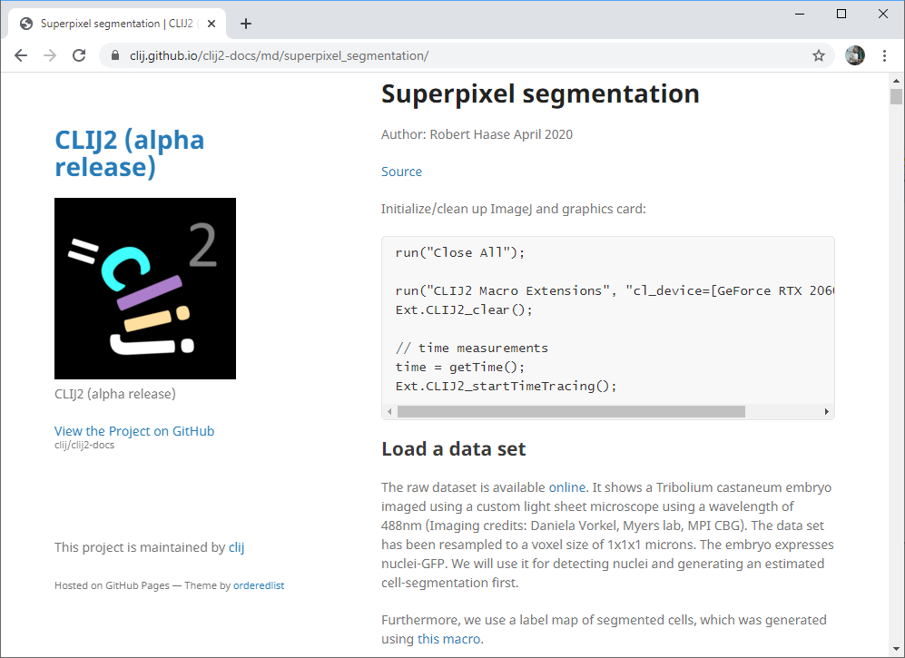
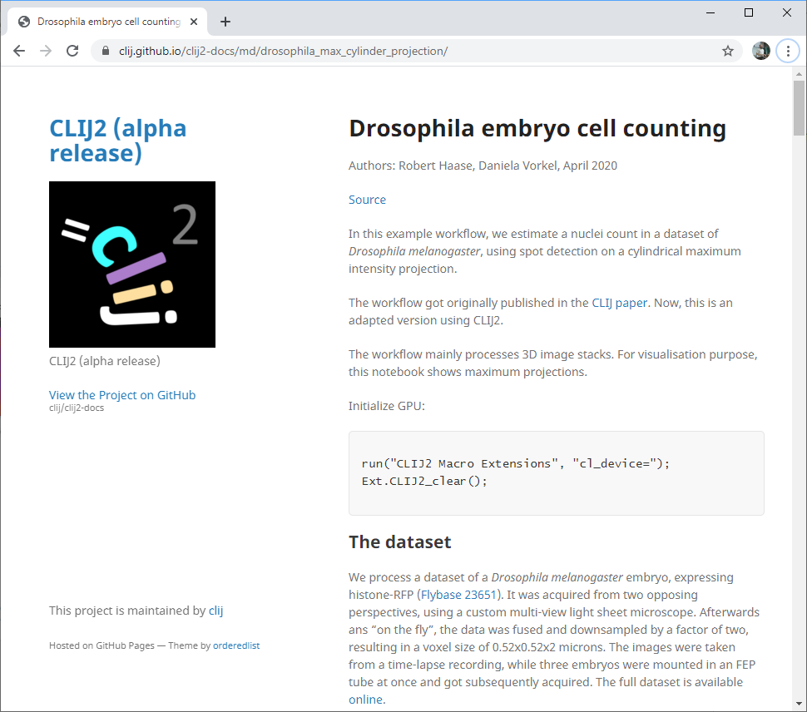
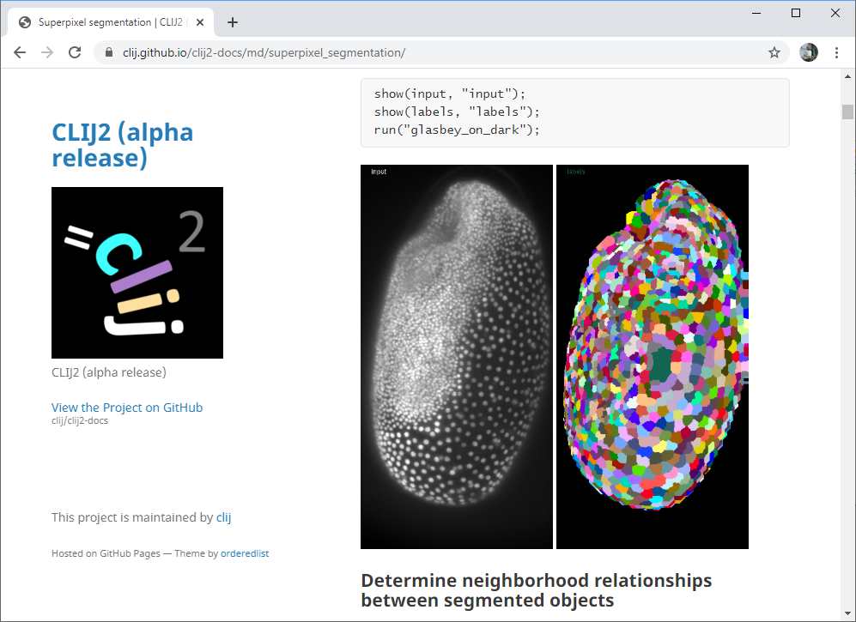
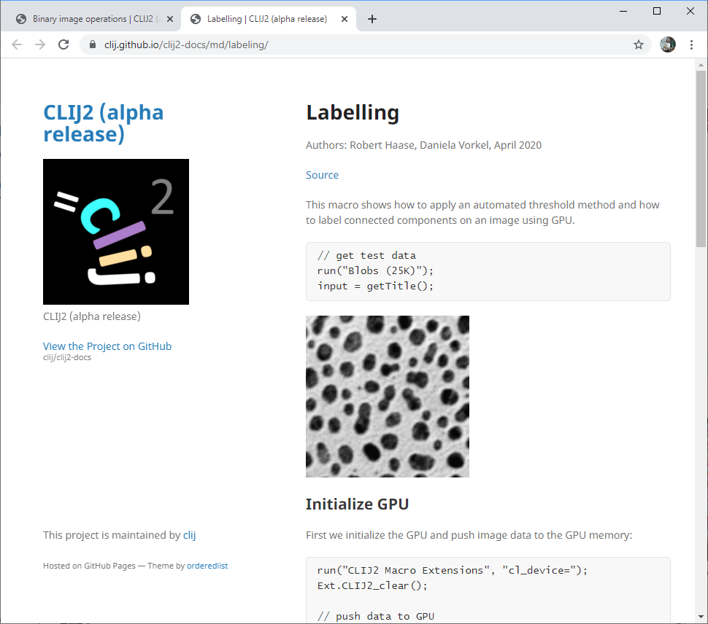
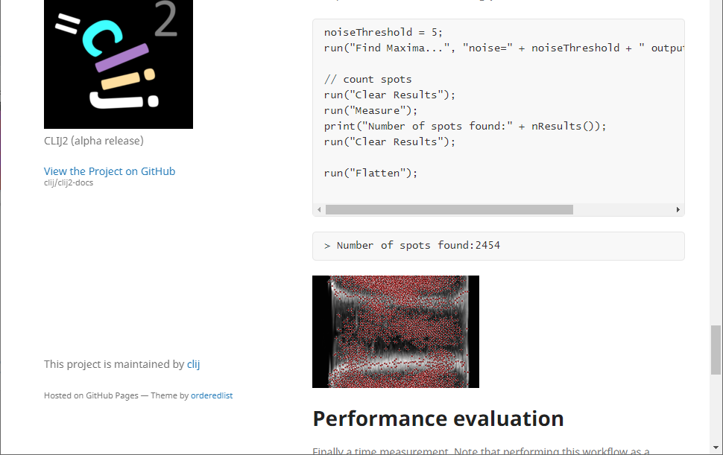
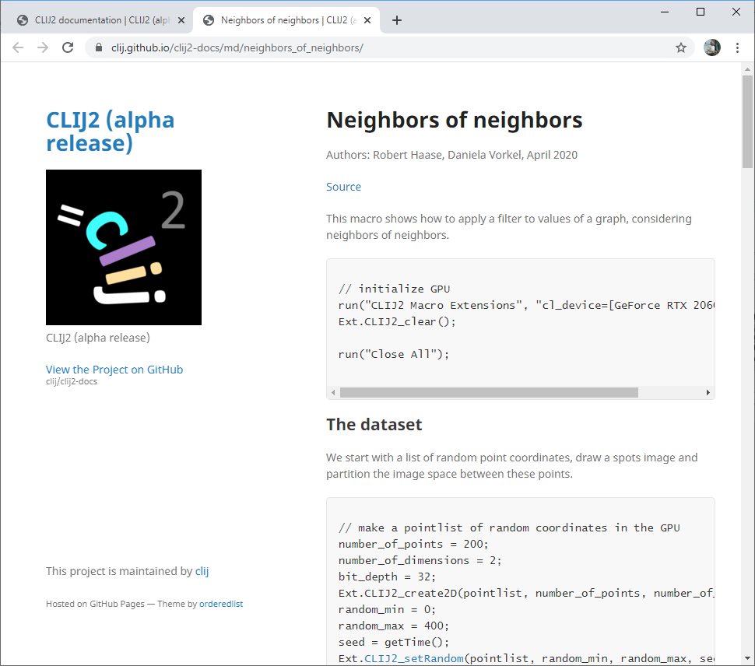
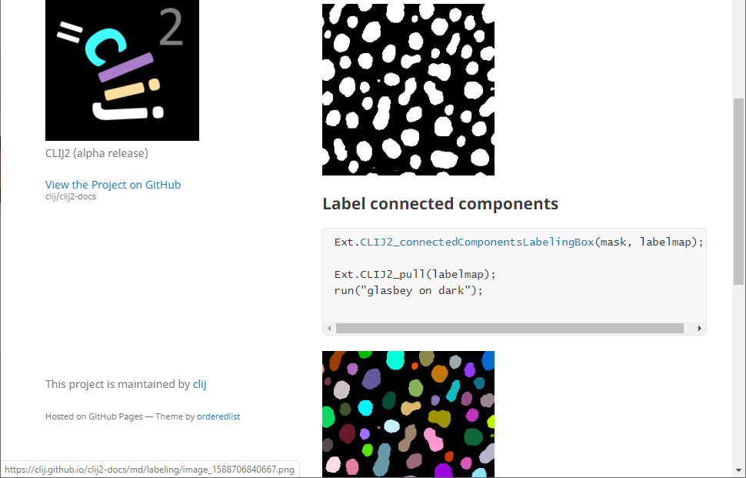
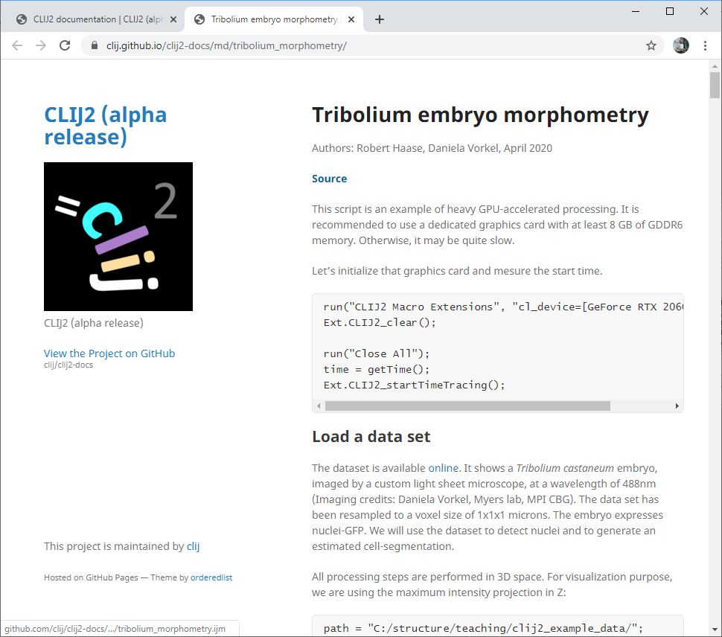
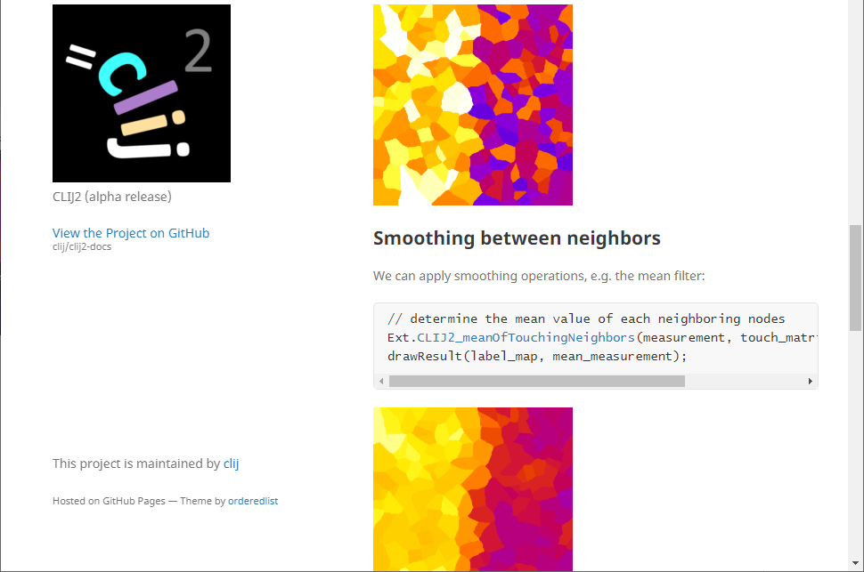
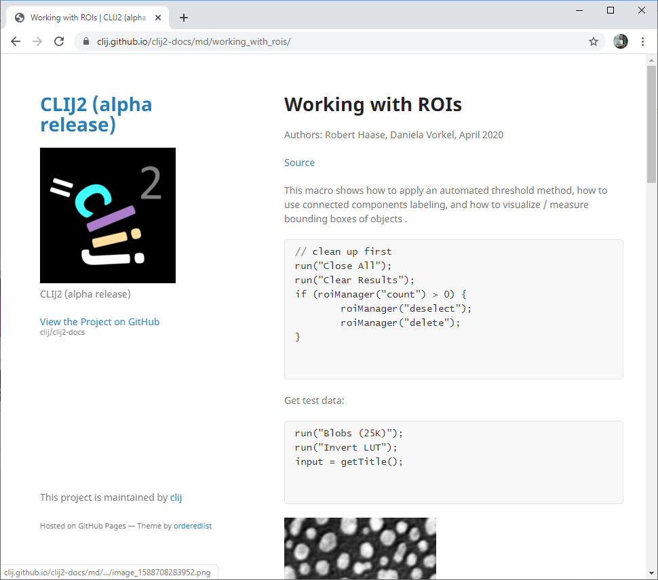
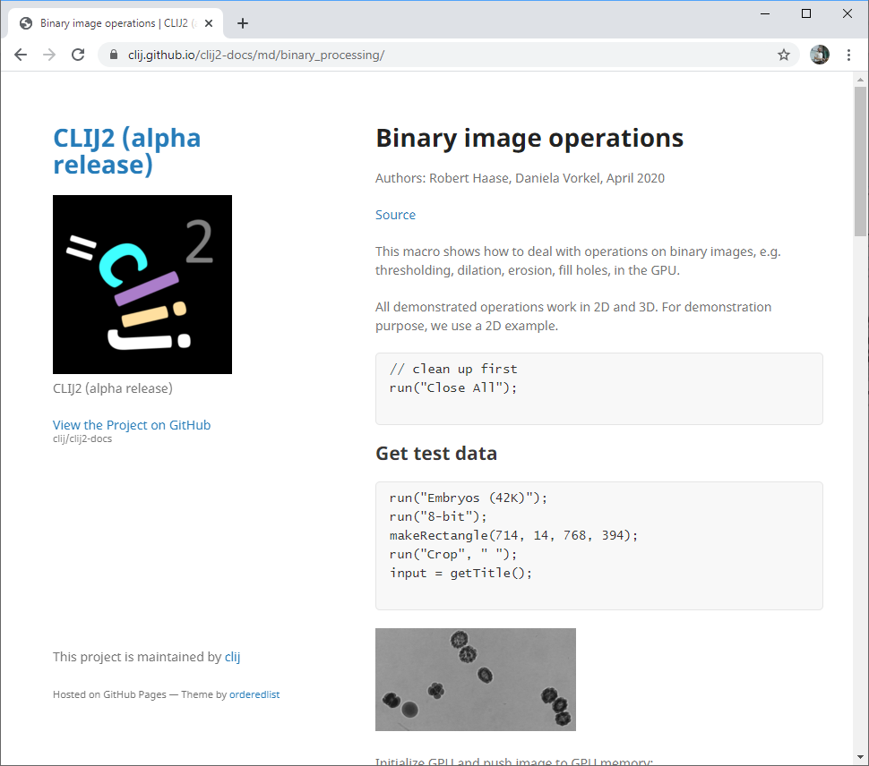
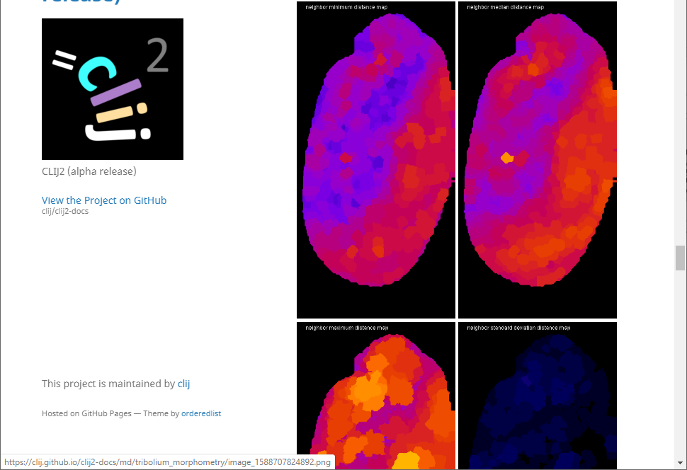
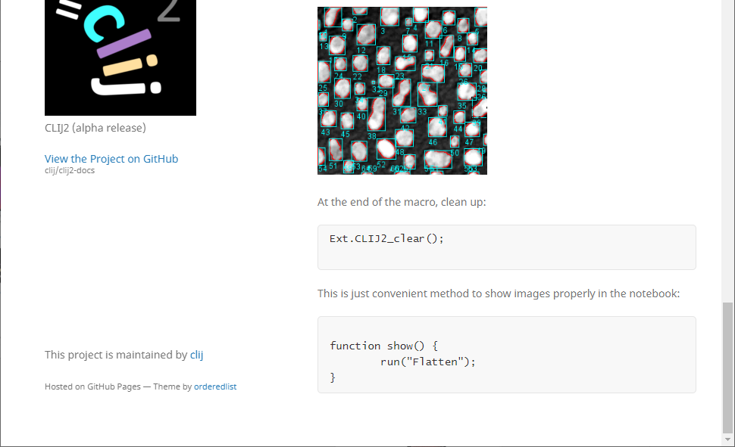
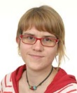
Online documentation: tutorials
Big thanks to
Dani Vorkel
(Myers lab)
@happifocus
https://clij.github.io/

Slide 20
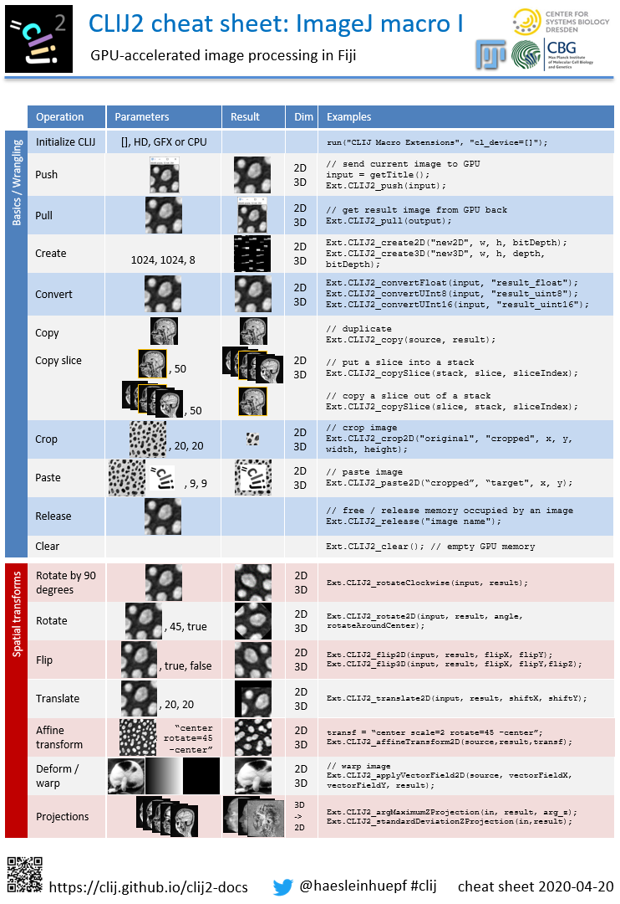
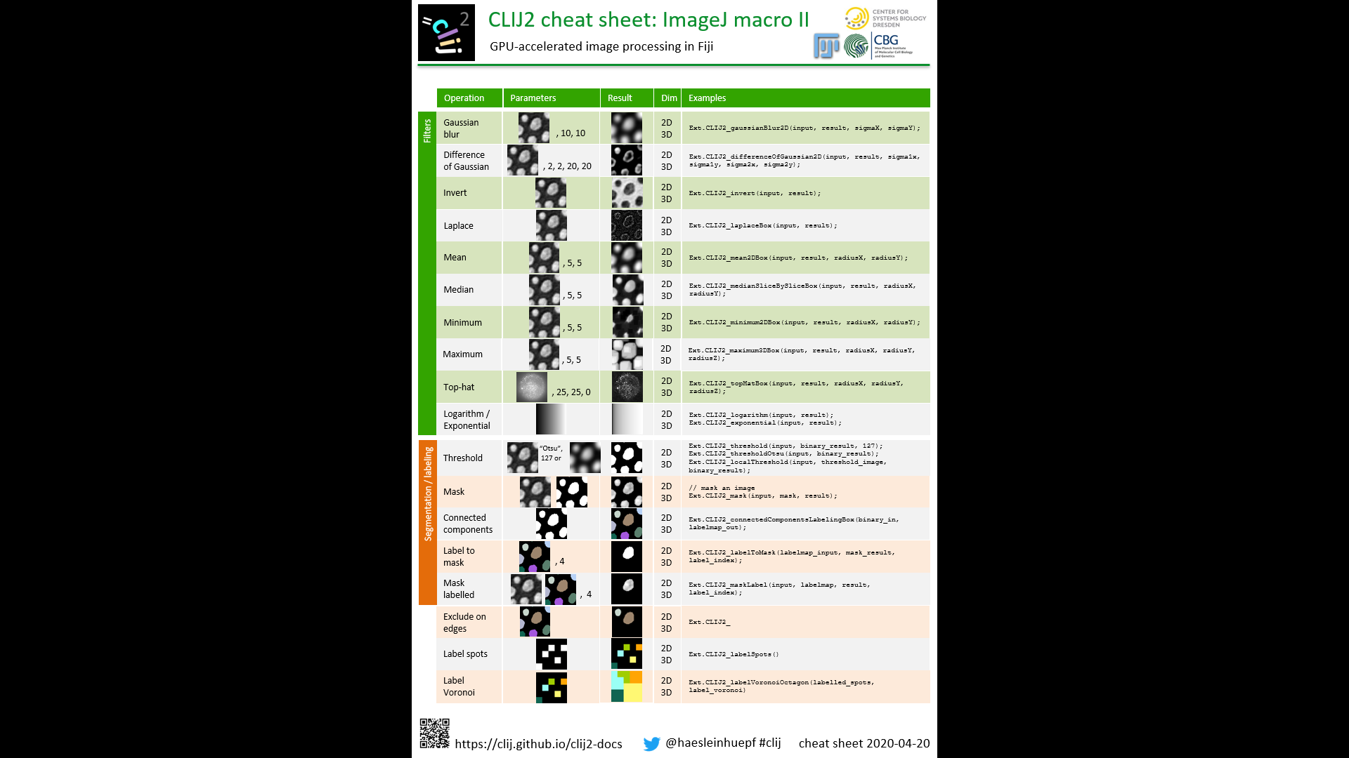
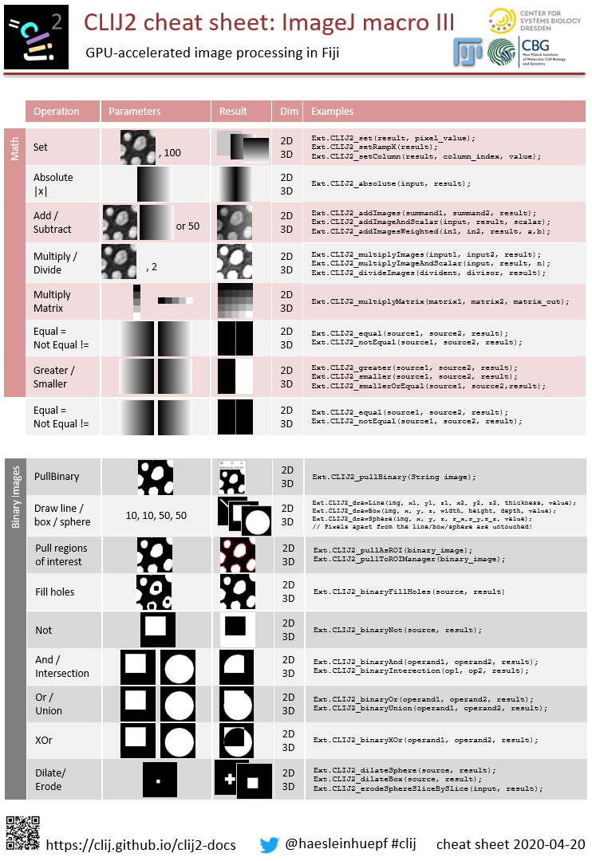
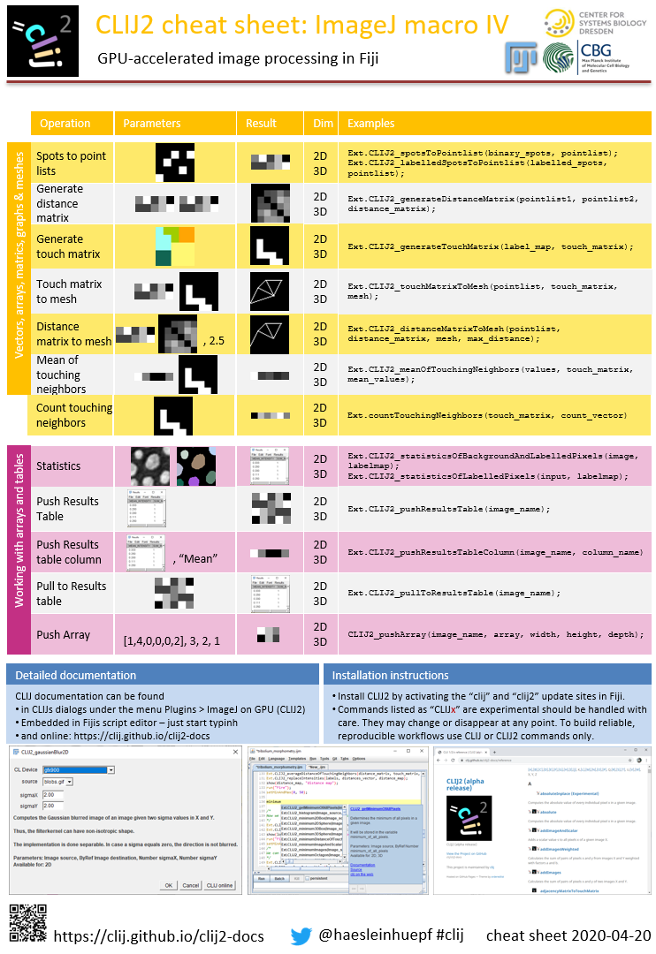
Online documentation: Cheat sheets
Cheat sheets show the most important methods with input and output parameters visually.
https://clij.github.io/clij2-docs/CLIJ2-cheatsheet_V3.pdf

Slide 21
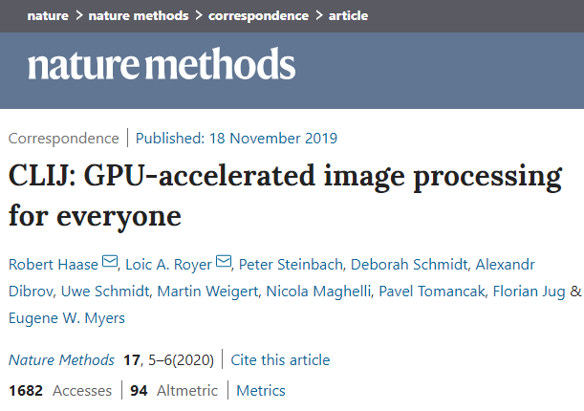
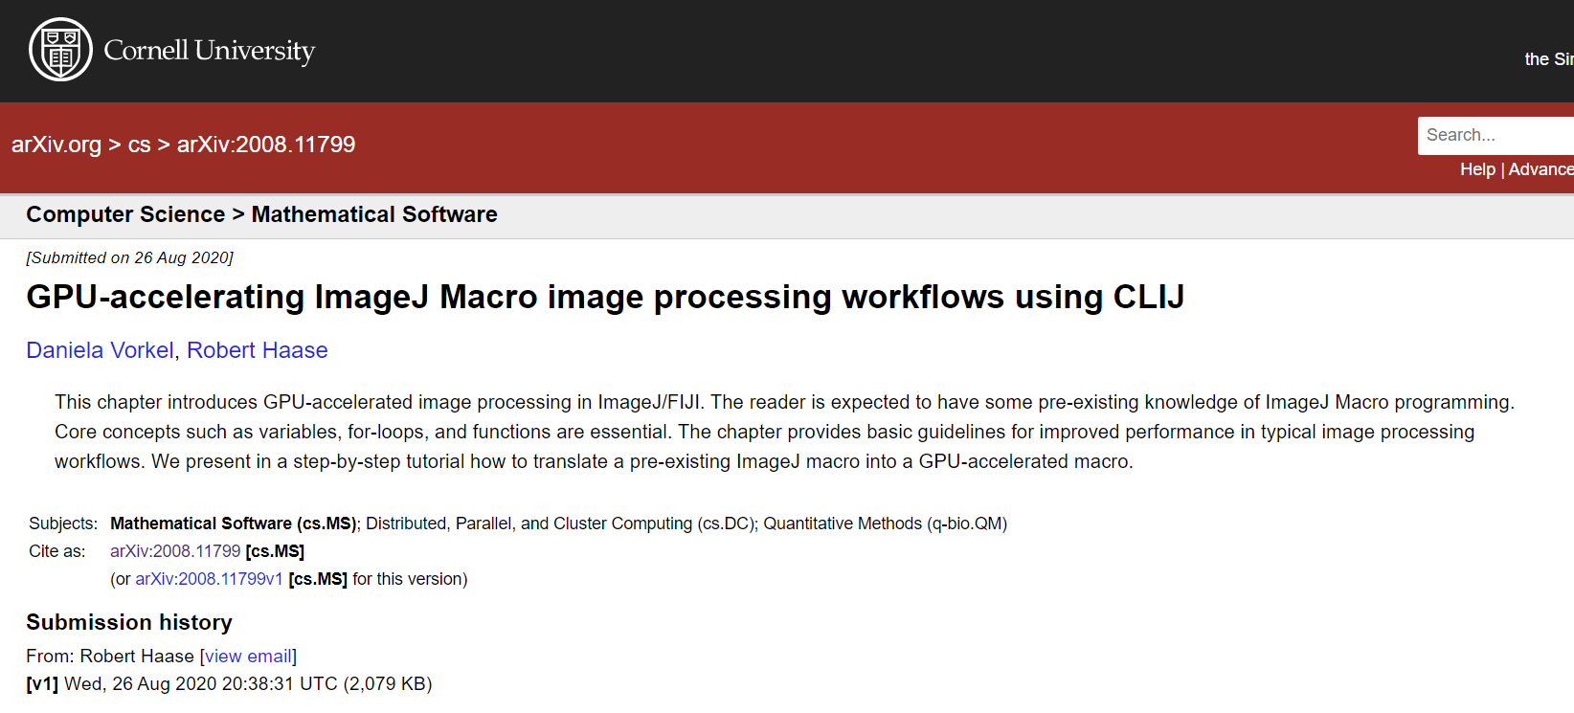
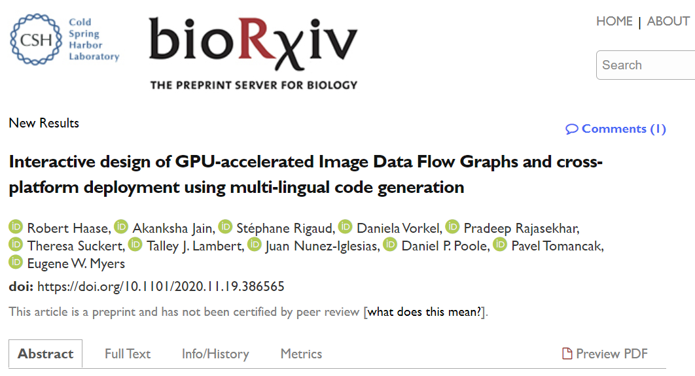
If you use it, please cite it.
If you work with CLIJ and friends, please cite the paper(s).
  Thank you. ☺
Nat Methods 17, 5-6 (2020) doi:10.1038/s41592-019-0650-1
https://arxiv.org/abs/2008.11799 https://www.biorxiv.org/content/10.1101/2020.11.19.386565v1

Slide 22
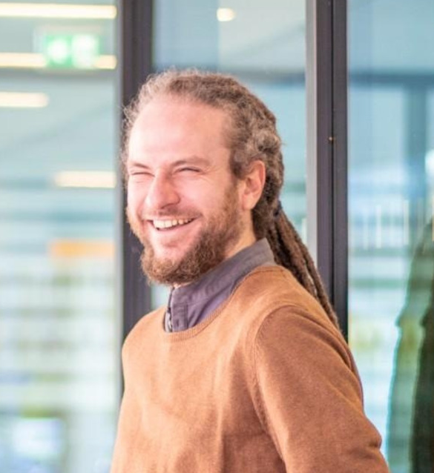
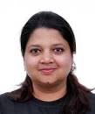
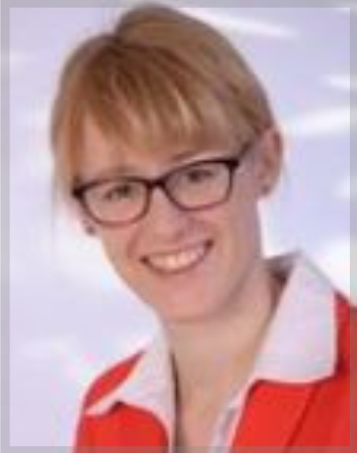
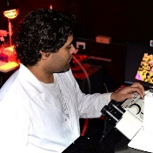

















Acknowledgements
Robert Haase
(TU Dresden)
Main author of CLIJ2!
Author of source presentations.
@haesleinhuepf
Akanksha Jain
(Treutlein lab)
@jain_akanksha_
Dani Vorkel
(Myers lab)
@happifocus
Theresa Suckert (Krause lab, Oncoray)
Pradeep Rajasekhar (Poole lab, Monash U)
@pr4deepr
Talley J. Lambert
(HMS)
@TalleyJLambert
Juan Nunez-Iglesias (Monash)
@jnuneziglesias
Pavel Tomancak
(CSBD / MPI-CBG)
@PavelTomancak
Gene Myers
(CSBD / MPI-CBG)
@TheGeneMyers
https://fiji.sc
https://napari.dev
Stéphane Rigaud
(Institut Pasteur)
@StRigaud
Jean-Yves Tinevez
(Institut Pasteur)
@jytinevez
Florian Jug
(CSBD / MPI-CBG)
@florianjug
Szabolcs Horvát
(Modes lab)
@szhorvat
Johannes Girstmair
(Tomancak lab)
@jogirstmair
Brian Northon
@truenorth_ia
Matthias Arzt
(Myers/Jug lab)
Alex Herbert (University of Sussex)
Alexandr Dibrov (MPI CBG)
Bertrand Vernay (IGBMC, Strasbourg)
Bert Nitzsche (PoL TU Dresden)
Bradley Lowekamp (NIAID Washington)
Bram van den Broek (Netherlands Cancer Institute)
Brenton Cavanagh (RCSI)
Bruno C. Vellutini (MPI CBG)
Carl D. Modes (CSBD/MPI-CBG)
Curtis Rueden (UW-Madison LOCI)
Damir Krunic (DKFZ)
Daniel J. White (GE)
Deborah Schmidt (CSBD/MPI CBG)
Douglas P. Shepard (Univ Arizona)
Eduardo Conde-Sousa (Univ. of Porto)
Erick Ratamero (The Jackson Laboratory)
Gaby G. Martins (IGC)
Gayathri Nadar (MPI CBG)
Guillaume Witz (Bern University)
Giovanni Cardone (MPI Biochem)
Irene Seijo Barandiaran (MPI CBG Dresden)
Jan Brocher (Biovoxxel)
Jim Rowe (SLCU Cambridge)
Juergen Gluch (Fraunhofer IKTS)
Kisha Sivanathan (Harvard Medical School)
Kota Miura
Laurent Thomas (Acquifer)
Lior Pytowski (University of Oxford)
Loic A. Royer (CZ Biohub)
Marion Louveaux (Institut Pasteur Paris)
Martin Weigert (EPFL Lausanne)
Matthew Foley (University of Sydney)
Nico Stuurman (UCSF)
Nicola Maghelli (MPI CBG)
Nicolas Brouilly (IBDM Marseille)
Nik Cordes (Los Alamos National Laboratory)
Noreen Walker (MPI CBG Dresden)
Ofra Golani (Weizmann Institute of Science)
Patrick Dummer
Peter Haub
Pete Bankhead (U. of Edinburgh)
Peter Steinbach (HZDR Dresden)
Pit Kludig
Rita Fernandes (University of Porto)
Romain Guiet (BIOP-EPFL)
Ruth Whelan-Jeans
Sebastian Munck (VIB Leuven)
Siân Culley (MRC LMCB)
Stein Rørvik
Stéphane Dallongeville (Pasteur)
Tanner Fadero (UNC-Chapel Hill)
Thomas Irmer (Zeiss)
Tobias Pietzsch (MPI-CBG)
Uwe Schmidt (MPI CBG)
Wilson Adams (VU Biophotonics)
https://image.sc
http://eubias.org/
NEUBIAS/
MPI CBG Core Facilities
  Advanced Imaging Facility
  Light Microscopy Facility
  Scientific Computing
  IT Department
  Fly lab
Funding:
R.H. was supported by the German Federal Ministry of Research and Education (BMBF) under the code 031L0044 (Sysbio II) and by the Deutsche Forschungsgemeinschaft under Germany’s Excellence Strategy – EXC2068 - Cluster of Excellence Physics of Life of TU Dresden.
@haesleinhuepf
@PoLDresden

Slide 23
Sources
Interactive image data flow graphs and GPU-accelerated image processing for everyone, by Robert Haase, PUBLISHED 10 MAR 2021 (https://doi.org/10.7490/f1000research.1118519.1) CC-BY 4.0
GPU-accelerated image analysis in Fiji and napari, by Robert Haase,
PUBLISHED 23 APR 2021 (https://doi.org/10.7490/f1000research.1118544.1) CC-BY 4.0
CLIJ crash course: GPU-accelerated image processing in Fiji, by Robert Haase, PUBLISHED 19 AUG 2022 (https://doi.org/10.7490/f1000research.1119099.1) CC-BY 4.0
3D Image Data Science with open tools, by Robert Haase, PUBLISHED 17 AUG 2022 (https://doi.org/10.7490/f1000research.1119096.1) CC-BY 4.0
Hitchhiking through a diverse Bio-image Analysis Software Universe, by Robert Haase, PUBLISHED 05 JUL 2022 (https://doi.org/10.7490/f1000research.1119026.1) CC-BY 4.0

Slide 24
How to cli

Slide 25

CLIJ-Assistant
CLIJ is centered around this button

Slide 26

CLIJ-Assistant
Interactive workflow design
https://clij.github.io/

Slide 27


Image Data Flow Graph design
The menu order and content is intentional: From preprocessing to analysis
https://clij.github.io/assistant

Slide 28
Fiji search bar
In Fijis search bar result, there is a new category: CLIJ2-assistant which offers IDFG operations

Slide 29



Exercise 1: Installation
Just activate the CLIJ update sites, in menu Help > Update…
Linux users: you may need to install OpenCL, e.g. apt-get install ocl-icd-devel
Basic installation:
clij
clij2
IJMMD
IJPB (MorpholibJ)
3D ImageJ Suite
BoneJ
clijx-assistant
clijx-assistant-extensions
3
2
1
https://clij.github.io/clij2-docs/installationInFiji

Slide 30


Exercise 2: Testing if CLIJ works
Get an example macro from http://clij.github.io/
> Code examples
> ImageJ Macro
> benchmarking.ijm
https://clij.github.io
Notes:
/*
# Measure speedup (Benchmarking)
Authors: Robert Haase, Daniela Vorkel, April 2020
[Source](https://github.com/clij/clij2-docs/tree/master/src/main/macro/benchmarking.ijm)
This macro shows how to measure the performance of image processing done by ImageJ in the CPU
and by CLIJ2 in the GPU.
First, let's get test data:
*/
//open("c:/structure/data/t1-head.tif")
run("T1 Head (2.4M, 16-bits)");
input = getTitle();
// visualize the center plane
run("Duplicate...", "duplicate range=64-64");
/*
## Measure processing time in the CPU
We start to measure the processing time of standard ImageJ operations in the central processing unit (CPU).
Note that we repeatedly execute this operation to get some insight about different processing times when
calling the same operation subsequently. Especially, the first execution could be slower, because of the
[warm-up effect](https://stackoverflow.com/questions/36198278/why-does-the-jvm-require-warmup).
We measure and save the current processing times as a variable `time`, before printing `(getTime() - time)`.
As an example of image processing, we use the mean filter:
*/
// Local mean filter in the CPU
for (i = 1; i <= 10; i++) {
// duplicate the original image to avoid blurring the same image again and again
selectWindow(input);
run("Duplicate...", "duplicate range=1-129");
// actual blur operation
time = getTime();
run("Mean 3D...", "x=3 y=3 z=3");
print("CPU mean filter no " + i + " took " + (getTime() - time) + " msec");
// keep the first blurred image and close the duplicates
if (i == 1) {
blurred_image = getTitle();
} else {
close();
}
}
selectWindow(blurred_image);
// visualize the center plane
run("Duplicate...", "duplicate range=64-64");
/*
## Measure of processing time in the GPU
As done for the CPU, we repeat the same strategy to measure the processing time in the GPU. As the performance of
GPU-accelerated processing also depends on data transfer time between the CPU and GPU memory,
we consider the taken time for `push()` and `pull()` commands.
Let's start with the initialization of the GPU:
*/
run("CLIJ2 Macro Extensions", "cl_device=");
Ext.CLIJ2_clear();
/*
# Push images to GPU
*/
time = getTime();
Ext.CLIJ2_push(input);
print("Pushing one image to the GPU took " + (getTime() - time) + " msec");
// clean up ImageJ
run("Close All");
/*
# Process images in the GPU using CLIJ2
Again, we use the mean filter of CLIJ2:
*/
// Local mean filter in the GPU
for (i = 1; i <= 10; i++) {
time = getTime();
Ext.CLIJ2_mean3DBox(input, blurred, 3, 3, 3);
print("CLIJ2 GPU mean filter no " + i + " took " + (getTime() - time) + " msec");
}
/*
# Apply the mean filter using convolution using CLIJ2
*/
time = getTime();
Ext.CLIJ2_create3D(structuring_element, 7, 7, 7, 32);
Ext.CLIJ2_set(structuring_element, 1. / 7 / 7 / 7);
print("Preparing the convolution kernel in GPU memory took " + (getTime() - time) + " msec");
for (i = 1; i <= 10; i++) {
time = getTime();
Ext.CLIJ2_convolve(input, structuring_element, blurred);
print("CLIJ2 GPU mean filter using convolution no " + i + " took " + (getTime() - time) + " msec");
}
/*
# Compare CLIJ2 with its predecessor: [CLIJ](https://www.nature.com/articles/s41592-019-0650-1)
Once more, we use the mean filter, but of CLIJ:
*/
// Local mean filter in the GPU
for (i = 1; i <= 10; i++) {
time = getTime();
Ext.CLIJ_mean3DBox(input, blurred, 3, 3, 3);
print("CLIJ GPU mean filter no " + i + " took " + (getTime() - time) + " msec");
}
/*
# Pull a result image from the GPU
*/
time = getTime();
Ext.CLIJ2_pull(blurred);
print("Pulling one image from the GPU took " + (getTime() - time) + " msec");
// visualize the center plane
run("Duplicate...", "duplicate range=64-64");
/*
For documentation purpose, we also should report about the used GPU:
*/
Ext.CLIJ2_getGPUProperties(gpu, memory, opencl_version);
print("GPU: " + gpu);
print("Memory in GB: " + (memory / 1024 / 1024 / 1024) );
print("OpenCL version: " + opencl_version);
/*
At the end of the macro, clean up:
*/
Ext.CLIJ2_clear();

Slide 31

Exercise 3: Segment blobs.gif
Design a workflow for segmenting blobs.gif (File > Open Samples…)
Export the workflow as ImageJ Macro script and ImageJ Macro Markdown.
Optional: Export the workflow as Icy Javascript, as Icy protocol and for QuPath as groovy script. Feel free to generate a Fiji plugin.
Optional: if you only used operations, which are "py" compatbile, export a clEsperanto-based Jupyter notebook and a Python script that uses Napari.

Slide 32

Exercise 4: Study your hardware properties
Execute this script:
https://github.com/clij/clij2-docs/blob/master/src/main/macro/clInfo.ijm
What GPU is used per default?
Home much memory does it have available?
How large can a single image be when being processed in the GPU?
Assume your image stack is 1024x1024 pixels large and of type 32-bit float, how many planes can it have so that it still fits in GPU memory?
Notes:
// CLIJ example macro: clInfo.ijm
//
// Outputs information about OpenCL devices
//
// Author: Robert Haase
// December 2018
// ---------------------------------------------
run("CLIJ2 Macro Extensions", "cl_device=");
Ext.CLIJ2_clInfo();
4096 kB

Slide 33




Advanced Exercise 5
Repeat Counting neighbors in grids of cells
https://clij.github.io/clij2-docs/md/count_neighbors/
Goals:
Label objects and count neighbors (image)
Measure touch-portion
1
4
3
2
Notes:
// CLIJ example macro: clInfo.ijm
//
// Outputs information about OpenCL devices
//
// Author: Robert Haase
// December 2018
// ---------------------------------------------
run("CLIJ2 Macro Extensions", "cl_device=");
Ext.CLIJ2_clInfo();

