Slide 1
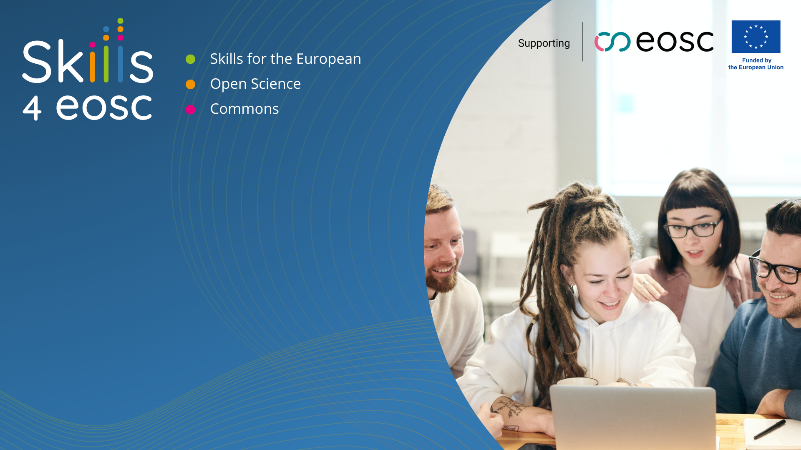

Skills4EOSC: Skills for the European Open Science Commons
Emma Lazzeri, GARR
orcid.org/0000-0003-0506-046X
emma.lazzeri@garr.it

Slide 2
Supporting an EOSC-ready digitally skilled workforce:
Researchers can transform how they carry out research and exploit research outputs, leading to better quality and contributing to the Horizon Europe EOSC Partnership.
Horizon Europe call INFRA 2021 EOSC01-01

Slide 3
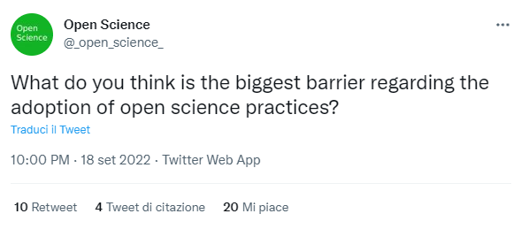
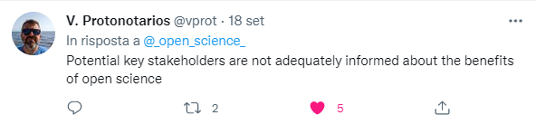
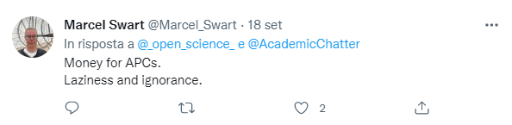
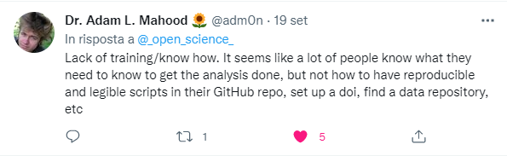
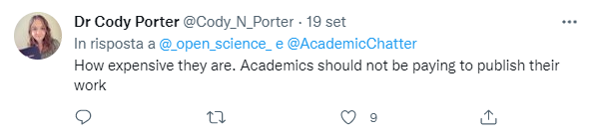
Meeting the stakeholders’ needs
https://twitter.com/_open_science_/status/1571589893595463682?t=dK7ApIFOVp7ACFTXxeBXAA&s=08

Slide 4



How?
Propose
Coordinate
Enable
A FAIR-by-design methodology for open science teaching and learning
Network of Competence Centers on Open Science and FAIR Data
Raise competences for an EOSC-skilled European workforce

Slide 5
Skills4EOSC Main Objective
Advance Open Science skills by unifying the current training landscape into a common and trusted pan-European ecosystem, closing the three gaps identified in the EOSC Strategic Research and Innovation Agenda in relation to Open Science competences:
lack of Open Science and data expertise,
lack of a clear definition of data professional profiles and corresponding career paths, and
fragmentation in training resources.

Slide 6
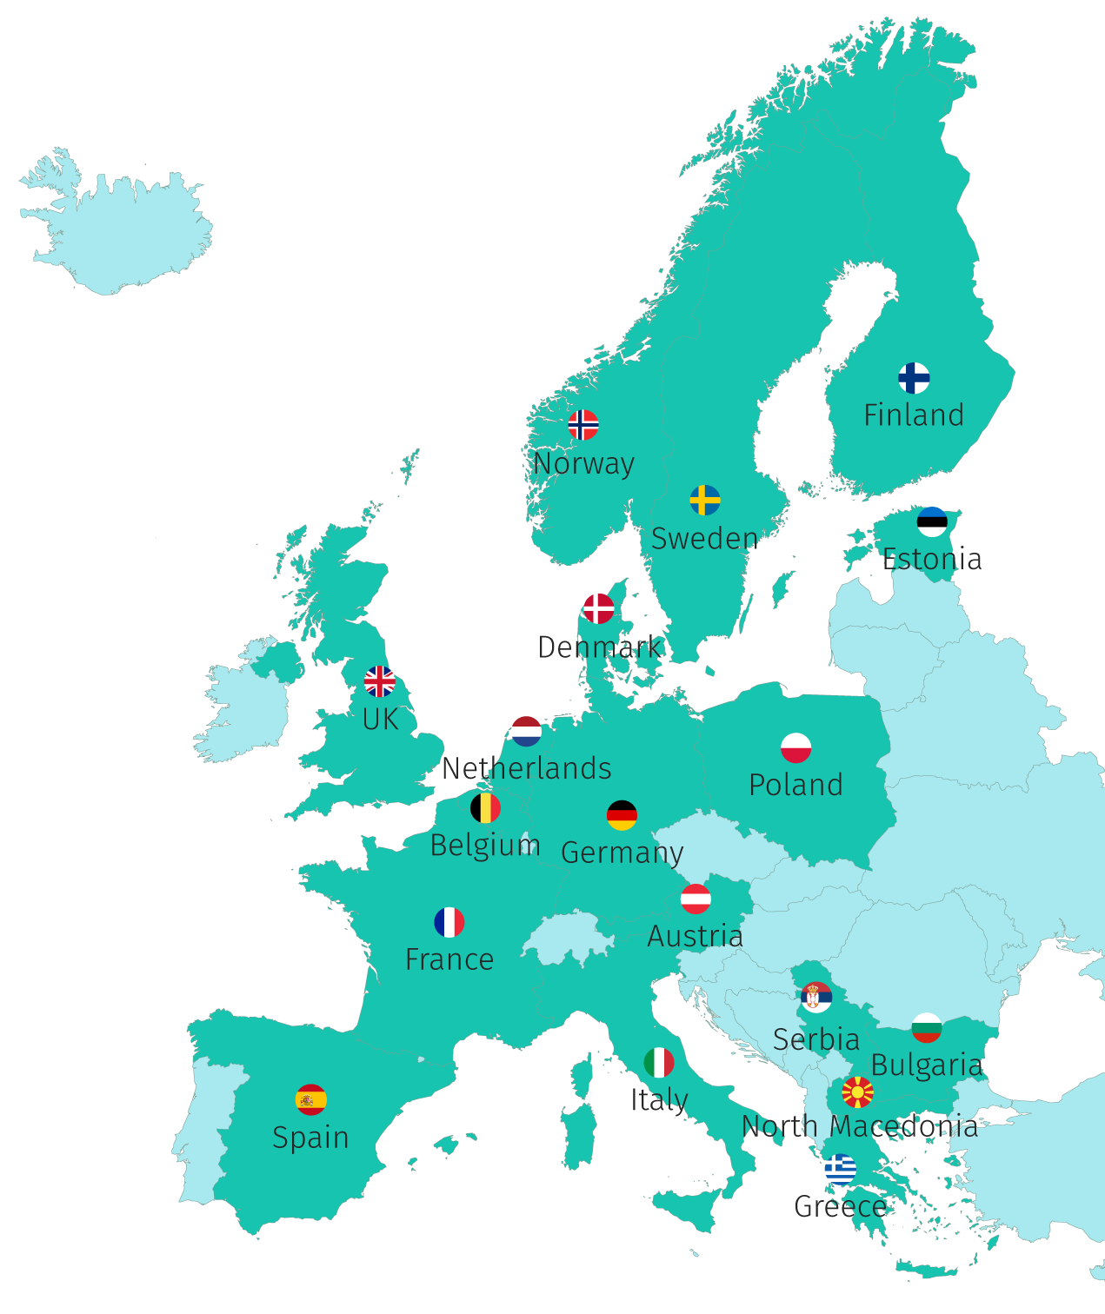
The Consortium
44 Participants, 18 Countries
“Key doers” in Open Science in their Country/Region/Domain
2 ESFRI Research Infrastructures
GARR is the coordinator

Slide 7
Key Concepts
Lifelong learning through professional networks
Competence Centre Network
Harmonise curricula and learning paths
FAIR-by-design learning materials
Train
of
Trainers
Minimum viable
skillset

Slide 8

Points of strenght
familiarity with the context of applying open science skills development in Member States,
knowledge of local and regional programmes and
contacts with key decision makers which allow influencing the status quo at these levels.
Photo by Keyur Nandaniya on Unsplash

Slide 9
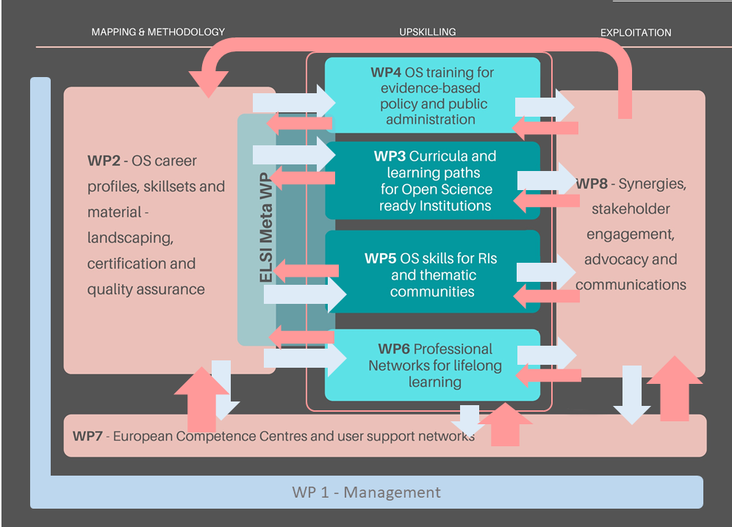
Methodology
WP3 OS training for evidence-based policy and public administration
WP4 Curricola and learning paths
for Open Science
ready institutitions

Slide 10
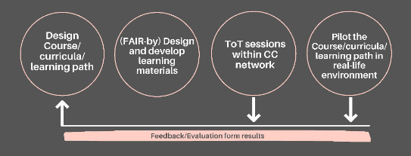
Train of trainers, desing, test

Slide 11
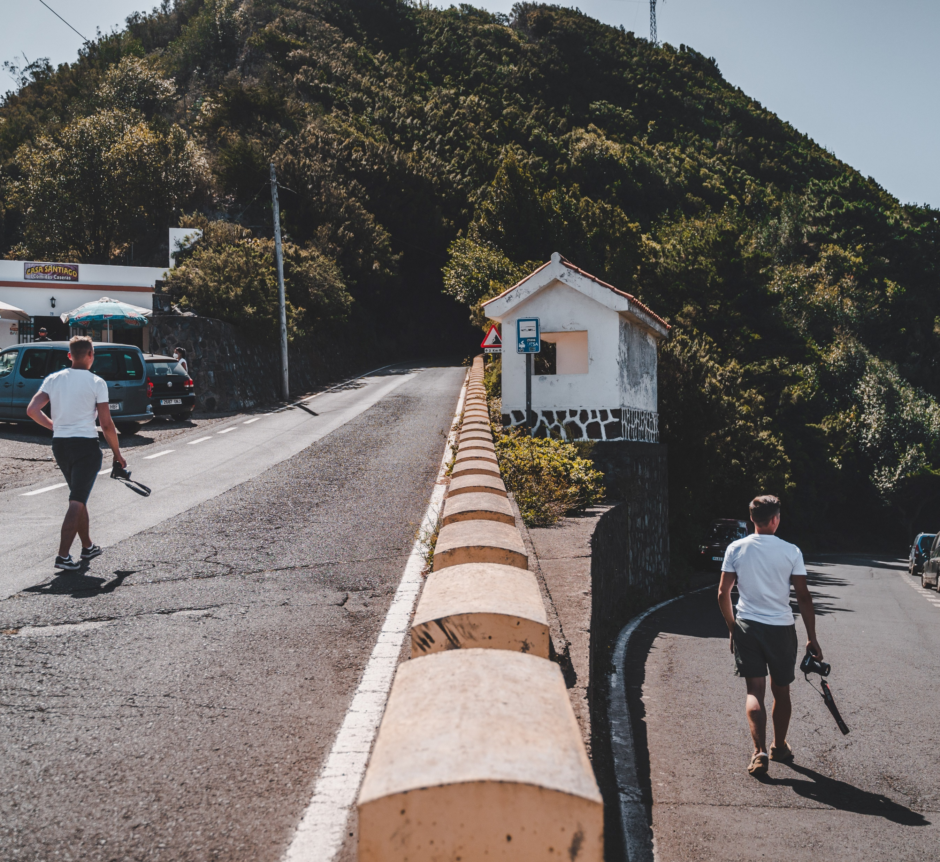




Developing paths for different targets
Science for policy: honest brokers, civil servants, policy makers
Institutions: undergraduate, PhD, data stewards and professionists, including data librarian and curators, legal and ethical experts
Research Infrastructures and thematic communities: designing training with and for researchers and professionists
Professional networks: lifelong learning through peer networks
Photo by Majestic Lukas on Unsplash

Slide 12

Engage and allign
Alignment with national and international funders, policy makers and national open science programmes,
Engagement of key stakeholders on the European level
Photo by Edwin Andrade on Unsplash

Slide 13




We are open…to collaboration!
Collaborative Environment
Best practice exchange
Train of Trainers to upskill Competence Centres
Consortium variety
Different level of engagement and maturity, diversity of stakeholder representation
Collaboration is key also with organization outside the consortium: we are supporting the EOSC together!
Learn from your peers, apply and adapt others approach and strategy
Also for organisations and individuals outside the Consortium

Slide 14


Thank you!
Questions?
This presentation is released under a CC-BY 4.0 license. To cite this presentation, please copy and paste:
Lazzeri, Emma. (2022, September 21). Skills4EOSC: Skills for the European Open Science Commons. Iberian EOSC Workshop 2022. Zenodo. https://doi.org/10.5281/zenodo.717946.

