Slide 1


e-Science 2022
A Framework for Extracting Scientific Measurements and Geo-Spatial Information from Scientific Literature
Muhammad Asif Suryani ^{1,2,3}, Yannick Wölker ^{1,2,3}, Deepak Sharma ¹ ,Christian Beth ¹, Klaus Wallmann ², Matthias Renz ¹
  Archaeoinformatics - Data Science, Christian-Albrechts-University Kiel, Germany. ¹
  GEOMAR Helmholtz Centre for Ocean Research Kiel, Germany. ²
  Helmholtz School for Marine Data Science (MarDATA), Kiel Germany. ³
  mas@informatik.uni-kiel.de, ywoelker@geomar.de, des@informatik.uni-kiel.de, cbe@informatik.uni-kiel.de
  kwallmann@geomar.de, mr@informatik.uni-kiel.de
Suryani, Wölker, Sharma, Beth, Wallmann, Renz – Data Science | CAU Kiel, GEOMAR, MARDATA

Slide 2
Presenter Introduction
Muhammad Asif Suryani
  Doctoral Researcher at Archaeoinformatics - Data Science, Christian-Albrechts-University Kiel, Germany.
  Marine Geosystems, GEOMAR, Kiel, Germany.
  Helmholtz School for Marine Data Science Kiel, Germany.
  mas@informatik.uni-kiel.de
Area of interest
  Information Extraction, Natural Language Processing, Recommender Systems.
            Career Highlights
              Masters in CSE from GIK Institute, Pakistan.
              Bachelors in Telecom Engineering, Pakistan.
Suryani, Wölker, Sharma, Beth, Wallmann, Renz – Data Science | CAU Kiel, GEOMAR, MARDATA 2

Slide 3
Presentation Outline
Problem Statement
Introduction
Bigger Picture
Related work
Proposed Framework
Results and Discussion
Conclusion/Future work
Reference
Suryani, Wölker, Sharma, Beth, Wallmann, Renz – Data Science | CAU Kiel, GEOMAR, MARDATA 3

Slide 4
Problem Statement
Data is an important but expensive in many scientific disciplines
Scientific Papers are often a rich source of information and data:
  The information is scattered throughout the publication and could be of diverse types and exhibit rich context.
  To automatically extract relevant information alongside its context is challenging.
  Scientific Measurements in this regard showcase broader context i.e. Spatial aspect
  In Marine Science scientific measurements are largely reported in publications normally with spatial context.
Suryani, Wölker, Sharma, Beth, Wallmann, Renz – Data Science | CAU Kiel, GEOMAR, MARDATA 4

Slide 5
Introduction
Researchers encapsulate their findings in research papers.
  Normally, research papers are well written and structured for the human readers.
  The readers could search their relevant Information for these sources manually.
    The desired information could be expressed anywhere in the document i.e. text, tables and figures.
    Number of publications are rapidly increasing.
  Automatic extraction of relevant information from these papers may provide a solution which is linked to type of information and domain.
Suryani, Wölker, Sharma, Beth, Wallmann, Renz – Data Science | CAU Kiel, GEOMAR, MARDATA 5

Slide 6
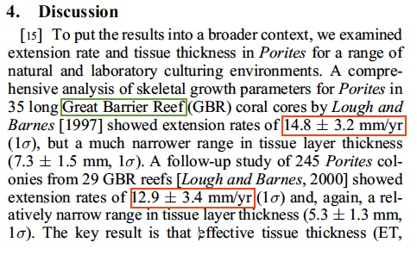
Introduction (contd.)
In Marine Geology, researcher perform experiments at various oceanographic locations and record complex measurements.
  These measurements has considerable impact on the environment
  especially on seafloor.
  These measurements are compiled in scientific publications, e.g. Mass Accumulation Rate (MAR) Sedimentation Rate (SR).
  For better understanding of MAR and SR measurements,
  it is necessary to consider their spatial context.
Sample text with Sedimentation rate [1]
Suryani, Wölker, Sharma, Beth, Wallmann, Renz – Data Science | CAU Kiel, GEOMAR, MARDATA 6

Slide 7
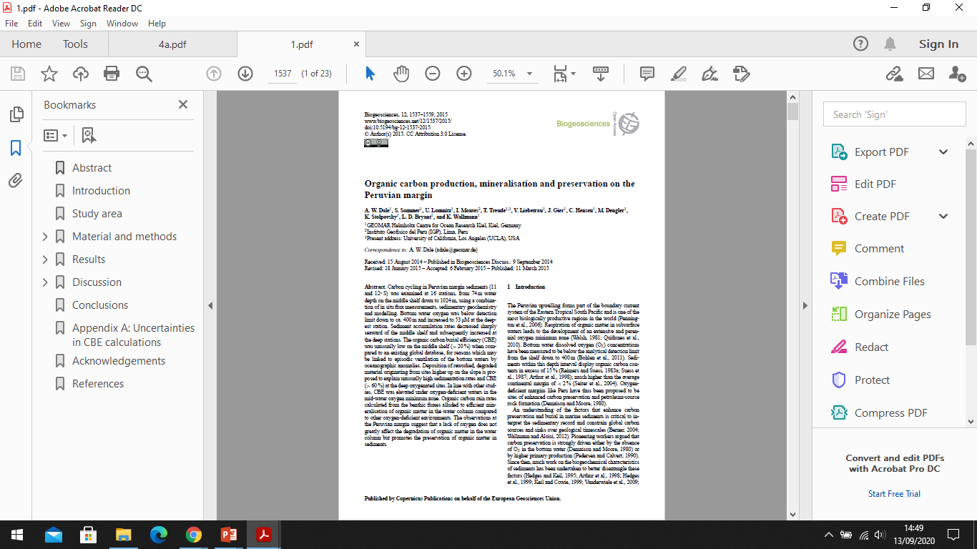
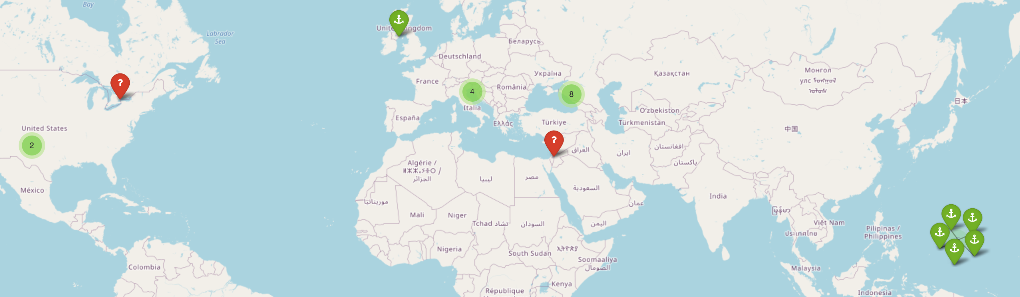
Bigger Picture
Measurement Extraction
Data Extraction
Information Linking
Location Extraction
[2]
Suryani, Wölker, Sharma, Beth, Wallmann, Renz – Data Science | CAU Kiel, GEOMAR, MARDATA 7

Slide 8
Related Work
Considering Measurement extraction, spatial information extraction and Information linking few approaches could address this problem individually, but only to some extent.
  Grobid-quantities module based on Conditional Random Fields (CRFs), capable of extracting quantities from scientific literature ^{[3,4]}, e.g. Grobid-Astro
  Quantulum3 has been used recently to extract measurements from the tabular data ^{[5]}.
    Extraction is performed using rule-based approach and disambiguation of units using Wikipedia articles.
Spatial Information extraction could be seen as Named Entity Recognition (NER) task:
  spaCy is an open source library that could be tailored accordingly^{[6,7]}, e.g. ScispaCy
  Grobid-ner is a module capable of extracting general entities ^{[8]}.
Suryani, Wölker, Sharma, Beth, Wallmann, Renz – Data Science | CAU Kiel, GEOMAR, MARDATA 8

Slide 9
Related Work (contd.)
Spatial entities could showcase important metadata information i.e. geocoding
  Geoparsepy module provide coordinate base information in combination with NER ^{[9]}.
  Edinburgh Geoparser can be used with several gazetteers including GeoNames ^{[10]}.
  GeoPy module provide coordinates for spatial entity beside rich functionalities ^{[11]}.
Information linking especially Heterogeneous linking problem is not well explored up to our knowledge.
  MARVE framework perform measurement extraction by Grobid-quantities and POS tags are used to link it to the relevant entity with pre-defined conditions^{[12]}.
Suryani, Wölker, Sharma, Beth, Wallmann, Renz – Data Science | CAU Kiel, GEOMAR, MARDATA 9

Slide 10
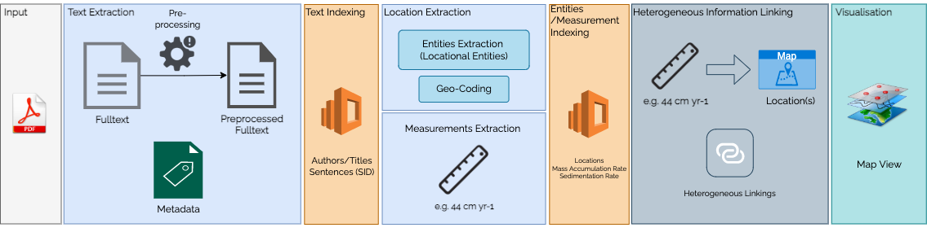
Proposed Framework
Proposed Framework mainly comprise of following modules:
  Text Extraction
  Measurement Extraction
  Location Extraction
  Heterogeneous Information Linking
  Visualisation
Suryani, Wölker, Sharma, Beth, Wallmann, Renz – Data Science | CAU Kiel, GEOMAR, MARDATA 10

Slide 11
Proposed Framework (contd.)
Text Extraction module focuses on text extraction from scientific documents normally available in Portable Document Format (PDF).
  Text extraction is performed using pdfminer.six ^{[13]}.
  Text Pre-processing e.g. remove unrecognized characters and replacements
  Metadata is also produced for indexing.
Measurement Extraction uses the text to find the relevant measurements e.g. MAR and SR
Measurement | Unit | Example
Mass Accumulation Rate | Mass/Area/Time | 42 𝑔 𝑐𝑚−2 𝑦𝑟−1
Sedimentation Rate | Length/Time | 40 𝑐𝑚 𝑦𝑟−1
Suryani, Wölker, Sharma, Beth, Wallmann, Renz – Data Science | CAU Kiel, GEOMAR, MARDATA 11

Slide 12
Proposed Framework (contd.)
Measurement extraction is based on Grobid-quantities ^{[3]}.
  The MAR and SR are represented in non-SI units.
  Grobid-quantities module is enhanced considering targeted measurements and their unit variants.
Location Extraction module consist of two sub modules:
  Locational entities extraction modules is based on spaCy ^{[6]} which target oceanographic entities.
  Geo-coding module uses service of GeoPy ^{[11]} which provide coordinates that are essential for linking and visualization.
Suryani, Wölker, Sharma, Beth, Wallmann, Renz – Data Science | CAU Kiel, GEOMAR, MARDATA 12

Slide 13
Proposed Framework (contd.)
Heterogeneous Information Linking uses extracted measurements and locations. Emphasising measurement’s possible location candidates by two different approaches.
  Simple Linking approach look for location candidate on adjacent sentences (Pre and Post)
  NN Linking approach look for N location candidates in each direction.
Information filtering combine locational candidates from both approaches.
  Segregate them into land location candidates and water location candidates
Visualisation module provide an interactive map view using Folium ^{[14]}.
Suryani, Wölker, Sharma, Beth, Wallmann, Renz – Data Science | CAU Kiel, GEOMAR, MARDATA 13

Slide 14
Results and Discussion
Annotation is important for measurement extraction and location extraction.
  Performed with experts on corpus from research publications.
  For measurement extraction a set of 1000 annotations covers 100 MAR and SR variants.
  For location extraction, a set of 3200 sentences is annotated.
Text Extraction module achieve an average performance of 96.4%.
Suryani, Wölker, Sharma, Beth, Wallmann, Renz – Data Science | CAU Kiel, GEOMAR, MARDATA 14

Slide 15
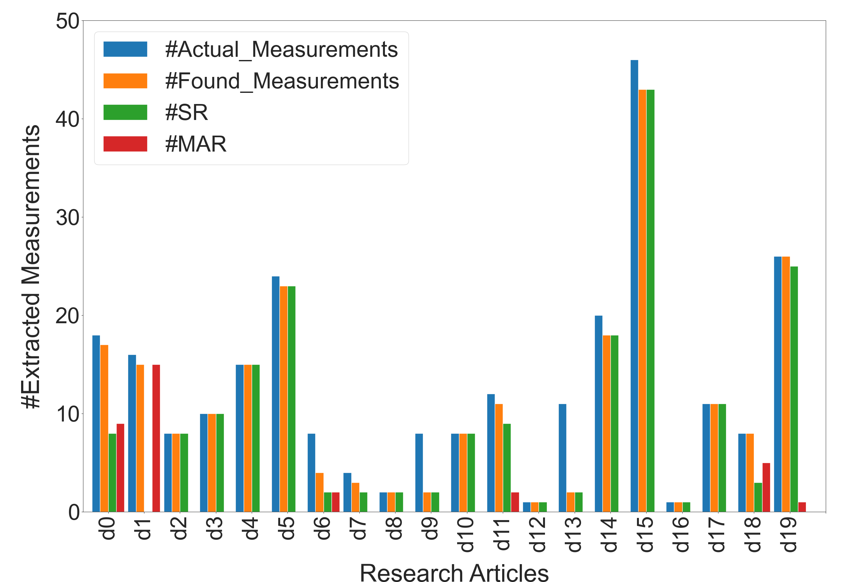
Results and Discussion (contd.)
Measurement extraction module has been evaluated on test set of 20 full papers.
Achieve highest precision and 0.90 F1-score.
The diagram also indicates the distribution of MAR and SR values.
Suryani, Wölker, Sharma, Beth, Wallmann, Renz – Data Science | CAU Kiel, GEOMAR, MARDATA 15

Slide 16
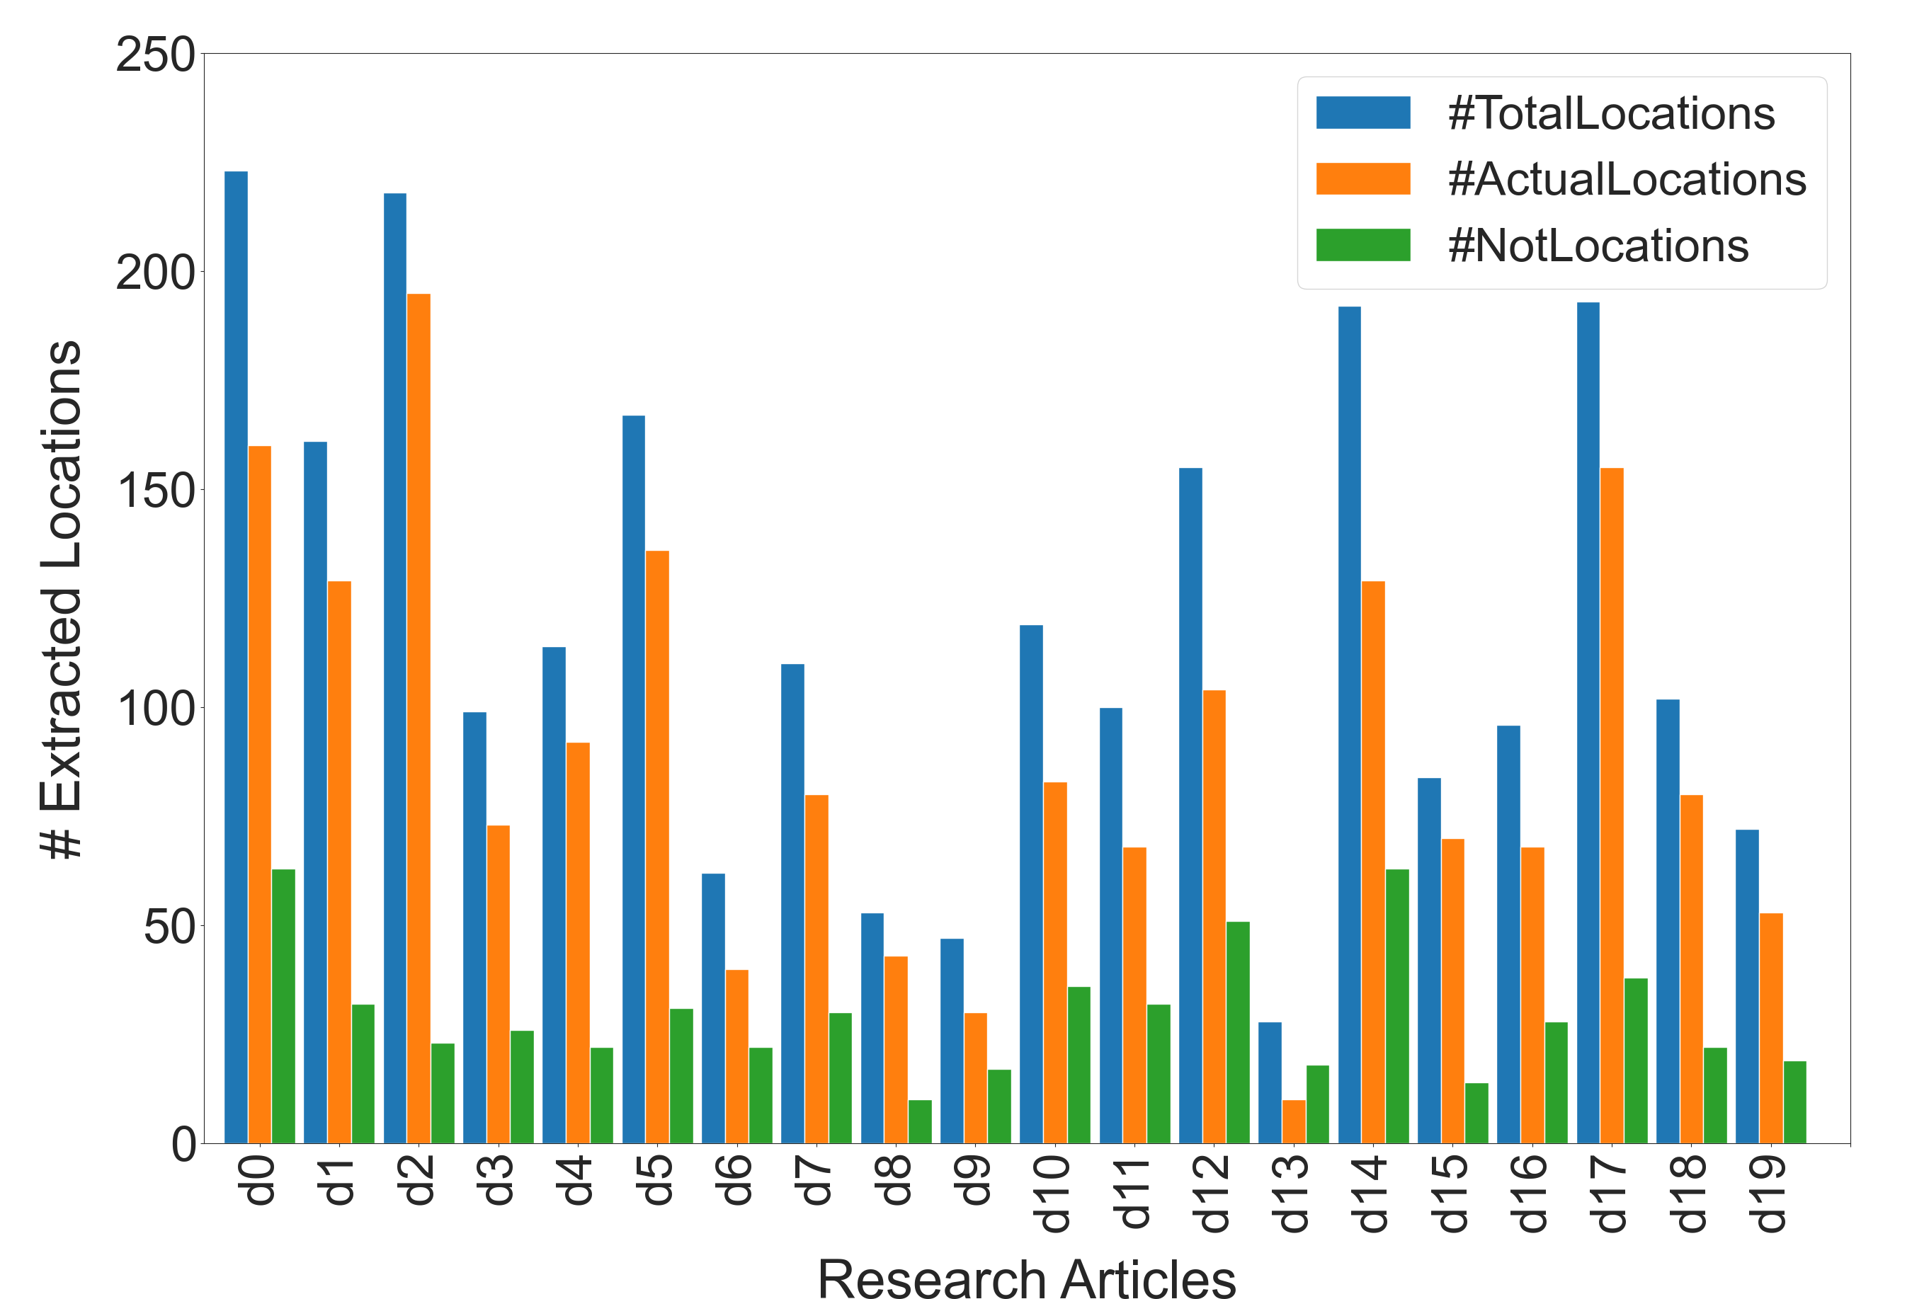
Results and Discussion (contd.)
Location extraction module has been evaluated on test set of 20 full papers.
Achieve precision of 0.70 and 0.78 F1-score.
Orange bars indicates locations entities with valid geo-code.
Green bars indicate entities with no geo-code.
Suryani, Wölker, Sharma, Beth, Wallmann, Renz – Data Science | CAU Kiel, GEOMAR, MARDATA 16

Slide 17
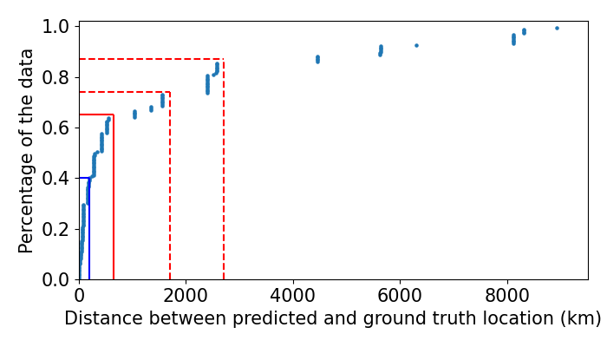
Results and Discussion (contd.)
Error threshold showcase the quality of the linking module on set of 20 papers,
Predefined links as ground truth by experts
The solid red line cross at an error of 650km and cover 65% of the data points.
Suryani, Wölker, Sharma, Beth, Wallmann, Renz – Data Science | CAU Kiel, GEOMAR, MARDATA 17

Slide 18
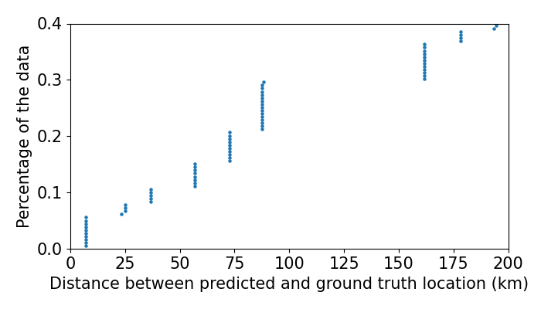
Results and Discussion (contd.)
The diagram elaborates the blue lines from previous diagram.
It highlights the data points within considerable close vicinity of 200km.
Suryani, Wölker, Sharma, Beth, Wallmann, Renz – Data Science | CAU Kiel, GEOMAR, MARDATA 18

Slide 19
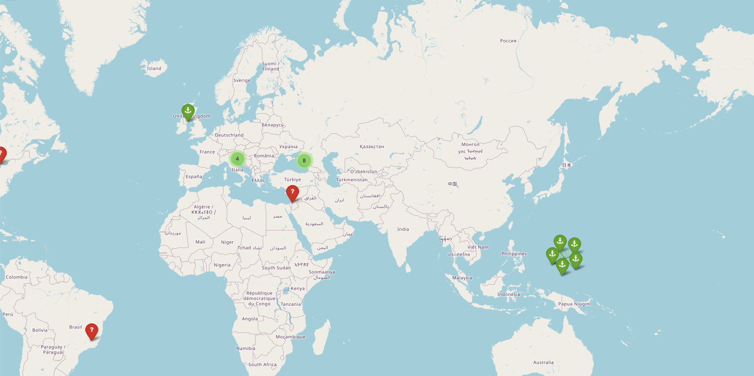
Results and Discussion (contd.)
Visualisation module showcase the location candidates on map.
Green markers with anchor sign are water locations
Red markers indicates the land.
Suryani, Wölker, Sharma, Beth, Wallmann, Renz – Data Science | CAU Kiel, GEOMAR, MARDATA 19
Notes:
The green group markers are of more interest it indicates to abstract location i.e. Challenger Deep which is in a close vicinity of the actual measurement locations.

Slide 20
Conclusion / Future work
Proposed framework handles a challenging task to extract measurements and location information.
Measurements are linked to possible location candidates by Heterogenous information linking,
Visualisation module provide an interactive map view for enhanced experience.
This framework could be enhanced to cover other important components i.e. Tables and Figures.
The information linking could be represented as rich repository, which could be seen as an information network of measurements and locational entities.
Suryani, Wölker, Sharma, Beth, Wallmann, Renz – Data Science | CAU Kiel, GEOMAR, MARDATA 20

Slide 21
References
[1] M. K. Gagan, G. B. Dunbar, and A. Suzuki, “The effect of skeletal mass accumulation in porites on coral sr/ca and δ18o paleothermometry,” Paleoceanography, vol. 27, no. 1, 2012.
[2] A. W. Dale, S. Sommer, U. Lomnitz, I. Montes, T. Treude, V. Liebetrau, J. Gier, C. Hensen, M. Dengler, K. Stolpovsky et al., “Organic carbon production, mineralisation and preservation on the peruvian margin,” Biogeosciences, vol. 12, no. 5, pp. 1537–1559, 2015.
[3] L. Foppiano, L. Romary, M. Ishii, and M. Tanifuji, “Automatic identification and normalisation of physical measurements in scientific literature,” in Proceedings of the ACM Symposium on Document Engineering 2019, 2019, pp. 1–4.
[4] L. Foppiano, T. M. Dieb, A. Suzuki, and M. Ishii, “Proposal for automatic extraction framework of superconductors related information from scientific literature,” in 電子情報通信学会サービスコンピュー ティング研究会2019 年度第一回研究会, 第43 回MaDIS 研究交 流会合同研究会, 2019.
[5] T. Ceritli and C. K. Williams, “Identifying the units of measurement in tabular data,” arXiv preprint arXiv:2111.11959, 2021.
[6] M. Honnibal and I. Montani, “Natural language understanding with bloom embeddings, convolutional neural networks and incremental parsing,” Unpublished software application. https://spacy. io, 2017.
[7] M. Neumann, D. King, I. Beltagy, and W. Ammar, “Scispacy: fast and robust models for biomedical natural language processing,” arXiv preprint arXiv:1902.07669, 2019.
[8] G. Contributors, “grobid-ner: A named-entity recogniser based on grobid,” https://github.com/kermitt2/grobid-ner, 2014–2022, [Online; accessed May 31, 2022].
[9] U. of Southampton, “Geoparsepy,” https://pypi.org/project/geoparsepy/, 2022, [Online; accessed: May 31, 2022].
[10] C. Grover, R. Tobin, K. Byrne, M. Woollard, J. Reid, S. Dunn, and J. Ball, “Use of the edinburgh geoparser for georeferencing digitized historical collections,” Philosophical Transactions of the Royal Society A: Mathematical, Physical and Engineering Sciences, vol. 368, no. 1925, pp. 3875–3889, 2010.
[11] G. Contributors, “Geopy - python wrapper for geocoding services,” https: //geopy.readthedocs.io/en/stable/#, [Online; accessed: May 31, 2022].
[12] K. Hundman and C. A. Mattmann, “Marve: Measurement context extraction from text,” in Proceedings of 23rd ACM SIGKDD International Conference on Knowledge Discovery and Data Mining, 2017.
[13] PDFminer, “pdfminer.six,” https://github.com/pdfminer/pdfminer.six, [Online; accessed: March 20, 2022].
[14] ——, “Folium - python data, leaflet.js maps,” https: //python-visualization.github.io/folium/, [Online; accessed: May 31, 2022].
Suryani, Wölker, Sharma, Beth, Wallmann, Renz – Data Science | CAU Kiel, GEOMAR, MARDATA 21

Slide 22
Thank you
Suryani, Wölker, Sharma, Beth, Wallmann, Renz – Data Science | CAU Kiel, GEOMAR, MARDATA

