Slide 1

RO-Crate: packaging metadata love notes into
FAIR Digital Objects
Professor Carole Goble CBE FREng
The University of Manchester, UK
ELIXIR-UK Head of Node
carole.goble@manchester.ac.uk
Significant contributor & RO-crate leader:
Stian Soiland-Reyes, The University of Manchester/ The University of Amsterdam
soiland-reyes@manchester.ac.uk
HMC Conference 2022, 05 October 2022
https://helmholtz-metadaten.de/en/events/hmc-conference-2022
Notes:
HMC Keynote: Carole Goble, The University of Manchester
Title: RO-Crate: packaging metadata love notes into FAIR Digital Objects
Abstract
The Helmholtz Metadata Collaboration aims to make the research data [and software] produced by Helmholtz Centres FAIR for their own and the wider science community by means of metadata enrichment [1]. Why metadata enrichment and why FAIR? Because the whole scientific enterprise depends on a cycle of finding, exchanging, understanding, validating, reproducing), integrating and reusing research entities across a dispersed community of researchers.
Metadata is not just “a love note to the future” [2], it is a love note to today’s collaborators and peers. Moreover, a FAIR Commons must cater for the metadata of all the entities of research – data, software, workflows, protocols, instruments, geo-spatial locations, specimens, samples, people (well as traditional articles) – and their interconnectivity. That is a lot of metadata love notes to manage, bundle up and move around. Notes written in different languages at different times by different folks, produced and hosted by different platforms, yet referring to each other, and building an integrated picture of a multi-part and multi-party investigation. We need a crate!
RO-Crate [3] is an open, community-driven, and lightweight approach to packaging research entities along with their metadata in a machine-readable manner. Following key principles - “just enough” and “developer and legacy friendliness - RO-Crate simplifies the process of making research outputs FAIR while also enhancing research reproducibility and citability. As a self-describing and unbounded “metadata middleware” framework RO-Crate shows that a little bit of packaging goes a long way to realise the goals of FAIR Digital Objects (FDO)[4], and to not just overcome platform diversity but celebrate it while retaining investigation contextual integrity.
In this talk I will present the why, and how Research Object packaging eases Metadata Collaboration using examples in big data and mixed object exchange, mixed object archiving and publishing, mass citation, and reproducibility. Some examples come from the HMC, others from EOSC, USA and Australia, and from different disciplines.
Metadata is a love note to the future, RO-Crate is the delivery package.
[1] https://helmholtz-metadaten.de/en
[2] Scott, Jason The Metadata Mania, http://ascii.textfiles.com/archives/3181, June 2011
[3] Soiland-Reyes, Stian et al. “Packaging Research Artefacts with RO-Crate”. Data Science, 2022; 5(2):97-138, DOI: 10.3233/DS-210053
[4] De Smedt K, Koureas D, Wittenburg P. “FAIR Digital Objects for Science: From Data Pieces to Actionable Knowledge Units”. Publications. 2020; 8(2):21. https://doi.org/10.3390/publications8020021

Slide 2

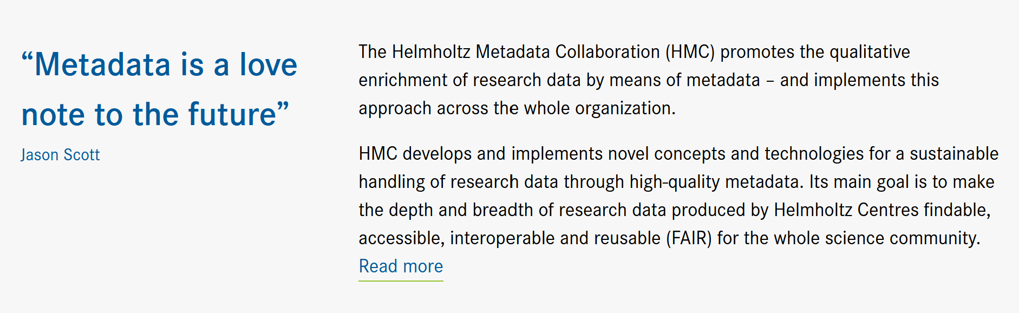

Slide 3
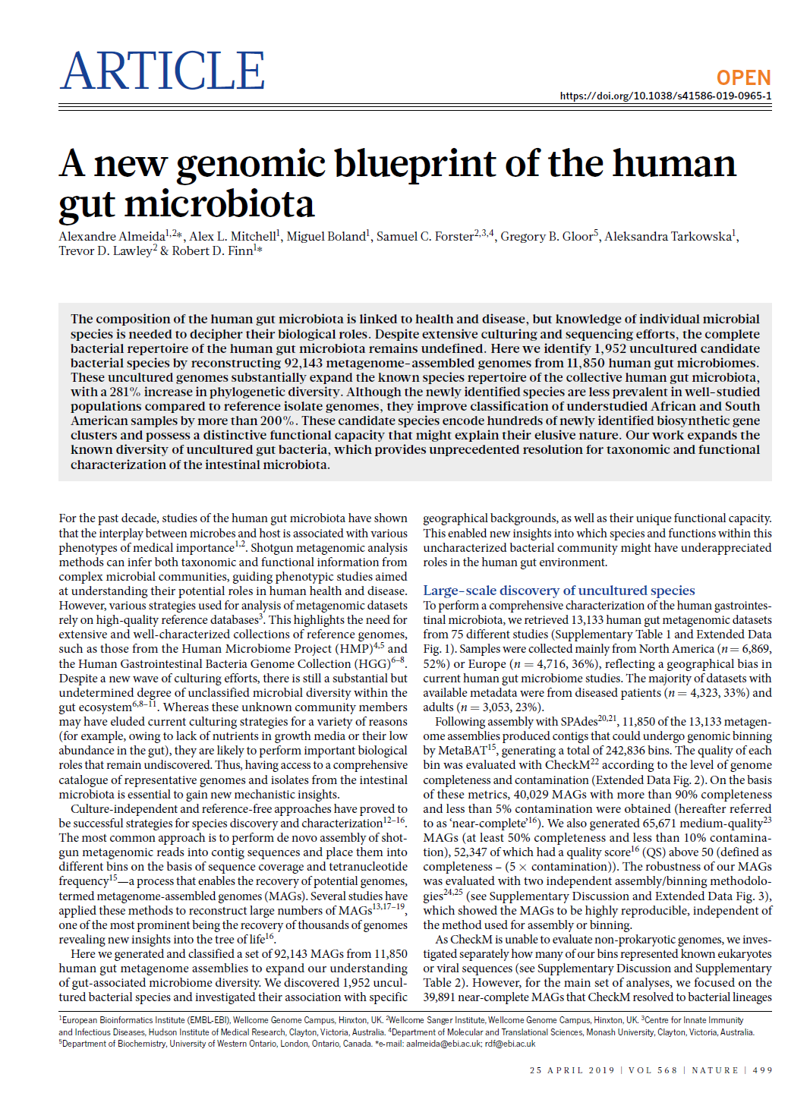
Multi-institute Team Science
Collaborators
Using different platforms
Almeida, A., Mitchell, A.L., Boland, M. et al. A new genomic blueprint of the human gut microbiota.
Nature 568, 499–504 (2019). https://doi.org/10.1038/s41586-019-0965-1
Notes:
1European Bioinformatics Institute (EMBL-EBI), Wellcome Genome Campus, Hinxton, UK. 2Wellcome Sanger Institute, Wellcome Genome Campus, Hinxton, UK. 3Centre for Innate Immunity
and Infectious Diseases, Hudson Institute of Medical Research, Clayton, Victoria, Australia. 4Department of Molecular and Translational Sciences, Monash University, Clayton, Victoria, Australia.
5Department of Biochemistry, University of Western Ontario, London, Ontario, Canada. *e-mail: aalmeida@ebi.ac.uk; rdf@ebi.ac.uk

Slide 4
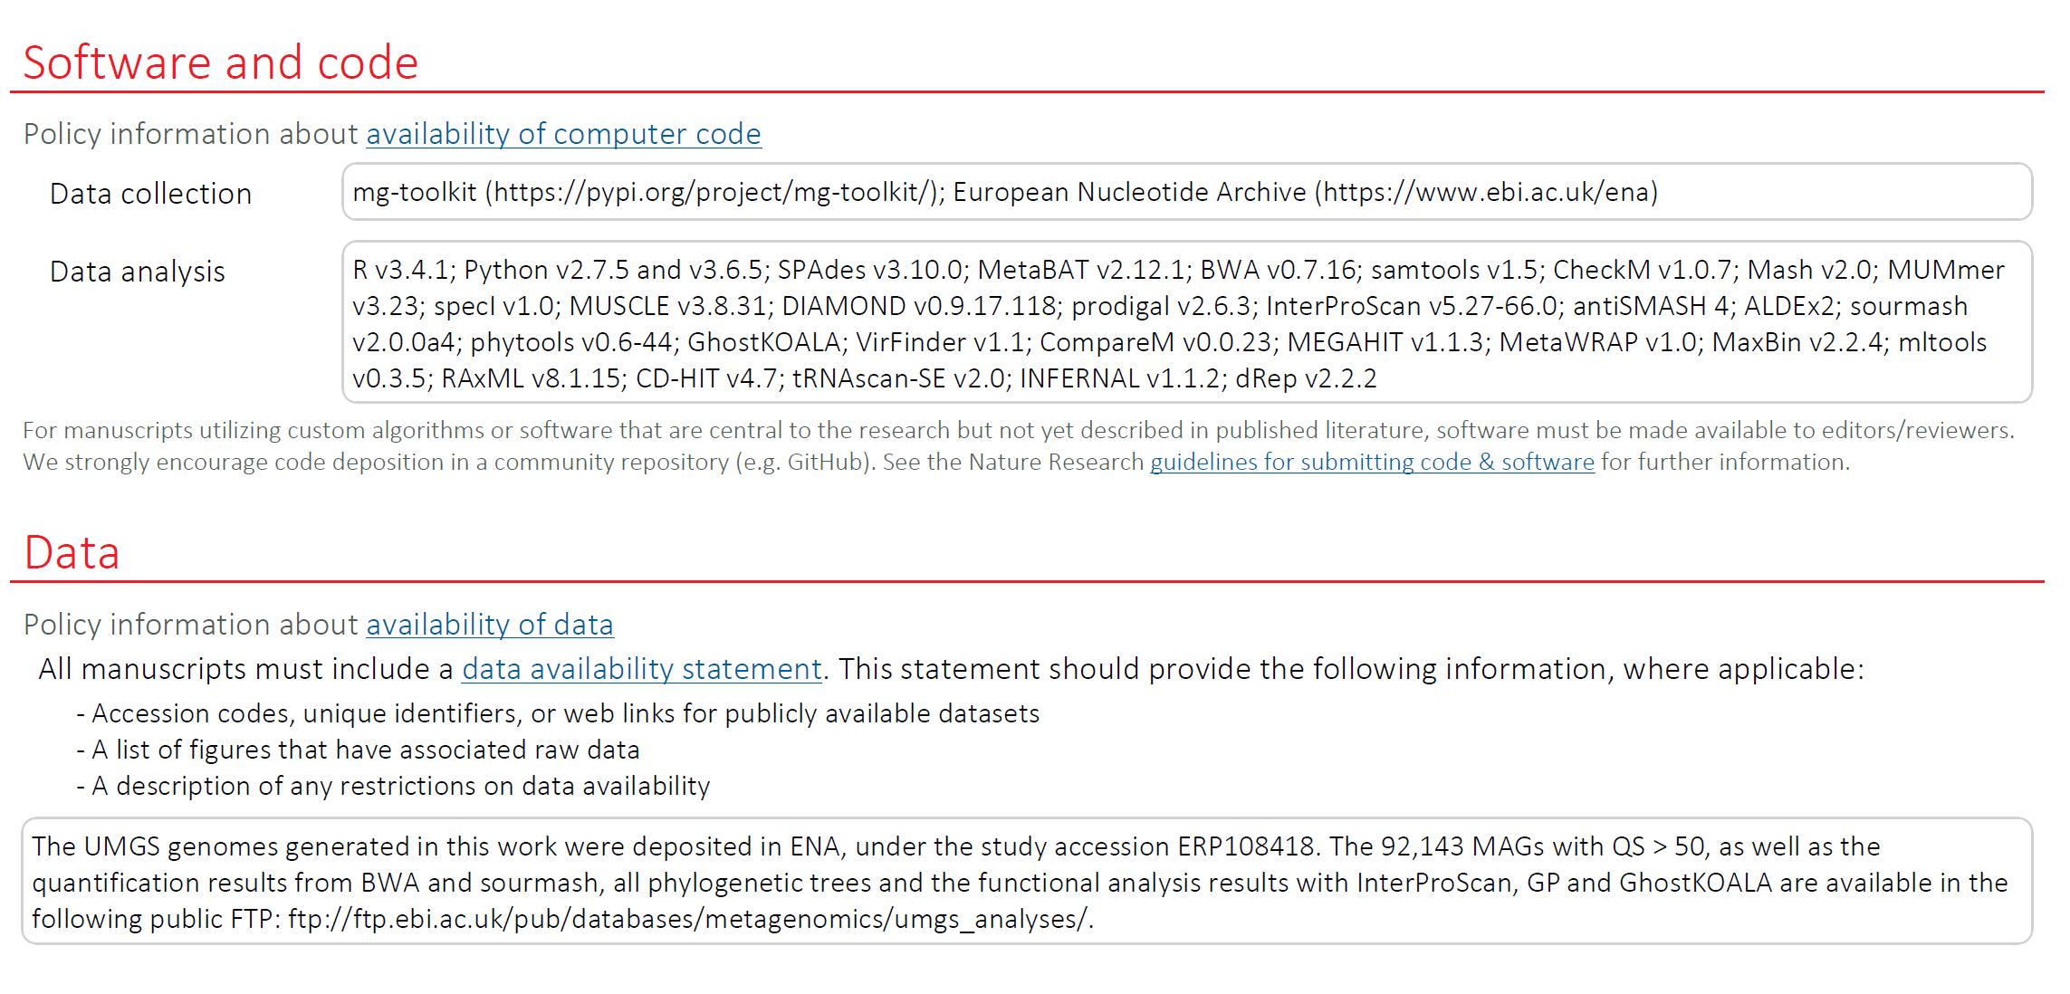
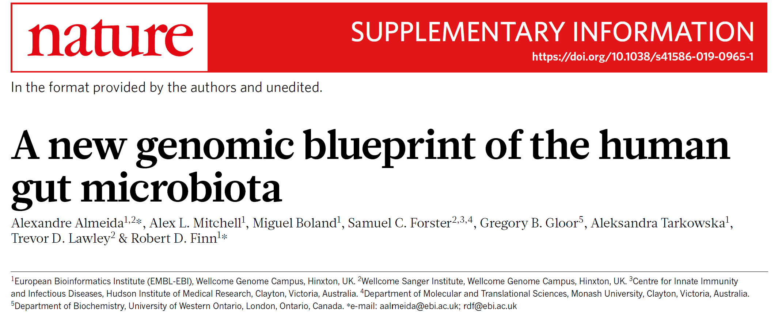
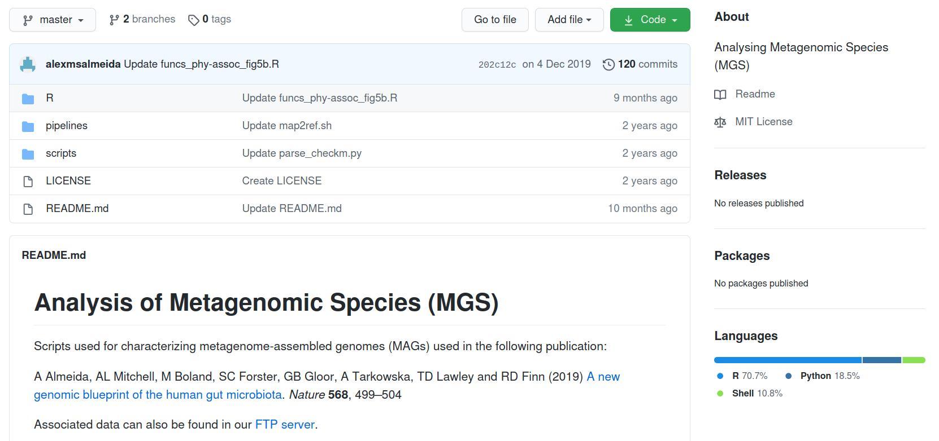

FAIR Mixed and Multi Object
Source data and results
Instruments, software, workflows, scripts…
Different data types…
Public archives, spreadsheets, project ftp servers…

Slide 5
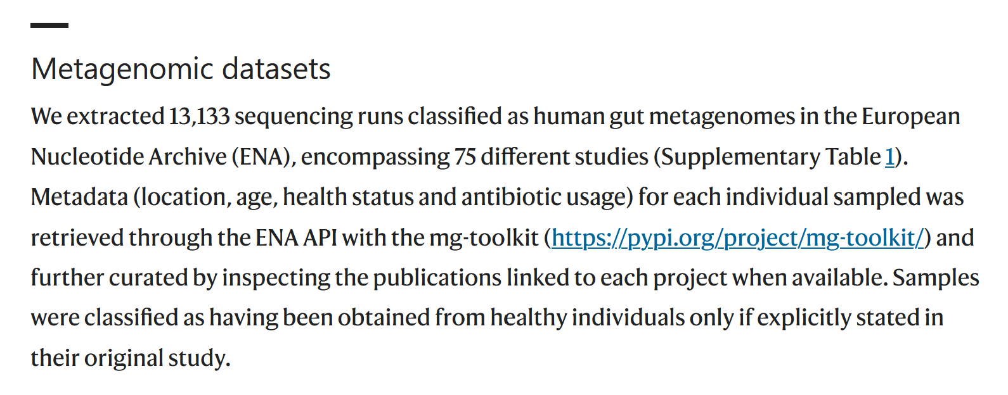
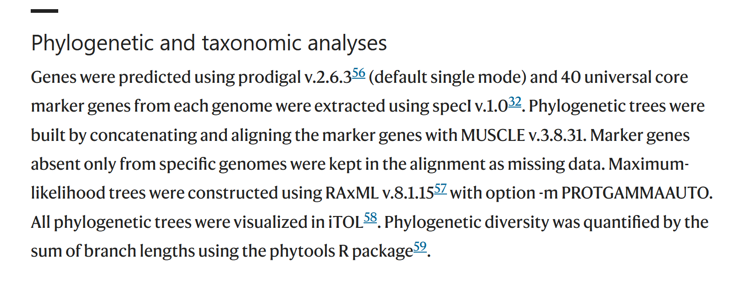
FAIR Reproducible Methods
Parameter settings. Configurations. Test data.

Slide 6
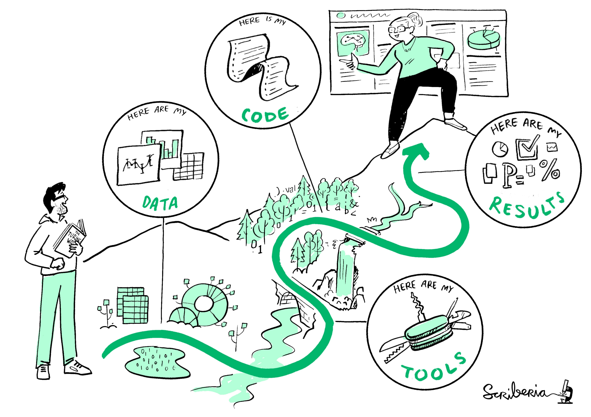
This image was created by Scriberia for The Turing Way community and is used under a CC-BY licence.
Notes:
Research and reuse journey

Slide 7



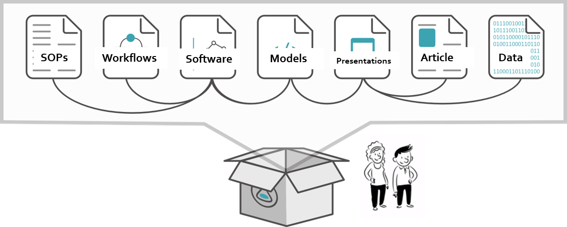











Scattered and diverse metadata
Multiple platforms and repositories

Slide 8




Scattered and diverse metadata
Multiple platforms and repositories
Big data, Sensitive data
Data remains at home.
Metadata references the data.
Manage the integrity of the referencing.
Notes:
it is a love note to today’s collaborators and peers
Import, record, and curate study metadata
Perform searches on metadata to find relevant data
Export data with their metadata
Connect data with tools

Slide 9


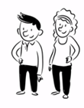



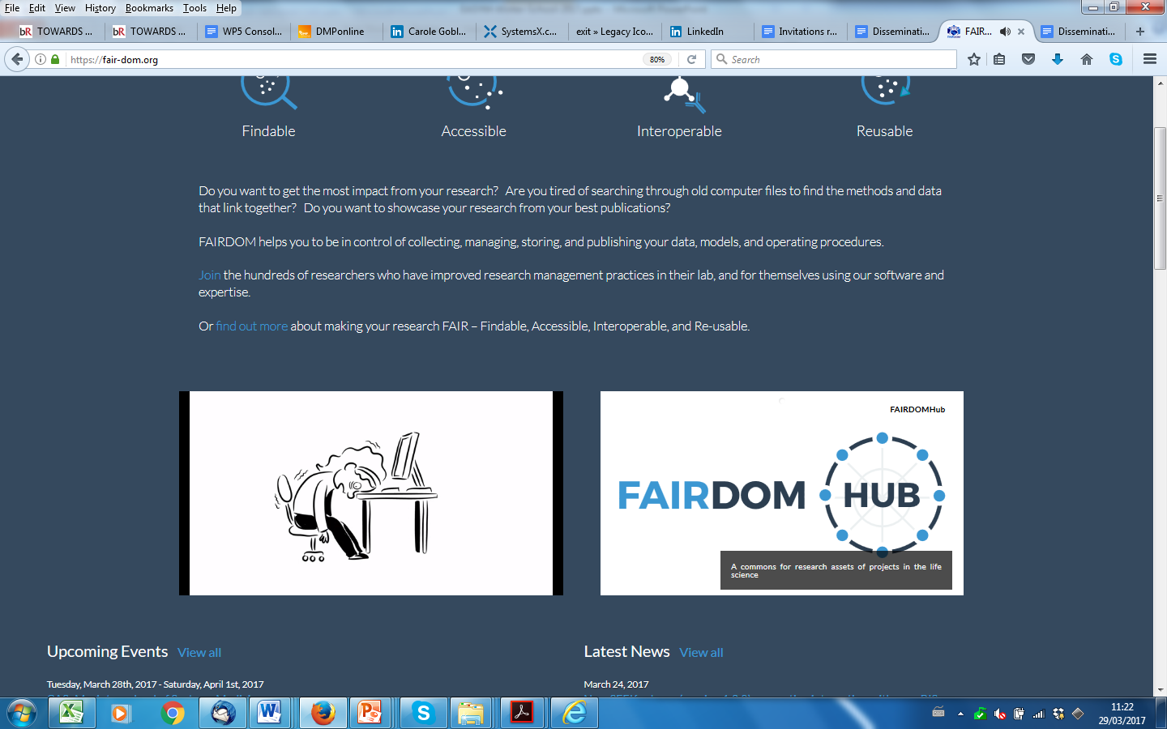






Metadata love letter delivery
: Research Objects
Each object in its own repository or platform with its own metadata
Notes:
Rebuild to be reproducible
Contextualised
Active, Unified
Semantic linking
And then De-contextualised
Static, Fragmented
Lost Semantic linking

Slide 10
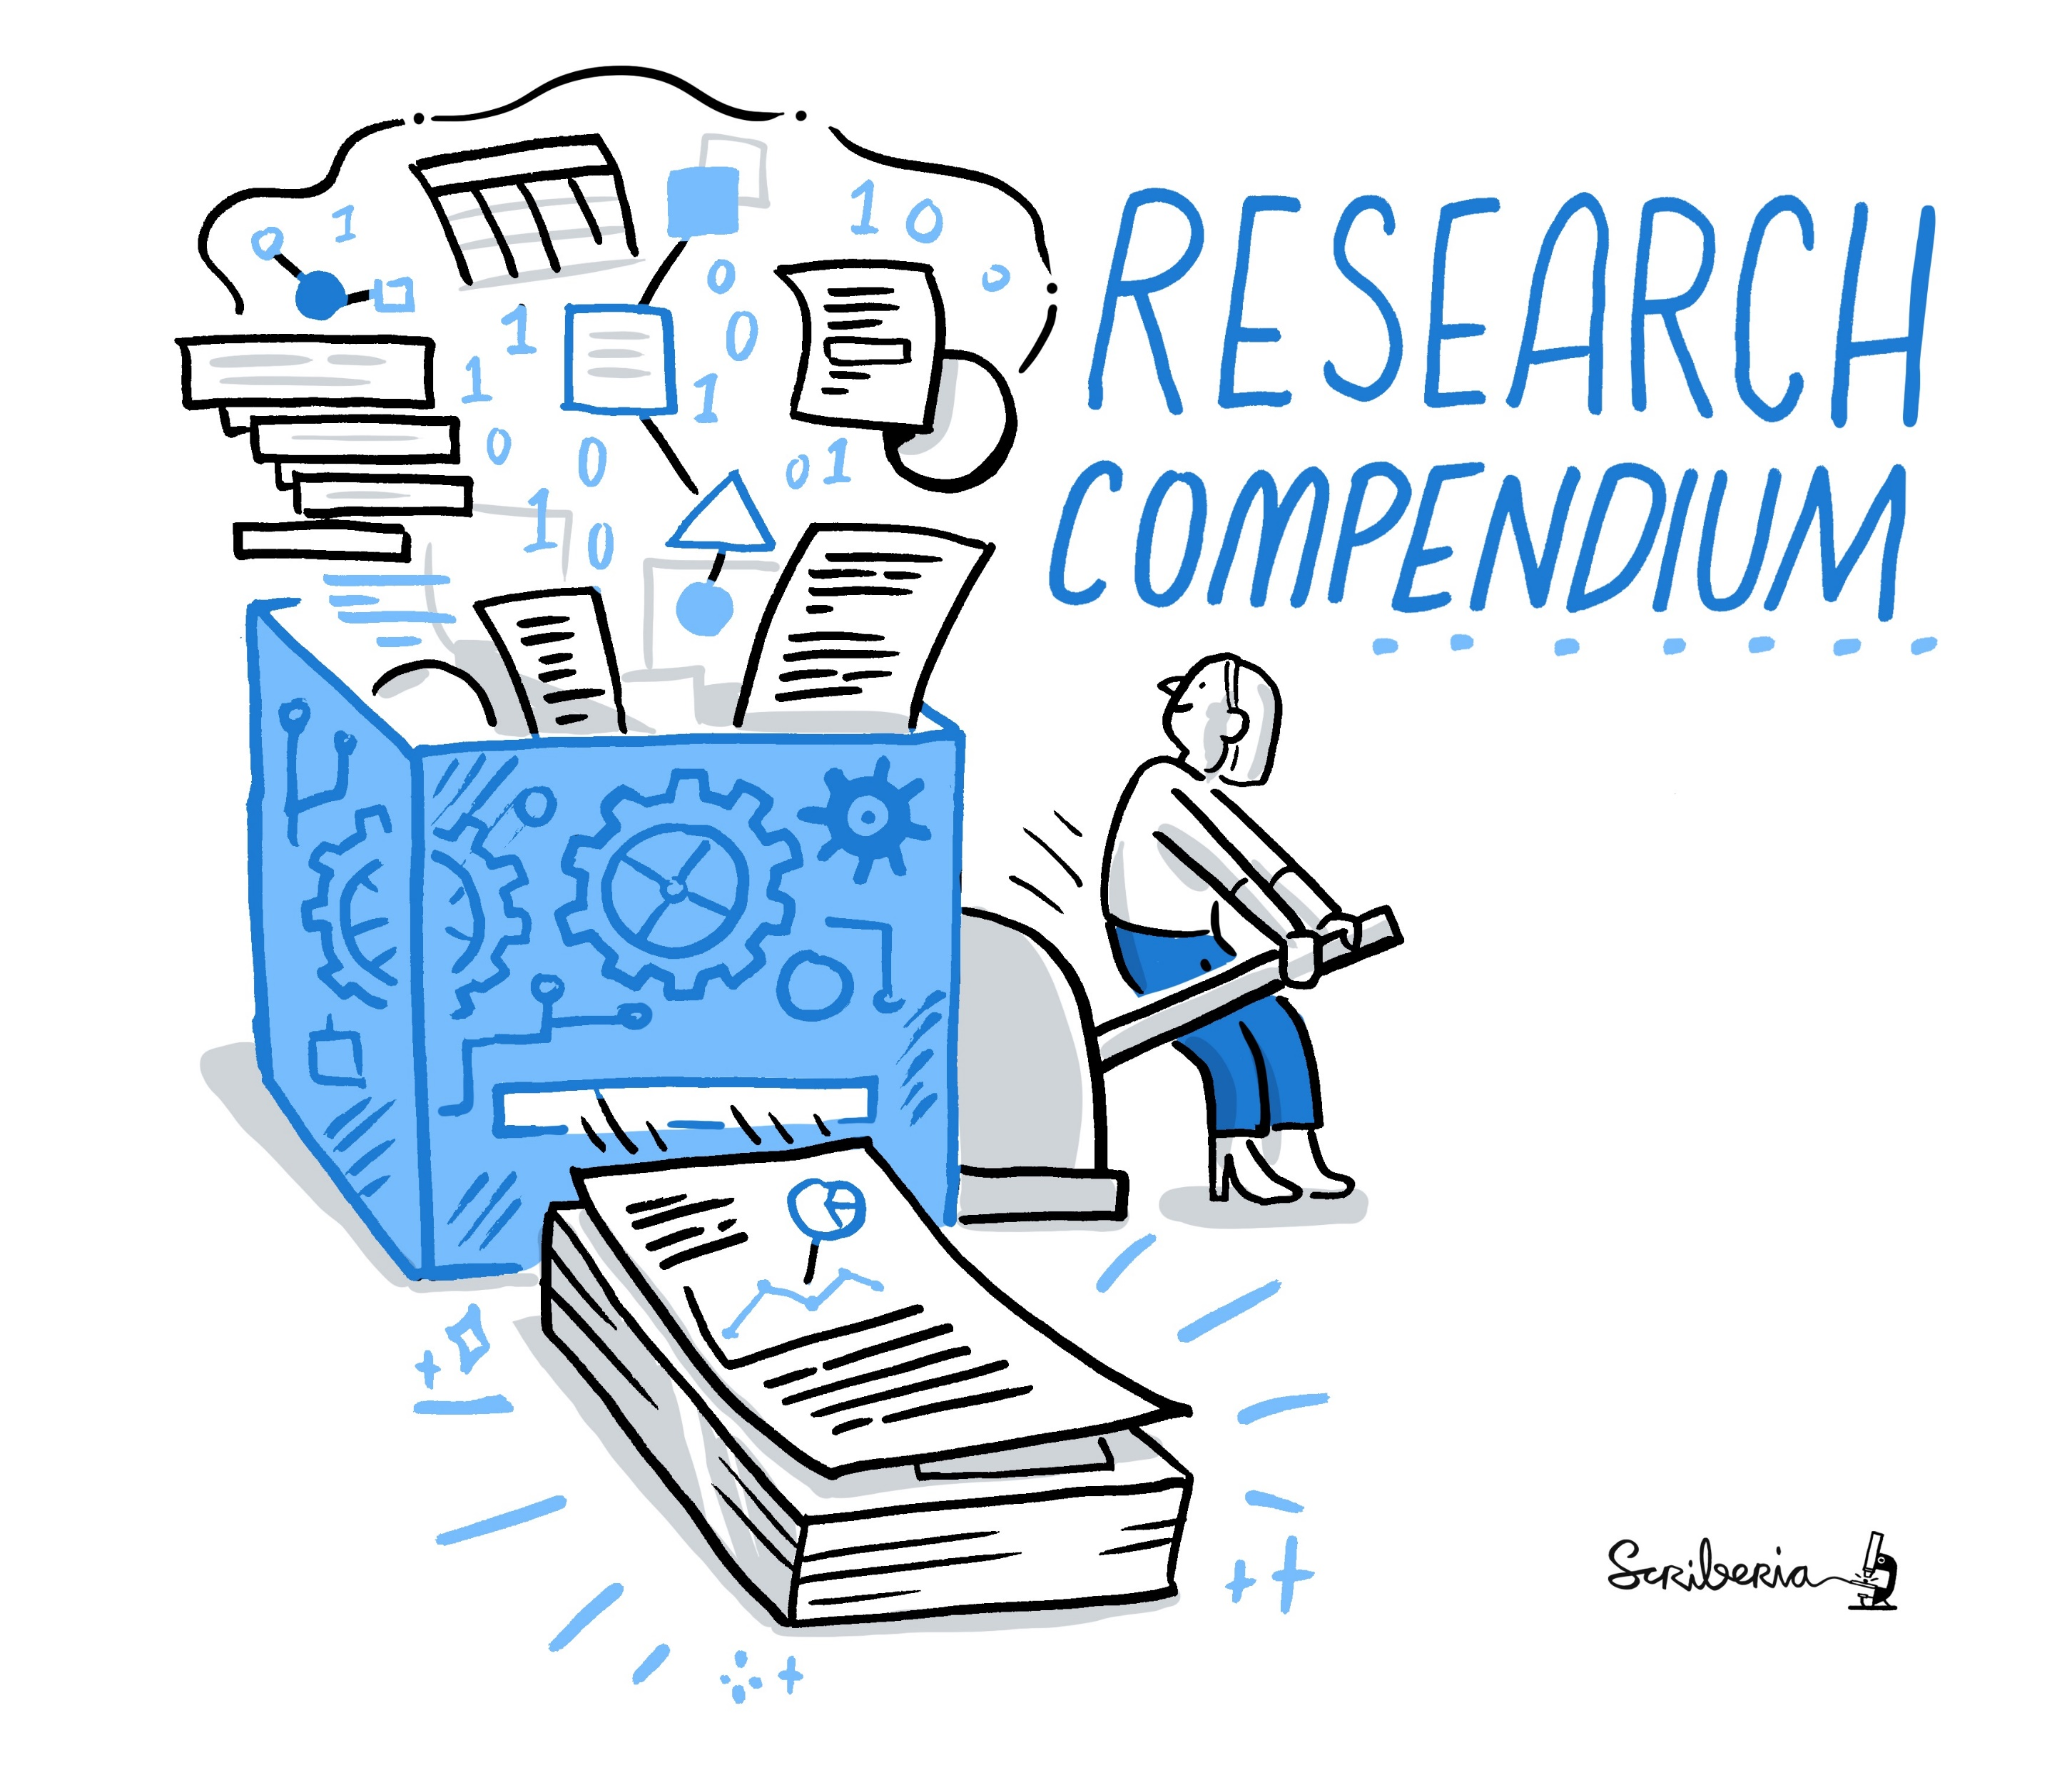
This image was created by Scriberia for The Turing Way community and is used under a CC-BY licence.

Slide 11









Package files and URL addressable resources
Repositories have their own approaches
DataONE data package
CodeOcean capsule
Whole Tale capsules
Compendiums
CombineArchive
DataCrate …
Integrated view
Describe package and parts
Need something Infrastructure independent
Exchange between repositories, registries and services.
Avoid vendor lock-in
Overlaying the
Research Digital Ecosystem
Notes:
Overcome fragmentation
citing, shipping around, storing, archiving, sharing.

Slide 12


Package files and URL addressable resources
Repositories have their own approaches
DataONE data package
CodeOcean capsule
Whole Tale capsules
Compendiums
CombineArchive
DataCrate …
My Platform
Need something Infrastructure independent
Exchange between repositories, registries and services.
Avoid vendor lock-in
Currency of exchange across
Research Digital Ecosystem

Slide 13

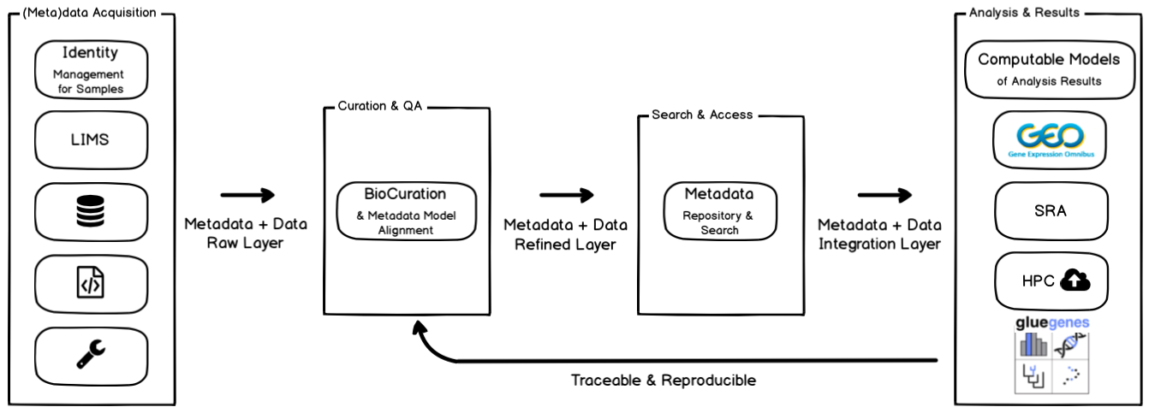
BioConnect Data Packages
  Import, record, and curate study metadata.
  Search on metadata. Export data with their metadata.
  Connect data with tools
An index of biological research data, analysis tools, and models
hosted internally or externally: LIMS, machine generated data files, manually generated data files, spreadsheets
Abigail Miller
https://zenodo.org/record/7116702#.YzinYLTMKF4

Slide 14
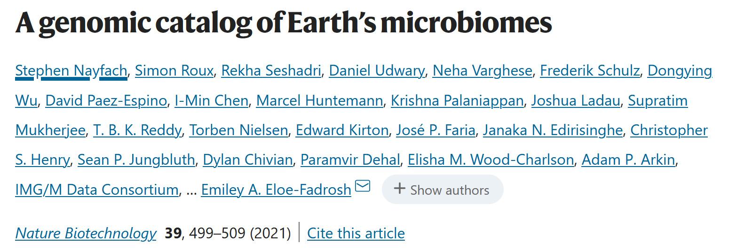
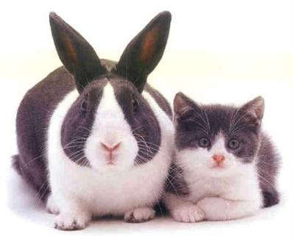
A snapshot of living objects: Science Changes
Software, reference datasets, methods change
Results may vary
What if we released research rather than published it?
Like software releases?

Slide 15

Release Research Objects
Do Research
Research Infrastructure
Publish Research
Scholarship Market place
Science 2.0 Repositories: Time for a Change in Scholarly Communication Assante, Candela, Castelli, Manghi, Pagano, D-Lib 2015

Slide 16
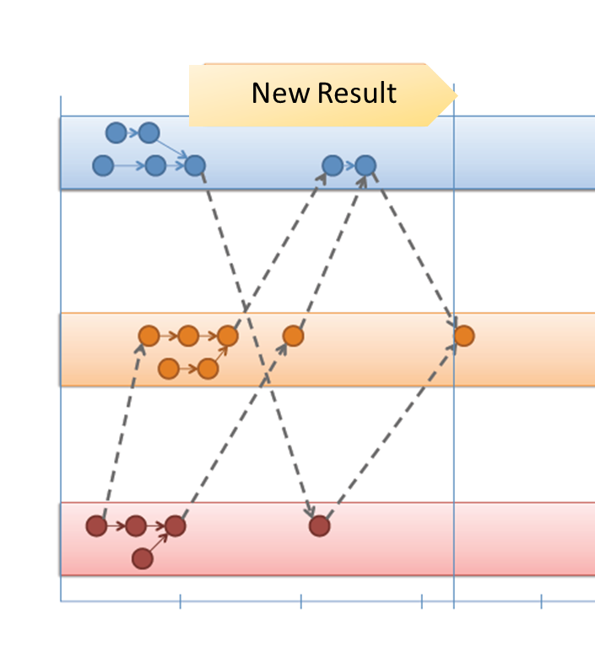
Metadata delivery on released research objects
All the related research objects needed to reuse & reproduce results
Self-described metadata objects context, dependencies and relationships between the objects.
Virtual objects referencing scattered resources
Living object for released research as its being created rather than “publish” it?
Scale up and working across all platforms. Moving knowledge between different teams.
Actionable knowledge units
Including digital twins.
A way of exchanging, archiving, reporting, citing research entities
combine open science with open scholarship
Notes:
Combining open scholarship with open science
Articles & Workflow and (double loop)
Reproducibility and exchange
A notebook is a kind of RO
has RO package its own metadata, can be registered and deposited in its own right, unpackaged and accessed, activated and reproduced if appropriate
What if that bundle was an actionable knowledge unit? Like a digital twin or CBK or FDO

Slide 17
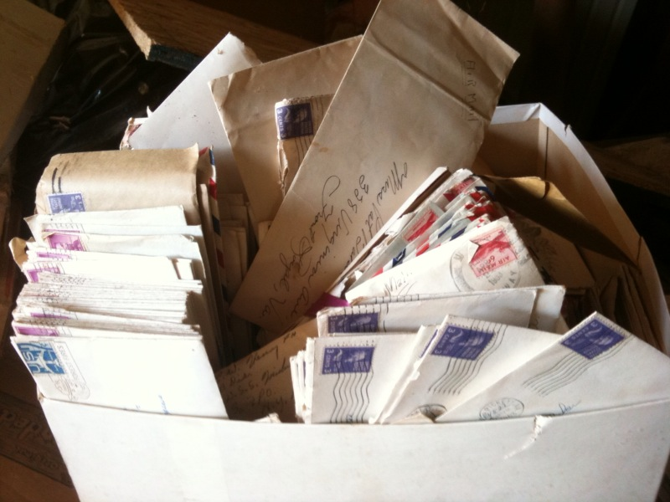
Metadata is a love note to collaborators & peers
We need frameworks to be FAIR.
For boxing stuff up.
For platform independent unified reporting, exchange, archiving of metadata.
That copes with diversity and legacy.
And that mortals can use.
https://www.flickr.com/photos/ryanishungry/5796976028/
Notes:
Metadata is not just “a love note to the future” [2], it is a love note to today’s collaborators and peers. Moreover, a FAIR Commons must cater for the metadata of all the entities of research – data, software, workflows, protocols, instruments, geo-spatial locations, specimens, samples, people (well as traditional articles) – and their interconnectivity. That is a lot of metadata love notes to manage, bundle up and move around. Notes written in different languages at different times by different folks, produced and hosted by different platforms, yet referring to each other, and building an integrated picture of a multi-part and multi-party investigation. We need a crate!

Slide 18
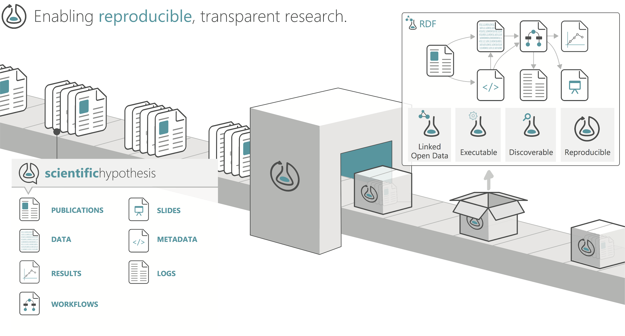

https://www.researchobject.org/
Notes:
Format for packaging up scattered resources and self describing that package and its parts
integrated view + context
metadata and PIDs reference digital and real things
datasets, workflows, services, software & people, places etc.

Slide 19

A little bit of packaging goes a long way
Practical lightweight packaging approach to aggregate files and/or any URI-addressable content, with contextual information into a metadata rich structured archive.
http://www.researchobject.org/ro-crate/
Notes:
Practical lightweight approach to package research data entities (any object) with metadata

Slide 20



A little bit of packaging goes a long way
Infrastructure independent to overcome repository and service silos: Practical, lightweight, robust.
Familiar, developer friendly Lo-Tek - web native, off-the-shelf, machine and human readable, search engine accessible: PIDs + JSON-LD + Schema.org + BagIT/Zip/OCDL.
One size does not fit all - embrace diversity, legacy, unknowns – open-ended, multi-interpretation, self-describing. Extensible metadata + pre-existing ontologies: Duck type profiling.
Notes:
Practical lightweight approach to package research data entities (any object) with metadata
Reuse don’t reinvent
prepare for more
Known and Unknown unknowns, One size does not fit all
descriptive openendedness , multi-interpretation
Structured archive
Aggregate files and/or any URI-addressable content, with contextual information to aid decisions about re-use.
Web native, off-the-shelf so machine and human readable, search engine and developer friendly.
Infrastructure independent to overcome repository silos.
Embrace diversity and legacy: self-describing, extensible metadata and pre-existing ontologies.

Slide 21
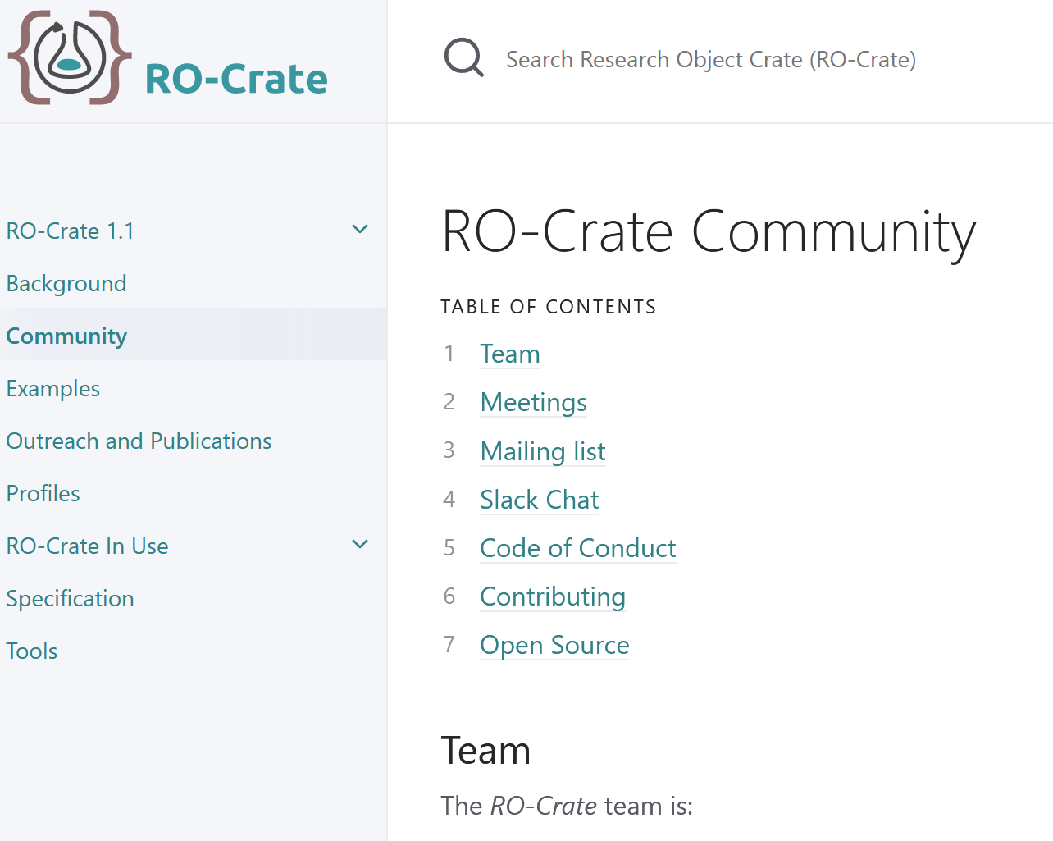

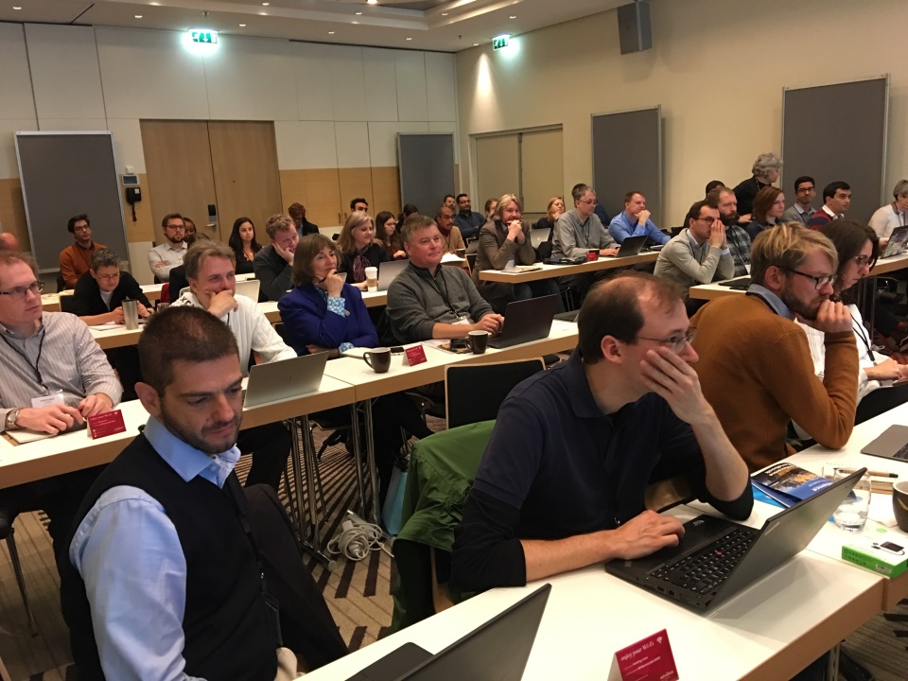









It takes an open village, with sponsors, leaders and application drivers
Biohackathon
https://biohackathon-europe.org/
https://www.researchobject.org/ro-crate/community.html
Packaging research artefacts with RO-Crate.
Data Science https://doi.org/10.3233/DS-210053
RO-Crate Specification 1.1
https://w3id.org/ro/crate/1.1
Notes:
Leadership
Diverse set of people
Variety of stakeholders
Set of collective norms
Open platform for communication
87 people in slack

Slide 22













Structured self-describing, machine readable, metadata objects
RO-Crate Metadata file
Linked Data
JSON-LD
Schema.org
Structured metadata about the RO-Crate and content
type
id
description
datePublished
…
author
organisation
license
RO-Crate Content
type, id
description
datePublished
creator
size
format …
links to web resources
Standard
Packaging
BagIT, Zip
https://github.com/o/script
files
directories
https://zenodo.org/record/3541888
Archive file format / packaging system
Notes:
Spec
via Zip, Bagit and OCFL Objects
@type: MUST be Dataset
@id: MUST end with / and SHOULD be the string ./
name: SHOULD identify the dataset to humans well enough to disambiguate it from other RO-Crates
description: SHOULD further elaborate on the name to provide a summary of the context in which the dataset is important.
datePublished: MUST be a string in ISO 8601 date format and SHOULD be specified to at least the precision of a day, MAY be a timestamp down to the millisecond.
license: SHOULD link to a Contextual Entity in the RO-Crate Metadata File with a name and description. MAY have a URI (eg for Creative Commons or Open Source licenses). MAY, if necessary be a textual description of how the RO-Crate may be used.
ro-crate-metadata.json
This document specifies a method, known as RO-Crate (Research Object Crate), of organizing file-based data with associated metadata, using linked data principles, in both human and machine readable formats, with the ability to include additional domain-specific metadata.
The core of RO-Crate is a JSON-LD file, the RO-Crate Metadata File, named ro-crate-metadata.json. This file contains structured metadata about the dataset as a whole (the Root Data Entity) and, optionally, about some or all of its files. This provides a simple way to, for example, assert the authors (e.g. people, organizations) of the RO-Crate or one its files, or to capture more complex provenance for files, such as how they were created using software and equipment.
While providing the formal specification for RO-Crate, this document also aims to be a practical guide for software authors to create tools for generating and consuming research data packages, with explanation by examples.
At the basic level, an RO-Crate is a collection of files and resources represented as a Schema.org Dataset, that together form a meaningful unit for the purposes of communication, citation, distribution, preservation, etc. The RO-Crate Metadata File describes the RO-Crate, and MUST be stored in the RO-Crate Root.
While RO-Crate is well catered for describing a Dataset as files and relevant metadata that are contained by the RO-Crate in the sense of living within the same root directory, RO-Crates can also reference external resources which are stored or accessed separately, via absolute URIs. This is particularly recommended where some resources cannot be co-hosted for practical or legal reasons, or if the RO-Crate itself is primarily web-based.
It is important to note that the RO-Crate Metadata File is not an exhaustive manifest or inventory, that is, it does not necessarily list or describe all files in the package. Rather it is focused on providing sufficient amount of metadata to understand and use the content, and is designed to be compatible with existing and future approaches that do have full inventories / manifest and integrity checks, e.g. by using checksums, such as BagIt and Oxford Common File Layout OCFL Objects.
The intention is that RO-Crates can work well with a variety of archive file formats, e.g. tar, zip, etc., and approaches to capturing file manifests and file fixity, such as BagIt, OCFL and git (see also appendix Combining with other packaging schemes). An RO-Crate can also be hosted on the web or mainly refer to web resources, although extra care to ensure persistence and consistency should be taken for archiving such RO-Crates.

Slide 23

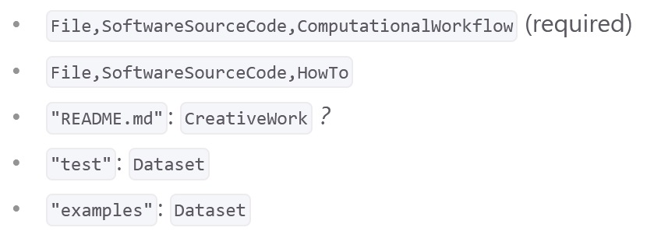


Unbounded Boundary Objects
Descriptive Profiles
Checklist-style typing
must, should, optionals
Mixed Objects
Data, Software, Documents…
Unbounded
External References
Unbounded
+ community vocabularies,
formats and standards
Notes:
Musts, Shoulds Optionals
prepare for more
Known and Unknown unknowns, One size does not fit all
descriptive openendedness , multi-interpretation
Personal story
How do I define a checklist of what is expected to be in a type of RO?
RO Crate Profile
Profile Library / Registry
Simple picture

Slide 24
Unbounded Boundary Objects
Descriptive Profiles
Checklist-style typing
must, should, optionals
Openendedness
Known knowns, known unknowns and unknown unknowns
Multi-interpretation
Interlinguia cross domains
Mixed profiles
Cross domains
Interpret what you care about
Unbounded
+ community vocabularies,
formats and standards
Notes:
Musts, Shoulds Optionals
prepare for more
Known and Unknown unknowns, One size does not fit all
descriptive openendedness , multi-interpretation
Personal story
How do I define a checklist of what is expected to be in a type of RO?
RO Crate Profile
Profile Library / Registry
Simple picture

Slide 25

Profiles: Unbounded Boundary Objects
Descriptive Profiles
Checklist-style typing
Data Cubes
Run
Unbounded
Profile portfolio
Testing
Notes:
Time for a Profile Registry!
Personal story
How do I define a checklist of what is expected to be in a type of RO?
RO Crate Profile
Profile Library / Registry
Simple picture

Slide 26
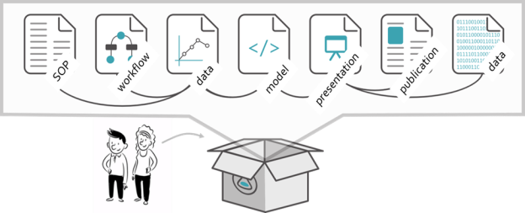
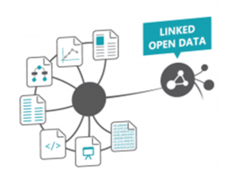
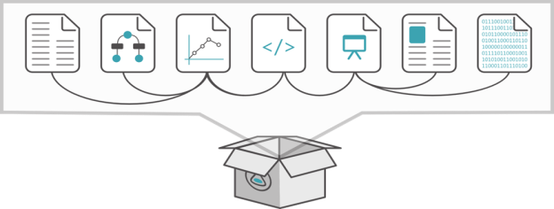
Self-describing Profiles using Just Enough Linked Data
A FAIR Knowledge Web of Research Objects
Descriptive Profiles
contextual entities + community vocabularies
and standards
Metadata Graph inside the RO-Crate
Contextual entities and PIDs connect to the outside world & other RO-Crates
Notes:
prepare for more
Known and Unknown unknowns, One size does not fit all
descriptive openendedness , multi-interpretation
Map across metadata
Threaded publications
Data Science on the Assets of Data Science
BOUNDARY OBJECTS
Recording & linking together the components of an experiment
Linking across experiments.
Linked Ros
No time for details
Don’t be constrained by what actually exists!!

Slide 27
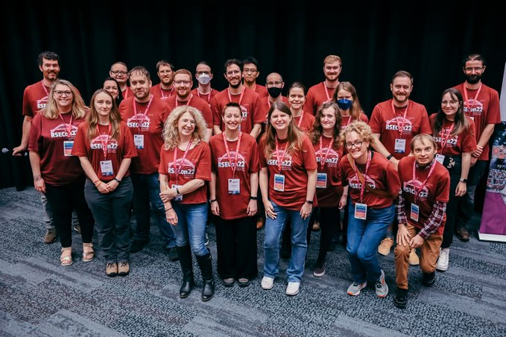
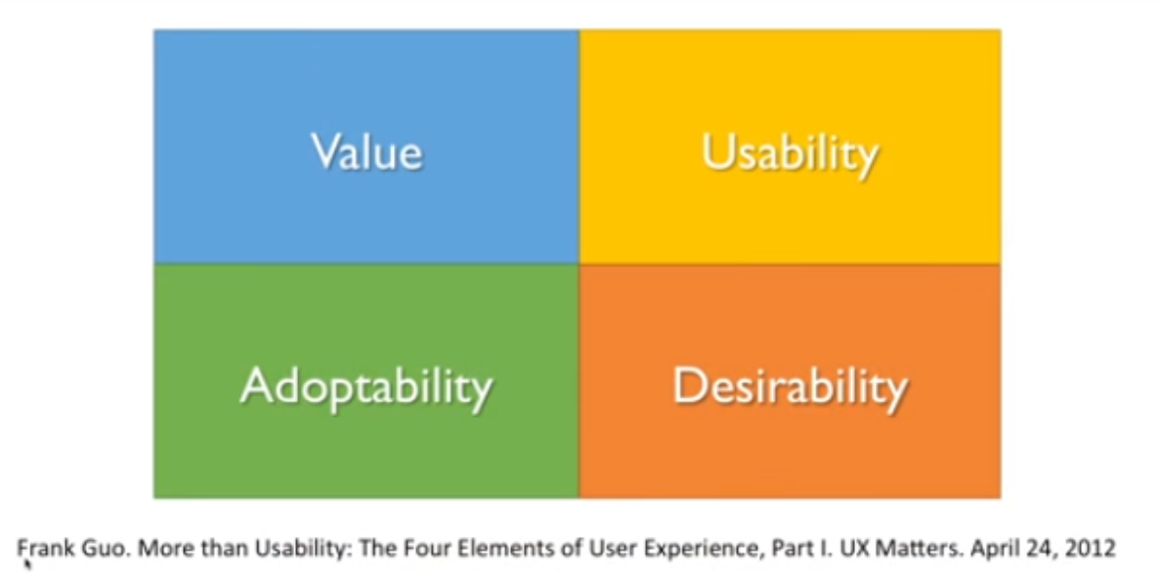
Developers Matter – this is Middleware!
RSECon 2022 – Research Software Engineers!
https://society-rse.org/

Slide 28
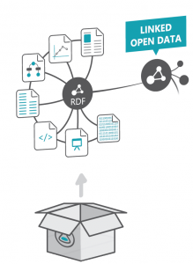
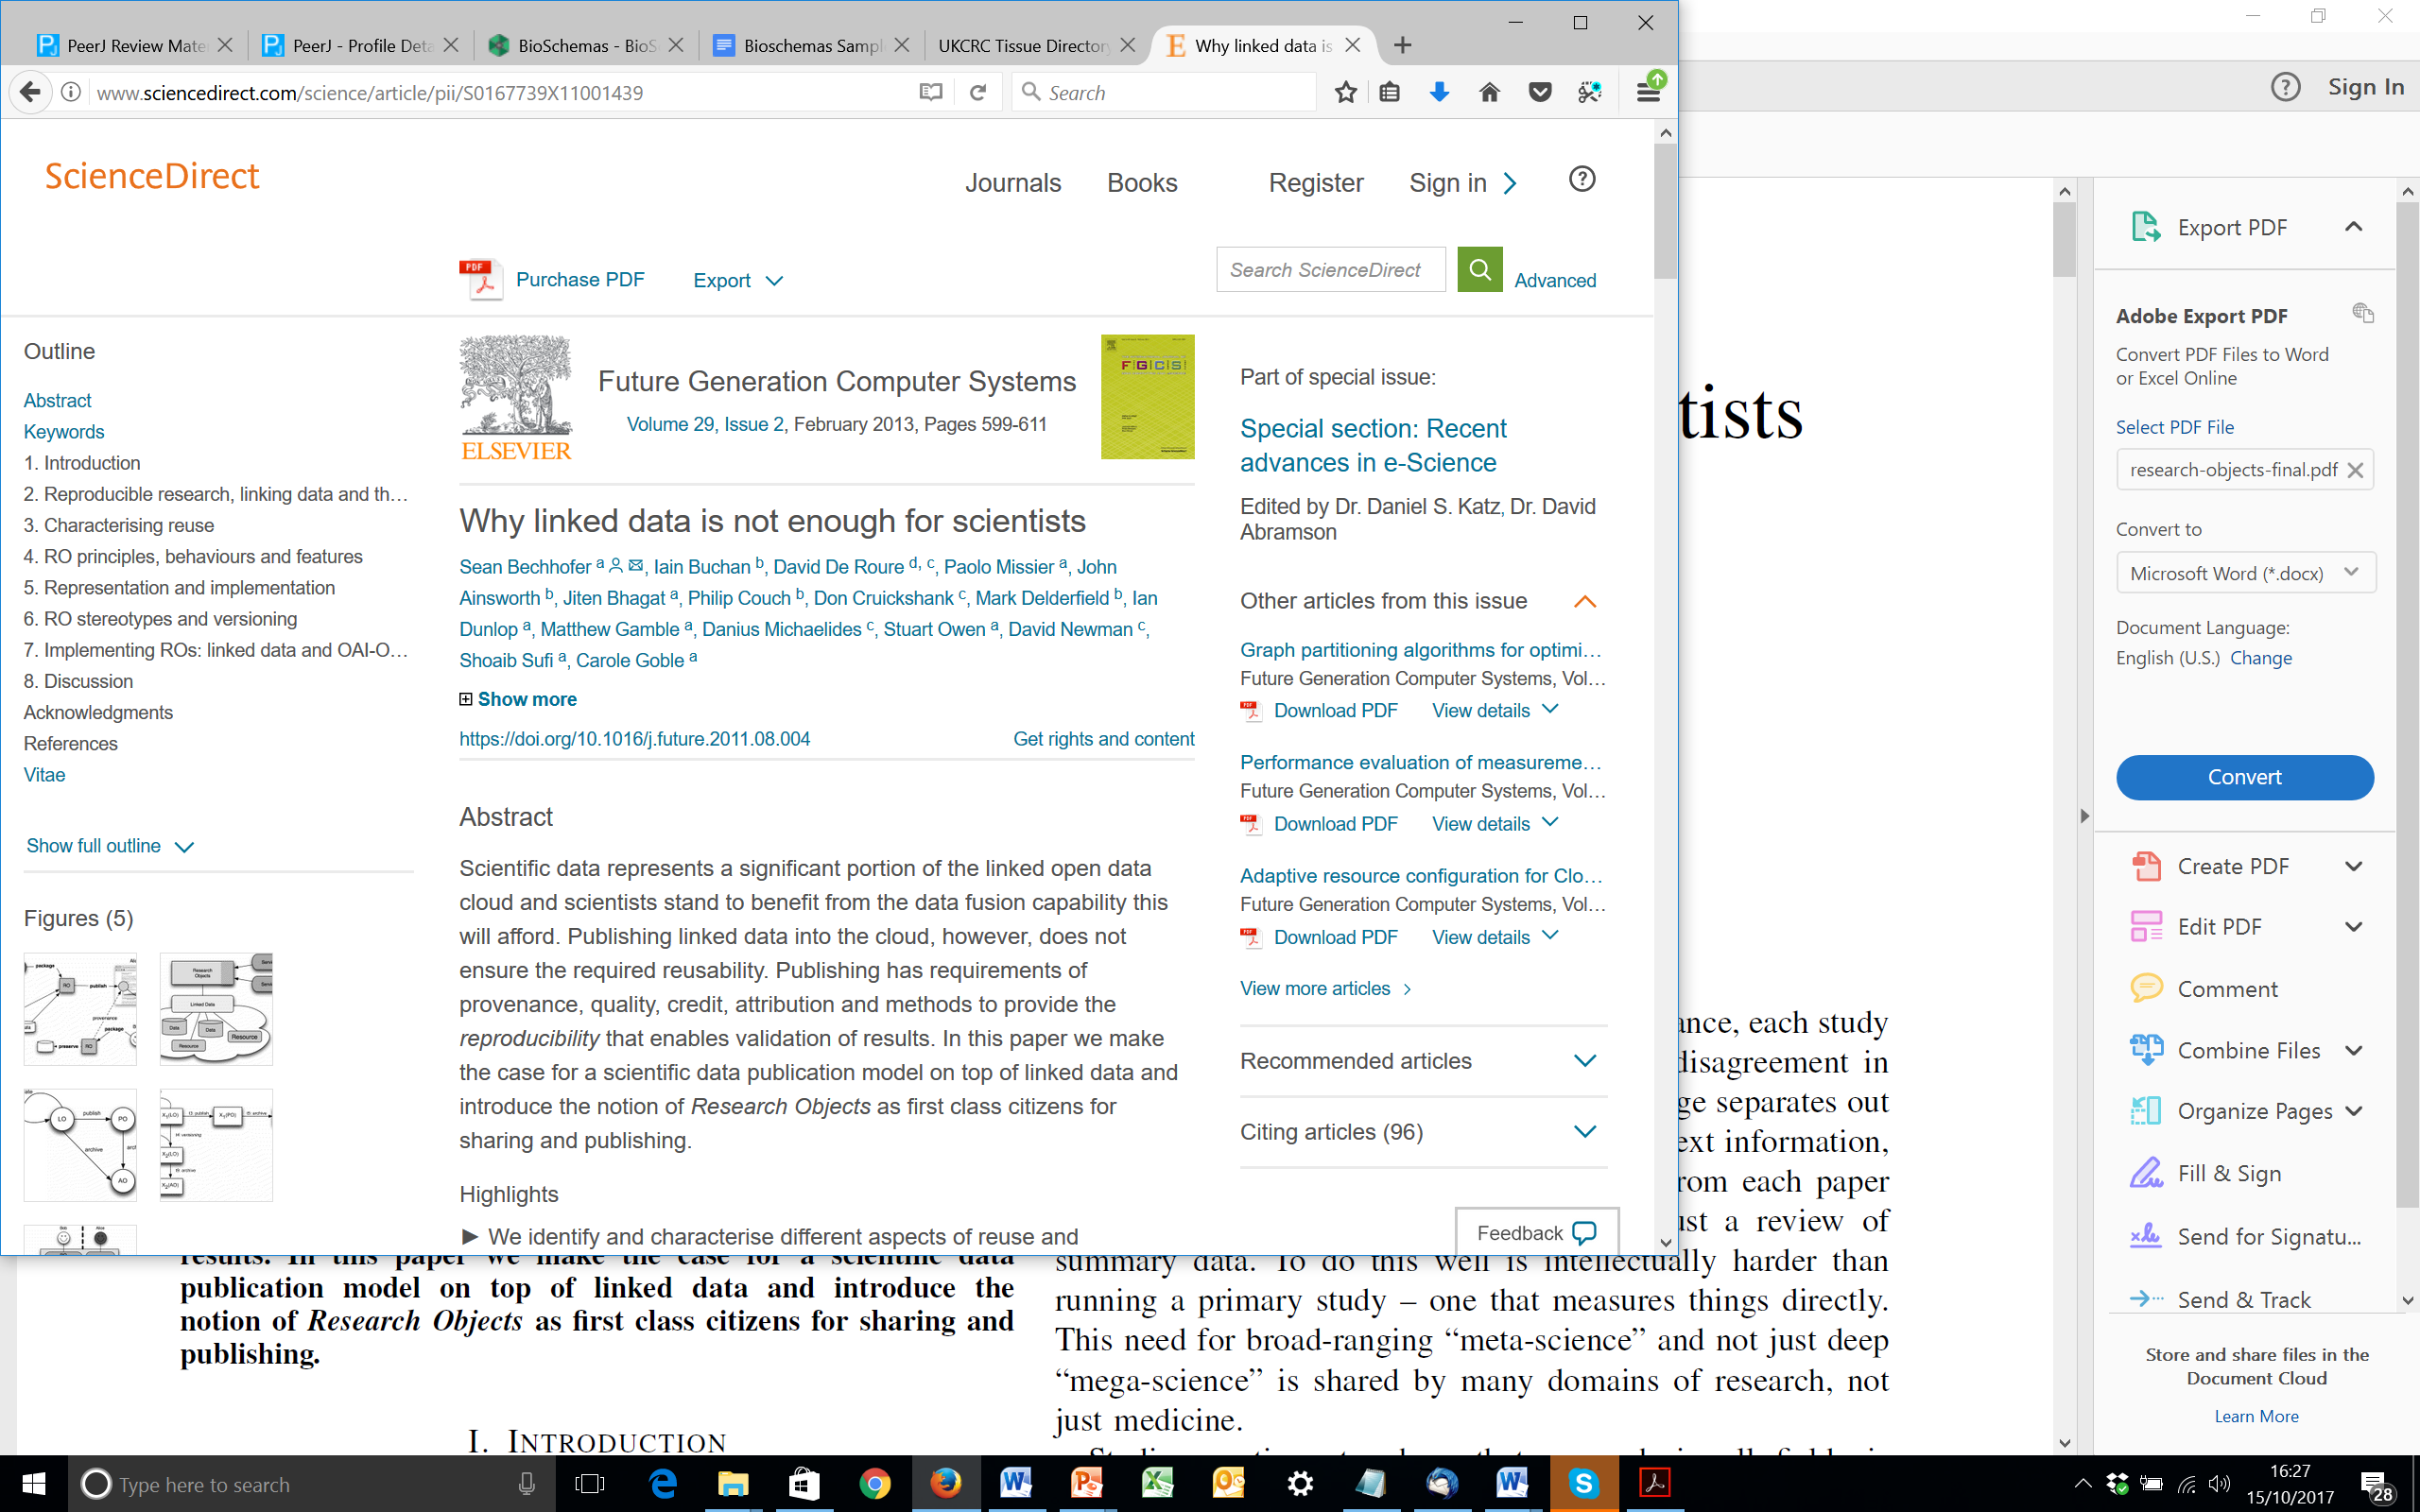
Developer Friendly??
ROs
rich RDF
stack
Mismash of ontologies combined together to describe metadata file
RDF Shapes
Represent profiles
Hard to make checklists
SHACL, ShEx
Notes:
Limited flexibility, fewer features
Opinionated guide to best practices
Documentation, examples
Libraries, tools
Community
"just enough complexity / standards”
sufficient extra benefits from what already exists…
…without compromising the developer entry-level experience so much that they rather do their own thing.
Simpler opinionated guide to best practices
Practical, lightweight robust
just enough just in time underware
Web native, off-the-shelf, Lo-Tek
Machine and human readable, search engine and developer friendly.
A little bit of semantics: JSON-LD and Schema.org
Usable: Limited flexibility, documentation, examples, libraries, tools, community
Cope with domain diversity and legacy: infrastructure independent, self-describing profiles, extensible with additional metadata and pre-existing ontologies – “duck typing”
fewer features
easier to understand, conceptually simpler
opinionated guide to current best practices
software stacks widely used on the Web

Slide 29
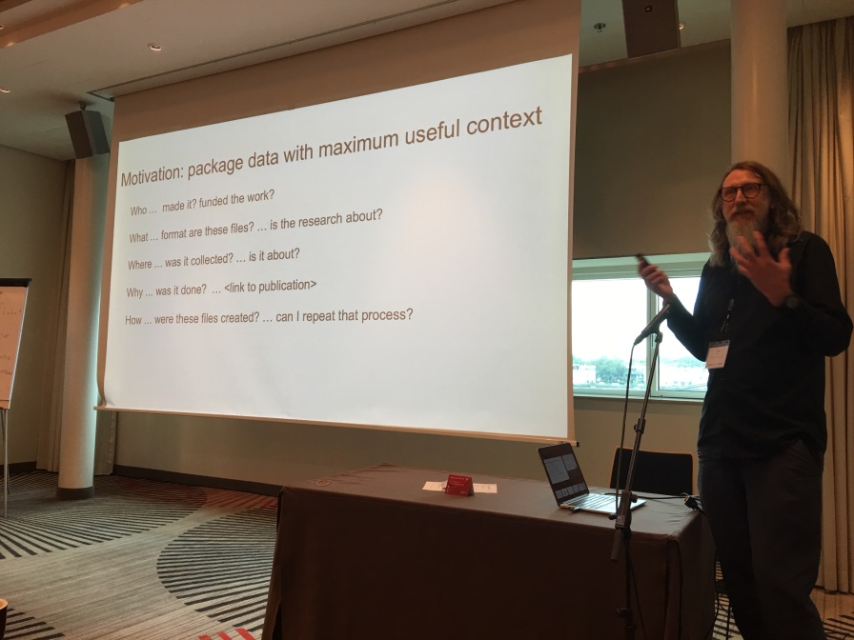
Developer Friendly
+
ROs
rich RDF
stack
DataCrate simple web stack
Peter Sefton
sufficient extra benefits from what already exists…
…without compromising the developer entry-level experience so much that they rather do their own thing.
Semantic Web world vs Real World
Open Repositories & Dig Lib Community
Notes:
Limited flexibility, fewer features
Opinionated guide to best practices
Documentation, examples
Libraries, tools
Community
"just enough complexity / standards”
sufficient extra benefits from what already exists…
…without compromising the developer entry-level experience so much that they rather do their own thing.
Simpler opinionated guide to best practices
Practical, lightweight robust
just enough just in time underware
Web native, off-the-shelf, Lo-Tek
Machine and human readable, search engine and developer friendly.
A little bit of semantics: JSON-LD and Schema.org
Usable: Limited flexibility, documentation, examples, libraries, tools, community
Cope with domain diversity and legacy: infrastructure independent, self-describing profiles, extensible with additional metadata and pre-existing ontologies – “duck typing”
fewer features
easier to understand, conceptually simpler
opinionated guide to current best practices
software stacks widely used on the Web

Slide 30

Developer Friendly, Problem Driven
simplifications rather than generalisations
fewer features, more directed
easier to understand, conceptually simpler
opinionated guide to current best practices
constrained and predictable but not too cumbersome to work with
retain just enough linked data for benefits
querying, vocabularies, clickable URIs,
knowledge graphs
with all the stuff developers need
documentation, examples, libraries, tools
+
ROs
rich RDF
stack
DataCrate simple web stack
Adoptability!!!!
Notes:
Need a format that is constrained and predictable but not too cumbersome to work with
software stacks widely used on the Web
Limited flexibility, fewer features
Opinionated guide to best practices
Documentation, examples
Libraries, tools
Community
"just enough complexity / standards”
sufficient extra benefits from what already exists…
…without compromising the developer entry-level experience so much that they rather do their own thing.
Simpler opinionated guide to best practices
Practical, lightweight robust
just enough just in time underware
Web native, off-the-shelf, Lo-Tek
Machine and human readable, search engine and developer friendly.
A little bit of semantics: JSON-LD and Schema.org
Usable: Limited flexibility, documentation, examples, libraries, tools, community
Cope with domain diversity and legacy: infrastructure independent, self-describing profiles, extensible with additional metadata and pre-existing ontologies – “duck typing”
fewer features
easier to understand, conceptually simpler
opinionated guide to current best practices
software stacks widely used on the Web

Slide 31
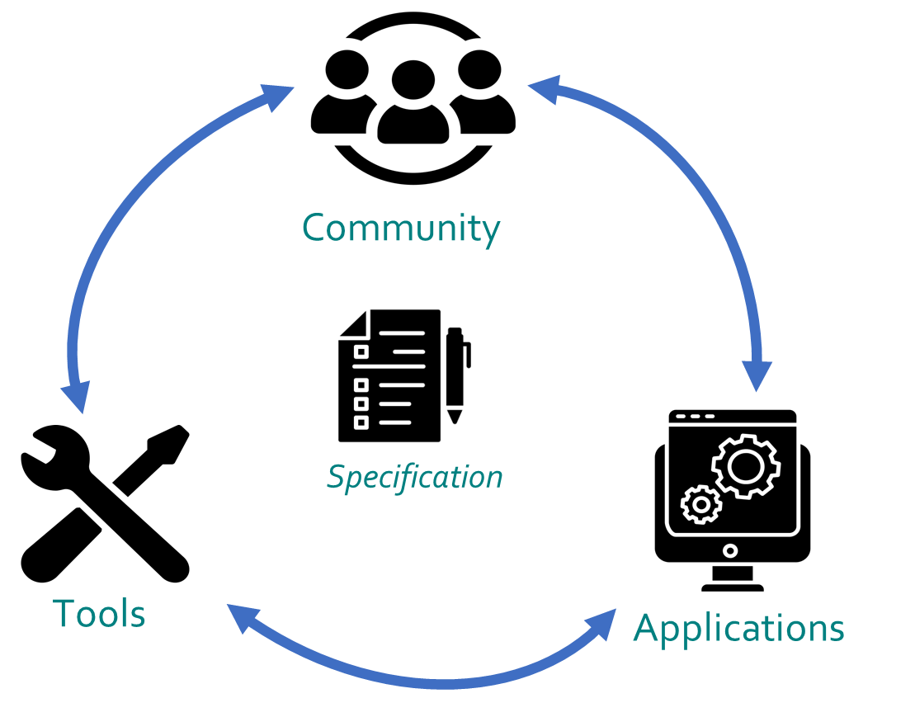






Developer Friendly, Tool development
Infrastructure facing
Software libraries
Contact: andreas.pfeil@kit.edu
https://www.npmjs.com/package/ro-crate
https://github.com/ResearchObject/ro-crate-ruby
https://pypi.org/project/rocrate/
https://github.com/kit-data-manager/ro-crate-java
Packaging research artefacts with RO-Crate. Data Science https://doi.org/10.3233/DS-210053
RO-Crate Specification 1.1
https://w3id.org/ro/crate/1.1
Notes:
Now lets have some applications. Infrastructure facing, user facing
https://github.com/e11938258/RO-Crates-and-Excel

Slide 32
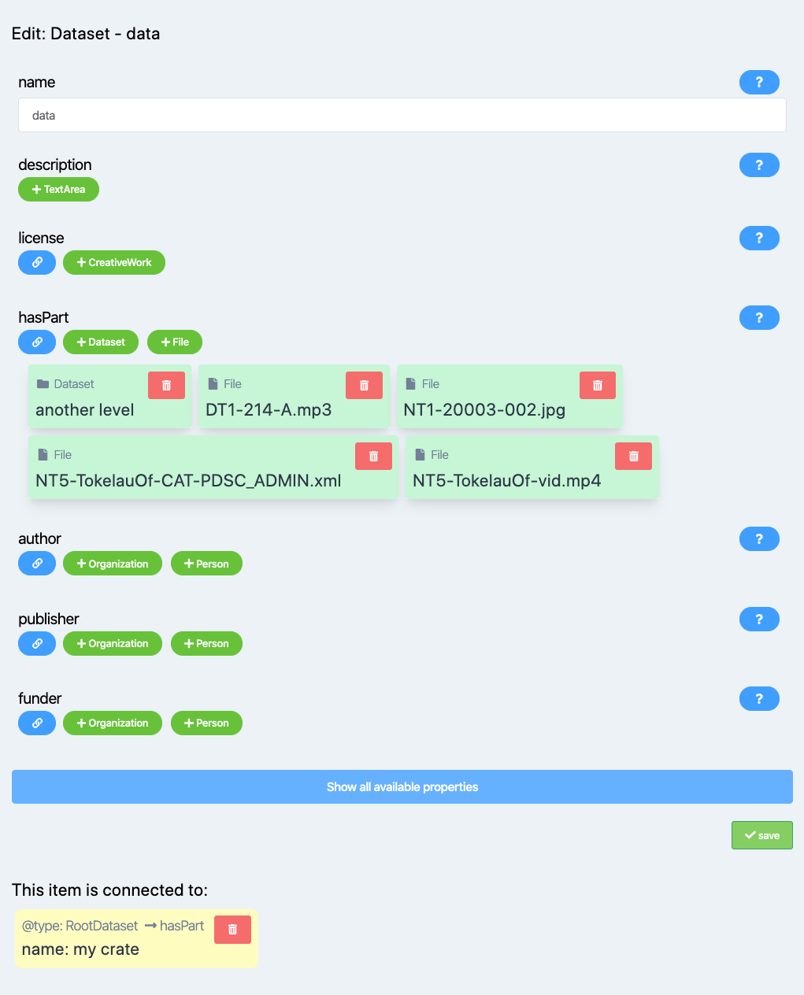
Developer Friendly, Tool development
User Facing
Describo
Packaging research artefacts with RO-Crate. Data Science https://doi.org/10.3233/DS-210053
https://uts-eresearch.github.io/describo/
Notes:
Now lets have some applications. Infrastructure facing, user facing
https://github.com/e11938258/RO-Crates-and-Excel
Use cases – cross cutting and then examples….
Not a shopping list
(stian has this somewhere…)
And tools
Look at the skype and minutes
RSECon examples

Slide 33

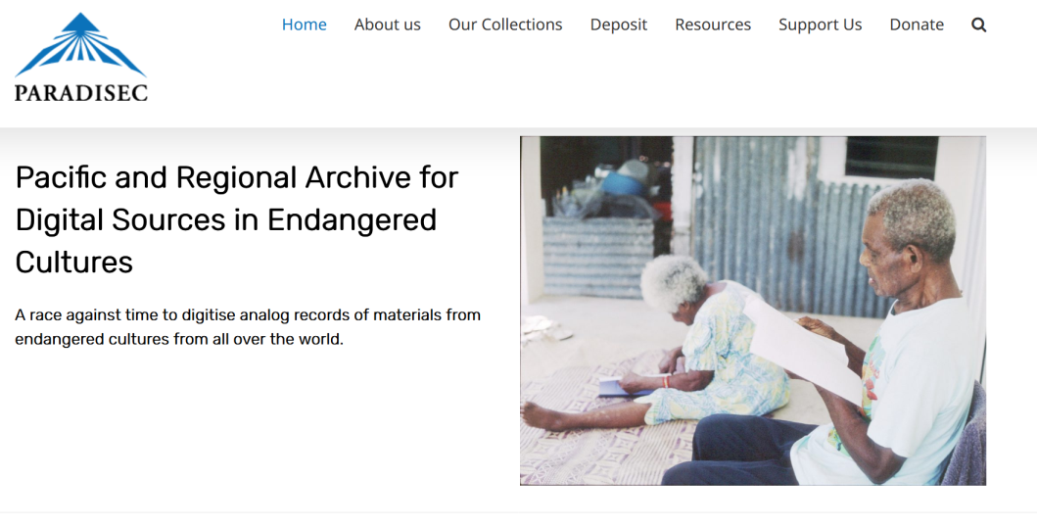


FAIR Research Data Packaging
Repositories & registries
A data curation service for endangered languages: 500K+ files, 28K+ items, 574 collections
Submission / download
Exchange between repositories
Mixed objects
Search metadata
Aggregate data collections
Archiving and accessibility
Mixed artefacts, mixed metadata
Peter Sefton, Marco La Rosa
Ana Trisovic

Slide 34
Back to BioConnect ….
+
+
Packaging
Structure
File type defs for tabular data
RO-Crate
ISA format
Frictionless data
Abigail Miller
https://zenodo.org/record/7116702#.YzinYLTMKF4
Notes:
Need a format that is constrained and predictable but not too cumbersome to work with
Large data files
Include files under 10MB
Still potential to produce packages that are too large to download
Efficient metadata structure
Animals, samples, data files could be redundant under multiple nodes
File type definitions
How to represent contents and structure of data files

Slide 35
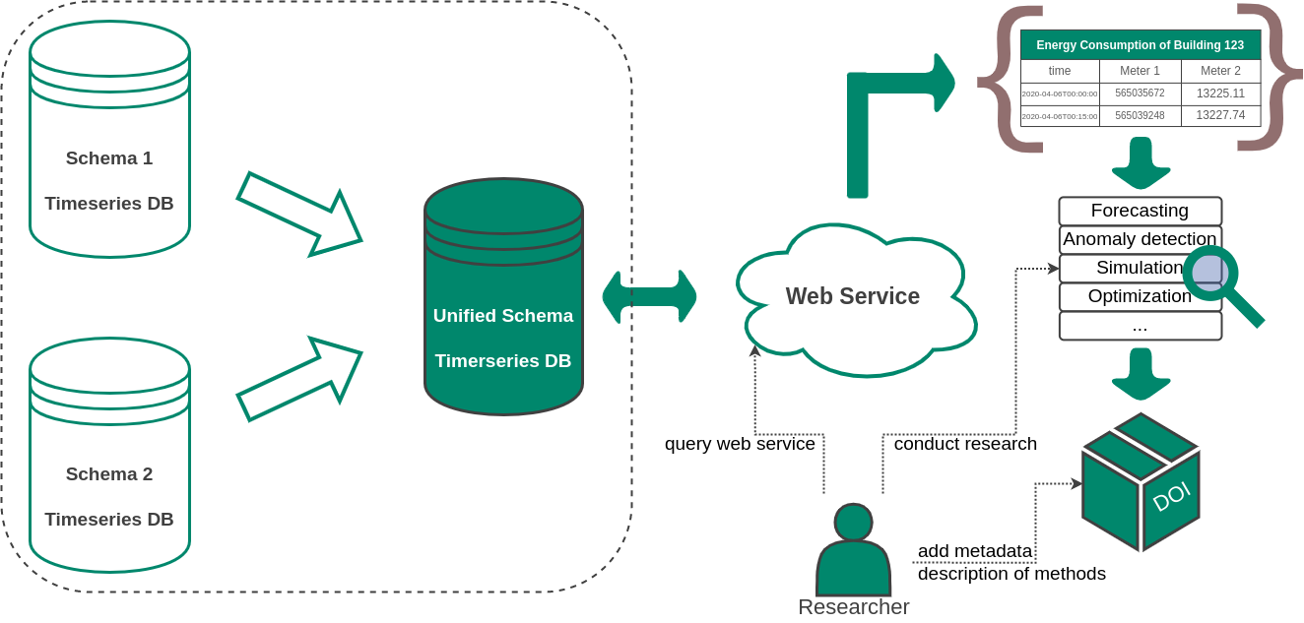

Exporting data using an interchange format
HMC Hub Energy
Time series data from different databases exported with metadata description of their structure and content into a single web service
Web service using
ro-crate-java
Data file format: CSV
LD-Vocabularies: RO-Crate Context, QUDT, CSVW
Jan Schweikert - Institute for Automation and Applied Informatics
Notes:
Requirement: Service to export data into an interchange format
providing: a list of buildings & a list of energy carriers and a timespan
result: file(s) with metadata description of their structure and content

Slide 36

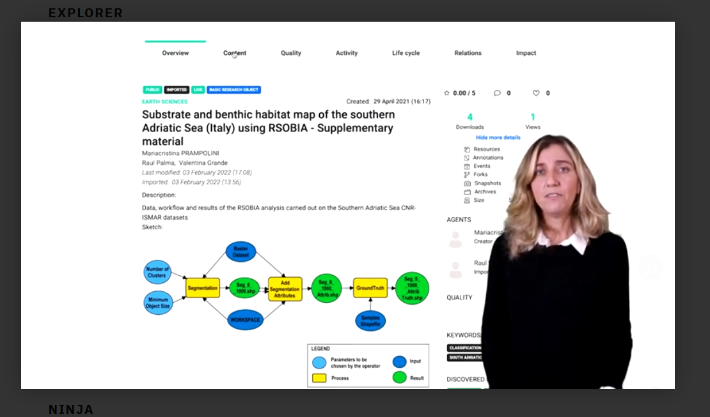

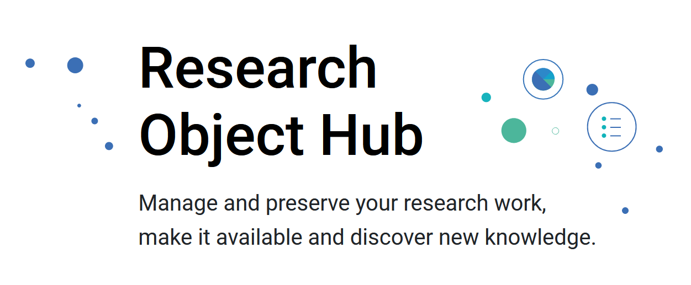
EOSC, Copernicus, Earth Science
RO-Crate + Data Cubes
Mixed object sharing
Reproducibility
https://youtu.be/Rsuxn0m4bIM
https://www.reliance-project.eu/
Raul Palma, Oscar Corcho, Daniel Garijo
Notes:
Combining RO-Crate with data schemas
Tabular: Frictionless Data, Data Cubes, CSV file, Excel
2800 ROs in the Hub

Slide 37

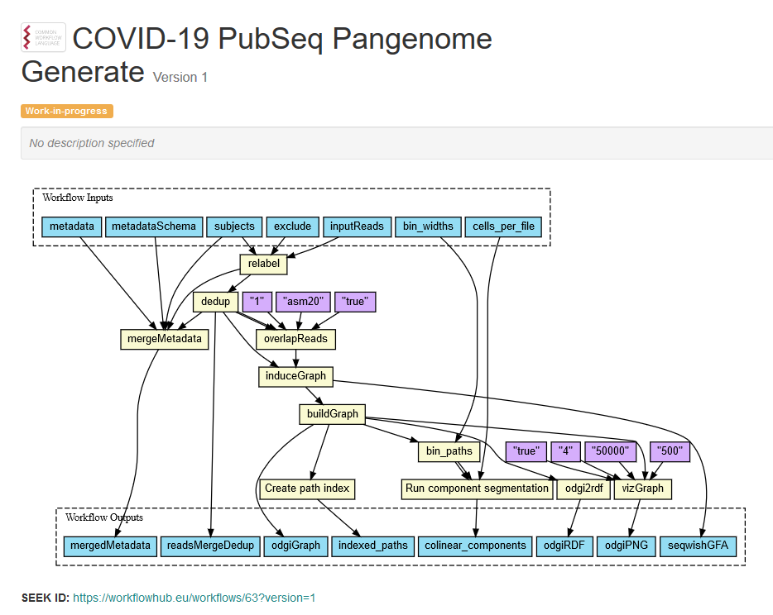
Computational Workflows
Packaging workflow files & companion objects
Notes:
Galaxy: https://github.com/galaxyproject/galaxy/pull/14606 - there's a video of the RO-Crate/BCO export there

Slide 38




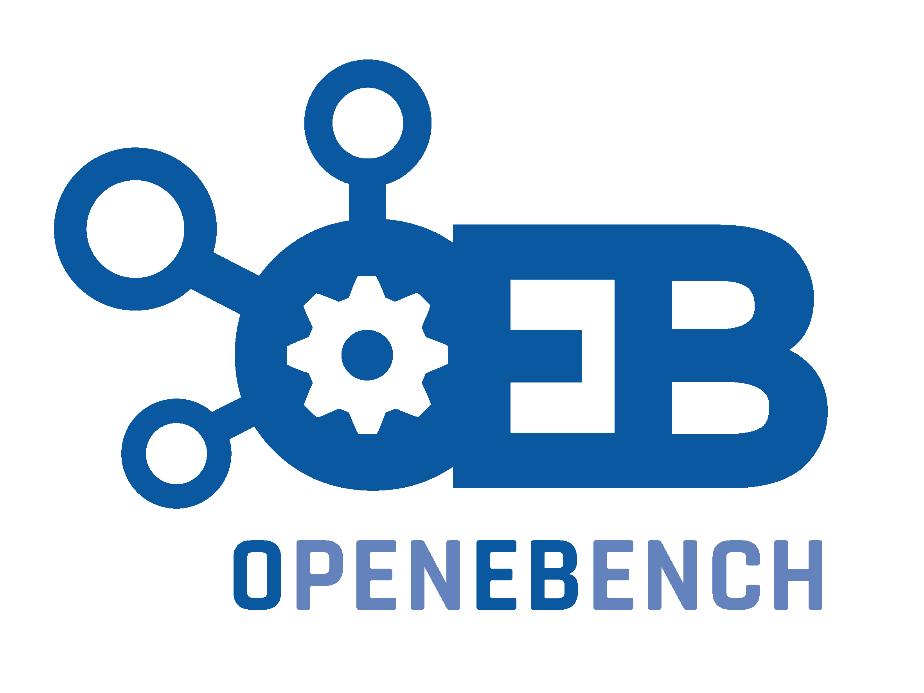
Computational Workflows
Packaging workflow files & companion objects
Submission / download
Exchange between services and systems
Reproducibility
Citation
Notes:
Galaxy: https://github.com/galaxyproject/galaxy/pull/14606 - there's a video of the RO-Crate/BCO export there

Slide 39
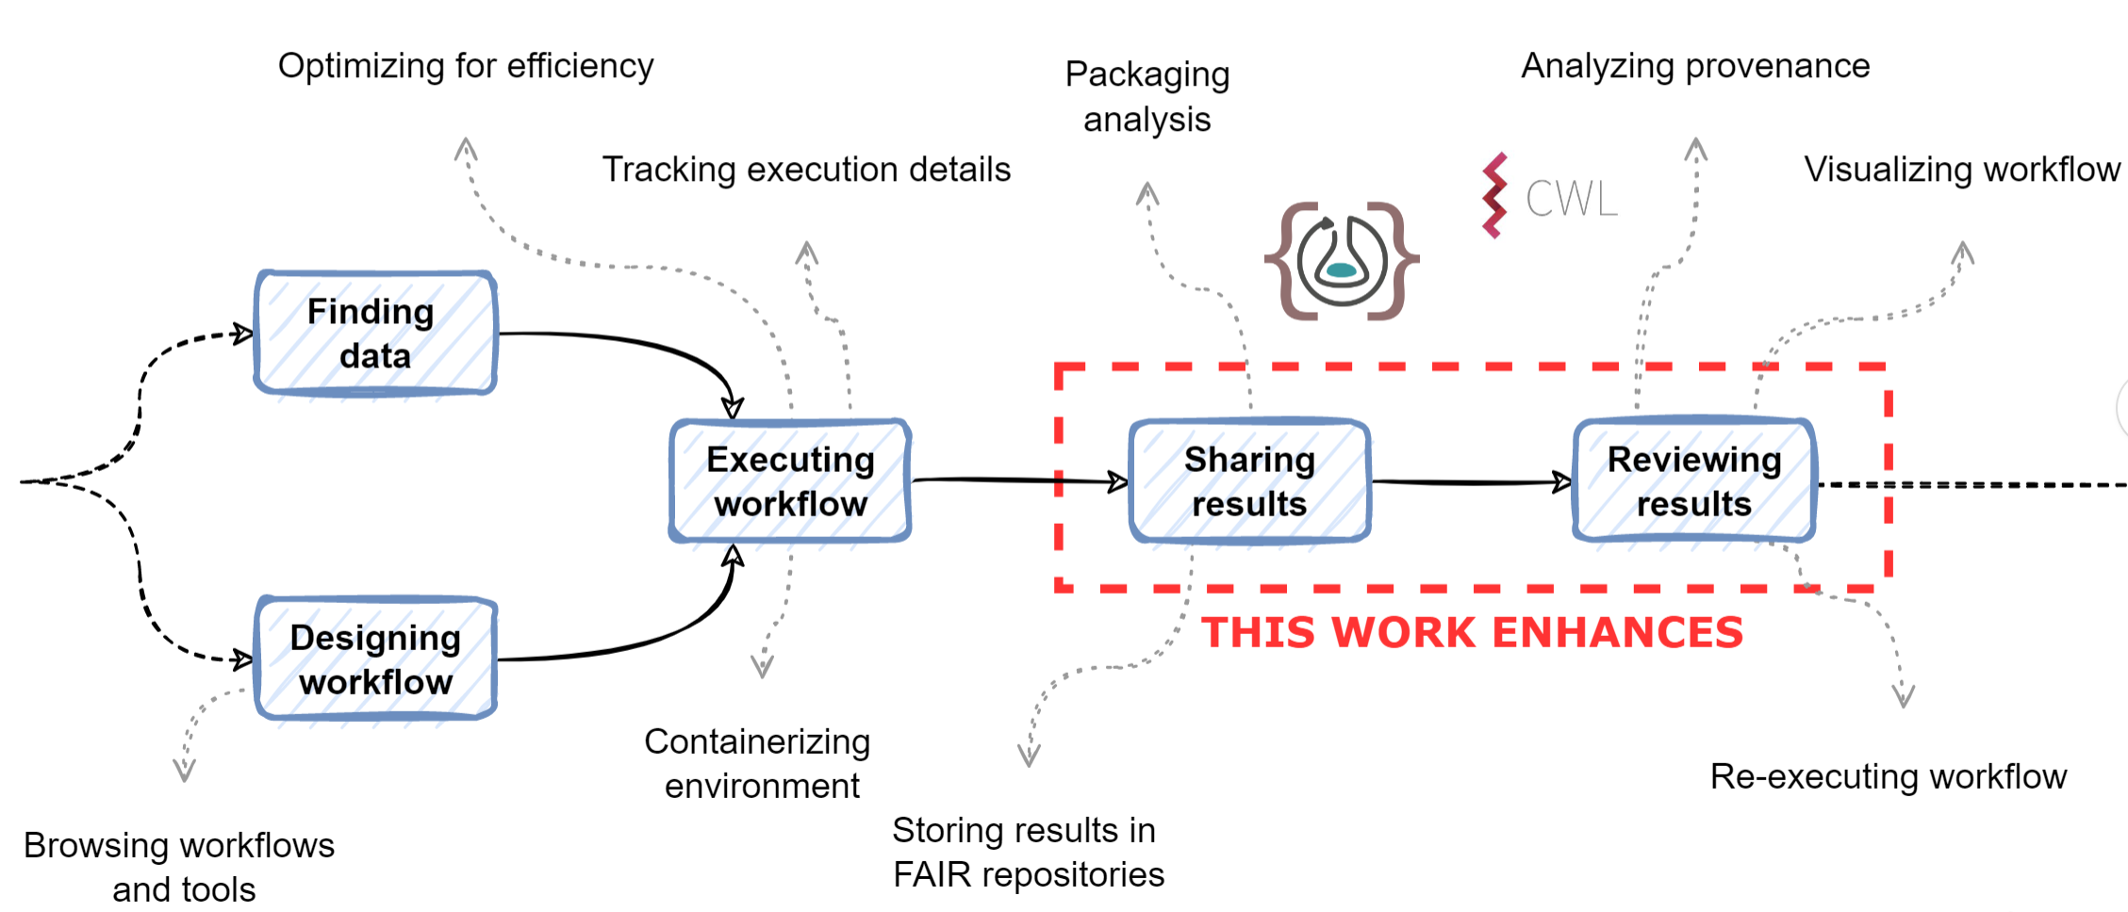

Data provenance collection and
Pipeline Provenance Packaging
Renske de Wit
PROV
CWLPROV
2022-09-27 Renske de Wit: A Non-Intimidating Approach to Workflow Reproducibility in Bioinformatics
Simone Leo
https://www.researchobject.org/workflow-run-crate/
https://www.researchobject.org/ro-crate/1.1/provenance

Slide 40
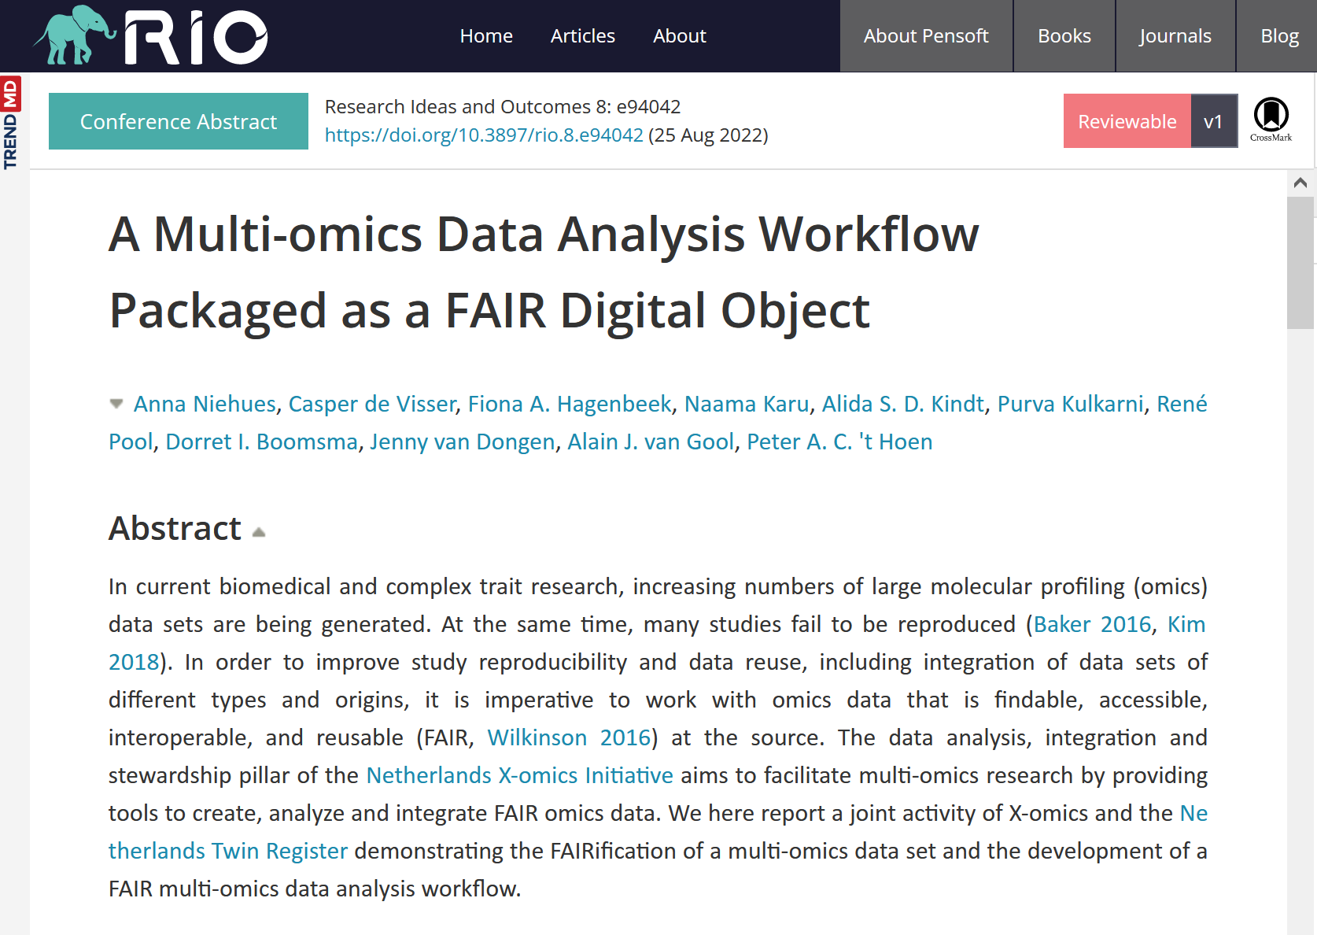
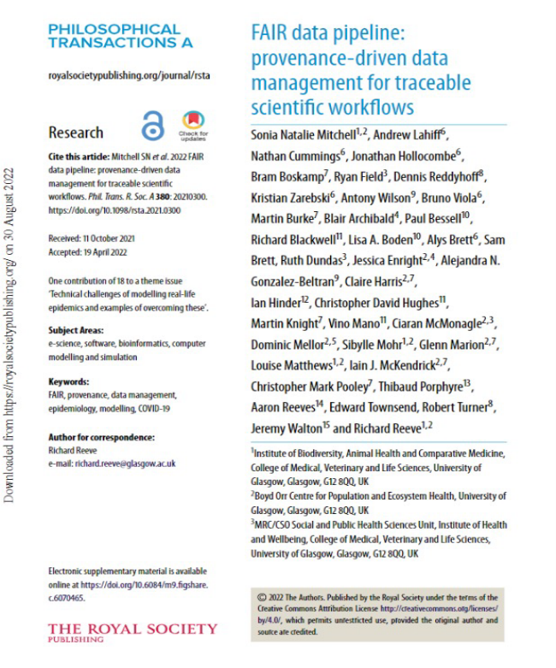
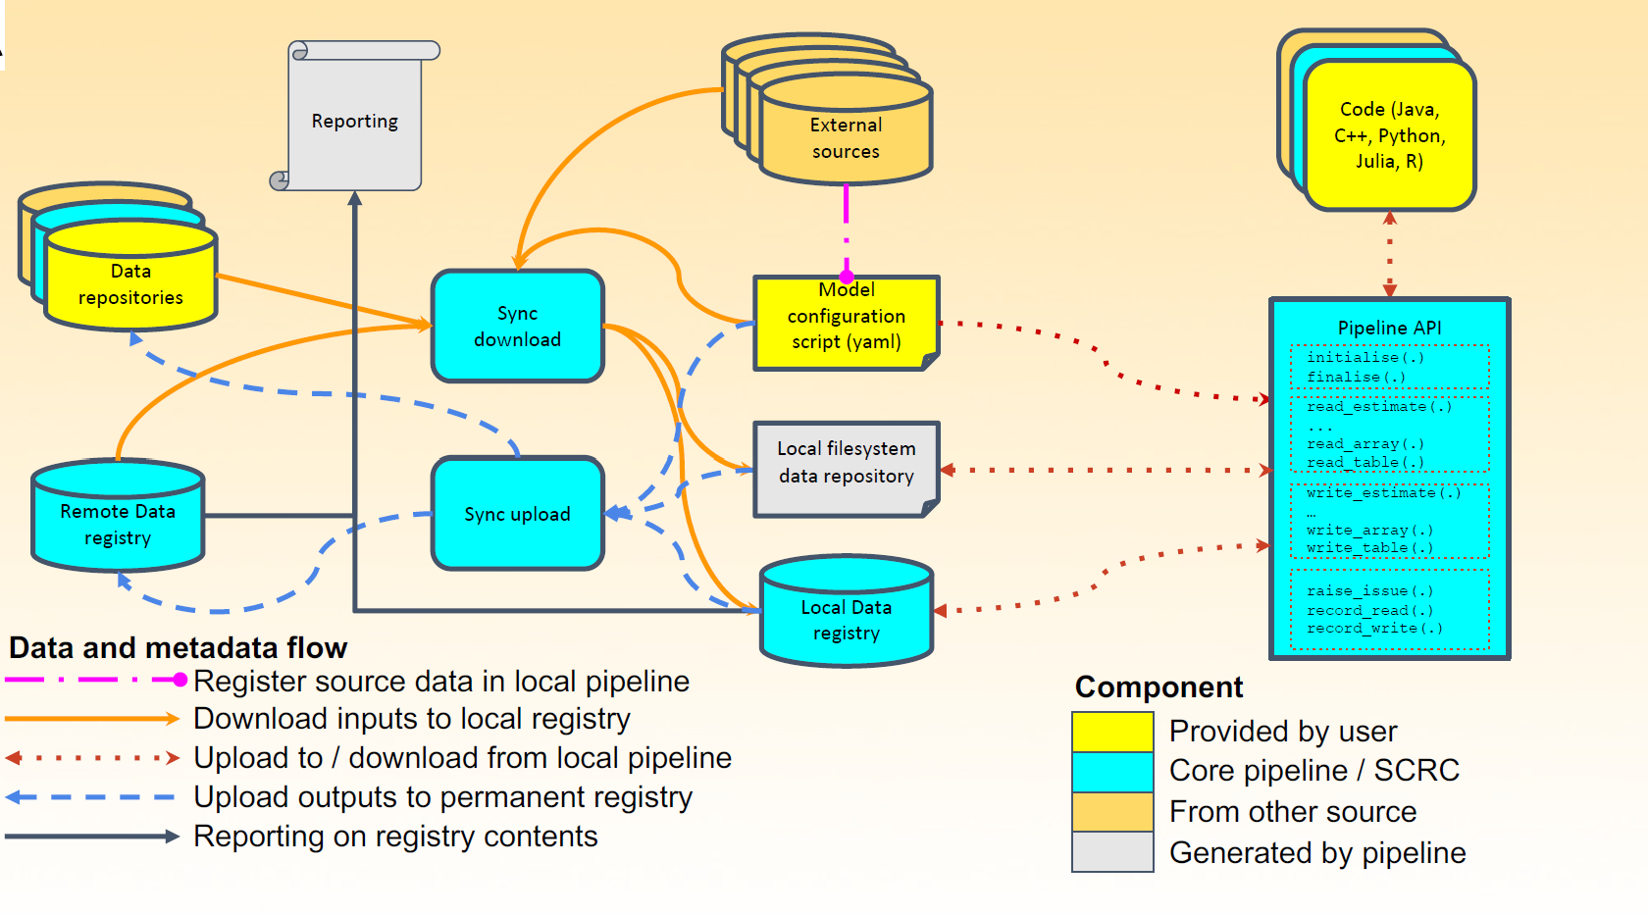
Workflow, results and traceable provenance packaging,
FAIR Research Objects
Human Infectious Disease Modelling
https://doi.org/10.1098/rsta.2021.0300
Netherlands X-omics Initiative
https://riojournal.com/article/94042/
Notes:
These are not in our inner circle
RIO- it’s a nextflow object in an RO-Crate

Slide 41
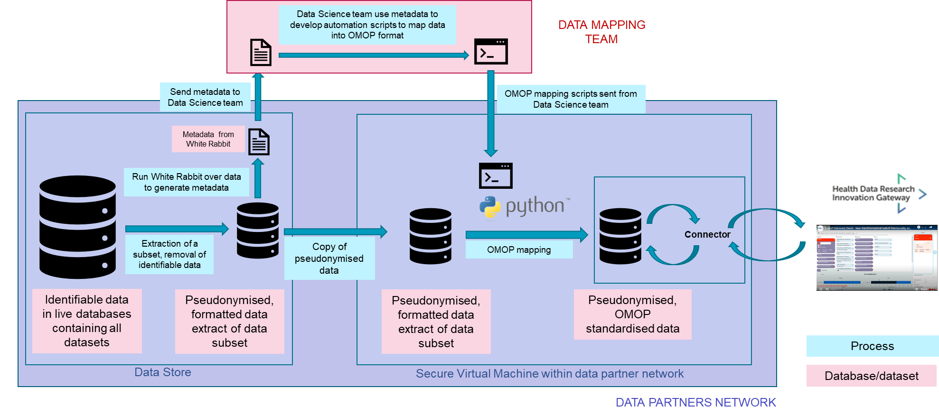

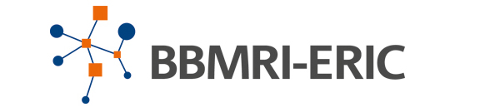

Federated Pipelines & Provenance Packaging
Federated analytics, distributed research pipelines, over Trusted Research Environments for sensitive data
Controlled access to sensitive data
Exchange between data platforms
Reporting & sharing pipelines
Reporting results & provenance
Common Provenance Model handoffs between different orgs
OMOP mapping pipelines
Tom Giles, Rudolf Wittner
Notes:
Local data to OMOP transformation pipelines.
Data connectors for secure healthcare environments.
Results and provenance collection for Federated Analytics.
Controlled access to sensitive data.
The Common Provenance Model (CPM) is created to document distributed research pipelines – where each step of the pipeline is performed independently by a different organization or organizational unit. An example could be from the digital pathology domain, where the beginning of the pipeline starts by biological sample acquisition at a hospital, continues through sample processing and data generation in a laboratory, and ends with data processing and AI model training at a research infrastructure.
distributed research pipelines & federated analytics
CARROT - Rapid OMOP Transformer - By capturing metadata, contextual and providence information we hope to make it easier for researchers to access the information about resources required to build federated analytics queries
We are developing a tool to help data partners transform their data to OMOP (CaRROT) and an open-source data connector for deployment in secure healthcare environments (HUTCH)
OMOP transformation and Federated Analytics across TREs
HUTCH is being developed from the perspective of an infrastructure layer
to allow it to talk to lots of different data formats and query portals
The HUTCH internal transfer language is built on a RO-Crate schema.org model
This ensures interoperability whilst also potentially making machine discoverable the metadata, structure, history, authorship and provenance of data resources
https://github.com/HDRUK/hutch
https://github.com/HDRUK/CaRROT-Mapper

Slide 42
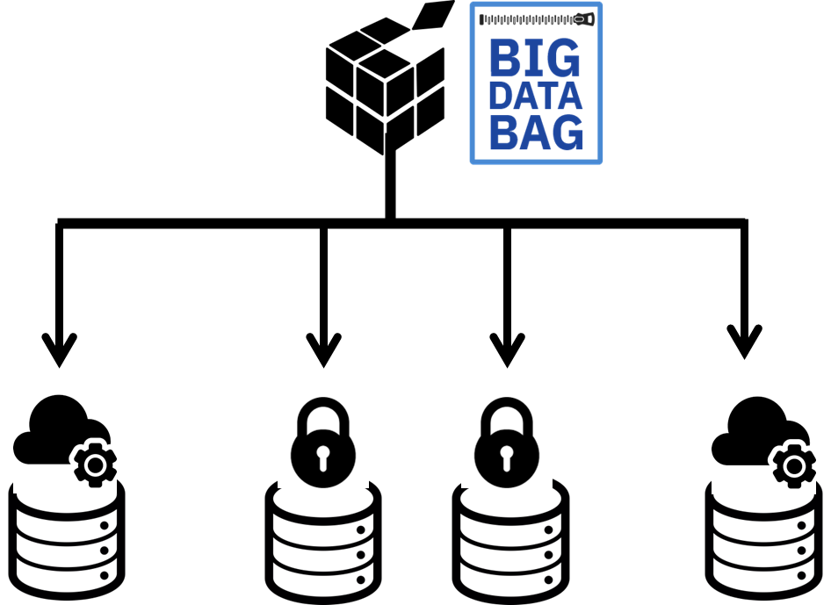

Handling big & sensitive data
Scalable collections of references while data stays at host
Big genomic & clinical data, images etc,
distributed over multiple locations.
Retain & archive processed datasets
Reference & transfer large data on demand
Controlled access
Moving data between archives
Ravi Madduri, Kyle Chard, Carl Kesselman, Ian Foster
https://doi.org/10.1109/BigData.2016.7840618
Notes:
Madduri, R., Chard, K., D'Arcy, M., Jung, S. C., Rodriguez, A., Sulakhe, D., Deutsch, E., Funk, C., Heavner, B., Richards, M., Shannon, P., Glusman, G., Price, N., Kesselman, C., & Foster, I. (2019). Reproducible big data science: A case study in continuous FAIRness. PloS one, 14(4), e0213013. https://doi.org/10.1371/journal.pone.0213013
RO-Crate and bioimage data – for packaging, moving between archives and for archiving while data stays at its host

Slide 43
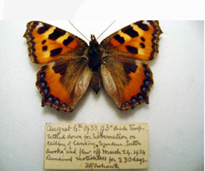
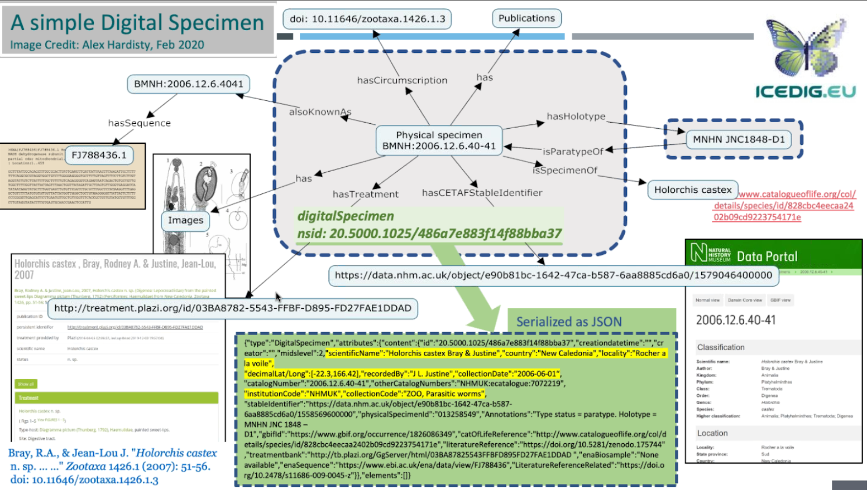


Biodiversity Digital Objects and Digital Twinning
Digital Surrogate FAIR Digital Object
Bags of references
predicting biodiversity dynamics
courtesy of Alex Hardisty, Dimitris Koureas
Hardisty et al (2022): The Specimen Data Refinery: A Canonical Workflow Framework and FAIR Digital Object Approach to Speeding up Digital Mobilisation of Natural History Collections. Data Intelligence 4(2): 320–341.
https://doi.org/10.1162/dint_a_00134
https://biodt.eu/

Slide 44


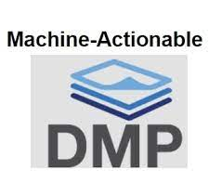
Lots of stuff needs packaging + metadata …
Conversational Survey results
https://coneytoolkit.cefriel.it/10.4126/FRL01-006429412
Mario Scrocca, Irene Celino
Package citations, citing 1000s of datasets
Shelley Stall, Chris Erdmann,
Christine Kirkpatrick
Deb Agarwal
GhaithArf/ro-crate-rda-madmp-mapper
10.4126/FRL01-006423291
https://data.agu.org/DataCitationCoP/
10.1002/essoar.10509966.1
Tomasz Miksa
Notes:
Machine-actionable data management plans can be used to generate template RO-Crates, as demonstrated by Tomasz Miksa - or indeed the other way, from an exemplary RO-Crate to generate a maDMP template. We will work on this in ELIXIR Biohackathon.
AGU mass citations…
Cefriel and Survey Ontology …

Slide 45

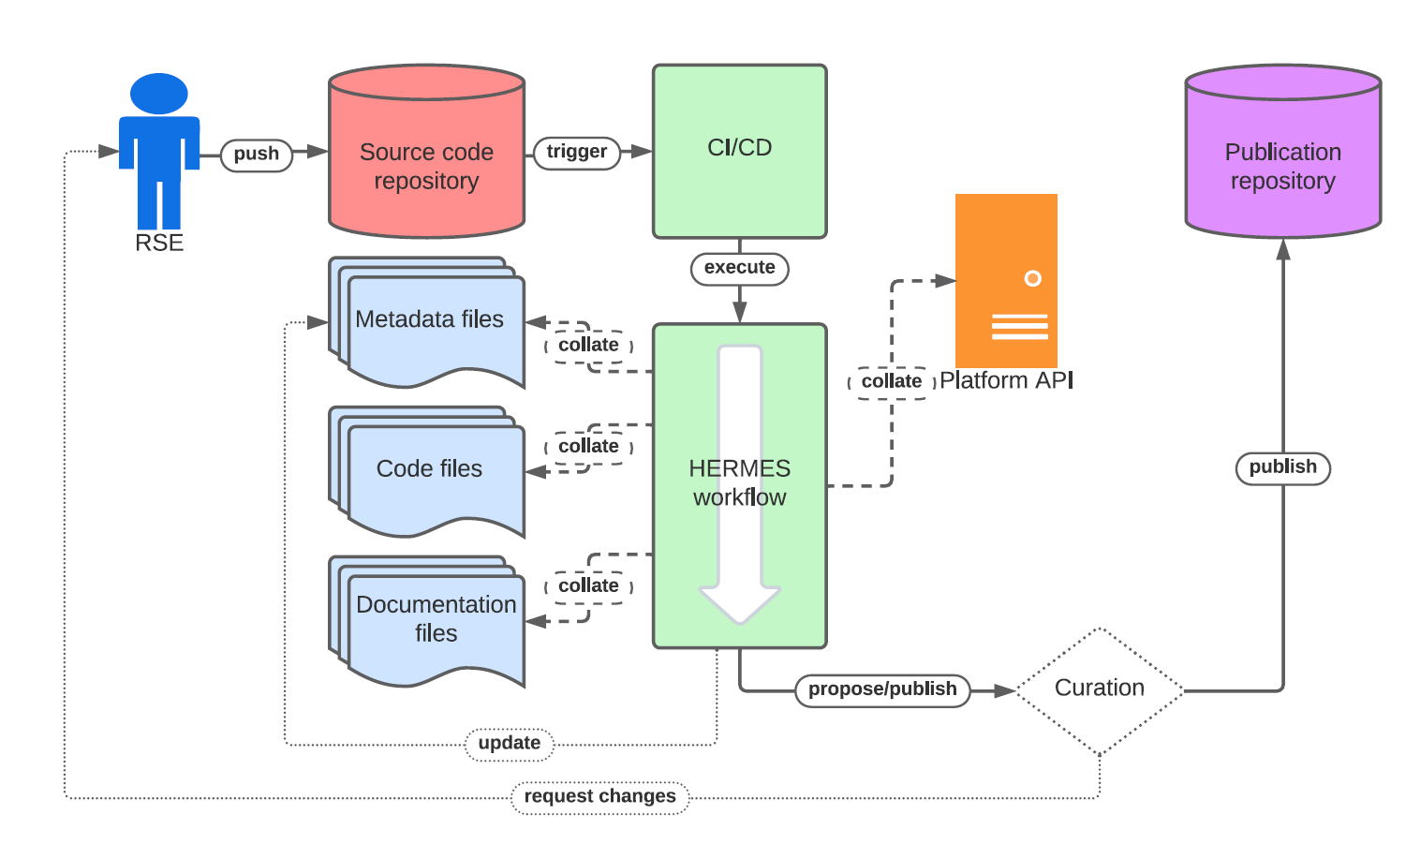
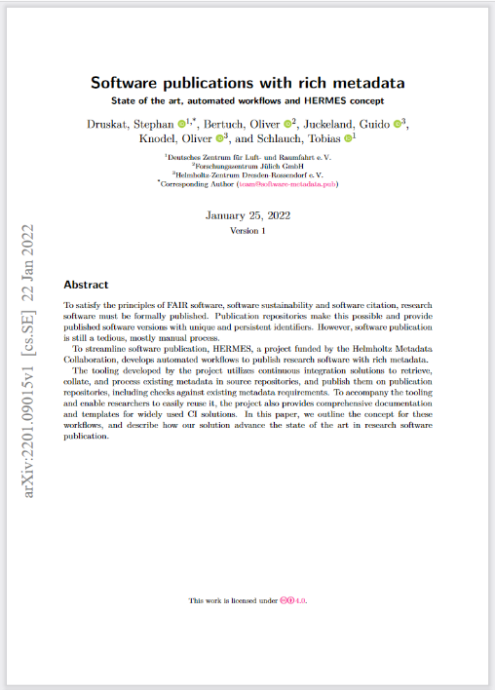

Back to Mixed Object Publishing …
HERMES Helmholtz Rich Metadata Software Publication
Druskat, S., Bertuch, O., Juckeland, G., Knodel, O., & Schlauch, T. (2022). Software publications with rich metadata: state of the art, automated workflows and HERMES concept. ArXiv, abs/2201.09015.
https://virtual.oxfordabstracts.com/#/event/public/3101/submission/110
Notes:
Gigascience
Publishing
Go back the bridging between science and scholarship….

Slide 46
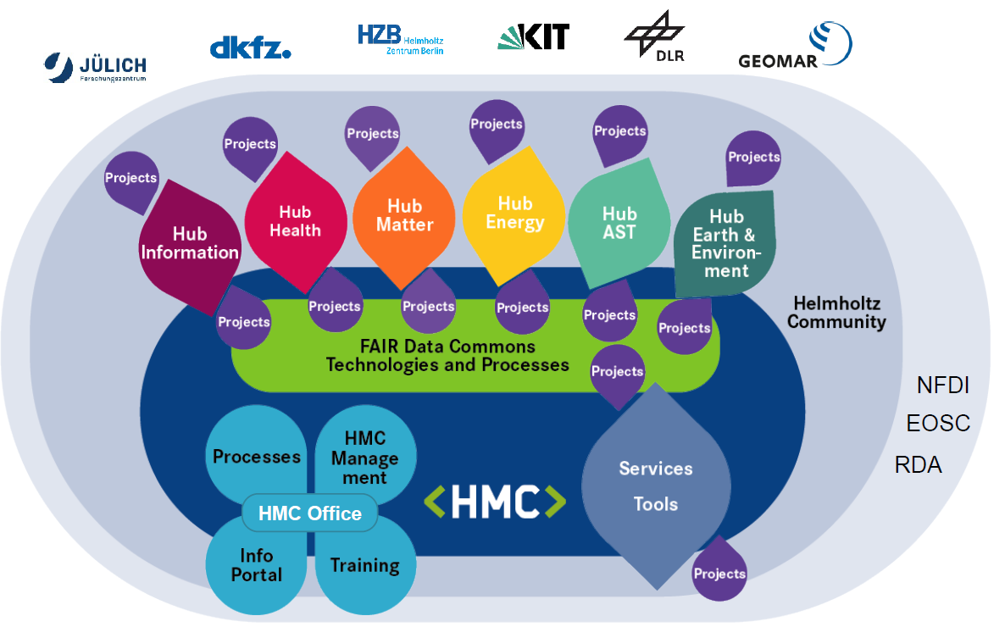
FAIR Data Commons
Testbed for
FAIR Digital Objects and
RO-Crate
Courtesy: Sören Lorenz, Stefan Stanfed
https://helmholtz-metadaten.de/en/fair-data-commons/overview

Slide 47

So a little bit of packaging goes a long way…
Platform independent exchange between repositories and services
Transfer collections of secure distributed datasets
Describe, export and archive data collections, datasets, pipelines/workflows with their metadata
Citation aggregation
Reproducibility, connect data with tools
Provenance collection
Mixed object publication
FAIR Digital Objects
Notes:
Import, record, and curate study metadata
Perform searches on metadata to find relevant data
Export data with their metadata
Connect data with tools
RO-Crate preserves metadata and the objects – workflow, data, datasets, whatever…
Archive/republish independent of repository
Move content from one repository / registry / services to another
Point to and cite content and don’t move it
Recording & sharing reproducible results & methods

Slide 48




FAIR Digital Objects …. Two Takes
The Principles
The FDOF Forum
Find, Access
Interoperate, Reuse
RO-Crate support of principles and adherence to the principles.
FAIR assessment in Research Objects*, ROHub, Profile registry…
*https://dgarijo.com/papers/TPDL2022_gonzalez.pdf
https://fairdo.org/ https://www.fdo2022.org
Notes:
https://doi.org/10.1007/978-3-031-16802-4_6 "FAIROs: Towards FAIR assessment in Research Objects"
Esteban's paper w/@Daniel Garijo on RO-Crate assessment is out - preprint on https://dgarijo.com/papers/TPDL2022_gonzalez.pdf (edited)
FAIR Objects
FAIR-IMPACT
Find – registries
Interop reuse - profiles
To be FAIR
each digital object type has its own metadata requirements,
and may have its own repositories and registries
https://op.europa.eu/en/publication-detail/-/publication/d787ea54-6a87-11eb-aeb5-01aa75ed71a1/language-en/format-PDF/source-190308283
https://www.eoscsecretariat.eu/sites/default/files/eosc-interoperability-framework-v1.0.pdf
Schwardmann (2020), Digital Objects – FAIR Digital Objects: Which Services Are Required? Data Science Journal
EOSC Interoperability Framework Draft (2020)
Hardisty A, et al (2020) Conceptual design blueprint for the DiSSCo digitization infrastructure RIO 6: e54280.
DONA Digital Object Architecture Digital Object Interface Protocol (2018)
https://fairdigitalobjectframework.org/
Findable
Accessible
Interoperable
Reusable
Explicit metadata and discoverability

Slide 49
FAIR Digital Object (FDO) – conceptual view
Predictable implementation of FAIR for active objects - not just static data
Distributed architecture
Self-describing digital objects
Several types of metadata
Encapsulation of operations
RO-Crate implements FDO with current web stack
FDO Type
Operation
Collection
Operation
FDO
Operation
Bytes
Bytes
PID
20.301/a
PID Record
FDO
Attributes
20.123: “Alice” 20.789: <http://...>
20.456: 10.1234/ab
FDO
Metadata
Soiland-Reyes, Sefton, et al (2022): Creating lightweight FAIR Digital Objects with RO-Crate. Research Ideas and Outcomes, 1st Intl Conf on FAIR Digital Objects
PID Profile
FAIR Digital Objects for Science: From Data Pieces to Actionable Knowledge Units: https://doi.org/10.3390/publications8020021
Notes:
CRUD
Extensible operations
FAIR Digital Object, conceptually speaking, is a data structure that describes a. A Persistent Identifier (PID) can be looked up to a PID Record, where we find a list of attributes of the FDO. These can be references, the most important one is the type, as that tells us the purpose of the FDO and what attributes to expect.
The PID Profile tells us how conceptual FDOs are realized with particular technologies, for instance using DOIs and a PID record in JSON.
For Data objects there are usually some bytes that can be requested through Operations like the familiar CRUD (Create-Read-Update-Delete), but also
Attributes can reference other FDOs, so you don’t need to squeeze it all into the PID Record but can have separate Metadata in different formats that describe this FDO further.
Now crucially all of these are FDOs, it’s turtles all the way down, so what I just said also apply to types, profiles, metadata and operations, and these are therefore can be distributed and re-used. A Collection is likewise just another FDO that points to the PIDs of other FDOs.
Distributed architecture
Rigid Persistent Identifiers
Self-describing digital objects
Data/metadata abstraction
Several types of metadata
Machine actionable
Encapsulation of operations
Data/metadata abstraction
Several types of metadata

Slide 50

FAIR RO-Crates as a realization of FDOs
A bunch of papers/posters at FDO2022
Implementing FDO web with current web standards
FAIR Signposting – to look up
RO-Crate describe object
Types from schema.org
Metadata files
Directives to profiles the FDO conforms to
Community APIs (like GA4GH)
https://signposting.org/FAIR/
Soiland-Reyes, Sefton, et al (2022): Creating lightweight FAIR Digital Objects with RO-Crate. Research Ideas and Outcomes, 1st Intl Conf on FAIR Digital Objects
Notes:
Now let’s look at how we realize FDO using RO-Crate and the existing Web.
I’m looking now at an FDO in our registry WorkflowHub, so when you resolve the DOI you get a nice HTML landing page. This is what regular users normally expect from identifiers, not some mystic JSON. We’ll keep those under the hood for now.
But to be an FDO we need machine readability, right? So here we use the Web standards.
FAIR Signposting allows a computer program to look up related links, which we in FDO terms can call the PID Record.
This gives the high level FDO aspects we saw before: We have a type, from schema.org and bioschemas
We have the PID itself, a downloadable ZIP, and a metadata file that we can parse.
This is then the PID Profile for RO-Crate, the program can get straight at the download if it so wants, using regular HTTP operations.
But we want to know more! And that is why we use JSON-LD in the RO-Crate Metadata file, where you can extend to your heart’s delight. For instance in this case we can find out it’s a Workflow RO-Crate, a profile of RO-Crate that describes workflows, a Galaxy workflow, some ORCID identifiers of people who contributed.
So here we see that we don’t need to invent new Digital Object protocols to implement FDO, the Web can do it perfectly, as long as we put in the right links for signposting.
Now some of you may be Linked Data experts already and say, hey, we always did this, but with some magic content-negotiation or embedded statements. I don’t want to open that can of worms now, but suffice to say that is very fragile for consumers. Here we have declared explicitly what metadata you can get to which profile – and you can have many of these. In fact in WorkflowHub we also link to Datacite XML as alternative metadata. So that is realization of the FDO principles to allow full predictable machine actionability. Next for us now, in projects like EuroScienceGateway, we will expand the green bits on operations, how to do other active things with the object. We use GA4GH APIs for instance to launch a workflow in UseGalaxy, these operations to “wake up” the object we will also add to the FDO with RO-Crate.

Slide 51

Metadata is a love note to the FAIR future….
….RO-Crate is the delivery package in a multi-platform, mixed object research ecosystem.
Keep it practical, real and simple
Adoption and diversity friendliness
Metadata middleware to drive the release of research, reproducible scholarship and knowledge graphs.
It takes a village– like HMC
To make Research Objects normative
  Promote to researchers but …... target Research Infrastructures to deliver
Notes:
Real Use Cases Considered Essential!
Building out in the open accelerated progress
RO-Crate is metadata middleware
smart use of wheels already invented
it takes a village: get tools, services on board
developer friendly, firm best practice
A little bit of semantics goes a long way…
Schema.org + JSON-LD
…prepare for more
Known and Unknown unknowns, One size does not fit all
descriptive openendedness , multi-interpretation
Metadata sucks
auto-curation is the way forward folks!
Whats the contribution HMC can make!!! Commons
Next steps - publishers
Getting the repos and publishers on board
Wwhat are th
De facto Community standard to recommended standard
CASEAR
Find, metadata/document, prepare, don’t drop into the FAIR
Crosscut, refactor
Granularity of DOI on a RO-Crate. FAIR signposting.
Can we include that into FAIR-IMPACT
Stability of com

Slide 52










Acknowledgements
The RO-Crate team is:
Peter Sefton https://orcid.org/0000-0002-3545-944X (co-chair)
Stian Soiland-Reyes https://orcid.org/0000-0001-9842-9718 (co-chair)
Eoghan Ó Carragáin https://orcid.org/0000-0001-8131-2150 (emeritus)
Oscar Corcho https://orcid.org/0000-0002-9260-0753
Daniel Garijo https://orcid.org/0000-0003-0454-7145
Raul Palma https://orcid.org/0000-0003-4289-4922
Frederik Coppens https://orcid.org/0000-0001-6565-5145
Carole Goble https://orcid.org/0000-0003-1219-2137
José María Fernández https://orcid.org/0000-0002-4806-5140
Kyle Chard https://orcid.org/0000-0002-7370-4805
Jose Manuel Gomez-Perez https://orcid.org/0000-0002-5491-6431
Michael R Crusoe https://orcid.org/0000-0002-2961-9670
Ignacio Eguinoa https://orcid.org/0000-0002-6190-122X
Nick Juty https://orcid.org/0000-0002-2036-8350
Kristi Holmes https://orcid.org/0000-0001-8420-5254
Jason A. Clark https://orcid.org/0000-0002-3588-6257
Salvador Capella-Gutierrez https://orcid.org/0000-0002-0309-604X
Alasdair J. G. Gray https://orcid.org/0000-0002-5711-4872
Stuart Owen https://orcid.org/0000-0003-2130-0865
Alan R Williams https://orcid.org/0000-0003-3156-2105
Giacomo Tartari https://orcid.org/0000-0003-1130-2154
Finn Bacall https://orcid.org/0000-0002-0048-3300
Thomas Thelen https://orcid.org/0000-0002-1756-2128
Hervé Ménager https://orcid.org/0000-0002-7552-1009
Laura Rodríguez-Navas https://orcid.org/0000-0003-4929-1219
Paul Walk https://orcid.org/0000-0003-1541-5631
brandon whitehead https://orcid.org/0000-0002-0337-8610
Mark Wilkinson https://orcid.org/0000-0001-6960-357X
Paul Groth https://orcid.org/0000-0003-0183-6910
Erich Bremer https://orcid.org/0000-0003-0223-1059
LJ Garcia Castro https://orcid.org/0000-0003-3986-0510
Karl Sebby https://orcid.org/0000-0001-6022-9825
Alexander Kanitz https://orcid.org/0000-0002-3468-0652
Ana Trisovic https://orcid.org/0000-0003-1991-0533
Gavin Kennedy https://orcid.org/0000-0003-3910-0474
Mark Graves https://orcid.org/0000-0003-3486-8193
Jasper Koehorst https://orcid.org/0000-0001-8172-8981
Simone Leo https://orcid.org/0000-0001-8271-5429
Marc Portier https://orcid.org/0000-0002-9648-6484
Paul Brack https://orcid.org/0000-0002-5432-2748
Milan Ojsteršek https://orcid.org/0000-0003-1743-8300
Bert Droesbeke https://orcid.org/0000-0003-0522-5674
Chenxu Niu https://orcid.org/0000-0002-2142-1731
Kosuke Tanabe https://orcid.org/0000-0002-9986-7223
Tomasz Miksa https://orcid.org/0000-0002-4929-7875
Marco La Rosa https://orcid.org/0000-0001-5383-6993
Cedric Decruw https://orcid.org/0000-0001-6387-5988
Andreas Czerniak https://orcid.org/0000-0003-3883-4169
Jeremy Jay https://orcid.org/0000-0002-5761-7533
Sergio Serra https://orcid.org/0000-0002-0792-8157
Ronald Siebes https://orcid.org/0000-0001-8772-7904
Shaun de Witt https://orcid.org/0000-0003-4196-3658
Shady El Damaty https://orcid.org/0000-0002-2318-4477
Douglas Lowe https://orcid.org/0000-0002-1248-3594
Xuanqi Li https://orcid.org/0000-0003-1498-6205
Sveinung Gundersen https://orcid.org/0000-0001-9888-7954
Muhammad Radifar https://orcid.org/0000-0001-9156-9478
Rudolf Wittner https://orcid.org/0000-0002-0003-2024
Oliver Woolland https://orcid.org/0000-0002-4565-9760
Paul De Geest https://orcid.org/0000-0002-8940-4946
Douglas Fils https://orcid.org/0000-0002-2257-9127
Florian Wetzels https://orcid.org/0000-0002-5526-7138
Raül Sirvent https://orcid.org/0000-0003-0606-2512
Abigail Miller https://orcid.org/0000-0001-9228-2882
Jake Emerson https://orcid.org/0000-0003-0617-9219
Davide Fucci https://orcid.org/0000-0002-0679-4361
https://www.researchobject.org/ro-crate/

