Slide 1

UNDERSTANDING AND IMPLEMENTING PREMIS
A tutorial in two parts
Karin Bredenberg
Kommunalförbundet Sydarkivera
Eld Zierau
Royal Danish Library
Micky Lindlar
TIB – Leibniz Information
Centre for Science and Technology

Slide 2
Purpose of the Tutorial
Introduce PREMIS
Set a baseline of common understanding
Introduce you to the PREMIS community
Answer questions:
  We might need to put them in parking but all questions will be answered!

Slide 3


Who are we?
From the PREMIS Editorial Committee:
Karin
Eld
Micky
Form the audience via show of hands or online reactions:
Have you heard of PREMIS?
Do you know the PREMIS data model?
Have you used PREMIS in practice?
Are you from
  a library?
  an archive?
  a university?
  Something else?
Notes:
No round the room
Send survey before session -> Rather prepare questions for simple raising of hands

Slide 4

What do we want you to think about?
During this first part think about your use case!
  I want to use PREMIS …???
Example: I’m digitising a number of publications made at my institution and I need to preserve these for the future and making sure they are accessible 50 years from now.

Slide 5
Agenda
9:30-10:15 | Introduction to PREMIS
 | Welcome Background (brief history and rationale) On-line presence Benefits of implementing PREMIS
10:15-11:00 | Implementation
 | Outline of the main entities and the data model Your use cases
11.30-12.45 | Implementation and case studies
 | PREMIS Conformance & interoperability Data Dictionary
12:45-13.00 | Wrap Up
 | Introduction to exercise (Objects, Events, Agents, Rights) at home Answers to questions
Break 11.00-11.30

Slide 6
TODAY WE WONT TALK ABOUT SOME THINGS
Karin Bredenberg
Kommunalförbundet Sydarkivera

Slide 7
Not today
PREMIS in super detail
PREMIS OWL in detail
PREMIS in METS in detail
Environments (after main presentation in slide deck)

Slide 8
DIGITAL PRESERVATION METADATA -
WHY IS IT NEEDED AND WHAT DOES IT LOOK LIKE?
Background (brief history and rationale)
Karin Bredenberg
Kommunalförbundet Sydarkivera

Slide 9
What is digital preservation metadata?
Digital preservation metadata =
    Metadata to ensure long-term accessibility
    of digital resources
Digital objects must be self-descriptive
Must be able to describe, manage and discover independently from the systems that were used to create them
    XML (machine and human readable)
Often bundled with the content files
in an information package

Slide 10




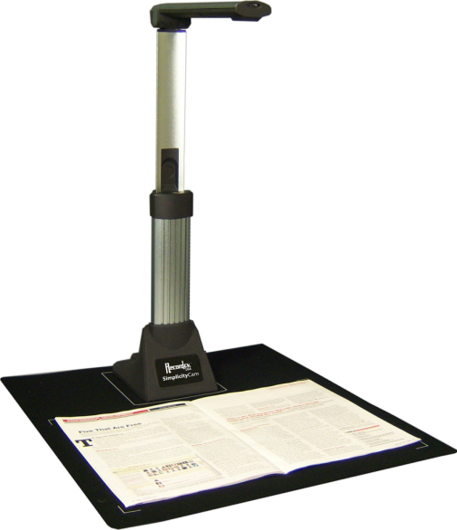
Domain
Born digital
Digitized

Slide 11
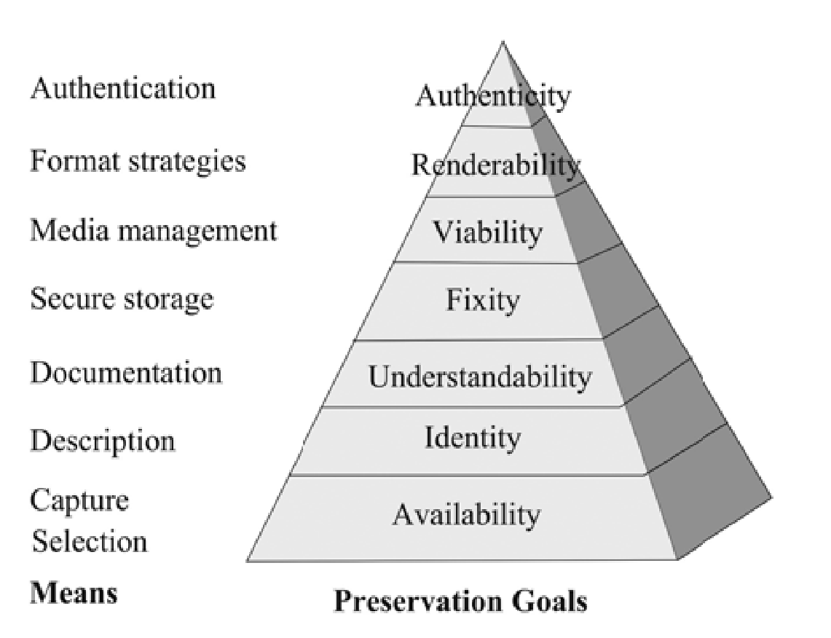
DP metadata supports preservation goals
Preservation Pyramid
(from Priscilla Caplan)

Slide 12
Availability
The object is in our control or in the control of a trusted, accessible repository

Slide 13
Identity
Each relevant entity is persistently and uniquely identifiable
The entities can be File, Work, Person, Organisation, Licence, …
Metadata needed to be known
  Identifier type
  Identifier value
Notes:
PREMIS states [8] that “for a given identifier to be usable, it is necessary to know the identifier scheme and the namespace in which it is unique. If a particular repository uses only one type of identifier, the repository would not need to record the scheme in association with each object. The repository would, however, need to know this information and to be able to supply it when exchanging metadata with other repositories.”

Slide 14
Understandability
The object and entites is possible to understand
Metadata needed to be known
  Physical structure
    Embedded files
    File sequence
  Logical structure
Context needed to be known
  Original source
  Related items
And much more

Slide 15
Fixity
The object is unchanged
Metadata needed to be known
  Checksums
  Message digests
  Hash function
Event creating them needs to give
  Algorithms
  Date/time
  Originator
  Type
Notes:
Intentional or accidental change
Decay: rapid and potentially complete

Slide 16
Viability
The object is readable
Metadata needed to be known
  Data carrier metadata
    Type of medium
    Its preservation characteristics
    Age of medium
    Date of recording
    Usage patterns

Slide 17
Renderability
The object can be rendered or executed
Metadata needed to be known
  Format information
  Rendering information
      Software
      Hardware
      Other dependencies:
      schemas,
      style sheets,
      encodings, etc.
Technology dependence
Notes:
Complex environments
Not self-descriptive
Complex formats

Slide 18
Authenticity
Authenticity: The object is what it purports to be
Integrity: The object is whole and unimpaired
Object transformations
  Pre-emptive preservation actions
    Bit migration
    Content migration
    Replacing part of the rendering stack
  Forensic transformation actions

Slide 19
Authenticity
Metadata needed to be known
  Structural metadata (for integrity)
  Digital signatures
  Access rights
  Provenance metadata:
    History of all actions performed on the resource
    (events and dates)
    History of custodianship (agents: decision makers, administrators, tools)
  Significant characteristics
  Lost characteristics
  Business rules (policy, strategy) guiding preservation actions
Notes:
Goals
Manage potential loss of object characteristics
Demonstrate degree of authenticity
Explain decisions

Slide 20
Rights
Avoid Rights violations during preservation!!!
Metadata needed to be known
  Rights information for preservation actions during copyright / license period

Slide 21
WHAT IS PREMIS?
Background (brief history and rationale)
Karin Bredenberg
Kommunalförbundet Sydarkivera

Slide 22
The PREMIS standard
International de-facto standard for metadata
to support the preservation of digital objects and
ensure their long-term usability.
  Information you need to know for preserving digital objects
      Preservation Metadata: Implementation Strategies
Developed by an international team of experts.
Implemented in digital preservation projects around the world.
Incorporated into commercial and open-source
digital preservation tools and systems.

Slide 23
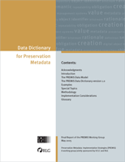
The PREMIS standard
Data Dictionary (PREMIS 3.0)
  http://www.loc.gov/standards/premis/v3/premis-3-0-final.pdf
  Version 3 – major release
XML schema v3.0
  http://www.loc.gov/standards/premis/premis.xsd
OWL ontology
Supporting documentation
Notes:
Refer to data model later

Slide 24
Activities
The PREMIS Editorial Committee
  Coordinates revisions and implementation of the standard
PREMIS Implementors' Group forum (pig@loc.gov)
  Email message to listserv@listserv.loc.gov:
  Text: subscribe pig <your name>
Preservation metadata workshop (@iPres)

Slide 25
Scope
What PREMIS DD is:
  Common data model for organizing/thinking about preservation metadata
  Standard for exchanging preservation metadata in information packages between repositories
  Implementable
  Technically neutral
  Core metadata

Slide 26
Scope
What PREMIS DD is not:
  Out-of-the-box solution
  All needed metadata
  Lifecycle management of objects outside repository
  - increasing support for integration with outside
  Rights management standard
  - strong support for rights statements

Slide 27
Scope
What PREMIS DD is not:
  It is not limited to or customized for archives and libraries.
  It does not dictate that you need to use every feature.
    But you should examine for yourself which features you can knowingly ignore.
  It is not only useful if you implement metadata.
  You can use it to assess the metadata quality of systems you use.
  Everyone modeling the digital landscape can and should use the high-level modeling feature.

Slide 28
Tailoring PREMIS to needs
Evolving metadata
  Increasing experience ensuring the longevity of digital objects
  Changing future technical possibilities
  Changing future legal framework
Tailoring solutions
  Varying needs
    Content-types
    Institutional policies
    Intended use
  Off-the-shelf (OS/commercial)
  or custom-built
Off-the-shelf systems
Predefined metadata profiles
Out-of-the-box tools
Predefined metadata profiles
Out-of-the-box tools
Configured, extended, adapted
Metadata profiles and tools
Metadata profiles and tools
Custom-built systems
Metadata profiles and tools
Notes:
Intended use = OAIS designated community

Slide 29
ON-LINE RESOURCES
Karin Bredenberg
Kommunalförbundet Sydarkivera

Slide 30
Webpages
Webpage
  https://www.loc.gov/standards/premis/
Vocabularies
  https://id.loc.gov/vocabulary/preservation.html
Ontology
  https://id.loc.gov/ontologies/premis.html
Tools at COPTR
  https://coptr.digipres.org/index.php/PREMIS_(Preservation_Metadata_Implementation_Strategies)
Zenodo
  https://zenodo.org/communities/premis
Notes:
Refer to data model later

Slide 31
E-mail list
PREMIS Implementors' Group forum (pig@listserv.loc.gov)
  Subscribe through the form:
  https://listserv.loc.gov/cgi-bin/wa?A0=PIG
Notes:
Refer to data model later

Slide 32
Micky Lindlar
TIB – Leibniz Information Centre for Science and Technology
BENEFITS OF IMPLEMENTING PREMIS

Slide 33
Implementable, core preservation metadata
Supports Preservation Principles
viability, renderability, understandability, authenticity, and identity of digital objects
Core Information
what most preservation repositories need to know to preserve digital materials over the long term
Implementable
rigorously defined, supported by guidelines for creation, management, and use, and oriented toward automated workflows
Technical Neutrality
no assumptions made about preservation technologies, strategies, metadata storage and management, etc.

Slide 34
Benefits of implementing PREMIS (1)
exchange consistency?
hdl="galapagos.6754.1"
IDobj="hdl.galapagos.6754.1"
ID="1"
TYPE="hdl"
GROUPID="galapagos.6754"
ID="6754.1"
GID="galapagos"

Slide 35
Interoperability through implementable preservation metadata
IDobj="hdl.galapagos.6754.1"
hdl="galapagos.6754.1"
premis:objectIdentifier
premis:objectIdentifierType="hdl"
premis:objectIdentifierValue="galapagos.6754.1"
PREMIS
<galapagos.6754.1> a premisOwl:IntellectualEntity ;
premisOwl:identifier <http://hdl.handle.net/galapagos.6754.1> .
<http://hdl.handle.net/galapagos.6754.1> a http://id.loc.gov/vocabulary/identifiers/hdl .
ID="1"
TYPE="hdl"
GROUPID="galapagos.6754"
ID="6754.1"
GID="galapagos"

Slide 36

Benefits of implementing PREMIS (2)
What do I need to know about a digital object I am preserving?
  … today
  … in the future
How can I best capture that information?
Is there a good practice?
How was it created?
What is it?
What has been done to it?
What am I allowed to do with it?

Slide 37
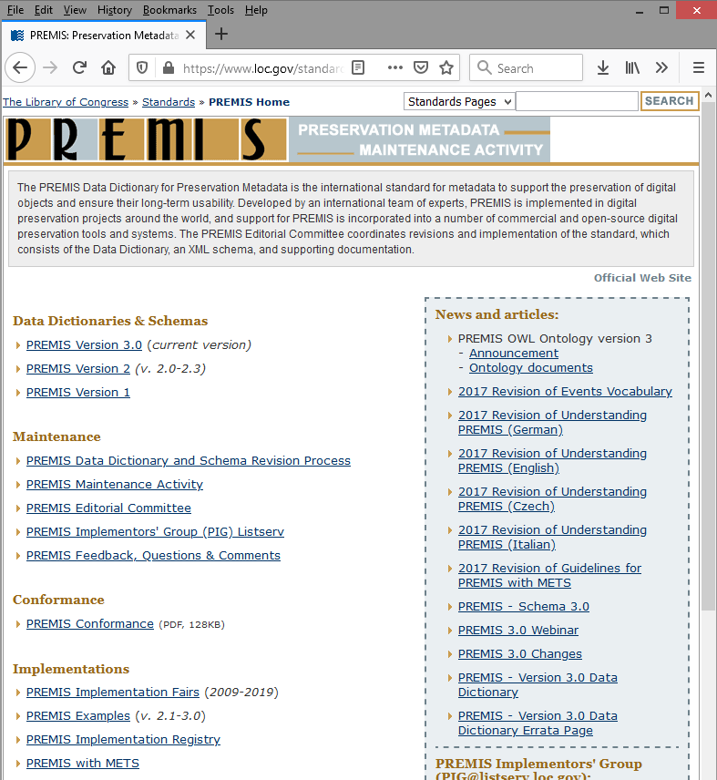
De-facto standard for preservation metadata
PREMIS = “things that most working preservation repositories are likely to need to know in order to support digital preservation” -- PREMIS Data Dictionary
valuable resource to know what you need to capture
a method to model the
information you need
a data model with MANY
implementations in different
institutions
a community of users with
good resources

Slide 38





Eld Zierau
Royal Danish Library
OUTLINE OF MAIN ENTITIES
THE DATA MODEL & KEY CONCEPTS

Slide 39

The PREMIS Data Model
Why have a data model?
  Organizational convenience
  (for development and use)
  But: not a formal entity-relationship model; not sufficient to design databases
The PREMIS Data Model is created by the community and experts in digital preservation

Slide 40








PREMIS - Data model includes:
Entities
“things” relevant to digital preservation
Semantic Units
detailed information
of entities
Rights
identifiers
identifiers
identifiers
Object
identifiers
Agent
agentIdentifier
identifiers
identifiers
agentname
Event
agentType
…
Relationships
specifies relations
between entities
Notes:
Object concerned – events/actions on objects, agents involved in event, rights for …

Slide 41

Objects
Rights
It is the objects that you preserve
Objects can be intellectual entities, representations or bitstreams (more later)
Implementation choices :
A repository does NOT have to manage all types of Objects
Object
Agent
Event
Examples:
A PDF file
An image within a file
A book
A book representation

Slide 42
Events
Rights
An action that involves or impacts at least one Object or Agent
Can document digital provenance, needed to track history of Object
Implementation choices:
Determining which Events are in scope
Determining which Events should be recorded, as well as level of granularity
Object
Agent
Event
Examples:
Validation Event
e.g. using JHOVE
Ingest Event

Slide 43
Agents
Rights
Person, organization, or software program/system
Intended only to identify the agent, and to allow linking from other entity types.
Implementation choices:
use richer scheme that may be appropriate.
Object
Agent
Event
Examples:
John Smith (a person)
IIPC (an organization)
JHOVE version 1.5
(a software program)

Slide 44

Rights Statements
Rights to undertake an action(s) associated with an Object(s) in the repository.
Implementation choices :
Can use other schemes
PREMIS form:
Agent X
grants Permission Y
to the repository in regard to Object Z.
Rights
Object
Agent
Event
Example:
Helen Smith
grants FCLA digital repository permission
to the repository in regard to make three copies of metadata_derived.pdf for preservation purposes.

Slide 45

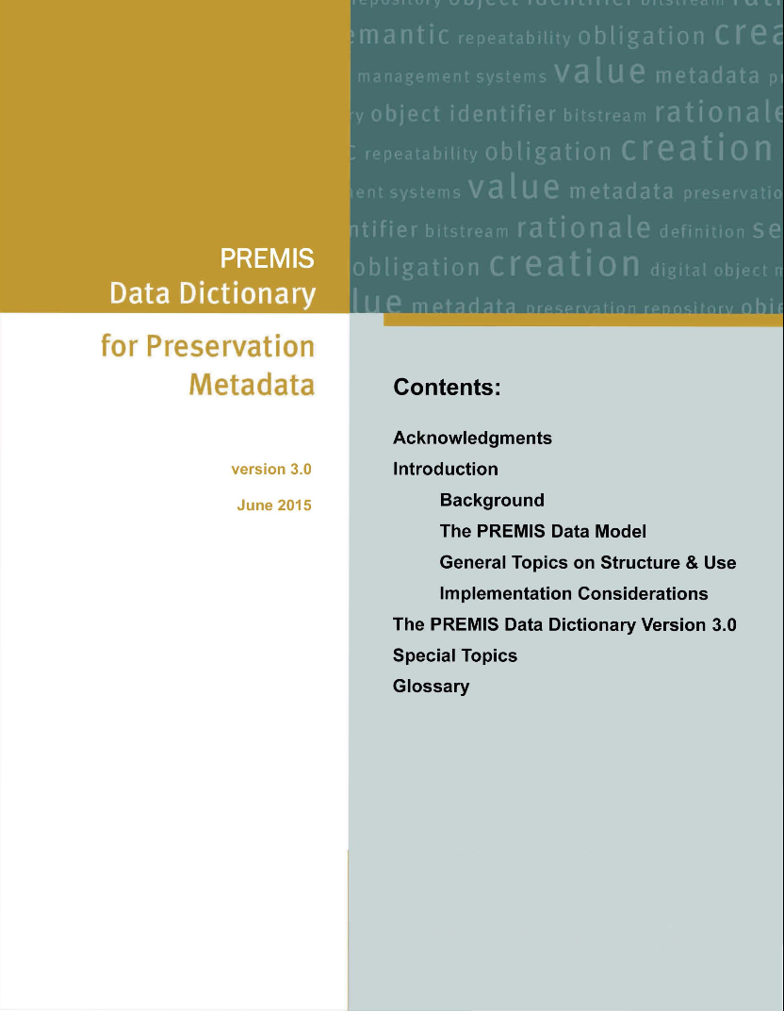
A digitization example
Rights
Object
Agent
Event
Agent
(digitizer)
Event
(digitization)
Object: file
Identifier,
type (person),
name (Karin Bredenberg)
Identifier,
type (creation),
date/time
etc.
Identifier,
fixity,
file format,
creating application, preservation level etc.
Data Dictionary
(PREMIS 3.0)
http://www.loc.gov/standards/premis/v3/premis-3-0-final.pdf

Slide 46
A digitization example
Rights
Data Dictionary
(PREMIS 3.0)
http://www.loc.gov/standards/premis/v3/premis-3-0-final.pdf
Object
Agent
Event
Agent
(digitizer)
Event
(digitization)
Object: file
Identifier,
type (person),
name etc.
Identifier,
type (creation),
date/time
etc.
Identifier,
fixity,
file format,
creating application, preservation level etc.
Data Dictionary
(PREMIS 3.0)
http://www.loc.gov/standards/premis/v3/premis-3-0-final.pdf

Slide 47
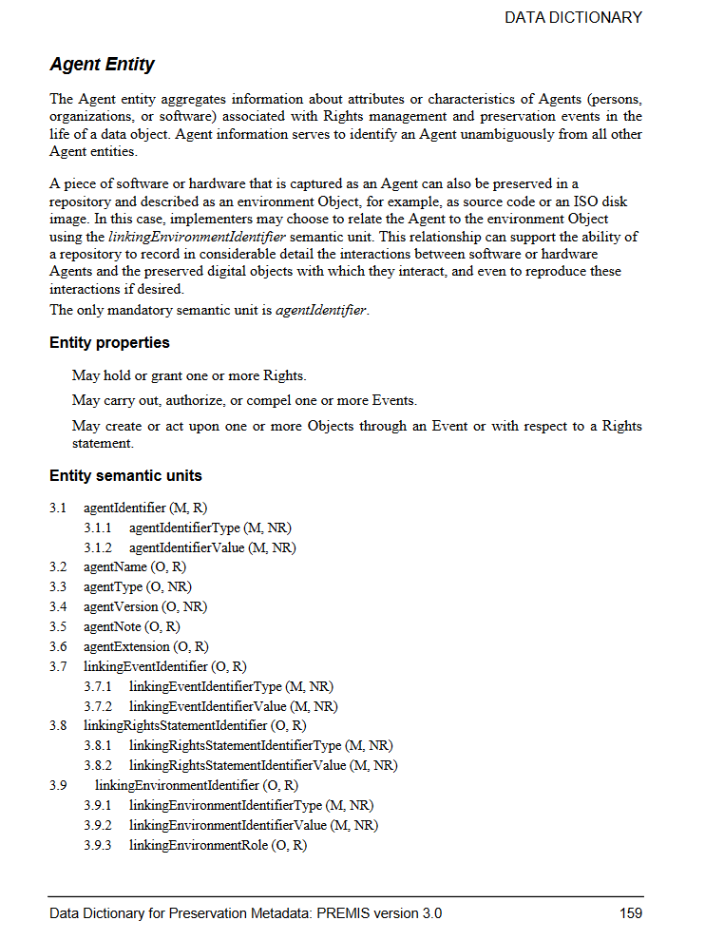
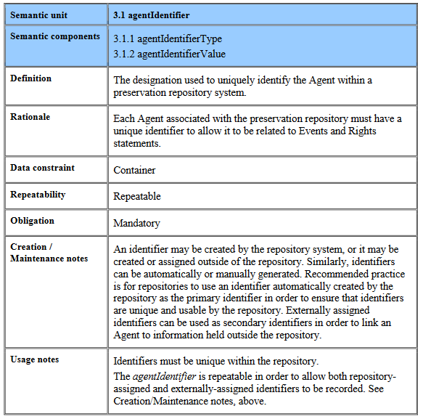
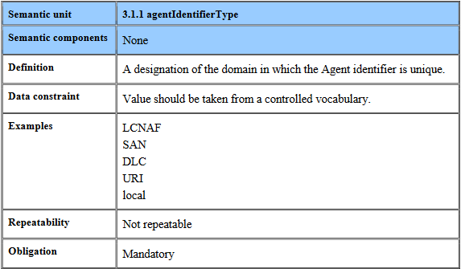
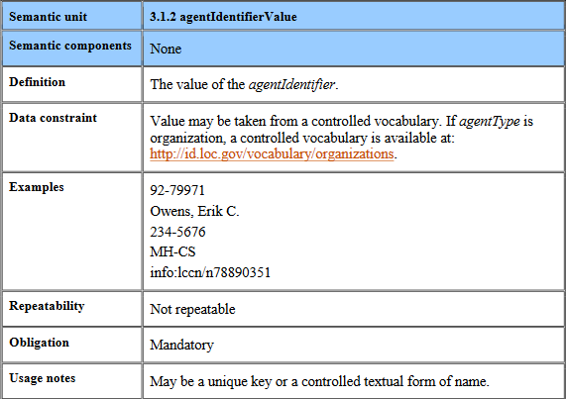
Sample Data Dictionary Entry
agentIdentifier
agentIdentifierType
agentIdentifierValue
Mandatory (M)
Optional (O)
Repeatable (R)
Not Repeatable (NR)

Slide 48
XML example
AgentIdentifier
AgentIdentifierType
AgentIdentifierValue
Examplified by XML using XML schema v3.0:
http://www.loc.gov/standards/premis/premis.xsd
<premis>
<object
<event> ... </event>
<agent>
... >
...
</object>
xsi:type="file"> ... </object>
... </agent>
</premis>
<agentIdentifier>
<agentIdentifierType>
UUID
</agentIdentifierType>
<agentIdentifierValue>
41d10-099-1e2-9
</agentIdentifierValue>
</agentIdentifier>
...
</agent>
</premis>
<rights> ... </rights>
Agent
(digitizer)
Event
(digitization)
Object: file
Notes:
Refer to data model later

Slide 49

objectCategory (types of objects)
Rights
Object
Agent
Event
intellectual
entity
representation
file
bitstream
TIFF
p1
Book
Object
Original TIFFs
TIFF
p2
Derived
e-pub
E-pub
a distinct intellectual that is considered relevant in the context of digital preservation
set of objects, including structural metadata, that, taken together, constitute a complete representation
named and ordered sequence of bytes that is known by an operating system
data within a file with properties relevant for preservation purposes
Notes:
Important to document relations, like putting preservation data in PREMIS
Parallel encoded text, update challenge
Nouns and verbs

Slide 50
PREMIS 3 - Data model includes:
Entities
“things” relevant to digital preservation
Rights
identifiers
identifiers
identifiers
Object
identifiers
Agent
identifiers
identifiers
Event
intellectual entity
Representation
File
Bitstream
Notes:
Object concerned – events/actions on objects, agents involved in event, rights for …

Slide 51
WHAT USE CASES DO YOU SEE?

Slide 52
LET’S HAVE A BREAK!
11.00-11.30

Slide 53

HOW TO USE PREMIS?
The Data Dictionary in action: PREMIS Conformance and repository interoperability
PREMIS Conformance & interoperability
Micky Lindlar
TIB - German National Library of Science and Technology

Slide 54
PREMIS Conformance statement
http://www.loc.gov/standards/premis/premis-conformance-20150429.pdf
Baseline requirements:
For every implemented Entity (Objects, Events, Rights, Agents) mandatory semantic units must be captured
  For those levels of Object that the repository supports (IE, representation, file, bitstream)
Requirements for
Shared name = Shared definition!
Shared definition without shared name -> needs documentation

Slide 55
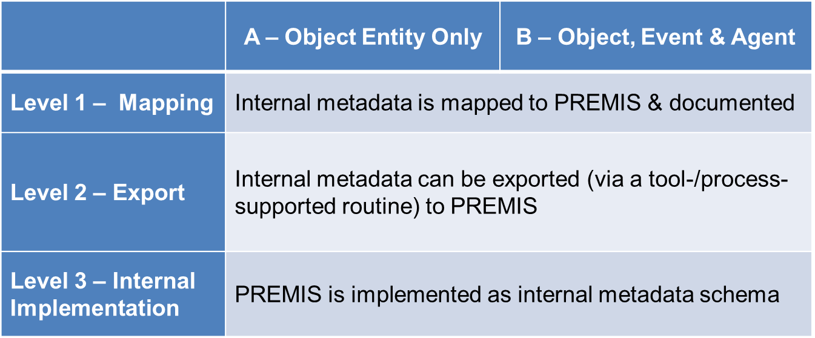
PREMIS Conformance Levels

Slide 56



Example: What‘s conformant and what isn‘t?
None
DOI: 10.5281/zenodo.5569542
Eindeutiger Bezeichner:10.5281/zenodo.5569542
<dc:identifier>https://zenodo.org/record/5569578</dc:identifier> <dc:identifier>10.5281/zenodo.5569578</dc:identifier> <dc:identifier>oai:zenodo.org:5569578</dc:identifier>
<objectIdentifier>fmt/18</objectIdentifer>
premis:objectIdentifier
premis:objectIdentiferType=„doi“
premis:objectIdentifierValtue=„10.5281/zenodo.5569542“

Slide 57
Which Entities to implement?
Object is the core Entity (level A);
Event and Agent are closely related (level B); implementing Agents has strong implications: it means the repository is able to manage and follow the use of its Agents in the Object lifecycle.
The Rights Entity (excluded from the conformance statement) helps a repository tracking the intellectual property rights governing the Object, or some institutional policy.
Notes:
An example of Agents registry : https://github.com/kieranjol/FIscripts/blob/master/premis_agents.csv

Slide 58
Use case: For building other standards
As a basis extended with locally-defined elements: Preservation Metadata Dictionary (Netherlands Institute for Sound and Vision).
https://publications.beeldengeluid.nl/pub/389/BIJLAGE-C_Metadatadictionary-English.pdf
As a free source of inspiration: DEPIP (Data Exchange Protocol for Interoperability and Preservation), ISO 20614.
https://www.iso.org/standard/68562.html
No conformance, inspiration!

Slide 59
Use case: As a self-assessment tool
Am I able to provide information about my digital assets following the Data Dictionary structure and requirements?
  I.e., documenting the mapping between my metadata structure and PREMIS semantic units.
Conformance level 1 « through mapping » (see the Conformance Statement document, p. 5: http://www.loc.gov/standards/premis/premis-conformance-20150429.pdf#page=5)
Notes:
Semantic units in PREMIS are applicable or not for a specific type of Entity, mandatory or not, repeatable or not.
Shared registries, data exchange and certification were envisioned as objectives for PREMIS.
DD constraints are not strongly prestriptive, e.g., the fixity semantic container is not mandatory in order to accomodate all use cases and implementation choices, though it seems unlikely that a repository would not be able to provide a checksum for its files.
Semantic units considered as mandatory in the DD only if the Entity and the parent semantic container is implemented.

Slide 60
Use Case: As an export format
Preferably in a PREMIS-endorsed expression (XML or RDF)
Conformance level 2 « through export » (see the Conformance Statement document, p. 5: http://www.loc.gov/standards/premis/premis-conformance-20150429.pdf#page=5)

Slide 61
Use case: As the native format of the repository Data Management module
Where to store PREMIS data?
Any technology, using a PREMIS-endorsed expression or not, can be used
  Excel
  CVS file
  XML database
  RDF triple store
  (relational) database
  etc.
Conformance level 3 « through internal implementation » (see the Conformance Statement document, p. 6: http://www.loc.gov/standards/premis/premis-conformance-20150429.pdf#page=6)
Notes:
Though any technology can be used, at this level of conformance, using the exact SU names is mandatory (no extra mapping is required).

Slide 62
Examples for different implementations:
RDF and XML
<http://nri.library.ca/5143-026.nrw> a premis:File ;
premis:fixity <5143-026Fixity>
.
<5143-026Fixity> a crypHashFunc:sha256 ;
rdf:value "71f920fa275127a7b60fa4d4d41432a3 ";
dce:creator "hashlib.sha256"
.
<premis:fixity>
<premis:messageDigestAlgorithm>SHA-256</premis:messageDigestAlgorithm>
<premis:messageDigest>
d2bed92b73c7090bb30a0b30016882e7069c437488e1513e9deaacbe29d38d92
</premis:messageDigest>
<premis:messageDigestOriginator>NRI</premis:messageDigestOriginator>
</premis:fixity>

Slide 63
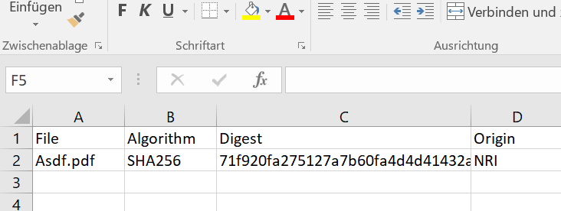
Examples for different implementations:
CSV and spreadsheet
File, Algorithm, Digest, Origin;
Asdf.pdf; SHA-256, 71f920fa275127a7b60fa4d4d41432a3, NRI;

Slide 64
Eld Zierau
Royal Danish Library
DATA DICTIONARY
DESCRIPTION OF DATA MODEL

Slide 65
PREMIS - Data model includes:
Entities
“things” relevant to digital preservation
Semantic Units
detailed information
of entities
Rights
identifiers
identifiers
identifiers
Object
identifiers
Agent
identifiers
agentIdentifier
identifiers
Event
agentIdentifierType
agentIdentifierValue
agentname
Relationships
specifies relations
between entities
agentType
…
Notes:
Object concerned – events/actions on objects, agents involved in event, rights for …

Slide 66
Semantic Units
…
Two kinds of semantic unit:
  Container: groups together related semantic units
  Semantic components: semantic units grouped under the same container
Example:
  AgentIdentifier [container]
AgentIdentifierType [semantic component]
AgentIdentifierValue [semantic component]
…
…
…

Slide 67
Semantic Units
A semantic unit is a property of an entity
A piece of information most repositories need to know in order to carry out their digital preservation functions
Example:
[container]
[semantic component]
[semantic component]
Two kinds of semantic unit
agentIdentifier
groups together related semantic units
agentIdentifierType
agentIdentifierValue

Slide 68
Semantic units - Properties of Entities
Rights
Object
Agent
Event

Slide 69

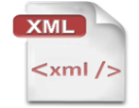

High level semantic units for Objects
what is my preservation strategy for this object?
what technical information on it?
which object is it?
TIFF
10Mb
ark:/12148/btp6k102002g/f1
what software or hardware should be used to handle the object?
what kind of object?
which of its characteristics do I want to preserve in it?

Slide 70
PREMIS Object Entity – Semantic Units
objectIdentifier
always mandatory
objectCategory
objectCharacteristics
object
significantProperties
preservationLevel
originalName
storage
signatureInformation
environmentFunction
environmentDesignation
environmentRegistry
environmentExtension
relationship
linkingEventIdentifier
linkingRightsStatementIdentifier

Slide 71
PREMIS Object Entity – Semantic Units
objectIdentifier
objectIdentifierType
objectCategory
objectIdentifierValue
objectCharacteristics
object
significantProperties
preservationLevel
originalName
storage
signatureInformation
environmentFunction
environmentDesignation
environmentRegistry
environmentExtension
relationship
linkingEventIdentifier
linkingRightsStatementIdentifier

Slide 72
objectCategory
Values:
  intellectual entity
  representation
  file
  bitstream
Implemented as an xsi:type in PREMIS XML-schema so not explicitly recorded
intellectual
entity
representation
file
bitstream
TIFF
p1
Book
Object
Original TIFFs
TIFF
p2
Derived
e-pub
E-pub
<premis>
<object xsi:type="file">
...
</object>
...
</premis>

Slide 73
PREMIS Object Entity – Semantic Units
objectIdentifier
objectCategory
objectCharacteristics
specific characteristic
object
significantProperties
mandatory for file or bitstream
preservationLevel
originalName
Technical properties common to all/most file formats
storage
signatureInformation
environmentFunction
environmentDesignation
As technology agnostic as possible
environmentRegistry
environmentExtension
relationship
linkingEventIdentifier
linkingRightsStatementIdentifier

Slide 74
objectCharacteristics
mandatory for file or bitstream
Technical properties common to all/most file formats
As technology agnostic as possible

Slide 75
PREMIS Object Entity
objectIdentifier
objectCategory
objectCharacteristics
specific characteristic
object
significantProperties
mandatory for file or bitstream
preservationLevel
originalName
compositionLevel
Technical properties common to all/most file formats
storage
fixity
signatureInformation
size
environmentFunction
format
environmentDesignation
creatingApplication
As technology agnostic as possible
environmentRegistry
inhibitors
environmentExtension
objectCharacteristicsExtension
relationship
linkingEventIdentifier
linkingRightsStatementIdentifier
Notes:
Inhibitor: Feature of a Digital Object intended to inhibit access, copying, Dissemination, or
Migration. Common Inhibitors are Encryption and password protection.

Slide 76



Composition Level
sometimes there is more than one layer of characteristics
chapter1.pdf
chapter1.pdf.gz
Composition Level 0
Composition Level 1
Or they be part of other files e.g.
Mail attachments
Images in PDF’s etc

Slide 77


objectCharacteristicsExtension
Container to include externally defined semantic units – e.g. for more granularity
Might contain format specific metadata for a file – e.g. technical metadata for still images (MIX)

Slide 78
objectCharacteristicsExtension - example
<premis> ...
<object xsi:type="file">
<objectCharacteristics> ...
<objectCharacteristicsExtension>
<mix:mix xsi:schemaLocation=
"... http://www.loc.gov/standards/mix/mix20/mix20.xsd">
...
<mix:BasicImageInformation>
<mix:BasicImageCharacteristics>
<mix:imageWidth>5894</mix:imageWidth>
<mix:imageHeight>7768</mix:imageHeight>
...
</mix:BasicImageCharacteristics>
</mix:BasicImageInformation>
...
<mix:mix>
</objectCharacteristicsExtension> ...
<objectCharacteristics> ...
</object> ...
</premis>
All semantic units named … Extension works like this

Slide 79
PREMIS Object Entity – Semantic Units
objectIdentifier
objectCategory
objectCharacteristics
object
significantProperties
preservationLevel
originalName
more general info
storage
signatureInformation
environmentFunction
environmentDesignation
environmentRegistry
environmentExtension
relationship
linkingEventIdentifier
linkingRightsStatementIdentifier
Notes:
Digital signatures rely on an external (mutually trusted) authority to verify the signature.

Slide 80
preservationLevel
What preservation treatment/strategy the repository plans for this object
Varying preservation options dependent on factors such as value, uniqueness, preservability of format
A business rule only relevant in a given repository
Contains
preservationLevelType, e.g. logicalStrategy or BitSafety
preservationLevelValue, e.g. migration or High
preservationLevelRole (context), e.g. intention or requirement
preservationLevelRationale, when differs from policy
preservationLevelDateAssigned when Level was assigned

Slide 81
PREMIS Object Entity – Semantic Units
objectIdentifier
objectCategory
objectCharacteristics
object
significantProperties
preservationLevel
originalName
storage
signatureInformation
environmentFunction
environmentDesignation
environmentRegistry
environments
environmentExtension
relationship
linkingEventIdentifier
entity linking
linkingRightsStatementIdentifier

Slide 82

Relationships: Semantic Unit Identifiers
Rights
Realtionship
Identifier
Identifier
Identifier
environments
Object
Identifier
Agent
Identifier
Identifier
Event
Relationships
specifies relations
between entities

Slide 83
Relationships: Semantic Unit Identifiers
Rights
linkingRightsStatementIdentifier
linkingRightsStatementIdentifier
linkingObjectIdentifier
linkingAgentIdentifier
Object
Agent
linkingObjectIdentifier
linkingAgentIdentifier
Event
linkingEventIdentifier
linkingEventIdentifier

Slide 84
Linking Objects with Agents and Events
linkingRightsStatementIdentifier
  linkingRightsStatementIdentifierType
  linkingRightsStatementIdentifierValue
linkingEventIdentifier
  linkingEventIdentifierType
  linkingEventIdentifierValue
Likewise for the other entities
except there may be possibility of specifying roles, e.g. for Event because the same Agent may have a different Role in the digital Archive system

Slide 85
Relationships: Semantic Unit Identifiers
Rights
Identifier
Identifier
Identifier
Object
Identifier
Agent
Identifier
Identifier
Event

Slide 86
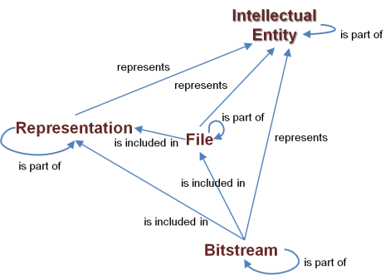
Objects and their interrelations
Object
is part of
Intellectual Entity
is part of
Representation
represents
is included in
is part of
File
is part of
Bitstream

Slide 87

PREMIS Object Entity – Semantic Units
Object
Example:
Representation pointing to an Intellectual Entity
relationship
relationshipType
structural
relationshipSubType
represents
relatedObjectIdentifier
Identifier of Intellectual Entity
  (type, value, sequence)
relation through (because of) an Event – e.g. for migration
relatedEventIdentifier
  (type, value, sequence)
relatedEnvironmentPurpose
environments
relatedEnvironmentCharacteristic
Objects can be associated with Events in two ways:
If the Object has an associated Event with relationship
If the Object has an associated Event with no relationship to a second Object, e.g. ingest: use linkingEventIdentifier

Slide 88
Properties of Entities - Semantic units
Rights
Object
Agent
Event

Slide 89
PREMIS Event Entity
Mandatory semantic units are: eventIdentifier, eventType, and eventDateTime.
Must be related to one or more Objects.
Can be related to one or more Agents.
event
eventIdentifier
eventType
Rights
eventDateTime
Object
Agent
eventDetailInformation
eventOutcomeInformation
Event
linkingAgentIdentifier
linkingObjectIdentifier

Slide 90
eventType
Names the event
Recommended to use a controlled vocabulary, e.g.
  http://id.loc.gov/vocabulary/preservation/eventType.html
Could use coded values
Granularity is implementation-specific
Ingestion
Virus check
creation
Validation
Compression
Message digest calculation
…
Decompression
migration
Fixity check

Slide 91
PREMIS Event Entity
eventDetailInformation and eventOutcomeInformation
Includes extension to allow use of other standards for the information
event
eventIdentifier
eventType
Rights
eventDateTime
Object
Agent
eventDetailInformation
eventOutcomeInformation
Event
linkingAgentIdentifier
linkingObjectIdentifier

Slide 92
Properties of Entities - Semantic units
Rights
Object
Agent
Event

Slide 93
PREMIS Agent Entity
The only mandatory semantic unit is agentIdentifier
May hold or grant one or more Rights.
May carry out, authorize, or compel one or more Events.
May create or act upon one or more Objects through an Event or with respect to a Rights statement.
agentIdentifier
agent
agentName
Rights
agentType
agentVersion
Object
Agent
agentNote
Event
agentExtension
linkingEventIdentifier
linkingRightsStatementIdentifier
linkingEnvironmentIdentifier

Slide 94
agentType
Can use controlled vocabulary, e.g. http://id.loc.gov/vocabulary/preservation/agentType.html
  hardware
  organization
  person
  software

Slide 95
Properties of Entities - Semantic units
Rights
Object
Agent
Event

Slide 96




PREMIS Rights Entity
license
copyright
Other
other
statute
rightsStatement
rights
rightsStatementIdentifier
rightsBasis
Rights
copyrightInformation
Object
Agent
licenseInformation
One of
these
must be present!
statuteInformation
Event
otherRightsInformation
rightsGranted
linkingObjectIdentifier
linkingAgentIdentifier
rightsExtension

Slide 97




Dependent units about rights
Specifying different types of rights
If more than one basis applies, the entire rights entity should be repeated.
rightsBasis
= copyright
copyrightInformation
= license
licenseInformation
= statute
statuteInformation
= other
otherRightsInformation
Other

Slide 98
Example rightsBasis and copyrightInformation
rightsBasis = copyright
copyrightInformation
copyrightStatus = copyrighted
copyrightJurisdiction = us copyrightStatusDeterminationDate = 2008-09-10
copyrightNote = Copyright expiration expected in 2022
copyrightDocumentationIdentifier = [link]

Slide 99




PREMIS Rights Entity
rightsStatement
rights
rightsStatementIdentifier
rightsBasis
Rights
copyrightInformation
Object
Agent
licenseInformation
statuteInformation
Event
otherRightsInformation
rightsGranted
linkingObjectIdentifier
linkingAgentIdentifier
rightsExtension

Slide 100
rightsGranted
What action is allowed?
Under what conditions?
Are there time constraints?
Contains
Act (e.g. migrate, modify, … could use eventType values)
Restriction (description of condition or limitation on act)
termOfGrant (start and end dates of rights granted)
  startDate (e.g. 2005-01-01)
  endDate (e.g. 2005-01-01)
termOfRestriction (start and end dates of restriction granted)
  startDate (e.g. 2005-01-01)
  endDate (e.g. OPEN)
rightsGrantedNote (additional inf. about the rights granted)

Slide 101
PREMIS 3 - Entities
Rights
identifiers
identifiers
identifiers
Object
identifiers
Agent
identifiers
identifiers
Event
Completed

Slide 102







Data Model - environments
Rights
identifiers
identifiers
identifiers
Object
- can be environment
identifiers
Agent
identifiers
environment can at the same time be a content object e.g. preserved software source code
identifiers
Event

Slide 103
Environments as independent objects
What is needed to render or use
a content object
  Operating system
  Application software
  Hardware
  Computing resources
Notes:
Could be a separate slide:
Environments: i.e. hardware and software needed to use digital objects
Described and preserved reusing the Object entity,
Described as Intellectual Entities,
preserved as Representation, File or Bitstream.
Semantic units that are specific to Environment descriptions
Capture the function and designation of the Environment,
Link to descriptions in external registries.
Represented as
Aggregate environments or as
Individual components of an environment
(e.g. an executable file, a stylesheet);
Relationships become important.
Direct relationship between Agents and Objects to capture the Environment that acted as the Agent in an Event.

Slide 104
Example:
An object and its rendering environment
Intellectual Entity
for content Object
Intellectual Entity
hardware
Intellectual Entity
operating system
Intellectual Entity
software application
File Object
ISO image
File Object
executable file
File
Content Object
represents =
relationshipType: structural
relationshipSubType: represents
requires =
relationshipType: dependency
relationshipSubType: requires
Notes:
An object and its environment: indirect link
Environments as IE and as content Object
An intellectual entity can be represented as a representation, a single file or a single bitstream.
Since all are objects, relationship between a representation or a file to its intellectual entity is handled through relationships. This would need an additional structural relationshipSubType of « represents » / « is represented as ».
This is important since, with Environment, we can have other kinds of relationship between an intellectual entity and a file (e.g. a dependency link)

Slide 105












rights
object
agent
agent
event
agentIdentifier
agentName
An agent is actually an environment acting as an agent
e.g. a format migration software agent involved in a preservation action
Relation points out the environment object acting as the agent
agentType
agentVersion
agentNote
agentExtension
linkingEventIdentifier
linkingRightsStatementIdentifier
linkingEnvironmentIdentifier

Slide 106



object
rights
object
agent
objectIdentifier
event
objectCategory
objectCharacteristics
significantProperties
preservationLevel
originalName
storage
e.g. function: SW, level: 1
function: OS, level: 2
signatureInformation
environmentFunction
name, version, origin, …
e.g. for SW Windows XP Professional
environmentDesignation
environmentRegistry
name, key, role
-alternative: Link to an external registry
environmentExtension
relationshipType: dependency
relationshipSubType: requires
relationship
linkingEventIdentifier
linkingRightsStatementIdentifier

Slide 107





rights
object
agent
Rights
2
3
event
1
Object
A
object
Environment for A
Agent
Event
object to environment - specify computational context
environment to object - documentation, specifications, surrogates
environment to environment - inclusion, dependency, derivation, other

Slide 108
Additional environment information
relationship
Different environments can support different uses/purposes of objects
create, edit, modify, render…
relationship
Characteristics describing how the environment
supports its purpose
unspecified, minimum, known to work, recommended …
Notes:
An assessment of the extent to which the described environment supports its purpose.
Rationale If multiple environments are described, this element can help to distinguish between them.
Data constraint Value should be taken from a controlled vocabulary. A controlled vocabulary is available at: http://id.loc.gov/vocabulary/preservation/environmentCharacteristic.

Slide 109
PREMIS Object Entity – Semantic Units
Object
relationship
relationshipType
relationshipSubType
A controlled vocabulary is available at: http://id.loc.gov/vocabulary/preservation/environmentPurpose
relatedObjectIdentifier
  (type, value, sequence)
relatedEventIdentifier
  (type, value, sequence)
relatedEnvironmentPurpose
e.g. create, edit, modify, render
relatedEnvironmentCharacteristic
e.g. unspecified, minimum, recommended,
known to work

Slide 110

WRAP UP
Karin Bredenberg
Kommunalförbundet Sydarkivera
DD
Where to find it and What it is for
Current activity in PREMIS EC
Book
Exercises

Slide 111
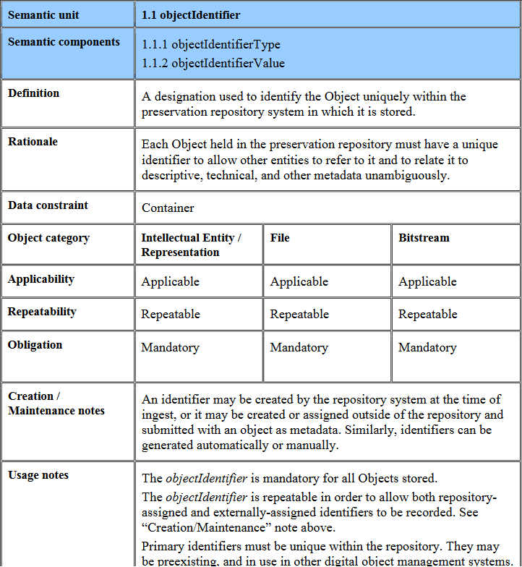
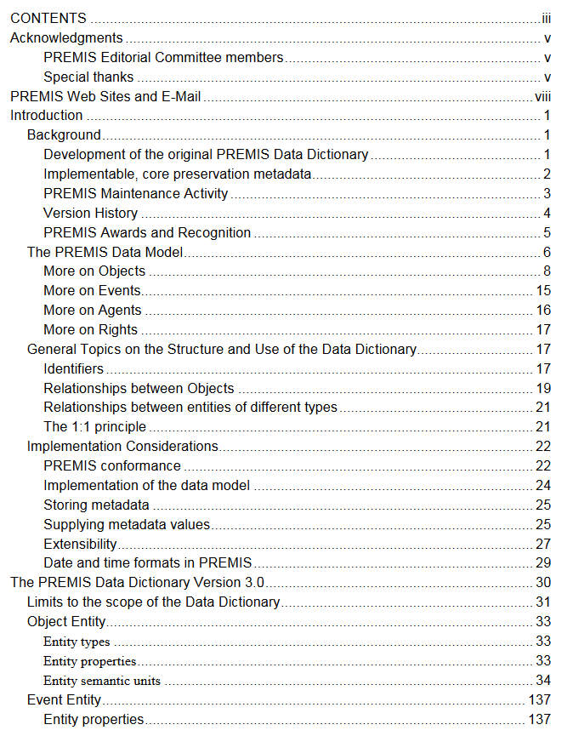
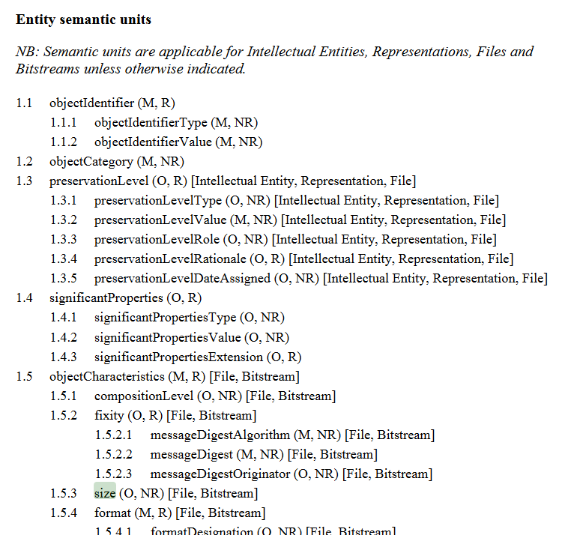
Sum up – Data Dictionary
Lots of other information

Slide 112

Where? and What??
Where
  Resources: http://www.loc.gov/standards/premis/
  PREMIS Implementors Group Forum: PIG@listserv.loc.gov
What PREMIS is for today have given you a good explanation to and you now need to explore it further
Images in this style is taken from digitalbevaring.dk

Slide 113
Resources
Understanding PREMIS
PREMIS-in-METS guidelines
Conformance statement
Examples of implementation
http://www.loc.gov/standards/premis/

Slide 114
Current activity
Move the DD to a TEI-format to simplify maintenance and transformations to publications
DD updates following the ontology work
Enhance our use of Zenodo
Setup of new wiki
Rights overhaul

Slide 115
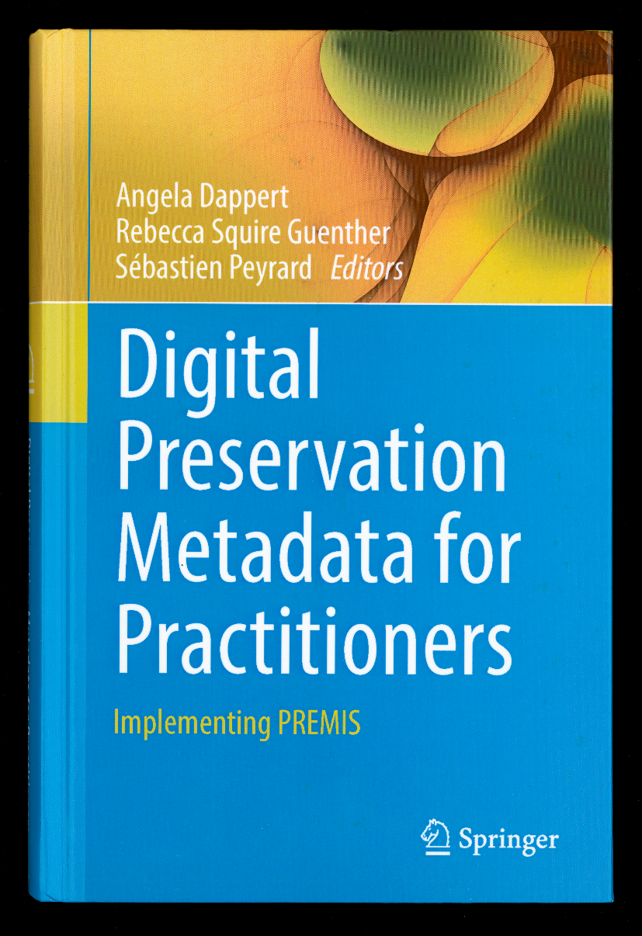
Book
ISBN E-book:
978-3-319-43763-7
ISBN Hardcover:
978-3-319-43761-3
http://www.springer.com/gp/book/9783319437613

Slide 116
Exercises
Today have been really filled!
Three exercises to start working with PREMIS metadata
  Print them out!
Solutions is also published!

Slide 117
Exercises
Today have been really filled!
Three exercises to start working with PREMIS metadata
  Print them out!
Solutions is also published!
The aid is seen on next slide
On your own!

Slide 118
Sample Data Dictionary table of contents
Version 3 Hierarchical listing of semantics units.pdf https://doi.org/10.5281/zenodo.5569578
On your own!

Slide 119
PREMIS Object Entity – Exercise
Exercise to get a feeling for the object!
  Objectexercise.pdf
  https://doi.org/10.5281/zenodo.5569614
Page 1
  Find the different object types!
The rest of the pages
  With the data stated, fill your PREMIS semantic units.
  Take help from the hand-out with all the semantic units!
On your own!

Slide 120
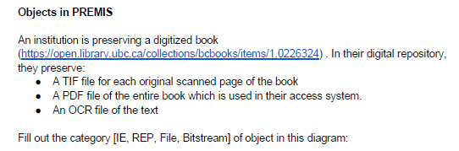
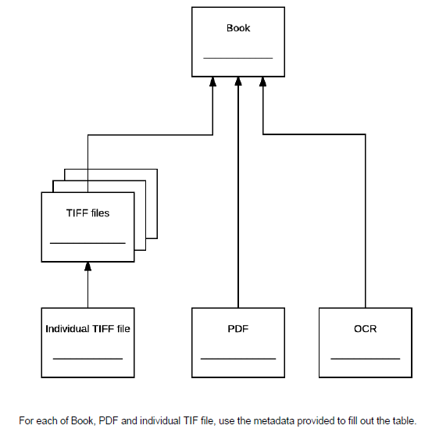
PREMIS Object Entity – Exercise
On your own!

Slide 121
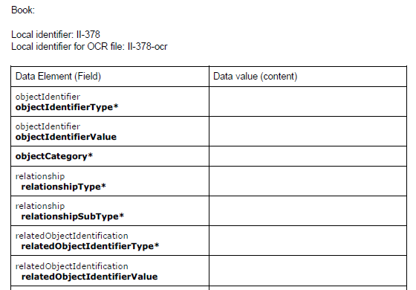
PREMIS Object Entity – Exercise
On your own!

Slide 122
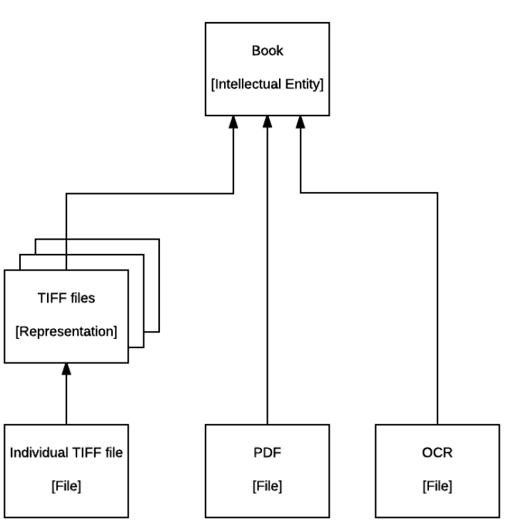
Exercise answers
On your own!
Objectexercise-answers.pdf

Slide 123
PREMIS Events, Agents and Rights Entity – Exercise
Exercise to get a feeling for the events, agents and rights!
  Eventsagentsrightsexercise.pdf
  https://doi.org/10.5281/zenodo.5569644
For the pages
  With the data stated, fill your PREMIS semantic units.
  Take help from the hand-out with all the semantic units!
On your own!

Slide 124
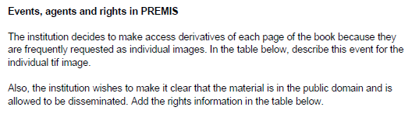
PREMIS Events, Agents and Rights Entity – Exercise
On your own!

Slide 125
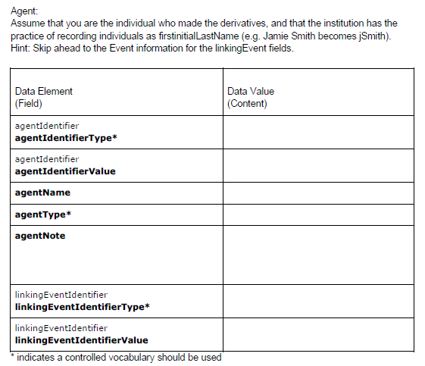
PREMIS Events, Agents and Rights Entity – Exercise
On your own!

Slide 126
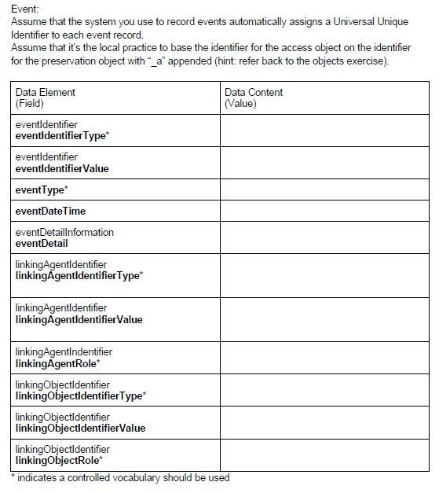
PREMIS Events, Agents and Rights Entity – Exercise
On your own!

Slide 127
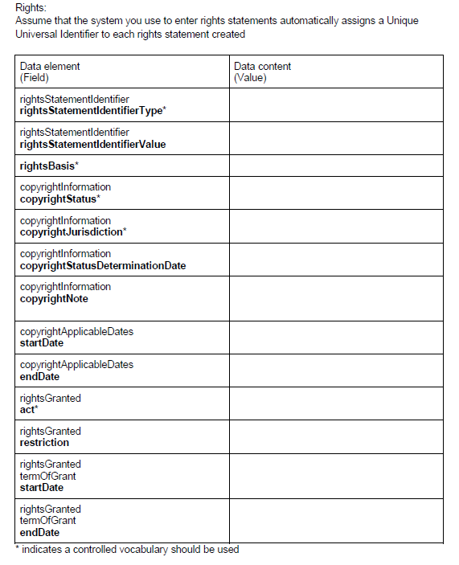
PREMIS Events, Agents and Rights Entity – Exercise
On your own!

Slide 128
Exercise answers
Eventsagentsrightsexercise-Answers.pdf
On your own!

Slide 129
PREMIS Environments – Exercise
Exercise to get a feeling for the environments!
  Environmentsexercise.pdf
  https://doi.org/10.5281/zenodo.5569651
For the pages
  With the data stated, fill your PREMIS semantic units.
  Take help from the hand-out with all the semantic units!
On your own!

Slide 130
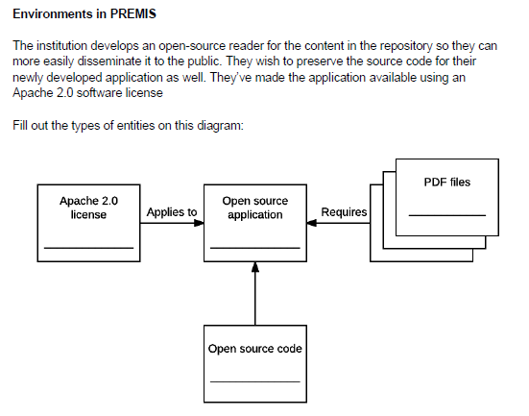
PREMIS Environments – Exercise
On your own!

Slide 131
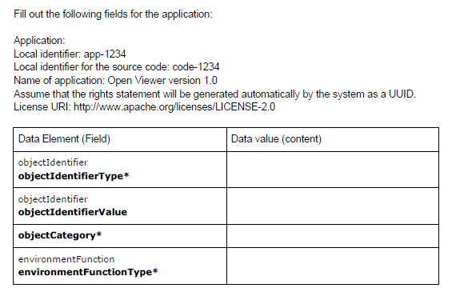
PREMIS Environments – Exercise
On your own!

Slide 132
Exercise answers
Environmentsexercise-Answers.pdf
On your own!

Slide 133
Extra example to look at on your own
Main page: http://id.kb.dk/index_UK.html
Showed example: http://id.kb.dk/metadata/structure.html
Postcard: http://id.kb.dk/metadata/postcardExample.html
Link to paper: https://mfr.de-1.osf.io/render?url=https://osf.io/kfetm/?direct%26mode=render%26action=download%26mode=render

Slide 134
Questions in parking?!

Slide 135
Today
You have had an introduction to PREMIS!
Use the resources to learn more!
Participate in the discussions!

Slide 136
Finally…
PREMIS is a community standard.
Send examples
Ask questions
Send suggestions
Take part!

Slide 137
Thank you!
Karin, Eld and Micky

