Slide 1

Dataverse introduction
Archiving data in a Dataverse repository
Example presentation
Notes:
This is an example presentation on Dataverse as a repository software that can be used in a workshop introducing dataverse as a system to find data.

Slide 2

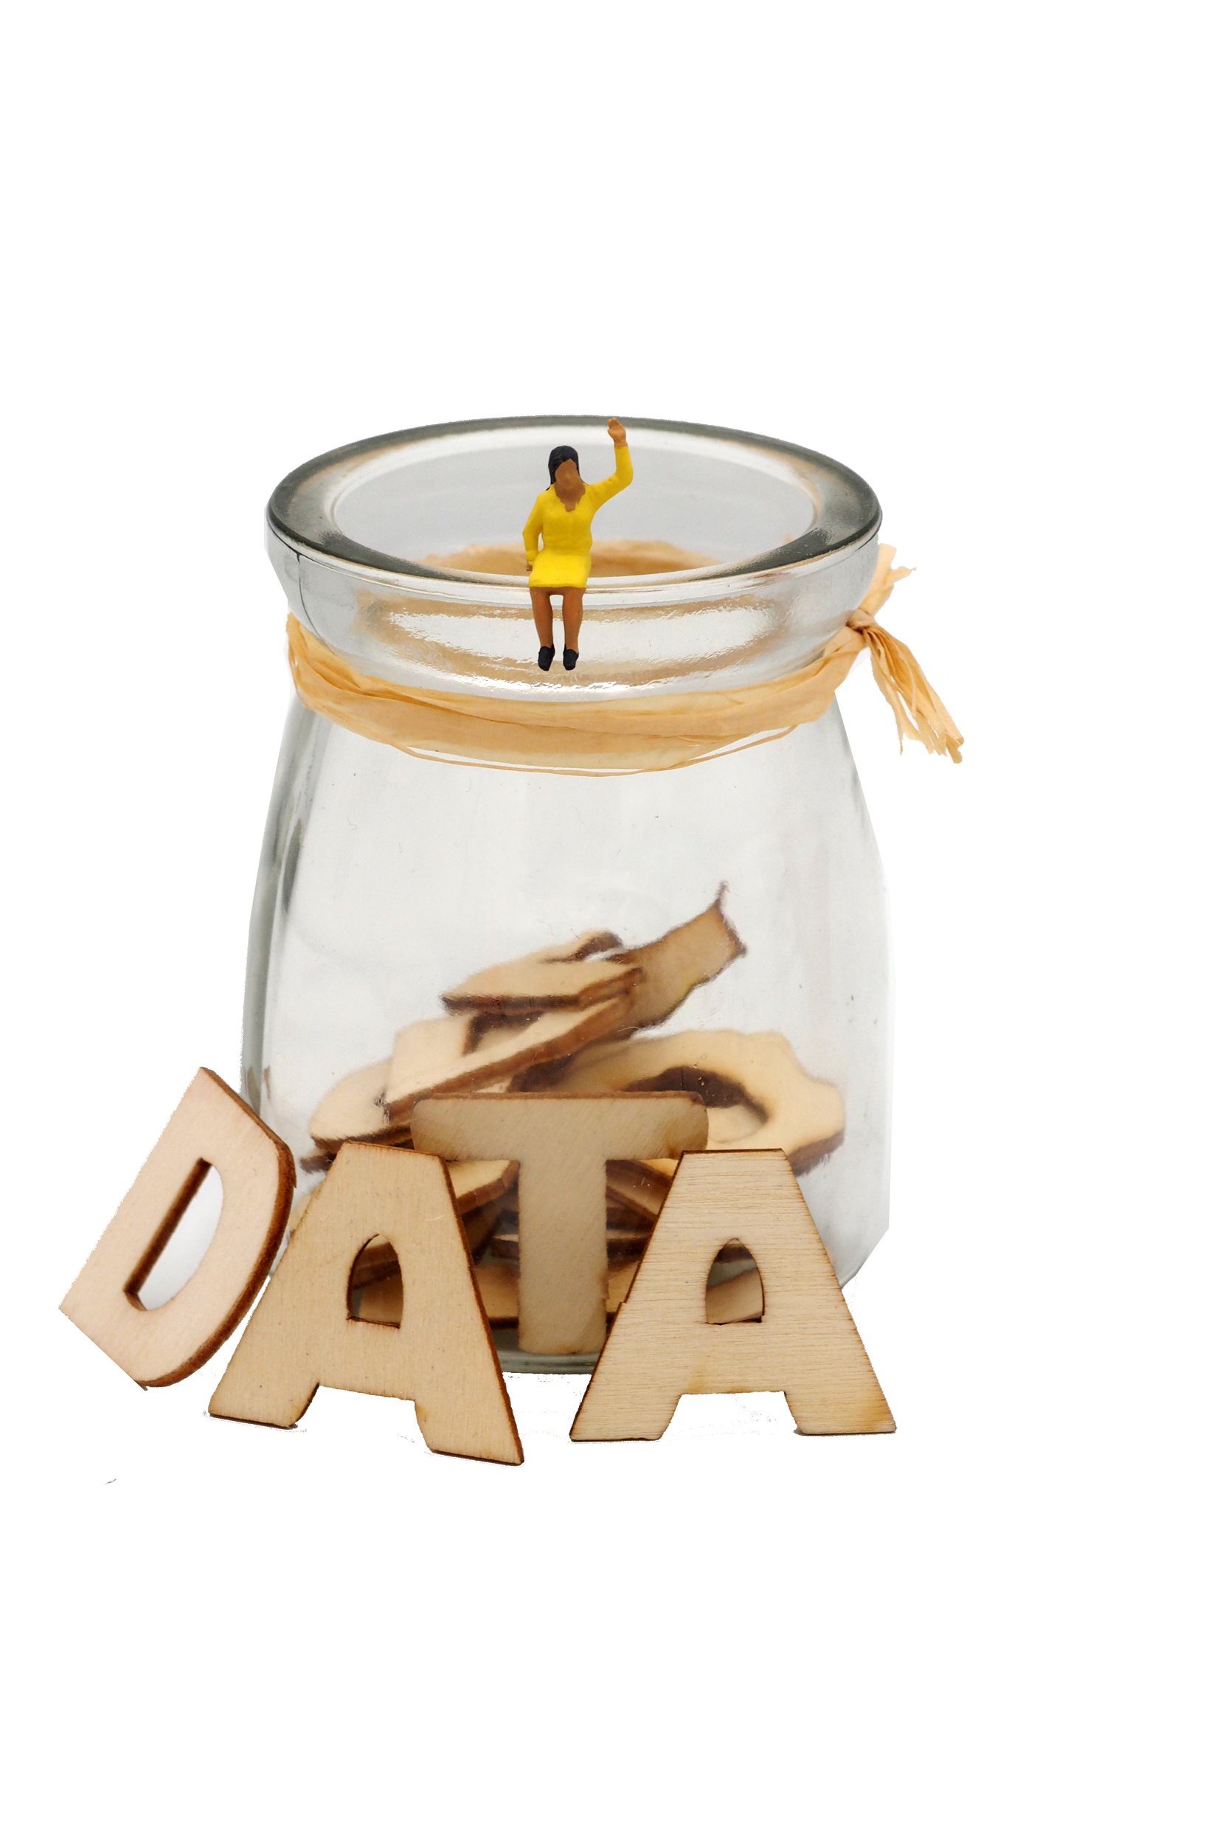
Overview
Dataverse introduction
Archiving data in a Dataverse repository
This presentation follows the instructions presented in the Dataverse End User Manual created in the SSHOC project available at: https://doi.org/10.5281/zenodo.6347488
Image: CC-BY-SA CESSDA DMEG https://dmeg.cessda.eu/
Notes:
Provide overview
This session is about introducing types of data available and how to find data for a research project.
Five sections
Lectures/talking but also practical activities where the aim is to find data for a specific research question
Assumes no prior knowledge but we recognise you may come with relevant experience and knowledge, therefore - opportunity to share and learn from each other

Slide 3
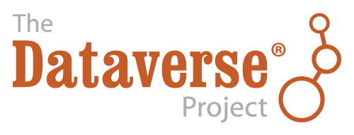
Dataverse
Dataverse is an open source research data repository software, that is being developed by Harvard’s Institute for Quantitative Social Science (IQSS) since 2006
and supported by the The Global Dataverse Community Consortium (GDCC).
It is used to share, preserve, cite, explore, and analyze research data.
https://dataverse.org/
Notes:
Here you can mention your own repository

Slide 4
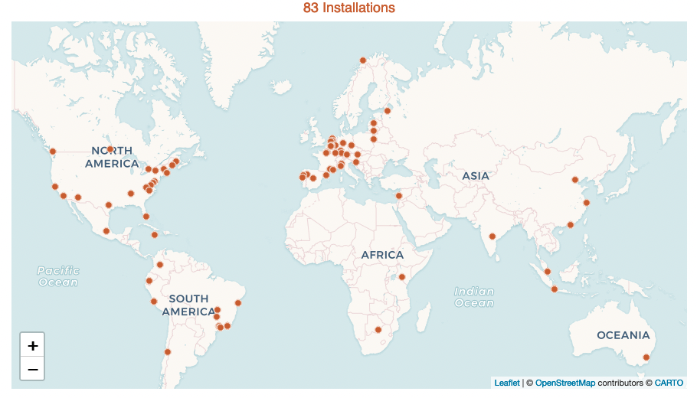
Dataverse
Notes:
Dataverse has 83 installations worldwide.
The most recent number is available at https://dataverse.org/

Slide 5
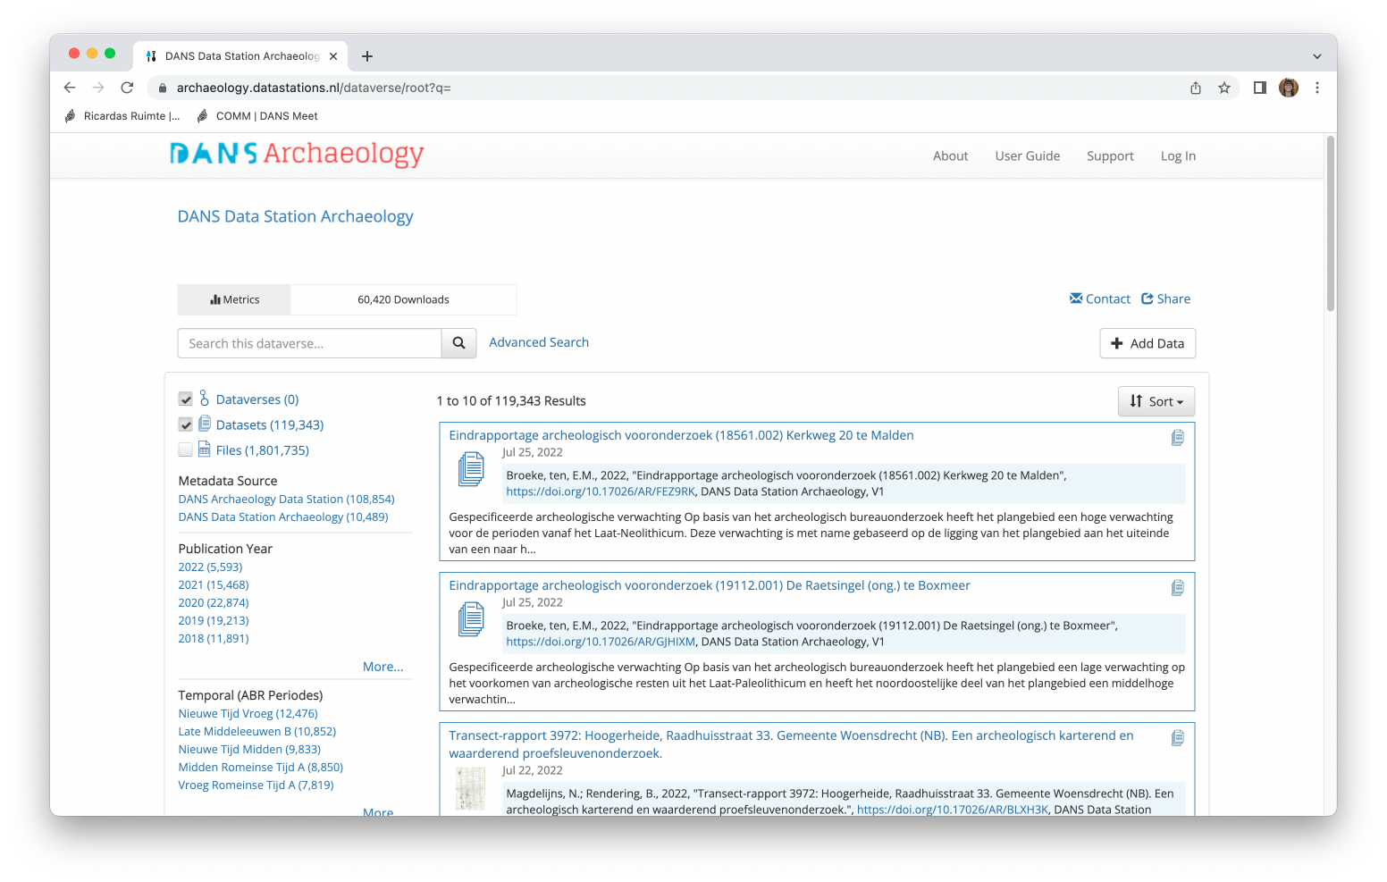
DANS Data Station
Notes:
You can show your own archive here as an example

Slide 6
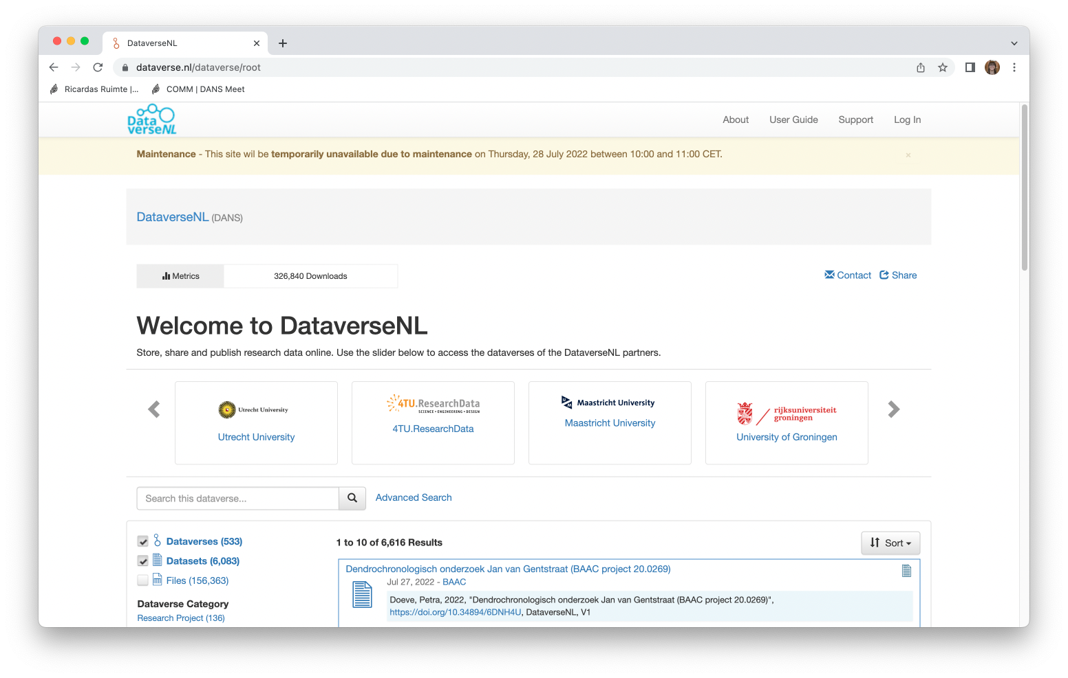
DataverseNL
Notes:
You can show your own archive here as an example

Slide 7
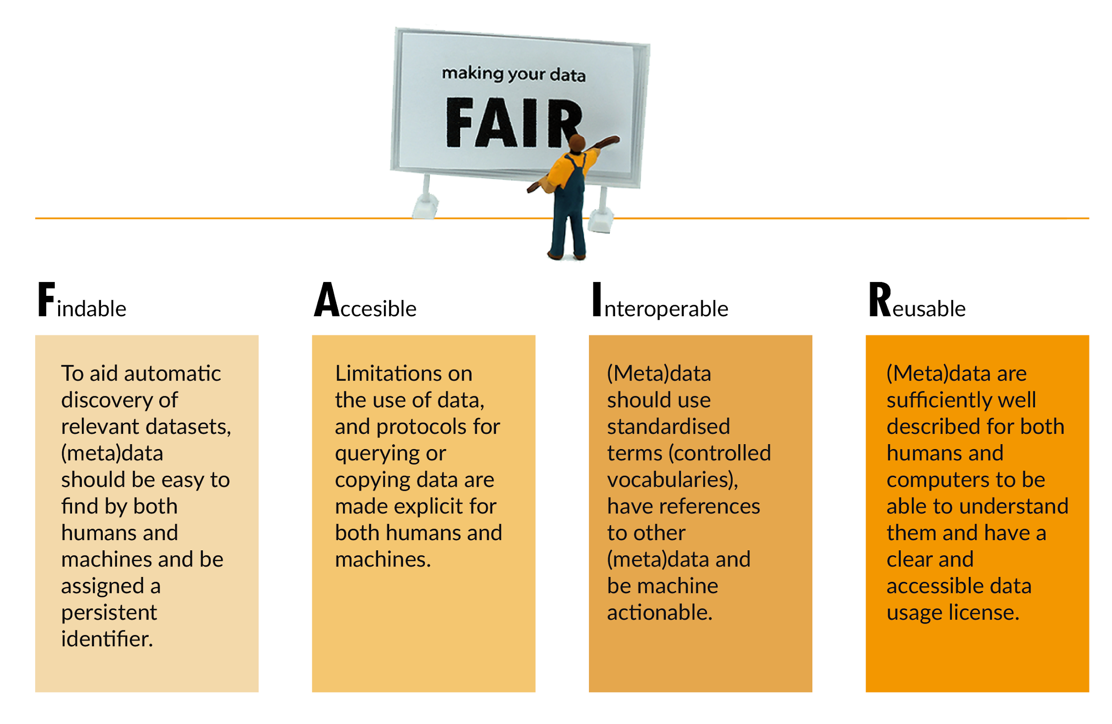
Dataverse helps make data FAIR
Image: CC-BY-SA CESSDA DMEG https://dmeg.cessda.eu/
Notes:
Explain the FAIR principles in short

Slide 8
Dataverse helps make data FAIR
Datasets have a Persistent Identifiers (PID), e.g. DOI
Includes standardized metadata blocks for different domains
  Metadata fields can be customized per collection
  Templates can be created for easier metadata entry
Metadata can be exported in various formats
Information on features: https://dataverse.org/software-features
Notes:
Dataverse has certain features that helps make data FAIR, we list them for Findable

Slide 9
Dataverse helps make Data FAIR
Datasets have a Persistent Identifiers (PID), e.g. DOI
Datasets can be openly available or access can be restricted
  Restrictions can be indicated per data file
Metadata is openly accessible even for restricted datasets
Information on features: https://dataverse.org/software-features
Notes:
Dataverse has certain features that helps make data FAIR, we list them for Accessible

Slide 10
Dataverse helps make Data FAIR
Includes standardized metadata blocks for different domains
Metadata can be exported in various formats
Controlled vocabularies can be connected to use standardised terms to describe data
Information on features: https://dataverse.org/software-features
Notes:
Dataverse has certain features that helps make data FAIR, we list them for Interoperable

Slide 11
Dataverse helps make Data FAIR
Datasets can be openly available or access can be restricted
  Restrictions can be indicated per data file
Supports various licenses
Statistical files (SPSS, STATA) are transformed into tabular data files
Information on features: https://dataverse.org/software-features
Notes:
Dataverse has certain features that helps make data FAIR, we list them for Reusable

Slide 12
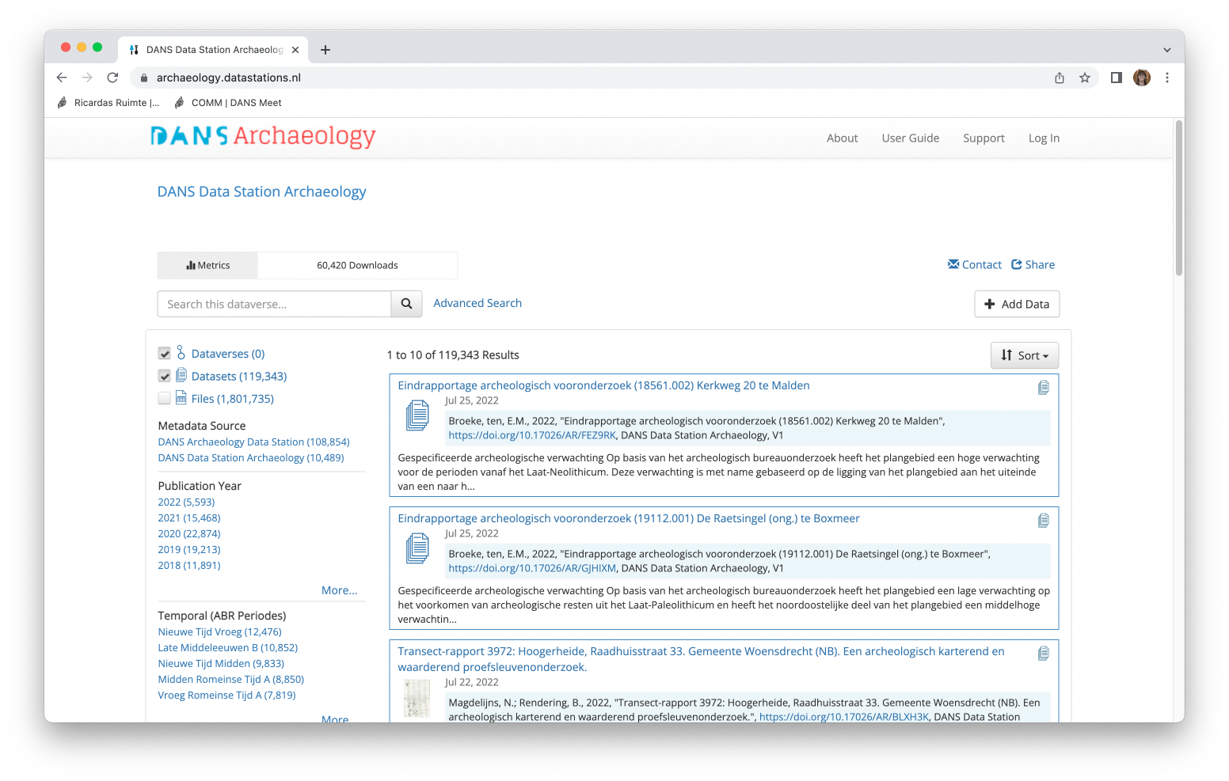
A closer look into a Dataverse repository
Number of datasets and files
Facets to filter
Example repsitory: DANS Data Station Archeaology: https://archaeology.datastations.nl/
Notes:
Here you can show your own repository

Slide 13
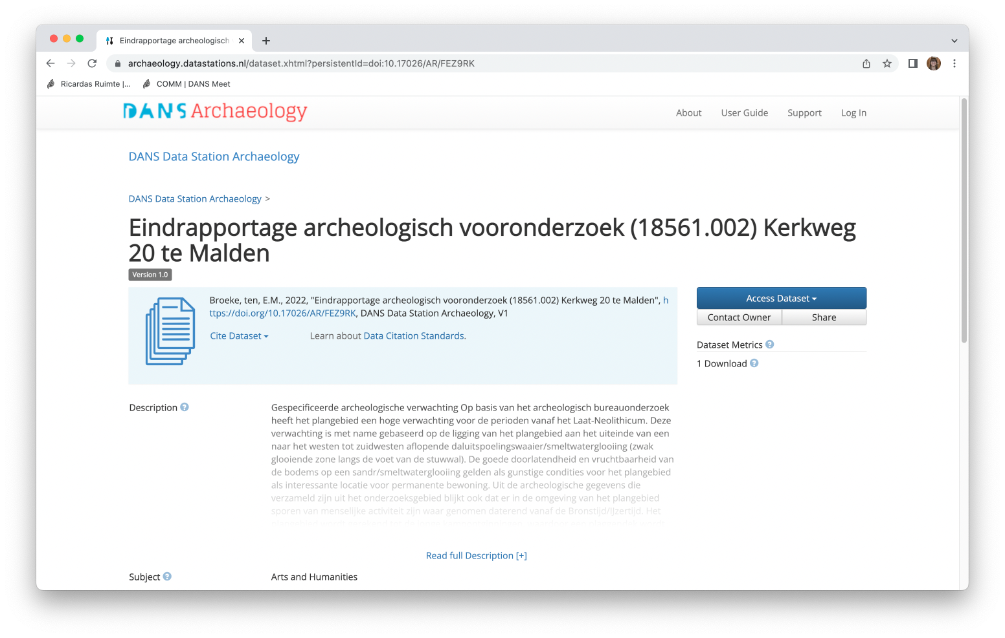
A closer look into a Dataverse repository
Citation information
Download information and metrics
Example repsitory: DANS Data Station Archeaology: https://archaeology.datastations.nl/
Notes:
Here you can show your own repository

Slide 14
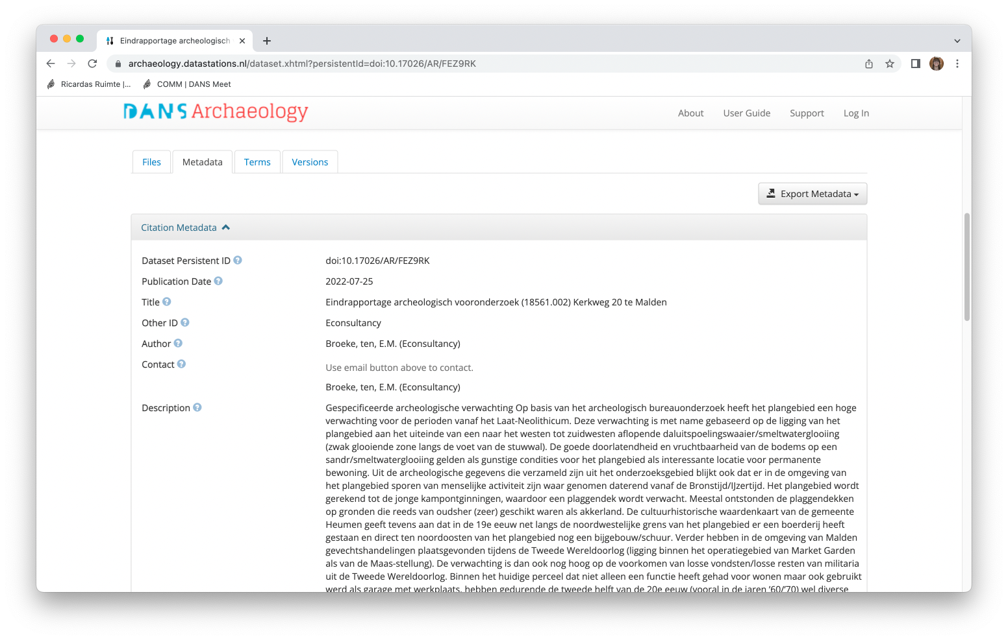
A closer look into a Dataverse repository
General information
Example repsitory: DANS Data Station Archeaology: https://archaeology.datastations.nl/
Notes:
Here you can show your own repository

Slide 15
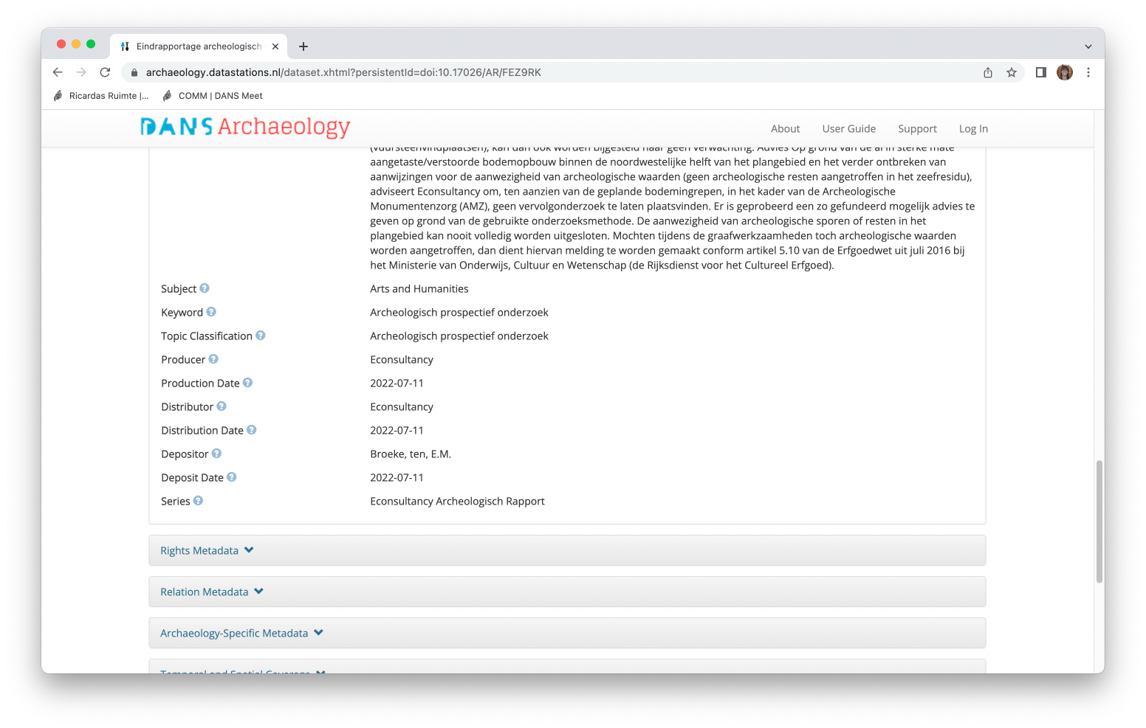
A closer look into a Dataverse repository
Example repsitory: DANS Data Station Archeaology: https://archaeology.datastations.nl/
Notes:
Here you can show your own repository

Slide 16
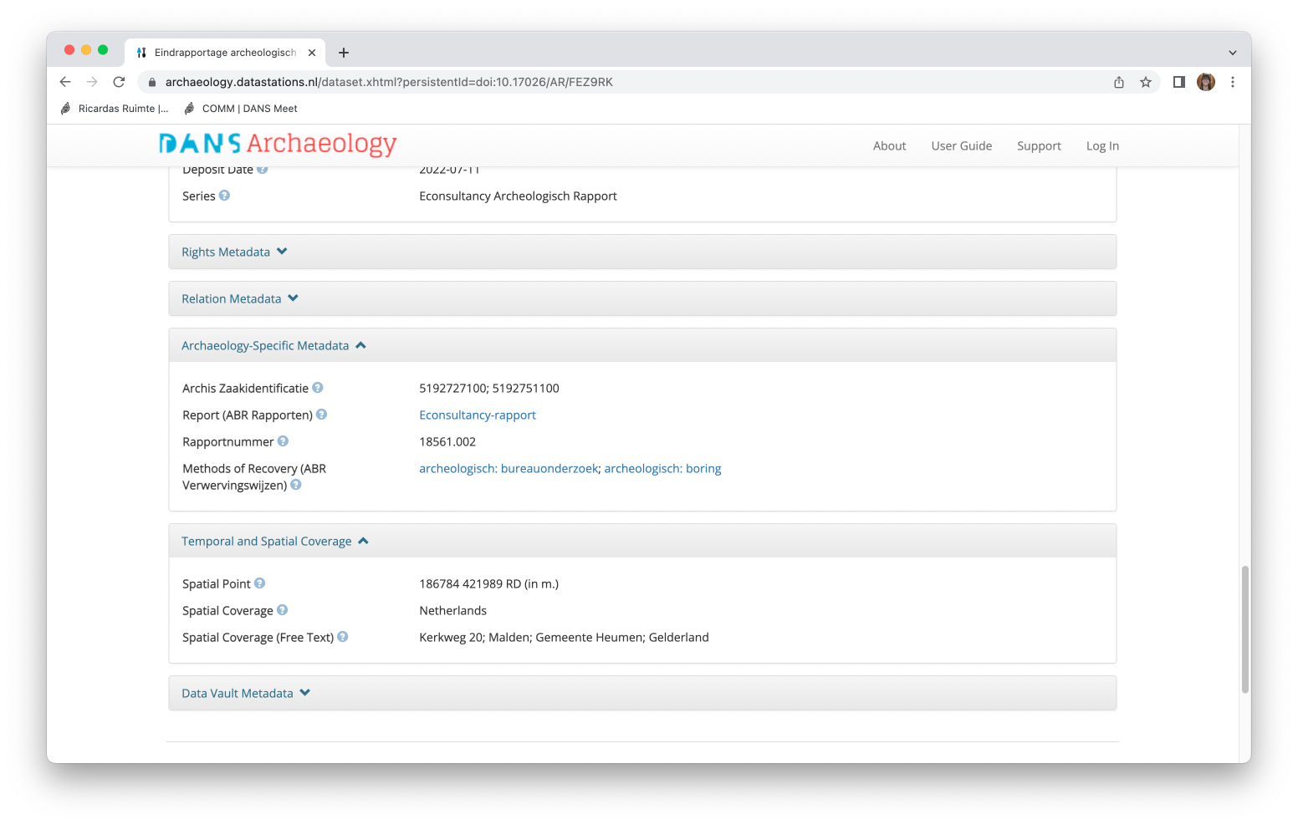
A closer look into a Dataverse repository
Domain-specific information
Example repsitory: DANS Data Station Archeaology: https://archaeology.datastations.nl/
Notes:
Here you can show your own repository

Slide 17
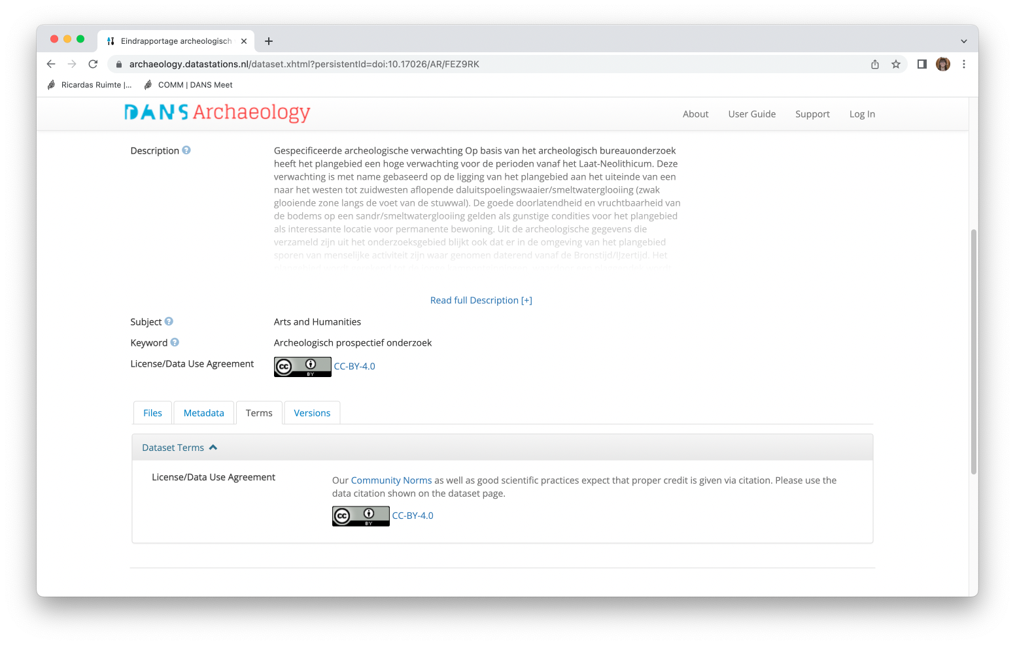
A closer look into a Dataverse repository
Information on license and terms of use
Example repsitory: DANS Data Station Archeaology: https://archaeology.datastations.nl/
Notes:
Here you can show your own repository

Slide 18
Archiving data in a Dataverse repository
Information taken from Dataverse End User Manual available at: https://doi.org/10.5281/zenodo.6347488
Notes:
Feel free to use your own example
Dataverse is organised according to collections.
An example here is given from the Dutch DataverseNL platform where different Dutch research institutes have their own collection or subdataverse

Slide 19
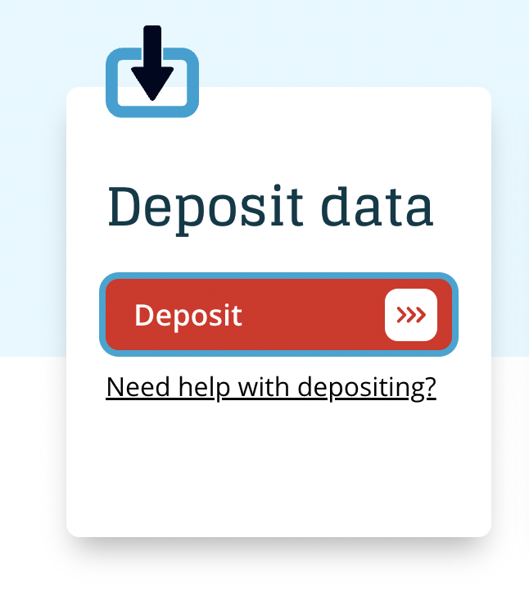
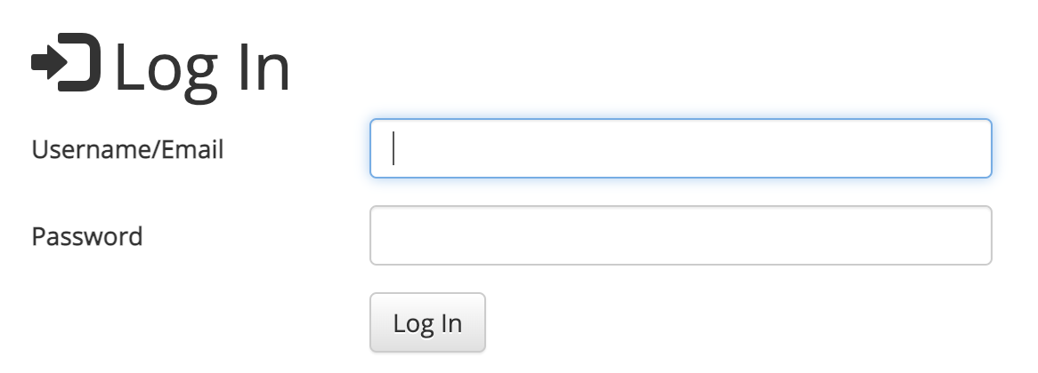
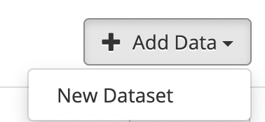
Archiving data in a Dataverse repository
Go to your Dataverse repository and log in
Click on “Add data” → “New Dataset”
Notes:
Screenshots are taken from https://dans.knaw.nl/en/data-stations/archaeology/ but feel free to use your own examples

Slide 20
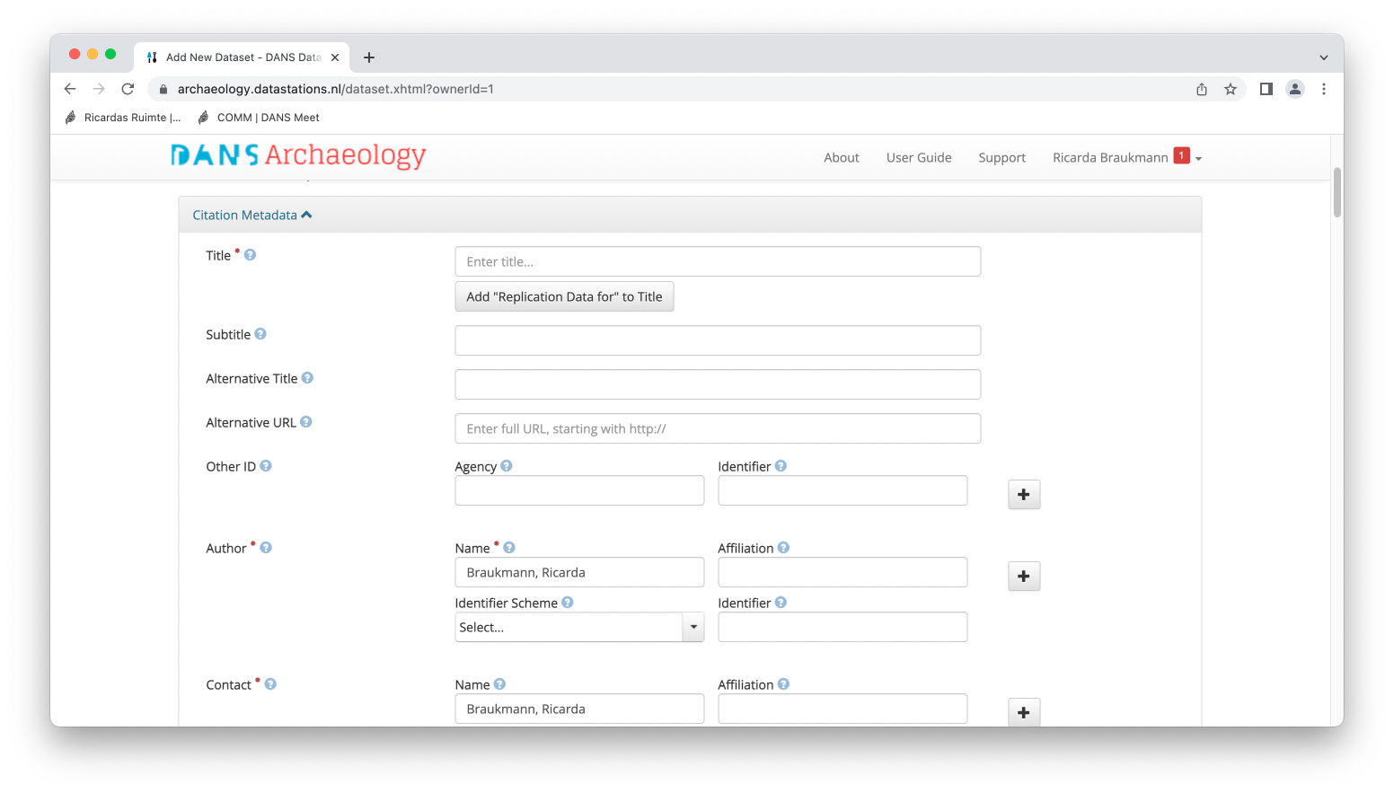
Archiving data in a Dataverse repository
Fill in the citation metadata (e.g. the dataset name, author, description etc.)
Provide as much detail as possible and note that required fields are marked by asterisks
Notes:
Screenshots are taken from https://dans.knaw.nl/en/data-stations/archaeology/ but feel free to use your own examples

Slide 21
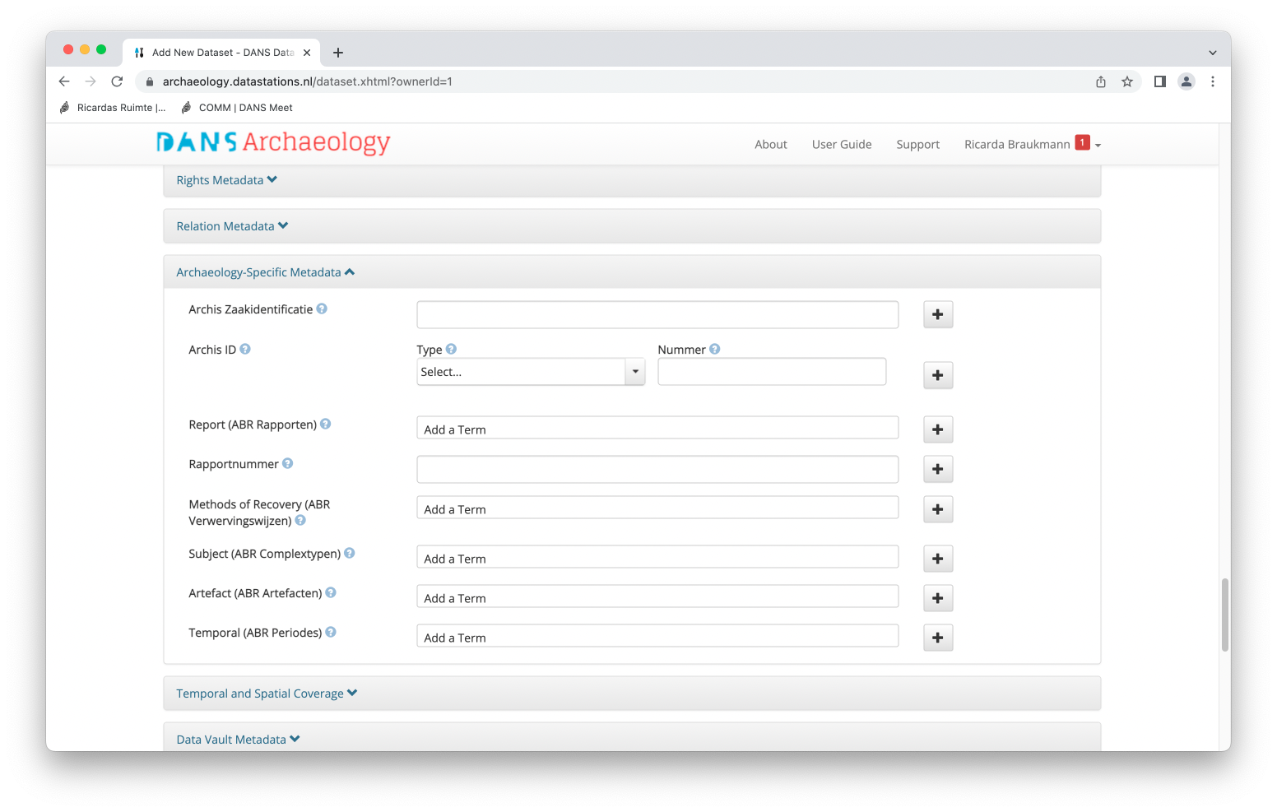
Archiving data in a Dataverse repository
Depending on your system you may have additional metadata blocks to fill in
Provide as much detail as possible and note that required fields are marked by asterisks
Notes:
Screenshots are taken from https://dans.knaw.nl/en/data-stations/archaeology/ but feel free to use your own examples

Slide 22
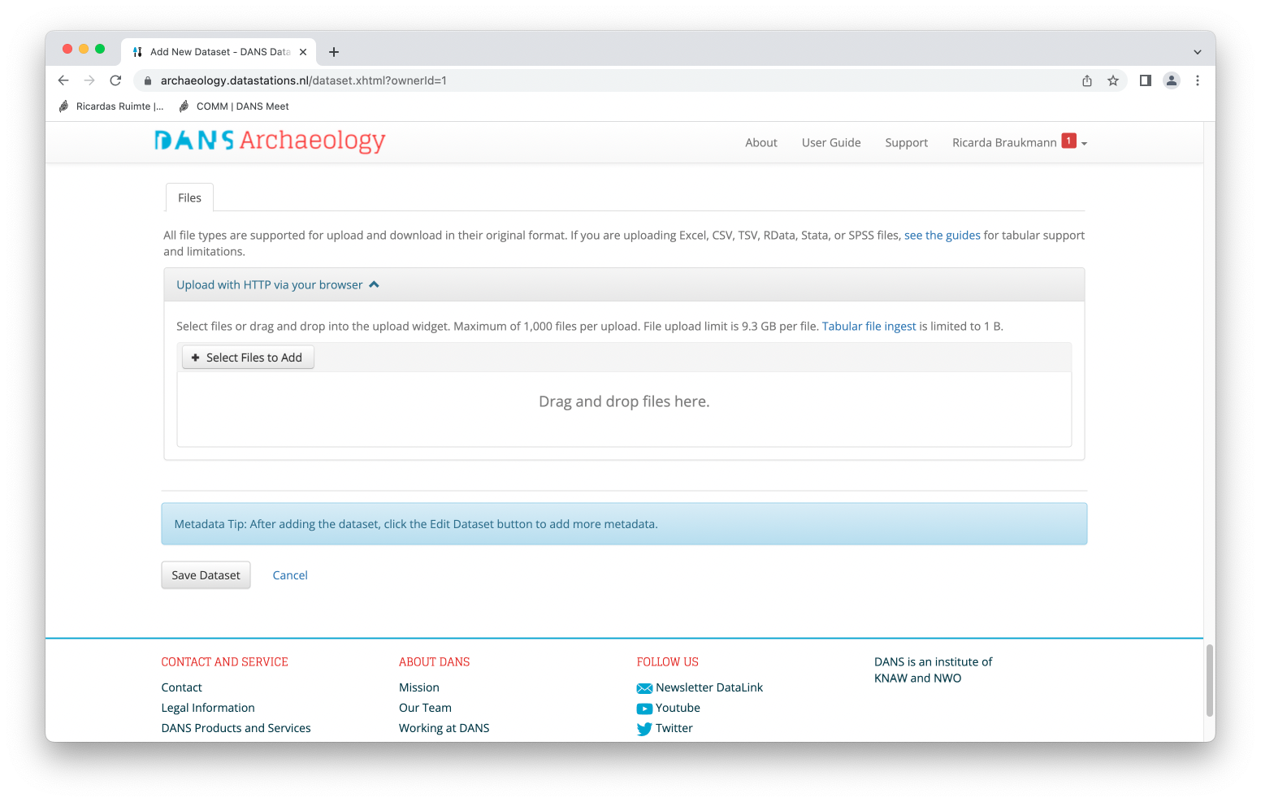
Archiving data in a Dataverse repository
Add files and save the the dataset
Notes:
Screenshots are taken from https://dans.knaw.nl/en/data-stations/archaeology/ but feel free to use your own examples

Slide 23
Archiving data in a Dataverse repository
After saving the initial dataset, you can perform additional edits to your dataset’s
METADATA
FILES
FILE METADATA AND RESTRICTIONS
TERMS
ROLES AND PERMISSIONS
Notes:
Screenshots are taken from https://dans.knaw.nl/en/data-stations/archaeology/ but feel free to use your own examples

Slide 24

Archiving data in a Dataverse repository
After saving the initial dataset, you can perform additional edits to your dataset’s
METADATA
Describes your data and facilitates search
Dataset metadata in various blocks + File level metadata
Archives may use controlled vocabularies (e.g. ELSST) → use the terms were possible to enhance search results and interoperability of your data
For datasets with similar metadata, you may be able to use templates !
Metadata can be exported in various formats!
Image: CC-BY-SA CESSDA DMEG https://dmeg.cessda.eu/
Notes:
Screenshots are taken from https://dans.knaw.nl/en/data-stations/archaeology/ but feel free to use your own examples

Slide 25
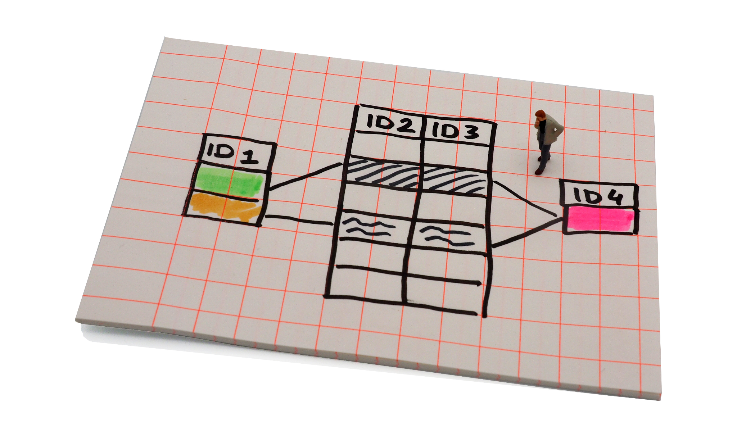
Archiving data in a Dataverse repository
After saving the initial dataset, you can perform additional edits to your dataset’s
FILES
You can upload additional files under the File tab
Some files will automatically be transformed into sustainable formats
  SPSS, STATA files and other tabular data is transformed into TAB files readable by many programmes
  Ingest may take some time - you will receive an email when it is done :)
  Under download, the original files and the converted files will be available
Image: CC-BY-SA CESSDA DMEG https://dmeg.cessda.eu/
Notes:
Screenshots are taken from https://dans.knaw.nl/en/data-stations/archaeology/ but feel free to use your own examples

Slide 26
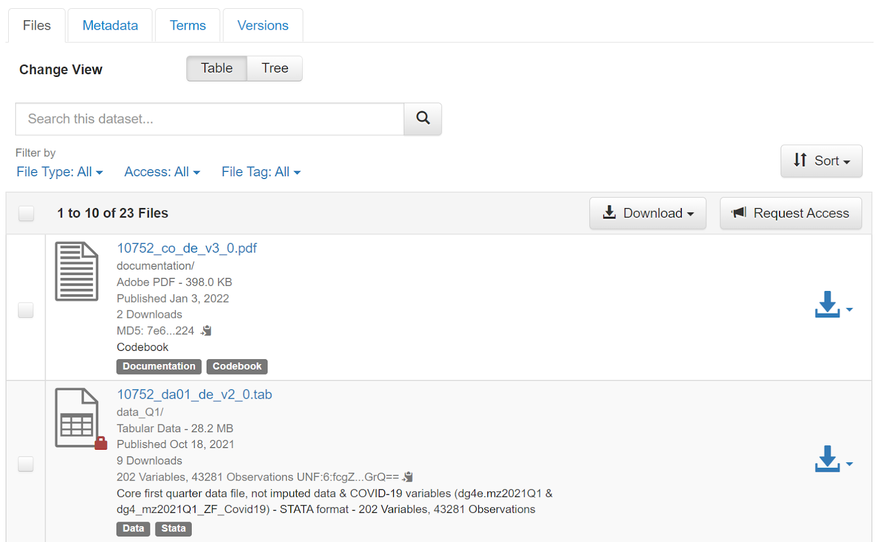
Archiving data in a Dataverse repository
After saving the initial dataset, you can perform additional edits to your dataset’s
FILE METADATA AND RESTRICTIONS
You can edit the metadata of your data files to include more specific information
You can restrict access to particular files
  Restricted files are indicated by a lock
  You can allow access requests to the files
You can replace files with a new version
Notes:
Screenshots are taken from https://dans.knaw.nl/en/data-stations/archaeology/ but feel free to use your own examples

Slide 27
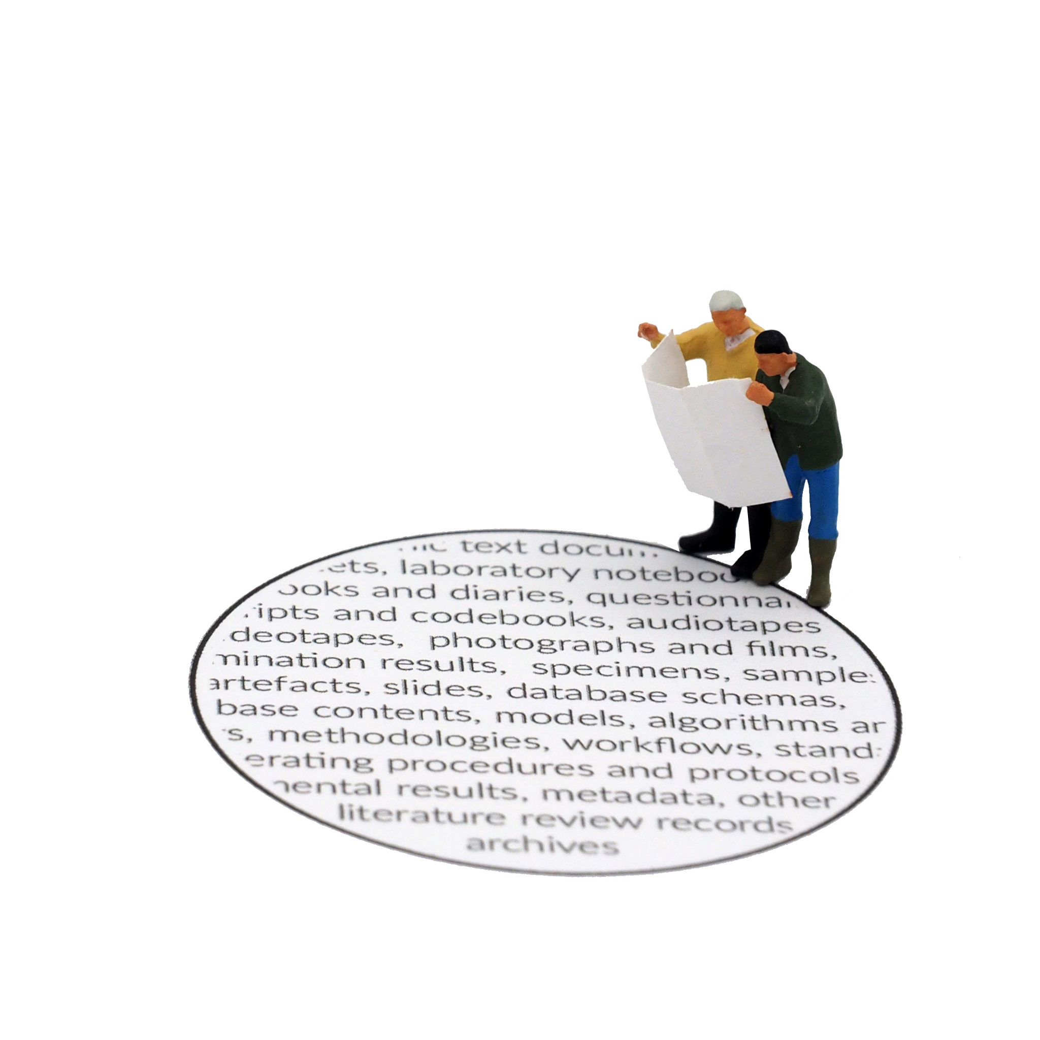
Archiving data in a Dataverse repository
After saving the initial dataset, you can perform additional edits to your dataset’s
TERMS
Here you can define the Terms of Use and the Access Conditions
Depending on your archive, specific licenses will be presented to choose from
Often archives offer
  Open licenses for datasets that are available open access
  Dedicated licenses for datasets that have access restrictions
You can set your data to be accessible only with an access request
  Logged in users send a request through the ‘Request Access’ button
  Remember to use an email address for contact that will remain available!
Image: CC-BY-SA CESSDA DMEG https://dmeg.cessda.eu/
Notes:
Screenshots are taken from https://dans.knaw.nl/en/data-stations/archaeology/ but feel free to use your own examples

Slide 28
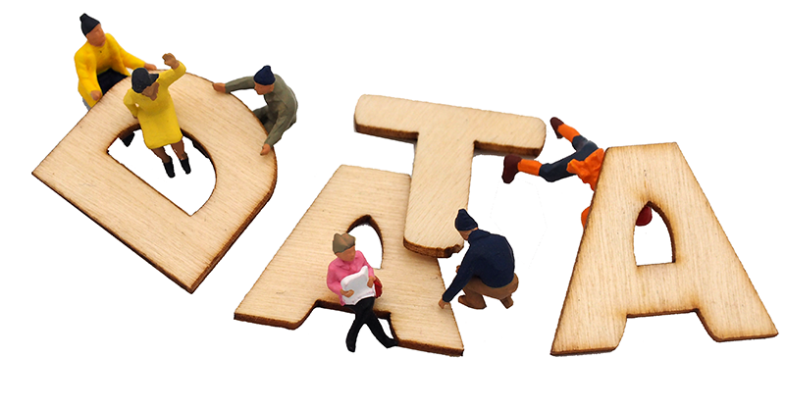
Archiving data in a Dataverse repository
After saving the initial dataset, you can perform additional edits to your dataset’s
ROLES AND PERMISSIONS
You can assign roles and permissions on data level or file level
Note that not all Dataverse installations let you modify the settings
You may for instance want to add a collaborator who can edit and upload files to your dataset.
Image: CC-BY-SA CESSDA DMEG https://dmeg.cessda.eu/
Notes:
Screenshots are taken from https://dans.knaw.nl/en/data-stations/archaeology/ but feel free to use your own examples

Slide 29

Archiving data in a Dataverse repository
SUBMITTING YOUR DATASET FOR REVIEW
After checking your dataset and all the information you provided you can submit your dataset for review.
The Curator of the Dataverse will be notified and can publish the dataset or contact you
Do remember that once a dataset is published it must remain published.
→ Use the DOI of your data to refer to it!
Image: CC-BY-SA CESSDA DMEG https://dmeg.cessda.eu/
Notes:
Note that in some cases users can publish their datasets themselves.

Slide 30
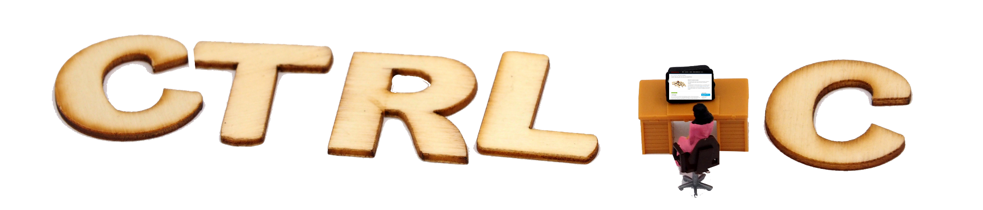
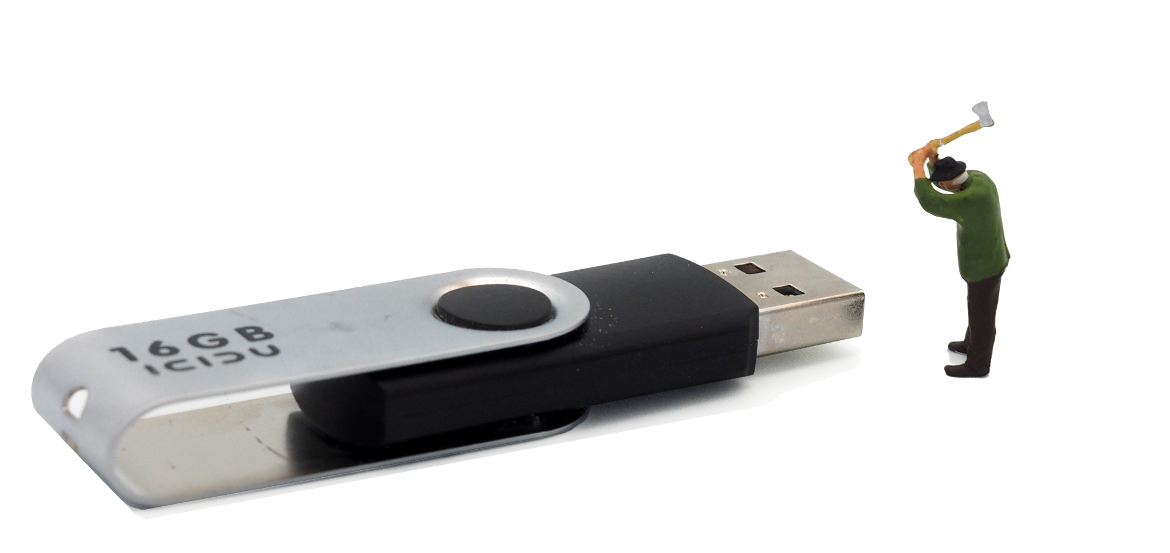
Archiving data in a Dataverse repository
CREATING A NEW VERSION
You can create a new version of your dataset
In the “version” tab you can find all the versions that were published
DEACCESSIONING A DATASET
Published datasets cannot be deleted
They can be deaccessioned if there is a good reason
  Basic information will remain available
  The reason for deaccession will be listed
  The DOI will point to that information
Images: CC-BY-SA CESSDA DMEG https://dmeg.cessda.eu/
Notes:
Note that in some cases users can publish their datasets themselves.

Slide 31
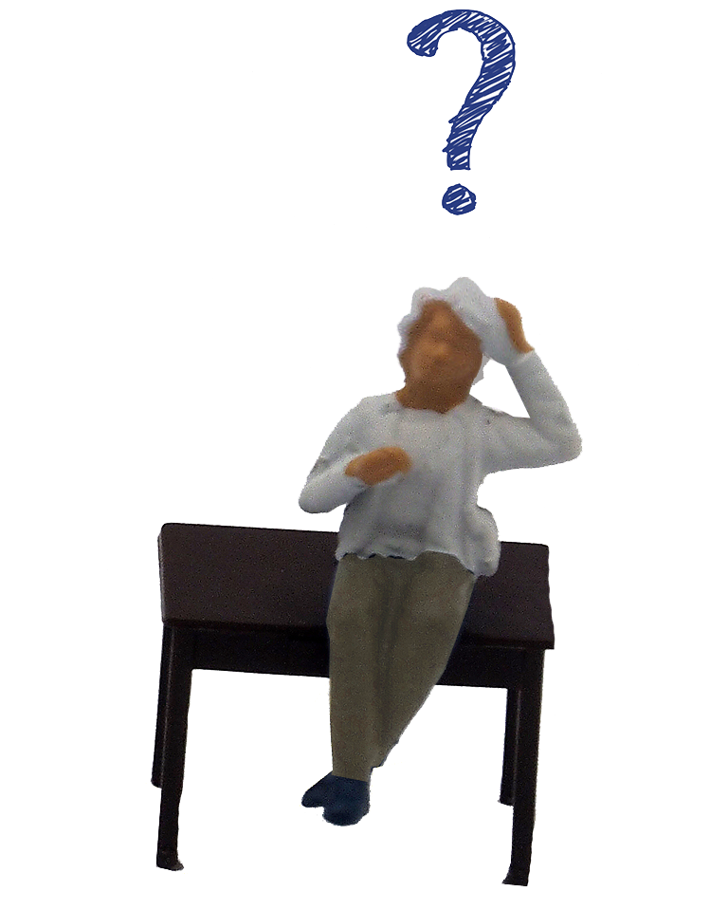
Any questions?

Slide 32
Time to try it yourself
Images: CC-BY-SA CESSDA DMEG https://dmeg.cessda.eu/
Notes:
Depending on your audience you can here present a link to the repository where the researchers should upload their data.
If available you could use a test environment
Alternatively, you could upload a test dataset together and walk your participants through the steps.

Slide 33
Any questions?

