Slide 1

Archiving & Publishing
How to Archive and Publish your Data
Example presentation
Notes:
This is an example presentation on Archiving and Publishing data is based on the presentation “TTT_PR_Ch6_Archive_v1.0.pdf” available at cessda.eu/ttt

Slide 2
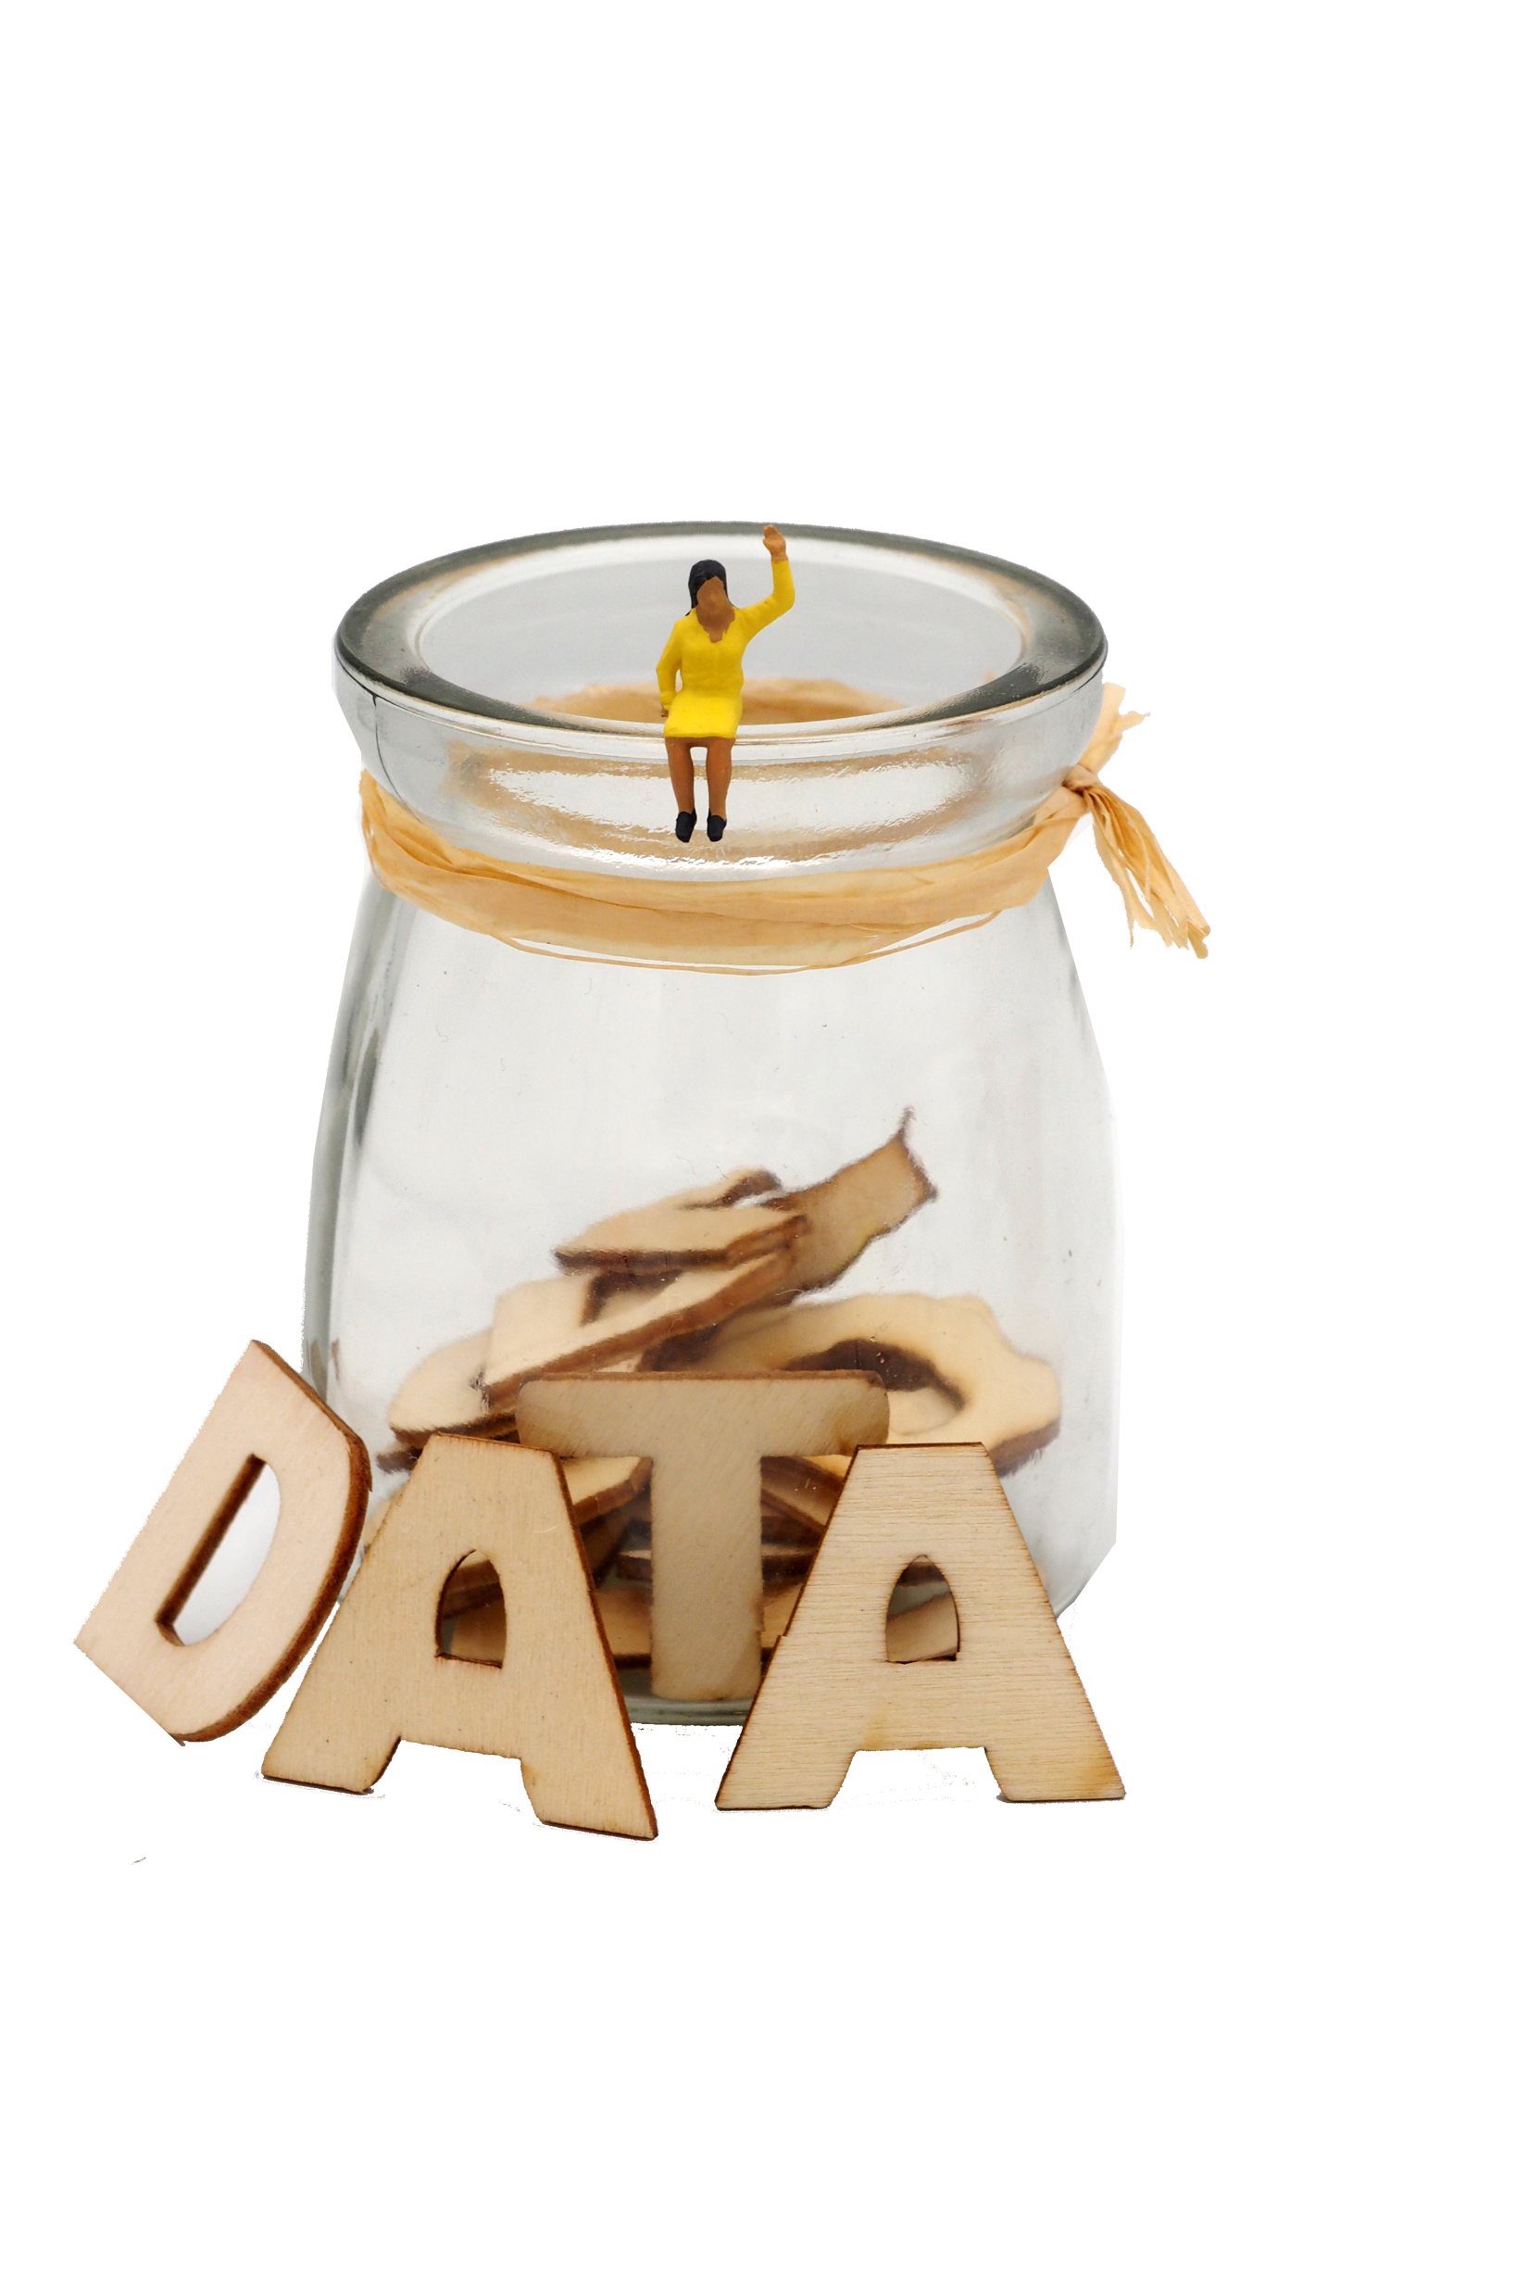
Overview
Areas to be covered:
» reasons to archive & publish
» data publication;
» different data publication routes;
» a domain specific data repository;
» publishing with CESSDA archives;
» promoting data publication.
Archiving and publishing your data properly will enable both your future self as well as future others to get the most out of your data.
Image: CC-BY-SA CESSDA DMEG https://dmeg.cessda.eu/
Notes:
Provide overview
This session is about introducing types of data available and how to find data for a research project.
Five sections
Lectures/talking but also practical activities where the aim is to find data for a specific research question
Assumes no prior knowledge but we recognise you may come with relevant experience and knowledge, therefore - opportunity to share and learn from each other

Slide 3
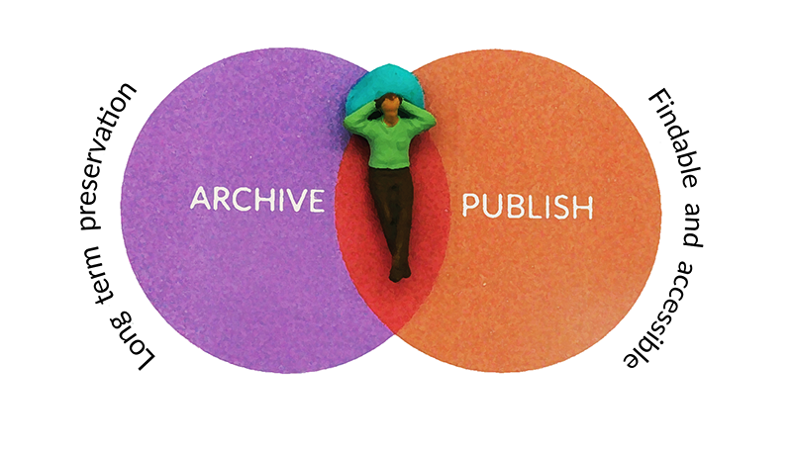
Towards Archiving and Publishing
Archiving? Publishing? Sharing?
Image: CC-BY-SA CESSDA DMEG https://dmeg.cessda.eu/

Slide 4
Archiving data
store your data in a suitable file format, with adequate documentation and keep your data safe on a long term
make sure you can read and access the data later on
allow access to others for verification purposes
Image: CC-BY-SA CESSDA DMEG https://dmeg.cessda.eu/

Slide 5
Publishing data
is the act of publicly disclosing the research data you've collected,
making them findable
accessible &
reusable.
Image: CC-BY-SA CESSDA DMEG https://dmeg.cessda.eu/

Slide 6
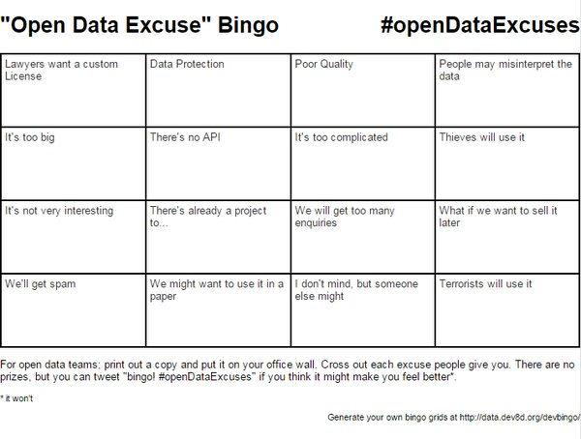
Reasons not to share your data?
We may want to use it in a paper
It is not very interesting
People may misinterpret the data
Poor quality
…

Slide 7
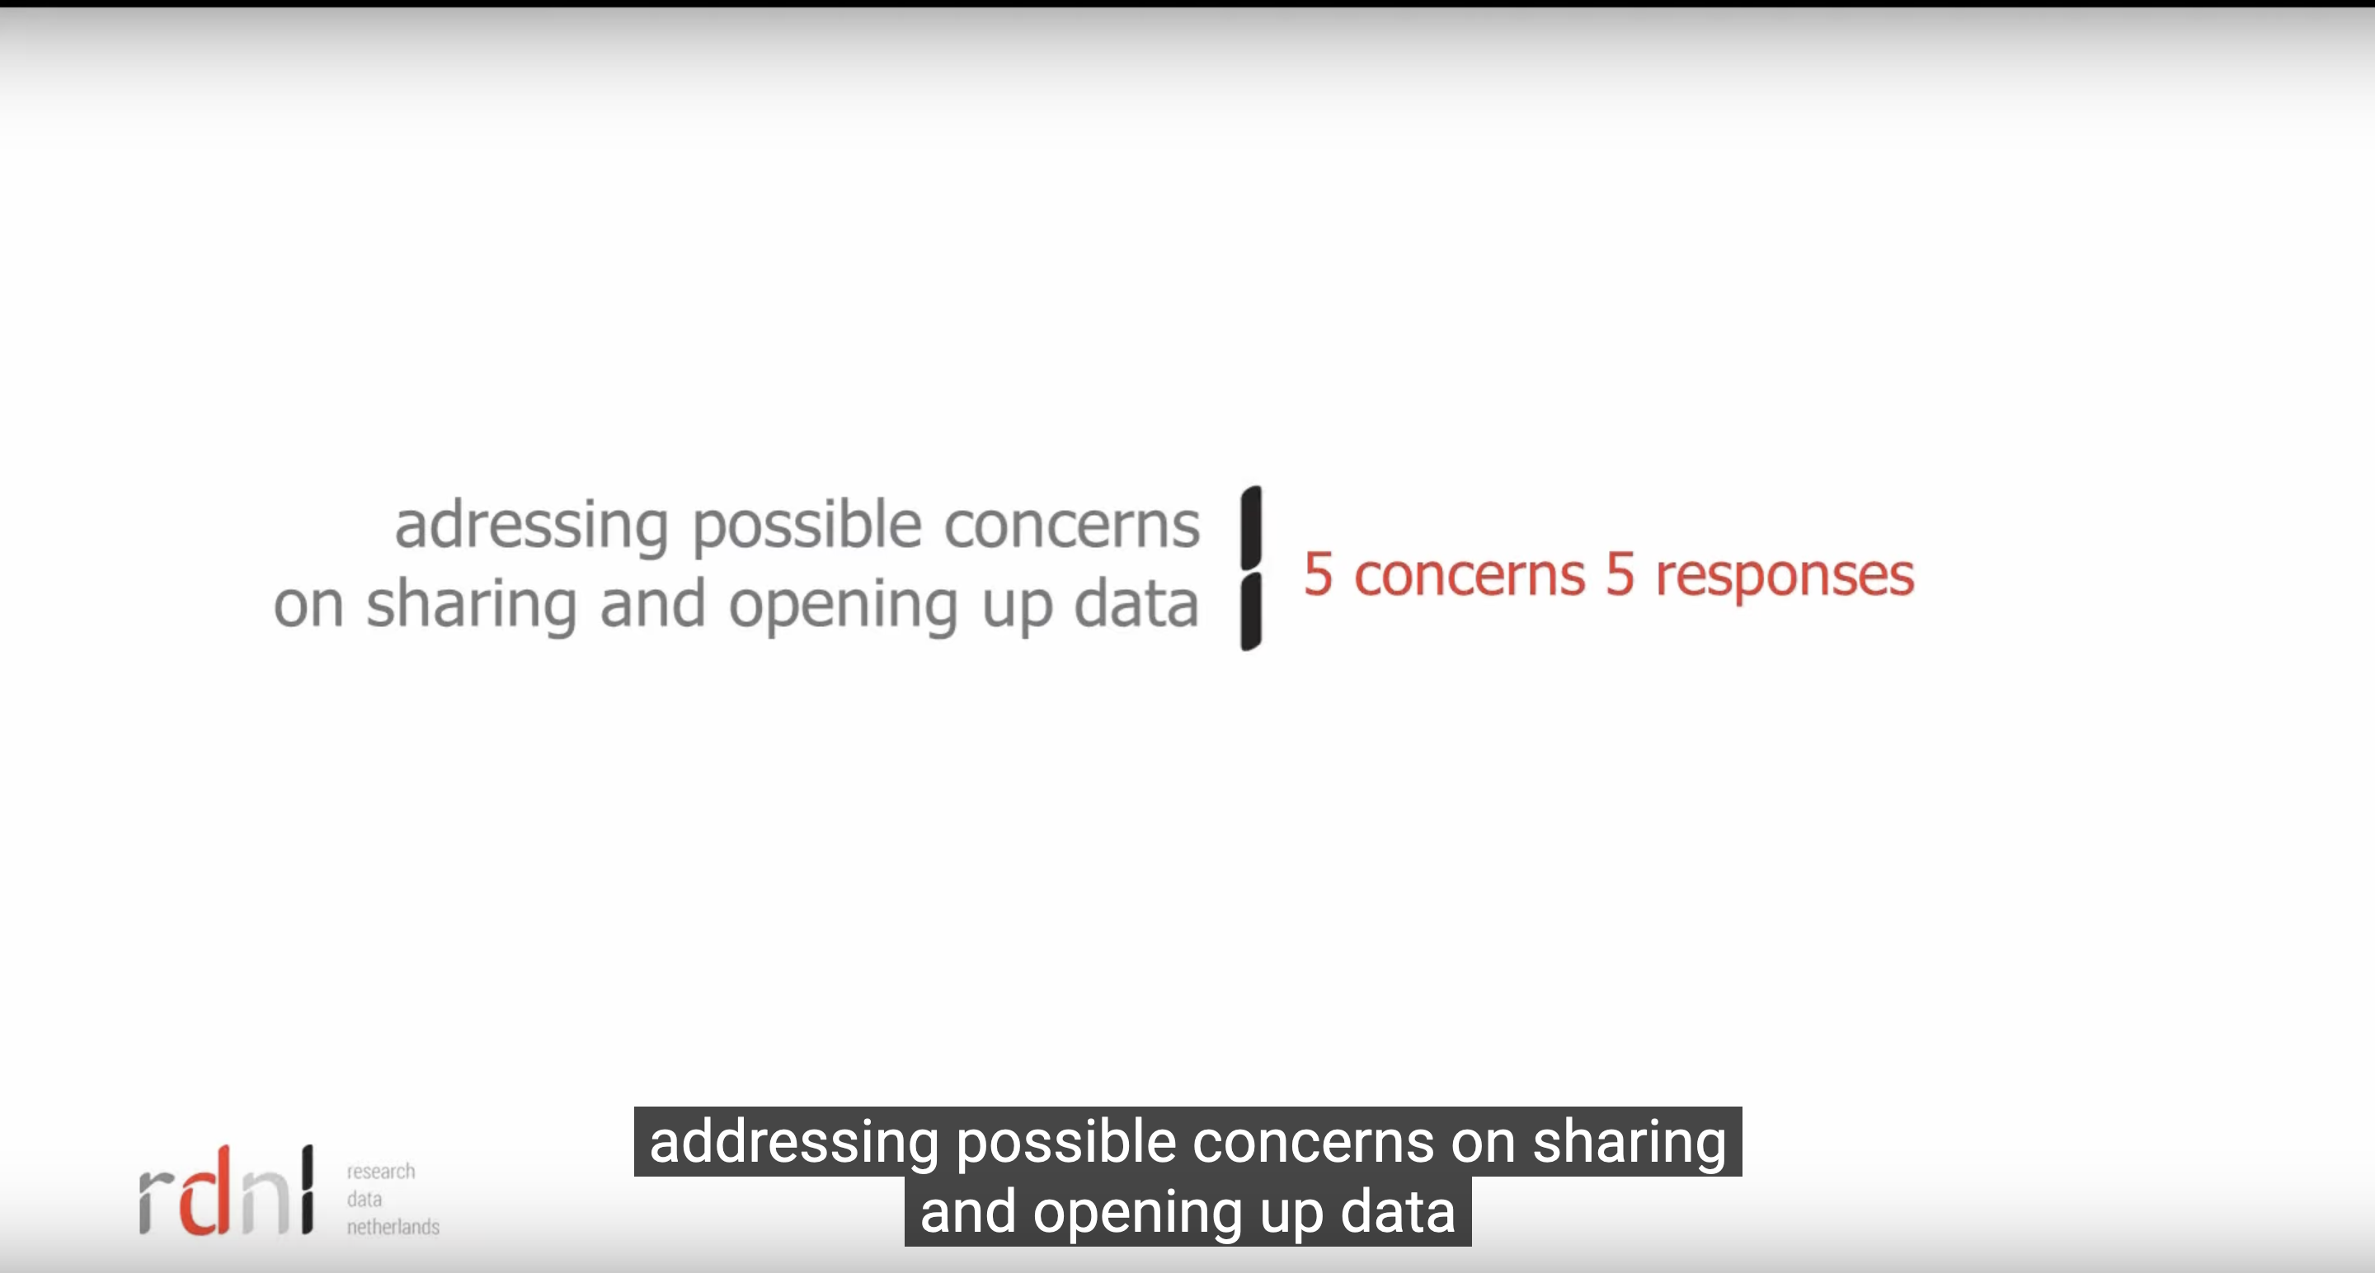
Reasons not to share your data
Video from https://www.youtube.com/watch?v=8qRLgQa1wT4
Notes:
Here you may want to show this video or you may want to pauze and discuss with your audience how they think about the mentioned reasons

Slide 8
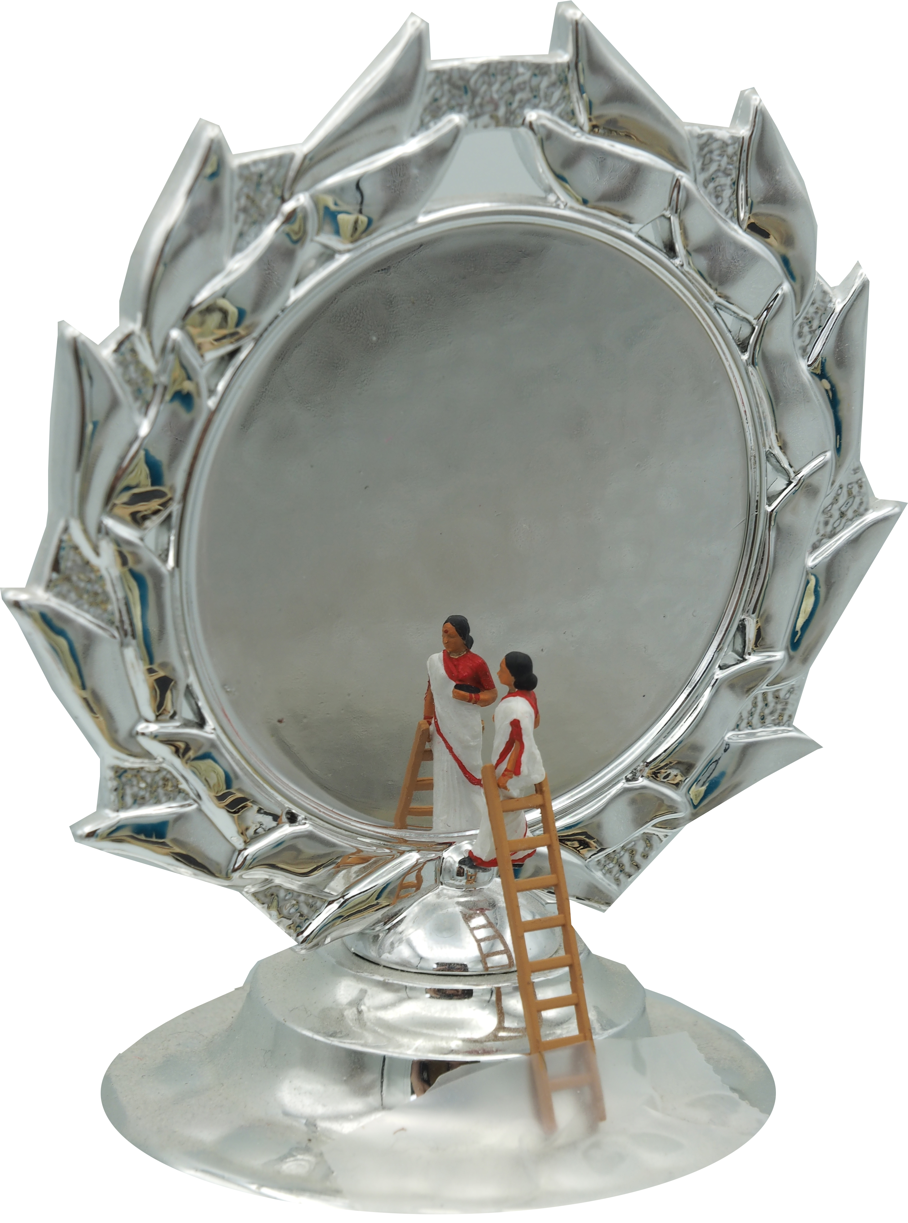
Reasons to share data
Career benefits
  increased visibility, reuse and citation and therefore recognition of scholarly work
Scientific progress
  enabling new collaborations, new data uses and links to the next generation of researchers
Norms
  openness of research data is at the heart of scientific ethics
External drivers
  Funders and publishers requirements

Slide 9
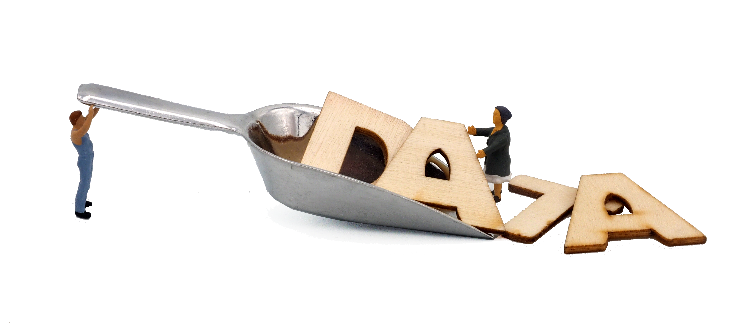
How to select data for Archiving & Publishing
Does your data have potential value in terms
  » of reuse
  » national/international standing and quality
  » importance for history
  » uniqueness (the data contain non-repeatable observations)
  » originality, size, scale
  » costs of data production or
  » innovative nature of the research?
Image: CC-BY-SA CESSDA DMEG https://dmeg.cessda.eu/

Slide 10
How to select data for Archiving & Publishing
Is your dataset reusable?
» Can the data be read and used?
» Are metadata available and sufficient to let future users understand your data?
» Any legal objections which prevent the data from being published?
Image: CC-BY-SA CESSDA DMEG https://dmeg.cessda.eu/

Slide 11
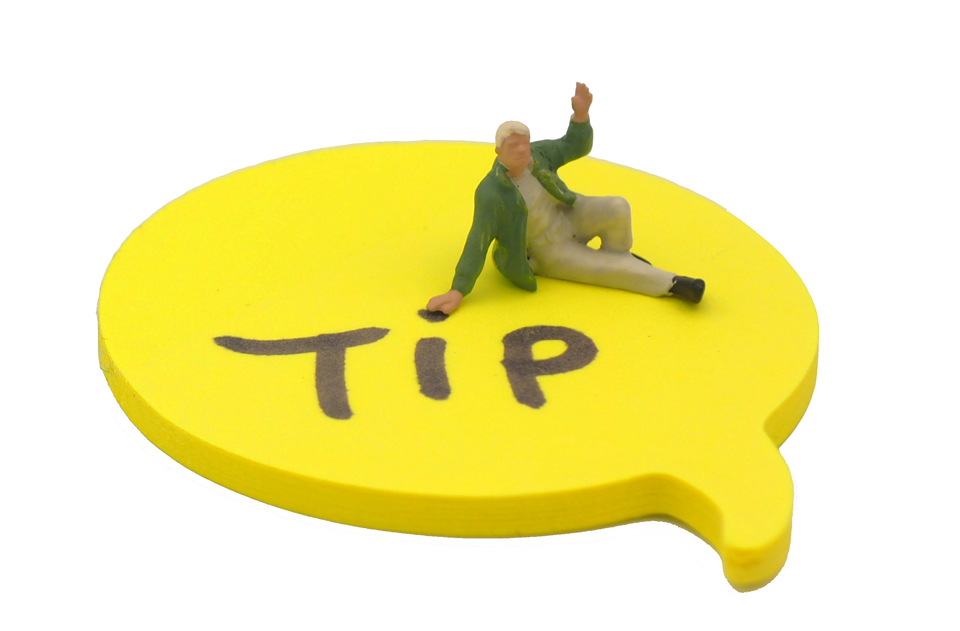
Timing is everything!
If you archive and publish your data as soon as data collection ends, your knowledge about your data is still very high.
Image: CC-BY-SA CESSDA DMEG https://dmeg.cessda.eu/

Slide 12
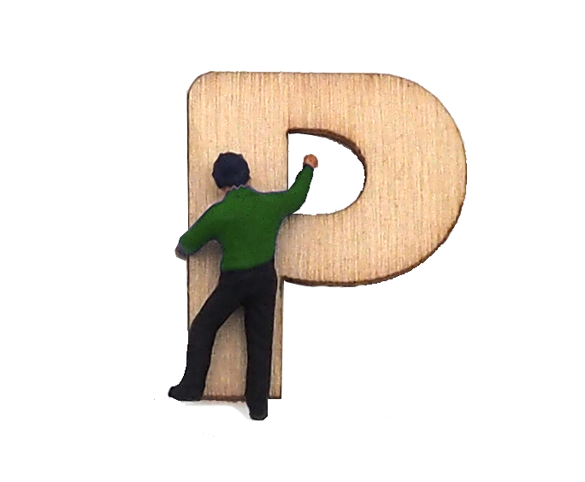
What is data publication
It is expected that a Data Publication will ensure that data will potentially be considered as a first-class research output. Knowledge Exchange (2013).
Image: CC-BY-SA CESSDA DMEG https://dmeg.cessda.eu/

Slide 13
What is data publication
Publishing with a capital “P“
  » Properly documented with metadata;
  » Reviewed for quality;
  » Searchable and discoverable in catalogues (or databases);
  » Citable in articles
Publishing with a small “p“
» there are no guarantees that the data will be there after some time or that the files will not get corrupted.
(Brase et al., (2009)
Image: CC-BY-SA CESSDA DMEG https://dmeg.cessda.eu/

Slide 14


Which data repository to chose?
Recommended by OpenAIRE (2016)
1. A (trusted) domain repository already established for your research domain.
2. If a domain repository isn't available, use an institutional research data repository.
3. If none of the above is available, use a general purpose repository (e.g. Zenodo)
→ Find your own at re3data.org: a registry of over 1500 research data repositories.

Slide 15
Choose between self-archiving and expert help
While self-archiving is a quick and easy way to publish data, archiving with the help of an expert will enhance data quality.
Image: CC-BY-SA CESSDA DMEG https://dmeg.cessda.eu/

Slide 16
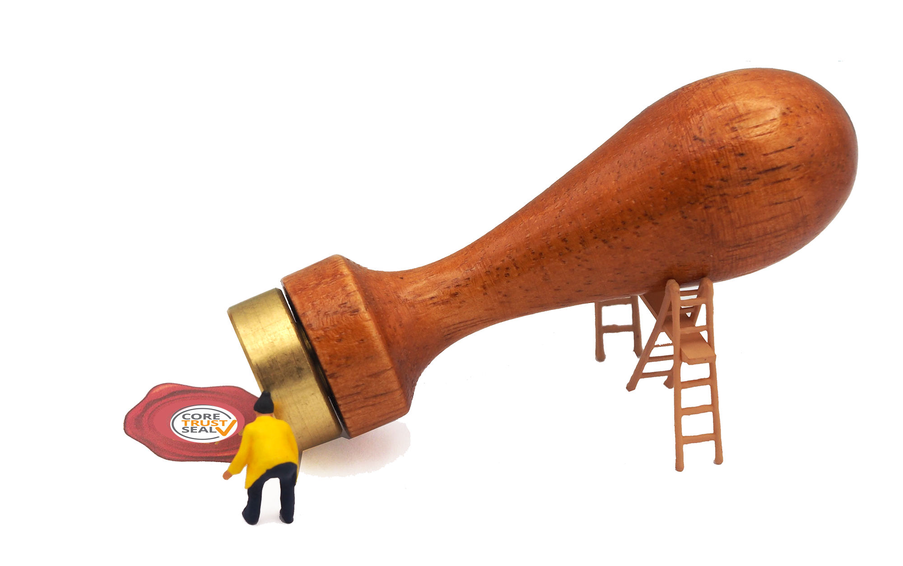
CESSDA repositories
(Trusted) domain specific data repositories
→ For high-quality data with a potential for reuse, we recommend you to assure long-term access by publishing them with a trusted repository, like many of the CESSDA archives.
Advantage of having expert help within reach
→ help you to increase the comprehensibility, visibility, findability, reusability, longevity and the overall quality of your datasets.
Image: CC-BY-SA CESSDA DMEG https://dmeg.cessda.eu/

Slide 17
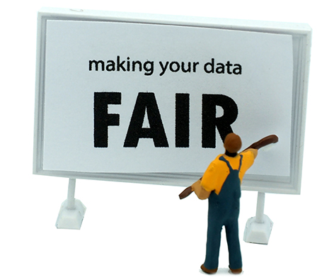
CESSDA repositories
Accessible and protected when needed
→ Following the principle ”as open as possible, as closed as necessary”
Comprehensibility
CESSDA expert will advise you on what information is needed to understand your data.
Ensuring that your metadata is as rich and complete as possible helps in making sure your data meet the F (Findability) and I (interoperability) in FAIR data management.
Image: CC-BY-SA CESSDA DMEG https://dmeg.cessda.eu/

Slide 18
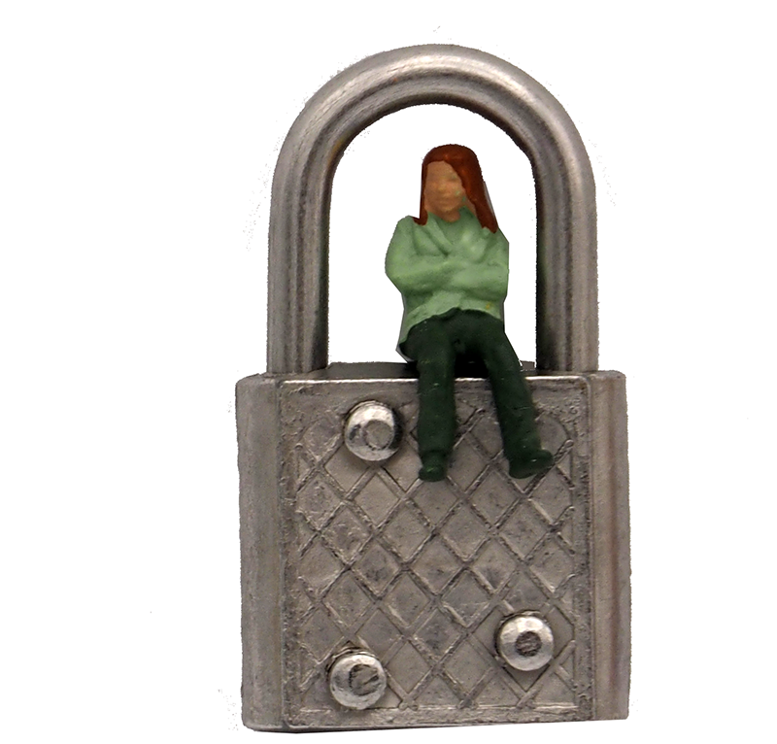
CESSDA repositories
Findability and visibility
→ When you publish your data at a CESSDA archive your data become more visible through data citation, scientific credits, active promotion
Accessibility and reusability
→ With a combination of data licensing and access categories CESSDA data archives can control the exact level of access and permitted reuse.
Image: CC-BY-SA CESSDA DMEG https://dmeg.cessda.eu/

Slide 19
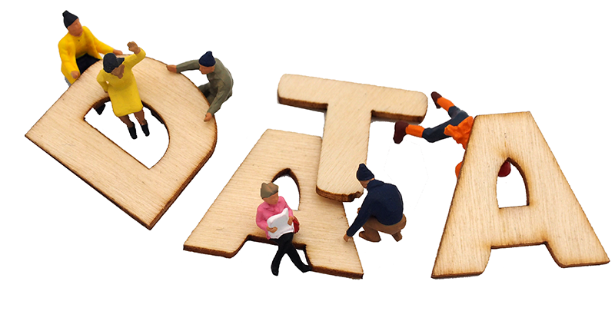
CESSDA repositories
Longevity
Archive provides advice on the best file formats for long-term preservation
expertise and services to convert data to new formats
add value to the data, e.g. by new functionality to query the data.
Quality
experts will review the quality your data by judging e.g. the content of the study, methodology, relevance, legal consistency and documentation of materials.
Image: CC-BY-SA CESSDA DMEG https://dmeg.cessda.eu/

Slide 20
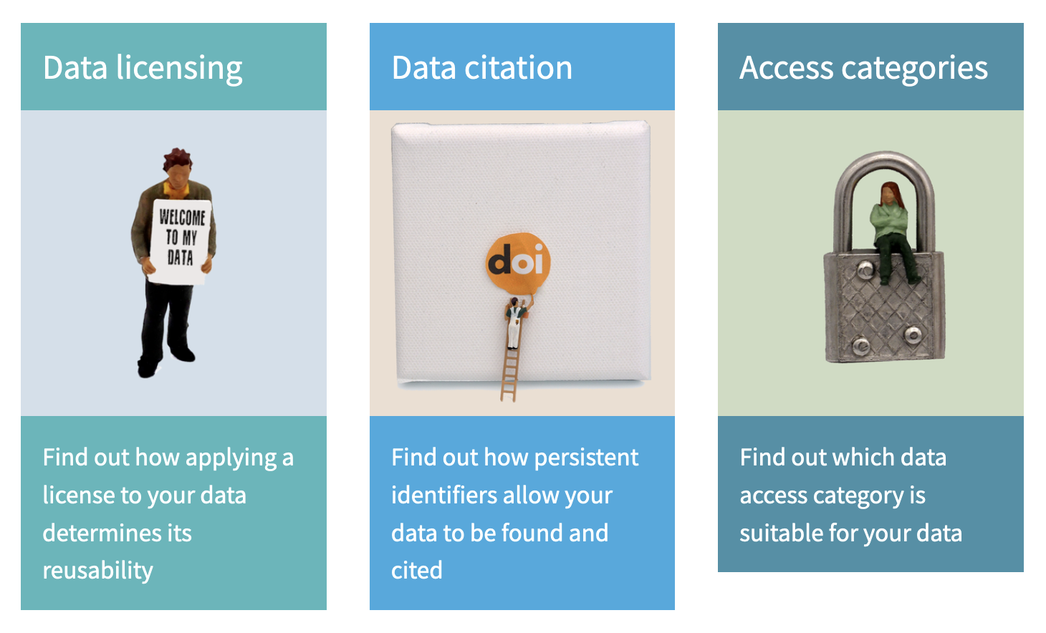
DMEG provides in-depth information about
Image: CC-BY-SA CESSDA DMEG https://dmeg.cessda.eu/

Slide 21

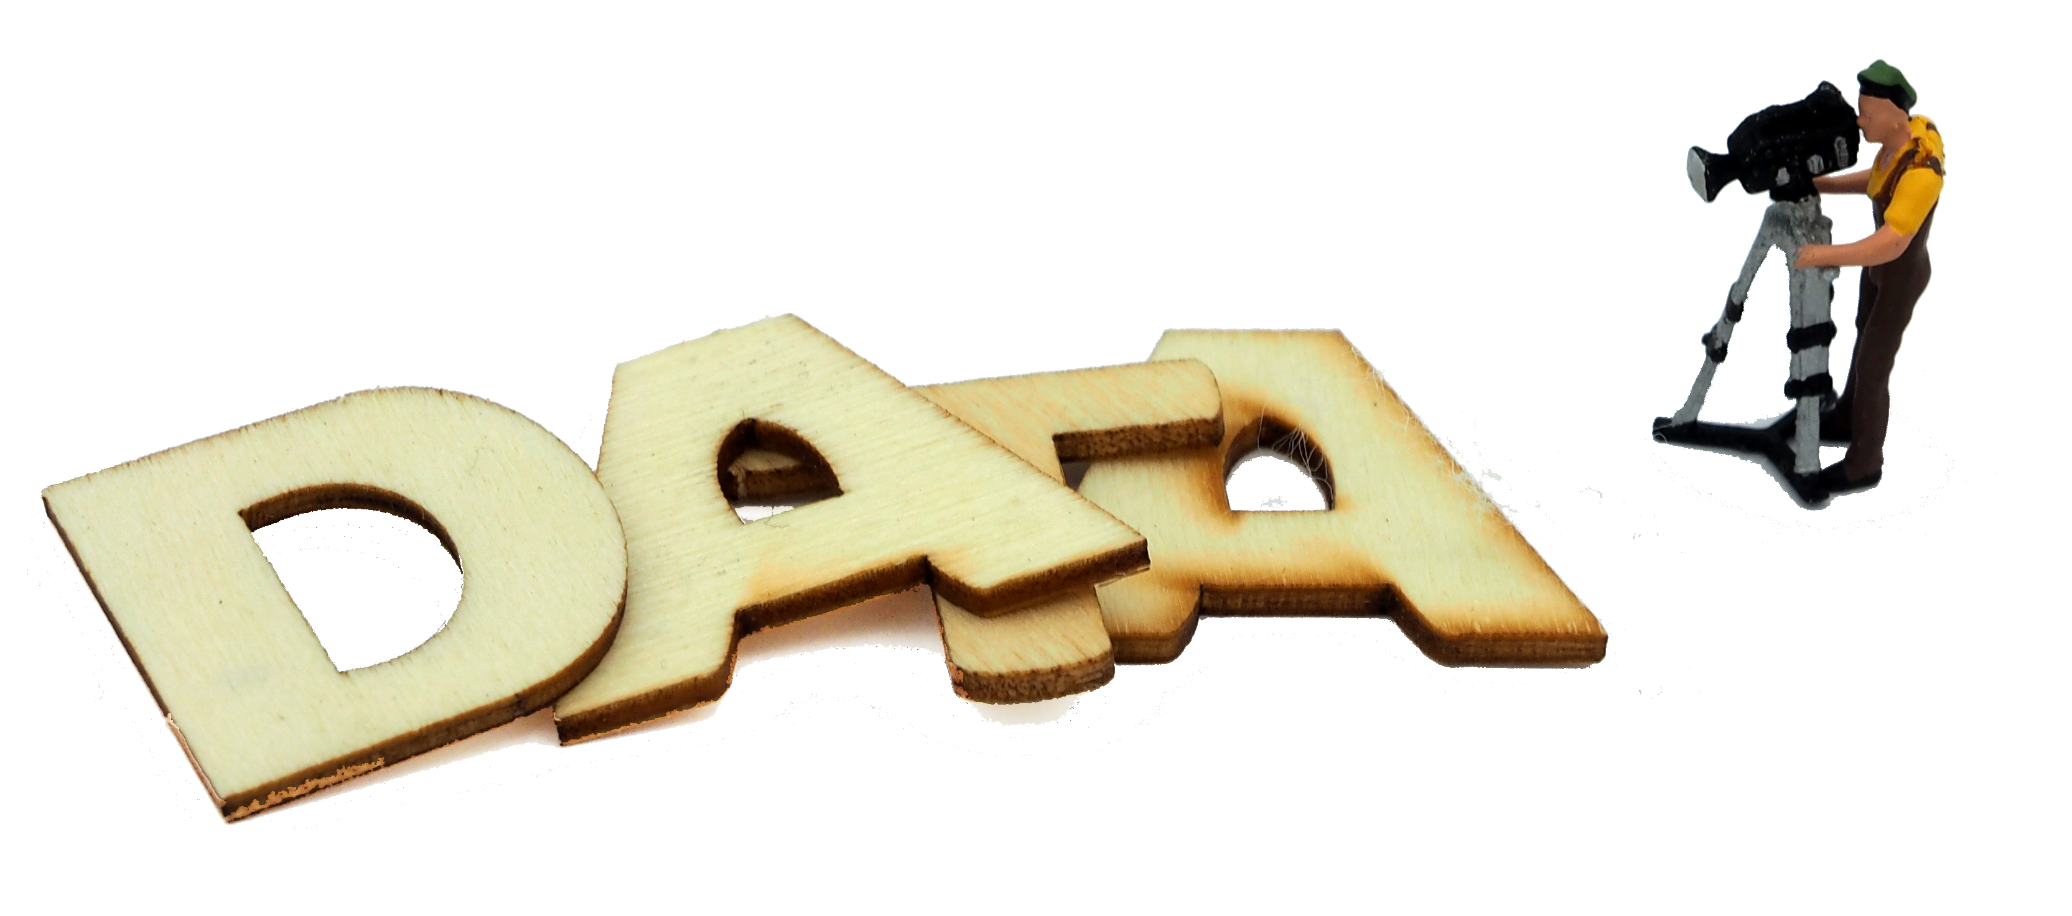
How to make data more visible
Choose open access
Licence your data
Always cite your data
Publish in a data journal
Teach with your data set
Choose a data repository which promotes your data
Grow your data‘s impact with altmetrics
Image: CC-BY-SA CESSDA DMEG https://dmeg.cessda.eu/

Slide 22
Citing data - example from ADP
At ADP* the citation is composed of:
[Principal Investigators]. ([Version Year]). [Title]. Slovenia, Ljubljana: University of Ljubljana, Social Science Data Archives. [Study Number] Accessible at: [link]
Example:
Hafner - Fink, M. in Malešič, M. (2016). Slovensko javno mnenje 2015: Mednarodna raziskava Stališča o delu (ISSP 2015), Mednarodna raziskava Stališča o vlogi države (ISSP 2016), Ogledalo javnega mnenja in raziskava Stališča o varnosti [Data file]. Ljubljana: Univerza v Ljubljani, Arhiv družboslovnih podatkov. ADP - IDNo: SJM15. Accessible at: http://www.adp.fdv.uni-lj.si/opisi/sjm15/
*ADP is the Slovenian Social Science Data Archives and Service Provider for CESSDA.

Slide 23
Citing data - example from GESIS
At GESIS* the citation is composed of:
[Principal Investigators]. ([Version Year]): [Title]. [Data Collector]. GESIS Data Archive, Cologne. [Study Number] Data File Version [Version Number], [DOI]
Example:
Schmitt, Hermann; Popa, Sebastian Adrian; Devinger, Felix (2015): European Parliament Election Study 2014, Voter Study, Supplementary Study. GESIS Data Archive, Cologne. ZA5161 Data file Version 1.0.0, doi:10.4232/1.5161
*GESIS is the German Service Provider for CESSDA.

Slide 24
Concluding remarks
Archiving and publishing your data properly will enable both your future self as well as future others to get the most out of your data.

Slide 25
Any questions?

