Slide 1

Data publication and licenses
A short introduction
Example presentation
Notes:
This is an example presentation on licenses and data publication based on the CESSDA DMEG chapter 6

Slide 2

Data publication and licenses
What are licenses?
What are common licenses for data?
Considerations in chosing a license
How licenses affect re-use
This presentation is based on information from Chapter 6 Archive and Publish of the CESSDA Data Management Expert Guide available at: dmeg.cessda.eu
Image: CC-BY-SA CESSDA DMEG https://dmeg.cessda.eu/

Slide 3
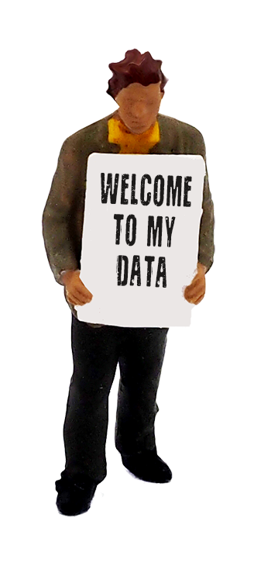

What are licenses?
A licence agreement is a legal arrangement between the depositor of the dataset and the data repository, signifying what a user is allowed to do with the data.
Specifying a license is an important aspect of FAIR
It explicitly says how data can be re-used!
Images: CC-BY-SA CESSDA DMEG https://dmeg.cessda.eu/

Slide 4
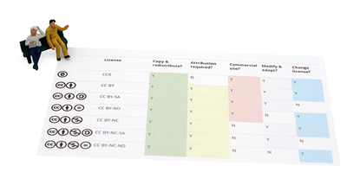
What are common licenses for data?
Most data archive offer the option to either make data available under an open license or to restrict access.
For openly accessible datasets, Creative Commons licenses are often used.
This video explained Creative Commons
Image: CC-BY-SA CESSDA DMEG https://dmeg.cessda.eu/
Notes:
https://vimeo.com/13590841 You can show this short video to introduce the audience to creative commons. A remark should be made that this is not directed at researchers but CC licenses are generally used by all kinds of people who want to share their work.

Slide 5
What are common licenses for data?
For openly accessible datasets, Creative Commons licenses are often used.
CC0: data is completely in the public domain without restrictions.
CC-BY: Users can distribute, remix, adapt, and build upon your work, even commercially, but they have to credit you for the original creation
CC-BY-SA: Same as CC-BY and users need to license their new creations under identical terms.
CC-BY-NC: Same as CC-BY but users are not allowed to use the data for commercial purposes.
Image: CC-BY-SA CESSDA DMEG https://dmeg.cessda.eu/
Notes:
These CC licenses are often used in archives.

Slide 6
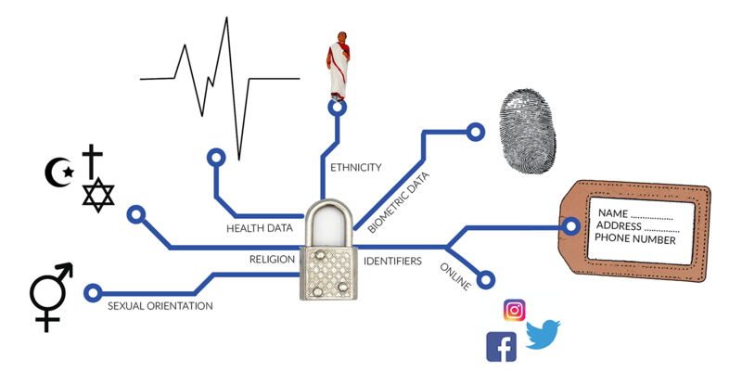
What are common licenses for data?
Some datasets cannot be made available under an open license.
Data might need to be restricted due to e.g.
Copyright issues
Sensitive personal data
Information that can be exploited and harmful
In these cases data archives restrict access and apply specific licenses.
At DANS, Dutch national centre of expertise and repository for research data, for example a dedicated DANS license is applied to restricted datasets.
Image: CC-BY-SA CESSDA DMEG https://dmeg.cessda.eu/
Notes:
Information on restricted datasets;
You may want to include information from your own repository

Slide 7


Considerations in chosing a license
Follow the principle “As open as possible, as closed as necessary”
  Only add restrictions when truly needed (i.e. sensitive data etc.)
When choosing a restrictive license, consider:
  Even demanding attribution can impair the re-usability.
  The least open license wins when combining datasets.
  An interesting presentation for more background:
Be sure who owns the data
Only the data owner can determine the license for the data. In research context, universities often want to retain the rights to the data → Check your institutional policy.
Image: CC-BY-SA CESSDA DMEG https://dmeg.cessda.eu/
Notes:
Consider that even asking for attribution can impair the re-usability!
For instance if someone wants to combine 100 datasets, attributing all originals may be time consuming.
The least open license wins when combining datasets!
If you want to combine a CC-BY and CC-BY-SA dataset the new dataset would need to have a CC-BY-SA license.

Slide 8
Exercise and further reading
Combining datasets with different licenses can be difficult
To learn more about this topic, you can
  Perform this exercise from GESIS
  Read this section on Remixing CC-Licensed Work
  Look at these slides from Leigh Doods talking about when licenses don’t mix
Notes:
You can end the presentation with a small exercise for instance from GESIS available in the Train-the-trainer package: https://dmeg.cessda.eu/content/download/4318/48736/file/TTT_EX_GESIS_Licenses_v1.0.pdf
Or you could give the participants one of the two links to study
These give more background on how and why combining licenses can be difficult and how important it is to chose a license that is as open as possible.

Slide 9
Any questions?

