Slide 1
A guide to foster open innovation at your university : the use case of Ocean I3
Julieta Barrenechea University of Bordeaux

Slide 2
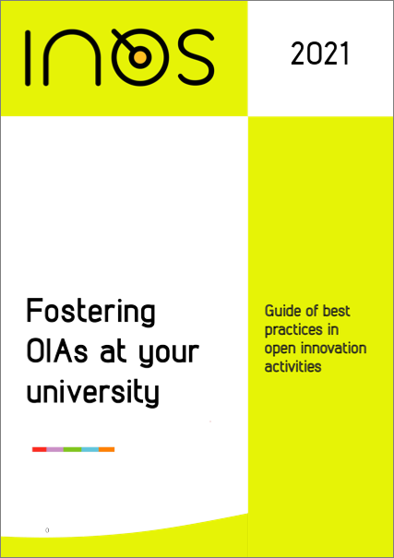

5 practical elements of openess
The incorporation of open, cross-boundary participation and collaboration
The use of open innovation tools and resources
the training of soft and technical skills necessary for Open Science and Open Innovation practices
The generation of activity outputs that are made open access
The activity’s availability as an education resource
3 major needs
Improve an existing activity
Frame an activity from A to Z
Get inspired

Slide 3
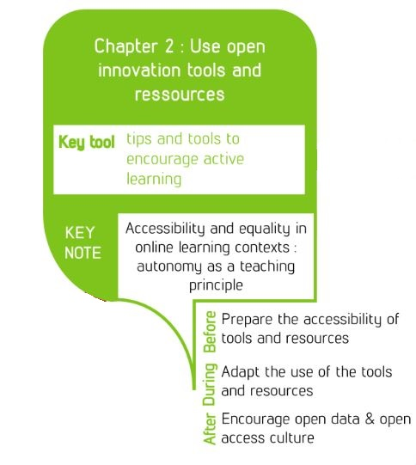
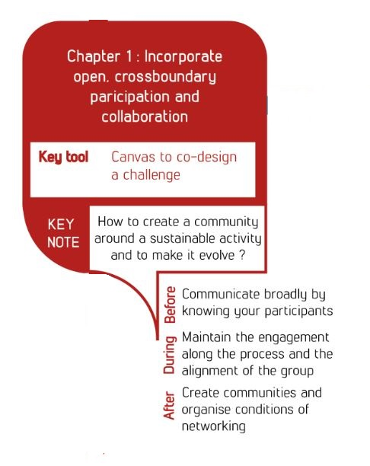


How to foster openess in open-innovation activities?
Innovation focused
This project has been funded with the support of the Erasmus+ programme of the European Union. The
European Commission’s support for the production of this website does not constitute an endorsement
of the contents, which reflect the views only of the authors, and the Commission cannot be held
responsible for any use which may be made of the information contained therein.

Slide 4
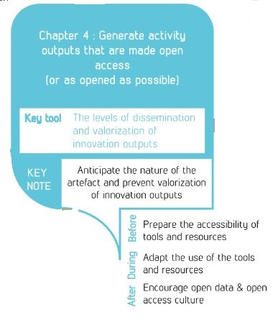
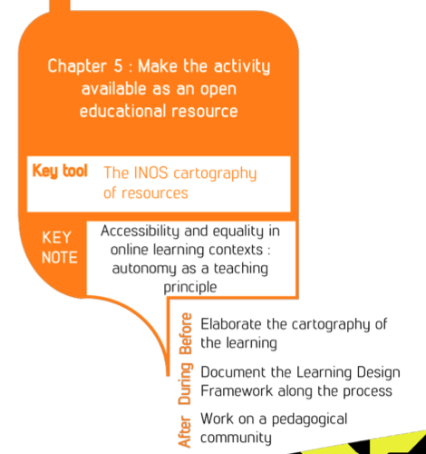
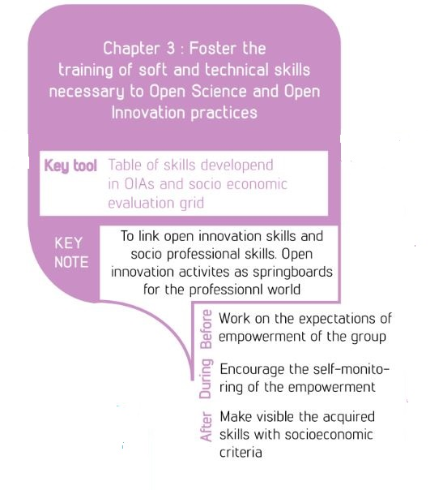
How to foster openess in open-innovation activities?
Pedagogical focus
This project has been funded with the support of the Erasmus+ programme of the European Union. The
European Commission’s support for the production of this website does not constitute an endorsement
of the contents, which reflect the views only of the authors, and the Commission cannot be held
responsible for any use which may be made of the information contained therein.

Slide 5

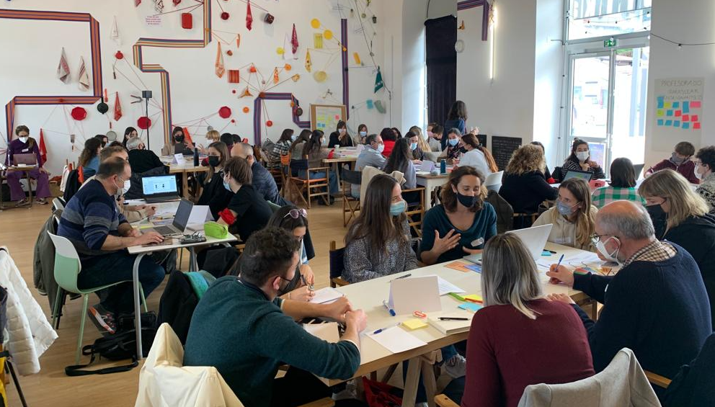


Challenged Based Learning cross-border project
University of Bordeaux, University of the Basque Country, and Euskampus Foundation
Challenged Based Learning interdisciplinar and innovative training approach with an important territorial engagement.
A common mission: "ocean pollution by plastics".
Topic áreas: Ocean sustainability / Plastic pollution / Climate change
Extra-curricular activity
Open to all disciplines and levels: Degree, Ms, PhD
Last cross border workshop 03-25-2022
Web Oi3 : https://oceani3.com

Slide 6
Ocean i3 create and make evolve an open and enlarged learning community
Chapter 1 Incorporate open, crossboundary participation and collaboration
After
3.Consolidate community
Transparency in : roles, expectations, interest, contributions and gains.
Sustainably working in open science mode
Results Dissemination
Stable “Innovation team” : mentors
360º evaluation
1.Creating the enlarge community
3 Profiles
Stakeholders: challenges and external mentoring
Teachers: methodology, mentoring.
Students: research projects and teams
Diversity as a key
Intersectorial, interuniversity, interdisciplinary, intercultural.
Workshop 0 co-cration with mentors
2.Engagement in learning process
Itinerary : 5 cross-border workshops, Complex challenge, pedagogical kit
Meaning for each contributor
“Problematisation”: shared definition and understanding - ALIGNEMENT
Multiple disciplinary entry points
Multiple capacities envolved
Collaborative working plan
Mentoring
self-consciousness of learning
Before
During

Slide 7
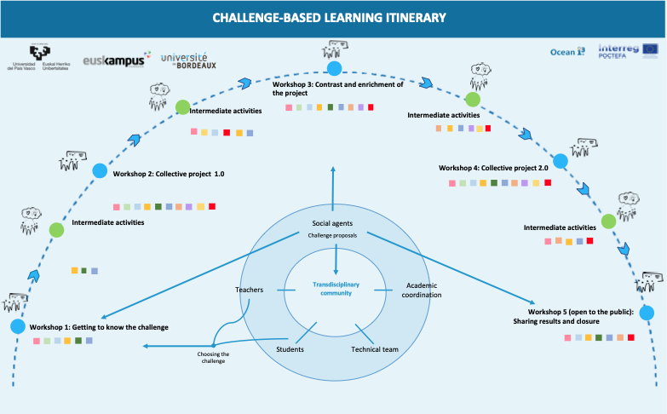
During: Itinerary Methodology

Slide 8
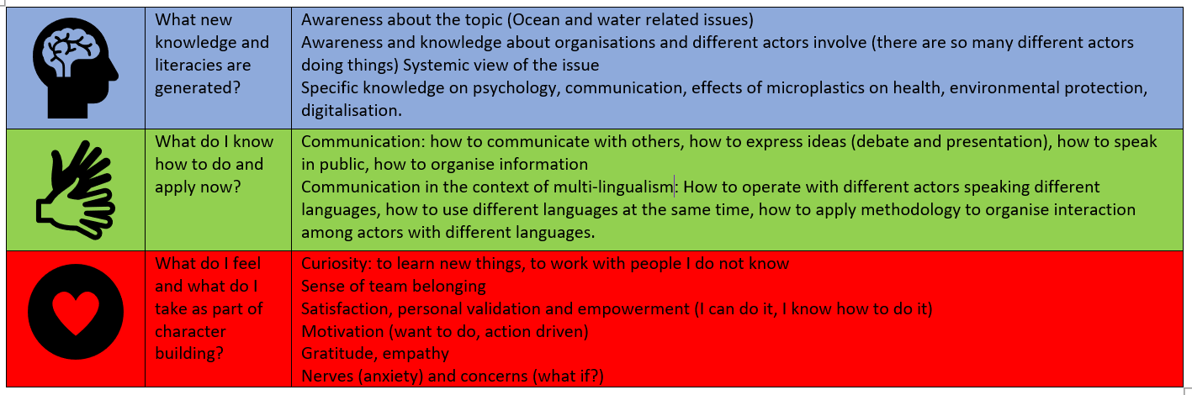
After: 360º self-consciousness of learning (21-22)
From: María García Alvarez Phd. UPV/EHU

Slide 9
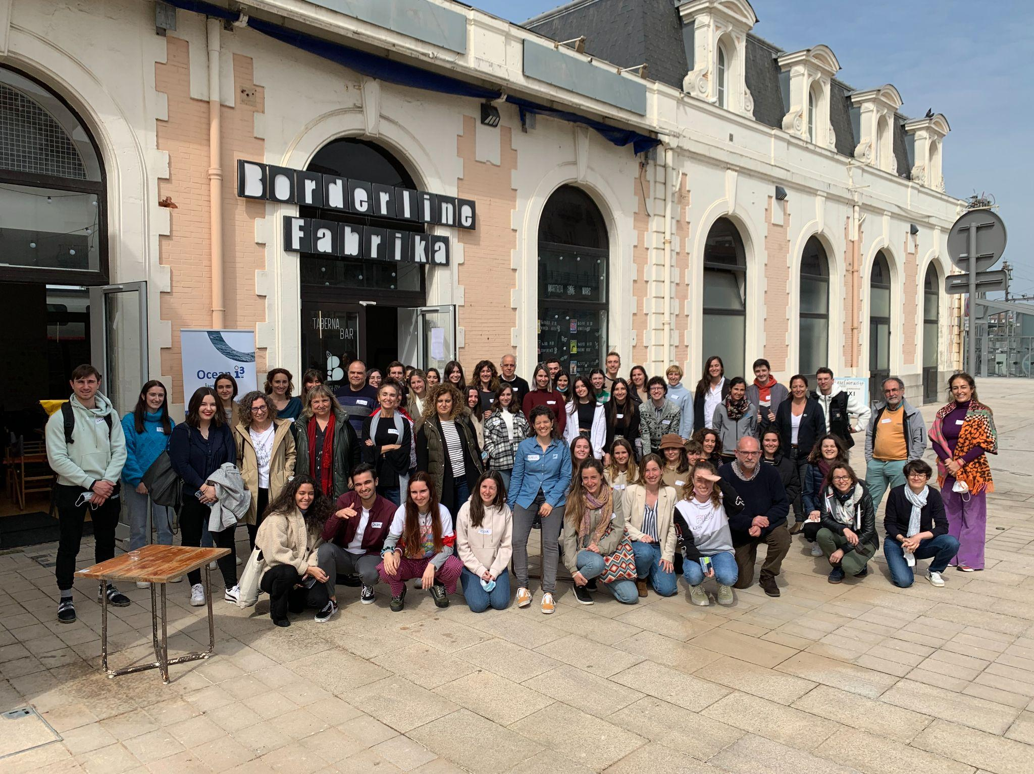
Ocean i3 a community evolving over 4 years
From 2018-2022
124 international students
41 teachers
18 disciplines involved
25 socio-economic actors involved
22 territorial challenges

Slide 10
Thank you!
Eskerrik asko!
Merci!
Gracias!

