Slide 1
Ici’s treatment

Slide 2
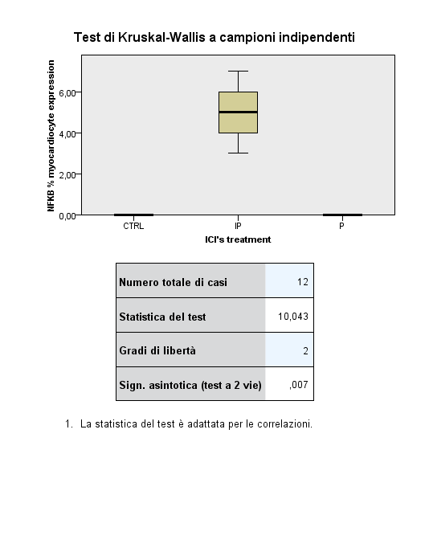
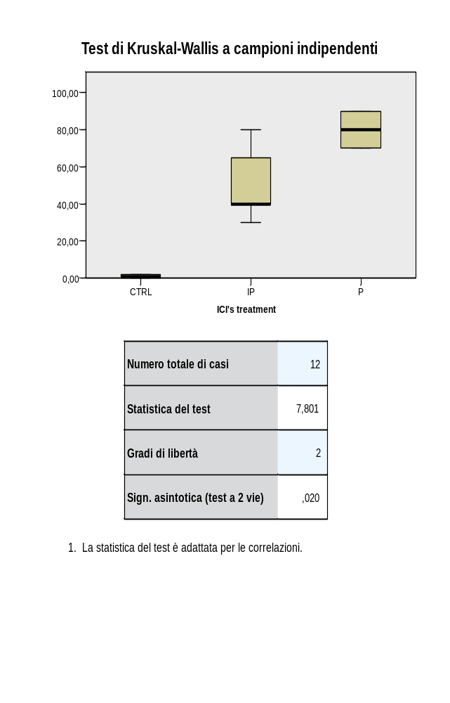
NFKB expression (%)
P.value: 0,007
P.value: 0,020

Slide 3
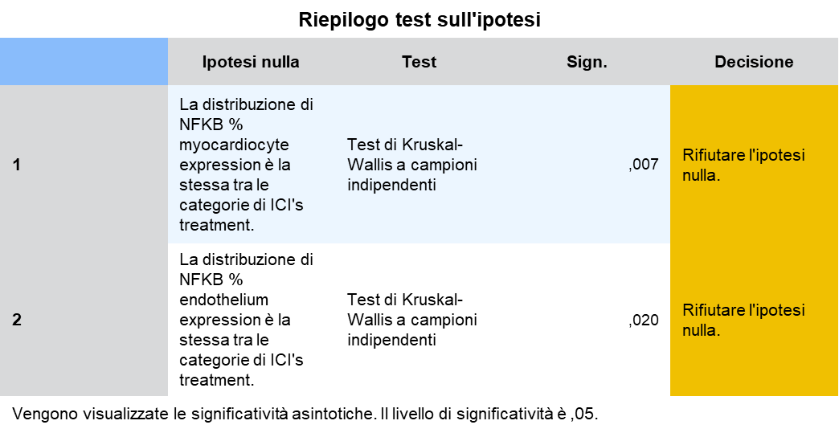
SIGN. STAT: variabili quantitative

Slide 4
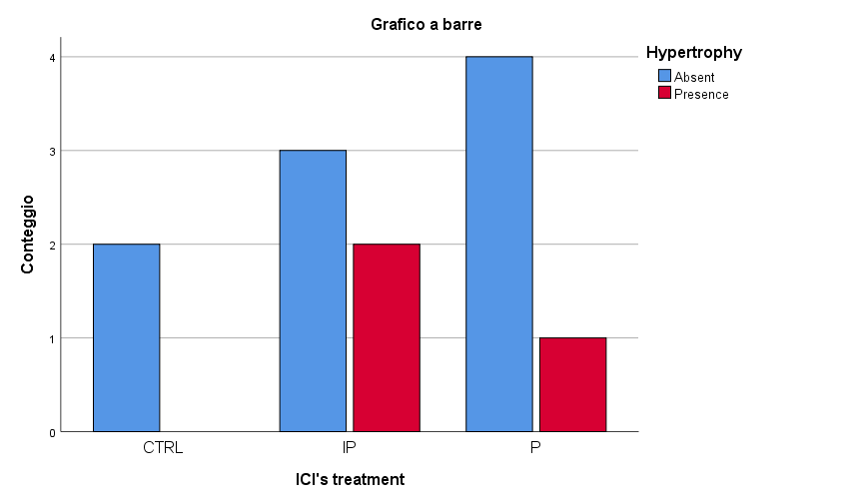
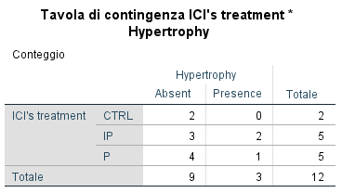
HYPERTROPHY

Slide 5
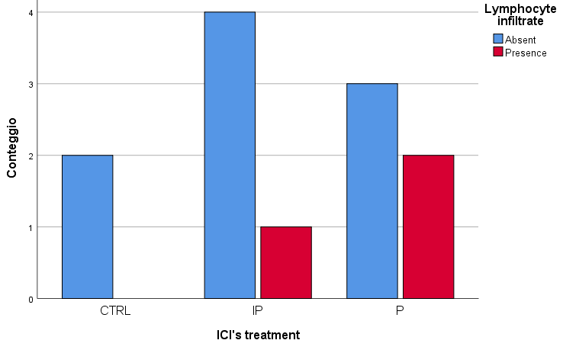
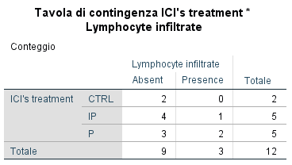
Lymphocyte infiltrate

Slide 6
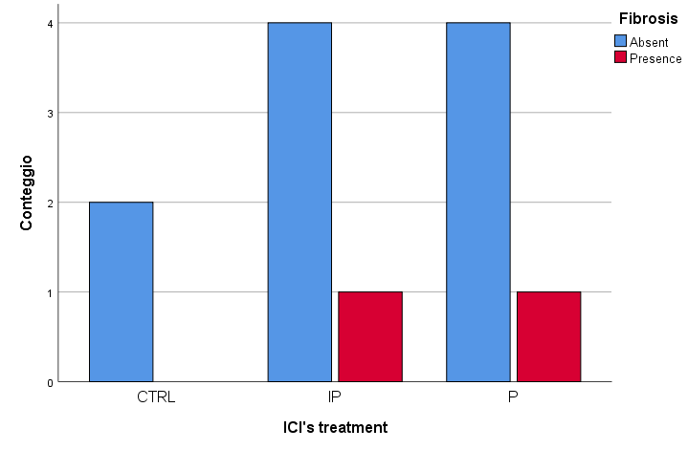
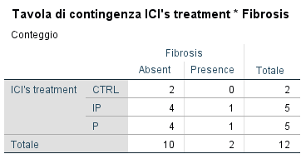
Fibrosis

Slide 7
La necrosi non si presenta in nessun caso

