Slide 1





Create Your Own Dataverse Training
Online Train-the-trainer Workshop
Ricarda Braukmann (DANS-KNAW)
Kim Ferguson (DANS-KNAW)
Licence: CC-BY 4.0

Slide 2
Programme
10:30-10:45 Welcome
10:45-11:15 Background on Dataverse
11:15-11:20 Short Break
11:20-12:00 Session 1: Example materials and outlines
12:00-13:00 Lunch Break
13:00-13:45 Session 2: Breakout session for your own workshop design
13:45-13:50 Short Break
13:50-14:35 Session 3: Planning and troubleshooting
14:35-15:00 Wrap-up

Slide 3
Housekeeping Announcements
The presentations will be recorded (gallery view)
The recording will be paused during the breakout sessions
Please mute yourself when you are not talking
Raise your hand if you have any questions or post them in the chat
All materials for this workshop are available on Zenodo: https://doi.org/10.5281/zenodo.7037615

Slide 4
Getting to know each other
Go to www.menti.com and use the code 5151 4441

Slide 5
Our workshop
We will cover
Basic introduction of Dataverse
Materials that can be re-used for training on
  Dataverse
  Data discovery
  Data archiving
Ways to plan your training
Tips to deal with unforeseen circumstances
We will not cover
Detailed technical information about Dataverse
Guidelines on Dataverse installations
Newest Dataverse developments
External tools related to Dataverse
Dataverse user guide: https://guides.dataverse.org/
Dataverse user community: https://groups.google.com/g/dataverse-community

Slide 6
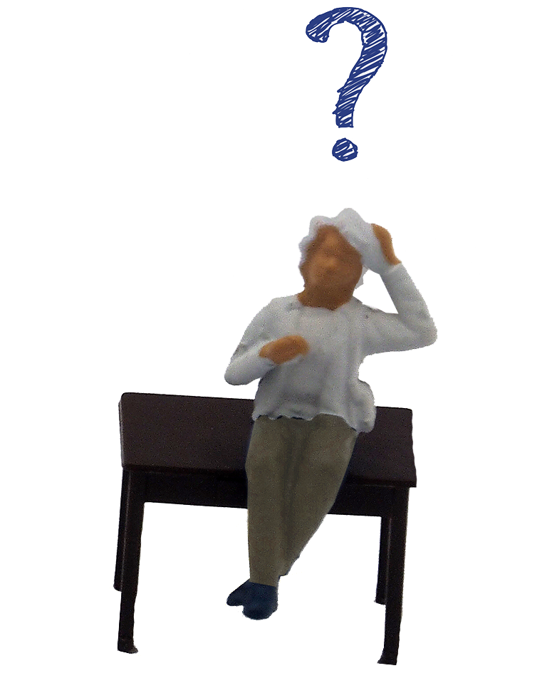
Any questions?
Image: CC-BY-SA from https://dmeg.cessda.eu/

Slide 7


Background on Dataverse
Ricarda Braukmann

Slide 8

Dataverse
Dataverse is an open source research data repository software, that is being developed by Harvard’s Institute for Quantitative Social Science (IQSS) since 2006
and supported by the The Global Dataverse Community Consortium (GDCC).
It is used to share, preserve, cite, explore, and analyze research data.
https://dataverse.org/
Notes:
Here you can mention your own repository

Slide 9
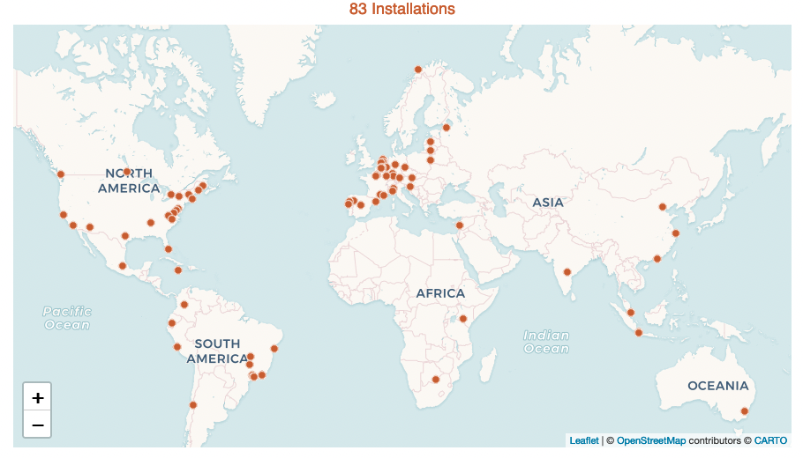
Dataverse installations
Notes:
Dataverse has 83 installations worldwide.
The most recent number is available at https://dataverse.org/

Slide 10
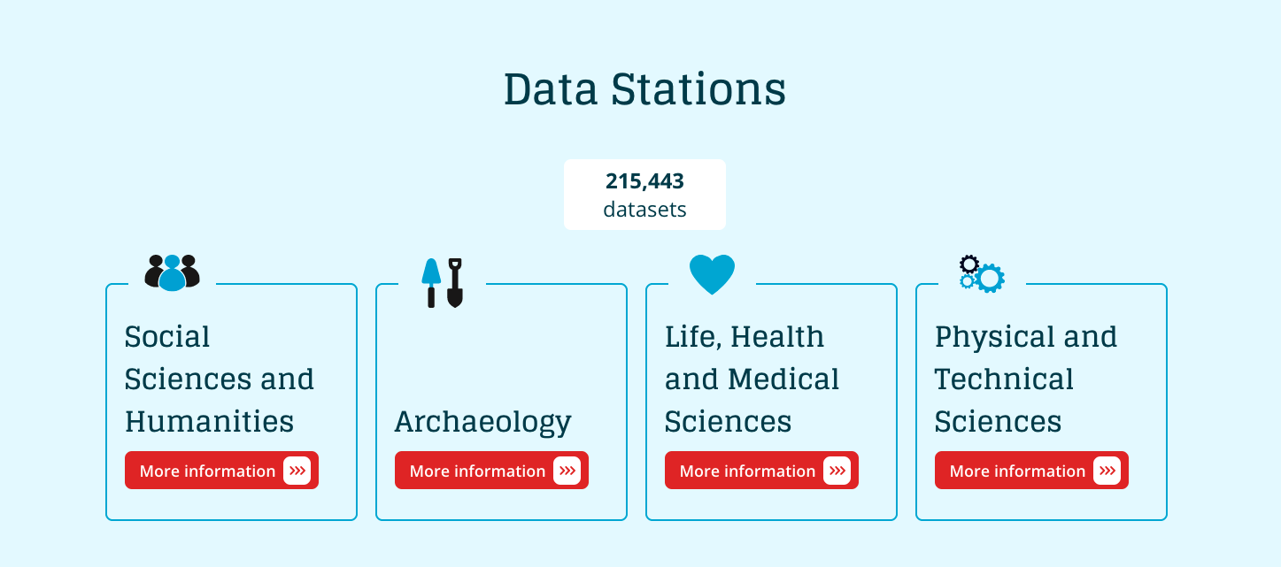
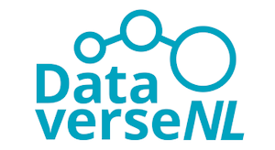
DANS - Data Archiving and Networked Services
The Dutch national centre of expertise and repository for research data
→ CESSDA Service Provider for the Netherlands
Offer data archiving services for individual researchers and institutes
Offer advice and training on Research Data Management, FAIR Data and Open Science
Notes:
You can show your own archive here as an example

Slide 11
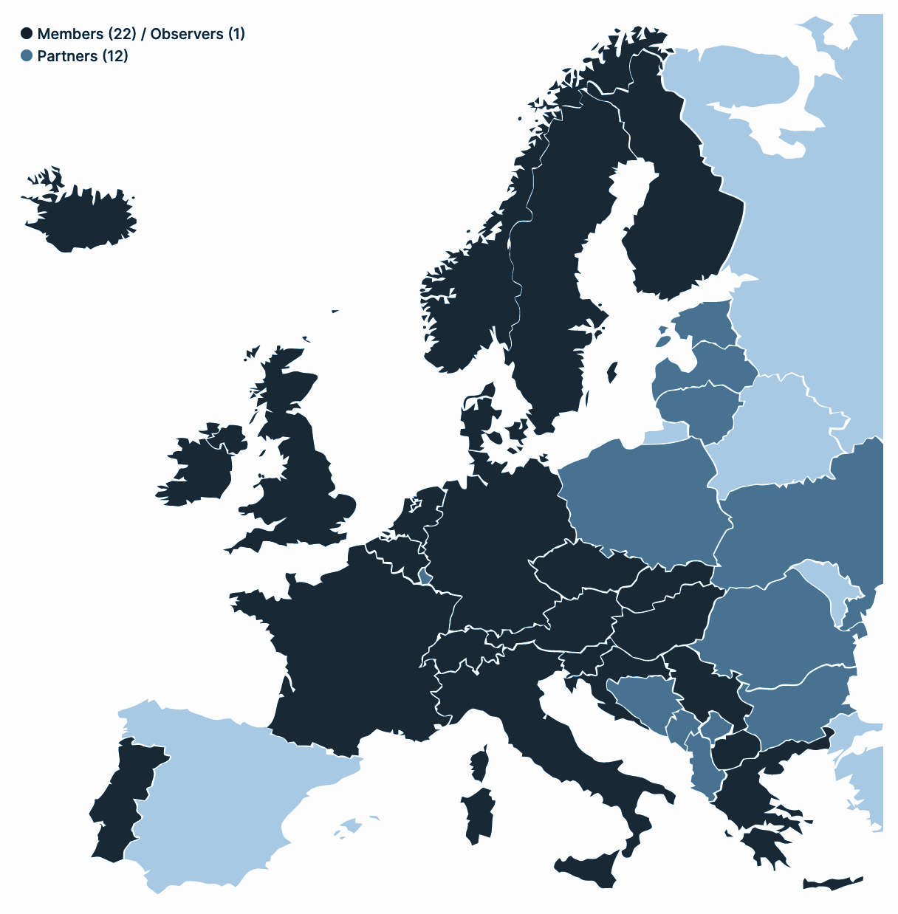
Consortium of European Social Science Data Archives
Cross-European resource discovery
Improved quality of data and metadata
A wider selection of comparable data
Certification of data archiving organisations
Professional training for data archivists and scientific community
Improved mechanisms for data access and analysis
Strong involvement of organisations outside Europe

Slide 12

DANS Data Stations
Data Archiving service for researchers
Making use of Dataverse technology (transitioning from our in-house system EASY)
DANS manages the technical infrastructure
DANS manages the curation of the data
Long term storage in our Vault
Core Trust Seal certified
https://www.coretrustseal.org/wp-content/uploads/2021/09/20210906_DANS-EASY.pdf
https://dans.knaw.nl/nl/

Slide 13
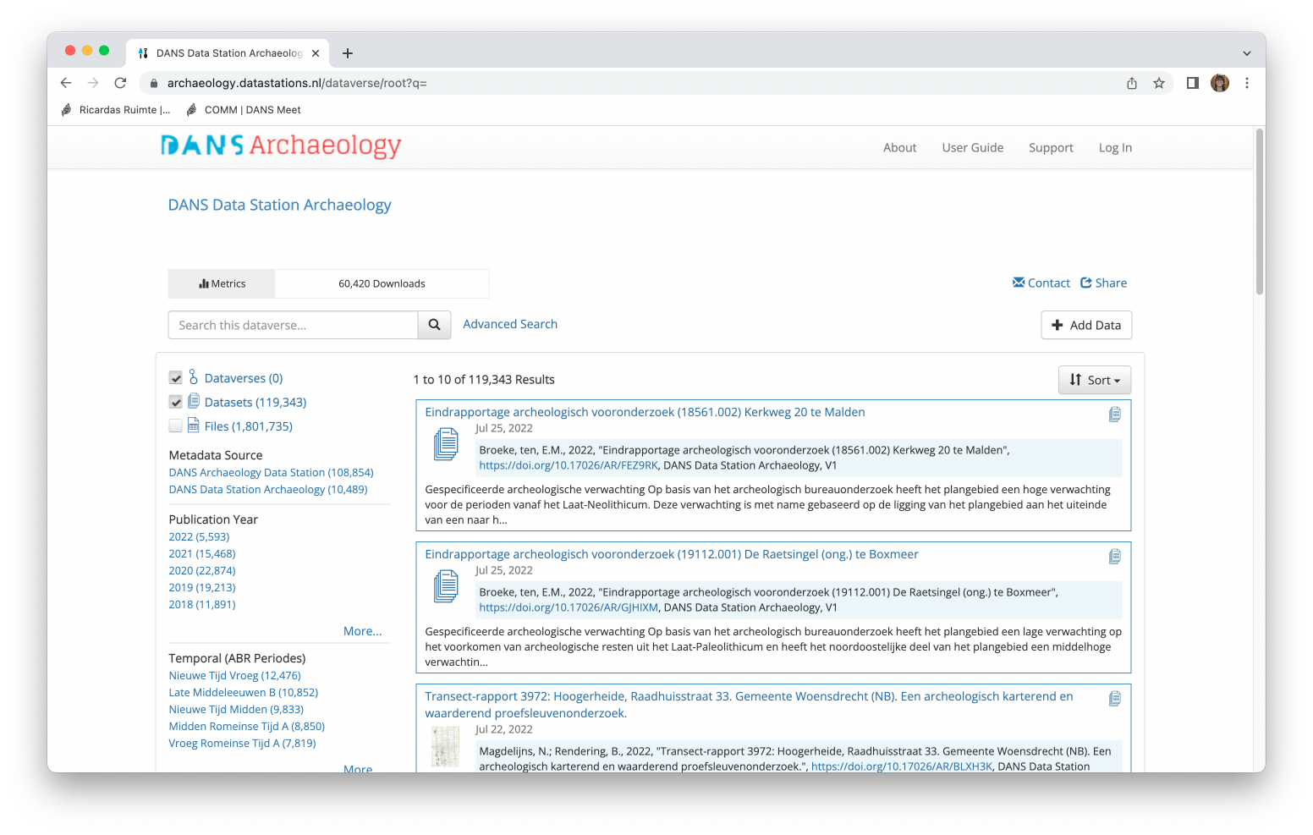
DANS Data Station Example
Notes:
You can show your own archive here as an example

Slide 14
DataverseNL
Shared data archiving service provided by participating institutes and DANS
Making use of Dataverse technology
DANS manages the technical infrastructure
Institutes manage the curation and deposit of the data
Long term storage in our Vault
Core Trust Seal certification needs to be applied for by the institute
Within DataverseNL you can currently find 18 institutional Dataverses
https://dataverse.nl/
Notes:
You can show your own archive here as an example

Slide 15
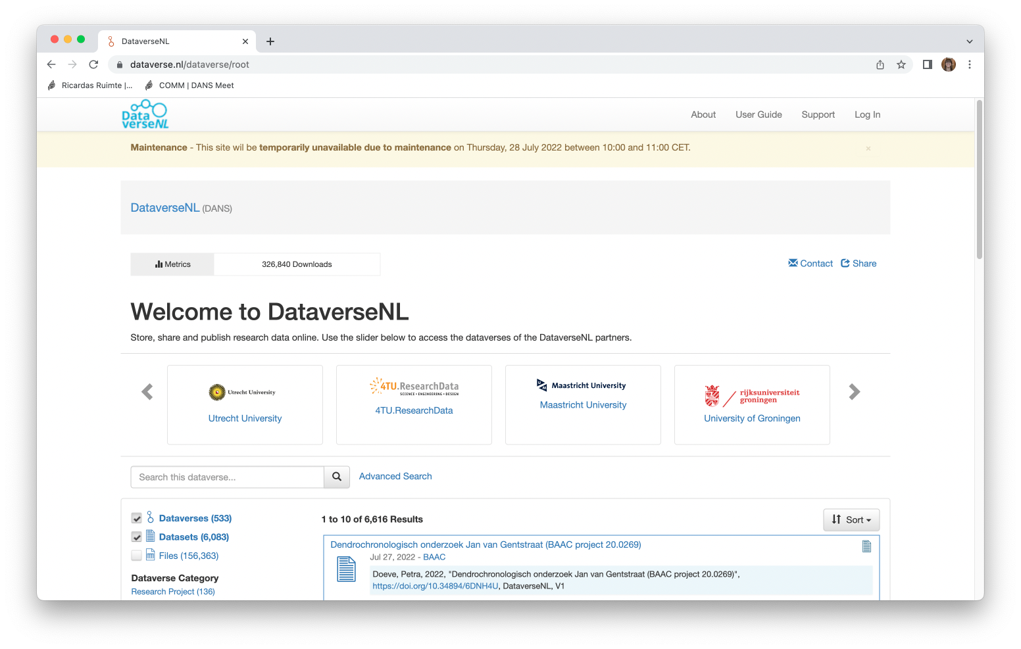
DataverseNL screenshot
Notes:
You can show your own archive here as an example

Slide 16
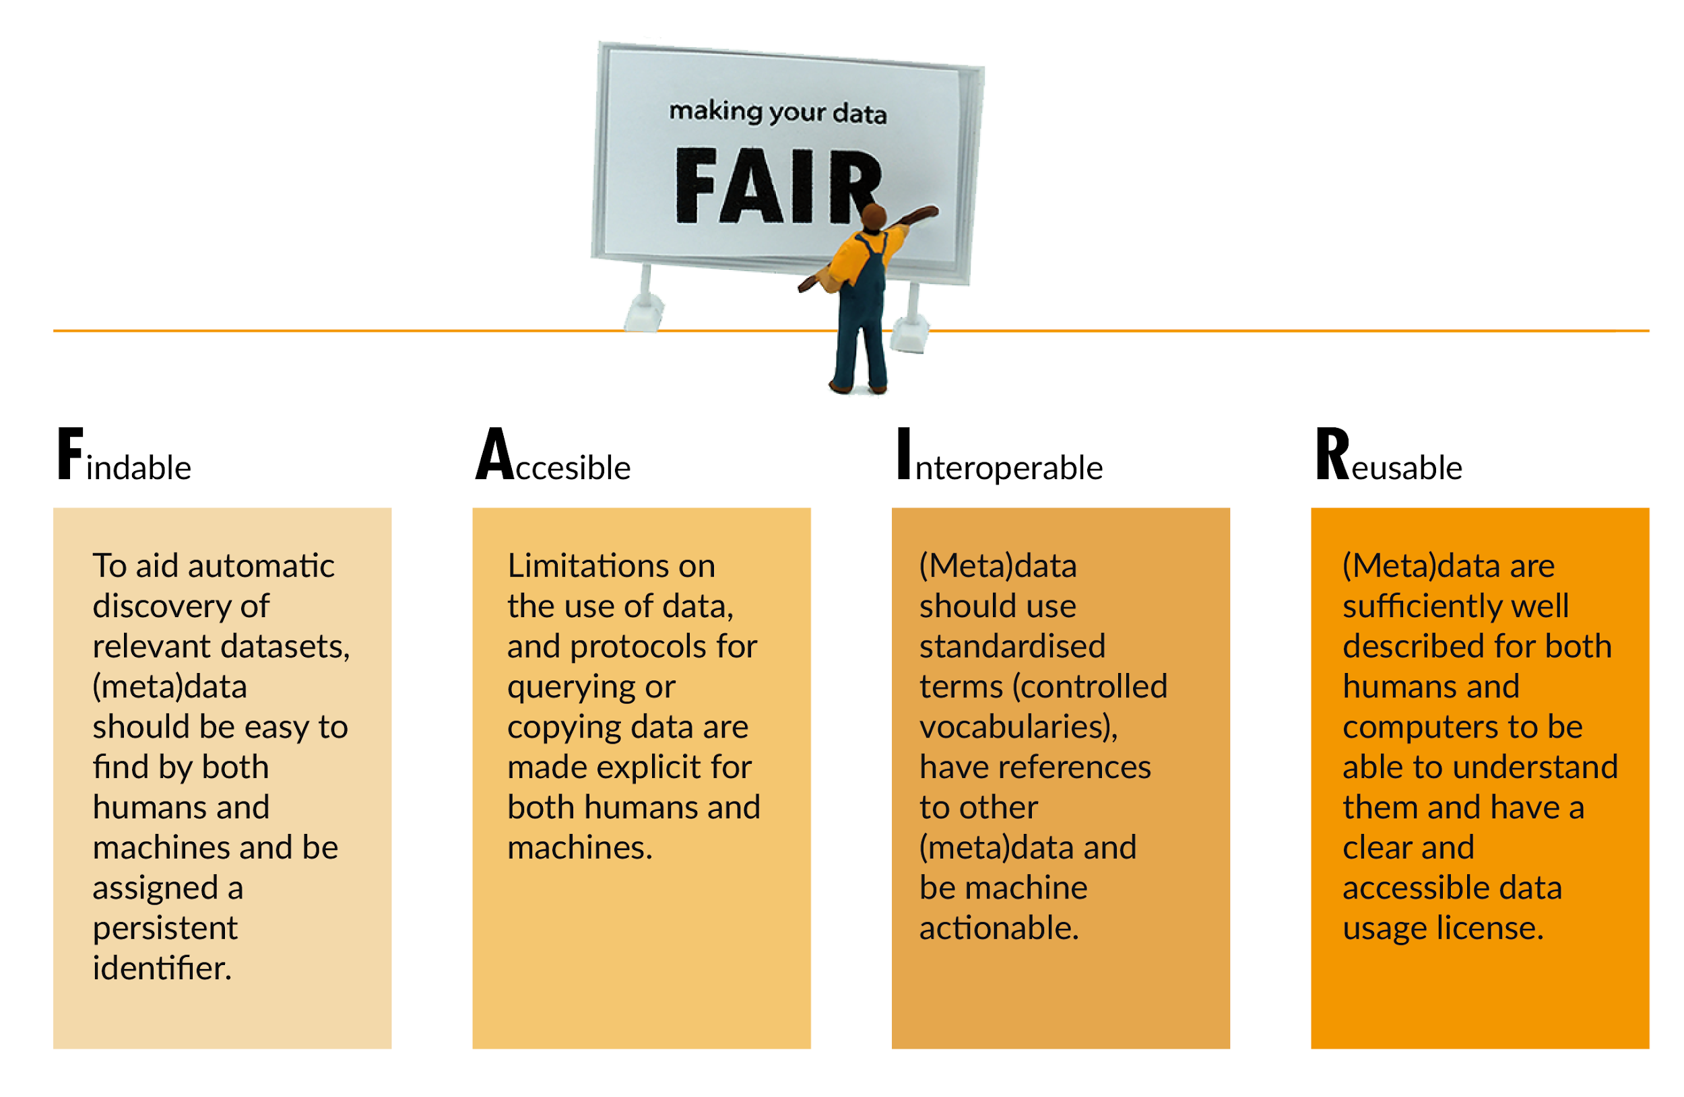
Dataverse helps make data FAIR
Image: CC-BY-SA CESSDA DMEG https://dmeg.cessda.eu/
Notes:
Explain the FAIR principles in short

Slide 17
Dataverse helps make data FAIR - F
Datasets have a Persistent Identifiers (PID), e.g. DOI
Includes standardized metadata blocks for different domains
  Metadata fields can be customized per collection
  Templates can be created for easier metadata entry
Metadata can be exported in various formats
Information on features: https://dataverse.org/software-features
Image: CC-BY-SA CESSDA DMEG https://dmeg.cessda.eu/
Notes:
Dataverse has certain features that helps make data FAIR, we list them for Findable

Slide 18
Dataverse helps make Data FAIR - A
Datasets have a Persistent Identifiers (PID), e.g. DOI
Datasets can be openly available or access can be restricted
  Restrictions can be indicated per data file
Metadata is openly accessible even for restricted datasets
Information on features: https://dataverse.org/software-features
Image: CC-BY-SA CESSDA DMEG https://dmeg.cessda.eu/
Notes:
Dataverse has certain features that helps make data FAIR, we list them for Accessible

Slide 19
Dataverse helps make Data FAIR - I
Includes standardized metadata blocks for different domains
Metadata can be exported in various formats
Controlled vocabularies can be connected to use standardised terms to describe data
Information on features: https://dataverse.org/software-features
Image: CC-BY-SA CESSDA DMEG https://dmeg.cessda.eu/
Notes:
Dataverse has certain features that helps make data FAIR, we list them for Interoperable

Slide 20
Dataverse helps make Data FAIR - R
Datasets can be openly available or access can be restricted
  Restrictions can be indicated per data file
Supports various licenses
Statistical files (SPSS, STATA) are transformed into tabular data files
Information on features: https://dataverse.org/software-features
Image: CC-BY-SA CESSDA DMEG https://dmeg.cessda.eu/
Notes:
Dataverse has certain features that helps make data FAIR, we list them for Reusable

Slide 21
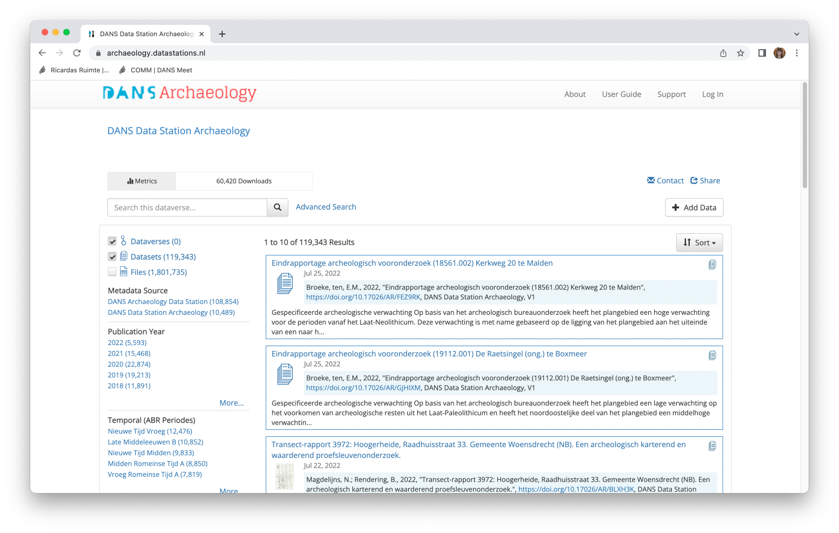
A closer look into a Dataverse repository [1]
Number of datasets and files
Facets to filter
Example repsitory: DANS Data Station Archeaology: https://archaeology.datastations.nl/
Notes:
Here you can show your own repository.
Dataverse - is a container folder
Within a Dataverse you can have another Dataverse
Dataverses contain Datasets, published files e.g. from a research study.

Slide 22
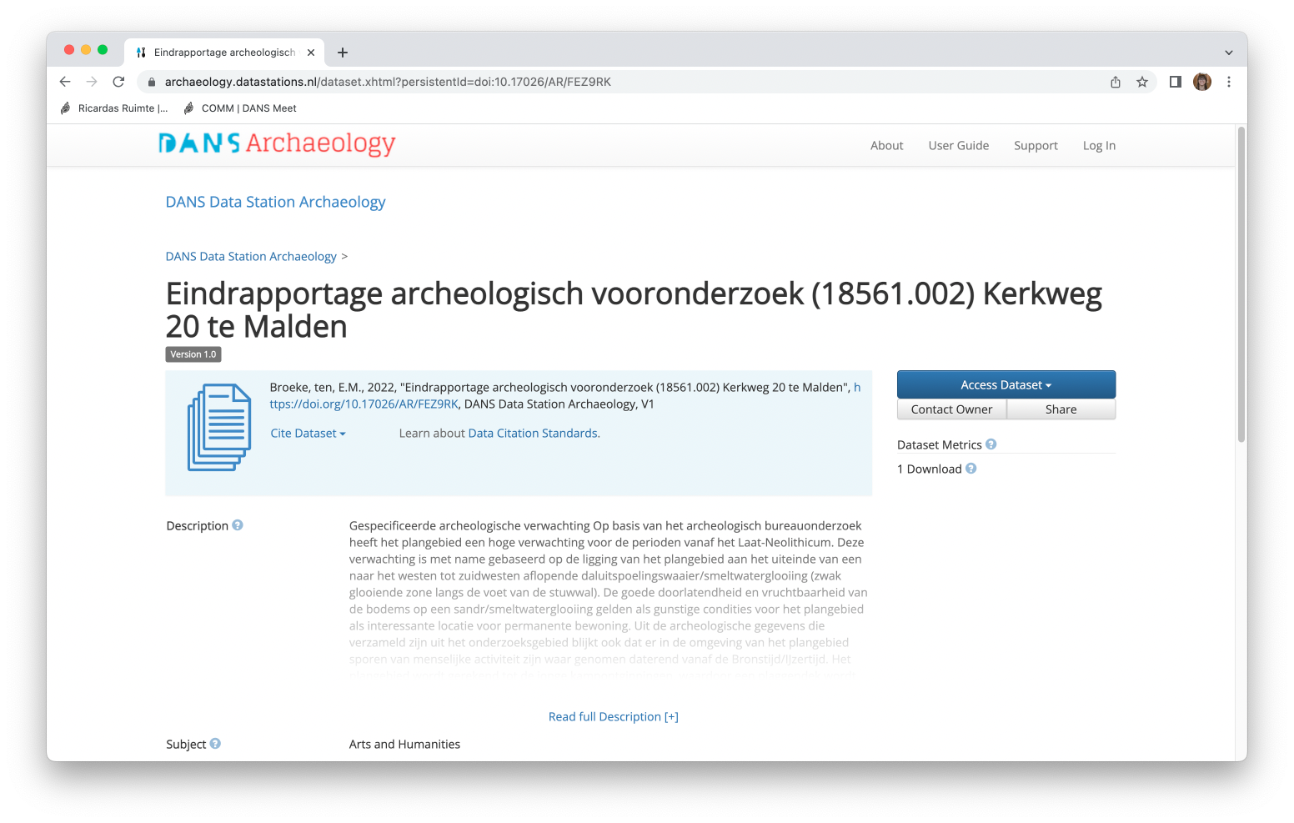
A closer look into a Dataverse repository [2]
Citation information
Download information and metrics
Example repsitory: DANS Data Station Archeaology: https://archaeology.datastations.nl/
Notes:
Here you can show your own repository

Slide 23
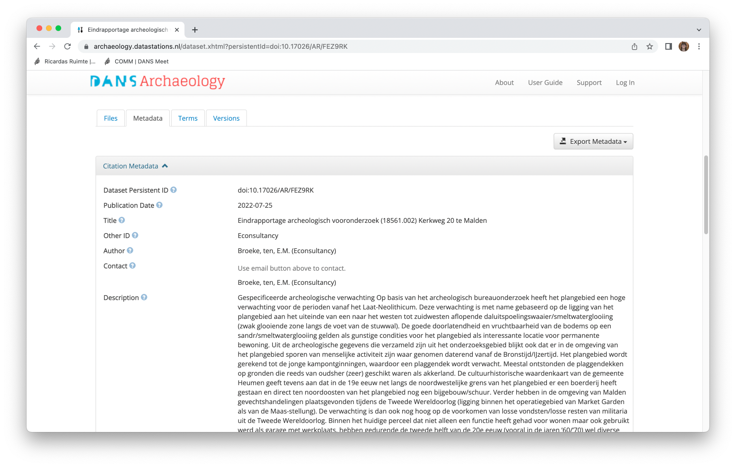
A closer look into a Dataverse repository [3]
General information
Example repsitory: DANS Data Station Archeaology: https://archaeology.datastations.nl/
Notes:
Here you can show your own repository

Slide 24
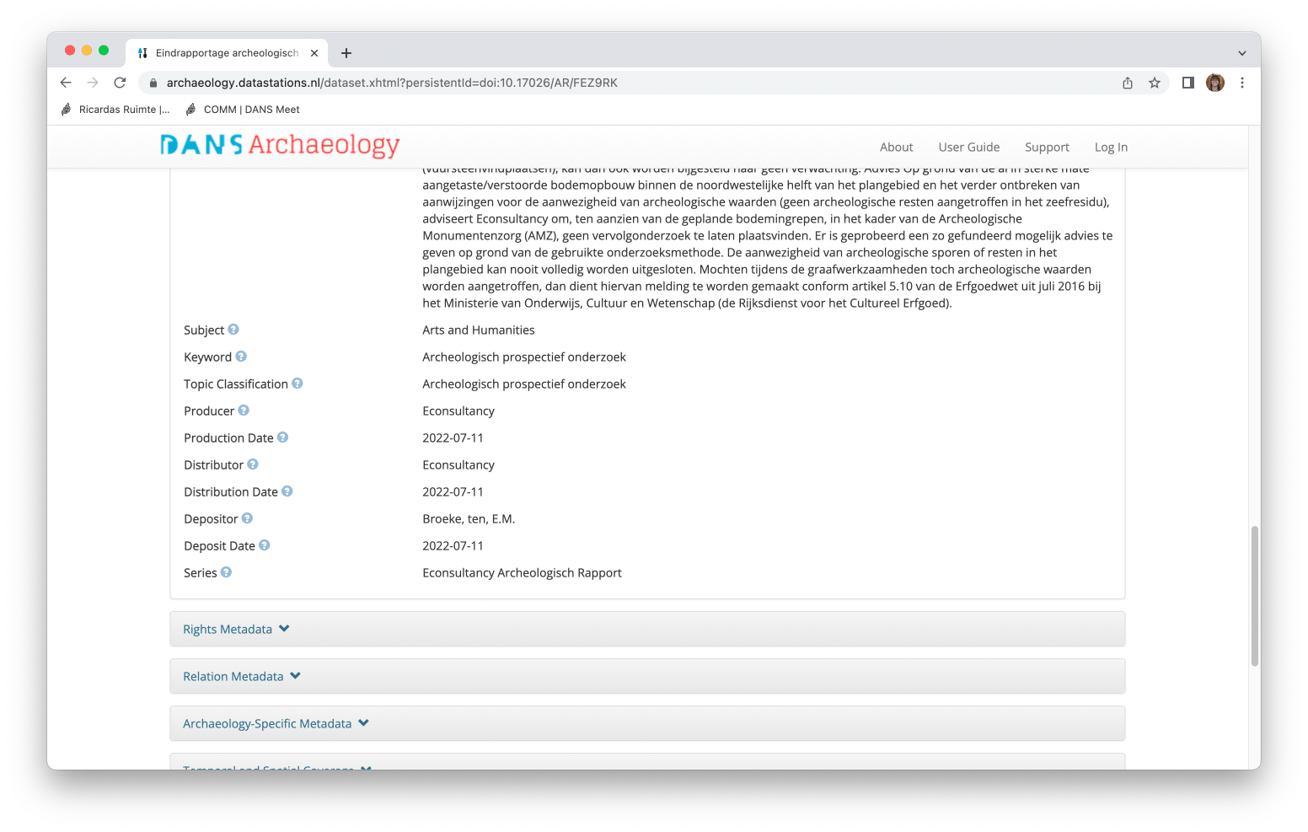
A closer look into a Dataverse repository [4]
Example repsitory: DANS Data Station Archeaology: https://archaeology.datastations.nl/
Notes:
Here you can show your own repository

Slide 25
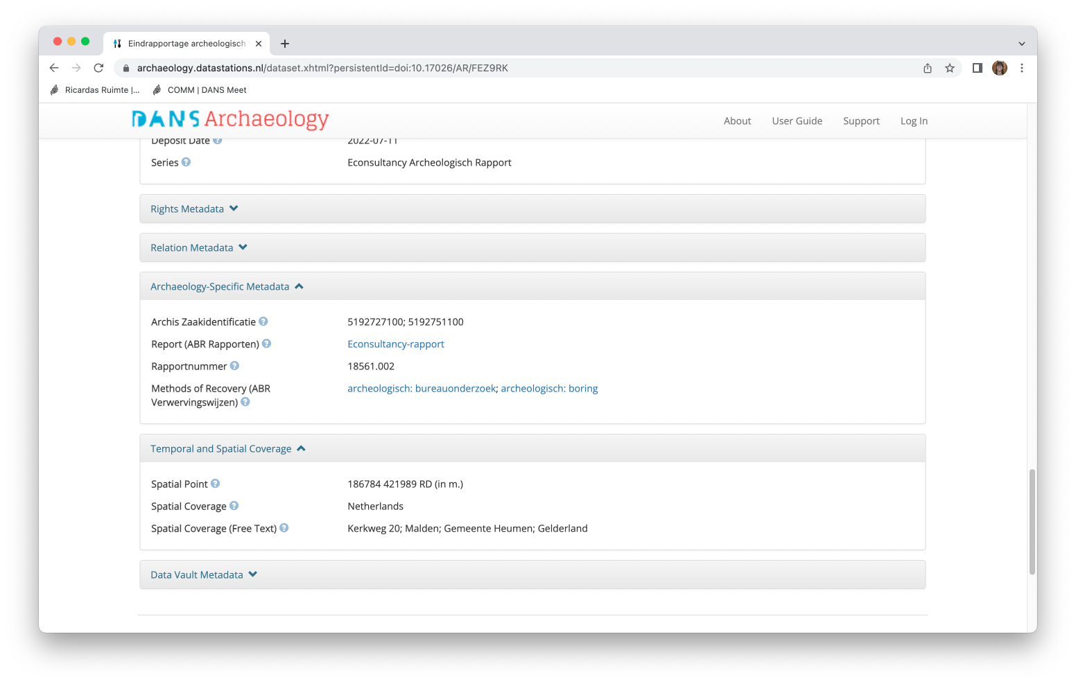
A closer look into a Dataverse repository [5]
Domain-specific information
Example repsitory: DANS Data Station Archeaology: https://archaeology.datastations.nl/
Notes:
Here you can show your own repository

Slide 26
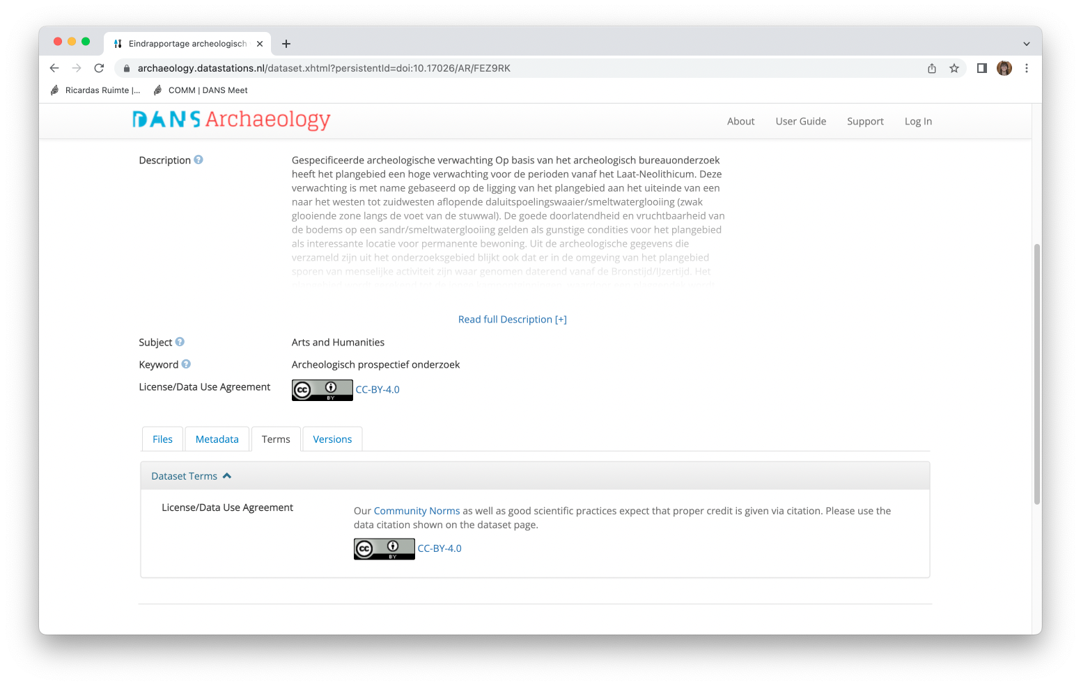
A closer look into a Dataverse repository [6]
Information on license and terms of use
Example repsitory: DANS Data Station Archeaology: https://archaeology.datastations.nl/
Notes:
Here you can show your own repository

Slide 27
Dataverse can be set up in various ways
Dataverse structure - e.g. do you want sub-Dataverses for different collections?
Metadata blocks and required fields - e.g. what fields are required or optional?
Controlled vocabulary support - e.g. do you want to use certain terms to describe data?
Roles and permissions - e.g. who can create a new Dataverse? who can publish a dataset?
Workshop: How to set up and configure a Dataverse repository that suits your needs (Danciu et al., 2022) https://doi.org/10.5281/zenodo.6625972
Dataverse Manual for Local Admins (Huis in ‘t Veld et al., 2020) https://doi.org/10.34894/ADBKTN (in Dutch)

Slide 28
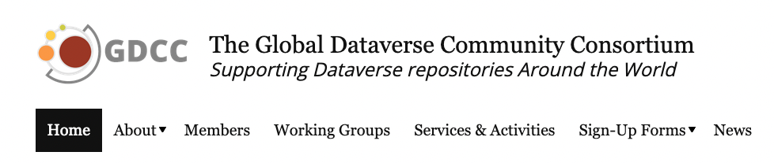

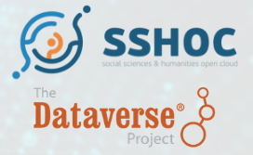
Dataverse is supported by a large community
Global Dataverse Community Consortium (GDCC) provides a collaborative venue to leverage economies of scale in support of Dataverse repositories around the world.
32 organisations
Dataverse community meetings
Active discussion groups
Dataverse community within CESSDA
https://dataversecommunity.global/
https://groups.google.com/g/dataverse-community
https://www.sshopencloud.eu/news/developing-sshoc-dataverse

Slide 29
Any questions?
Image: CC-BY-SA from https://dmeg.cessda.eu/

Slide 30
Programme
10:30-10:45 Welcome
10:45-11:15 Background on Dataverse
11:15-11:20 Short Break
11:20-12:05 Session 1: Example materials and outlines
12:00-13:00 Lunch Break
13:00-13:45 Session 2: Breakout session for your own workshop design
13:45-13:50 Short Break
13:50-14:35 Session 3: Planning and troubleshooting
14:35-15:00 Wrap-up

Slide 31
Session 1: Example materials & outlines
Ricarda Braukmann

Slide 32

How can you train people to use Dataverse?

Slide 33

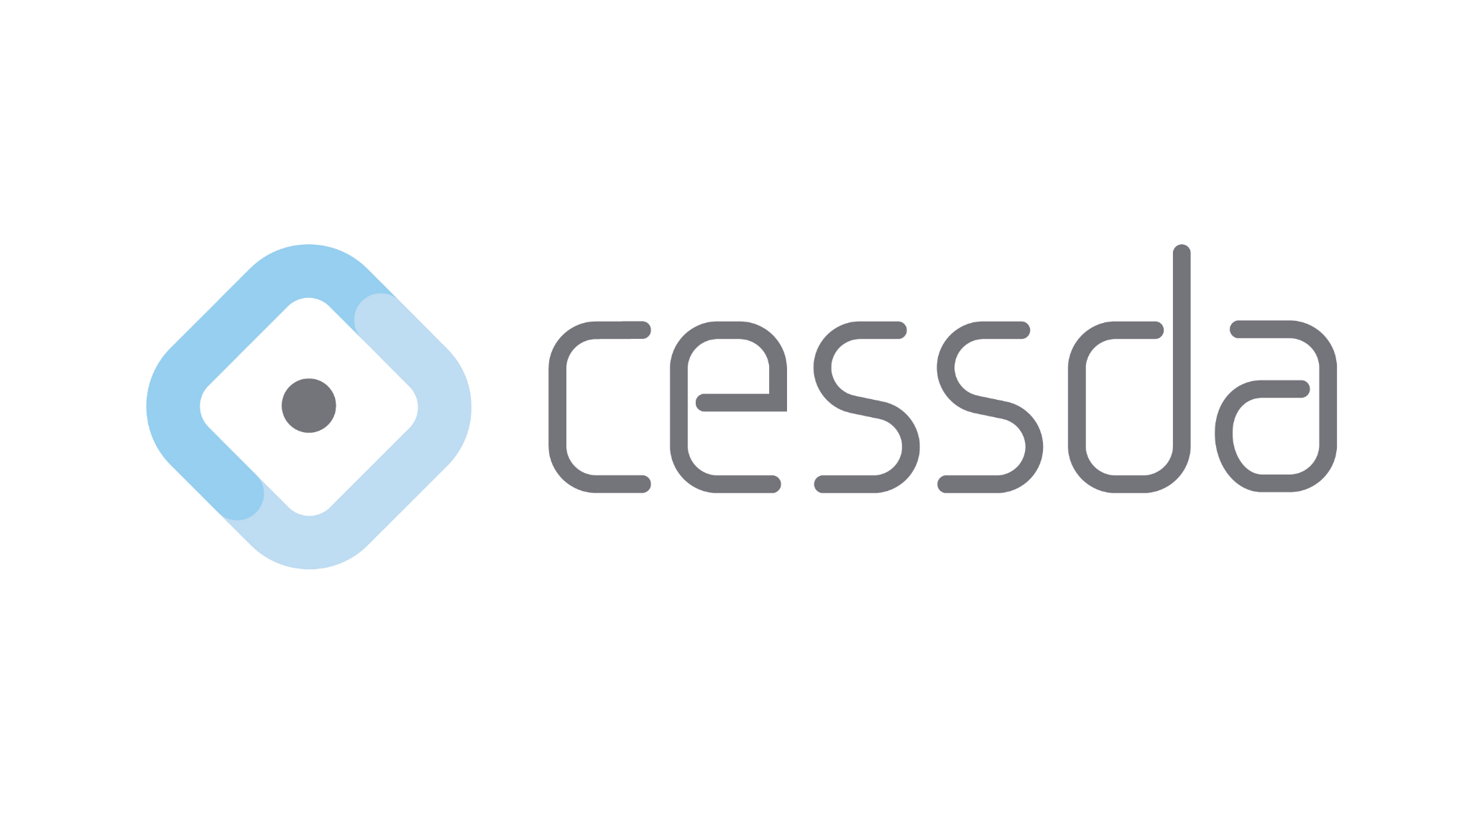
Sources of existing training materials
Existing materials from Dataverse
  Guides
  Slides
  Videos
  Workshops
Existing materials from CESSDA
  CESSDA Data Management Expert Guide
  Train-the-trainer materials
  Resource directory
  Workshops

Slide 34
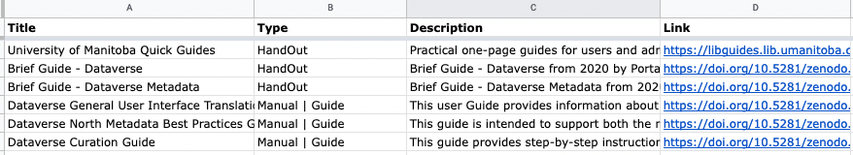
Dataverse materials [1]
We created an overview of relevant materials we found
  Dataverse website [https://dataverse.org/presentations]
  Dataverse Guide [https://guides.dataverse.org/en/latest/user/index.html]
  DataverseTV [https://dataverse.org/dataversetv]
  Zenodo search [https://zenodo.org]
→ Aug2022_CollectionofDataverseMaterialsForTraining

Slide 35
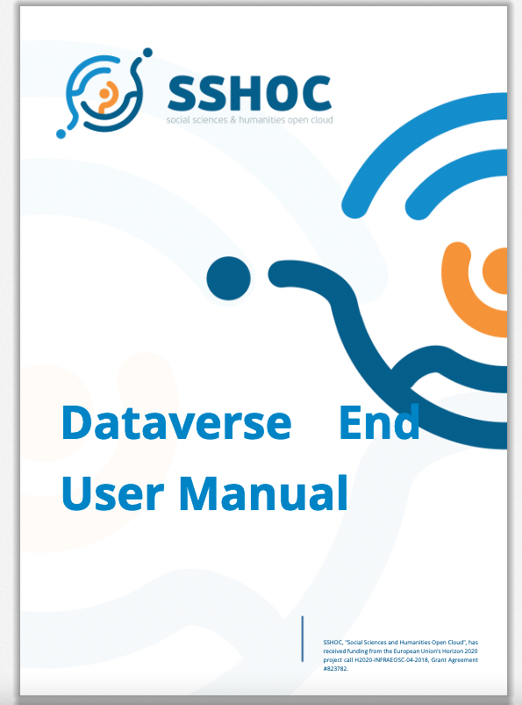
Dataverse materials [2]
One resource that will come back a few times today:
Dataverse End User Manual
Created within the SSHOC Project¹
Summarizing all the information a Dataverse user (researcher) needs to
  set up an account
  search and find data
  reuse data
  deposit data
  manage data submissions
Available at https://doi.org/10.5281/zenodo.6347488
¹ SSHOC, "Social Sciences and Humanities Open Cloud", has received funding from the European Union’s Horizon 2020 project call H2020-INFRAEOSC-04-2018, grant agreement #823782. See: https://www.sshopencloud.eu/

Slide 36
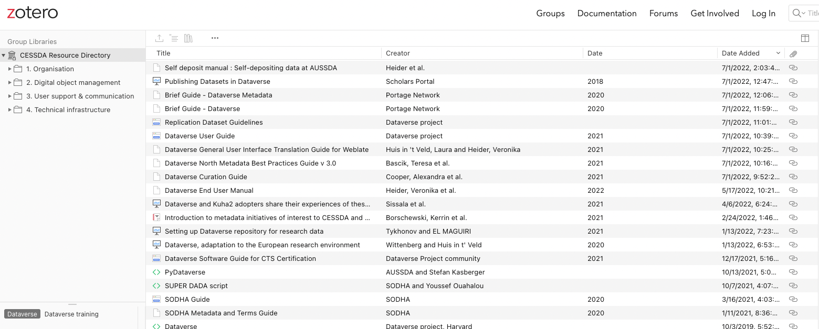
CESSDA Resource Directory
CESSDA has a resource directory on Zotero
→ You can filter on “Dataverse training”
https://www.zotero.org/groups/2382601/cessda_resource_directory/library

Slide 37
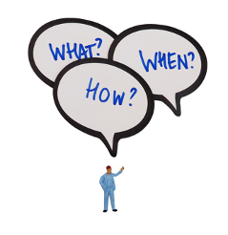


CESSDA Data Management Expert Guide [1]
Guide on Research Data Management (RDM)
  For early career researchers (in the social sciences)
Provides useful information on RDM in one central place
Created by CESSDA training team 2017-2020, updated regularly.
Free to use at www.cessda.eu/dmeg
https://dmeg.cessda.eu/

Slide 38
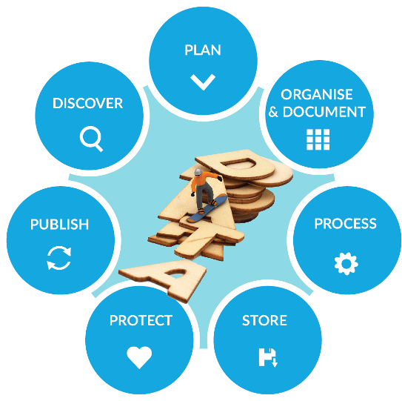
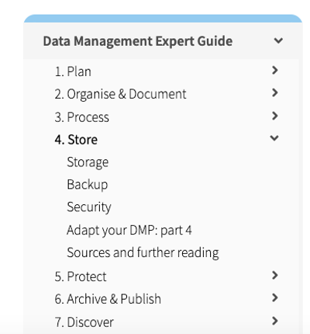
CESSDA Data Management Expert Guide [2]
Follows the Research Data Life Cycle

Slide 39

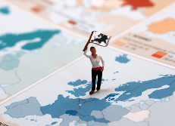
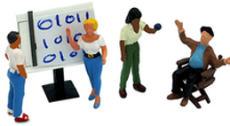
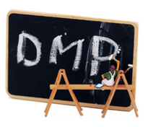
CESSDA Data Management Expert Guide [3]
Has a couple of recurring elements
Expert Tips
European diversity
Qualitative & Quantitative data
Adapt your Data Management Plan (DMP)

Slide 40
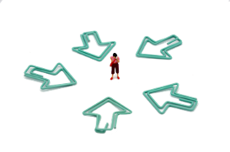
The DMEG as a resource for Trainers
Train-the-trainer (TTT) package - Free to use at www.cessda.eu/ttt
Workshop Outlines
Presentations
Exercises
Documents (DMP, handouts, workshop evaluation forms, …)
Images

Slide 41

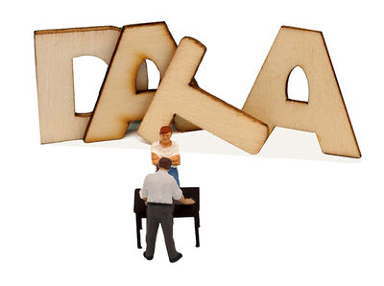
Workshop Outlines and Materials
For today’s training, we created two example workshop outlines with links to materials
Dataverse training focussed on using Dataverse to find and re-use data
Dataverse training focussed on depositing and archiving data in Dataverse

Slide 42
Workshop Outline 1 Finding Data [1]
Context of the Workshop
Level: Beginner
Time frame: Half day workshop (ca 3 - 3.5 hours)
Target group: Early career researchers /PhD candidates
Recommended no. of participants: 15-30; more is possible but there is less room for interaction

Slide 43
Workshop Outline 1 Finding Data [2]
Learning Goals
Participants will know arguments for re-using data
Participants will have a basic understanding of what Dataverse is
Participants will be able to search for relevant datasets in Dataverse

Slide 44
Workshop Outline 1 Finding Data [3]
Programme
09:00 - 09:15 Welcome
09:15 - 09:45 Presentation 1: Discovering Data for Re-use
09:45 - 10:00 Discussion
10:00 - 10:30 Break
10:30 - 11:00 Presentation 2: Dataverse Introduction
11:00 - 11:30 Interactive session - Finding Data for your own research
11:30 - 12:15 Add on session on licences [optional]
12:15 - 12:30 Wrap up

Slide 45
Workshop Outline 1 Finding Data [4]
Detailed programme and example assignments
DISCOVERING DATA FOR REUSE
Background on data discovery and re-use
Building on the Data Discovery Chapter of the DMEG
Example presentation: WO1_Presentation_DataDiscovery

Slide 46
Workshop Outline 1 Finding Data [5]
Detailed programme and example assignments
DATAVERSE INTRODUCTION
Background on Dataverse
Building on the Dataverse User Guide
Example presentation: WO1_Presentation_DataverseDiscovery

Slide 47
Workshop Outline 1 Finding Data [6]
Detailed programme and example assignments
INTERACTIVE SESSION ON FINDING DATA
Let participants use Dataverse to search data
Give them a topic to search from or let them chose themselves
Building on the Dataverse User Guide

Slide 48
Workshop Outline 1 Finding Data [7]
Detailed programme and example assignments
ADDITIONAL SESSION ON LICENSES
Information about licenses and re-use
Building on the section about licenses in Chapter 6 of the DMEG
Example exercise from the CESSDA TTT
Example presentation: WO1_Presentation_Licenses

Slide 49
Workshop Outline 2 Depositing Data [1]

Slide 50
Workshop Outline 2 Depositing Data [2]
Context of the Workshop
Level: For beginners, basic introduction to research data management
Time frame: Half day workshop (ca 3 - 3.5 hours)
Target group: Early career researchers /PhD candidates
Recommended no. of participants: 15-30; more is possible but there is less room for interaction

Slide 51
Workshop Outline 2 Depositing Data [3]
Learning Goals
Participants will…
… know at least three reasons for why archiving data is important
… know the advantages of a trustworthy digital repository
… have a basic understanding of what Dataverse is
… be able to upload a dataset in Dataverse

Slide 52
Workshop Outline 2 Depositing Data [4]
Programme
09:00 - 09:15 Welcome
09:15 - 09:45 Presentation 1: Archiving & Publishing Data
09:45 - 10:00 Discussion
10:00 - 10:30: Break
10:30 - 11:00: Presentation 2: Dataverse Introduction
11:00 - 11:30 Interactive session - Depositing your own data
11:30 - 11:45 Discussion
11:45-12:00 Wrap up

Slide 53
Workshop Outline 2 Depositing Data [5]
Detailed programme and example assignments
ARCHIVING AND PUBLISHING DATA
Background on data archiving and publication
Building on the Archive & Publish Chapter of the DMEG
Example presentation: WO2_Presentation_Archive

Slide 54
Workshop Outline 2 Depositing Data [6]
Detailed programme and example assignments
DATAVERSE INTRODUCTION
Background on Dataverse
Building on the Dataverse User Guide
Example presentation: WO2_Presentation_DataverseArchive

Slide 55
Workshop Outline 2 Depositing Data [7]
Detailed programme and example assignments
INTERACTIVE SESSION ON DEPOSITING YOUR OWN DATA
Let participants use Dataverse to deposit data
  Use a test environment for training if available
  deposit a dataset together
Building on the Dataverse User Guide

Slide 56
Any questions?
Image: CC-BY-SA from https://dmeg.cessda.eu/

Slide 57
Programme
10:30-10:45 Welcome
10:45-11:15 Background on Dataverse
11:15-11:20 Short Break
11:20-12:00 Session 1: Example materials and outlines
12:00-13:00 Lunch Break
13:00-13:45 Session 2: Breakout session for your own workshop
13:45-13:50 Short Break
13:50-14:35 Session 3: Planning and troubleshooting
14:35-15:00 Wrap-up

Slide 58
Session 2: Breakout session for your own workshop design
Ricarda Braukmann & Kim Ferguson

Slide 59
Chose a breakout room
Chose a breakout room
Breakout Room 1 will focus on audience 1 / topic 1
Breakout room 2 will focus on audience 2 / topic 2
Individually
Start to create your own workshop outline [You can use the workshop outlines as a basis]
What topic do you want to cover?
Who is your audience?
What duration do you want your workshop to be?
Start collecting materials you want to use for your workshop
Consider the materials linked in the workshop outlines
Consider materials presented before (e.g. CESSDA DMEG, Dataverse Manuals)
Consider other materials you may already have → Please share useful sources!
If you like, take the last 10-15 minutes to exchange with the others in your group.

Slide 60
Programme
10:30-10:45 Welcome
10:45-11:15 Background on Dataverse
11:15-11:20 Short Break
11:20-12:00 Session 1: Example materials and outlines
12:00-13:00 Lunch Break
13:00-13:45 Session 2: Breakout session for your own workshop design
13:45-13:50 Short Break
13:50-14:35 Session 3: Planning and troubleshooting
14:35-15:00 Wrap-up

Slide 61
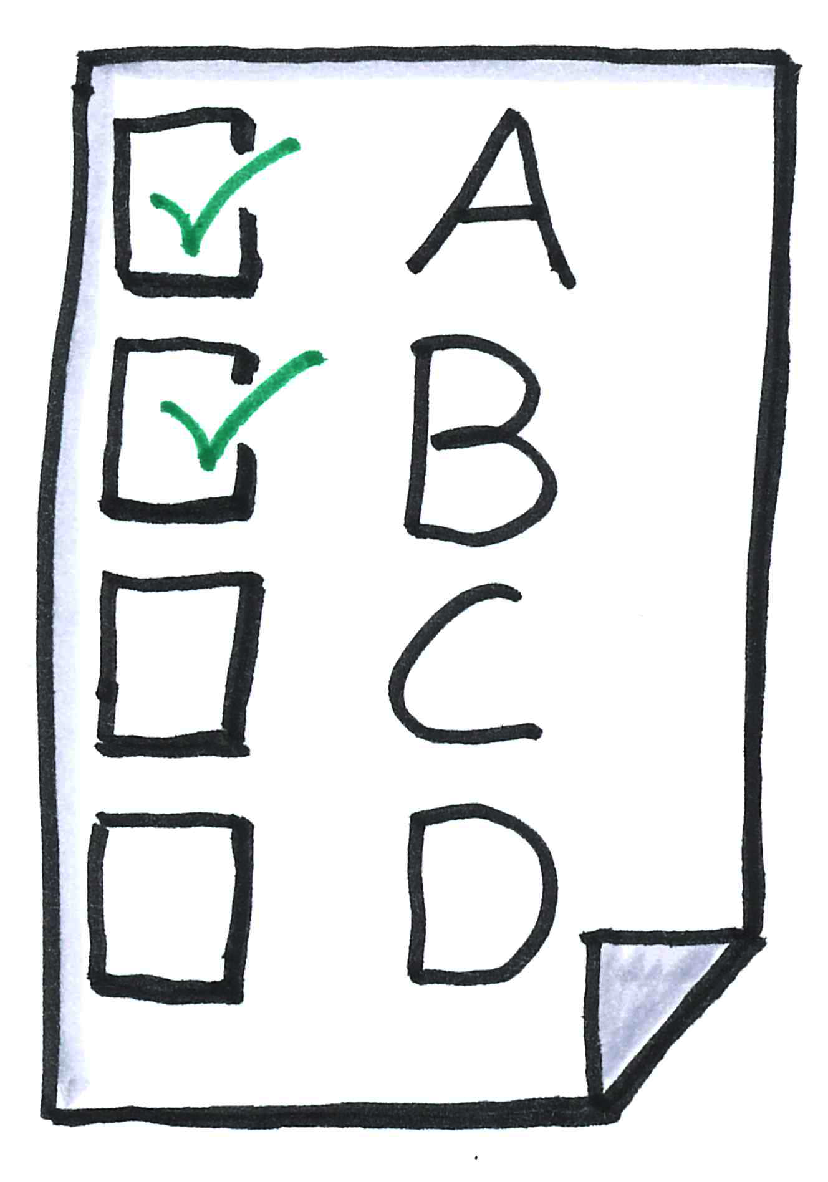
Session 3: Planning & Troubleshooting
Kim Ferguson
Notes:
image is cc0

Slide 62
Checklists: taking the stress out of planning
Takeaway from this training: an event planning checklist
  CESSDA+DANS+SSHOC, all in one
Online offerings, adapt as necessary
Two (complementary) forms: Table or Narrative
Checklist here - let’s check it out!

Slide 63
Checklists: Things to keep in mind
Checklists should be suitable to your situation
→ edit the list as necessary
More than one person organising
→ share the tasks but keep a single list
The list doesn’t check itself
→ Assign tasks and set dates, follow-up

Slide 64
Planning is great, but what about the unexpected?
That’s where troubleshooting comes in, with some help from Gwen Franck’s Train-the-Trainer Game 2.0
Designed for FOSTER, it includes six variable elements:
Audience type, audience mood, and knowledge level
Audience size, training type
Trouble

Slide 65
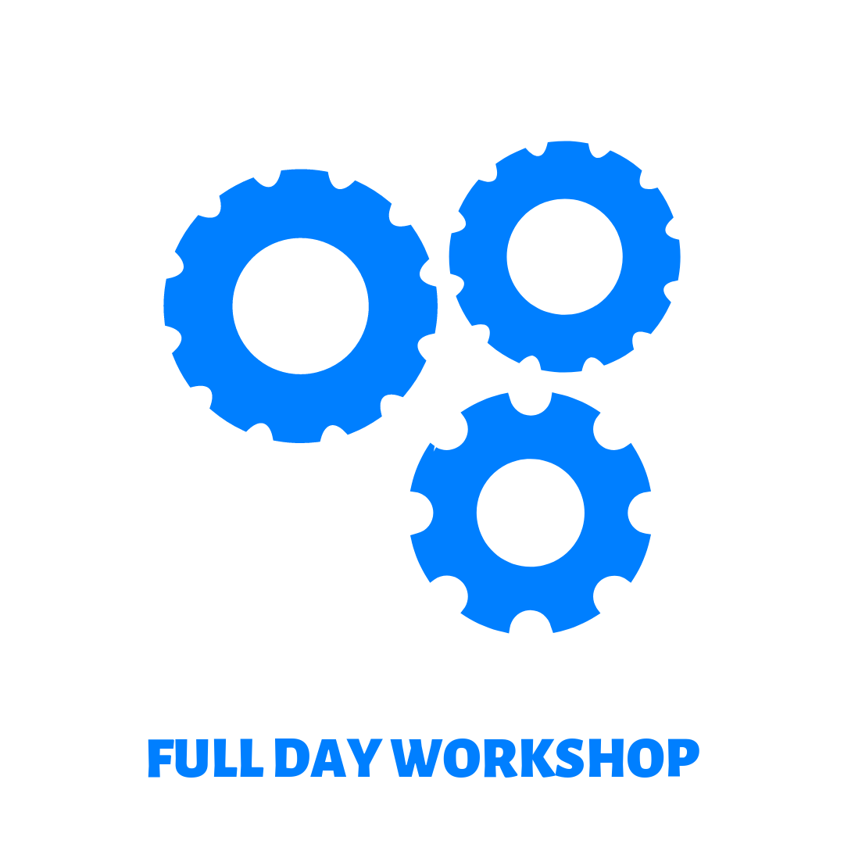
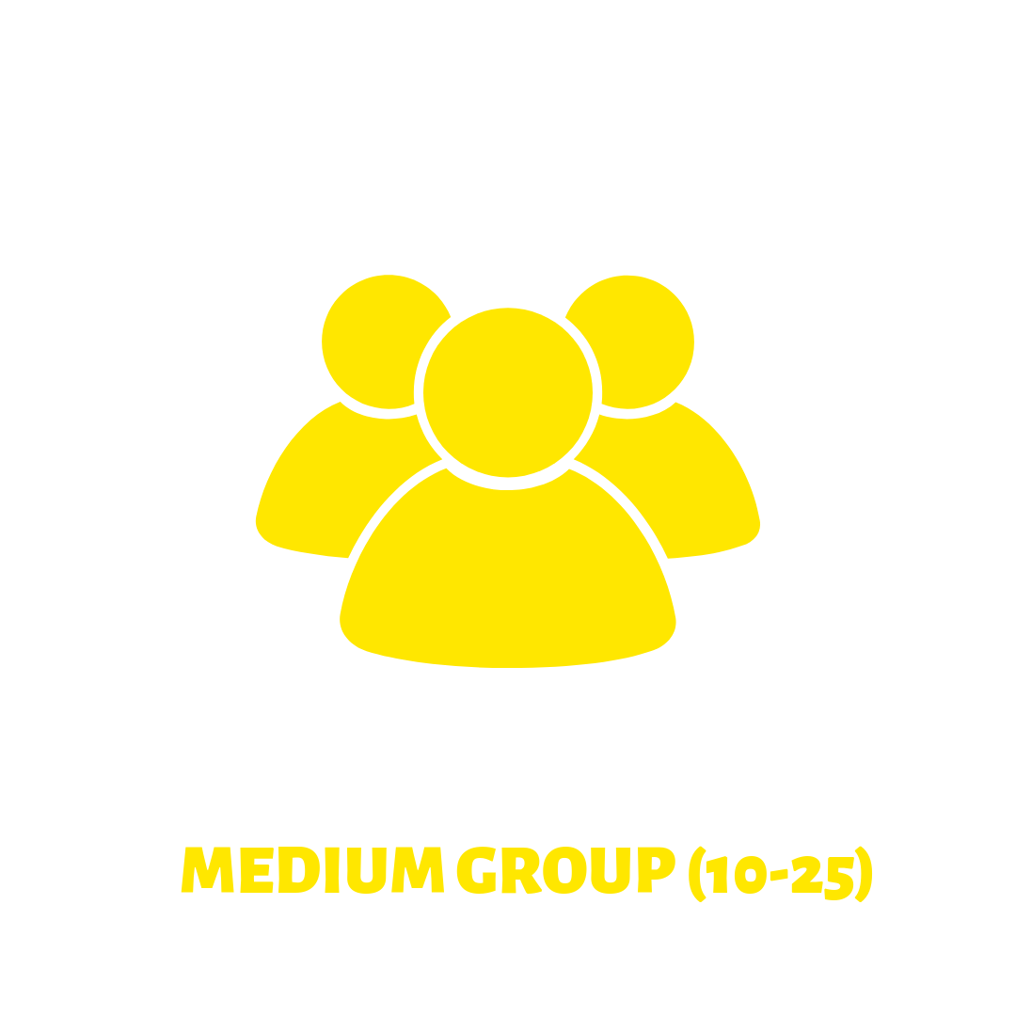
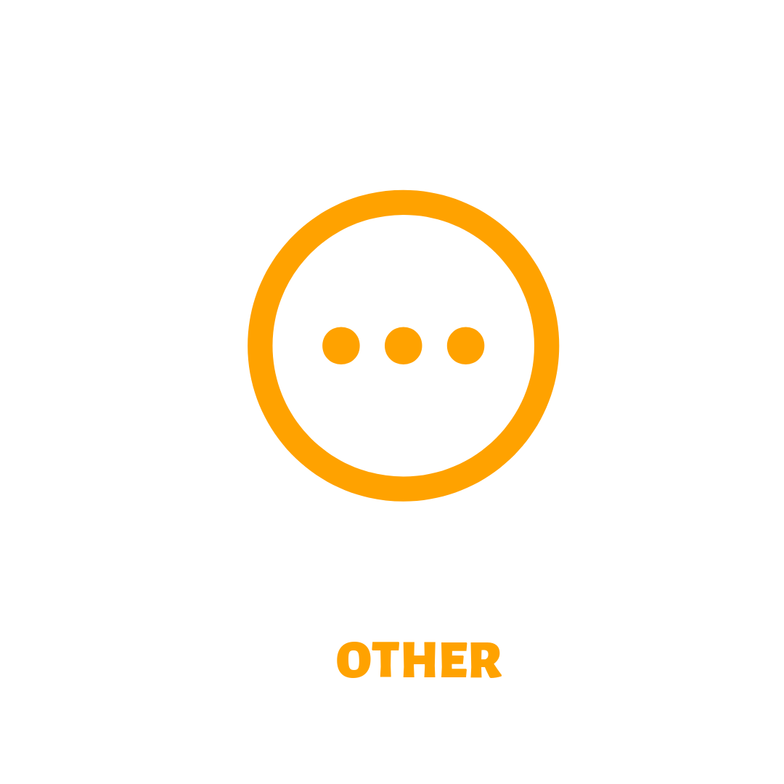

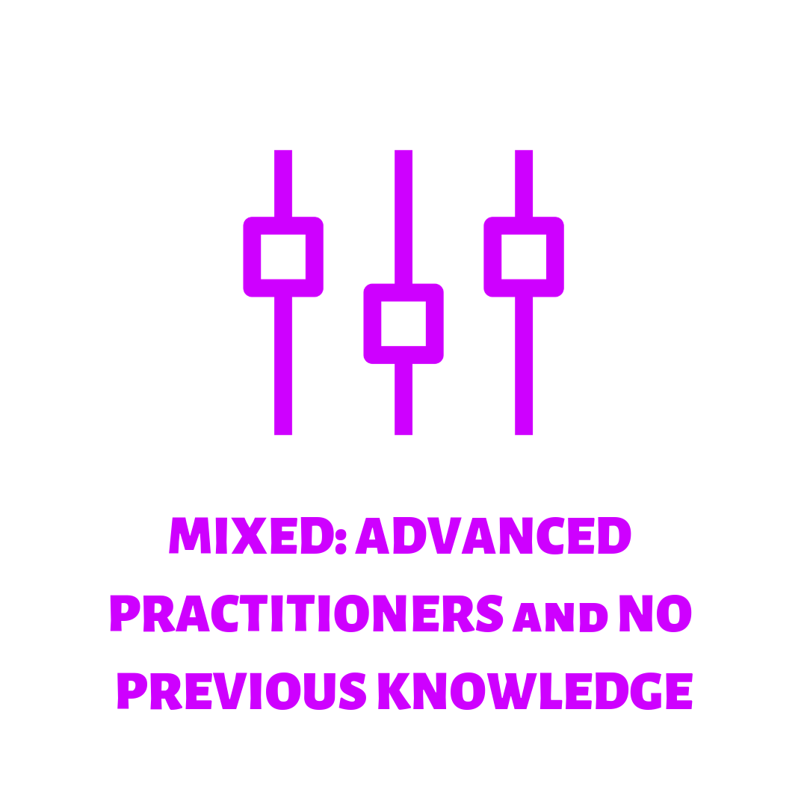
Things somewhat within your control
Things somewhat outside your control
Training type
  (1 hr webinar, full day workshop, etc.)
Audience size
Audience type
  (researchers, policy makers, librarians, etc.)
Knowledge level
Audience mood
  (skeptical, off-topic questions, uninterested, etc.)
Trouble
Images from Gwen Franck’s Train-the-Trainer game

Slide 66



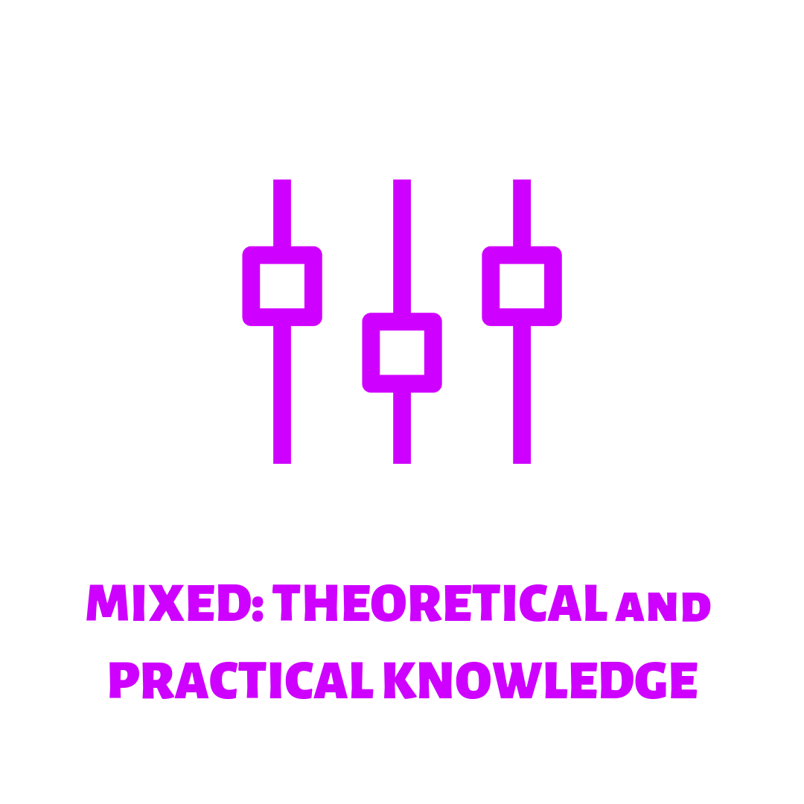


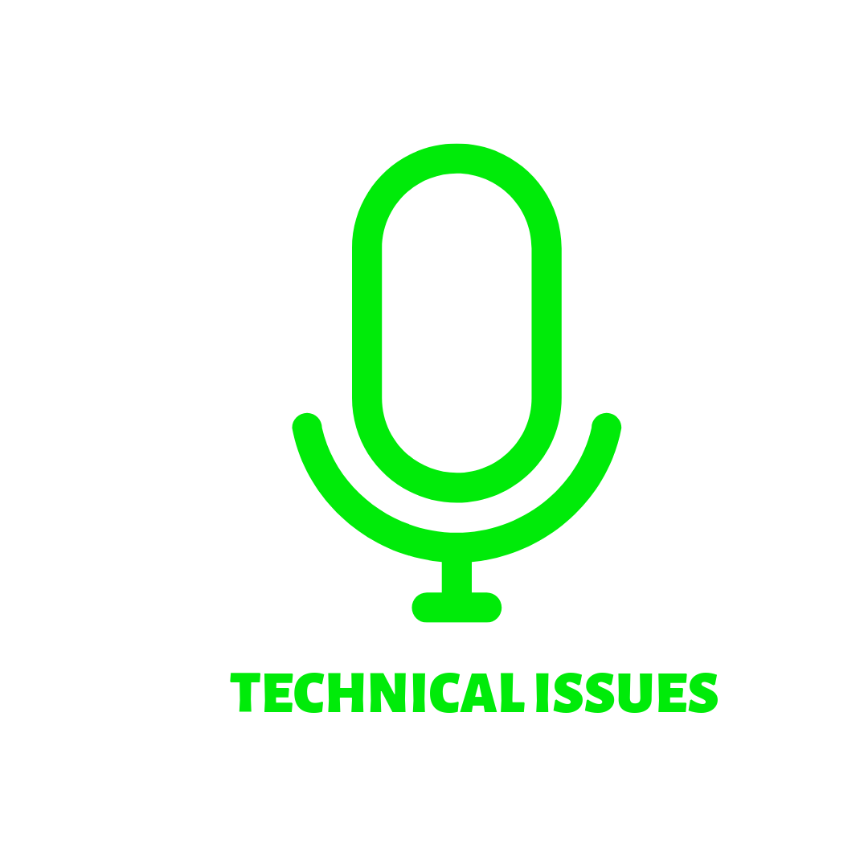

1 hour webinar for designated community
Possible solutions?
In the moment
Preparing for in advance
sound checks
spare microphone, camera, or laptop
liaise with tech support
ethernet cable (if spotty wi-fi)
having mobile data for hotspot
Recorded webinar that is streamed with live Q&A afterwards*
Variable audience type and background knowledge (on topic), audience size potentially unknown
Images from Gwen Franck’s Train-the-Trainer game

Slide 67
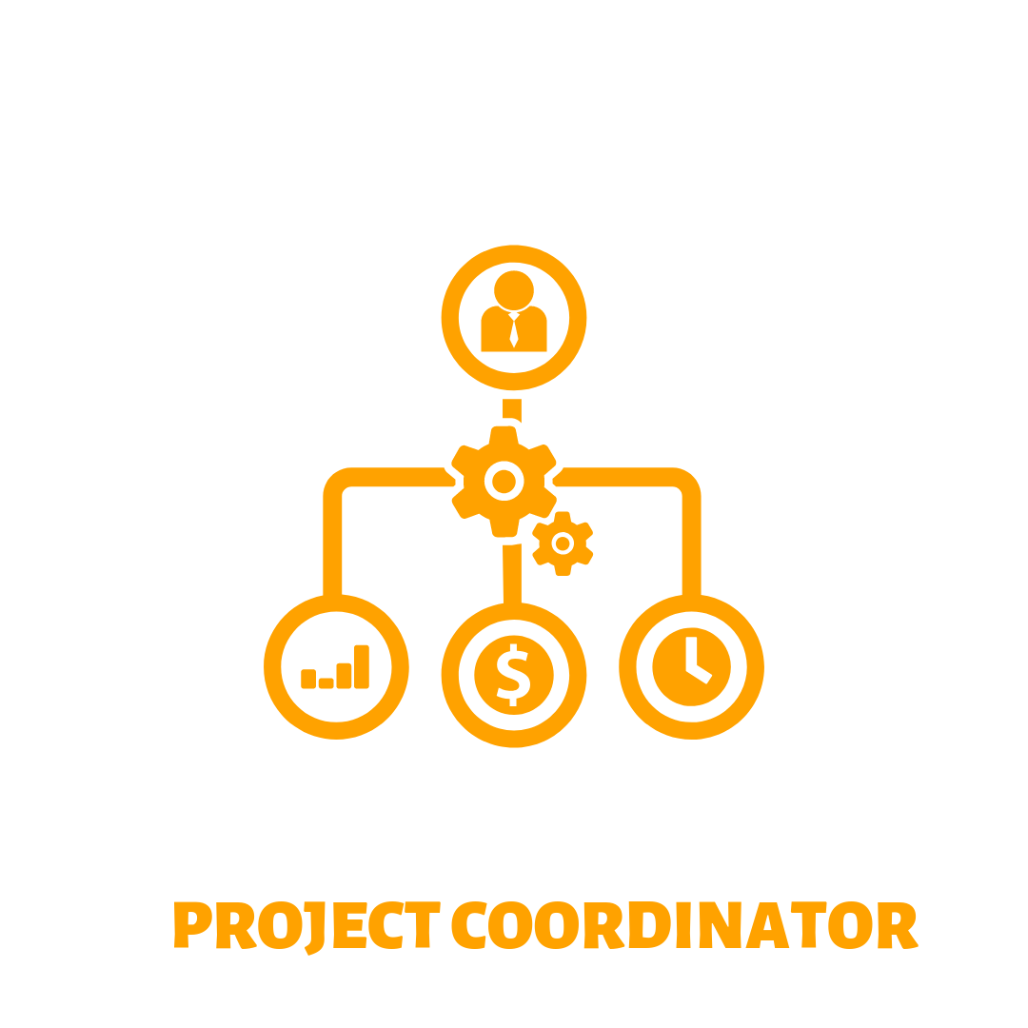


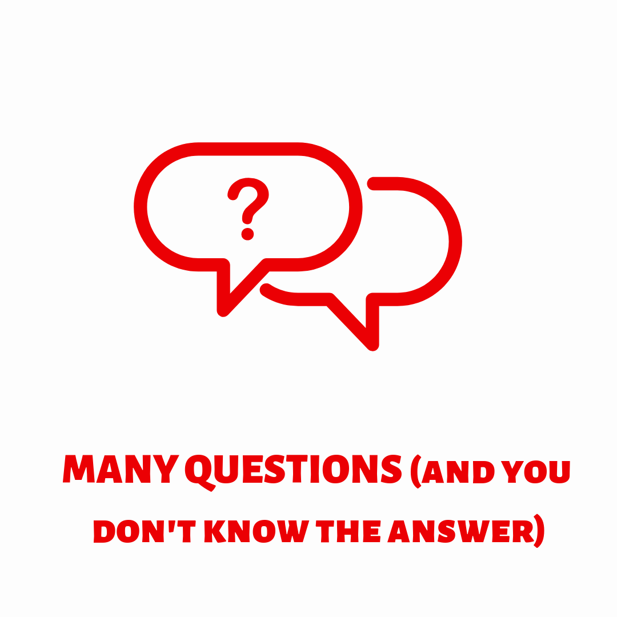
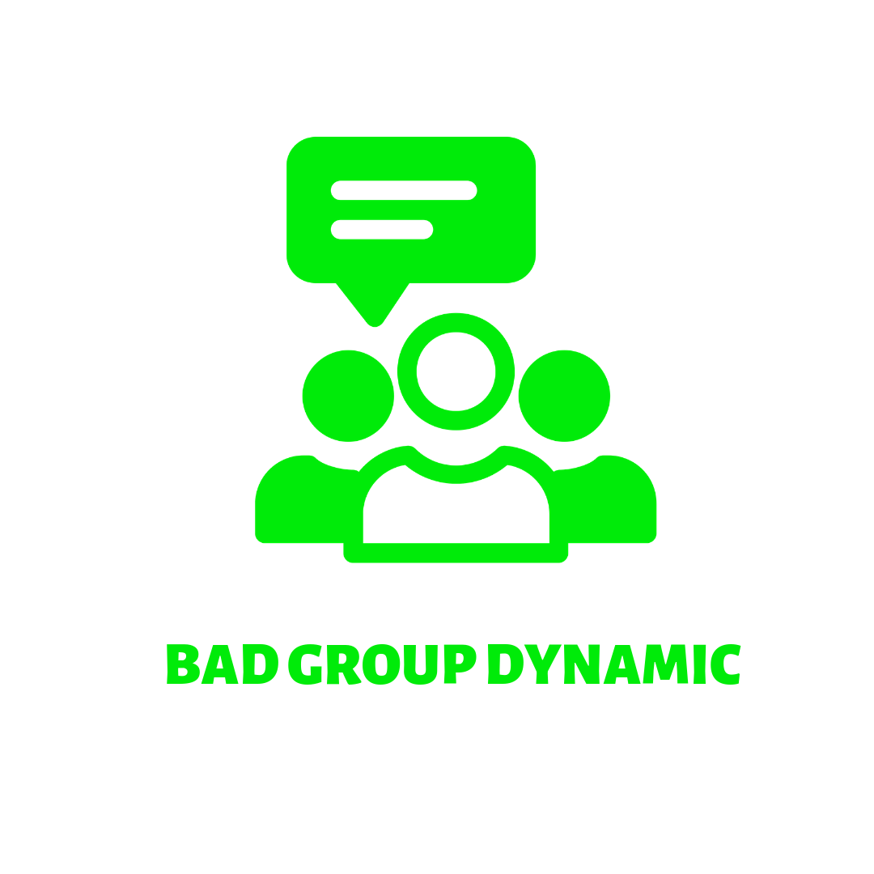

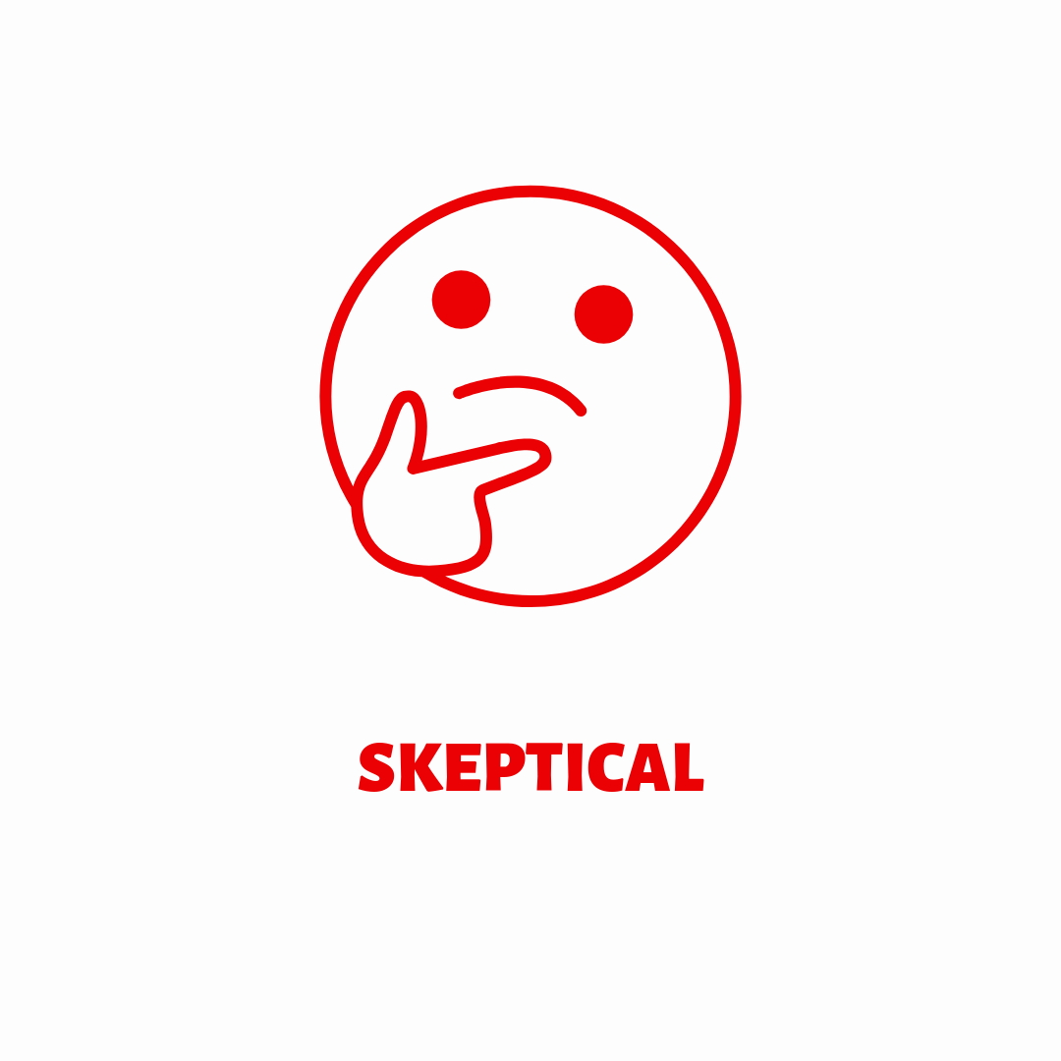


Full day training workshop for staff
Possible solutions?
Data steward/
ICT steward
In the moment
Preparing for in advance
Engage management
Make flash cards or notes
Indicate that you’re still learning
Open questions for follow-up
Feed them
Provide proper breaks
Likely small audience with similar knowledge level, variable moods
Images from Gwen Franck’s Train-the-Trainer game

Slide 68
Troubleshooting
How about your experiences?

Slide 69
Wrap-up
Kim Ferguson

Slide 70
Wrap Up
Tell us what you achieved today!

Slide 71
Any remaining questions?
Image: CC-BY-SA from https://dmeg.cessda.eu/

Slide 72
Wrap Up - Feedback
We really appreciate your feedback → Please fill in our survey at https://tinyurl.com/CESSDA-Dataverse now or after the training.

Slide 73
Thank you for joining us!
Ricarda Braukmann - ricarda.braukmann@dans.knaw.nl
Kim Ferguson - kim.ferguson@dans.knaw.nl
Licence: CC-BY 4.0

Slide 74
References
Gwen Franck’s Train-the-Trainer game, CC by 4.0, https://fosteropenscience.eu/node/2570

