Slide 1
Rights Retention Strategies
(as means of achieving open research)

Slide 2
A background on copyright & research communications
Open-access (OA) literature is digital, online, free of charge, and free of most copyright and licensing restrictions
OA removes price barriers (licensing fees, pay-per-view fees)
  AND permission barriers (most copyright and licensing restrictions)
  Here's how the Budapest Open Access Initiative (BOAI, 2002) put it:
  “…By 'open access' to this literature, we mean its free availability on the public internet, permitting any users to read, download, copy, distribute, print, search, or link to the full texts of these articles, crawl them for indexing, pass them as data to software, or use them for any other lawful purpose, without financial, legal, or technical barriers other than those inseparable from gaining access to the internet itself. The only constraint on reproduction and distribution, and the only role for copyright in this domain, should be to give authors control over the integrity of their work and the right to be properly acknowledged and cited."
Taken from Peter Suber’s Open Access Overview: https://legacy.earlham.edu/~peters/fos/overview.htm

Slide 3
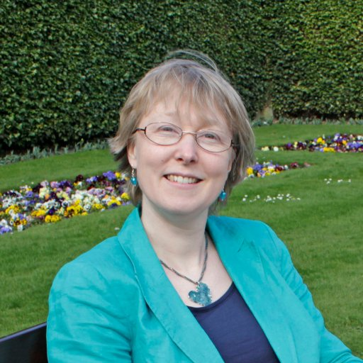
Aileen Fyfe (@AileenFyfe on twitter)
historian of academic publishing
at University of St Andrews
Journals pre-date the invention of copyright e.g. Journal des sçavans (1665) & Philos. Trans. R. Soc. (1665)
Scholarly organisations such as The Royal Society were historically supportive of efforts to reprint, reuse and share research papers, so long as credit and priority were appropriately attributed. No payment was sought for re-use.
The Royal Society only introduced copyright transfer forms to take copyright away from authors in 1990.
Takeaways: (1) Publishers do not need full copyright transfer to publish research
      (2) Academic publishers only started grabbing copyright from authors between 1970-1999
https://blogs.lse.ac.uk/impactofsocialsciences/2019/06/03/what-the-history-of-copyright-in-academic-publishing-tells-us-about-open-research/

Slide 4
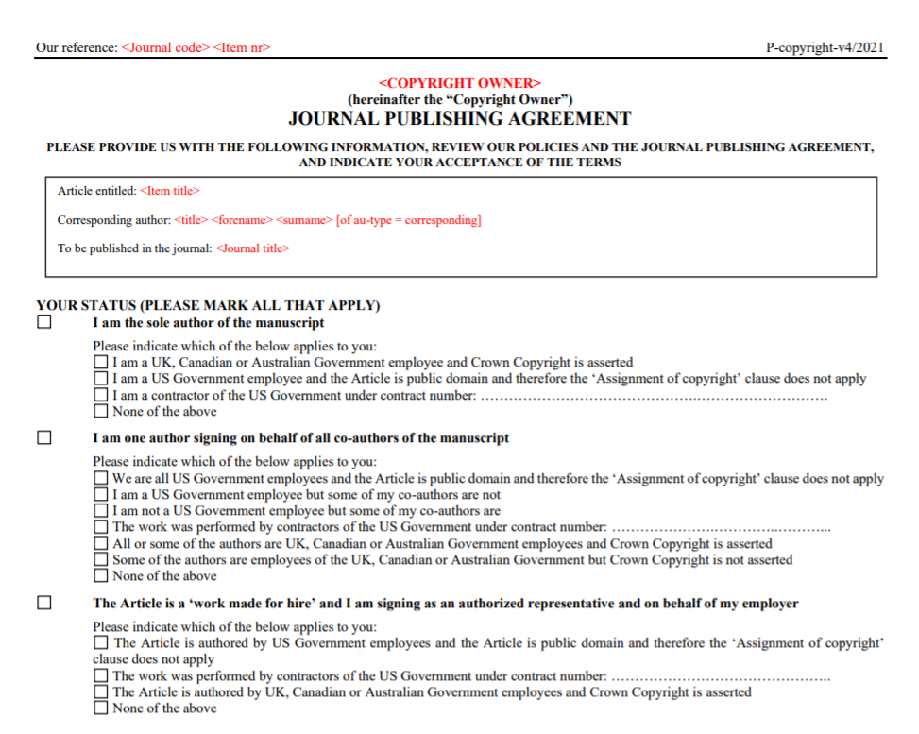
Page 1 (of 4) of Elsevier’s sample copyright transfer agreement.
https://www.elsevier.com/about/policies/copyright accessed 2021-07-06

Slide 5
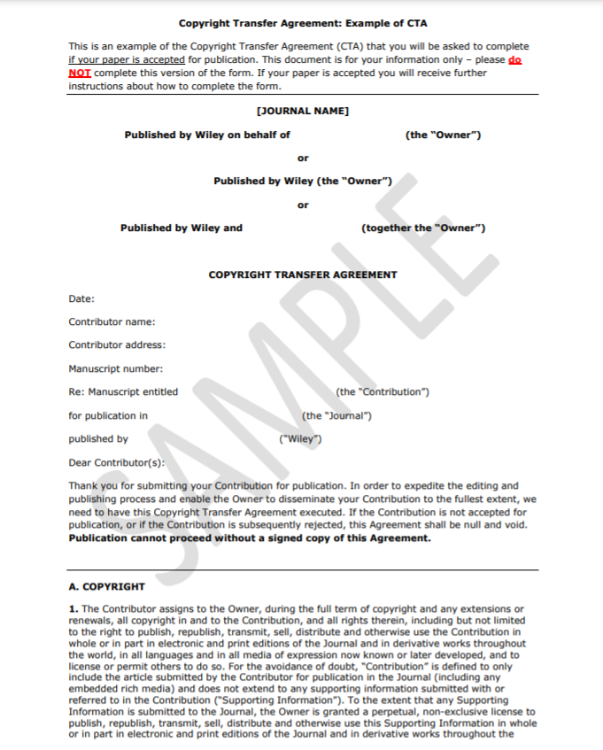
Page 1 (of 6) of Wiley’s sample Copyright Transfer Agreement (CTA): https://authorservices.wiley.com/asset/Copyright-Transfer-Agreement-Sample.pdf
accessed 2021-07-06

Slide 6
Why fight a battle for rights?

Slide 7

Copyright transfer helps enforce a scarcity of access
Copyright holding by publishers is not ‘benign’
The American Psychological Association (APA) pay Digimarc to send out DMCA ‘takedown notices’ on their behalf, alleging copyright infringement. Lumen has records of over 12,600 notices sent on APA’s behalf in the last six months
In the last six months, the number of Lumen-recorded (not all of them) takedown notices sent out are:
>12,600 on behalf of the American Psychological Association (APA)
>5,000 on behalf of Oxford University Press (OUP)
>5,000 on behalf of Cambridge University Press (CUP)
>3,500 on behalf of Wiley
>1,500 on behalf of Taylor & Francis
Data from: https://www.lumendatabase.org/ (an Arcadia Fund grantee), as of 2021-07-06

Slide 8
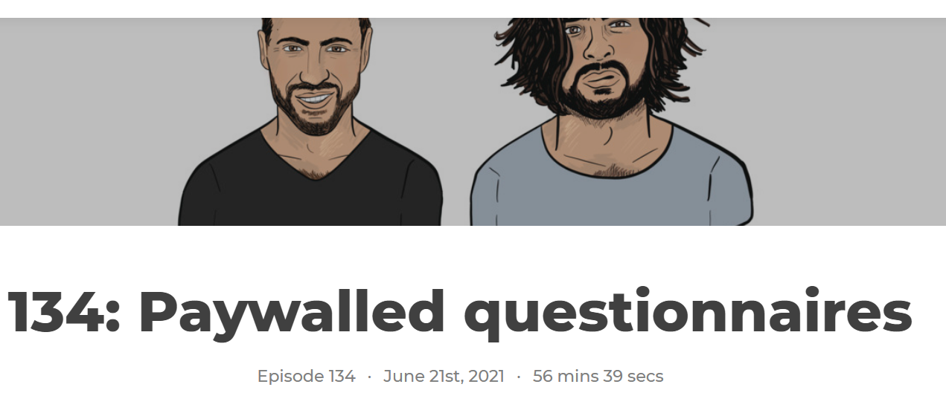
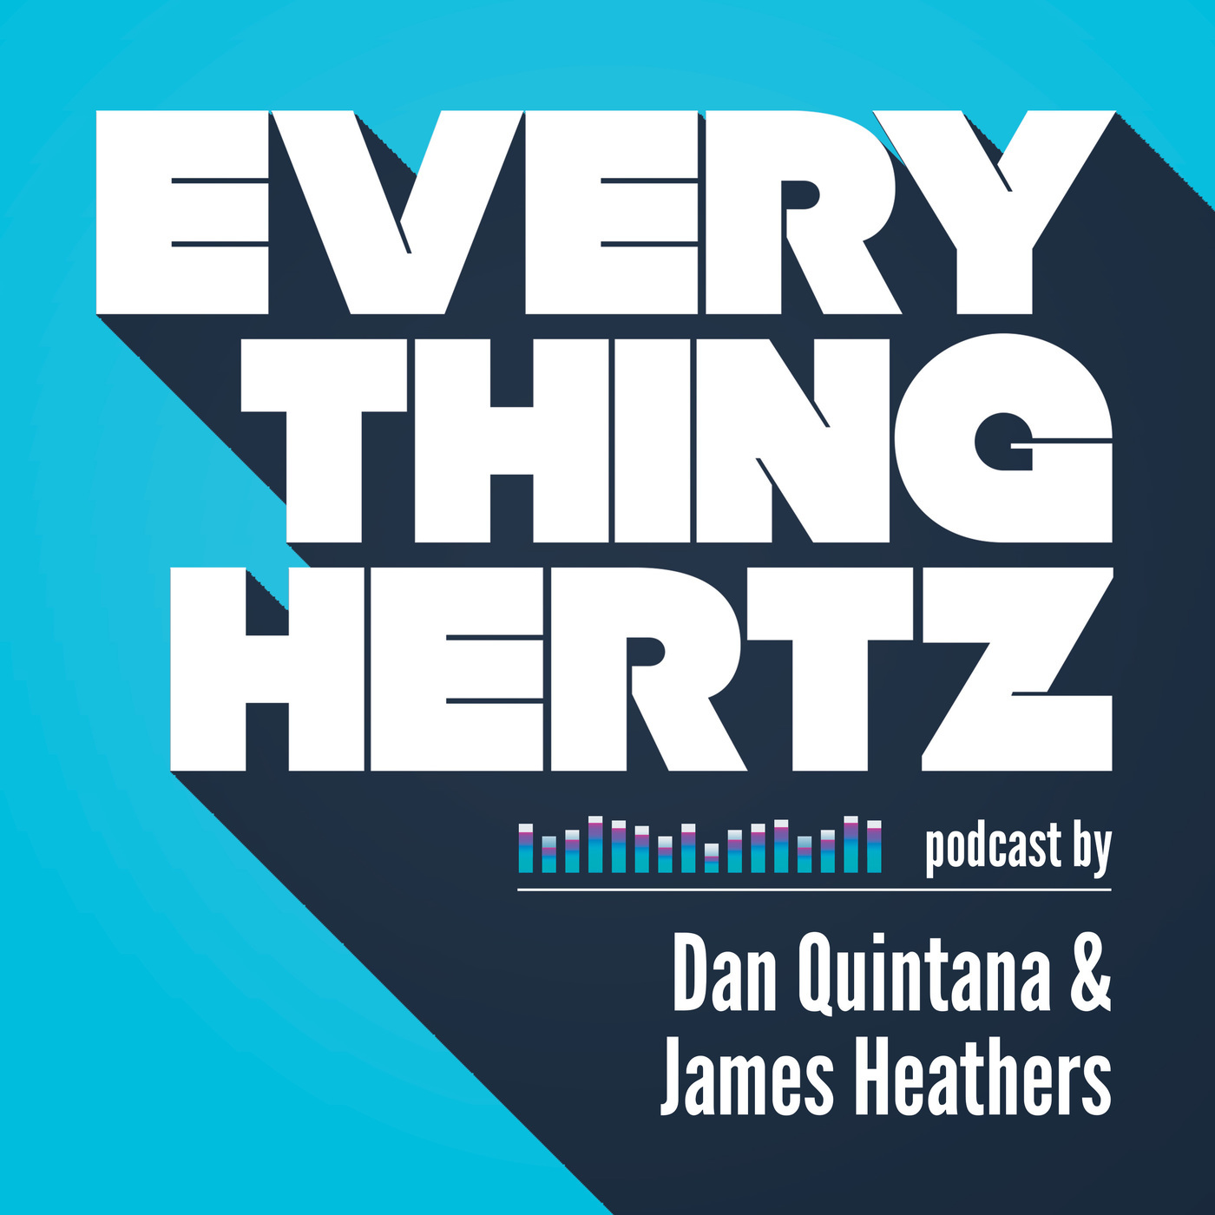
CC BY licensing enables criticism & replication attempts
Copyright infringement claims are involved in over 400 documented article retractions.
A lot of these are plagiarism which CC BY protects against
BUT… some authors unscrupulously use “all rights reserved” copyright as a means of impeding replication attempts
“Copyright claim prompts retraction of study on alexithymia in autism” by Niko McCarty for Spectrum News 9th June 2021
https://everythinghertz.com/134
Data from the Retraction Watch Database: http://retractiondatabase.org/, as of 2021-07-12

Slide 9
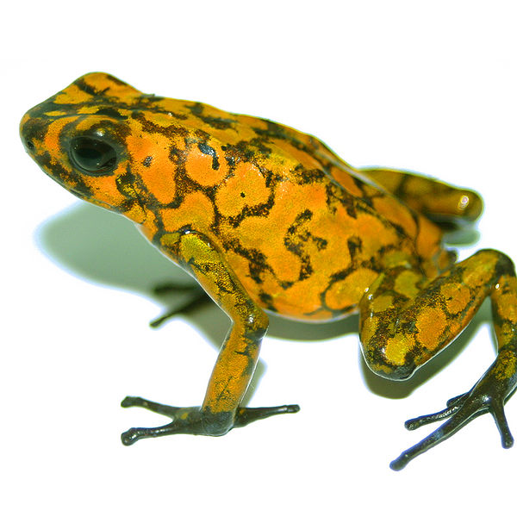
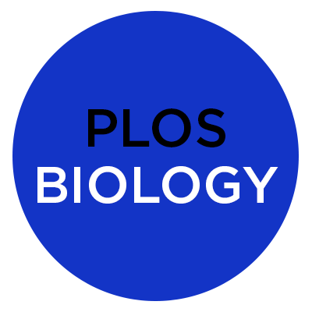

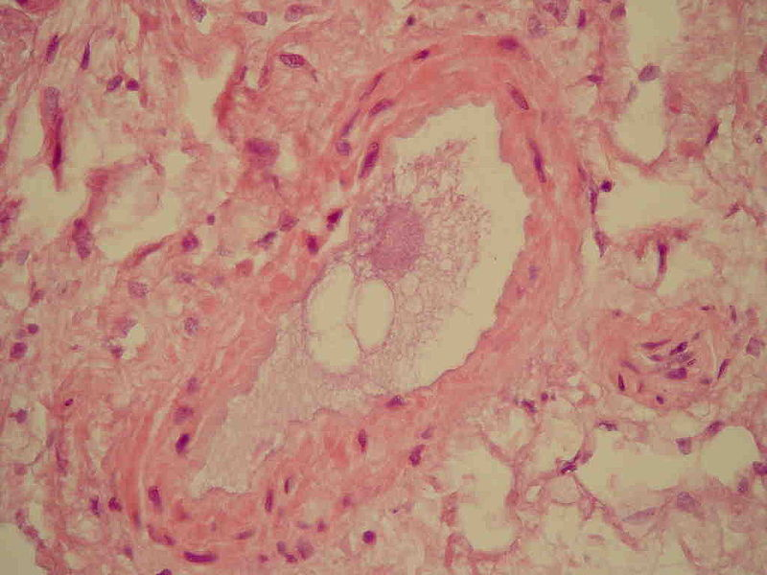
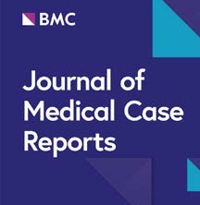
CC BY licensing enables frictionless re-use
Open Educational Resources (OER)
Oophaga sylvatica
Fat embolism syndrome
(WP article)
~200 pageviews every day
Fat embolism syndrome
Open Educational Resources (OER)

Slide 10

Non-open licensing makes re-use expensive and/or totally prevented
Open Educational Resources (OER)
If non-open licensed journal article
Oophaga sylvatica
Extra payment often required for licensed re-use
Educational Resources

Slide 11
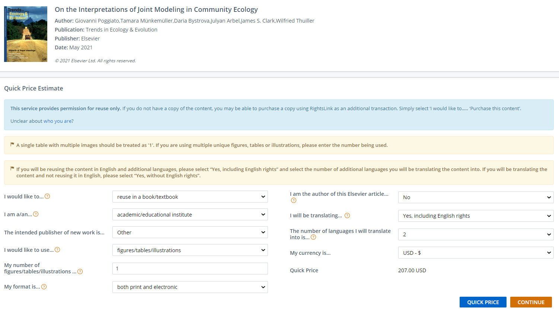
Reproducing 1 figure in a textbook, is priced at $207 USD

Slide 12
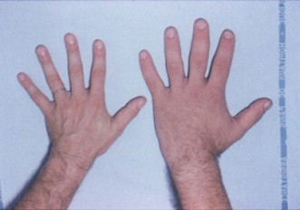
Greater impact specifically because of CC BY enabled re-use
Chanson, P., Salenave, S. (2008) Acromegaly. Orphanet J Rare Dis 3, 17. https://doi.org/10.1186/1750-1172-3-17
https://en.wikipedia.org/wiki/Pituitary_gland
1,900 pageviews per day
~700,000 pageviews per year
https://en.wikipedia.org/wiki/Acromegaly
2,500 pageviews per day
~900,000 pageviews per year
Acromegaly
Fig.1 Orphanet Journal of Rare Diseases (2008)
(an academic journal article would be exceptional to receive >100,000 pageviews in its 1st/best year)

Slide 13
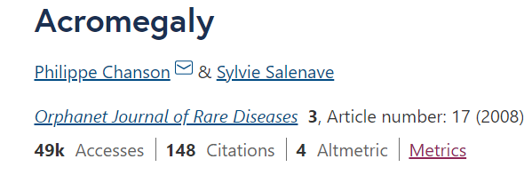
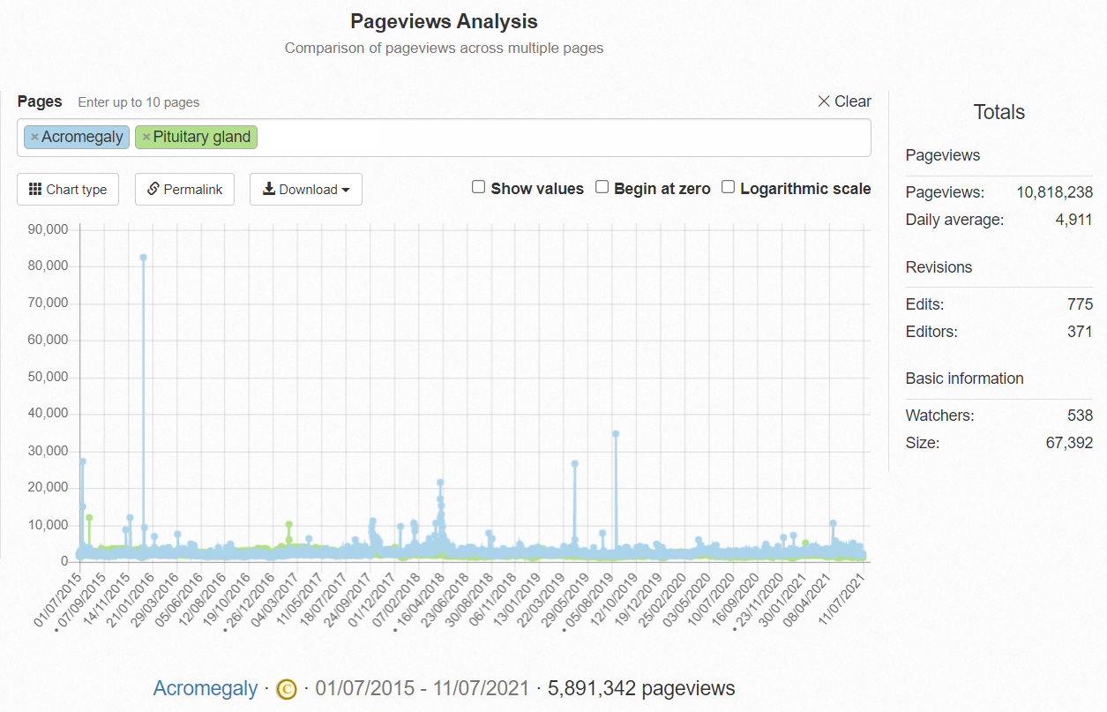
Some of the content, e.g. figures contributes to pages that have been viewed cumulatively >10,800,000 times since mid-2015, over at Wikipedia
Originally published -> 49,000 views
https://pageviews.toolforge.org/?project=en.wikipedia.org&platform=all-access&agent=user&redirects=0&range=all-time&pages=Acromegaly|Pituitary_gland

Slide 14
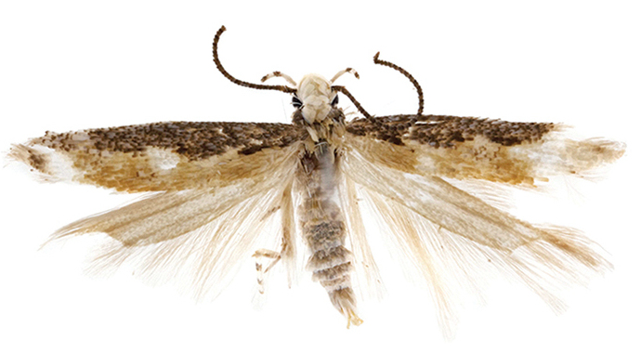
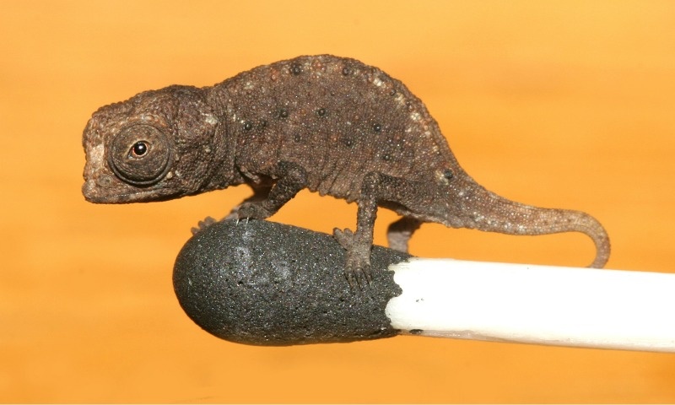
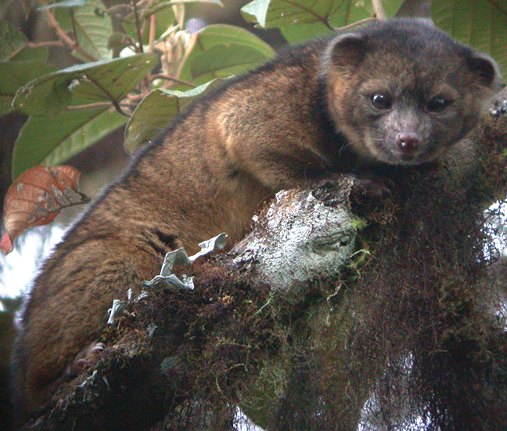
Neopalpa donaldtrumpi
217,000+ pageviews
Brookesia micra
126,000+ pageviews
https://en.wikipedia.org/wiki/Neopalpa_donaldtrumpi
https://en.wikipedia.org/wiki/Brookesia_micra
the Olinguito
287,000+ pageviews
https://en.wikipedia.org/wiki/Olinguito

Slide 15
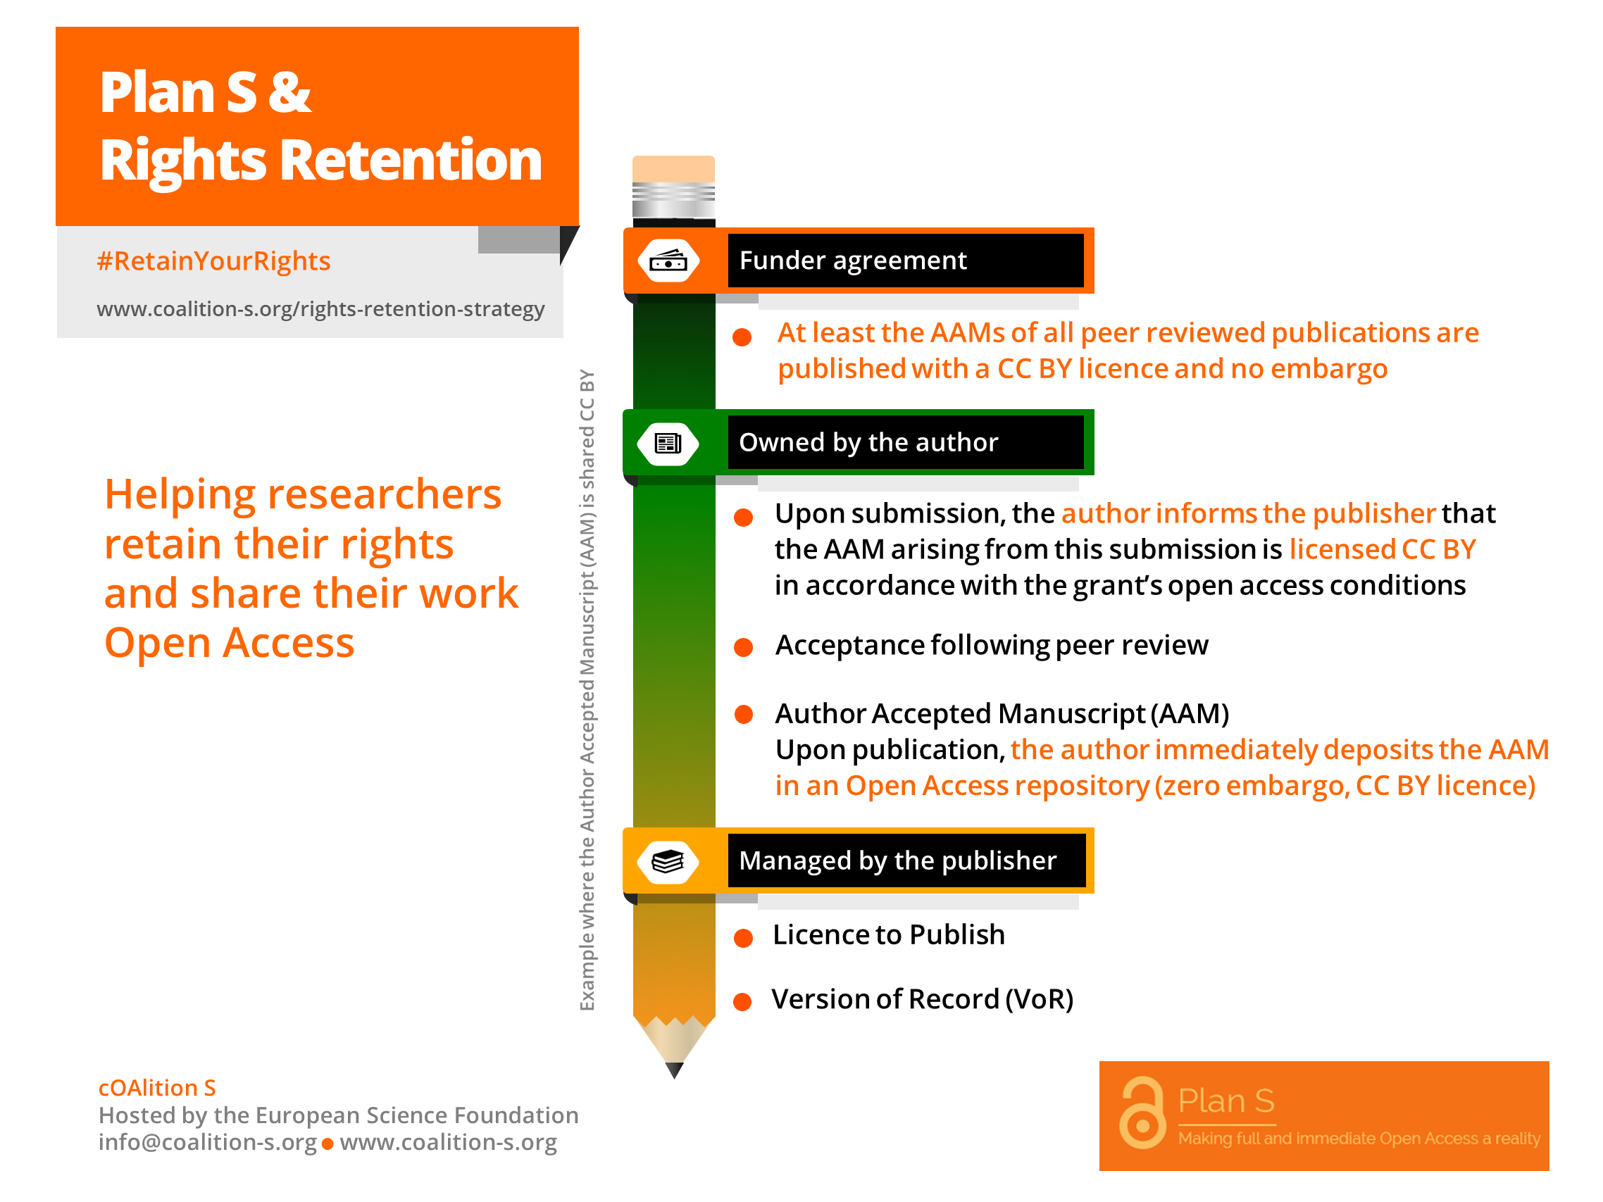

Slide 16
Examples of RRS In Action
A researcher in receipt of a Wellcome Trust grant submitted a manuscript for consideration by the Italian journal Galenos published by Fabrizio Serra editore [Commercial Publisher]
In the submitted manuscript, the researcher includes the RRS ‘magic words’ giving fair notice to the publisher that the manuscript is covered by the Rights Retention Strategy:
The full title of the project is: Plants and Minerals in Byzantine Popular Pharmacy. A Multidisciplinary Approach (217861/Z/19/Z) … I am most grateful to the Wellcome Trust for making my research possible …
For the purpose of open access, the author has applied a CC BY public copyright licence to any Author Accepted Manuscript version arising from this submission.
The journal accepts the manuscript after peer-review and publishes it.
The author after acceptance, can then upload the author accepted manuscript to a repository.

Slide 17

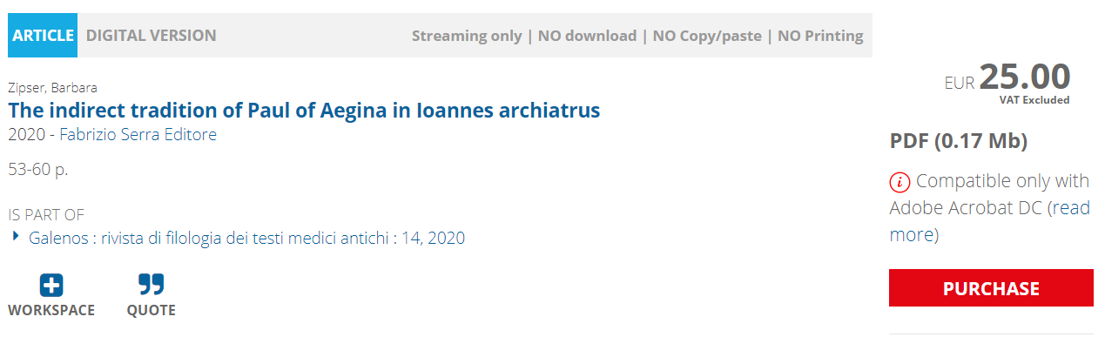
The ‘Version of record’ … Paywalled
https://www.torrossa.com/en/resources/an/4900705
https://doi.org/10.19272/202020501003
The VOR will eventually become freely available at JSTOR after a 5-year moving wall embargo

Slide 18
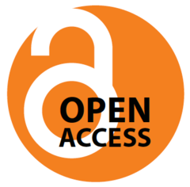
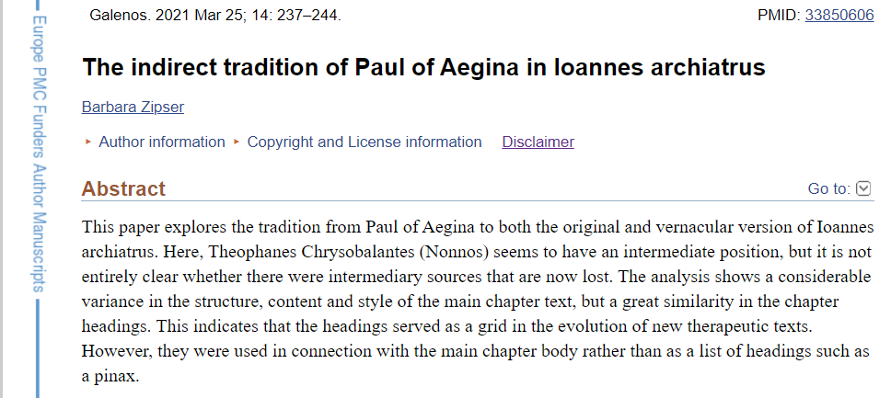
The Author Manuscript is open access
The full text author manuscript is openly available thanks to the RRS at both:
NCBI PMC: https://www.ncbi.nlm.nih.gov/pmc/articles/PMC7610590/
EuropePMC: https://europepmc.org/article/PMC/PMC7610590

Slide 19
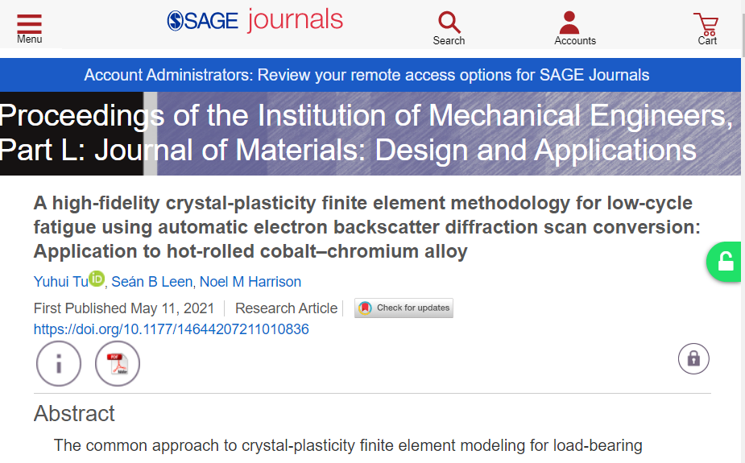


Example #2
Unpaywall finds the OA version
Paywalled at the journal, £32

Slide 20
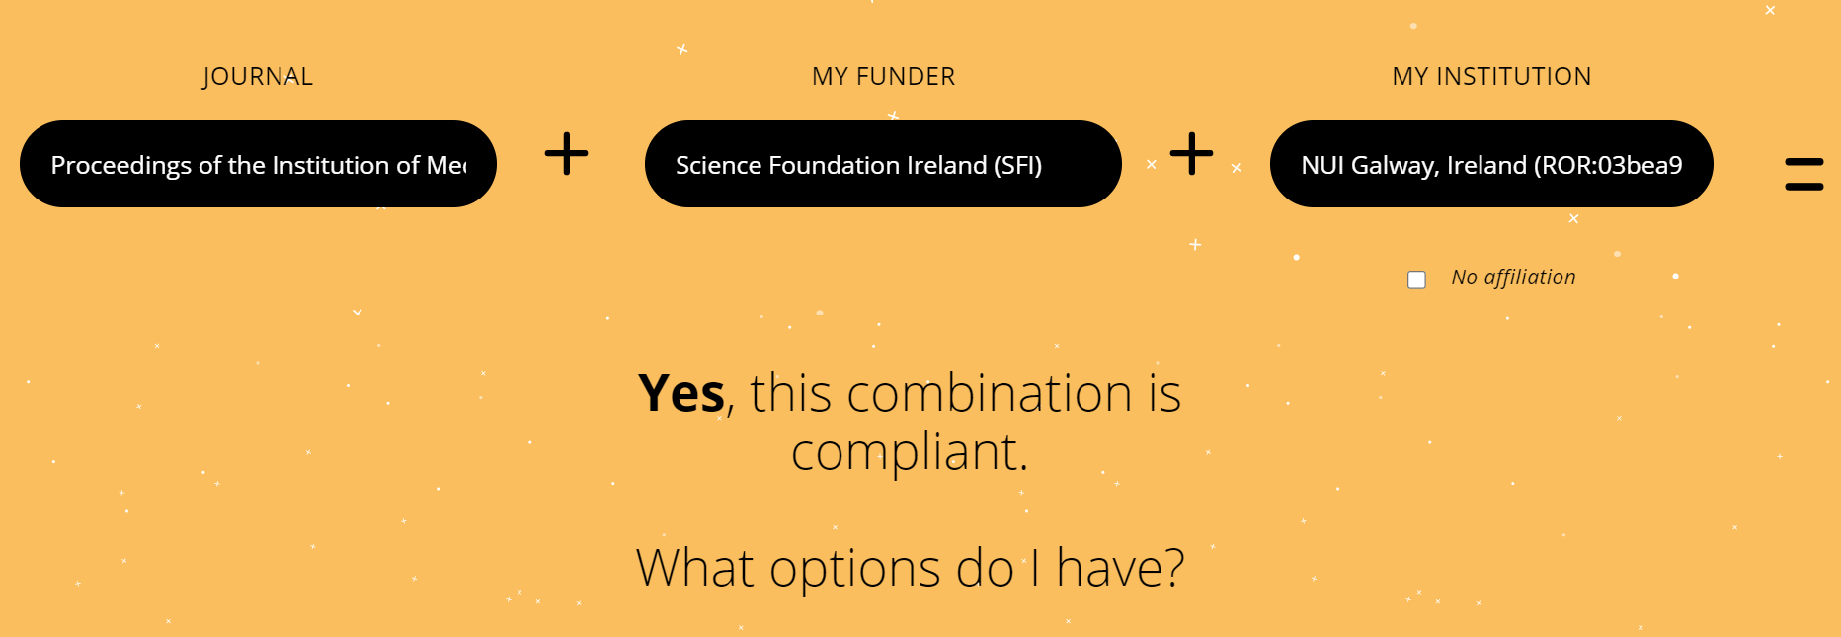
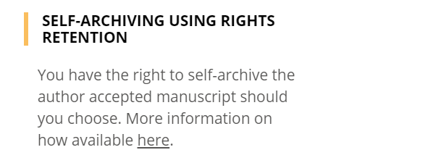
(Interestingly, there is no compliant ‘gold OA’ option, even though NUI Galway has a “transformative agreement” with SAGE Publications – this SAGE journal lies outside that agreement)
https://journalcheckertool.org/

Slide 21

Here’s the OA version of the same work, at the Galway institutional repository
https://aran.library.nuigalway.ie/handle/10379/16760

Slide 22
observations arising from RRS so Far… (1)
‘Copyfraud’ : some publisher production workflows have “© [the publisher]” stamps embedded
in a very automated manner. Publishers need to take more care to read what they publish
and ensure that copyright assignment is accurately indicated, not just blithely printed.
(this is also an issue for repositories hosting AAMs too; check the licence!)
RRS is a good backstop for “transformative agreement” gaps/errors/failures
-> RRS AAM offers a compliance backstop route to ensure OA where journal processes fail

Slide 23
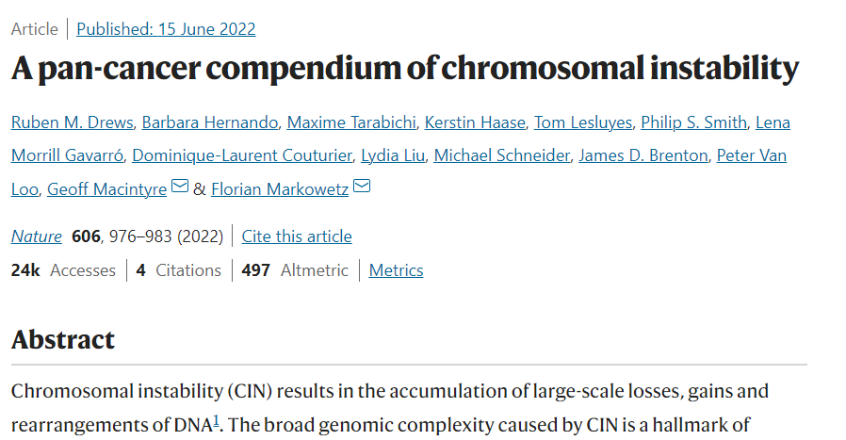
https://www.nature.com/articles/s41586-022-04789-9

Slide 24
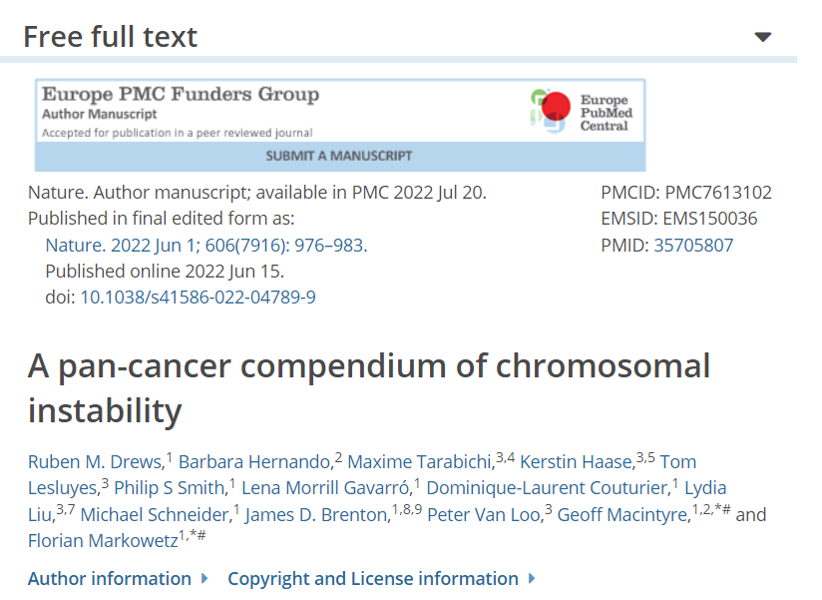
https://europepmc.org/article/MED/35705807

Slide 25
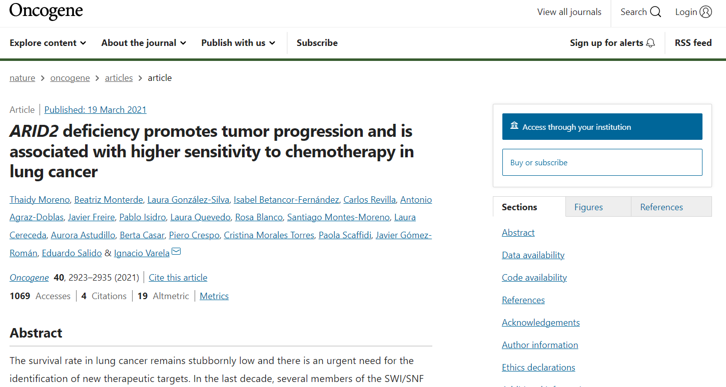
https://www.nature.com/articles/s41388-021-01748-y

Slide 26
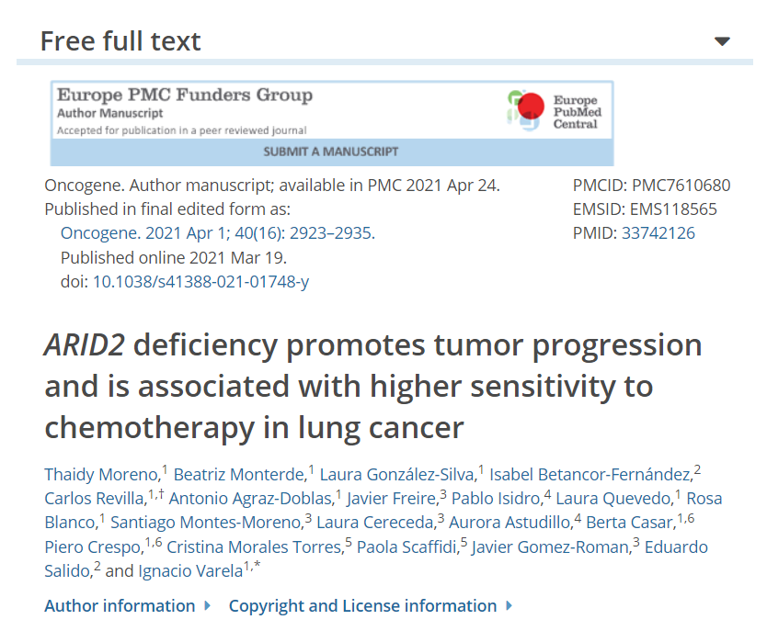
https://europepmc.org/article/MED/33742126

Slide 27
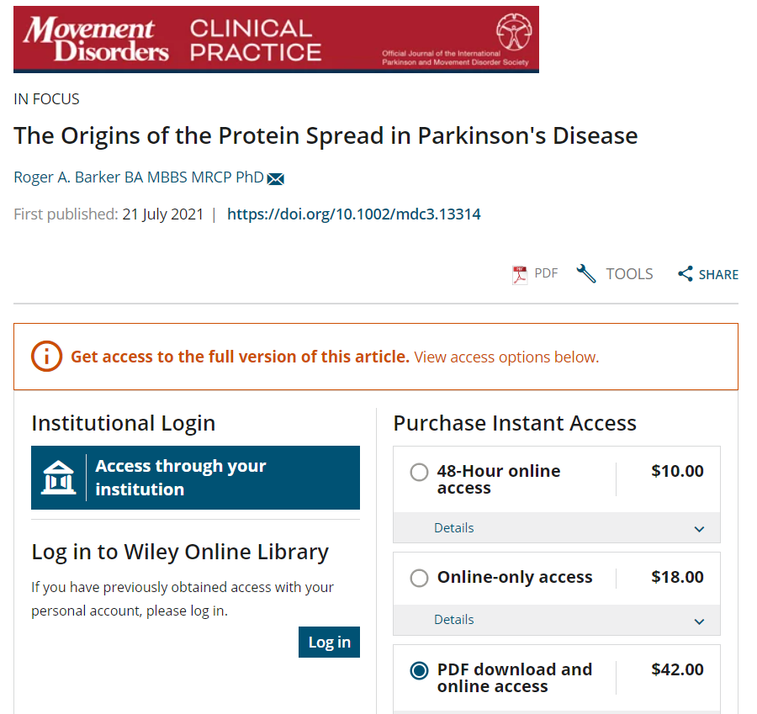
https://movementdisorders.onlinelibrary.wiley.com/doi/full/10.1002/mdc3.13314

Slide 28
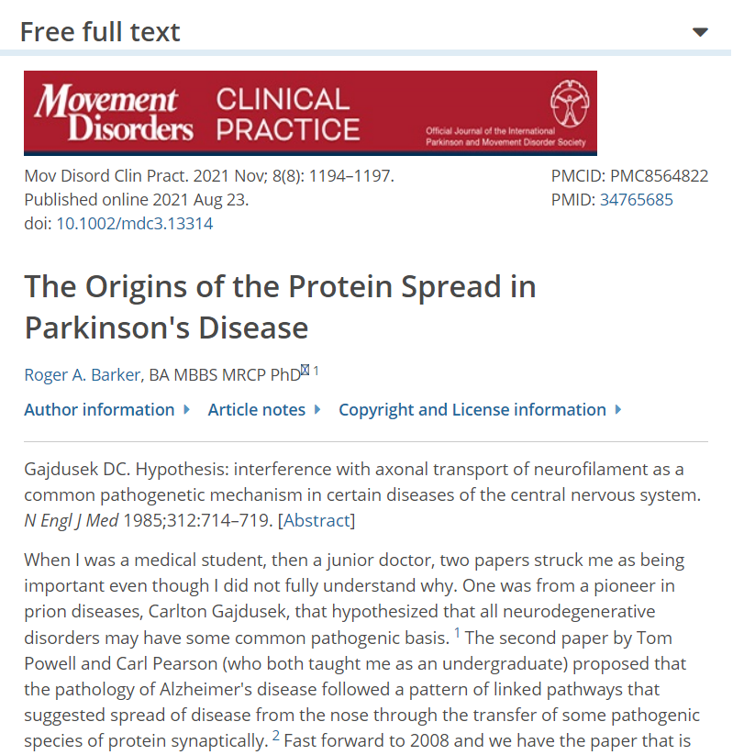
https://europepmc.org/article/MED/34765685

Slide 29
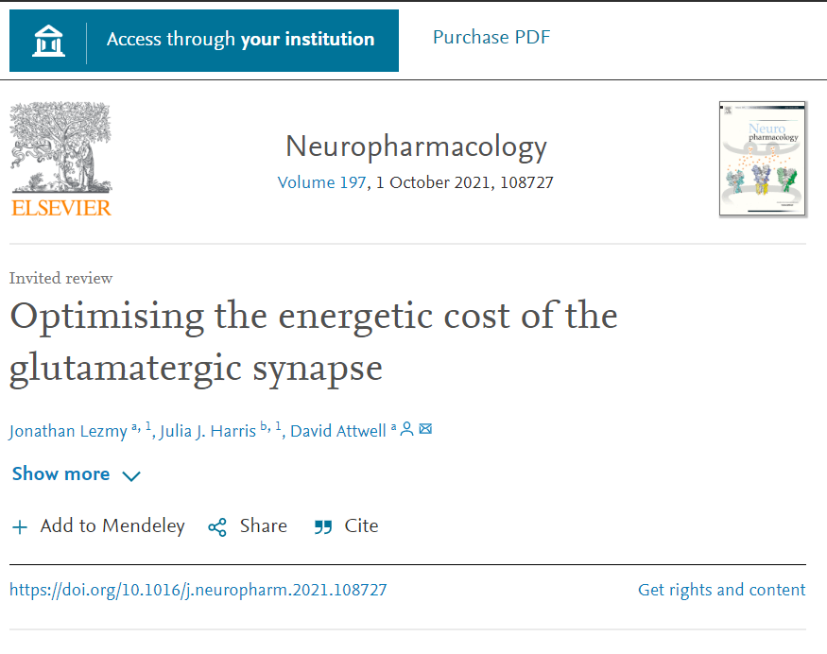
https://doi.org/10.1016/j.neuropharm.2021.108727

Slide 30
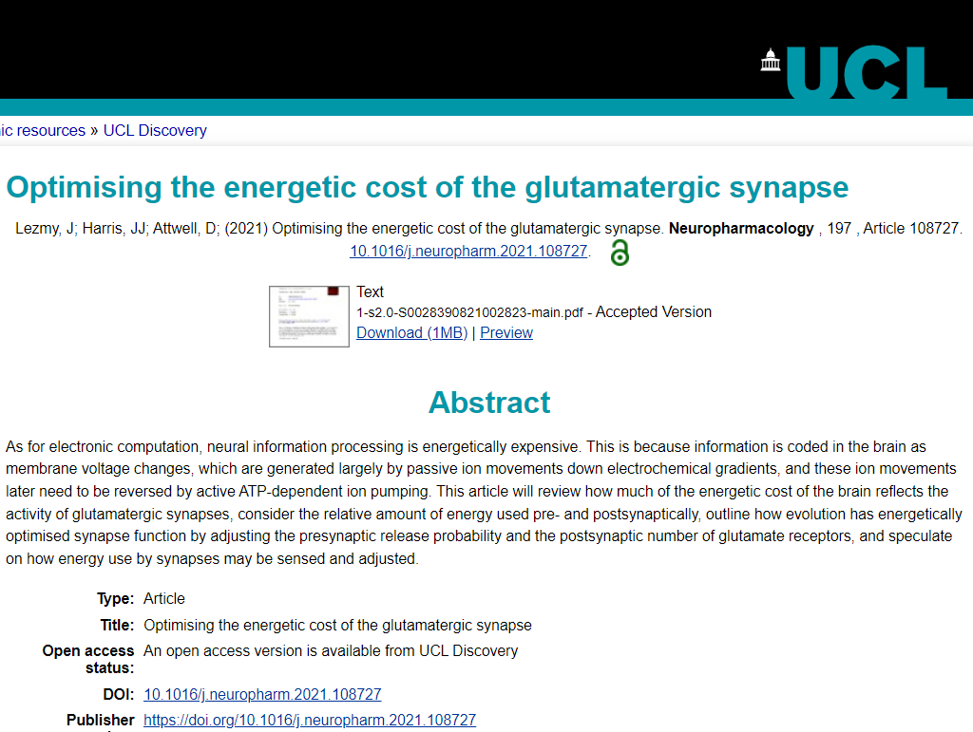
https://discovery.ucl.ac.uk/id/eprint/10131970/

Slide 31
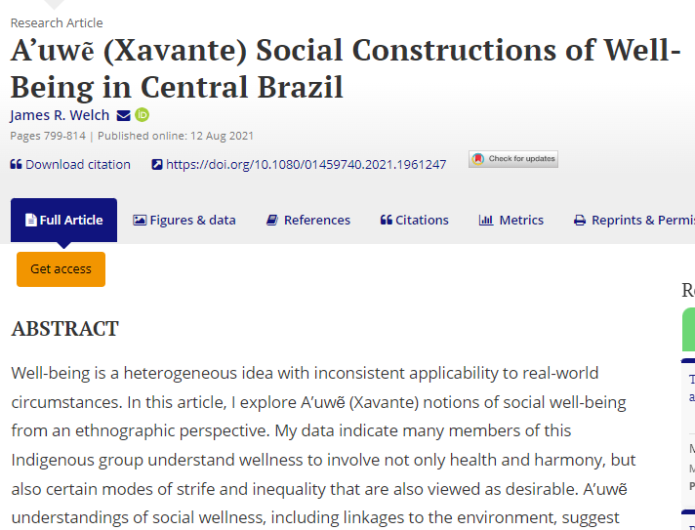
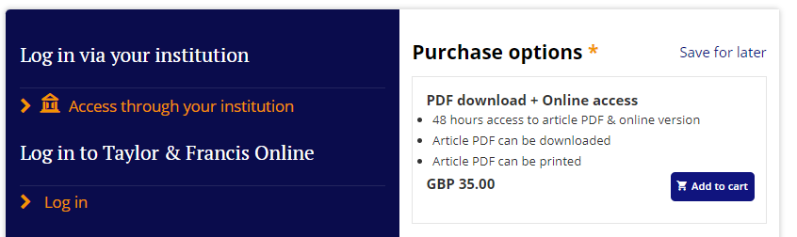
https://www.tandfonline.com/doi/full/10.1080/01459740.2021.1961247

Slide 32
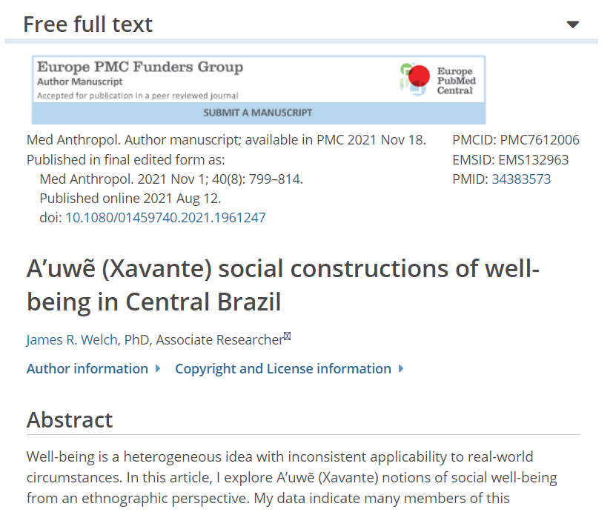
https://europepmc.org/article/MED/34383573

Slide 33
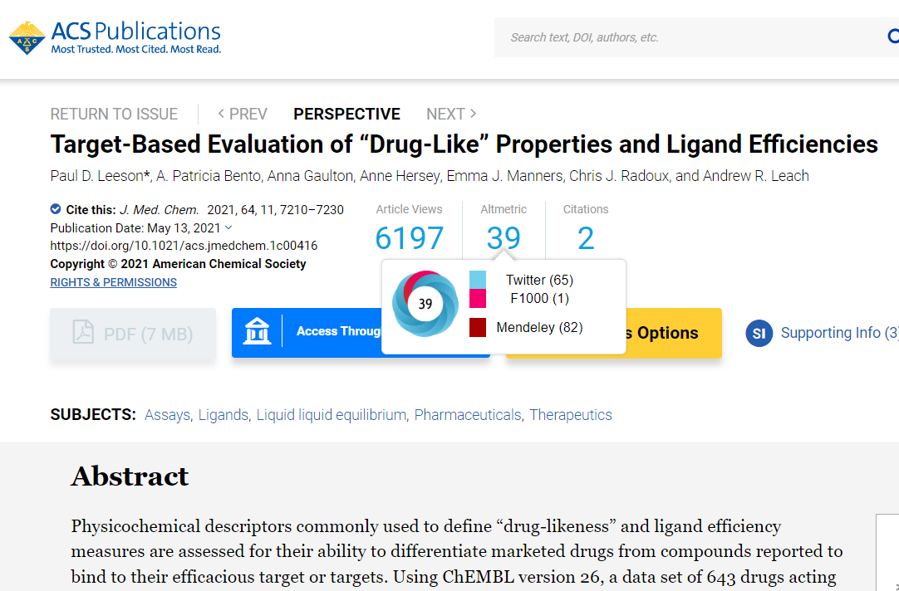
https://pubs.acs.org/doi/full/10.1021/acs.jmedchem.1c00416

Slide 34
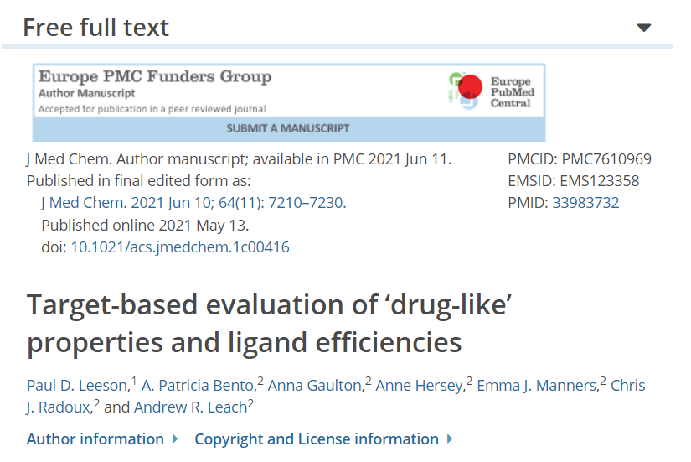
https://europepmc.org/article/MED/33983732

Slide 35
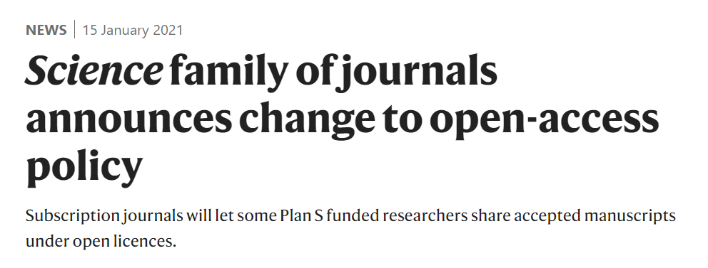
“in July 2020 cOAlition S contacted over 150 publishers to clarify their position with respect to the Rights Retention Strategy, asking them to respond by a certain date.
Not a single publisher stated that they would reject a submission on the grounds that the author has applied a public copyright licence to the AAM”
https://www.coalition-s.org/the-rrs-and-publisher-equivocation-an-open-letter-to-researchers/

Slide 36
observations arising from RRS so Far… (2)
* Publishers encouraging authors to breach their funder’s grant conditions
“Some publishers, who recognise that from a copyright perspective the prior licence trumps any conflicting provision in a subsequent licence, are now asking authors to agree to specific terms within their publishing agreements to try and stop them sharing their AAM immediately on publication.
These practices put cOAlition S-funded researchers in a position where they either have to breach their funder’s grant conditions (by embargoing their AAM) and risk not being eligible for future funding; or breach their publishing agreement (by not embargoing their AAM) and subsequently risk the publisher taking action against them.” -- https://www.coalition-s.org/the-rrs-and-publisher-equivocation-an-open-letter-to-researchers/

Slide 37
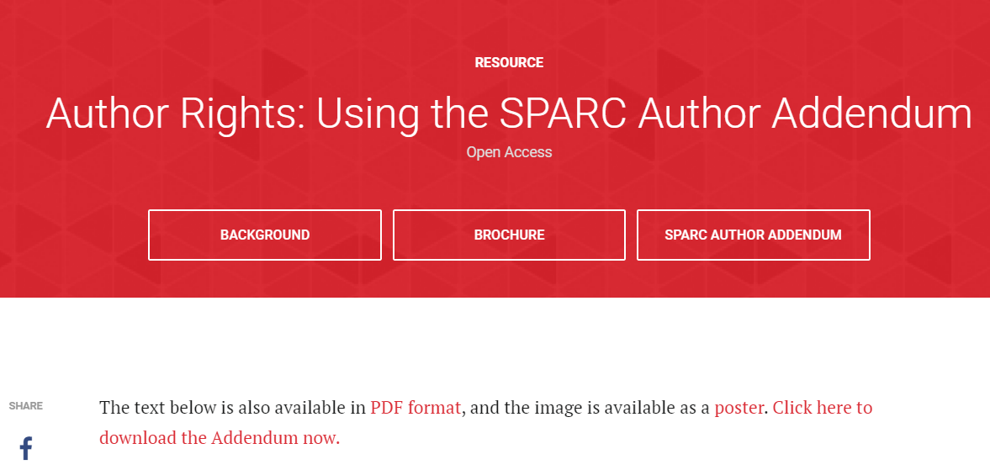
https://sparcopen.org/our-work/author-rights/brochure-html/
More addenda here: http://oad.simmons.edu/oadwiki/Author_addenda

Slide 38
Research Funders using the rights retention strategy as part of a range of measures to support achieving open access, include but are not limited to:
Wellcome Trust (WT)
Bill & Melinda Gates Foundation (BMGF)
National Science Centre, Poland / Narodowe Centrum Nauki (NCN)
Science Foundation Ireland (SFI)
Luxembourg National Research Fund / Fonds National de la Recherche (FNR)
Austrian Science Fund / FWF Der Wissenschaftsfonds
Arcadia Fund
The Howard Hughes Medical Institute (HHMI)
Aligning Science Across Parkinson’s (ASAP)
French National Research Agency / Agence Nationale de la Recherche (ANR)
SNSF does not support the rights retention strategy, as far as I know (???) https://www.coalition-s.org/plan-s-funders-implementation/

Slide 39
Further reading:
Stephen Eglen’s (2021)
Primer on the Rights Retention Strategy
http://doi.org/10.5281/zenodo.4668132
The cOAlition S rights retention strategy website:
https://www.coalition-s.org/resources/rights-retention-strategy/

