Slide 1
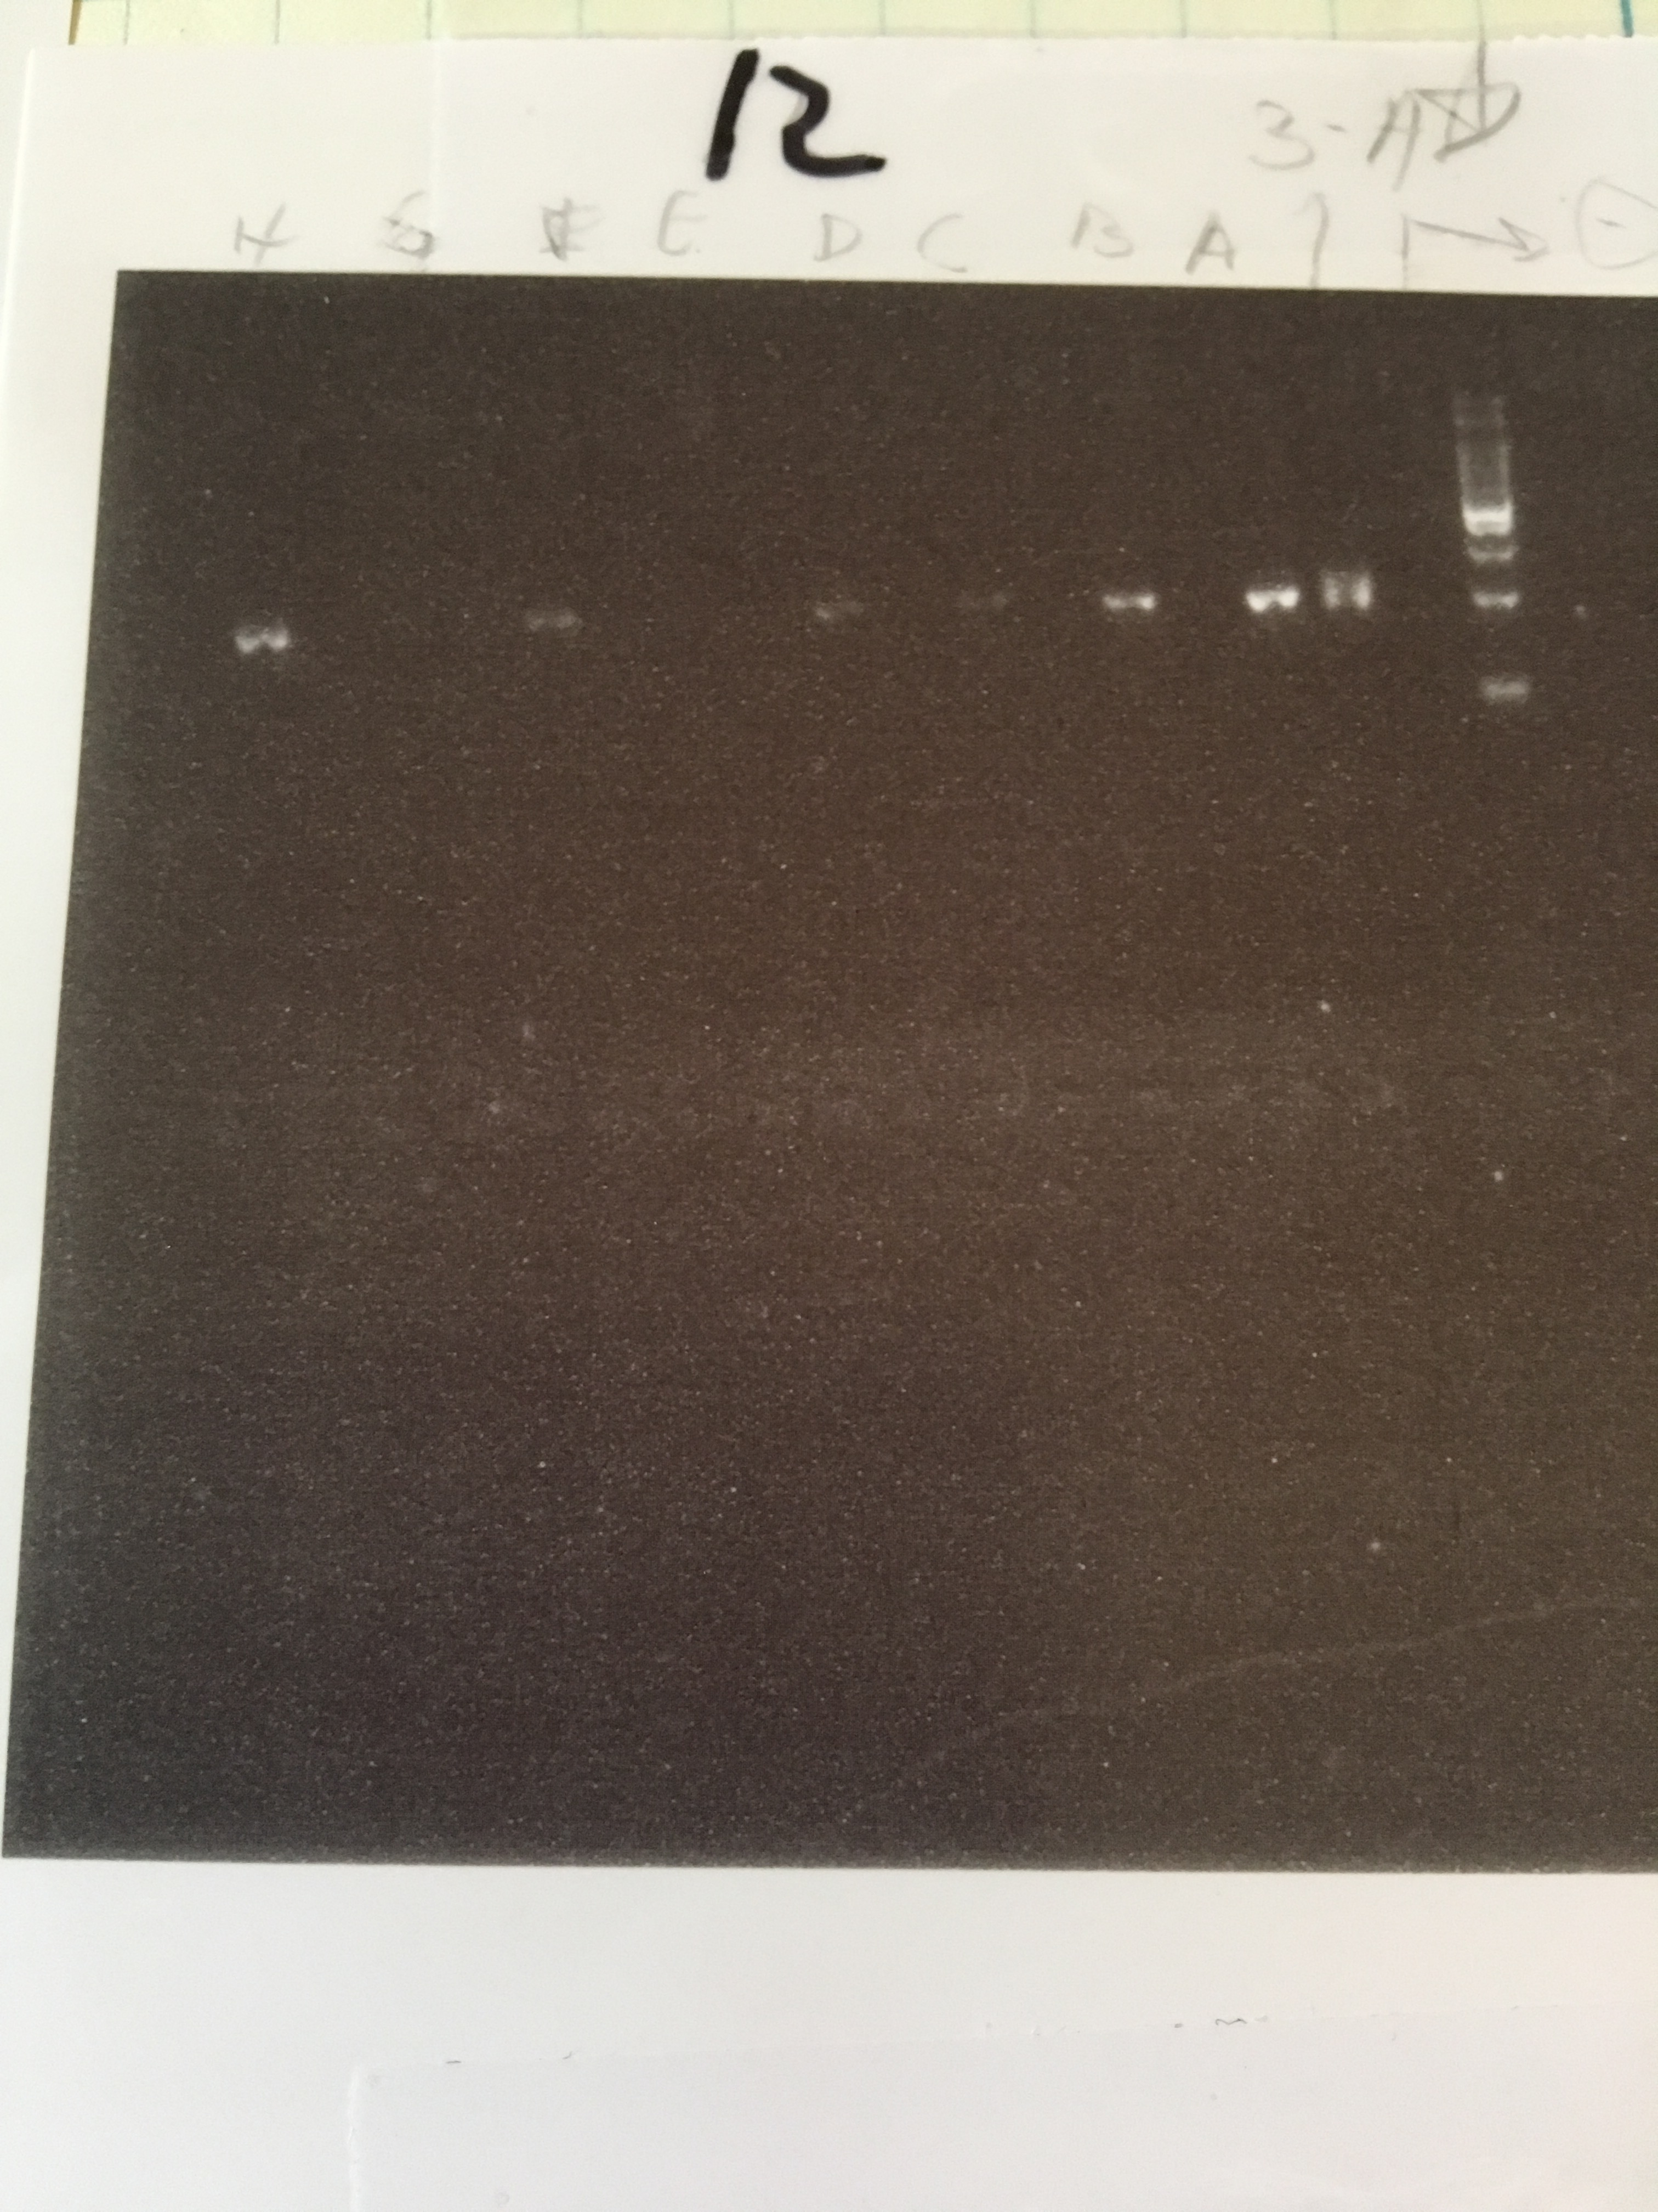
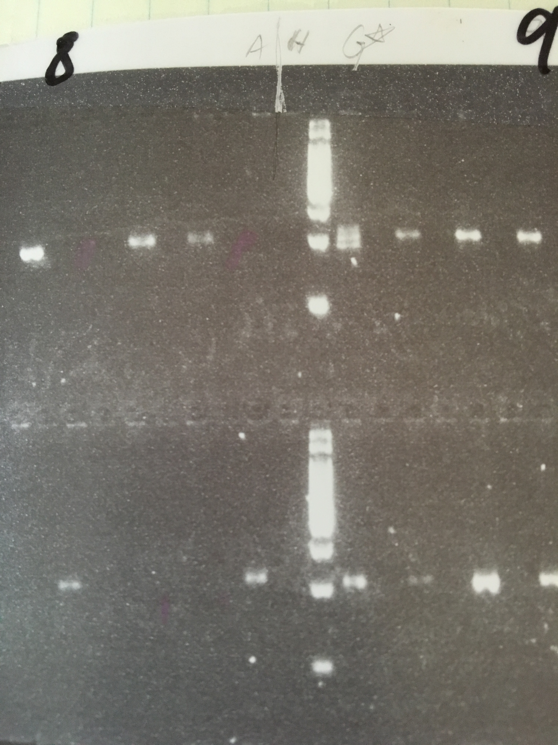
2016 field data- hybrids in contact zones
Hybrids shown with 2-3 bands, rather than one band.
Hybrid
Hybrid
Mosquito gulch family 6 offspring #3
Mosquito gulch contact zone family 10 offspring #9

Slide 2
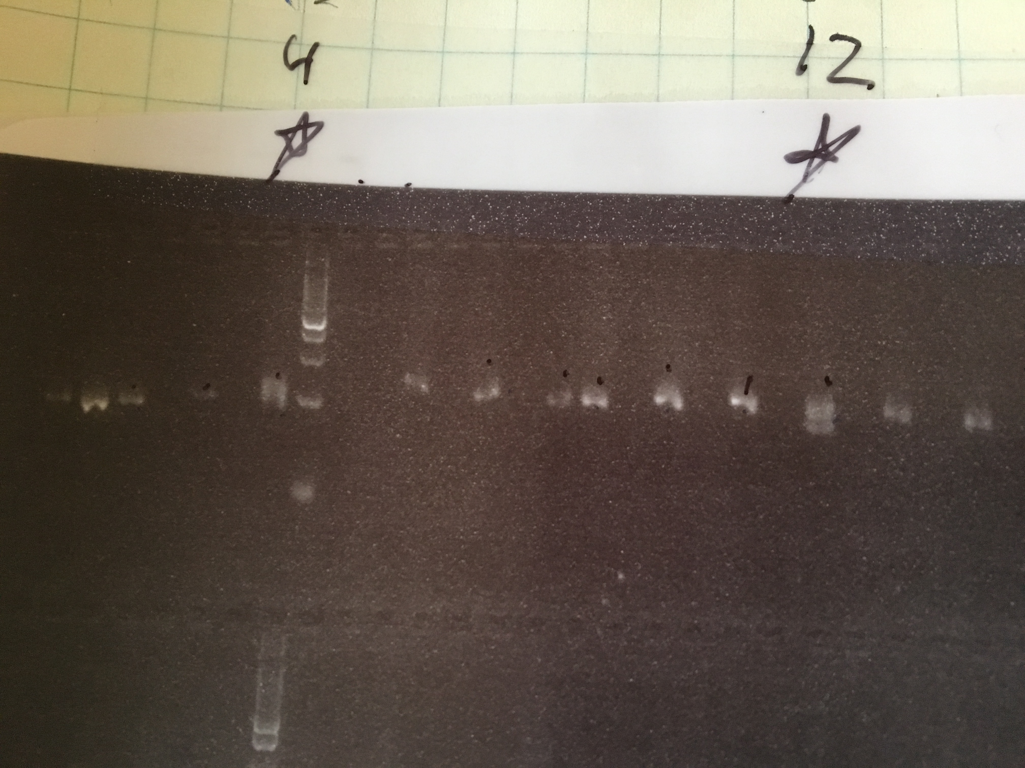
These are the two same hybrids from the previous slide, re-tested with a different PCR and gel to confirm hybrid status.

