Slide 1
Control of Bacterial Growth
By Edwin Amuga O.

Slide 2
Introduction
Control of growth of microorganisms is essential to prevent contamination, stop the spread of disease and infection, and reduce food spoilage.
Using physical or chemical agents allows for control of microbial growth.
Physical control is achieved by heat, radiation or filtration.
Chemical control is achieved by many different natural and synthetic agents; including antibiotics, bleach, ethanol, hydrogen peroxide and more.
Different bacteria can require different methods of control depending on cell wall structure, presence of a spore, location, and more.

Slide 3
Terminology
Sterilization: to kill or remove all microorganisms
Autoclave: device that pressurizes to create heat and steam for sterilization.
Thermal Death Time: time needed to kill all cells at a specific temperature.
Thermal Death Point: minimum temperature at which all cells are killed within 10 minutes.
Pasteurization: using heat to reduce the number of cells in a liquid.
Bactericidal: agents that kill bacteria.
Bacteriostatic: agents that inhibit growth of bacteria.
Minimum inhibitory concentration: minimum concentration of antimicrobial agent needed to inhibit the growth of an organism.
Sterilant: an agent that kills all microorganisms including spores.
Disinfectant: an agent that kills microorganisms, but not spores. (Used on Surfaces)
Sanitizer: an agent that reduces the number of microorganisms. (Used on food surfaces)
Antiseptic: an agent that kills microorganisms or inhibits their growth, but is non-toxic to animals. (Used on living tissue)
Madigan et. al., 2018, pp.164-170

Slide 4
Differential Staining
Gram Staining (cell wall structure)
  Differentiates cell wall structure
Endospore Staining (spore production)
  Steam is needed to force the primary stain into the spore
Capsule Staining (capsule production)
  Extracellular capsule made up of polysaccharides or polypeptides is resistant to stains

Slide 5
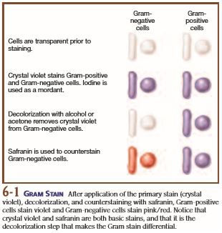
Gram Staining
Use 24 hr culture
Crystal violet (1 min)
rinse with water
iodine as mordent (1 min)
rinse with water
decolourize (~20 sec)
rinse with water
counterstain with safranin (~50 sec)
rinse with water and blot dry
gram positive cells keep purple crystal violet and gram negative cells are reddish-pink with safranin
Leboffe & Pierce, 2011, p. 45

Slide 6
Staining Tips
Make slides first and allow to air dry while you perform other tasks
Easier to use plate culture on a drop of water; do not use a drop of water if you take a loop of broth culture instead
Spread the culture thin to air dry quickly
Record colour(s) seen, shape and arrangement of cells and measure cell length
Always work over a stain tray
Liquid waste is poured into chemical waste jug in fume hood
Paper square in solid waste beaker with orange biohazard bag

Slide 7
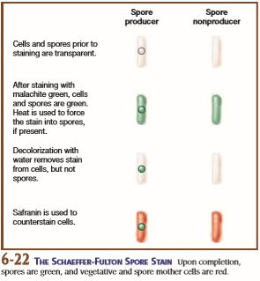
Endospore Staining
Use 48hr culture
Malachite green steamed into spore, kept moist with a paper towel square and add stain to prevent it from drying (fume hood) for 5 min
rinse with water
counter-stain with safranin (60-90 seconds)
rinse with water and blot dry
spores are green and vegetative portion of cell is pinky-red
Leboffe & Pierce, 2011, p. 52

Slide 8
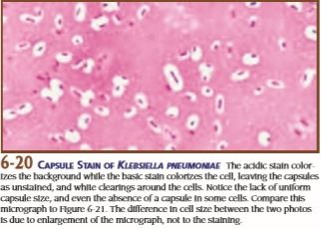
Capsule Stain
Acid stain and basic stain to colour within cells and the background
capsules show as clear halos around cells
Leboffe & Pierce, 2011, p. 51

Slide 9
Antibiotics
Terminology
Selective toxicity: inhibits growth or kills pathogens without affecting the host
Narrow spectrum: kills or inhibits growth of select bacteria
Broad spectrum: kills or inhibits growth of many bacterial types
Antibiotic class: grouping of chemical structure of the antibiotic
Mode of action: mechanism(s) that the antibiotic targets on or in the bacterial cell
Madigan et. al., 2018, pp. 852-858

Slide 10
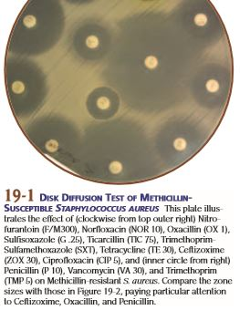
Kirby-Bauer Test
Antibiotic Susceptibility by Disk Diffusion
A swab is used to coat the whole surface of the agar plate with the pure culture of the bacteria
Antibiotic disks are placed on the surface of the bacterial lawn.
The antibiotic will diffuse into the agar with the lowest concentration being the farthest from the disk.
The zone of inhibition around the disk is due to the lack of growth of bacteria in that area inhibited by the antibiotic.
The diameter of the zone is measured and compared to known standards to interpret if the bacteria is sensitive or resistant to the antibiotic.
Madigan et. al., 2018, p. 839
Leboffe & Pierce, 2011, p. 222

Slide 11
Kirby-Bauer Procedure
Antibiotic Disk Susceptibility
Label two 100mm Mueller-Hinton plates with group #, date, MH, organism (E. coli or B. subtilis)
Use 24 hr culture broth
Use only ONE cotton swab to spread 24hr culture on two 100mm MH plates
Completely cover plates with culture and let sit with lid on for 2-3 minutes
Use tweezers (flamed and cooled) to place 3 different discs on each swabbed plate
Leave upright for a couple minutes, then parafilm
Measure diameter (mm) of clearing compare to Table 2.2 to indicate if bacteria are resistant, susceptible or intermediate

Slide 12
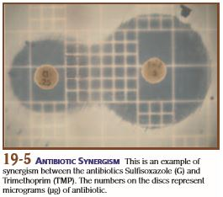
Combined Effects of Antibiotics
Combining two antibiotics that have a similar mode of action can increase the effect that each would have individually.
Synergistic effect is when both antibiotic disks show a combined zones of inhibition on the swabbed agar plate.
Additive effect is when both antibiotic disks do not have a combined effect. Two distinct zones of inhibition on the swabbed agar plate.
Antagonistic effect is when one antibiotic interferes with the action of the other antibiotic. Smaller zones of inhibition than usual.
Leboffe & Pierce, 2011, p. 225

Slide 13
Combined Effects Procedure
Label two 100mm MH plates with group #, date, organism, MH, antibiotics used
On bottom place a small dot in the very centre of the plate with your sharpie, then measure and ‘dot’ or ‘x’ the distances indicated for each combination of antibiotics (Tri-Tet 14mm apart, Tri-Sulf 12.5mm apart)
Use the 24 hr broth culture
Use only ONE swab to spread culture over complete surface of both MH plates, let dry for a couple minutes
Use tweezers (flamed and cooled) to place the two antibiotic discs on the measured places, let sit for a couple minutes
Parafilm the plates and then use coloured scientific tape from your drawer to tape together all 4 MH plates with antibiotic discs
Record if clearing is combined or separate

Slide 14
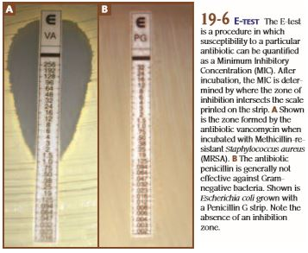
Minimum Inhibitory Concentration
Commercial test strips
Different companies produce strips of a gradual gradient of antibiotic concentration for testing the minimum inhibitory concentration (MIC)of an antibiotic on an organism.
E Test is short for Epsilon test
E test strips (bioMérieux)
M.I.C.E. strips (Oxoid)
Leboffe & Pierce, 2011, p. 225

Slide 15
Minimum Inhibitory Concentration
E Test Strip Procedure
Use swab to spread culture over complete surface of the MH plate, let dry for a couple minutes
Use tweezers (flamed and cooled) to place the E Test strip on the centre of the plate, let sit for a couple minutes
Read and record the results (record the antibiotic name also)
Each strip contains one type of antibiotic at a gradient of concentrations (0.016 μg/μl to 256 μg/μl)
Where clearing begins is the lowest concentration required to inhibit growth; look for colonies growing within the clearing (mutants)

Slide 16
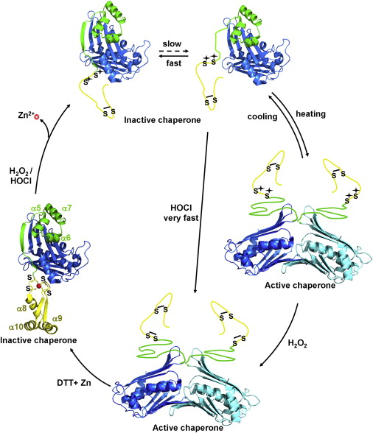
Bleach Effects
Household bleach is a solution of ~5-7% sodium hypochlorite used as a common disinfectant and sanitizer.
The chlorine compound acts as an oxidizing agent that causes the unfolding of essential bacterial proteins, which then causes the proteins to clump and become non-functional (Winter et.al., 2008)
Figure 7. Hsp33—A Paradigm for HOCl's Oxidative Unfolding Activity (Winter et.al., 2008)

Slide 17
Bleach Effects Procedure
Label the 60mm tryptic soy agar plate (TSA) with your group #, date, organism, age of bleach
Use 24 hr broth culture
Use only ONE cotton swab to spread culture over whole surface of the plate and let sit with lid on for a couple minutes
With tweezers (flamed and cooled), dip clean filter paper disk into bleach solution, touch to side of tube to remove excess, then place in centre of plate for 10 minutes (lid on while you wait)
Remove used disc into orange biohazard bag and parafilm plate. Place plate at the side bench with all completed bleach plates
Measure diameter of clearing in mm and describe amount of growth on rest of plate for all 10 plates

Slide 18
Temperature: Lethal Effects
High temperatures cause proteins to denature (unfold).
Mesophiles survive in temperature ranges between ~10oC and ~45oC
Some mesophilic bacteria can survive temporarily outside of their cardinal temperature range by producing spores.
By testing bacterial survivability at various temperatures, we can identify the Thermal Death Point and confirm the ability of a bacteria to produce spores.
Madigan et. al., 2018, pp. 152-153

Slide 19
Temperature Effects Procedure
Label a 100mm TSA plate with group #, date, organism; draw in two lines across the diameter to make four sections and label with temperatures (40, 60, 80, 100oC)
Use 48 hr broth culture tube labeled with ‘temp’, add your coloured scientific tape with group # onto the glass of the tube
Taking your tube in the test tube rack and using tongs, place the tube into the 40oc water bath for 10 min, remove using tongs and take back to your bench
With your loop, aseptically, simple streak in the 40oC section of your 100mm TSA plate
Place tube into the 60oC bath for 10 min, repeat as above, then repeat for 80oC and 100oC (caution hot water produces steam and can burn, must use tongs and heat resistant gloves provided by bath)
Parafilm the plate, incubate for 24 to 48 hrs and then record amount of growth
Growth is recorded as +++ = a lot, ++ = moderate, + = low, - = no growth

Slide 20
References
Leboffe MJ and Pierce BE (2011) A Photographic Atlas for the Microbiology Laboratory, 4th edition. Morton Publishing Company, Colorado.
Madigan MT, Bender KS, Buckley DH, Sattley WM, and Stahl DA (2018) Brock Biology of Microorganisms, 15th edition. Pearson Education, Inc., New York.
Winter J, Ilbert M, Graf PCF, Ozcelik D, and Jakob U (2008) Bleach Activates a Redox-Regulated Chaperone by Oxidative Protein Unfolding. Cell 135 (4), pp. 691-701.

