Slide 1
Impact of Research on society & Bibliometrics
Thank you for joining us.
The presentation will start in few minutes.
As it will be registered, please turn off your microphone.
Due to the big numbers of participants, please switch off your camera.
Sébastien Perrin, Sorbonne University
Kristell Roser, Sorbonne University

Slide 2
Impact of Research on society & Bibliometrics
Sébastien Perrin, Sorbonne University
Kristell Roser, Sorbonne University

Slide 3
Impact on society
Impact of Research on society & Bibliometrics
Assessing Research Impact
  Science and society
  Opening science
  Citizen science
  Assessing Science
  Bibliometric indicators
  Uses of Bibliometrics
  Limits of bibliometric indicators
  An example of bibliometric analysis

Slide 4
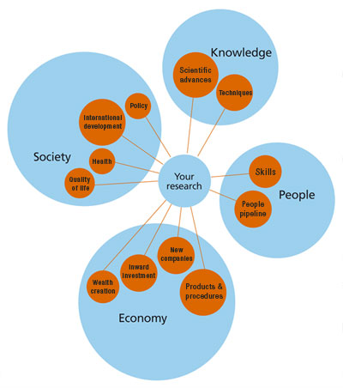
Research impact on society
Research funding in France levels at 50 billion euros (2,2 % of the GDP)
  In the European Union budget, 8% are dedicated to funding research
Source: Engineering and Physical Sciences of Research Council
Notes:
Depending on your focus: the economy, labor, food, health, religion, philosophy, education, ecology

Slide 5
Research impact on society
A difficult question, various approaches
Consensus: science is at the core of modern society
Source: Engineering and Physical Sciences of Research Council
Notes:
Depending on your focus: the economy, labor, food, health, religion, philosophy, education, ecology

Slide 6

Does science rule society?
Salomon’s House in New Atlantis (1626) by Francis Bacon
CC-BY-SA - RaphaelMoreno0601, 2018
Notes:
FB considered as the inventor of the modern conception of the scientific method

Slide 7
Does science rule society?
Salomon’s House in New Atlantis (1626) by Francis Bacon
“We have three that bend themselves, looking into the experiments of their fellows, and cast about how to draw out of them things of use and practice for man's life and knowledge” – Francis Bacon, New Atlantis (1626)

Slide 8
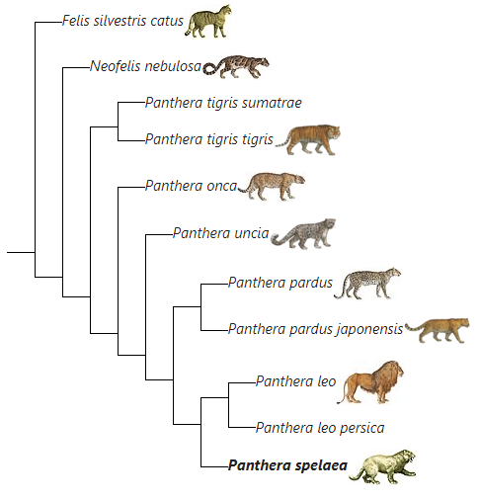
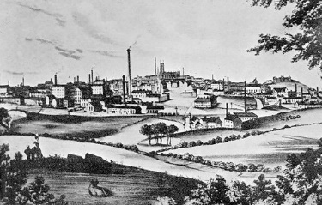
Does science rule society?
It became effective during the 19th century
Big changes in beliefs and social organization
CC-BY-SA – Wellcome Foundation
CC-BY-SA - OmicronR, 2019

Slide 9
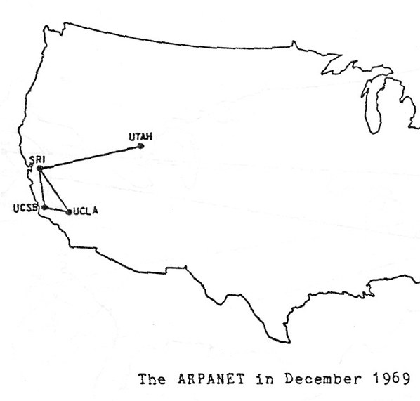
Does science rule society?
CC-BY - ITU Pictures
Science: huge public investments after WW2
Focus: Internet, the meta-innovation
  Allowing anyone to access all mankind’s knowledge
  Vannevar Bush’s “memex” that would accelerate science (1945)
  Joseph Licklider : computers will make every human a scientist and allow communication and collaboration free from geographical limits (1960, 1968)
  The history of the Internet became more or less a model for innovation emerging in universities

Slide 10



Science and Economy: making science profitable
Bayh-Dole Act (1980): US universities are allowed to own and sell patents
Rise of the big scientific publishers in the 1960s-1970s
The Lisbon Strategy for the European Union (2000)
  The “knowledge-based economy”: innovation is considered as the motor for growth
Patent law by Nick Youngson CC BY-SA 3.0 Pix4free

Slide 11
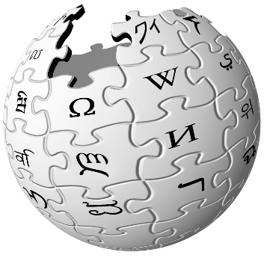
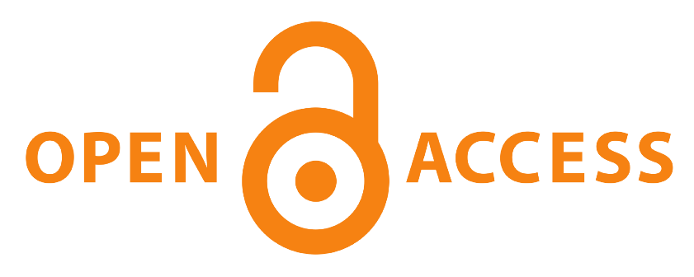

Claiming Science as a common good
Rise of a new conception of knowledge: Free software (1985), Creative Commons (2001), Wikipedia (2001)
Public Library of Science launched through a petition (2001), Budapest conference (2001), Berlin Declaration on Open Access (2003)
Early open repositories / publishing platforms : arXiV (1991), SciELO (1997), HAL (2001)…
Notes:
At the same time…

Slide 12

Opening Science: a new paradigm
Academic world is turned towards society
Openness and transparency make research outputs and outcomes better
The National Plan for Open Science launched in France in 2018
Notes:
The academic world is turned towards society. Science is at the heart of societal changes: global warming, sanitary crisis, economical crisis, Ukrainian crisis… Society must understand what the scholarly community can bring to it. Knowledge is a common good that must be made available to all. That is why the knowledge that has been produced by the scholarly community should be accessible to all without any barriers and certainly not being kept behind paywalls.
Openness and transparency make research outputs and outcomes better.

Slide 13

Beyond communicating Science
Society demands to understand and sometimes to be involved
With the internet, there are many opportunities for the public to be aware of science processes and findings (videos, blogging, social network, games…)
Openness goes beyond the mere communication of Science
© Sorbonne Université
Notes:
Usually, the relations between Science and Society are focused on popularization.
Example : la Fête de la Science (France), MT180

Slide 14
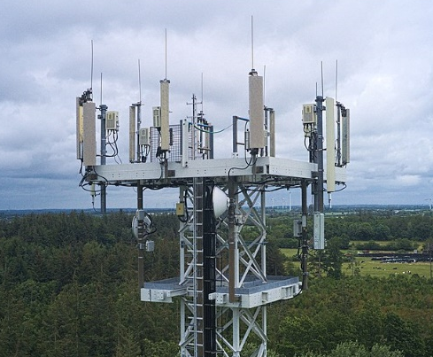

Citizen Science: from openness to empowerment
Involving the public in data collection, but also in the definition of the research questions
With the internet, there are many ways to contribute (ex: Science Ensemble)
Open Science prepares the next step of democracy
A volunteer collecting data about the local birds – CC-BY-SA: SEED Citizen Science Hub
Vodafone 5G antenna in Hattstedt (Germany) – CC-BY-SA: Fabian Horst
Notes:
Citizen Science to allow citizen to better understand the world, technical and ecological issues.
Important topics: climate change, biodiversity, pandemics, nuclear energy, 5G network…

Slide 15
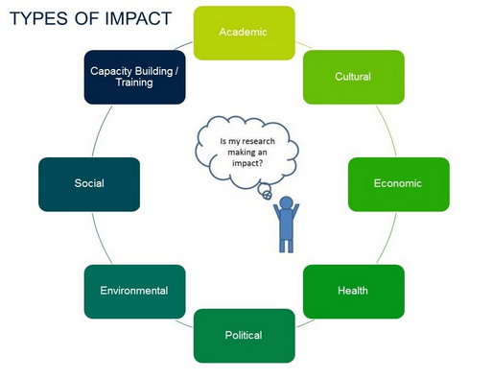
Research impact
Source: Withyman C., 2018
Notes:
As we just saw, we are surrounded by research and innovation technologies. A researcher, working on his field, is allowed to wonder if his research makes an impact and what is impacted by his research: Academics, Culture, Economics, Health, Politics, Social, Environment… ?

Slide 16
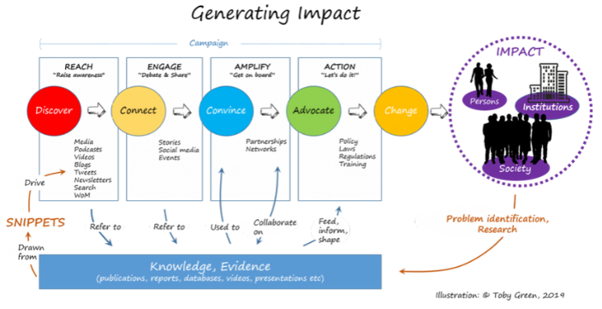
Research impact
Notes:
It would also be interesting to wonder how to generate impact and how to measure this impact. This diagram shows the different steps from discovery to action and, importantly, the relationship between knowledge and information in this process.

Slide 17
Bibliometrics in research’s assessement and policy
  Assessment of the scientific performance through:
    evaluation of research proposals,
    allocation of research funding,
    university rankings.
Notes:
And how assessing the impact of research? With Bibliometrics.
Research’s assement and policy are achieved by evaluation of the scientific performance of research groups, departments, and institutions through evaluation of research proposals, allocation of research funding, university rankings, such as the Shanghai Ranking, the Leiden ranking and the Academic Ranking of World Universities.

Slide 18

Bibliometrics to measure the impact of Science
Statistical methods
  to explore the impact of :
    science fields,
    a set of researchers,
    a particular paper,
  to identify particularly impactful papers.
Notes:
Bibliometrics is the use of statistical methods to analyse publications. It is used to explore the impact of the science field, of a set of researchers, of a particular paper, or to identify particularly impactful papers within a specific field of research.
Metrics have been set up to make research evaluation more objective.

Slide 19

Commonly used bibliometric indicators
Authors and institutions
  Publication counts
  Citation counts: number of times an author has been cited
  H-index: measure of productivity and impact of a researcher
Journals
  Journal impact factor: evaluation of the relative importance of a journal
  TOP factor: score of transparency and openness
VERALUBIMOVA/ISTOCKPHOTO.COM
Notes:
Bibliometrics indicators are more and more applied by governments and other funding organizations mainly because of their large-scale applicability, lower costs and time as well as their perceived objectivity. The goal is to optimize research allocations and make funding more efficient and effective.
Bibliometrics indicators

Slide 20

Commonly used bibliometric indicators
Articles
  Citation counts: number of times an article has been cited
Subjects
  Highly cited papers are within the top 1% of papers in an academic field
  Hot papers are in top 0.1% of papers in an academic field

Slide 21
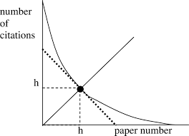

Bibliometric indicators
H-index: h publications cited at least h times
Lack of clear concept
Inability to assess early career researchers
Lack of field normalization
Differences between databases
Popularity, uninformed use
Source: Hirsch, 2005
Notes:
Introduced by Hirsch in 2005, the H-index is designed to measure productivity and citation-based impact simultaneously. It is determined by calculating where h number of articles have been cited at least h times.

Slide 22
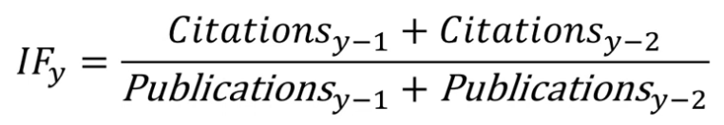
Bibliometric indicators
Journal Impact Factor: average number of citations per published paper averaged over two years
Not to evaluate the quality of the journal
Not to compare cross-discipline journals
Notes:
The journal impact factor, introduced by Garfield in 1972 as a measure of journal impact and computed by normalizing the expected relationship between journal size and number of received citations, is certainly the most widespread and well known among the bibliometric indicators, but is also the simplest and most crude.
The impact factor can be influenced and biased (intentionally or otherwise) by many factors. Extension of the impact factor to the assessment of journal quality or individual authors is inappropriate. Extension of the impact factor to cross-discipline journal comparison is also inappropriate. Those who choose to use the impact factor as a comparative tool should be aware of the nature and premise of its derivation and also of its inherent flaws and practical limitations.

Slide 23

Bibliometric indicators
TOP Factor grades the quality of process and implementation of scholarly values
Transparency and reproducibility of research
Not to rank the journal
Notes:
Launched in February 2020 by the US Center for Open Science, the TOP Factor is discribed by its authors as "a first step toward evaluating journals based on their quality of process and implementation of scholarly values. This alternative to the JIF may reduce the dysfunctional incentives for journals to publish exciting results whatever their credibility".
“TOP Factor is based primarily on the Transparency and Openness Promotion (TOP) Guidelines, a framework of eight standards that summarize behaviors that can improve transparency and reproducibility of research.”
According to David Mellor, Director of Policy at the Center for Open Science, the “TOP Factor is not a single number to rank journals. It is a modular set of indicators of journal policies to facilitate the visibility of good research practices.”

Slide 24
Uses of Bibliometrics
Rankings
  Own methodology and indicators
Ranking Institute | Date of inception
Shanghai Academic Ranking’s of World Universities (ARWU) | 2003
THE World University Rankings | 2004
QS World University Rankings | 2004
CWTS Leiden Ranking | 2006
Source: Kayyali, 2020
Notes:
One of the uses of Bibliometrics is rankings. Who never heard about the Shanghai, the QS or the Leiden?
Academic ranking is a set of criteria by which the performance of a university or educational institution is compared with that of another institution.
Each ranking has its own methodology and indicators, for example, the Leiden Ranking takes into account open access publications.

Slide 25
Uses of Bibliometrics
Rankings
  Brand the institution
  Improve organization and management
  Help take important decisions
  Influence partnerships and collaborations
Notes:
Bibliometric indicators are more and more applied by governements and other funding organization mainly because of their large-scale applicability lower costs and time as well as their perceived objectivity.
Although rankings brand the institution, they are tools that improve organization and management, help take important decisions, and influence partnerships and collaborations.

Slide 26
Bibliometric indicators: limits
Assessing young scientists
  Short career
  Few publications
Comparing journals
  Interdisciplinarity
  Human and Social Sciences
Notes:
Bibliometric indicators are nowadays controversial, specially when assessing young scientists. How evaluating a young researcher who has a short career? The difficulty with assessing young scientists is well known. Their short career to date yields a brief publication record, making differences in the numbers of publications between candidates statistically questionable.
What about comparing journals? How dealing with interdisciplinarity? Another questionning concerns Human and Social Sciences: monographies versus journals articles, longer times to write/publish, and less audience…

Slide 27
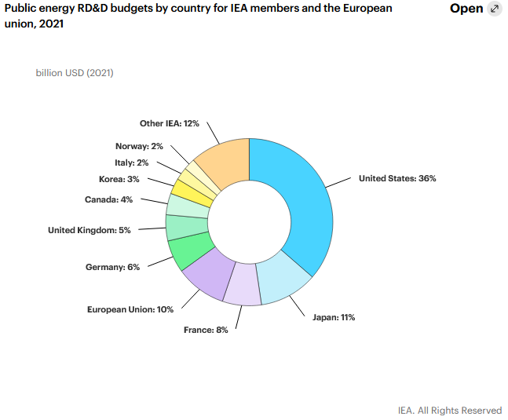
Bibliometric analysis: an example
2021 Public RD&D budget:
  EU: USD 2.5 billion
  France: USD 1.9 billion
Notes:
Let me now show an example of bibliometric analysis of a scientific subject everybody heard about: renewable energy.
All over the world, the study of renewable energy draws interest of various scientific schools, economics, and especially stakeholders, who can benefit from the use of renewable energy technologies.
In 2021, EU spent USB 2.5 billion in energy R&D, France spent USD 1.9 billion.

Slide 28
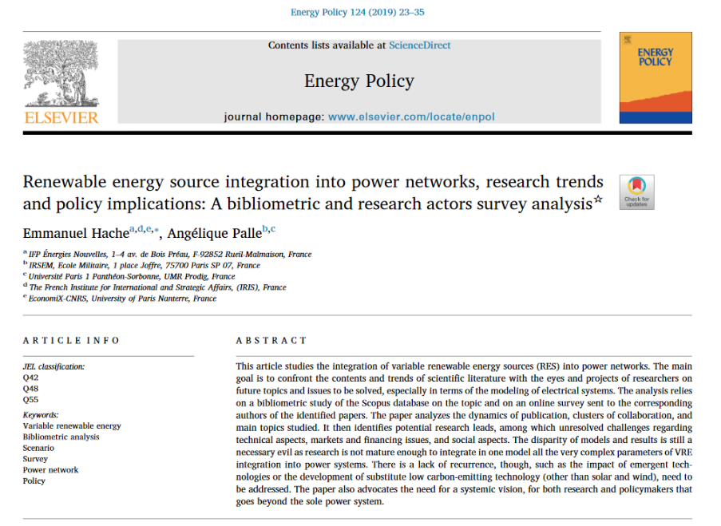
Notes:
This open-access article aims to analyze existing research of renewable energy, to identify the most influential publications, authors, organizations patterns of development research areas.
In this study, Hache and Palle analyze the dynamics of publication, clusters of collaboration, and main topics, based on 10,000 publications.

Slide 29
Bibliometric indicators used
Number of publications by years / country / research institution
Most popular areas of research
Collaboration network
Most influential actors
Key concepts
Notes:
They produced indicators surch as…
Published in January 2019, it has been cited 61. It is available on HAL, the French open access repository.

Slide 30
Opening research
Opportunities to gain recognition and resources:
  Preserve and accessible content
  Special funding / institutional supports
  More citations
  More projects and collaborators
  More media coverage
Notes:
Open research is a good way to have impact and gives opportunities to gain recognition and resources.

Slide 31
“[OA] increases a work’s visibility, retrievability, audience, usage, and citations, which all convert to career building. For publishing scholars, it would be a bargain even if it were costly, difficult, and time-consuming. But… it’s not costly, not difficult, and not time-consuming.”
Peter Suber
Notes:
In his 2012 book Open Access, Peter Suber summed it up best: "[OA] increases a work’s visibility, retrievability, audience, usage, and citations, which all convert to career building. For publishing scholars, it would be a bargain even if it were costly, difficult, and time-consuming. But…it’s not costly, not difficult, and not time-consuming.’’

Slide 32
Bibliography
Haustein, S., Larivière V. The Use of Bibliometrics for Assessing Research: Possibilities, Limitations and Adverse Effects. In Incentives and Performance. 2015. DOI: 10.1007/978-3-319-09785-5_8
Research output metrics: Bibliometric indicators. University of Hull. Available on line: https://libguides.hull.ac.uk/bibliometrics/indicators
Hirsch J. E. An index to quantify an individual's scientific research output. Proc Natl Acad Sci U S A. 2005 Nov 15;102(46):16569-72. Doi: 10.1073/pnas.0507655102. Epub 2005 Nov 7.
Science-Metrix. Analytical Support for Bibliometrics Indicators. 2018 https://www.science-metrix.com/sites/default/files/science-metrix/publications/science-metrix_open_access_availability_scientific_publications_report.pdf
Aria, M., Misuraca, M., Spano, M. Mapping the Evolution of Social Research and Data Science on 30 Years of Social Indicators Research. Social indicators research, 2020-02-04, Vol.149 (3), p.803-831
Belter, C. W. Bibliometrics indicators: opportunities and limits. J Med Libr Assoc. 2015 Oct; 103(4): 219–221. doi: 10.3163/1536-5050.103.4.014
Setti, G. Bibliometric Indicators: Why Do We Need More Than One? IEEE access, 2013, Vol.1, p.232-246
Kurmis A. P. Understanding the limitations of the journal impact factor. J Bone Joint Surg Am 2003 Dec;85(12):2449-54. doi: 10.2106/00004623-200312000-00028
Kayyali M. Pros and Cons of University Rankings. International Journal of Management, Sciences, Innovation, and Technology v1 n1 p1-6 Dec 2020
New Measure Rates Quality of Research Journals’ Policies to Promote Transparency and Reproducibility. Center for Open Science. 2020. Available online: https://www.cos.io/about/news/new-measure-rates-quality-research-journals-policies-promote-transparency-and-reproducibility
Hache, E. and Palle, A. Renewable energy source integration into power networks, research trends and policy implications: A bibliometric and research actors survey analysis. Energy Policy 2019 Jan; 24: 23-35
MKiernan E. C., Bourne P. E. et al. Point of View: How open science helps researchers succeed. 2016 eLife 5:e16800.
Suber P. Open Access. (2012) MIT Press.

Slide 33
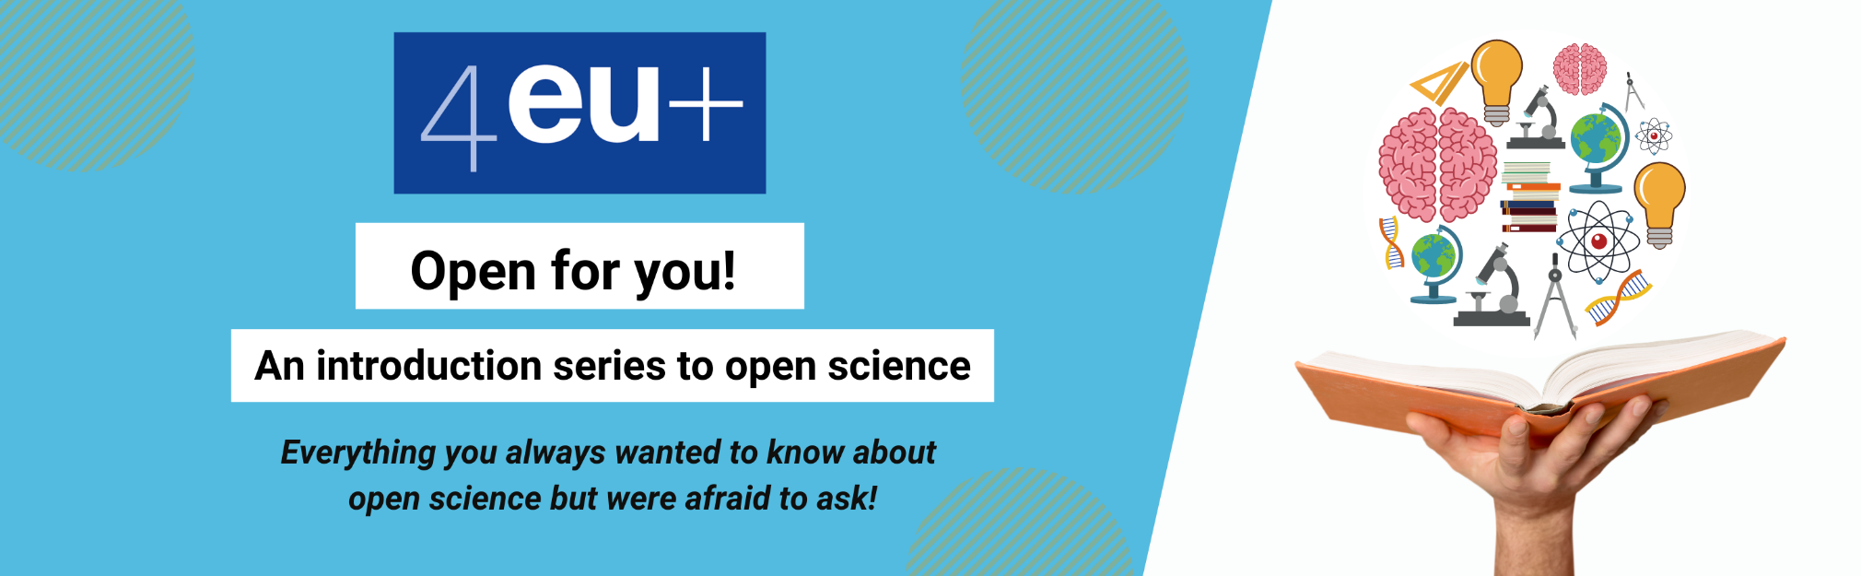
Please find the presentation support here on our website: https://4euplus.eu/4EU-273.html

Slide 34
Thank you!
Sébastien Perrin, Sorbonne University
Kristell Roser, Sorbonne University

