Slide 1
5th open force field workshop
June 28, 2022 | Virtual meeting

Slide 2
Speakers
David Mobley
Jeff Wagner
Lily Wang
Diego Nolasco

Slide 3
Feedback?
Feel free to use the Chat and Q&A features in Zoom to ask questions during the talks. Speakers will answer questions in the Q&A after they’re done with their presentations.
We will host a brief open discussion after the conclusion of talks. Use the “raise hand” feature and a host will enable your mic when it’s your turn.

Slide 4

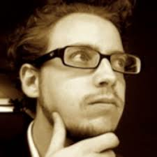
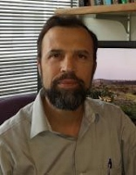


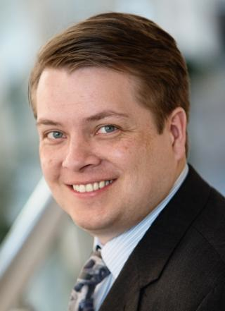

We’re here because of you – and because we share a common set of tractable problems
INDUSTRY
ACADEMIC
AbbVie
BASF
Bayer
Boehringer-Ingelheim
Bristol Myers Squibb
Cresset
Janssen
GlaxoSmithKline
Merck KGaA
OpenEye
Pfizer
Roche
Vertex
Eli Lilly
… and others
John Chodera (MSKCC)
Michael Gilson (UC San Diego)
David Mobley (UC Irvine)
Michael Shirts (CU Boulder)
PROJECT STAFF
Jeff Wagner
Technical Lead
Lily Wang
Science Lead
Plus affiliates:
Danny Cole (Newcastle)
Lee-Ping Wang (UCD)
Dennis Della Corte (BYU)
MolSSI (Virginia Tech)
...

Slide 5




Openness is central, because our problems are too big to tackle alone or in small groups
Open source Python Toolkit: modern infrastructure for building/using force fields
Open curated QM / physical property/binding datasets: data to build on
Open infrastructure: Extend our tools; run your own benchmarks
Open science: Everything done in the open; everyone can get involved

Slide 6






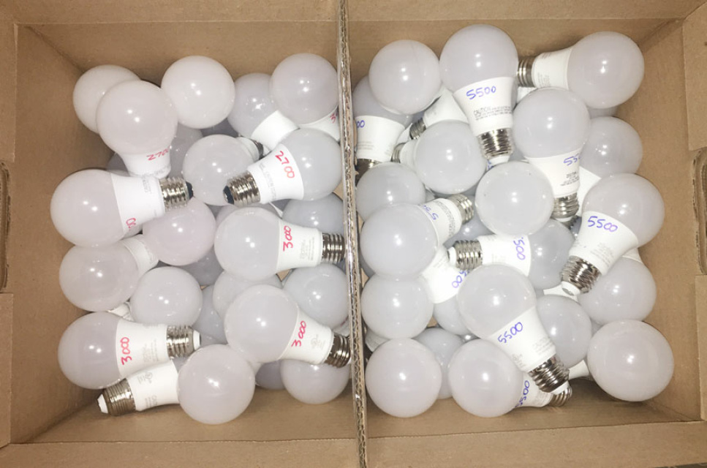
We’ve moved to trying a variety of ideas in parallel, then rolling the best into our force fields
We viewed this originally as a linear, planned process
FF
ForceBalance
Test
We’re learning it works better as a parallel process where the best ideas may be unexpected and apparent only later
...

Slide 7
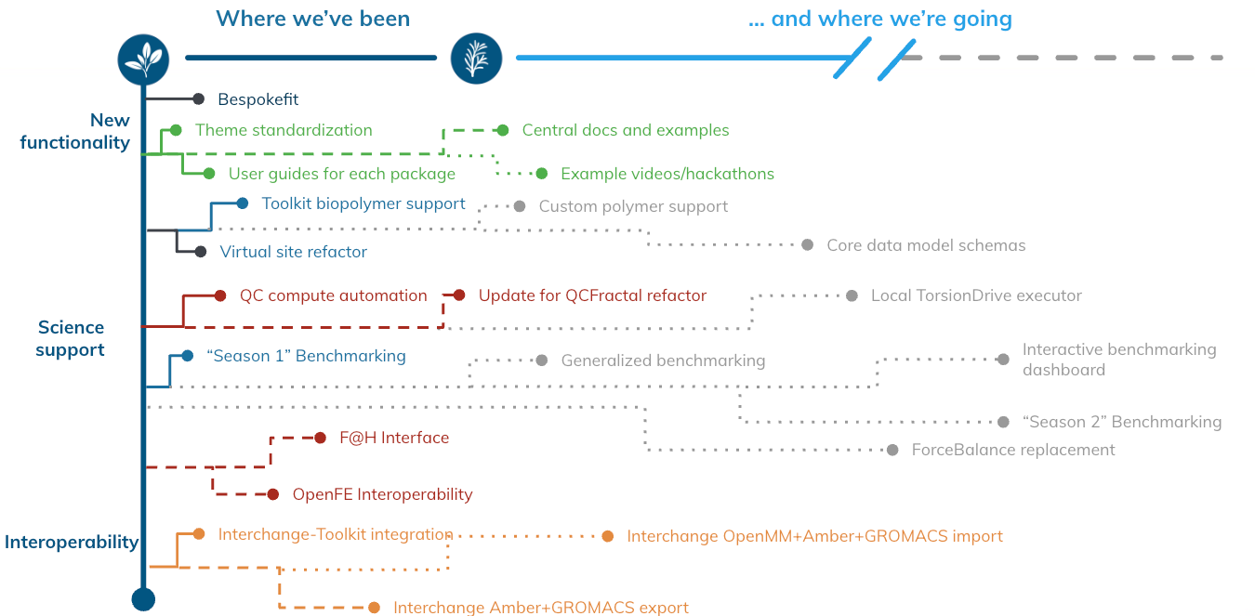
Before we can do the science, we need infrastructure, so you’ll hear about great infrastructure…

Slide 8
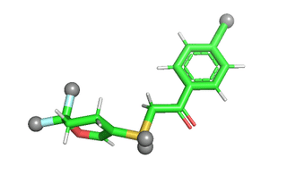
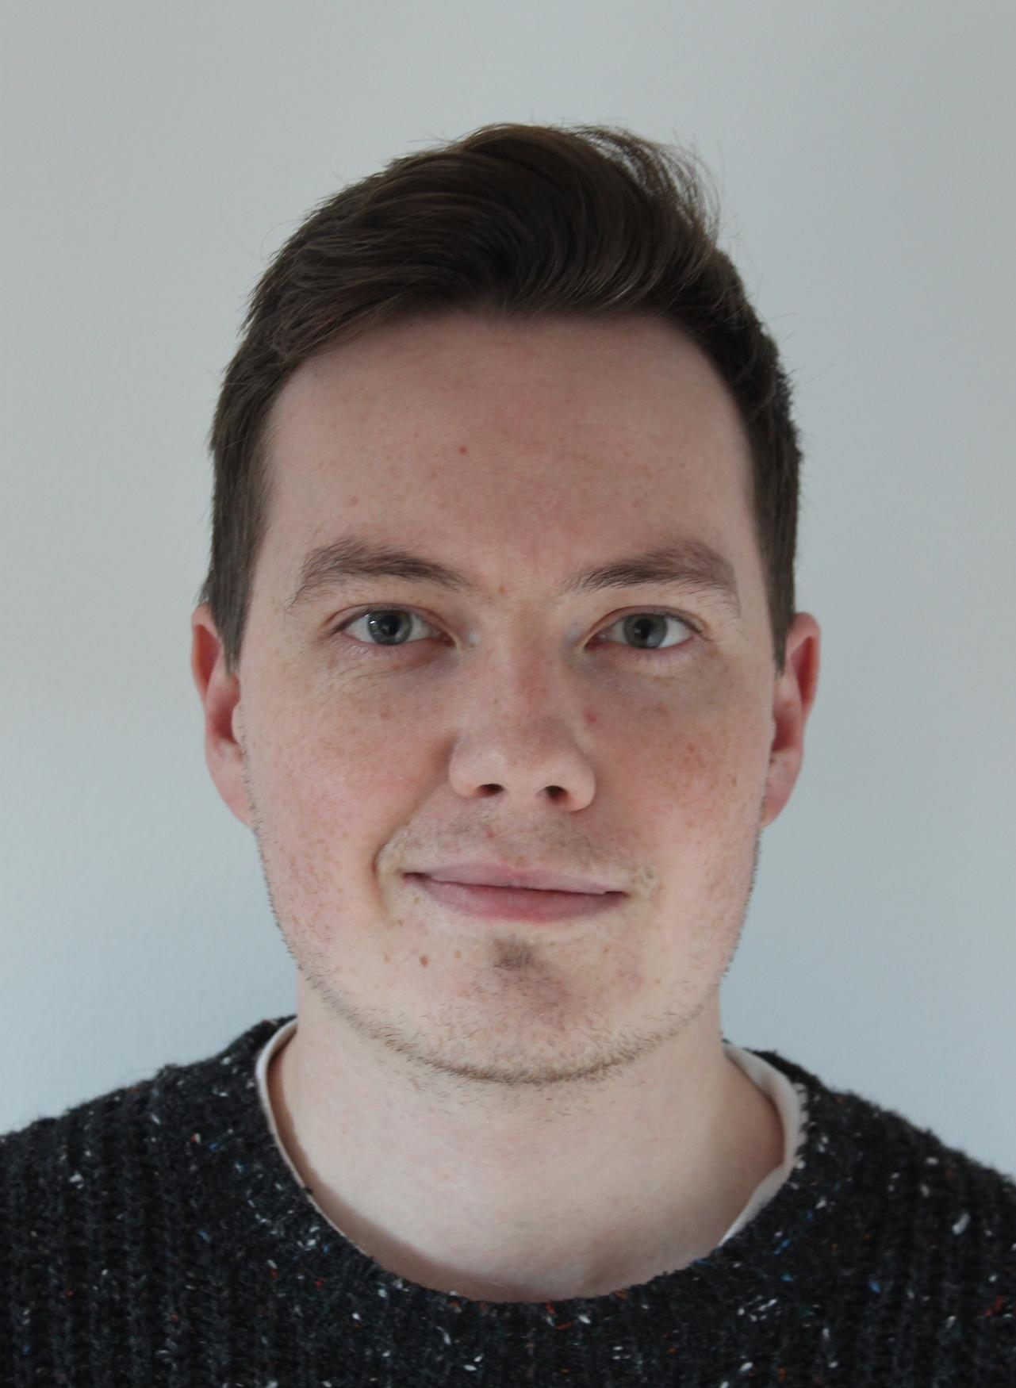
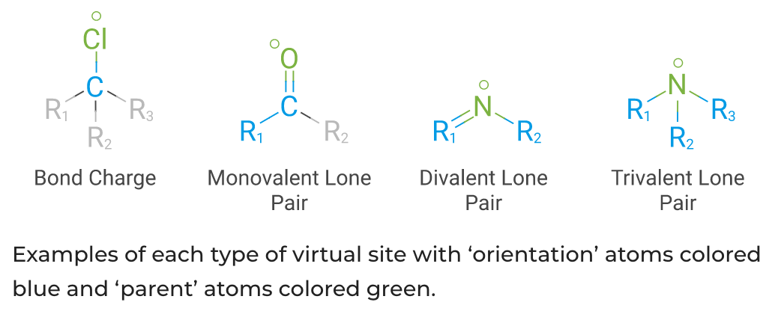
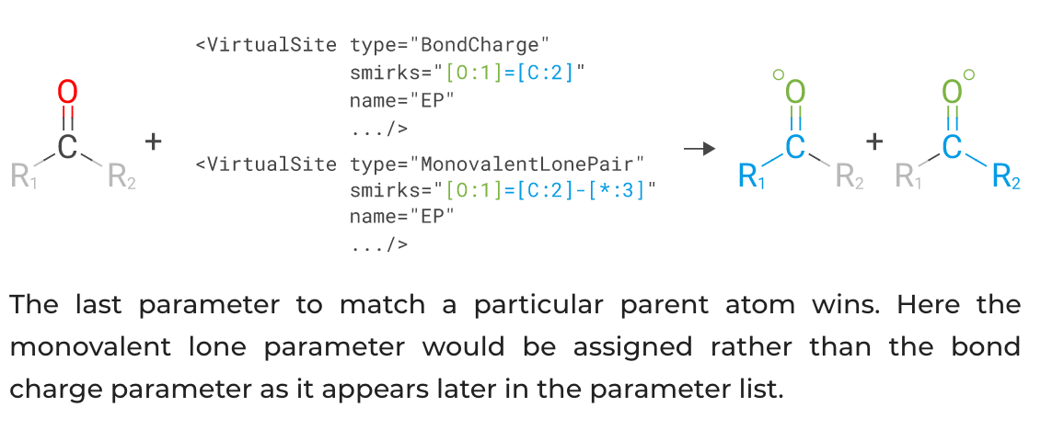
…including virtual site support for off-site charges

Slide 9
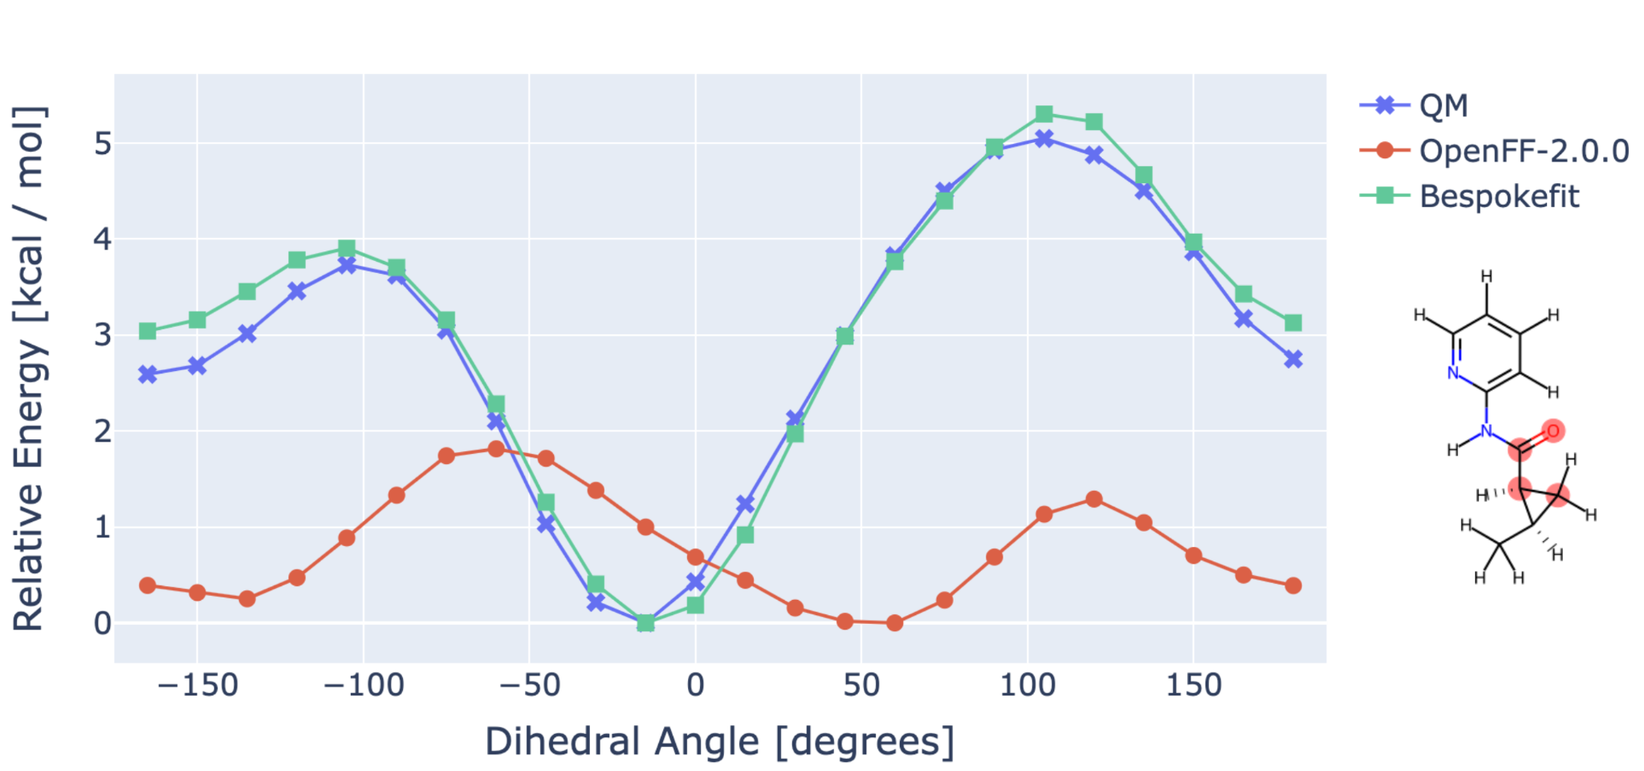
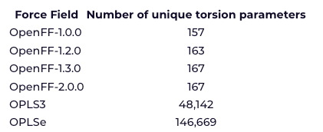
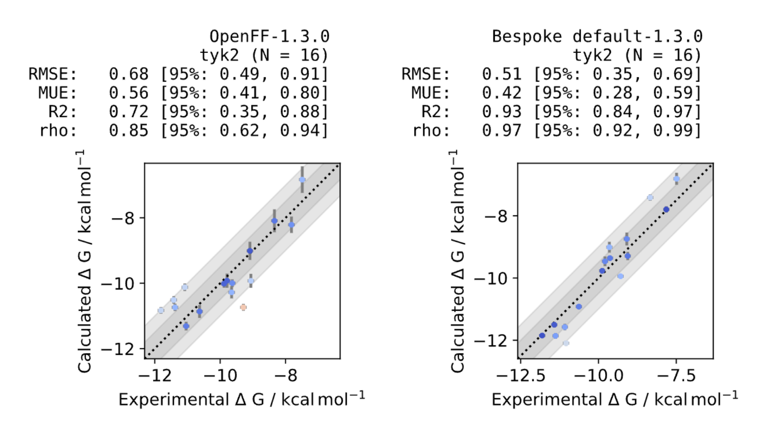
As well as our BespokeFit release for custom, more accurate torsional parameters
Can retrain torsion parameters to bespoke torsion scans generated for ‘fragments’ of original molecule
Very fast with GFN-XTB or similar; also works with QM method of choice

Slide 10
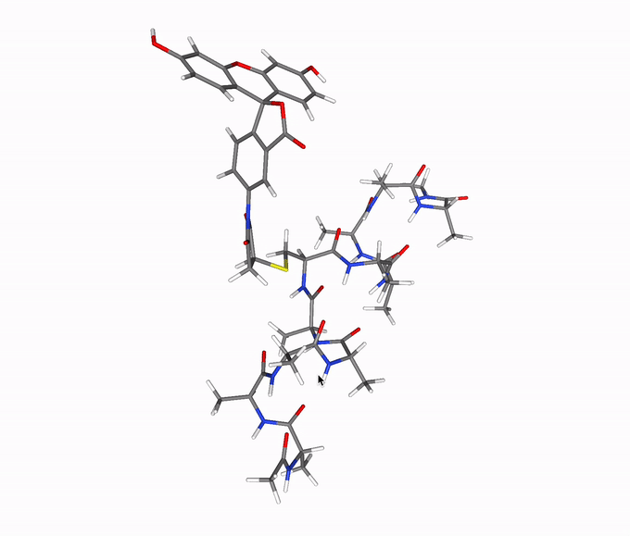
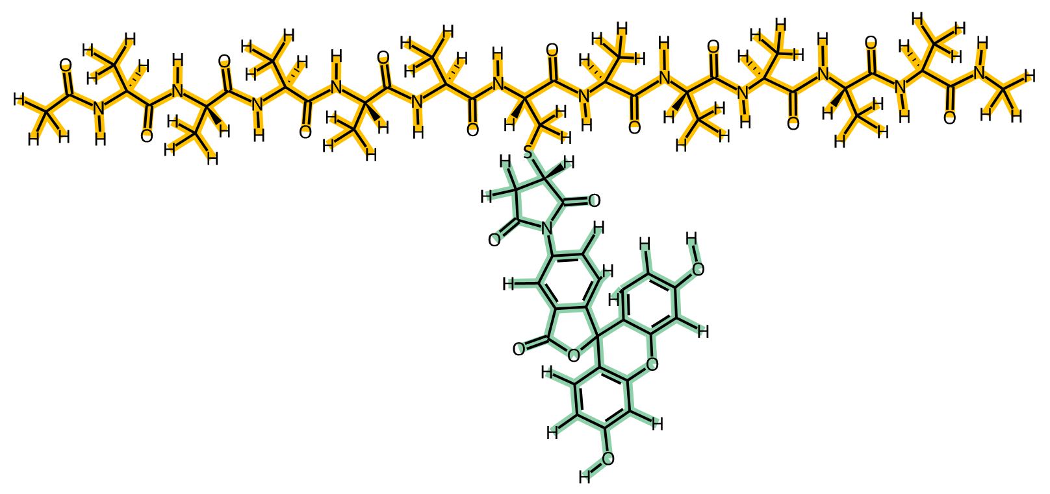
And of course you’ll hear about biopolymer support for our Rosemary release
Handling post-translational modifications will no longer be terrible
Amber FF14SB (SMIRNOFF port)
Sage

Slide 11
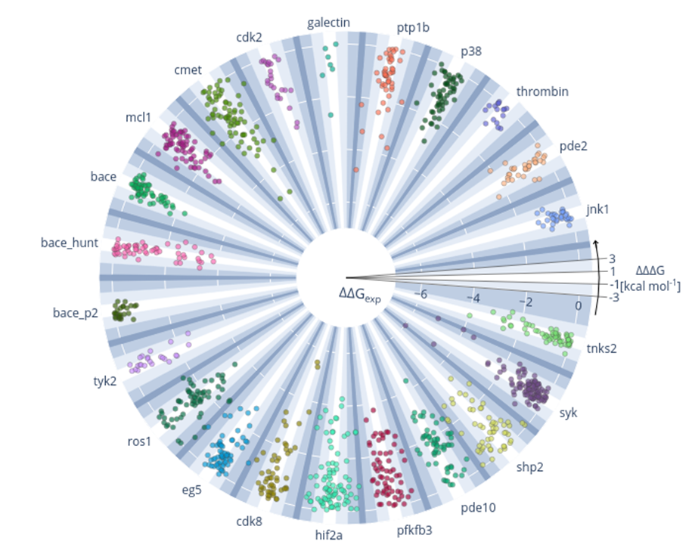
We have an ongoing need to benchmark on binding free energies, leading to a push to use Folding@Home
Overview over all calculations performed
Radial: exp. ΔΔG in kcal/mol
Polar: difference between calc. and exp. ΔΔG, ΔΔΔG in kcal/mol
Protein ligand benchmark
https://github.com/openforcefield/protein-ligand-benchmark

Slide 12
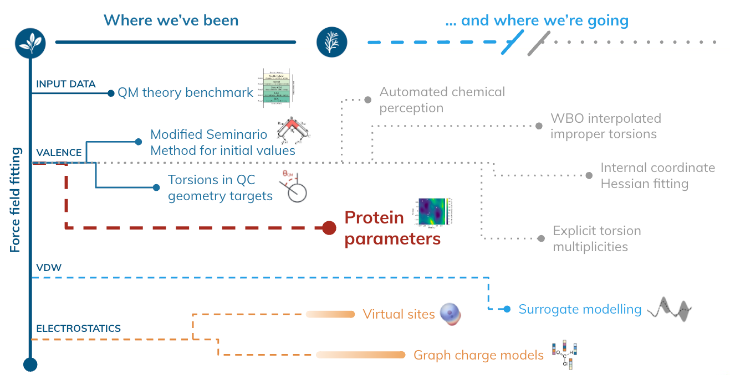
Meanwhile, there’s a ton of great science going on

Slide 13
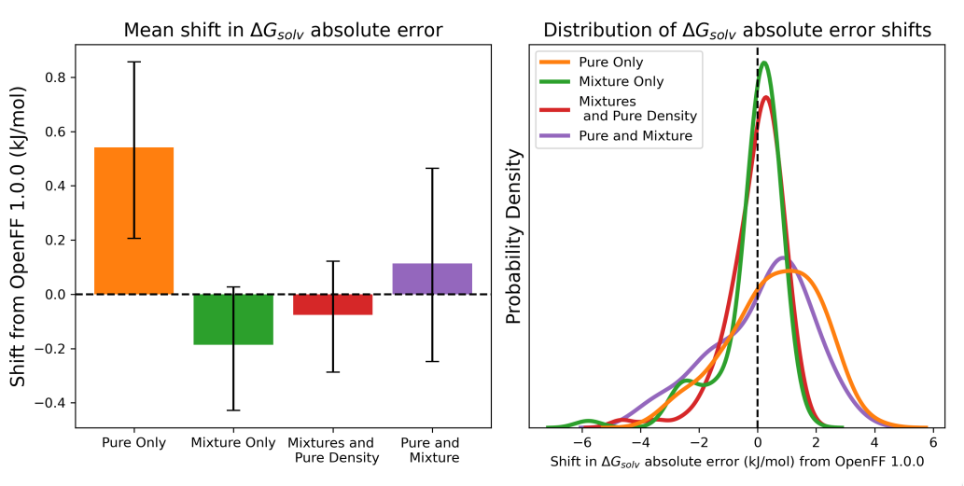
In Sage, fitting to mixture data substantially improved force field predictive power, a totally new result
Benchmarked refit vdW parameters against solvation free energies + transfer free energies
  Subset of FreeSolv and MNSol
Training to mixture data significantly improves performance relative to training to pure data only, or pure + mixture

Slide 14
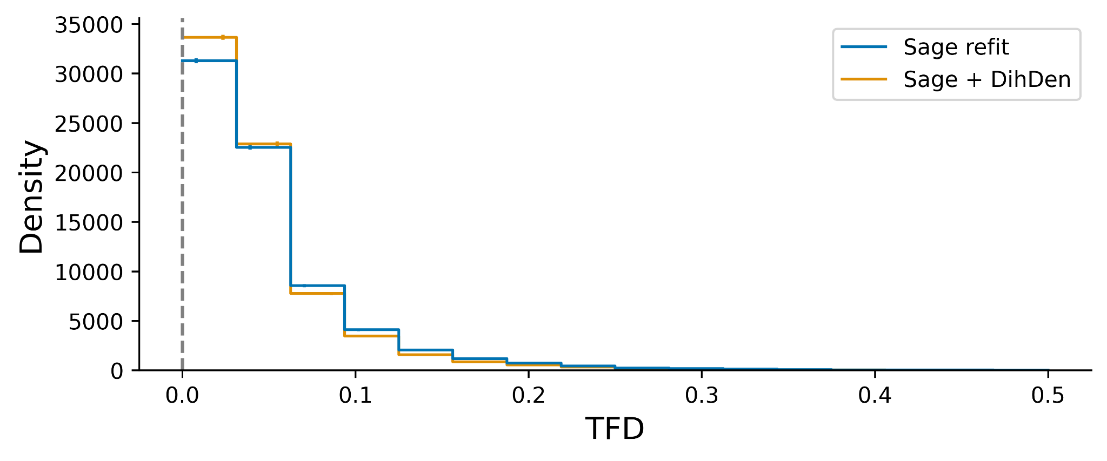
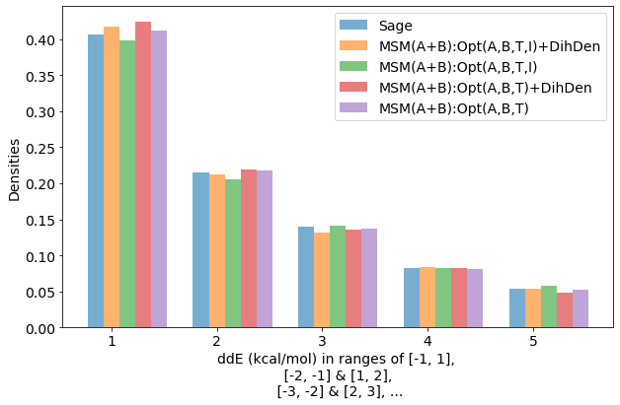
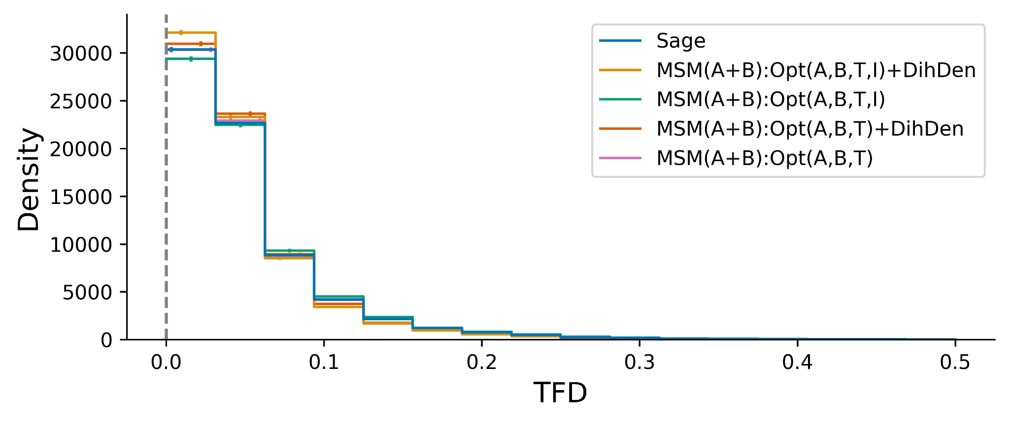
Simple improvements to the force field fitting process provide accuracy benefits - coming out soon
Objective function ignored dihedral deviations in optimized geometries; updating provides better FFs
New initial guesses from the modified Seminario method (MSM) improved accuracy, give more physical values
Starting to fit impropers improves RMSD and TFD, maintains good ddE
Cumulatively these improve accuracy substantially
Industry benchmark set
Industry benchmark set

Slide 15
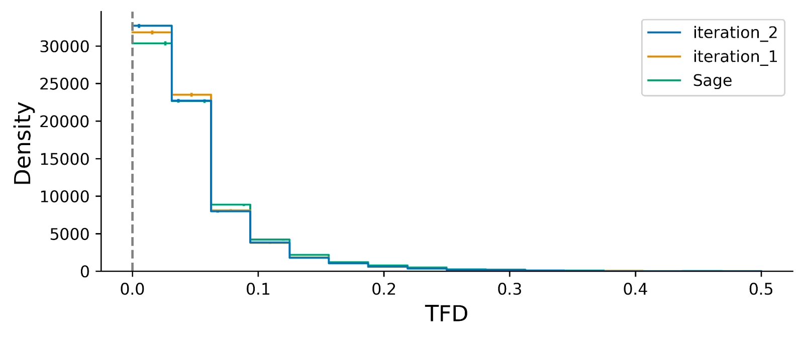
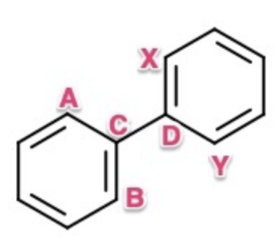
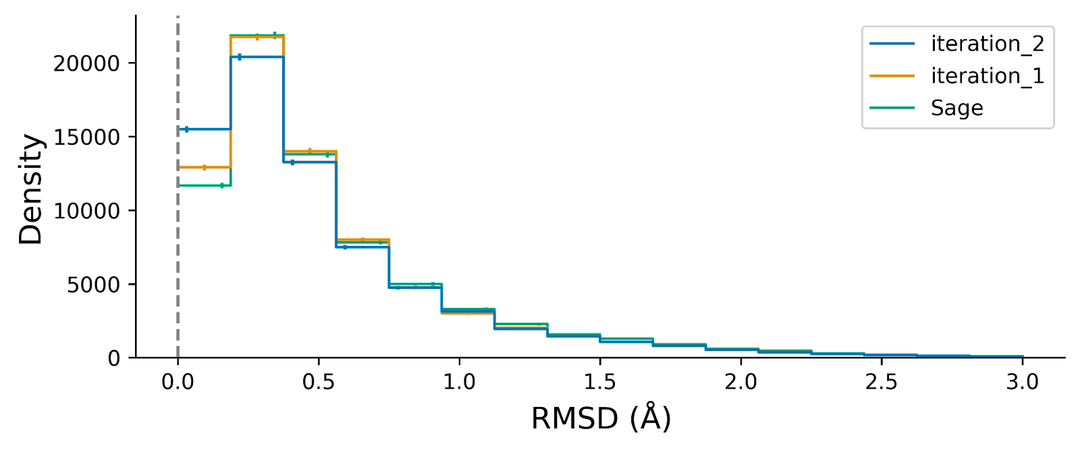
We’re finishing a fix to a problem with torsion multiplicities which will further improve accuracy
Multiplicity: Number of torsion parameters applied to a central bond
We realized it’s incorrect to mix multiplicity for torsions
e.g. t116: [*:1]-[#16X2,#16X3+1:2]-[#6:3]-[#1:4]
Refits on optimization data are improved; TDs and full refit in progress

Slide 16
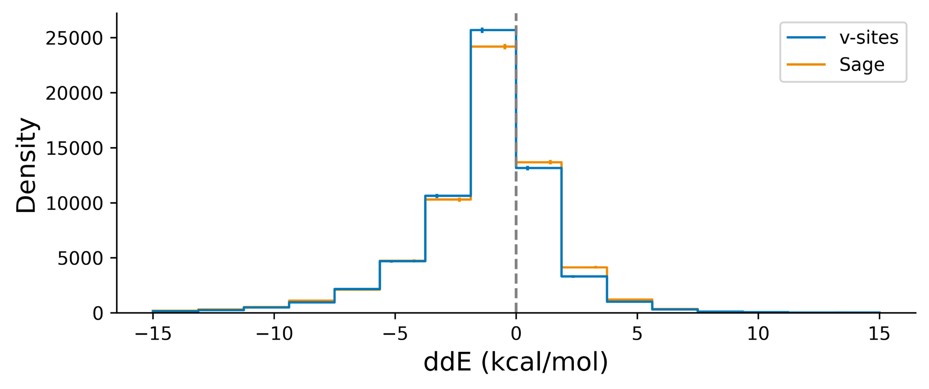
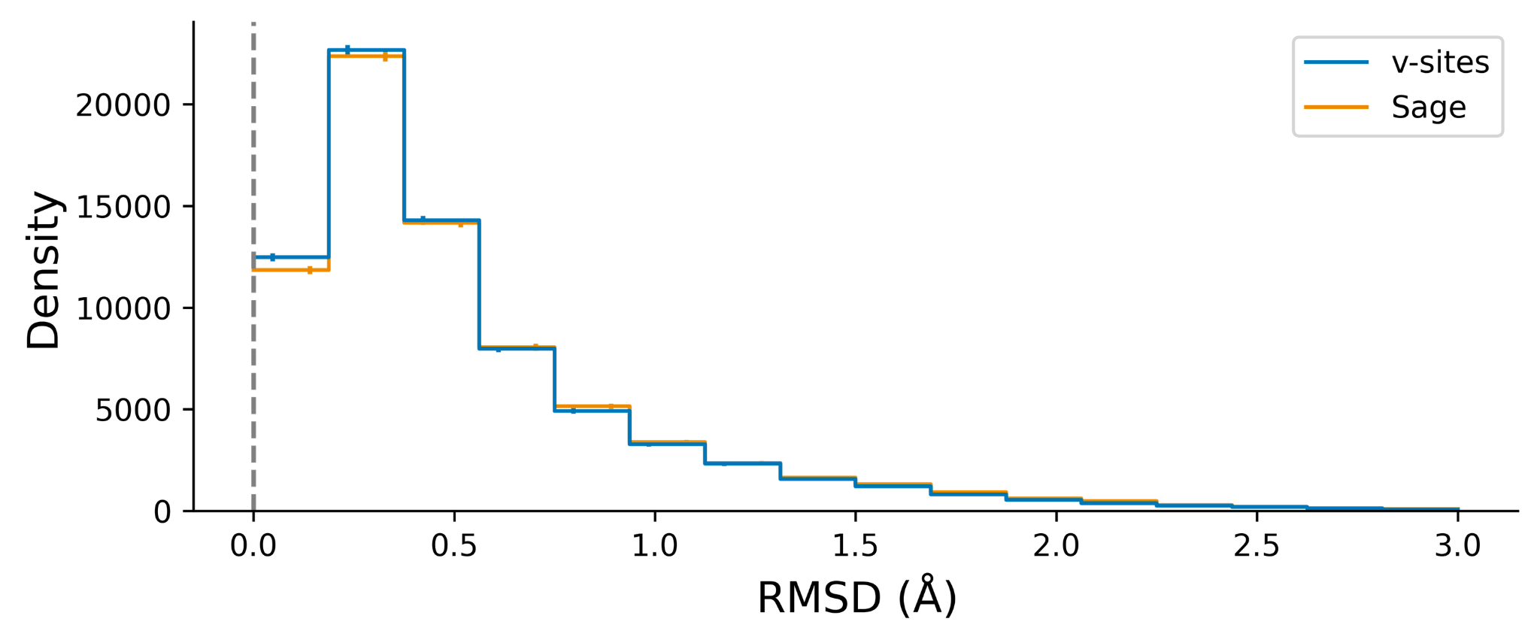
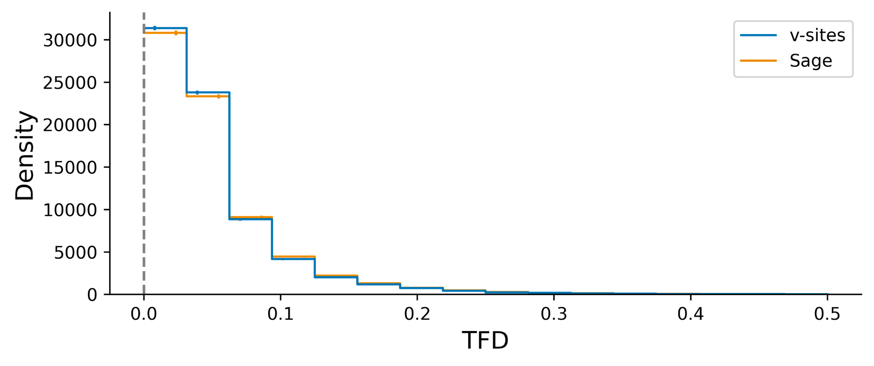
Preliminary tests of virtual sites improve accuracy broadly, even for gas phase energetics
Benchmarks show modest improvements

Slide 17
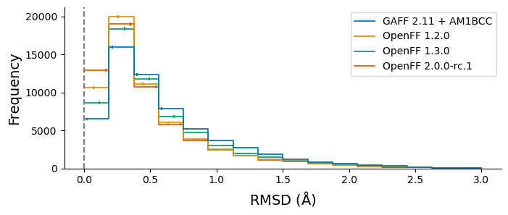
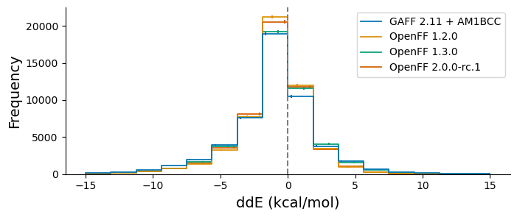
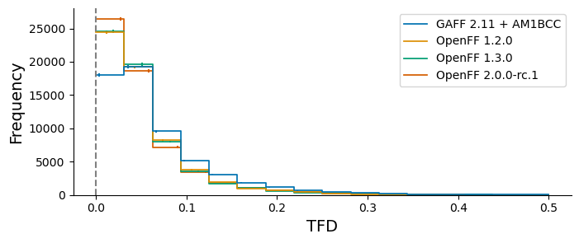
Automated benchmarking with industry has been great, indicates progress relative to QM
SAGE showed excellent performance when benchmarked against the Public OpenFF Industry Benchmark Season 1 v1.0
* 95% bootstrapped confidence intervals

Slide 18
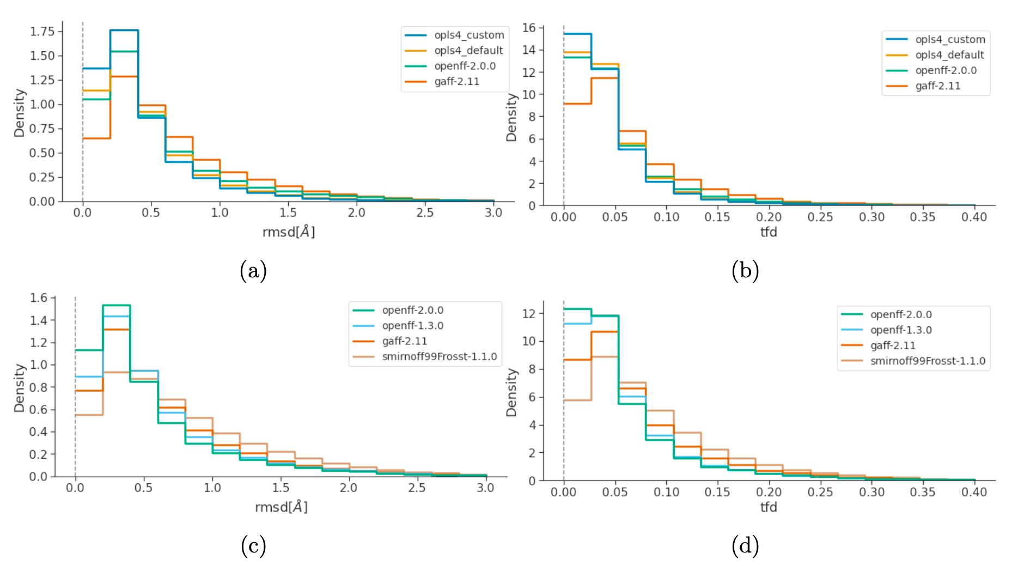
Benchmarking on proprietary datasets shows similar performance, significant improvement

Slide 19
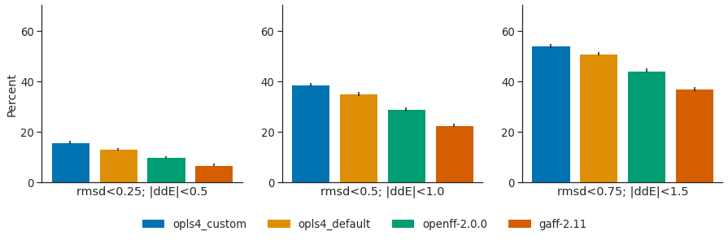
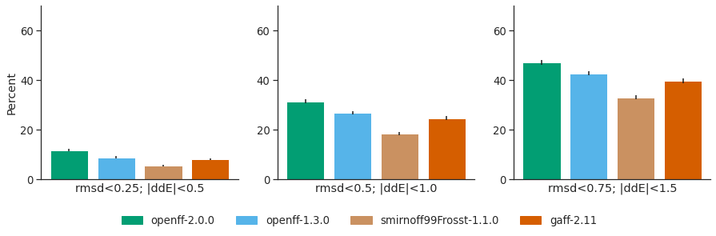
We’ve made marked improvement in force field accuracy, at least based on gas phase conformers
Public data
Percentages of conformations “correctly” predicted (RMSD and |ddE| within threshold)
Proprietary data (internal partner testing)

Slide 20
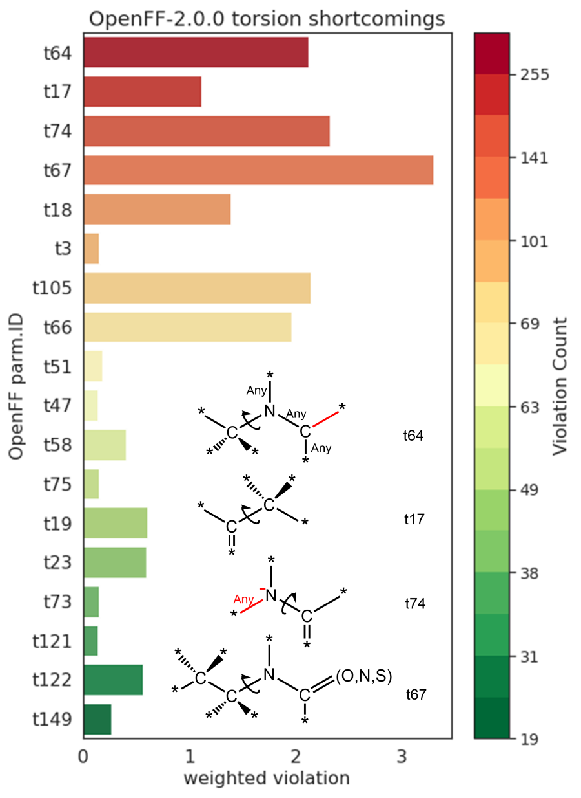
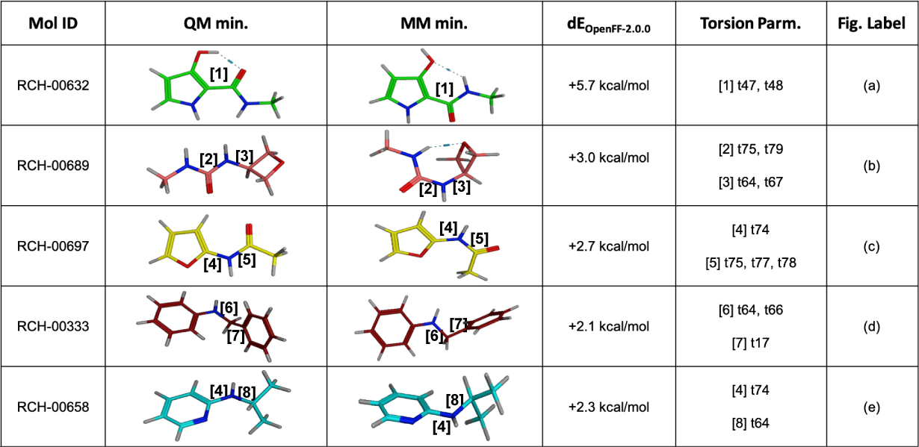
We can use benchmark data to look for trouble spots

Slide 21
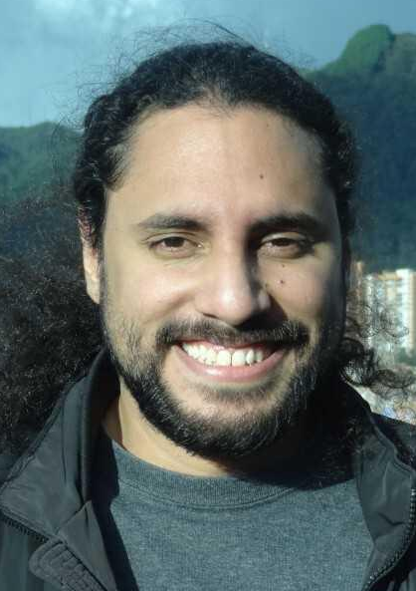
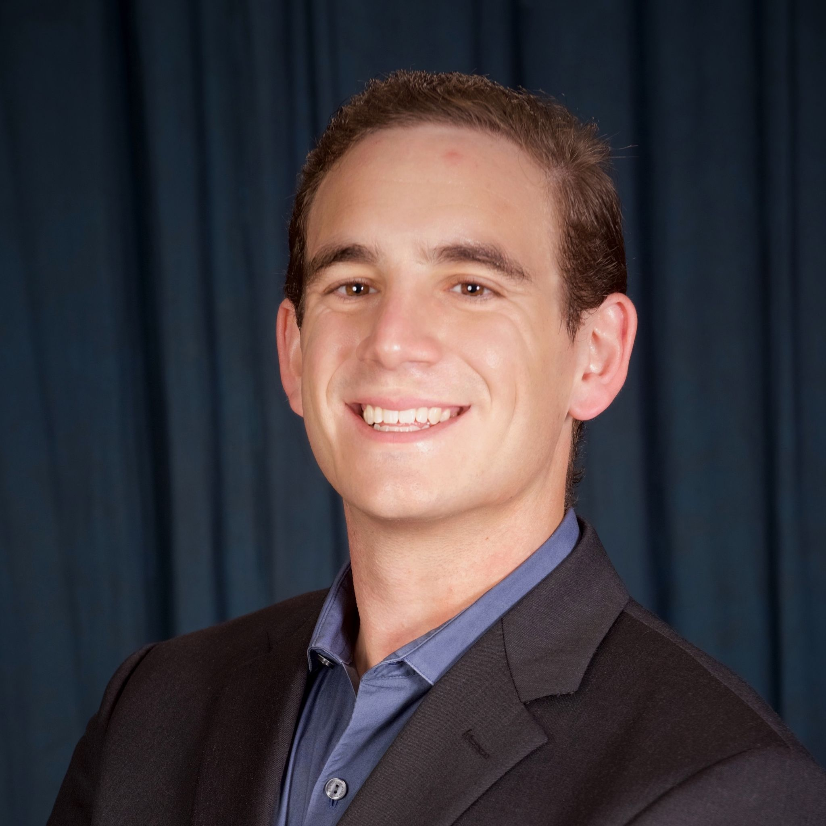
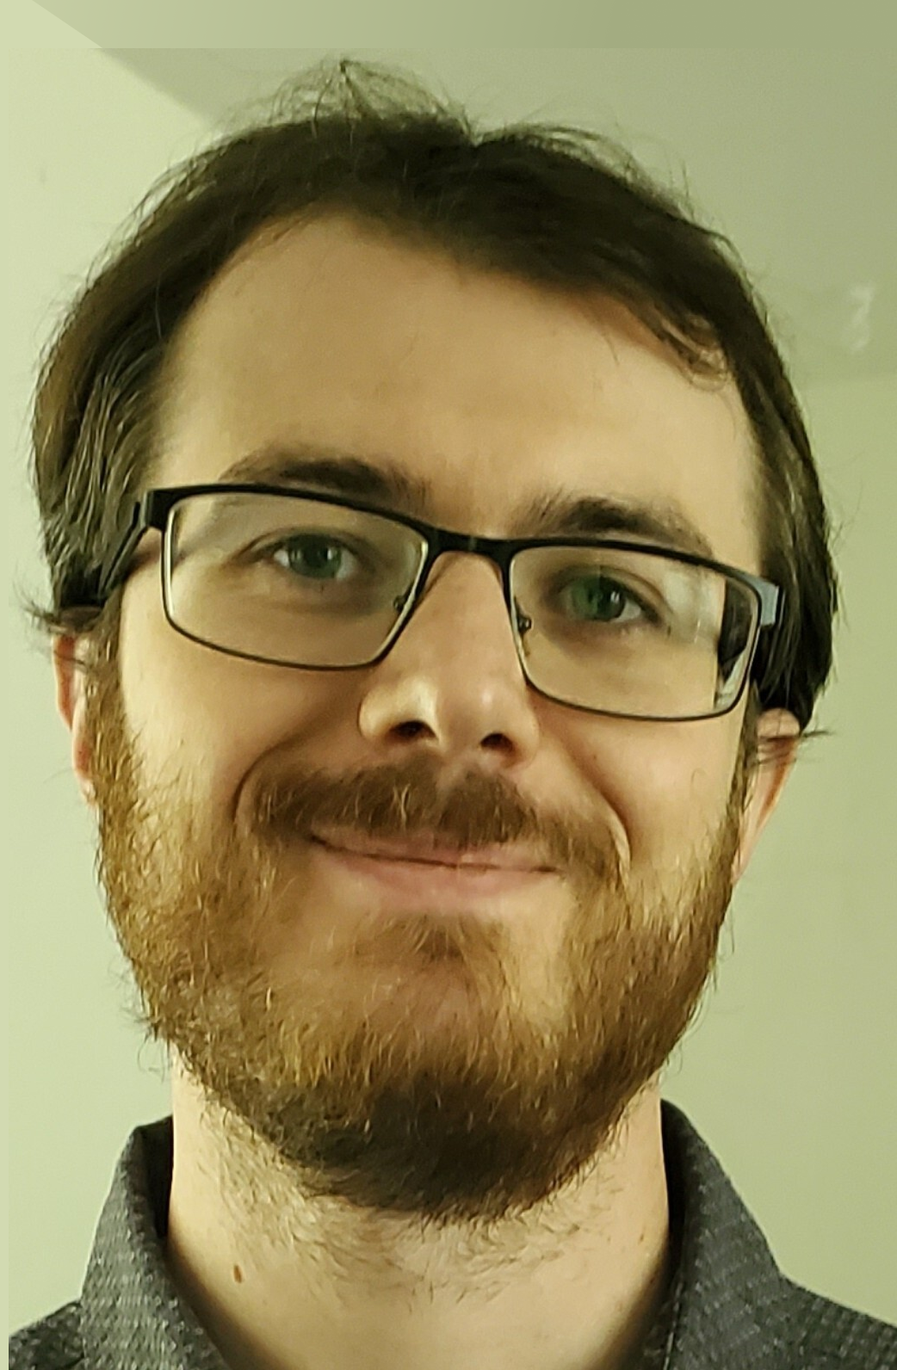
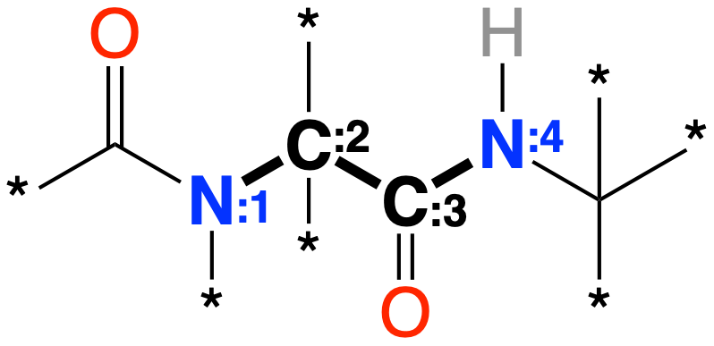

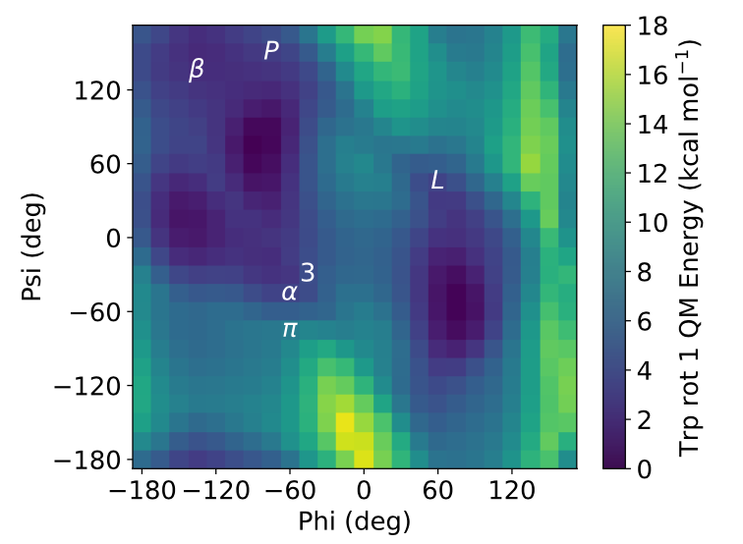
And we’ll give a quick update on status of the protein force field and its parameterization
Ψ
Iván
Pulido
Jeff
Wagner
Chapin Cavender
[#6X3](=O)-[#7X3:1]-[#6X4:2]
-[#6X3:3](=O)-[#7X3H1:4]-[#6X4]
Software
Selecting parameters
QC Data
Adding biopolymer support to OpenFF Toolkit
Encoding protein-specific parameters with SMARTS
Systematic generation of torsion and optimization data for amino acids

Slide 22
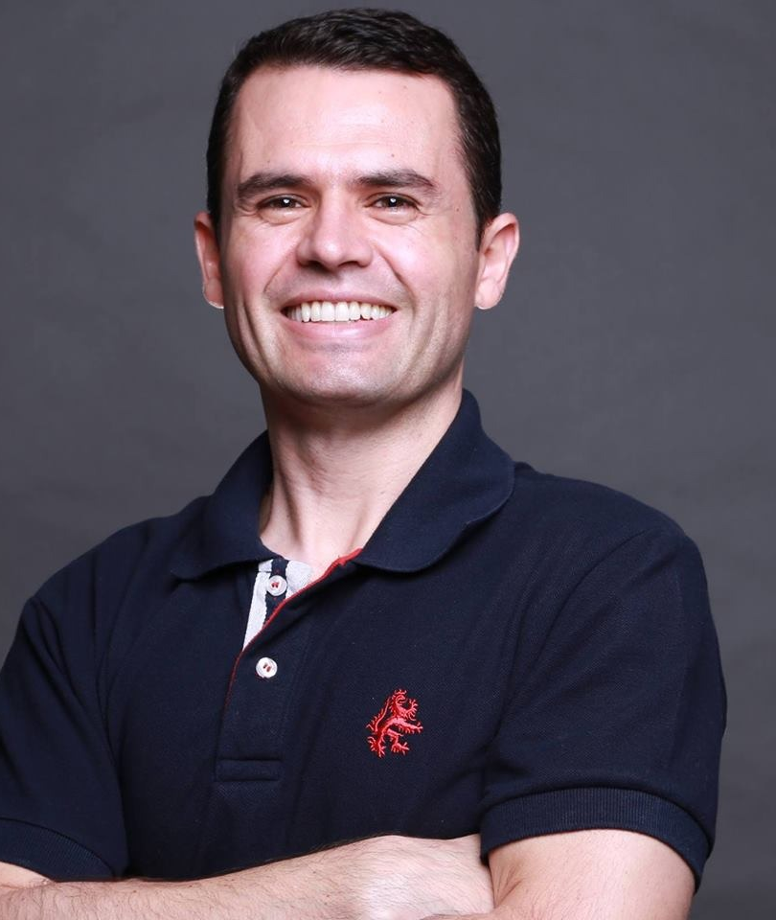
Infrastructure in 2022
Our Organizational Values (in order of priority!)
Product leadership
  Accurate force fields
  Accessible infrastructure
  Broad interoperability
Proximity with users
  Custom solutions
  Joint development
Operational excellence
  Transparency
  Predictability

Slide 23
Infrastructure in 2022
Our Organizational Values
Product leadership
  Accurate force fields
  Accessible infrastructure
  Broad interoperability
Proximity with users
  Custom solutions
  Joint development
Operational excellence
  Transparency
  Predictability

Slide 24
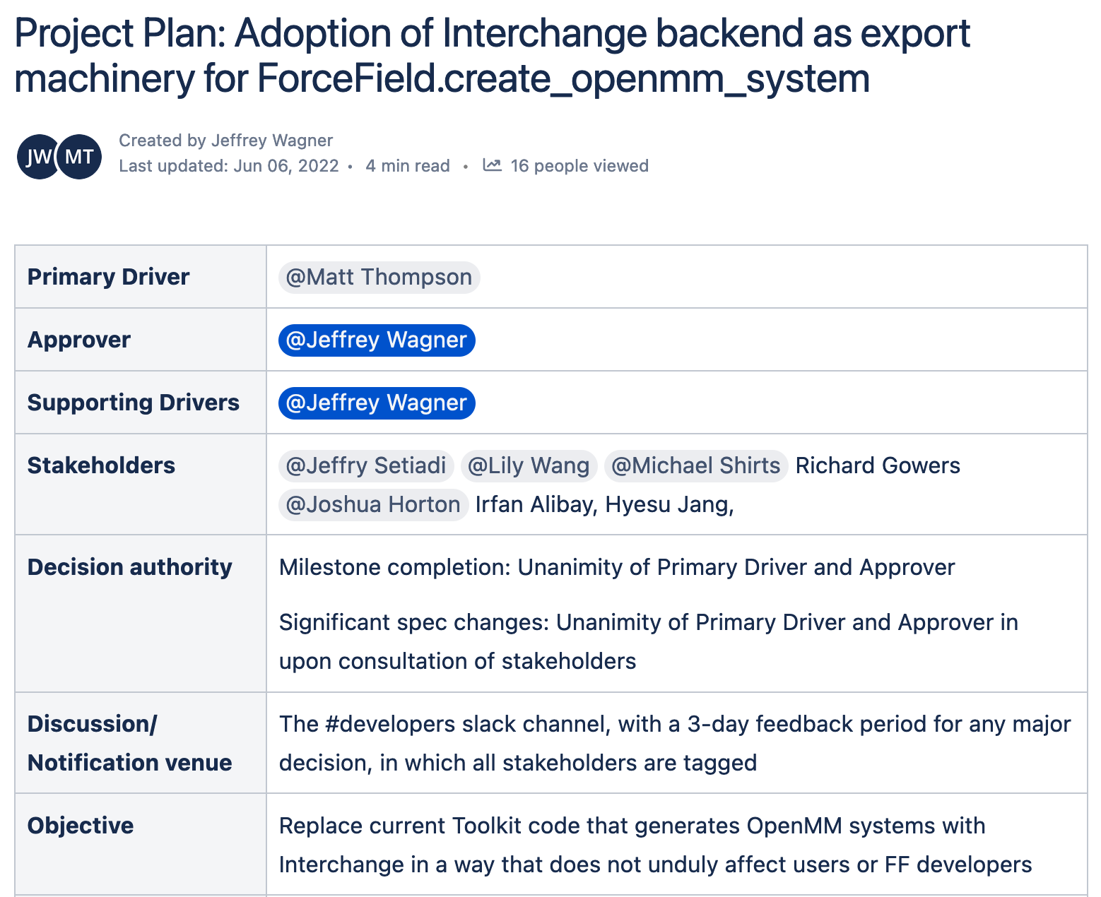
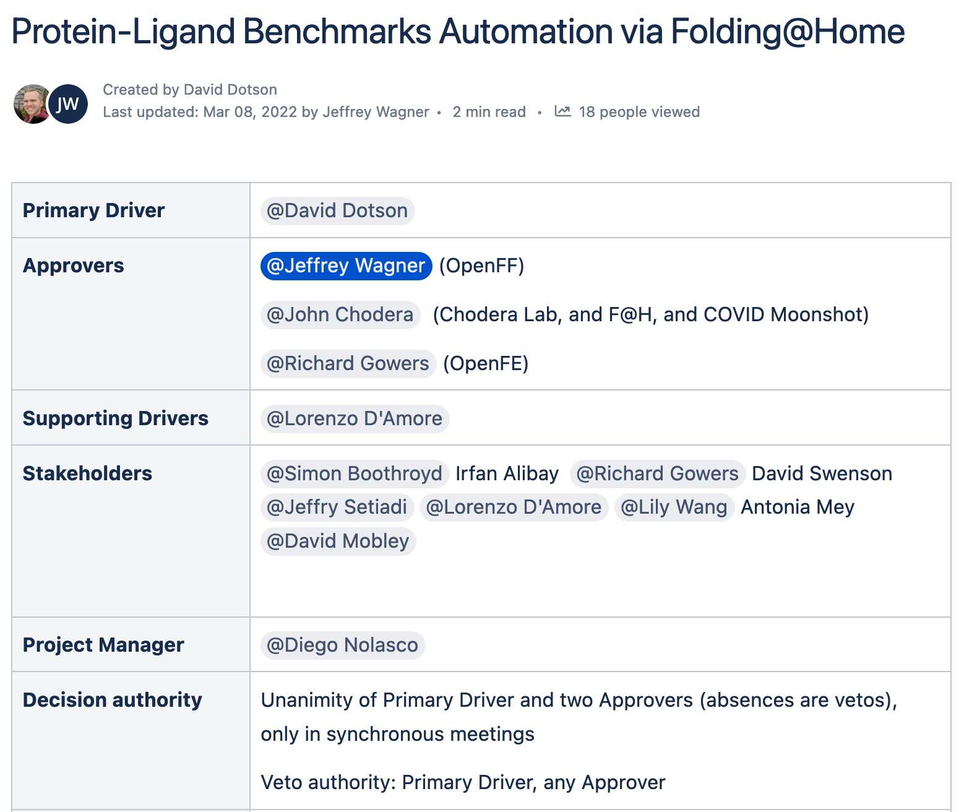
Making major efforts predictable and transparent
https://openforcefield.atlassian.net/wiki/spaces/IN/pages/2225111061/Project+Plan+Adoption+of+Interchange+backend+as+export+machinery+for+ForceField.create+openmm+system
https://openforcefield.atlassian.net/wiki/spaces/IN/pages/1447231531/Protein-Ligand+Benchmarks+Automation+via+Folding+Home

Slide 25
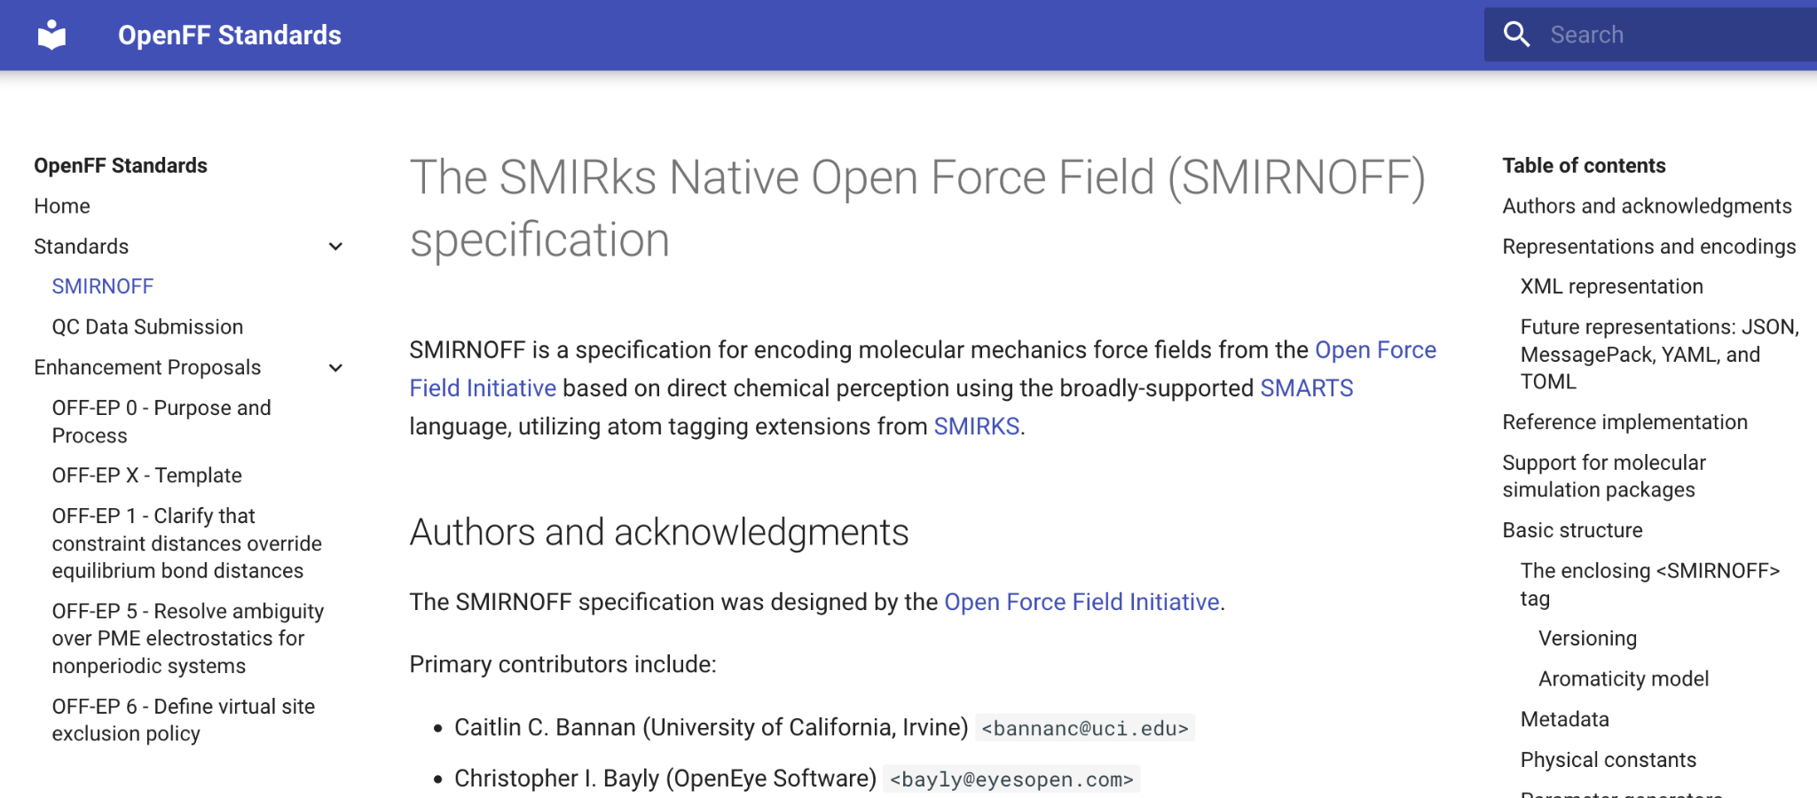
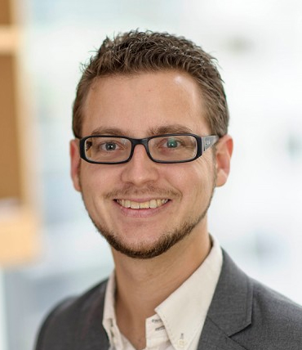
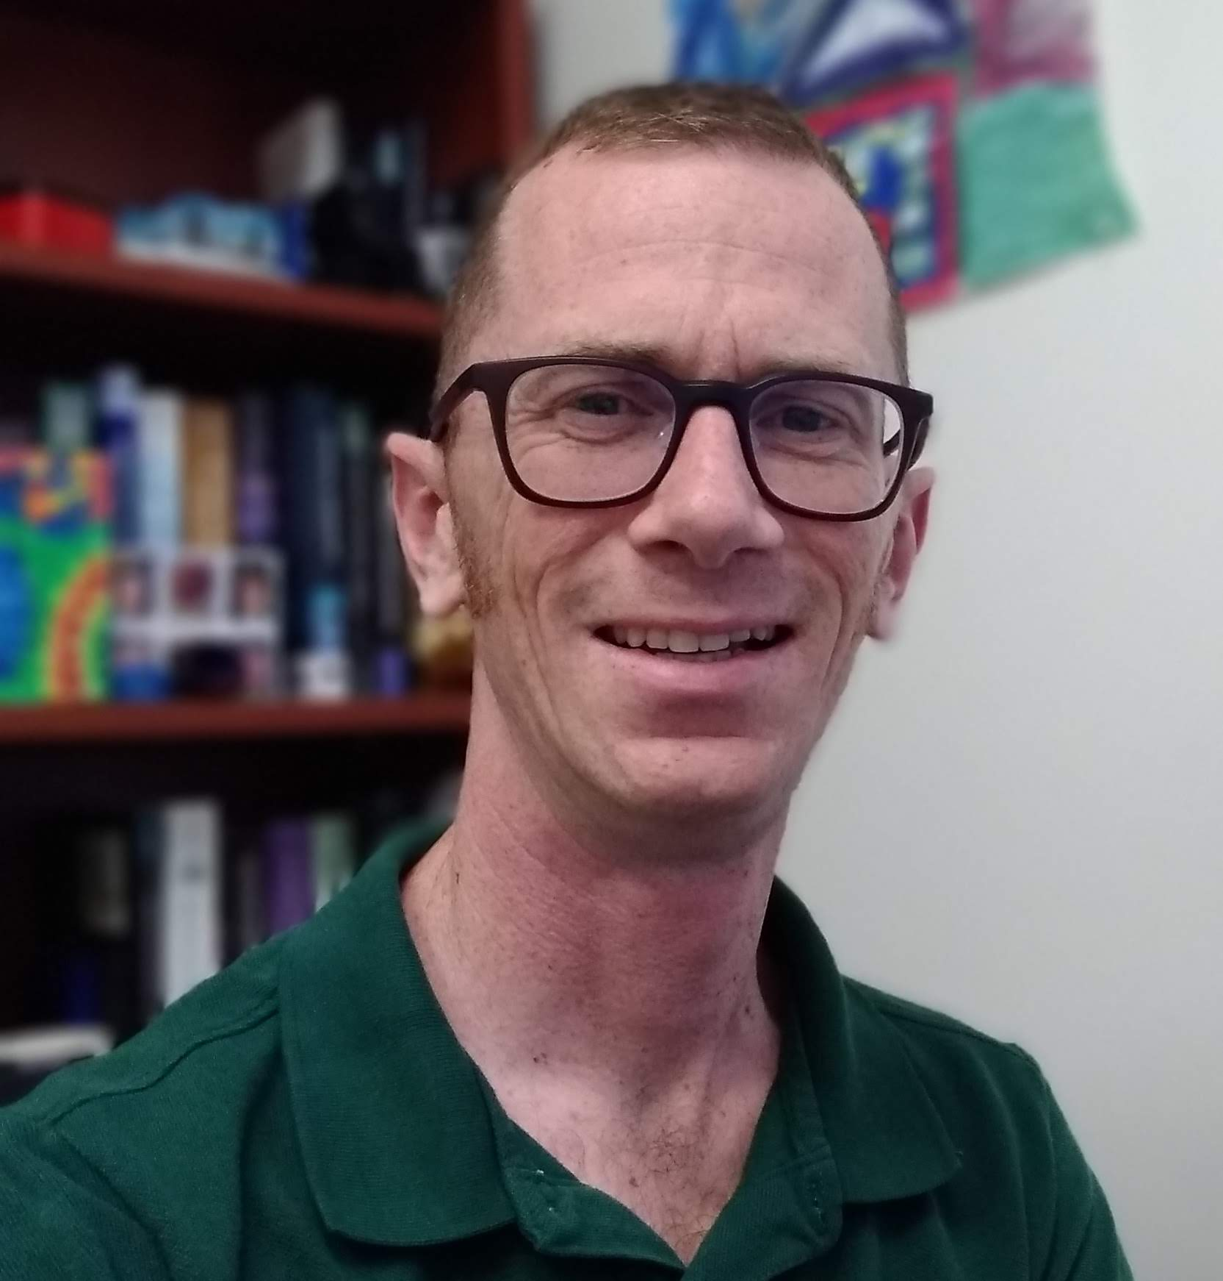
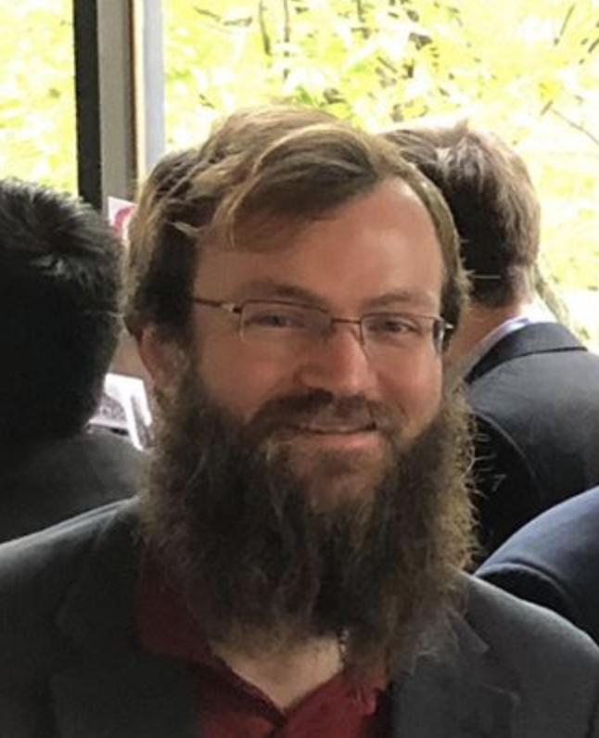
We have standards!
(source) https://github.com/openforcefield/standards
(published) https://openforcefield.github.io/standards/standards/smirnoff/

Slide 26

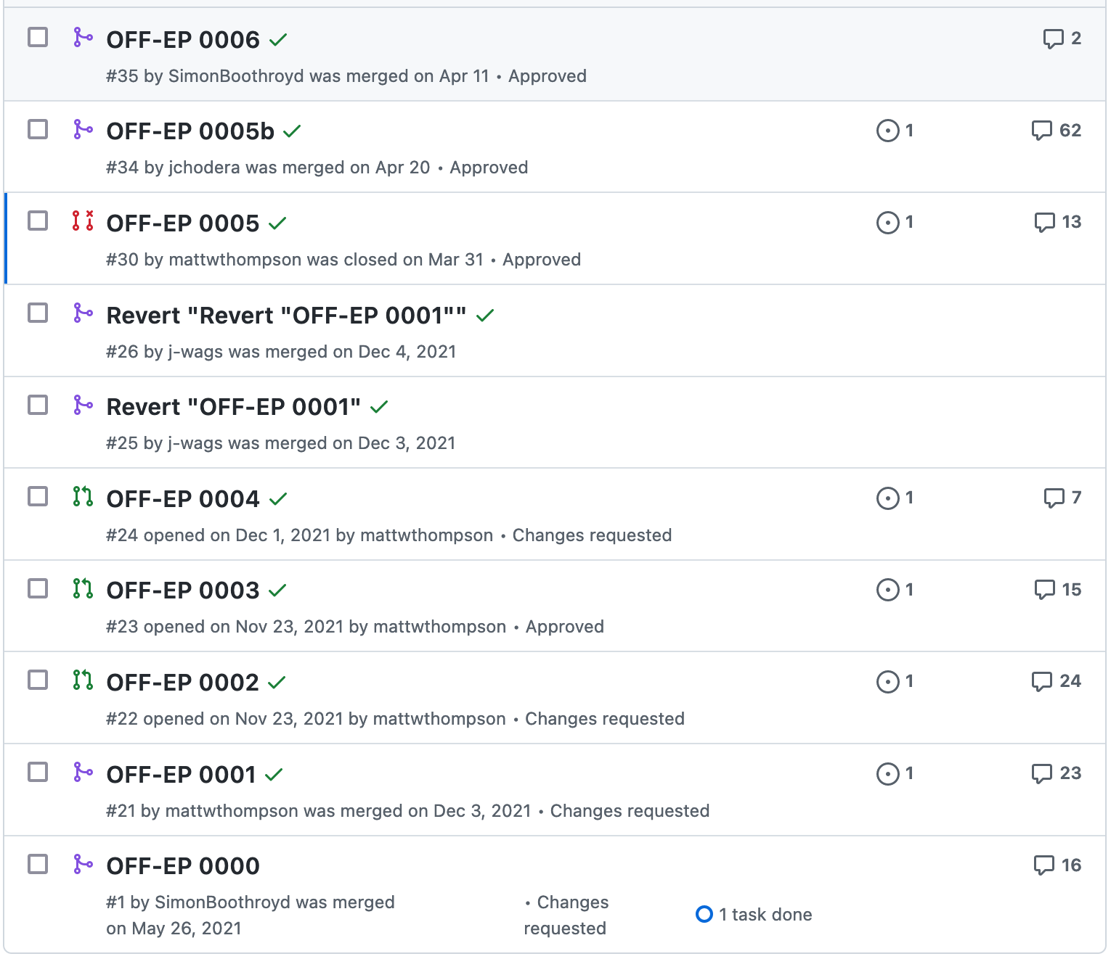
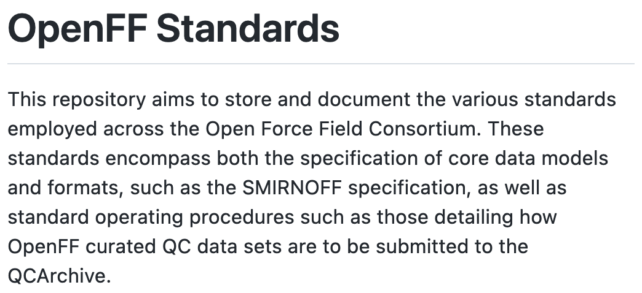
We have standards!
(source) https://github.com/openforcefield/standards
(published) https://openforcefield.github.io/standards/standards/smirnoff/

Slide 27
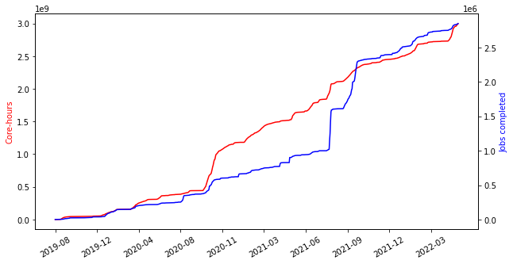
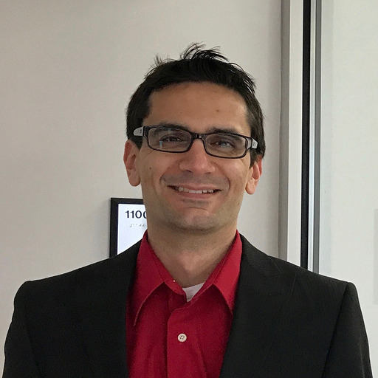





QC compute has continued scaling

Slide 28

Fitting pipeline
Where we’re going
Where we’ve been
… and where we’re going
Bespokefit
New functionality
Theme standardization
Central docs and examples
User guides for each package
Example videos/hackathons
Toolkit biopolymer support
Custom polymer support
Virtual site refactor
Core data model schemas
QC compute automation
Update for QCFractal refactor
Local torsiondrive executor
Science support
“Season 1” Benchmarking
Generalized benchmarking
Interactive benchmarking dashboard
“Season 2” Benchmarking
F@H Interface
ForceBalance replacement
OpenFE Interoperability
Interoperability
Interchange-Toolkit integration
Interchange OpenMM+Amber+GROMACS import
Interchange Amber+GROMACS export

Slide 29
Fitting pipeline
Where we’re going
Where we’ve been
… and where we’re going
Bespokefit
New functionality
Theme standardization
Central docs and examples
User guides for each package
Example videos/hackathons
Toolkit biopolymer support
Custom polymer support
Virtual site refactor
Core data model schemas
QC compute automation
Update for QCFractal refactor
Local torsiondrive executor
Science support
“Season 1” Benchmarking
Generalized benchmarking
Interactive benchmarking dashboard
“Season 2” Benchmarking
F@H Interface
ForceBalance replacement
OpenFE Interoperability
Interoperability
Interchange-Toolkit integration
Interchange OpenMM+Amber+GROMACS import
Interchange Amber+GROMACS export

Slide 30
Infrastructure in 2022
Our Organizational Values
Product leadership
  Accurate force fields
  Accessible infrastructure
  Broad interoperability
Proximity with users
  Custom solutions
  Joint development
Operational excellence
  Transparency
  Predictability

Slide 31



BespokeFit has been released
https://docs.openforcefield.org/projects/bespokefit/en/latest/getting-started/quick-start.html

Slide 32

BespokeFit has been released
https://docs.openforcefield.org/projects/bespokefit/en/latest/getting-started/quick-start.html

Slide 33

BespokeFit has been released
https://docs.openforcefield.org/projects/bespokefit/en/latest/getting-started/quick-start.html

Slide 34




Partner benchmarking manuscript headed for submission

Slide 35
Python toolkits help us find our weak spots
Figure 5: Molecular fragments of the Roche dataset containing concerning torsions. Global minima conformers optimized with QM and MM are shown with the concerning torsion(s) marked in brackets. Relative (dE) energies calculated according to equation 1 and torsion parameter(s) associated with corresponding concerning torsion(s) are reported.
Figure 6: Analysis of torsion violations in the Public OpenFF Industry Dataset. Inset: 2D sketch chemistry match of selected torsion parameters. Elements in red color (bond, charge) may or may not exist, meaning that the corresponding atom can be either tri- or dicoordinated, respectively

Slide 36
Infrastructure in 2022
Our Organizational Values
Product leadership
  Accurate force fields
  Accessible infrastructure
  Broad interoperability
Proximity with users
  Custom solutions
  Joint development
Operational excellence
  Transparency
  Predictability

Slide 37

Our projects are becoming widely-adopted

Slide 38


Our projects are becoming widely-adopted

Slide 39

Documentation - Central Docs
docs.openforcefield.org
https://docs.openforcefield.org/en/latest/

Slide 40

Documentation - “Molecular Gastronomy”

Slide 41


Documentation - Theme standardization

Slide 42


Documentation - Theme standardization

Slide 43



Transition to OpenFF-units

Slide 44


OpenFF Toolkit-Interchange native interoperability
https://mybinder.org/v2/gist/j-wags/4b9716cfd7c4c5efee03ff63ec6a964e/HEAD

Slide 45



New code paths…

Slide 46
…same old behavior

Slide 47

Integrating Interchange into the OpenFF Toolkit

Slide 48
Must
Should
Could
Want
Interchange-0.2.0
System Combination
AMBER Interoperability
GROMACS Interoperability
OpenMM Interoperability
ParmEd Interoperability
LAMMPS Interoperability
CLI
Tool
ML export
MoSDeF interoperability
Documentation
AMBER export
AMBER import
GROMACS export
GROMACS import
OpenMM export
OpenMM import
API docs
Examples
User guide
GROMACS “vanilla” export
GROMACS export hierarchy info compatibility
GROMACS export vsites
OpenMM “vanilla” export
OpenMM export hierarchy info compatibility
OpenMM export vsites
AMBER “vanilla” export
AMBER export hierarchy info compatibility
AMBER export vsites
We will make exporters before importers

Slide 49
Extensive virtual site refactor

Slide 50


The F@H interface and OpenFE interoperability

Slide 51
OpenFF Toolkit Refactor - Supporting proteins
PDB file
Explicit hydrogens
Canonical AAs
PDB spec atom names
Molecule.from_polymer_pdb
(adds formal charges, bond orders)
OpenFF Toolkit Molecule
https://mybinder.org/v2/gist/j-wags/4b9716cfd7c4c5efee03ff63ec6a964e/HEAD

Slide 52

Sometimes a toolkit will just… do the right thing
RDKit

Slide 53

But other times it won’t
RDKit

Slide 54

PDB files don’t contain complete chemical information!

Slide 55




CCD to the rescue!
Molecule.from_polymer_pdb
(adds formal charges, bond orders)

Slide 56

OFFMols are getting a PDB hierarchy API

Slide 57

PDB hierarchy info will be interoperable

Slide 58


The power of SMIRNOFF

Slide 59



The power of SMIRNOFF
+
→
AAAAACAAAAA
Fluorescein-5-maleimide

Slide 60
The power of SMIRNOFF - The fine print
SMIRNOFF parameter specification is hierarchical
Parameters that appear later in a SMIRNOFF specification override those which come earlier if they match the same pattern... This hierarchical structure means that a typical parameter file will tend to have generic parameters early in the section for each force type, with more specialized parameters assigned later.
Multiple SMIRNOFF representations can be processed in sequence
Multiple SMIRNOFF data sources (e.g. multiple OFFXML files) can be loaded in sequence. If these files each contain unique top-level tags (such as <Bonds>, <Angles>, etc.), the resulting force field will be independent of the order in which the files are loaded. If, however, the same tag occurs in multiple files, the contents of the tags are merged, with the tags read later taking precedence over the parameters read earlier, provided the top-level tags have compatible attributes. The resulting force field will therefore depend on the order in which parameters are read.
This behavior is intended for limited use in appending very specific parameters, such as parameters specifying solvent models, to override standard parameters.

Slide 61

Franken-Force field

Slide 62

The power of SMIRNOFF
Bonds
Partial charges
Amber FF14SB (SMIRNOFF port)
Sage
AM1BCC
(some assembly required)

Slide 64
Where we’ve been
… and where we’re going
2016
2019
2021
202X
202X
SMIRNOFF99Frosst
Parsley
Sage
Rosemary
Rosemary
Initial SMIRNOFF port of the parm@Frosst force field
Retrained valence parameters against a redesigned QC data set
Self consistent biopolymer + small molecule force field
Retrained vdW parameters against physical property data + retrained valence parameters
Self consistent biopolymer + small molecule force field

Slide 65

Rosemary
A protein force field
Trp1 QM energy (kcal mol⁻¹)
Ψ
ψ (°)
Iván
Pulido
Jeff
Wagner
Chapin Cavender
[#6X3](=O)-[#7X3:1]-[#6X4:2]
-[#6X3:3](=O)-[#7X3H1:4]-[#6X4]
φ (°)
Software
Selecting parameters
QC Data
Adding biopolymer support to OpenFF Toolkit
Encoding protein-specific parameters with SMARTS
Systematic generation of torsion and optimization data for amino acids

Slide 66





Rosemary
A protein force field
Trp2 QM energy (kcal mol⁻¹)
Trp1 - Trp2 QM energy
Do side-chains impact protein backbone torsions?
ψ (°)
ψ (°)
φ (°)
φ (°)
Ala1 QM energy (kcal mol⁻¹)
Trp1 QM energy (kcal mol⁻¹)
Ala1 - Trp1 QM energy
Yes → train individual torsions for each side-chain
ψ (°)
ψ (°)
ψ (°)
Use different rotamers for validation
φ (°)
φ (°)
φ (°)

Slide 67


Rosemary
A protein force field
Trp1 QM energy (kcal mol⁻¹)
Ψ
ψ (°)
Iván
Pulido
Jeff
Wagner
Chapin Cavender
[#6X3](=O)-[#7X3:1]-[#6X4:2]
-[#6X3:3](=O)-[#7X3H1:4]-[#6X4]
φ (°)
+
Software
Selecting parameters
QC Data
Fitting
Benchmarking
Adding biopolymer support to OpenFF Toolkit
Encoding protein-specific parameters with SMARTS
Systematic generation of torsion and optimization data for amino acids
Fit protein-specific torsions to QC data, and re-fit valence and LJ parameters
Curate and benchmark to NMR observables

Slide 68

Where we’ve been
… and where we’re going
VALENCE
Force field fitting
Protein parameters
VDW
ELECTROSTATICS
Graph charge models

Slide 69



Graph charges
Neural networks for fast electrostatics
ESP / EF
+
+
RESP2 δ=0.6
Simon Boothroyd
Hypothesis
Software
Training
Testing
A graph convolutional model can produce fast, conformer-independent, high quality charges
Support for graph models added to the OpenFF toolkit. Infrastructure for applying graph models to molecules created
A GNN will be trained to similar quality as AM1BCC (ELF10)
Trained parameters will be benchmarked against experimental and physical property data

Slide 70





Espaloma
Neural networks for force field parameters
Absolute binding free energy performance
Yuanqing
Wang
OpenFF 1.2.0
Espaloma
RMSE = 0.91
RMSE = 0.47

Slide 71

Where we’ve been
… and where we’re going
VALENCE
Force field fitting
Protein parameters
VDW
Virtual sites
ELECTROSTATICS
Graph charge models

Slide 72


Virtual sites
Proof of concept: halogens and pyridines
ESP of C-Br has a sigma hole at HF/6-31G*
HF/6-31G*
Sage
With virtual sites

Slide 73





Virtual sites
ESP / EF
+
+
RESP2 δ=0.6
Simon Boothroyd
Owen
Madin
Trevor
Gokey
Hypothesis
Software
Training
Testing
Interoperability
The inclusion of off-site charges should improve the accuracy of a force fields electrostatic interactions
Virtual site support added to the OpenFF toolkit. Support for training to QC ESP + EF data
Virtual sites will be trained against ESP / EF QC data, based on input from the Cole group
Trained parameters will be benchmarked against experimental and physical property data
In order to include into mainline force field need major simulation packages to support proposed v-sites
‹#›

Slide 74


Virtual sites
Proof of concept: halogens and pyridines
ΔH_{mix}(𝑥) of mixtures containing Chlorine
OpenFF 1.3.0
OpenFF 2.0.0
FF + new BCCs / v-sites

Slide 75



Virtual sites
Proof of concept: halogens and pyridines
ΔH_{mix}(𝑥) of Heteroaromatics
OpenFF 1.3.0
OpenFF 2.0.0
FF + new BCCs / v-sites

Slide 76
Virtual sites
Proof of concept: halogens and pyridines
Benchmarks show modest improvements

Slide 77

Where we’ve been
… and where we’re going
INPUT DATA
QM theory benchmark
VALENCE
Force field fitting
Protein parameters
VDW
Virtual sites
ELECTROSTATICS
Graph charge models

Slide 78


QM data theory
Balancing accuracy and speed
Pavan Behara
Hyesu Jang
The three axes along of WFT methods:
Basis set, Hamiltonian, and the treatment of electron correlation.
Courtesy: Timo Fleig, urn:nbn:de:hbz:061-20070312-091913-8
Jacob’s ladder of density functional approximation for exchange correlation energy
Courtesy: 10.1016/j.ccr.2015.03.019

Slide 79

QM data theory
Balancing accuracy and speed
B3LYP-D3BJ/DZVP best balance of quality and speed
~0.1 kcal/mol

Slide 80


Where we’ve been
… and where we’re going
INPUT DATA
QM theory benchmark
Modified Seminario Method for initial values
VALENCE
Torsions in QC geometry targets
Force field fitting
Protein parameters
VDW
Virtual sites
ELECTROSTATICS
Graph charge models

Slide 81






Fitting protocol
Modified Seminario Method for initial values
S
O
72°
N
1.7 Å
Josh Horton
Pavan Behara
Problem incorrect sulfonamide valence angles in simulation
Diagnosis equilibrium valence angles decreased unphysically between releases
Proposal
Use modified Seminario method to derive initial bond and angle values from QM Hessian matrix

Slide 82

Fitting protocol
Updates for better fits
Fitting metrics: including dihedral deviations fitting to QM geometries [DihDen]
Starting points: Modified Seminario Method for angles and bonds [MSM(A+B)]
Changing both and optimizing all valence parameters [MSM(A+B):Opt(A, B, T, I)+DihDen] shows improvements in RMSD and TFD
Pavan Behara

Slide 83

Where we’ve been
… and where we’re going
INPUT DATA
QM theory benchmark
Modified Seminario Method for initial values
VALENCE
Torsions in QC geometry targets
Force field fitting
Protein parameters
VDW
Virtual sites
Surrogate modelling
ELECTROSTATICS
Graph charge models

Slide 84



Surrogate modelling
Escaping local minima with global optimization
Simon Boothroyd
Owen Madin

Slide 85


Surrogate modelling
Escaping local minima with global optimization

Slide 86

Where we’ve been
… and where we’re going
INPUT DATA
QM theory benchmark
Automated chemical perception
Modified Seminario Method for initial values
VALENCE
Torsions in QC geometry targets
Force field fitting
Protein parameters
VDW
Virtual sites
Surrogate modelling
ELECTROSTATICS
Graph charge models

Slide 87



Automated chemical perception
Bonds
Angles
Torsions
Find new parameters based on QM geometry (bonds, angles, torsions)
Trevor
Gokey

Slide 88
Where we’ve been
… and where we’re going
INPUT DATA
QM theory benchmark
Automated chemical perception
WBO interpolated improper torsions
Modified Seminario Method for initial values
VALENCE
Internal coordinate Hessian fitting
Torsions in QC geometry targets
Force field fitting
Protein parameters
Explicit torsion multiplicities
VDW
Virtual sites
Surrogate modelling
ELECTROSTATICS
Graph charge models

Slide 89
Where we’ve been
… where we’re going
… where we can go
2016
2019
2021
202X
20XX
SMIRNOFF99Frosst
Parsley
Sage
Rosemary
OpenFF

Slide 90

What are our organizational value disciplines?

Slide 91

Why should we have a strategy?

Slide 92

What is a project for?
of Deployment

Slide 93

How does strategy affect our daily lives?

Slide 94
How does strategy affect our daily lives?
Hierarchical Structures
Bureaucratic Bonds
Activity Management
Centralized Information
Sector Results
Physical Environment
Interdisciplinary Structures
Value-based Relationships
Self-Managing Teams
Distributed Information
Collective Results
Virtual Environment

Slide 95
Where we’ve been
… where we’re going
… where we can go together
2016
2019
2021
202X
20XX
SMIRNOFF99Frosst
Parsley
Sage
Rosemary
OpenFF

Slide 96
Where we’ve been
… and where we’re going
INPUT DATA
QM theory benchmark
Automated chemical perception
WBO interpolated improper torsions
Modified Seminario Method for initial values
VALENCE
Internal coordinate Hessian fitting
Torsions in QC geometry targets
Force field fitting
Protein parameters
Explicit torsion multiplicities
VDW
Virtual sites
Surrogate modelling
ELECTROSTATICS
Graph charge models

Slide 97
Fitting pipeline
Where we’re going
Where we’ve been
… and where we’re going
Bespokefit
New functionality
Theme standardization
Central docs and examples
User guides for each package
Example videos/hackathons
Toolkit biopolymer support
Custom polymer support
Virtual site refactor
Core data model schemas
QC compute automation
Update for QCFractal refactor
Local TorsionDrive executor
Science support
“Season 1” Benchmarking
Generalized benchmarking
Interactive benchmarking dashboard
“Season 2” Benchmarking
F@H Interface
ForceBalance replacement
OpenFE Interoperability
Interoperability
Interchange-Toolkit integration
Interchange OpenMM+Amber+GROMACS import
Interchange Amber+GROMACS export

Slide 98
Discussion questions
Who is interested in non-protein polymer support in force fields?
What should be our best practice for combining parameterized components before Interchange can import from external formats? ParmEd or OpenMMForceFields?
Where should we plan to go after graph charges and virtual sites?
What should OpenFF look like in 3 years? How many people? Continued focus on core products or keep developing new products?

