Slide 1

International Data Week 2022 Seoul
Bringing Clarity to Solid Earth Chemistry Data:
A Standardized Database Derived From Cyberinfrastructures
J ZhangZhou¹*, Chuntao Liu¹, Jiali Lei¹, Ben Qin¹, Lyu Yang², Urmi Ghosh³, Shichao Ji⁴, Arka Sahu⁵, Tuhin Chakraborty⁶, Hejia Zhang⁷, Fang Huang⁸, Shichun Huang⁹, Brenhin Keller¹⁰, Jie Deng¹¹, Mingcheng Duan¹², Yongsheng He¹³, Zheng Xu⁴, Yuan Li⁴, Sayan Sen¹⁴, Can He¹⁵, Proteek Chowdhury¹⁶, Weihua Huang¹, Enjiang Yue¹, Donghao Zheng¹, Yunfeng Chen¹, Andre Python¹
¹ School of Earth Sciences, Zhejiang University, Hangzhou 310027, China
² School of Gemmology, China University of Geosciences, Wuhan 430074, China
³ Department of Geology and Geophysics, Indian Institute of Technology (IIT) Kharagpur, 721302 Kharagpur, India
⁴ Guangzhou Institute of Geochemistry, Chinese Academy of Sciences (CAS), Guangzhou 510640, China
⁵ Department of Geological Sciences, Jadavpur University, Kolkata 700032, India
⁶ Department of Geology, Rhodes University, Makhanda 6140, South Africa
⁷ Institute of the Environment and Sustainability, University of California, Los Angeles, CA 90095, USA
⁸ CSIRO Mineral Resources, Kensington, WA 6151, Australia
⁹ Department of Geoscience, University of Nevada, Las Vegas, 4505 S. Maryland Pkwy, Las Vegas 89154, USA.
¹⁰ Department of Earth Sciences, Dartmouth College, Hanover, NH 03755, USA
¹¹ Department of Earth, Planetary, and Space Sciences, University of California, Los Angeles, 90095, USA
¹² School of Earth Sciences and Resources, China University of Geosciences (Beijing), Beijing 100083, China
¹³ State Key Laboratory of Geological Processes and Mineral Resources, China University of Geosciences (Beijing), 100083, China
¹⁴ Zuckerberg Institute for Water Research, Ben-Gurion University of the Negev, Midreshet Ben-Gurion, 8499000, Israel
¹⁵ School of Earth Sciences and Engineering, Sun Yat-Sen University, Guangzhou, 510275, China
¹⁶ Department of Earth and Planetary Sciences, University of California, Riverside, CA 92521, USA
* Corresponding author: zhangzhou333@zju.edu.cn (ZhangZhou J)

Slide 2
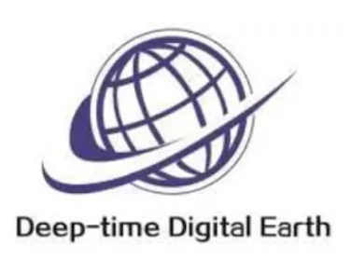

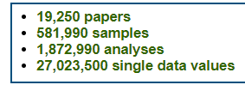





Cyber Infrastructure
2020
2020
DFG
NSF
NASA
NSF, NASA

Slide 3
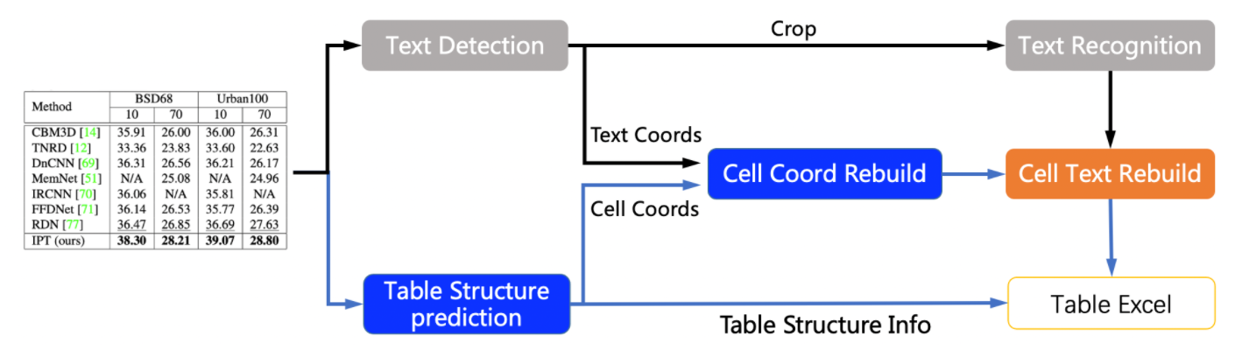
Data compilation
2021
Portable Document Format
PDF
HTML
hypertext markup language
(by Andrian Lee)

Slide 4

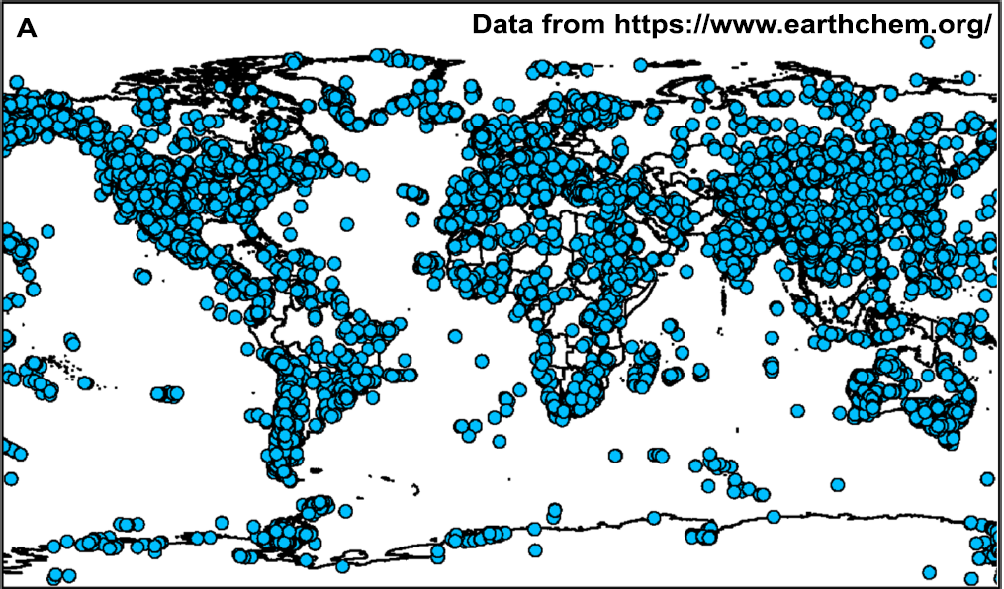

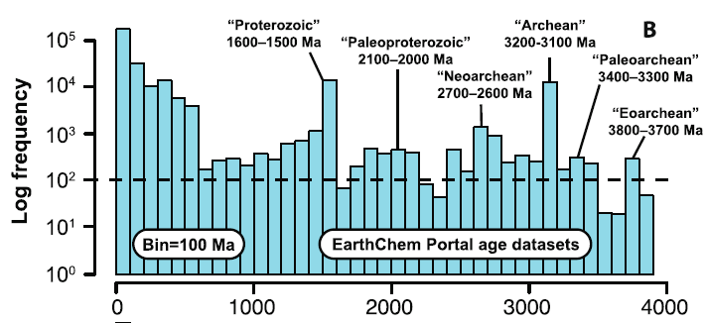
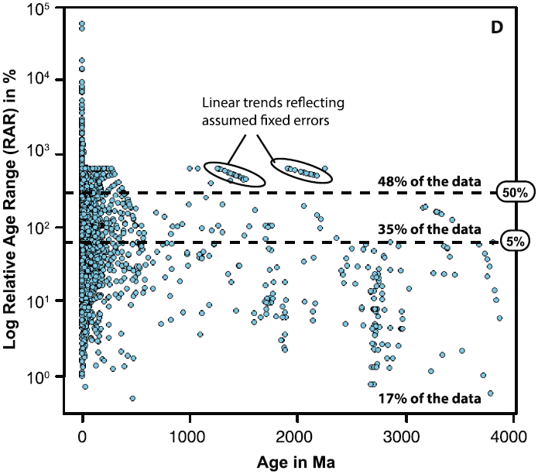
(Doucet et al. 2022 Precambrian Research)

Slide 5
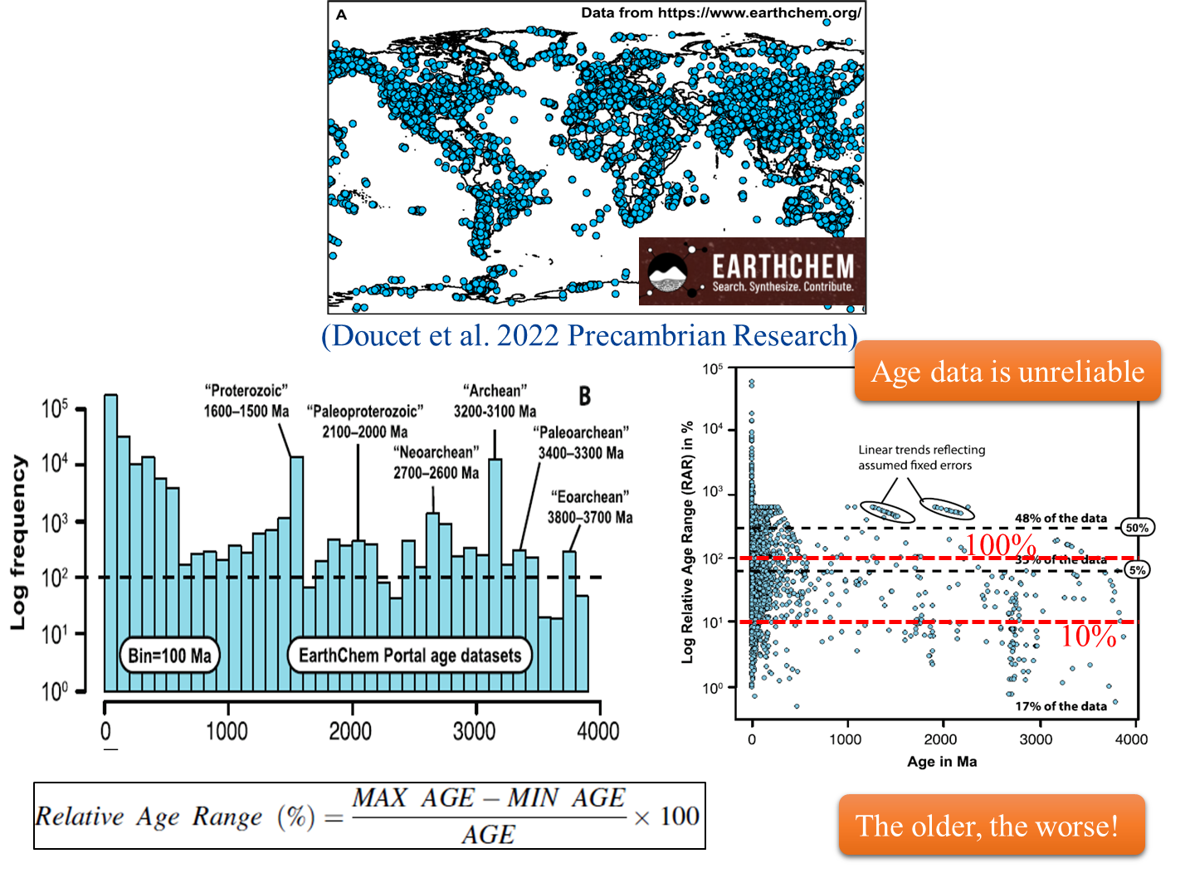

Slide 6
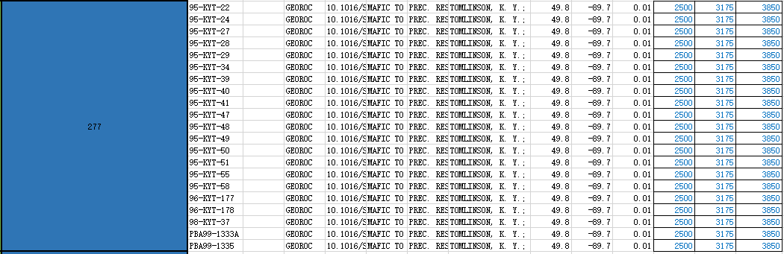
Example 1
Min Age Age Max Age

Slide 7
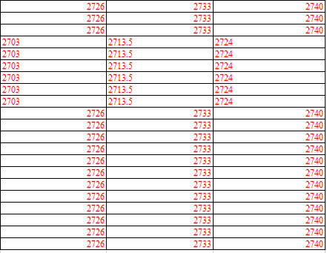
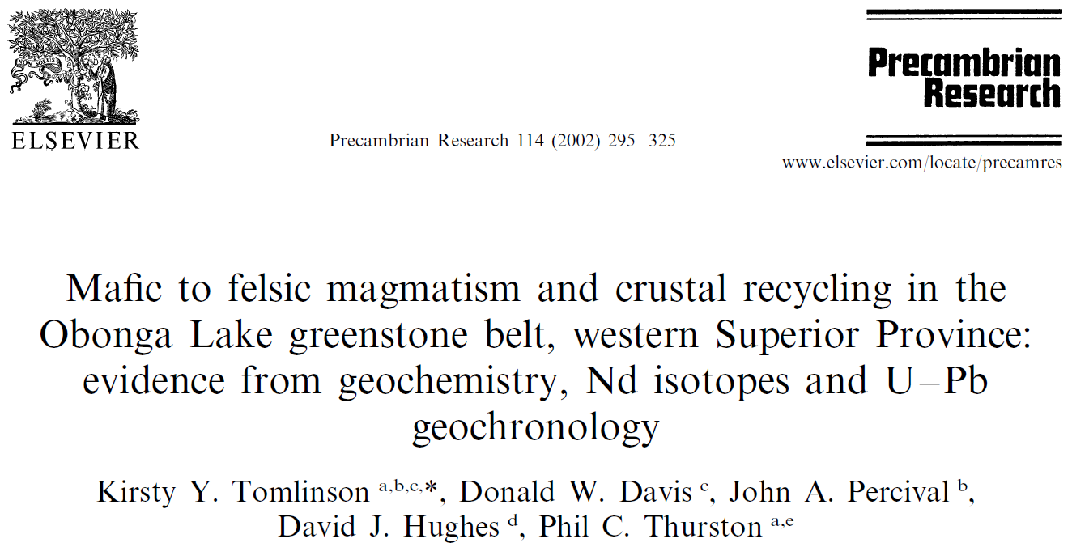
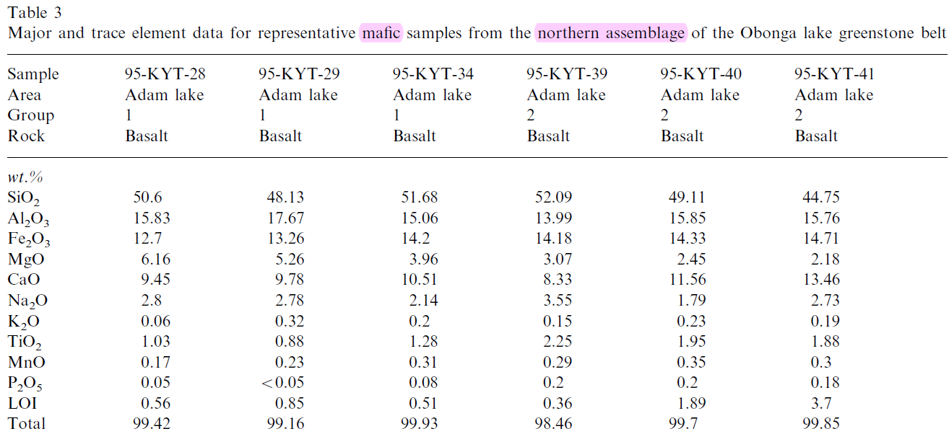
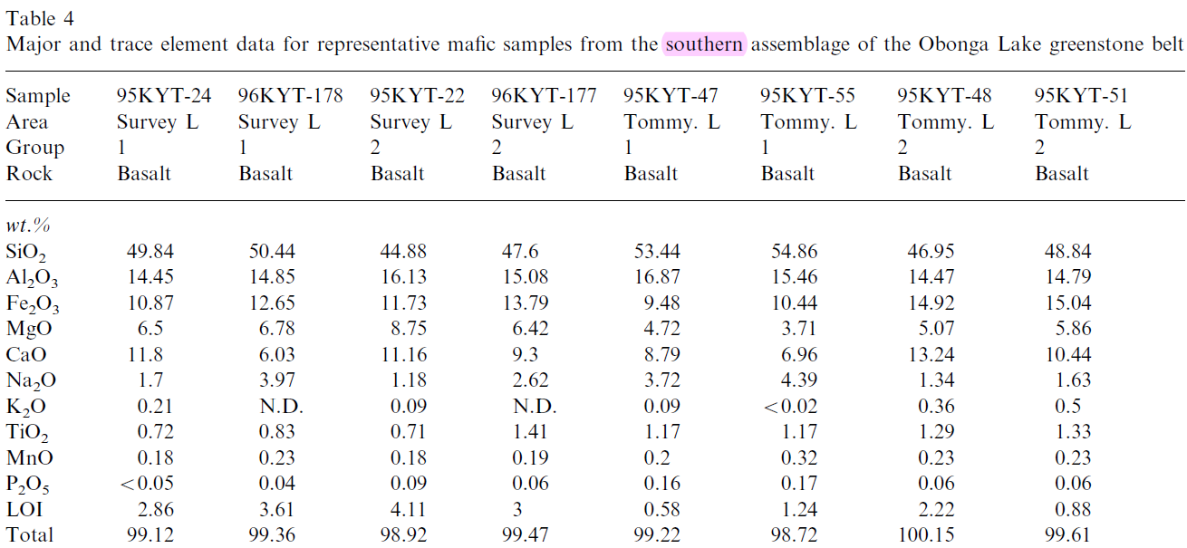
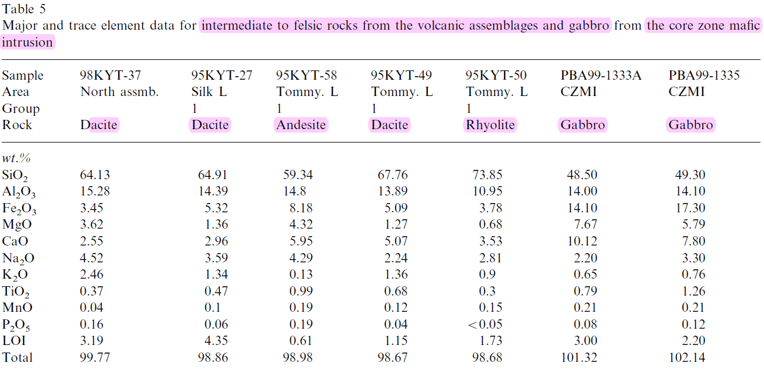
Example 1
Min Age Age Max Age
Min Age Age Max Age
Carefully check

Slide 8
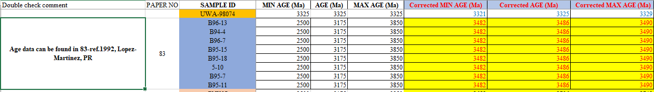
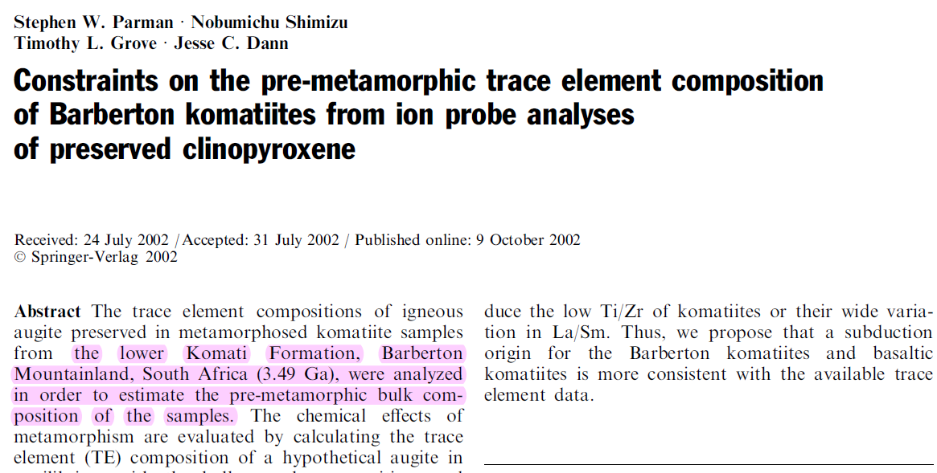
Example 2
Original paper
No exact age!

Slide 9
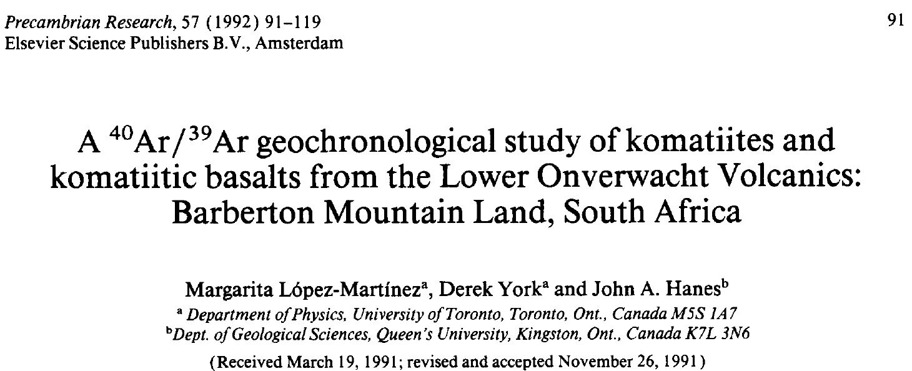
Example 2
Original paper
Reference paper
No exact age!

Slide 10
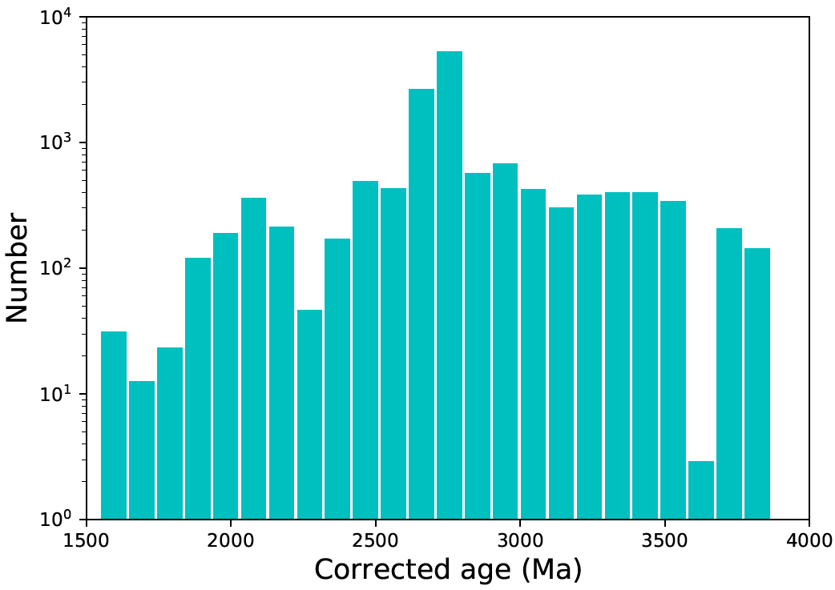
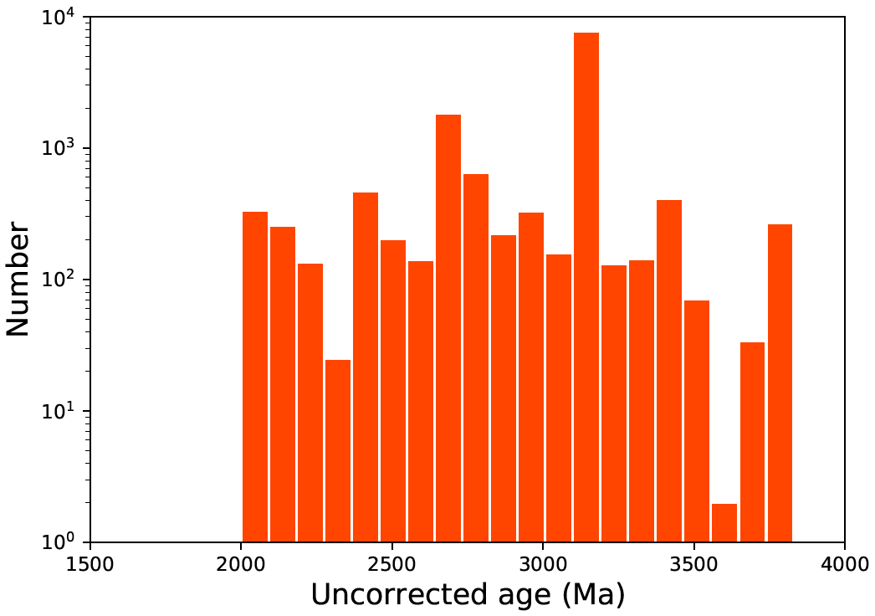
N~14500
3175 Ma
N~13600
(Liu et al., in prep)

Slide 11
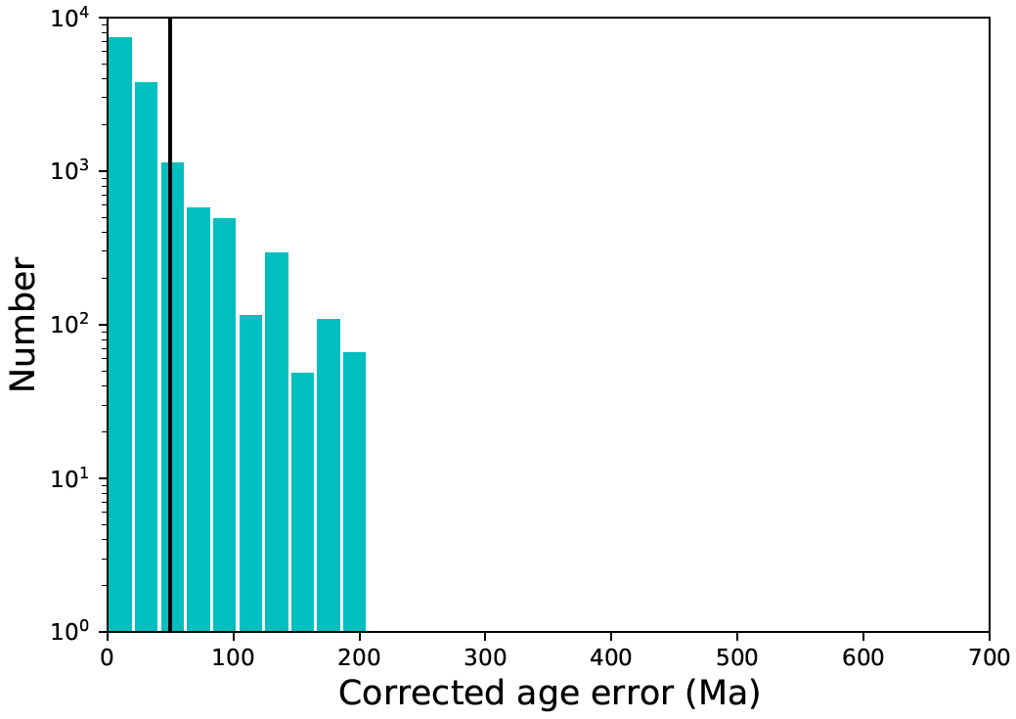
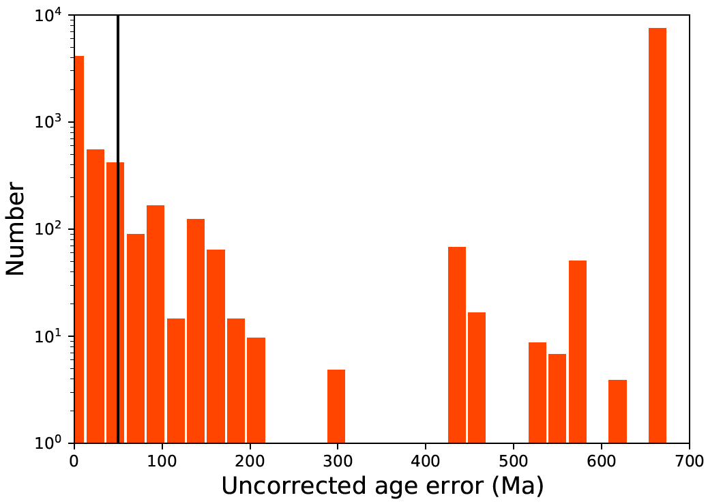
N~14500
<50 Ma, ~81%
2σ
3175 Ma
N~13600
675 Ma
(Liu et al., in prep)

Slide 12
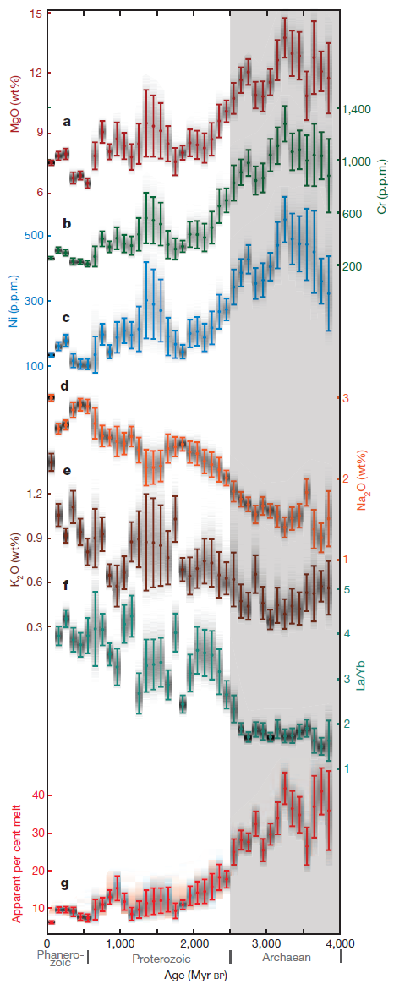
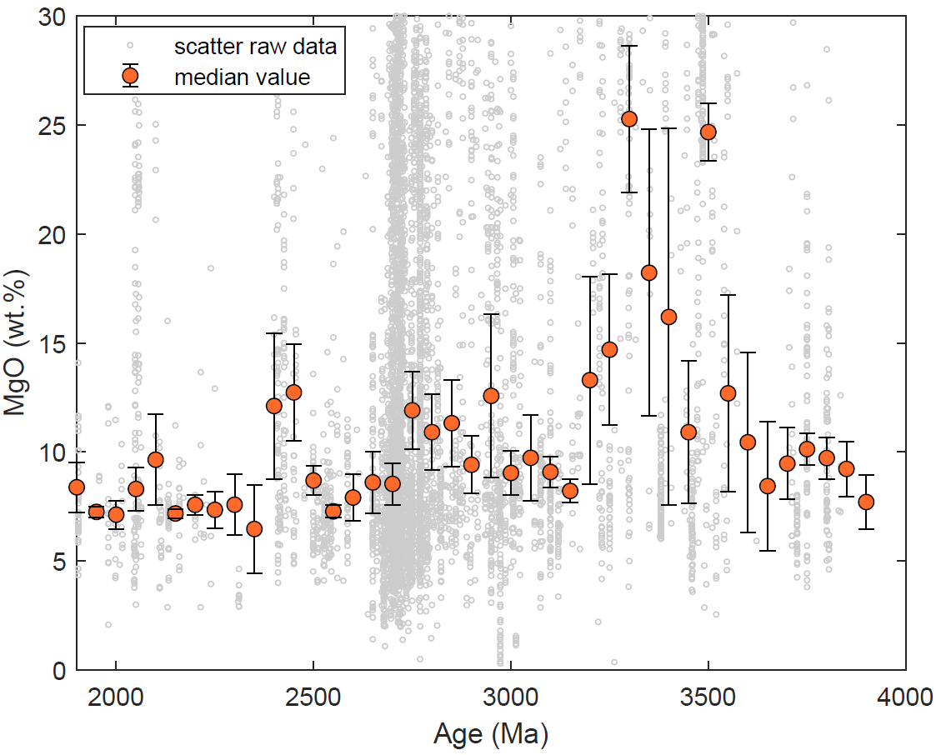
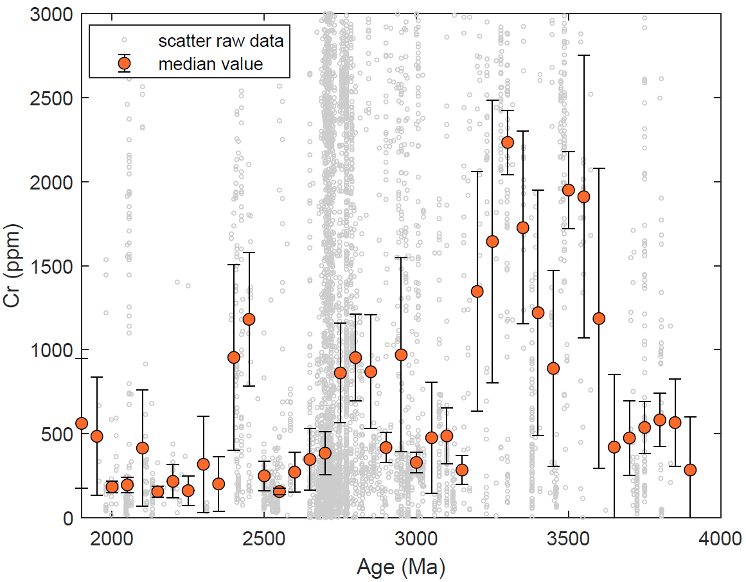
~3.3-3.15
No systematic decrease at~2.5 Ga
~2.7-2.8
2012, Keller & Schoene, Nature
(Liu et al., in prep)

Slide 13
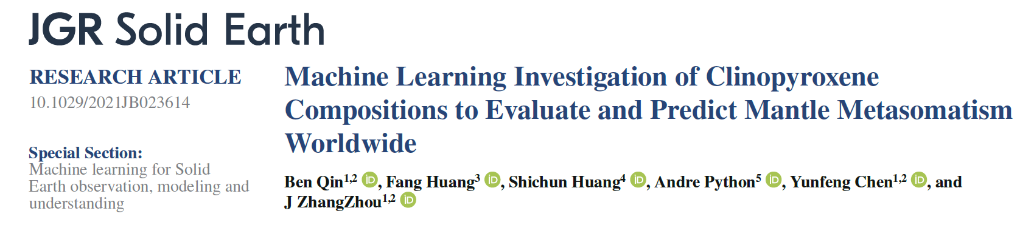
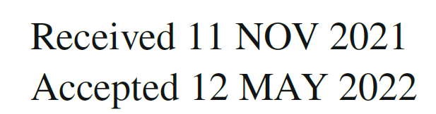
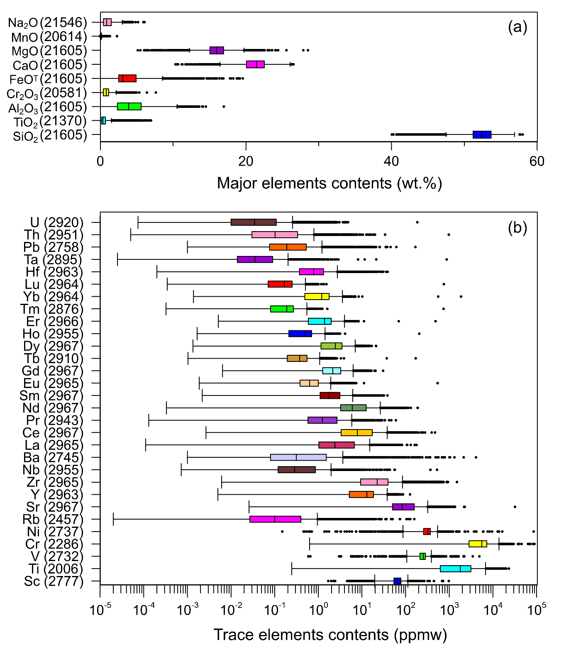

Data cleaning & processing
Downloading…
SiO₂ (WT%)
MgO(WT%)
FeO(WT%)
CaO(WT%)

Slide 14
Correlations
Minerals
Xenolith
Eruptive Rock
Cpx
Opx
Olivine
Spinel
Garnet
Peridotite
Lherzolite
Wehrlite
Harzburgite
Dunite
Pyroxenite
Basalt
Kimberlite

Slide 15
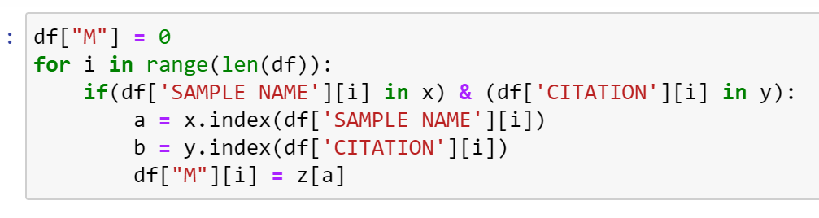
Find Mineral Pairs
Method
Python code:
Garnet- Olivine 2500 pairs
subset=[‘SAMPLE NAME’] / CITATION
Garnet - OPX 2400 pairs
subset=[‘SAMPLE NAME’] / CITATION
Garnet - OPX - Olivine 1800 pairs
subset=[‘SAMPLE NAME’] / CITATION
CPX - Garnet 800 pairs
subset=[‘SAMPLE NAME’] / CITATION

Slide 16
Find Mineral Pairs
Method
Python code:
Garnet- Olivine 2500 pairs
subset=[‘SAMPLE NAME’] / CITATION
Garnet - OPX 2400 pairs
subset=[‘SAMPLE NAME’] / CITATION
Garnet - OPX - Olivine 1800 pairs
subset=[‘SAMPLE NAME’] / CITATION
CPX - Garnet 800 pairs
subset=[‘SAMPLE NAME’] / CITATION
Each mineral > 20, 000 analysis

Slide 17


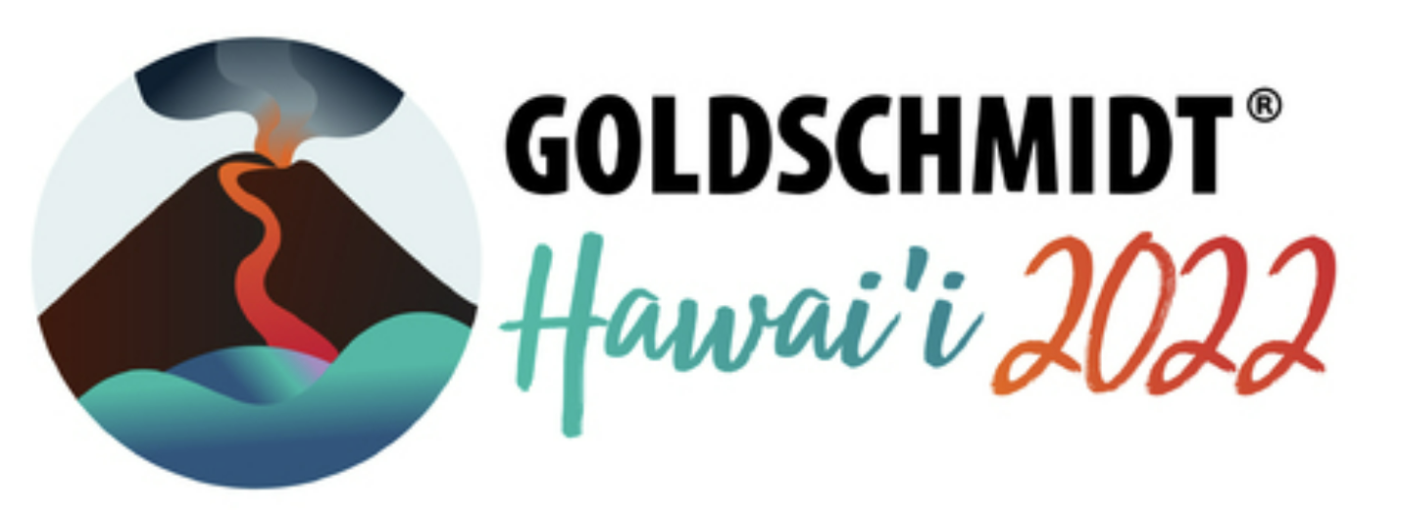
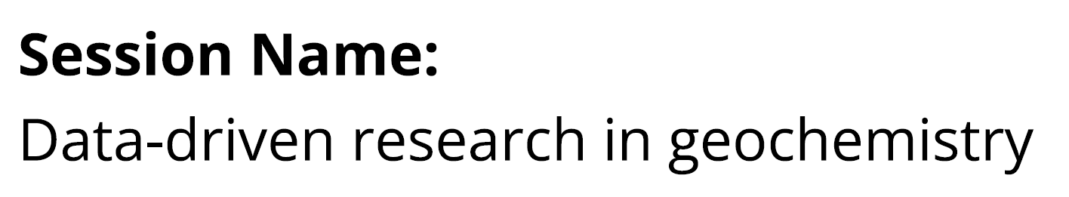
International Data Week 2022 Seoul
Data Science Week 2022 Seoul
Conveners:
ZhangZhou J. (ZJU)
Shuanna Morrison (Carnegie)
Alexander Lipp (ICL)
Tao Wen (Syracuse)
Acknowledgement: ZJU Earth Data Group

