Slide 1


EMI
Distributed Computing
User Survey
Nov 2010 – Feb 2011

Slide 2
The Distributed Computing User Survey 2010 was launched by EMI between November 2010 and February 2011 to capture a snapshot of the current research infrastructure user base
It was sent to user, administrators and developers in more than 60 Research Infrastructures projects and communities
Replies were submitted by 275 people

Slide 3
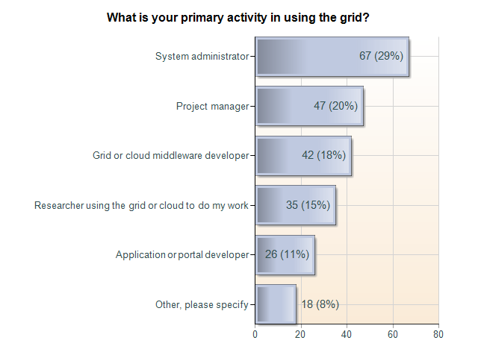

Slide 4
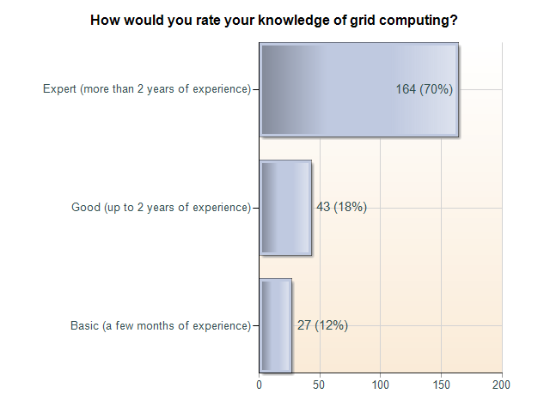

Slide 5
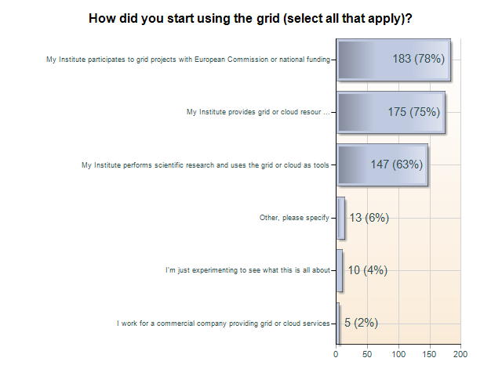

Slide 6
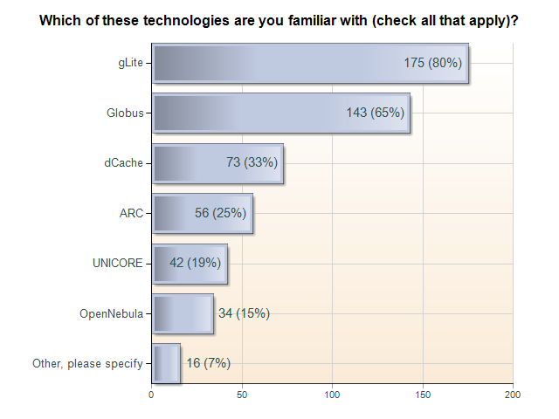

Slide 7
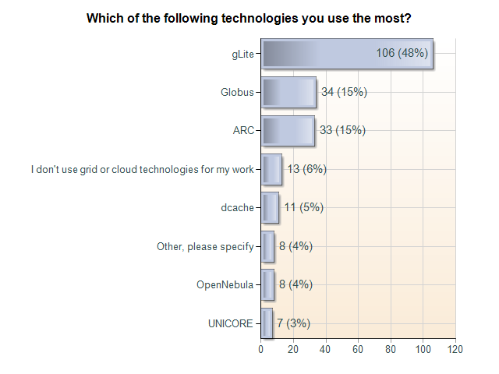

Slide 8
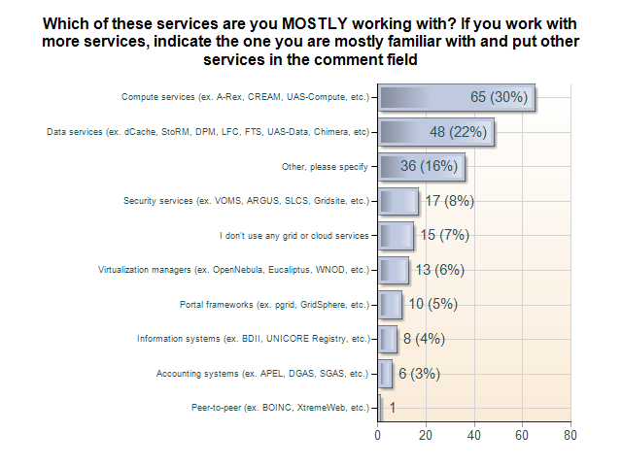

Slide 9
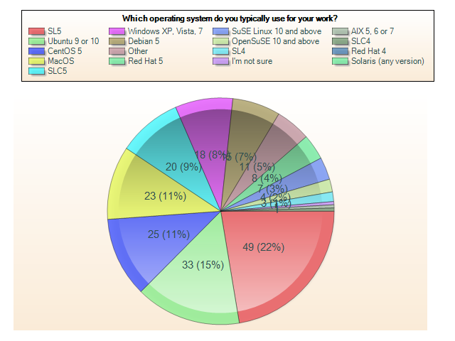

Slide 10
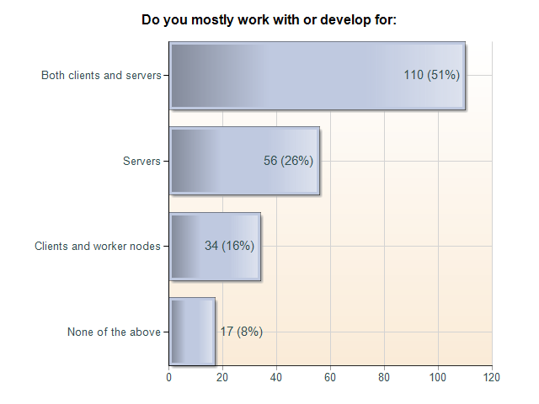

Slide 11
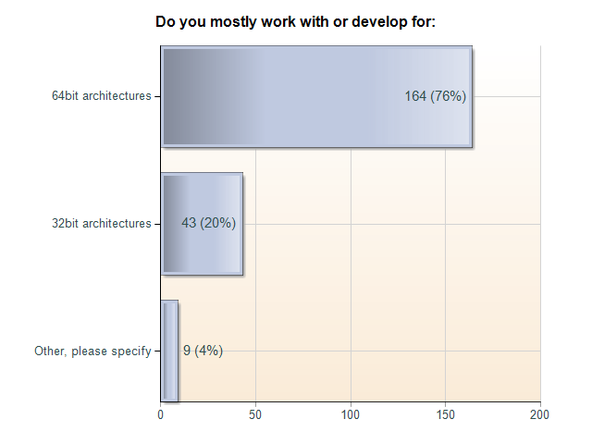

Slide 12
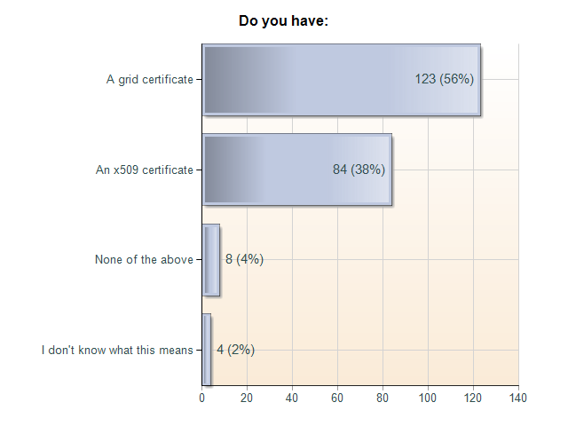
EMI Distributed Computing User Survey: Do you have:

Slide 13
