Slide 1

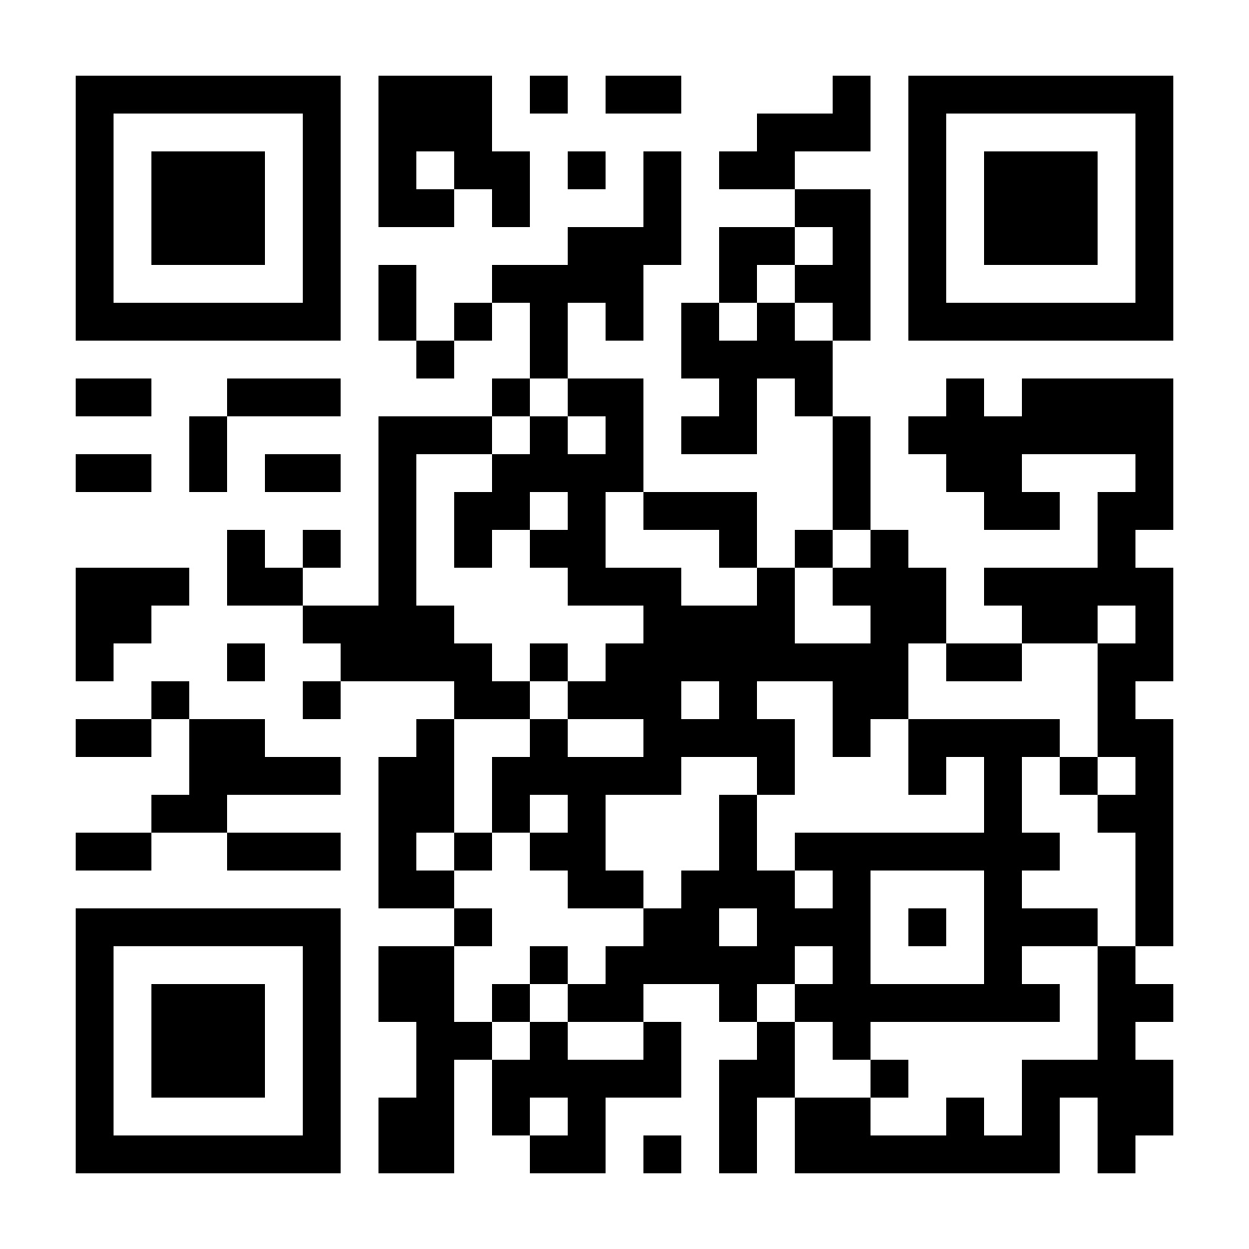
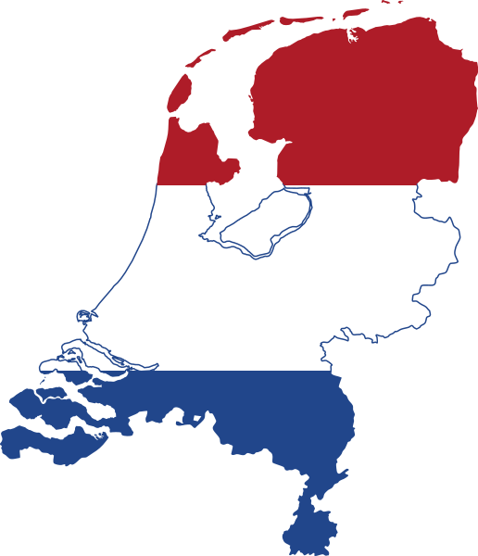
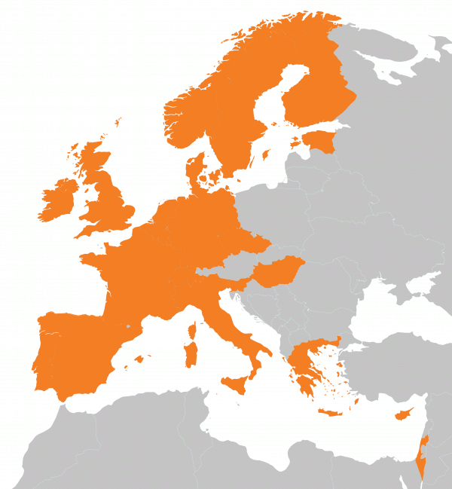








FAIR Data Implementation and Data Stewardship
Capacity Building in the Netherlands
Contributions to the ELIXIR-CONVERGE project
Celia W.G. van Gelder, Mijke Jetten & Rob W.W. Hooft (DTL/ELIXIR-NL)
ELIXIR Netherlands implements FAIR data stewardship in life sciences and health: in the interdisciplinary National Programme Open Science (NPOS), the Thematic Digital Competence Center for Life Sciences & Health (TDCC-LSH), in the national health data infrastructure Health-RI, together with the Netherlands Bioinformatics and Systems Biology community (BioSB). We link our national work to ELIXIR and CONVERGE and the European Open Science Cloud (EOSC).
Networks & people | We facilitate the DTL Data Stewards Interest Group (DSIG) meetings and Slack community (over 650 members), to share experiences and implement data stewardship, originally life sciences oriented but now open to all domains. The Health-RI Data Stewardship Community (DSC) unites health data stewards, not to reinvent the wheel locally. | The ELIXIR-NL community efforts match the CONVERGE WP1 Expert Network activities. WP1 network members participate in the DSIG meetings, thus actively driving knowledge exchange and connecting ELIXIR-NL and CONVERGE activities. ELIXIR-LU and ELIXIR-EE recently co-chaired meetings.
Training | We offer training for researchers and data stewards, e.g., Helis FAIR data stewardship courses, Marie Curie ITNs ProEVLifeCycle and Cosmic, and Covid-19 metadata workshops. We are part of Research Data Netherlands (RDNL), offering training for data stewards, and in Health-RI a training program on FAIR implementation is being developed. | ELIXIR-NL is actively contributing to and bringing in their FAIR data stewardship expertise in the CONVERGE WP2 training and capacity building activities. Examples are the Biohackathon training projects, the FAIR Hackathon to create lesson plans, and the FAIR Train the Trainer efforts.
Competencies | ELIXIR-NL led the development of the 2019 NPOS/ELIXIR Data Stewardship Competency Framework, including three data steward roles (policy, research and infrastructure) and eight competence areas (policy/strategy, compliance, alignment with FAIR data principles, services, infrastructure, knowledge management, network, data archiving and transferable skills). Responsibilities, tasks, KSAs and learning outcomes are provided for each role. In 2021, the framework was extended in the context of NPOS (report).
Tools | Data Stewardship should work for the benefit of a research project, not only for research as a whole. This is embodied in the work ELIXIR-NL does for the Data Stewardship Wizard, where data stewards and researchers can discover the best ways to use available options and services for their projects. | In CONVERGE WP3, we extend the Data Stewardship Wizard knowledge model with expertise from RDMkit writers and link the two resources together to make this information available at the Data Management Planning stage and help choose between (ELIXIR-offered) resources.
Industry | We consider industry partners at similar level to academic partners: in practice industry partners form ~30% of participation in many of our meetings, in providing as well as consuming roles. | In the context of CONVERGE WP4, in 2023, ELIXIR-NL will organise an SME Forum with Health-RI.
Covid-19 | As a national community and training effort, the Health-RI COVID data portal documents over 100 recent granted projects and includes data of the university medical centres. | ELIXIR-NL participates in CONVERGE WP7 (EGA maturity) and WP9 (virus surveillance), although virus surveillance is currently not a role for ELIXIR-NL and data is not published in open databases.
ELIXIR Netherlands is run by the Dutch Techcentre for Life Sciences (DTL), a public-private partnership of more than 50 life science organisations in the Netherlands. The majority of Dutch universities and university medical centres are DTL partners and a growing number of companies are joining the organisation.
Contact: elixir-nl@dtls.nl
Plaatjes om te gebruiken:

