Slide 1



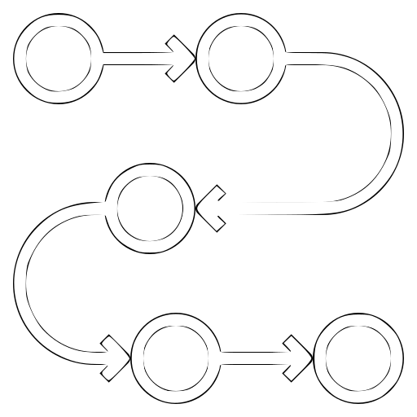


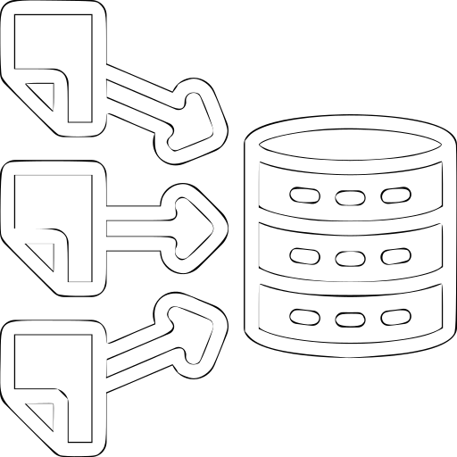



Slide 2

SHARE & REUSE
DESIGN & PLANNING
PROCESSING & ANALYSIS
COLLECT & CREATE

Slide 3

Data
sharing
Project
proposal
Code
sharing
Project
approved
Metadata
sharing
High level
policies
Licenses
Coaching
guidance
SHARE & REUSE
DESIGN & PLANNING
IP & IPR
Resource
planning
Data
preserve
DMP
draft
Version
control
Data
retrieval
PROCESSING & ANALYSIS
Quality
control
COLLECT & CREATE
Data
type
Scripts
algorithms
Provenance
Data
organization
Workflows
Analysis
Ready data
Metadata
standards
Raw data
& Active
Storage
backup

Slide 4
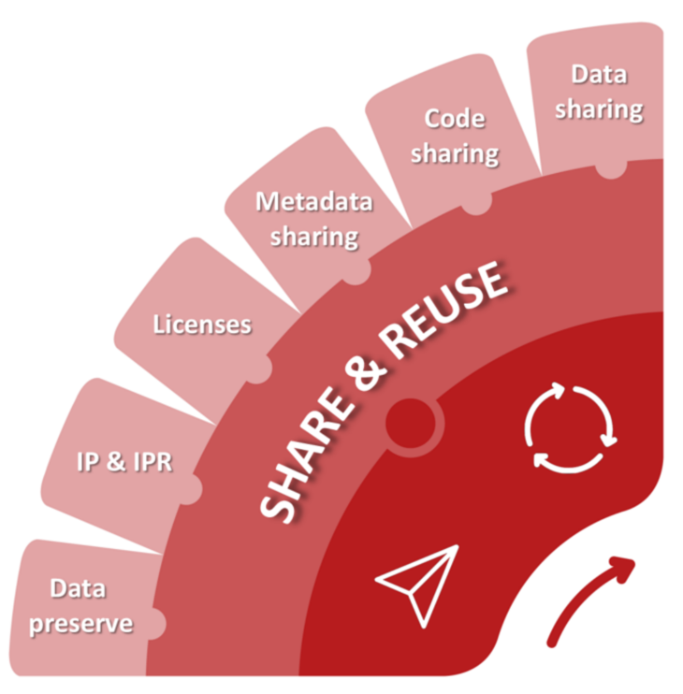
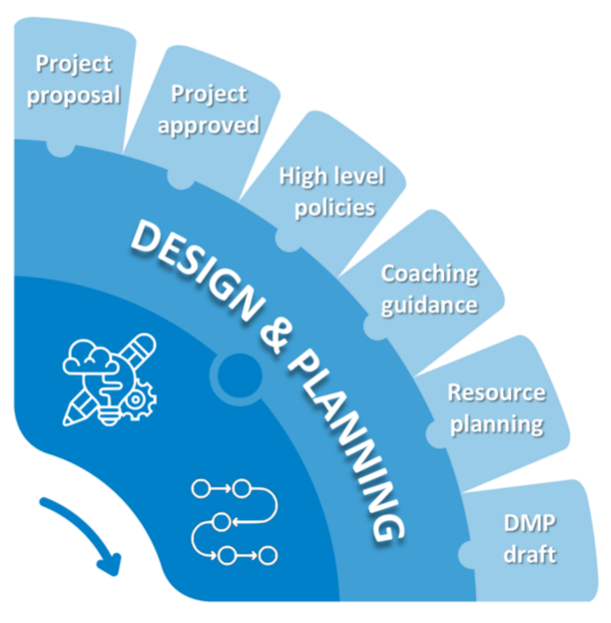
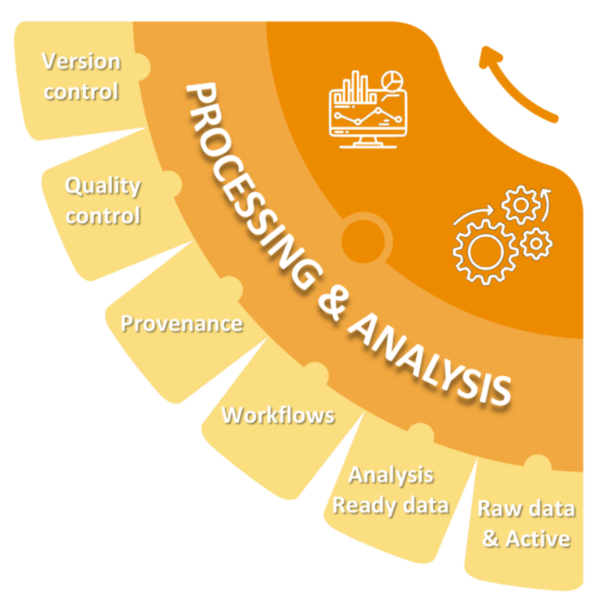
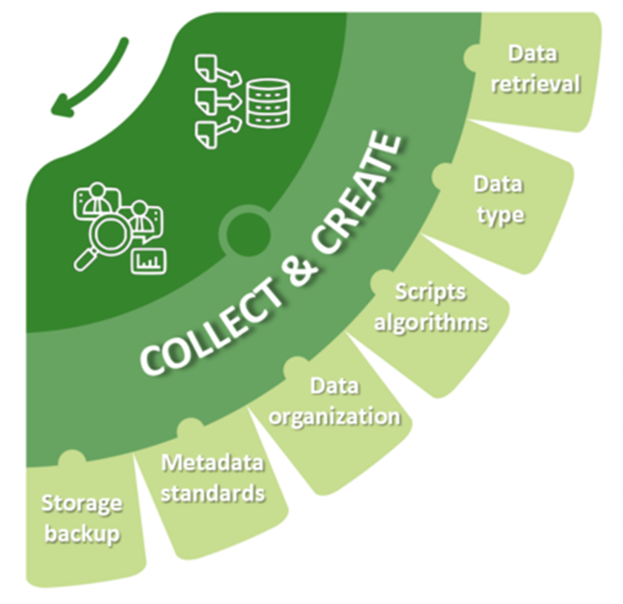

Slide 5


Slide 6













