Slide 1


Why we need FAIRness
University of Pisa - Phd course 2022
Gina Pavone, CNR 0000-0003-0087-2151
Day 2 - 6 June 2022
10.5281/zenodo.6597239

Slide 2
FAIR data and DMP
COURSE OUTLINE
May 30, 2022
June 8, 2022
All about FAIR!
What FAIR principles are and their value for research
Data Management Plan:
what it is, how to do it, some examples; hands on!
Mod. 2
Mod. 1
Mod. 3
June 6, 2022
Why we need fairness;
some examples;
Hands on!

Slide 3
Today’s agenda
University of Pisa
PhD students
FAIR
Why FAIR
Reuse
Exercise
Purpose, object and contents
Why it is important to manage research products following FAIR principles
The opportunities created by fostering reuse
Openness and FAIRness, access rights, licences, copyright
Recap
Why
How
Hands on!

Slide 4
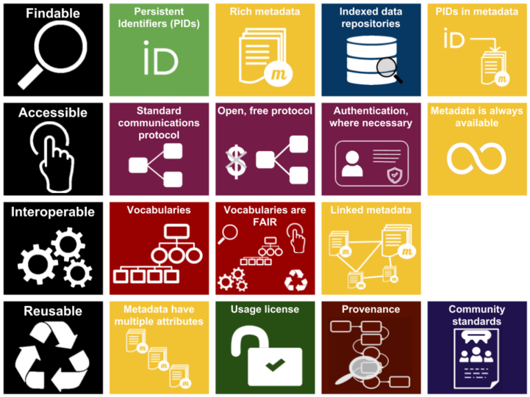
A quick recap
FAIR data infographic (CC-BY except F.A.I.R logos CC-BY-SA by Sangya Pundir

Slide 5

Accessible doesn’t mean Open

Slide 6

Software sharing: PIDs are still needed
https://guides.github.com/activities/citable-code/

Slide 7
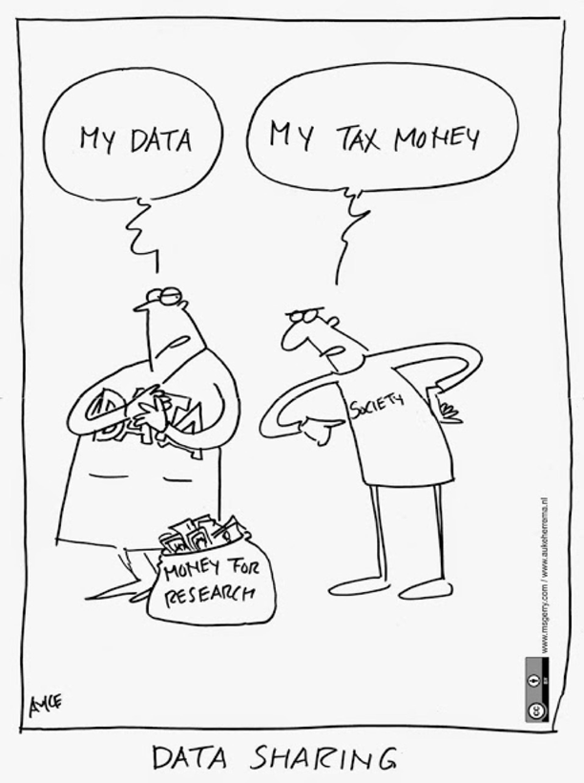




Data are not yours
Data is not intellectual work, it is fact and information
Copyright protection covers expressions and not ideas, procedures, operating methods or mathematical concepts as such.
Protection is on databases and not on data. Data are protected only and especially when they are collected and organized in a database.
The sui generis property right (only in Europe) covers not only the reproduction and dissemination of the database, but also the extraction and reuse of substantial parts of the database.

Slide 8
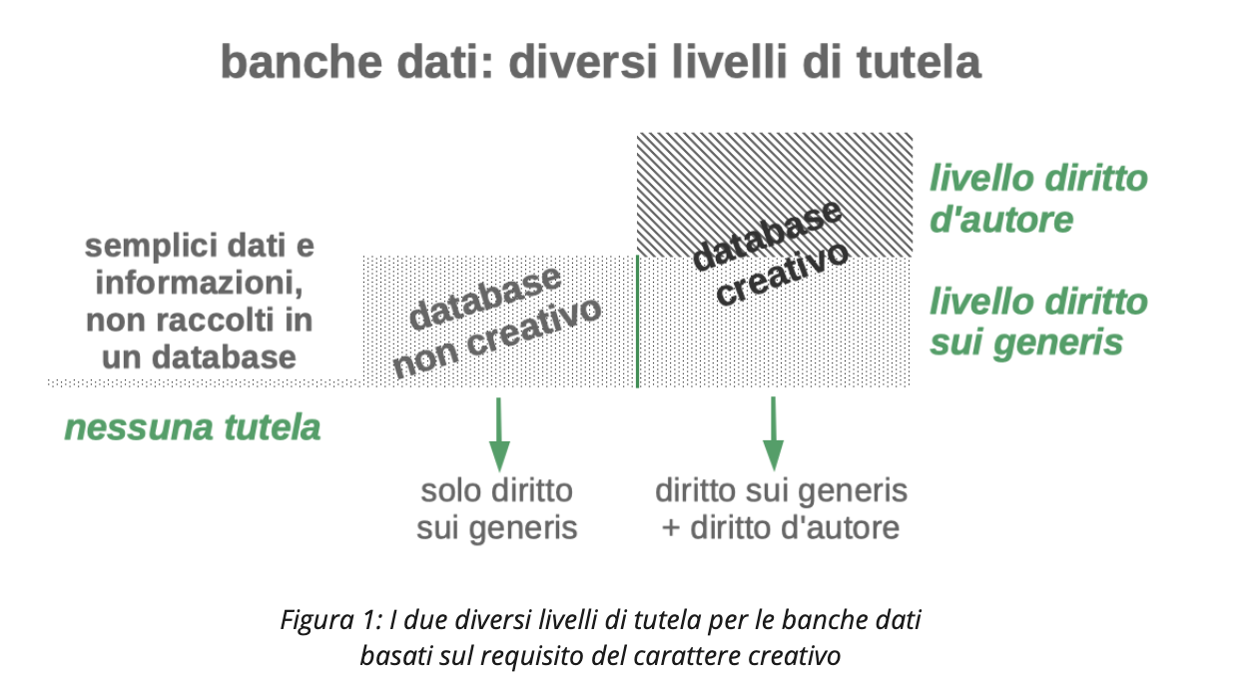
A valid resource (in Italian)
Aliprandi, Simone. (2022). Aspetti legali degli open data: la guida definitiva (1.0 (maggio 2022)). Zenodo. https://doi.org/10.5281/zenodo.6575822

Slide 9

Licenses
Tell other what they can do with your data

Slide 10
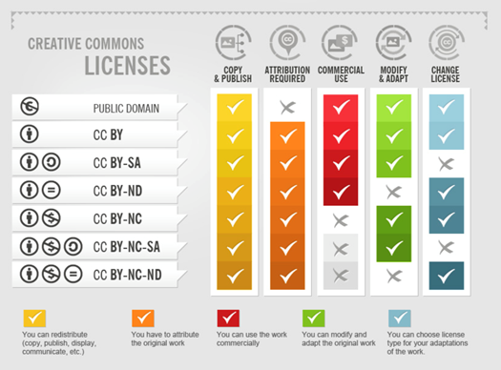
Creative Commons
Not all of us are legal experts capable of writing proper licenses.
Creative Commons and Public Domain create legal certainty for everyone, who wants to use works, that are licensed respectively.
It is important to follow and understand the different meanings of the licenses and follow the rules for using them.
CC-Infographic by Foter under CC-BY-SA 3.0 license.

Slide 11
Why FAIR
Making your research data Findable, Accessible, Interoperable and Reusable could:
Help peers and your future-self understand the research project and data
Facilitate data sharing and collaborations
Increase the visibility of research and can lead to more citations
Improve the transparency, reliability and reproducibility of research
Prevent data loss
And thereby:
Maximise potential from data assets
Maximise research impact
https://www.howtofair.dk/why-fair/
Notes:
DA AGGIUSTARE

Slide 12

Not only publications
Science is also:
data
software
protocols
negative results
lab notes
project deliverable
and much more…
Photo by Kilimanjaro STUDIOz on Unsplash
Notes:
There are many many parts of the scientific work which are not actually being evaluated

Slide 13
26 billion €
are going lost every year in Europe for not managing the data properly
Directorate-General for Research and Innovation (European Commission), PwC EU Services Cost of not having FAIR research data, 2019-01-16

Slide 14
“Publishing research without data is simply advertising, not science” Graham Steel Graham Steel
Graham Steel

Slide 15
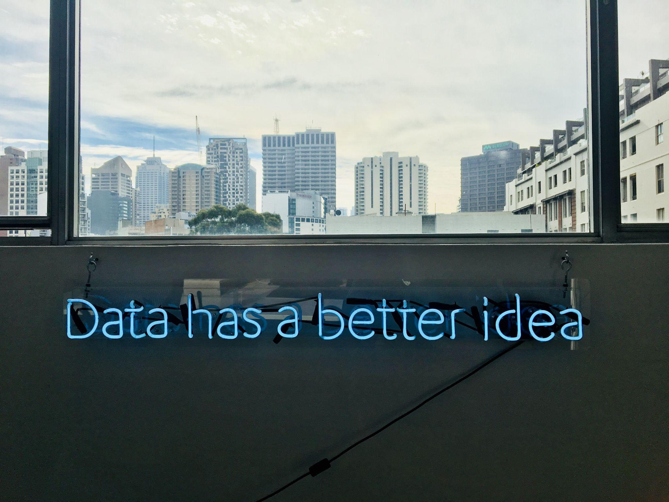
What happens if...
We do not manage and share research data in the correct way?

Slide 16
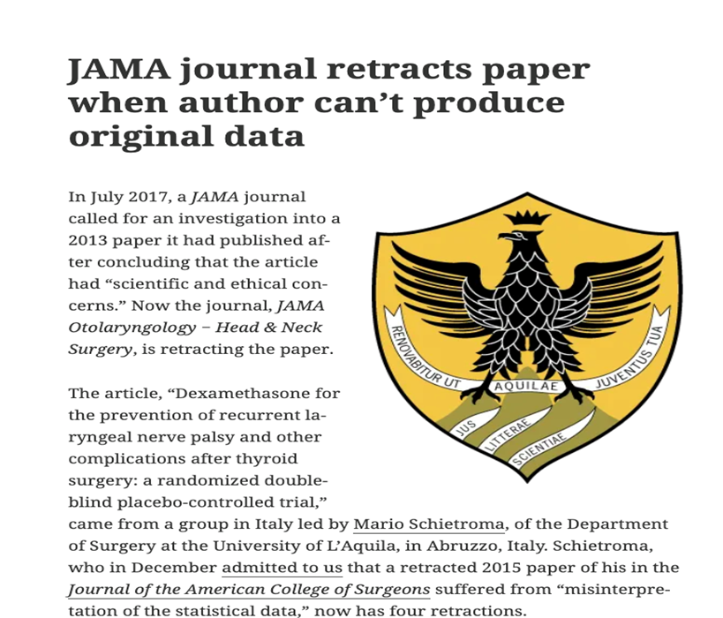
Data can be lost...
Neither [the original dataset and the approved protocol] have been provided by Dr Schietroma, and the university has informed us that “without those pieces of information the results of the papers under investigation cannot be validated.”
https://retractionwatch.com/2018/10/25/jama-journal-retracts-paper-when-author-cant-produce-original-data/

Slide 17
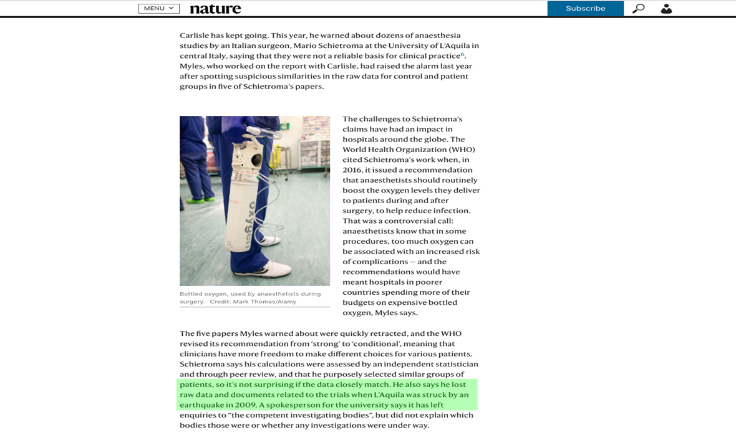
The importance of depositing research data
https://www.nature.com/articles/d41586-019-02241-z

Slide 18
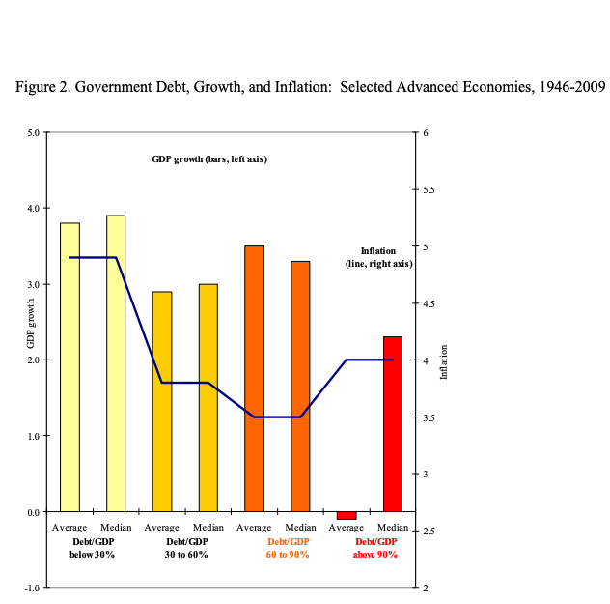
Errors can get undetected
The case with austerity theory.
The thesis: economic growth slows down dramatically when the size of a country's debt exceeds 90% of gross domestic product.
The results shown in the paper were used to support public austerity policies during the recent economic crisis.
But some considerations were based on wrong calculations.
This was discovered by a student who could not replicate the results and asked the authors for the original dataset.
Notes:
This was discovered by a student who could not replicate the results and asked the authors for the original dataset.

Slide 19
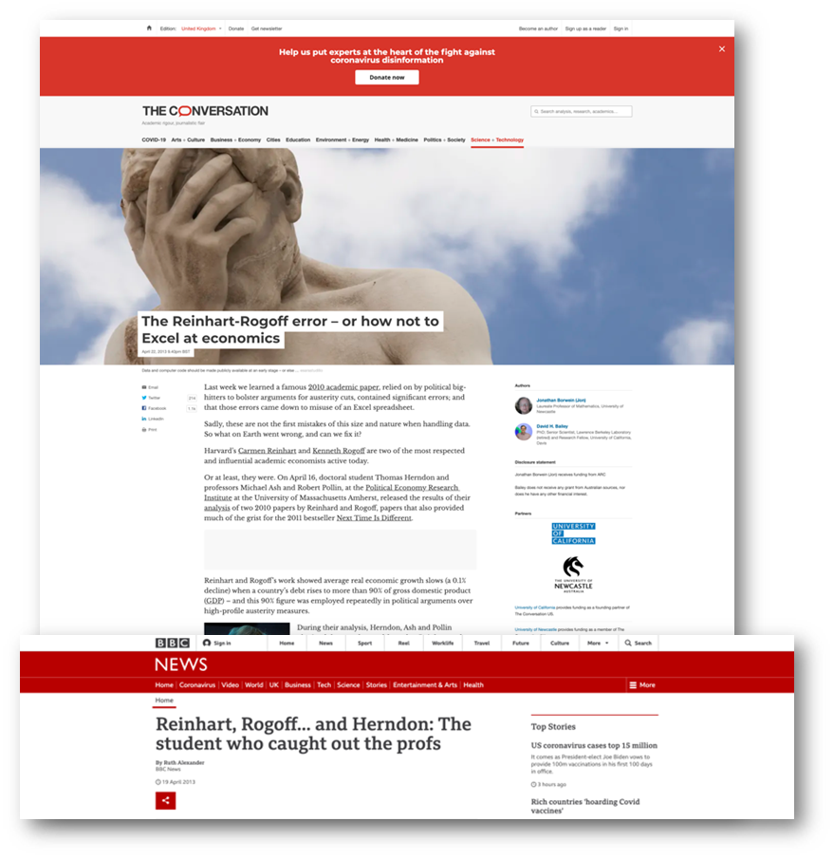
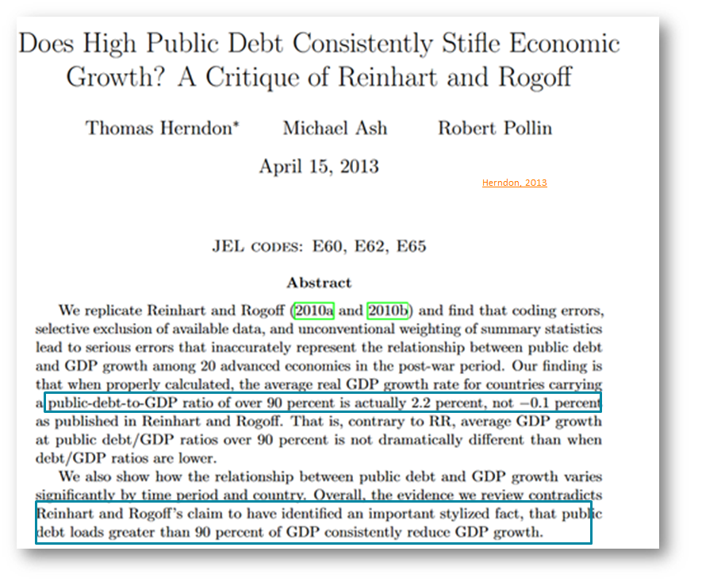
Errors and miscalculations

Slide 20
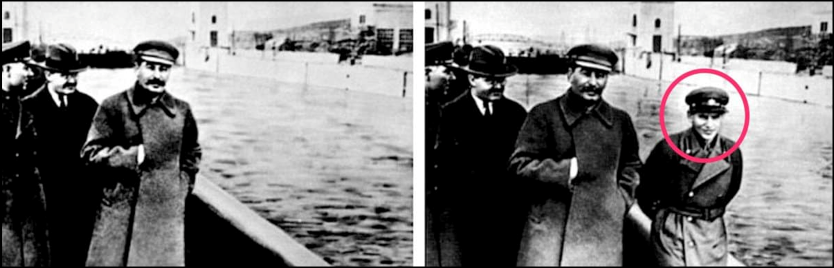
Data can be manipulated
Nikolai Ivanovich Yezhov was a Soviet secret police official under Joseph Stalin who was head of the NKVD from 1936 to 1938, during the height of the Great Purge. After he fell from Stalin's favour he was executed. Among art historians, he also has the nickname "The Vanishing Commissar" because after his execution, his likeness was retouched out of an official press photo; he is among the best-known examples of the Soviet press making someone who had fallen out of favour "disappear".
The Newseum (1 September 1999). “The Commissar Vanishes" in The Vanishing Commissar”.
Archived from the original on 8 February 2007.
https://en.wikipedia.org/wiki/Nikolay_Yezhov

Slide 21
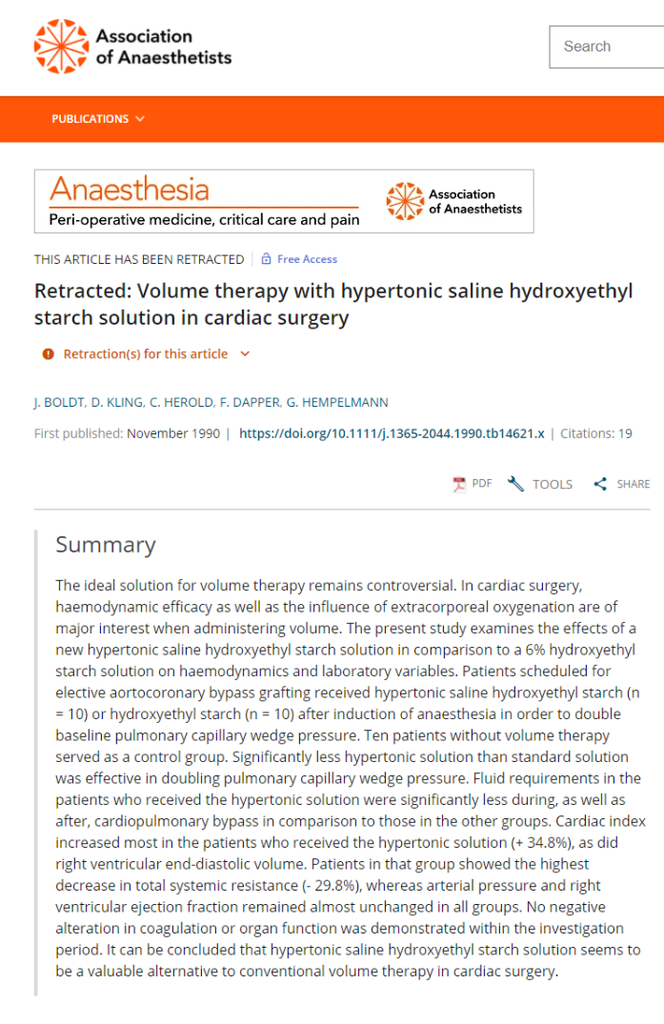
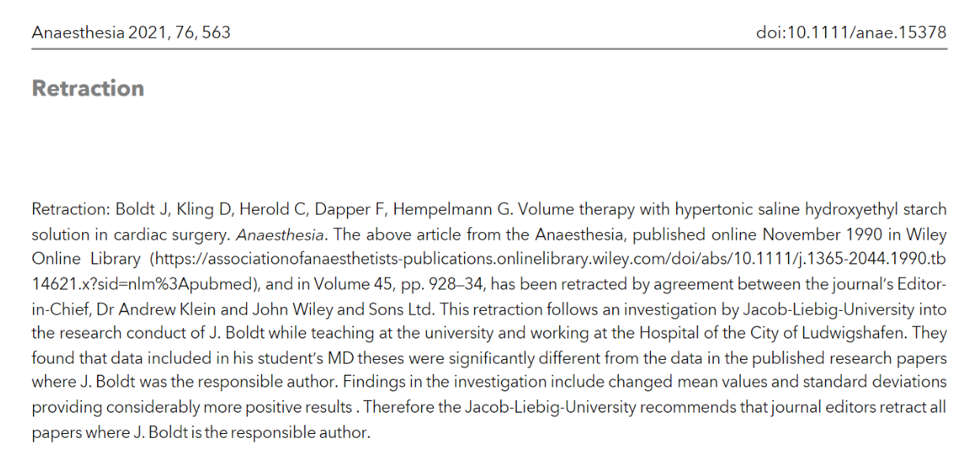
Data can be manipulated
Largely used drug in surgery due to evidence in scientific papers.
An investigation by Jacob-Liebig-University into the research conduct of J. Boldt.
They found that data included in his student’s MD theses were significantly different from the data in the published research papers where J. Boldt was the responsible author
Findings in the investigation include changed mean values and standard deviations providing considerably more positive results
Notes:
This was discovered by a student who could not replicate the results and asked the authors for the original dataset.

Slide 22
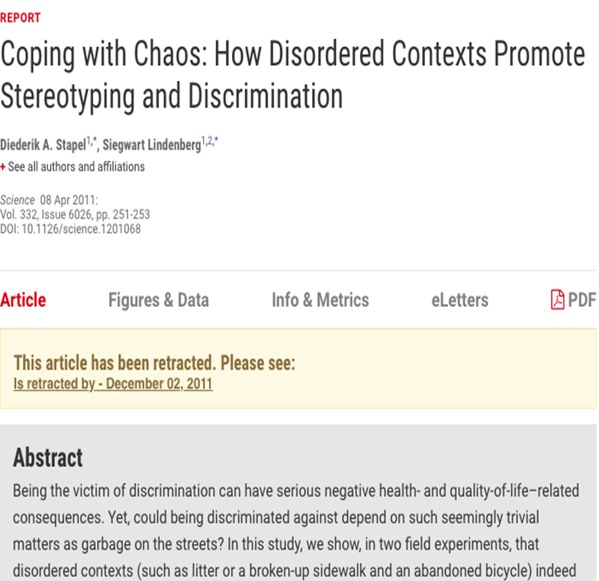
Data can be invented
58 articles published by Diederik Stapel were withdrawn because they were based on invented data.
His papers had been published in scientific journals considered prestigious (very high IFs!).
Following reports from three doctoral students, the Dutch university for which he worked had started an investigation. Stapel then admitted that he had fabricated the data on numerous occasions.
If he had shared his data before, he probably wouldn't have been able to fabricate fakes for so long.
This case led the Netherlands become one of the pioneer countries in Open Science policy and practices
http://www.insidehighered.com/news/2011/11/28/scholars-analyze-case-massive-research-fraud
Notes:
This was discovered by a student who could not replicate the results and asked the authors for the original dataset.

Slide 23
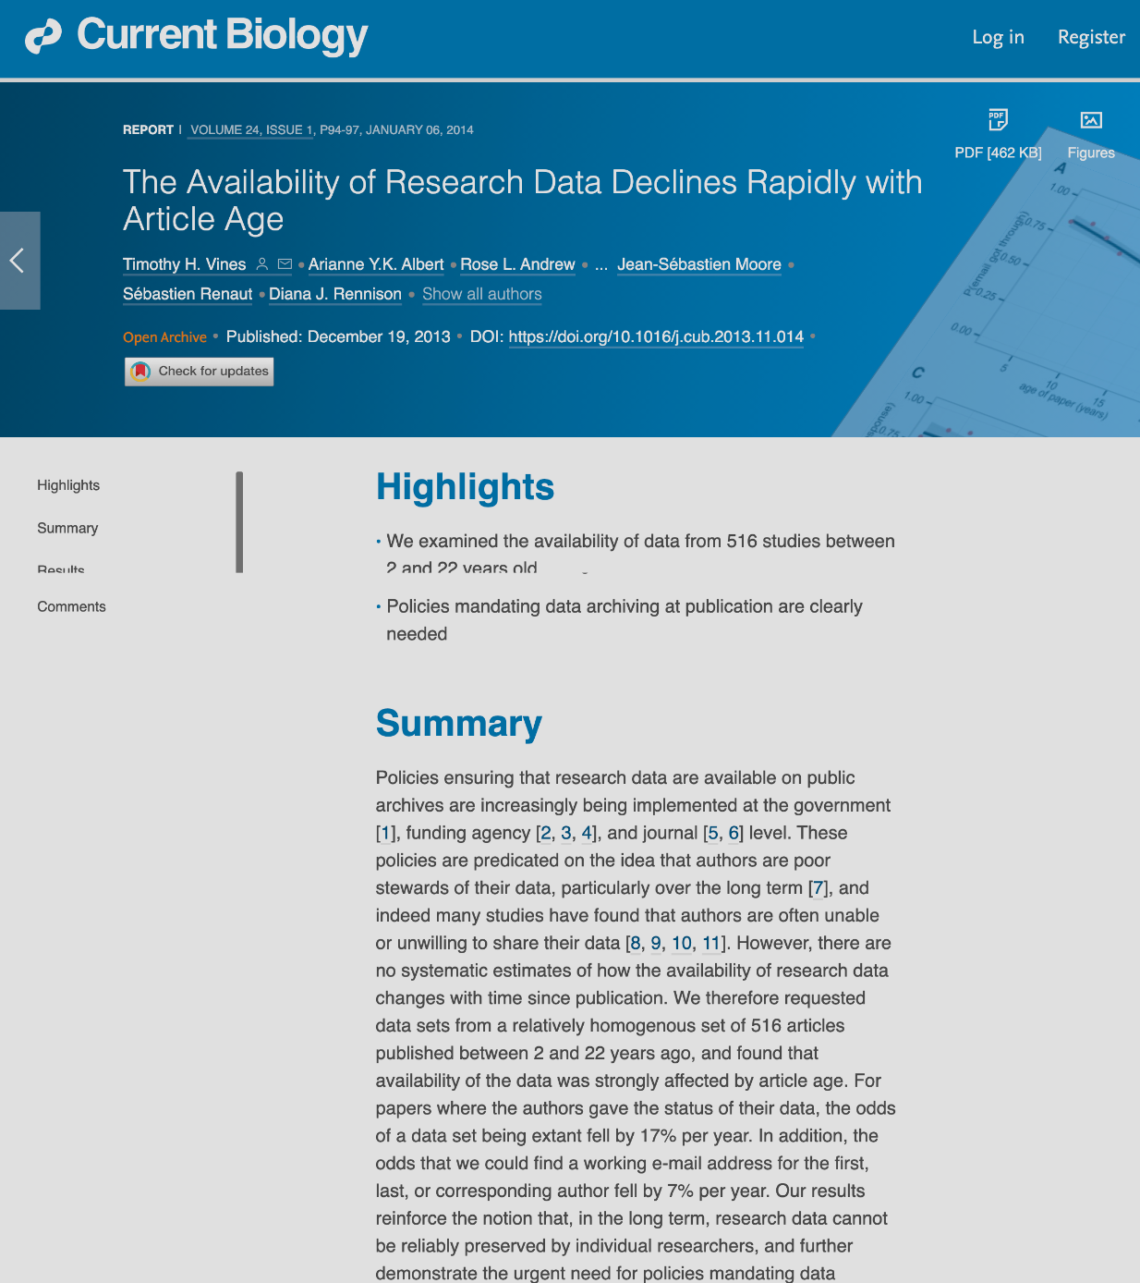
Reproducibility crisis
80% of data are unavailable after 20 years
In their parents' attic, in boxes in the garage, or stored on now-defunct floppy disks — these are just some of the inaccessible places in which scientists have admitted to keeping their old research data.
Such practices mean that data are being lost to science at a rapid rate.
https://www.cell.com/current-biology/fulltext/S0960-9822(13)01400-0
https://www.nature.com/articles/nature.2013.14416

Slide 24
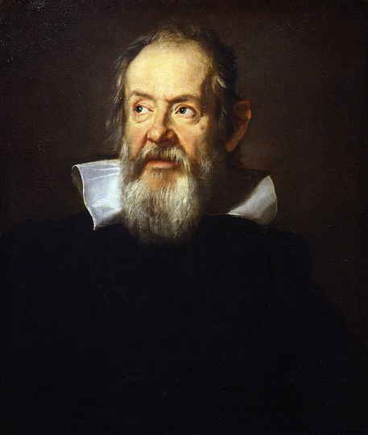
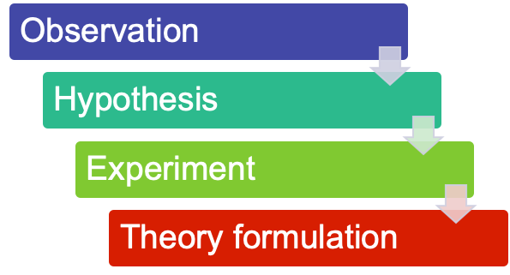
The scientific method: data is key
Portrait of Galileo Galilei by Justus Sustermans (Galleria degli Uffizi, Firenze), public domain

Slide 25

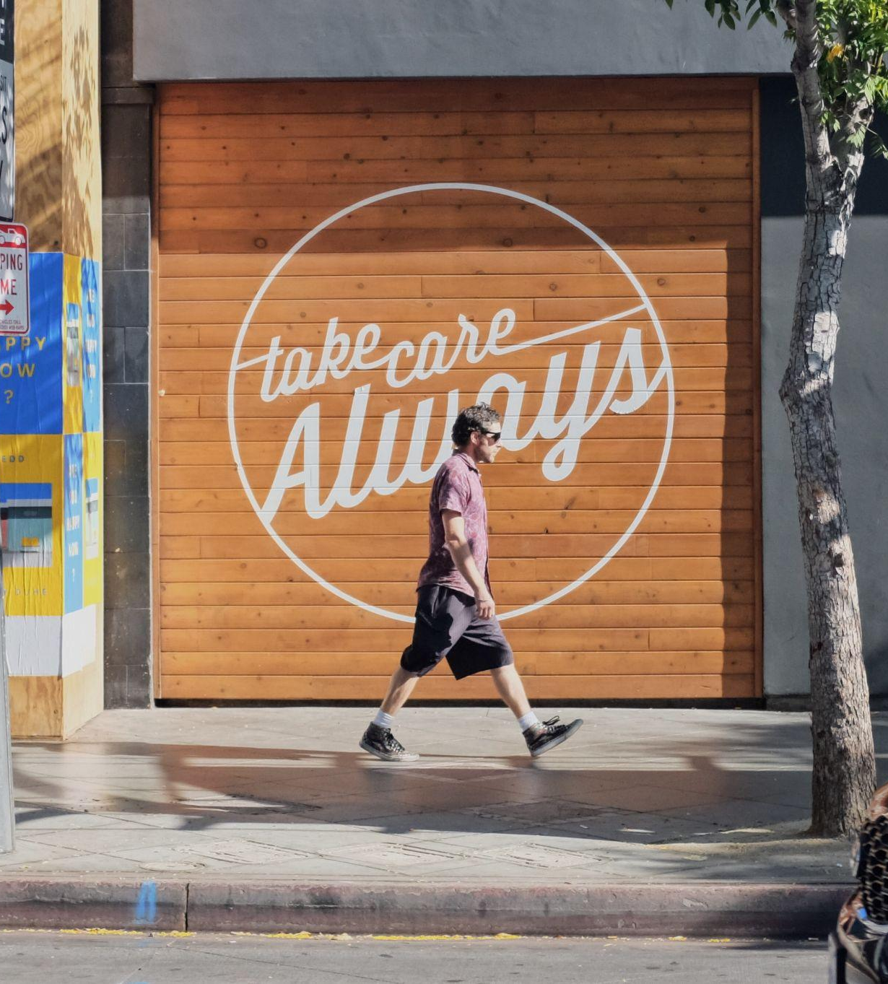





Why should you care?
If you manage it, you probably will not lose it
Organising your data will make your work more efficient
Some data is unique and not reproducible (meteorology, observation from the field) so you should take care of it
By correctly managing your data, you can improve research integrity
By managing your data, you enable validation and control
Someone else could use it in the future to advance scientific progress
Photo by Miguel Perales on Unsplash

Slide 26





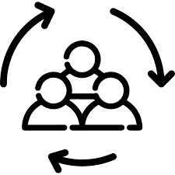
Why to share data - part 1
Avoid duplication of efforts
Reproducibility
For Science
New uses
(currently unknown)
Innovation processes
Control by the
scientific community, re-analysis, etc.
cross-disciplinary approaches
Re-interpretations
Notes:
DA TRADURRE

Slide 27




Why to share data - part 2
Publish a
data paper
To comply with mandates
For your own research
More citations
More visibility and impact
Notes:
DA TRADURRE

Slide 28
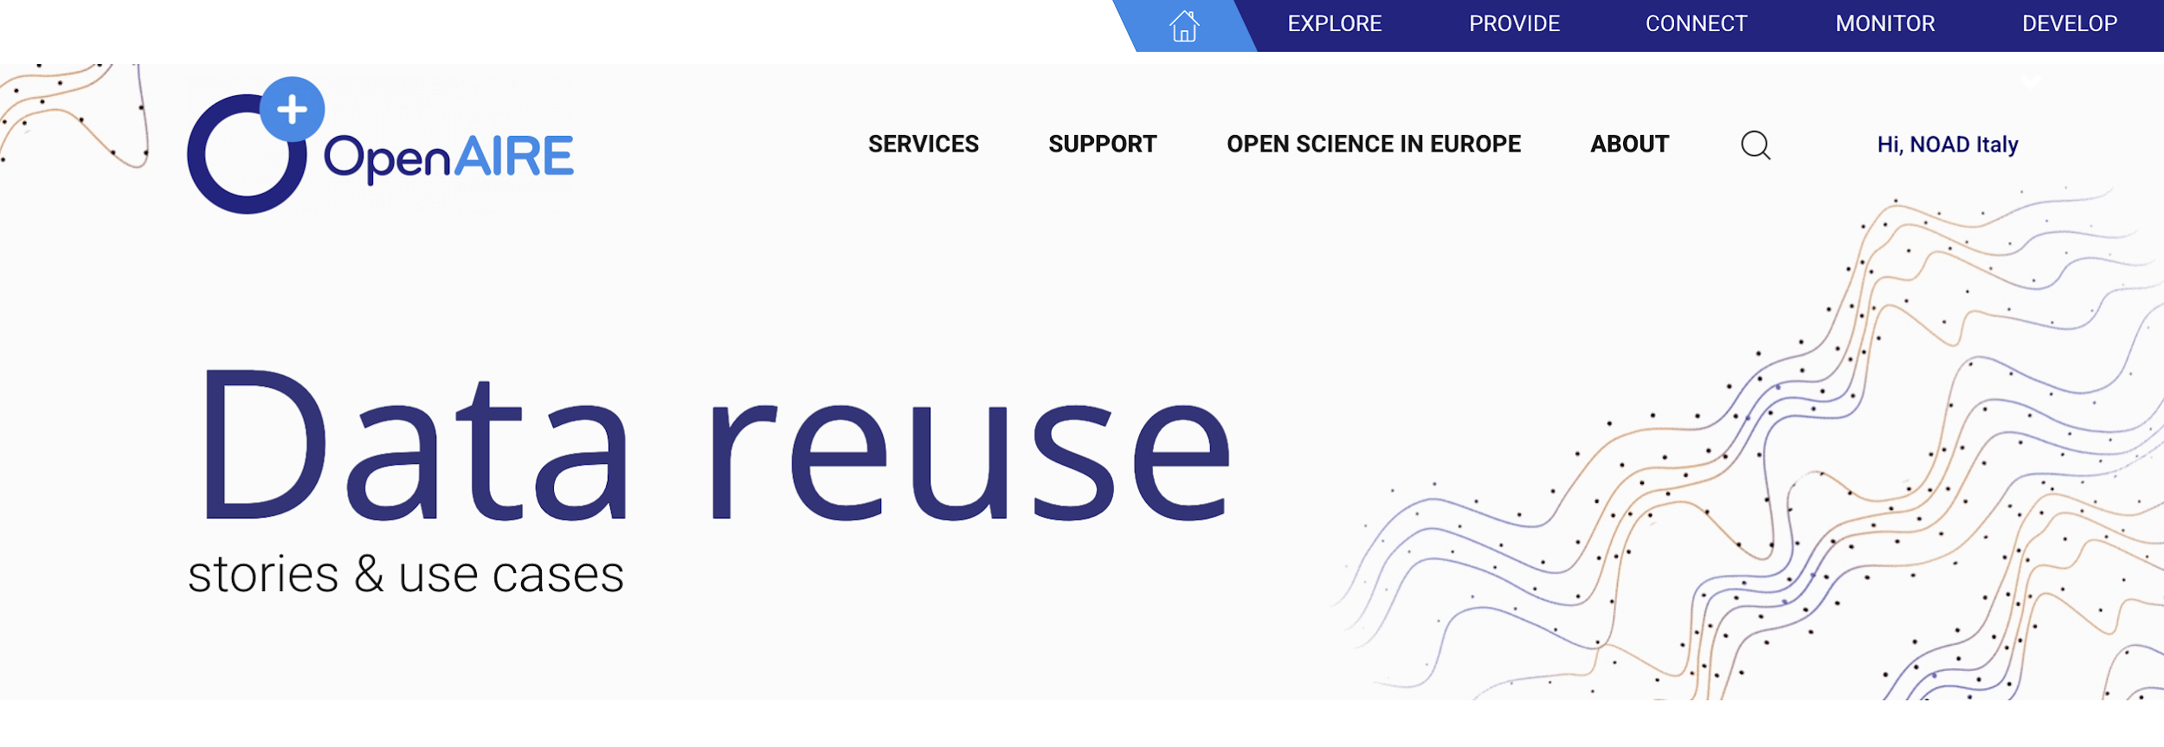
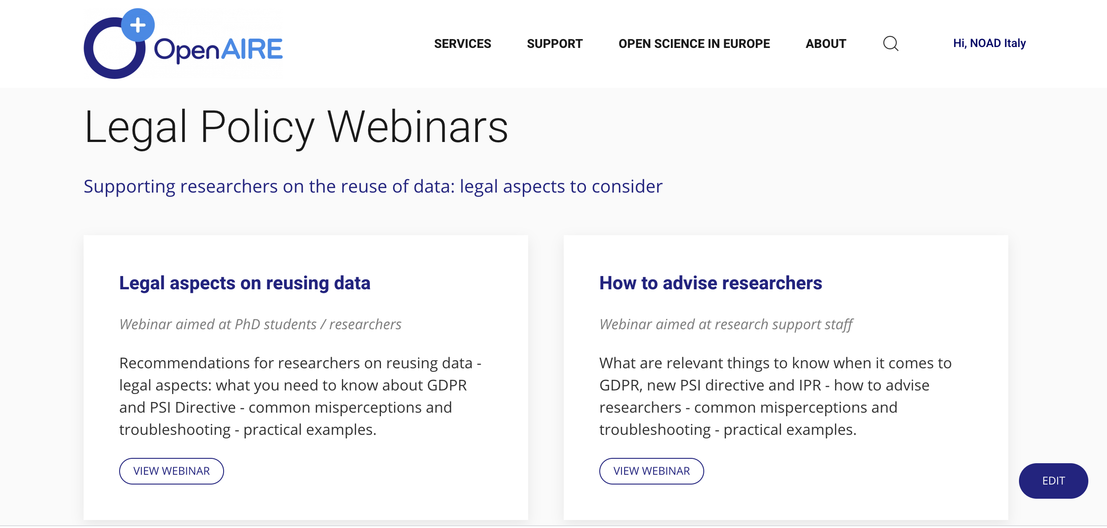
https://www.openaire.eu/data-reuse-use-cases

Slide 29





FishBase
Raw data released with a cc by-nc licence
(consortium 1)
A third consortium produces AquaMap
Institution two processes the data
2527 bibliographical citation
Report on fishing stocks discussed at the European Parliament
1 - Data reuse examples

Slide 30



Data from Marine floats (Argo)
Standardization process
Database: data released in CC-BY
Original raw data produced by Argo floats. Data are released with an open license (CC-0) on the institutional repository without any kind of processing.
The dataset is released with an open license (CC-BY) on the institutional repository and it is suggested to mention Institution 1 and Institution 2 in case of reuse.
A standardization process was necessary and then a new dataset was produced.
2 - Data reuse examples

Slide 31
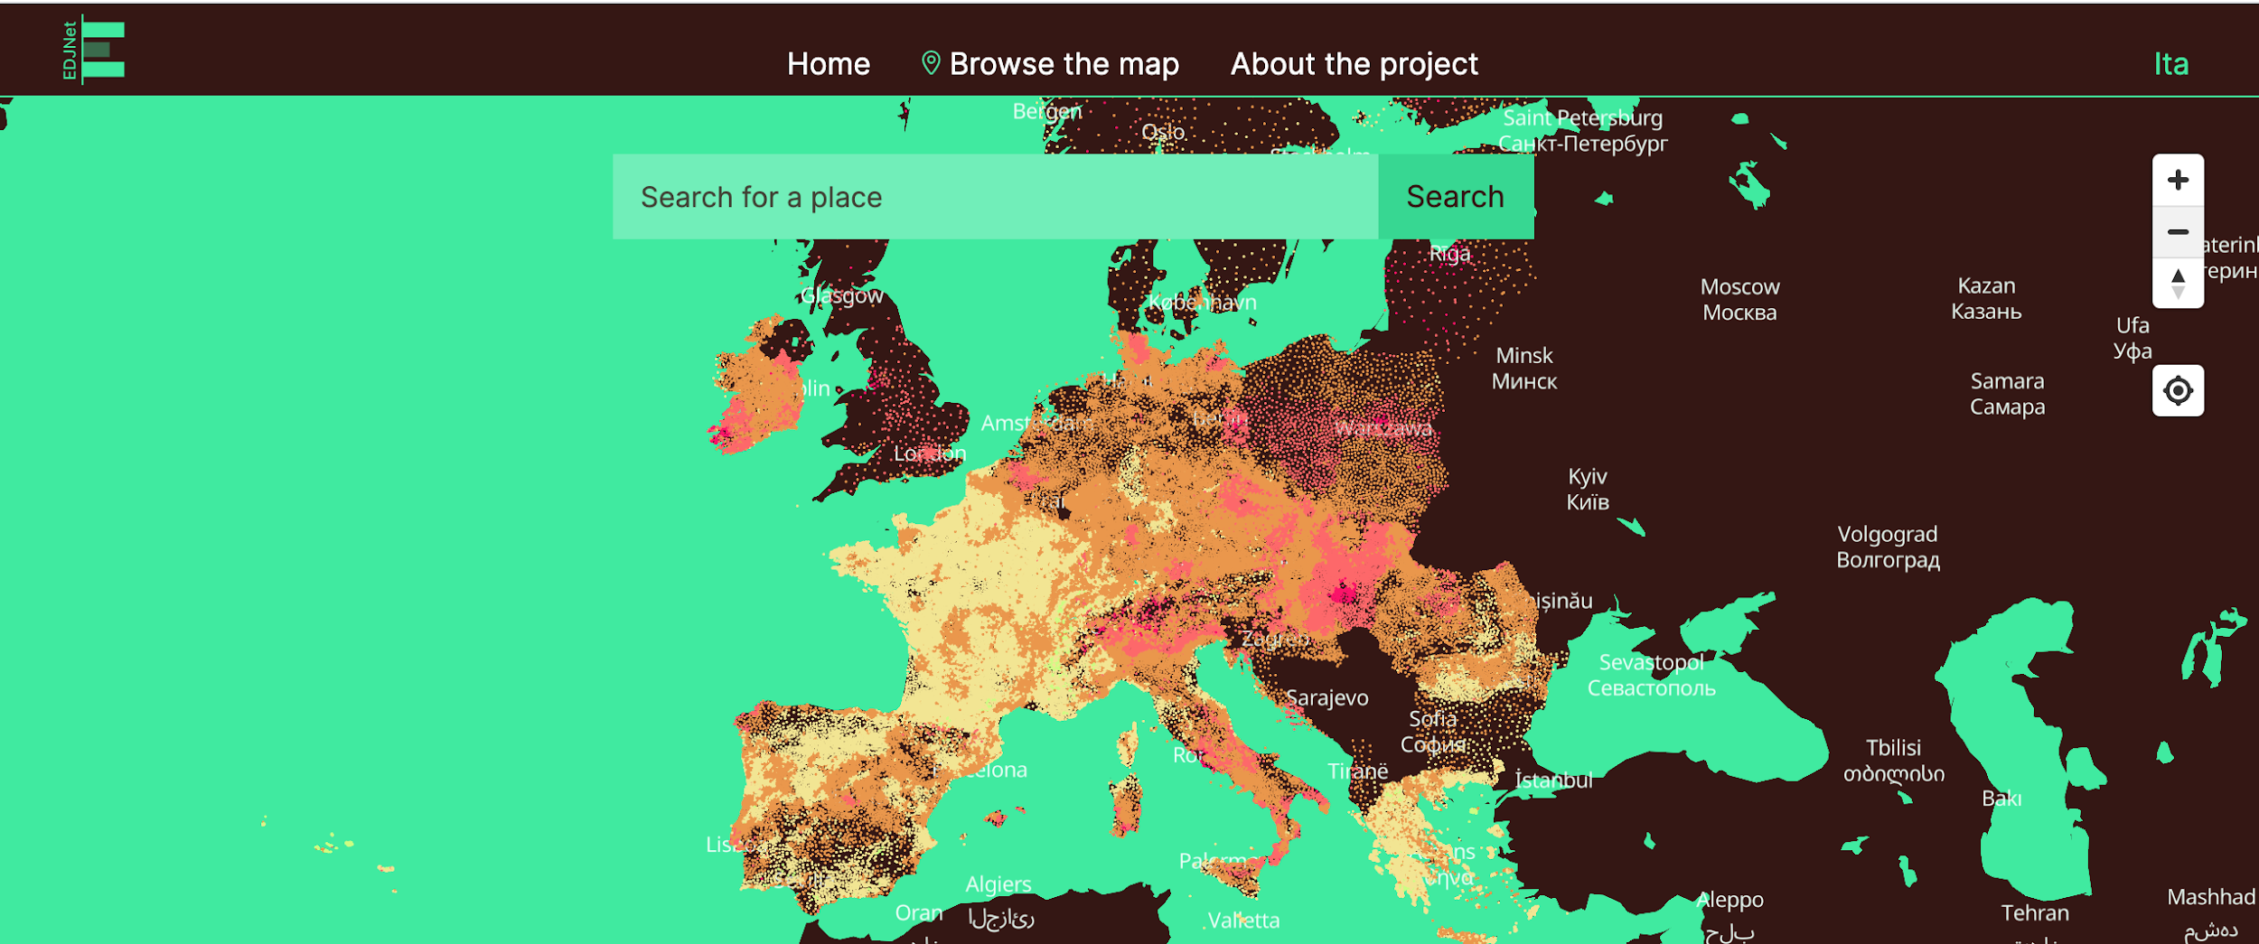
Data reuse examples - a journalistic investigation
Based on data from the Copernicus project. https://climatechange.europeandatajournalism.eu/en/

Slide 32
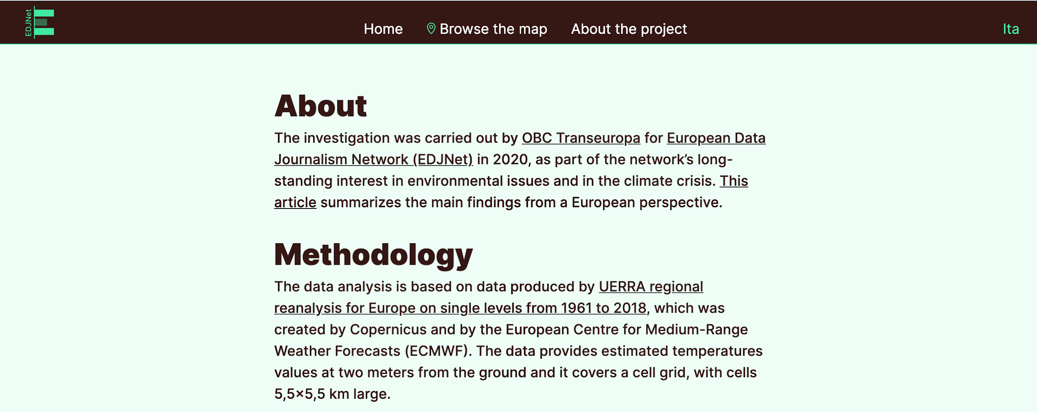

Slide 33
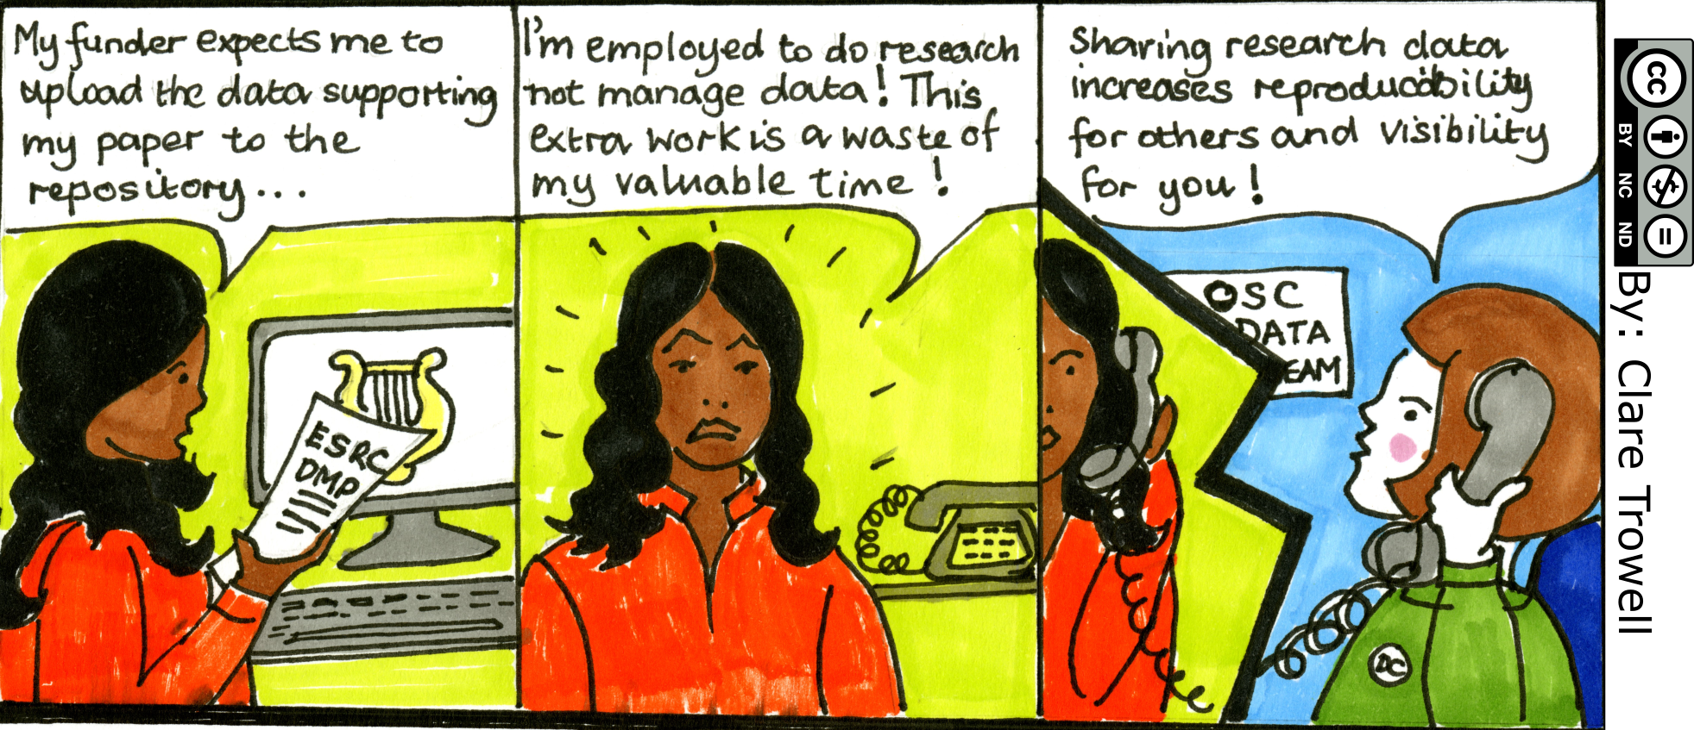
For reproducibility and visibility
https://www.data.cam.ac.uk/intro-data-champions/data-champions-cartoons
Notes:
Università di Cambridge

Slide 34
Hands on!

Slide 35
Exercise 1
Open Zenodo.org and find a record for software. Answer the following questions:
  What is the DOI?
  Is it linked to GitHub?
  Which license applies?
  Does it show versions?
  How many views? Downloads?
  Is it open access?
Time: 15 minutes
Credit: https://au-research.github.io/FAIR-data-101-training/findable/activities

Slide 36

Exercice 1: results
Did you find a record that met all the requirements?
Difficulties?
Doubts?
Questions?
Check Zenodo search guide: https://help.zenodo.org/guides/search/
Photo by Markus Winkler on Unsplash

Slide 37


Slide 38
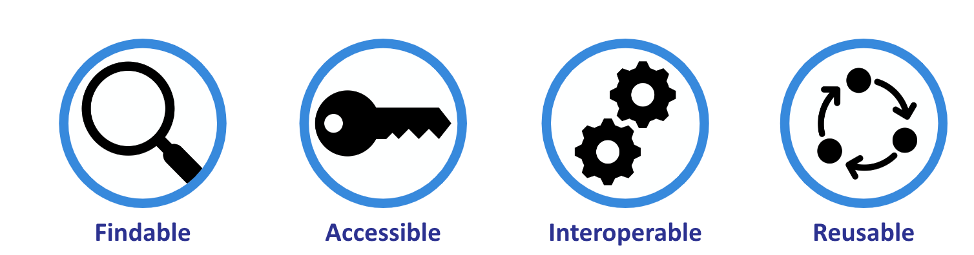
Exercice 2
Go to sandbox.zenodo.org and upload you file following FAIR principles
Time: 20 minutes

Slide 39
Exercice 2 results
Did you use the Orcid for the author(s)?
Did you notice that you can use communities to enhance findability?
Did you fill in the field “subject”?
Did you used keywords?
What field would you use if you are uploading a contribution to a conference?
Did you linked to other resources (ie. some sort of supplementary material or whatever)?
What if you want to add editors (or other contributors) to your uploand?

Slide 40

Exercice 3: assess your own record
Go to https://ardc.edu.au/resources/aboutdata/fair-data/fair-self-assessment-tool/
Answer questions related to the principles underpinning Findable, Accessible, Interoperable and Reusable (FAIR)
What was your score?
Estimated time: 10 minutes

Slide 41
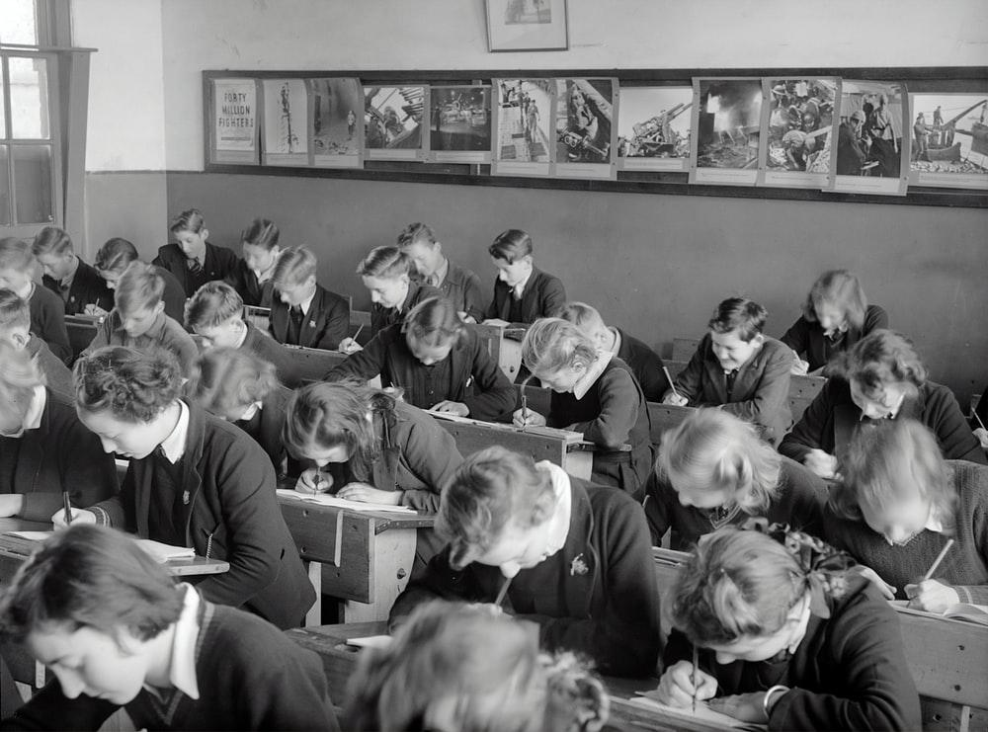
Exercice 4: take the quiz!
Try to answer to this quiz:
https://docs.google.com/forms/d/e/1FAIpQLSeHzqF8usfGGSoQPO5w46DNnTRXWIAvRkuWKz0lwF4U5uaQrg/viewform
The quiz reuses some of the following resources: https://au-research.github.io/FAIR-data-101-training/

Slide 42

Thank you!
Ask questions and interact in the VRE: https://services.d4science.org/group/phdunipi_os21-22
gina.pavone@isti.cnr.it

