Slide 1


All about FAIR principles
University of Pisa - Phd course 2022
Gina Pavone, CNR-ISTI 0000-0003-0087-2151
module 1 - 30 May 2022
10.5281/zenodo.6597239

Slide 2

Gina Pavone
Research fellow at the Institute of Information Science and Technologies of the Italian National Research Council in Pisa, Italy.
Research focus: Open Science and Open Access; Research Data Management
OpenAIRE National Open Access Desk (NOAD) for Italy
Coordinator of the editorial board of open-science.it website
My background: data journalism

Slide 3
FAIR data and DMP
COURSE OUTLINE
May 30, 2022
June 8, 2022
All about FAIR!
What FAIR principles are and their value for research
Data Management Plan:
what it is, how to do it, some examples; hands on!
Mod. 2
Mod. 1
Mod. 3
June 6, 2022
Why we need fairness;
some examples;
Hands on!

Slide 4
Today’s agenda
University of Pisa
PhD students
FAIR
Involved
Tools
Legal
Purpose, object and contents
Target, stakeholders, and involved components
Repositories, registries and other resources to go FAIR
Openness and FAIRness, access rights, licences, copyright
What
Who
How
About

Slide 5

Image by Gerd Altmann from Pixabay
Let’s say that…a researcher needs to find datasets containing data about proteins that are activated in specific tissues and combine these data with information of which genes are involved in the production of such proteins.
https://github.com/FAIRDataTeam/FAIRDataPoint/wiki/FAIR-Data-Point-Specification#usage-scenarios

Slide 6
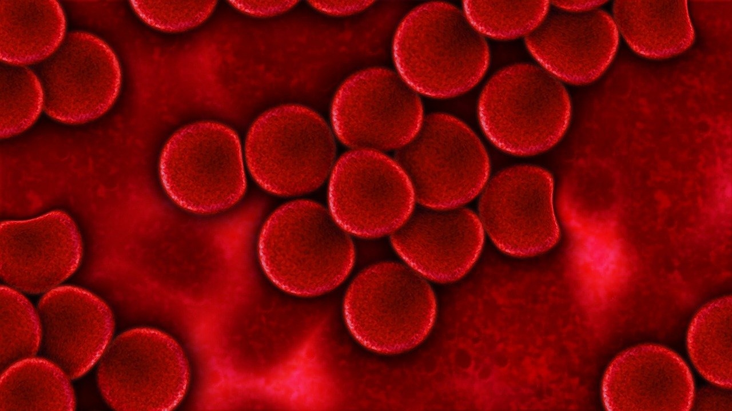
Image by Gerd Altmann from Pixabay
Or say….another researcher needs to know which biobanks carry a given type of biosample (e.g., blood samples) from patients possessing a specific phenotype (e.g., Alzheimer's disease) taken from a patient registry whose onset age was lower than 45 year-old. https://github.com/FAIRDataTeam/FAIRDataPoint/wiki/FAIR-Data-Point-Specification#usage-scenarios

Slide 7
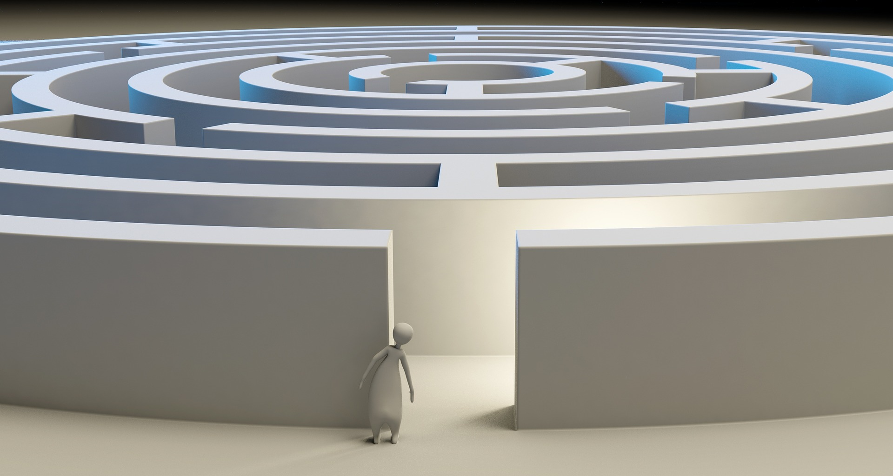
These data users need to use a straightforward search application that allows them to find the required information.
https://github.com/FAIRDataTeam/FAIRDataPoint/wiki/FAIR-Data-Point-Specification#usage-scenarios

Slide 8
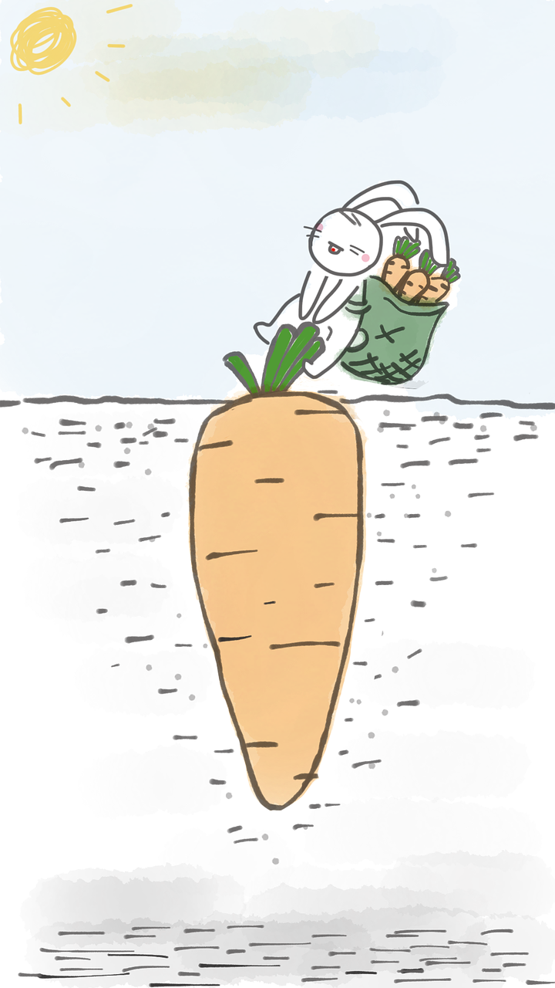
And it’s still not over…
What if…you are that researcher and you do not know if you have the permission to reuse that information?
You will have to check licences.
And then what if…the data you need is stored in a proprietary format and you do not have the software needed to access them?
You may not be able to use the data or you may have to find funds
And you will need to integrate them, combining different datasets.
And for this the data format from the datasets should be using a common representation technology that facilitates data integration.
Image by MJ Jin from Pixabay

Slide 9
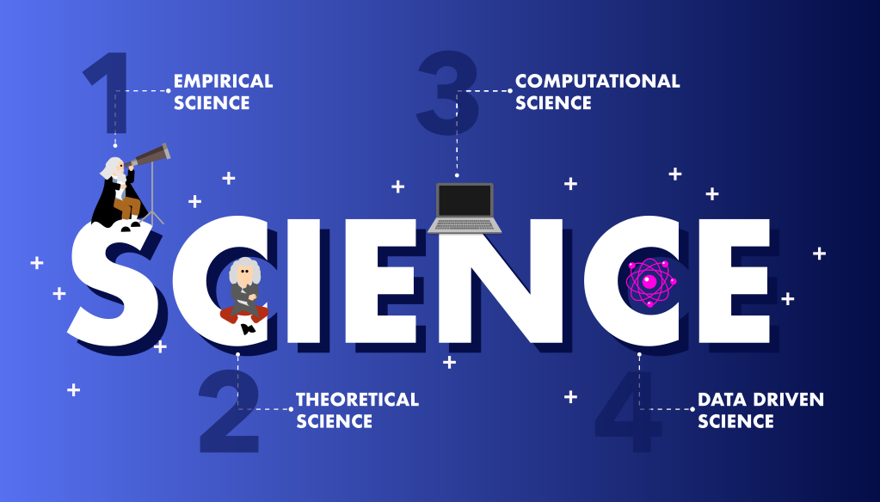
Evolution of Science, Viet Jeannaud, 2020, CC BY-SA 4.0
Notes:
Empiricism: observation and experimentation; scientists made hypotheses that they tried to test to confirm or not.
Theoretical science: theories to explain and generalise empirical observations. They thus established scientific laws in mathematical form
Computational science: Computing power allows scientists to make simulations to study complex phenomena. E.g. in meteorology
Data driven science: using simulations, measurement sensors or data from the Internet, research is based on large amounts of data.

Slide 10
What is data?
Facts, observations or experiences on which an argument or theory is constructed or tested.
Data are information!
(in a variety of forms and formats)
Data or it didn’t happen!
UCL Research Data Policy
https://www.ucl.ac.uk/library/research-support/research-data-management
Notes:
Data may be numerical, descriptive, aural or visual.
Data may be raw, abstracted or analysed, experimental or observational.

Slide 11
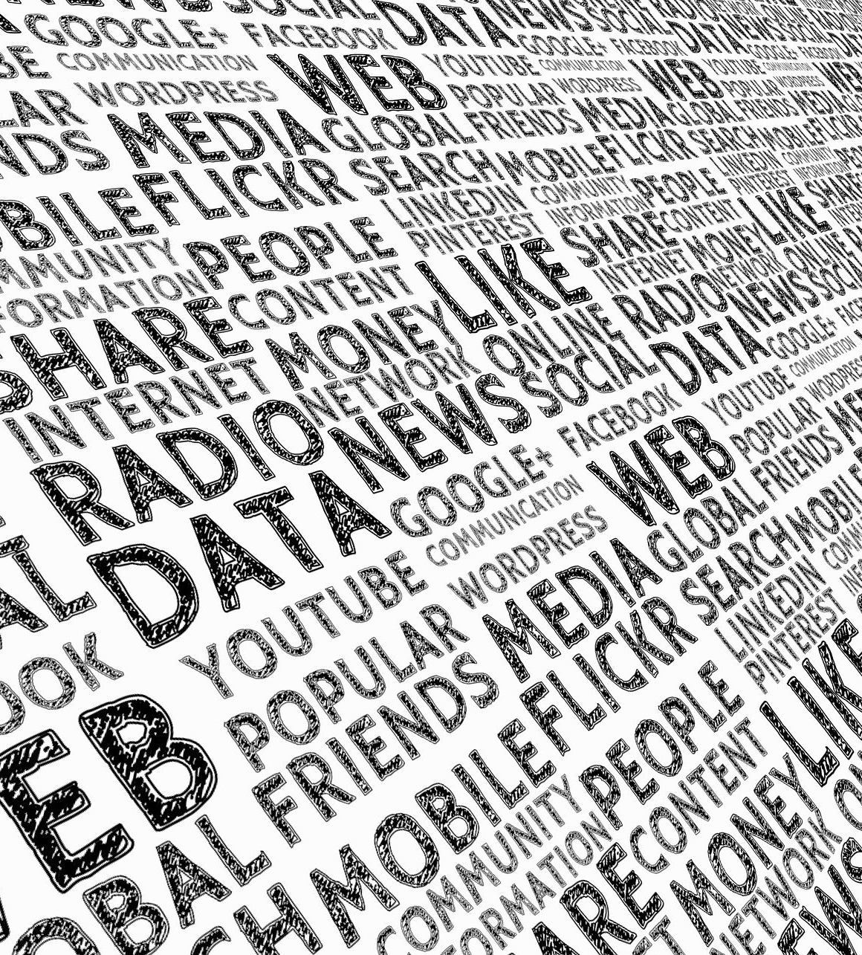
Types of research data
There is a huge variety of data types. Research data can be classified in different ways, for example based on their:
Content: numerical, textual, audiovisual, multimedia…
Format: spreadsheets, databases, images, maps, audio files, (un)structured text…
Mode of data collection: experimental, observational, simulation, derived/compiled from other sources
Digital (born-digital or digitized) or non-digital nature (e.g. paper surveys, notes…)
Primary (generated by the researcher for a particular research purpose or project) or secondary nature (originally created by someone else for another purpose)
Raw or processed nature
https://www.ugent.be/en/research/datamanagement/why/rdm-explained.htm
Image by Gerd Altmann from Pixabay

Slide 12
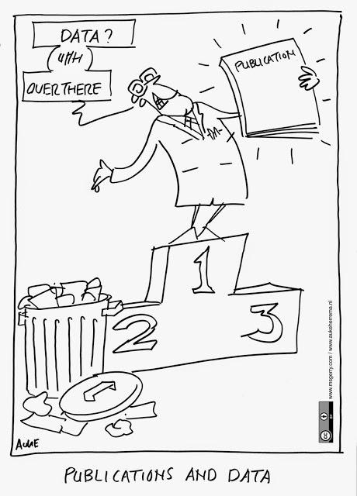
Data are first-class research objects
Check
Validation
Follow-ups
New research questions
Teaching
Business applications
...
cartoon credit: https://www.fosteropenscience.eu/
Notes:
There are many many parts of the scientific work which are not actually being evaluated

Slide 13
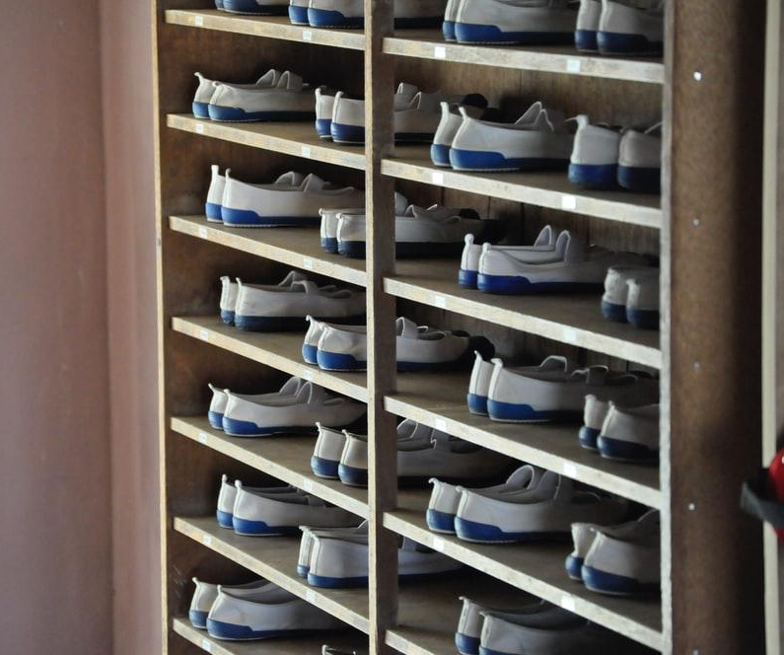
We need to Find the right match
We want that our contents will be read (and cited).
And we want to (easily) find/access and reuse scientific literature produced by others.
A sort of supply and demand matching!
Photo by Priscilla Du Preez on Unsplash

Slide 14

We need to Access

Slide 15

We, and our machines, need to Interoperate with the resource

Slide 16
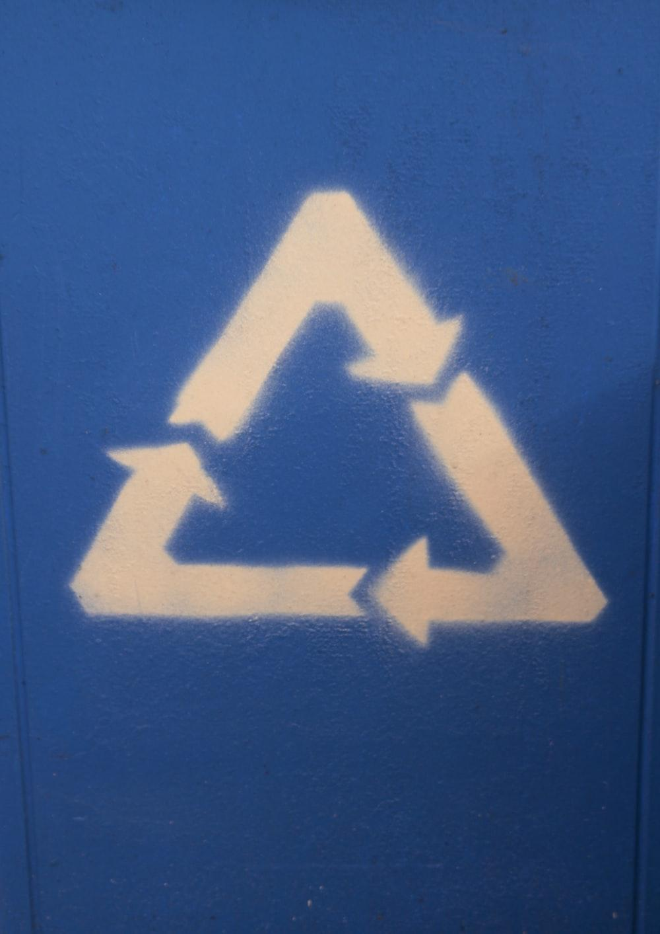
We also want to Reuse the resource (or someone else reuse ours)

Slide 17




The FAIR Principles
Others can easily discover your data
It is clear who, when and how can access your data (does not mean open)
Your data can be integrated with other data and/or they can be easily used and read by machines.
Your data can be reused by others in new research
Findable
Accessible
Interoperable
Reusable
Martínez-Lavanchy, P.M., Hüser, F.J., Buss, M.C.H., Andersen, J.J., Begtrup, J.W. (2019). 'FAIR Principles'. In: Holmstrand, K.F., den Boer, S.P.A., Vlachos, E., Martínez-Lavanchy, P.M., Hansen, K.K. (Eds.), Research Data Management (eLearning course). doi: 10.11581 / dtu: 00000049, Link to the video: https://vidensportal.deic.dk/RDMelearn
Notes:
Findable: others can discover your data
Accessible: your data can be made available to others
Interoperable: your data can be integrated with other data or can be easily used by machines
Reusable: your data can be used for other research

Slide 18
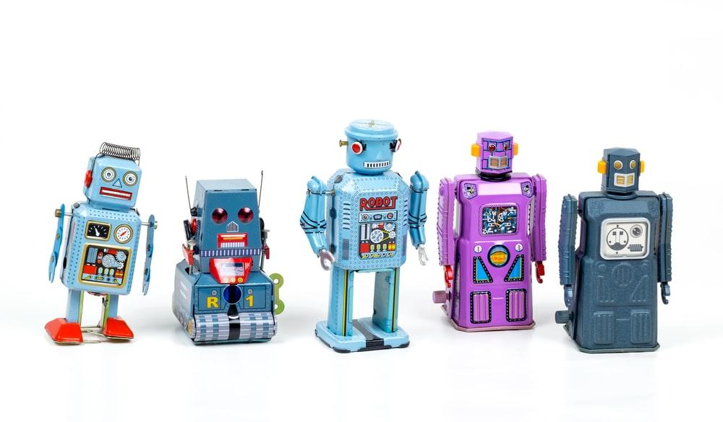

FAIR is an evolution of the open data movement
More nuanced
More machines

Slide 19
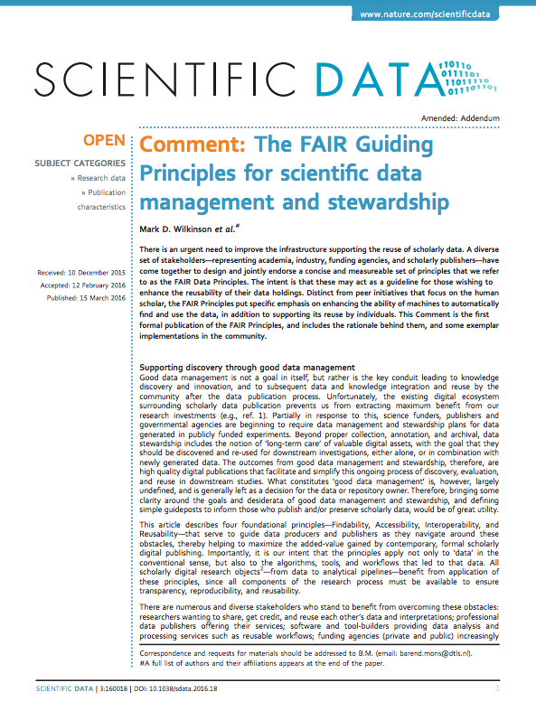
FAIR indicate a list of principles that can help you in making your data ready for Open Science
They are principles, not standards!
They were designed to enable optimal use of research data and methods
A group of different experts designed the FAIR principles between 2014 and 2016
They identified a set of 15 principles

Slide 20
The experts behind FAIR principles:
researchers wanting to share, get credit, and reuse each other’s data and interpretations;
professional data publishers offering their services;
software and tool-builders providing data analysis and processing services such as reusable workflows;
funding agencies (private and public) increasingly concerned with long-term data stewardship;
data science community mining, integrating and analysing new and existing data to advance discovery.

Slide 21
By applying the FAIR principles
It will be easier for you to produce high quality data
You will maximise the impact of your research
You will improve the recognition within and behind your research community
You will be compliant with a growing number of funding agencies requirements (e.g. European Commission)

Slide 22
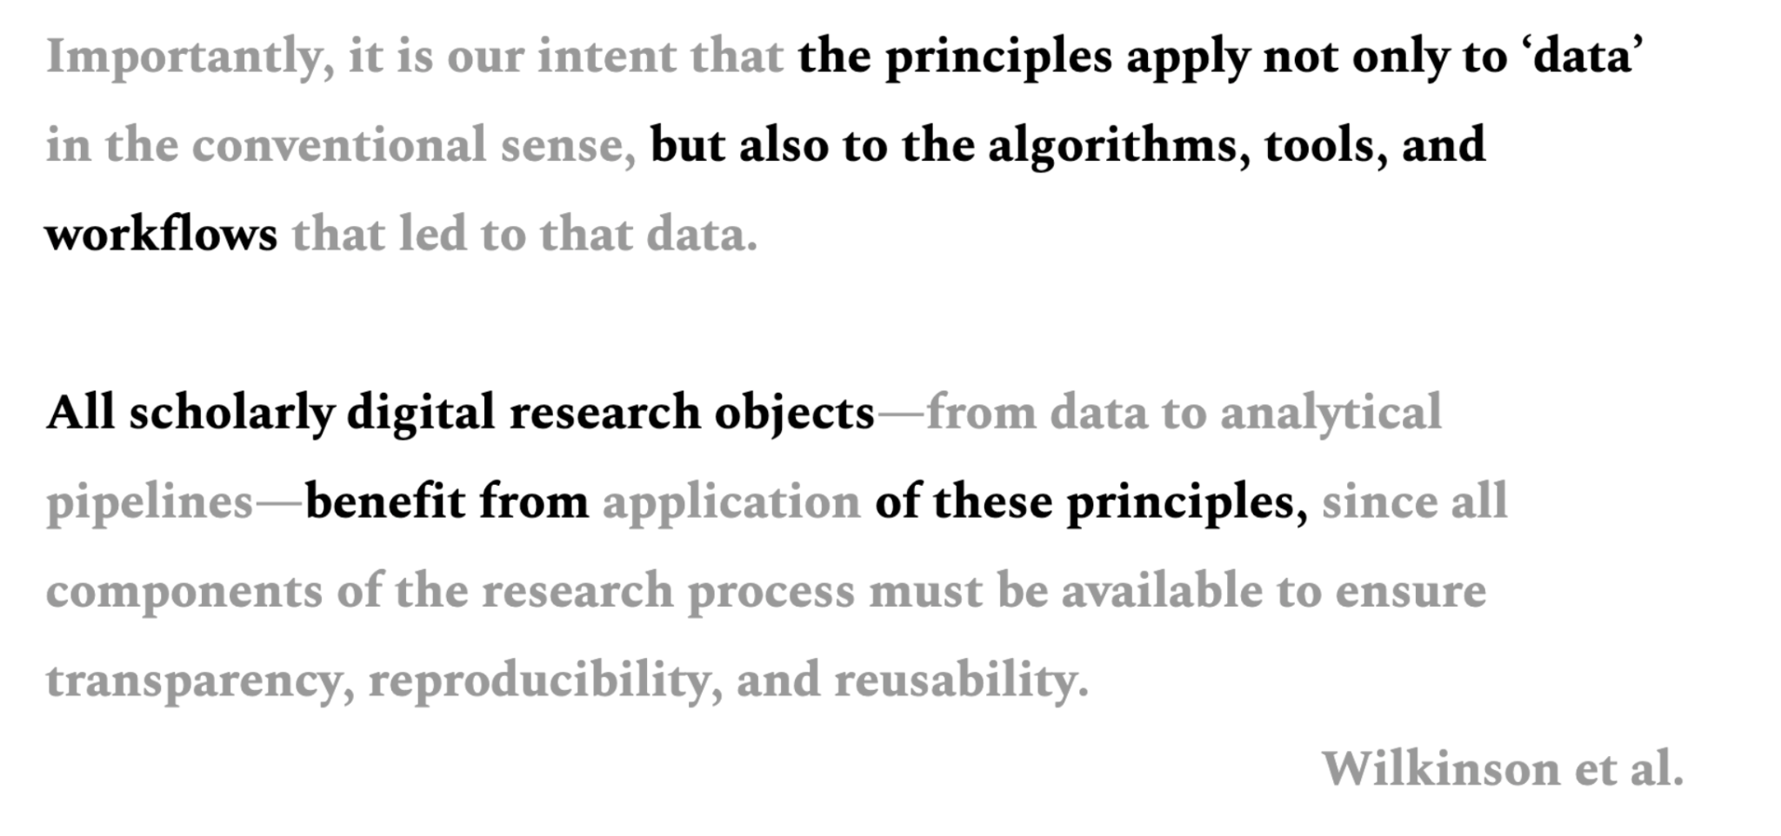
Notes:
Importantly, it is our intent that the principles apply not only to ‘data’ in the conventional sense, but also to the algorithms, tools, and workflows that led to that data. All scholarly digital research objects2—from data to analytical pipelines—benefit from application of these principles, since all components of the research process must be available to ensure transparency, reproducibility, and reusability.

Slide 23
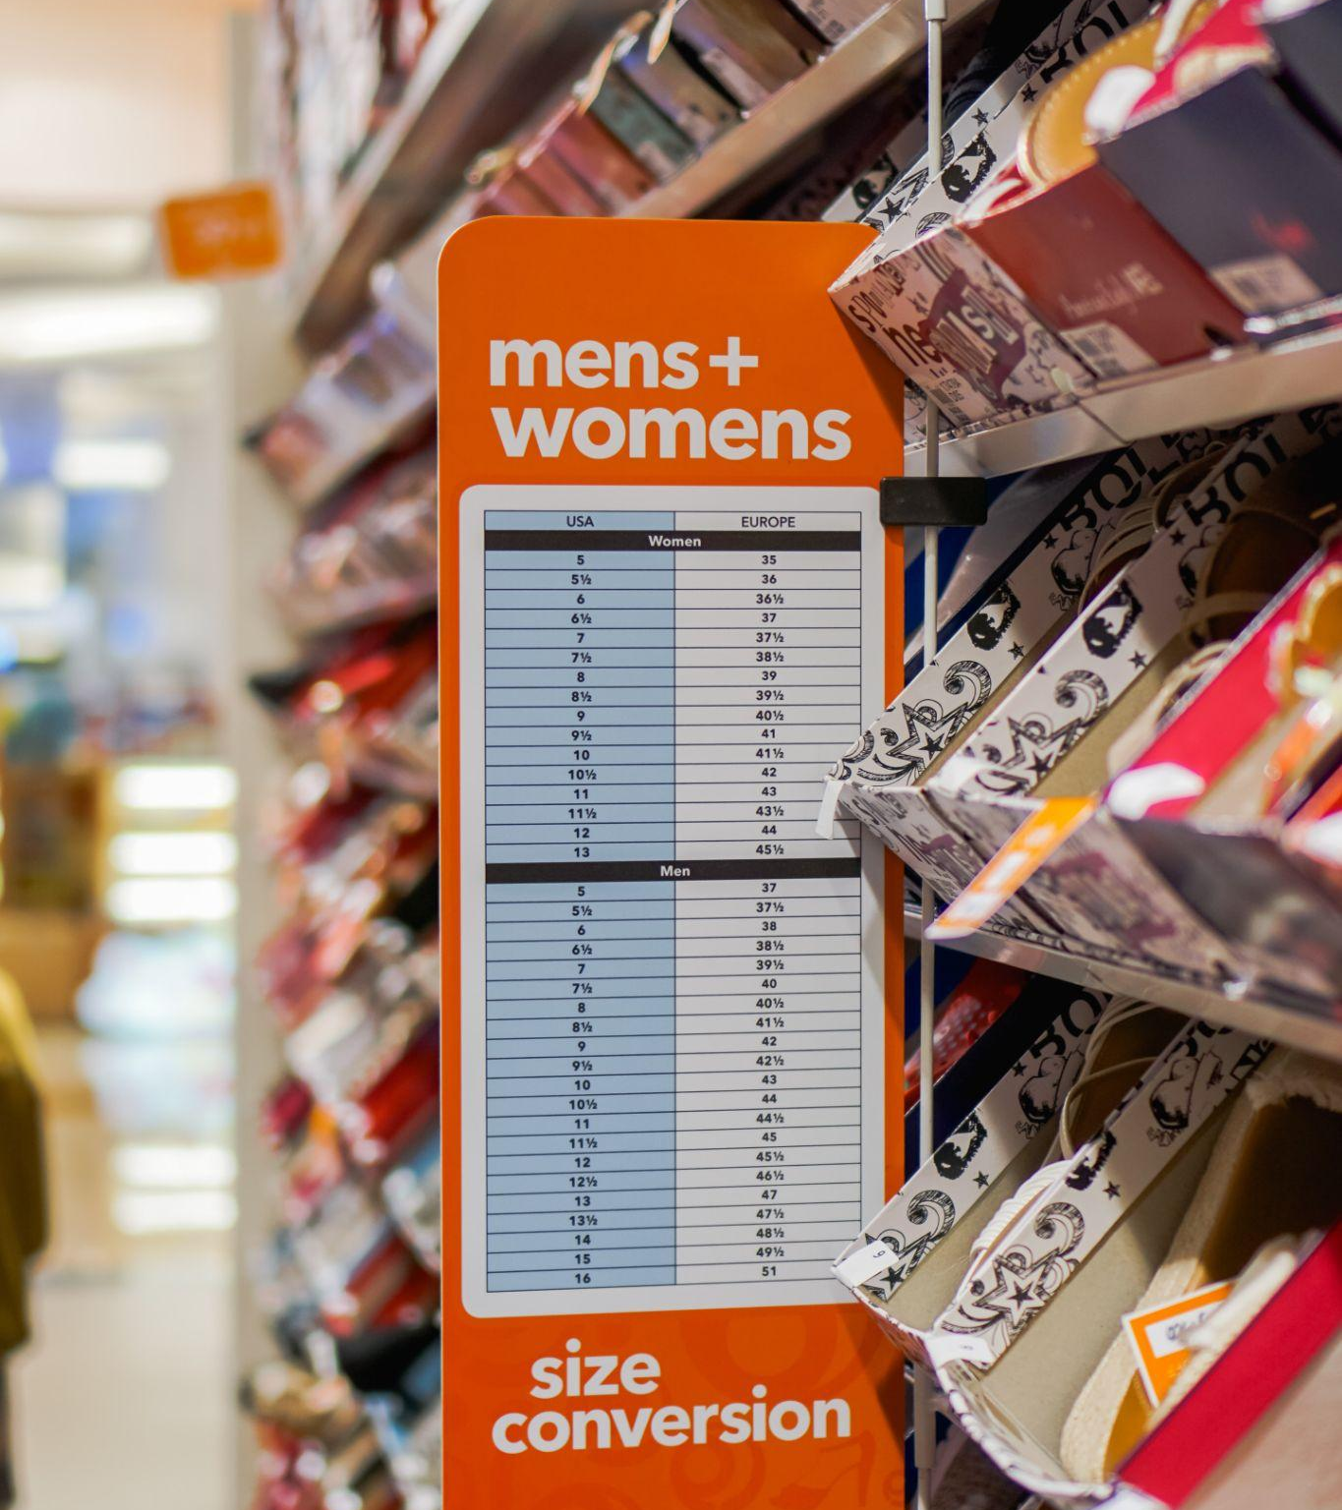
No one size
fits all
The application of the FAIR principles strongly depends on the specific discipline and on the way the single researcher works

Slide 24
Elements you need to make your data FAIR

Slide 25
F - Findable

Slide 26
Findable
The first step in (re)using data is to find them.
Metadata and data should be easy to find for both humans and computers.
Machine-readable metadata are essential for automatic discovery of datasets and services, so this is an essential component of the FAIRification process.

Slide 27
F1: (Meta) data are assigned globally unique and persistent identifiers

Slide 28

Persistent Identifiers
A persistent identifier (PI or PID) is a long-lasting reference to a document, file, web page, or other object.
The term persistent identifier is usually used in the context of digital objects that are accessible over the Internet.
Typically, such an identifier is not only persistent but actionable: you can plug it into a web browser and be taken to the identified source.
It is like the barcode used on products…

Slide 29
Many types of PIDs
Example services that supply globally unique and persistent identifiers
Identifiers.org provides resolvable identifiers in the form of URIs and CURIEs: http://identifiers.org
Universally unique identifier: https://en.wikipedia.org/wiki/Universally_unique_identifier
Persistent URLs: http://www.purlz.org
Digital Object Identifier: http://www.doi.org
Archival Resource Key: https://escholarship.org/uc/item/9p9863nc
Research Resource Identifiers: https://scicrunch.org/resources
Identifiers for funding organisations (see F3 & R1): https://www.crossref.org/services/funder-registry/
Identifiers for the world’s research organisations (see F3 & R1): https://www.grid.ac
People - ORCID
Projects - RAiD www.raid.org.au
Digital objects - DOI
Phisical samples IGSN - https://www.igsn.org/

Slide 30
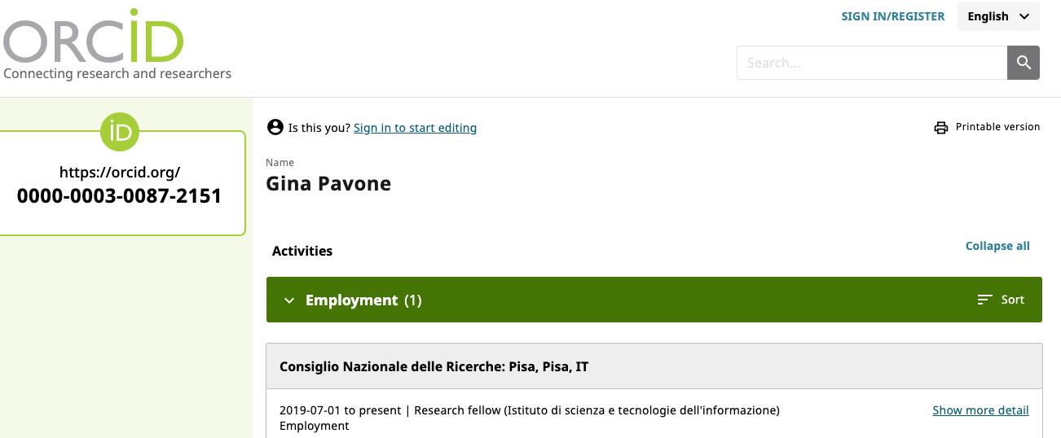
ORCID: do you have one? you should…
Open Researcher and Contributor ID
is a nonproprietary alphanumeric code to uniquely identify scientific and other academic authors and contributors

Slide 31
DOI - Digital Object Identifier
In computing, a digital object identifier (DOI) is a persistent identifier or handle used to identify objects uniquely, standardized by the International Organization for Standardization (ISO).
A DOI aims to be resolvable, usually to some form of access to the information object to which the DOI refers.
This is achieved by binding the DOI to metadata about the object, such as a URL, indicating where the object can be found
a DOI differs from identifiers such as ISBNs and ISRCs which aim only to identify their referents uniquely
Definition: Wikipedia

Slide 32
F1
Persistent identifiers remove ambiguity. They allow to find, cite and track (meta)data.
Globally unique (i.e., someone else could not reuse/reassign the same identifier without referring to your data)
It must be persistent. Registry services guarantee resolvability of that link into the future, at least to some degree.
https://www.go-fair.org/fair-principles/f1-meta-data-assigned-globally-unique-persistent-identifiers/

Slide 33
F2: Data are described with rich metadata

Slide 34
What are metadata?
Literally “data about data.”
The information we create, store, and share to describe things
ie. information about the item’s creation, name, topic, features, and the like
They allows us to interact with these things to obtain the knowledge we need
Metadata is key to the functionality of the systems holding the content, enabling users to find items of interest, record essential information about them, and share that information with others.
https://www.niso.org/publications/understanding-metadata-2017

Slide 35
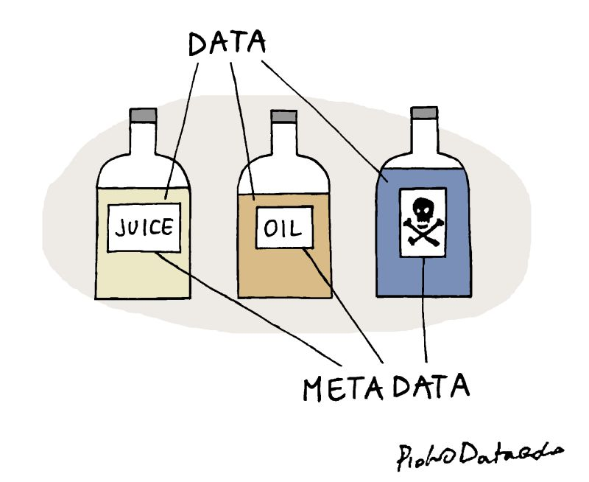
The difference between data and metadata
Piotr Kononow through https://twitter.com/aabella/status/1527533226574680064/photo/1

Slide 36
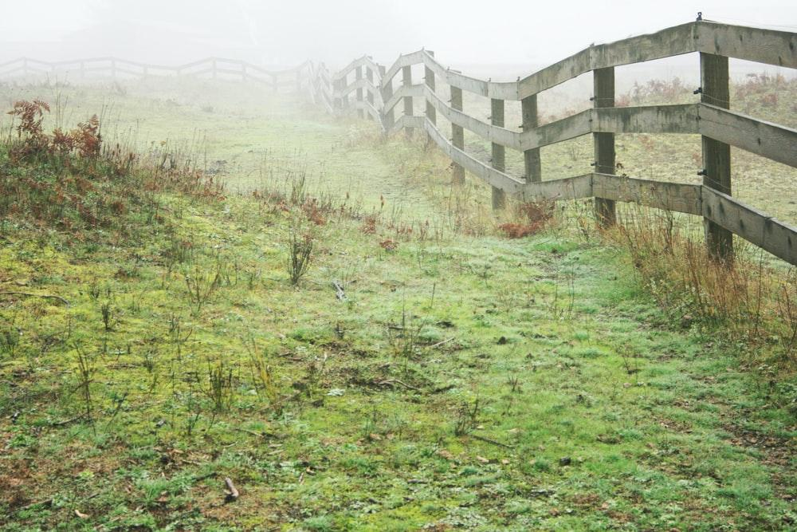
Data and metadata
Usually there is a fuzzy boundary between metadata and the information it describes
They do not necessarily are co-located
https://www.niso.org/publications/understanding-metadata-2017

Slide 37
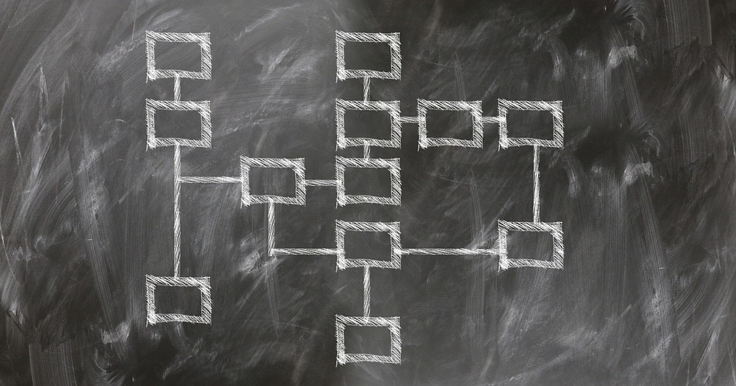
Structured information
Metadata has to be structured to some degree. The metadata is collected so that it can fulfill a useful purpose, and sorted into known categories. It is this notion of structure that turns raw information into actionable metadata
Metadata are collected and stored explanatory labels. Properties or elements are common terms for these labels
Image by Gerd Altmann from Pixabay
https://www.niso.org/publications/understanding-metadata-2017

Slide 38
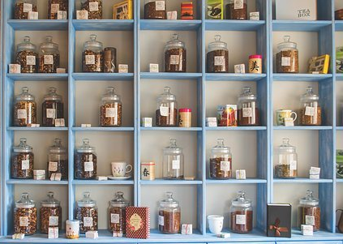
‘Rich’ information
‘Intrinsic’ metadata
e.g., the data captured automatically by machines)
‘Contextual’ metadata
e.g., the protocol used, with both keywords and links to a formal protocol document,
The measurement devices used ( with both keywords and links to manufacturers)
The units of the captured data, the species involved
The ‘object’ that is the focus of the study (genes/proteins/whatever….)
Any other details about the experiment.
https://www.go-fair.org/fair-principles/f2-data-described-rich-metadata/

Slide 39
Main types of metadata
Descriptive metadata | For finding or understanding a resource
Administrative metadata: Technical metadata Preservation metadata Rights metadata | - For decoding and rendering files - Long-term management of files - Intellectual property rights attached to content
Structural metadata | Relationships of parts of resources to one another
https://www.niso.org/publications/understanding-metadata-2017

Slide 40
Types of metadata: some examples
Descriptive metadata | - Title - Genre - Author - Publication date - Subject | Discovery Display Interoperability
Technical metadata | File type File size Creation date/time Compression scheme | Interoperability Digital object management Preservation
Preservation metadata | Checksum Preservation event | Interoperability Digital object management Preservation
Rights metadata | Copyright status License terms Rights holder | Interoperability Digital object management
https://www.niso.org/publications/understanding-metadata-2017
Notes:
. Descriptive and administrative metadata are considered distinct from structural metadata, which describes the relationships of parts of resources to one another; examples include pages in a sequence, a table of contents with pointers etc

Slide 41
Examples of metadata schema
Dublin core - describing resources on the web
Schema.org - commercial applications
Crossref - research outputs
Datacite metadata schema - describing research data
Disciplinari metadata
  Data Documentation Initiative
  Darwin Core - biological sciences

Slide 42
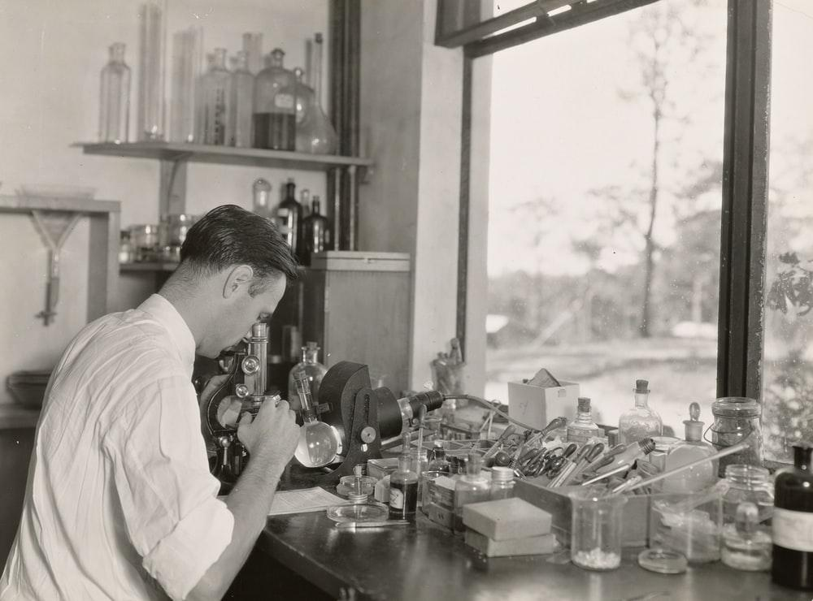
keep in mind:
Other researchers in any field, or their computer, should be able to properly understand the nature of your dataset.
Be as generous as possible with your metadata!
https://www.snf.ch/SiteCollectionDocuments/FAIR_principles_translation_SNSF_logo.pdf

Slide 43

Use your discipline specific standard!
You will spend less time curating and interpreting data and more time to actually make science!
https://rd-alliance.github.io/metadata-directory/

Slide 44
F2
Generous and extensive information on the resource:
its characteristics
descriptive information about the context, quality and condition
Someone should be able to find data based on the information provided by their metadata (even without the data’s identifier)
https://www.go-fair.org/fair-principles/f2-data-described-rich-metadata/

Slide 45
F3: Metadata clearly and explicitly include the identifier of the data they describe

Slide 46
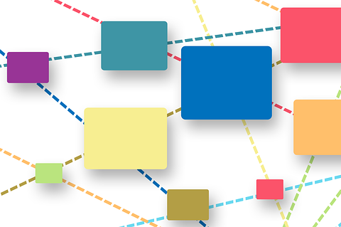
In other words:
The metadata and the data set they describe are separate files. The association between a metadata file and the data set is obvious thanks to the mention of the data set’s PID in the metadata.
https://www.snf.ch/SiteCollectionDocuments/FAIR_principles_translation_SNSF_logo.pdf

Slide 47

Not necessarily co-located

Slide 48
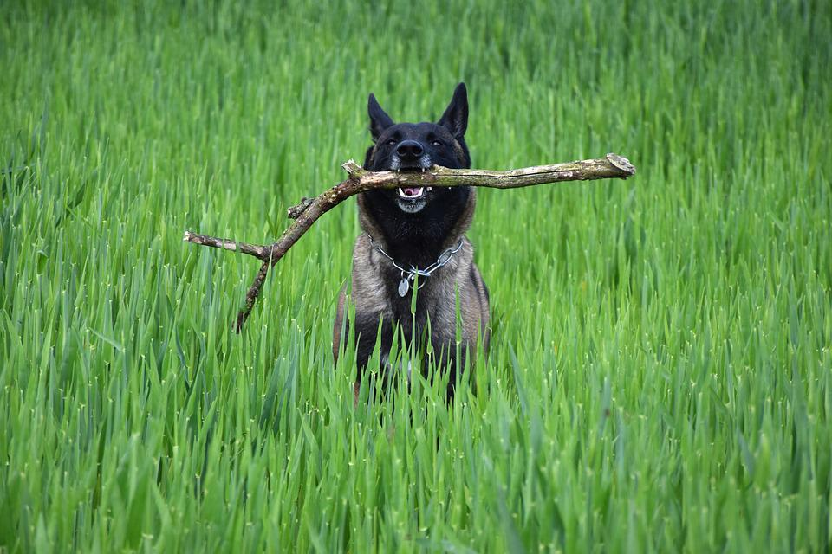
Resolvable

Slide 49
F3
The metadata and the dataset they describe are usually separate files. The association between a metadata file and the dataset should be made explicit by mentioning a dataset’s globally unique and persistent identifier in the metadata.
https://www.go-fair.org/fair-principles/f3-metadata-clearly-explicitly-include-identifier-data-describe/

Slide 50
F4: (Meta)data are registered or indexed in a searchable resource

Slide 51
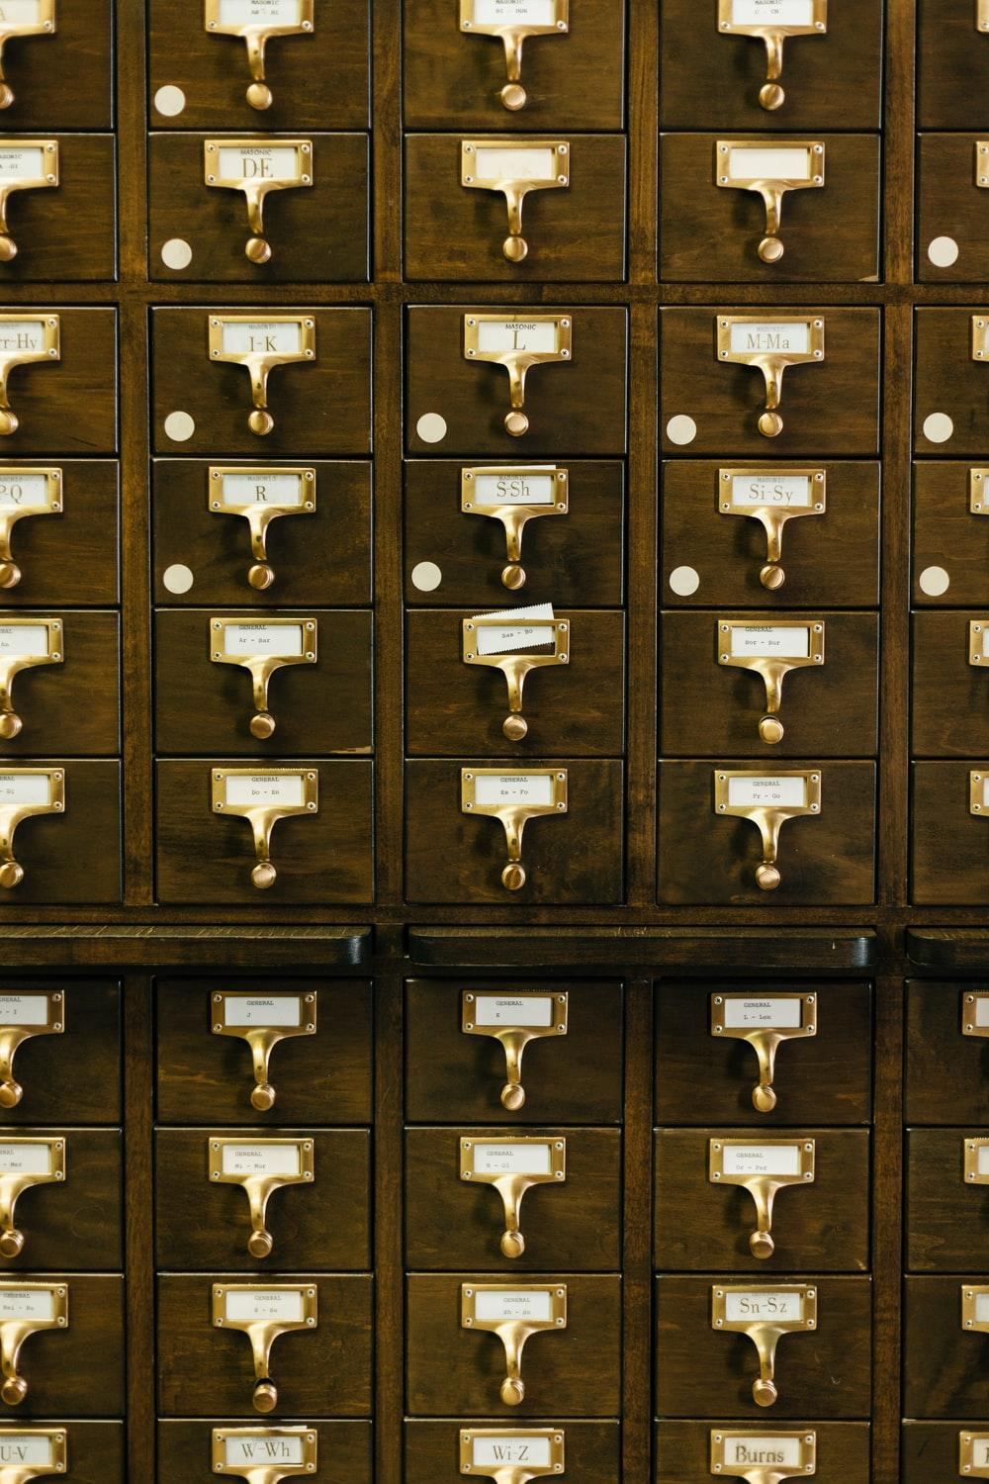
In other words:
Metadata are used to build easily searchable indexes of data sets. These resources will allow to search for existing data sets similarly to searching for a book in a library.
https://www.snf.ch/SiteCollectionDocuments/FAIR_principles_translation_SNSF_logo.pdf

Slide 52
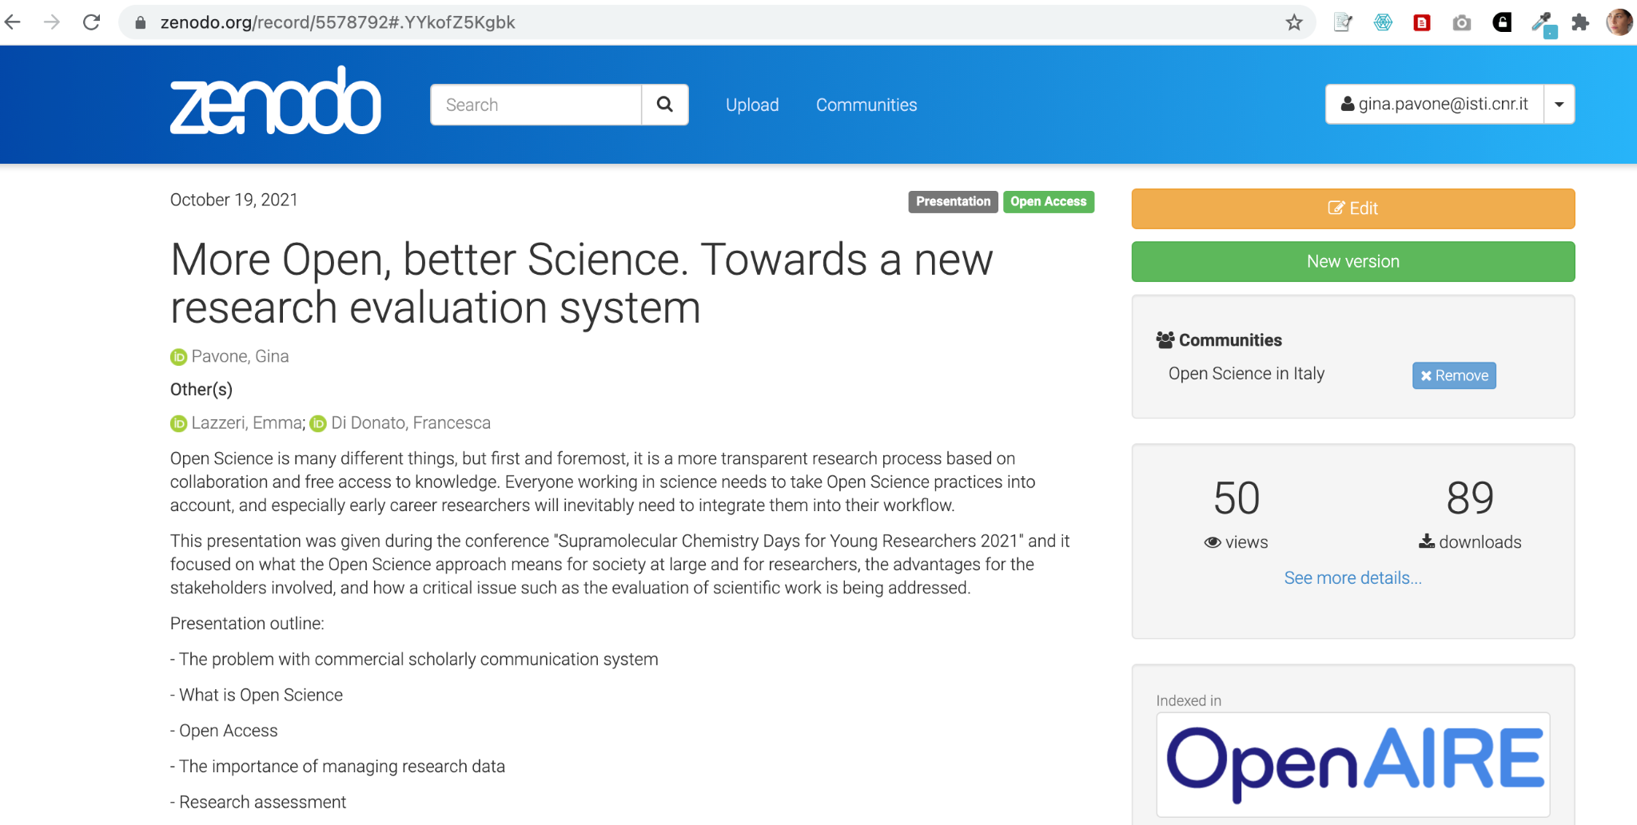
Repository
An open-access repository or open archive is a digital platform that holds research output and provides free, immediate and permanent access to research results for anyone to use, download and distribute.
To facilitate open access such repositories must be interoperable according to the Open Archives Initiative Protocol for Metadata Harvesting (OAI-PMH).
https://en.wikipedia.org/wiki/Open-access_repository

Slide 53
Open Access repositories
A repository stores Open Access digital objects and makes them available and downloadable. It’s accessible and interoperable through a OAI-PMH protocol and it deploys a long-term archiving policy
Thematic/
disciplinary
Literature
Why:
share (discovery) and
preserve
Who
manages
What type of content
National
Institutional
Data
Catch-all

Slide 54
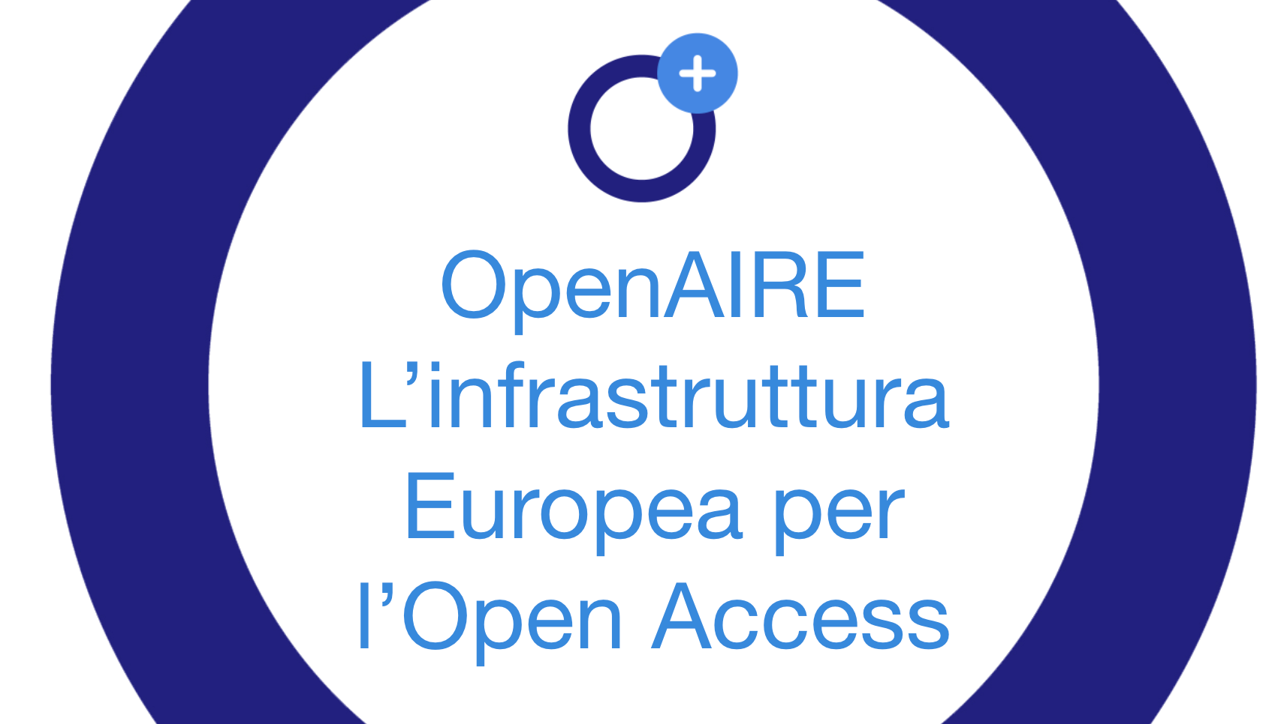
OpenAIRE

Slide 55







Collecting data from 97,000 sources around the world, it builds a graph linking research findings to projects, institutions, funding bodies, ...
Notes:
DA AGGIORNARE E TRADURRE

Slide 56
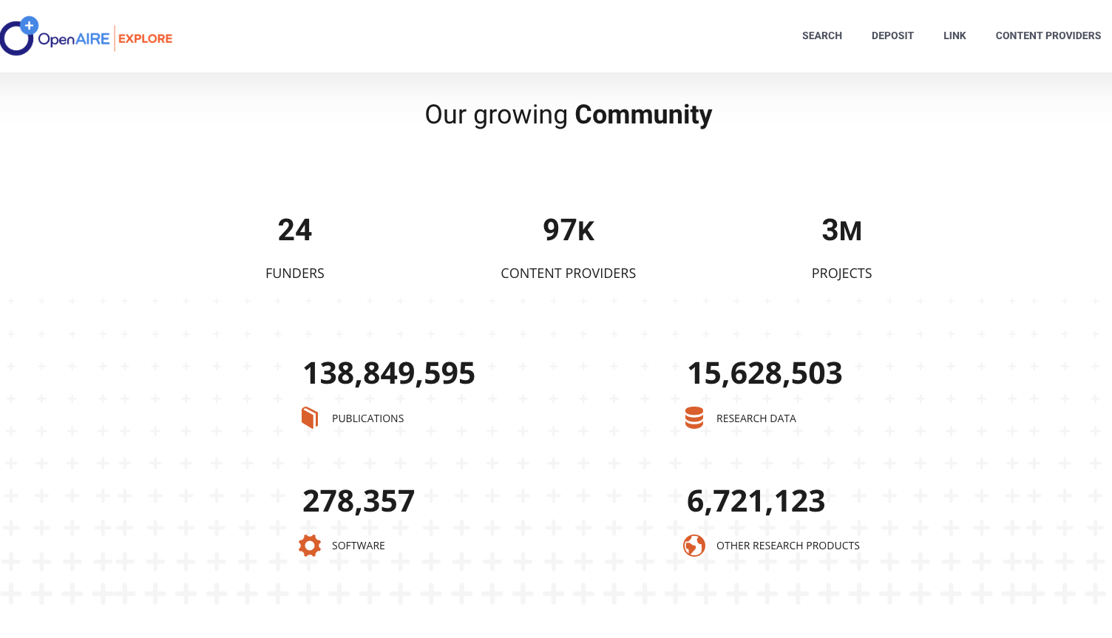
OpenAIRE in numbers

Slide 57
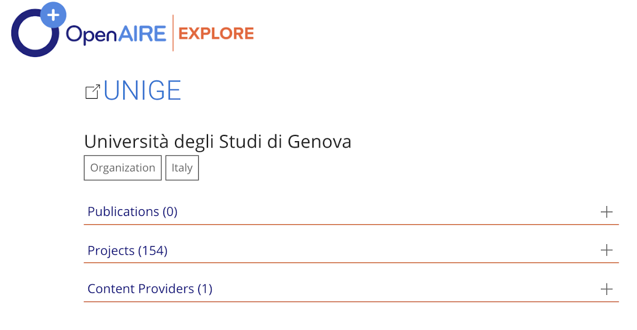
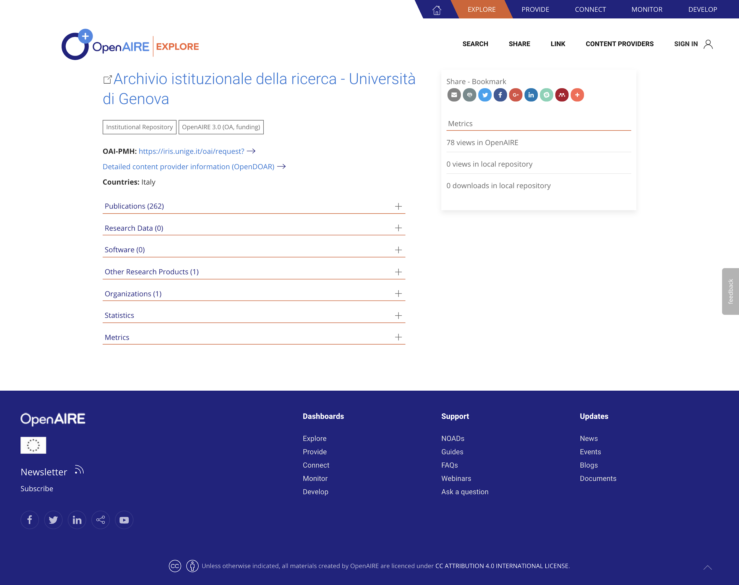
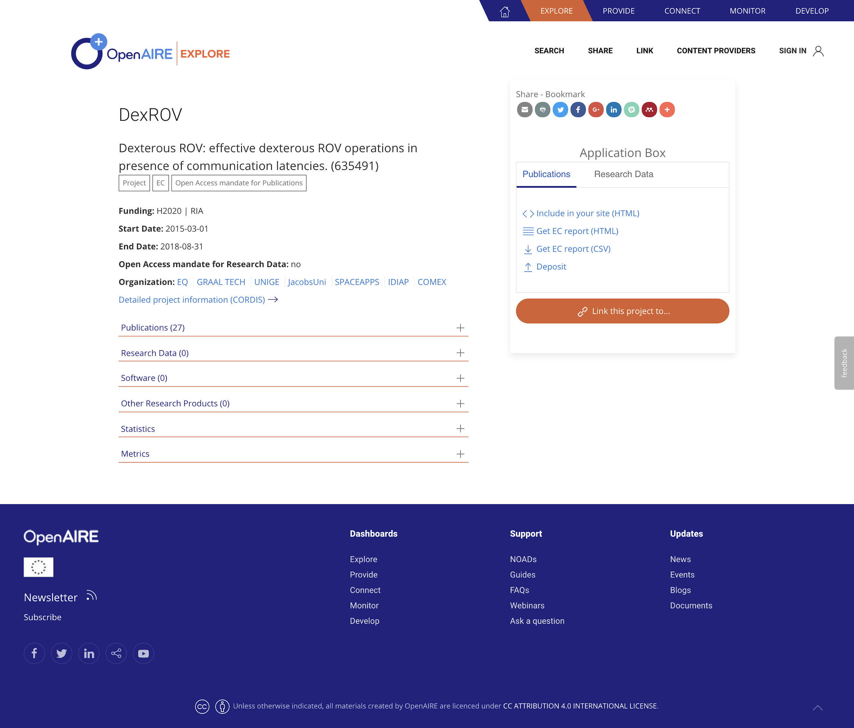
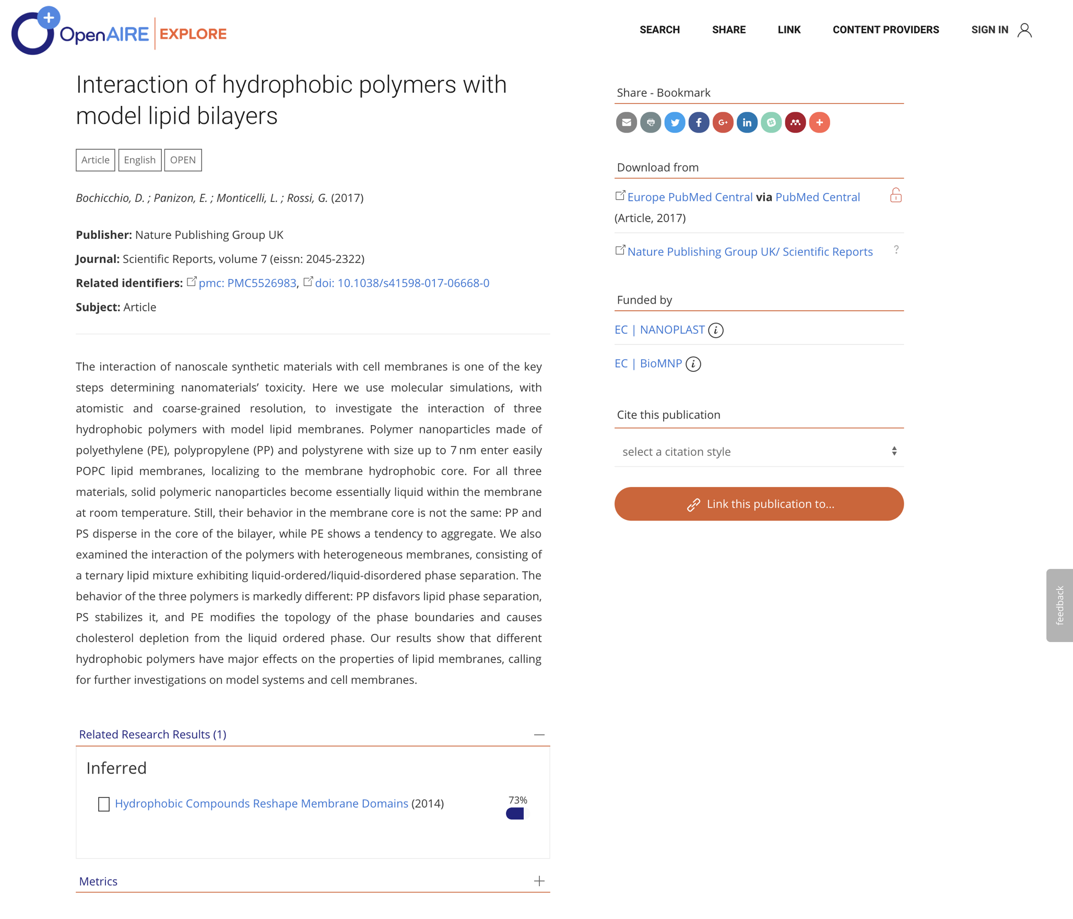
Many components of the graph
Organization
Repository
Project
Research output

Slide 58
Registries and other tools for findability
OpenDOAR https://v2.sherpa.ac.uk/opendoar/
A quality-assured, global Directory of Open Access Repositories
FAIRsharing: https://fairsharing.org/
A curated, informative and educational resource on data and metadata standards, inter-related to databases and data policies.
Re3data https://www.re3data.org/
Registry of research data repositories
Roar http://roar.eprints.org/
Registry of Open Access repositories
Google search/scholar + Unpaywall https://unpaywall.org/
Unpaywall is database of scholarly articles and a browser extension skip the paywall on millions of peer-reviewed journal articles: it free, and legal!

Slide 59
F4
Use appropriate resources to improve discoverability
https://www.go-fair.org/fair-principles/f4-metadata-registered-indexed-searchable-resource/

Slide 60


