Slide 1
Bibliographic and textual studies and the personal library
Alexandra Wingate, John A. Walsh, Caroline Nurkkala, Daniel Evans, Alyssa Mertka, and Jennifer Christie
Indiana University–Bloomington
Digital Humanities Benelux 2022
University of Luxembourg
1-3 June 2022

Slide 2
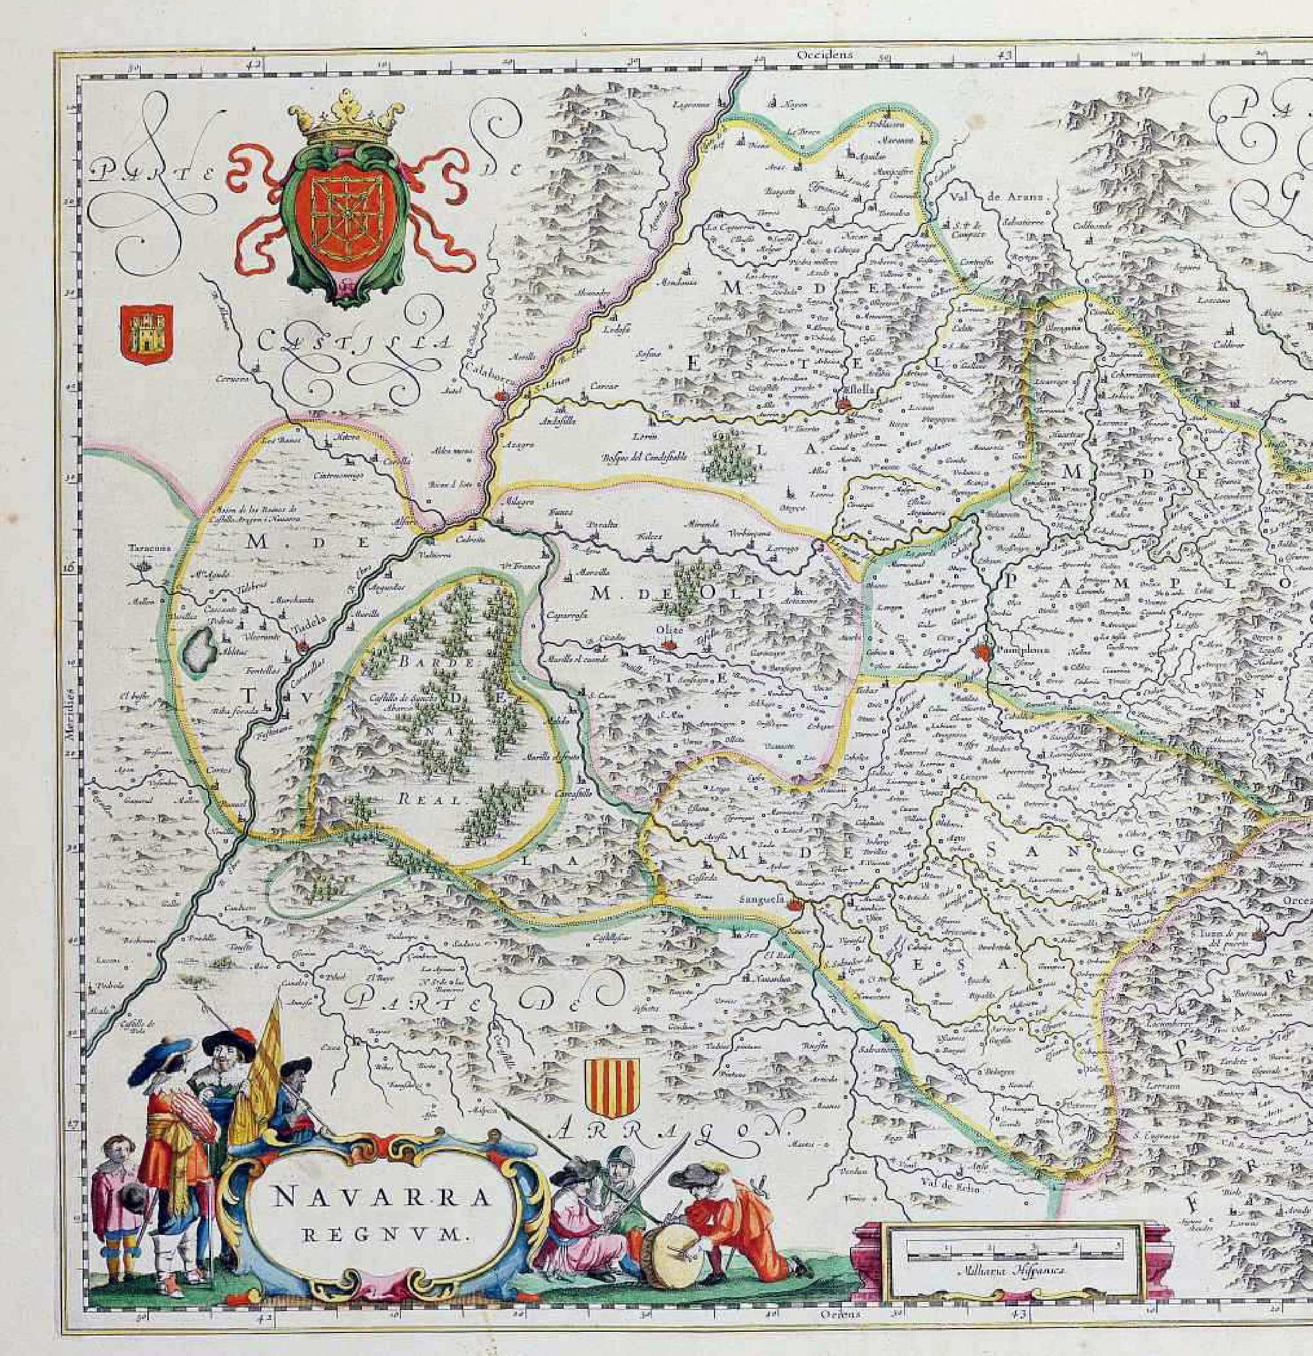
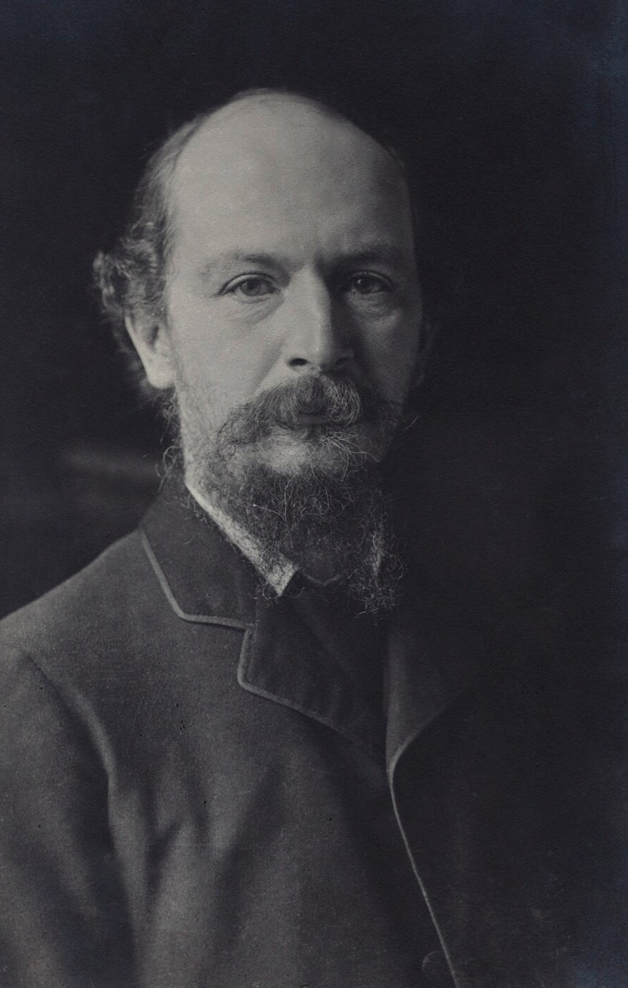
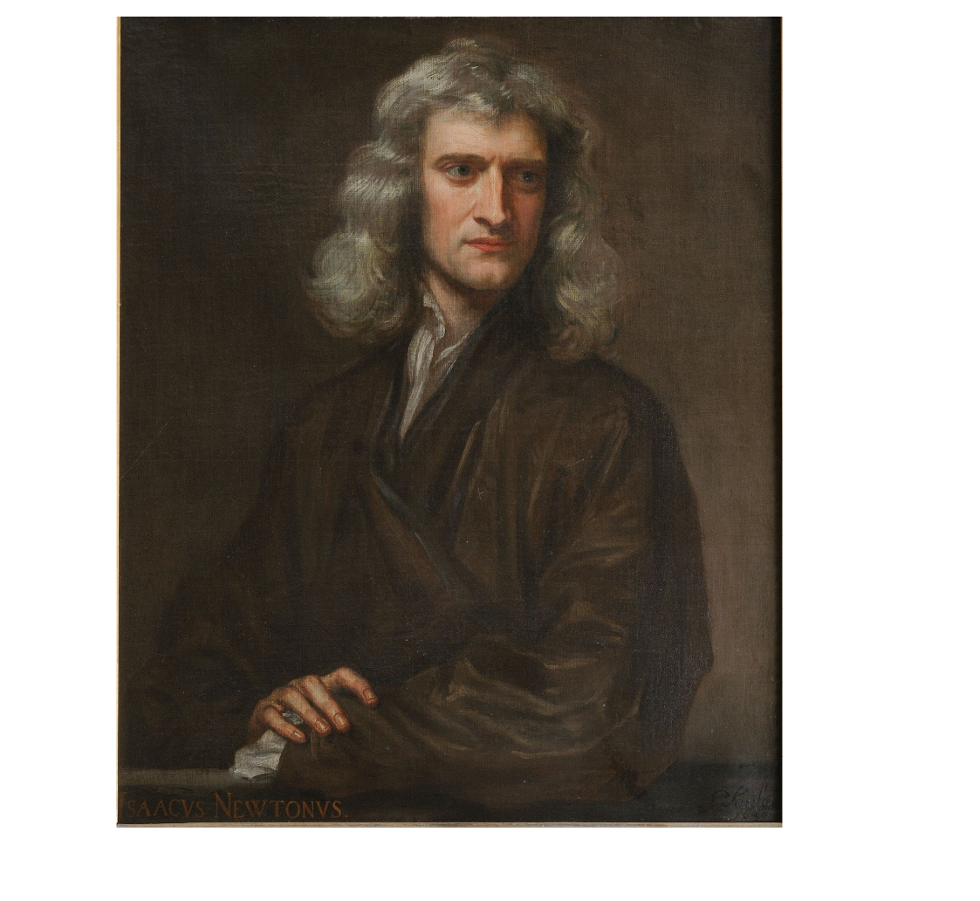
Introduction
Applying digital methods to the study of personal libraries from the 16th through 19th centuries
  34 individuals from early modern Navarre, Spain
  Isaac Newton, 1643-1727
  Algernon Charles Swinburne, 1837-1909

Slide 3
Introduction
Available & Appropriate Methods
Context
Resources
Whose library?
When and where was it created?
What's in it?
Where are the books now?
Information about the library
Information about owner
Bibliographies
Library catalog records
Digitized copies
OCRed copies/full text copies
Statistics
Visualization
Text Analysis
Citation Analysis

Slide 4
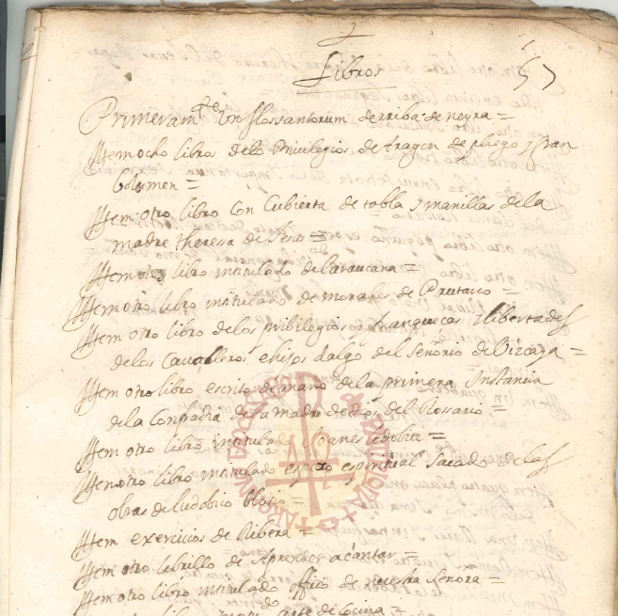
Private libraries of Navarre
Corpus of 34 private libraries from the late 16th to late 17th centuries
Libraries of:
  Clergy (27)
  Legal professionals (4)
  Women (3)
First page of the book inventory of Ana de Sarasa (d. 1629)
Archivo Diocesano de Pamplona, C/849, N.27, fol. 57r
used with permission of the ADP

Slide 5
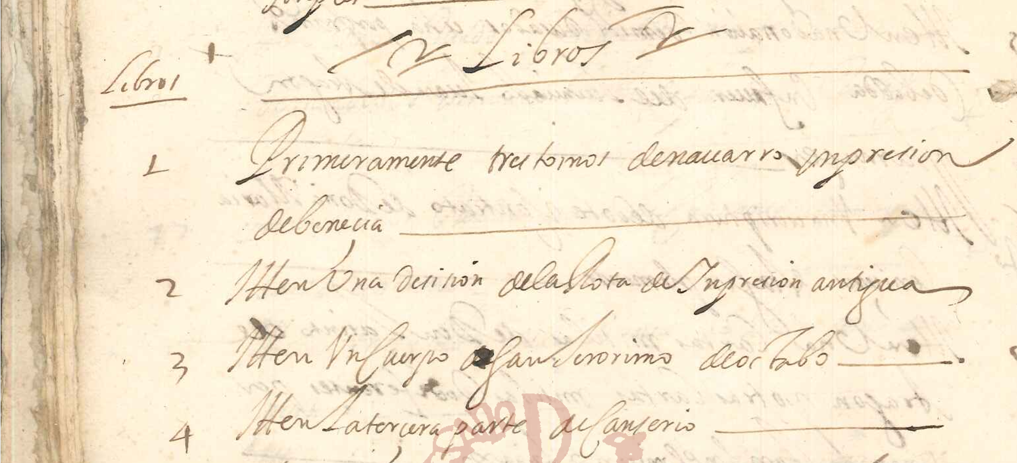
Data sources for Navarrese libraries
Post-mortem inventories found in the court case records of the secular and diocesan tribunals of Navarre
  Archivo Real y General de Navarra (AGN)
  Archivo Diocesano de Pamplona (ADP)
Beginning of the inventory of Pedro de Aragón, lawyer
(ADP, C/618, N. 10, f. 90v; used with permission of the ADP)

Slide 6
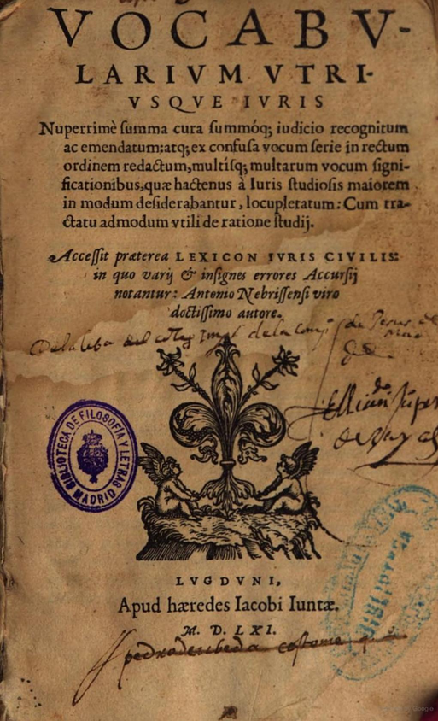
Data set creation: Identification and metadata
Iten veynte y un libros pequeños y grandes y medianos de Romance,
todos de diferentes tomos
(ADP, C/618 N. 10, f. 82v)
Also, twenty-one books, small and large and medium in Spanish, all different works
“Ytten bocabulario juris pequeño ynpression de Leon del año de sesenta y uno en pergamino”
(AGN, no. 89984, f. 46v)
Also, a small vocabulario juris impression of Lyon in the year '61 [bound] in parchment
Viable metadata:
Quantity (21)
Language (Spanish)
Viable metadata:
Author (Antonio de Nebrija)
Title (Vocabularium utriusque juris)
Quantity (1)
Language (Latin)
Format (octavo)
Place of publication (Lyon)
Year of publication (1561)
Printer (Jacques Faure and Jacques Giunta)
Binding (parchment)
Subject (Law)
Topic (roman law, canon law)
Bibliographic reference (USTC/153208)
Google Books, Universidad Complutense de Madrid
https://books.google.com/books?id=gMxODb-LdPcC
Notes:
After transcription, need to identify books to extent possible and add metadata
Varying levels of detail in description determines level of identification and metadata
Resources for identification
National/international bibliographies: Universal Short Title Catalog (USTC), Iberian Books
Library catalogs: WorldCat
Digitized book platforms: Google Books, HathiTrust, Internet Archive

Slide 7
Research questions for Navarrese libraries
What books did people own in early modern Navarre?
  Size
  Languages
  Subjects
  Popular authors
How many books did they own?
How do the books they own vary by gender, profession, socioeconomic status?
How did they organize their books?
What were books worth?

Slide 8
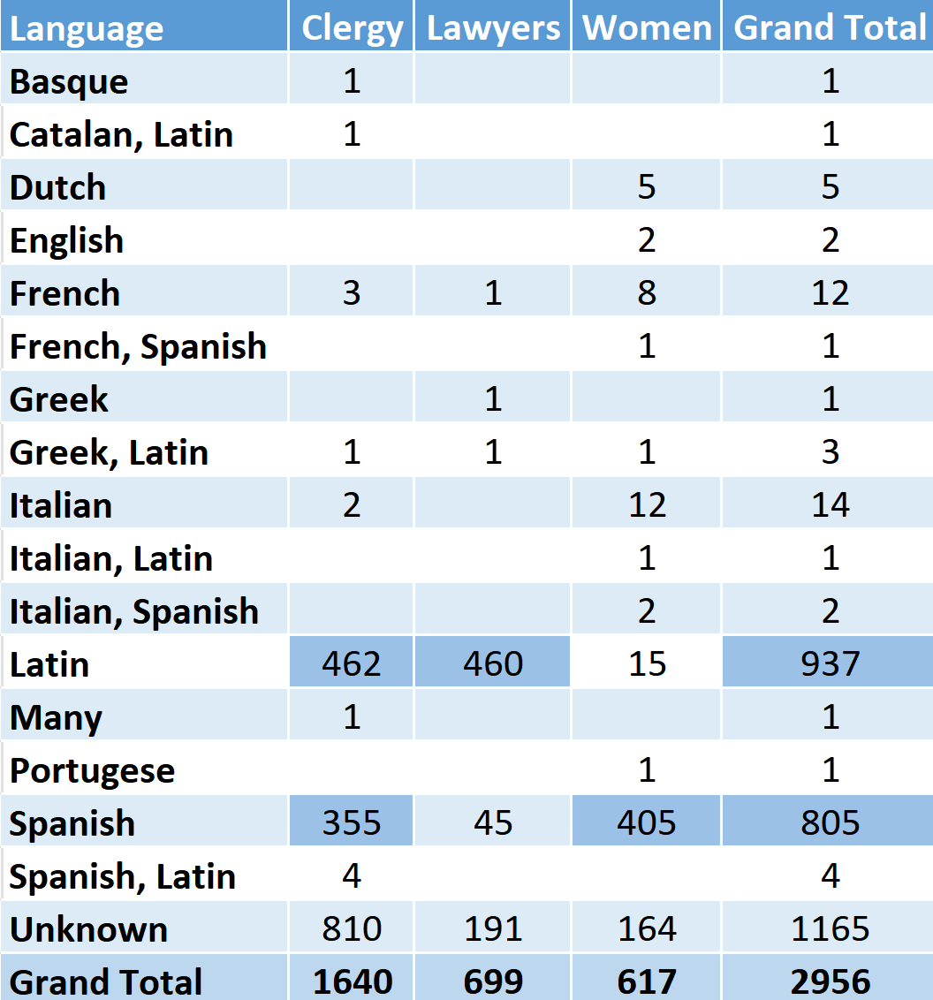
Methods: Basic statistics
Gender
  Women have more Spanish books
  Men have more Latin books or books in both Latin and Spanish
Profession
  Lawyers appear to have libraries with almost exclusively Latin books
  Clergy have a more even split between Spanish and Latin

Slide 9
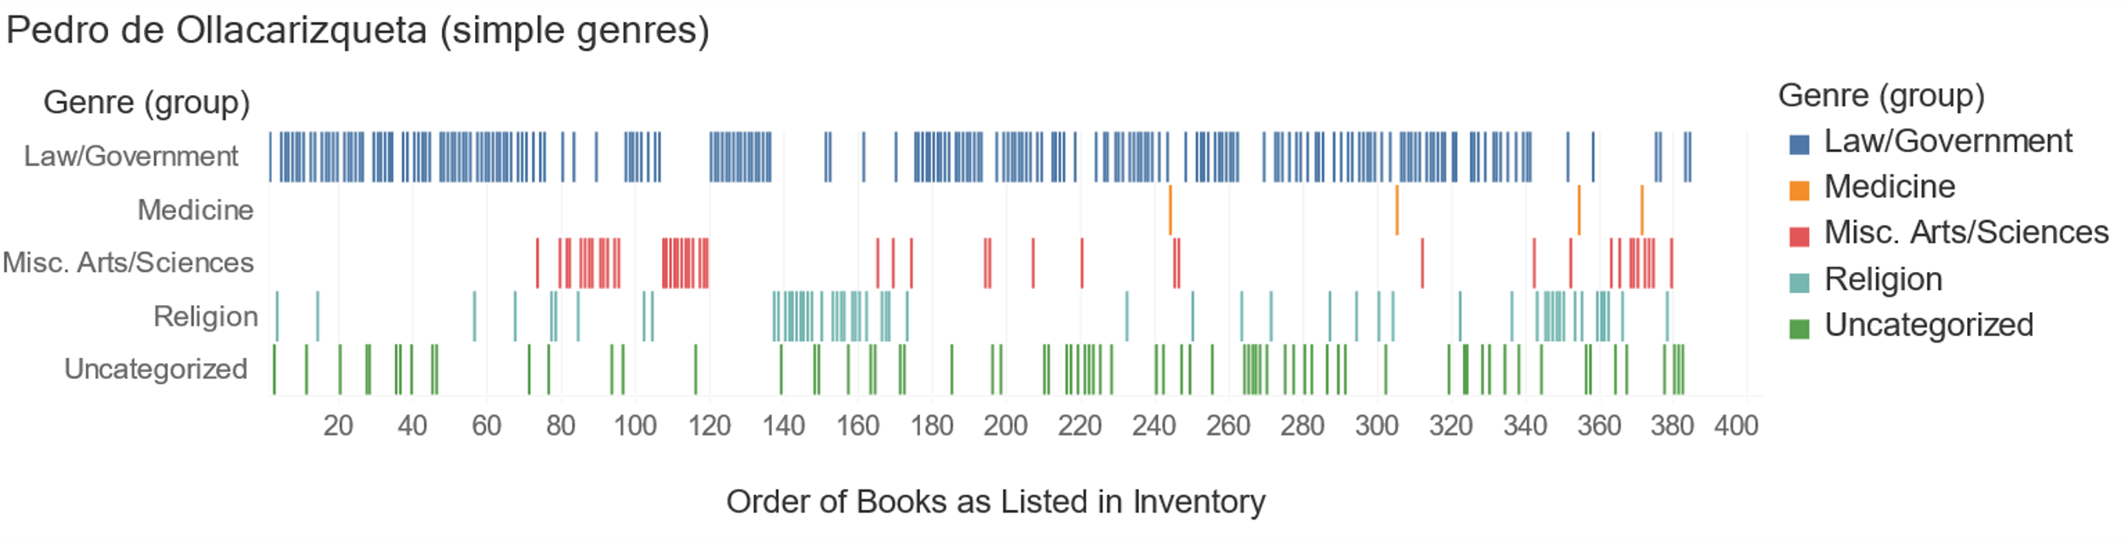
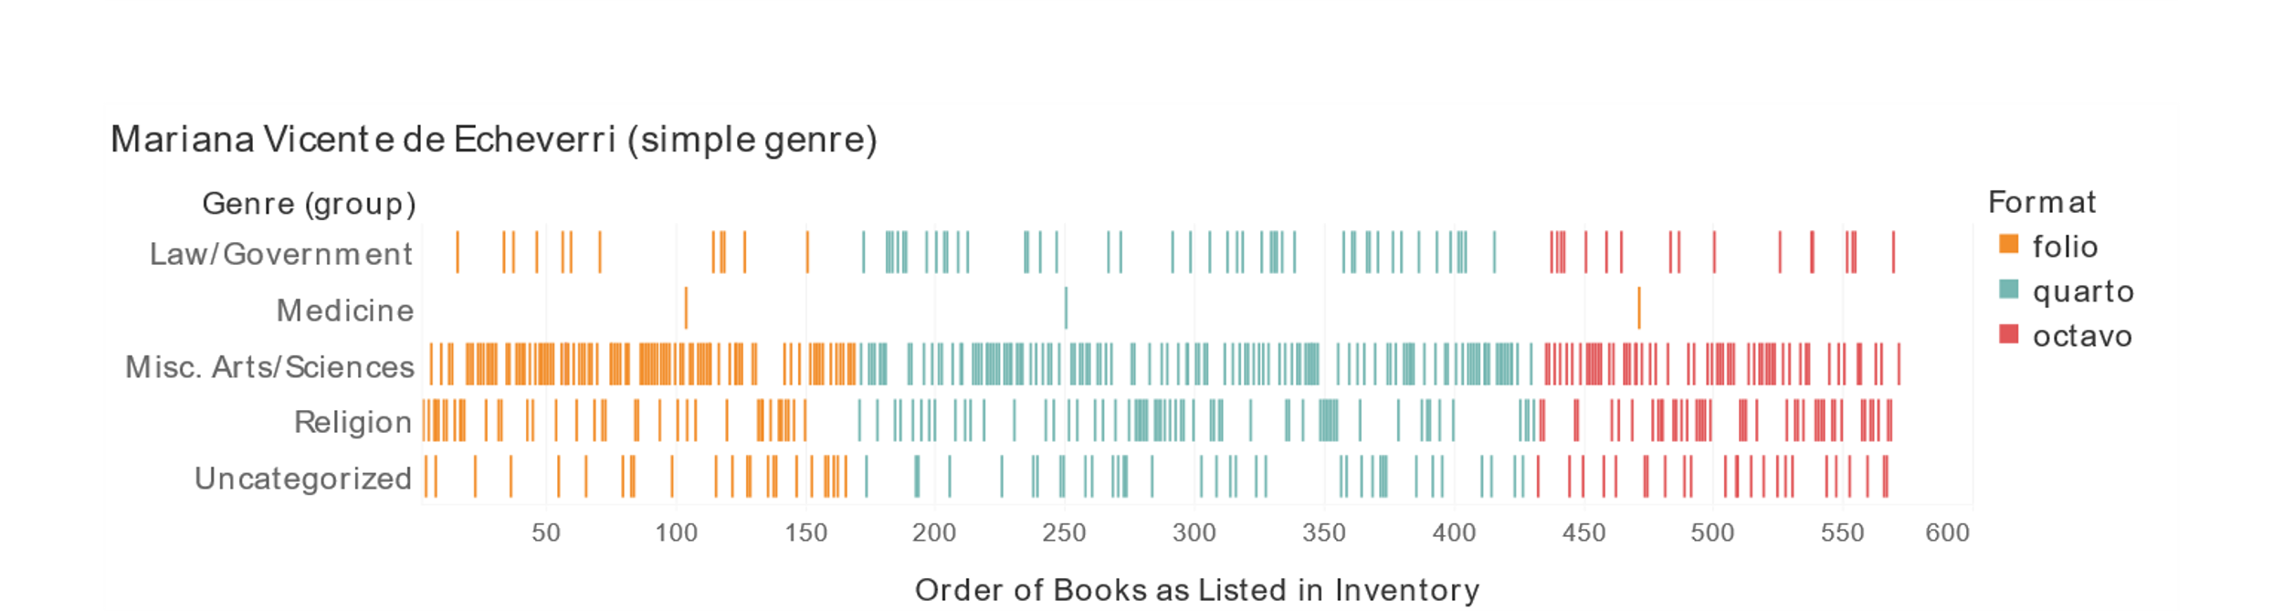
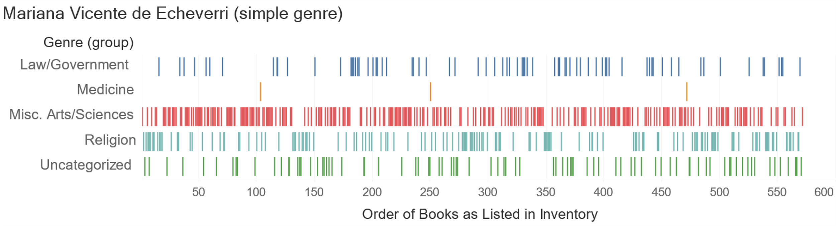
Methods: Visualization

Slide 10
Methodological limitations
Text-analysis
  Due to lack of identification of all the works in the library, cannot do text analysis of whole library
  Digitized copies not always available, much less good OCR
  OCR for 16th- and 17th-century books is difficult
Notes:
Look into difficulties with text analysis for Latin and early modern Spanish and whether that actually exists

Slide 11
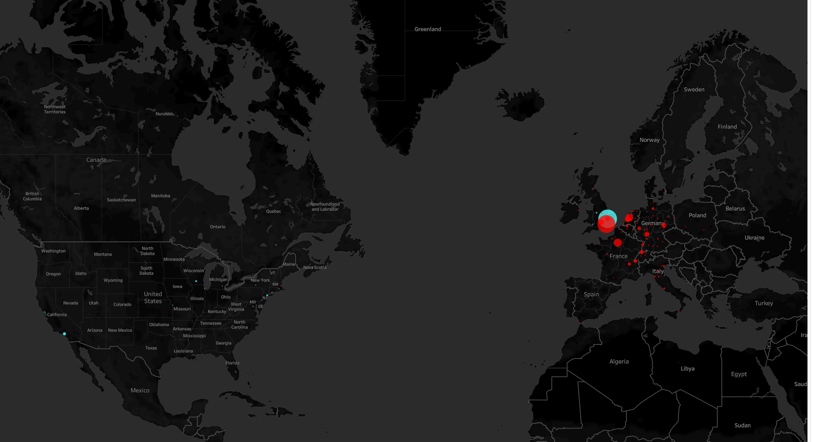
Library of Isaac Newton (1643-1727)
Place of publication
Current holding institution

Slide 12
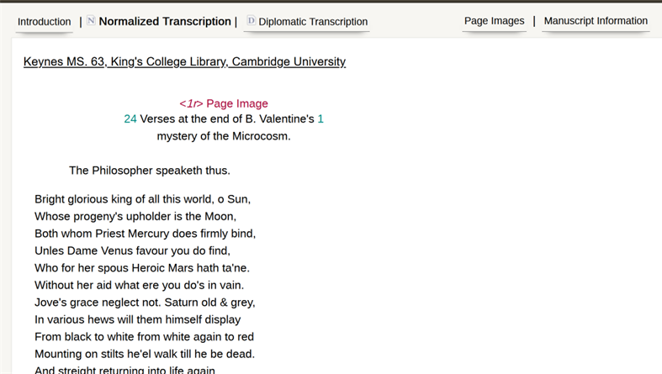
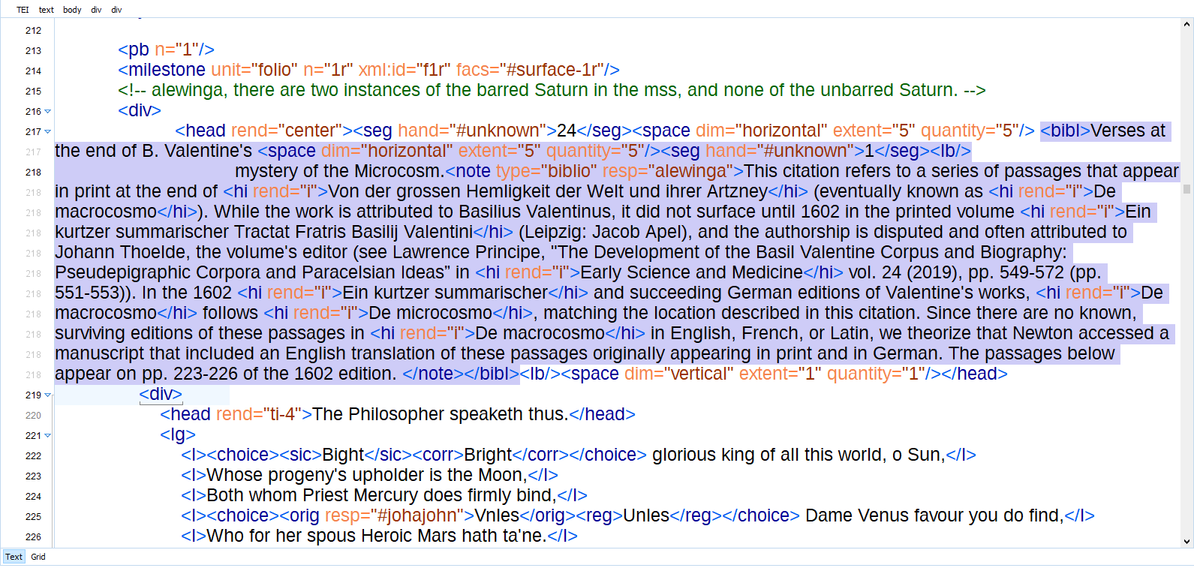
Newton's library: Data sources
John Harrison's The Library of Isaac Newton
  Huggin's list
  Musgrave Catalog
  Babson Collection catalog
  Newton's correspondence
  Duveen's Bibliotheca alchemica et chemica
  Bodleian Library, MS New College 361
  Portsmouth Collection catalog
  Sotheran's Bibliotheca chemica-mathematica
  Thame Park auction catalog
Newton's own manuscripts
  Correspondence
  Alchemical manuscripts (TEI-XML from Chymistry of Isaac Newton)

Slide 13
Newton's library: Data sets
Owned books
  Harrison's Library of Isaac Newton (print book) → The Newton Project "Books in Newton's Library" (HTML)
Consulted books
  Citation analysis of Newton's alchemical manuscripts transcribed in TEI
TEI transcriptions of
alchemical manuscripts
Spreadsheet and eventual relational database of books known to have been owned/used by Newton
Incorporated into database with data about watermarks, citations, ink-analysis of Newton's alchemical manuscripts
Notes:
Consulted = not owned at death

Slide 14
Newton's library: Research questions
What books did Newton own?
When did he acquire them?
Where and how often does he cite different works in his library?
By what date did Newton definitely finish working on a specific alchemical manuscript?
How did Newton's alchemical thought develop?

Slide 15
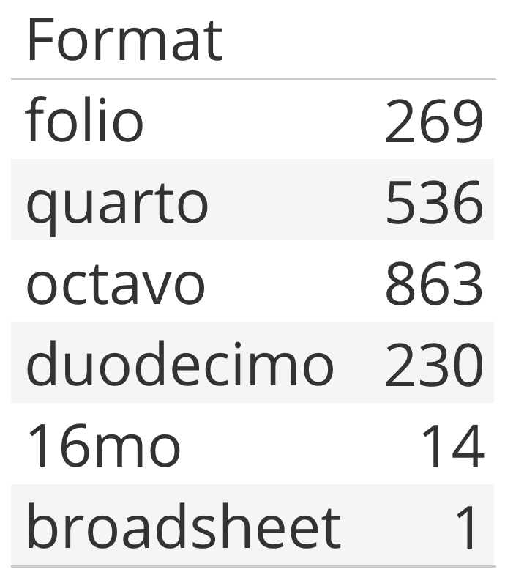
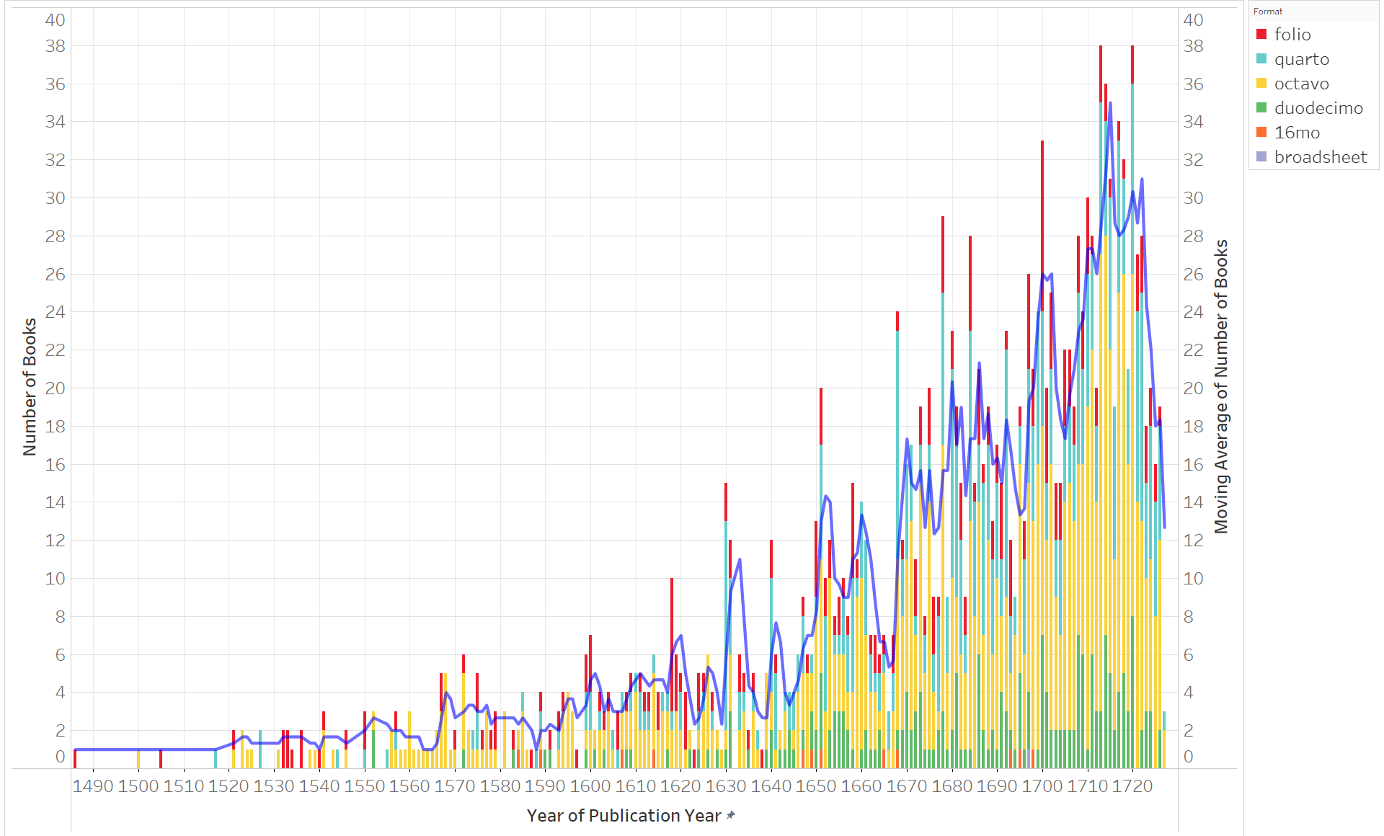
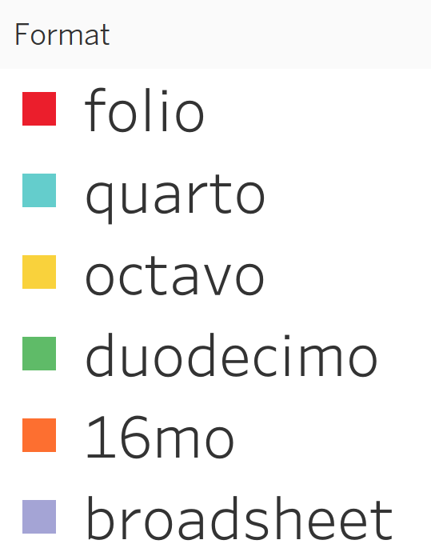
Methods: Statistics and Visualizations

Slide 16
Methods: Citation analysis
<bibl corresp=“CHYM000001.xml#Wingate2021” @cert=“high”>Wingate ch. 6<note type=“biblio” resp=“alewinga”>Newton is referencing chapter 6 of Wingate’s book…Citation certainty is rated “high likelihood” because…</note></bibl>
Certainty | @corresp | @cert | Description
Verified | Has value | No value | A citation is deemed verified when Newton has indicated page numbers in a citation and those page numbers can connect the citation to one and only one edition or issue of a work or compilation.
High likelihood | Has value | “high” | A citation is assigned high likelihood when the editor has confidence that Newton is citing a particular edition, issue, or state of a work because of contextual factors like word choice or the age of the manuscript, but the editor cannot definitively ascribe the citation to that particular edition or issue because Newton has failed to indicate page numbers.
Unknown likelihood | Has value | “unknown” | A citation is assigned unknown likelihood when the editor has confidence in the identity of the work Newton is citing but is uncertain about the edition or issue.
Ambiguous | No value | No value | A citation is deemed ambiguous when it cannot be sufficiently assigned to a particular work, much less an edition or issue.

Slide 17
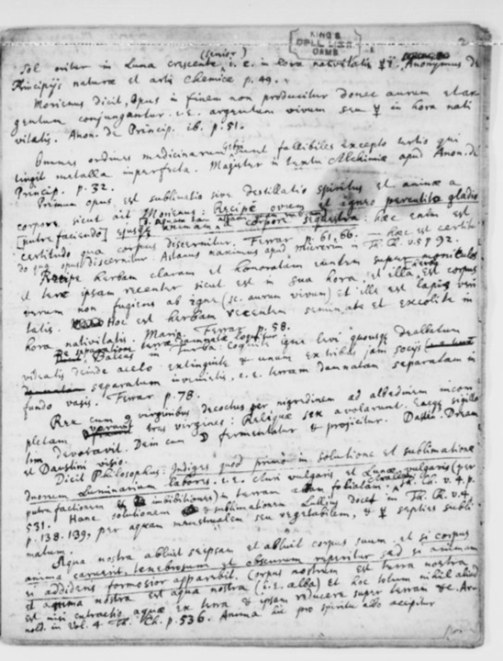
Methods: Citation analysis
Generating reports
High likelihood: 4
Dickinson1686: 1
Starkey1669: 1
Zetzner1660: 2
Keynes MS. 57
Total citations: 161
Verified: 94
Artis1610_1: 28
Artis1610_2: 9
Ashmole1652: 4
Combach1647: 7
Dickinson1686: 4
Eirenaeus_Philalethes1677: 2
Philalethes1654: 7
Starkey1669: 3
Zetzner1659a: 3
Zetzner1659b: 2
Zetzner1659d: 1
Zetzner1659e: 16
Zetzner1660: 3
Zetzner1661: 5
Unknown likelihood: 24
Artis1610_1: 5
Artis1610_2: 2
Ashmole1652: 3
Combach1647: 1
Despagnet1642: 2
Flammel1672: 2
Monte_Snyders1666: 3
Mynsicht1651: 1
Sendivogii1639: 1
Zetzner1659b: 1
Zetzner1659e: 1
Zetzner1661: 2
Ambiguous: 39

Slide 18
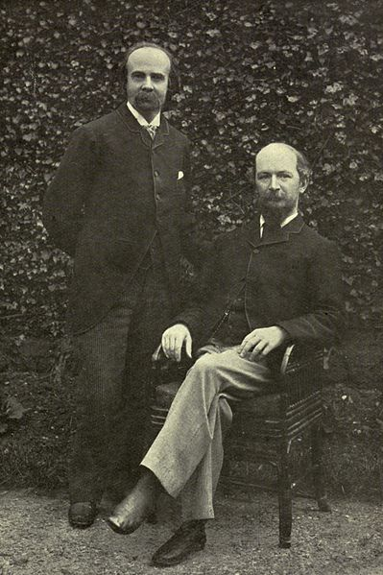
The Library of Algernon Charles Swinburne (1837-1909)
Swinburne died at The Pines on April 10th, 1909, leaving behind a large collection of books and manuscripts
Theodore Watts-Dunton, 1832-1914, his friend and caretaker for 30 years, was named Swinburne’s heir and administrator of his estate
Watts-Dunton gave bibliographer and forger T.J. Wise, 1859-1937, the first access to Swinburne’s library after his death
  “Nothing unpublished failed to become my property.” –T.J. Wise
  In addition to autograph manuscripts, Wise acquired many other works from Swinburne’s collections
Watts-Dunton and Swinburne at The Pines

Slide 19
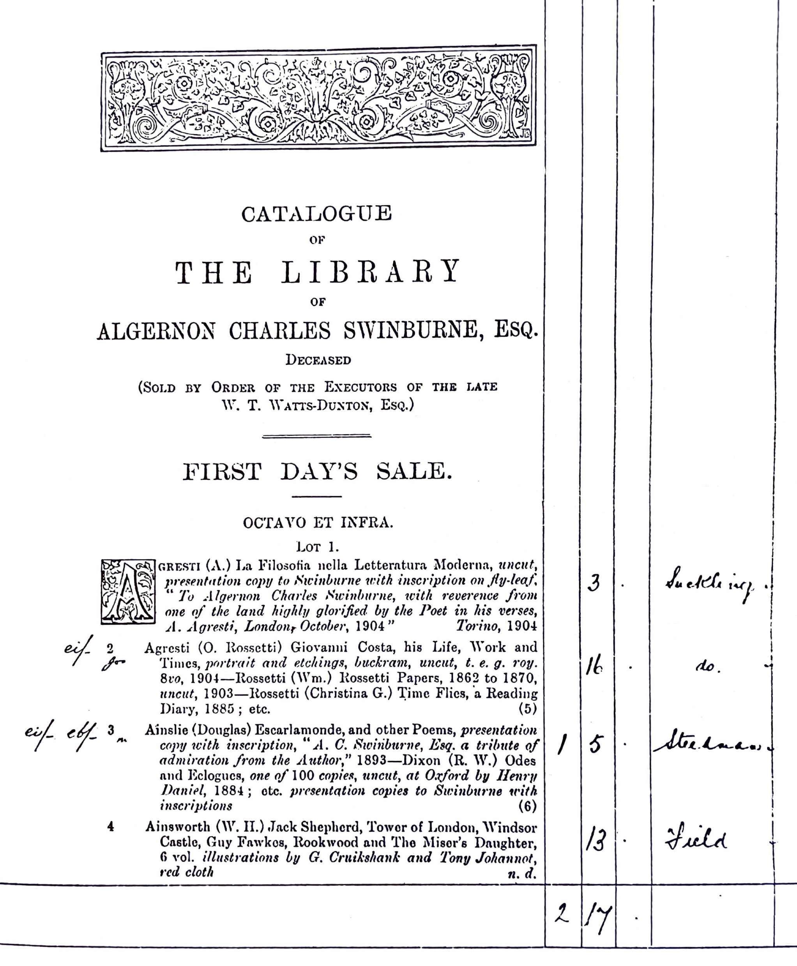
The Sotheby’s Sale (1916)
Held by Sotheby, Wilkinson & Hodge to sell the remainder of the library
19-21 June 1916 in London
Some featured authors:
  Charles Baudelaire
  William Blake
  Victor Hugo
  Dante Gabriel and Christina Rossetti
  Percy Bysshe Shelley
Also included: Elizabethan poetry and drama, Kelmscott Press publications, and some French literature

Slide 20
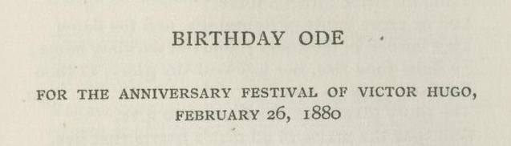
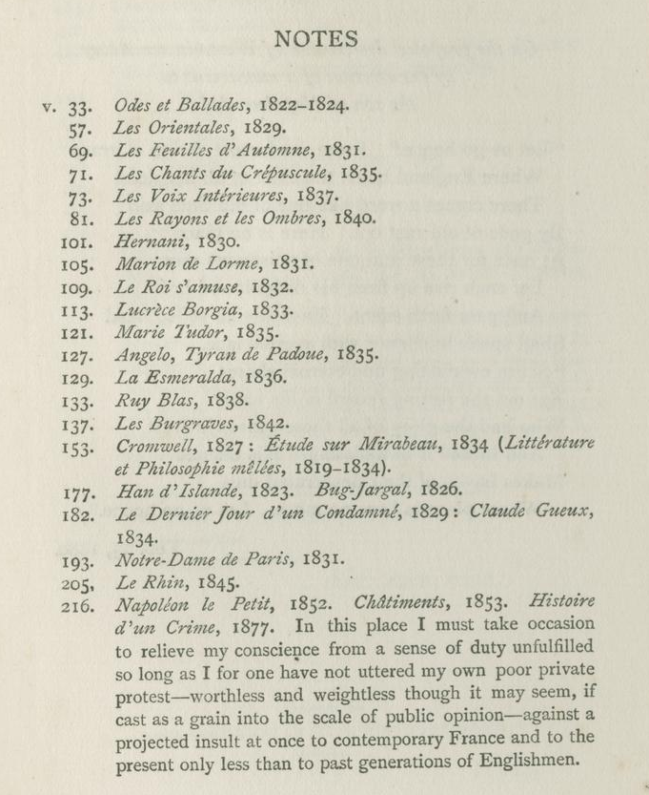
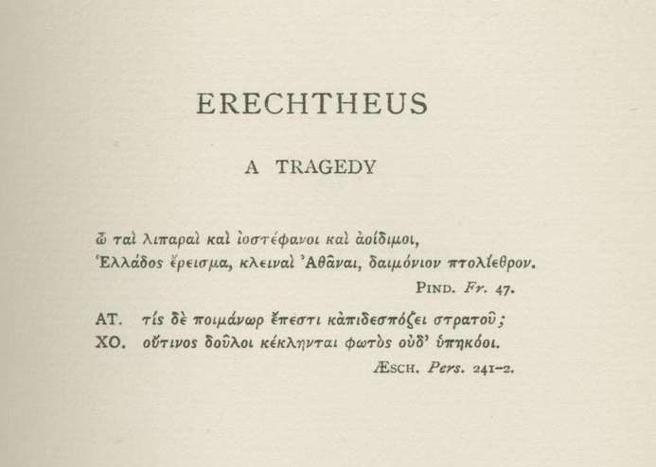
Epigraphs and notes

Slide 21
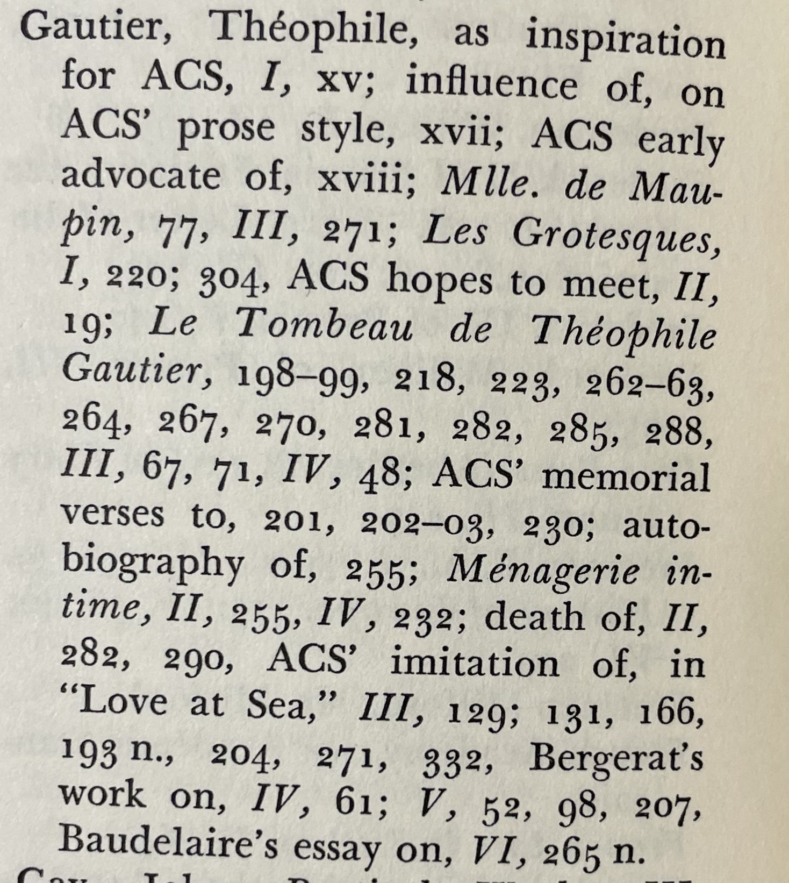
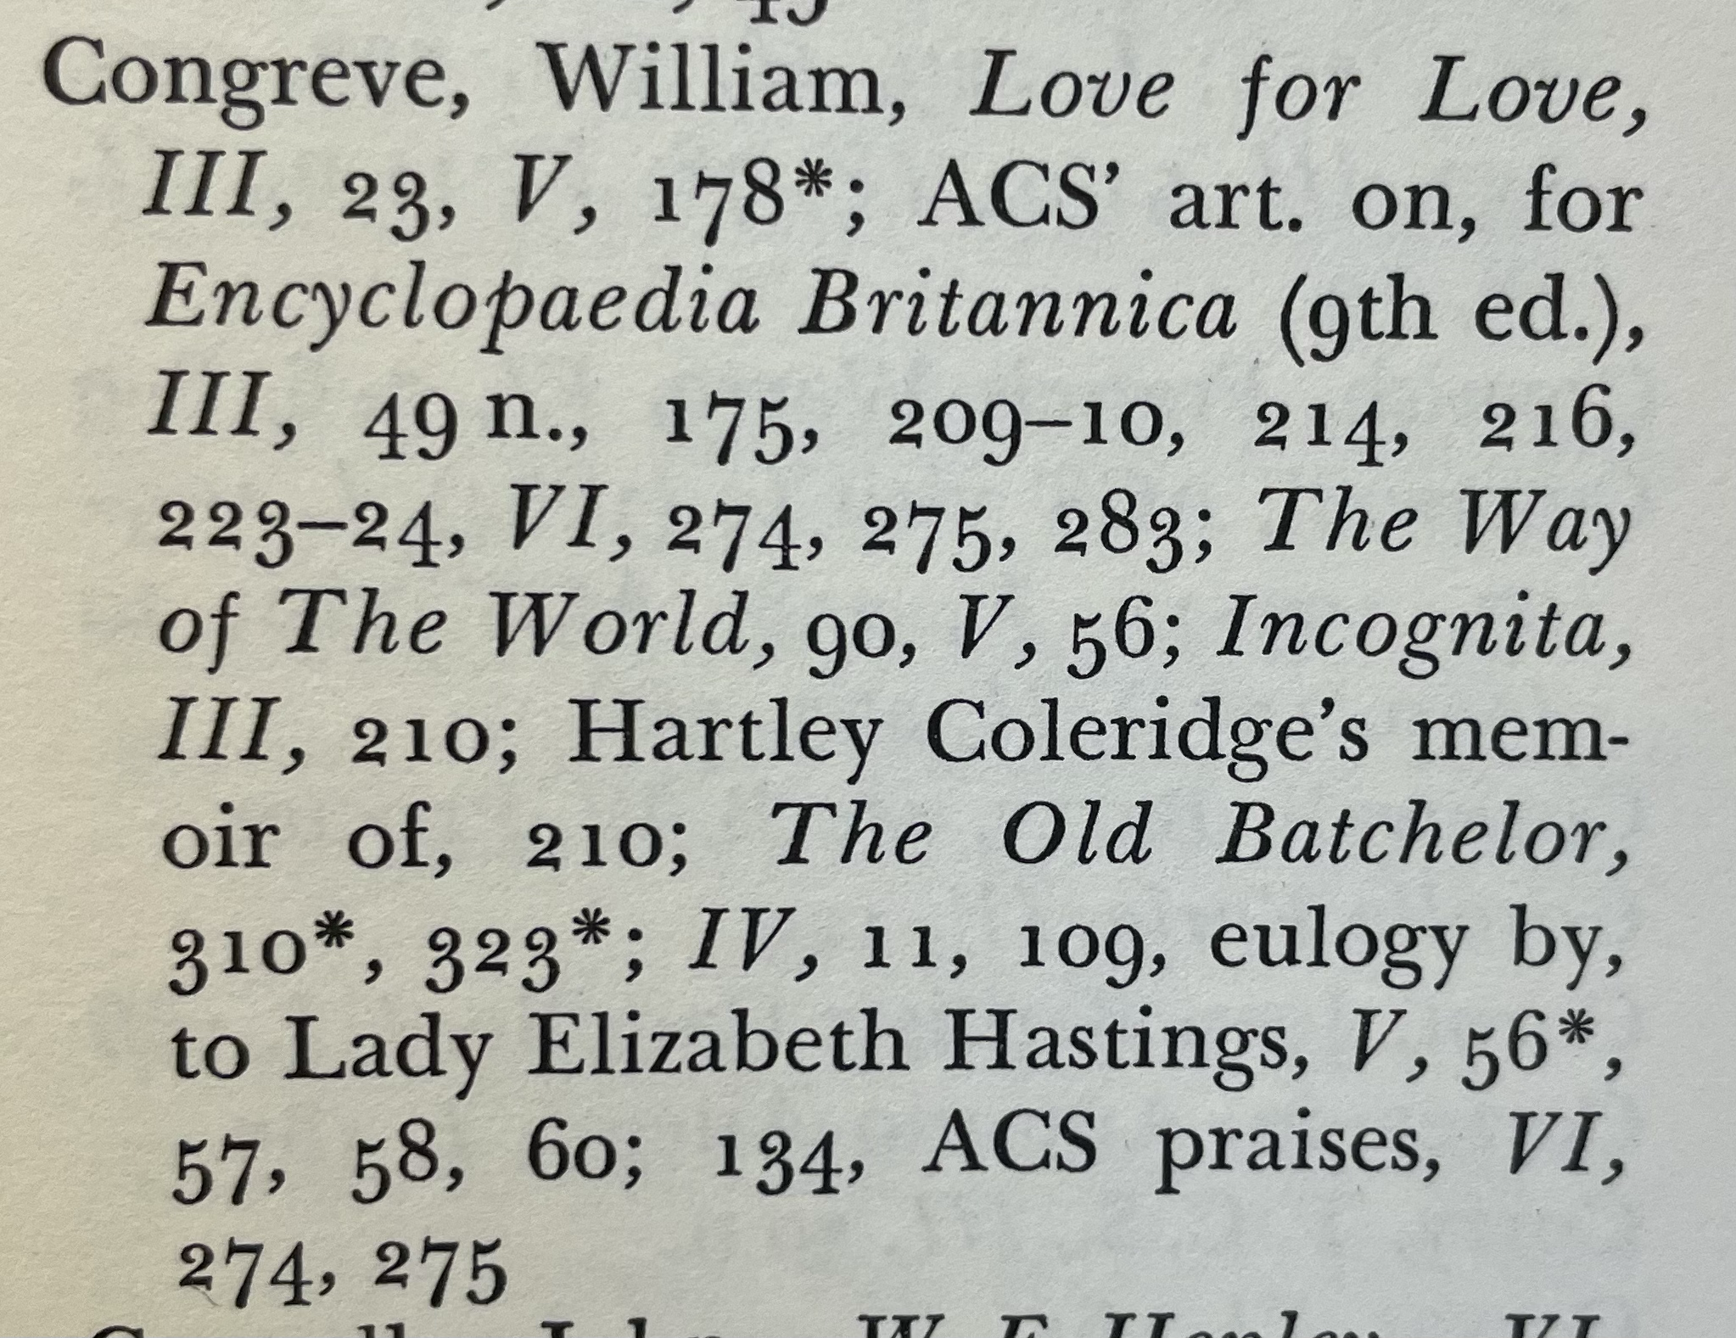
Letters
Letters (6 vols. Edited by Cecil Y. Lang. 1959-62)
Uncollected Letters of Algernon Charles Swinburne (4 vols., Edited by Terry L. Meyers, 2005)

Slide 22
Research Questions
What are the contents of Swinburne’s library?
  Publication dates, places of publication, languages, formats, genres, etc.
Can we identify intertextual connections and evidence of influence?

Slide 23
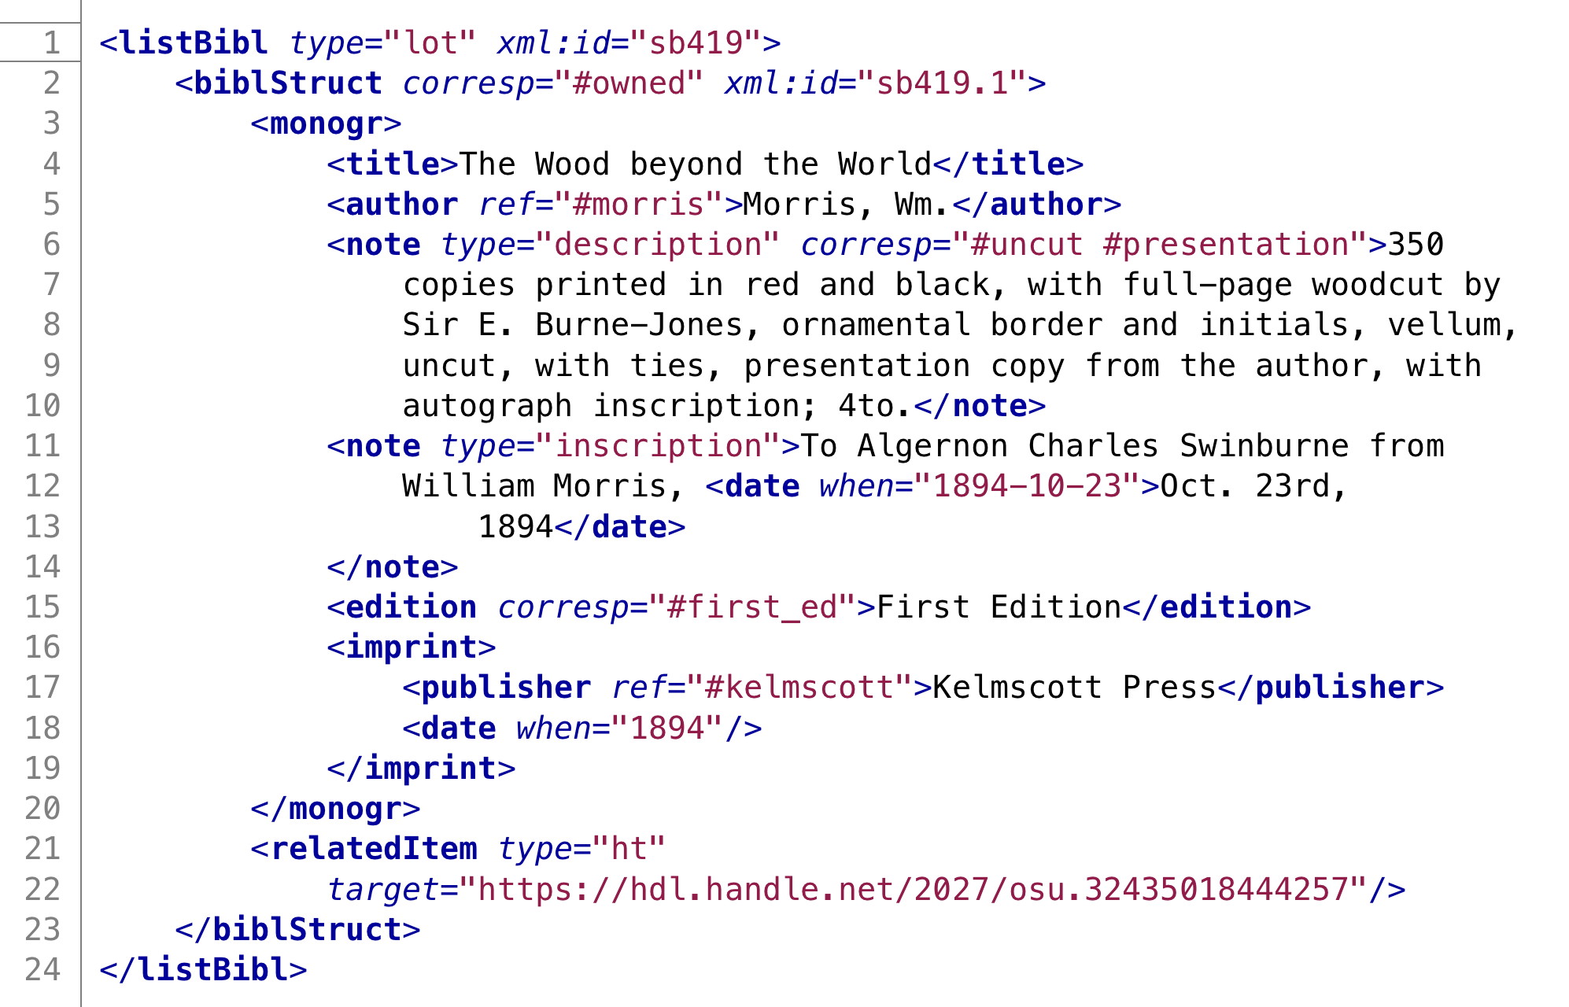
Method: TEI/XML

Slide 24
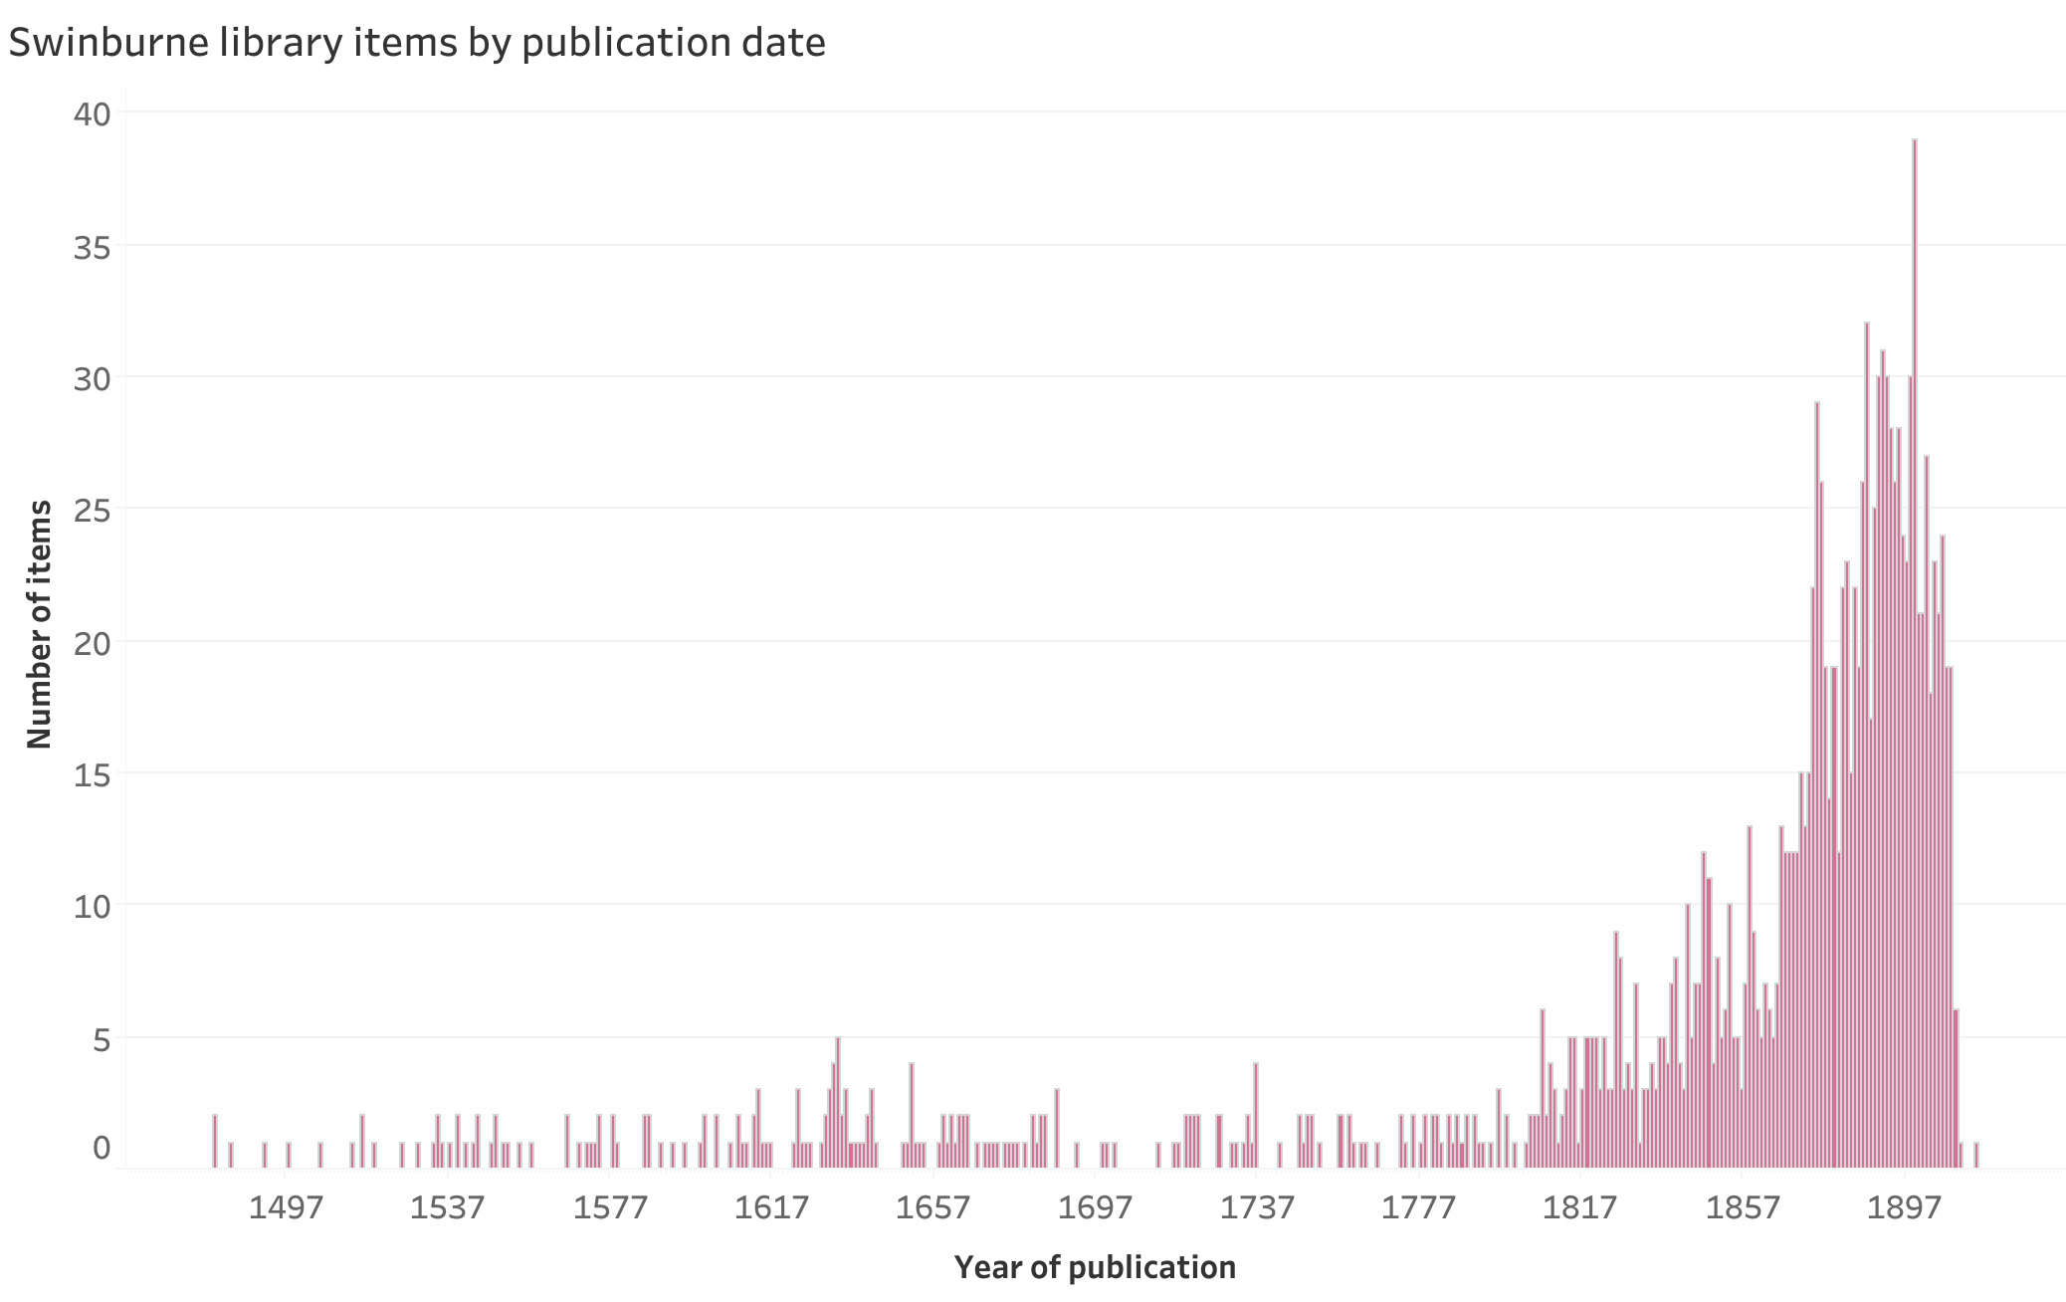
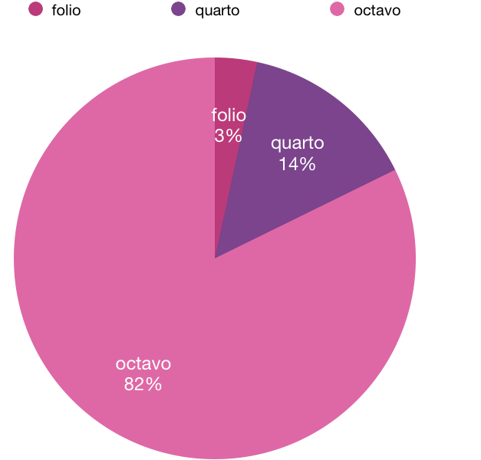
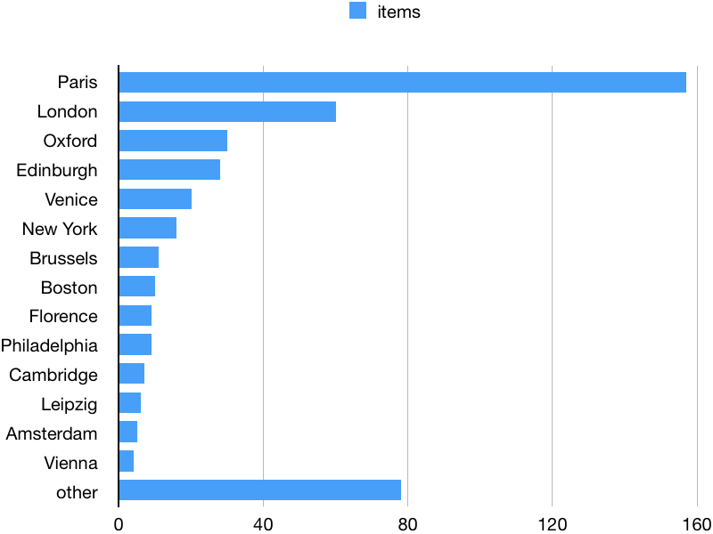
Method: Counting, statistics, visualization

Slide 26
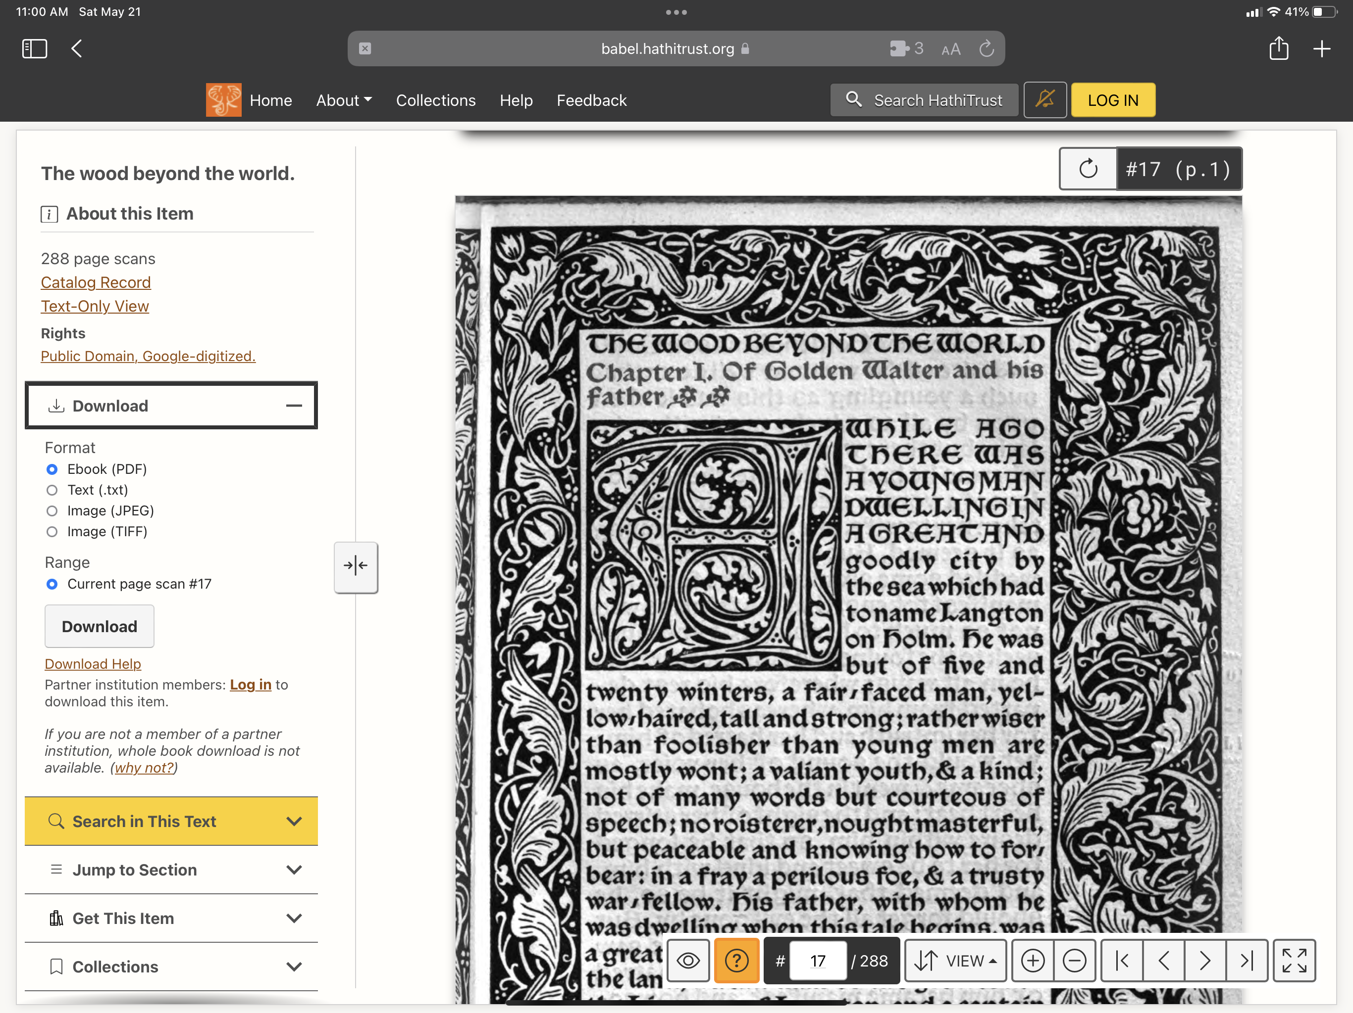

Slide 27
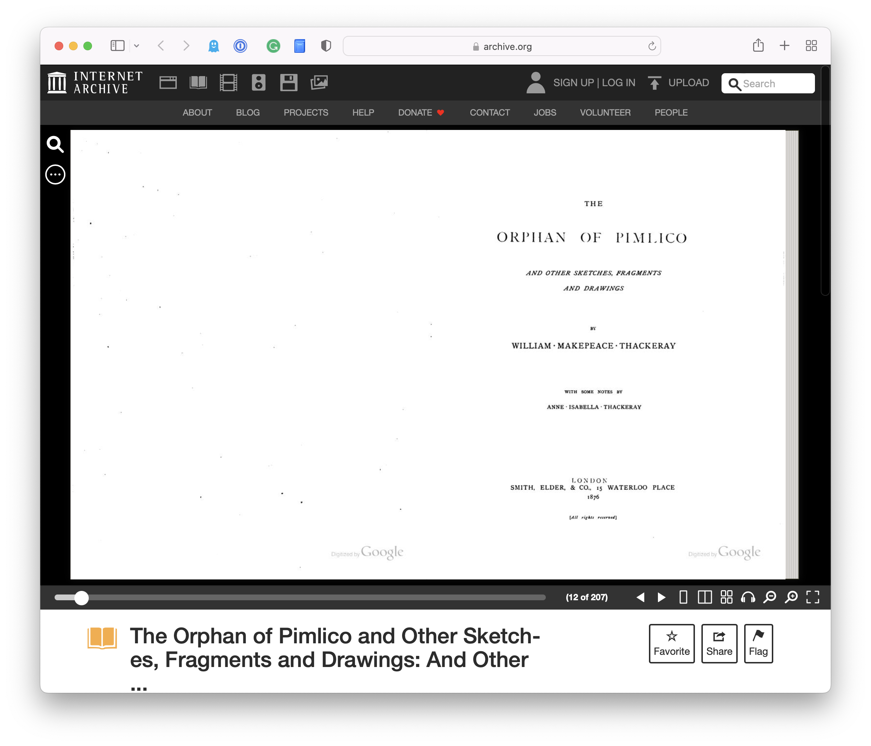
Full text pulled from multiple sources
HathiTrust Digital Library (OCR): 2373
Internet Archive (OCR): 120
Text Creation Partnership (transcribed and encoded in TEI): 62
Early English Books Online (EEBO; transcribed and encoded in TEI): 3
Eighteenth-Century Collections Online (ECCO; transcribed and encoded in TEI): 1
Google Books (OCR): 13

Slide 28
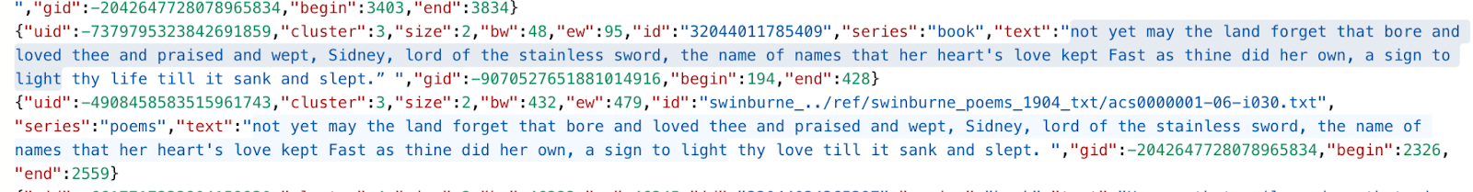
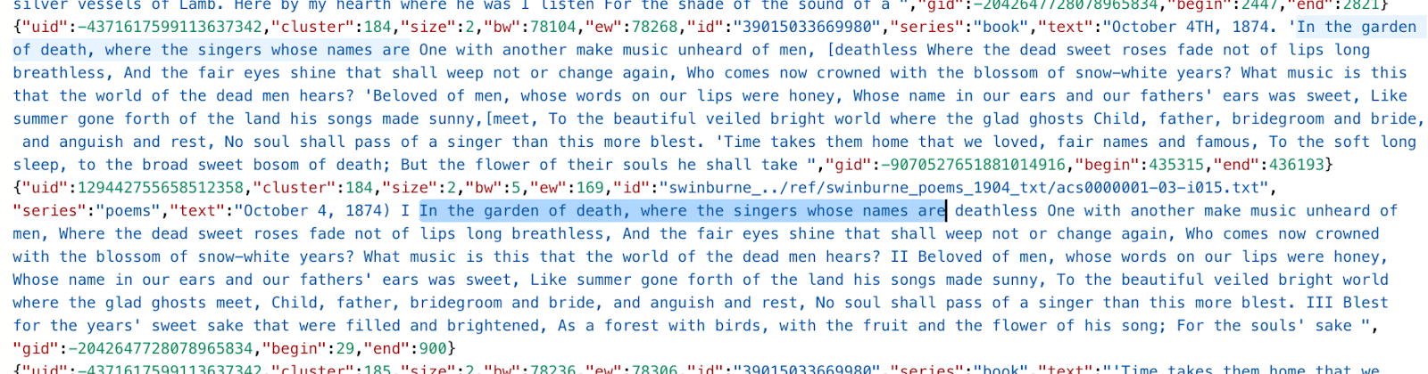
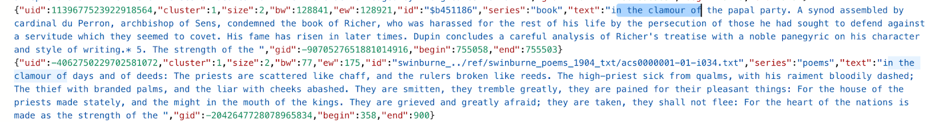
Methods: Full-Text Analysis
Cluster analysis of 4-grams to find text-reuse To do so we will use the Passim package to compare texts N-gram shingling Smith-Waterman alignment algorithm Optimized for parallelization Limited pre-processing Accept noisy OCR Strip out SGML / TEI tags Remove newlines and escape characters Treat each book within archive as a single document but each poem within Poems and Ballads as a single document Format into correct JSON for Passim

Slide 29
Conclusion – Comparison of methods
 | Navarrese libraries | Newton | Swinburne
Basic statistics | X | X | X
Visualization | X | X | X
Text analysis of books in library |  | X | X
Citation analysis |  | X | X
Comparative text analysis (library and writing) |  |  | X
Data formats | Heurist database, spreadsheet (past), TEI (future) | TEI, spreadsheet, database (future) | TEI, plain text

Slide 30
Thank you
John Walsh, jawalsh@indiana.edu, twitter: @jawalsh
Alex Wingate, alewinga@iu.edu, twitter: @alextheknitter

