Slide 1



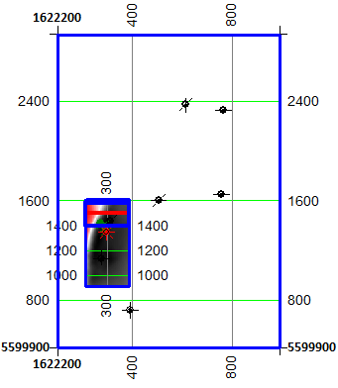
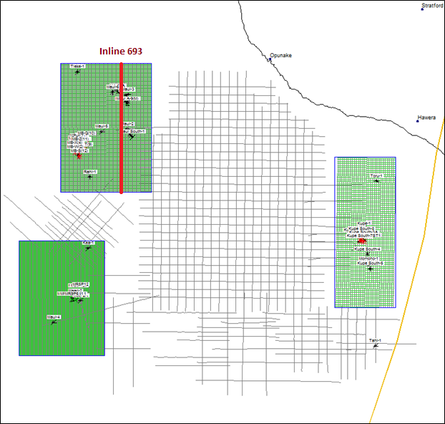
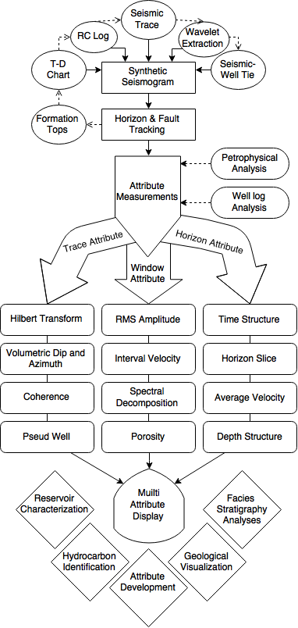

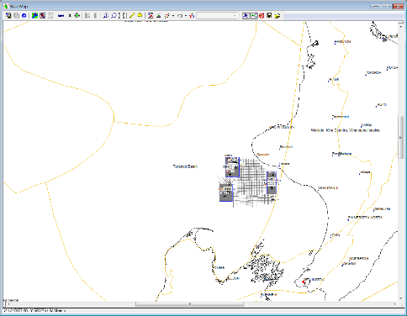
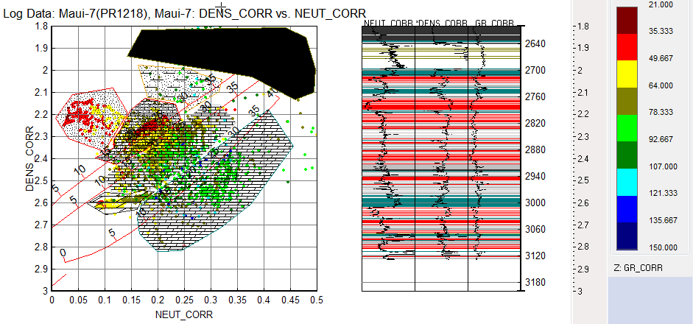
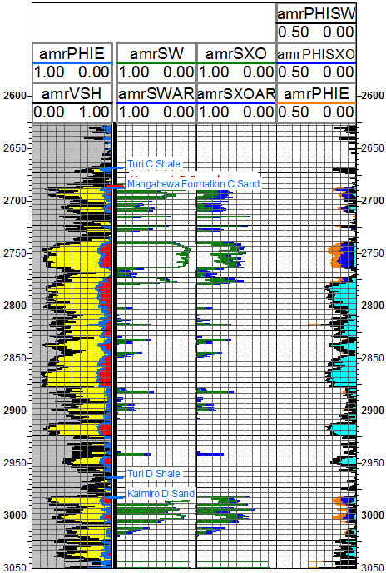
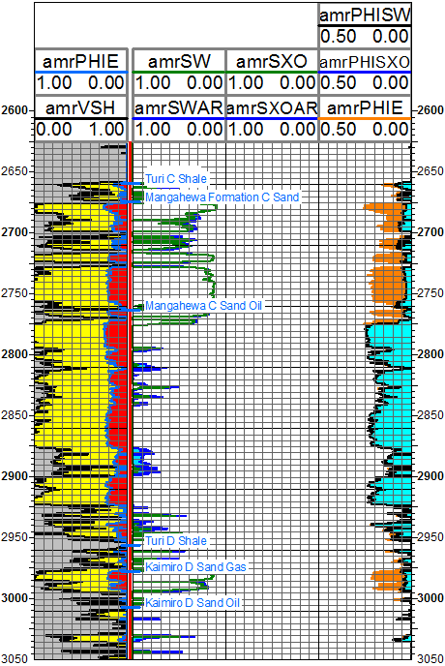
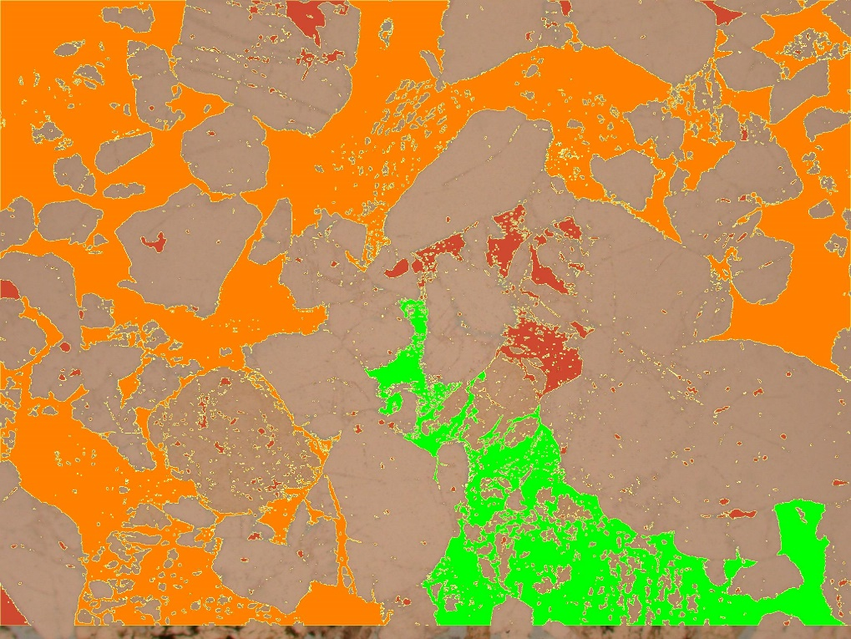
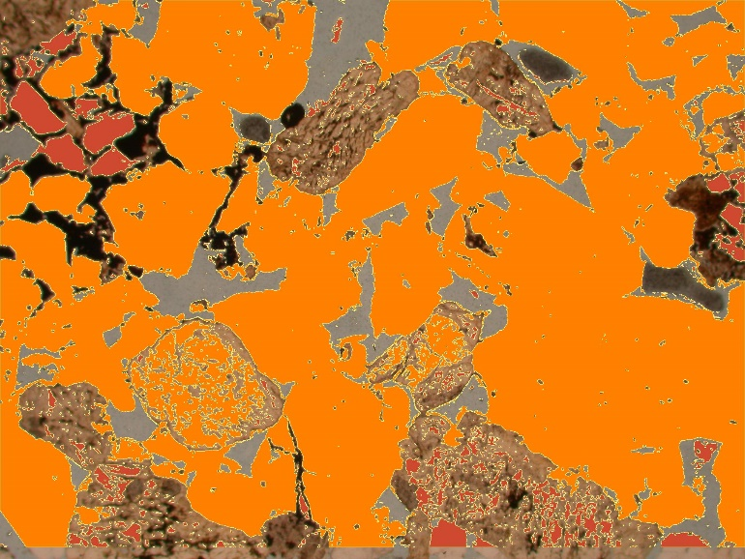
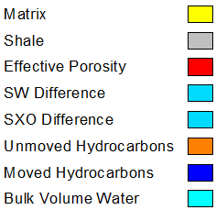
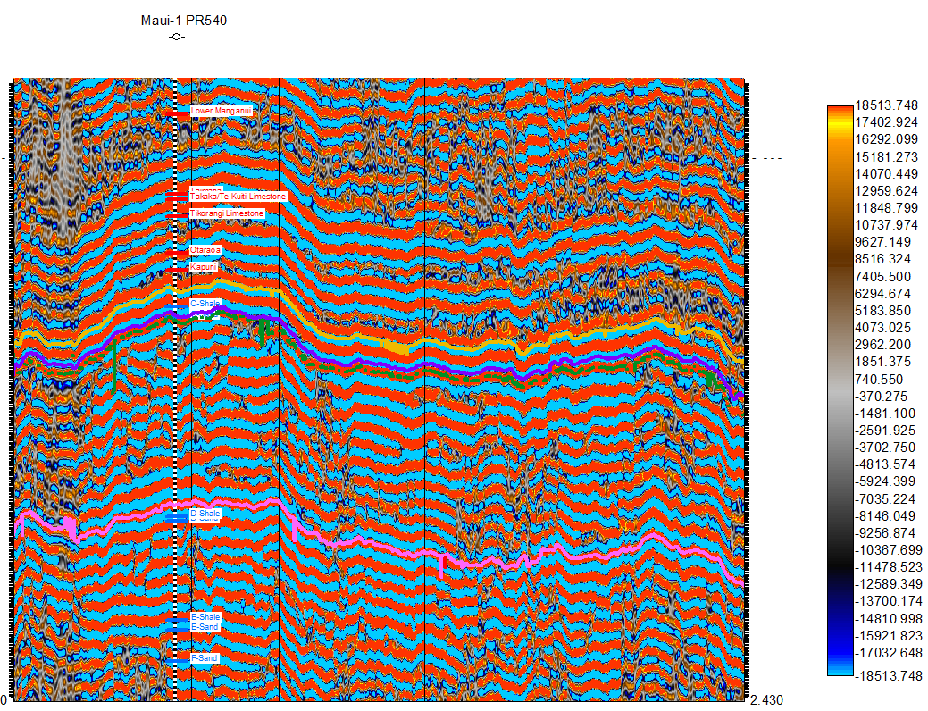
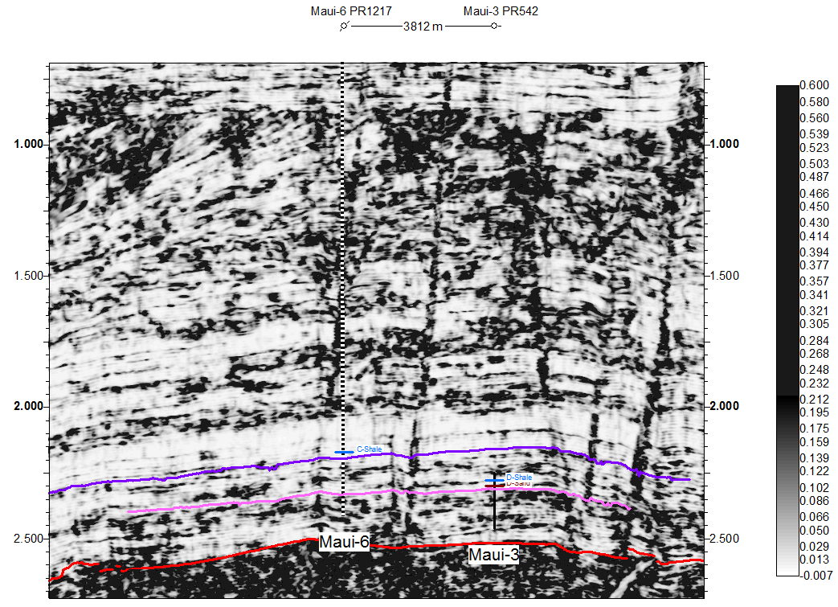
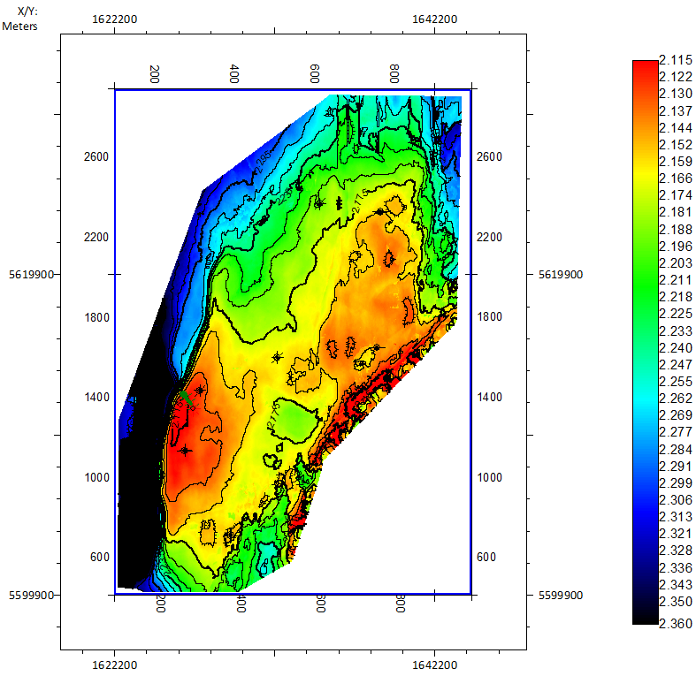
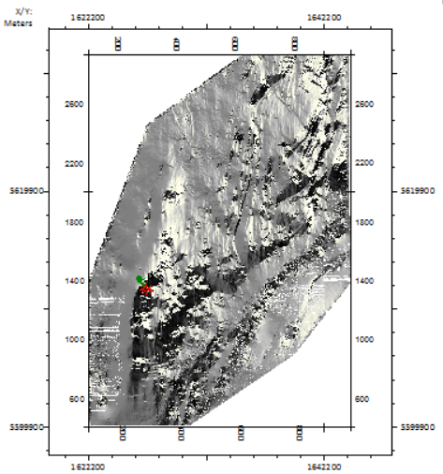
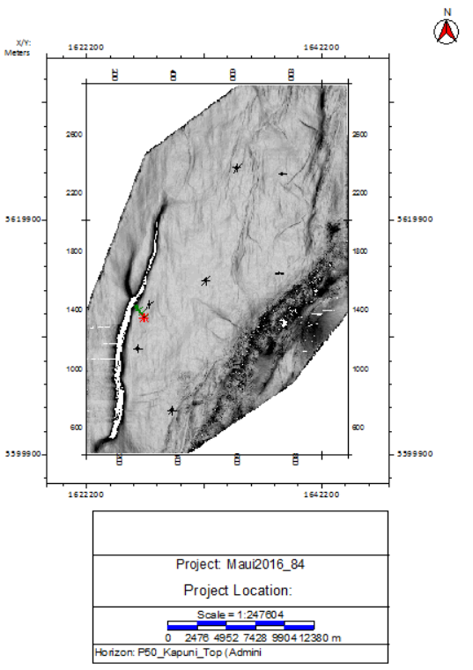
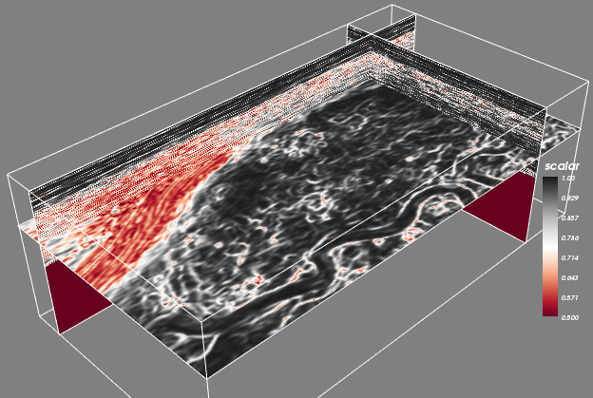
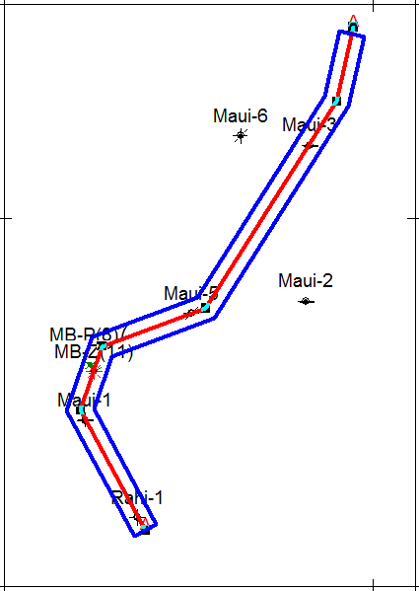
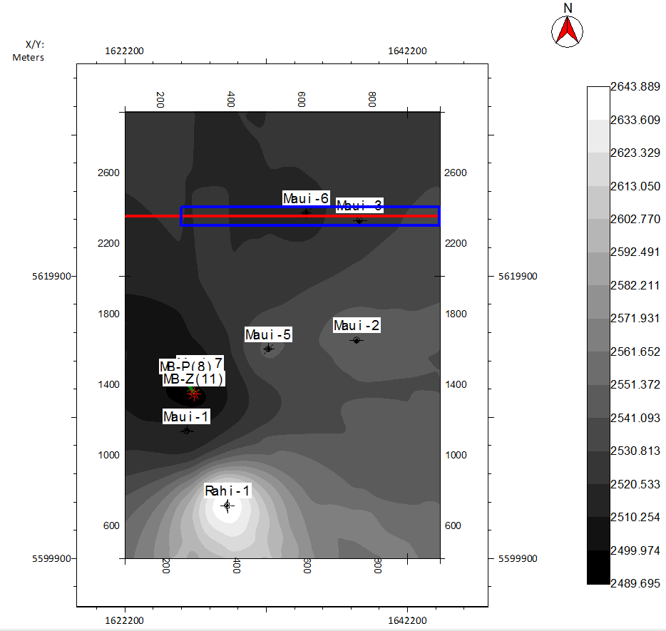
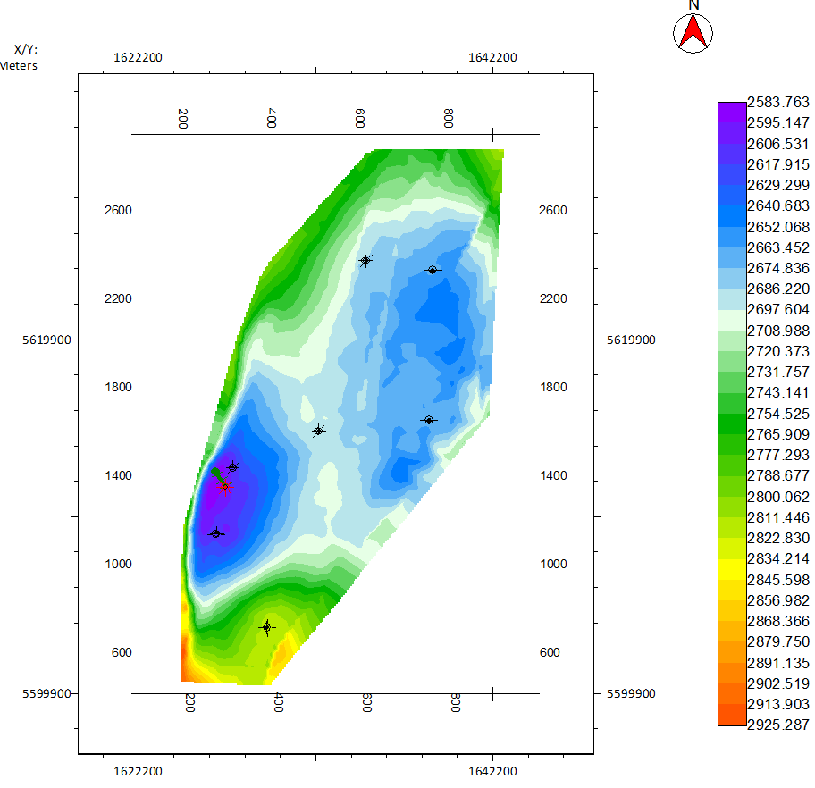
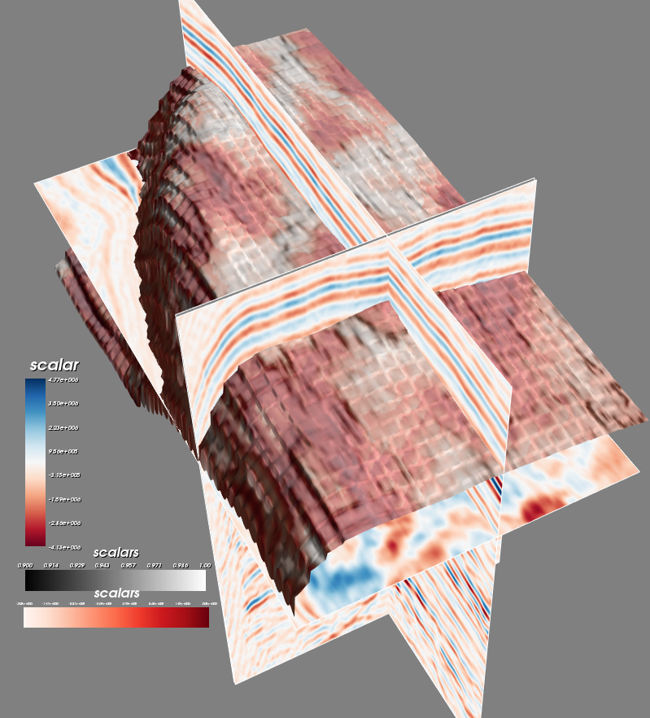
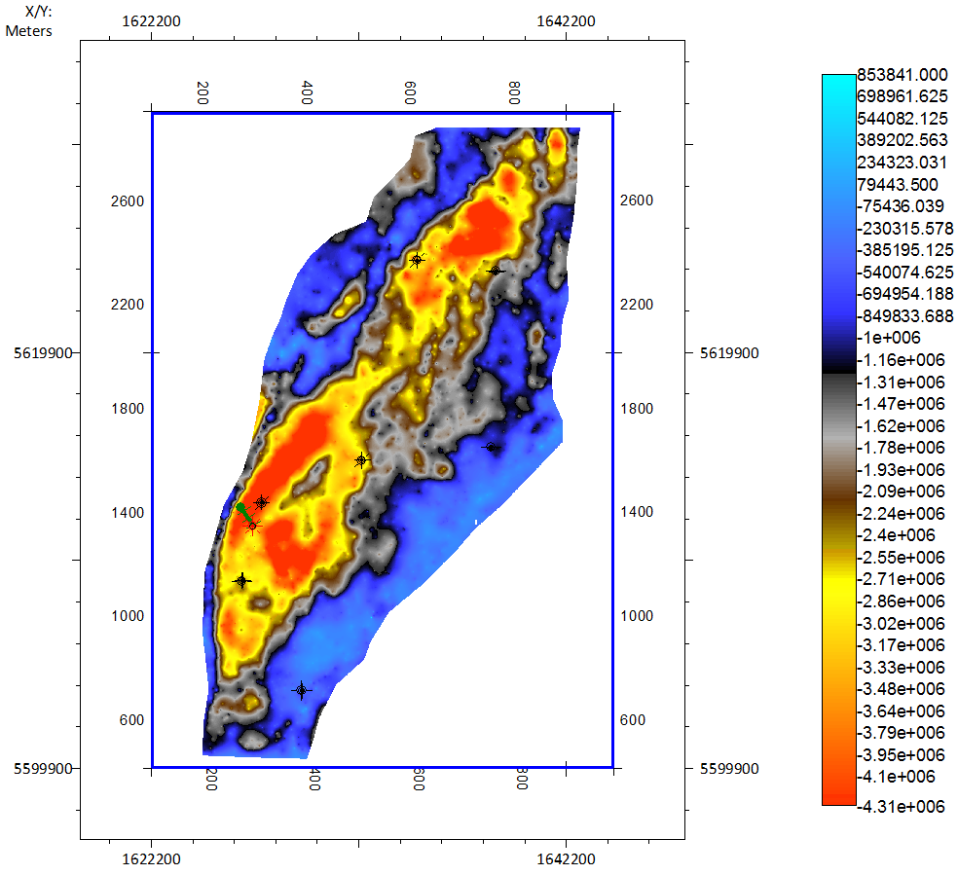
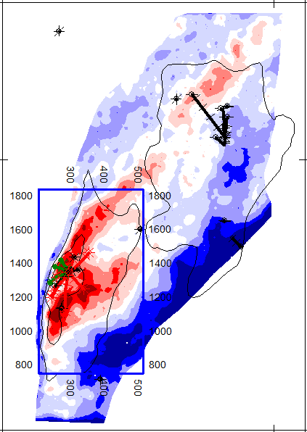
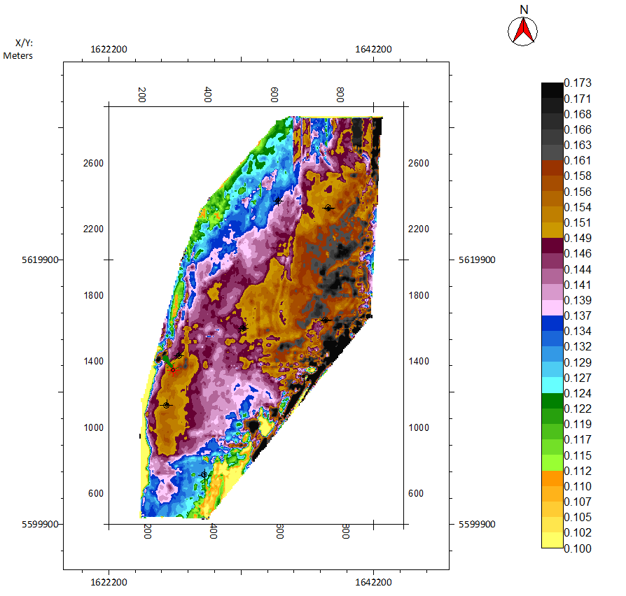
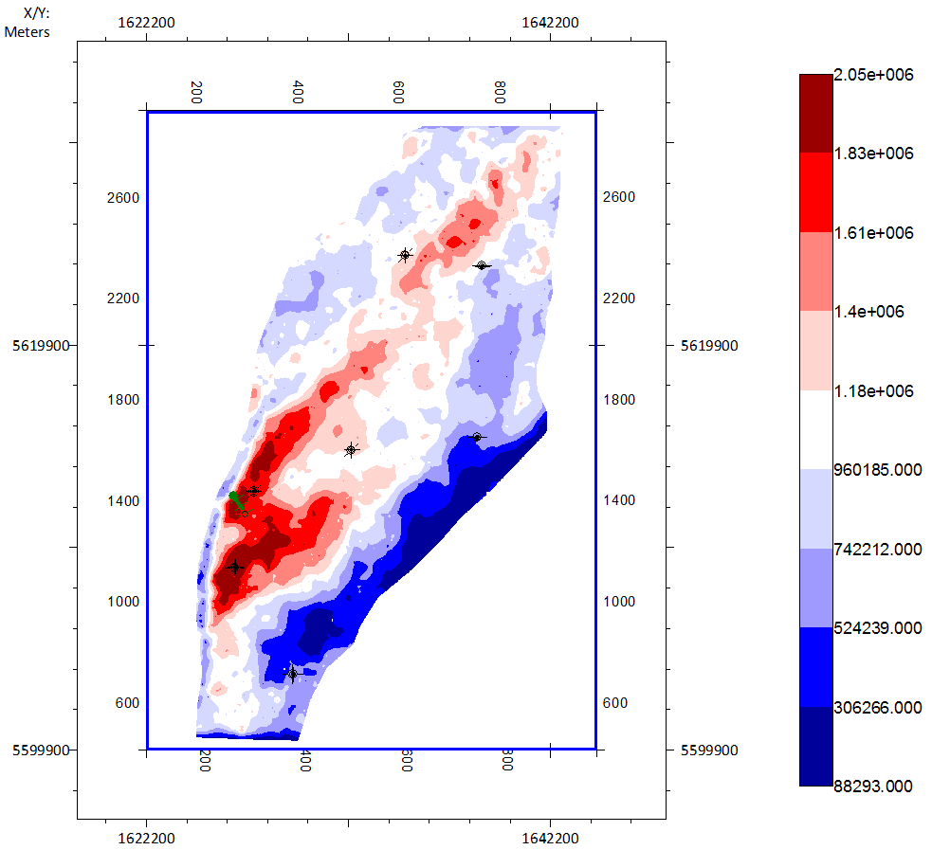
3D Seismic Attribute Analysis for Structure and Stratigraphy Identification in Maui field, Taranaki Basin, New Zealand.
Alhakeem A ¹ , Almubarak H ¹ , Liu K ¹ , Al-Bazzaz W ²
¹ Missouri University of Science and Technology, Rolla, Missouri, United States,
² Kuwait Institute for Scientific Research, Ahmadi, Kuwait
www.mst.edu
Seismic and Well Data
Work Flow
Summary
Grain Analysis
Pore Analysis
Φ, Porosity
PSD, Pore Size Distribution
Pc, Capillary Pressure
Roundness
Elongation
MHR
Pore Throats
Θ, Wettability
K, Permeability
GD, Grain Diameter
Pore Diameter
.
The Kapuni group within the Taranaki Basin in New Zealand is a potential petroleum reservoir. The objective of the study includes building a sequential approach to identify different geological features and facies sequences within the stratigraphy. Moreover, the study aimed to visualize the targeted formations by interpreting and correlating the regional geological data, 3D seismic, and well data. The study follows a sequential workflow. First, seismic interpretation is performed targeting Kapuni group formations, mainly, the Mangahewa C-Sand and Kaimiro D-Sand. Synthetic seismogram and well tie are conducted for structural maps, horizon slices, isopach and velocity maps. Then, attribute analyses including RMS, dip and azimuth, and eigenstructure coherence are implemented to identify discontinuity, unconformity, lithology, and bright spots. Algorithmic analysis is written in Python programming to generate and overlay the attributes to be displayed in 3D view. Overlaying of all attributes in a single 3D view significantly strengthens the summation of the outputs and supports the seismic interpretation. The attribute measurements are utilized to characterize the subsurface structure and depositional system such as fluvial dominated channels, point bars, and nearshore sandstones. The study follows a consecutive workflow that leads to several attribute maps for identifying the potential prospects and characterizing the targeted reservoir by using the available seismic and well data.
3D Maui
3D Maui
3D Kerry
Maui-B Field
Figure 1. Basemap of
3D Maari
the seismic data. The 2D/3D seismic surveys and wells used in this study in the Taranaki Basin bounded by the yellow line. 3D Maui Base is bounded by blue line illustrating the Maui-B field
Table 1. Wells used in the study
 | Well Name | KB Elev (m) | Total Depth (m) | TD Formation
1 | Maui-1 | 9.45 | 3509.77 | Pakawau Group
2 | Maui-2 | 34 | 3566.16 | Basement
3 | Maui-3 | 34 | 3401 | Pakawau Group
4 | Maui-5 | 26.8 | 3227 | Kapuni Group
5 | Maui-6 | 27 | 3228 | Kapuni Group
6 | Maui-7 | 27 | 3139 | Kapuni Group
7 | MB-Z(11) | 39.42 | 3100 | Kapuni Group
8 | Rahi-1 | 29 | 3501 | Basement
In-Progress
Seismic Interpretation and Well Log Analysis
Figure 2. Workflow of the study including the target objectives
Seismic and well tie
T-D chart, velocity log, and density log (RHOB) are used to generate acoustic impedance (AI), and reflection coefficient (RC) logs. synthetic seismograms generated for all the 9 wells and matched With the seismic data used for horizon picking for both C-Sand and D-Sand.
Petrophysical Analysis
Crossplots
Log analysis
MBZ(11)
Morphological analysis
Coal/Shale
Maui-7
Pores – orange, green, red
Grain – orange, red
Sandstone
Sandy Shale
Coal/Shale
Mangahewa
C-Sand formation
Sandy lime
Figure 5. Thin-section of the Kaimiro D-Sand with magnification 4 mm from Maui-7 at depth of 3011 ft. Porosity is estimated to be 32.5%
Limstone
Dolomite
shale
Discussion
Results show good PHIE and unmoved hydrocarbons indicating a potential reserve for the C-Sand near the well. PHIE value range near Kaimiro D-Sand is 15%-22.5%. Studying grains and pores along with stratigraphical maps leads to limit consistence area for the neural network.
Figure 3. Nuetron – density logs crossploted with gamma ray log data to identify facies and sequence stratigraphy
Figure 4. Wells Maui-7 and MBZ(11) are within the same area of MauiB. Petrophysical parameters are generated from the log analysis showing the shale volume (Vsh) and effective porosity (PHIE).
Mapping and Attribute Analysis
Attributes for horizon identification and structure mapping
Time Structure map
Attributes for discontinuities and stratigraphy identification
C-Sand
Dip and Azimuth Map
Coherence Map
Eigenstructure Coherence
C-Sand
MauiA field
C-Sand
C-Sand
fault
C-Sand
MauiB field
Figure 6. Spectral Decomposition for identifying horizon continuity
Figure 7. Coherence vertical seismic section of crossline 2354 showing faults
fault
channel
channel
Average Velocity Map
Depth Structure Map
Figure 8. Time Structure map shown anticline in the MauiB field near Maui-7. There is a dipping toward the north.
Figure 9. Coherence Map is corrected using the horizon dip map for better structure and stratigraphy identification to form the Eigenstructure Coherence
C-Sand
C-Sand
Attribute integration
Crossline 2354
MauiA
Horizon Amplitude Slice Map
RMS Map
C-Sand
Isochron Map
C-Sand
Structure, Amplitude, Eigenstructure Coherence
MauiB
C-Sand
Lagoon
shoreface
Bright Spot
marginal marine
Figure 11. Depth Structure Map
shown an anticline near the MauiB field. The Maui field can be identified by the fault system that surrounds the study area. The map shows a dipping toward the north and north-east.
tidalflat
Figure 10. Average Velocty Map
shown a low value near the MauiB field. Area near Rahi-1 well characterized by high average velocity value. While, in the MauiA field the highest velocity value is around Maui-6.
Costal Coals
MauiB
Field
Figure 12. Horizon Amplitude Slice Map shown Lagoon and tidalflat marginal marine: Red;
Costal Coals: Blue.
Figure 13. RMS and Isochron maps shown the reservoir consistency for characterization evaluation for better attribute and petrophysical analysis. The high value combination ensures good prospective.
Figure 14. Integration of amplitude horizon and Eigenstructure Coherence overlaid in 3D seismic structure view.
Conclusions
References
Acknowledgments
Analyzing of prospect and reservoir characterization of the MauiB field results petrophysical measurements of different parameters. The porosity is estimated to be 32.5% for Kaimiro in Maui-7 at depth of 3011 ft. This matches well with the porosity measurements from the log analysis
The study provides constraint for future exploration and drilling by developing attributes that identify the potential prospects and characterize the targeted reservoir by using the available seismic and well data.
The neural network modeling based on petrophysical analysis to generate 3D pseudo porosity volume is valuable for optimal reservoir characterization.
Al-Bazzaz, W. H., and Y. W. Al-Mehanna (2007), Porosity, Permeability, and MHR calculations using SEM and thin-section images for complex Mauddud-Burgan carbonate reservoir characterization, Soci, of Petr. Eng.
Asquith, G., and D. Krygowski (2004), Basic well log analysis, second edition, American Associ. of Petr. Geolo. and Soci. of Explo. Geoph., Meth. in Explo.
Bahorich, M., and S. Farmer (1995), The coherence cube, The Leading Edge, 14(10), 1053-1058.
Banchs, R., and R. Michelena (2002), From 3d seismic attributes to Pseudo-well-log volumes using neural networks: Practical considerations, Lead. Edge.
Brown, A. R. (2011), Interpretation of three-dimensional seismic data, seventh edition, AAPG Memoir 42 and SEG, 9.
Chopra, S., and K. J. Marfurt (2007), Seismic attributes for prospect identification and reservoir characterization, SEG. Gersztenkorn, A., and K. J. Marfurt (1999), Eigenstructure based coherence computations as an aid to 3-D structural and stratigraphic mapping, Geophysics, 64, 1468–1479.
Higgs, K. E., M. J. Arnot, G. H. Browne, and E. M. Kennedy (2010), Reservoir potential of Late Cretaceous terrestrial to shallow marine sandstones, Taranaki Basin, New Zealand, Marine and petroleum geology, 27(9).
Higgs, K.E., Raine, J.I., Baur, J.R., Sykes, R., King, P.R., Browne, G.H., Crouch, E. (2011), Depositional age, facies, and cyclicity within the Mangahewa reservoir fairway, Middle to Late Eocene, Taranaki Basin, GNS, 47.
King, P.R., G.P. Thrasher, K.J. Bland, P. Carthew, D. D’Cruz, A.G. Griffin, C.M. Jones, and D.P. Strogen (2010), Cretaceous-Cenozoic geology & petroleum systems of the Taranaki Basin, NZ. Digitally remastered version. GNS Science, Lower Hutt, Institute of Geological & Nuclear Sciences monograph.
New Zealand Petroleum and Minerals (NZPAM) (2014), NZ Petroleum Basins, 104, Ministry of Business, Innovation and Employment (MBIE), NZ.
New Zealand Petroleum and Minerals (2015), 2015 Petroleum Exploration Data Pack, External HDD, MBIE, Wellington, NZ.
We would like to express our sincere gratitude to the New Zealand Government (NZPAM) for providing the data and the Saudi Ministry of Education for sponsoring Mr. Aamer Alhakeem.
aaaxb2@mst.edu

